Slide 1
News, Particle group meeting
IN2P3/UCBL/lab news:
Preparations for the Next IP2I Director Appointment:
The search committee must send a report on both candidates for the IN2P3/UCBL by February 6
Appointment process: proposition by IN2P3 could be as early as February, opinion from Lab Council (when?), interview by CNRS section 04 (June?), nomination by IN2P3/UCBL, official start: September 2026 or January 2027
The IT domain ‘ipnl’ is being decommissionned. In the Reseda database mails will be p.nom@ip2i.in2p3.fr. In the particle group, transition on the week of March 2-6.
Progress on selecting M2 internship students?
R&D for future collider news:
Welcome to Lucas Leveque, post-doc PICMIC (3 months)
Green light from the lab direction to proceed with the construction of small MRPC chambers and test, under conditions
Gaelle is the new responsible for the Masterprojet FCC at IP2I + FCC team leader at CERN
2026 FCC / T-MRPC / DOTIX (?) funding partly received or received at a level below the request
CMS news:
Please continue subscribring to DAQ and DCS shifts
Anthony Laravine is our new validator for missions/demande d’achat
2026 CMS funding partly received: an unknown fraction of the total CMS Physique and Fonctionnement + 100% of our request of Semester 1 for the TGIR.
IN2P3 attribution of human ressources: none for IP2I. LLR: 1 year post-doc prolongation. IPHC 1 PhD/post-doc accompanying the CPJ.

Slide 2
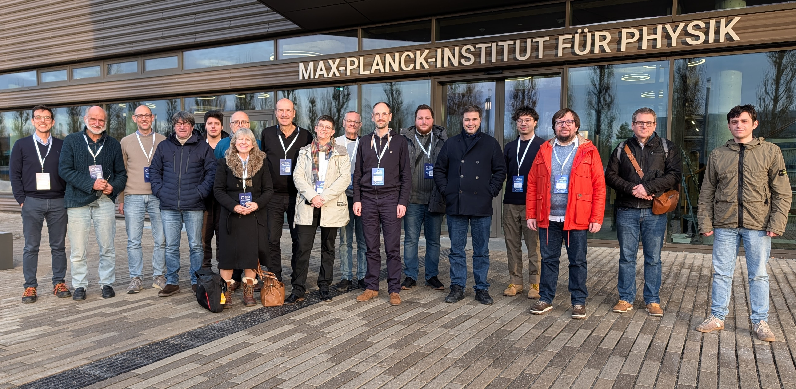
FCC – PED Wokshop Munich
Le 9ᵉ FCC Physics Workshop s’est tenu au Max-Planck-Institut (Munich, Allemagne) la dernière semaine de Janvier
~300 participants (~ 120-140 sur site).
Le workshop a débuté par le Forum des ECRs
https://indico.cern.ch/event/1588696/
La contribution française : 13 presentations , dont deux en séance plénière, et par la présidence de quatre sessions
French contribution : théorie, simulation, R&D sur les aimants et les détecteurs, mesures de luminosité et de sections efficaces, programme de physique des saveurs.
Presentation de Jessy + Didier session chair
France at the workshop:

Slide 3
Take away messages (Didier, Suzanne, Jessy can comment/correct)
CONTEXT
FCC-ee recommended by ESG as CERN’s next flagship project → FCC is now a project (not a study) → Project Design Phase (2026–2033)
Goal: Council approval in 2028–29, start of civil engineering ~2033 if approved
PROJECT DESIGN PHASE – FCC-PED GOALS
Deliver all inputs for Council approval (cost, R&D, feasibility, acceptability)
Structure the worldwide community toward Experiment EoIs (~2029)
Prepare ≥4 detector concepts → CDRs → TDRs
FCC- PED SHORT-TERM PRIORITIES (NEXT ~3 YEARS)
Launch conceptual design studies for ≥4 detectors
Consolidate IR layout, integration & background mitigation
Finalise software/analysis & computing model with IT
Validate EWPO precisions (Z, W) and theory uncertainties
Refine detector cost estimates and communication strategy
DESCOPED / STAGED FCC-ee – KEY MESSAGES (P. JANOT’ vision)
Descoping reduces cost but impacts physics (luminosity, top run)
Staging is preferred: upgrades must remain technically possible
Top run is essential → should be staged, not removed
4 IPs must be ensured from the start (not stageable)
Infrastructure must allow higher beam power & √s up to 365 GeV

Slide 4
Upcoming (known) events and deadlines
❑ Feb 2-6: Conference TIPP, Mumbai (India)
❑ Feb 3-6: Prospectives techniques et Journées R&T, IP2I
❑ Feb 9-13: CMS week, CERN
❑ Feb 16-18: CMS Induction Course, CERN
❑ Feb 23-27: DRD1 Collaboration meeting, CERN
❑ Mar 2-3: CMS Precision EWK Workshop: Open Symposium on W mass, Pisa
❑ Apr 7-10: DRD Calo 2025 Collaboration meeting, CERN
❑ Mar 11-13: Rencontres CMS France, IP2I
❑ Mar 15-22: Conference Moriond EW, La Thuile
❑ Mar 22-29: Conference Moriond QCD, La Thuile
❑ Apr 23: PhD Day, IP2I
❑ May 5-6: Journées de l’IN2P3, Paris
❑ May 18-22: LCHP 2026, Paris
❑ May 26-27: Top LHC France 2026, Paris
❑ Jun 1-5: Rencontres de Noirmoutier
❑ Jun 1-5: School of Statistics, Aussois
❑ Jun 8-12: FCC week, Helsinki (Finland)
❑ Jun 29-July 3: FCPPL/N workshop, IP2I
Talk from Thomas Clouvel (Clermont) in today’s meeting

Slide 5
News on our activities (tour de table)

Slide 6
Back-up slides

