Slide 1
Indirect Search For Dark Matter with Antares Telescope
Ziad charif
Under the direction of Vincent Bertin

Slide 2
Introduction
What’s dark matter? And how we know it exist
Neutrino astronomy
Searching for dark matter with neutrinos
Antares Telescope
The analysis
Conclusions

Slide 3
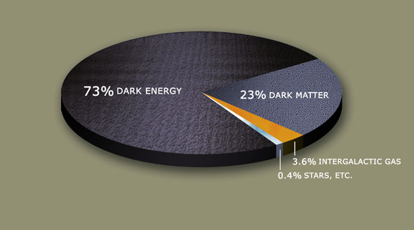
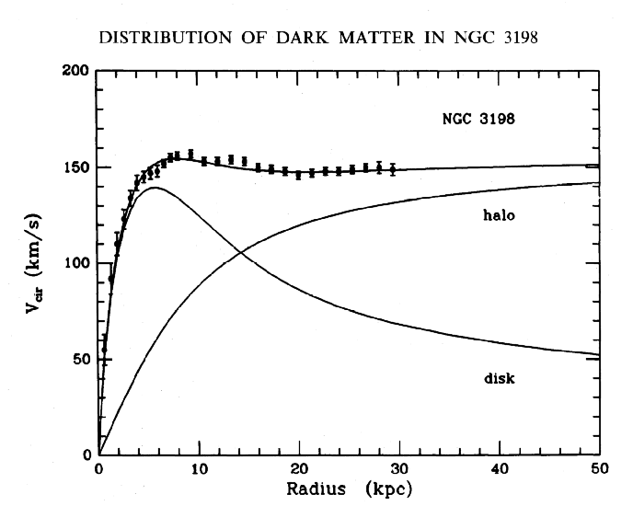
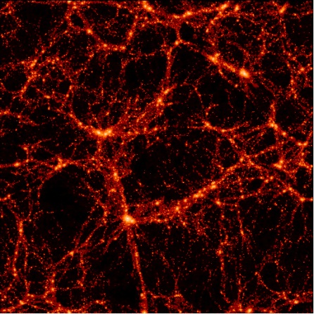
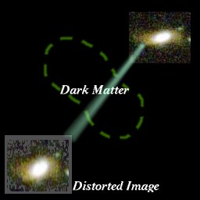
Dark Matter and the Evidence
Rotation curves of spiral galaxies
Galaxy groups emitting X-rays
Mass to luminosity ratios
Mass autocorrelation functions
Gravitational lensing
Other: CMB, BAO, etc.

Slide 4
Nature of Dark Matter
MOND(MOdified Newtonian Dynamics)
Super-Symmetry LSP
Kaluza-Klein
Dark fluid, a side effect of dark energy
From corrections to the conventional gravitational interaction as a result of the reconciliation of gravity with quantum mechanics

Slide 5
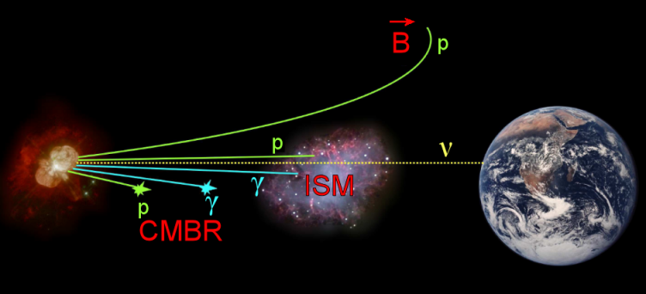
Neutrino Astronomy
Low cross-section messenger
No charge -> no deviation by magnetic fields
Ability to observe the inner workings of the astrophysical objects

Slide 6
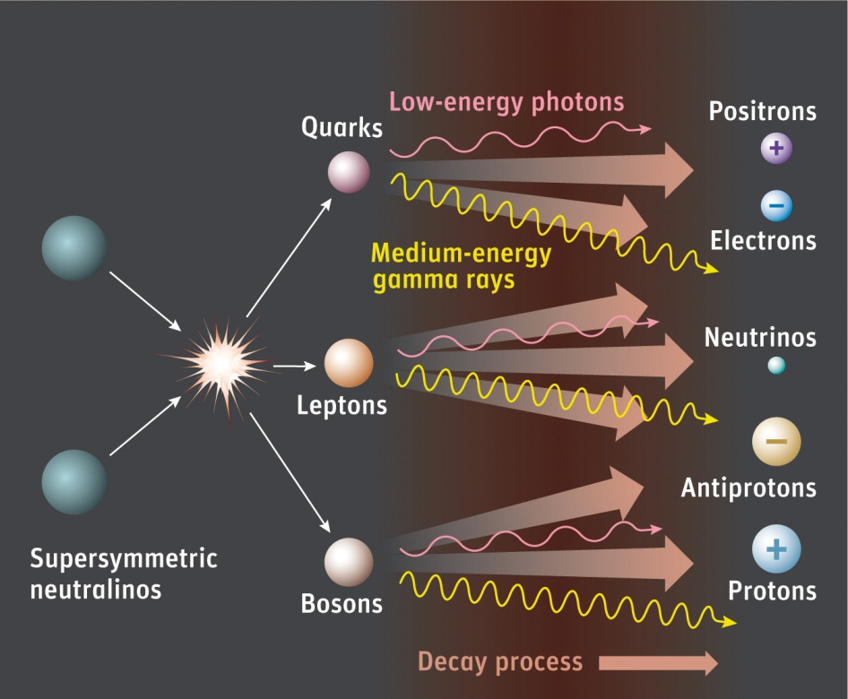
Dark matter search via neutrino astronomy
If DM is from a particle origin (LSP or LKP)
Auto-annihilation is possible
Unless the products are stable(photons or electrons)
There is always a neutrino
The sun is a very close
possible accumulation
of DM

Slide 7
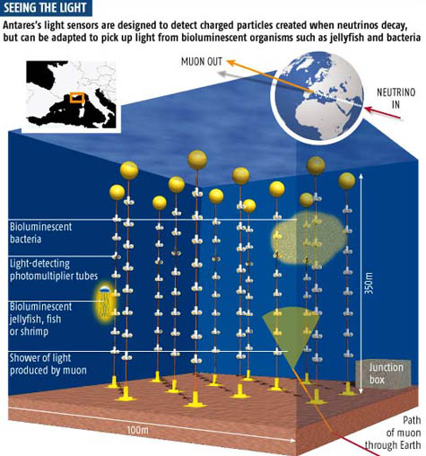
ANTARES
One of the only few Cherenkov neutrino telescopes in the world (Antares, Bakal, IceCube)
12 lines, 25 floors per line, with 3 OMs per floor. Totaling a sum of 900 OMs

Slide 8
Searching for DM in the sun
Data sample , 2008 data
Background noise consists of cosmic rays, hitting the earth atmosphere creating muons for down-going events and neutrinos for up-going events
The analysis will mostly focus on eliminating muons that are badly reconstructed as up-going and keeping the neutrinos at the end

Slide 9
Cuts
Apply basic cuts, as selection of events reconstructed as up-going
Events that touch 5 floors or more
Events that touch 2 lines or more
Then with more complex cuts:
Tchi2: or quality of reconstruction as a muon generating a Cherenkov cone
Bchi2: Or quality of reconstructions as a bright point , a characteristic of an electron emitting light

Slide 10
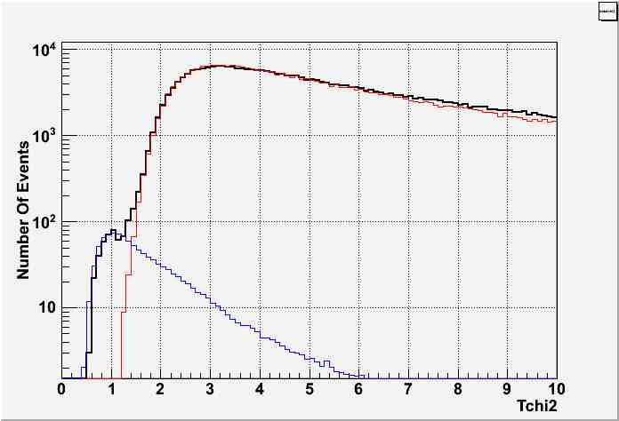
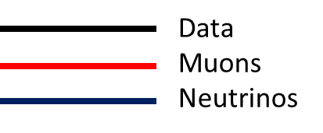
Tchi2

Slide 11
Tchi2
Tchi2=1.9
Events well reconstructed
Events badly reconstructed as muons emitting a Cherenkov light

Slide 12
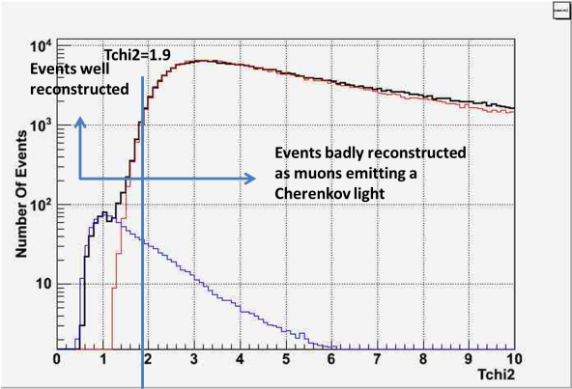
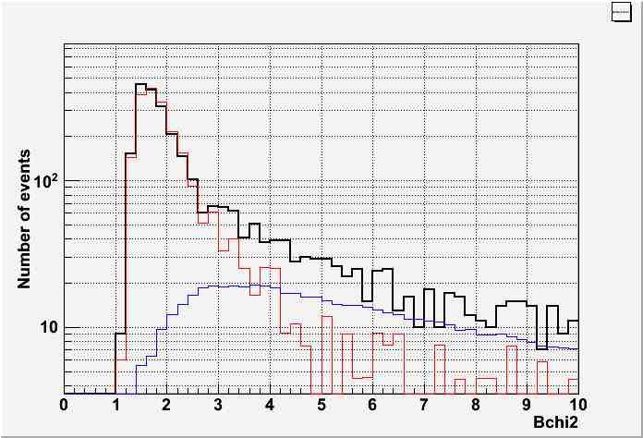
Bchi2

Slide 13
Bchi2
Bchi2=???
Remove
Keep

Slide 14
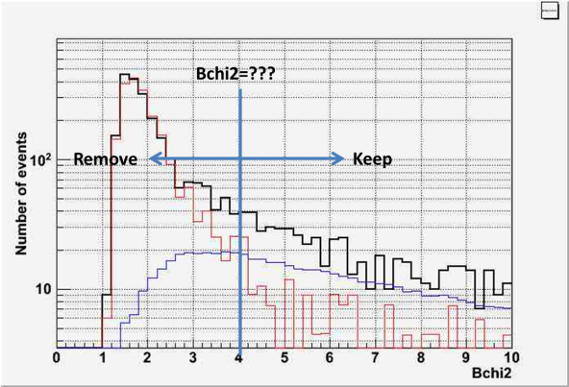
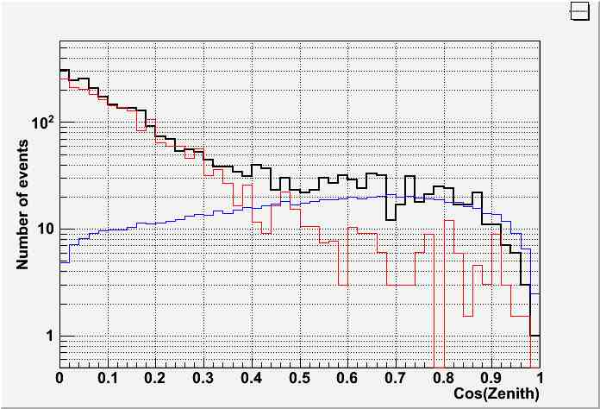
Zenith

Slide 15
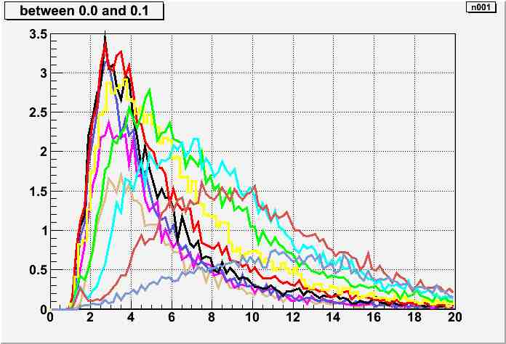
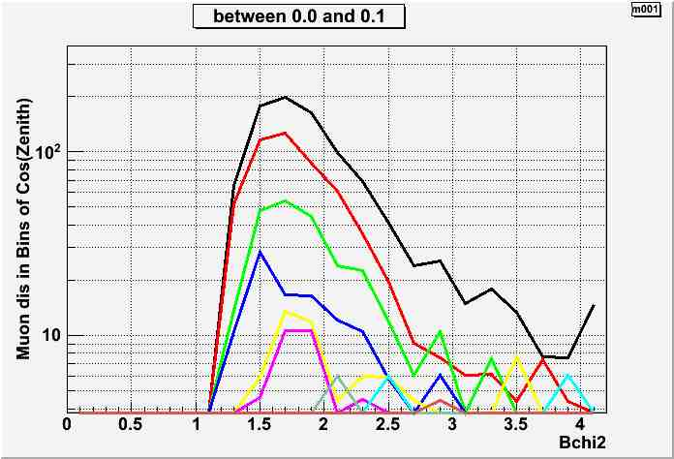
Bchi2 and Zenith
Neutrinos
Muons

Slide 16
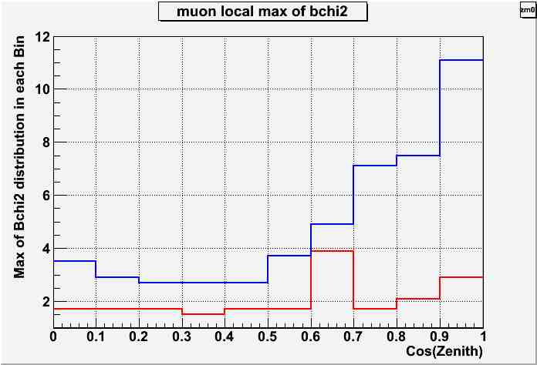
Bchi2 and Zenith

Slide 17
Bchi2 and Zenith
Bchi2 cut =
f( Cos [ zenith ] )

Slide 18

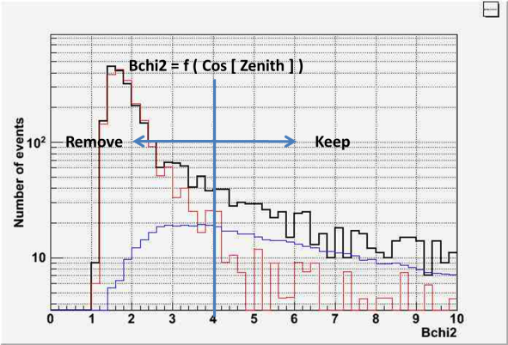
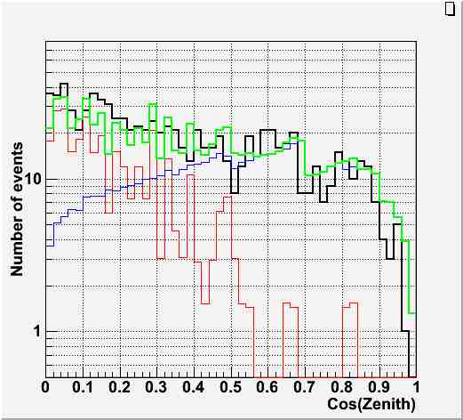

Slide 19


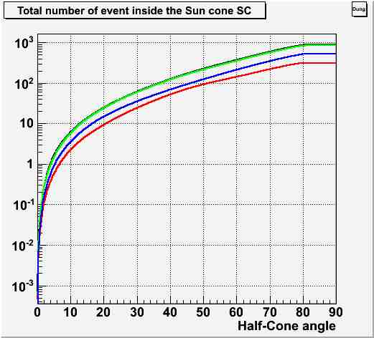
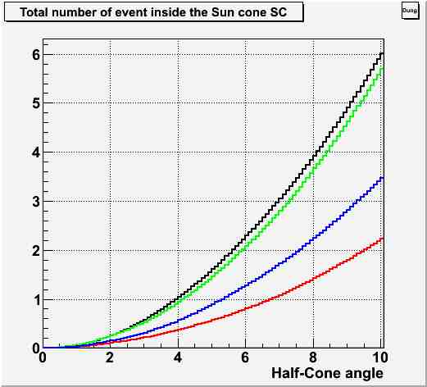
Background Noise estimation

Slide 20
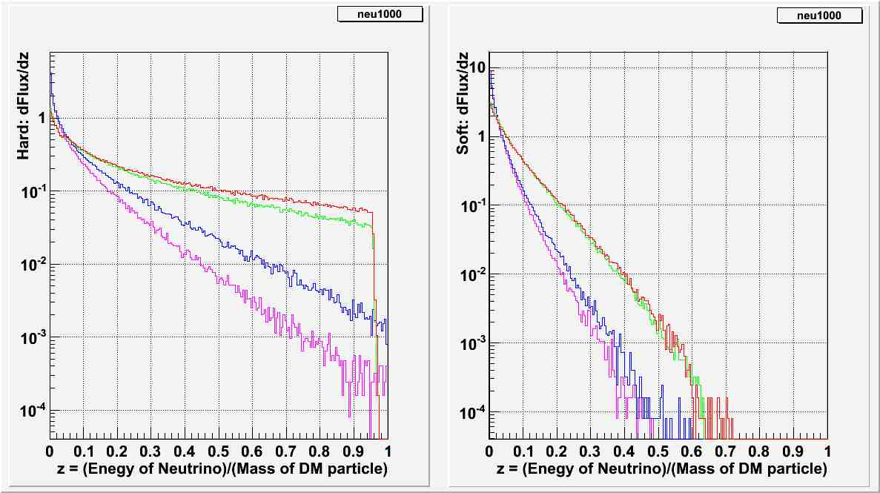






DM Differntial Flux
$$χ+χ \underset{→}{ } W+\overline{W}$$
$$χ+χ \underset{→}{ } b+\overline{b}$$
$$Mχ=\text{200}\text{GeV}$$
$$Mχ=\text{1}\text{T}\text{eV}$$
$$Mχ=\text{1}\text{T}\text{eV}$$
$$Mχ=\text{200}\text{GeV}$$

Slide 21
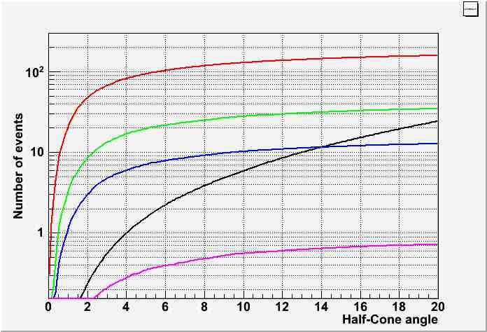




DM Neutrino Signal
1TeV Hard $υ+\overline{υ}$
200GeV Hard $υ+\overline{υ}$
1TeV Soft $υ+\overline{υ}$
200GeV Soft $υ+\overline{υ}$

Slide 22
Conclusions And Final Remarks
Hard decay channel has more chance of detection
More DM masses needs to be simulated
Find a cut that can differentiate between background noise and DM signal
Calculate the sensitivity of the detector to DM signals

