Slide 1
2nd meeting of the
Strategy Board (extended) dedicated to the evolution of ESCAPE and the new OSCARS programme
Giovanni Lamanna
ESCAPE Director
24/2/2026

Slide 2
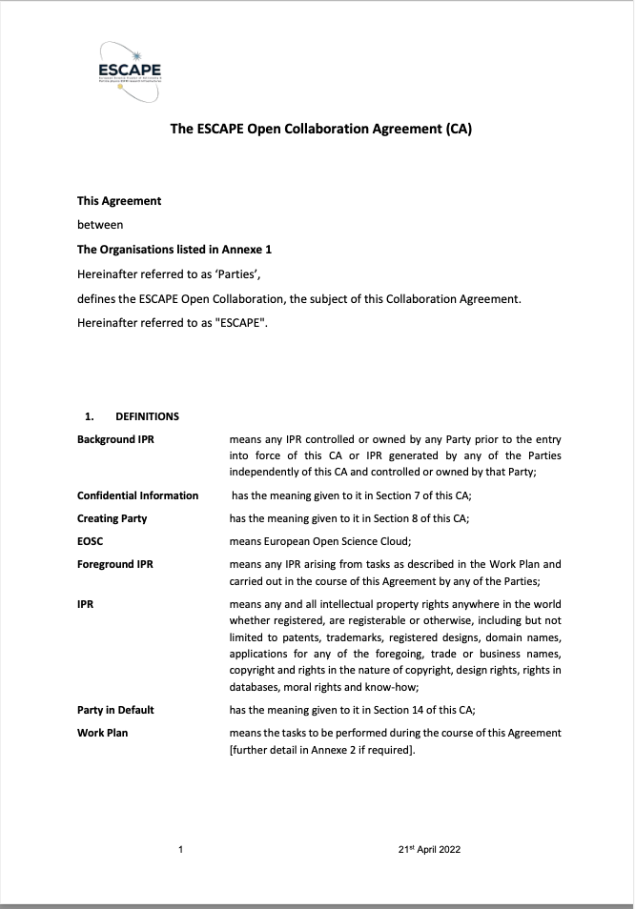
The ESCAPE Open Collaboration
Since February 2023, ESCAPE has a Collaboration Agreement signed by the Directors of all the partner RIs
https://projectescape.eu/
Giovanni Lamanna

Slide 3

2026 Horizon Europe calls preparation
The 5 Science Clusters are:
ENVRI - Environmental Science
ESCAPE - Astronomy and Particle Physics
LS RI - Life Science
PaNOSC - Photon and Neutron Science
SSHOC - Social Sciences and Humanities
https://science-clusters.eu/
During the last three years, some Science Clusters (SCLs) statements addressed to high-level stakeholders concerned the consolidation of the role of clusters in the Horizon Europe framework programme. SCLs to be seen as:
  ‘Facilitators, operators and aggregators’ of open/common data services for science and innovation.
  Able to reach out more partners (ESFRI and world-class RIs), consolidate synergies, pool other services in a broader dimension and guarantee coordination among RIs on European policies, innovation/technology programmes and other (multidisciplinary) sectoral data spaces.
Consequently, the EC is providing two more opportunities in 2026:
  HORIZON-INFRA-2026-01-EOSC-01 that will bring the SCLs to “OSCARS 2”.
  HORIZON-INFRA-2026-DEV-01-02 allowing us to build a new phase of our collaboration : “ESCAPE enhance”.
..and further in 2027:
  “OSCARS 2” supporting the evolution of the EOSC federation and its governance.
  “ESCAPE enhance” should strongly support and coordinate actions under HORIZON-INFRA-2027-SERV-01-01 and HORIZON-INFRA-2027-SERV-01-02
Meetings with the EC are currently being planned to discuss the evolution of ESCAPE and other SCLs (e.g. within FP10).
Giovanni Lamanna

Slide 4
2026 Horizon Europe calls preparation
HORIZON-INFRA-2026-01-EOSC-01: Uptake of FAIR data management practices and of EOSC by research communities and research infrastructures (40 MEur).
HORIZON-INFRA-2026-DEV-01-02: Consolidation of the research infrastructure landscape – pilots for strategic coordination, synergies and simplified access pathways, by large thematic clusters of pan-European research infrastructures (8 MEur max per project).
Both calls were presented in July 2025 during the last ESCAPE Strategy Board meeting
Individual meetings (September–December 2025) were proposed and organised between GL and each ESCAPE RI partner to gather interests and priorities. In addition, a questionnaire was sent to each ESCAPE member and your responses were analysed. (Many thanks to all of you!)
Meanwhile,
  OSCARS project is facing its mid-term review; EVERSE project is exploring new steps.
  The EOSC Federation is being developed, through the deployment of further Nodes and the discussion about a new governance by 2027, between partnership and joint undertaking.
  Current and future INFRA-EOSC funding programmes will support the adoption of federation (we are now awaiting the ESCAPE node!).
  HORIZON-INFRA-2027-01-EOSC-01-cofund will explore the 50%-50% cofunding between EC and Member states (we need to follow up in every single member state for the benefit of our science).
Giovanni Lamanna
24/2/2026

Slide 5
Results of the questionnaire
Main results / expectations from the questionnaires
About ESCAPE, EOSC and OSCARS 2
  Consolidation of the Community Competence Centre (CCC) as a tool for making cross-fertilisation within ESCAPE sustainable and strengthening the specific role of an RI as a technical contributor; willingness to play a role in a distributed configuration. ESCAPE as a central gateway to research standards for nuclear, astrophysics and particle physics individually.
  Community underrepresented in EOSC. We need to leverage the first group of EOSC national nodes + the CERN node and move towards a possible implementation or evolution of the existing one towards an ESCAPE node (with some RIs to start with); remain united to support the “physics of the two infinities” by leveraging our networks; further characterise VREs and manage them; engage with Member States that are considering co-funding EOSC in the future.
About “ESCAPE enhance”
  The RIs are interested in participating in coordination missions to extend the ESCAPE programme. Data services remain fundamental. The central gateway is considered necessary. Prioritise user access for standards and science, as well as services for innovation, research and development, and training; finally, support shared technological developments.
  Broad inclusivity in the longer term; strategic for INFRA-SERV-2027 and FP10; consideration of the weight and specific needs of nuclear, astronomy and high-energy physics, and general trust in the ESCAPE collaboration for such an ambitious path.
Giovanni Lamanna
24/2/2026

Slide 6
HORIZON-INFRA-2026-01-EOSC-01 (OSCARS 2)
The steering committee of the five SCLs (composed of the directors of the SCLs) have begun working on the OSCARS 2 proposal.
An initial meeting was held in Paris on 23 January 2026.
A second coordination meeting will be held in Seville on 9 March, prior to the OSCARS annual general meeting.
Several individual discussions (between GL and each SCL et al.) are ongoing.
Giovanni Lamanna
24/2/2026

Slide 7
HORIZON-INFRA-2026-01-EOSC-01 (OSCARS 2)
ACTIVITIES:
1) Accelerate FAIR adoption and the contribution to and use of EOSC resources by multiple research communities through open science projects.
This activity should be implemented through open calls that provide grants to third parties for open science projects through a cascading grant mechanism. The open calls should encourage, where applicable, cross-RI and/or cross-domain collaborations, including for data access, use and reuse.
Open science projects should address questions of high scientific impact, adopting best practices for FAIR data and service management and demonstrating their benefits. Their activities may include developing, annotating, curating and making FAIR high-value datasets, developing direct pipelines to integrate large-scale experimental data in repositories federated in EOSC, operationalising data access for AI-based applications, reusing existing datasets, enhancing existing and developing new vocabularies, data standards, metadata mappings and crosswalks, developing software, tools and services, or supporting open science community building.
They should cover a broad range of (academic and/or industrial) research communities and scientific disciplines, including those less represented in the EOSC Federation. They should make use of resources available in the EOSC Federation and adopt existing EOSC policies and standards, where possible. Projects should strive to ensure the sustained, beyond the projects’ duration, integration, deployment and operation of relevant outcomes in the EOSC Federation.
Giovanni Lamanna
24/2/2026

Slide 8
HORIZON-INFRA-2026-01-EOSC-01 (OSCARS 2)
At least EUR 29 million of the EU contribution to this topic should be used in this activity. The financial support to third parties for the open science projects must be provided in the form of grants that should be between EUR 100 000 and 250 000 per grant for a duration of 12 to 24 months. The consortium shall put in place adequate measures to support the integration of the open science projects’ results into the EOSC Federation. These could include mentoring, training and any other activities providing effective linkage to the EOSC Federation and EOSC Nodes, as needed for the specific nature of each project.
Giovanni Lamanna
24/2/2026

Slide 9
HORIZON-INFRA-2026-01-EOSC-01 (OSCARS 2)
ACTIVITIES:
2) Support the integration of thematic research and RI communities in the EOSC Federation
  2.1 Coordinating, aligning and networking existing community-based competence centres on FAIR and open science practices developed within the EOSC ecosystem.
  2.2 Developing training programmes, modules and material on FAIR and open science practices tailored to the specific needs of different thematic research communities. This activity should include feedback mechanisms to ensure that the training services are responsive to the evolving needs of EOSC user communities.
2.3 Developing frameworks for the provision and continuous evolution of high-impact services and data repositories onboarded to the EOSC Federation, fostering interoperability and integration of data and resources from diverse scientific domains and promoting their sharing through the EOSC Federation.
2.4 Establishing mechanisms for the integration and long-term sustainable provision of all relevant outcomes into the EOSC Federation, as well as for continuous feedback and adaptation, ensuring evolving requirements of researchers and RIs are met within the EOSC ecosystem.
2.5 Engaging underrepresented thematic research and RI communities to increase their integration in EOSC.
Giovanni Lamanna
24/2/2026

Slide 10
ACTIVITIES | WP1 | WP2 | WP3 | WP4 | WP5
1 (cascading grants) | X
2.1 (CCC) |  |  |  | X
2.2 (Training) |  | X
2.3 (EOSC onboarding) |  |  | X
2.4 (sustainability) |  |  | X
2.5 (engagement) | X
Management |  |  |  |  | X
WP5
(MANAGEMENT, COMMUNICATION, C.G. ADMINISTRATION, STRATEGY BOARD CHAIRING)
OPEN-SCIENCE PROJECTS
COORDINATION
EOSC-FEDERATION INTEGRATION
COORDINATION
WP1
WP3
WP2
WP4
Giovanni Lamanna
24/2/2026

Slide 11
HORIZON-INFRA-2026-01-EOSC-01 (OSCARS 2)
WP1
Scientific impact and engagement (ACTIVITIES : 1 and 2.5)
Accelerate FAIR adoption and the contribution to and use of EOSC resources by multiple research communities through open science projects through a cascading grant mechanism. (1)
Engaging underrepresented thematic research and RI communities to increase their integration in EOSC. (2.5)
WP2
Strengthening, surveying and conceiving training programmes (ACTIVITIES : 2.2)
Training programmes tailored to the specific needs of different thematic research communities and the evolving needs of EOSC user communities.
WP3
Enhancing the EOSC Federation’s impacts (ACTIVITIES : 2.3 and 2.4)
Developing frameworks for high-impact services and data repositories onboarded to the EOSC Federation.
Establishing mechanisms for the integration and long-term sustainable provision of all relevant outcomes into the EOSC Federation.
Giovanni Lamanna
24/2/2026

Slide 12
HORIZON-INFRA-2026-01-EOSC-01 (OSCARS 2)
WP4
Community-based competence centres (ACTIVITIES : 2.1)
Coordinating, aligning and networking existing community-based competence centres on FAIR and open science practices developed within the EOSC ecosystem.
WP5
MANAGEMENT, COMMUNICATION, C.G. ADMINISTRATION
Giovanni Lamanna
24/2/2026

Slide 13
HORIZON-INFRA-2026-01-EOSC-01 (OSCARS 2)
Some work to be done with the ESCAPE Executive Board to define priorities and opportunities (for the consolidation part; about 1.9 MEur).
Same for potential cascading grants (CG) (about 5.5 MEur).
Further discussions with the ESCAPE Strategy Board expected to gather suggestions from their own communities and envisage some specific focus for the CG.
EVERSE 2nd phase will be included in OSCARS 2 towards a “Knowledge Hub on Software” linked with the 5 CCCs.
Need to reach out new RIs and communities (within ESCAPE).
Conceiving and operating the ESCAPE Node (starting with the partner RIs which have declared their support).
Giovanni Lamanna
24/2/2026

Slide 14
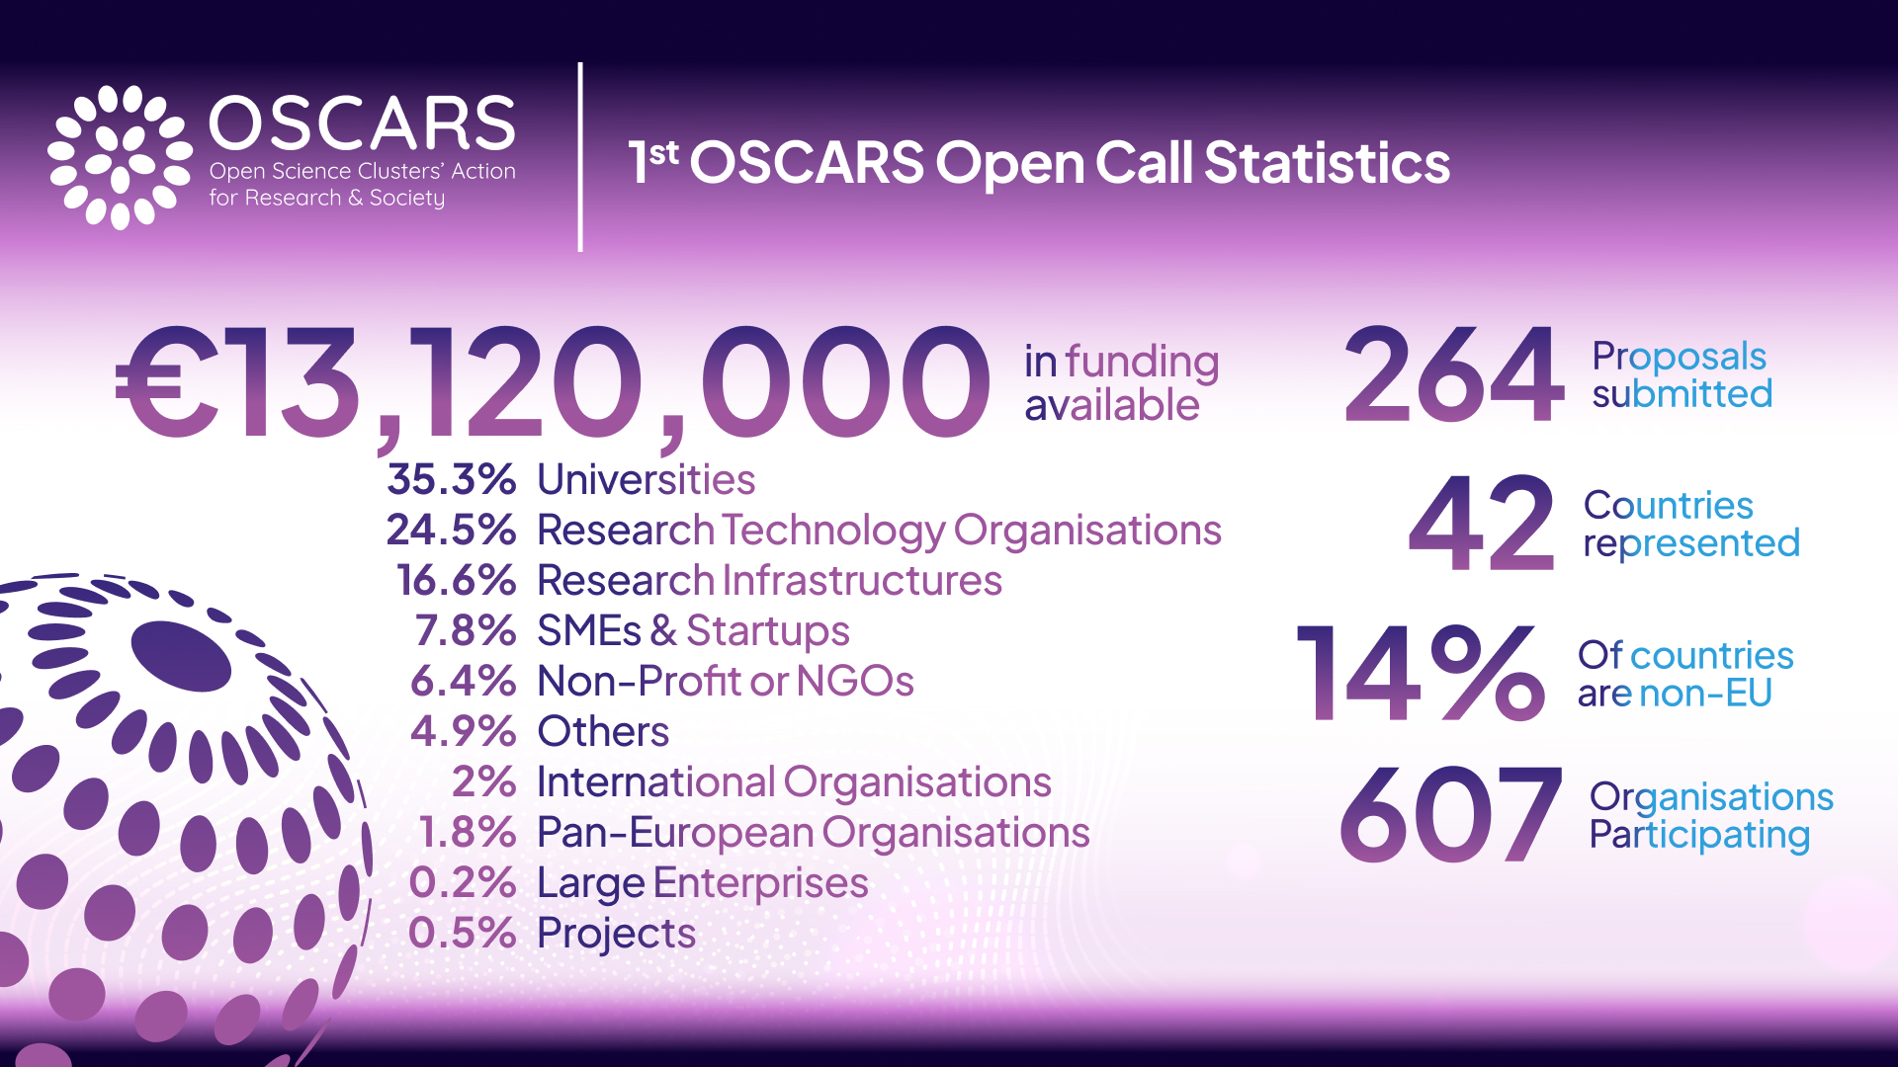
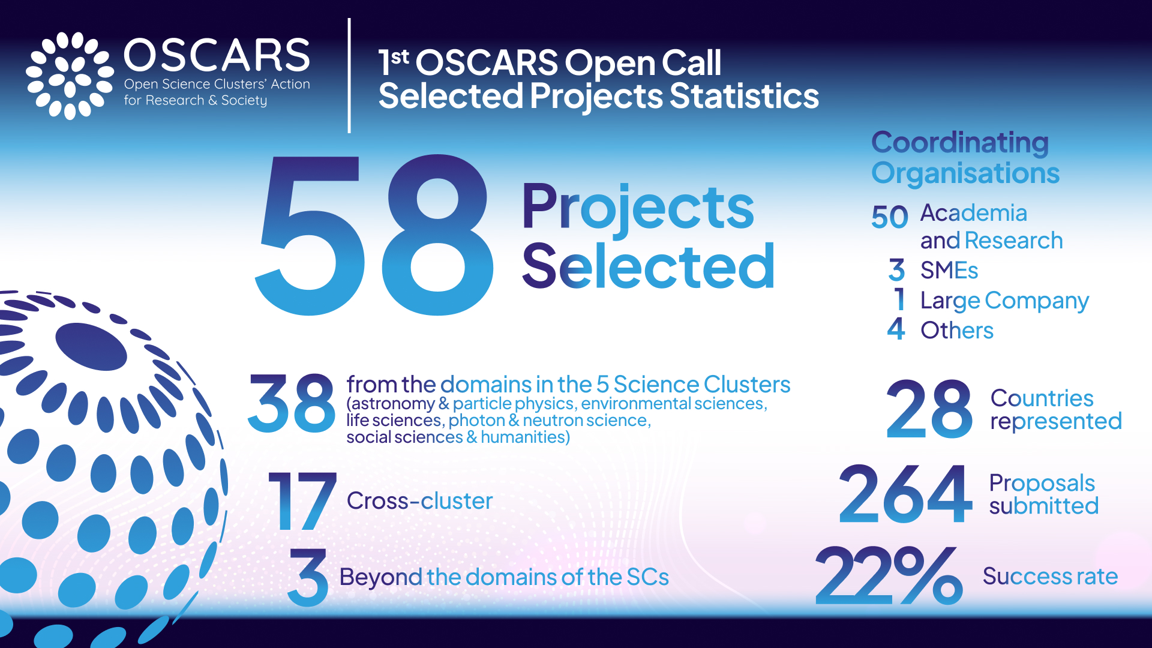
OSCARS 1st OPEN CALL
Total funding requested: € 55,548,003.44
174 Consortia - 90 Mono-beneficiary projects
More info at:
https://www.oscars-project.eu/news/264-proposals-submitted-1st-oscars-open-call
https://oscars-project.eu/news/1st-oscars-open-call-concluded-58-projects-selected
Total funding available: € 13,120,000.00
Total spent: € 13,640,457.16
Notes:
The 1st OSCARS Open Call for Open Science (OS) projects and services aimed to source Open Science projects, i.e., scientific research projects, citizen science projects or any other projects that will develop services or networks in the scientific disciplines covered by and beyond the Science Clusters.
Selected projects will make (meta)data, software, tools and/or workflows FAIR and available to fellow researchers and the general public, to facilitate accessibility and reuse by the scientific community at large.
48 projects have opted for the full 24 months duration.
50 projects will receive a contribution of more than € 200,000.
Funding is provided to selected projects upon successful conclusion of a Third-Party Project Agreement signed by the coordinating organisation of the selected projects.

Slide 15
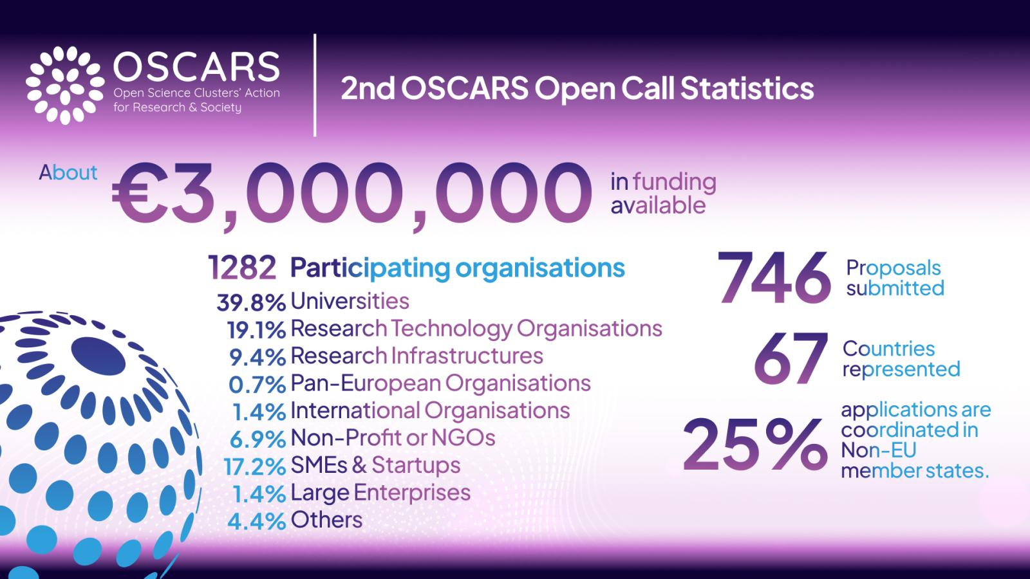
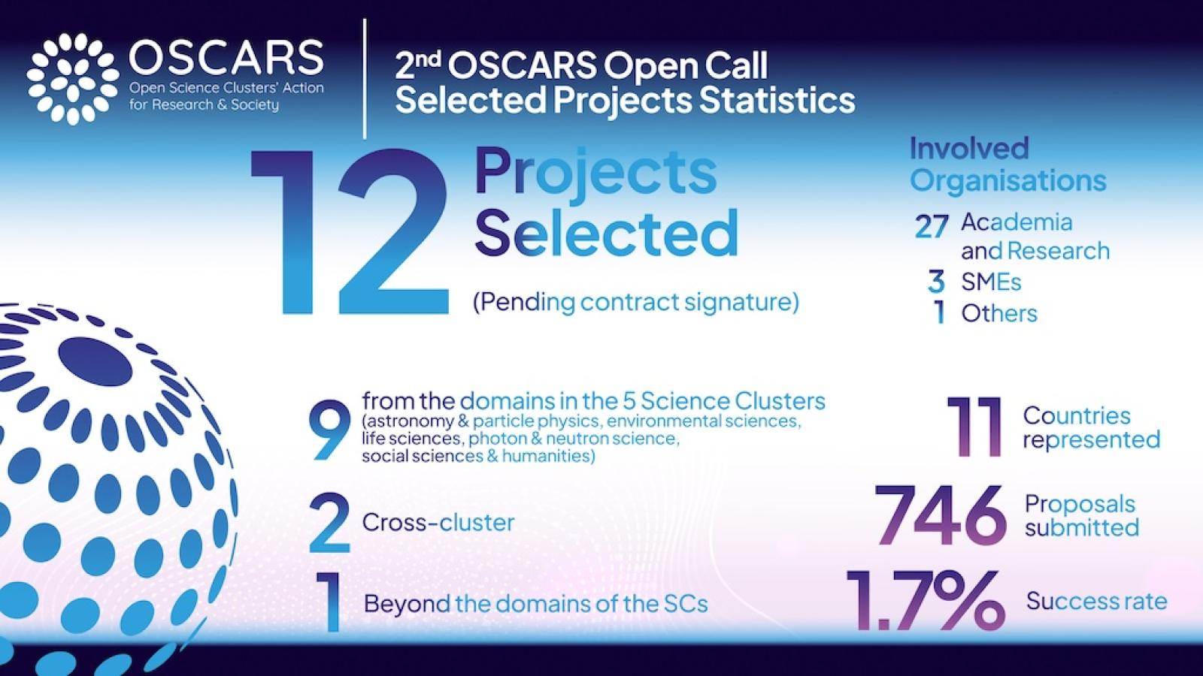
OSCARS 2nd OPEN CALL
Total funding requested: € 172,725,867.31
529 Consortia - 217 Mono-beneficiary projects
Total funding available: less than € 3,000,000
Total spent: € 2,913,194.50
More info at:
https://oscars-project.eu/news/2nd-oscars-open-call-concluded-12-projects-selected
https://oscars-project.eu/news/2nd-oscars-open-call-reflects-great-demand-open-science-funding-0
Notes:
5 projects have asked for 250 000€
11 for more than 200 000€
All of them have asked for 24 months

Slide 16
DISCUSSIONS
Q&A

Slide 17
Preparing the Horizon-Europe 2026 calls
2) HORIZON-INFRA-2026-DEV-01-02: Consolidation of the research infrastructure landscape – pilots for strategic coordination, synergies and simplified access pathways, by large thematic clusters of pan-European research infrastructures (8 MEur).
Proposals should involve, not necessarily as beneficiaries, ESFRI Landmarks and Projects and/or ERICs in the domain, other research infrastructures that are international European research organisations and, where relevant, well-established networks of key European research infrastructures open to external users. Proposals should elaborate on which key EU priorities and initiatives (such as Horizon Europe partnerships, missions) they will consider and the nature and objectives of the envisaged coordination mechanisms or joint activities.

Slide 18
HORIZON-INFRA-2026-DEV-01-02
Scope:
This topic aims at equipping large thematic clusters of research infrastructures of European interest with a policy arm combined with a technical arm, to increase awareness, findability and accessibility, better matching user needs. This thematic clustering is aligned with ESFRI approach: proposals should explicitly state which ESFRI domain they address*. Proposals should foresee close collaboration across projects under this topic to ensure, where applicable, policy coordination, technical interoperability and other synergies.
Building on the clusters under Horizon 2020 and Horizon Europe, on the development of catalogues of services, and on new access pathways and improved services such as under Horizon Europe INFRASERV projects.
*ESFRI domains: 1. Data, Computing and Digital Research Infrastructures; 2. Energy; 3. Environment; 4. Health & Food; 5. Physical Sciences and Engineering; 6. Social Sciences & Humanities. See ESFRI Landscape Analysis 2024 https://landscape2024.esfri.eu/

Slide 19
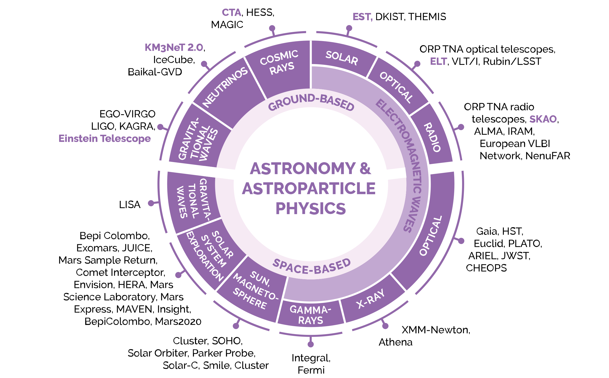
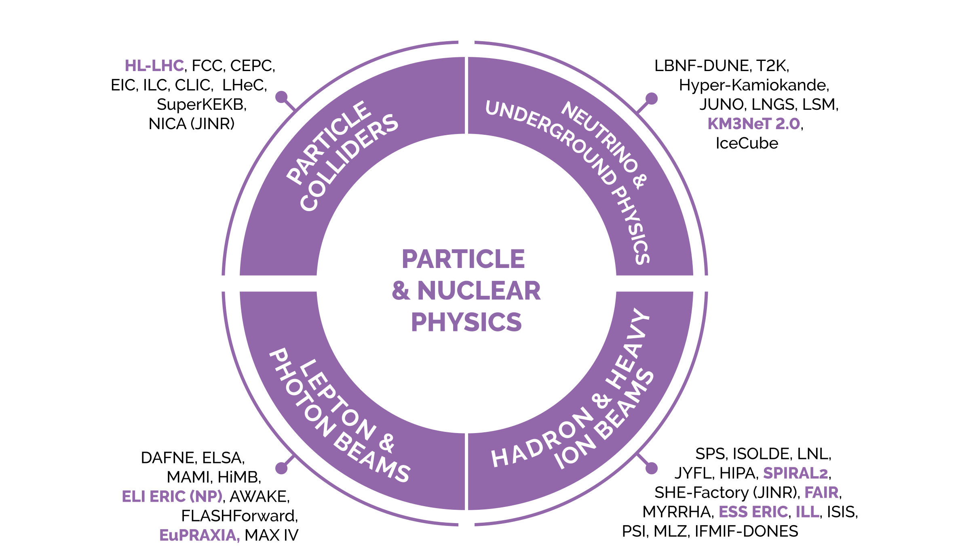
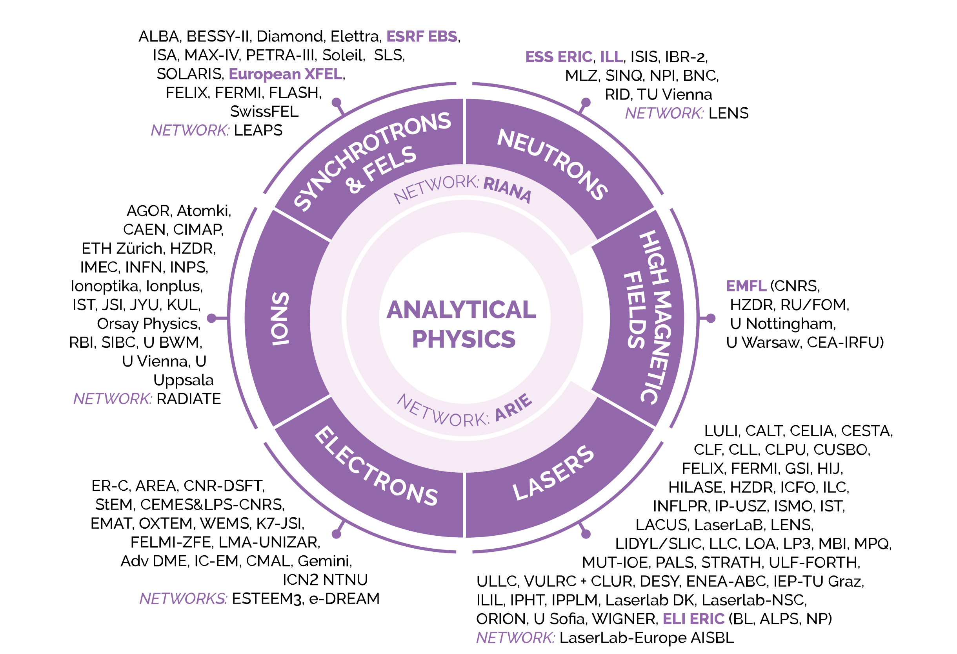
From ESCAPE to “ESCAPE enhance”
GL discussed the coordination between two
proposals (ESCAPE & LEAPS) in October 2025 with
Jakub Szlachetko (LEAPS).
He is looking into it these days
within the LEAPS strategy board.
LEAPS++ and PANOSC ++
(should be concerned)
https://landscape2024.esfri.eu/.

Slide 20
HORIZON-INFRA-2026-DEV-01-02
Expected Outcome:
Policy contribution, impact and visibility of research infrastructures of European interest, by large thematic domain, to relevant EU policy and priority initiatives, including beyond research, at national, regional, European and global level.
Listing the EU policy and priority initiatives: …
Point out the RIs’ contributions on them: …
Combine with community-based interests and expectations: …

Slide 22
HORIZON-INFRA-2026-DEV-01-02
Expected Outcome:
Policy contribution, impact and visibility of research infrastructures of European interest, by large thematic domain, to relevant EU policy and priority initiatives, including beyond research, at national, regional, European and global level.
Listing the EU policy and priority initiatives: …
Point out the Ris’ contributions on them: …
Combine with community-based interests and expectations: …
Improved coordination, complementarities, and where applicable, interoperability, harmonisation, integration and synergies among research infrastructures within large thematic domains and, where relevant, across domains.
Cross-fertilisation or complementarities. Overlapping is not required, but coordination is a must.

Slide 23
HORIZON-INFRA-2026-DEV-01-02
Expected Outcome:
A European portfolio of R&I services of European interest, supported by a common front page and few single-entry point access portals, integrated or interoperable catalogues of R&I services and converging access conditions and selection procedures, strengthening the European landscape of ESFRI-prioritised infrastructures and other world-class research infrastructures by large thematic domains.
This is almost a survey and a compilation of a “directory of skills and services”. Strategically, the technology platforms (cooperating with industries) will position us on TIs future funding. Data access services (such as ACME and other Astro-services legacy) would fit in. Competence Centres can be part of it. Innovation initiatives on nuclear physics (Spiral2-FAIR-CERN), environment (KM3NET), HEP/CERN transversal actions for society and multi-domain could be linked to therein; technology programmes (ESO et al.), physics for health, digital twin capacity, GEANT, CORSIKA and other simulators, RTA, green computing, HPC through multi-language code programming. It would be very large in size, but definitely relevant.
Increased awareness, findability and accessibility of research infrastructures for European researchers and innovators; simplified and adapted access pathways for new needs or new communities of users (e.g. where relevant, multidisciplinary R&I, EU collaborative research projects, EU operational or deployment programmes, public authorities, and industry, including SMEs, startups and scaleups).
Based on the point above, one needs to make the access oriented to a virtual cooperative space (VCS) for external inquiring.

Slide 24
“ESCAPE enhance”
EXPECTED OUTCOME | WP1 | WP2 | WP3 | WP4
1. Policy | X
2. Improved Coordination | X
3 Portfolio of R&I services |  | X
4 Ris’ awareness and access |  |  | X
Project management and communication |  |  |  | X
« ESCAPE enhance » aims at being either :
- the Astro-Particle-Nuclear agreed programme for a larger PSE proposal, including ”Analytical Physics RIs’ cluster”
(LEAPS and LENS ??) (that is our hope),
or:
- an individual proposal by itself (in such a case with a budget pro-rated to the number of ESFRIs and other RIs ?!)
and well-established bridges with a LEAPS/LENS’s one.

Slide 25
WP1
POLICY AND COORDINATION (Outcome 1 & 2)
TASK 1 - Establishing a coordination structure of ESCAPE
    - Expanding the Science Cluster’s programme and scope (as well as memberships).
    - Establishing political and technical arms, strengthening synergies (in view of INFRA-SERV-2027 calls).
    - Coordinating with “Analytical Physics RIs” cluster.
    - Enhance the ESCAPE Community-based Competence Centre (CCC) fields.
TASK 2.1 – Strengthening/improving coordination and enhancing representativeness of ASTROPHYSICS ESFRIs
TASK 2.2 – Strengthening/improving coordination and enhancing representativeness of HEP/ECFA ESFRIs
TASK 2.3 – Strengthening/improving coordination and enhancing representativeness of ASTROPARTICLE/APPEC ESFRIs
TASK 2.4 – Strengthening/improving coordination and enhancing representativeness of SPACE probes/ESFRIs
TASK 2.5 – Strengthening/improving coordination and enhancing representativeness of Nuclear Physics/NuPPEC ESFRIs
TASK 3 – Harmonising, integrating and interoperating research infrastructures
    - Activities from WP2-TASK3.1 and TASK3.2
    - Industrial-Liaison optimisation and Technical Infrastructures (TIs) promotion
    - Transdisciplinary from Physics-to-health/environment/energy
    - …

Slide 26
WP2
R&I SERVICES’ CATALOGUE (Outcome 3)
TASK 1 – Front page architectural conception, design, deployment and operation
TASK 2 – Scientific research services and their access/selection procedures (survey, critical analysis and selection)
TASK 3.1 – Technological innovation services and their access/selection procedures (survey, critical analysis and selection)
-> in coherence with WP1-TASK 3 output (Harmonising, integrating and interoperating research infrastructures)
TASK 3.2 – Deploying “pilot” federated activities aligned with EU priorities and strategy”
    Data-research and open science (leveraging the current ESCAPE programme)
    Digital twin (Monte Carlo generator and hybrid computational optimisation)
    New electronics for observatory, sensors and detectors (It may be advantageous to prioritise semiconductors)
    Vacuum and cryogenics
    Quantum technology for time synchronisation, computation and cybersecurity
  According to a matrix approach where all of the above pilot activities follow a few strategic pathways:
    Delivering services/technologies for reducing the environmental and climate footprint
    Enhancing HPC in Europe
    Supporting science for AI
    Mentoring the Digital transition
    New adoptions and therefore potential new competitive markets (for semiconductor, photonics, vacuum, new
    materials…)
    Linking to EOSC (from open science to data sovereignty)

Slide 27
WP2
R&I SERVICES’ CATALOGUE (Outcome 3)
TASK 1 – Front page architectural conception, design, deployment and operation
TASK 2 – Scientific research services and their access/selection procedures (survey, critical analysis and selection)
TASK 3.1 – Technological innovation services and their access/selection procedures (survey, critical analysis and selection)
-> in coherence with WP1-TASK 3 output (Harmonising, integrating and interoperating research infrastructures)
TASK 3.2 – Deploying “pilot” federated activities aligned with EU priorities and strategy”
    Data-research and open science (leveraging the current ESCAPE programme)
    Digital twin (Monte Carlo generator and hybrid computational optimisation)
    New electronics for observatory, sensors and detectors (It may be advantageous to prioritise semiconductors)
    Vacuum and cryogenics
    Quantum technology for time synchronisation, computation and cybersecurity
  According to a matrix approach where all of the above pilot activities follow a few strategic pathways:
    Delivering services/technologies for reducing the environmental and climate footprint
    Enhancing HPC in Europe
    Supporting science for AI
    Mentoring the Digital transition
    New adoptions and therefore potential new competitive markets (for semiconductor, photonics, vacuum, new
    materials…)
    Linking to EOSC (from open science to data sovereignty)
To be optimized in view of HORIZON-INFRA-2027-01-SERV-02

Slide 28
WP3
VIRTUAL COOPERATIVE SPACE (Outcome 4)
TASK 1 – Definition of user profile access requirements (surveying, analysing and documenting)
TASK 2 – Simplifying and adopting access policy
TASK 3 – ESCAPE for JENA++ assessment of working groups, elaborating cross-fertilisation roadmaps for:
    Researchers
    Public authorities
    Industry
    SMEs
    Startups
    TI
    …
TASK 4 - Deploy relevant thematic “technical forums” and “training schemes” (for cross-fertilisation purpose and strengthening cluster’s identity and offer)

Slide 29
WP3
VIRTUAL COOPERATIVE SPACE (Outcome 4)
TASK 1 – Definition of user profile access requirements (surveying, analysing and documenting)
TASK 2 – Simplifying and adopting access policy
TASK 3 – ESCAPE for JENA++ assessment of working groups, elaborating cross-fertilisation roadmaps for:
    Researchers
    Public authorities
    Industry
    SMEs
    Startups
    TI
    …
TASK 4 - Deploy relevant thematic “technical forums” and “training schemes” (for cross-fertilisation purpose and strengthening cluster’s identity and offer)
A test bench and an anticipation of HORIZON-INFRA-2027-01-SERV-01

Slide 30
WP4
MANAGEMENT AND COMMUNICATION
TASK 1 – Project coordination
TASK 2 – Retrieve indicators, produce impact assessment, and deploy validation mechanism
TASK 3 – Communication

Slide 31
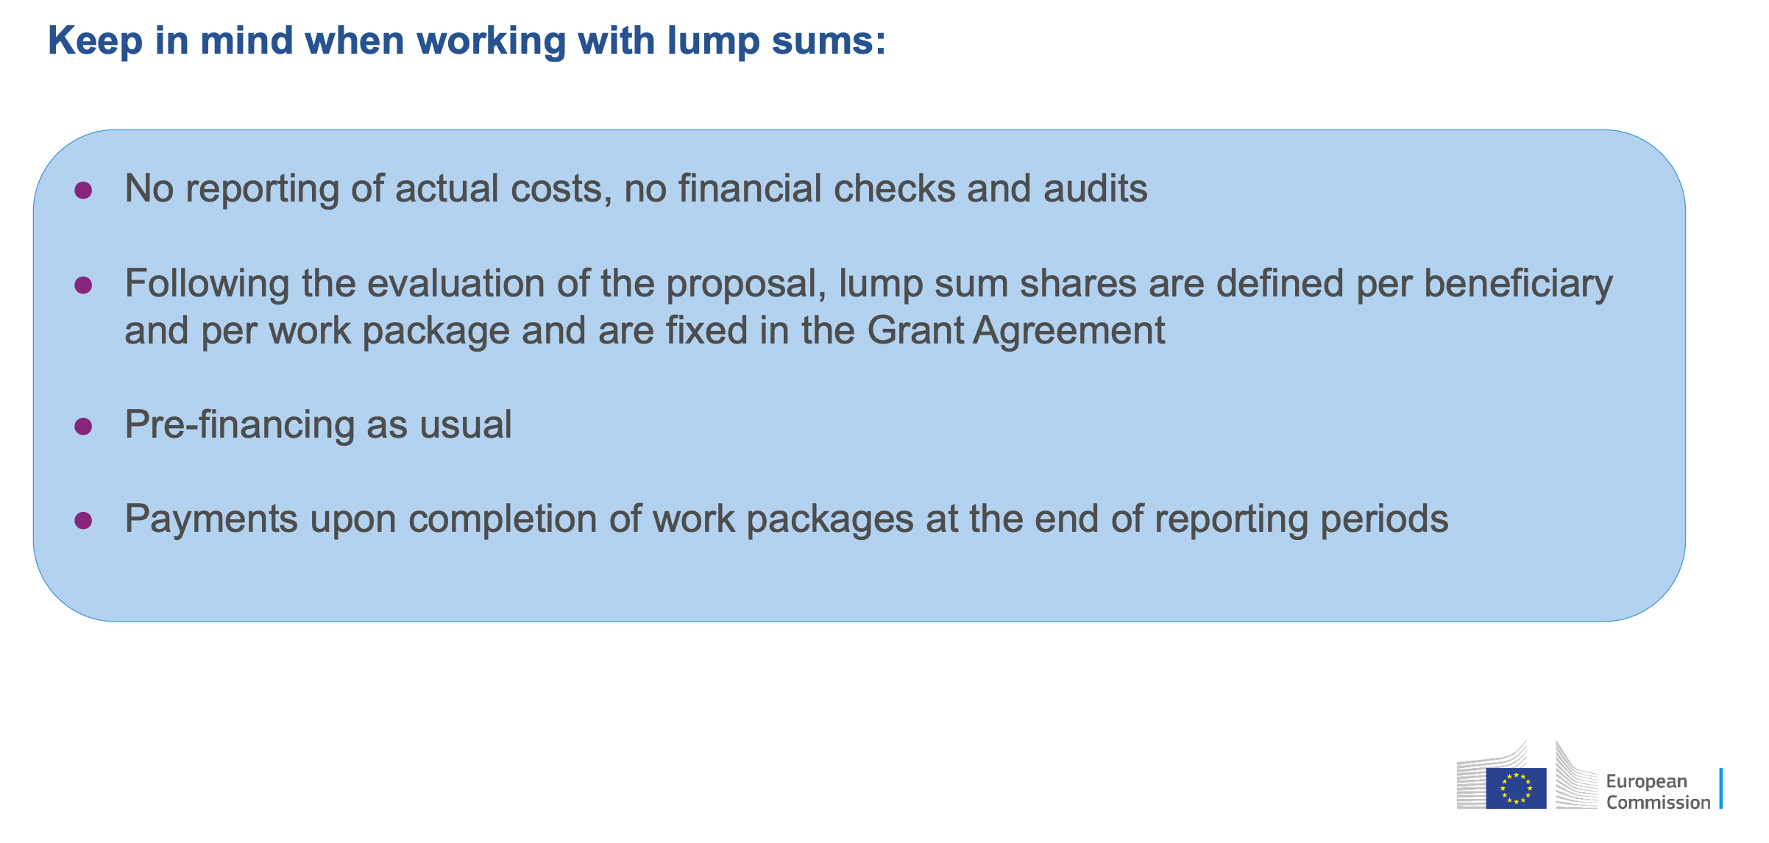

Slide 32
HORIZON-INFRA-2026-DEV-01-02
Proposals should address all of the following aspects:
Strengthening the representation of the research infrastructures cluster, as a single or coordinated voice, in key EU policy developments and strategic initiatives and contribute to policies in their domain with a research infrastructure component. Coordination with cross-domains fora, such as the ERIC Forum and EIROforum should also be ensured.
Strengthening coordination among research infrastructures to foster complementarities, interoperability, harmonisation, integration and synergies within the domain, and where relevant with other domains to address increasingly complex and multidisciplinary science and technology challenges.
Developing, optimising and connecting catalogues of research infrastructures services of European interest. Attention is required to new users, notably researchers and innovators from widening countries and candidate countries, industry (including SMEs, startups and scaleups), early-stage career researchers, and non-expert users. Flexibility to address future needs should be considered.
Developing and implementing intermediary services, user support, tools and notably AI assisted research infrastructure services navigation. When relevant, resulting data and digital services should be made accessible through EOSC.
Elaborating and promoting indicators flagging the strategic relevance of specific research infrastructures services to key EU R&I priorities and initiatives, including through common or coordinated impact assessments, and possible validation mechanisms with these initiatives.

Slide 33
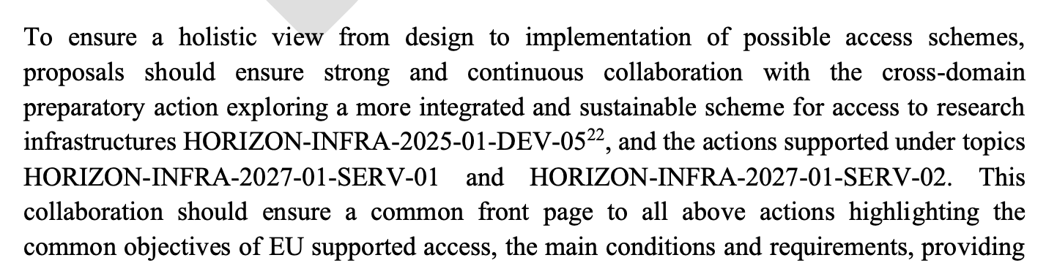
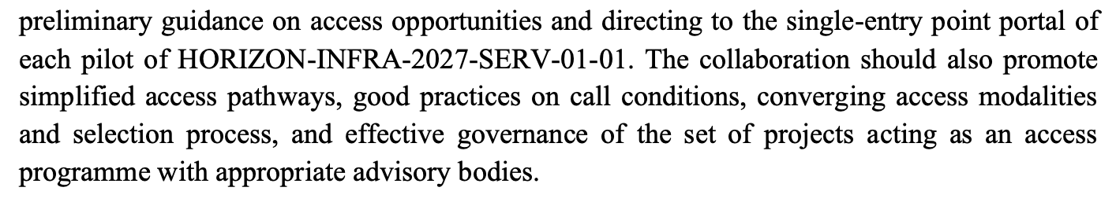
HORIZON-INFRA-2026-DEV-01-02
Preparatory
Phase
Next clusters’ calls

Slide 34
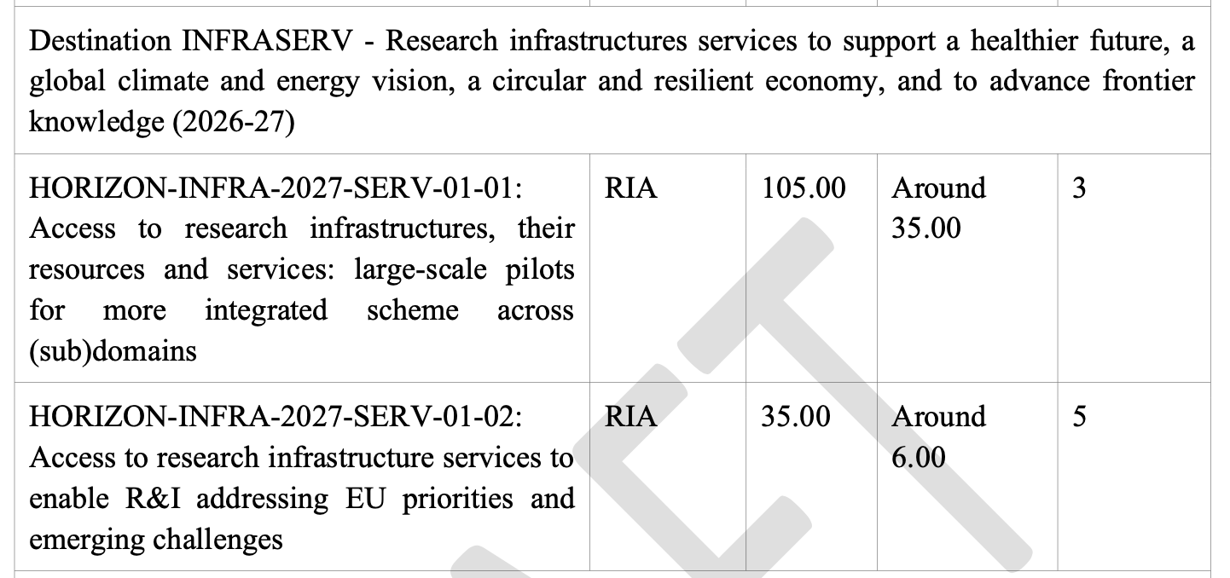
01-01: This topic aims at testing ‘access programme like’ projects providing trans-national access (on-site or remote) and/or virtual access to integrated and customised research infrastructure installations and services for excellent research, from frontier and curiosity- driven to applied research, offered by a wide range of complementary and interdisciplinary research infrastructures with experience in transnational access. Proposals are expected to address one of the following areas, based on ‘ESFRI scientific domains, and must explicitly state which area they address:
Area 1, covering Physical Sciences and Engineering; Data, Computing and Digital Research Infrastructures
Area 2, covering Health & Food; Social Sciences and Humanities
Area 3, covering Environment; Energy.
Proposals should include at least two ESFRI Landmark and/or European Research Infrastructure Consortium (ERIC) as beneficiary
01-02: This topic aims at providing trans-national access (on-site or remote) and/or virtual access to integrated and customised research infrastructure services … Access also includes ad hoc users’ training and scientific and technical support
Proposals should include at least one ESFRI Landmark or European Research Infrastructure Consortium (ERIC) as beneficiary

Slide 35
HORIZON-INFRA-2027-01-SERV-01
NEXT PRIORITY FOR ESCAPE
Access includes ad hoc users’ training and scientific and technical support (see Specific Features for Research Infrastructures). Additional training courses, including skills for data stewardship, may also be supported. In addition, proposals should better exploit the training potential of successful transnational access user projects by inviting researchers, notably early-stage career researchers, or research infrastructure technicians from widening and candidate countries to team up with selected user groups. Proposals should reserve sufficient resources for this purpose and should proactively advertise these opportunities. (which should be arranged after the selection of user projects and have no impact on their evaluation).
Access provision to existing services should be clear in the proposed activities and reflected in the allocated resources.
The improvement and development of services can also be supported, provided that the resulting services are offered already under the actions (short-term R&D) and that the long-term sustainability of such services is ensured.
Data management (and related ethics issues), interoperability, as well as the connection of digital services (e.g. data services) to the European Open Science Cloud, should be addressed where relevant. Proposals should take due account of major European or international initiatives relevant in the domain. When appropriate, they should foster the use and deployment of (open) global standards.
Proposals should include an outreach and engagement plan to actively advertise their services to the research communities, notably from widening countries and candidate countries and to relevant industries, including SMEs and, if applicable, provide dedicated support for the development of research partnerships and collaborations with researchers from widening countries and candidate countries. Proposals are expected to exploit synergies and to ensure complementarity and coherence with other EU grants supporting access provision.

Slide 36
HORIZON-INFRA-2027-01-SERV-02
To ensure a holistic view from design to implementation of possible access schemes, proposals
should ensure strong and continuous collaboration with the cross-domain preparatory action on
access HORIZON-INFRA-2025-01-DEV-05, with the pilots under topic HORIZON-INFRA-2026-
01-DEV-02, e.g. making use of the catalogues of services, navigation tool and links to key EU
initiatives, and with the actions supported under topic HORIZON-INFRA-2027-01-SERV-01.
This collaboration should ensure a common front page to all above actions, set up by one of the pilots, highlighting the common objectives of EU supported access, the main conditions and requirements, providing preliminary guidance on access opportunities and directing to the single-entry point portal of each pilot. The collaboration should also promote, the implementation of simplified access pathways, good practices on call conditions, converging access modalities and selection process, as well as effective governance of the set of projects acting as an access programme with appropriate advisory bodies.

Slide 37
ESCAPE phase II: conclusions
We need to collaborate effectively and reach agreement among ourselves quickly in order to optimise all these opportunities in 2026 and 2027, as well as in FP10.
We are called upon to capitalise on our networks and collaborative projects that have worked in the past, while respecting and supporting the ESCAPE cluster.
ESCAPE like the other four clusters, is recognised in the EU and considered a tool for cross-fertilisation and successful coordination in the longer term.
RIs that agree with and support this analysis are invited to Rome (or online) on 3 March for a working day on the rationalisation of WPs, taking into account what has been proposed today and discussed so far.

Slide 38
DISCUSSIONS
Q&A

