Slide 1
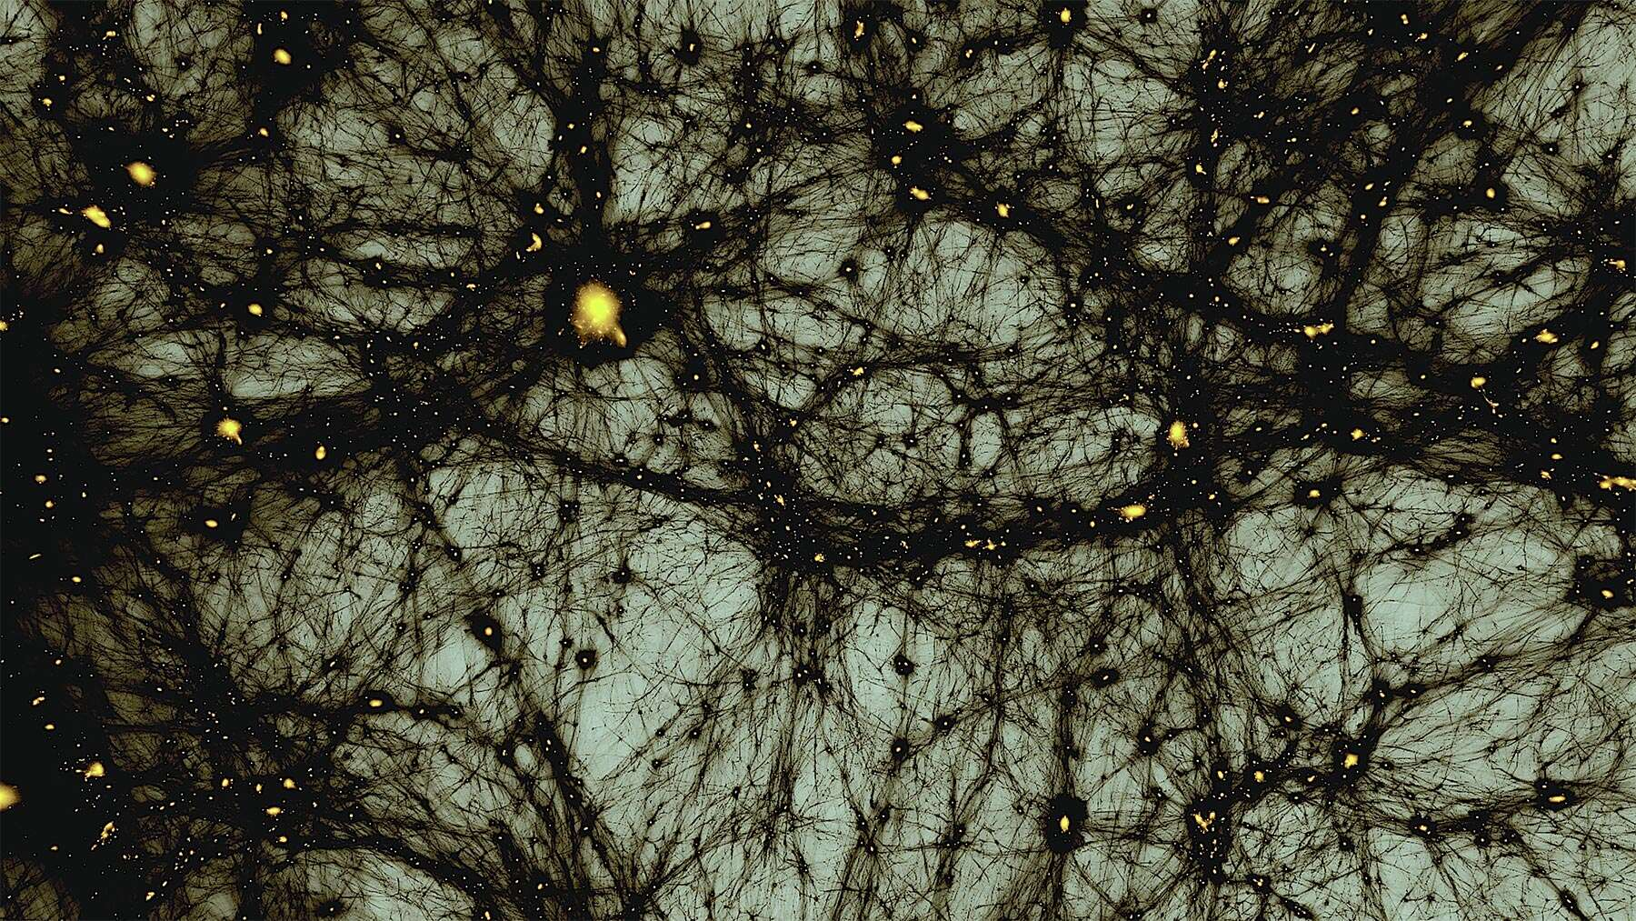
DARK MATTER: EVIDENCE and the SEARCH for the INVISIBLE UNIVERSE
GraSPA Annecy 2026
Thomas Chamos
Aristotle University of Thessaloniki
Undergraduate Physics Student

Slide 2
Why did I choose this topic?
It is one of the biggest unsolved problems in modern physics
It lies at the intersection of particle physics, astrophysics and cosmology
It is one of the main themes of this summer school
Its main ideas can be explained without advanced mathematics
”We know much more about what dark matter is not that what it is.”
Katherine Freese

Slide 3
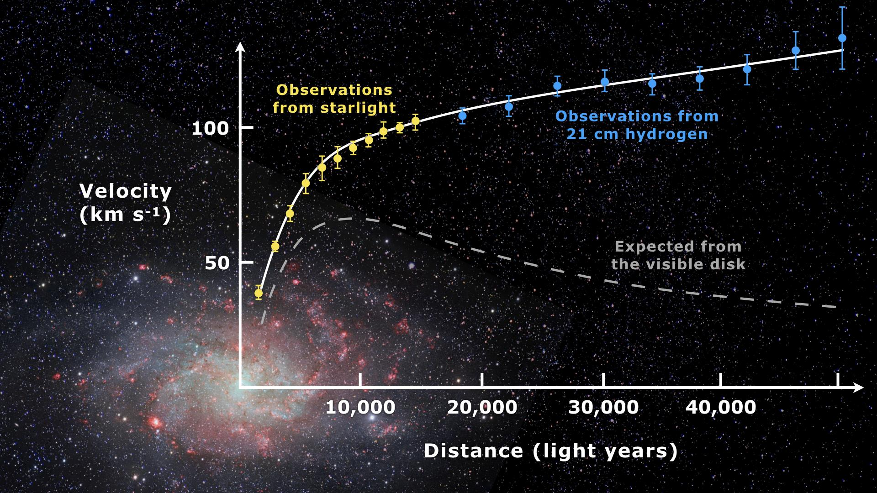
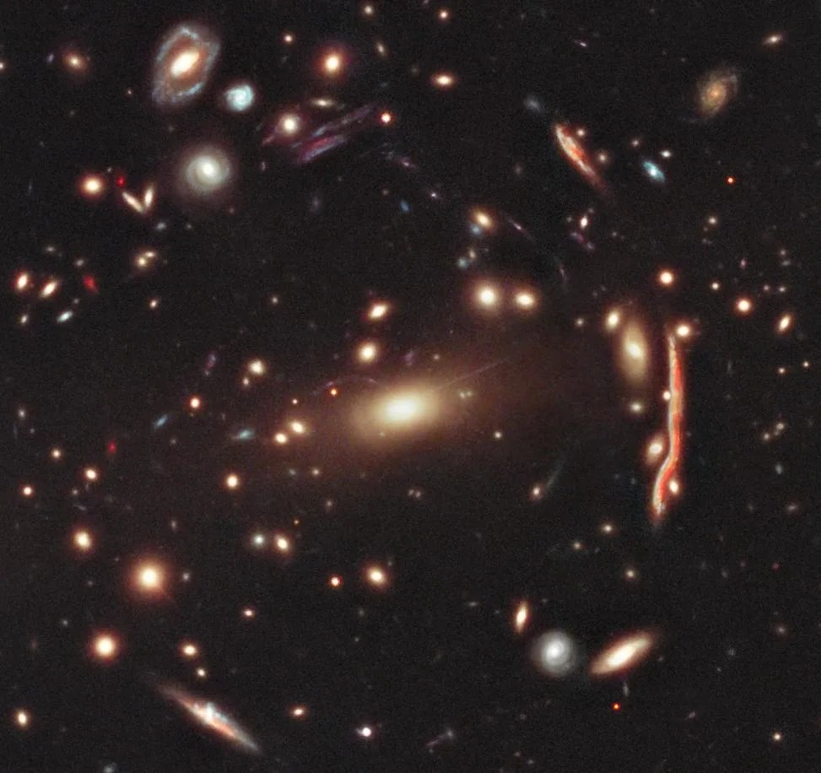
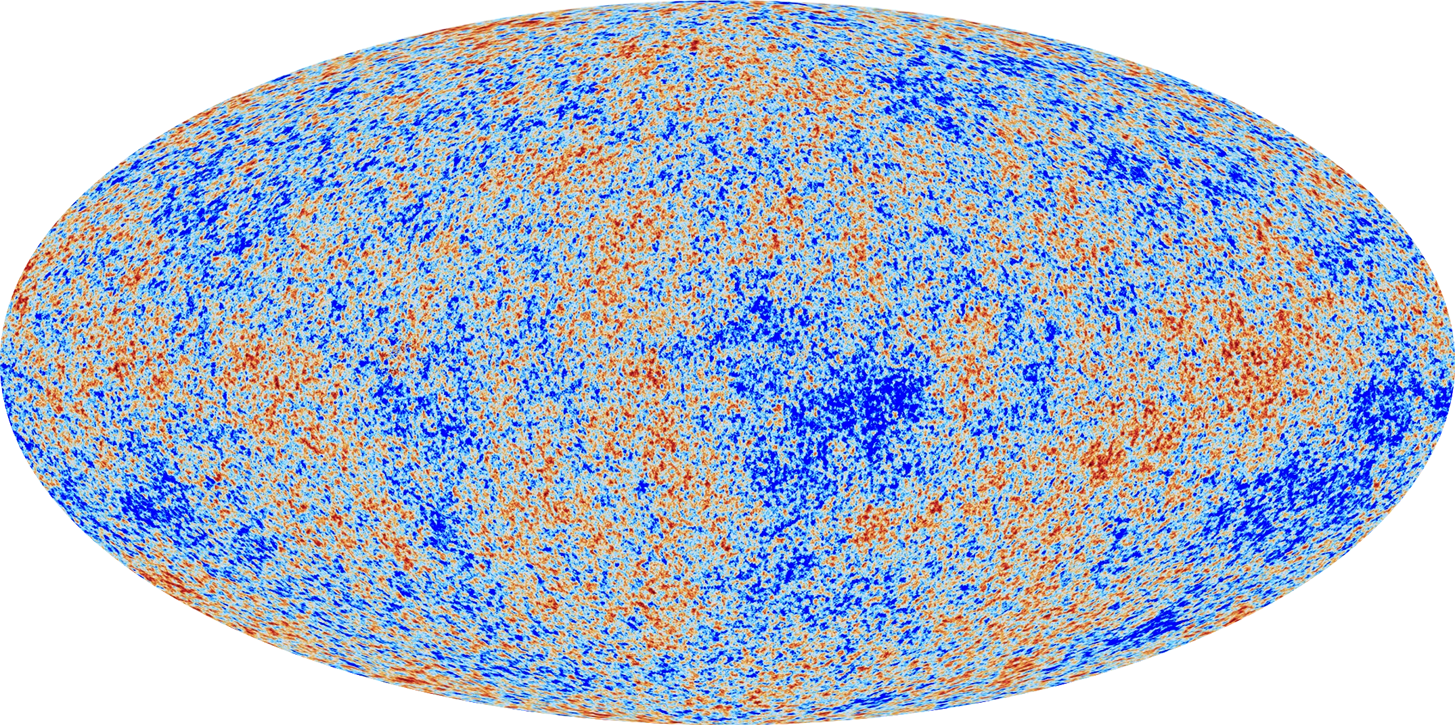
WHY DO WE Think DARK MATTER EXISTS?
Galaxy Rotation Curves
Gravitational Lensing
Cosmic Microwave Background
Stars orbit galaxies faster than visible matter alone can explain
Light is bent more strongly than visible matter alone predicts
CMB measurements show that about 27% of the Universe consists of dark matter
Three completely independent observations point to the same conclusion: most matter is invisible!

Slide 4
WHAT COULD DARK MATTER BE?
In case dark matter is in fact made from particles, here are the most promising (maybe made up) candidates:
Candidate | Idea
WIMPs | Heavy particles interacting via the weak force
Axions | Extremely light particles originally proposed to solve the strong CP problem
Sterile neutrinos | Hypothetical neutrinos interacting only through gravity
No candidate has yet been experimentally confirmed.

Slide 5
How do we search for it?
Direct Detection
Example:
XENONnT
LUX-ZEPLIN
Idea:
Look for dark matter colliding with nuclei underground
Indirect Detection
Example:
Fermi Gamma-ray Space Telescope
AMS-02
Idea:
Search for products of dark matter annihilation or decay
Collider Searches
Example:
LHC
Idea:
Produce dark matter in proton collisions
Observable:
Missing transverse energy
Despite decades of searches, no convincing detection has yet been made.

Slide 6
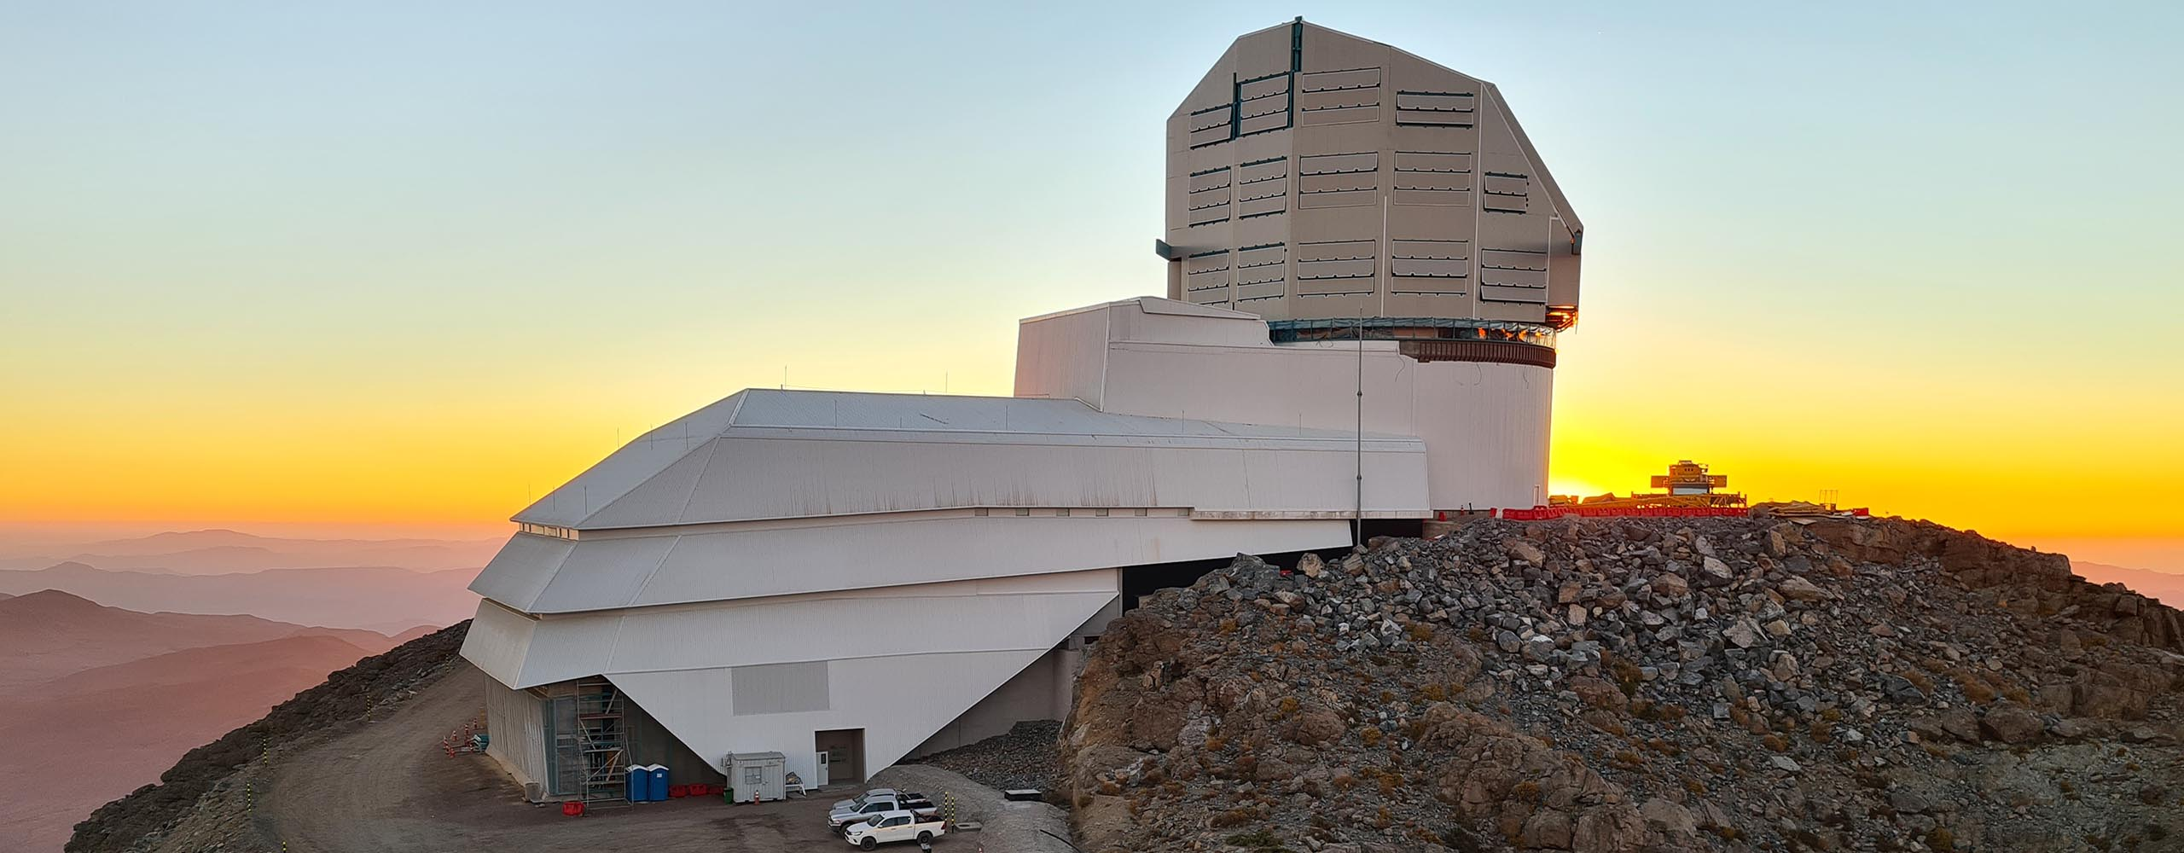
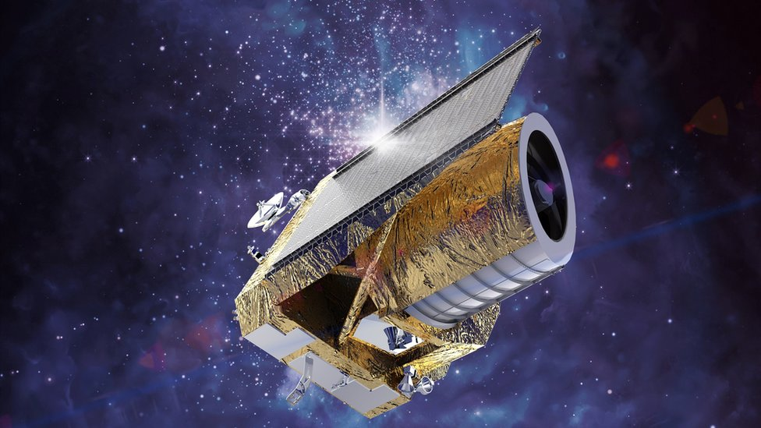
Conclusions & Outlook
Conclusions
Dark matter constitutes about 85% of all matter
Its existence is supported by multiple independent observations
Identifying its nature is one of the greatest challenges in modern physics
Future experiments
HL-LHC
DARWIN
Rubin Observatory
Euclid
Vera C. Rubin Observatory
Euclid

Slide 7
References
https://physicsworld.com/a/mond-versus-dark-matter-the-clash-for-cosmologys-soul/
Freese, K. The Cosmic Cocktail: Three Parts Dark Matter. Princeton University Press (2014).
https://astronomy.stackexchange.com/questions/34298/what-are-the-smallest-star-clusters-affected-by-galaxy-rotation-curve
https://science.nasa.gov/missions/hubble/bending-the-light/
https://www.esa.int/ESA_Multimedia/Images/2013/03/Planck_CMB
https://www.aura-astronomy.org/centers/nsfs-oir-lab/rubinobservatory/
Bertone, G., Hooper, D., & Silk, J. "Particle Dark Matter: Evidence, Candidates and Constraints." Physics Reports405, 279–390 (2005).
NASA – Dark Matter: https://science.nasa.gov/universe/dark-matter/
CERN – Dark Matter: https://home.cern/science/physics/dark-matter
Planck Collaboration (2018). Planck 2018 Results. VI. Cosmological Parameters.

Slide 8
Thank you for your attention!

