Slide 1

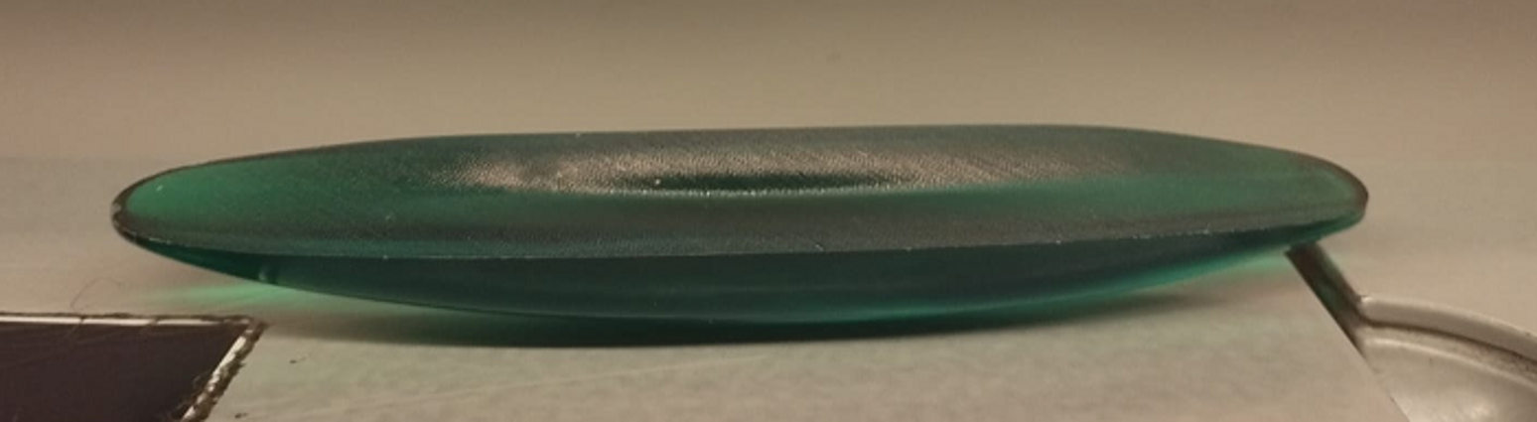
The Rattleback
Mechanical analysis
Figure 1. The studied rattleback (celt). Source: Author's photograph.
Manuel Peña García
[4th Year, Double Degree in Physics and Mathematics]
University of Oviedo

Slide 2
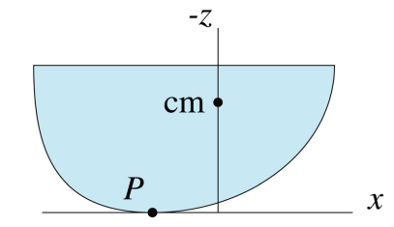
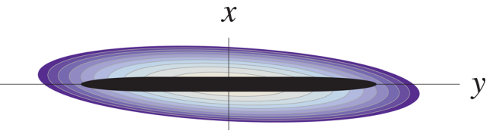
Geometry
Figure 2. A view of the rattleback from above. The contour plot indicates the shape of the bottom of the rattleback while the dark region represents the distribution of mass. Source: Case & Jalal, Am. J. Phys. (2014).
Figure 3. Cross section of rattleback during oscillation about the x-axis. Point P is the point of contact and “cm” is the center-of-mass. The horizontal axis represents x. Source: Case & Jalal, Am. J. Phys. (2014).

Slide 3
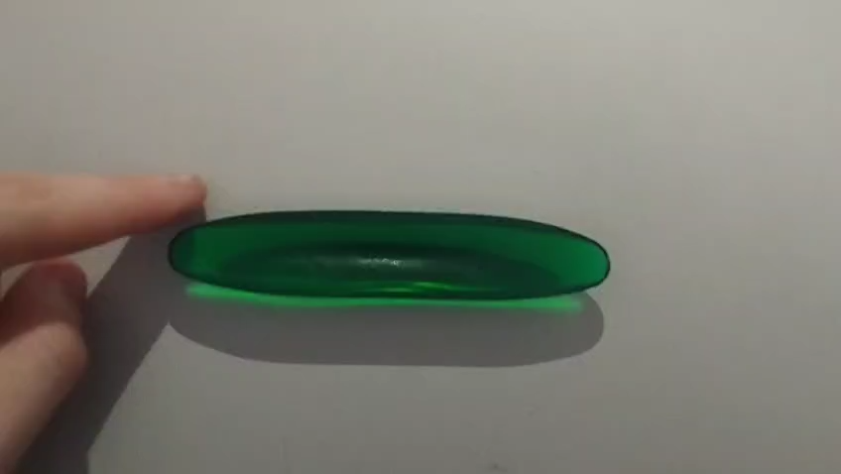
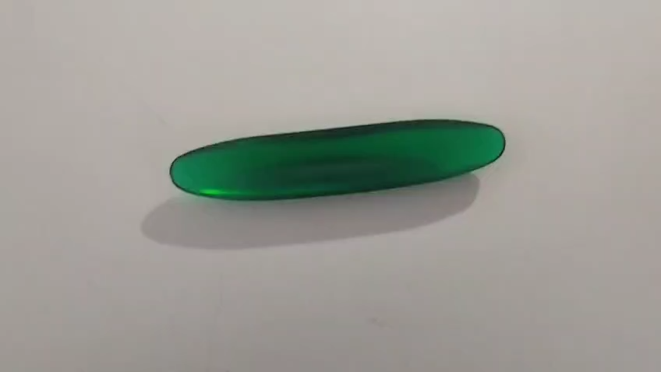
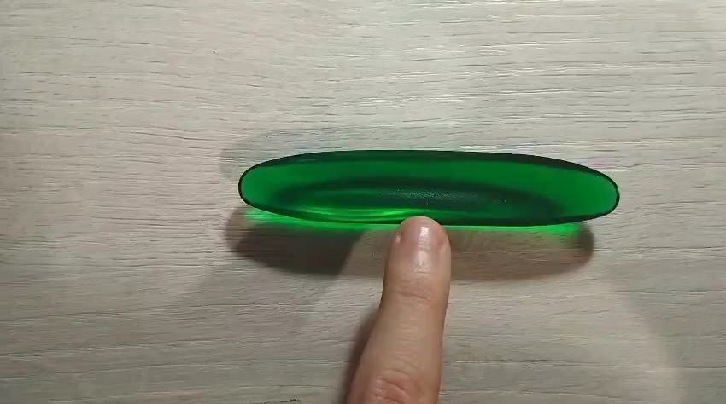
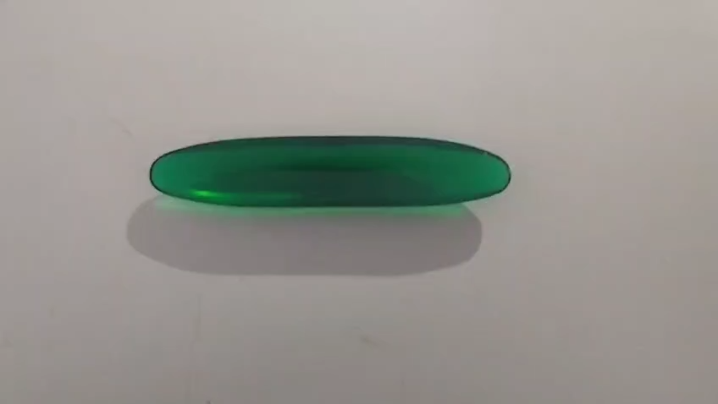
Observed Dynamics
Counterclockwise Spin
Figure 2. Counterclockwise rotation of the rattleback. Source: Author’s video
Clockwise Spin
Figure 3. Clockwise rotation of the rattleback. Source: Author’s video
Short-Axis Oscillation
Figure 4. Oscillation around the short horizontal axis. Source: Author’s video
Long-Axis Oscillation
Figure 5. Oscillation around the long horizontal axis. Source: Author’s video

Slide 4
Conclusions and Lessons Learned
Geometric asymmetry couples spin and oscillation.
Instability transfers kinetic energy between axes.
Friction generates the reversing torque.
A slight geometric asymmetry can fundamentally alter the dynamics of a rigid body.
This is a valuable way to approach rigid body beyond just mathematical equations.

