Slide 1
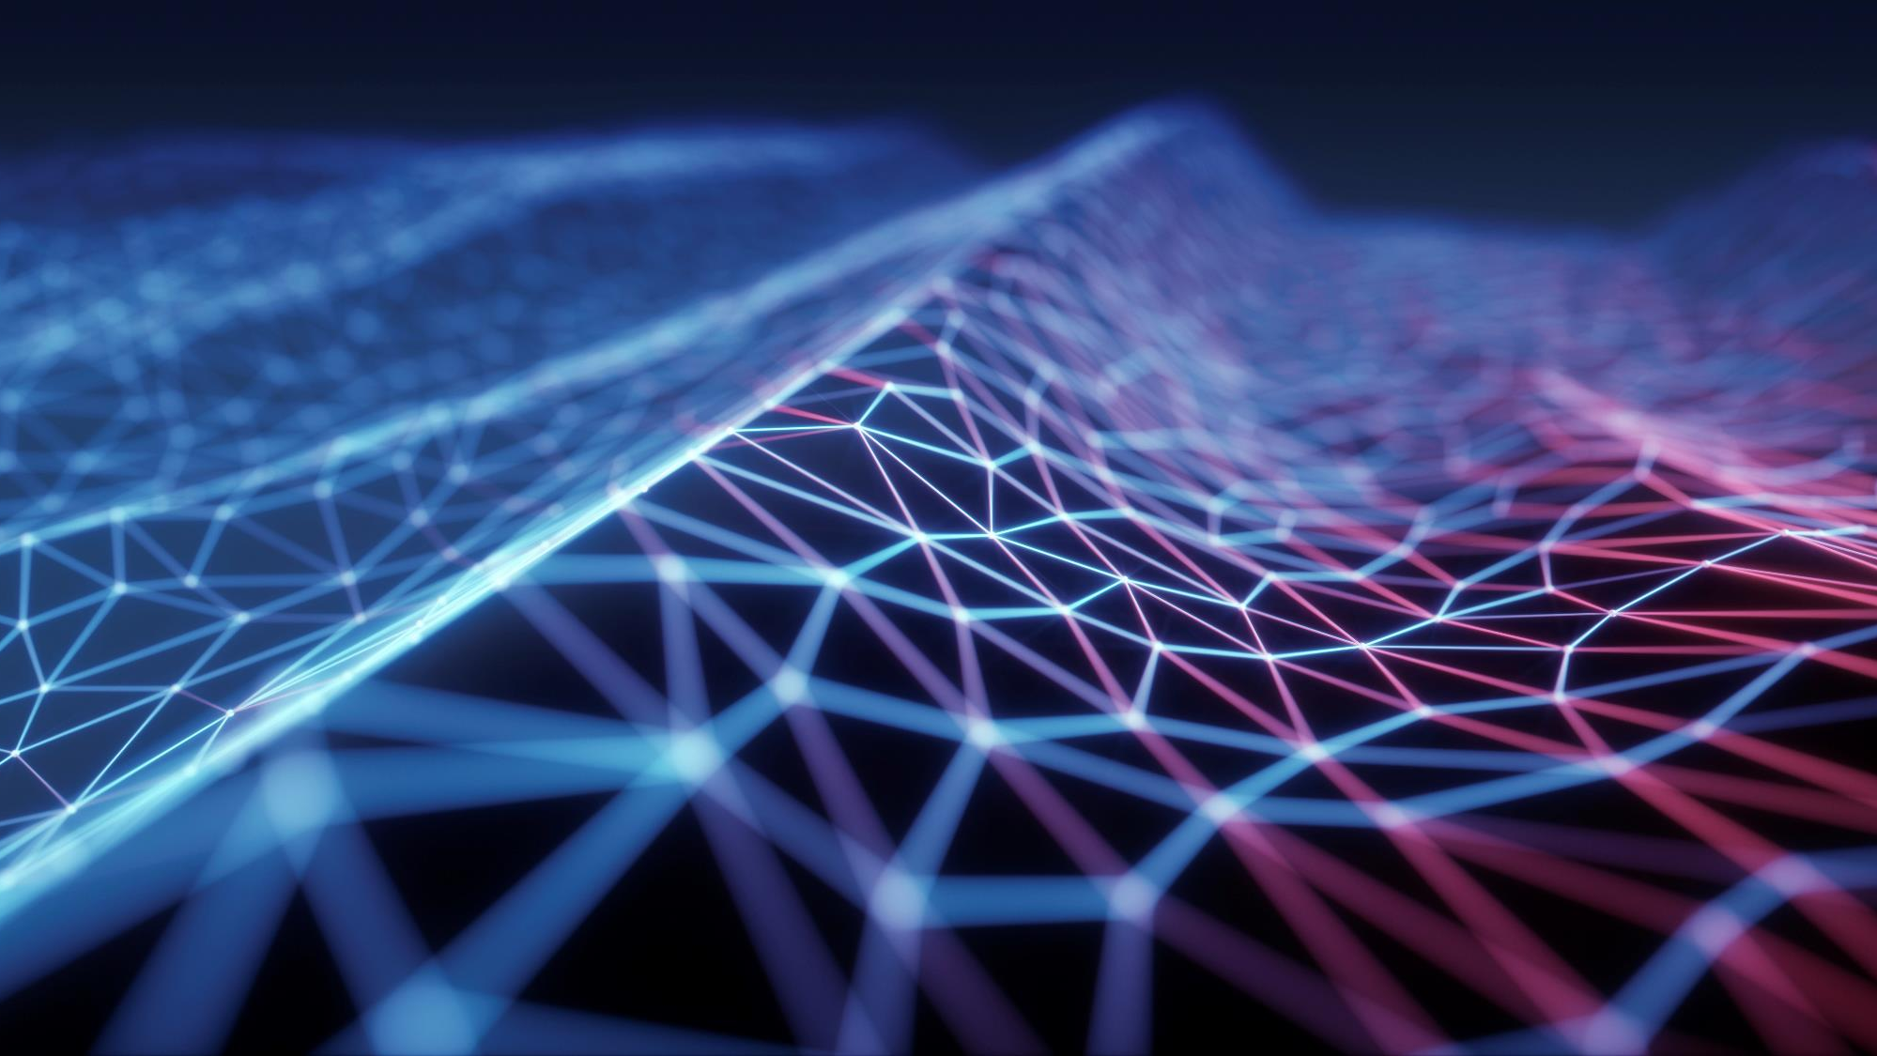
Optical tweezers
Miguel lorenzo vecino – university of salamanca

Slide 2
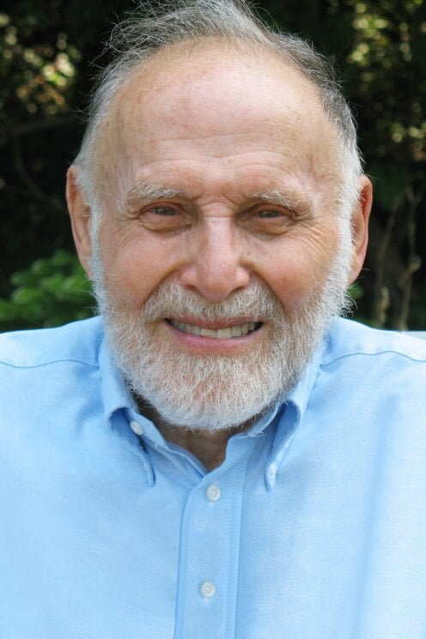
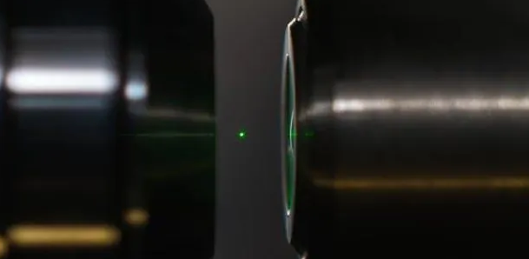
What are they?
Arthur Ashkin:
nobel Prize winner in 2018
Instruments that use a laser beam to hold, manipulate, and move microscopic objects without physically touching them.

Slide 3
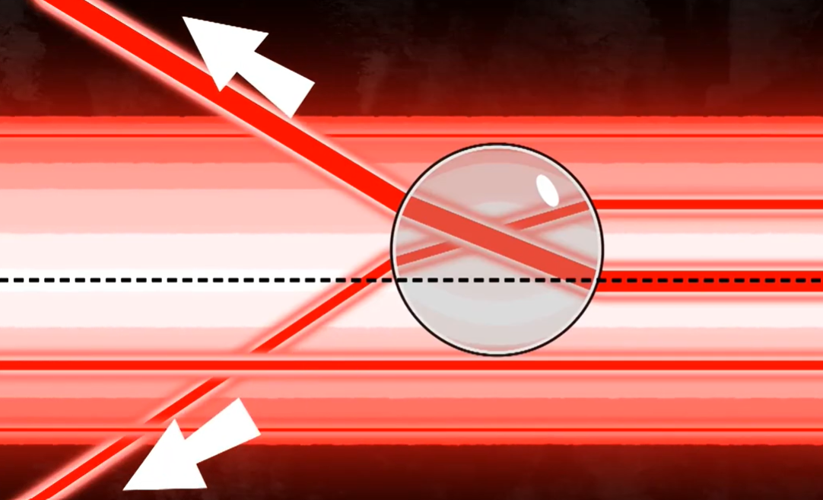
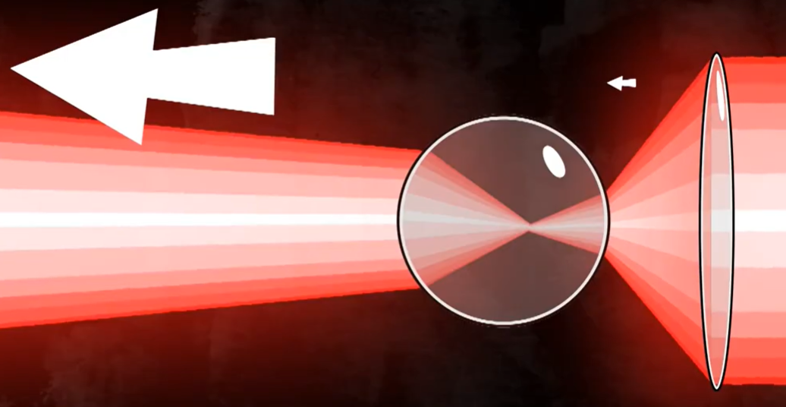
How does it work?
Radiation pressure
Conservation of linear momentum
Gradient force

Slide 4
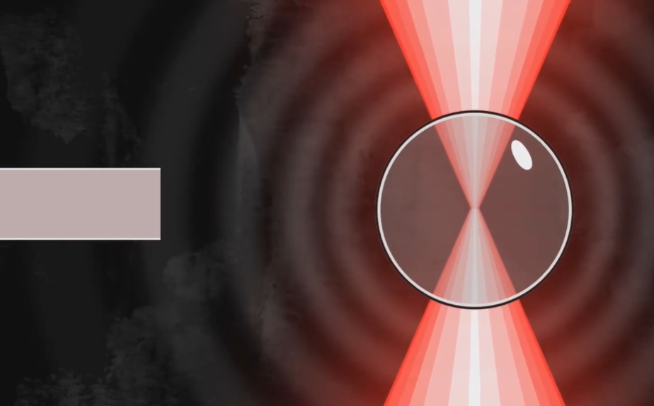
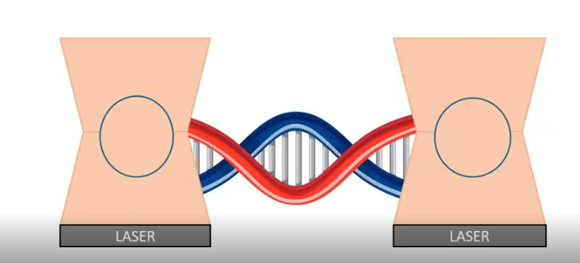
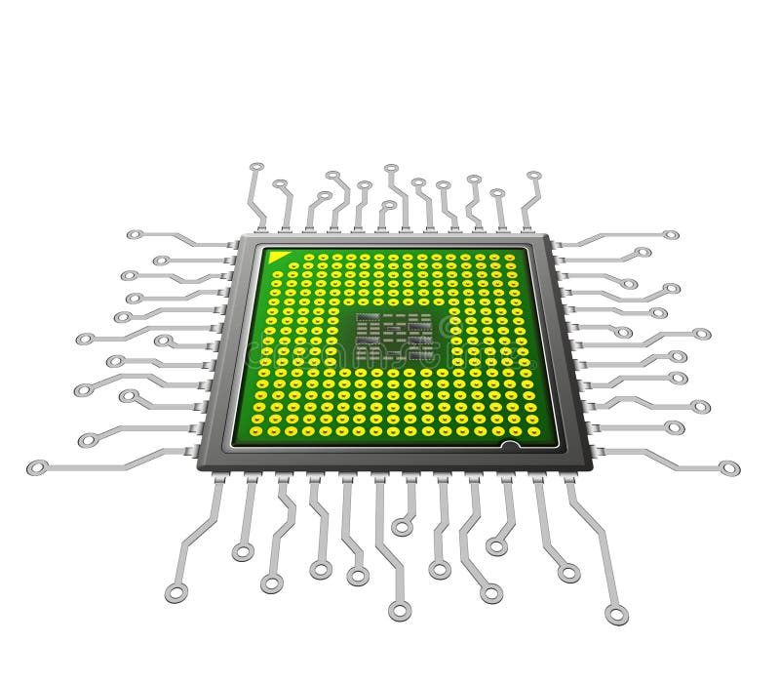
Applications:
Biology and medicine:
Fundamental physics:
Nanotechnology:

Slide 5
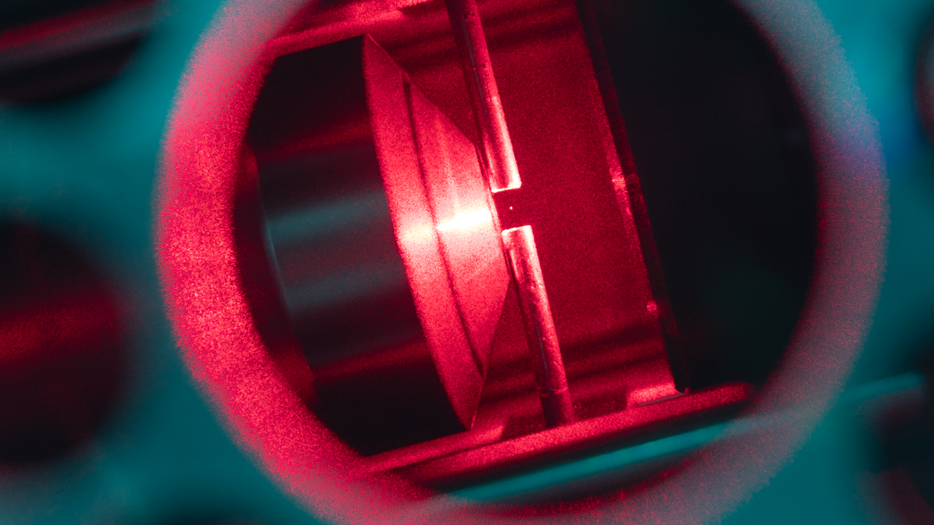
Conclusions and outlook:
Light as a mechanical tool to control the microworld.
A broad range of applications: from medical diagnostics to fundamental physics.

