Slide 1



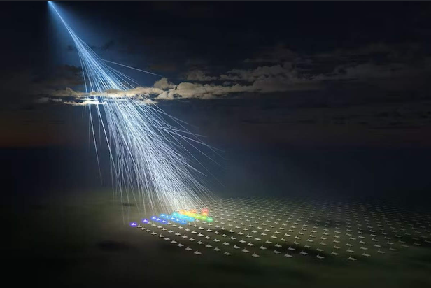

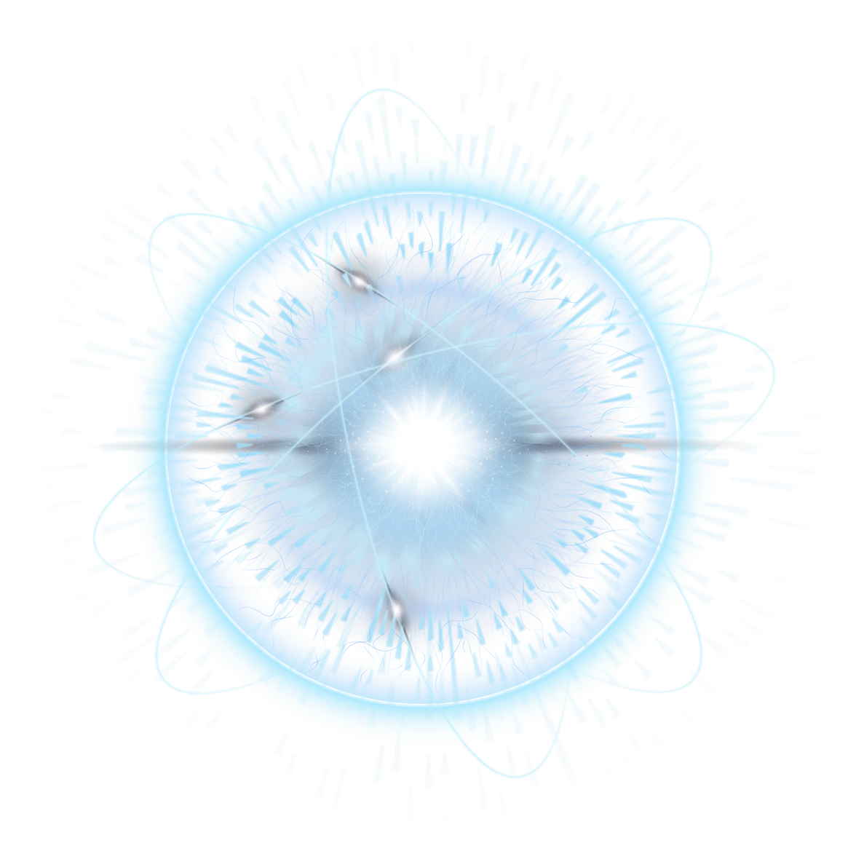

Detecting cosmic muons : How coincidence turns noise into a particle signal
Autor : Assann DEDE
GraSPA 2026

Slide 2
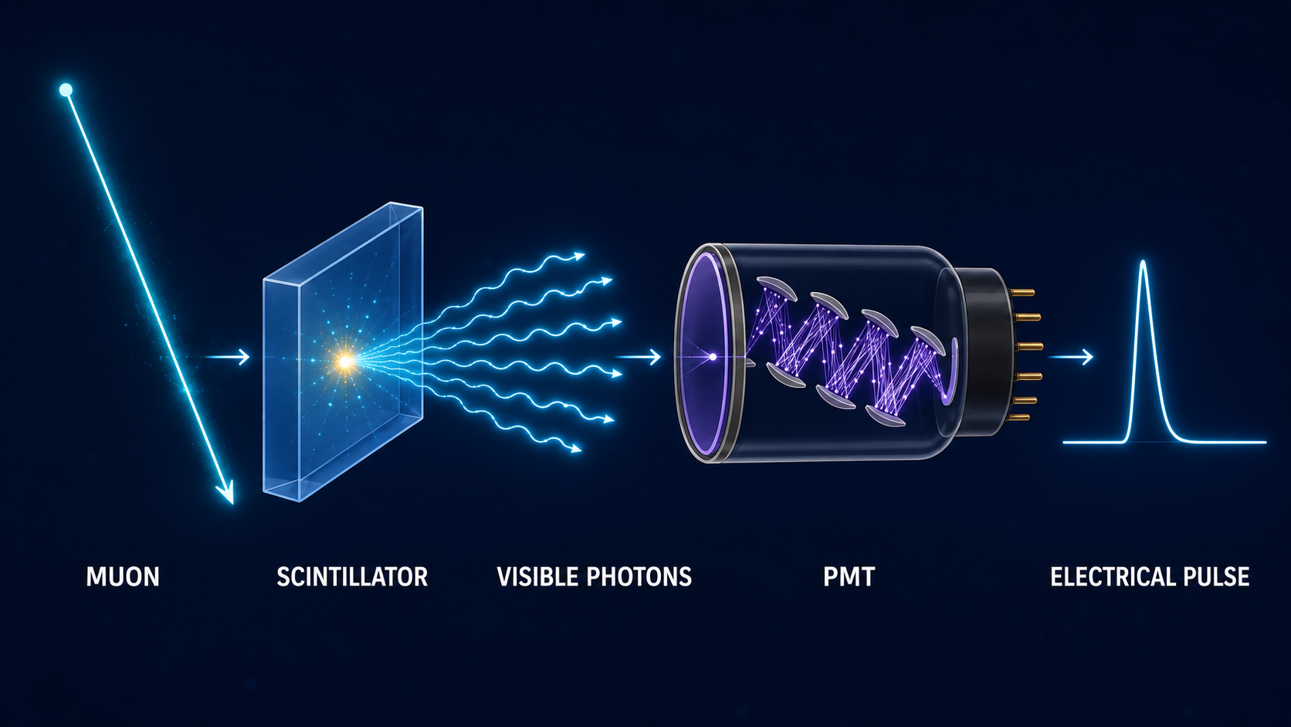
Turning a muon into an electrical signal

Slide 3
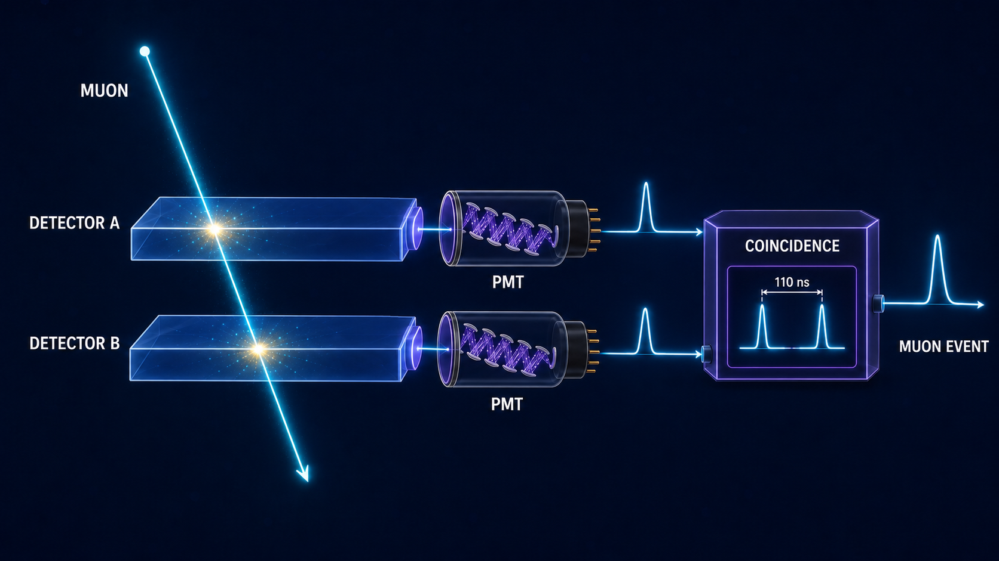
One signal is not enough

Slide 4

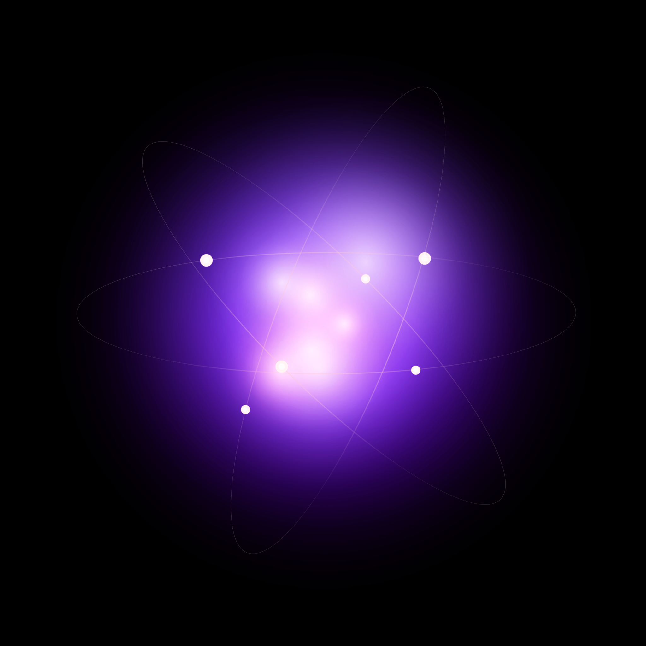
Did coincidence actually work ?
Measured coïncidence rate | Accidental coïncidence rate
9.8 events/sec | 22 μHz
8829 detected muons in 15 min | ~ 1 event every 12.6 hours
Deposited energy (Bethe-Bloch)
Main result :
Coincidence effectively eliminates noise
ΔE ≈ 1,2 × 1,03 × 5 ≈ 6,2 MeV
For ρ=1,0 g/cm³, e=5 cm
The physical signal was approximately 400,000 times larger than the accidental background.
9

Slide 5
From an electrical pulse to reliable physics
8 829 muons détectés en 15 min
→ Taux : 9,8 muons/seconde · Flux mesuré ≈ 0,37 µ/cm²/min (valeur théorique ~1, écart dû à la géométrie du télescope)
99% detector efficiency
Coincidence does not merely detect signals—it identifies correlated physical events.

