Slide 1
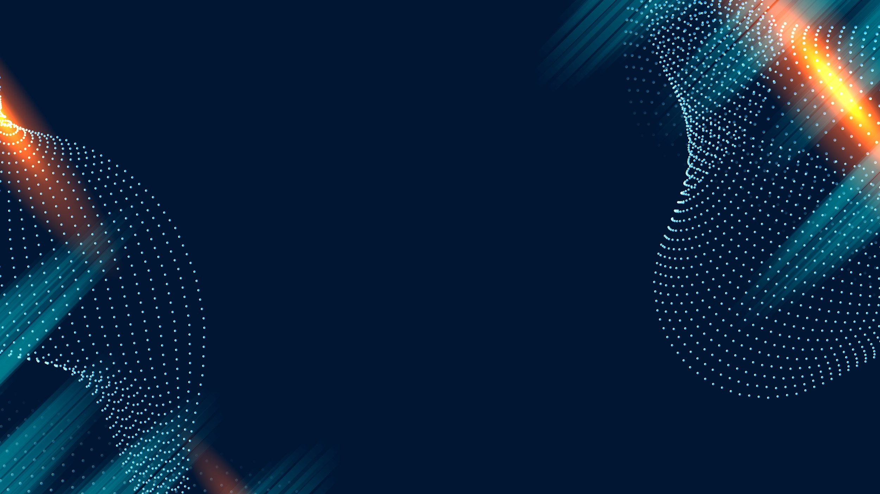


MUON DETECTOR IN NAPLES UNDERGROUND STATION
GraSPA 2026
FLAVIO CENTOFANTI
UNIVERSITY OF NAPLES – FEDERICO II
DEPARTMENT OF PHYSICS - "ETTORE PANCINI"

Slide 2

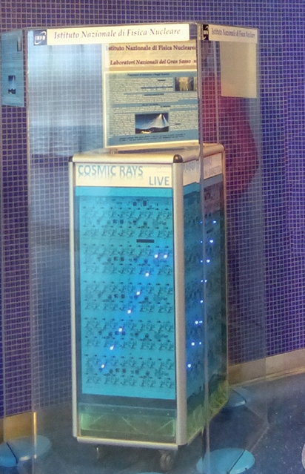
MUON DETECTOR IN NAPLES UNDERGROUND STATION
Forty meters underground, inside "Toledo" Metro Station, in Naples, there is a Muon detector!
Installed in 2015 thanks to a collaboration between INFN-Napoli, LNGS, and ANM.
A fascinating instrument inside one of the most beautiful European stations. Designed for curious citizens, passing tourists, and students eager to learn.

Slide 3
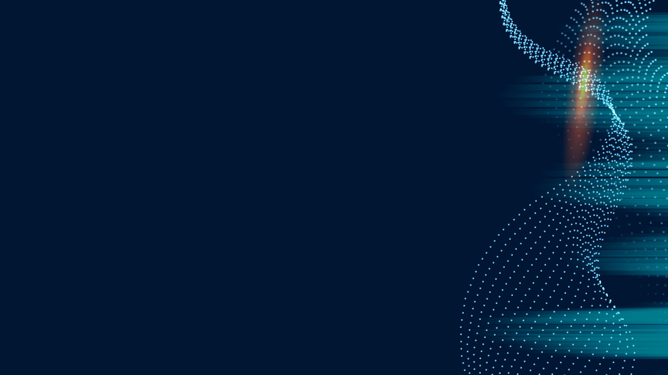
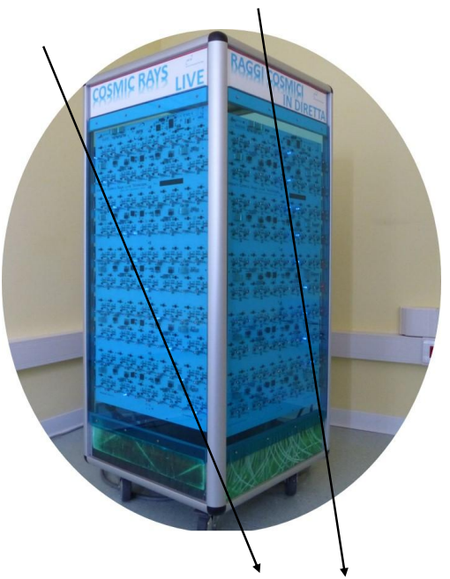
MUON DETECTOR IN NAPLES UNDERGROUND STATION
The detector observes the most penetrating part of cosmic rays: muons!
Unlike other particles, muons can pass through many layers of rock: that expains why the detector was put underground.

Slide 4

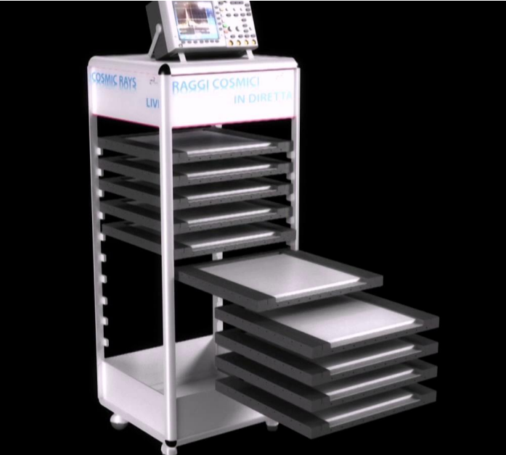
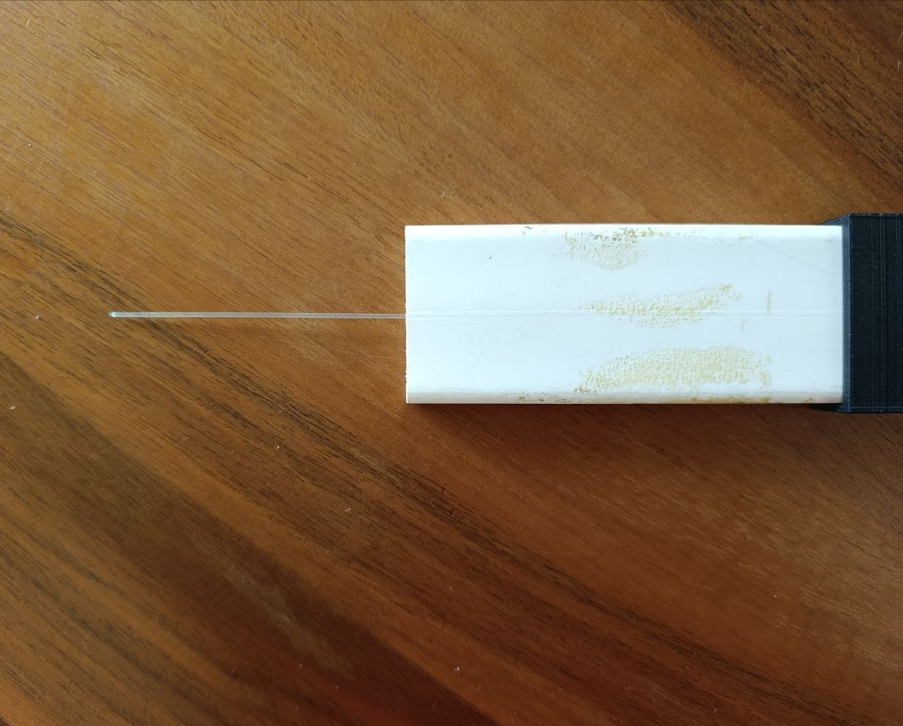
MUON DETECTOR IN NAPLES UNDERGROUND STATION
Picture of a scintillating bar.

Slide 5

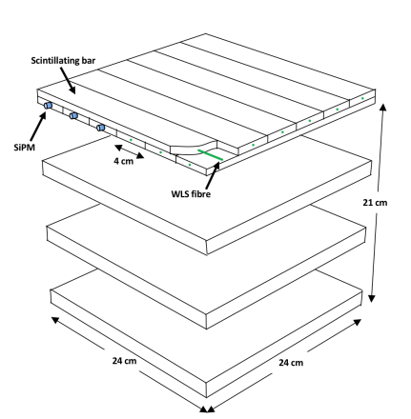
MUON DETECTOR IN NAPLES UNDERGROUND STATION
The Muon Detector has a similar functioning as the Cosmic Ray Cube: it is composed of 10 grids of 20 scintillating bars (10 along x-direction and 10 along y-direction) paired with SiPMs through optical fibers.
A LED is placed at the end of each bar, providing real-time visualization of cosmic rays.
Image showing the functioning of a Cosmic Ray Cube.

Slide 6
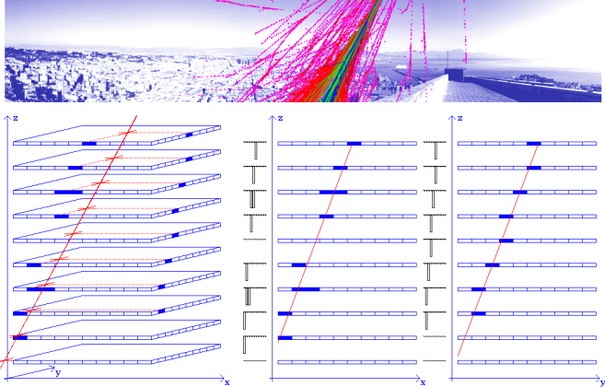
MUON DETECTOR IN NAPLES UNDERGROUND STATION
We understand that a muon has crossed the detector when we see the light of the LEDs.
Thanks to the light, we can recreate the trajectory of the particle: when in a grid two perpendicular bars emit light, we know that the particle has crossed the spot of intersection.
Data from the detector can be acquired through serial connection.

Slide 7
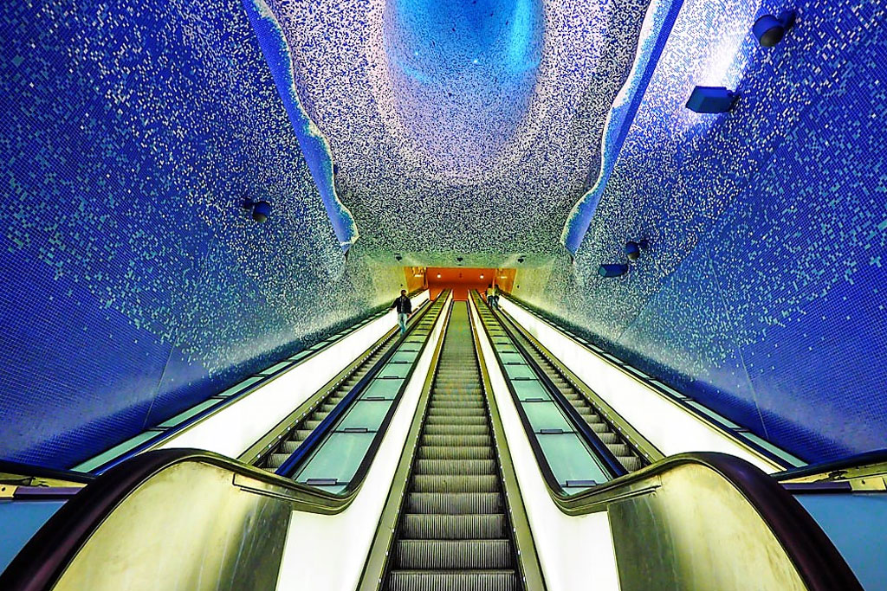
Thank you for your attention!

