Slide 1
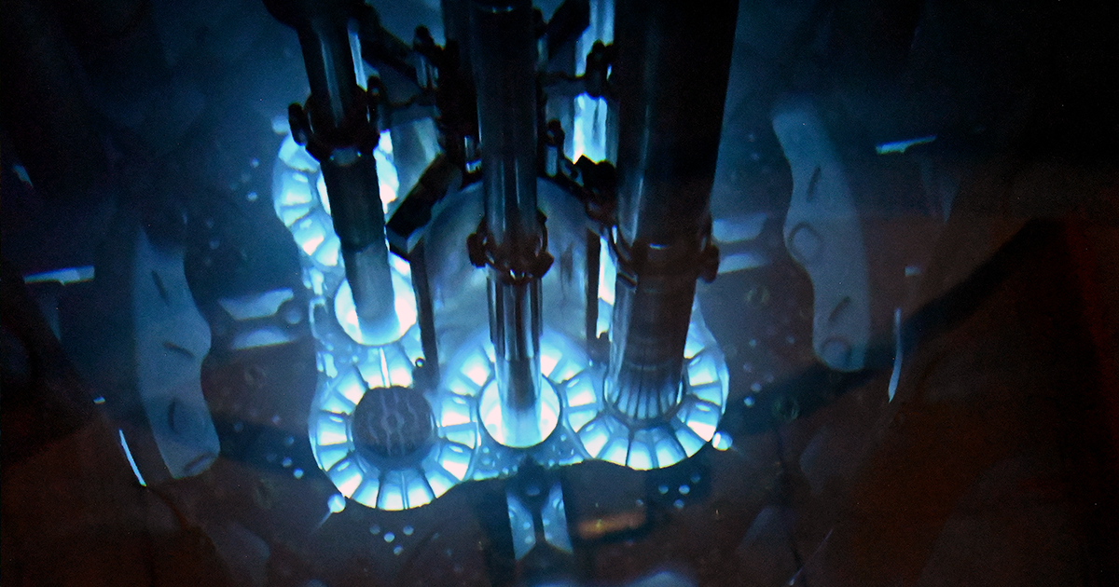

CERENKOV DETECTORS
>
Alessia Benesperi
University of Pisa – Bachelor’s Student in Physics
GraSPA 2026 Annecy, 17/07/2026

Slide 2
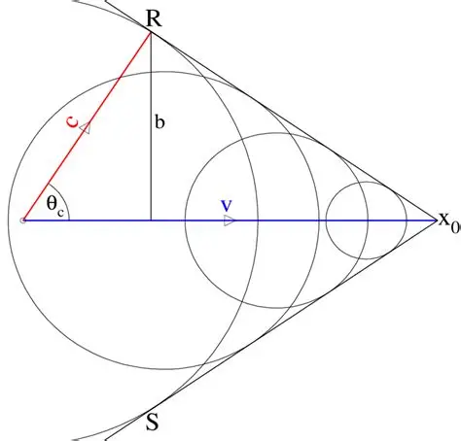
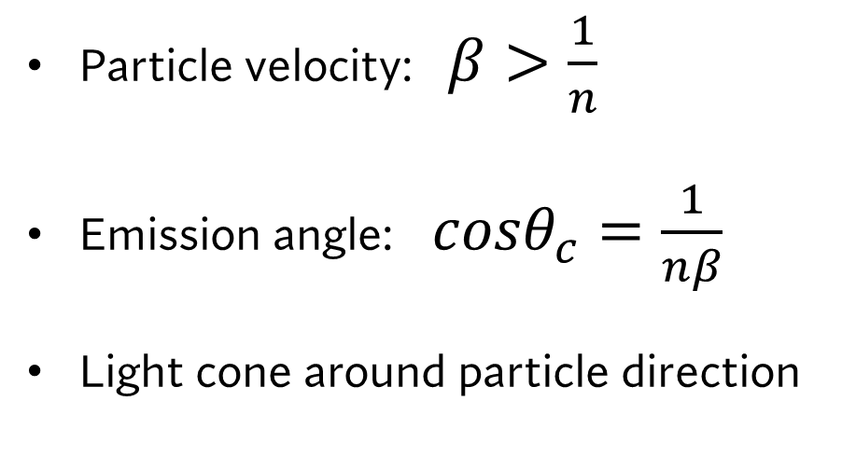
Cerenkov Effect
A charged particle moving faster than light in a medium -> emittion of radiation
Cerenkov Effect
Types of Cerenkov Detectors
$π^{+}/K^{+}$ separation in a beam
𝜋^+/𝐾^+ separation in a beam
Conclusions
>
Particle velocity: $β>\frac{1}{n}$
Emission angle: $cosθ_{c}=\frac{1}{nβ}$
Light cone around particle direction
Alessia Benesperi, GraSPA 2026

Slide 3
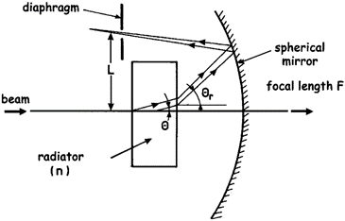
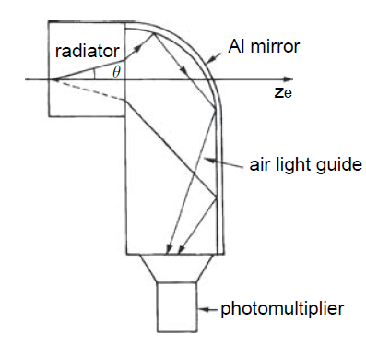
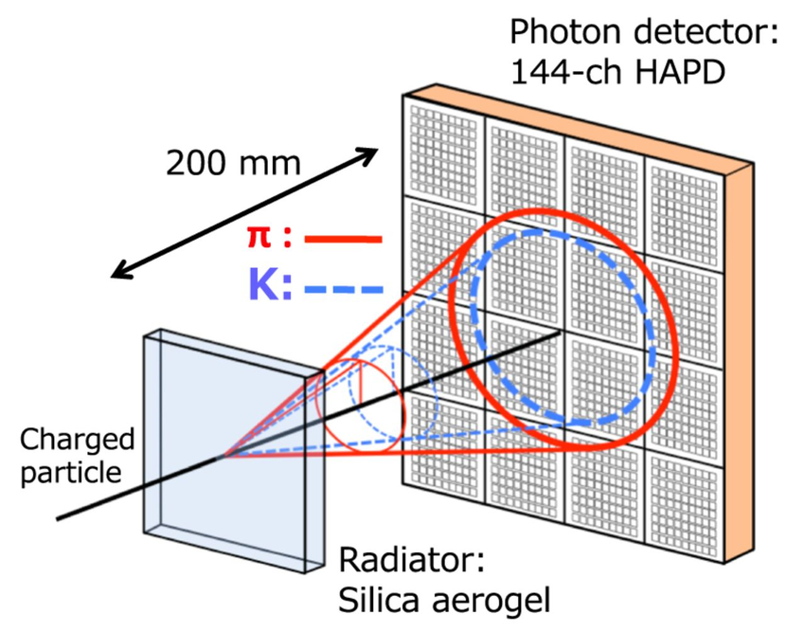
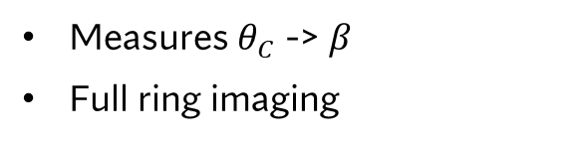
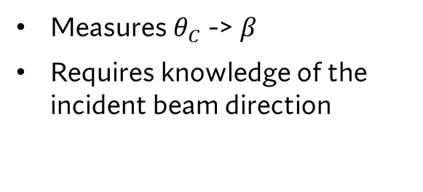
Cerenkov Effect
Types of Cerenkov Detectors
$π^{+}/K^{+}$ separation in a beam
𝜋^+/𝐾^+ separation in a beam
Conclusions
Types of Cerenkov Detectors
>
THRESHOLD
DIFFERENTIAL
RICH
Binary response: light/no light
Identification of different particles in a beam
Measures $θ_{C}$ -> $β$
Requires knowledge of the incident beam direction
Measures $θ_{C}$ -> $β$
Full ring imaging
Alessia Benesperi, GraSPA 2026

Slide 4
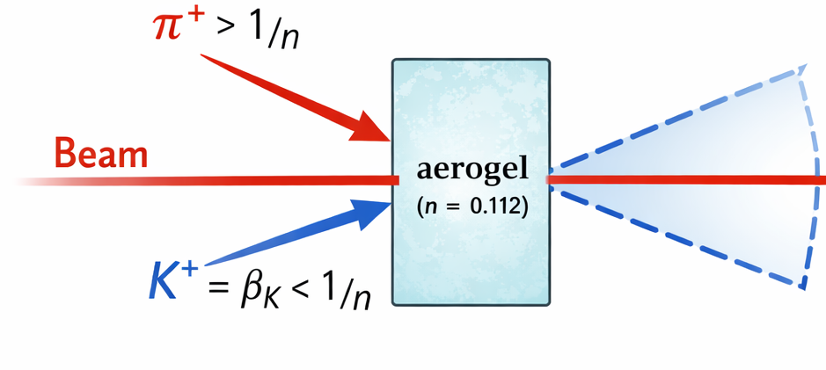


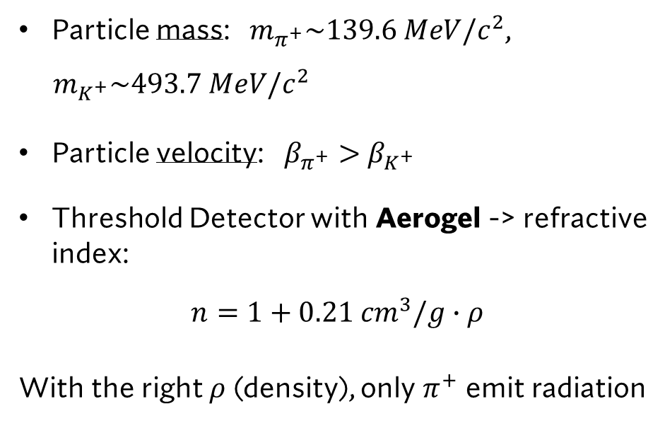

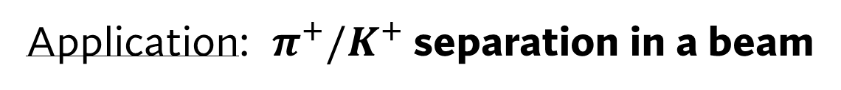




Cerenkov Effect
Types of Cerenkov Detectors
$π^{+}/K^{+}$ separation in a beam
𝝅^+/𝑲^+ separation in a beam
Conclusions
Application: $π^{+}/K^{+}$ separation in a beam
$$K^{+}$$
Particle mass: $m_{π^{+}}\sim 139.6 MeV/c^{2}$,
$m_{K^{+}}\sim 493.7 MeV/c^{2}$
Particle velocity: $β_{π^{+}}>$ $β_{K^{+}}$
Threshold Detector with Aerogel -> refractive index:
$$n=1+0.21 {cm}^{3}/g∙ρ$$
With the right $ρ$ (density), only $π^{+}$ emit radiation
$$π^{+}$$
Alessia Benesperi, GraSPA 2026

Slide 5
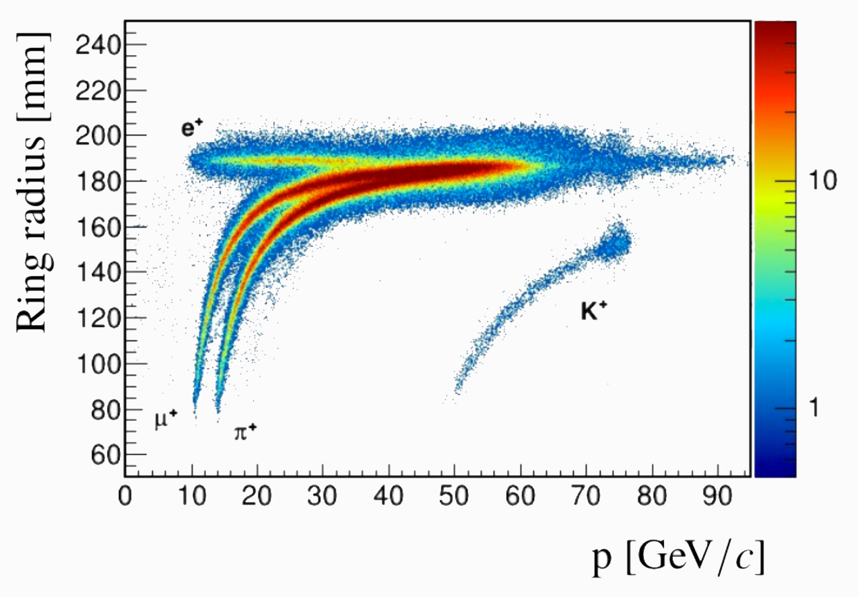
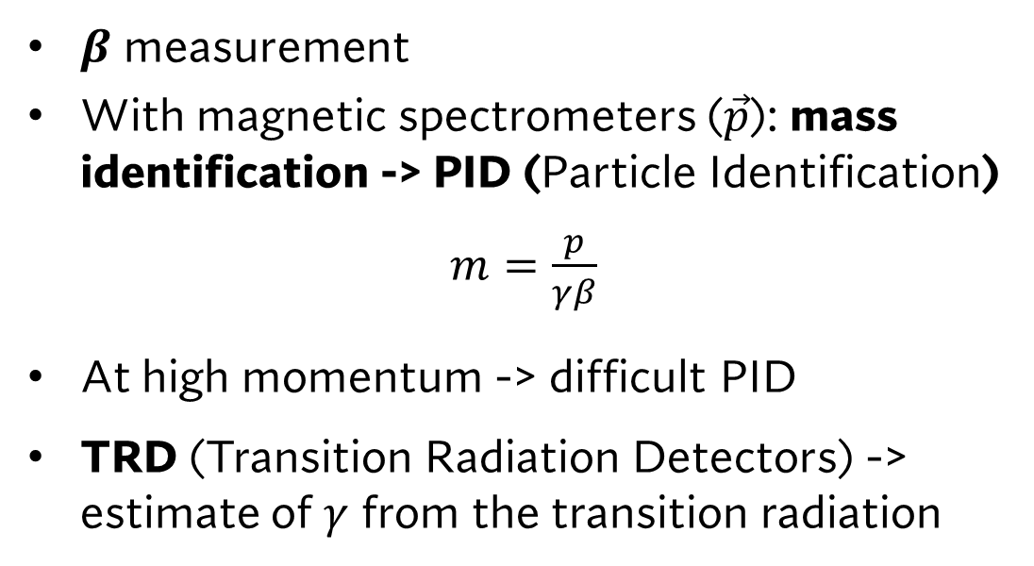
Cerenkov Effect
Types of Cerenkov Detectors
$π^{+}/K^{+}$ separation in a beam
𝜋^+/𝐾^+ separation in a beam
Conclusions
Conclusions
$β$ measurement
With magnetic spectrometers ($\vec{p}$): mass identification -> PID (Particle Identification)
$m=\frac{p}{γβ}$
At high momentum -> difficult PID
TRD (Transition Radiation Detectors) -> estimate of $γ$ from the transition radiation
Alessia Benesperi, GraSPA 2026

