Slide 1
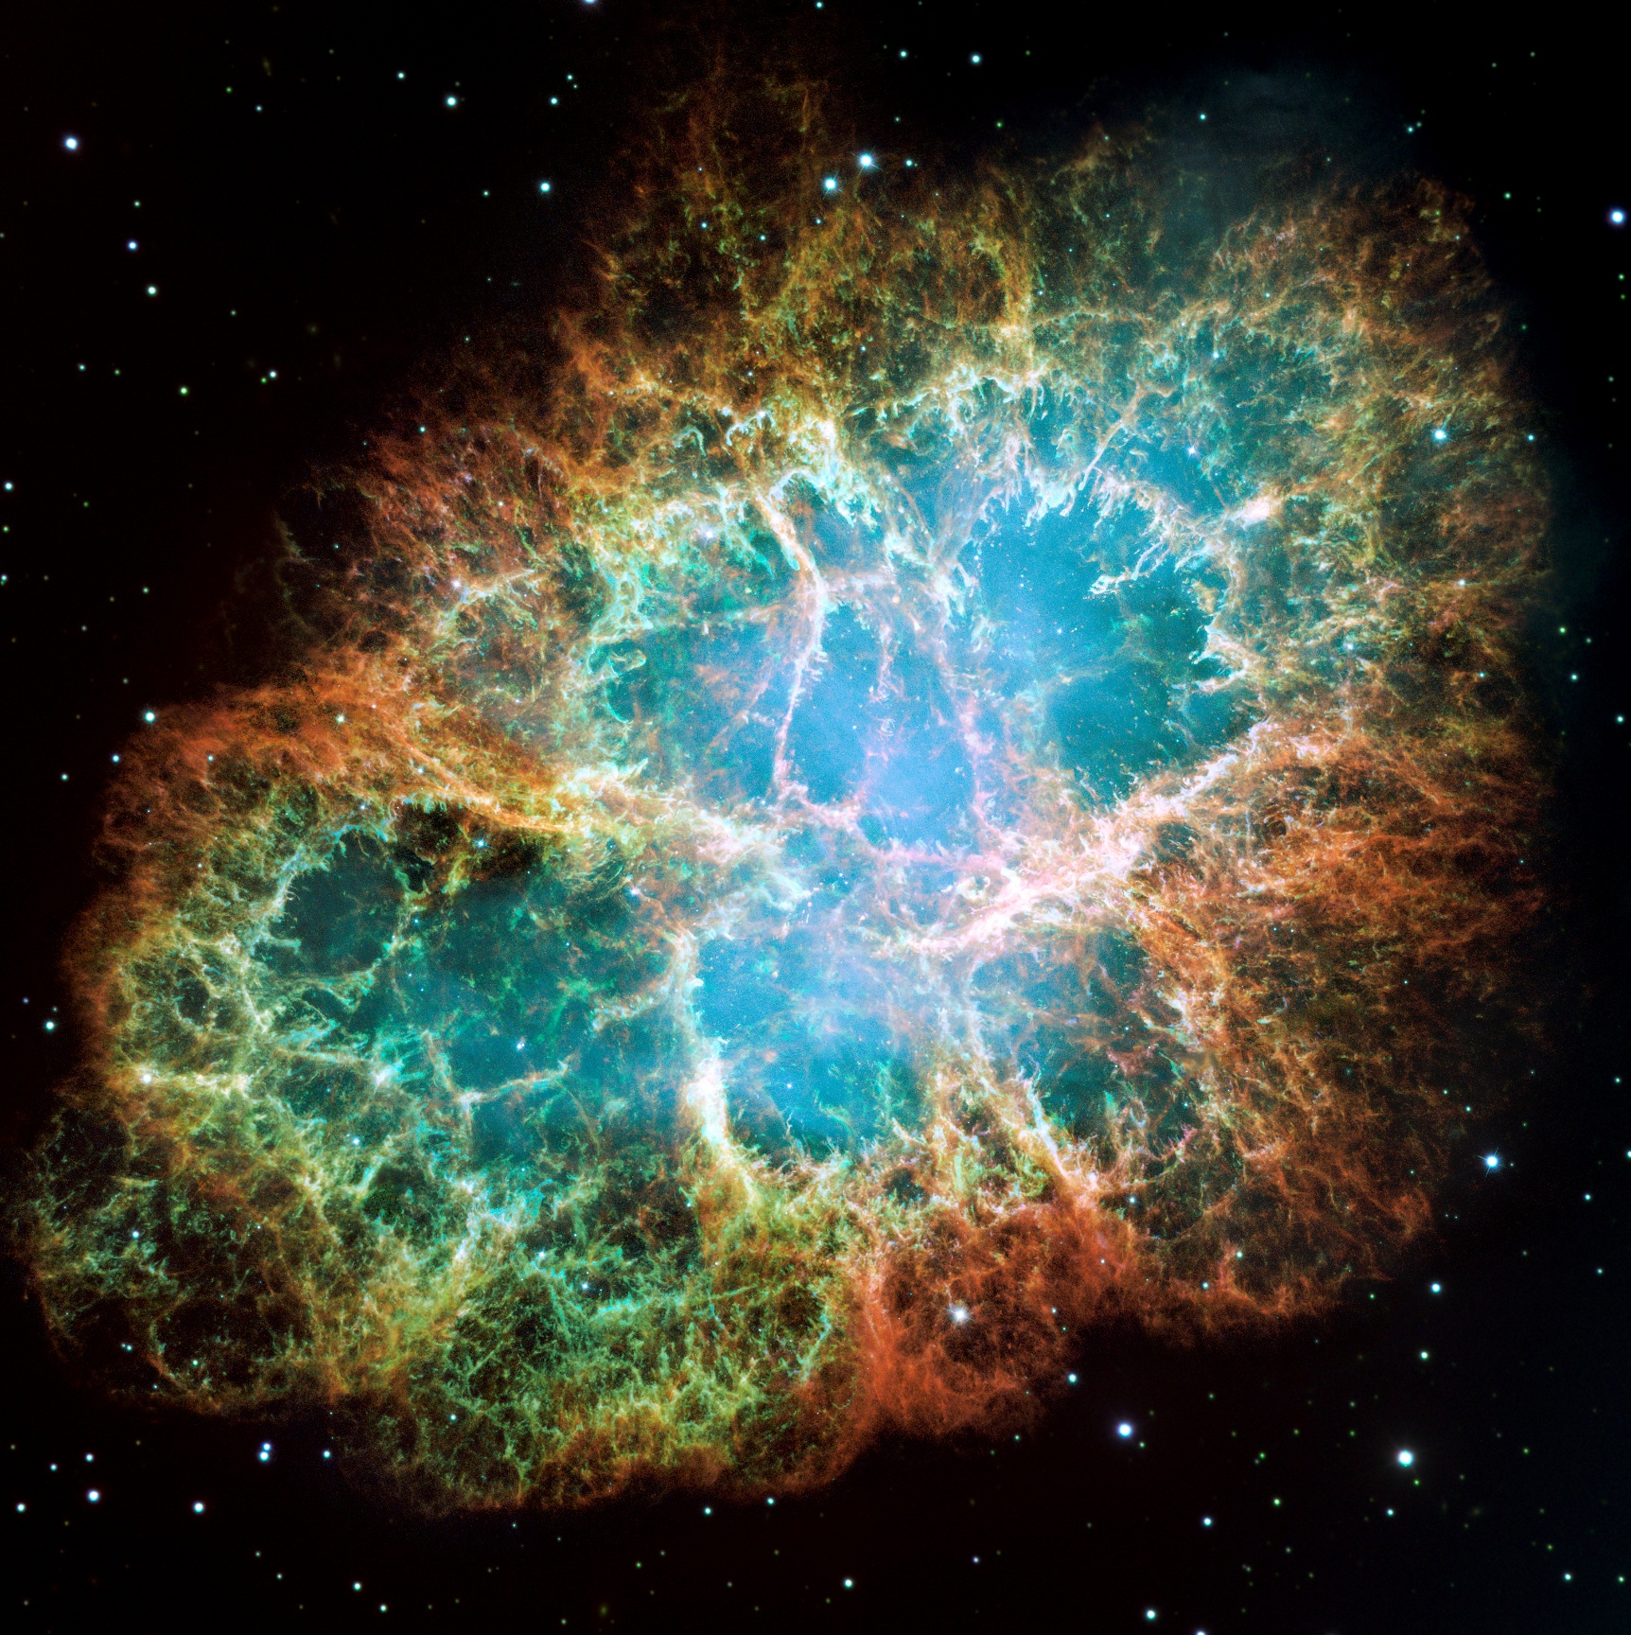
UPPER LIMIT ON THE MASS OF THE ELECTRON NEUTRINO FROM SN1987A
GRAspa Summer School 16-23/07/2026
Paola Gamba

Slide 2
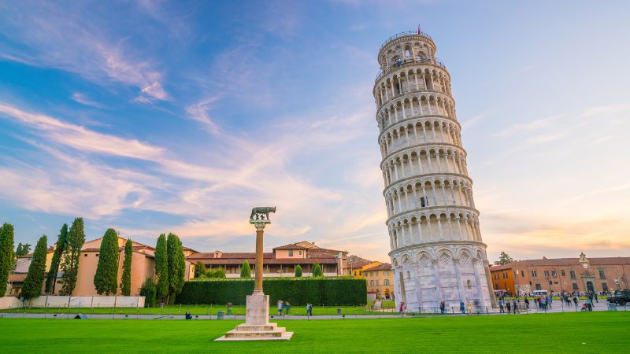
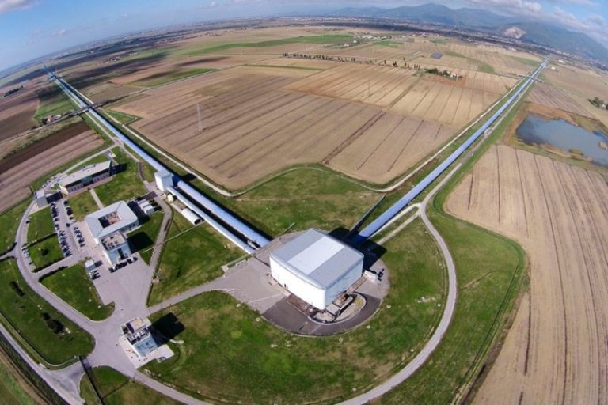
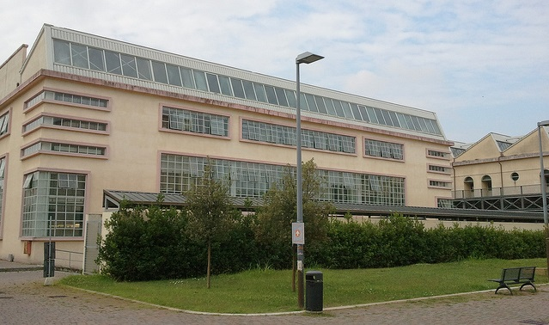
MY PRESENTATION…

Slide 3
SN1987A
On February 23, 1987 we detected the explosion of a Supernova in the Large Magellanic Cloud. Three hours before the visible light reached our telescopes, underground water Cherenkov detectors captured a sudden burst of neutrinos.
N. Event Kamiokande | Observation time [s] | Energy [MeV]
1 | 0 | 21.3 ± 2.9
2 | 0.107 | 14.8 ± 3.2
3 | 0.303 | 8.9 ± 2.0
4 | 0.324 | 10.6 ± 2.7
5 | 0.507 | 14.4 ± 2.9
6 | 0.686 | 7.6 ± 1.7
7 | 1.541 | 36.9 ± 8.0
8 | 1.728 | 22.4 ± 4.2
9 | 1.915 | 21.2 ± 3.2
10 | 9.219 | 10.0 ± 2.7
11 | 10.433 | 14.4 ± 2.6
12 | 12.439 | 10.3 ± 1.9
N. Event IMB | Observation time [s] | Energy [MeV]
1 | 0 | 39 ± 6
2 | 0.42 | 38 ± 6
3 | 0.65 | 41 ± 6
4 | 1.15 | 36 ± 6
5 | 1.57 | 30 ± 5
6 | 2.69 | 38 ± 6
7 | 5.01 | 21 ± 3
8 | 5.59 | 25 ± 4

Slide 4
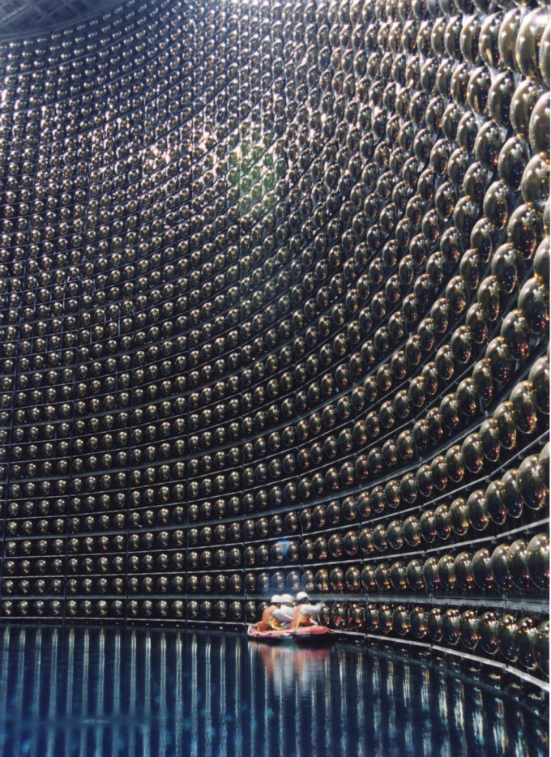
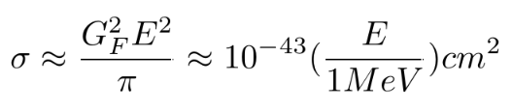

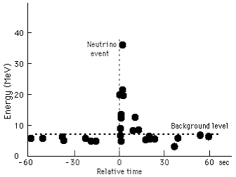





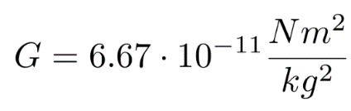




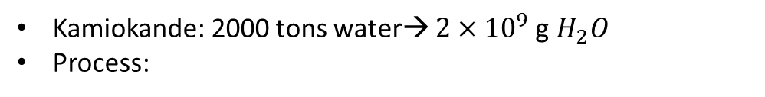
We can estimate the total energy released by the explosion.
1. DID THE SIGNAL ORIGINATE FROM THE SUPERNOVA?
Kamiokande: 2000 tons water→ $2×{10}^{9}$g $H_{2}O$
Process:
with a cross section:
Orders of magnitude: 10 neutrinos of 10 MeV.
Number of detected neutrinos =
Number of emitted neutrinos =
Knowing that d = 170000 light years.
Total energy of the explosion:
!
Gravitational binding energy of a newly born neutron star =
, using:
2. IS THE TYPICAL BURST CONSISTENT WITH THE OBSERVED DATA?
Random walk estimate:
→mean free path.

Slide 5


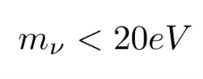
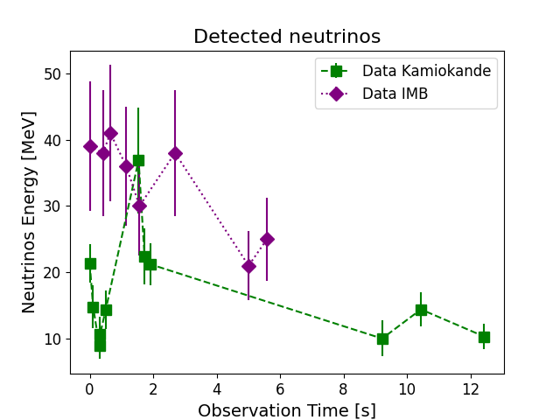
UPPER LIMIT OF NEUTRINO MASS:
If neutrinos were massive and emitted at the same time, higher-energy ones would travel faster and arrive first, creating a specific time spread.
Some higher-energy neutrinos arrived about 1.5 seconds after lower-energy ones!
!
BUT THE PATTERN IS DIFFERENT:
The initial emission pulse at the source must have lasted at least 1.5 seconds.

Slide 6
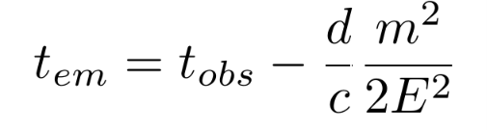
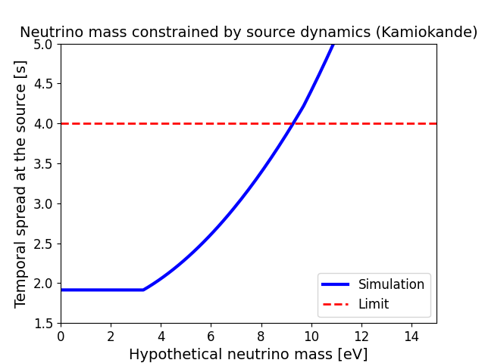
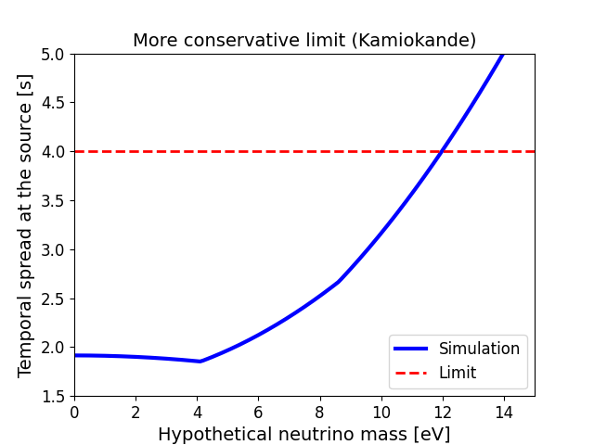

Physical constraint: we assumed that the kinematic effects caused by the mass cannot force us to hypothesize a source pulse dilated by more than a factor of two compared to our observed time.

Slide 7
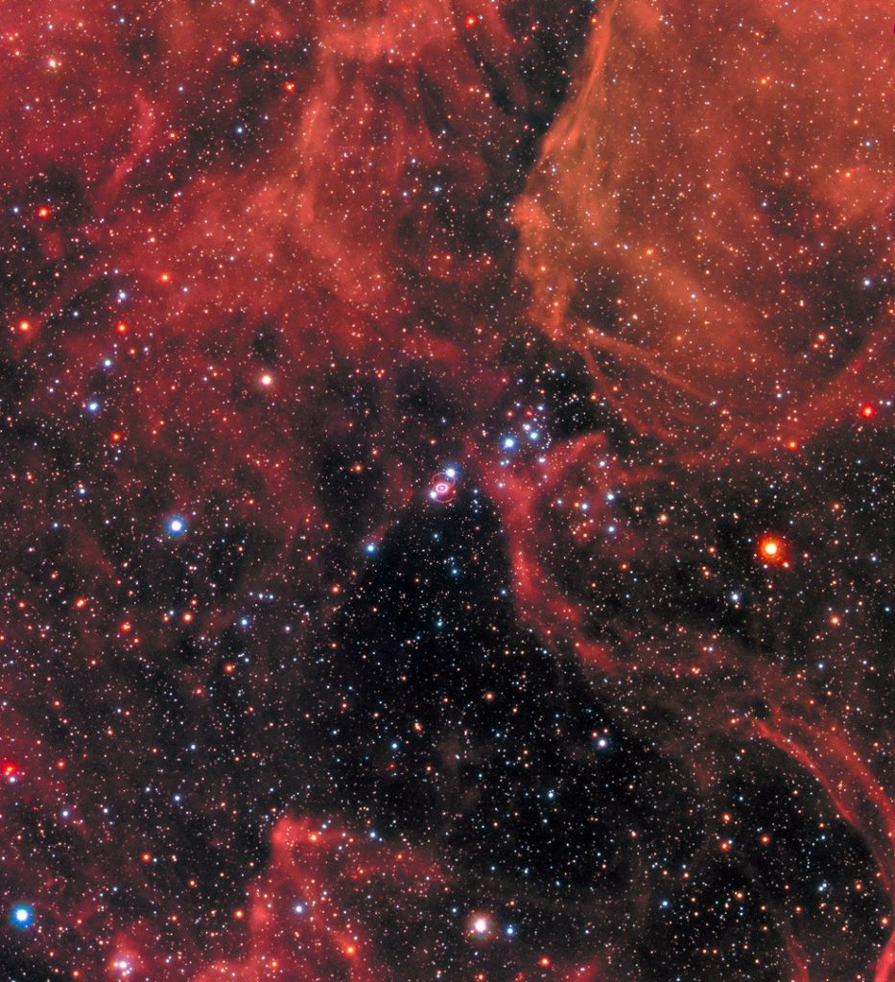
THANKS FOR YOUR ATTENTION!!

