Slide 1
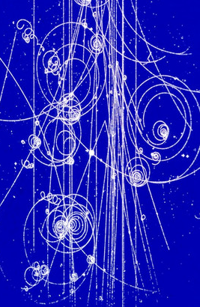

On CP violation
By Matilde Iacoponi

Slide 2

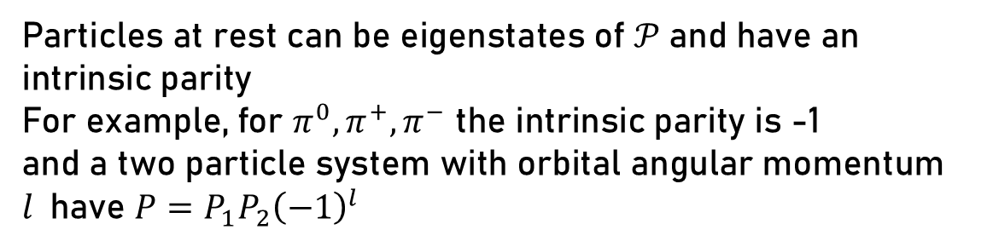
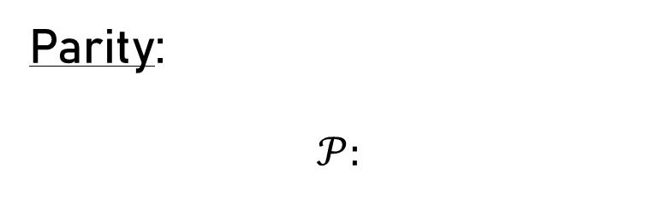


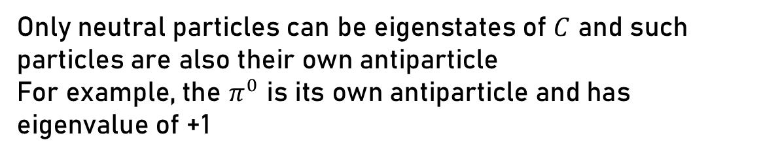


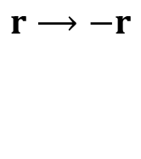

WHAT IS IT?
Parity:
$$𝒫:$$
$$\{$$
Particles at rest can be eigenstates of $𝒫$and have an intrinsic parity
For example, for $π^{0},π^{+},π^{−}$ the intrinsic parity is -1
and a two particle system with orbital angular momentum $l$have $P=P_{1}P_{2}{\left(−1\right)}^{l}$
$$r⟶−r$$
$$t ⟶ t$$
$$p⟶−p$$
$$j⟶j$$
Charge conjugation:
Only neutral particles can be eigenstates of $C$ and such particles are also their own antiparticle
For example, the $π^{0}$ is its own antiparticle and has eigenvalue of +1
$$𝒞\left|p,s,\{Q\}\right\rangle ⟶\left|p,s,\{−Q\}\right\rangle$$
The CP symmetry can be violated in three different ways: by violation in the wave function, by direct violation and by interference between decays
Matilde Iacoponi – 2/5

Slide 3
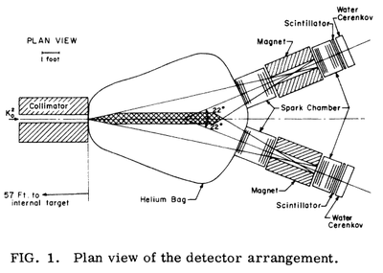
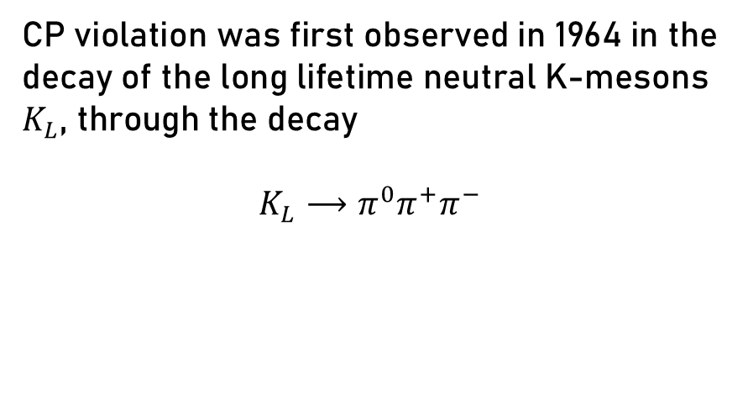
FIRST DISCOVERY
CP violation was first observed in 1964 in the decay of the long lifetime neutral K-mesons $K_{L}$, through the decay
$$K_{L}⟶π^{0}π^{+}π^{−}$$
Christenson et al, 1964
Matilde Iacoponi – 3/5

Slide 4
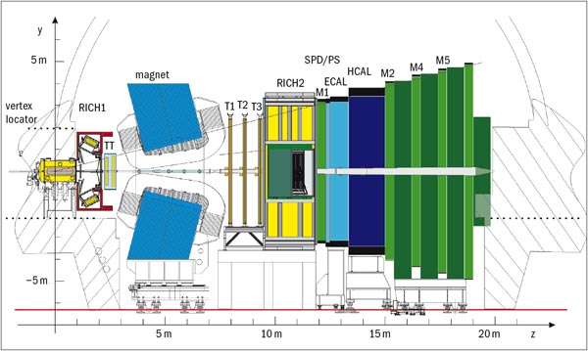
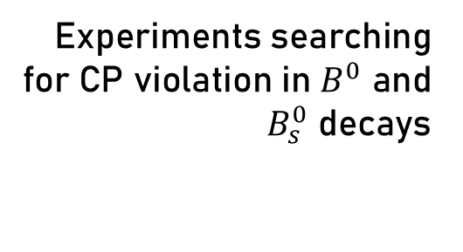
TODAY: LHCb
Experiments searching for CP violation in $B^{0}$ and $B_{s}^{0}$ decays
So far the experiments have measured parameters compatible with the SM
Matilde Iacoponi – 4/5

Slide 5
Thank you for the attention!

