Slide 1





Searching for New Physics at LHCb using Machine Learning
Mario López
BSc Physics – 4rd Year
University of Santiago de Compostela
Erasmus Student at Umeå University
Current Intership (at IGFAE):
Machine Learning techniques for the search
of Beyond Standard Model particles at LHCb.
Notes:
Hello everyone.
My name is Mario López and I'm a third-year Physics student from the University of Santiago de Compostela.
This year I'm doing my Erasmus at Umeå University, and during my internship I've been working with the LHCb collaboration at CERN.
Today I'd like to show you one of the projects I've been working on: searching for new particles using Machine Learning.

Slide 2
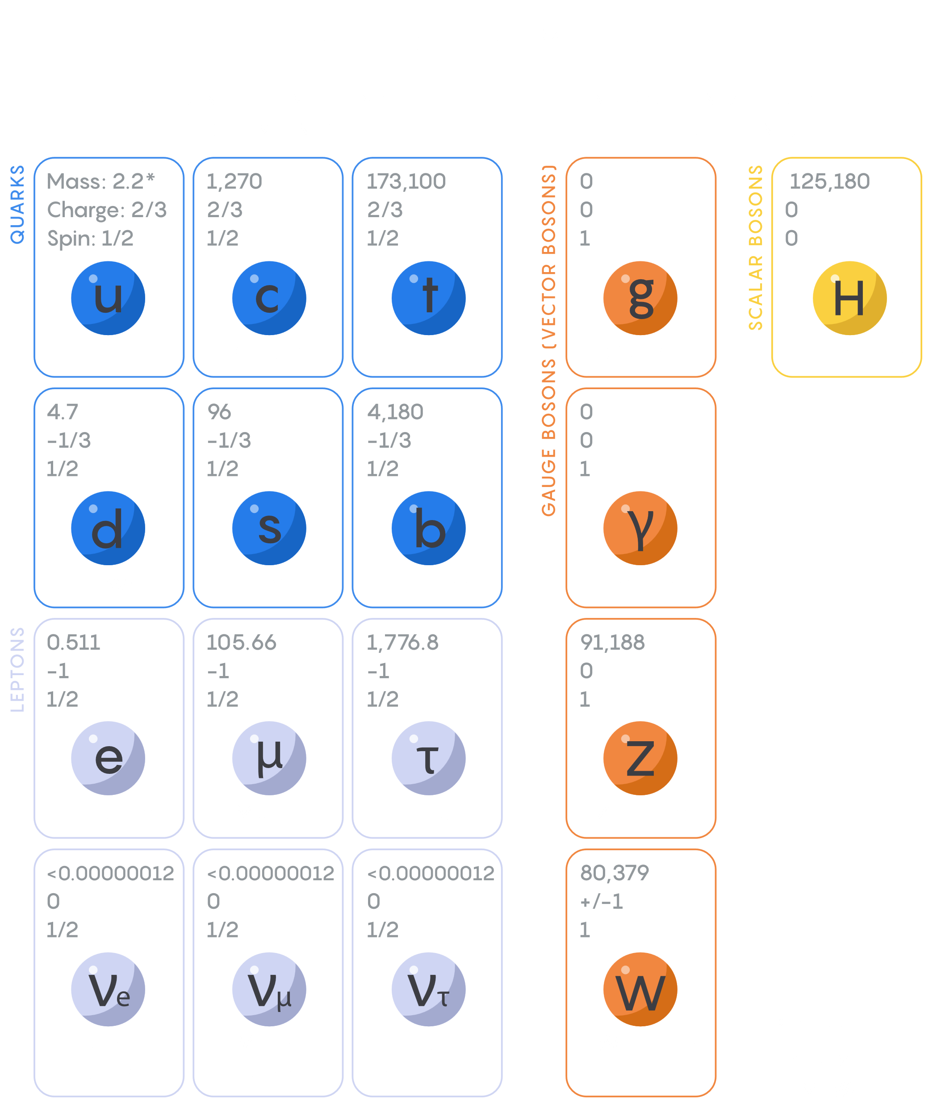
Why do we need new physics?
The Standard Model is incredibly successful...
✓ Describes all known fundamental particles
✓ Predicts experiments with remarkable precision
But it cannot explain:
• Dark Matter
• Dark Energy
• Matter–Antimatter Asymmetry
→ Physics Beyond the Standard Model
Notes:
Although the Standard Model describes particle physics incredibly well, we know it cannot explain phenomena such as dark matter or the matter–antimatter asymmetry.
This is why many theories predict new particles that could be produced at the LHC.
In my project we focused on two possible candidates: Axion-Like Particles, or ALPs, and Quirks.

Slide 3
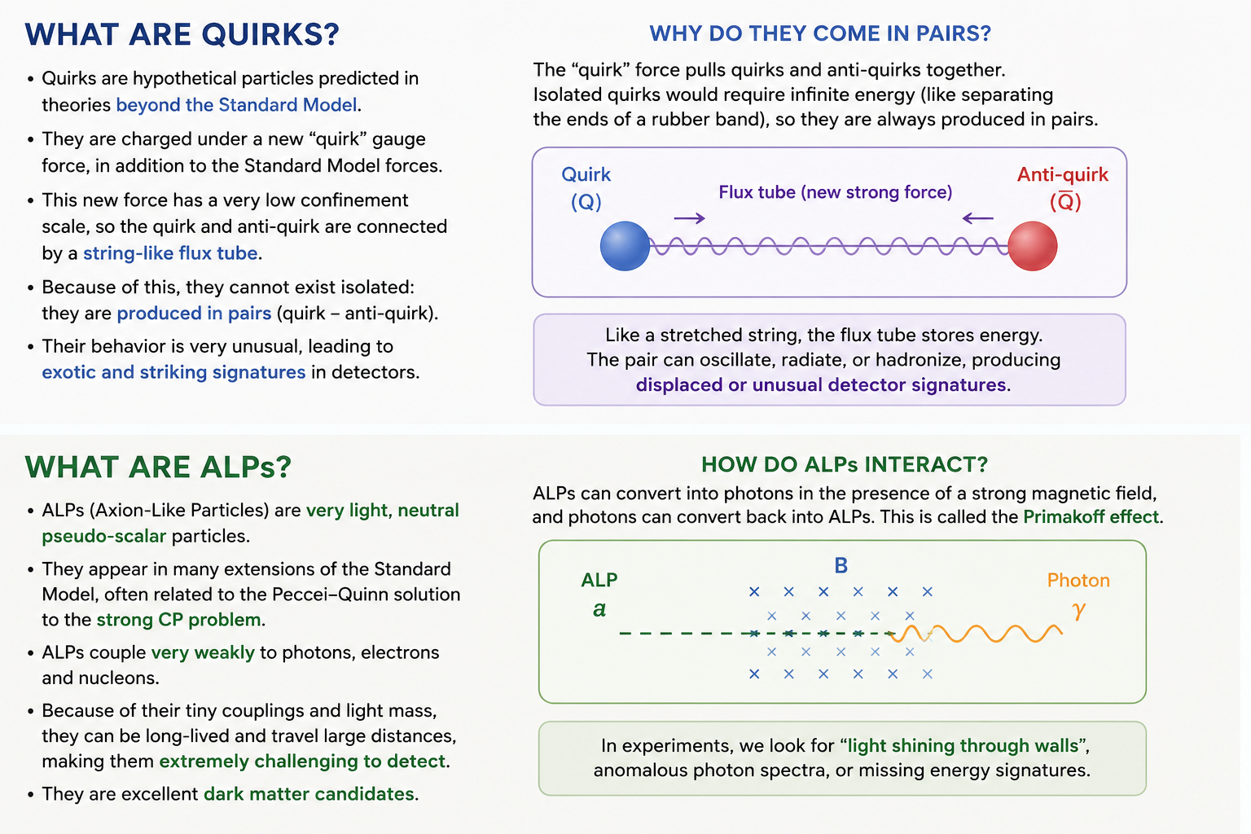
Two Candidates Beyond the Standard Model
Quirks
• New confining force
• Invisible 'string'
• Unusual detector tracks
Axion-Like Particles (ALPs)
• Weakly interacting
• Long-lived
• Can decay into detectable particles
Notes:
ALPs are hypothetical particles that interact very weakly with ordinary matter.
Because of this, they are very difficult to detect, but in some cases they decay into known particles that leave measurable signatures inside the detector.
Quirks are even more exotic.
Imagine producing two particles that are connected by an invisible elastic string.
Normally, when particles are created in a collision, they fly apart independently.
Quirks cannot do that.
The new force between them keeps them connected, so instead of moving independently they oscillate while travelling through the detector.
This produces very unusual tracks that look completely different from ordinary particle trajectories.
If we ever observed this kind of signature, it would be a very strong indication of new physics.

Slide 4
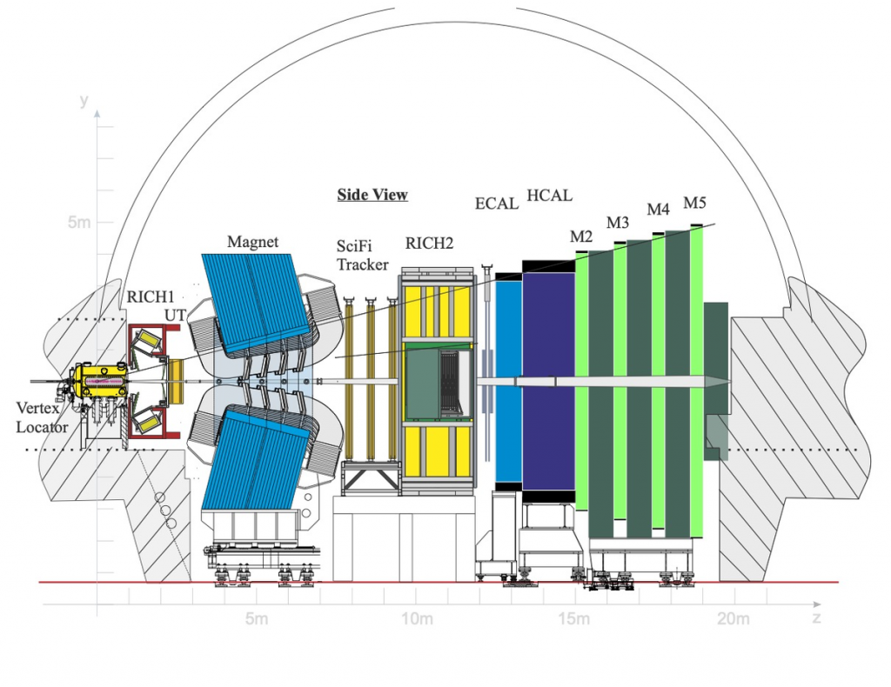
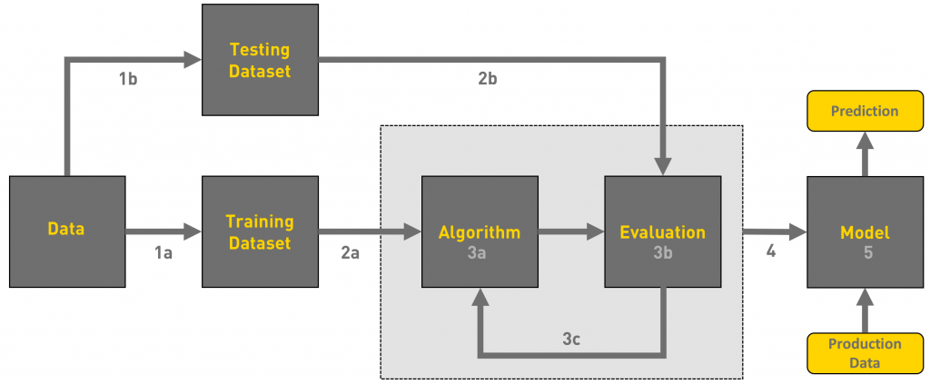
Searching for New Physics at LHCb
How do we search for them?
LHC collisions
↓
LHCb detector
↓
Event variables
↓
Machine Learning (BDTs)
↓
Signal vs Background
Objective:
Increase the sensitivity to ALPs and Quirks.
Notes:
The challenge is that the LHC produces billions of collisions, and almost all of them correspond to known physics.
The possible signal from ALPs or Quirks is extremely rare.
My project uses Machine Learning, specifically Boosted Decision Trees, to distinguish signal events from ordinary background events.
The better this classification is, the higher the probability of discovering new particles.

Slide 5
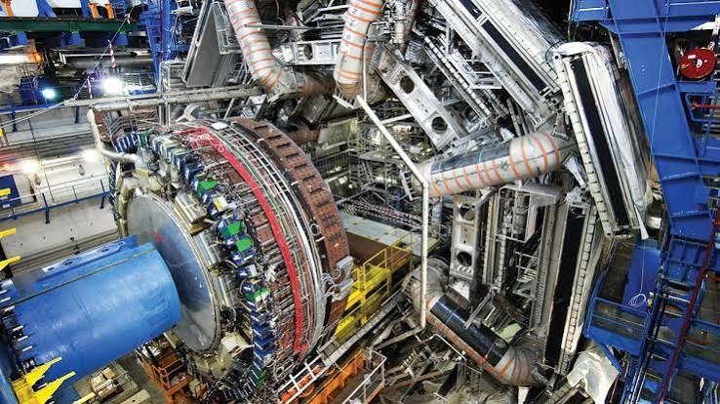
Conclusions
Main takeaways
✓ The Standard Model is incomplete.
✓ ALPs and Quirks are promising BSM candidates.
✓ LHCb is an excellent detector for these searches.
✓ Machine Learning is becoming essential.
What I learned
• Particle Physics
• Data Analysis
• Machine Learning
• Python
• C++
Notes:
To conclude, the Standard Model is not the final theory of nature.
ALPs and especially Quirks are exciting examples of particles that could reveal new physics.
Through this project I've learned how Machine Learning can be applied to real data from the LHC in the search for these new particles.
Thank you very much for your attention.

