Slide 1
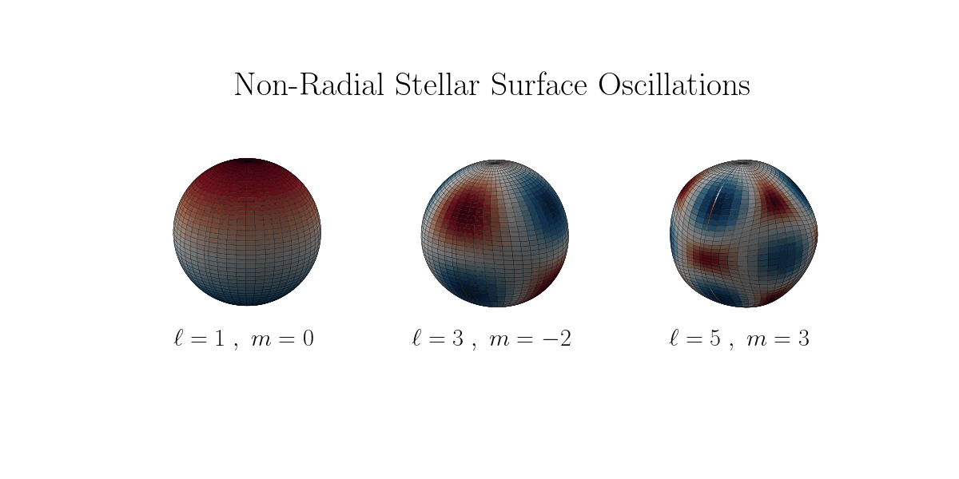
GraSPA 2026
Good Vibrations*
Kushagra Shrivastava
BSc. Physics with Astrophysics Spec., National University of Singapore
*Better scientific title in progress

Slide 2
Eddington’s Dilemma
Corona
Upper Chromosphere
Lower Chromosphere
Photosphere
“How to look inside?” (Eddington 1926, Rephrased)
Eddington, A. S. (1926). The internal constitution of the stars.

Slide 3
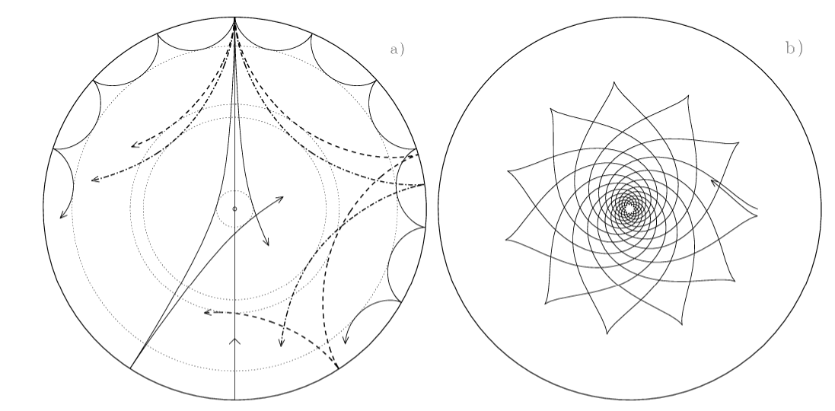
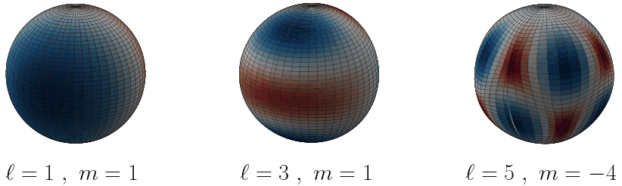
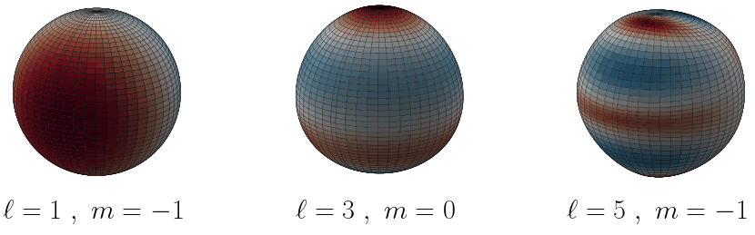
Probing with Asteroseismology
Figure adopted from Aerts et al. 2010
Pressure (p) Modes
Gravity (g) Modes
Density
Chemical Gradient
Internal Rotation Speeds
… and others
Aerts, C., Christensen-Dalsgaard, J. & Kurtz, D. W. (2010). Asteroseismology. Astronomy and Astrophysics Library, Springer.

Slide 4
Extracting science from Light Curves
FFT
(kind of)
Extraction
Based on the period spacings graph, we can determine properties such as chemical gradients, rotation rate, rotation direction, etc.
Spacing
Period or Frequency
Aerts, C., Christensen-Dalsgaard, J. & Kurtz, D. W. (2010). Asteroseismology. Astronomy and Astrophysics Library, Springer.

Slide 5
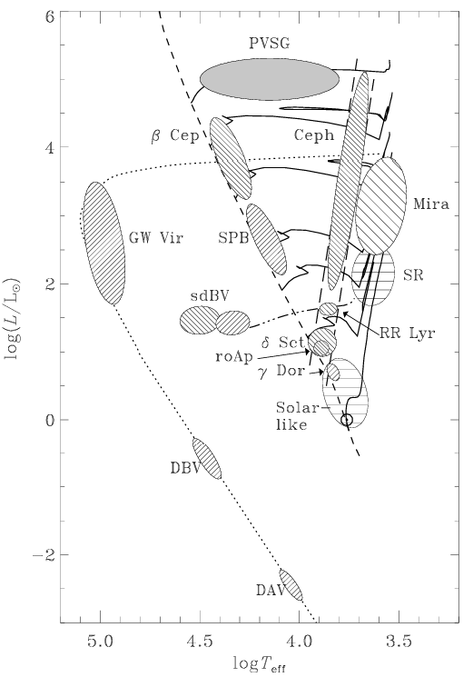
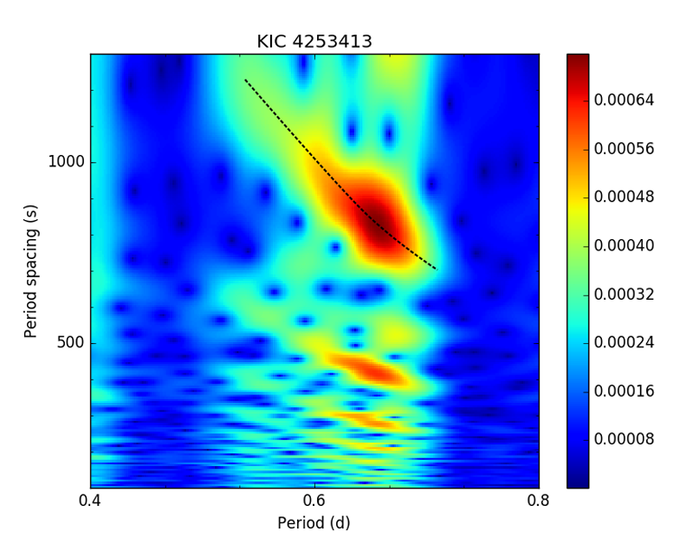

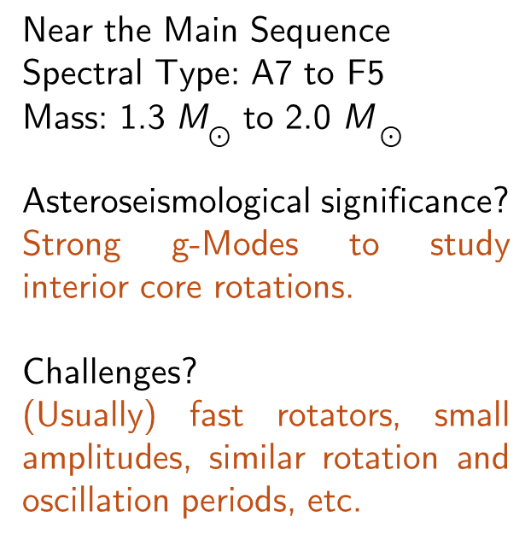
$γ$-Doradus stars and my project(?)
Figure out ways to better analyse the period spacing – period relations.
Near the Main Sequence
Spectral Type: A7 to F5
Mass: 1.3 M$⊙$ to 2.0 M $⊙$
Asteroseismological significance?
Strong g-Modes to study interior core rotations.
Challenges?
(Usually) fast rotators, small amplitudes, similar rotation and oscillation periods, etc.
Synchrosqeezing
Figure adopted from Gang Li et al. 2019
Figure adopted from Aerts et al. 2010
Gang Li, Timothy R Bedding, Simon J Murphy, Timothy Van Reeth, Victoria Antoci, Rhita-Maria Ouazzani, Period spacings of γ Doradus pulsators in the Kepler field: detection methods and application to 22 slow rotators, Monthly Notices of the Royal Astronomical Society, Volume 482, Issue 2, January 2019, Pages 1757–1785, https://doi.org/10.1093/mnras/sty2743

Slide 6
Thank You*
For surviving the rambling
*No really, thank you.

