Slide 1

Introduction to PandaX
Wei Wang (on behalf of PandaX Collaboration)
17th FCPPN/L Worshop, Lyon, Jun 29 – Jul 3, 2026

Slide 2
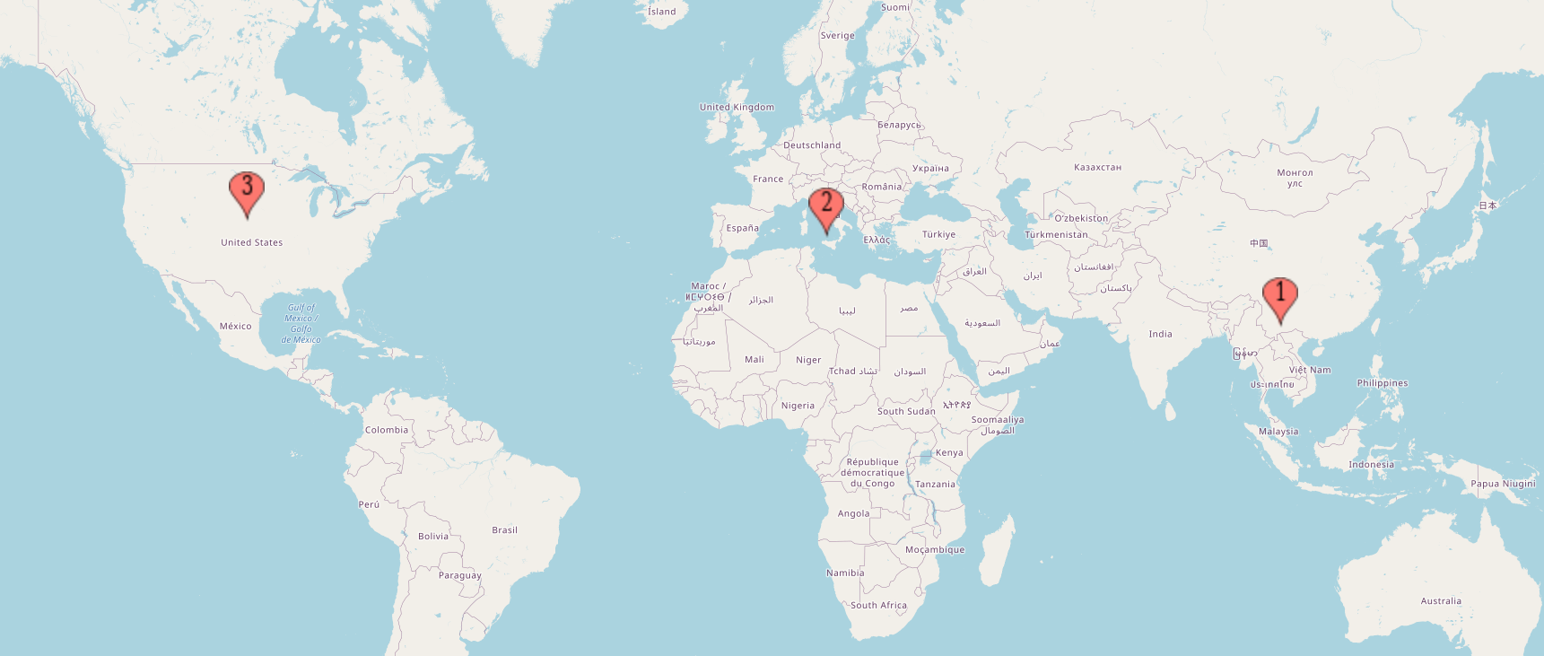
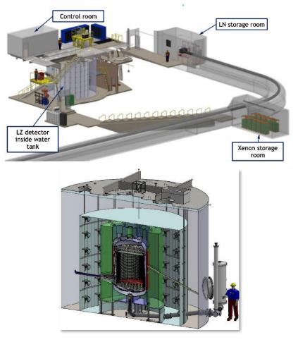
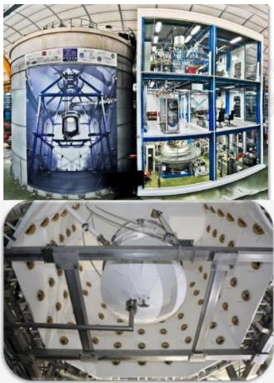
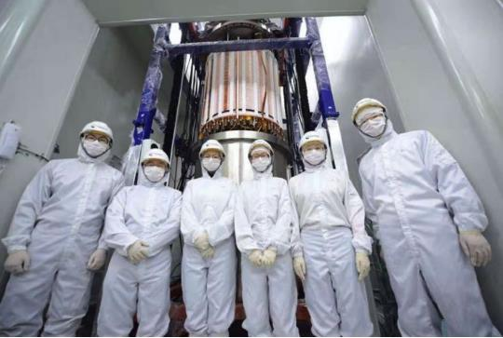
Global liquid xenon DM experiments
LZ
XENON
PandaX

Slide 3
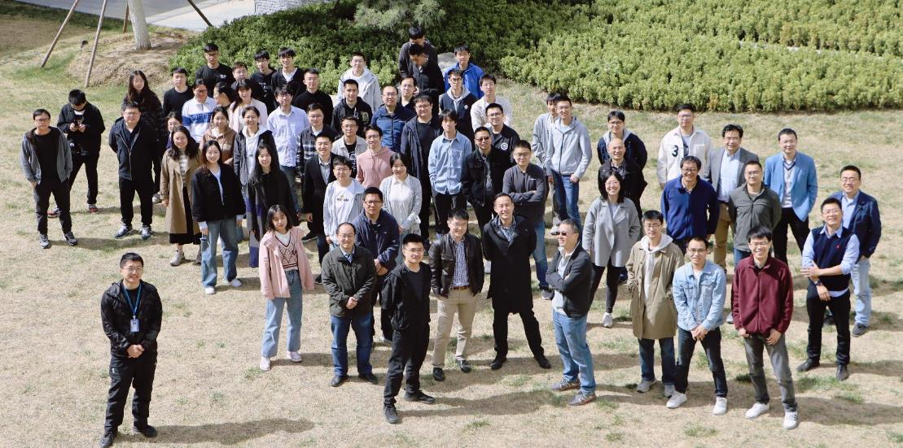
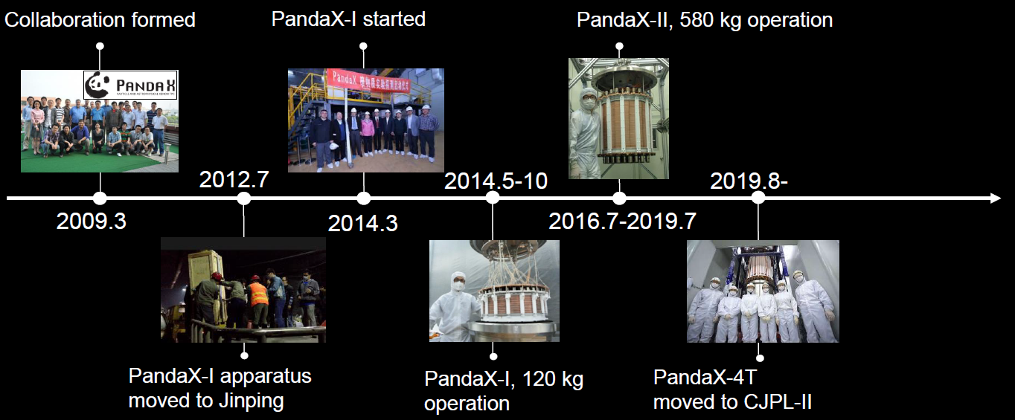
Particle and Astrophysical Xenon observatory

Slide 4
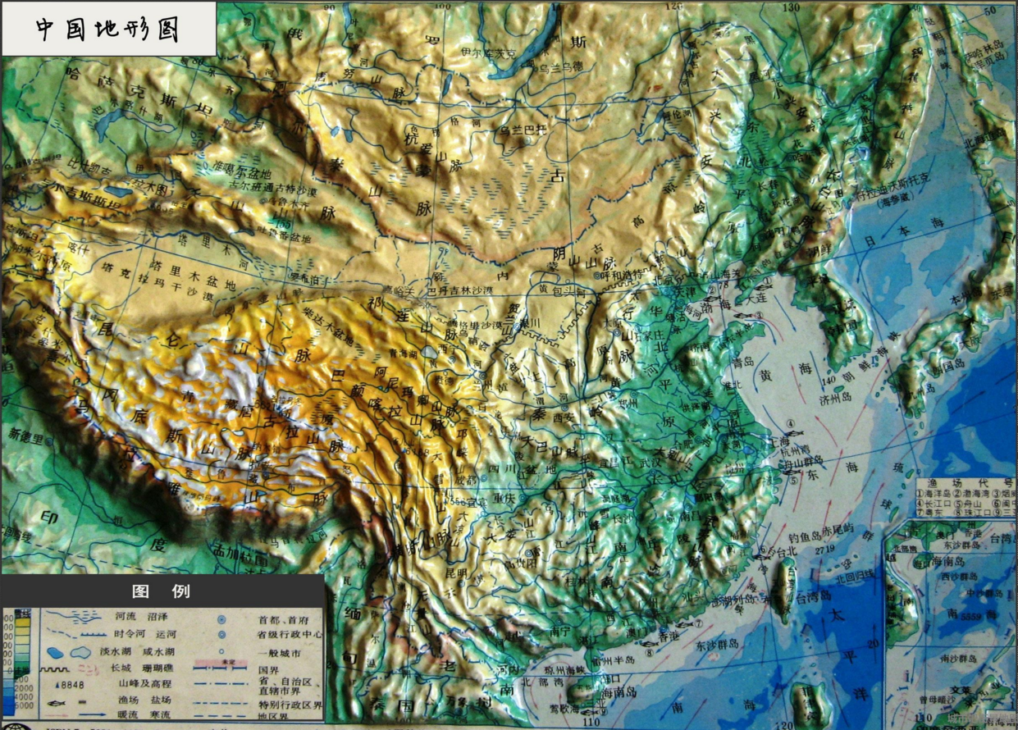
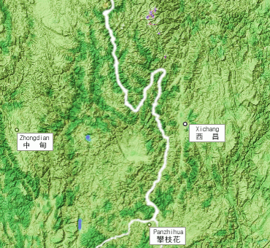
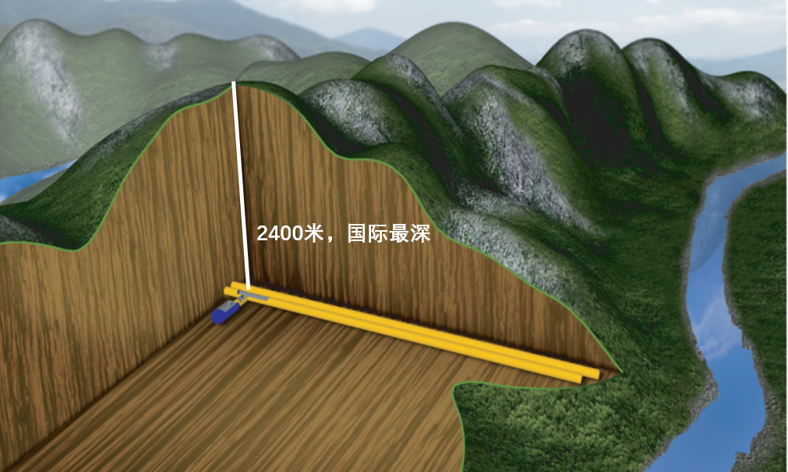
中国地形图
4

Slide 5
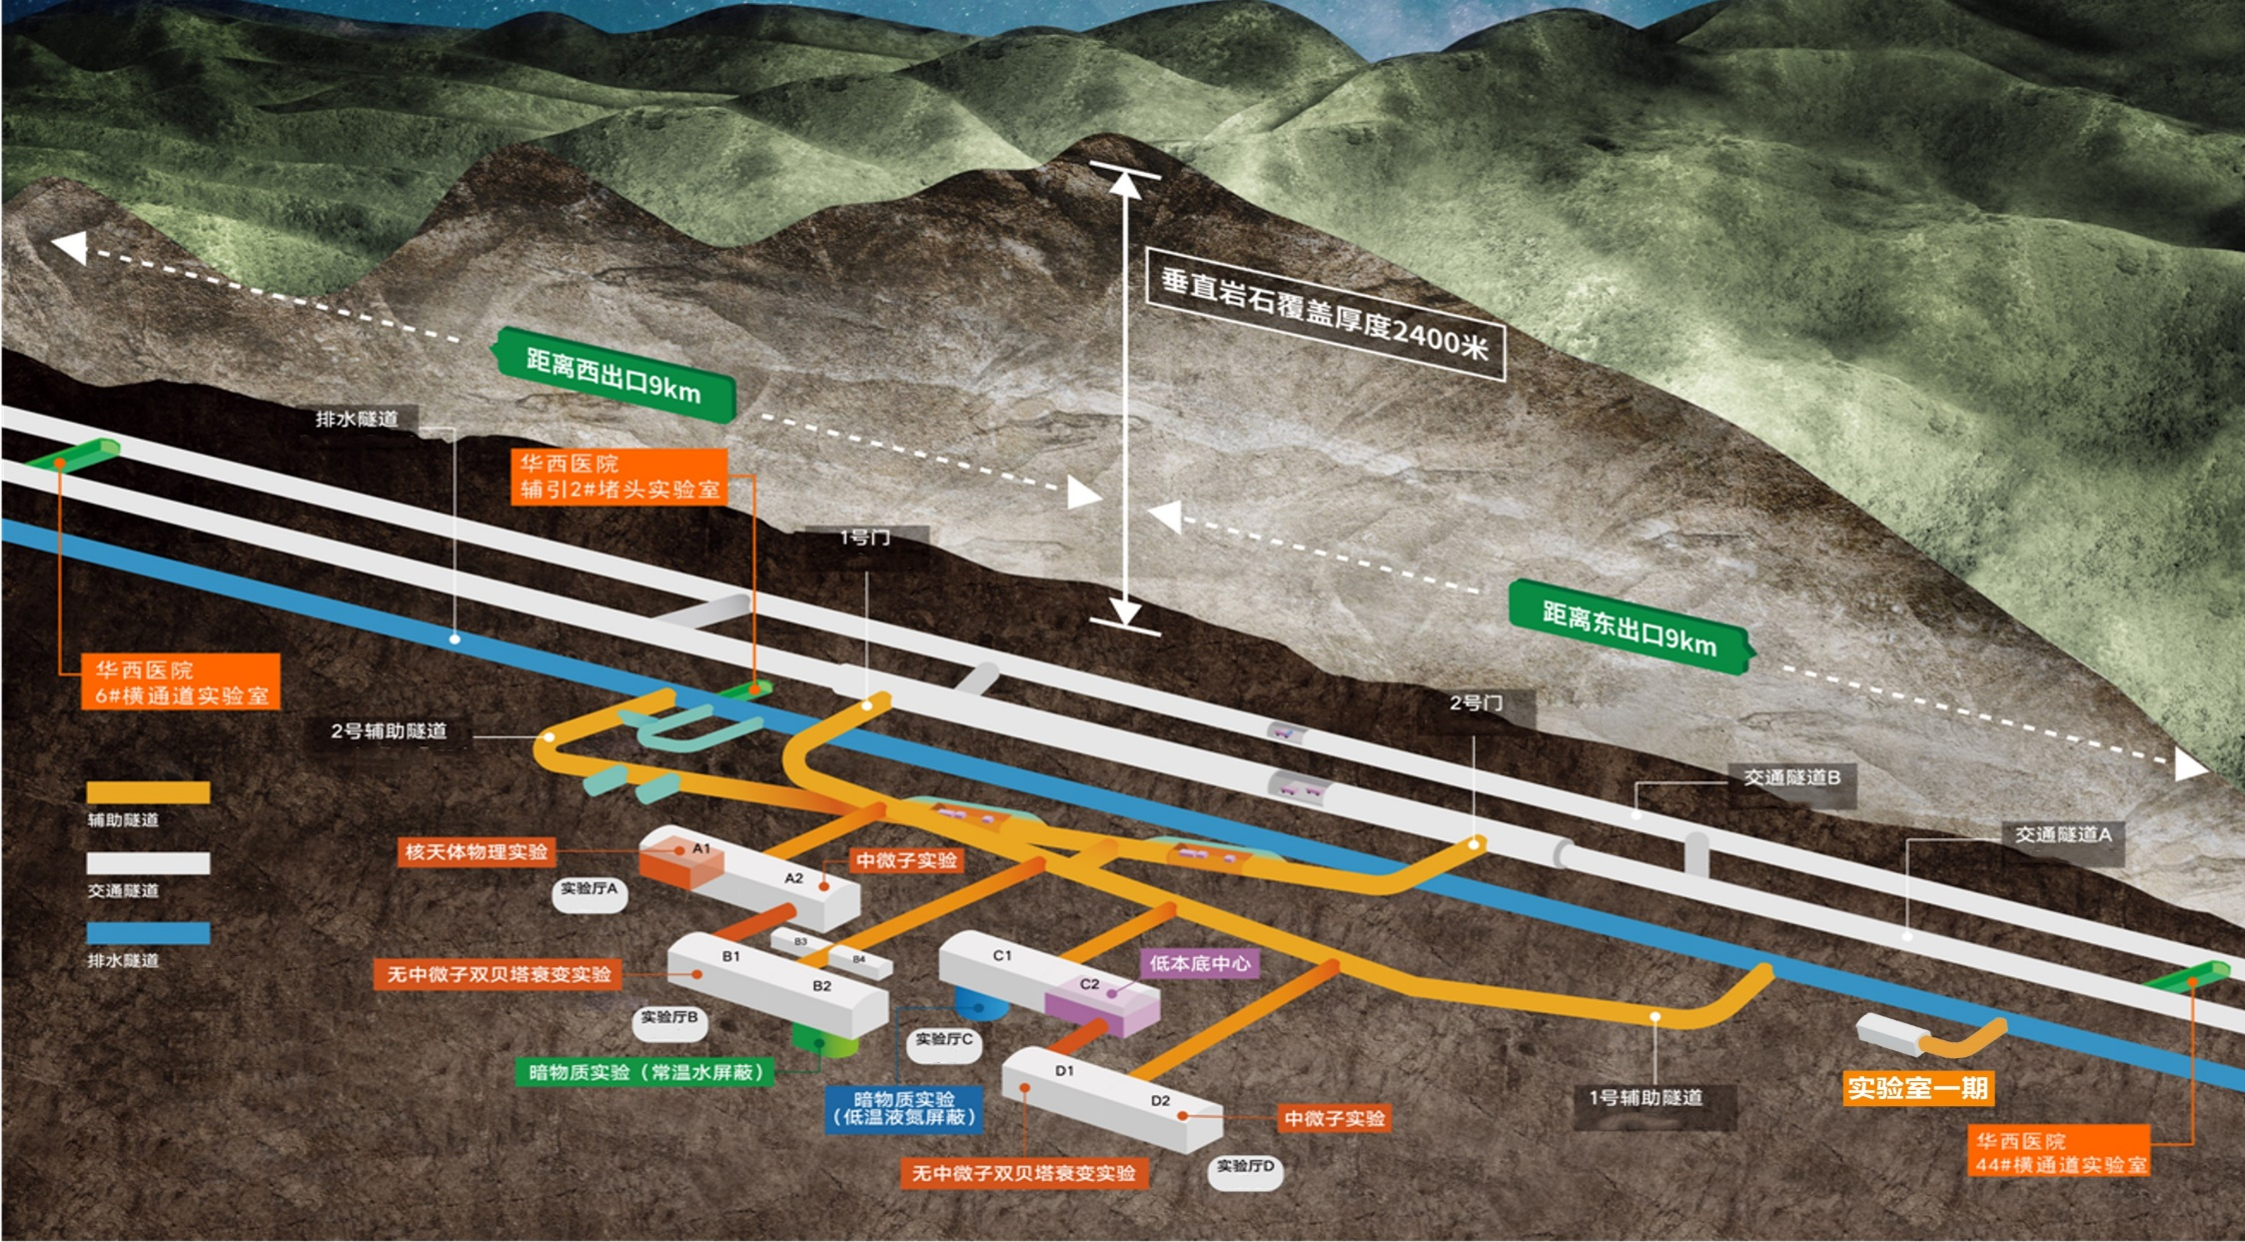
5

Slide 6
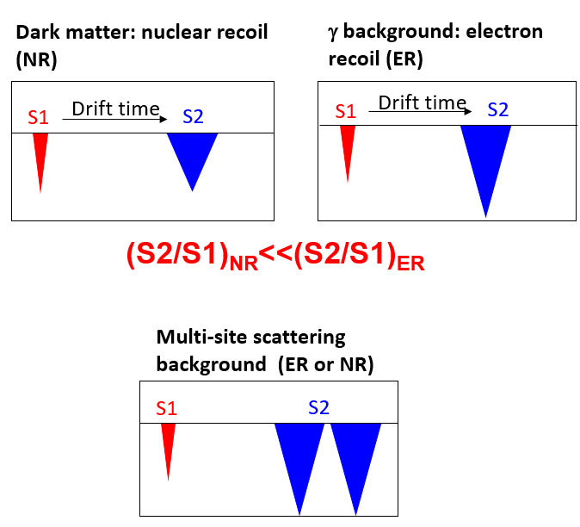
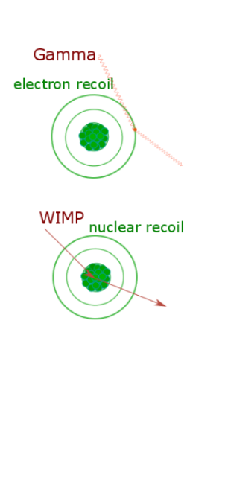
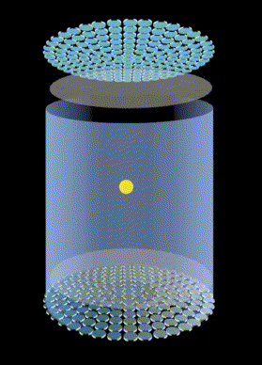
Dual-phase xenon time projection chamber (TPC)
Detector capability:
3D reconstruction and fiducialization
Good ER/NR rejection
Calorimeter capable of seeing a couple of photons/electrons

Slide 7
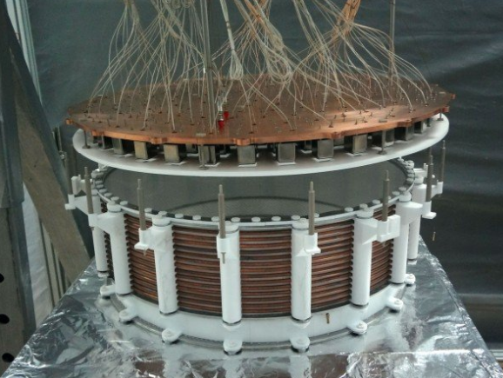
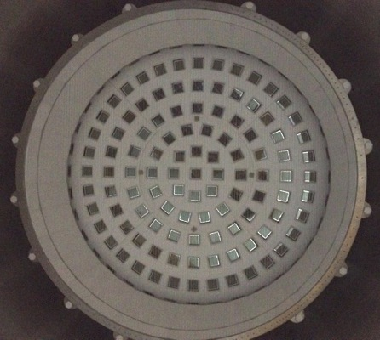
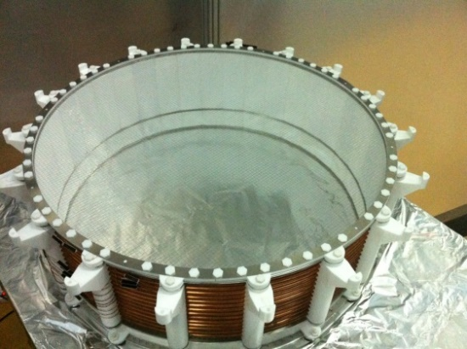
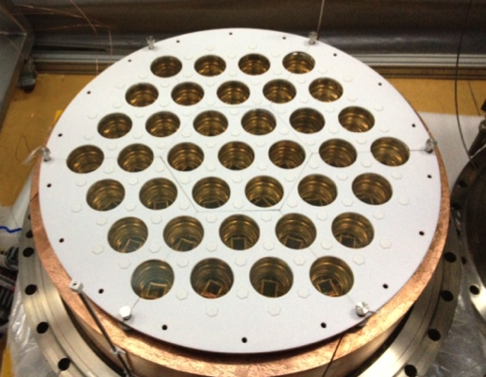
PandaX-I（2009-2014），120 kg
7

Slide 8
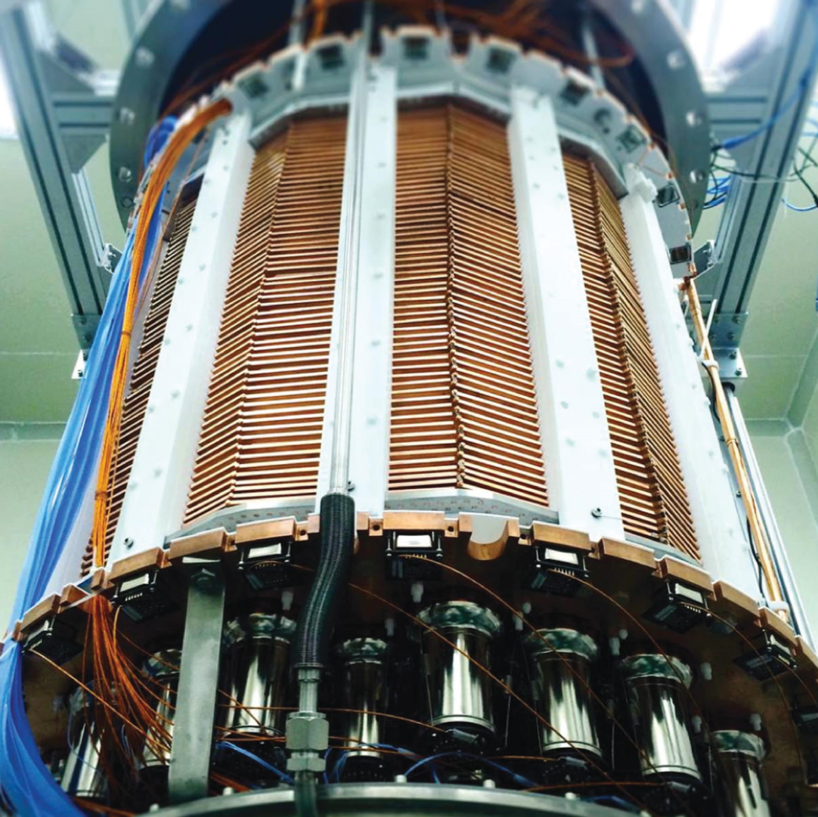
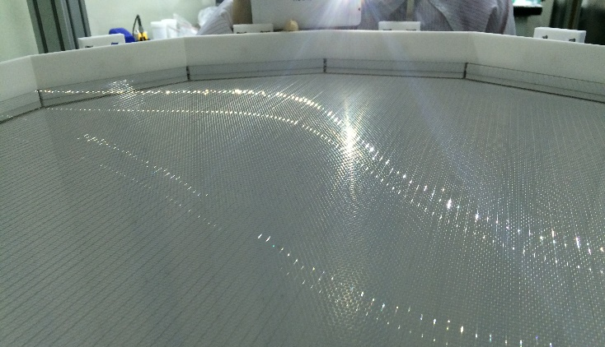
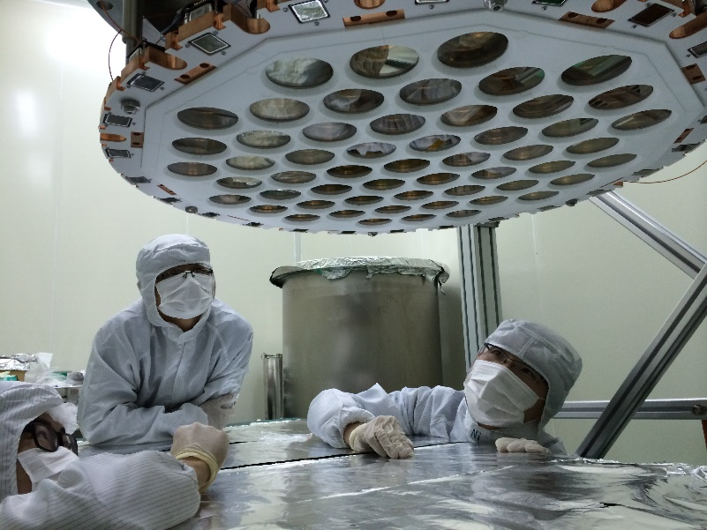
PandaX-II (2015-2019)
580kg
120kg
8

Slide 9
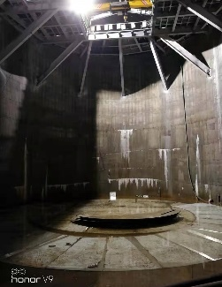
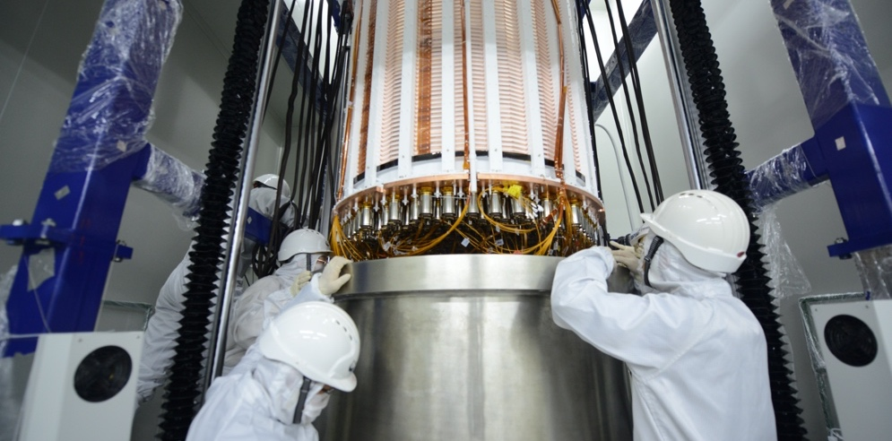
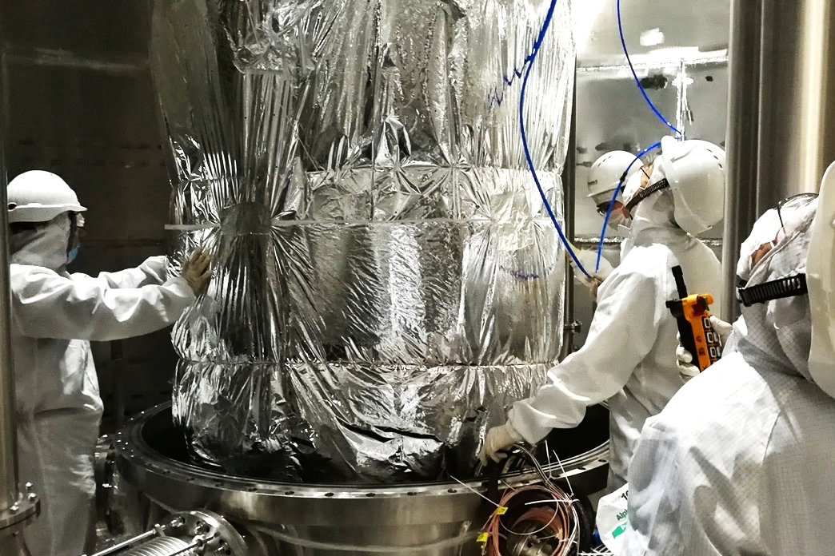
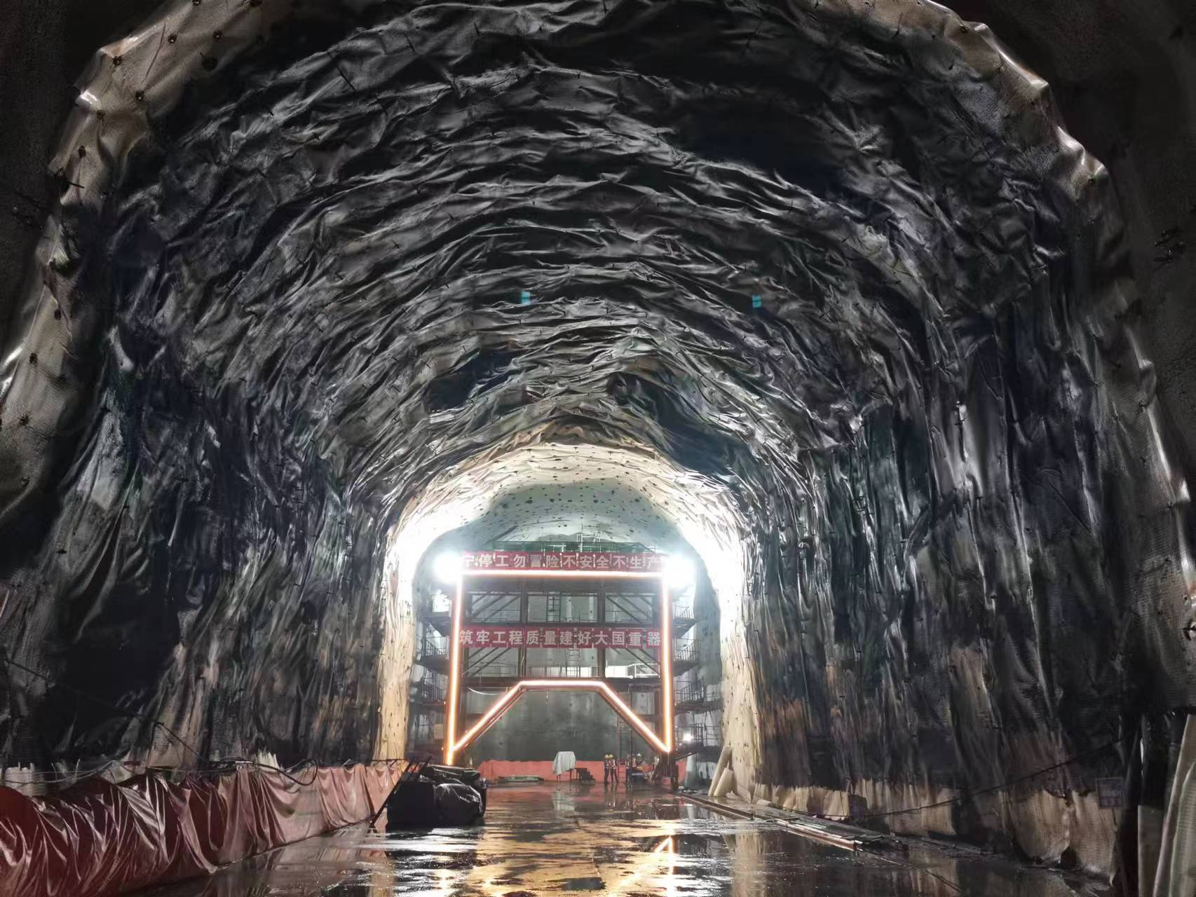
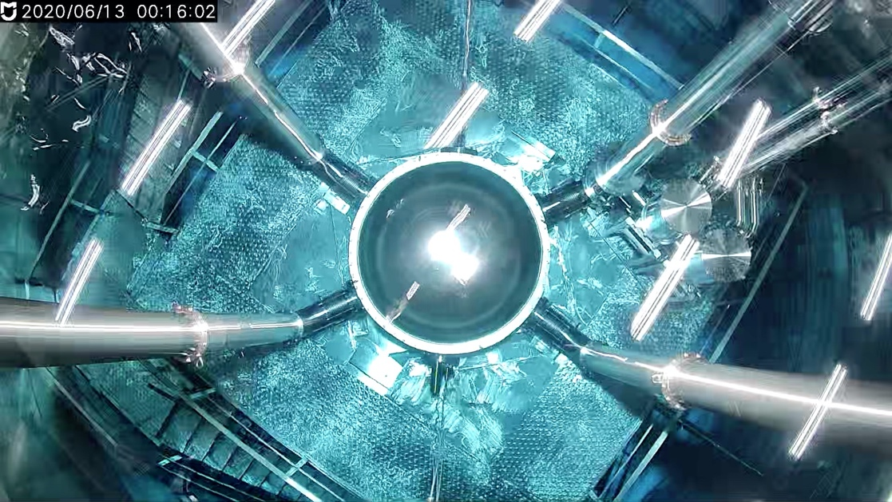
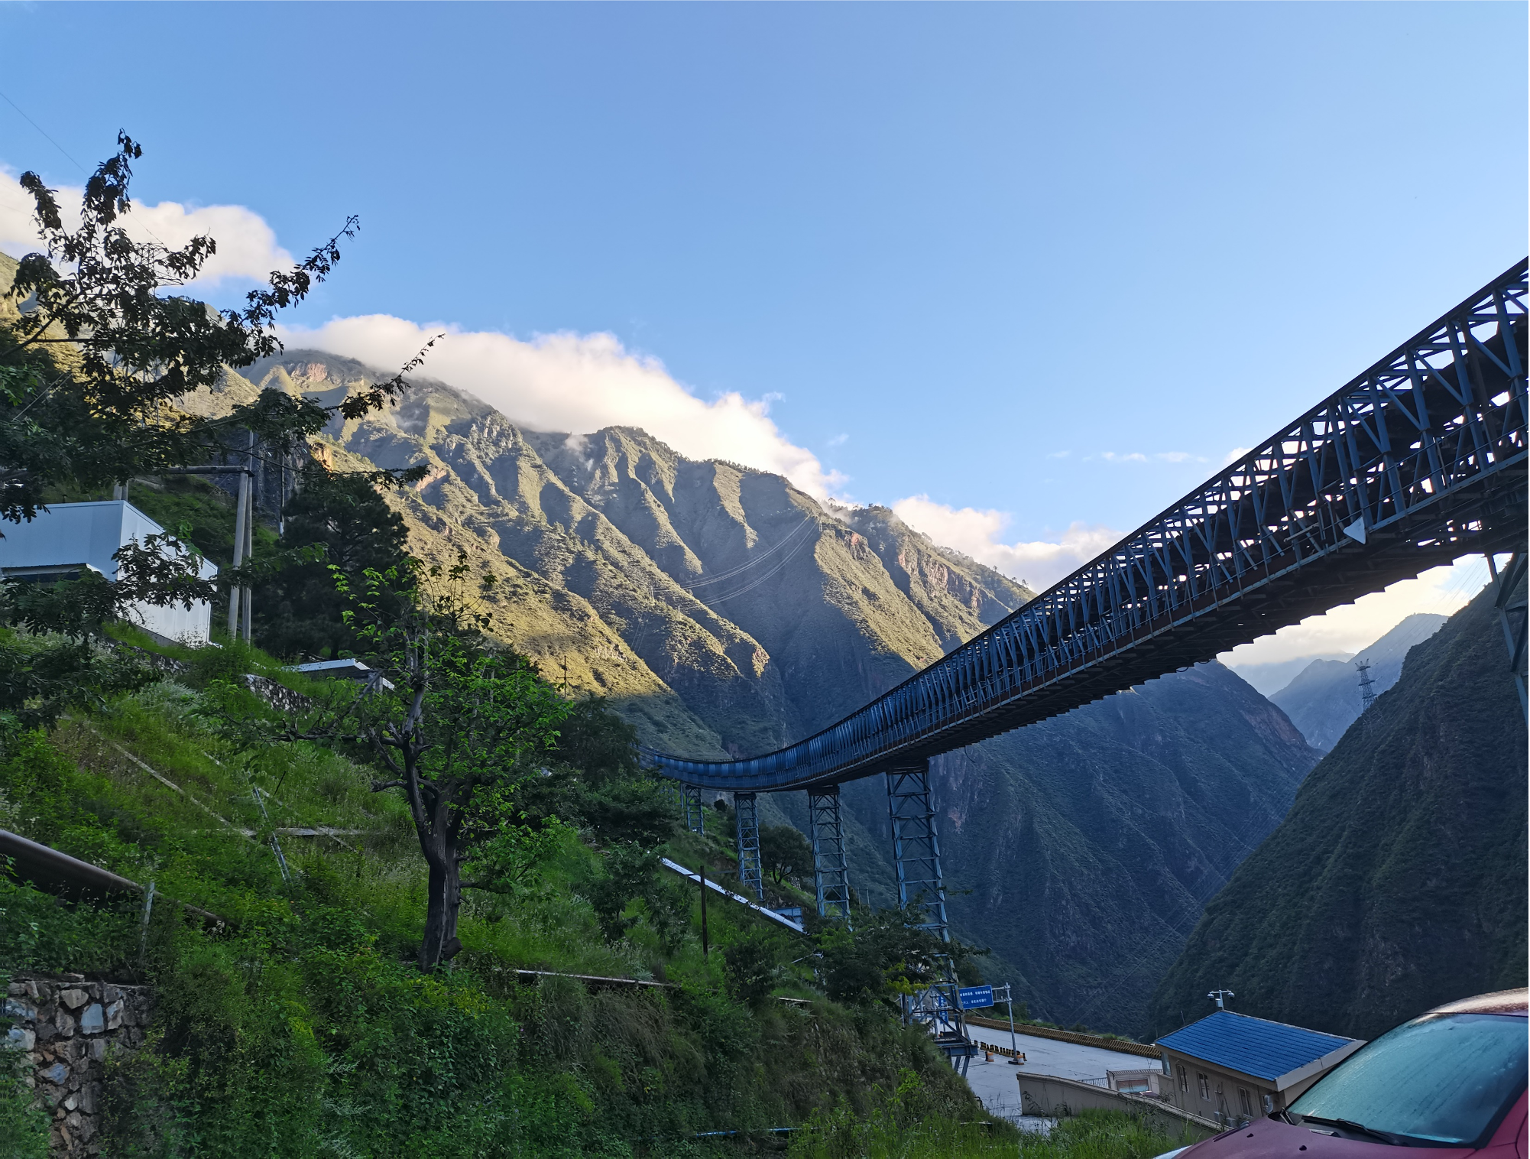
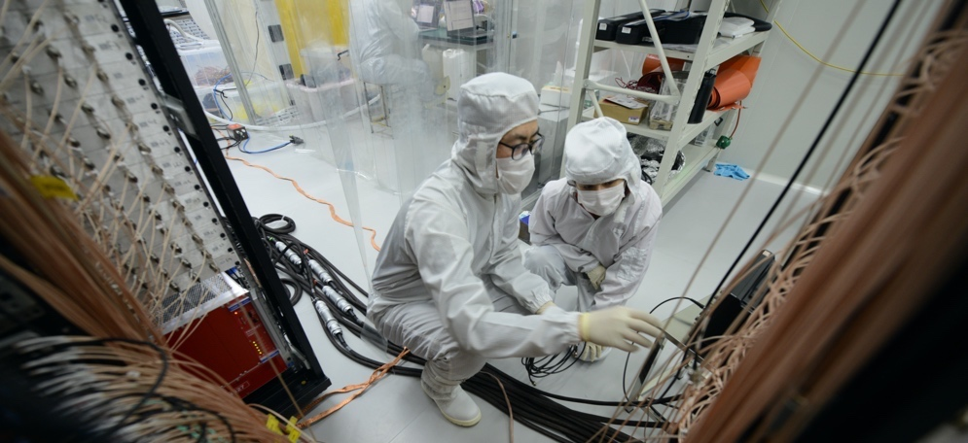
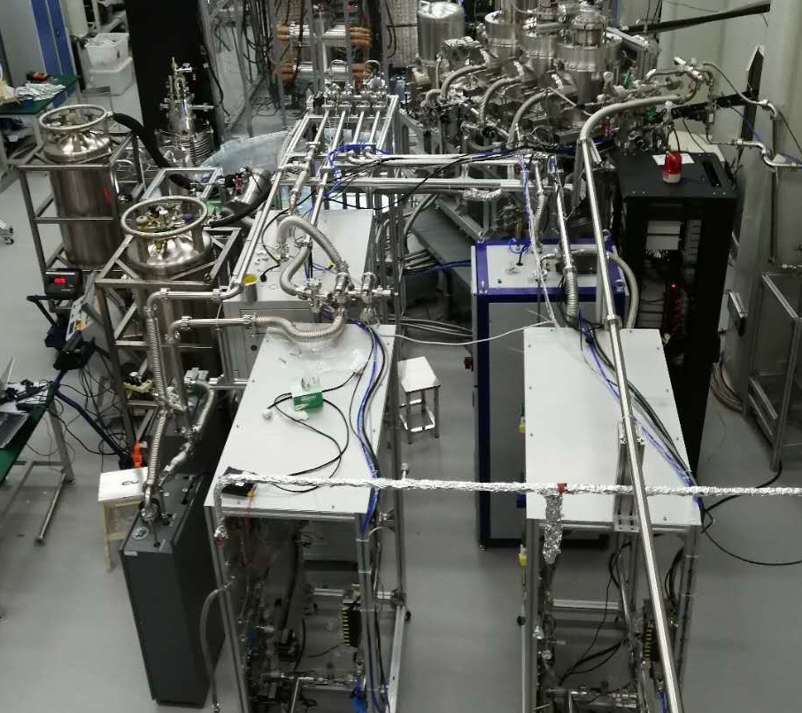
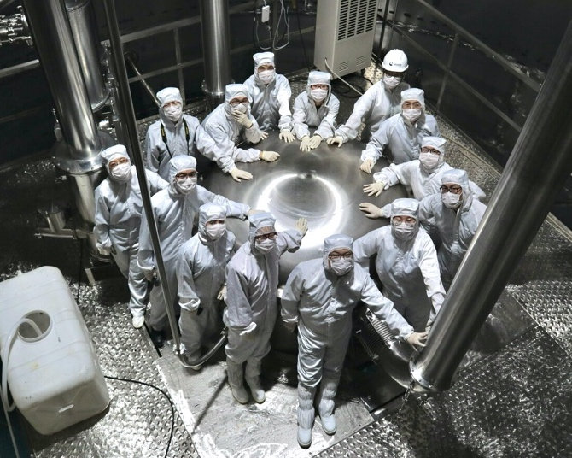
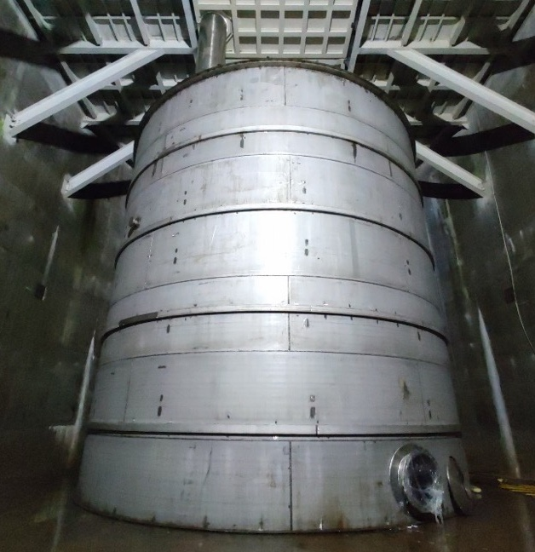
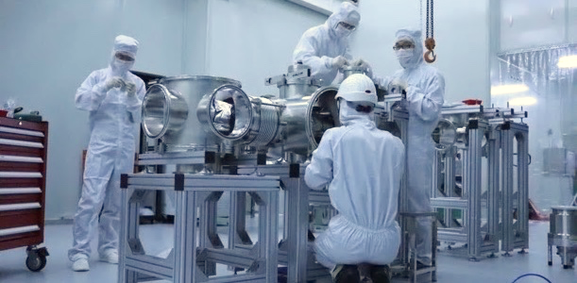

2018.4 water tank construction
2019.8 PandaX-4T instllation
2020.5 liquid xenon filling
2020/6-2020/11 integration tests

Slide 10
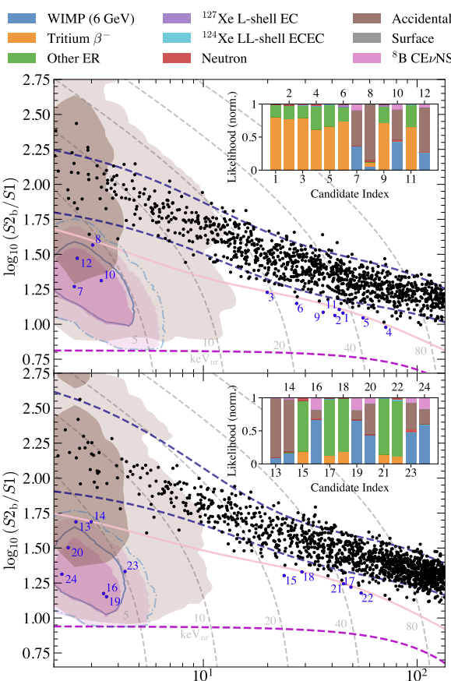
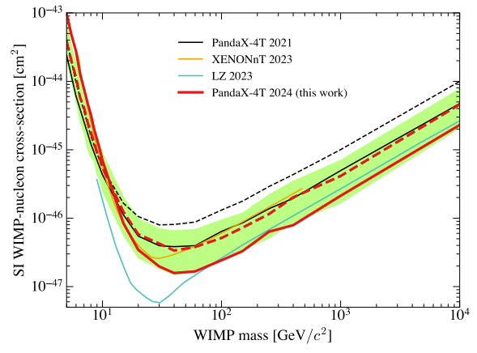
1.5 ton*year Exposure
10

Slide 11
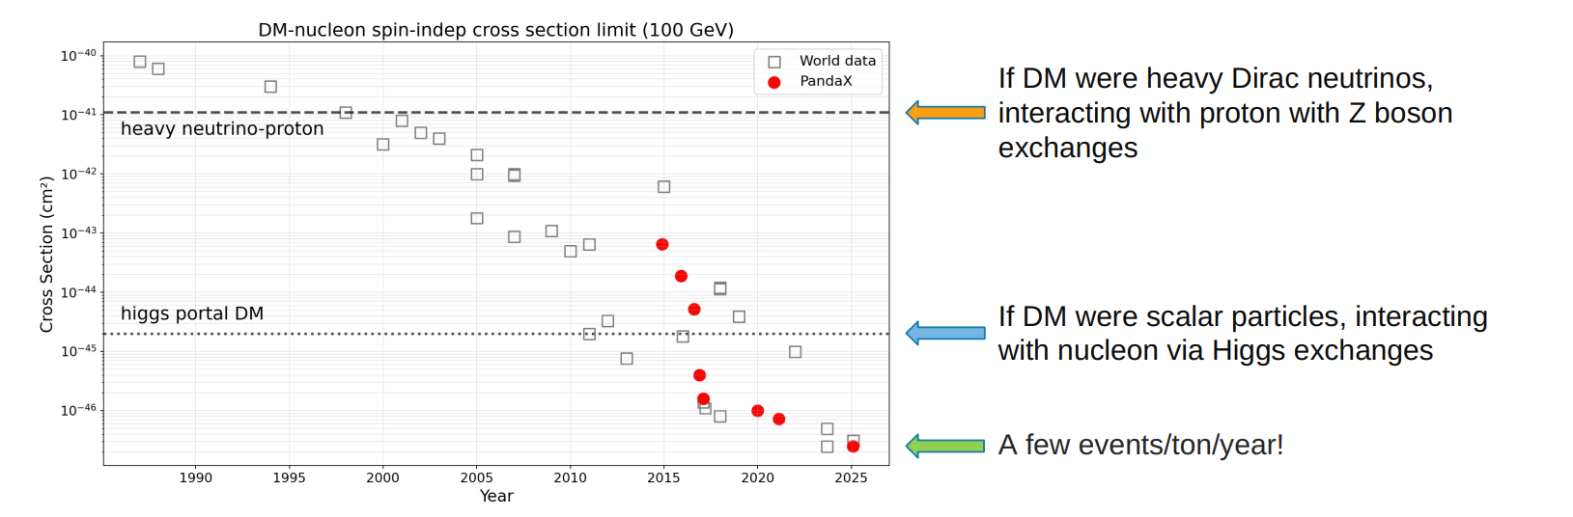
Improving DM sensitivity by more than three orders, over the past decade
11

Slide 12
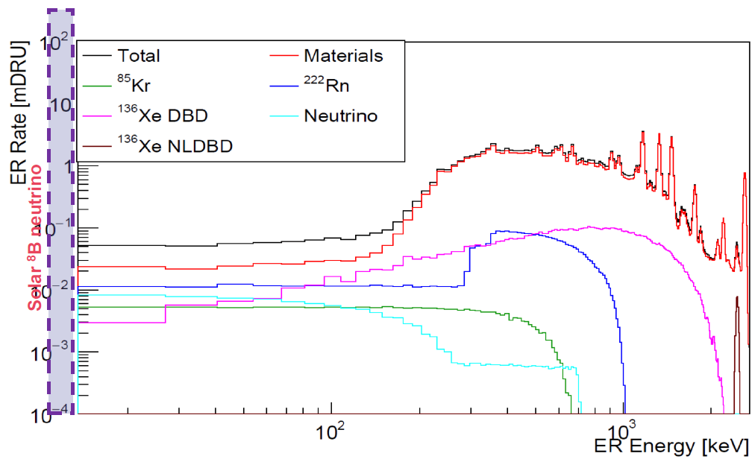
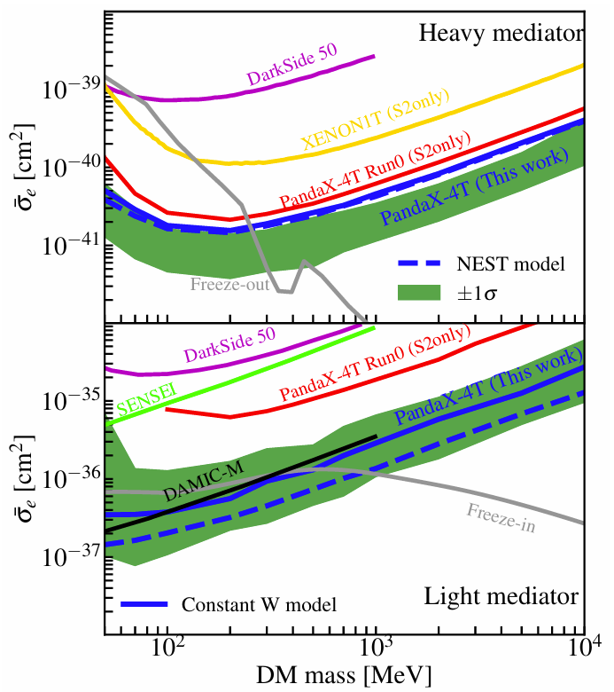
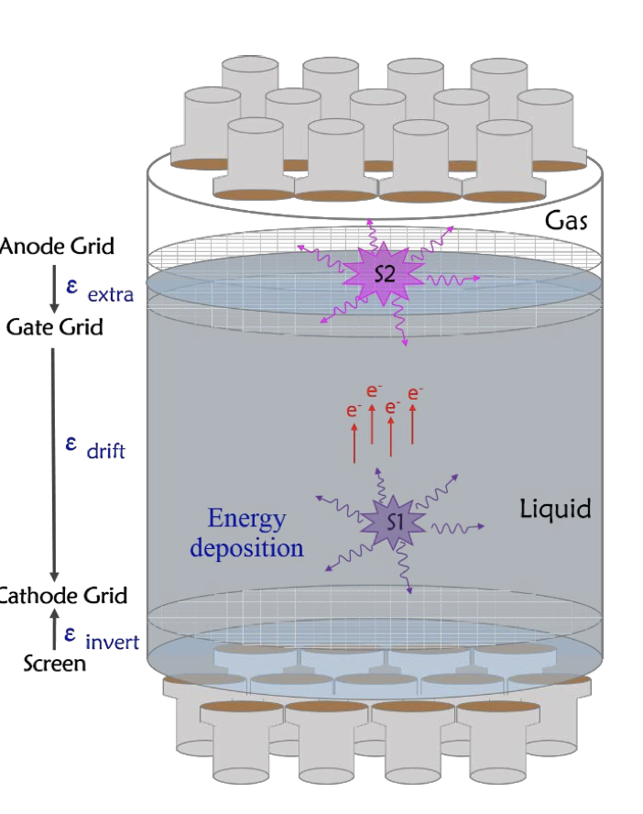
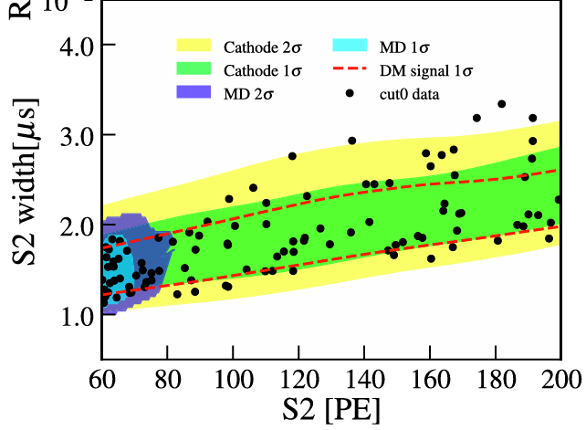
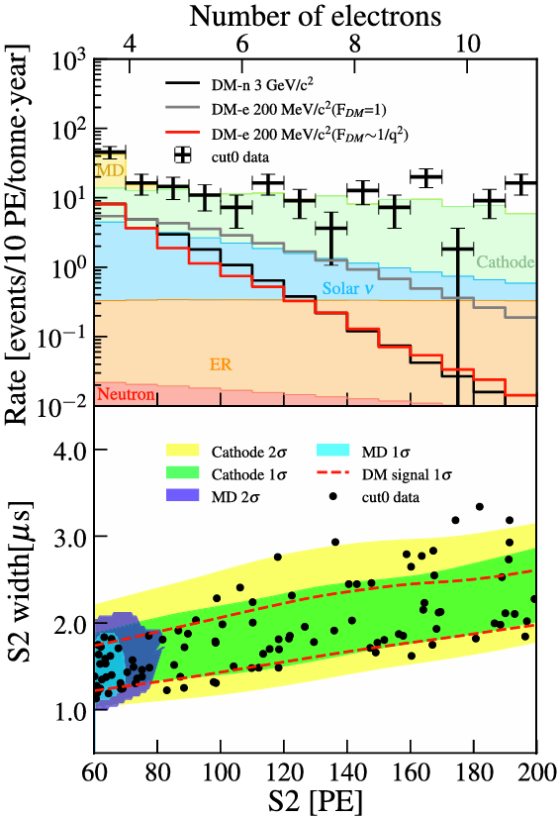
S2-only approach
PRL 130, 261001 (2023)
PRL 135, 211001 (2025)

Slide 13
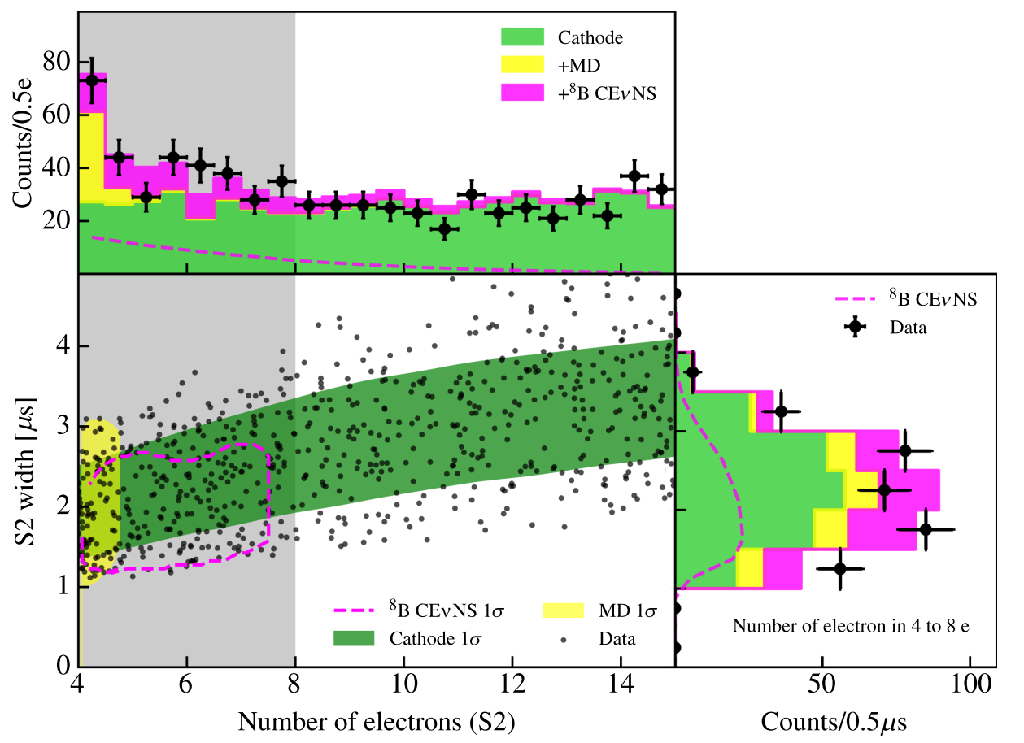
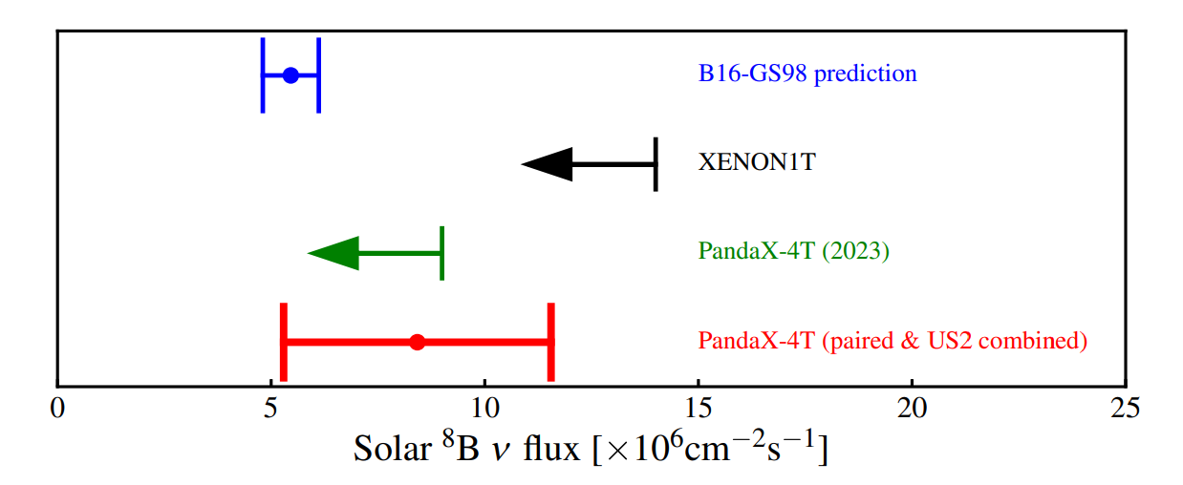
B8 neutrino CEvNS
Greatly benefit from S2-only data (~ton×year)
Best-fit B8 events: 75±28 (S2 only) and 3.5±1.3 (S1-S2 paired)
Reject background-only hypothesis with significance of 2.64σ
PRL 133, 191001 (2024), Editors’ Suggestion
XENONnT result in the same issue of PRL (191002), similar significance
Physics Magazine highlights of the year 2024
13

Slide 14
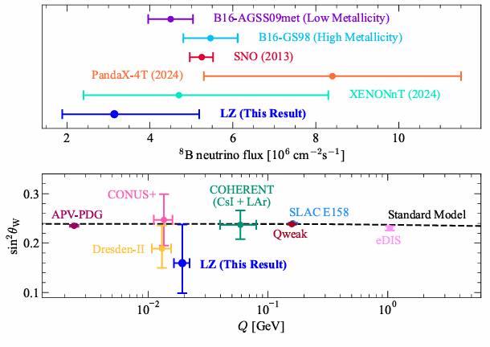
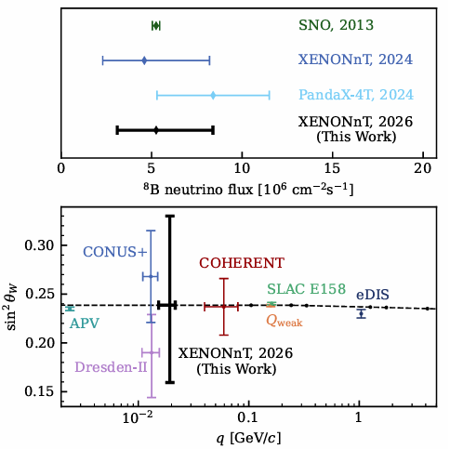
LZ/XENON latest results
LZ: 2512.08065
XENON: 2604.06002
A platform to study neutrino interactions + astrophysical neutrino observatory

Slide 15
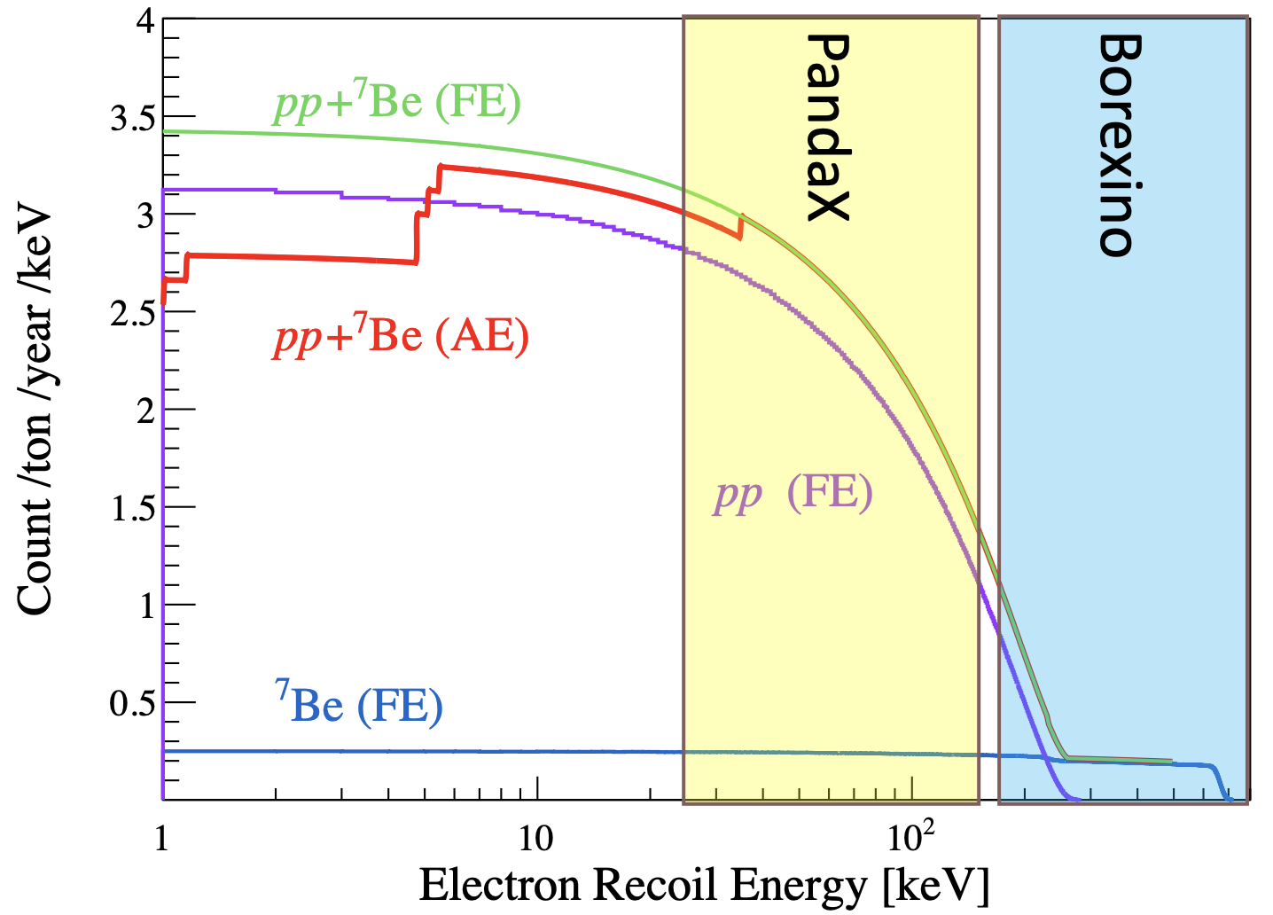
Solar pp neutrino – unique low E window
15

Slide 16
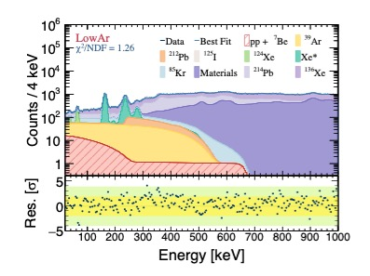
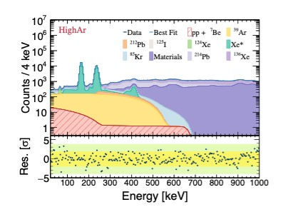
Recent release @ Neutrino 2026
1.9 ton*year data (Run 2)
Blind analysis with multi-step unblinding procedures
16

Slide 17
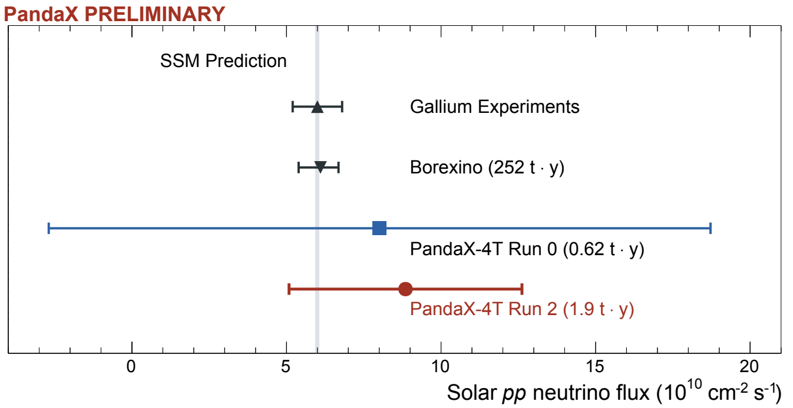
Recent release @ Neutrino 2026
Solar pp neutrino–electron scattering measured at recoil energy < 165 keV
Consistent with Standard Solar Model prediction
PRC 80, 015807 (2009)
Nature 562, 505 (2018)
17

Slide 18
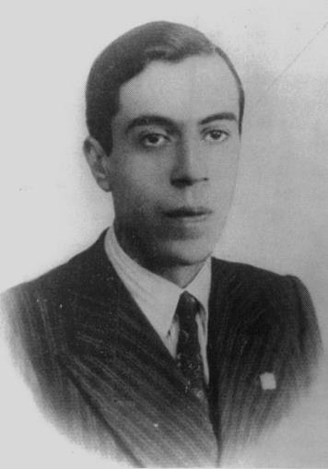
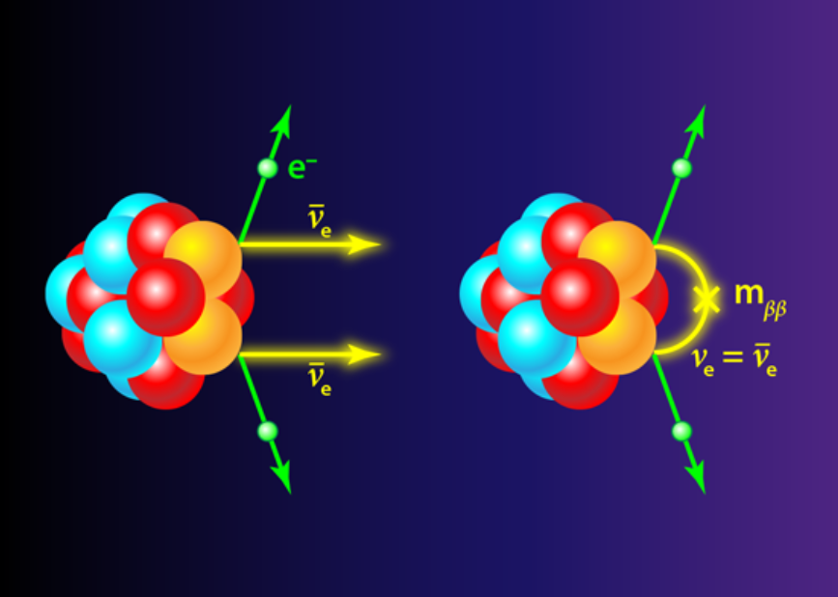
“Bigger fish”: Majorana neutrinos
1937, Majorana
18

Slide 19
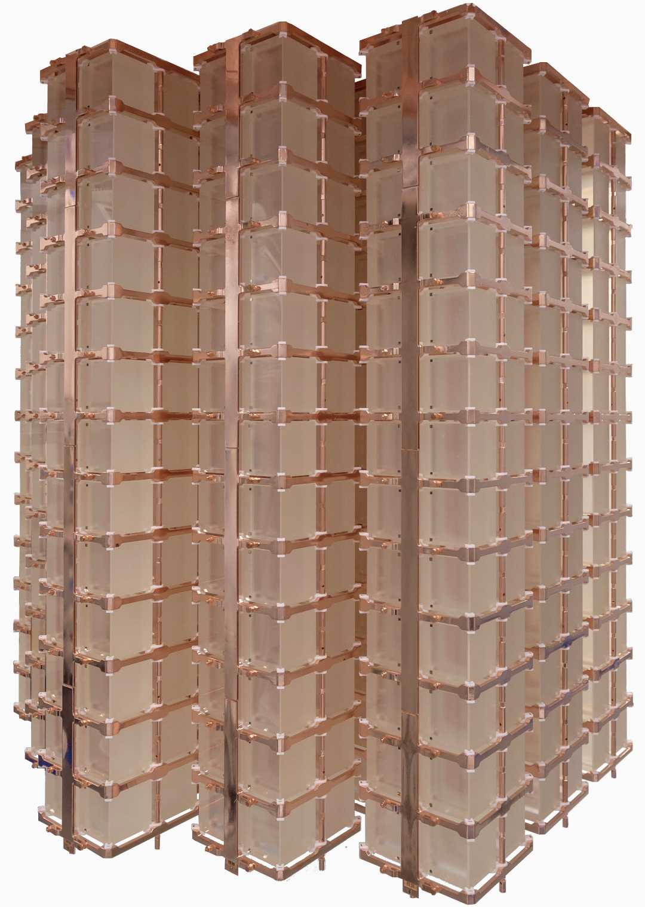


¹³⁰Te/¹⁰⁰Mo
⁷⁶Ge
¹³⁶Xe (8.9% natural abd.)
CUORE
CUPID
LEGEND family
CDEX
KamLAND-ZEN
Doped LS
EXO/nEXO
LXe TPC
19

Slide 20

Feature of Natural Xenon
0.1%
ECEC
DBD
DBD

Slide 21


¹³⁴Xe: a unique blessing
PRL 132, 152502 (2024)
21

Slide 22


Most accurate ¹³⁶Xe 2vbb (rate/spec)!
arXiv:2512.04849
PRL accepted
39.1 kg×year of Xe136, best fit: 54k events!
22

Slide 23

Race of Majorana neutrino mass
???
¹³⁶Xe 0vDBD
>2.1×10²⁴ year (best in nat. xe)
Science Bulletin 70, 1779 (2025)

Slide 24

April 17,2026
Bye-Bye PandaX-4T!
24

Slide 25


Next future
20T
43T

Slide 26



PandaX-20/40T @ CJPL
26

Slide 27

PandaX-20T schedule
2026.6-12 PandaX-20T infrastructure construction
2027.1-2027.6 PandaX-20T installation
2027.7-2027.12 PandaX-20T commissioning
2028.1- Physics operation
27

Slide 28


Scientific potentials of a 43T detector

Slide 29



10 Years from Now？
Isotopic separation according to scientific findings
Artificially Modified Isotopic Abundance
AMIA1
AMIA2
Discovery smoking gun！

Slide 30
Possible points of collaboration (20T)
Background control
  Vessel
  Photosensors boards and cables
  Outgassing (electronegative) ⇒ liquid circulation
  Emanation (radioactive)
Calibration system
Veto system
Analysis/simulation/slow control in the AI era
Collaboration highly welcome!
30

Slide 31
Sino-French Gateway to PandaX-20t and Beyond
Three PandaX institutes already host Sino-French engineering platforms — a practical bridge
for French groups entering the next liquid-xenon phase
Beihang University
Sun Yat-sen University
Shanghai Jiao Tong University
École Centrale de Pékin (ECPK)
Institut Franco-Chinois de l‘Énergie Nucléaire (IFCEN)
SJTU Paris Elite Institute of Technology (SPEIT)
Prof. Lisheng Geng
Prof. Wei Wang
Prof. Shaobo Wang
Dean • PandaX collaborator
Dean • PandaX collaborator
Dupty Dean • PandaX collaborator
French collaborators
Onboarding convenience
PandaX-20t phase and beyond
bilingual interface • mobility links • local hosts
A coordinated Sino-French network can lower the entry barrier and broaden the PandaX physics program in dark matter and rare neutrino event searches.
31
Message for PandaX-xT / PandaX-20t French outreach
Notes:
Sources consulted: PandaX official site; PandaX-xT arXiv design paper; Beihang Sino-French Engineer School news; IFCEN leadership page; SJTU Paris Elite Institute of Technology overview and faculty/news pages. User-supplied context used for PandaX membership and collaboration readiness.

Slide 32
Thank you!

Slide 33


Baseline scientific potential of 20T
FV 13 ton, ROI 1-10 keVee, 99.7% ER rejection
FV 2.4 ton natural, 1% resolution

