Slide 1
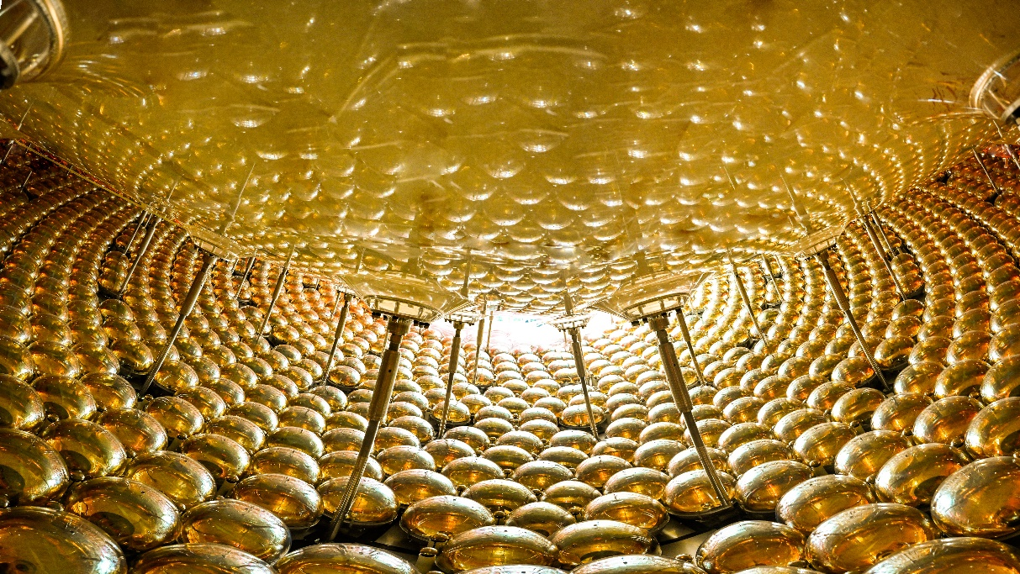
Neutrinos: Portal to New Physics
Yifang Wang
Institute of High Energy, Beijing
Lyon, July 3, 2026

Slide 2
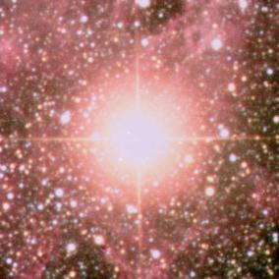
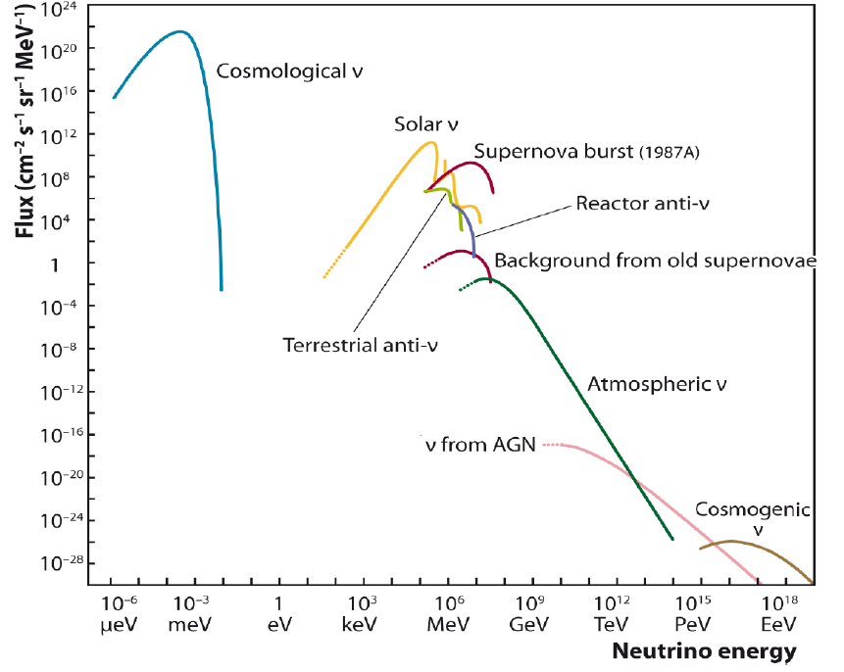
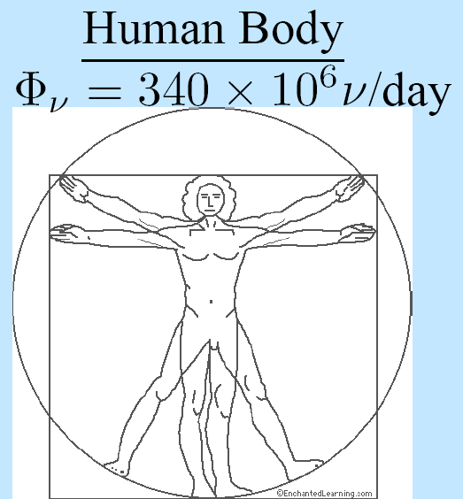
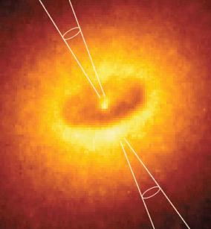
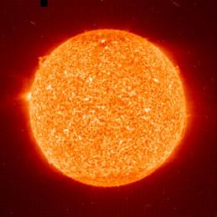
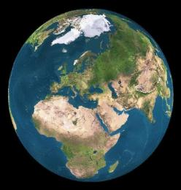
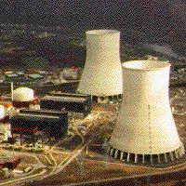
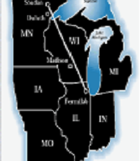
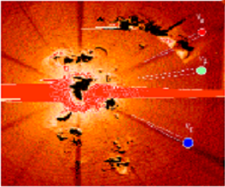
Neutrinos around us
Supernova
人体
arXiv: 1207.4952
Galaxy
accelerator
Big bang
Sun
Earth
reactor

Slide 3
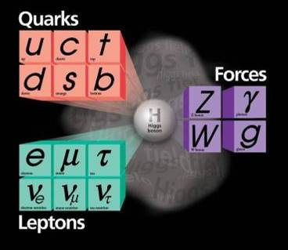
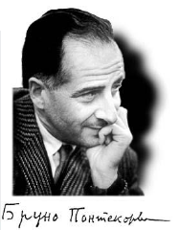

Neutrinos are Interesting and important
Fundamental building blocks of matter
Strange: only left handed – parity violation – Why ?
Extremely abundant ~ 300/cm³: mass is the key issue
The most sensitive probe to the mass: oscillation
  If ν has a mass, it can oscillation from one type to another
中微子
ν_{e}
ν_{μ}
ν_{e}
ν_{μ}
Oscillation probability：
P(ν_{e}−>ν_{μ}) = sin²(2θ) sin²(1.27Δm²L/E)
ν₁
ν₂
ν₃
Amplitude
Frequency
ν₁
ν₂
ν₃
Bruno Pontecorvo

Slide 4
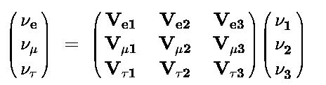
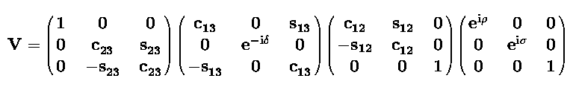
Neutrino Oscillation
Oscillation matrix for 3 generations：
Atmospheric
Reactor
Solar
Majorana phase
Atmospheric
accelerator
reactor
accelerator
solar
reactor
Double beta
decays
Neutrinos do oscillate
Known parameters： θ₂₃，θ₁₂，|ΔΜ²₂₃|， ΔΜ²₁₂，
Recent progress: θ₁₃
Unknown parameters: mass hierarchy(ΔΜ²₂₃), CP phase δ
1998 Atm. ν osc. θ₂₃
2002 Solar ν osc.θ₁₂
2002 reactor ν osc.θ₁₃

Slide 5
Neutrino-related Questions
Experimental questions
Physics implications
Mass ordering (m₃ > m₂ ?)
CP phase ➔ Leptogenesis
Only three generations ? Sterile neutrinos ? Right-handed neutrinos ?
Neutrinoless double beta decays ? Neutrinos are Dirac or Majorara ?
Absolute mass ?
Relic neutrinos, … ?
Model building, fundamental properties
matter-antimatter asymmetry in the Universe
Extension of Standard Model, parity restoration ?
How to modify SM ? New physics beyond SM (0νββ not exclusively from Majorara neutrinos) ?
fundamental properties, Cosmology
Cosmology
Neutrinos provide major paths towards physics beyond SM
Reactor ν is a great tool: from discovery, θ₁₂, θ₁₃ to mass ordering and 0νββ
5

Slide 6
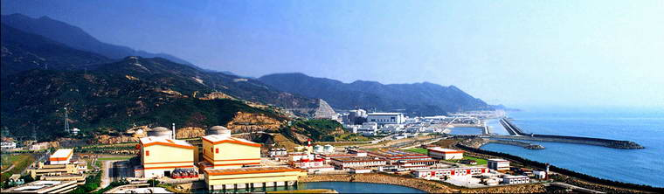


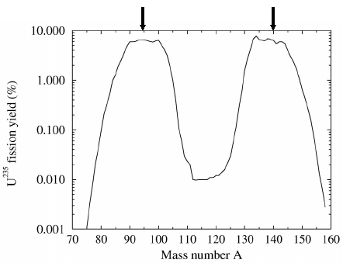
Reactor Neutrinos: Production and Detection
Signal: Inverse beta-decay (IBD) events
τ ≈ 200μs
Neutrinos dominantly from ²³⁵U and ²³⁹Pu
For example:
n + p → d + γ (2.2 MeV)
Prompt (e⁺) and delayed(nH) coincidence in time, space with distinctive energy features
  Proton source: Liquid Scintillator (LS, C_{n}H_{2n+2}) :
  Proton rich material (highest per volume)
  Target and detector at the same time
  High light yield, fast, well understood
  Easy handling for very large volume
  Cheap, only second to water
Each fission generates ~6 neutrinos ➔ 6 ×10²⁰ /s/reactor with 3 GW_{th} power

Slide 7
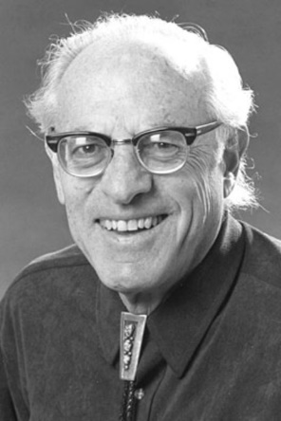
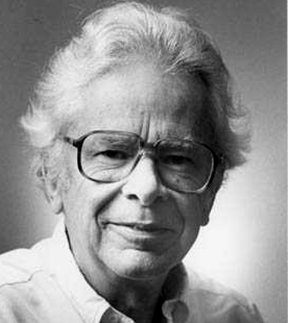
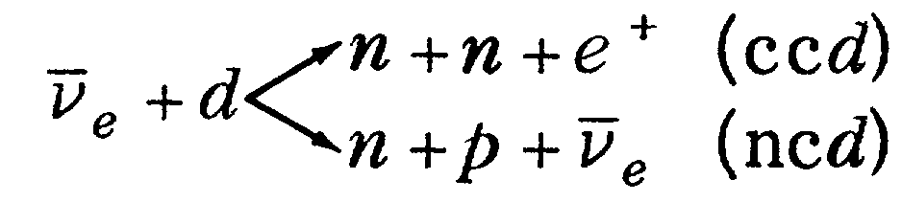
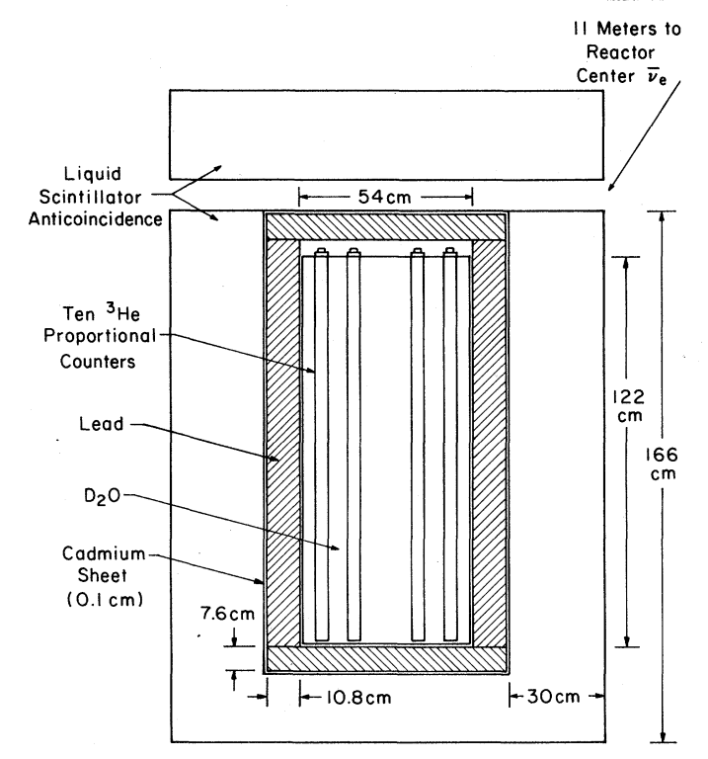
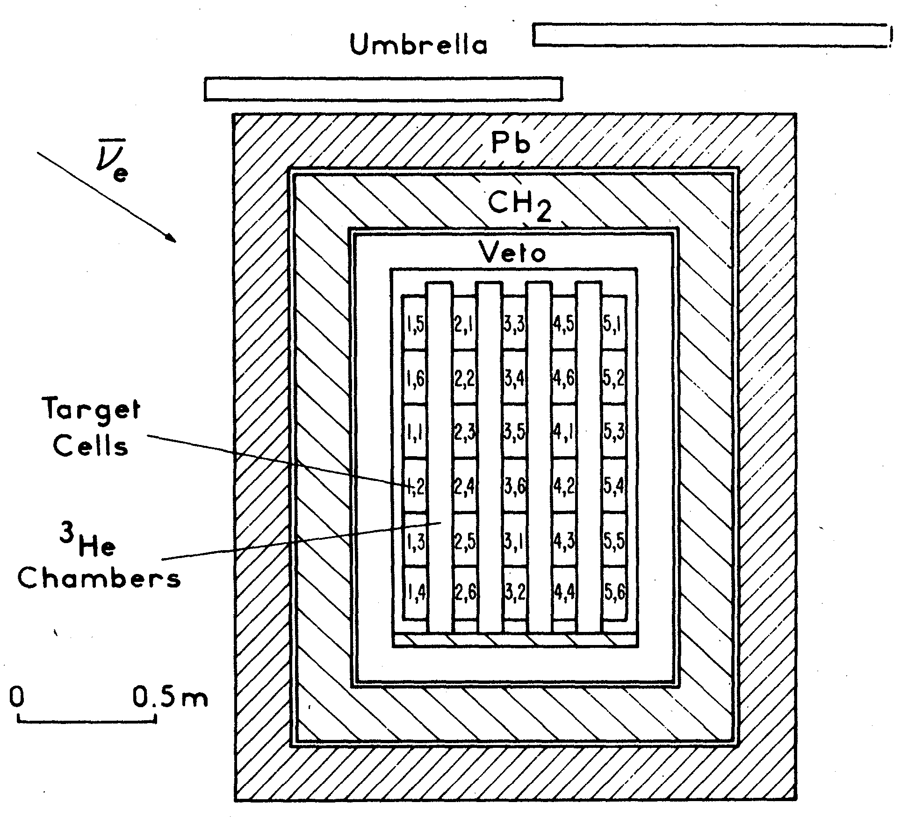
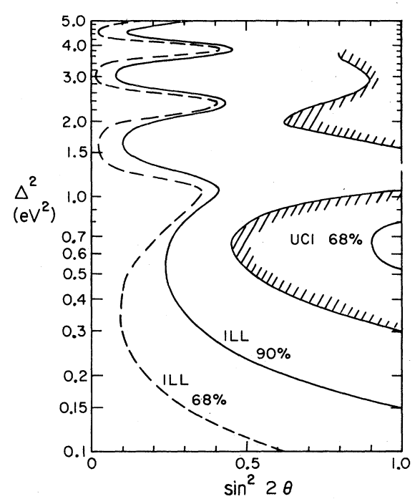
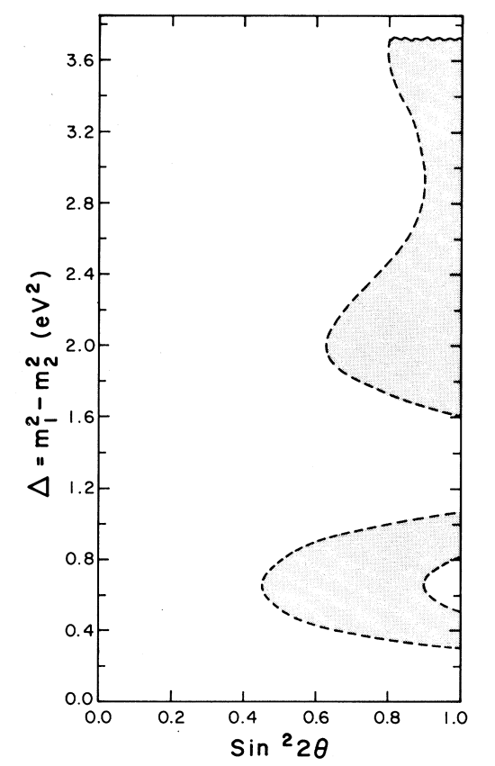
Beginning of Reactor Neutrino Oscillation exp.
Savannah River experiment: “Observation of neutrino oscillation”
ILL experiment 100 km from here
Techniques used up to now
Results: Now oscillation
  N_{exp}/N_{theo}.= 0.89±0.04(stat.)±0.14(syst.)
First reactor spectrum calculation:
P. Vogel, PRC 19(1979)2259
R ≡ r^{exp}_{ccd/ncd}/ r^{theo}_{ccd/ncd}
= 0.40 ± 0.22
F. Boehm: disproved false oscillation claims twice
Later: Palo Verde
F. Reines: Noble prize laureate 1995
F. Boehm et al., PLB97(1980)310
H.Kwon et al., PRD24(1981)1097
F. Reines et al., PRL 45(1980) 1307

Slide 8
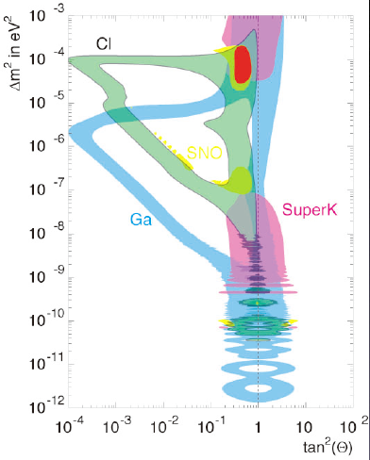
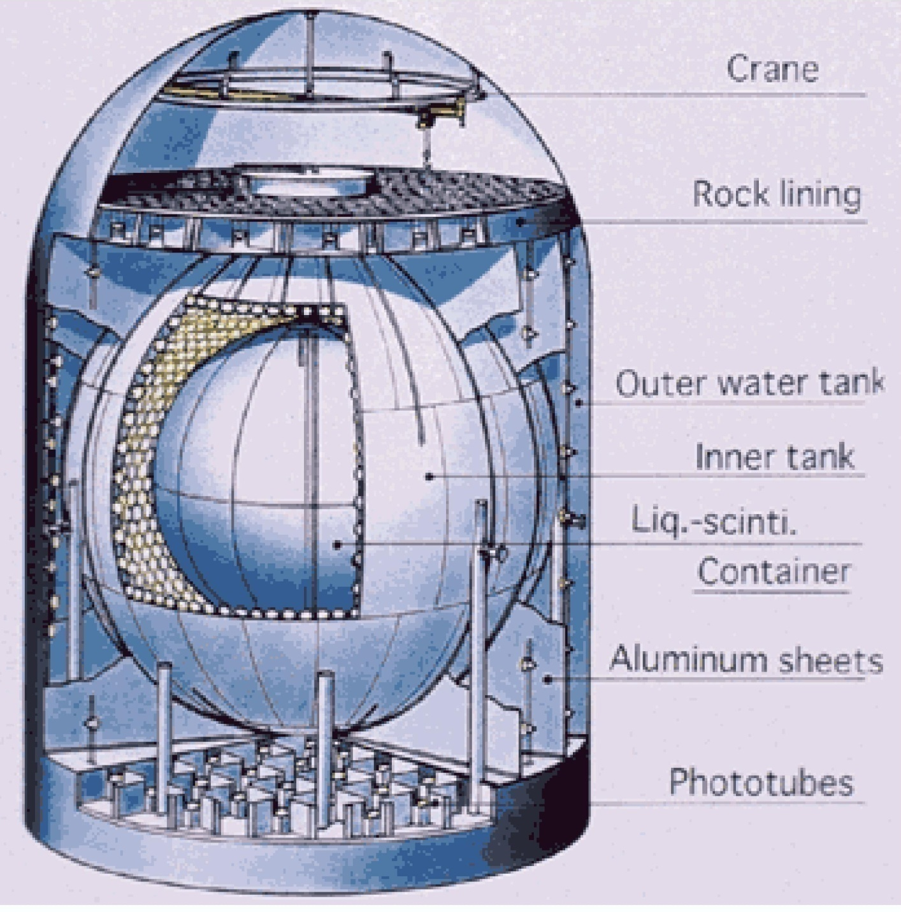
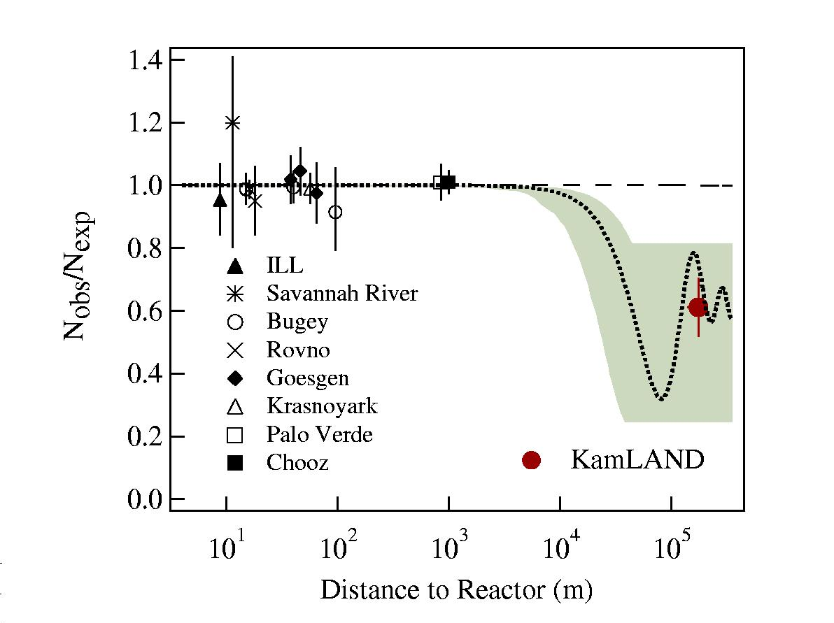
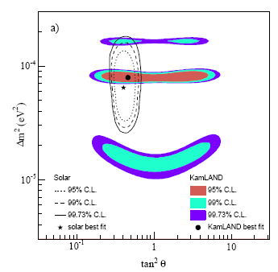
A Great Success: KamLAND
KamLAND once was considered as the ultimate reactor neutrino experiment with 1000 t LS
It measured all reactors in Japan with an average baseline of 180 km
It observed neutrino oscillation and determined θ₁₂ for the first time, luckily and surprisingly

Slide 9
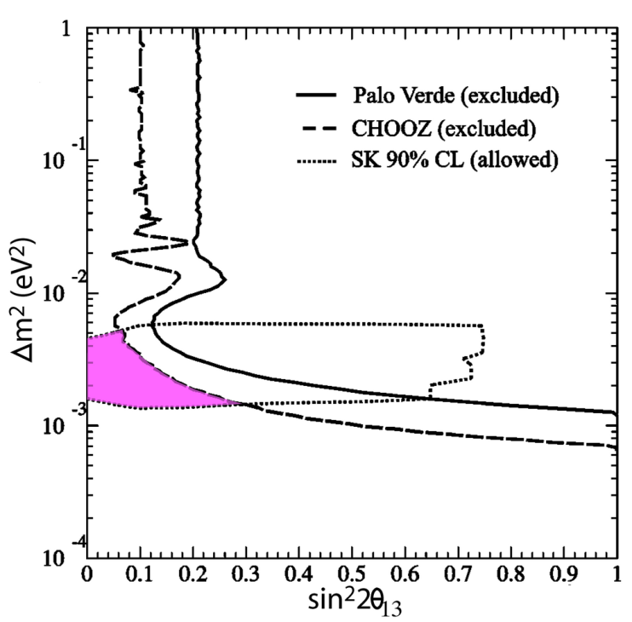
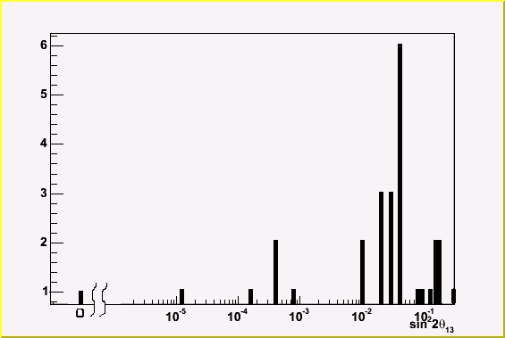
After KamLAND
Solar ν Oscillation
sin²2θ₁₂ ~ 0.9
ν₁
ν₂
ν₃
θ₁₃ ?
Atm. ν Oscillation
Sin²2θ₂₃ ~ 1
Allowed region
Sin²2θ₁₃ prediction
  A fundamental parameter of the SM
  Direction of future neutrino physics:
    Key for the CPV determination
9
9

Slide 10
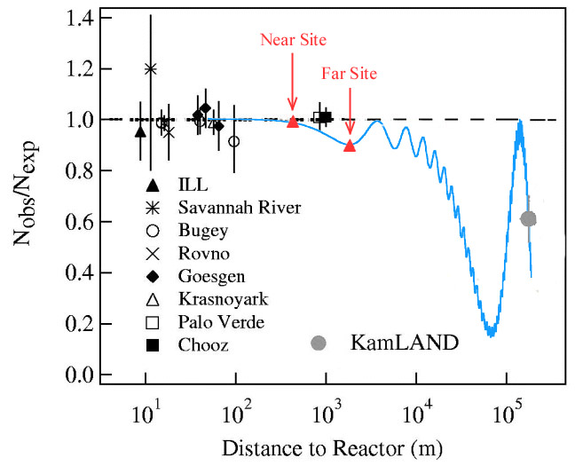
Measuring θ₁₃ at Reactors
At reactors
P_{e➔e} ≈ 1 − sin²2θ₁₃sin² (1.27Δm²₁₃L/E) − cos⁴θ₁₃sin²2θ₁₂sin² (1.27Δm²₁₂L/E)
At accelerators
P_{μ⎝e} ≈ sin²θ₂₃sin²2θ₁₃sin²(1.27Δm²₂₃L/E) +cos²θ₂₃sin²2θ₁₂sin²(1.27Δm²₁₂L/E)
− A(ρ)•cos²θ₁₃sinθ₁₃•sin(δ)
Independent from CP d and matter effect
Relatively cheap and quick
Precision of past experiments (3-6%):
Reactor power: ~ 1%
Spectrum: ~ 0.3%
Fission rate: 2%
Backgrounds: ~1-3%
Target mass: ~1-2%
Efficiency: ~ 2-3%
Our design goal：Δ(N_{obs}/N_{exp}) ~ 0.4% ➔ ÷10 improvement !

Slide 11
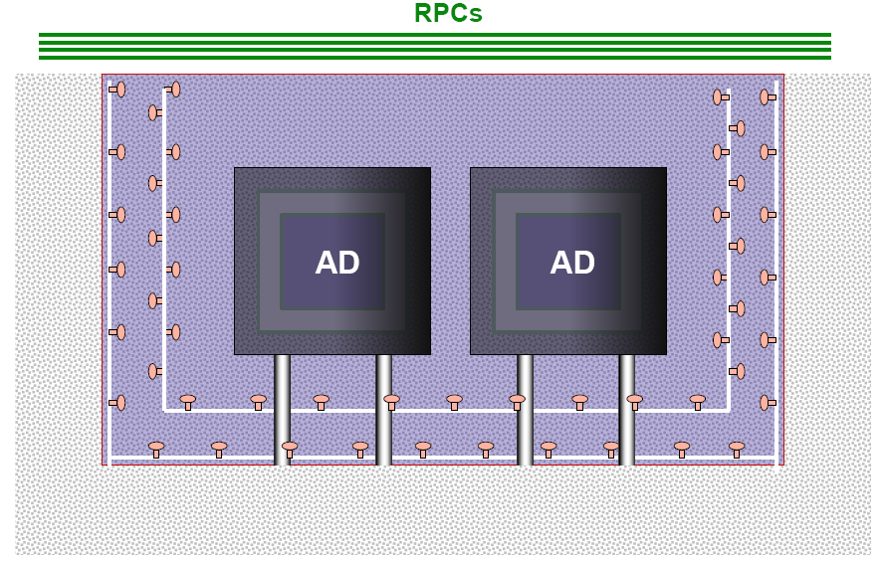
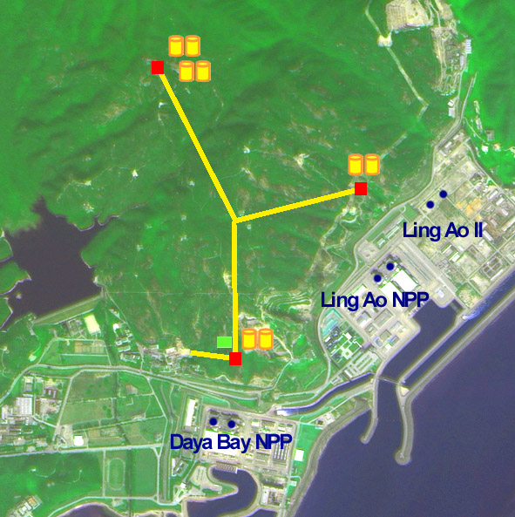
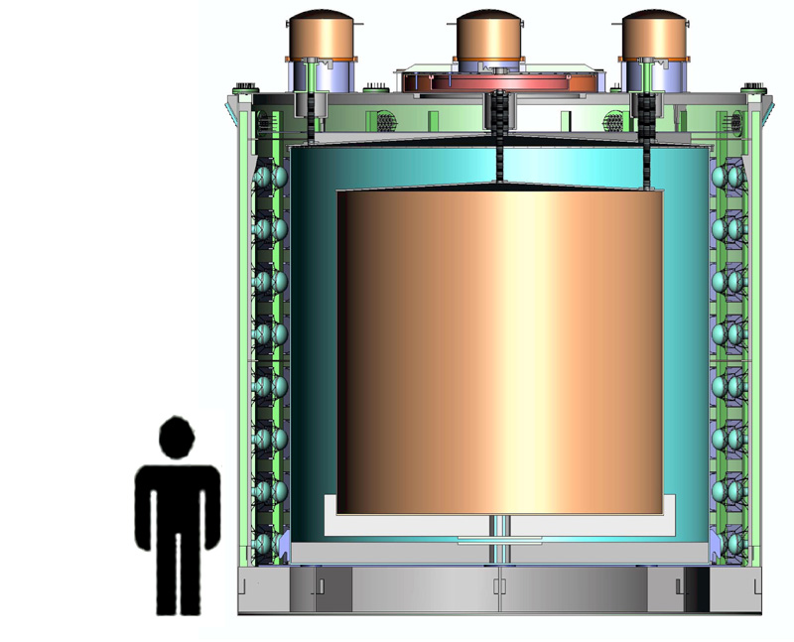
Daya Bay Experiment: Idea
Redundancy !!!
Relative measurement to cancel Corr. Syst. Err.
  2 near sites, 1 far site
Multiple AD modules at each site to reduce Uncorr. Syst. Err.
  Far: 4 modules，near: 2 modules
Multiple muon detectors to reduce veto ineff. ➔ goal 0.5%
  Water Cherenkov： 2 layers
  RPC： 4 layers at the top + telescopes
  Cross check; Reduce errors by 1/√N

Slide 12
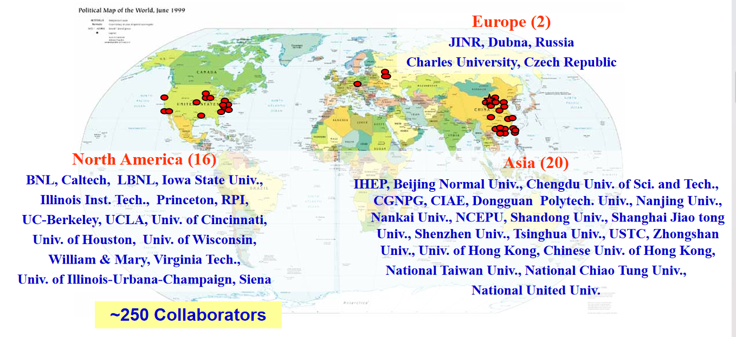
Daya Bay Collaboration

Slide 13
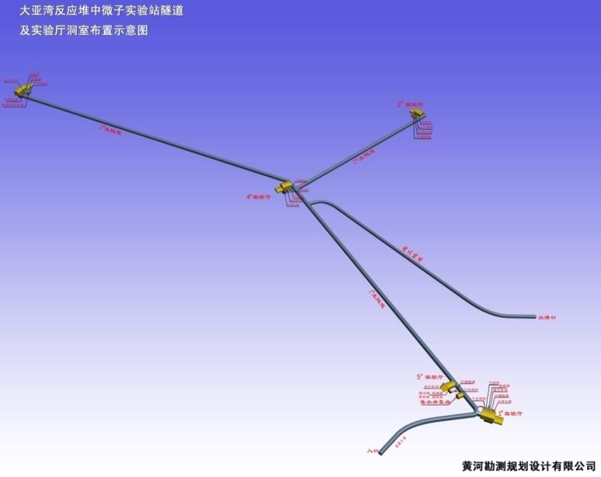
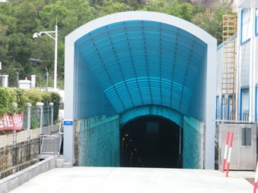
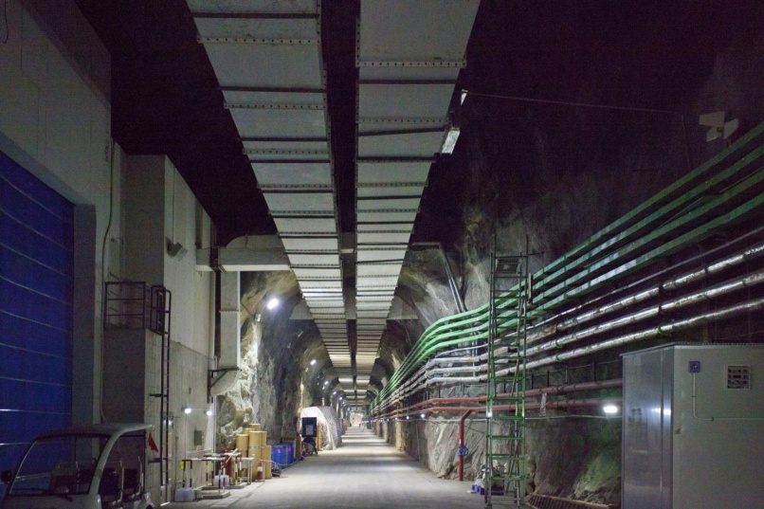
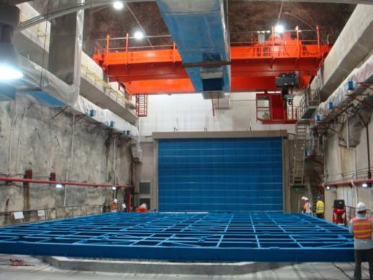
Tunnel and Underground Lab
Tunnel: ~ 3100m
3 Exp. hall
1 hall for LS
1 hall for water
A total of ~ 3000 blasting right next reactors. No one exceeds safety limit set by National Nuclear Safety Agency（0.007g）
13

Slide 14
Anti-neutrino Detector (AD)
Three zones modular structure:
  I. target: Gd-loaded scintillator
  II. γ-catcher: normal scintillator
  III. buffer shielding: oil
192 8” PMTs/module
Two optical reflectors at the top and the bottom, Photocathode coverage increased from 5.6% to 12%
Total weight: 110t
 | PMT | Coverage | pe yield | MO | Acc. Bkg. | ΔB/B
Daya Bay | 192 8" | ~6% | 163 pe/MeV | 50 cm | 1.4%/4.0% | 1.0%/1.4%
RENO | 354 10" | ~15% | 230 pe/MeV | 70 cm | 0.56%/0.93% | 1.4%/4/4%
Double Chooz | 390 10" | ~16% | 200 pe/MeV | 105 cm | 0.6% | 0.8%

Slide 15
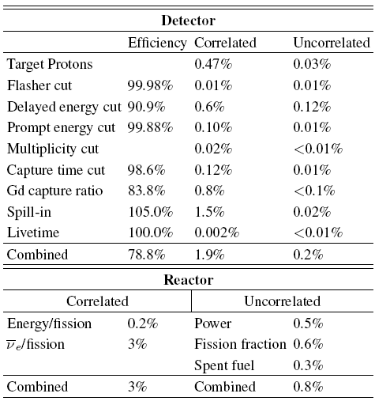
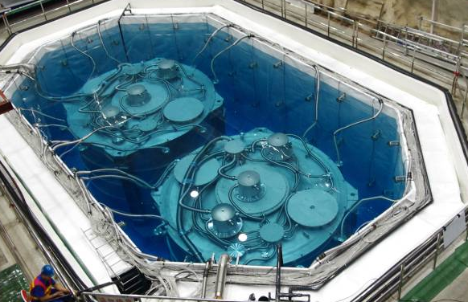
Precise Neutrino Experiment
Side-by-side Comparison
Expectation:
R(AD1/AD2) = 0.982
Measurement:
0.987 ± 0.004(stat) ± 0.003(syst)
Design：(0.18 - 0.38) %
Now：0.13%

Slide 16
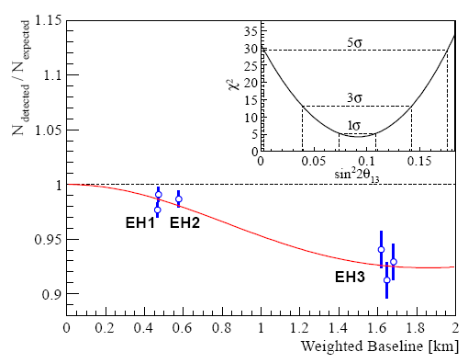
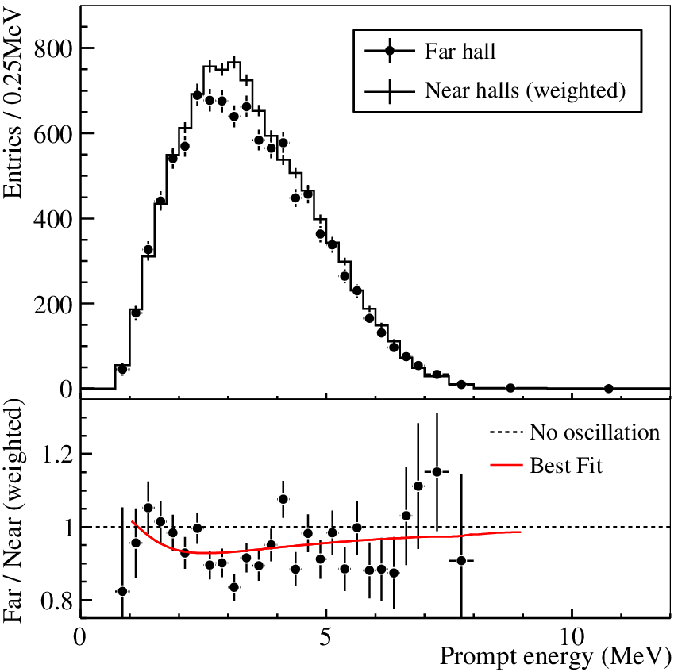
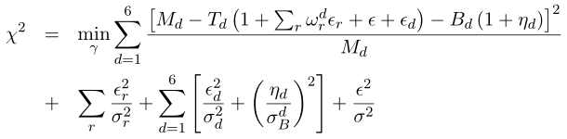
A New Type of Neutrino Oscillation
On Mar. 8, 2012, Electron anti-neutrino disappearance announced:
R = 0.940 ±0.011 (stat) ±0.004 (syst)
Sin²2θ₁₃ = 0.092 ± 0.016(stat) ± 0.005(syst)
χ²/NDF = 4.26/4, 5.2 σ for non-zero θ₁₃
F.P. An et al., Phys. Rev. Lett. 108, (2012) 171803; citation > 3000

Slide 17
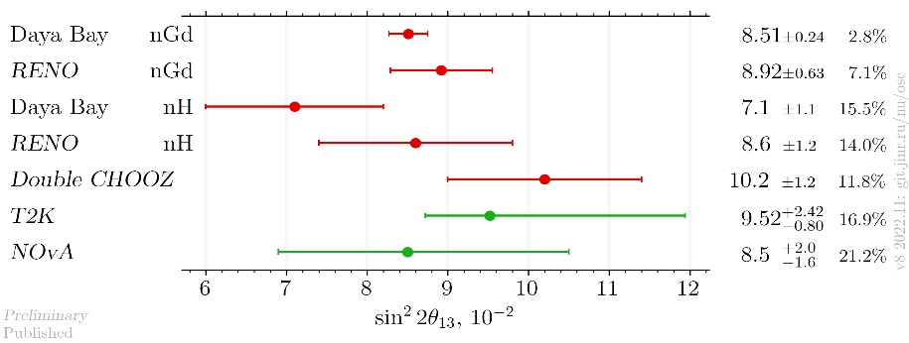
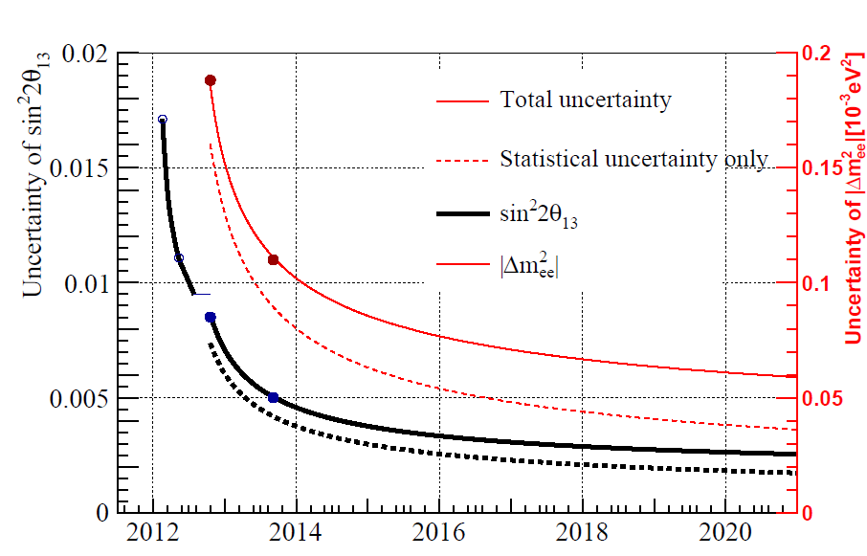
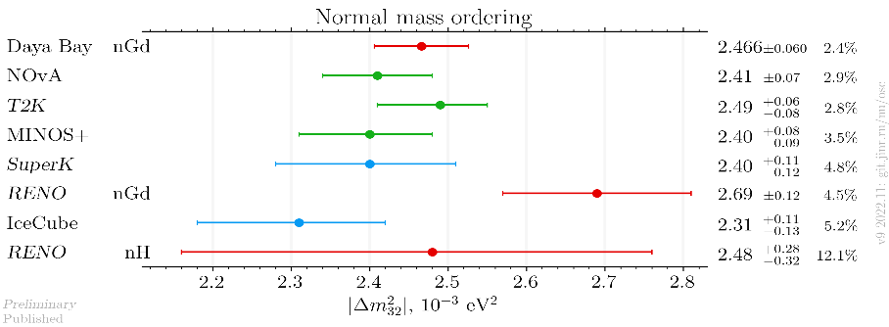
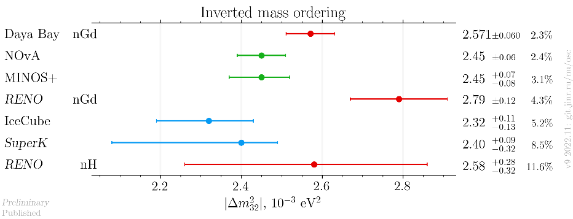
Results from all Experiments
sin²2θ₁₃
18.5%@2012
Δm²₃₂ (NO)
3.9%@2016
2.8%@2022
Δm²₃₂ (IO)
All three reactor experiments ceased operation
Final result from Daya Bay may reach 2.5%
17
Compiled by Maxim Gonchar at git.jinr.ru/nu/osc

Slide 18

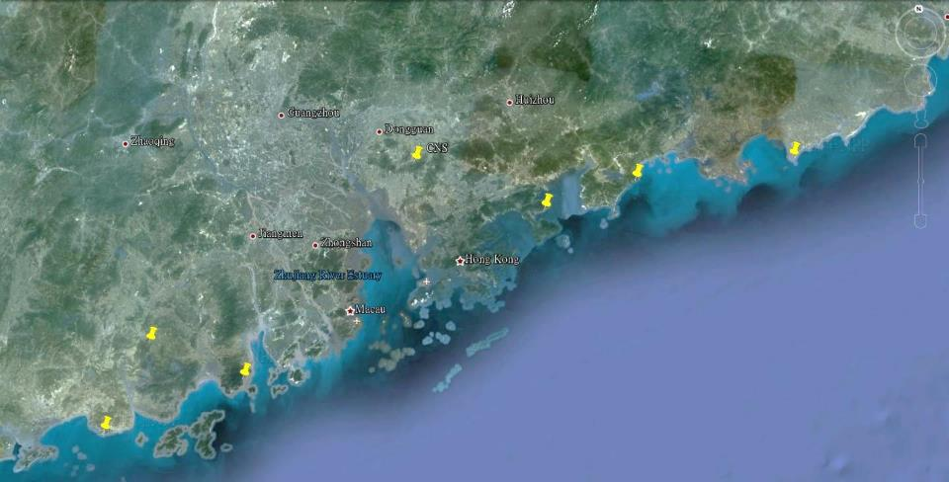


Next Step: JUNO Experiment
Continue to use reactor neutrinos and liquid scintillator
To determine the mass ordering (sign of Δm²₃₂) independent of the CP phase δ
Equal baseline to two reactor power plants: doubling the neutrino flux
Daya Bay
JUNO
Previous site candidate
Guang Zhou
2.5 h drive
Lufeng
NPP
Shen Zhen
Huizhou
NPP
Daya Bay NPP
Zhu Hai
Hong Kong
53 km
Macau
53 km
Taishan NPP 9.2 + 9.2 GW
Talk by Y.F. Wang at ICFA seminar 2008, Neutel 2011;
Paper by L. Zhan, Y.F. Wang, J. Cao, L.J. Wen, PRD78:111103,2008; PRD79:073007,2009
Yangjiang NPP 17.4 GW

Slide 19
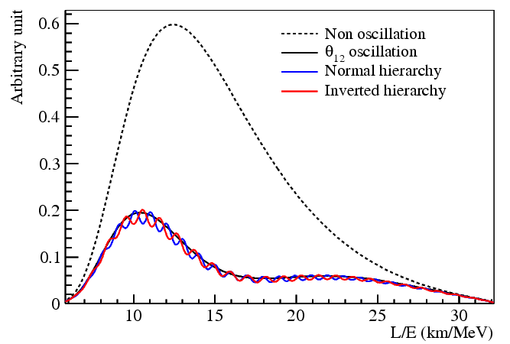
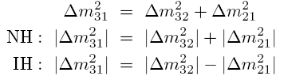


Mass Ordering by Reactor Neutrinos
Δm²₂₁
|Δm²₃₁|
~ 3%
Key parameters:
  Detector size: 20 kt
  Energy resolution: 3%/√E
  Thermal power: 36 GW
  Baseline: ~58 km
L. Zhan et.al, PRD79:073007, 2009
Equal distance:
ΔL < 200m !
θ₁₂ osc. maximum
S. Petcov and Piai, Phys. Lett. B 553, 94-106(2002)
J. Learned et al., PRD 78(2008)071302
L. Zhan et al., PRD 78(2008)111103
Y.F Li et al, PRD 88, 013008 (2013)

Slide 20







Physics at JUNO
Supernova Neutrinos
Cosmic evolution, star formation, supernova explosion mechanism
Diffuse Supernova Neutrinos:
Potential to discover
Atmospheric Neutrinos
Complementary to reactor neutrinos to improv the sensitivity to mass ordering
Solar Neutrinos
Examine the dynamics of stellar evolution
Reactor Neutrinos
Determine neutrino mass ordering
Measure oscillation parameters
700 m
Geoneutrinos
Examine the Earth's geophysical model
New physics searches
e.g., proton decay and sterile neutrinos
J. Phys. G 43 (2016) 030401
Prog. Part. Nucl. Phys. 123(2022), 103927

Slide 21



JUNO Project and the collaboration
Project firstly approved in China in 2013 and later in other countries. Civil construction started in 2015
Collaboration established in 2014, now >700 collaborators from 70 institutions in 16 countries/regions
Country | Institute | Country | Institute | Country | Institute
Armenia | YerPhI | China | SDU | Italy | INFN-CT
Belgium | ULB | China | SJTU | Italy | INFN-FE
Chile | SAPHIR | China | SUSTech | Italy | INFN-LNF
Chile | UNAB | China | SYSU | Italy | INFN-MI
China | BISEE | China | THU | Italy | INFN-MIB
China | CDUT | China | UCAS | Italy | INFN-PD
China | CNPRI | China | WHU | Italy | INFN-PG
China | CUGB | China | WuYiU | Italy | INFN-Roma3
China | DGUT | China | XJTU | Pakistan | PINSTECH (PAEC)
China | ECUT | China | XMU | Russia | JINR
China | GXU | China | ZZU | Slovakia | FMFI-UK
China | HIT | Czech | Charles U. | Taiwan-China | NCTU
China | HunanU | Finland | JyU | Taiwan-China | NKNU
China | IGGCAS | France | CPPM | Taiwan-China | NTU
China | IHEG-CAGS | France | IJCLab | Taiwan-China | NTUT
China | IHEP | France | IPHC | Thailand | CHULA
China | IMP | France | LP2iB | Thailand | NARIT
China | JNU | France | Subatech | Thailand | SUT
China | JXNU | Germany | EKUT | U.K. | U. Liverpool
China | KNRC | Germany | GSI | U.K. | U. Warwick
China | Nankai U. | Germany | U. Hamburg | USA | UC-Irvine
China | NCEPU | Germany | JGUMainz | USA | UMD-G
China | NJU | Germany | RWTH-AC
China | RNCG | Germany | TUM
+Observers: USTC, Peking Uni., Jilin Uni., Beijing Normal Uni., CIAE (China), PUC, UEL (Brazil)

Slide 22





~ 600m vertical shaft, ~1300m sloped tunnel

Slide 23




Detector Concept
Target mass of 20 kt liquid scintillator ➔ × 20 KamLAND, × 40 Borexino
Energy resolution < 3%@ 1MeV ➔ >1200 PE/MeV
 | KamLAND | JUNO | PE Ratio
Photon Statistics | 250 p.e./MeV | 1200 p.e./MeV | 5
PMT coverage | 34% | 75% | 2.2
LS transparency | ~12 m | > 20 m | ~0.9
Light yield(anthracene) | 30% | 45% | ~1.5
Detection Eff.(QE×CE) | ~15% | 30% | ~ 2
Steel frame+ Acrylic tank
Steel tank+ Acrylic tank
Key technologies needed:
  Transparent & high light yield liquid scintillator
  High detection efficiency 20” PMTs
  Radiopurity U/Th/K < 10⁻¹⁷ g/g for 20 kt LS
Detector Design(more than 10 options)：
  Central target container: acrylic or balloon ?
  Mechanical structure: steel frame or steel tank ?
  Buffer layer: Water or Mineral oil ?
Steel Tank + Balloon
Steel Tank + Acrylic blocks

Slide 24

Concept of JUNO for Mass Ordering
Two-layer structure for simplicity and cost: stainless steel frame + Acrylic tank
Water as VETO and Buffer ➔ radiopurity control of water
Calibration house
VETO system
Top Tracker
Water VETO with 2400 20’’ PMT + 348 20” spare PMTs + 600 8” PMTs from Daya Bay
Earth Magnetic Field shielding coils
Central detector
Steel structure (SSS)
Acrylic sphere(AS) + 20kt Liquid scintillator
17612 20” PMT
25600 3’’ PMT
AS: ID35.4m
SSS: ID40.1m
44m
43.5m

Slide 25

Central Detector
SS structure to hold the acrylic tank and PMTs, through steel bars with springs and rotating heads
Stress sensors on steel bars
Clearance between PMTs is ~3 mm, to maximize coverage
263 Acrylic panels thermally pressed and machined to the spherical shape, bonded together in-situ through PMMA polymerization
  Stress on acrylic < 3.5 MPa
  Difference of thermal expansion requires ±5 ºC since construction
Eur.Phys.J.Plus 139 (2024) 12, 1128, arXiv: 2311.17314

Slide 26

Steel Structure and the Installation Platform

Slide 27

Working for Acrylic on the Platform

Slide 28


Check the Surface Quality of the Acrylic

Slide 29




VETO
Water VETO:
  40 kt pure water for backgrounds shielding & tagging
  PMTs on the SS trust and on the pool wall
  5mm HDPE+Tyvek as Pool lining for cleanness & reflection
  100t/h pure water production plant with Rn & Ra removal system
Top tracker: refurbished OPERA plastic scintillators
Earth magnetic field compensation: 10% residual
Bottom CD and VETO
Top tracker

Slide 30






PMTs and Electronics
 | LPMT (20-inch) |  | SPMT (3-inch)
 | Hamamatsu | NNVT | HZC
Quantity | 5000 | 15012 | 25600
Charge Collection | Dynode | MCP | Dynode
Photon Efficiency | 28.5% | 30.1% | 25%
Dynamic range | [0, 100] PEs |  | [0, 2] PEs
Coverage | 75% |  | 3%
Reference | Eur.Phys.J.C 82 (2022) 12, 1168 |  | NIM.A 1005 (2021) 165347
Acrylic cover
Stainless Steel cover
Potted PMT
LPMT & sPMT
LPMT Underwater box
sPMT Underwater box

Slide 31



PMT Installation

Slide 32



Installation Completed

Slide 33

JUNO-Tao
To measure the reactor neutrino spectrum as a reference
  Mitigate possible fine structure and spectrum uncertainty issues
  Improve nuclear database, search for sterile neutrinos
Idea: Gd-loaded LS @-50ºC + SiPM
  700k/year@44m from the core(4.6 GW ), with ~10% bkg.
  Energy resolution: 4500 p.e./MeV ➔ ~2%@1 MeV
  10 m² SiPM (>94% coverage) w/ PDE > 50%
  Operating at -50 ºC to reduce the SiPM dark rate by 10³ to 50 Hz/mm²
  2.8 ton(1t fiducial volume) new type of Gd-LS for -50 ºC

Slide 34







Liquid Scintillator
For optimal transparency and light yield:
  Recipe: LAB + 2.5g/L PPO + 3 mg/L bis-MSB + 50mg/kg BHT
  Goal: LAB attenuation length > 24m, LS attenuation length > 20m, U/Th ~ 10⁻¹⁷ g/g
  Production: Four purification plants + LS Mixing + QA/QC + high purity N₂ and water
5000 m³ LAB storage tank
1) Al₂O₃ for optical transparency
2) Distillation for radiopurity
Mixing LAB with PPO and bis-MSB
1800 m SS pipes to underground
OSIRIS to monitor Rn and other backgrounds
4) Gas stripping to remove Rn and O₂
3) Water extraction to remove radioactive impurities

Slide 35


Background Control before the Liquid Filling
  U/Th/⁴⁰K in raw materials:
    Steel <1 ppb, raw LAB <1 ppq, PPO <0.1 ppt, Bis-MSB <3 ppt, BHT <0.2 ppt, acrylic <1ppt, water <0.1-1.0 ppq
  Water:
    Resistivity~18 MΩ*cm, U/Th < 10⁻¹⁵ g/g, Rn < 10mBq/m³
Water soluble paper film on acrylic to stop Rn decay daughters
  Surface protection and cleaning, clean room and air dust removal, …
  Air tight by leak check:
    < 1 mBq/m³ ²²²Rn in fresh LS
  Surface cleanness:
    Pure water wash to remove dust and paper film
    Water filling before LS

Slide 36




Water and LS Filling
Posters 17，324
Water filling for cleaning the CD, testing the mechanical structure, as well as the detector commissioning
Replace water by LS at a rate of 7 t/h, 6 months/volume
Optical transparency and radioactive background control:
    Weighted average LS attenuation length > 20m
    Weekly LAB/LS sampling: U/Th < 1$×$10⁻¹⁶ g/g by ICP-MS
    ²²²Rn in fresh LS by OSIRIS+CD: < 1 mBq/m³
    ¹⁴C ~(4-5)$×$10⁻¹⁷ g/g measured by several methods
by ICP-MS
LS Filling completed on 8/22/2025
LS in the CD: 23231.6 m³
Water in the pool: 41225.1 m³
Weighted average attenuation length = 20.6 m

Slide 37



Important Contributions from In2P3
Cooperation started in 2014
Major contributions on top tracker, 3” PMTs & electronics, background study, software and analysis
Top Tracker: IPHC
3-inch PMT and electronics: LP2i, SUBATECH, IJCLab
Radioactivity background:
LP2i, CPPM

Slide 38
Performance of the Detector

Slide 39




PMTs, Electronics and Trigger
Large PMTs
  17612-16 LPMTs installed for CD, 2400-1 LPMTs installed for VETO
  ~26 dead PMTs + electronics, ~1.2/month
  ~600 flashing PMTs (turned off)
  Gains of MCP (Dynode) PMTs are reduced from 7.4×10⁶ to 4.0×10⁶ (6.5×10⁶ to 5.5×10⁶), efficiencies not affected
Noise of electronics for LPMTs:
    Stable pedestals
    RMS ~2.8 ADC ch. ➔ ~0.055 PE
    PMT threshold: 0.2-0.3 PE
Dark rate continuously decreasing
sPMTs have similar performance
Trigger threshold: ~200 keV
Preliminary
17 kHz
15 kHz
A typical SPE waveform of PMT
  Variations due to HV changes and water temperature
SPE pulse shape and calibration
Noise of Electronics noise

Slide 40

Backgrounds of the Detector
For reactor neutrinos: (r < 17.2m & E > 0.7MeV)
  Clearly see the steel structure: acrylic surface background from dust is limited ➔ washing is effective
  Single event rate: < 6 Hz (design 7.2 Hz)
  Background simulation includes LS, PMTs, steel structure, acrylic and water (including Rn) ➔ Good agreement with data
LS purity:
Fiducial volume | ²³⁸U [10⁻¹⁷ g/g] | ²³²Th [10⁻¹⁷ g/g] | ²¹⁰Po [10⁴ cpd/kt]
 |  |  | Initial | Present (Jun. 1)
r < 16.5 m | 8.22±0.03 ±0.68 | 7.8±0.1 ±0.4 | 4.80±0.02 ±0.14 | 2.25±0.01 ±0.07
r < 15.0 m | 7.79±0.03 ±0.70 | 7.8±0.2 ±0.4 | 4.78±0.02 ±0.14 | 2.28±0.01 ±0.07
Preliminary
E>0.7MeV
First error is statistical and the second systematic.

Slide 41

Muon Events and Track Reconstruction
Muon trigger rate in CD ~5 Hz, in Water Pool ~4 Hz
Muon detection efficiency of CD through-going muons > 99.5%
Two types of track reconstruction methods: traditional and data-driven ML
Reconstructed angular distributions in good agreement with Monte Carlo simulation:
  Extremely important to veto muon tracks to reject cosmogenic ⁸He/⁹Li background
Work in progress
Work in progress
Muon’s flux and energy spectrum, mountain’s profile and density are well understood.

Slide 42


Data Taking
Data taking period for this analysis: 2025.08.30-2026.05.18
Golden data are selected for physics analysis
Water leak to LS
Power outage due to weather is one of the main causes of interruptions

Slide 43




Cracks on the Acrylic Tank
Main structure is safe, stress within expectations
However, a LS leak to water happened on March 21, 2025:
  Abnormal trigger rate observed and confirmed by under water robot
  Leak was stopped within 1 week using epoxy and tape by divers
  Further repair by epoxy and acrylic plate to reduce the stress (pulling open the crack) by 50%
Another leak of water to LS happened on March 19, 2026:
  Experienced divers were called to stop the leak within 2 days
  Further repair in the following two days
  A total of ~1Bq ²²²Rn went into LS, 13 days of data excluded
  No other increase of radioactive backgrounds in LS
epoxy

Slide 44

Calibration
1D (central axis): ¹³⁷Cs, ⁵⁴Mn, ⁴⁰K, ⁶⁸Ge, ⁶⁰Co, Am-C, Am-Be, sensors, laser
2D (cable loop): Am-C, ⁶⁸Ge, ¹³⁷Cs
3D using cosmogenic backgrounds:
  Bi-Po214 from Rn decays, spallation neutrons, other cosmogenic isotopes
Positions at which source calibration performed
No ²²²Rn leakage or other contaminations introduced during calibration

Slide 45



Reconstruction and Energy Correction
Vertex and energy are determined by maximum likelihood taking into account PMT response, geometry, optical properties, verified by calib. sources
Other reconstruction methods give similar results
Time dependent variations corrected by Po214 in the whole volume, check by n-H from IBD
Residual r-θ-t dependence (~1%) further corrected by ²¹⁴Po in the whole volume
Energy scale anchored at nH from ⁹Li+IBD
Final performance checked by IBD nH in r < 17.2m
  Residual spatial non-uniformity RMS ~0.2%
  Residual time dependent variation RMS ~0.3%
Preliminary
RMS = 0.05%
Preliminary
RMS = 0.3%

Slide 46




Energy Non-linearity
Preliminary
Non-linearities of LS and electronics are determined by calibration sources at the center: ⁶⁸Ge, ¹³⁷Cs, ⁵⁴Mn, ⁴⁰K, ⁶⁰Co, Am-C, and Am-Be
The non-linearity model for e⁺ is based on Geant4 and γ-sources
The model is constrained by cosmogenic isotopes, ¹¹C(e⁺), ¹⁰C(e⁺), ¹²B(e⁻), ⁸Li (e⁻), ⁸B(e⁺), ⁶He(e⁻), etc. in the whole volume
Using sPMTs to correct and constrain LPMT instrumental non-linearity
Uncertainty < 1%
γ @Detector center
Cosmogenic ¹²B
Cosmogenic ¹¹C
Cosmogenic ¹⁰C
46

Slide 47



Light Yield and Energy Resolution
Light yield at the detector center is ~1600 PE/MeV for ⁶⁸Ge and ~1785 PE/MeV for neutrons, in good agreement with MC
Energy resolution for ⁶⁸Ge is ~3.5% @ 2× 0.511 MeV at the center, slightly worse than the expected 3.1%
  Better MC for Č process, optical boundaries, δ electrons, …
  Possible improvements: ML to remove ¹⁴C, more calibration, better reconstruction and fitting methods, …
Energy resolution for alpha from ²¹⁴Po is ~2.9% @0.93MeV
⁶⁸Ge
Light yield of ⁶⁸Ge
Energy resolution vs r³
Preliminary
Preliminary

Slide 48


Energy Resolution Model
Energy resolution is particle type, energy and space dependent
An analytical R-dependent resolution model for e⁺ was built using Geant4 simulation and data from calibration sources (α, γ)
An energy response matrix was then used for e⁺ spectrum fitting after adding ¹⁴C pile-up to 5% events
Preliminary
Preliminary

Slide 49


Today New Results using 207 days of data
First results using 59 days of data recently published

Slide 50

Reactor Neutrino Selection
Prompt and delayed coincidence in time, space with energy features
energy
Similar to our “Nature” paper
time
What is new in this analysis:
  ~10% more fiducial volume (R=16.5m➔17.2m)
  a factor of 50 reduction of accidental bkg. using likelihood cut
  ~60% reduction of ⁹Li bkg.
  model independent estimate of the ²¹⁴Bi bkg.
space

Slide 51

Reactor Neutrino Event Rate versus Time
Measured reactor neutrino event rate consistent with expectation
Total live time is 207.2 days
χ²/n.d.f. = 40.1/37

Slide 52


Measured Reactor Neutrino Spectrum
Fitting constrained by the near detector spectra from TAO and Daya Bay (PRL 130 16, 161802)
Consistent results from three independent analyses

Slide 53



New Results of Solar Oscillation Parameters
Even though the statistical uncertainty is dominant, systematic errors become important:
  ²¹⁴Bi bkg. and detection eff. can be improved
Δm²₂₁ | 7.388±0.078 (1.60% →1.06%)
sin²θ₁₂ | 0.3036±0.0064 (2.8%→2.1%)

Slide 54


First Result of Δm²₃₁
Due to statistical fluctuations, JUNO only profiles of Δm²₃₁ have multiple minima
The final minimum for each mass ordering is obtained by using the Δm²₃₁ constraint from the Daya Bay result (PRL 130 16, 161802)
Feldman-Cousins (FC) method is used to determine the 1σ range of Δm²₃₁：~1% precision achieved
[-1.05%，+1.00%]
[-1.00%，+1.08%]

Slide 55

Adding Constraint from NuFit-LBL
Δm²₃₁ from reactor and accelerator neutrinos should align at the right mass ordering[1]
Adopt the NuFit-LBL results from [2]: normal mass ordering is favored at Δχ² = 4.86
[1] H. Nunokawa, S. Parke and R.Z. Funchal, Phys. Rev. D 72 (2005) 013009; Y. F. Li et al., Phys. Rev. D 88, 013008 (2013)
[2] NuFIT 6.0 (JHEP 12 (2024) 216 [arXiv:2410.05380]), www.nu-fit.org and M. Maltoni private communication

Slide 56


Neutrino Mass Ordering Significance
Frequentist approach using pseudo exp. to convert Δχ² to significance
Influence of δ_{CP} considered (scanned)
Normal Ordering is favored at 2.3σ
Bayesian approach using Markov Chain Monte Carlo(MCMC) method
Normal Ordering is favored with a Bayes factor of 10.18 ➔ 2ln κ= 4.64
  Consistent with the frequentist Δχ²

Slide 57

Consistent Results from Independent Analyses
Our 3 independent analyses got consistent results (0.2σ)
  different event reconstruction code, fiducial volume, selection cuts, efficiency, background estimation, energy response models and oscillation fitters

Slide 58
Comparison of Results on Oscillation Parameters
sin²2θ₁₂
Δm²₃₁
Δm²₂₁
Results from JUNO have smallest uncertainties

Slide 59


New Results on Geo-neutrinos
Fits are performed without constraint on geo-neutrino flux, but with 3.4±10% U/Th ratio
  Constraining the geo-nu flux doesn’t change oscillation results
Clear geo-nu signals at 1-3 MeV, giving a flux of 73 ± 11 TNU
  Largest geo-neutrino samples so far, and most precise measurement
JUNO result is higher than expectation from existing models, but not statistically significant
Need more JUNO data and more refined geological model predictions
geo-ν

Slide 60


Future of Neutrino Physics
In 5 years from now, Nova+T2K/SuperK +ORCA/Icecube +JUNO will determine the mass hierarchy
In 10 years from now, DUNE+HyperK will determine the CP phase
0νββ decay will be the next breakthrough
J. Cao et al., arXiv:1908.08355
Hints from cosmology: < ~1 eV
Guess from Oscillation: ~1 meV
Katrin will probe to ~ 0.2 eV
0ν ββ decay should target for ~ 1meV
LBNF/DUNE
(m _{ve})^{eff} =[Σ_{i} | U_{ei} |² m² _{vi} ]^{1/2}
⏐M_{ββ}⏐ = | Σ_{i} (U_{ei} )² m _{vi} |

Slide 61

JUNO-ββ
Once mass ordering is determined (~2030), JUNO will be upgraded for ββ-decays, in addition to existing capabilities
Cosmogenic backgrounds can be removed by a cut of LS volume along the muon track for seconds
 | Isotope | Mass(t) | <m_{ββ}>,meV
SNO+ | ¹³⁰Te | 8 | 19-46
KamLAND2-Zen | ¹³⁶Xe | 1 | ~20
NEXT-HD | ¹³⁶Xe | 1 | 14-40
nEXO | ¹³⁶Xe | 5 | 7-22
Darwin/Panda-nT | ¹³⁶Xe | 3-5 | 7-22
LEGEND-1000/CDEX-1t | ⁷⁶Ge | 1 | 10-40
AMoRE-II | ¹⁰⁰Mo | 0.1 | 12-22
CUPID | ¹⁰⁰Mo | 0.24 | 12-20
CUPID-1T | ¹⁰⁰Mo | 1 | 4-7
JUNO-ββ | ¹³⁶Xe | 50 | 4-10
 | ¹³⁰Te | 100 | 3-14
Insert a balloon filled with ¹³⁶Xe-loaded LS(or ¹³⁰Te) into the JUNO detector
Zhao et al., arXiv: 1610.07143, CPC 41（2017）5

Slide 62


Summary
Neutrinos are mysterious, interesting and full of treasure
Daya Bay determined θ₁₃, a good start for IHEP
JUNO will bring us more: mass ordering, diffused supernova neutrinos, unitarity of mixing matrix, and hopefully a supernova explosion
JUNO-ββ is very promising for the future: 0νββ, neutrino absolute mass
International collaboration is a must !

