Slide 1

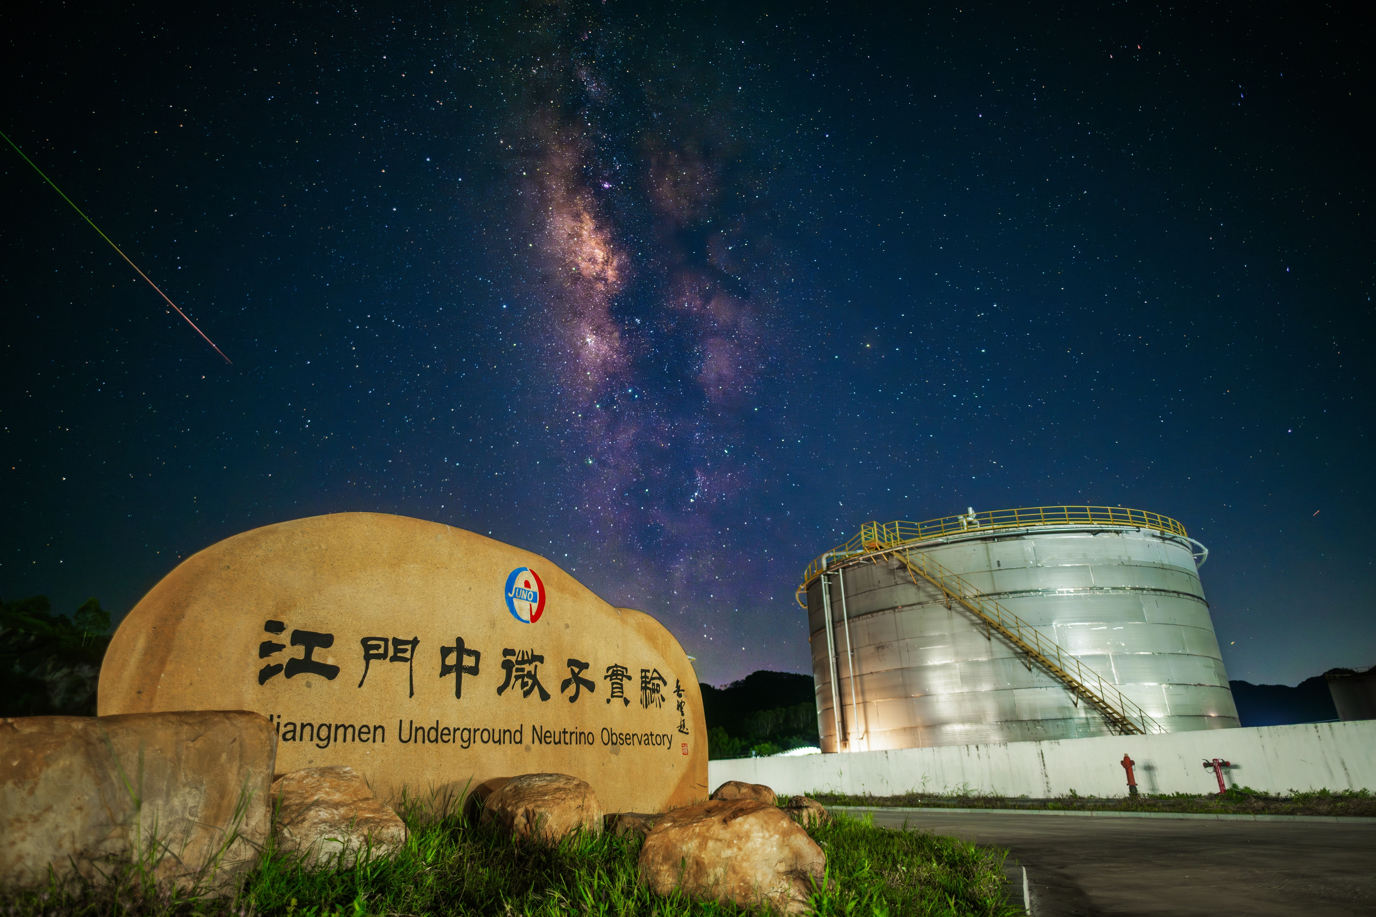


Astrophysics Program at JUNO
Yu-Feng Li
Institute of High Energy Physics, Beijing
2026/07/03
On behalf of the JUNO collaboration

Slide 2

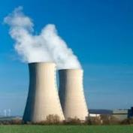

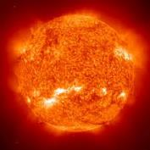
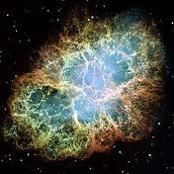


A multi-purpose observatory
Reactor
Atmosphere
Solar
Supernova
Earth
New physics
+
~60 IBDs per day
Several per day
Hundreds per day
~5000 IBDs for CCSN @10 kpc
Several IBDs per day
Neutrino oscillation & properties
Neutrinos as a probe
IBD: inverse beta decay
CCSN: core-collapse supernova

Slide 3

Focus on Supernova neutrino observation at JUNO

Slide 4
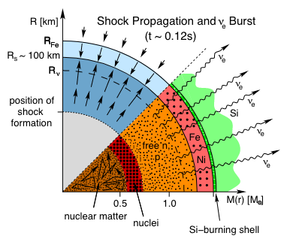
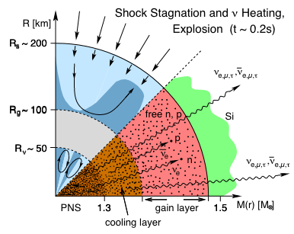
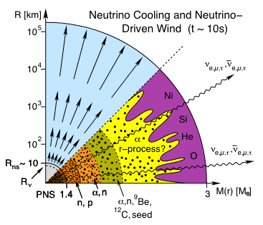
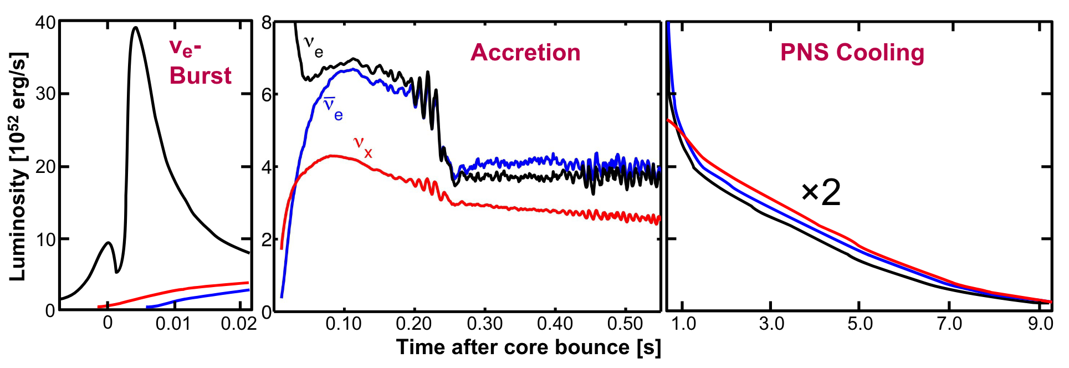
Supernova Neutrino Emission
H. T. Janka, et al., “Theory of core-collapse supernovae”

Slide 5
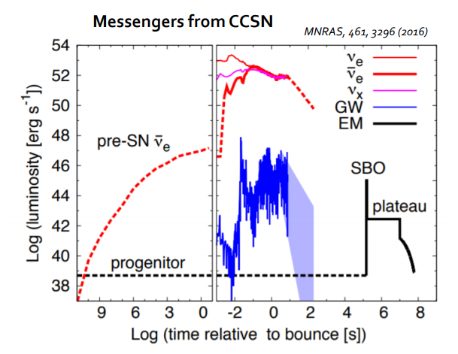
Multi-messenger Signals
The large liquid scintillator detectors, JUNO, has great potential on detecting both pre-SN and SN
Pre-SN neutrinos
  ~MeV neutrinos, much lower luminosity than SN burst neutrino
  visible ~days before core collapse for nearby galactic progenitors
SN burst neutrinos
  Few tens of MeV neutrinos, last for ~10s with burst, accretion and cooling stages
  Background almost free for SN burst neutrinos

Slide 6
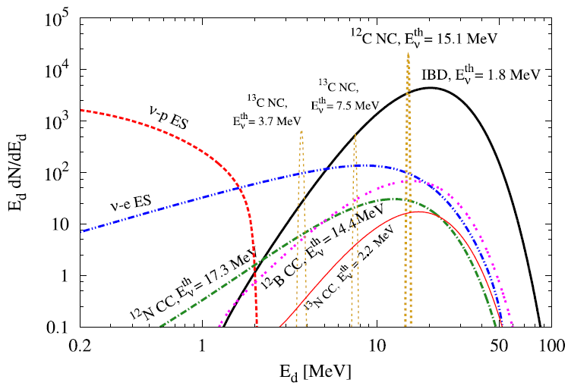
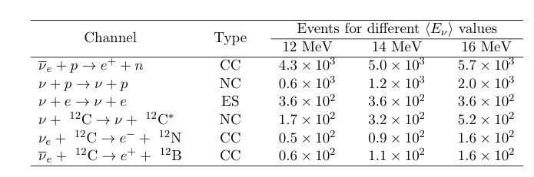

CCSN potential at JUNO
PPNP 123, (2022) 103927
Multi-channel detection, all flavors
~5000 IBD, ~300 eES, ~2000 pES，
~200 ¹²C CC, ~300 ¹²C NC @10 kpc
Early warning
CCSN Characteristics
  Time evolution & Energy spectra
  Total energy, luminosity, …
→ Test CCSN mechanism!
Neutrino properties
  Mass ordering
  Absolute mass
  New physics

Slide 7

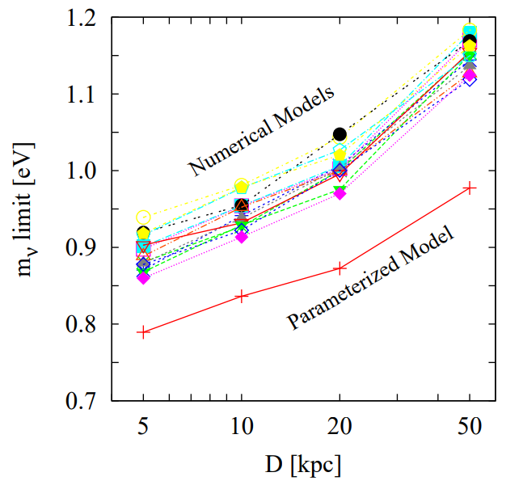
Particle Physics and Astrophysics
Time delay of massive neutrinos:
Flavor conversion
MSW effects
Fast and slow collective oscillations
Neutrino mass ordering:
Spectral comparison
Time profile
New particle and new physics
Axion (ALP)
keV sterile neutrinos
Dipole portal
… … …
→ Rich program to be explored!
J.S. Lu et al, JCAP 15’,1412.7418

Slide 8
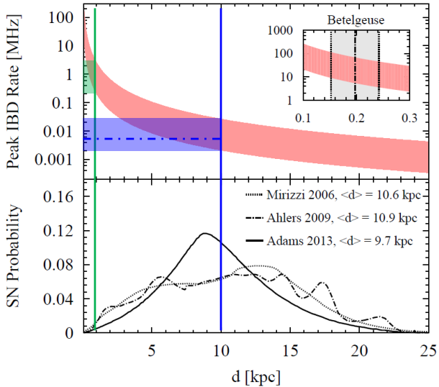
Early Warning
JPG 43 (2016) 3, 030401
Prompt and Online monitor systems designed for SN Early Warning
  Non-stop, continuous monitoring
  Not affected by any Run Modes (physics, calibration, PMT cooling, etc)
DAQ design can fulfil the requirements on SN data taking
  CCSN Data stream can reach MHz at 1 kpc.
  No data loss for Time and Charge (TQ) stream at > 0.2 kpc
  No loss of waveforms at > 3.6 kpc.

Slide 9
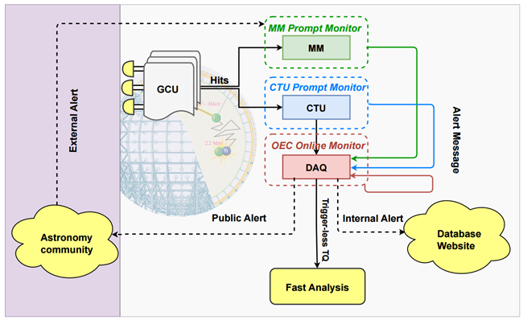
Redundant Monitoring System
Three independent monitoring system: JCAP 01 (2024) 057 arXiv: 2309.07109 [hep-ex]
The OEC monitor uses reconstructed event information from the Online Event Classification (OEC) software.
The Multi-Messenger (MM) Trigger monitor uses a dedicated low energy trigger system.
The CTU Prompt monitor runs on FPGAs of the electronic boards in the global trigger system (under debugging)
Alerts to SNEWS 2.0 since 28 Nov 2025
Fast analysis of CCSN characterization

Slide 10
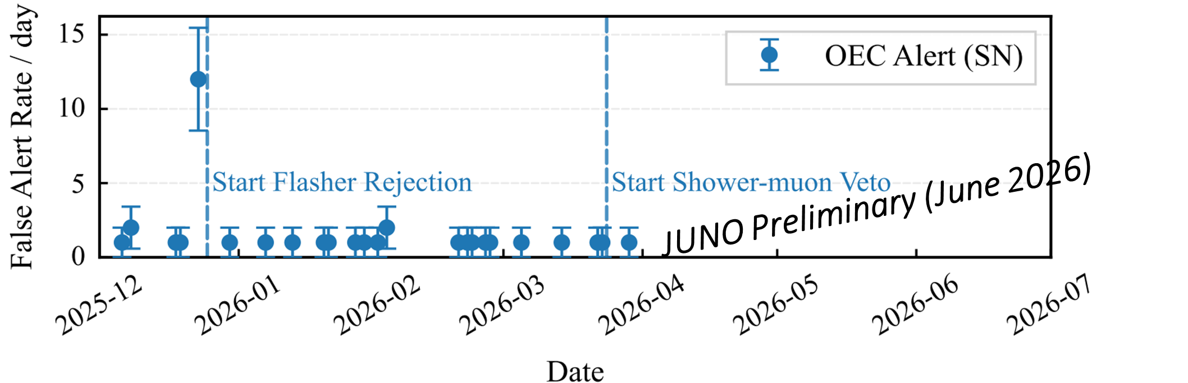
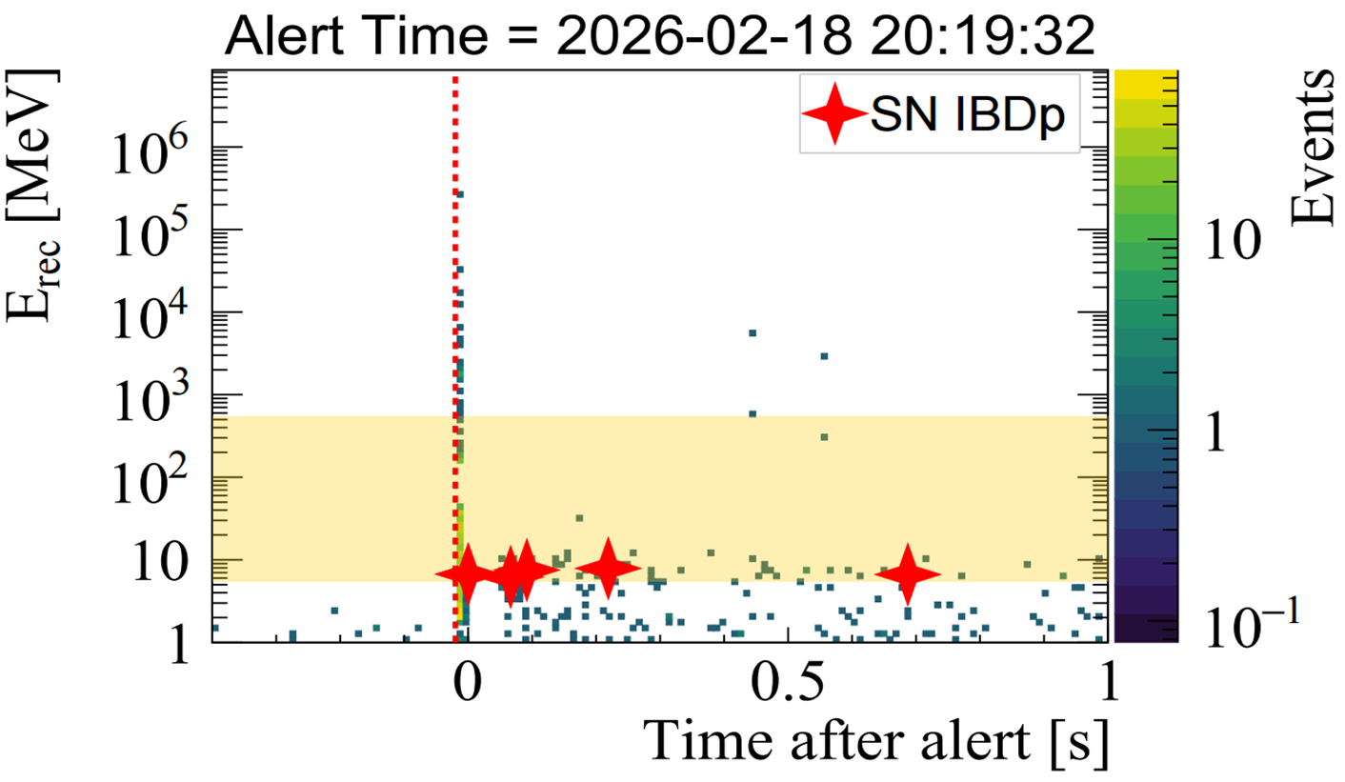


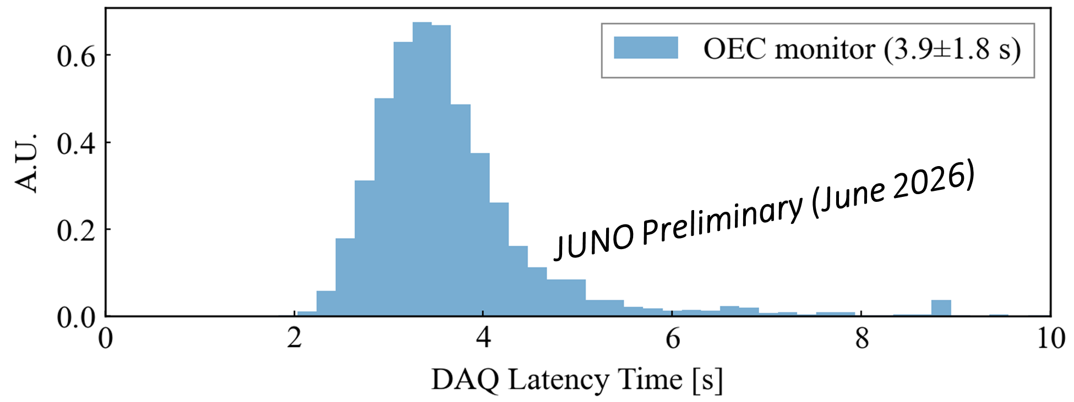
OEC Monitor: Status
Live time: 97% (99.8% after upgrade), reliable during calibration and cooling runs.
False alert rate: 1–3 alerts/week (early stage), 1/3 months (current configuration).
DAQ latency time: around 4 s.
Validation with laser tests

Slide 11
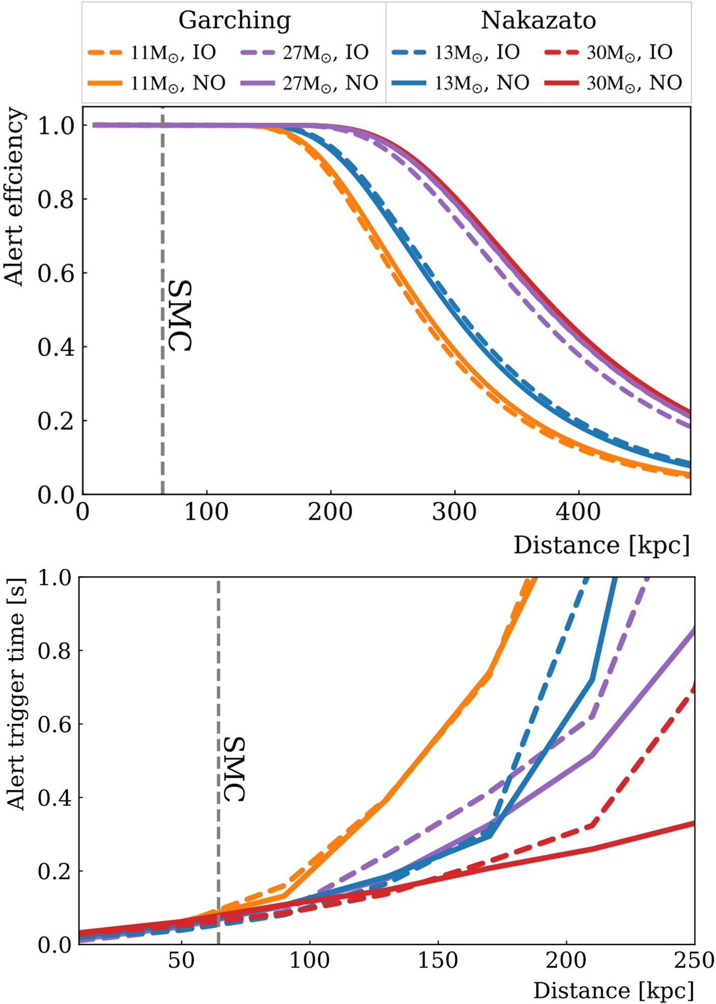

OEC Monitor: Performance
Evaluated based on real background and signal simulations.
Signal: 80% efficiency base on MC,
Background:
Reactor IBDs and Li9. ~27 candidates/day.
Alert efficiency > 50% for CCSN within 350 kpc
Alert triggers in 20 ms at 10 kpc after core bounce (DAQ latency at second level)

Slide 12
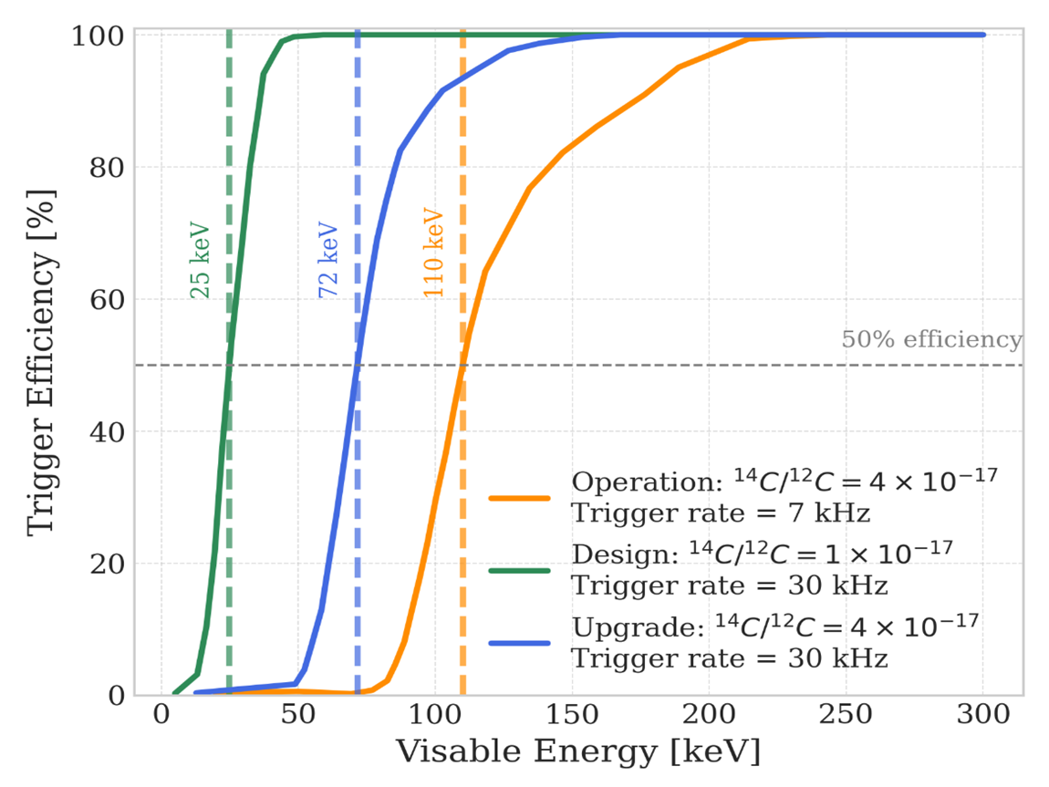
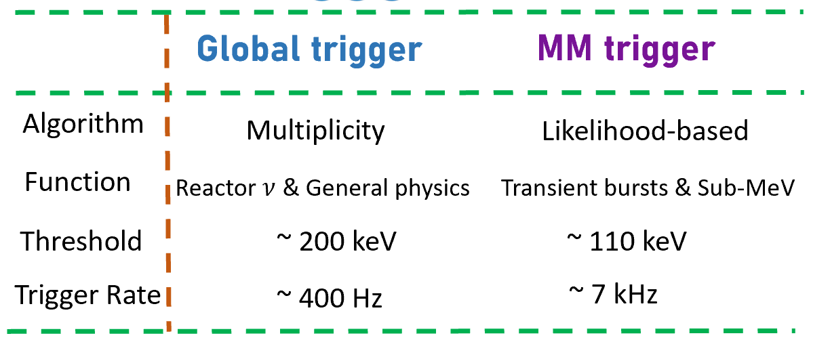
MM Trigger Monitor: Status
MM trigger: dedicated system for transient and/or low energy events
Current operation: 110 keV with 7 kHz trigger rate.
Serve as a fast, low-energy and low-latency monitor for supernova burst and other transients

Slide 13
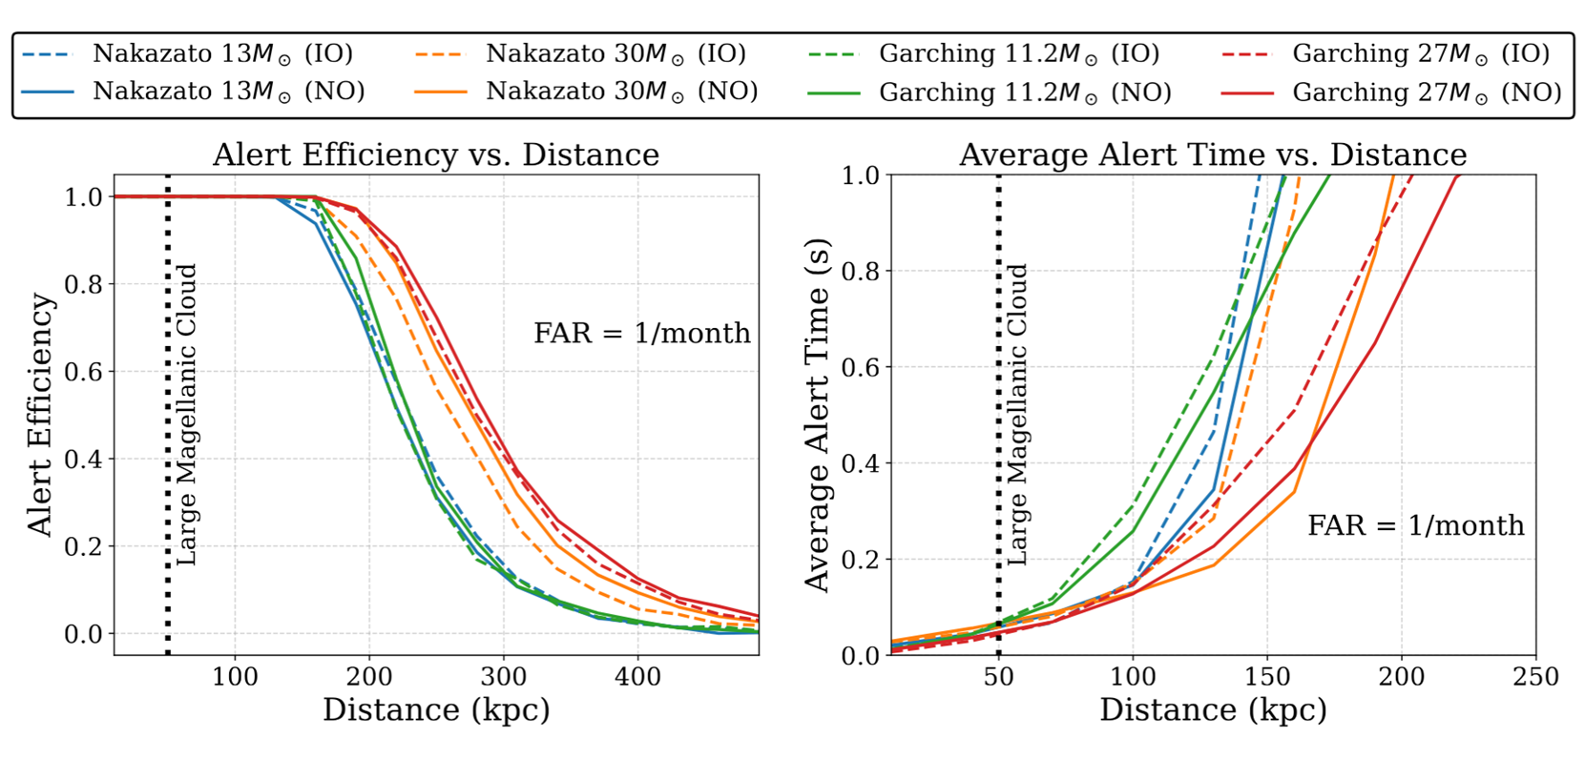
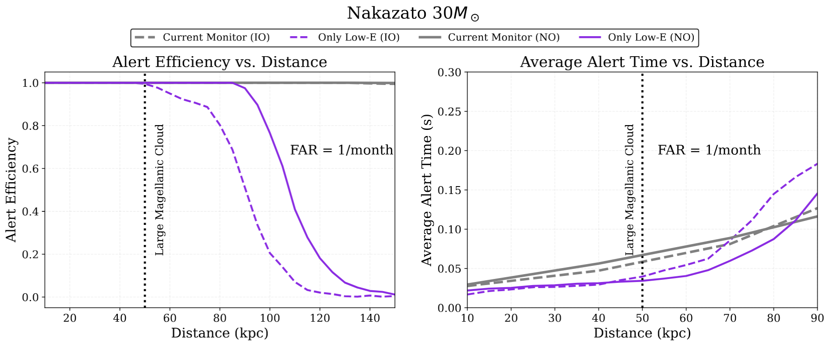
MM Trigger Monitor: Performance
Running with both high-energy (5-20 MeV, CCSN) and low-energy (0.1-5 MeV) mode.
High energy: complementary to other CCSN monitors
excellent coverage, and fast (0.1 s)
Low energy: unique tool to monitor CCSN and transient bursts
much quicker thanks to the νe burst

Slide 14
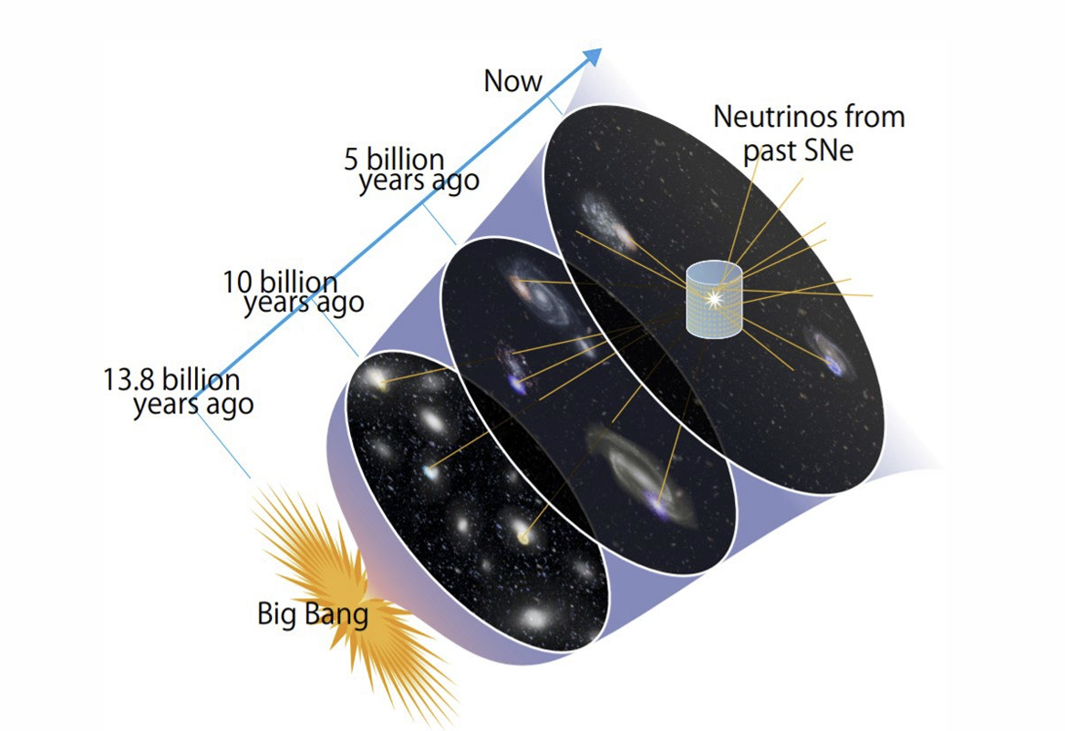
DSNB: another probe of supernova physics
We need to wait for the next Galactic (and nearby) supernova neutrino burst
Diffuse Supernova Neutrino Background (DSNB):
→ A guaranteed diffuse source of neutrinos from all the past supernovae !

Slide 15
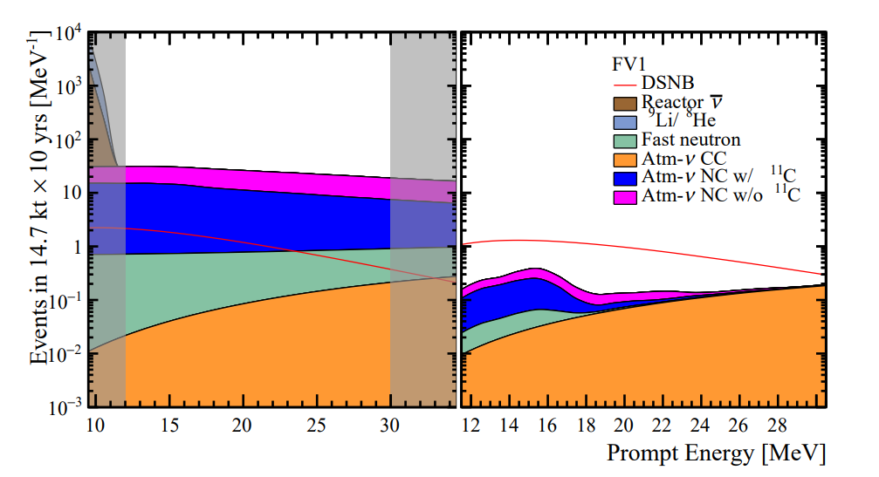
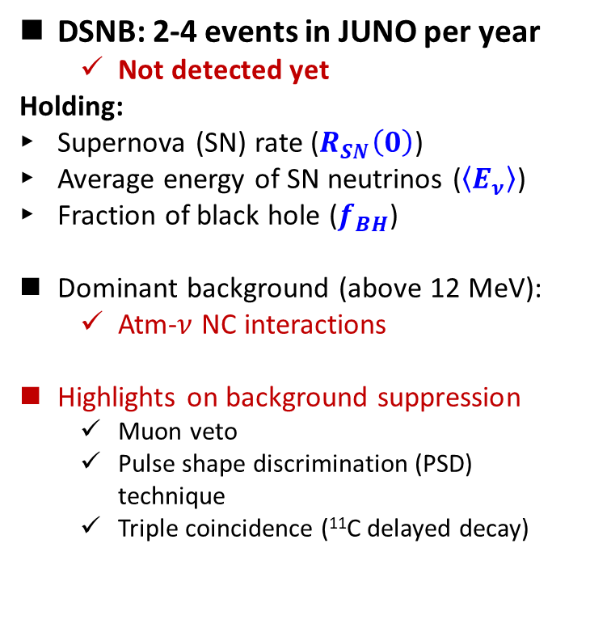
DSNB at JUNO: signal v.s. background
DSNB: 2-4 events in JUNO per year
  Not detected yet
Holding:
Supernova (SN) rate ($R_{SN}\left(0\right)$)
Average energy of SN neutrinos ($\left\langle E_{ν}\right\rangle$)
Fraction of black hole ($f_{BH}$)
Dominant background (above 12 MeV):
  Atm-$ν$ NC interactions
Highlights on background suppression
  Muon veto
  Pulse shape discrimination (PSD) technique
  Triple coincidence (¹¹C delayed decay)
JUNO, arXiv: 2205.08830
JCAP 10 (2022) 033
Before background suppression
Background evaluation: 0.7 per year → 0.54 per year
PSD: signal efficiency 50% → 80% (1% residual background)
Realistic DSNB signal model: non-zero fraction of failed Supernova
S/B improved from 2 to 3.5

Slide 16
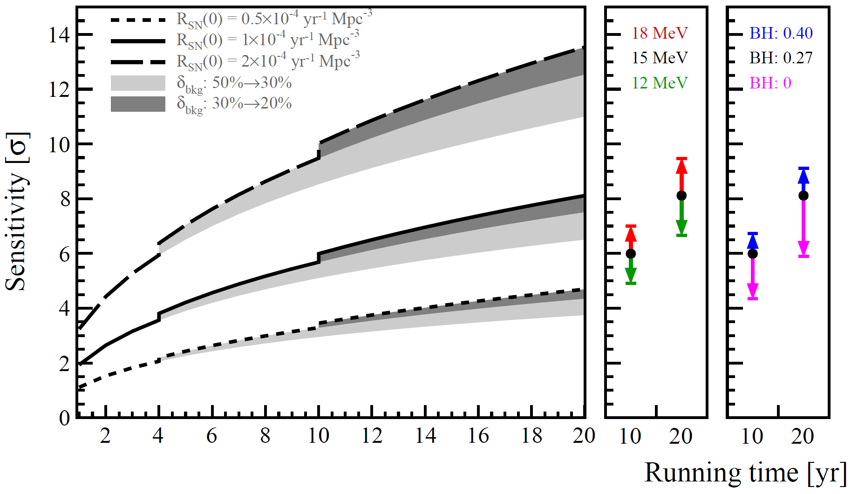
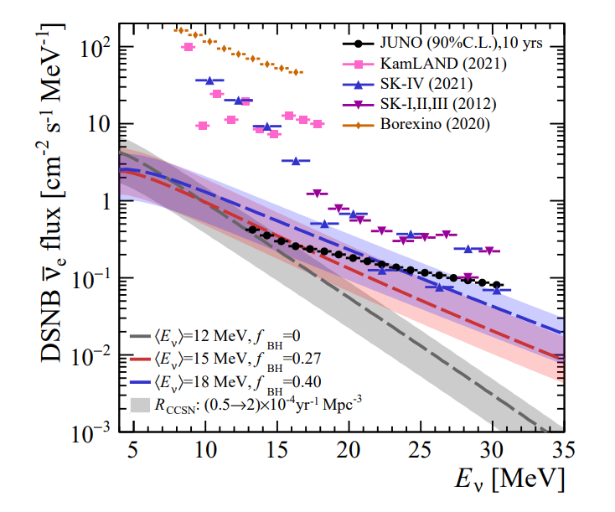
DSNB at JUNO: sensitivity
arXiv: 2205.08830, JCAP 10 (2022) 033
Reference model
If no positive observation, JUNO can set the world-leading best limits of DSNB flux
With the nominal model (black solid curve (left plot)): 3$σ$ (3 yrs) and 6$σ$ (10 yrs)

Slide 17
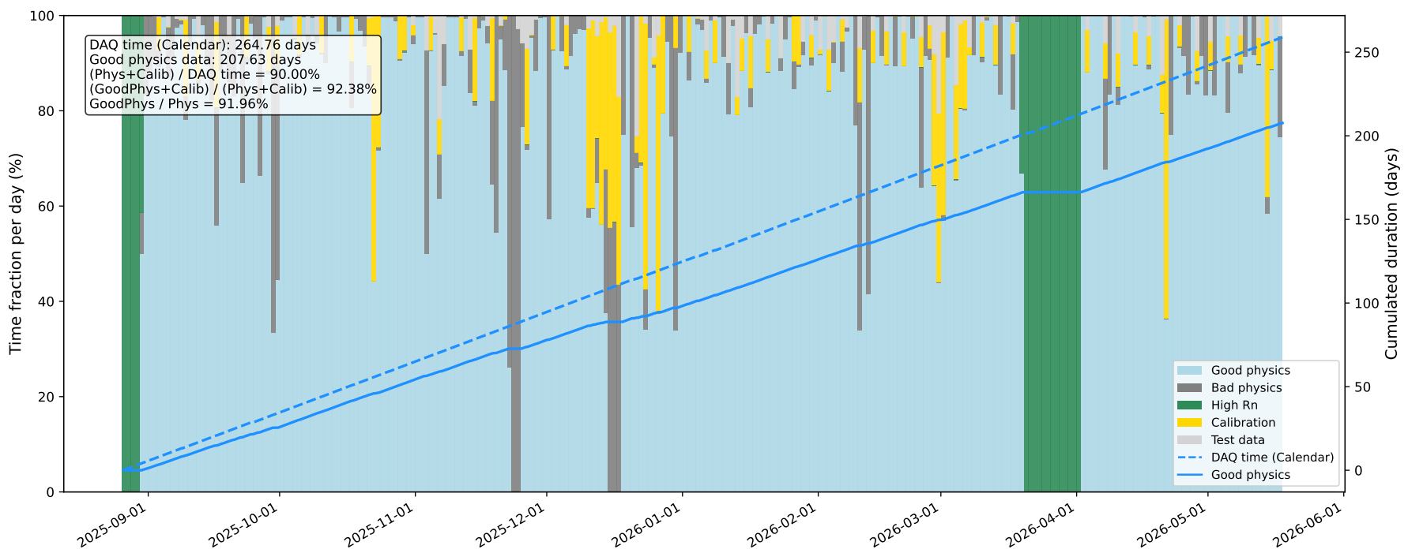
First limit on DSNB (207 days’ data)
Similar IBD selection criteria to the reactor neutrinos (with Fiducial Volume 16.5 m).
Extended the prompt energy range and increased the muon veto energy.

Slide 18
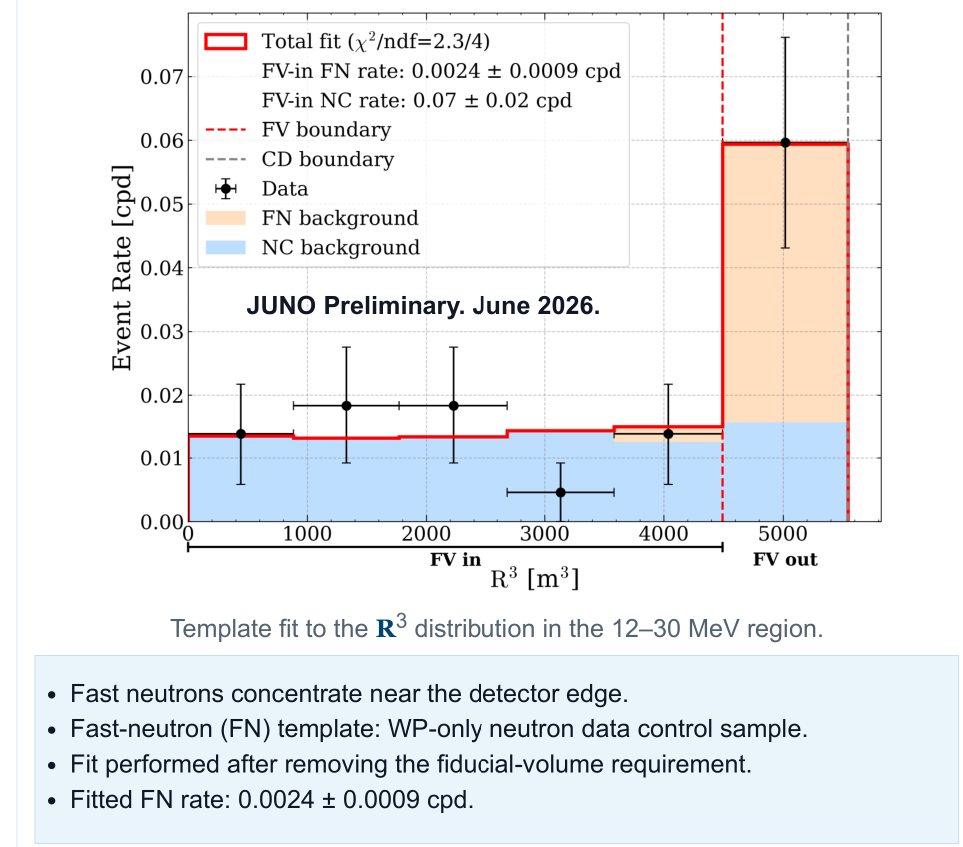
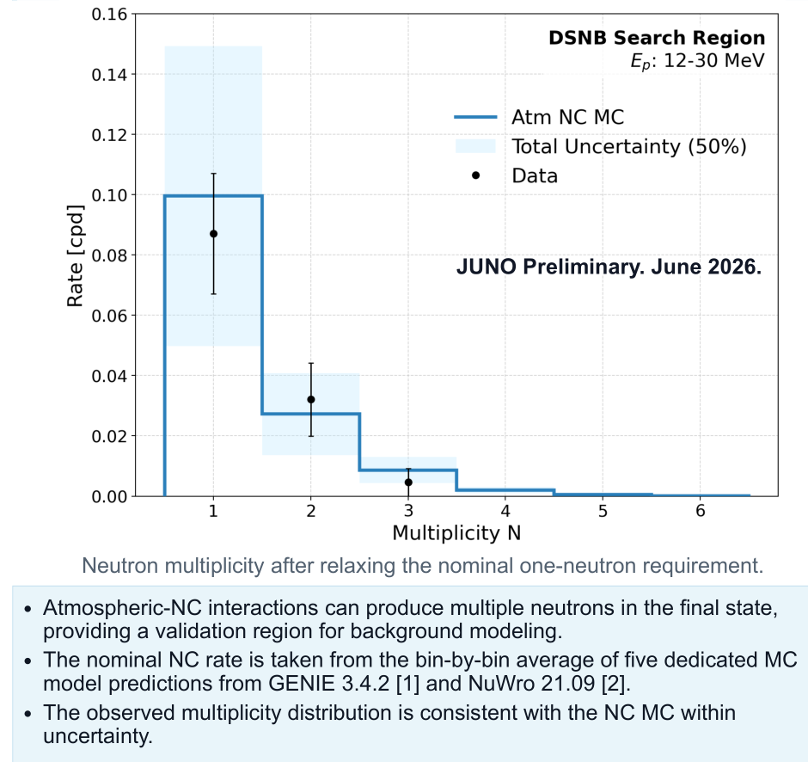
First limit on DSNB: backgrounds

Slide 19
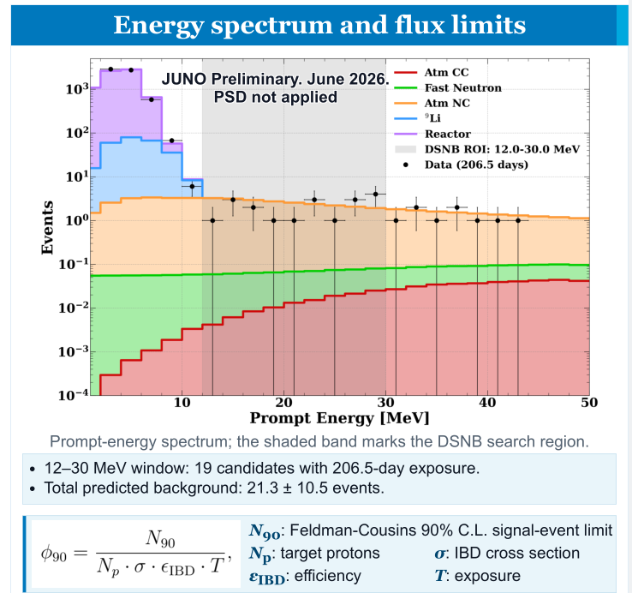
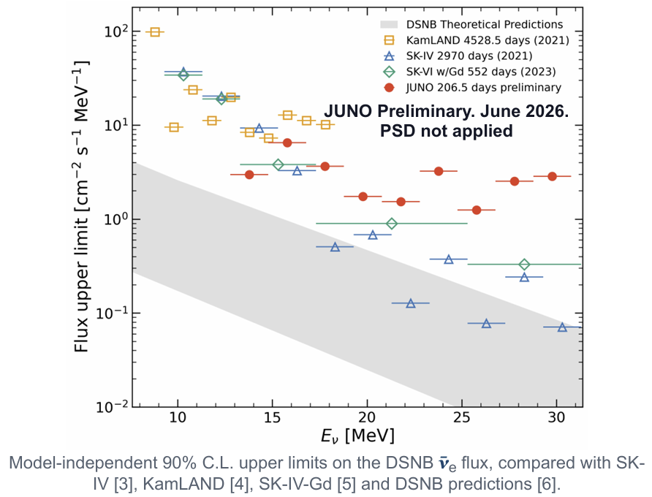
First limit on DSNB: results

Slide 20
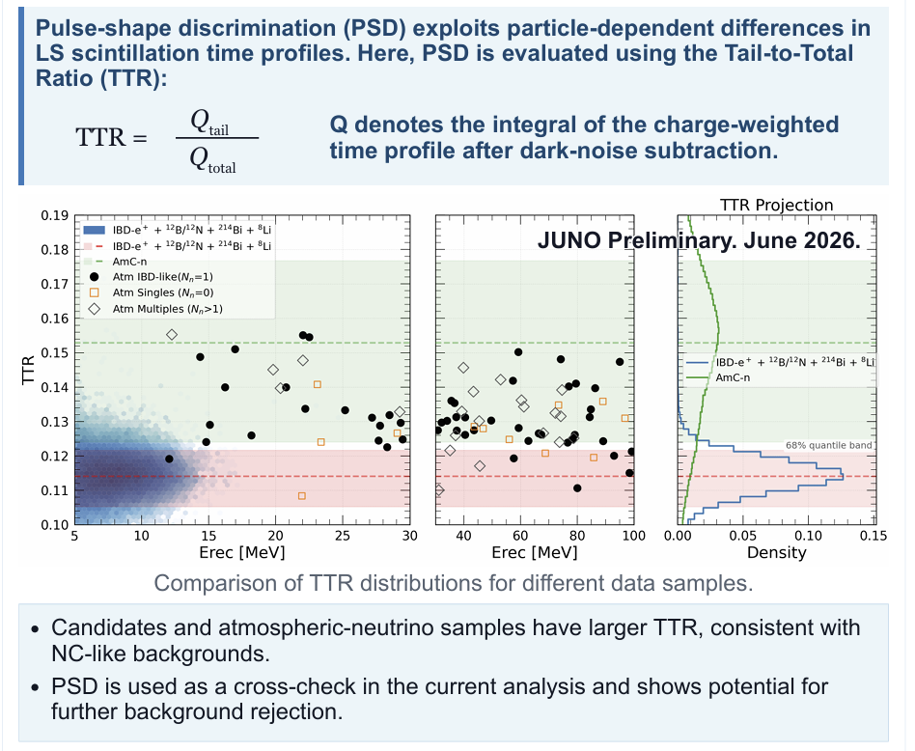
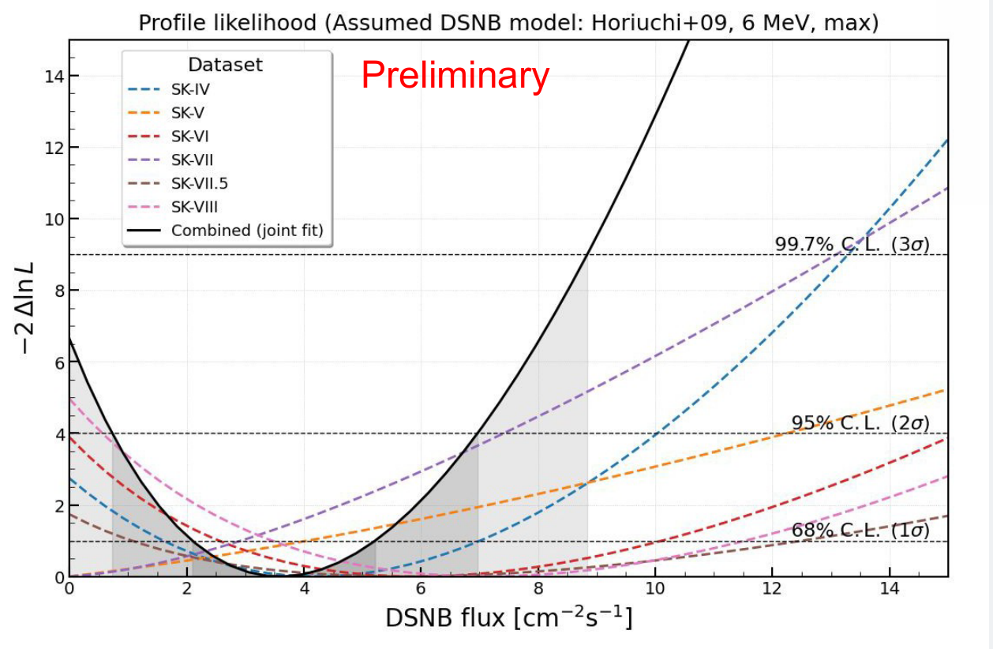
First limit on DSNB: further improvement
2.6σ
SK-Gd limit at Neutrino2026 (Sekiya’s talk)
JUNO may be able to test this flux level in a short running time !

Slide 21
China-French Cooperation (FCPPN/L)
Supernova neutrino is one of the well cooperated topics between institutions of China and French within the JUNO Collaboration.
  Co-Coordinators of supernova neutrino group (SUBATECH Nantes and IHEP Beijing):
  Lead the realization and optimization of CCSN monitoring
  Monitoring with 3-inch PMTs
  Various physics studies and detector simulation task
JUNO-ASTRO project from FCPPN
→ Visiting student from SUBATECH to IHEP this year.

Slide 22
Summary
JUNO has been in stable operation since August 2025, with many exciting results.
World leading capability in supernova neutrino observation
CCSN: testing the mechanism of supernova burst, and neutrino properties.
Status: several redundant monitor systems have been running
A: Good coverage (~ 350 kpc alert distance), B: Fast (~ tens of ms alert time)
C: Stable DAQ operation (~4 s latency, stable data storage handling)
D: Alert issued to SNEWS 2.0 since last Nov.
DSNB: guaranteed source of supernova neutrinos, yet to be observed.
Status: first JUNO limit has been obtained with 207 days’ data
Good understanding of background, and world competitive limits achieved.
Excellent China/French cooperation in supernova related studies.

Slide 23

Thank you!

Slide 25
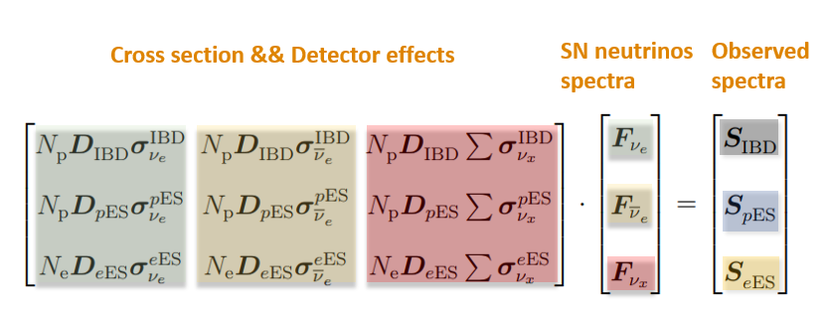
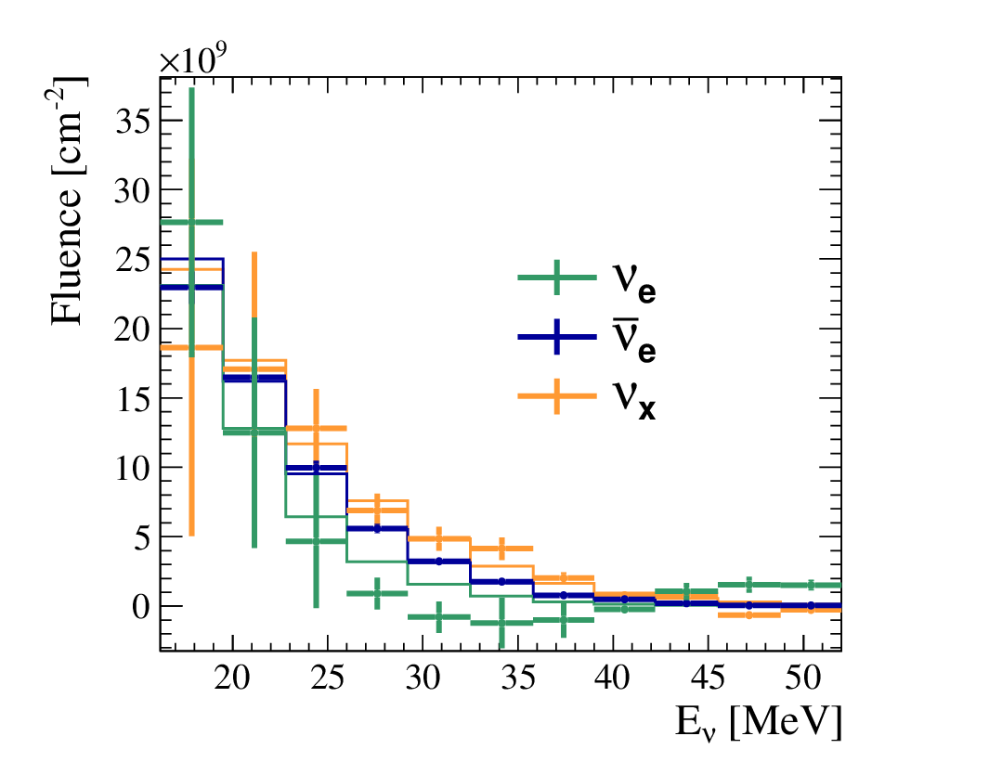
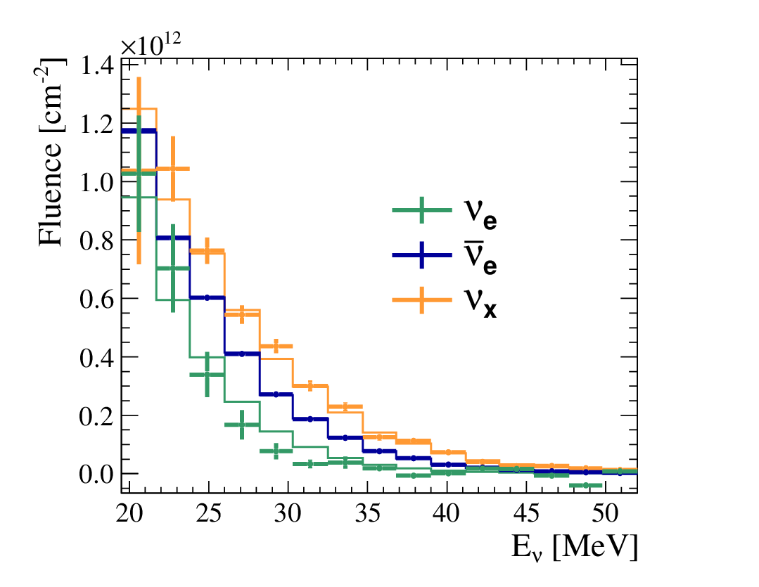
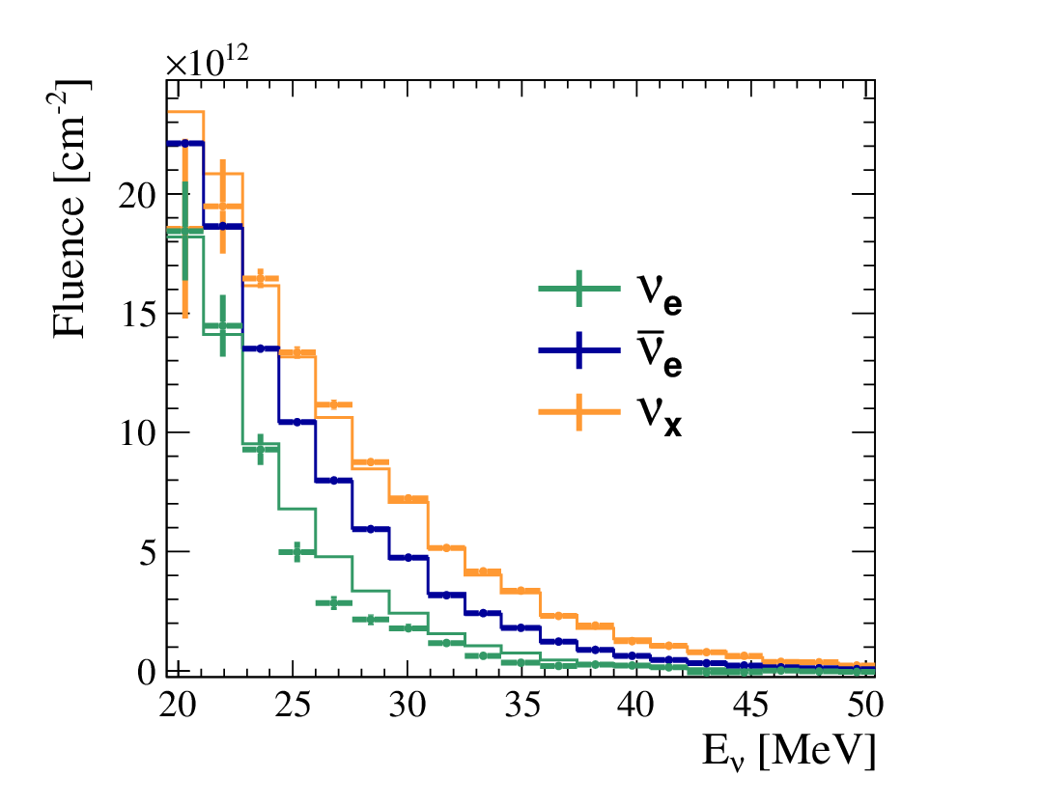
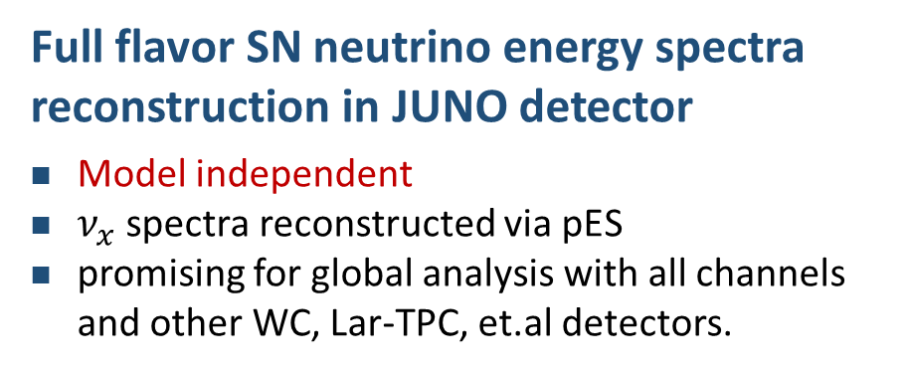
Energy spectral reconstruction
Full flavor SN neutrino energy spectra reconstruction in JUNO detector
Model independent
$ν_{x}$ spectra reconstructed via pES
promising for global analysis with all channels and other WC, Lar-TPC, et.al detectors.
Li, Li, Wang, Wen, Zhou, PRD, 2018
Li, Huang, Li, Wen, Zhou, PRD, 2019
10kpc
1kpc
0.2kpc
0.2kpc
Energy threshold:
< 0.2 MeV

Slide 26
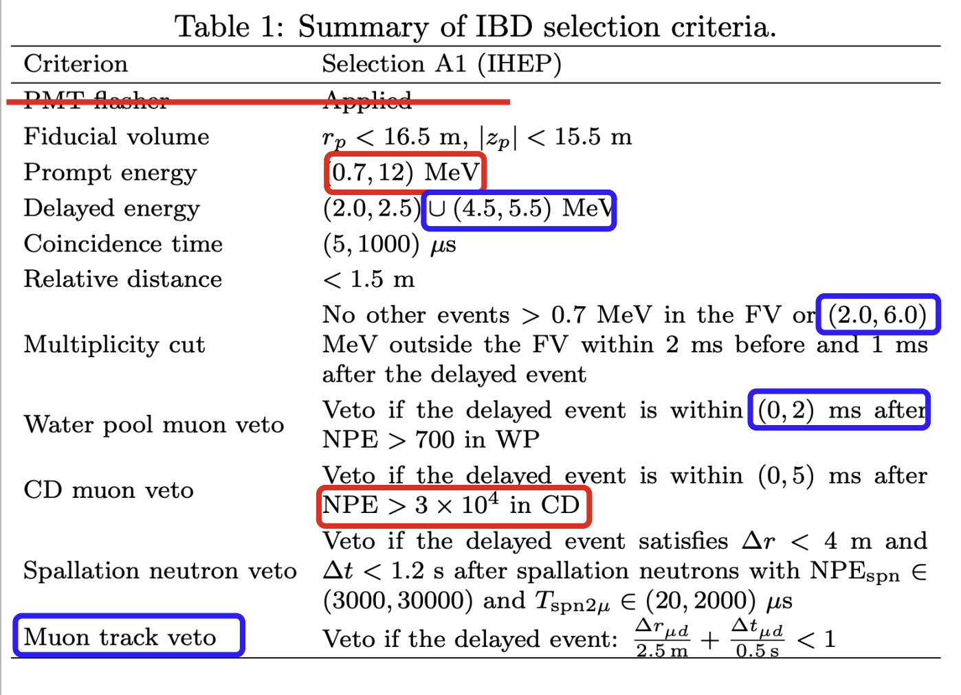
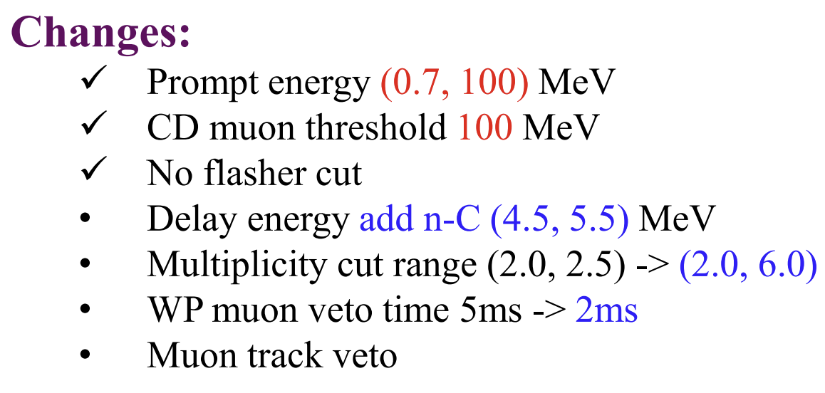
Event Selection

