Slide 1
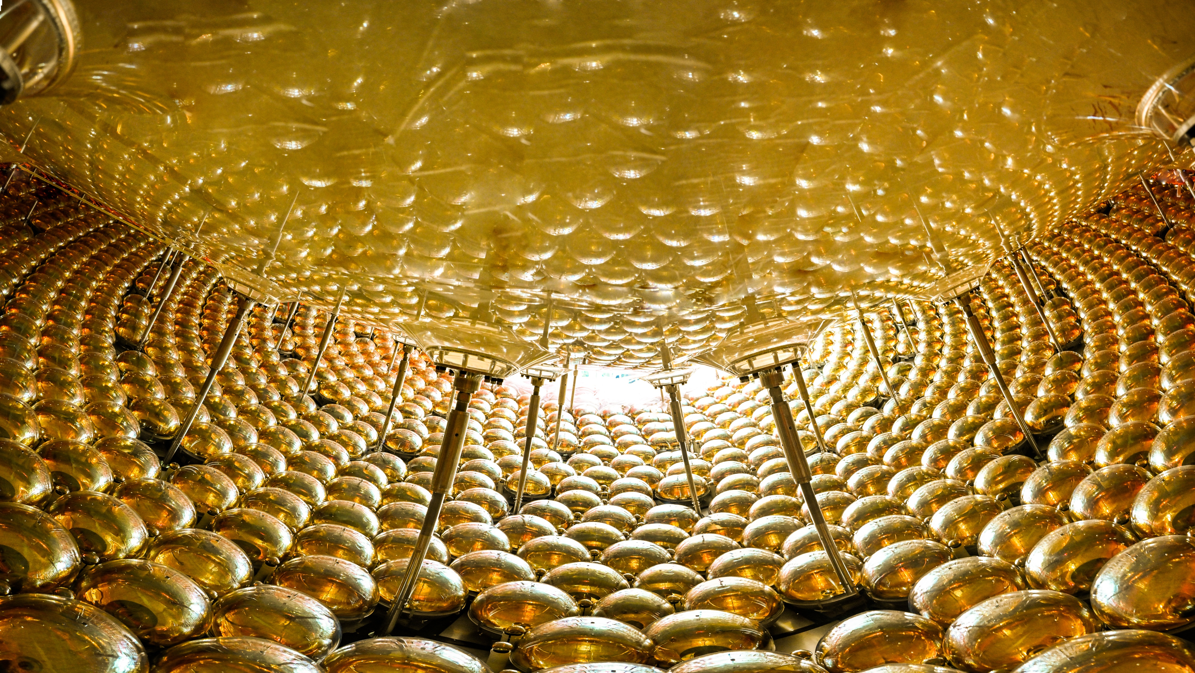
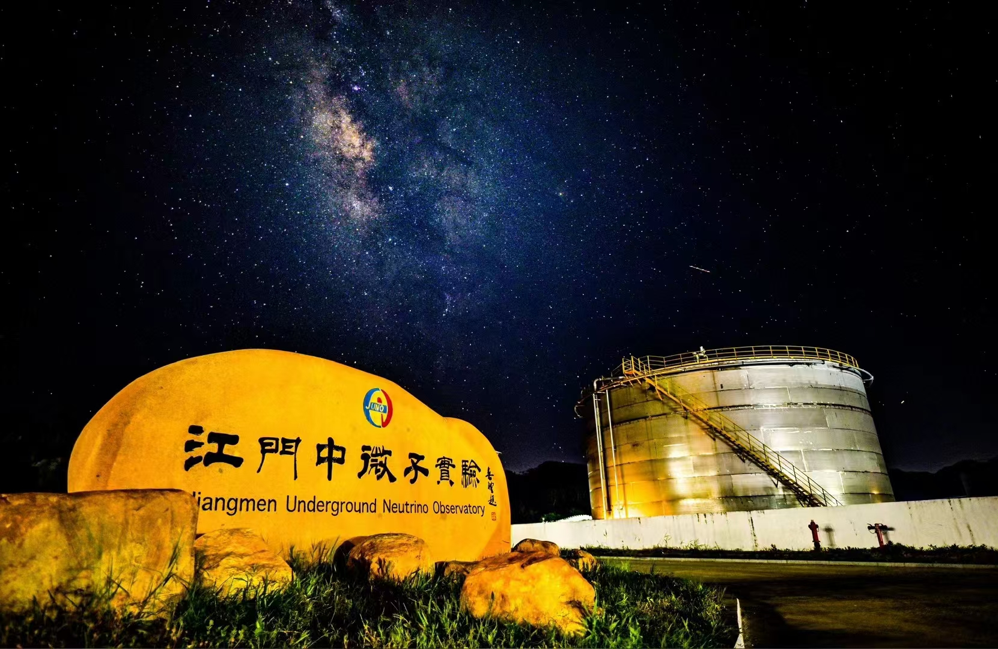

JUNO and Its First Physics Results
王为 (Wei Wang, on behalf of JUNO Collaboration)
School of Physics &
Sino-French Institute of Nuclear Engineering & Technology
中山大学 (Sun Yat-sen University)
The 17th FCPPN/L Workshop, Lyon, Jun 29 - Jul 3, 2026

Slide 2
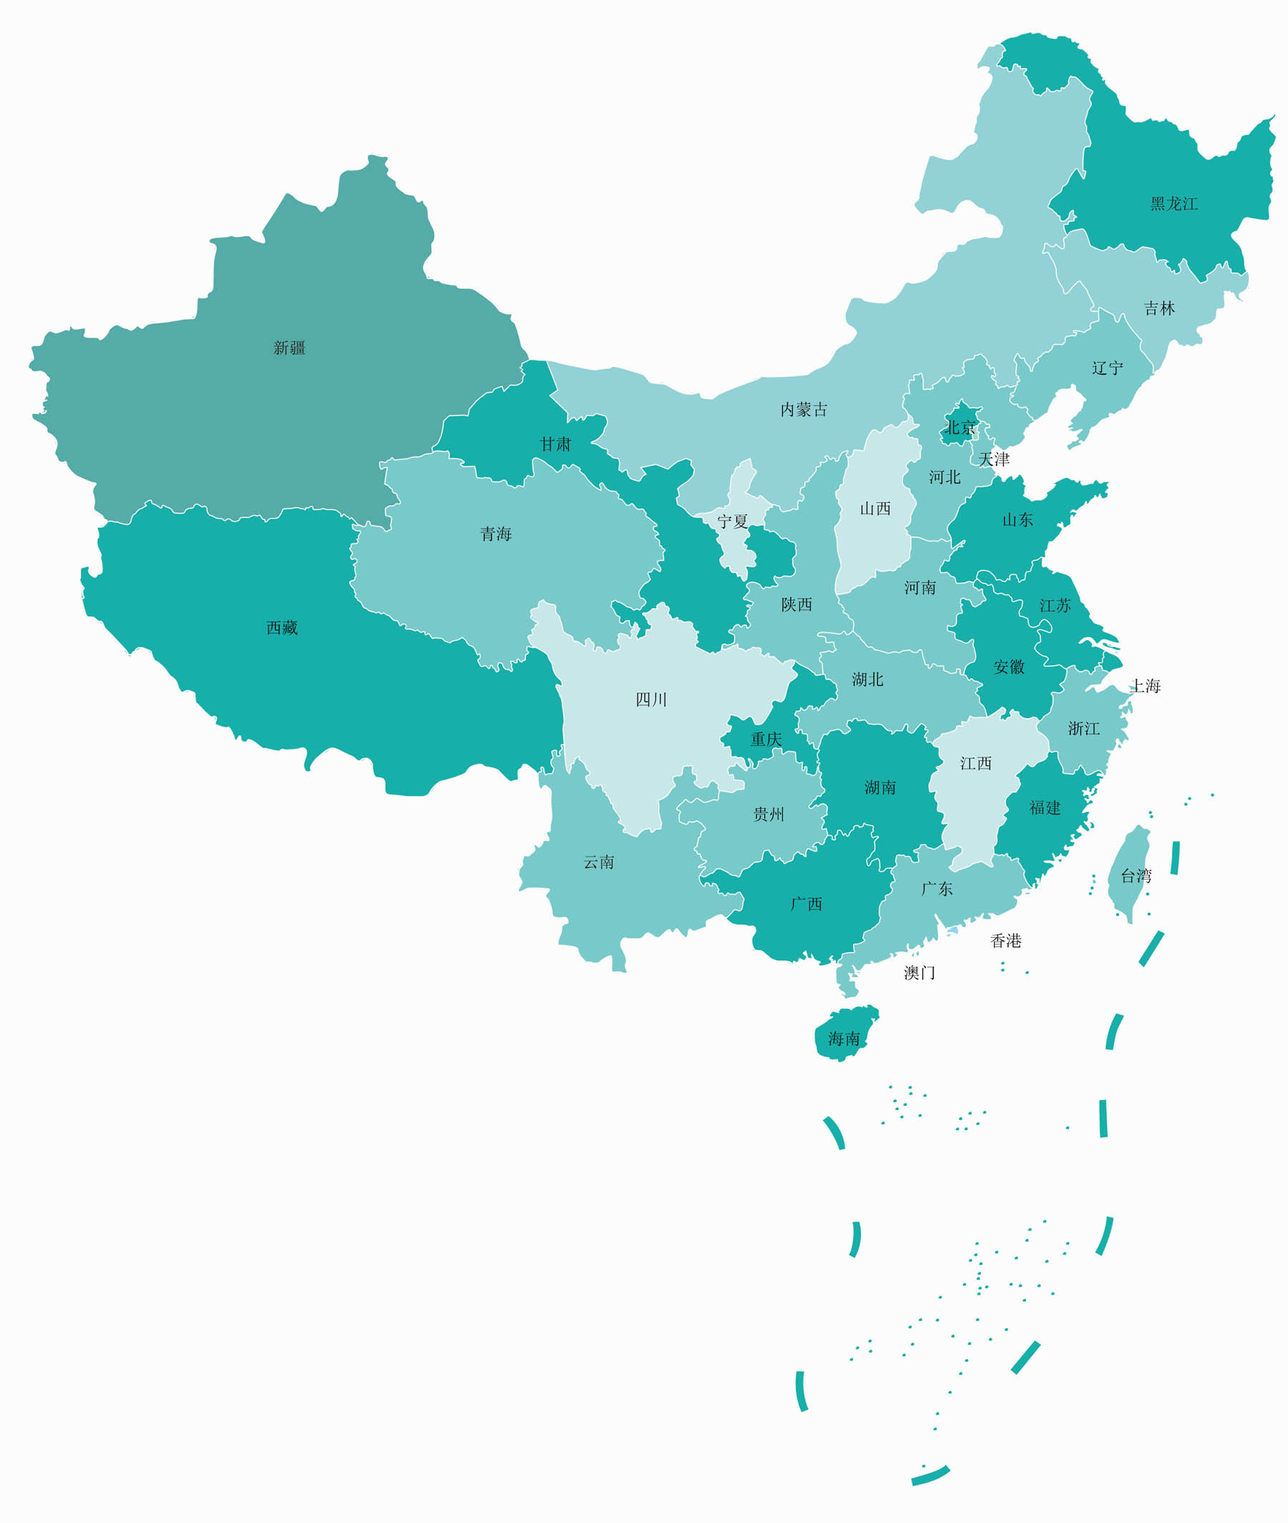
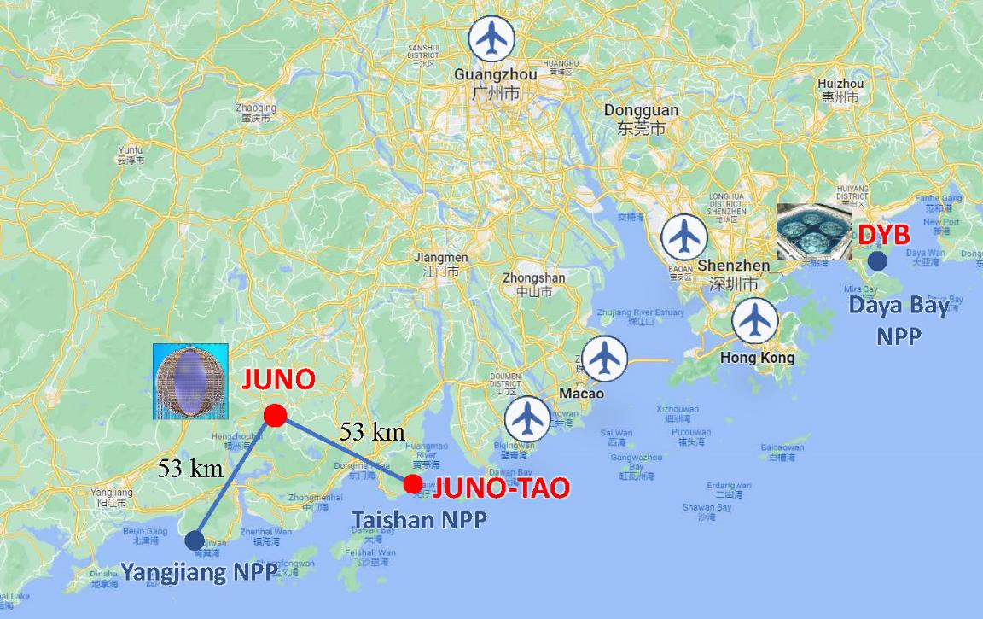
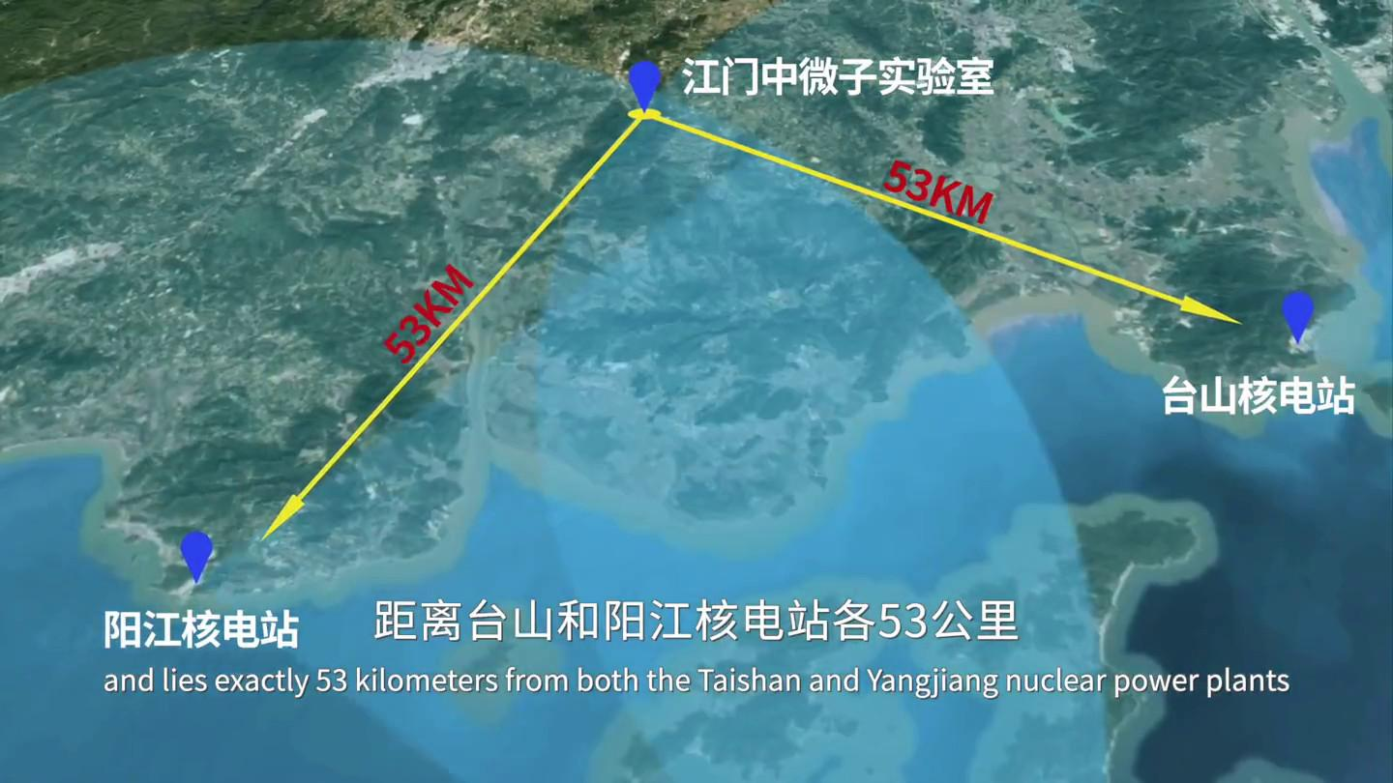
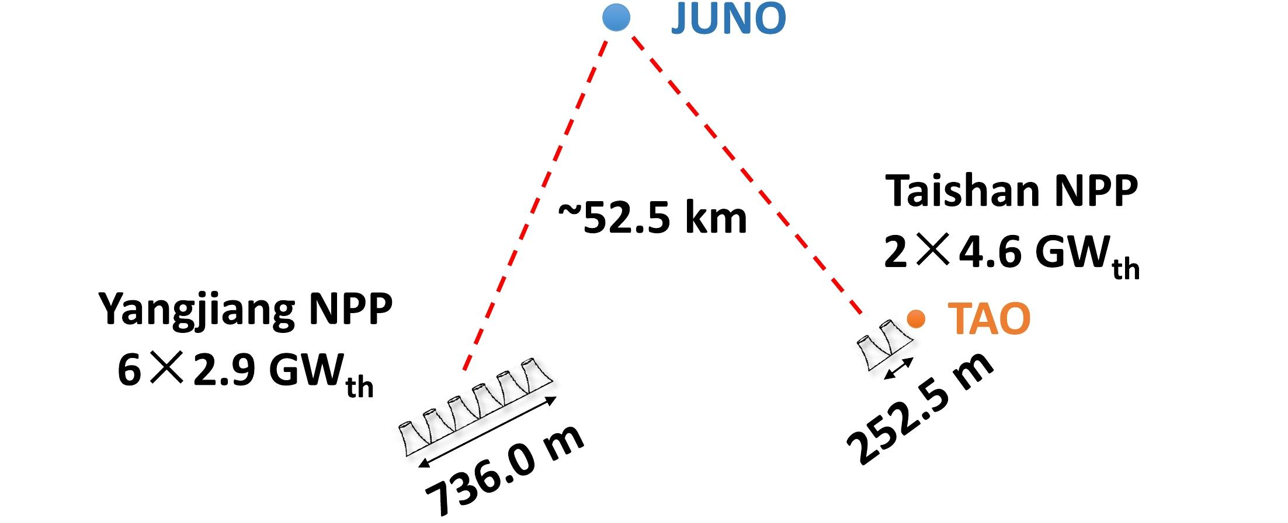
Jiangmen Underground Neutrino Observatory (JUNO)
A medium-baseline detector JUNO, ~52.5km
A very short-baseline detector TAO, ~43m
Primary Physics: Neutrino Mass Ordering
6 PWR cores
17.4 GW_{th}
2 EPR cores
9.2 GW_{th}

Slide 3

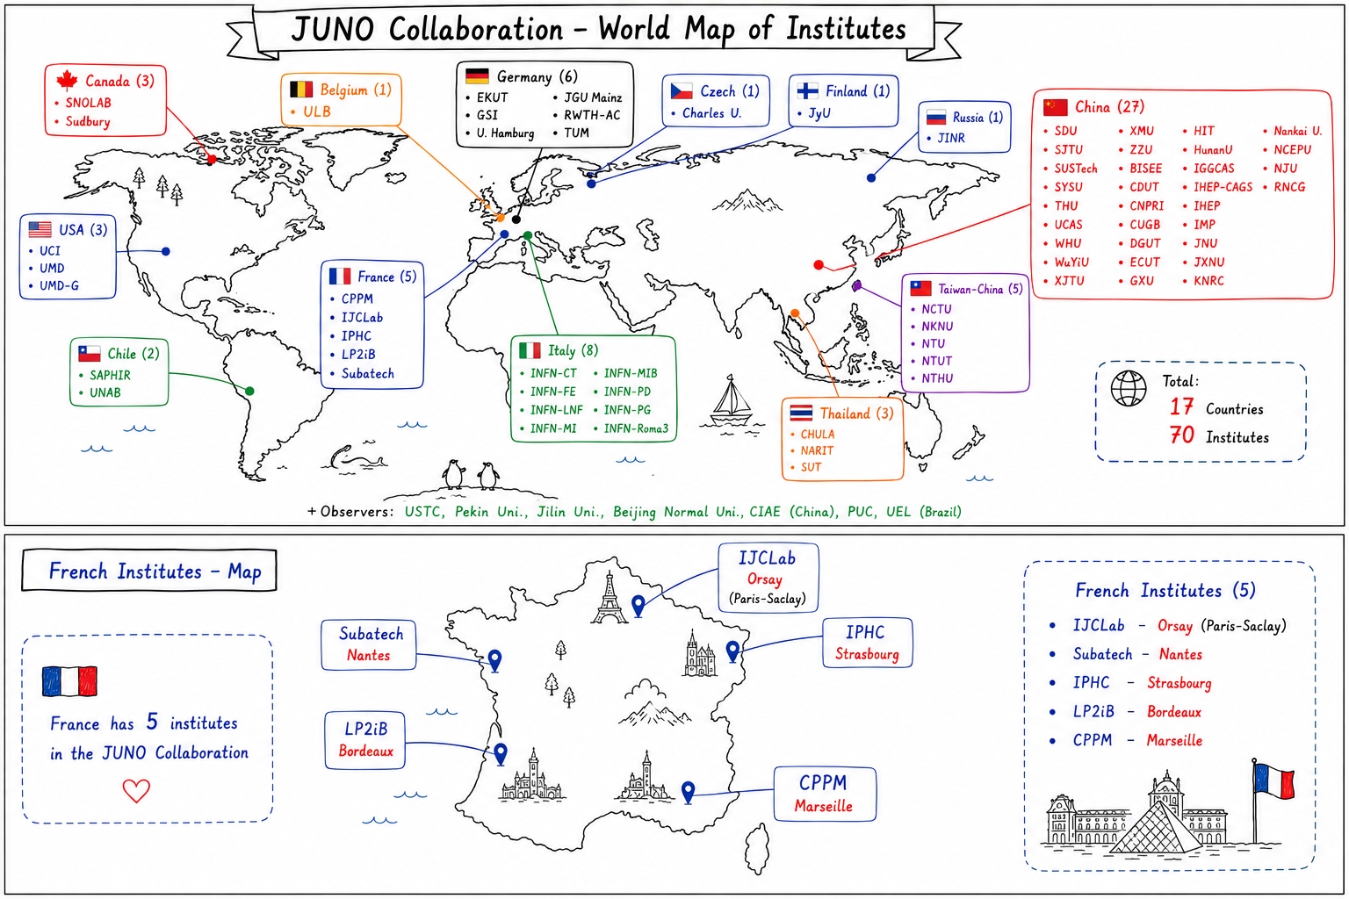
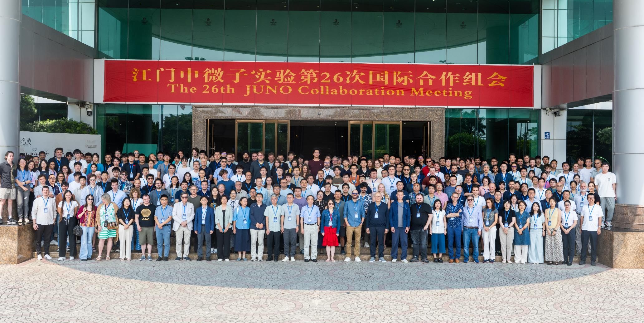
The JUNO Collaboration
Zoom in France:

Slide 4
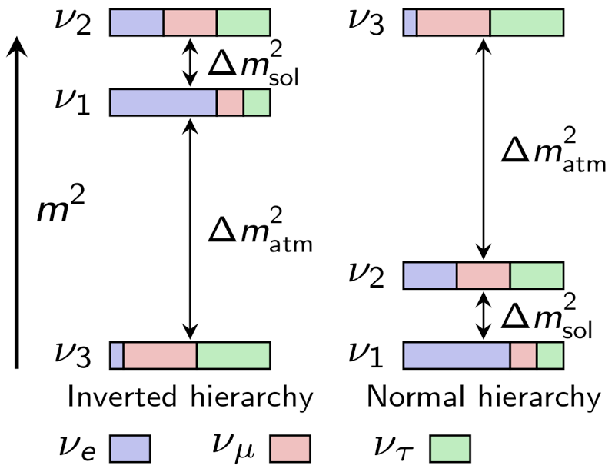
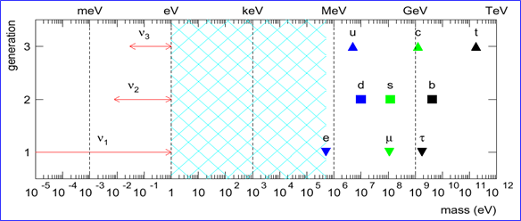
The Quest to Neutrino Mass Ordering
Mass ordering of charged fermions are “normal” --- roughly even on log-scale
Absolute neutrino masses are UNKNOWN
Oscillations tell Neutrino Mass Ordering

Slide 5
Experimental Efforts Resolving 𝛎 Mass Ordering
Source / Principle | Matter Effect | Interference of Solar&Atm Osc. | Collective Oscillation | Constraining Total Mass or Effective Mass
Atmospheric 𝛎 | Hyper-K, IceCube-DeepCore, ORCA
Beam 𝛎µ | T2K, NO𝛎A, DUNE
Reactor 𝛎e |  | JUNO
Supernova Burst 𝛎 |  |  | Massive Detectors with Good E Resolution
Interplay of Measurements |  |  |  | Cosmo. Data, KATRIN, Proj-8, 0νββ

Slide 6


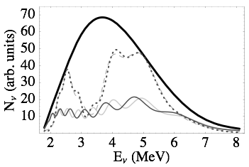
Known θ13 Enables Neutrino Mass Hierarchy at Reactors
Mass hierarchy reflected in the spectrum
Independent of the unknown CP phase
Learned et al, PRD78(2008)071302(R)
Petcov&Piai, Phys. Lett. B533 (2002) 94-106
Zhan et al, PRD78 (2008)
111103
L~20km
After a few years……
Zhan et al, PRD79 (2009) 073007
Li et al, PRD 88 (2013) 013008
∝ sin²2θ13

Slide 7
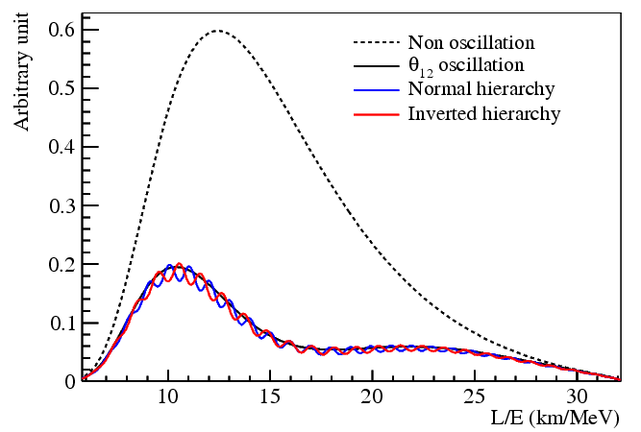
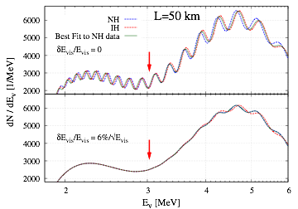
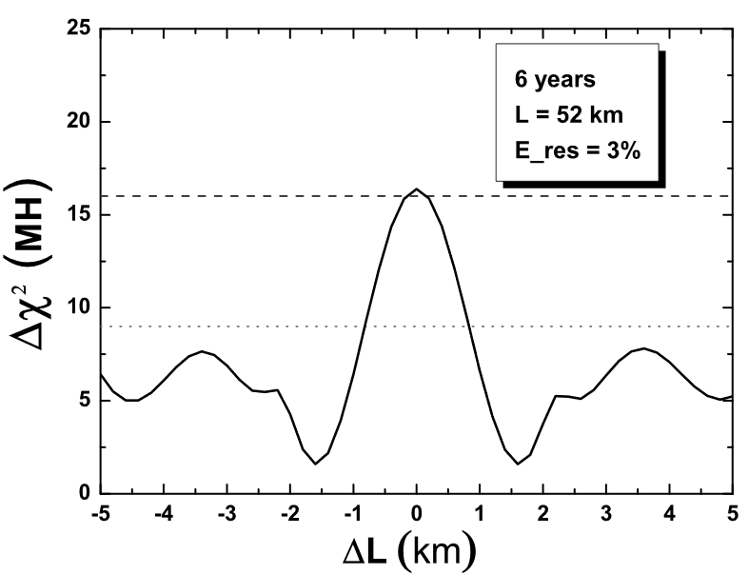
Challenges in Resolving NMO using Reactors
Energy resolution: ~3%/sqrt(E)
Energy scale uncertainty: <1%
Statistics (the more the better)
Reactor distribution: <~0.5km
Reproduction based on State-of-Art Knowledge
Y.F. Li et al
PRD88(2013)013008
S.F. Ge et al
JHEP 1305 (2013) 131
X. Qian et al PRD 87, 033005 (2013)

Slide 8
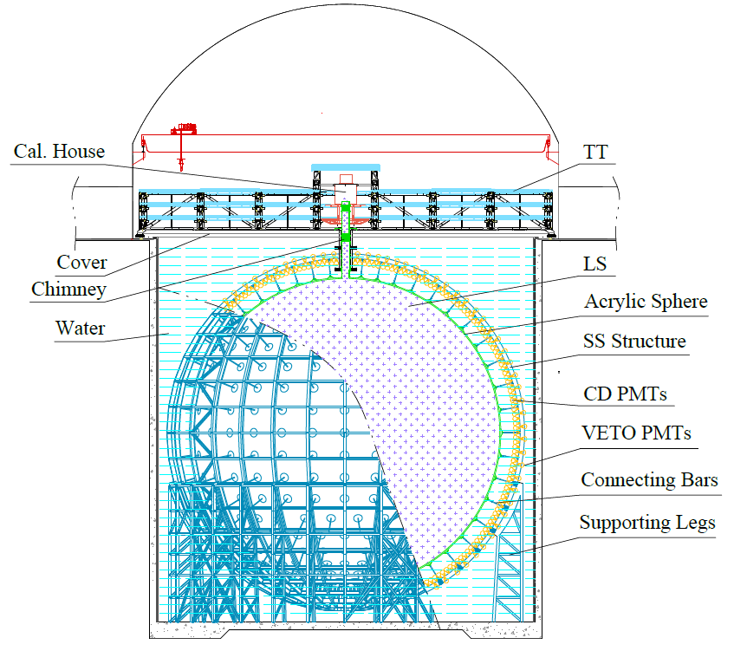
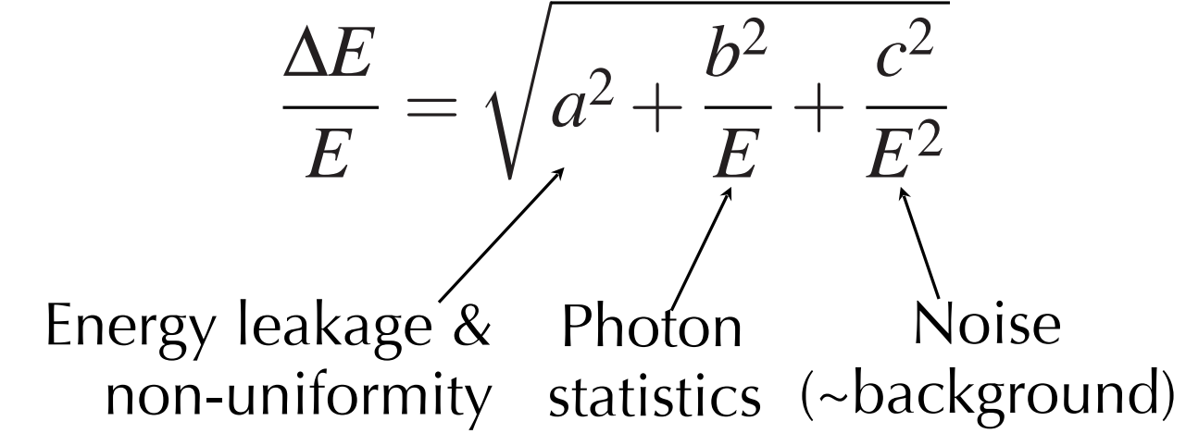
The Conceptual Design of the JUNO Detector
Acrylic Sphere:
  Inner Diameter (ID): 35.4 m
  Thickness:12 cm
Stainless Steel (SS) Structure:
  ID: 40.1 m, Outer Diameter (OD): 41.1 m
  17612 20-inch PMTs, 25600 3-inch PMTs
Water pool:
  ID: 43.5 m, Height: 44 m, Depth: 43.5 m
  2400 20-inch PMTs
Top Tracker (TT)
35 kton
water
20 kton LS

Slide 9
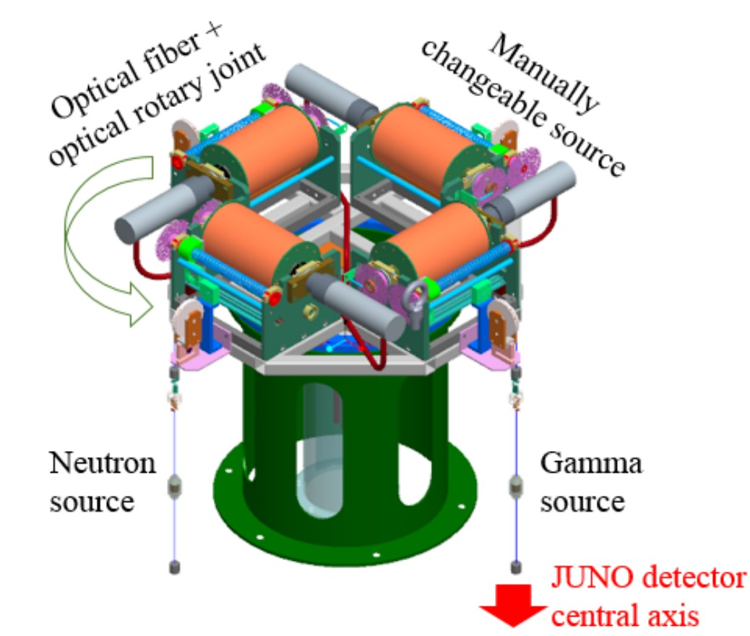
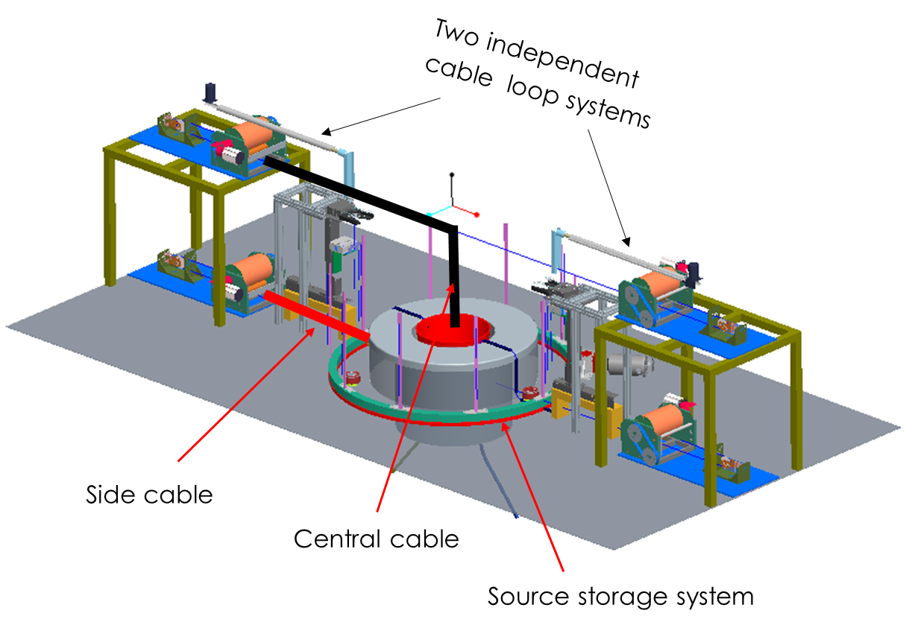
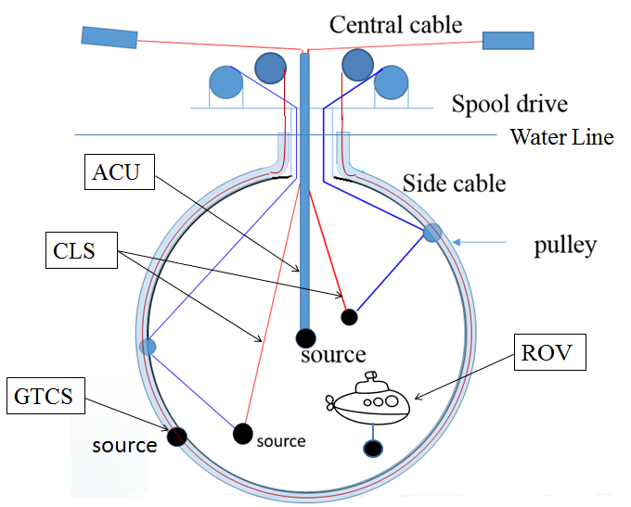
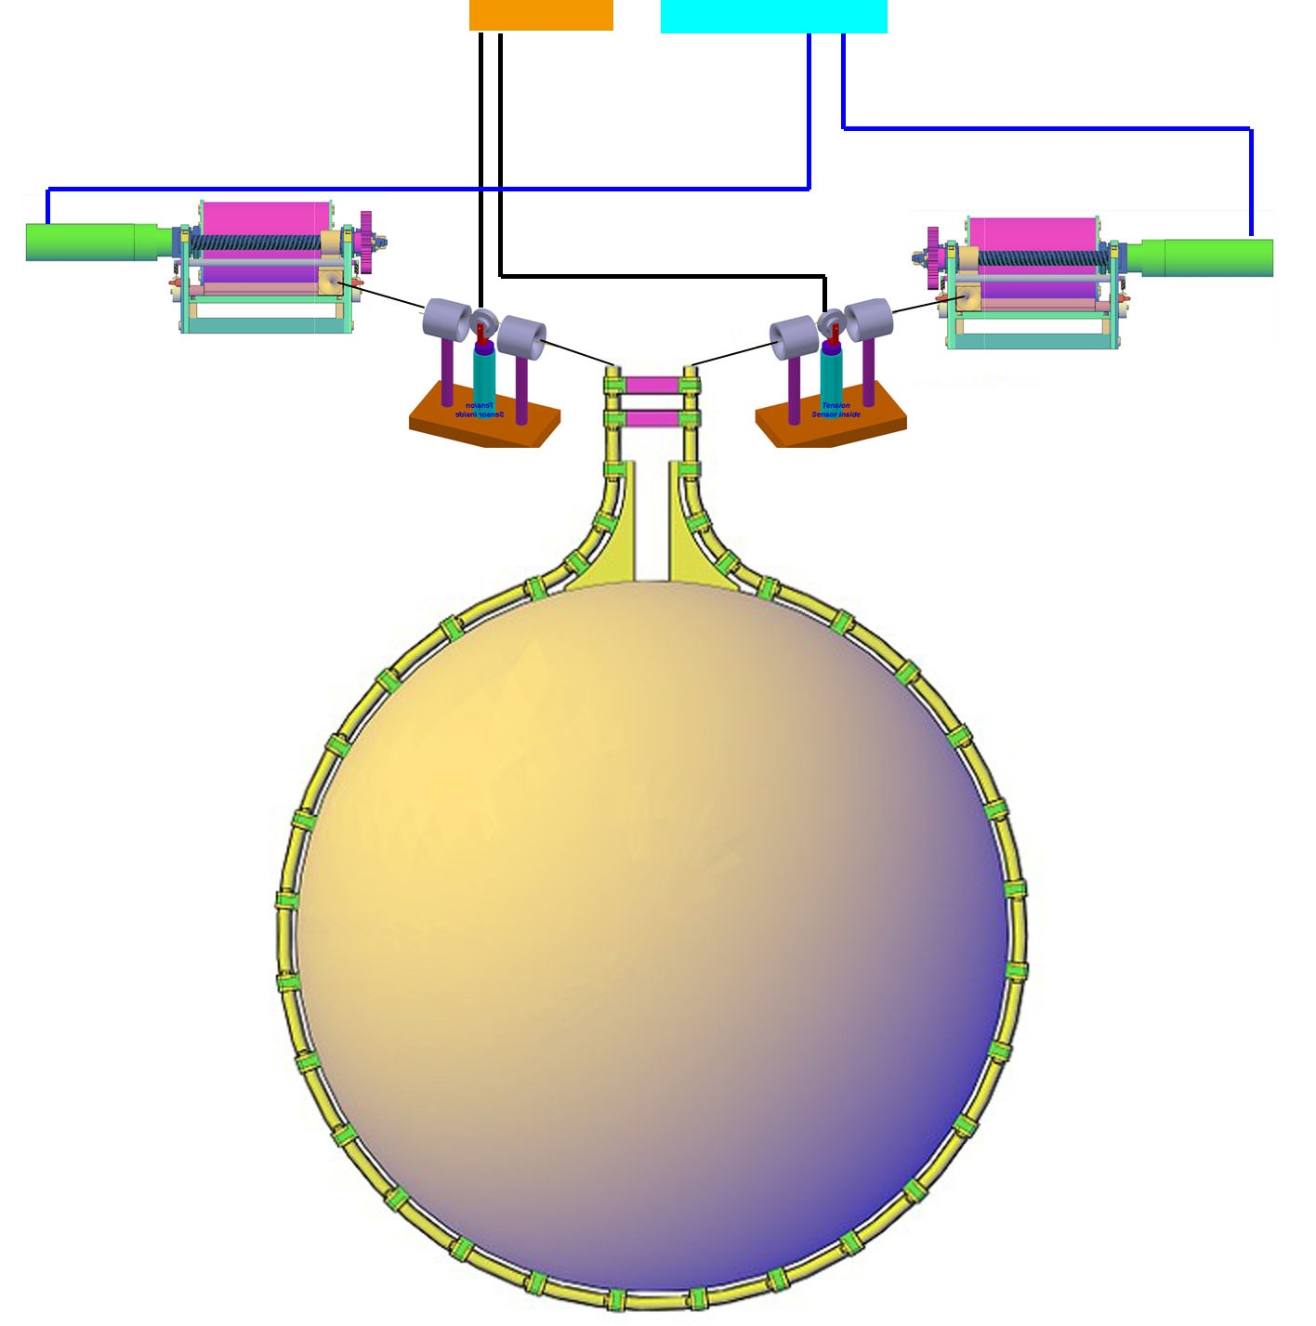
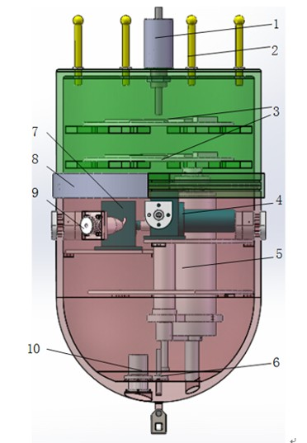
A Comprehensive Calibration System
Automatic Calibration Unit (ACU)
Cable Loop System (CLS)
Remotely Operated under-liquid-scintillator Vehicles (ROV)
Guide Tube Calibration System(GTCS)
Complementary for covering entire energy range of reactor neutrinos and full-volume position coverage inside JUNO central detector
9

Slide 10
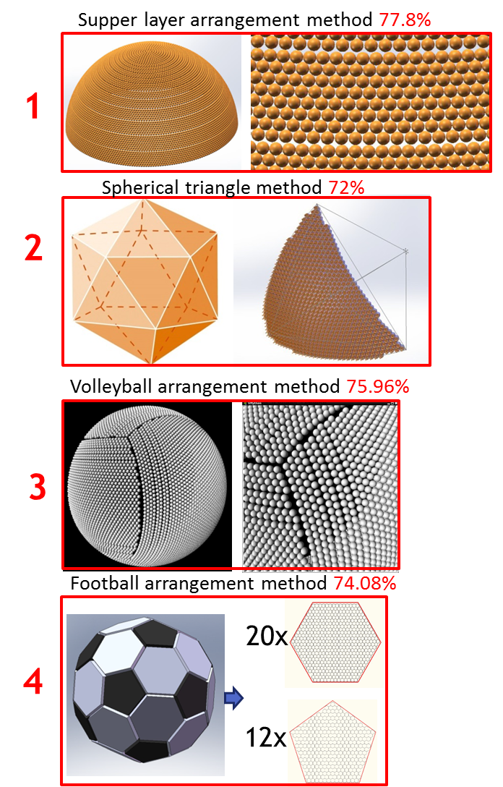
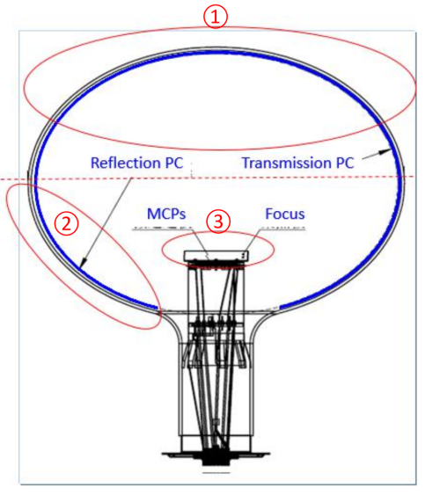
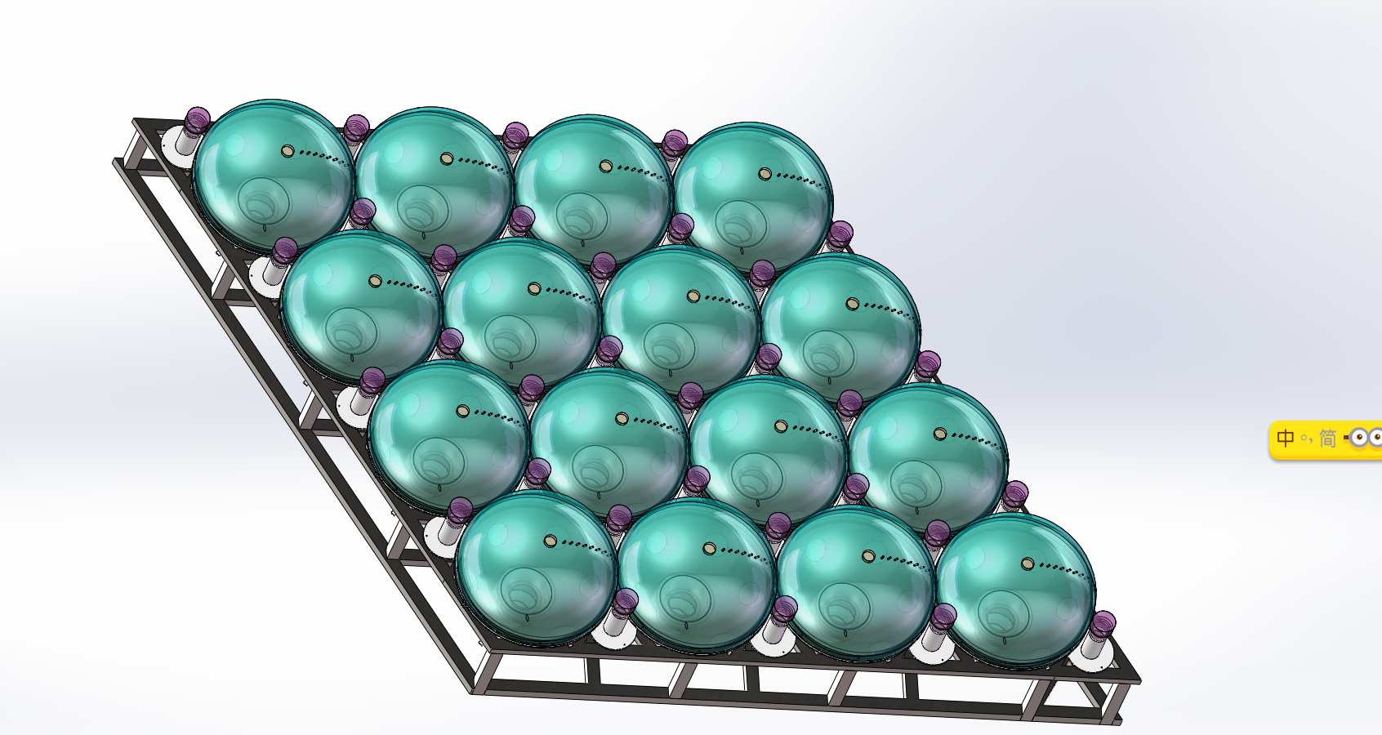
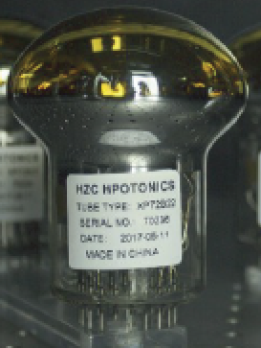
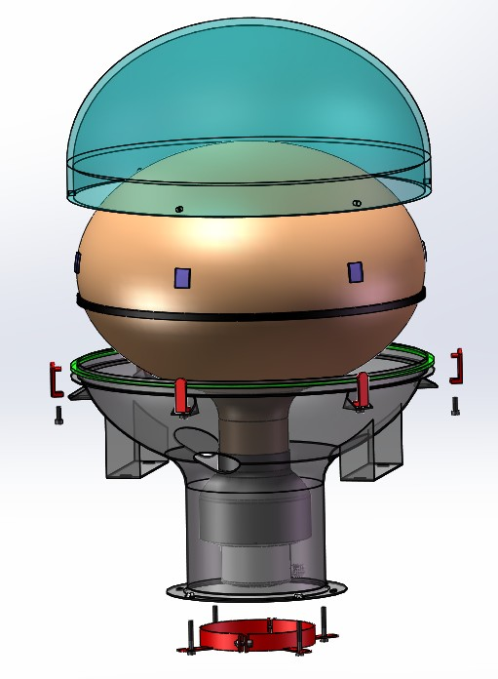
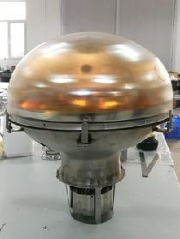
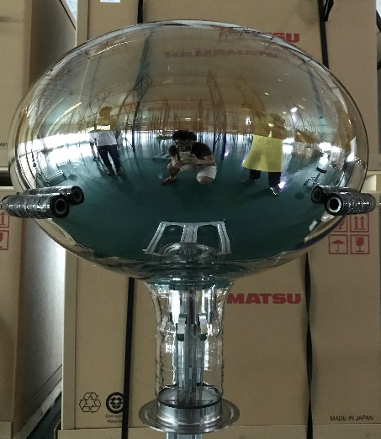
Packing PMTs as Tight as Possible and Keep Them Safe
20” PMT (~18K)
MCP-PMT (~13K)
Hamamatsu HQE (5K)
3”sPMT(~25K)
HZC XP72B22 (Photonis)

Slide 11
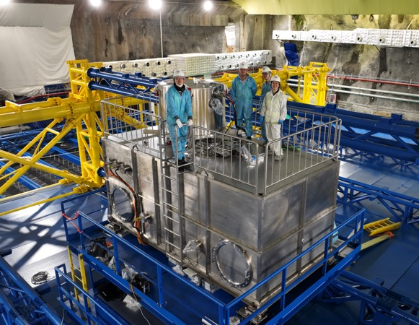
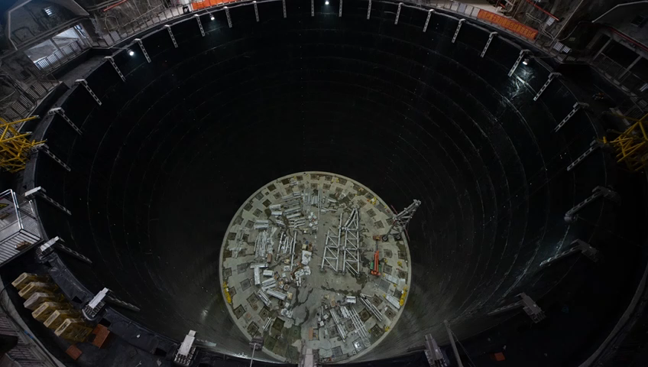
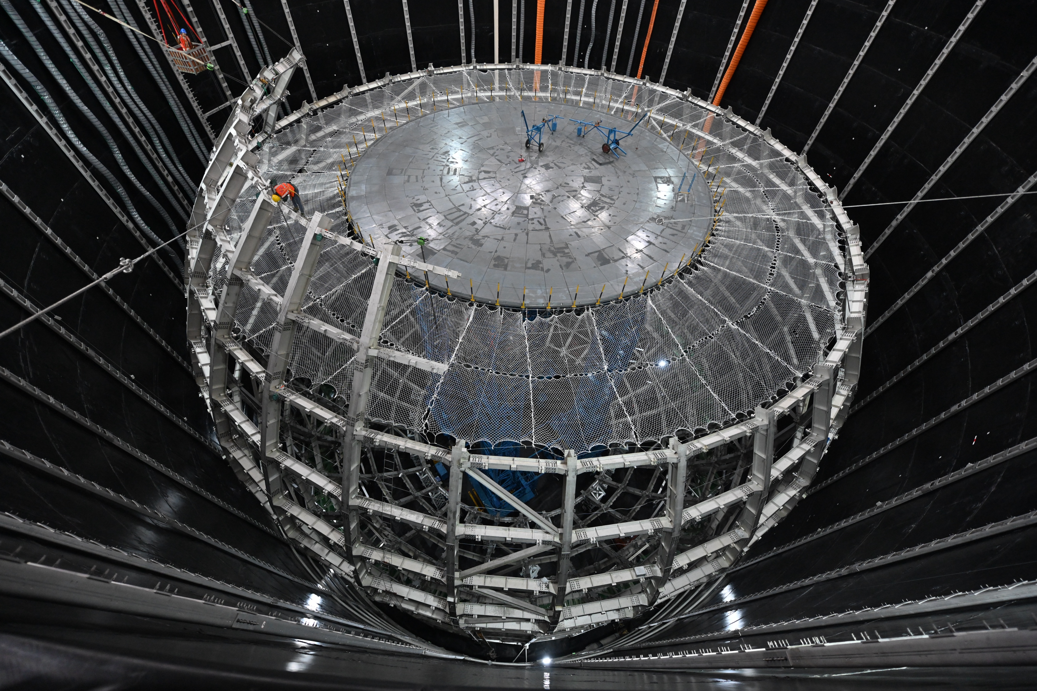
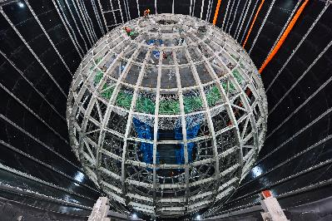
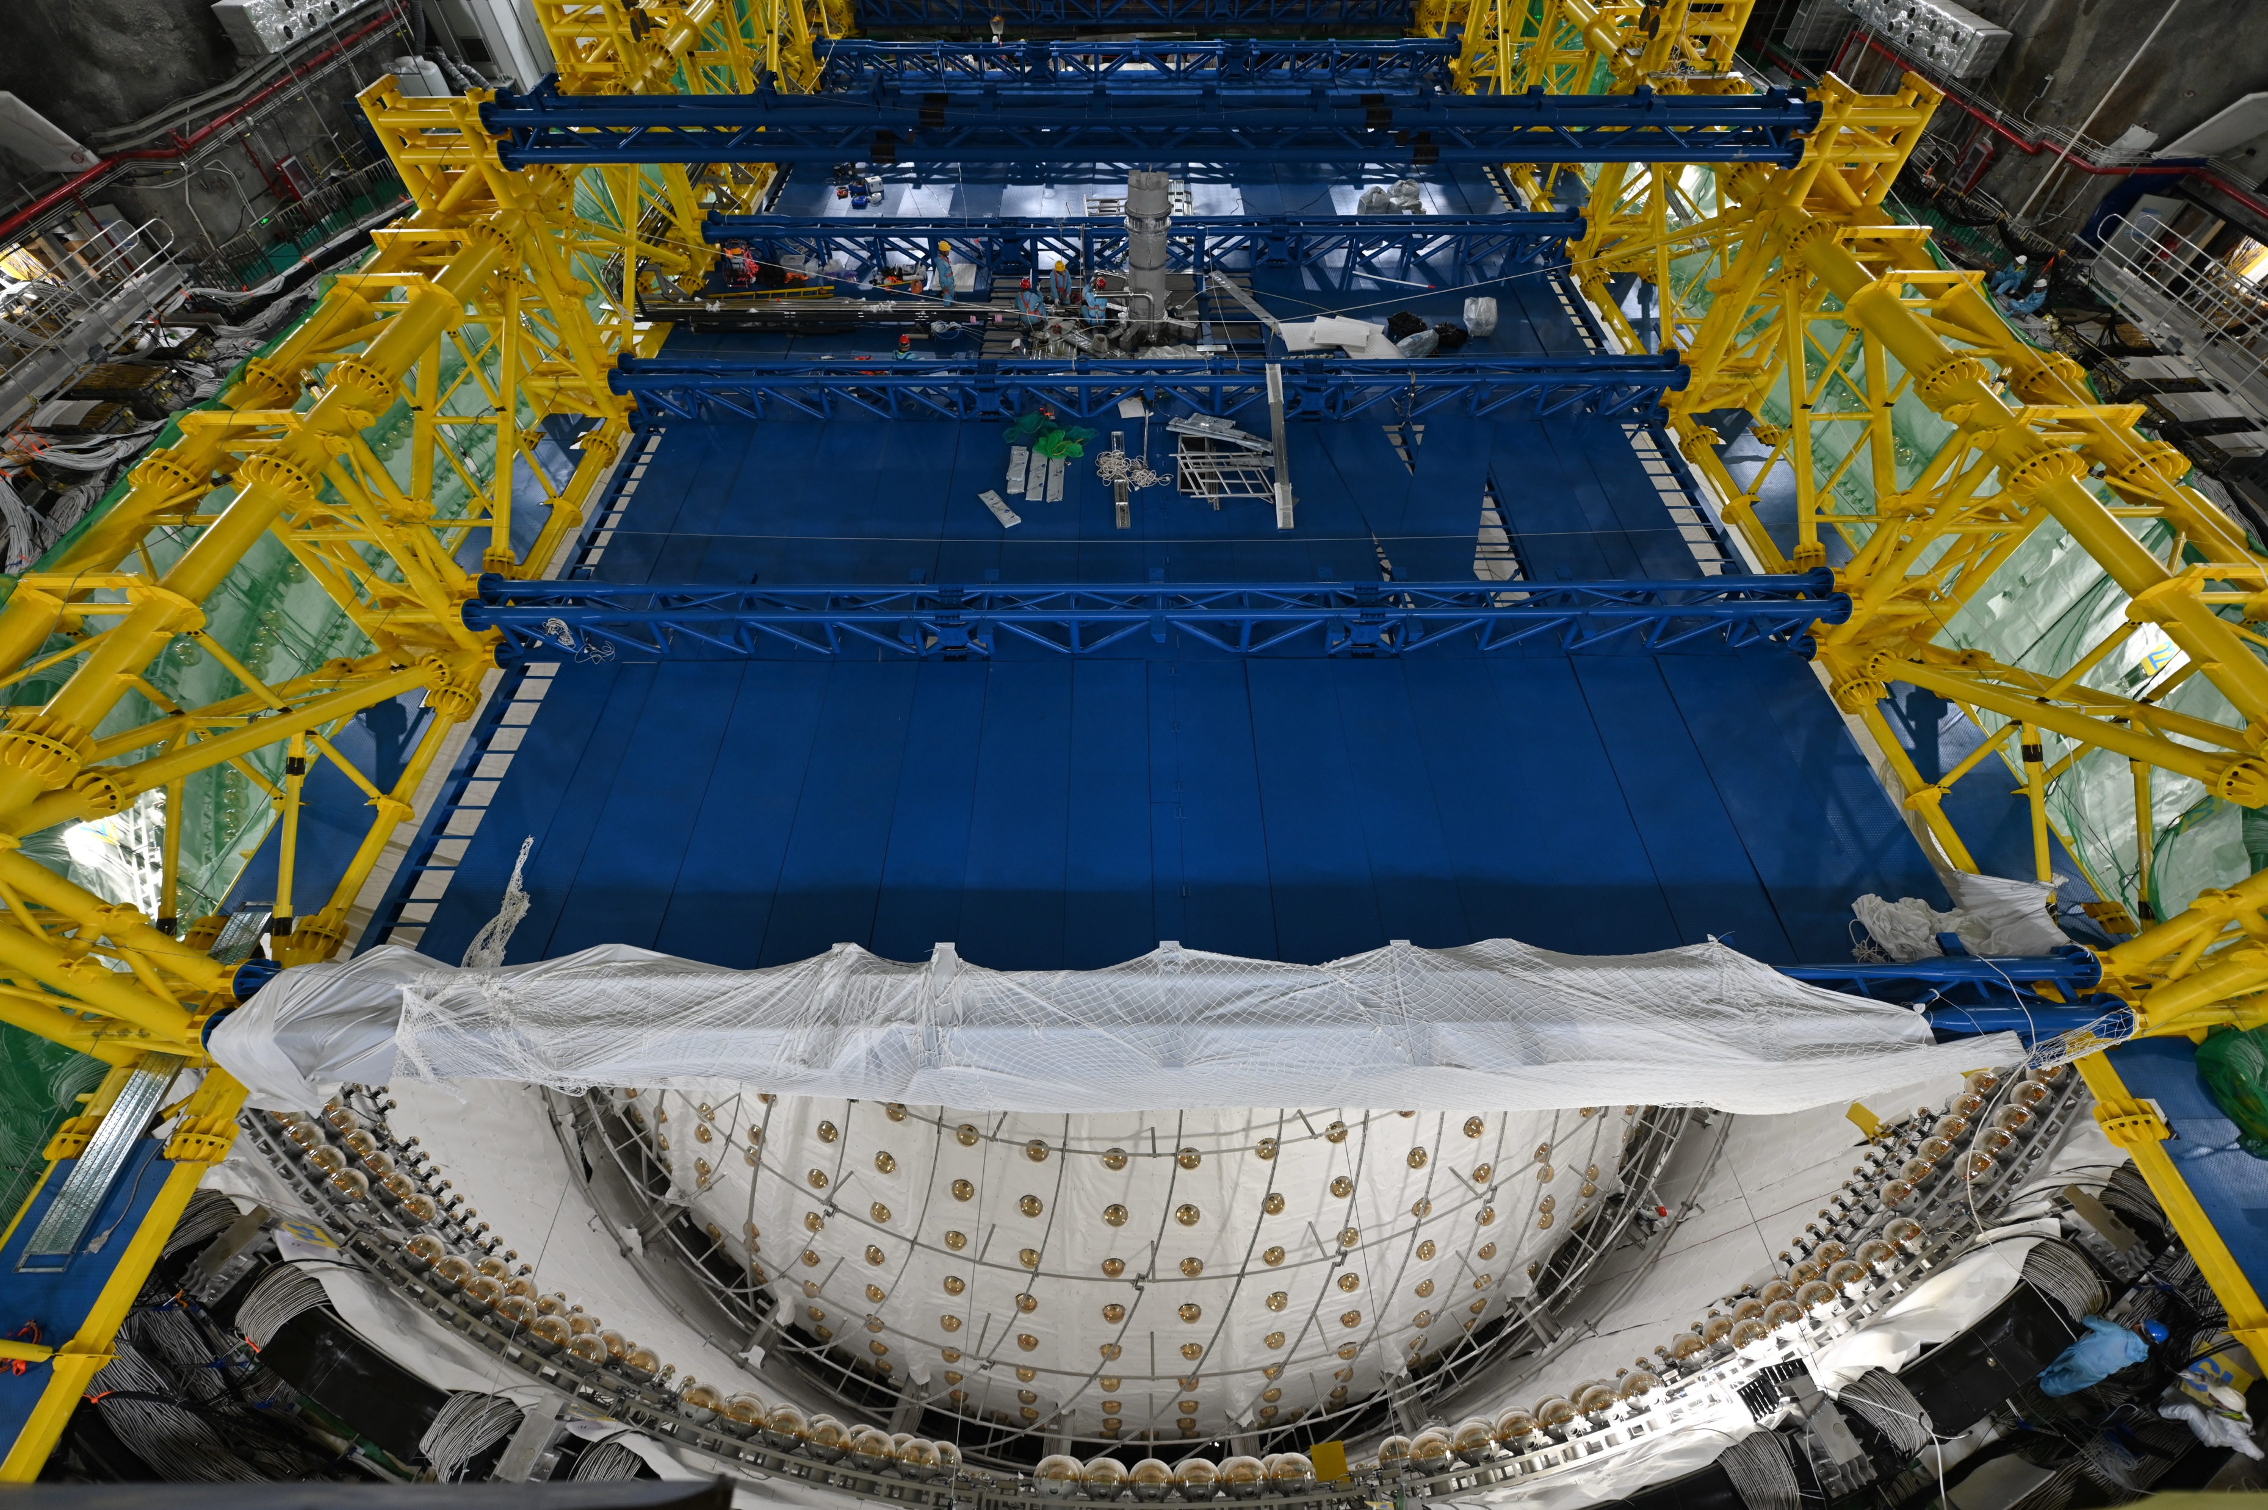
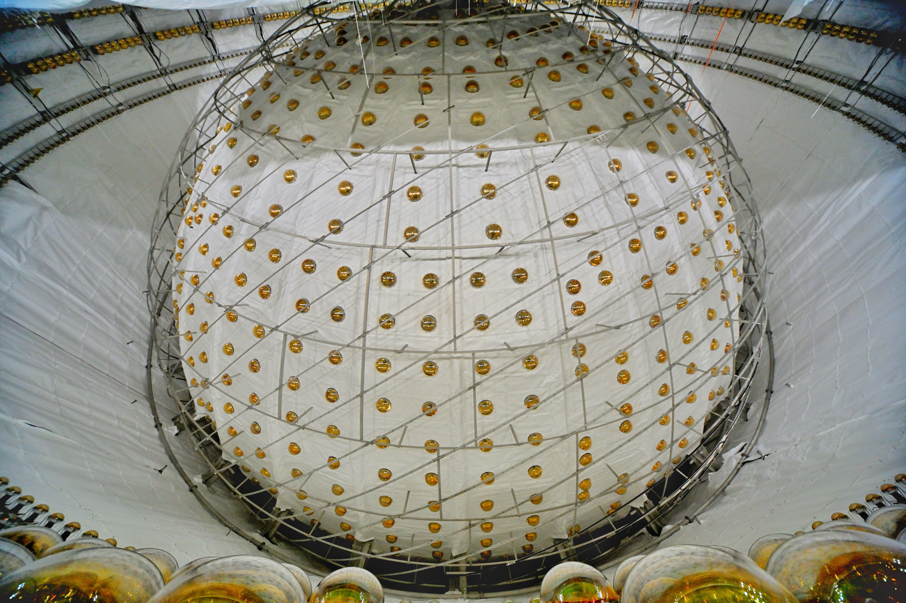
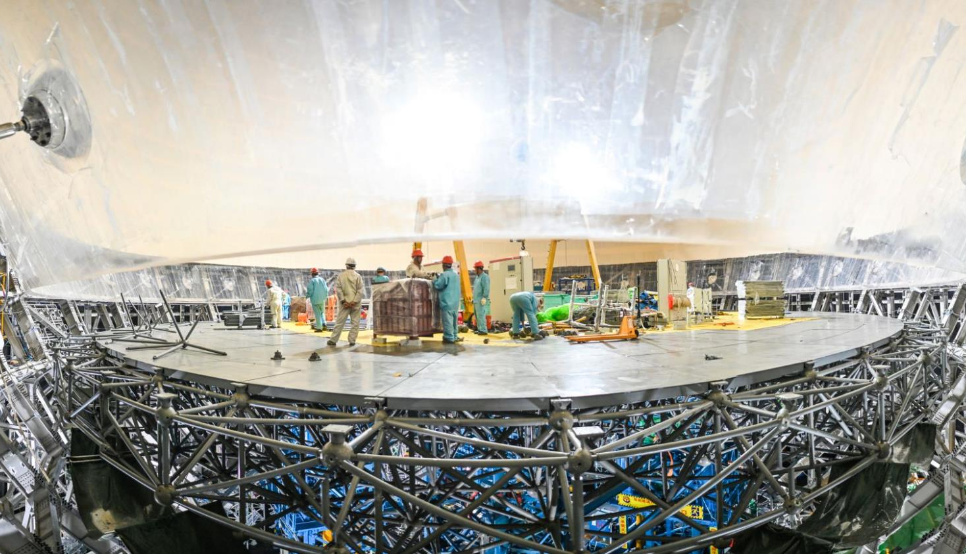
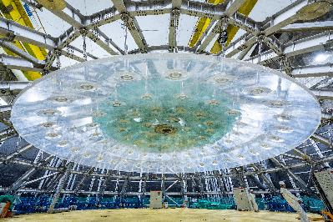
The Construction of the Central Detector of JUNO

Slide 12
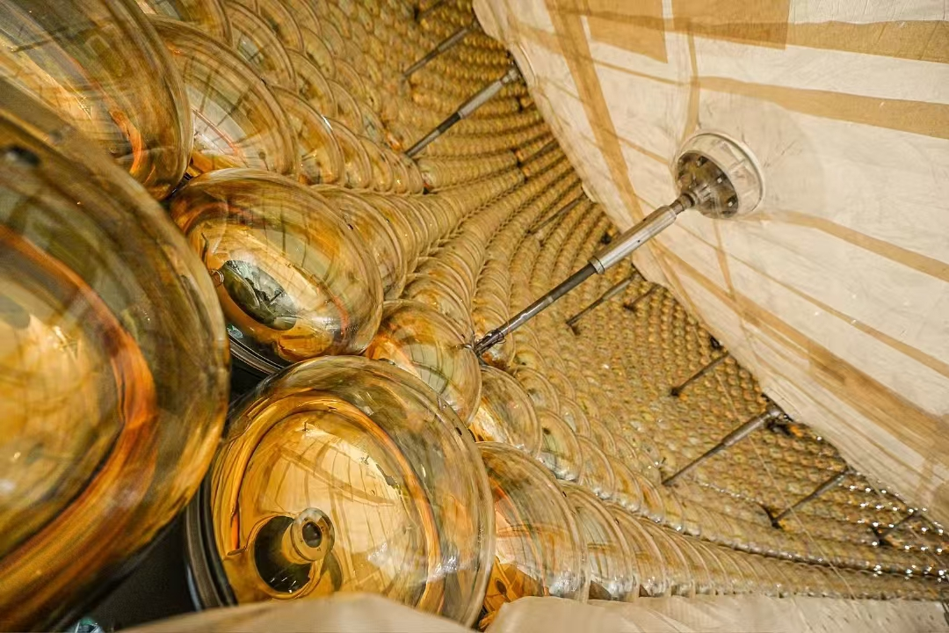
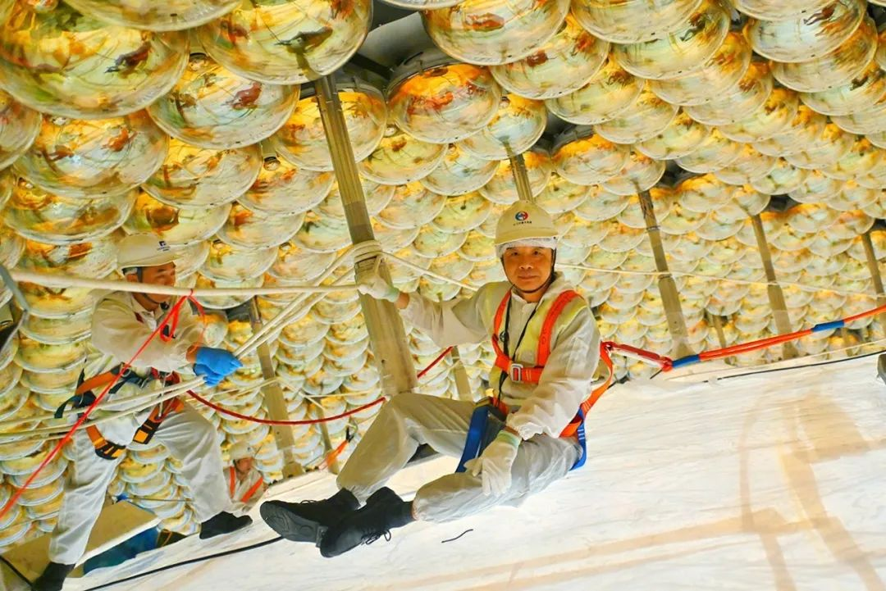
Views from Inside of the Central Detector
 | LPMT (20-inch) |  | SPMT (3-inch)
 | Hamamatsu | NNVT | HZC
Quantity | 5,000 | 15,012 | 25,600
Coverage | 75% |  | 3%
Reference | Eur.Phys.J.C 82(2022) 12, 1168 |  | NIM.A 1005 (2021) 165347

Slide 13
13

Slide 14
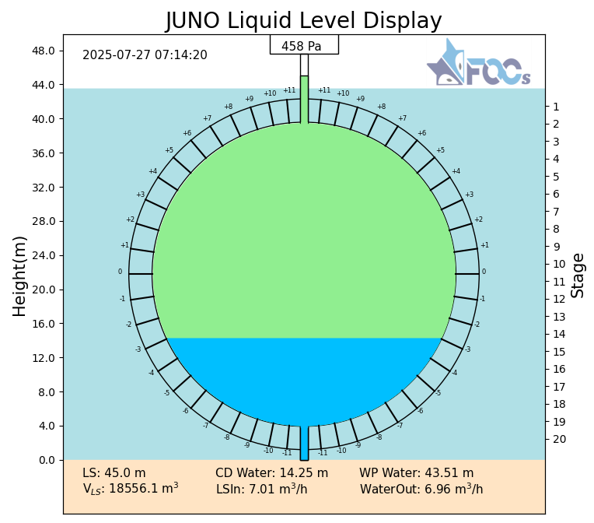
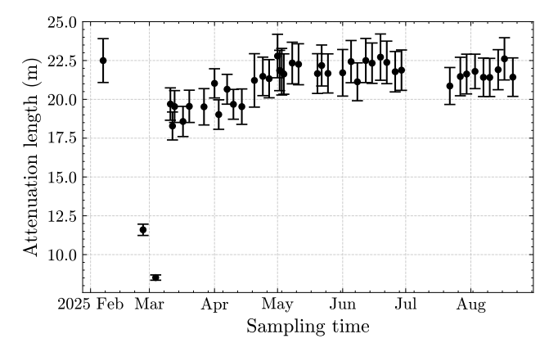
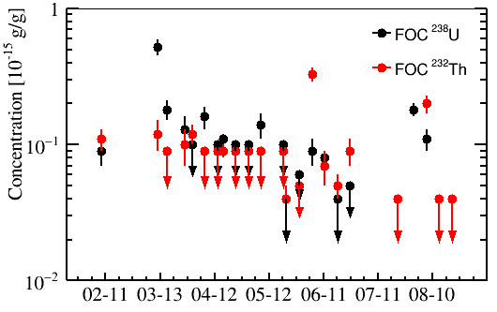
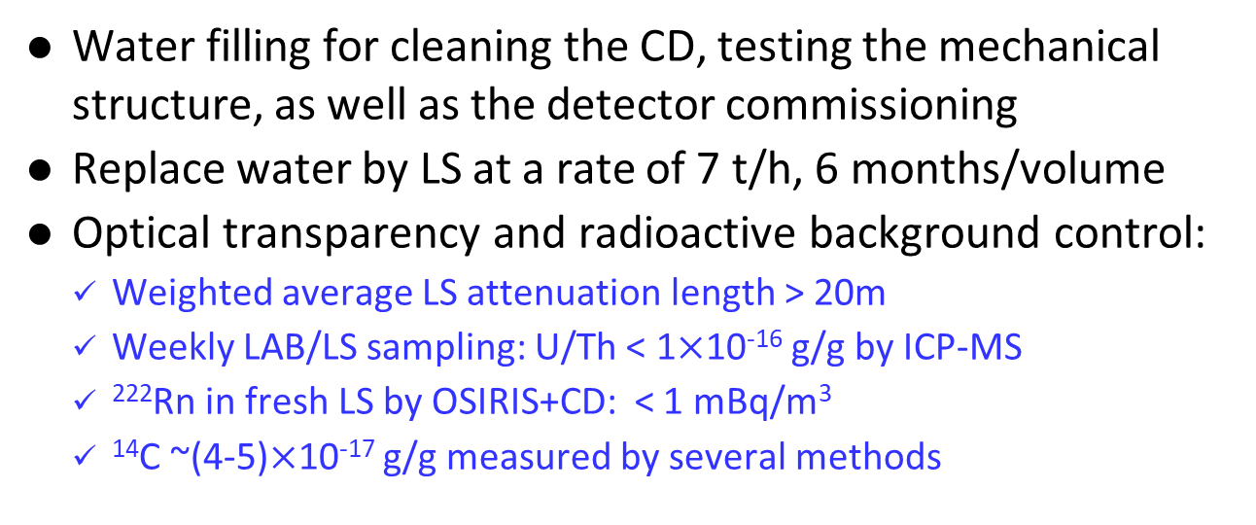
Water and LS Filling
Yifang’s Slide @ 𝛎’26
Water filling for cleaning the CD, testing the mechanical structure, as well as the detector commissioning
Replace water by LS at a rate of 7 t/h, 6 months/volume
Optical transparency and radioactive background control:
    Weighted average LS attenuation length > 20m
    Weekly LAB/LS sampling: U/Th < 1$×$10⁻¹⁶ g/g by ICP-MS
    ²²²Rn in fresh LS by OSIRIS+CD: < 1 mBq/m³
    ¹⁴C ~(4-5)$×$10⁻¹⁷ g/g measured by several methods
by ICP-MS
LS Filling completed on 8/22/2025
LS in the CD: 23231.6 m³
Water in the pool: 41225.1 m³
Weighted average attenuation length = 20.6 m

Slide 15
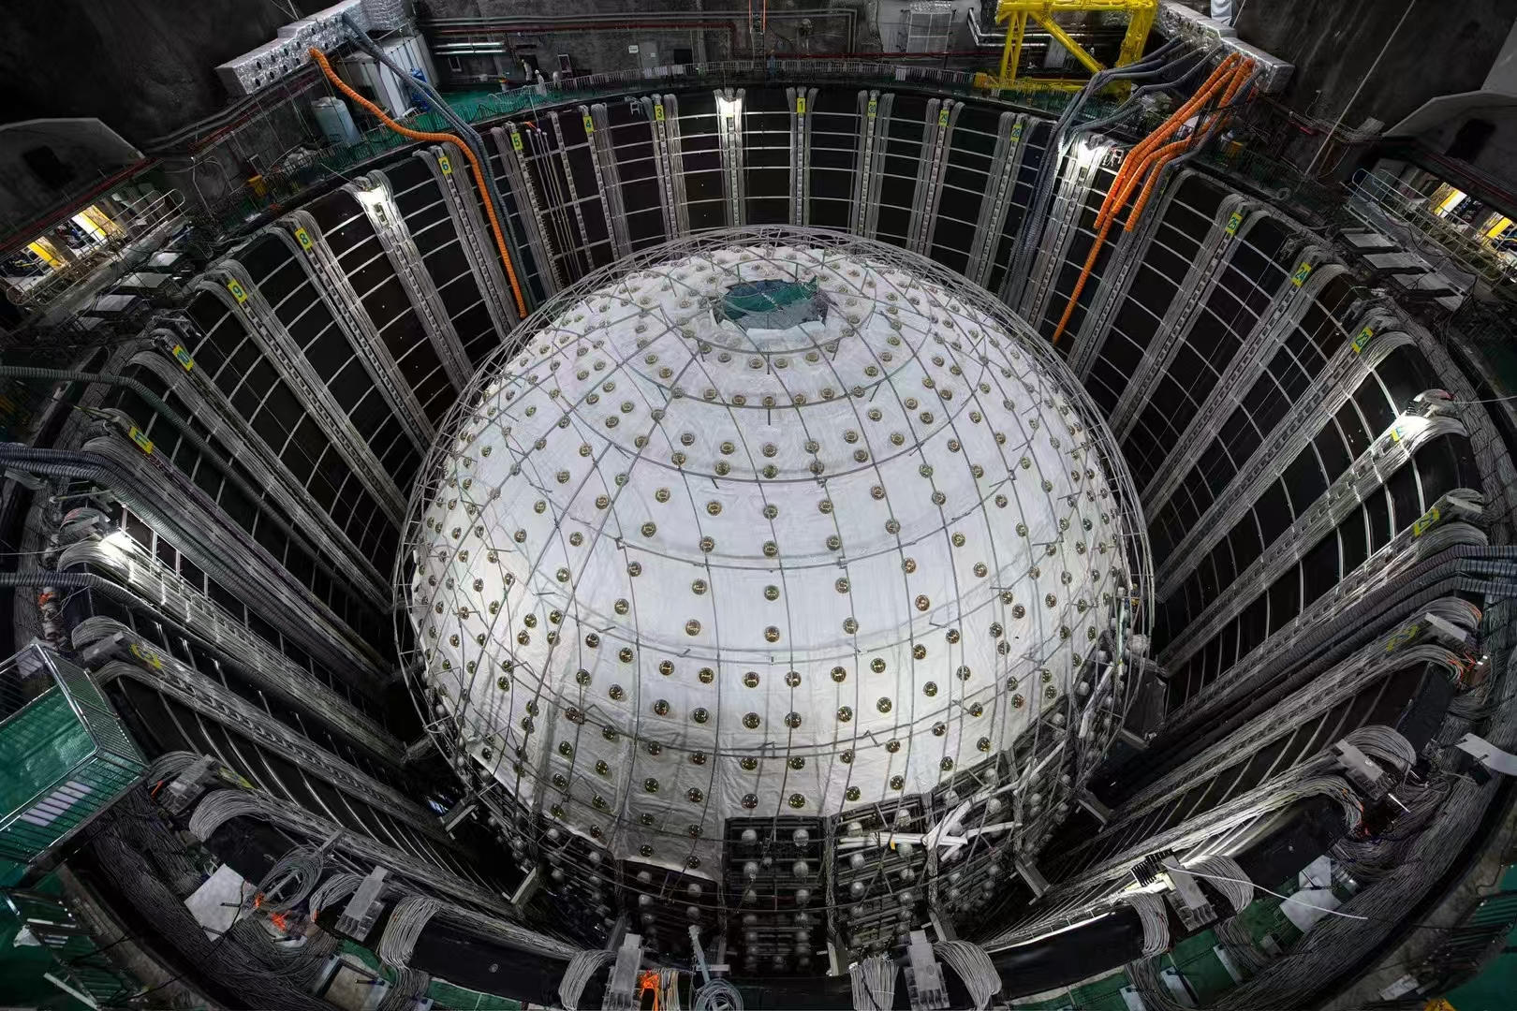
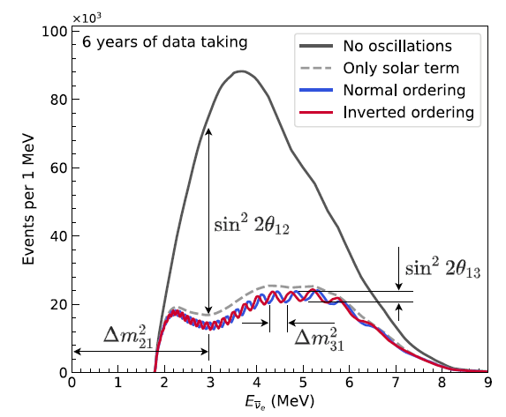
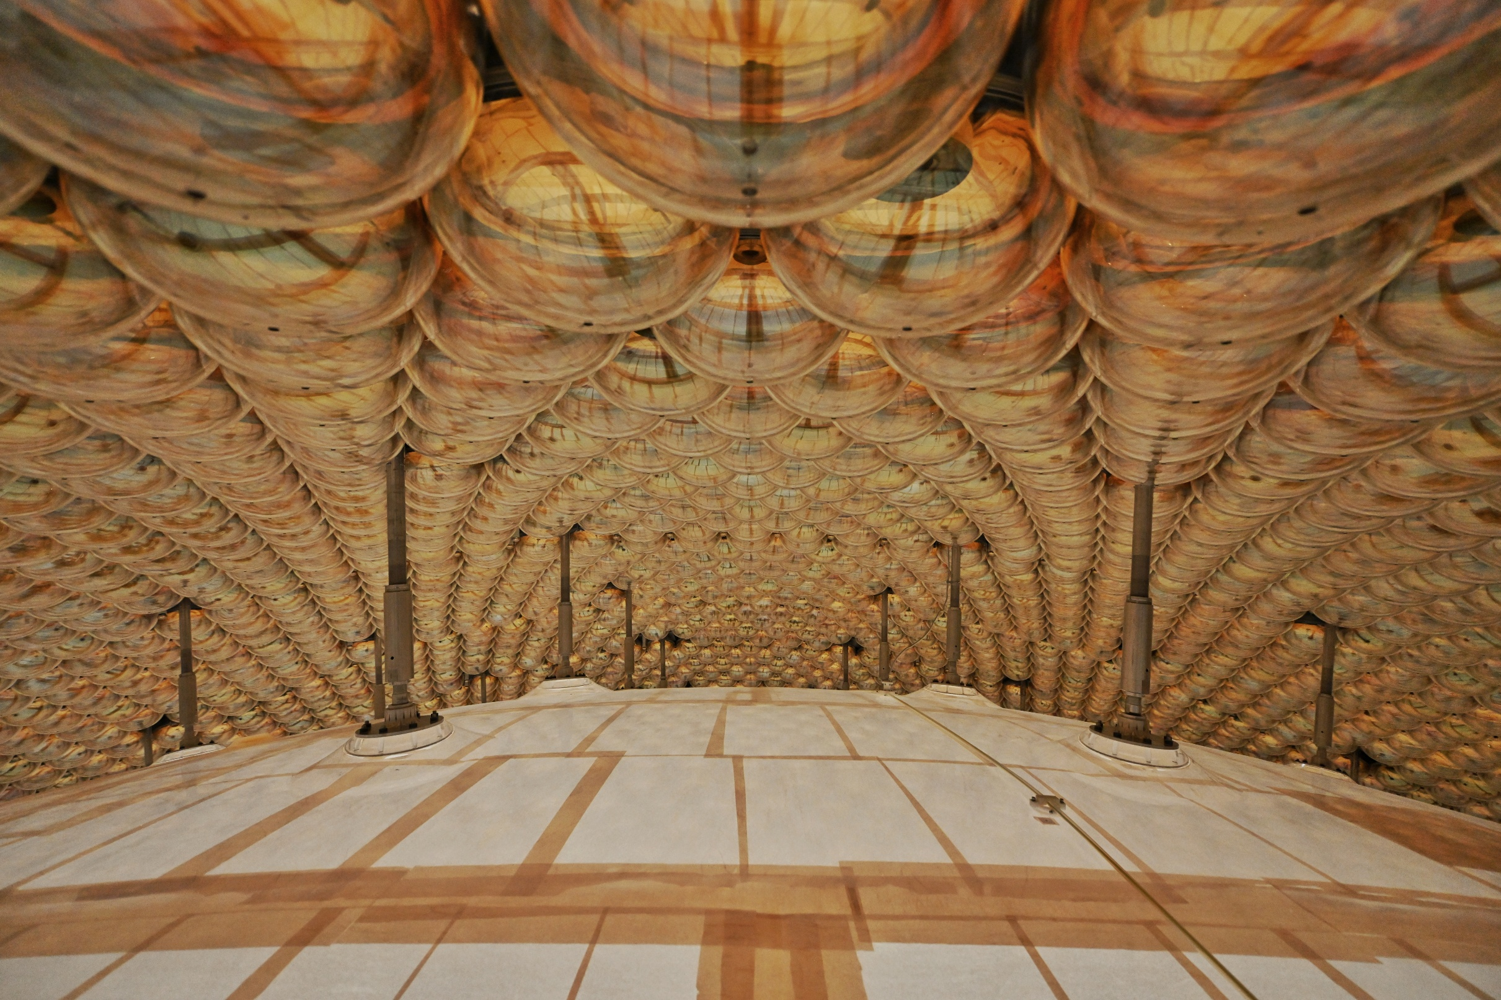
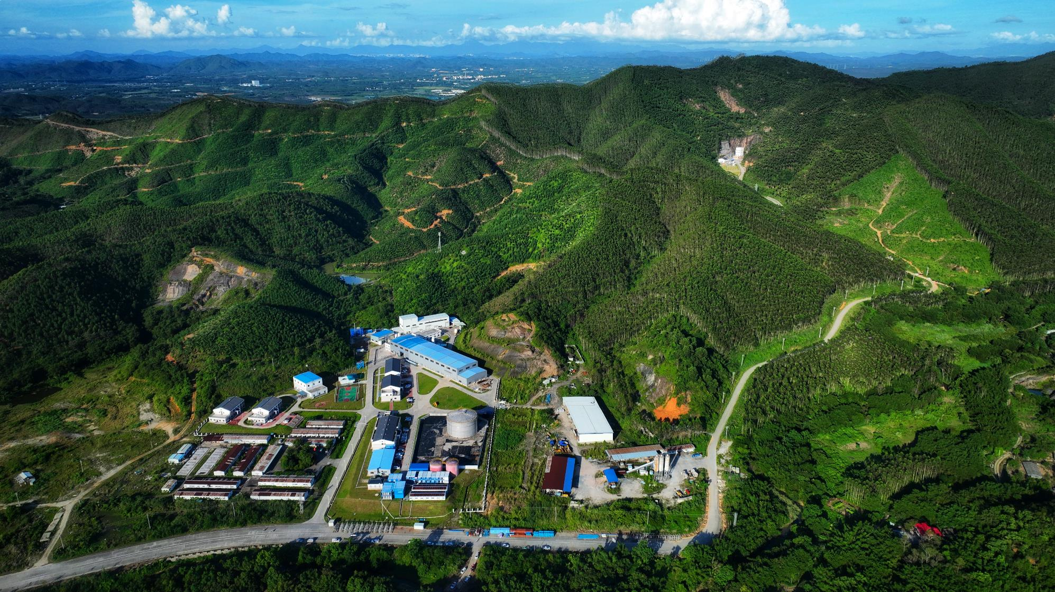
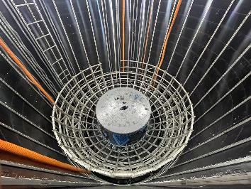
Major Milestones of the JUNO Experiment
Project Approved
and Funded!
Civil completed
Detector Const. Started
Civil Started
2023-2024-2025
2013
2015
2017
2021
2022
NNVT PMTs
Delivered
Detector completing,
Filling starting
Summer 2025: Data Taking!

Slide 16
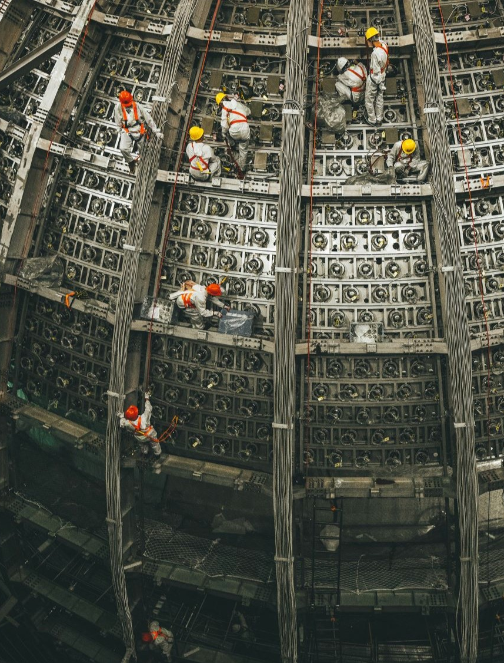
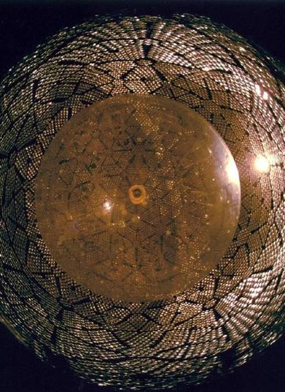
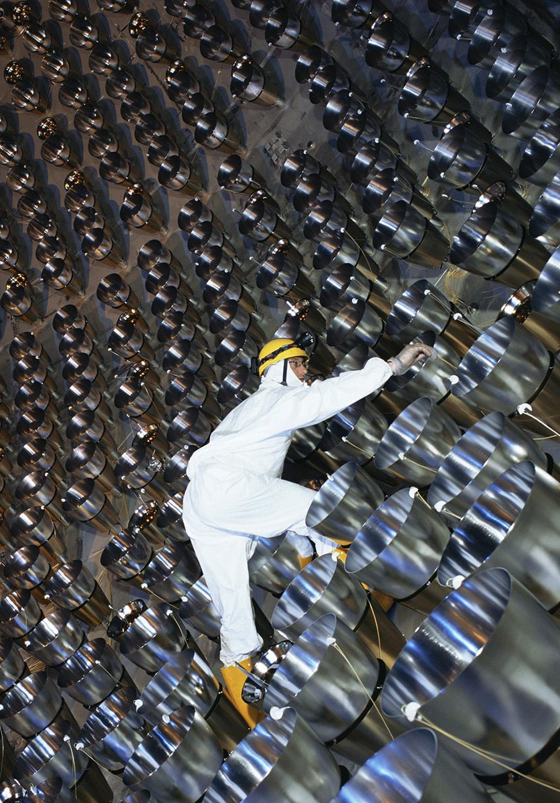


The Evolution of Large Volume LS Detectors: 1956-2025
From 200+kg to 20kt over 70 years
300 L
8 x 20 tons
300 t
1000 t
20,000 t
16

Slide 17



The First Physics Results from JUNO (Nov 2025 & Jun 2026)
First results using 59 days of data already published, Nov 2025 – Jun 2026
First Neutrino Mass Ordering 207 days of data @ 𝛎’26

Slide 18


Data Taking
Yifang’s Slide @ 𝛎’26
Data taking period for this analysis: 2025.08.30-2026.05.18
Golden data are selected for physics analysis
Water leak to LS
Power outage due to weather is one of the main causes of interruptions

Slide 19

Calibration
Yifang’s Slide @ 𝛎’26
1D (central axis): ¹³⁷Cs, ⁵⁴Mn, ⁴⁰K, ⁶⁸Ge, ⁶⁰Co, Am-C, Am-Be, sensors, laser
2D (cable loop): Am-C, ⁶⁸Ge, ¹³⁷Cs
3D using cosmogenic backgrounds:
  Bi-Po214 from Rn decays, spallation neutrons, other cosmogenic isotopes
Positions at which source calibration performed
No ²²²Rn leakage or other contaminations introduced during calibration

Slide 20



Reconstruction and Energy Correction
Yifang’s Slide @ 𝛎’26
Vertex and energy are determined by maximum likelihood taking into account PMT response, geometry, optical properties, verified by calib. sources
Other reconstruction methods give similar results
Time dependent variations corrected by Po214 in the whole volume, check by n-H from IBD
Residual r-θ-t dependence (~1%) further corrected by ²¹⁴Po in the whole volume
Energy scale anchored at nH from ⁹Li+IBD
Final performance checked by IBD nH in r < 17.2m
  Residual spatial non-uniformity RMS ~0.2%
  Residual time dependent variation RMS ~0.3%
Preliminary
RMS = 0.05%
Preliminary
RMS = 0.3%

Slide 21




Energy Non-linearity
Yifang’s Slide @ 𝛎’26
Preliminary
Non-linearities of LS and electronics are determined by calibration sources at the center: ⁶⁸Ge, ¹³⁷Cs, ⁵⁴Mn, ⁴⁰K, ⁶⁰Co, Am-C, and Am-Be
The non-linearity model for e⁺ is based on Geant4 and γ-sources
The model is constrained by cosmogenic isotopes, ¹¹C(e⁺), ¹⁰C(e⁺), ¹²B(e⁻), ⁸Li (e⁻), ⁸B(e⁺), ⁶He(e⁻), etc. in the whole volume
Using sPMTs to correct and constrain LPMT instrumental non-linearity
Uncertainty < 1%
γ @Detector center
Cosmogenic ¹²B
Cosmogenic ¹¹C
Cosmogenic ¹⁰C
21

Slide 22



Light Yield and Energy Resolution
Yifang’s Slide @ 𝛎’26
Light yield at the detector center is ~1600 PE/MeV for ⁶⁸Ge and ~1785 PE/MeV for neutrons, in good agreement with MC
Energy resolution for ⁶⁸Ge is ~3.5% @ 2× 0.511 MeV at the center, slightly worse than the expected 3.1%
  Better MC for Č process, optical boundaries, δ electrons, …
  Possible improvements: ML to remove ¹⁴C, more calibration, better reconstruction and fitting methods, …
Energy resolution for alpha from ²¹⁴Po is ~2.9% @0.93MeV
⁶⁸Ge
Light yield of ⁶⁸Ge
Energy resolution vs r³
Preliminary
Preliminary

Slide 23


Energy Resolution Model
Yifang’s Slide @ 𝛎’26
Energy resolution is particle type, energy and space dependent
An analytical R-dependent resolution model for e⁺ was built using Geant4 simulation and data from calibration sources (α, γ)
An energy response matrix was then used for e⁺ spectrum fitting after adding ¹⁴C pile-up to 5% events
Preliminary
Preliminary

Slide 24

Reactor Neutrino Selection
Yifang’s Slide @ 𝛎’26
Prompt and delayed coincidence in time, space with energy features
energy
Similar to our “Nature” paper
time
What is new in this analysis:
  ~10% more fiducial volume (R=16.5m➔17.2m)
  ~60% reduction of ⁹Li bkg.
  a factor of 50 reduction of accidental bkg. using likelihood cut
  model independent estimate of the ²¹⁴Bi bkg.
space

Slide 25

Reactor Neutrino Event Rate versus Time
Yifang’s Slide @ 𝛎’26
Measured reactor neutrino event rate consistent with expectation
Total live time is 207.2 days
χ²/n.d.f. = 40.1/37

Slide 26


Measured Reactor Neutrino Spectrum
Yifang’s Slide @ 𝛎’26
Fitting constrained by the near detector spectra from TAO (talk by Yichen) and Daya Bay (PRL 130 16, 161802)
Consistent results from three independent analyses

Slide 27



New Results of Solar Oscillation Parameters
Yifang’s Slide @ 𝛎’26
Even though the statistical uncertainty is dominant, systematic errors become important:
  ²¹⁴Bi bkg. and detection eff. can be improved
Δm²₂₁ | 7.388±0.078 (1.60% →1.06%)
sin²θ₁₂ | 0.3036±0.0064 (2.8%→2.1%)

Slide 28


First Result of Δm²₃₁
Yifang’s Slide @ 𝛎’26
Due to statistical fluctuations, JUNO only profiles of Δm²₃₁ have multiple minima
The final minimum for each mass ordering is obtained by using the Δm²₃₁ constraint from the Daya Bay result (PRL 130 16, 161802)
Feldman-Cousins (FC) method is used to determine the 1σ range of Δm²₃₁：~1% precision achieved
[-1.05%，+1.00%]
[-1.00%，+1.08%]

Slide 29

Adding Constraint from NuFit-LBL
Yifang’s Slide @ 𝛎’26
Δm²₃₁ from reactor and accelerator neutrinos should align at the right mass ordering[1]
Adopt the NuFit-LBL results from [2]: normal mass ordering is favored at Δχ² = 4.86
[1] H. Nunokawa, S. Parke and R.Z. Funchal, Phys. Rev. D 72 (2005) 013009; Y. F. Li et al., Phys. Rev. D 88, 013008 (2013)
[2] NuFIT 6.0 (JHEP 12 (2024) 216 [arXiv:2410.05380]), www.nu-fit.org and M. Maltoni private communication

Slide 30


Neutrino Mass Ordering Significance
Yifang’s Slide @ 𝛎’26
Frequentist approach using pseudo exp. to convert Δχ² to significance
Influence of δ_{CP} considered (scanned)
Normal Ordering is favored at 2.3σ
Bayesian approach using Markov Chain Monte Carlo(MCMC) method
Normal Ordering is favored with a Bayes factor of 10.18 ➔ 2ln κ= 4.64
  Consistent with the frequentist Δχ²

Slide 31
Summary --- This is Just the Beginning!
The JUNO detector and TAO are successfully built and operating smoothly
Initial performance shows that the detector works well as designed
Solar oscillation parameters further improved by a factor of 1.3-1.5
First measurement on Δm²₃₁, a precision of ~1%
With external constraint, Normal Mass Ordering is favored at ~2.3σ
NOTE: Many physics results not covered

Slide 32


Nuclear Power Plants and Reactor Neutrinos
中微子会带走反应堆~5%的能量！

Slide 33




展望未来：3个中微子振荡参数精度将达到优于1%的程度！
sin²$2θ_{12}$, $∆m_{21}^{2}$, |$∆m_{32}^{2}$|, leading measurements in 100 days; precision <0.5% in 6 years
Chin. Phys. C46 (2022) 12, 123001

Slide 34



展望未来：质量排序最终达到个标准方差
 | Design | Now
Thermal Power | 36 GW_{th} | 26.6 GW_{th} (26%$↓$)
Signal rate | 60 /day | 47.1 /day (22%$↓$)
Overburden | ~700 m | ~ 650 m
Muon flux in LS | 3 Hz | 4 Hz (33%$↑$)
Muon veto efficiency | 83% | 91.6% (11%$↑$)
Backgrounds | 3.75 /day | 4.11 /day (10%$↑$)
Energy resolution | 3.0% @ 1 MeV | 2.95% @ 1 MeV (2%$↑$)
Shape uncertainty | 1% | JUNO+TAO
3𝜎 NMO sens. Exposure | <6 yrs $×$ 35.8 GW_{th} | ~6 yrs $×$ 26.6 GW_{th}
Sensitivity mostly from 1.5-3 MeV
JUNO NMO median sensitivity:
3σ (reactors only) @ ~6 yrs * 26.6 GW_{th} exposure
Combined reactor and atmospheric neutrino analysis in progress: further improve the NMO sensitivity
arXiv:2405.18008 (2024)

Slide 35
PMT Characterization, Potting and Assembly in a Warehouse

Slide 36





Characterizing/Testing Every Single PMT with Great Care
1000 PE,gain=1X10⁷
SPE Gain reduced by 30%@charge=41C.

