Slide 1

China Jinping Underground Laboratory
(CJPL)
Yue Qian
Tsinghua University(THU)
Charling Tao
THU and CPPM
Long term FCPPL collaboration with LSM Modane.
Now partner of Nexus cf (talk of Feyrouz Malek)

Slide 2
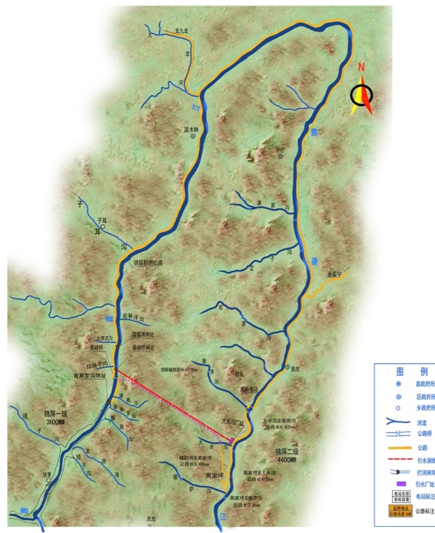
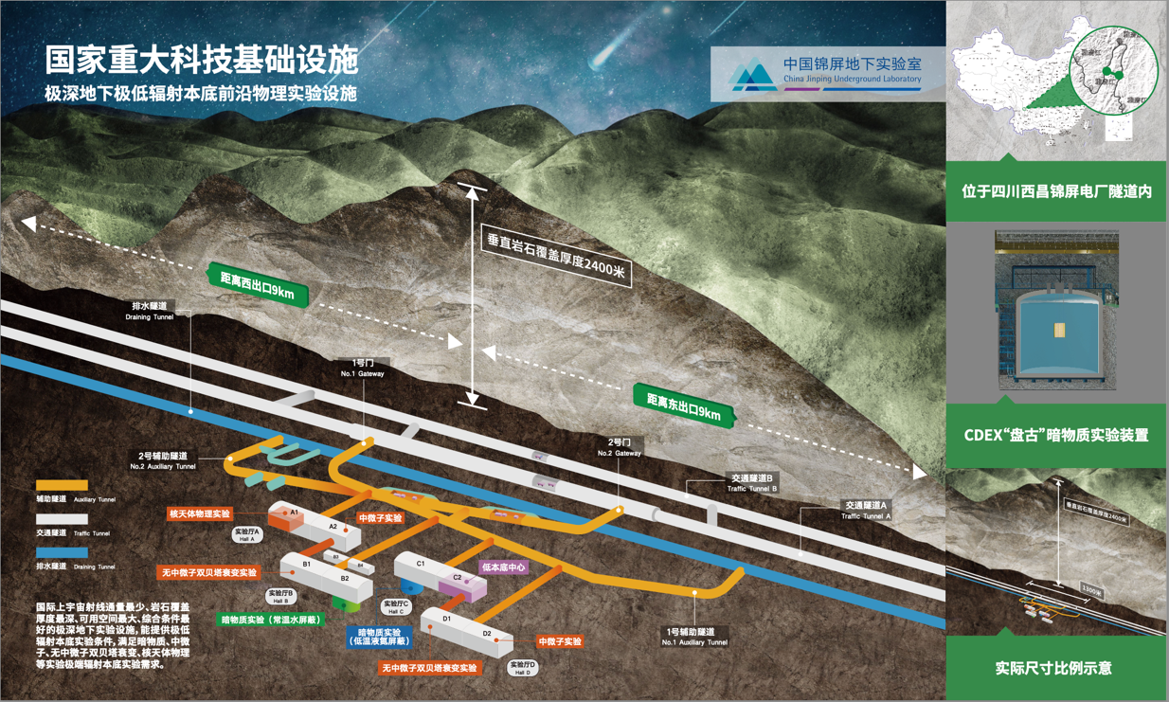
China Jinping Underground Laboratory (CJPL)
Yalong
River
Jinping-I
Hydroelectric
Power Plant
Jinping-II
Hydroelectric
Power Plant
CJPL
JinPing traffic tunnel
~18km length, overburden 2400m
CJPL, located in Xichang City of Sichuan, has advantages with a rock overburden of 2400m, ultra-low muon flux and environmental radiation background. Construction started in 2009
CJPL-I Total space: ~4000 m³, and CJPL-II total space 300000 m³.
Dark matter experiments (CDEX, PandaX) First world class results obtained less than 5 years after start of construction!
nuclear astrophysics(JUNA) , gravitational wave experiment, and others are running in CJPL

Slide 3
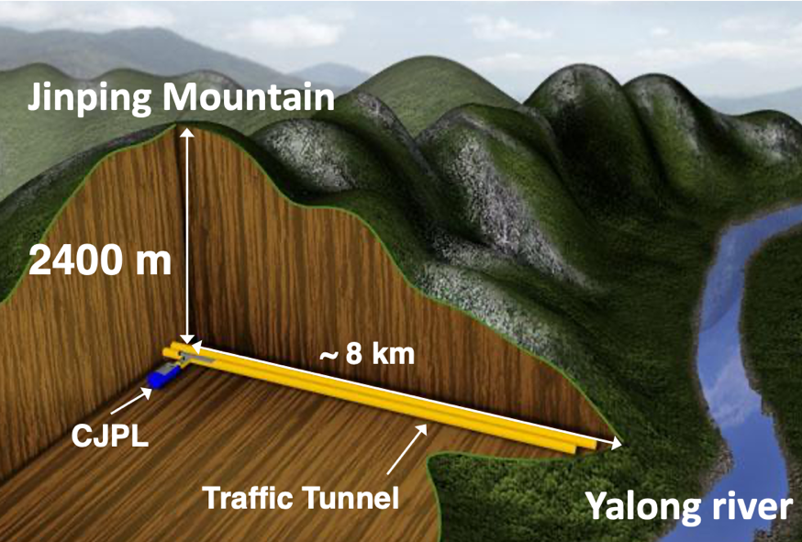
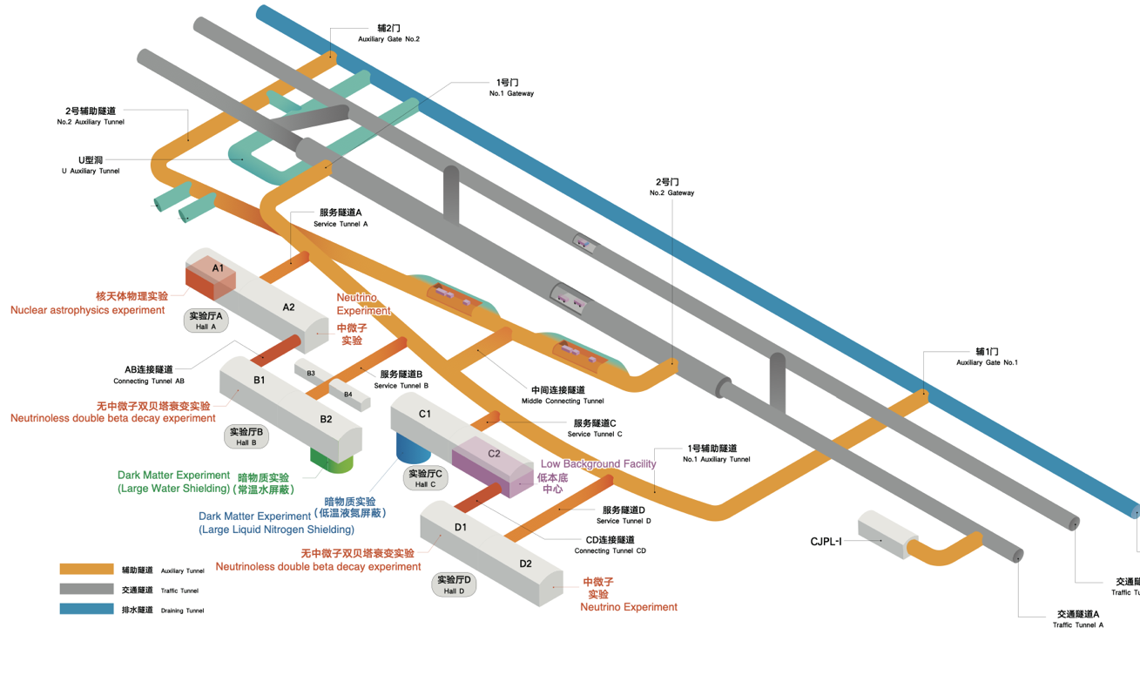
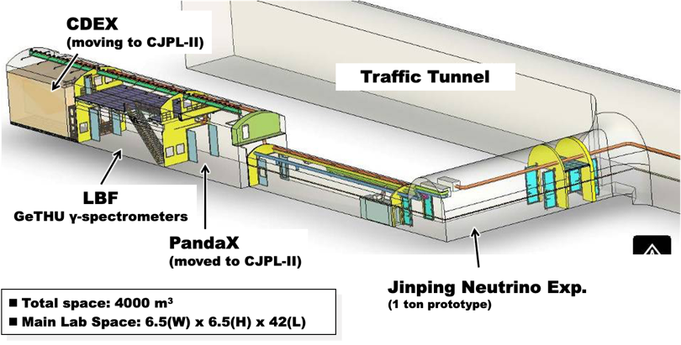
China Jinping Underground Laboratory (CJPL)
Rock overburden 2400 m
Muon flux 3.03×10⁻¹⁰ cm⁻²s⁻¹
Experimental space >330,000 m³
Astro. Phys. 172 , 103147, (2025)
CJPL-II
（330,000 m³）
CJPL-I
(4000 m³)

Slide 4
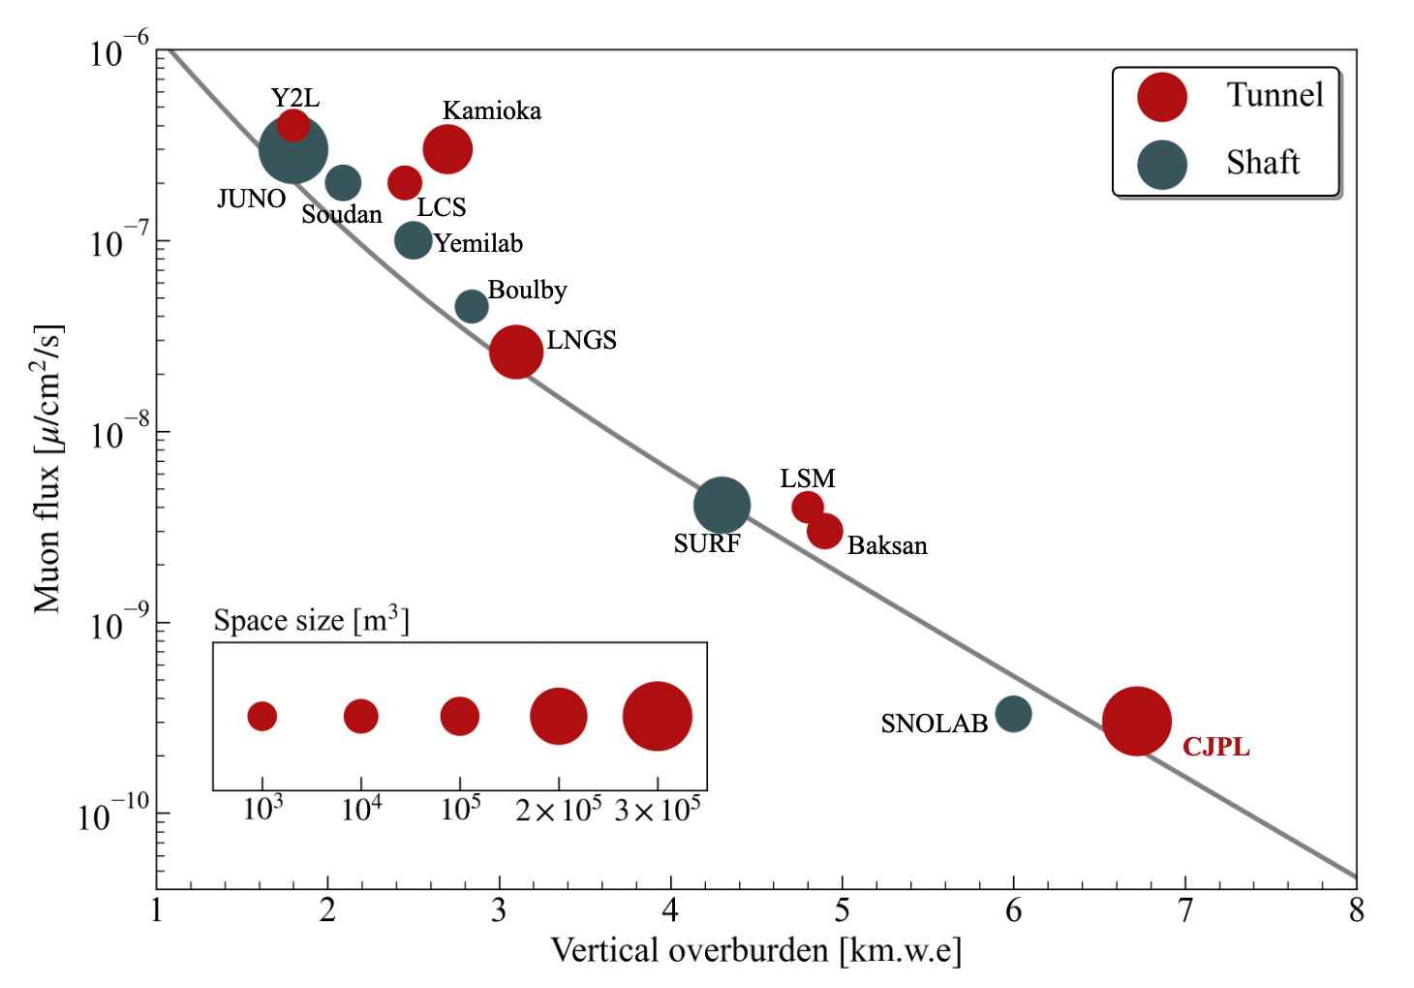
Features of CJPL
Deepest (2400 m) and Largest (>330,000 m³) UG-Lab
with an extremely low μ-flux of ~96 m⁻²yr⁻¹
μ-flux at CJPL-II
  3.03±0.24(stat)±0.18(sys)×10⁻¹⁰ cm⁻²s⁻¹
Astro. Phys. 172 , 103147, (2025)

Slide 5
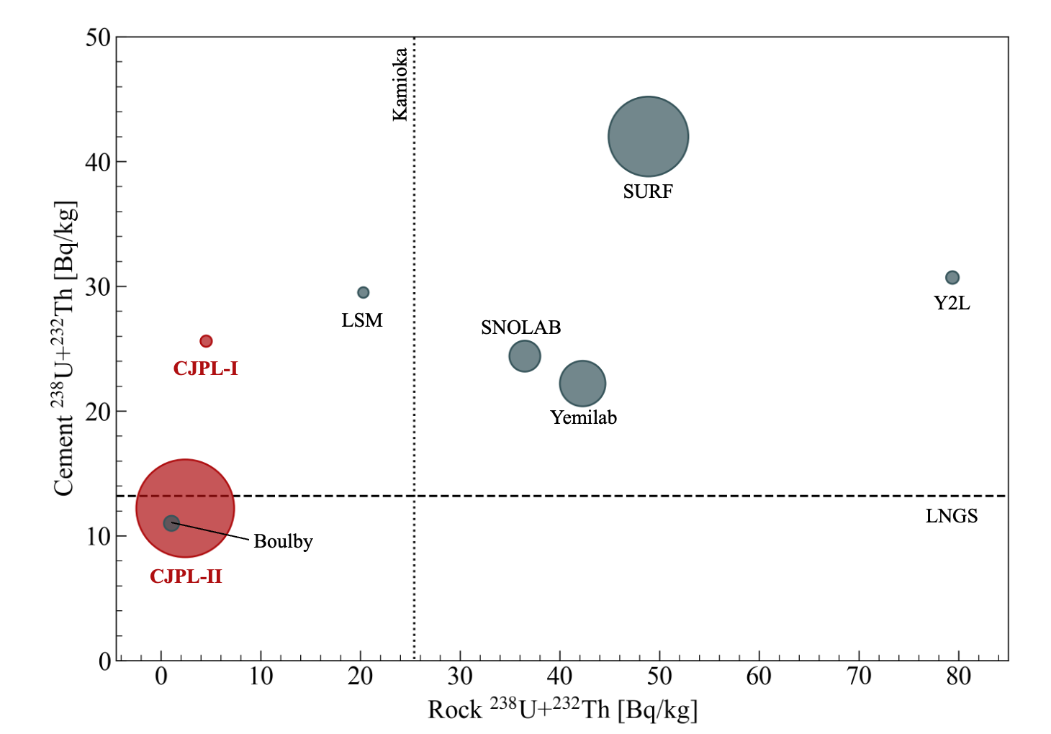
Features of CJPL
Low background Rock and Cement
Tunnel
Ideal Site
Rock in Jinping mountain has low U, Th containments
Rock sample measured by Ge det.
Shaft
(Unit: Bq/kg) | U-238 | Th-232
Jinping Rock | 1.8±0.2 | <0.27
Ground (Beijing) | ~25 | ~50
Control U, Th in cement
Selected raw material
Improved production process
Material screening
Sci Sin-Phys Mech Astron, 2025, 55: 111017

Slide 6
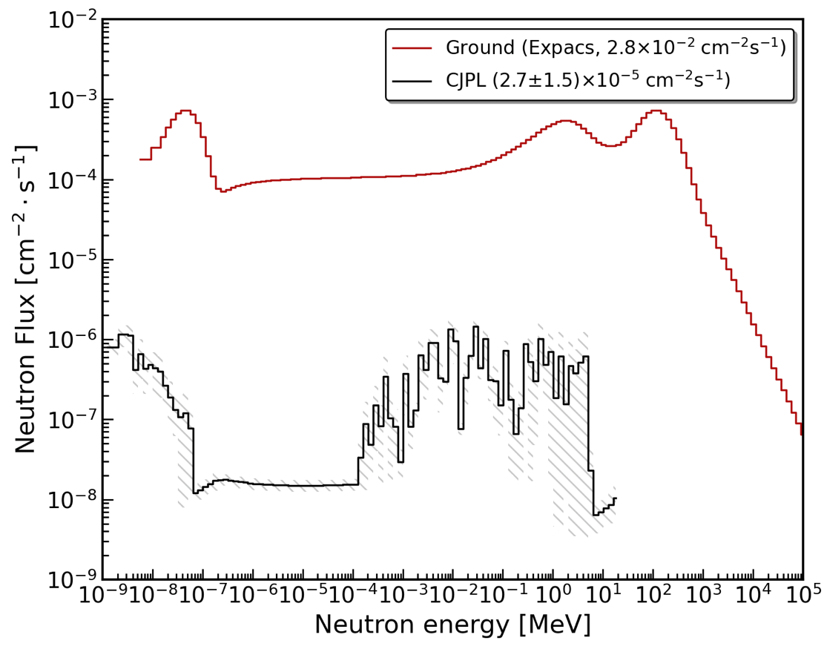
Features of CJPL
Neutron Flux ~1000 times lower than ground level
Lab | Neutron Flux [n/cm²/s]
 | Fast Neutron | Thermal Neutron
Y2L | 8.0E×10⁻⁷ | (2.4±0.2)×10⁻⁵
Soudan | / | (0.7±0.08±0.08)×10⁻⁶
LCS | (0.66±0.01)×10⁻⁶ | (1.13±0.02)×10⁻⁶
Yemilab | (1.4±0.1)×10⁻⁶ | (1.9±0.1)×10⁻⁶
Kamioka | (11.5±1.2)×10⁻⁶ | (8.25±0.58)×10⁻⁶
Boulby | 1.7×10⁻⁶ (E>0.5 MeV) | /
LNGS | 0.86×10⁻⁶ (E>1 keV) | 2.9×10⁻⁶ (E<1 keV)
SURF | / | (1.7±0.1±0.1)×10⁻⁶
LSM | (4.0±1.0)×10⁻⁶ | (1.6±0.1)×10⁻⁶
Baksan | 5.3×10⁻⁷ (E>700 keV) | /
SNO | 4.6×10⁻⁶ | 4.7×10⁻⁶
CJPL | (3.6±2.8)×10⁻⁶ (>1MeV) | (7.0±1.8)×10⁻⁶ (<0.5 eV)
 | PE-Room：(4.9±0.9±0.5)×10⁻⁹ (1-10 MeV)
Expacs: simulated surface neutron spectrum
https://phits.jaea.go.jp/expacs/
Neutron spectrum at hall of CJPL-I
NIMA 859 (2017) 37–40
AAPPS Bull. 34, 25, 2024. NIMA. 626-627, S64–S68, 2011. NIMA. 812:1–6, 2016, Eur. Phys. J. Plus. 127: 108, 2012. Eur. Phys. J. Plus, 127: 109, 2012. Eur. Phys. J. Plus. 127: 111, 2012

Slide 7
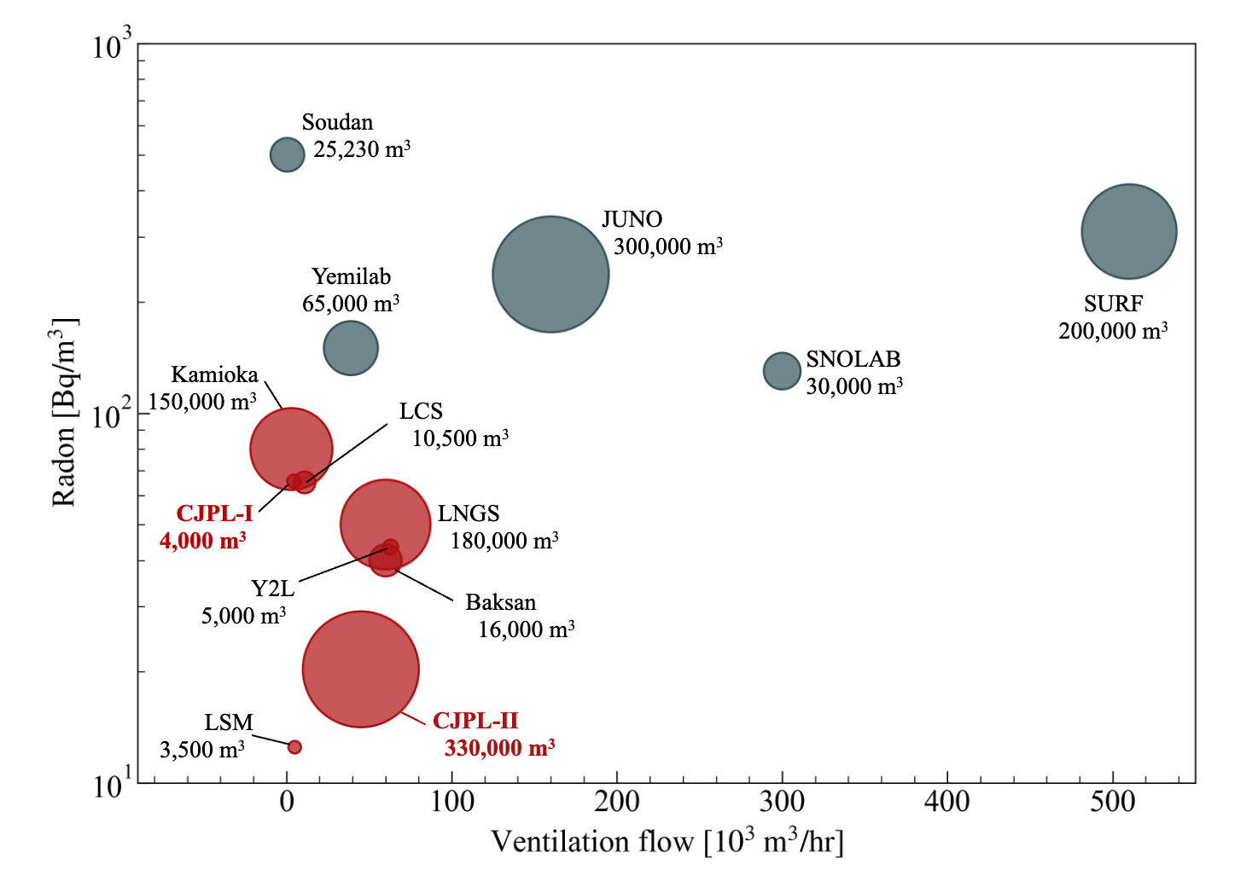
Features of CJPL
Low Radon in large experimental space (~20 Bq/m³)
Tunnel
Shaft
Radon Control
45,000 m³/h ventilation via pressurized pipes
All experiment area in positive pressure
Dedicated Radon-proof layer cover all surfaces of the Lab
Boulby (7,200m³)
Rn～2.4 Bq/m³
Sci Sin-Phys Mech Astron, 2025, 55(11): 111018

Slide 8
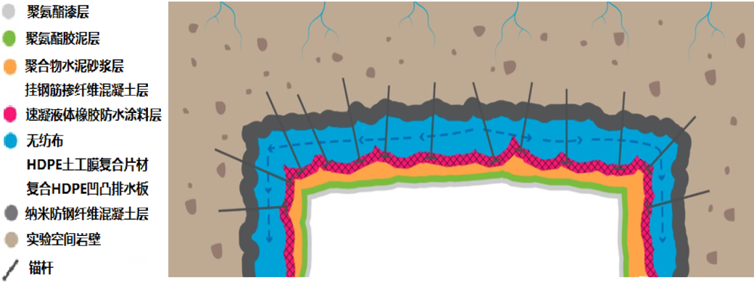
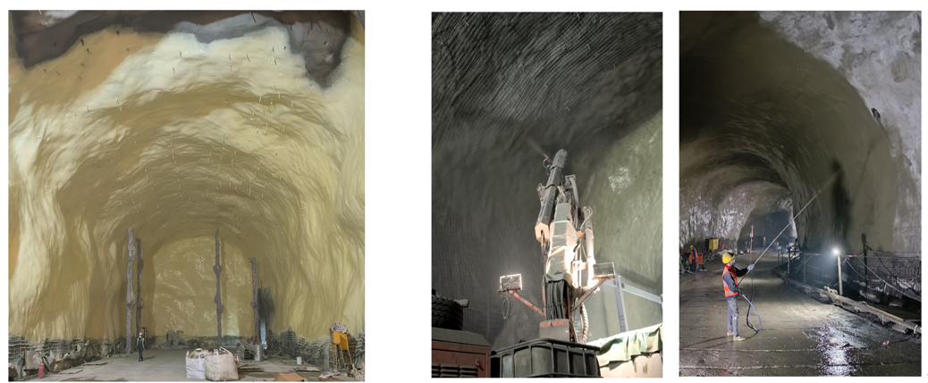
Radon Control in CJPL-II
Water-Resistant and Radon Suppression (WRRS) layer
  A dedicated multi-layer protection against underground water and radon
Features of the WRRS layer
Preventing water and radon permeating from the rock simultaneously
Covering the full-space of each experiment hall (walls and floor)
Using low-background materials in WRRS
7 layers, 9 processing, dozens of materials
Water-resistant and radon suppression layer

Slide 9
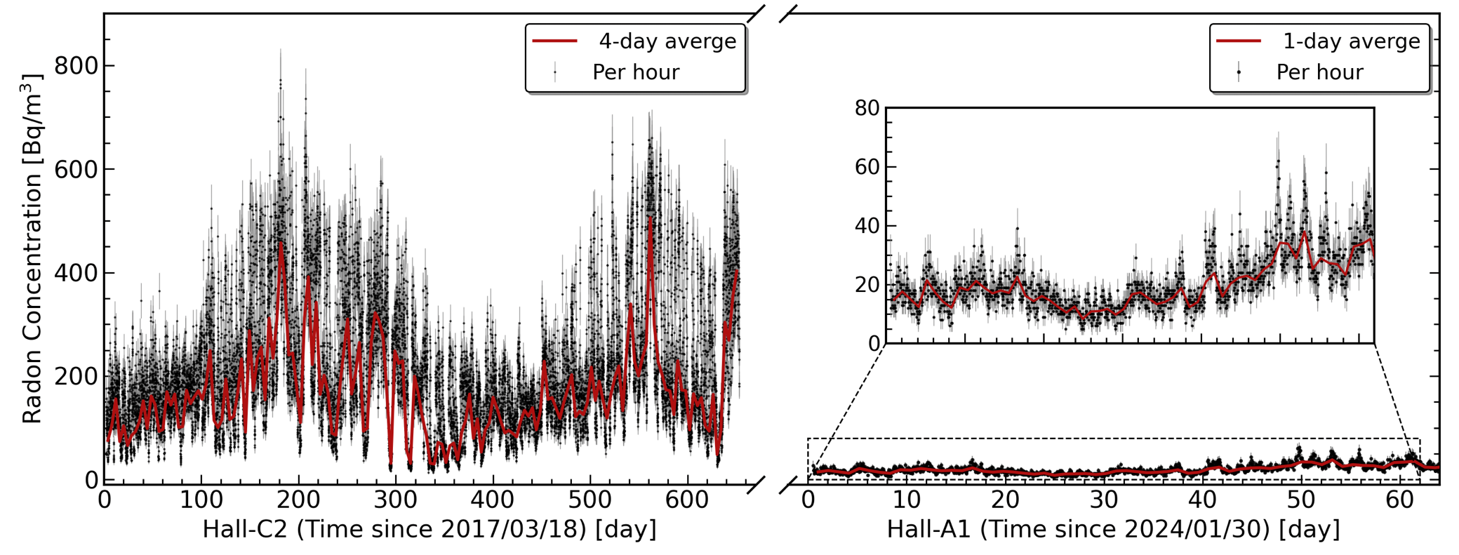
Radon Control in CJPL-II
Monitoring Rn-222 Before/After building WRRS
  Rn-222 in ventilation air ~ 20 Bq/m³ (Typical outdoor level)
  WRRS and ventilation reduce Radon from ~200 Bq/m³ to 20 Bq/m³
No WRRS (2017)
WRRS (2024)
Average~ 20.3 Bq/m³
Ref：Sci Sin-Phys Mech Astron, 2025, 55(11): 111018

Slide 10
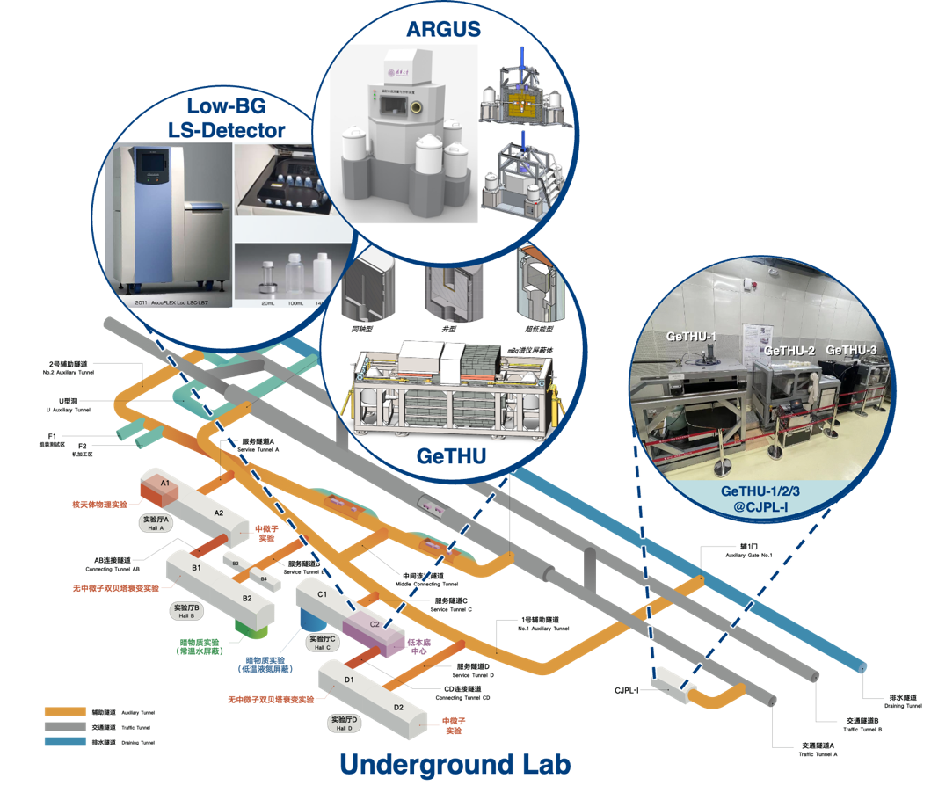
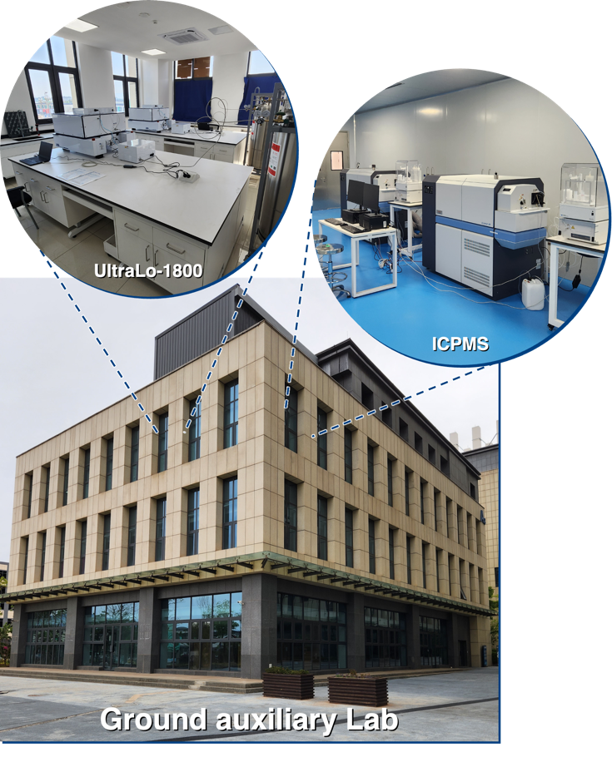
Low background facilities in CJPL
ARGUS
~10.0 μBq/kg
2 sets,
Element-XR ICPMS
2 sets
low-Background LS
2 sets,
XIA UltraLo-1800
GeTHU:
3 sets in CJPL-I
15 sets in CJPL-II
Underground Lab
Ground lab in Xichang city

Slide 11
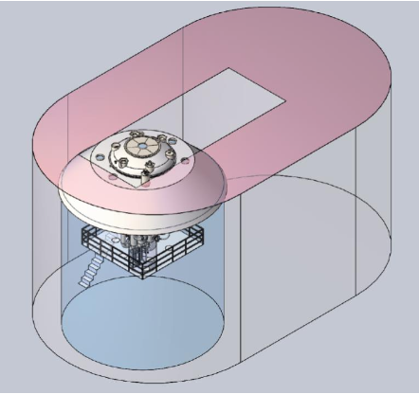
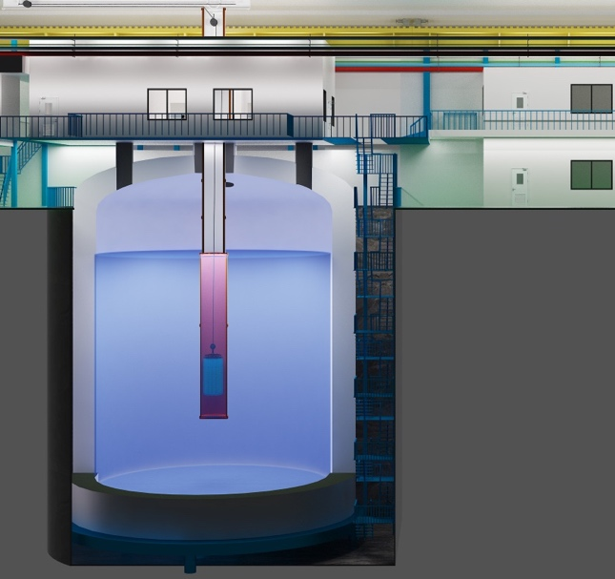
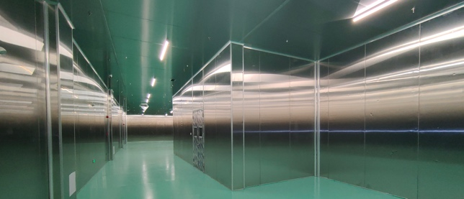
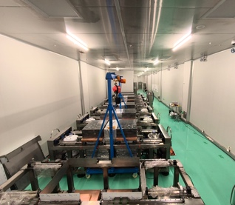
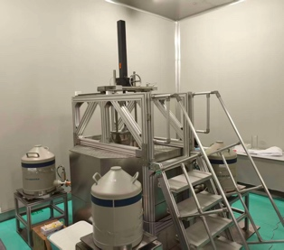
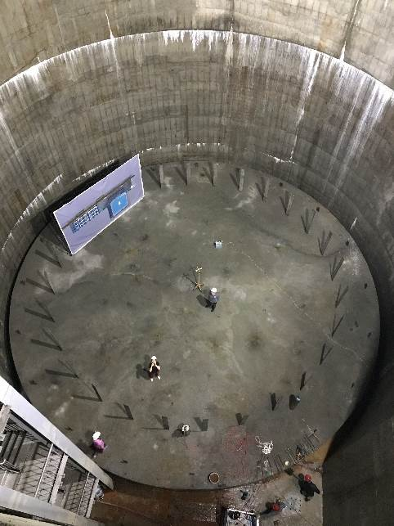
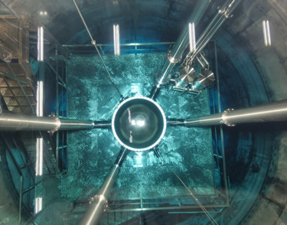
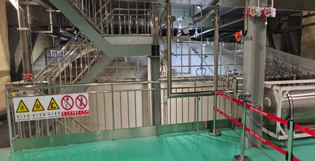
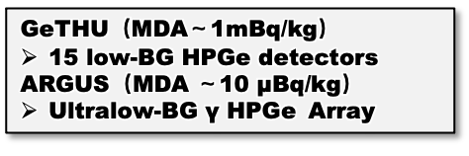
Shielding Facilities at CJPL-II
Large Water Shielding in B2-Hall
PandaX LXe-TPC DM & 0𝛎𝛃𝛃 experiment
Large LN₂ Shielding in C1-Hall
For CDEX HPGe DM & 0𝛎𝛃𝛃 experiment
Large PE Shielding Room in C2-Hall
Total 16 low-BG HPGe γ spectrometers
5500 m³ Water
1745 m³ LN₂ Tank
LN filling completed
1 m thick PE wall
Providing low γ/n environment
GeTHU
ARGUS
Pit
GeTHU（MDA～1mBq/kg）
15 low-BG HPGe detectors
ARGUS（MDA ～10 μBq/kg）
Ultralow-BG γ HPGe Array
Look at the PandaX det.
Top view of the Tank

Slide 12
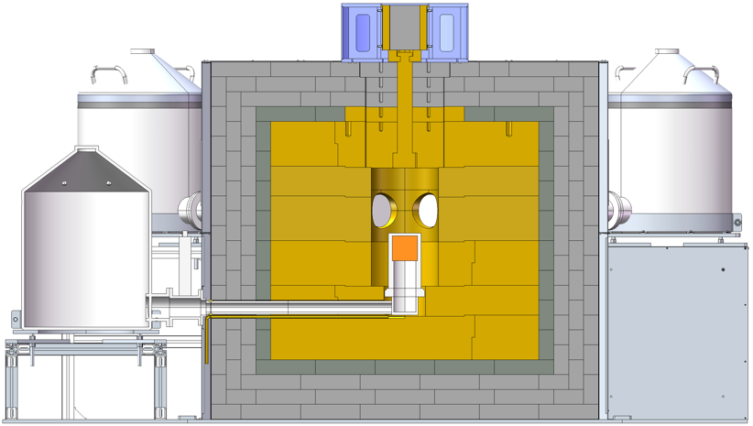
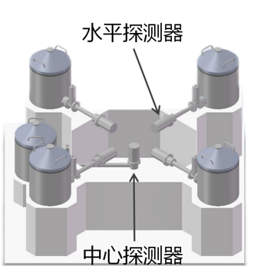
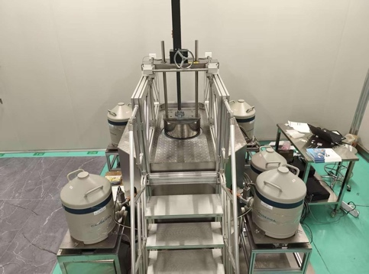
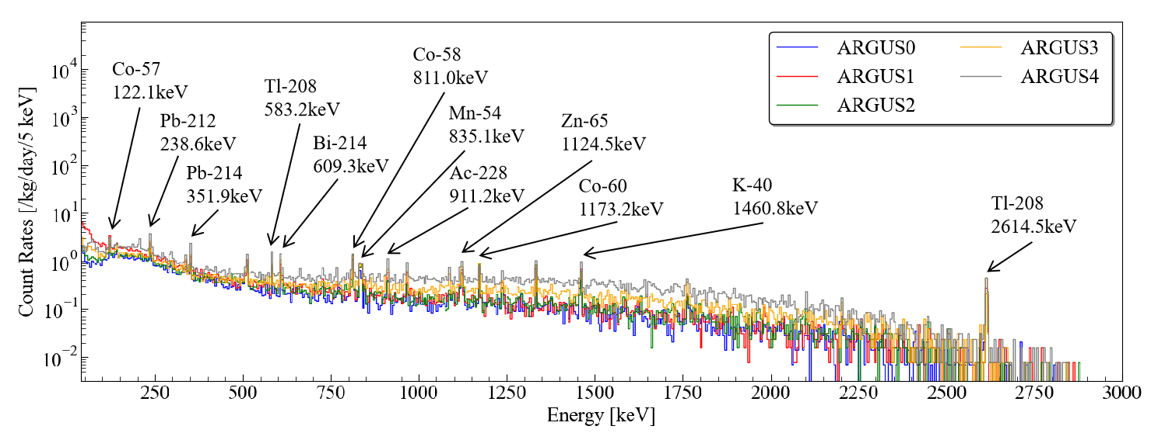
ARGUS（ARray of GermaniUm gamma ray Spectrometer）in CJPL-II
  Five HPGe detectors assembled by Canberra.
  The MDA ~49.50 μBq/kg for a Copper sample in 609keV ROI by ARGUS.
unpublished result!
unpublished result!
ARGUS
ARray of GermaniUm gamma ray Spectrometer
Ref：TAUP2025 POSTER，Ultra-Low Background Germanium Spectrometers at the CJPL，2025.08，XiChang
Background spectrum by ARGUS in 60 days

Slide 13
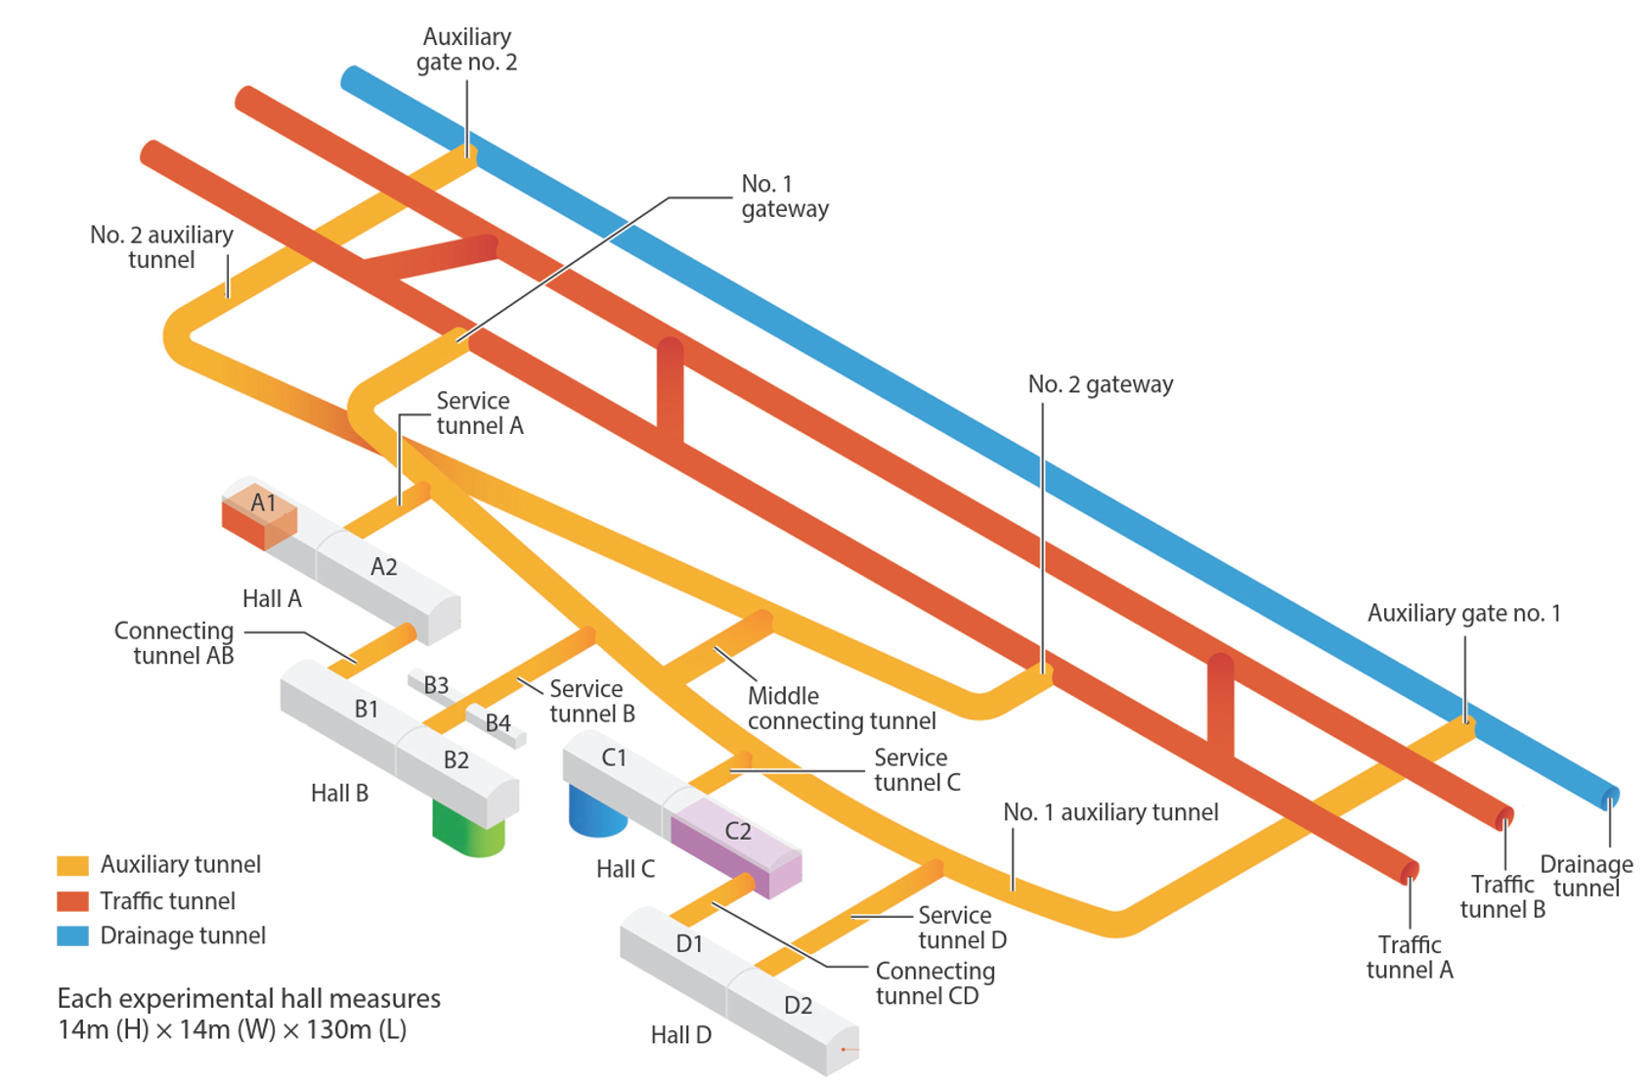
Research Activities at CJPL-II
JUNA (A1)
Jinping Underground Nuclear Astrophysics experiment
CDEX (C1)
DM&0𝛎𝛃𝛃 via Natural Ge and Enriched Ge array
PandaX (B2)
DM&0𝛎𝛃𝛃 via LXe-TPC
CUPID-CJPL
Mo-100 0𝛎𝛃𝛃 via LMO scintillation bolometer
GeoDEX (D1)
Deep underground geologic time variation in-situ detector experiment
And more:
ICSER
Integrated Circuit Soft Error Research
JPDUQIE
Underground Quantum
Qubit experiment
…
JNE (D2)
Jinping Neutrino Program
CJPL welcomes researchers worldwide to submit proposals!

Slide 14

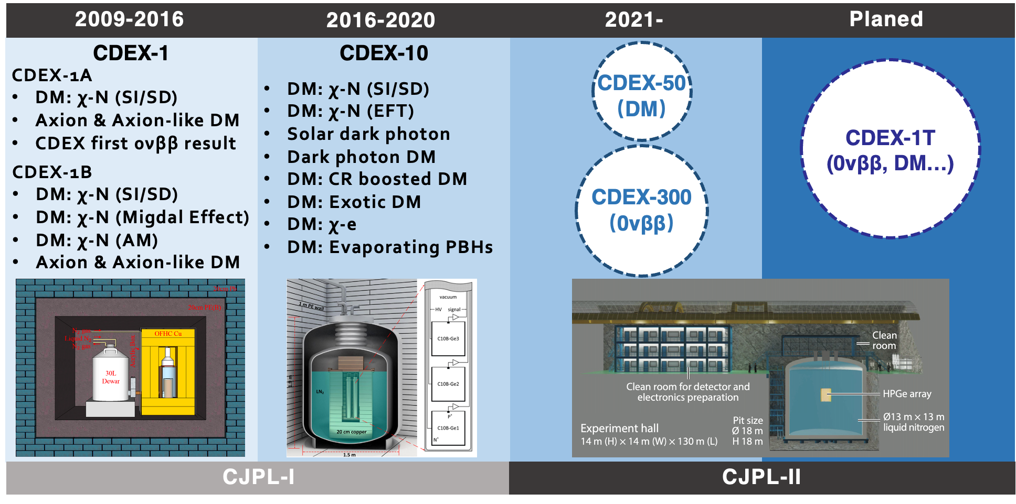
CDEX
CDEX (China Dark Matter Experiment)
(China Dark Matter Experiment)
Founded in 2009, 11 institutions, more than 100 people now
Focused on Dark Matter detection and Ge-76 0νββ search using HPGe technology

Slide 15
CDEX (China Dark Matter Experiment)
Main features
  Uses p-type point-contact germanium (pPCGe) detectors
  Extremely low energy threshold (around 160 eV)
  Excellent energy resolution
  Liquid nitrogen cooling
  Optimized for very small nuclear recoil signals
  CDEX specializes in the low-mass WIMP region.
Latest scientific results
  No statistically significant dark matter signal.
  World-leading limits on light WIMPs in the sub-10 GeV region.
  New constraints on sub-GeV dark matter using the Migdal effect.
  Improved background suppression demonstrating the feasibility of scaling toward a ton-scale experiment.

Slide 16
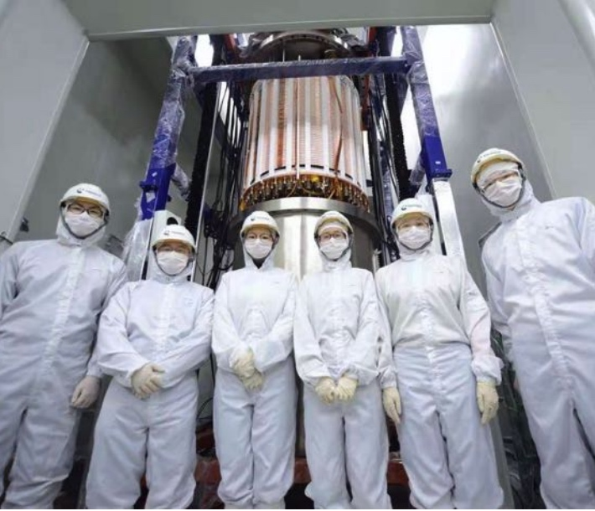
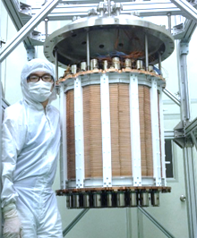
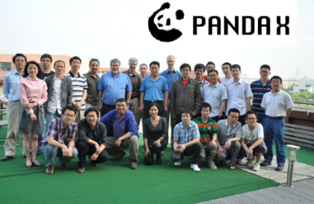
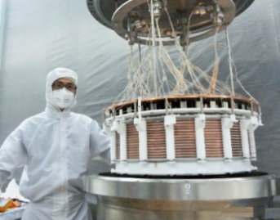
PandaX (Particle and Astrophysical Xenon Detector)
Started in 2009, consists of dozens of universities and research Institutions
Goals: Increase LXe detector mass for DM and neutrino studies
PandaX-4T
3.7 ton
Phase-II
580 kg
PandaX
Phase-I
120 kg
2009
2010-2014
2015-2019
2020-

Slide 17
PandaX (cf talk by Wang Wei)
Scientific objectives multipurpose experiment searching for:
  WIMP dark matter
  neutrinoless double beta decay
  exotic rare interactions
  neutrino physics
Main features
  Multi-ton xenon target
  Dual-phase liquid Xenon Time Projection Chamber (TPC)
  Simultaneous measurement of scintillation (S1) and ionization (S2)
  Full 3D event reconstruction
  Water shielding
Planned PandaX- 20T
Latest results: Dark Matter Search Results from 1.54 Tonne·Year Exposure of PandaX-4T , Phys Rev Lett 2025 Jan 10;134(1):011805.
Among the world's strongest limits
on spin-independent WIMP–nucleon scattering over a broad mass range.

Slide 18
Jinping Neutrino Program (Solar-ν，Geo-ν)
Scientific objective
The Jinping Neutrino Experiment aims to become one of the world's most precise detectors for low-energy neutrinos. Primary targets include:
  solar neutrinos
  geo-neutrinos
  supernova neutrinos
  neutrino oscillation physics
Why Jinping?
  CJPL is unusually far from nuclear reactors, giving it the lowest reactor-neutrino background of any major underground laboratory.
  This is a major advantage for measuring natural neutrino sources.
Planned detector:
  approximately 4-kiloton ultra-pure liquid scintillator
  extremely low radioactive background
  high light yield
  precision energy calibration
Current status
  A 1-ton prototype has been successfully operated.
  Engineering and detector R&D continue for the full-scale experiment.

Slide 19
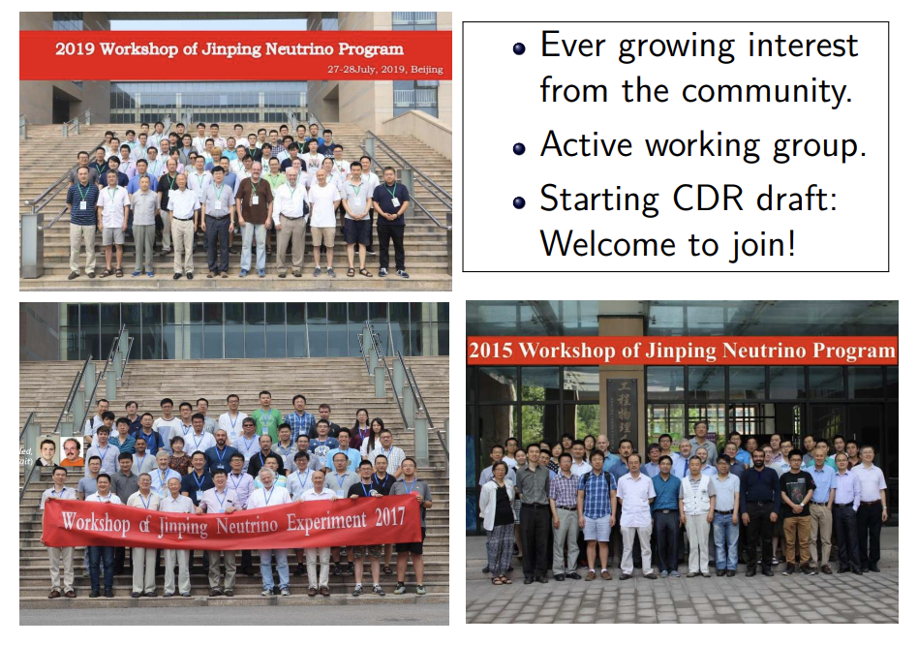
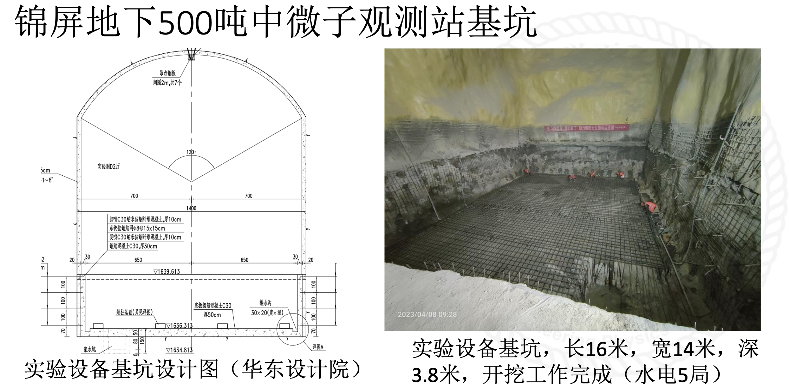
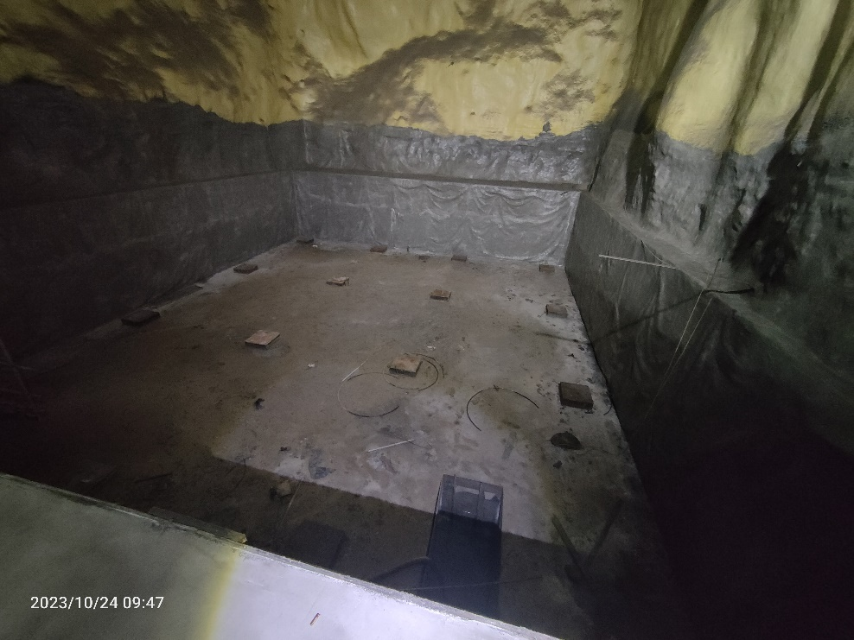
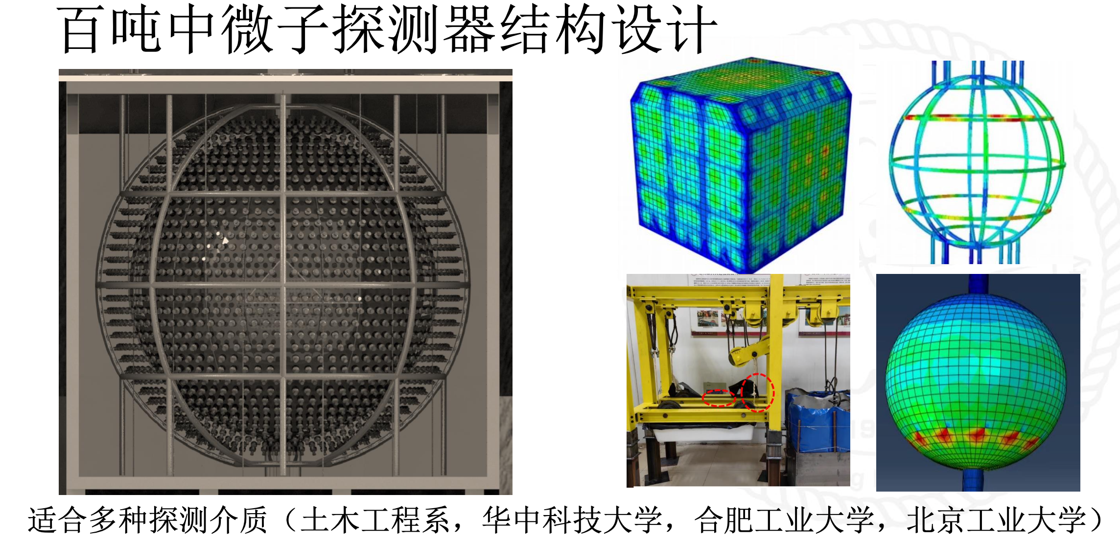
Jinping Neutrino Program (Solar-ν，Geo-ν)
Pit for 500-ton Neutrino Observatory at Hall D2
Hall D2
1-ton prototype at CJPL-I
Neutrino detector design

Slide 20
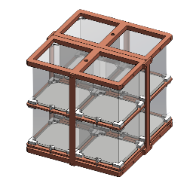
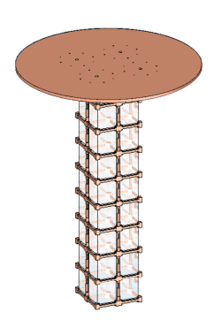
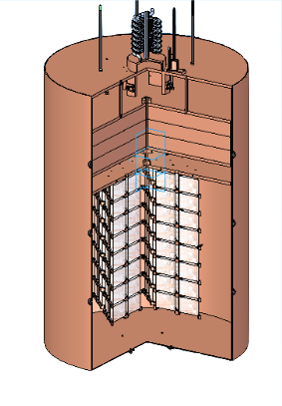
CUPID-CJPL
0νββ experiment based on Mo-100 isotope and LMO crystal calorimeter array.
Possible CUPID-1T configuration
Crystal Testing
(2023-2028)
CUPID-CJPL-200/1T
(2028+)
> 250 kg enriched crystals
Develop CUPID-reach/1T Technology
CUPID-CJPL Demo
(2026-2028)
10 kg enriched crystals
10 kg experiment
- low enrichment
- demonstrate key technologies
250 kg+ experiment
- high enrichment
- probe m_{ββ} below 10meV
Build CUPID-reach or CUPID-1T at CJPL
20

Slide 21
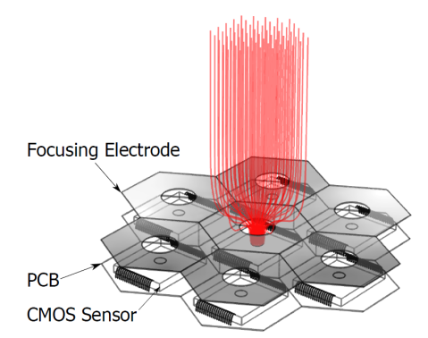
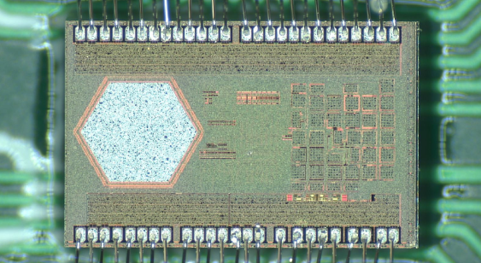
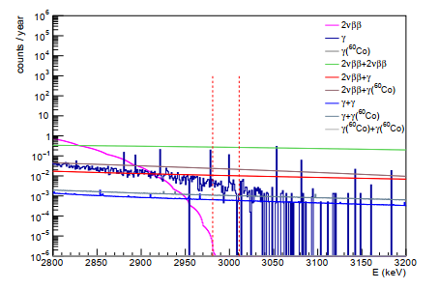
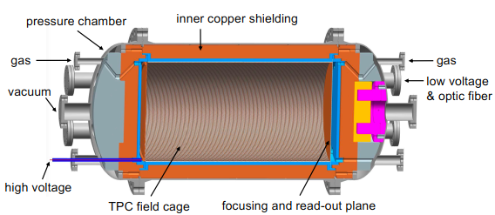
NvDEx
0νββ experiment based on Se-82 isotope and High pressure TPC.
Topmetal technique to readout the ion signal.
High pressure ⁸²SeF₆ gas as the source and target.
200kg per module * 5

Slide 22
JUNA (Jinping Underground Nuclear Astrophysics)
Scientific objective JUNA studies the nuclear reactions that power stars. Instead of detecting particles from space, it reproduces stellar fusion reactions in the laboratory.
Main features
  Underground electrostatic accelerator ➔ Very low cosmic-ray background
  Direct measurements at stellar energies previously inaccessible
  Focus on reactions important for:
    hydrogen burning
    helium burning
    carbon–nitrogen–oxygen (CNO) cycle
    stellar nucleosynthesis
Major reactions studied:
  ¹³C(α,n)¹⁶O
  ²⁵Mg(p,γ)²⁶Al
  ¹⁹F(p,α)¹⁶O
  other key stellar fusion reactions
Reduced uncertainties in stellar evolution and nucleosynthesis models.
Improved constraints on the origin of elements and stellar burning processes.
These measurements are considered internationally significant because the underground environment allows background levels impossible to achieve in surface laboratories.

Slide 23
Taiji (太极)
Proposed satellite-based gravitational wave observatory
Triangle of three spacecraft orbiting the Sun linked by laser interferometers
Two alternative plans for Taiji:
  take a 20 percent share of the European Space Agency’s LISA project
  launch China's own satellites by 2033 to authenticate the ASE project.
Test their instruments inside CJPL
Plan a new ~ 100m short-arm experiment.

Slide 24
MIMAC in CJPL ?
For details on the MIMAC detector and its potential,
cf talk in this meeting by Olivier Guillaudin and Tao Yi
- Measurement of neutron background (cf talk by Fayrouz Malek)
- Directional Dark Matter detection (cf talk by Illias Ourahou)

Slide 25
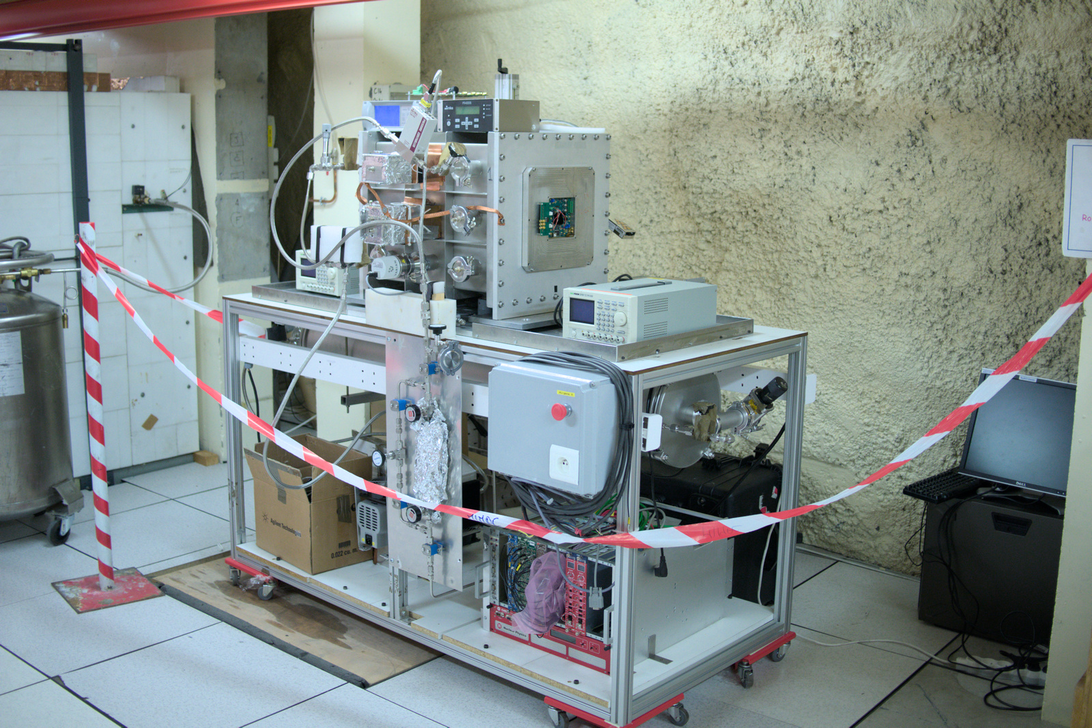


Development of µTPC Micromegas for Directional Detection of Rare Events :
D2S2 (MIMAC)
D2S2 : Directional Detection of dark matter and neutrons for Science and Society
LPSC (Grenoble) : D. Santos, F. Malek
- M. Marton, N. Sauzet, O. Guillaudin (G. Bosson, J. Bouvier), O. Bourrion, E. Lagorio, C. Houaro, Ilias Ourahou (PhD LPSC)
CPPM (Marseilles) : C. Tao , J. Busto
USTC (Hefei) : Z. Zhang,
CERN / GDD : Rui de Oliveira

Slide 26
Summary
CJPL is a world-level underground low-background platform for multipurpose scientific and technological research with rock overburden of 2400m and internal capacity of 300000 m³;
Several collaborations including CDEX、PandaX、JUNA have run their facilities in CJPL and achieved a number of cutting-edge research results;
CJPL welcomes more collaborations in the world to establish their experiments therein;

