Slide 1




High-Quality Scientific Data Ecosystem
for HEP Facility
Peng HU, Hao HU, Fazhi QI, etc.
Computing Center, Institute of High Energy Physics, CAS
Jul. 2, 2026
Notes:
Hello, everyone, I’m Hu Peng, from computing center of IHEP. The title my presentation is “High-Quality Scientific Data Ecosystem for HEP Facility”.

Slide 2
Outline
1
Background
2
Data Ecosystem
3
Summary & Plan
Notes:
My presentation is divided into these sections. First, I’ll start with the background.

Slide 3
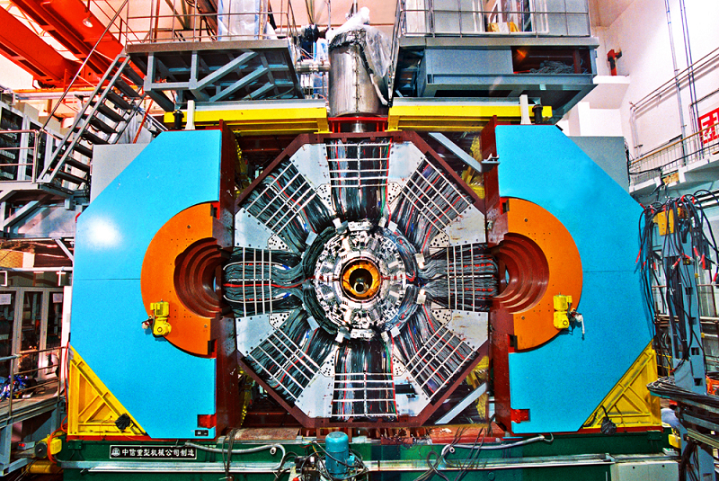
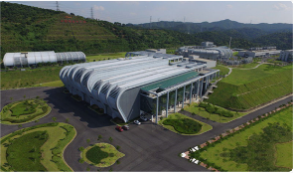
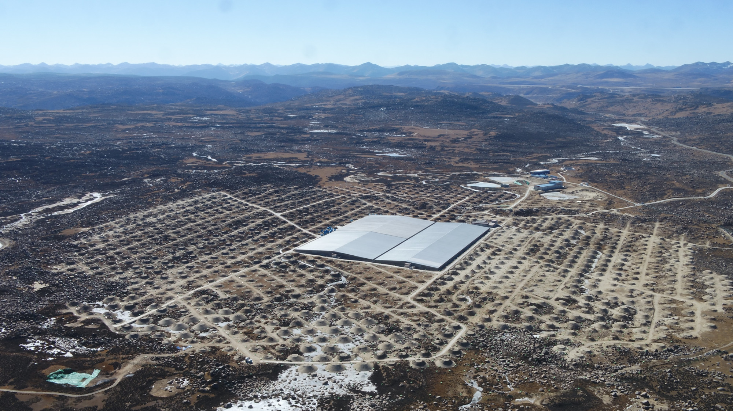
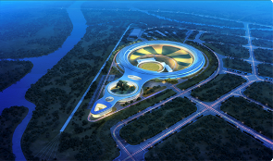
HEP Facilities & Exp. Data
High Energy Physics (HEP) facilities generate massive volumes of raw experimental data each year, which constitute one of the core outputs of these facilities.
HEP Facilities
Particle Physics Data (BEPC, BESIII)
Neutron Data (CSNS)
BESIII: ~750 TB of raw experiment data per year
CSNS-II: ~2 PB of raw experiment data per year
Astrophysical Data (LHAASO, HXMT)
Photon Data (BSRF, HEPS)
LHAASO: ~750 TB of raw experiment data per year
HEPS: ~300 PB of raw experiment data per year
Massive Amount of Raw Experiment Data of HEP Facilities
Notes:
There are many high energy physics facilities in IHEP. Such as BESIII, LHAASO, BSRF, and HEPS.
Naturally, the experiment data is the core output of these facilities. And we are facing a massive amount of the experiment data.
Such as, after construction of CSNS-II, it will produce about 2 PB of raw data each year.
And HEPS will produce nearly 300 PB of raw data each year.
Therefore, improving the data usage efficiency is crucial to accelerating scientific research.

Slide 4
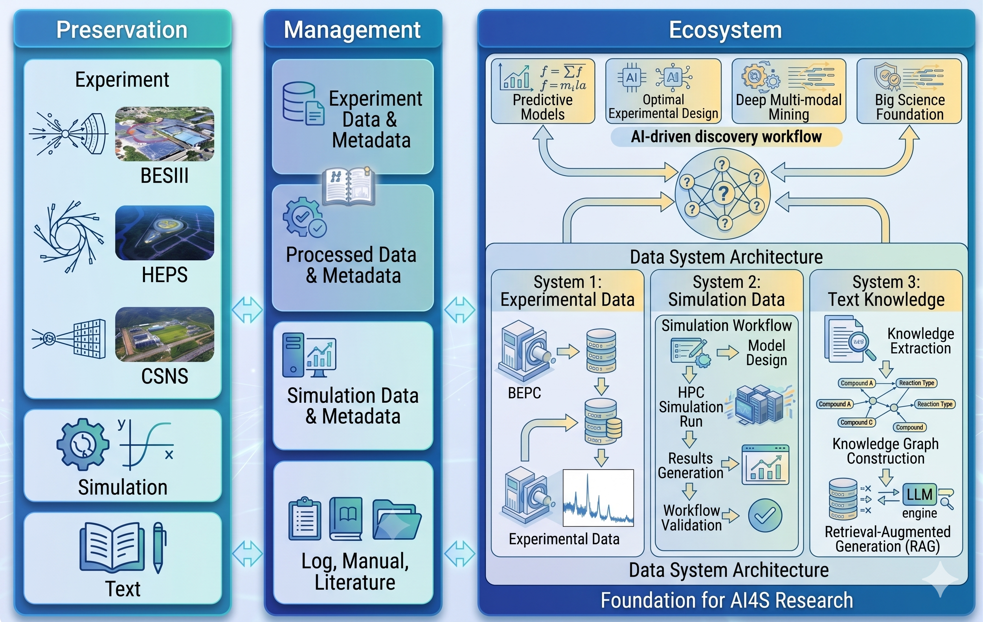
Data Usage
Simulation Data
BESIII/LHAASO: Monte Carlo Simulation
HEPS/BSRF/CSNS: First-principle Calculation, Molecular Dynamics Simulation…
Text
Equipment: Operation Manual & Log Files
User: Application & Log Files
Scientific Literature
…
Data Preservation
Data Management
Data Ecosystem
Notes:
On top of experimental data, these facilities also includes a large amount of simulation text and text data.
Specifically, simulation methods like Monte Carlo, first-principles, and molecular dynamics generate data that we can combine and compare with experiment results.
The text data, such as operation manuals and experimental logs, can be utilized to build knowledge bases for AI applications.
As a result, there is a shift in data usage, evolving from long-term storage toward full-lifecycle management to build a multi-type data ecosystem for scientific research.

Slide 5
Outline
1
Background
2
Data Ecosystem
3
Summary & Plan
Notes:
Next, I‘d like to introduce our data ecosystem, taking HEPS as a prime example.

Slide 6
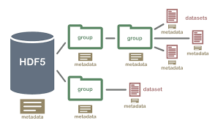
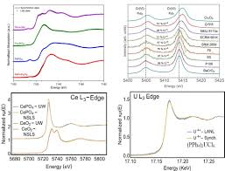
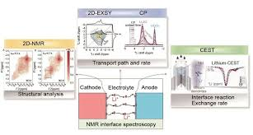
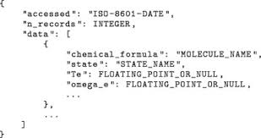

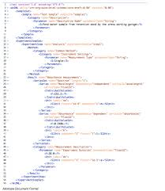
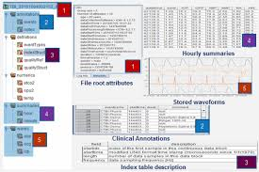
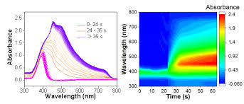
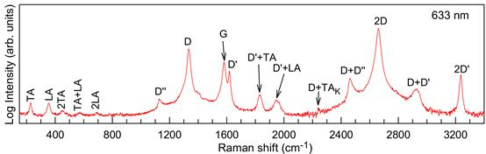

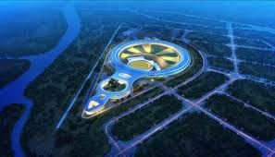
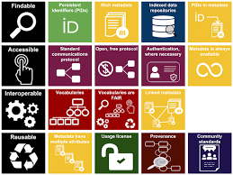

Archtecture of Data Ecosystem——HEPS
Data Strategy & Policy
Data Model
Experiment
Data
Metadata
Data Standard
Data Format
Data Sharing
After 2 Years
Notes:
First, on the data policy side, we use HDF5 as the unified format for all raw data.
We also define comprehensive scientific metadata—including samples, beamlines, and experimental methodologies.
To support open science, this data is opened up for public sharing and reuse after two years.

Slide 7



Archtecture of Data Ecosystem——HEPS
Data Strategy & Policy
Data Strategy & Policy
HEPS Data Management
Simulation Data
Experiment Data
Text
Analysis
Software
Knowledge
Base
Full Life Cycle
Simulation Data
Raw Data Processed Data
Full Life Cycle
Notes:
Next, we built a full-lifecycle experimental data management system, and we’ve successfully extended it to cover both simulation and text data.

Slide 8
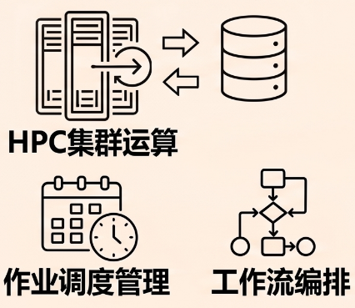
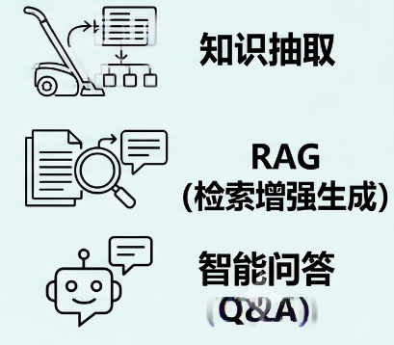
Archtecture of Data Ecosystem——HEPS
Data Strategy & Policy
Simulation & Data System
HEPS Data Management
Knowledge Base System
Simulation Data
Experiment Data
Text
Analysis
Software
Knowledge
Base
Data
Extraction
Full Life Cycle
Simulation Data
Raw Data Processed Data
HPC
Full Life Cycle
RAG & KG
Smart Q&A
Job
Workflow
Notes:
For simulation data, we’ve developed a workflow system to run simulations.
Together with the data management system, it forms a unified simulation and data framework.
As for text data, we built a knowledge base system to create various repositories through RAG, knowledge graphs, and data extraction.
Next, I will introduce these systems one by one.

Slide 9
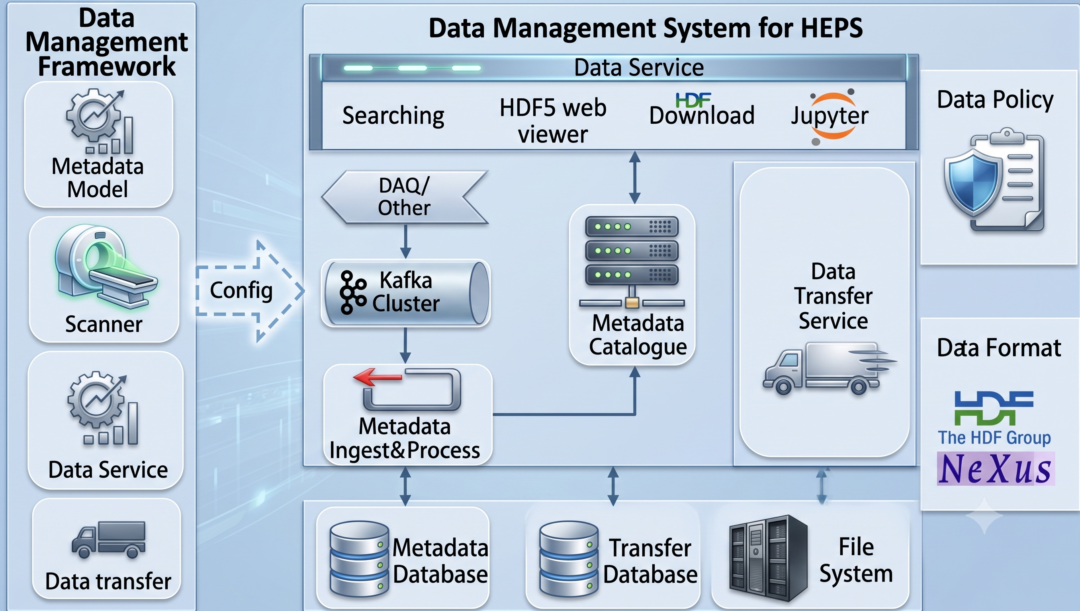
Data Management
DOMAS Framework for Data Management
Core modules:
Metadata Catalogue
Message Processing
Data Transfer
Data Service
File Scanner
Characterization:
E-scale big data storage
Complex metadata management
Standardized data formats
Apply to several HEP facilities in China: BSRF, CSNS, HEPS, WNS, AliCPT
DOMAS framework serves as the foundation for data management
Notes:
For data management, we have developed a framework called DOMAS.
It consists of several modules: metadata catalogue, message processing, data transfer, services, and a file scanner.
In short, the control system and file scanner send out the data generation messages.
Then the message processing system handle these messages, writing metadata into the database, and transfer data files to central storage and tape storage,
finally, users can get the data via data services.

Slide 10
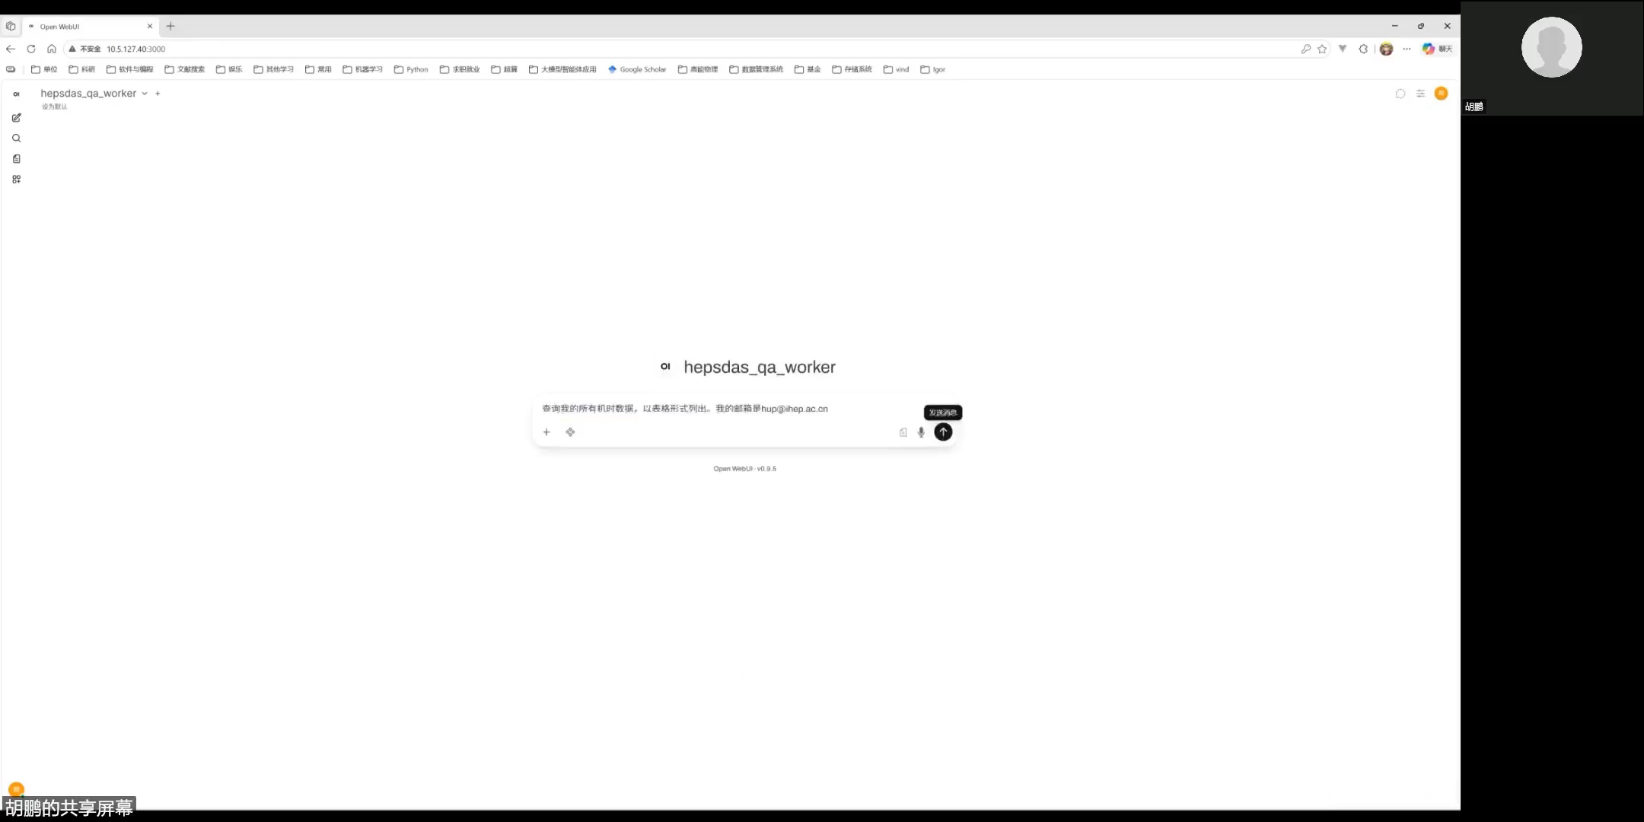
Smart Data Service
Data MCP Service
Current: Integrated into NRS Data Analysis Agent
Future: More Data Analysis Agents & Dr. Sai Synchrotron Agent Will Be Integrated
Documentation for Data Service APIs, MCP Services & Agents:
https://note.ihep.ac.cn/0tsSJDucRZmCGCD8YtHNMg
Data Service is Becoming More Intelligent
Notes:
Besides, we have developed a data MCP service for smart Q&A.
It allows users to get their data using natural language.
Currently, this MCP service is being integrated into the NRS data analysis agent.
And we plan to integrate it into more agents, including the Dr. Sci Synchrotron agent.

Slide 11
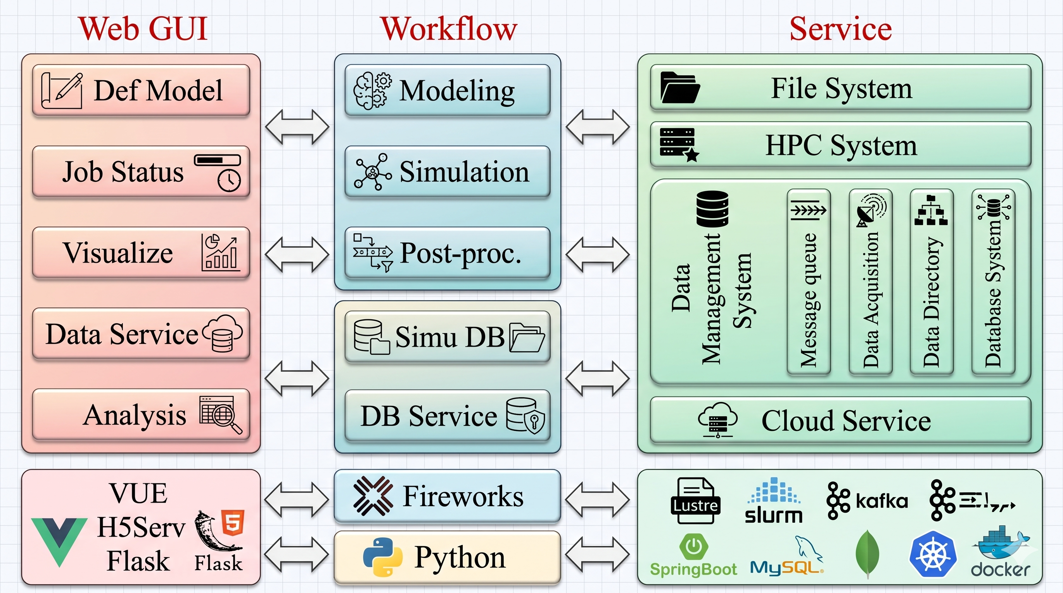
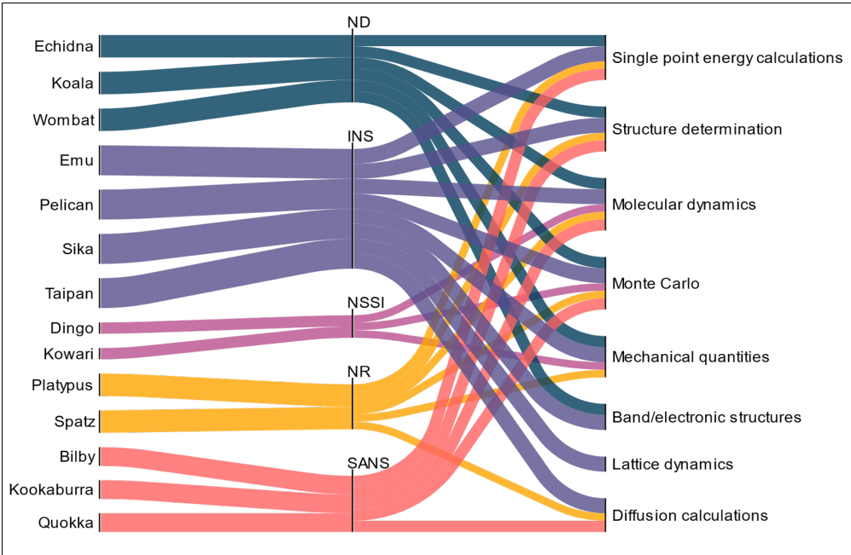
Simulation & Data System
Comprehensive Scientific Metadata:
Software & Versions, Input Params, Processes, Results, etc.
Distributed Simulation Job Scheduling:
HPC, Software Environments, Slurm
Simulation
Methods
Framework for Simulation & Data System
Neutron
Instrument
Integrate Full-Lifecycle Simulation Data into Data System for HEP Facilities
Notes:
Next is the simulation and data system. It features a simulation workflow framework.
Users don't need to worry about underlying resources like Slurm. Everything runs automatically, and they can monitor it in the real time.
all of the simulation data and metadata are managed—including the input parameters, workflows, slurm job and the final results.

Slide 12
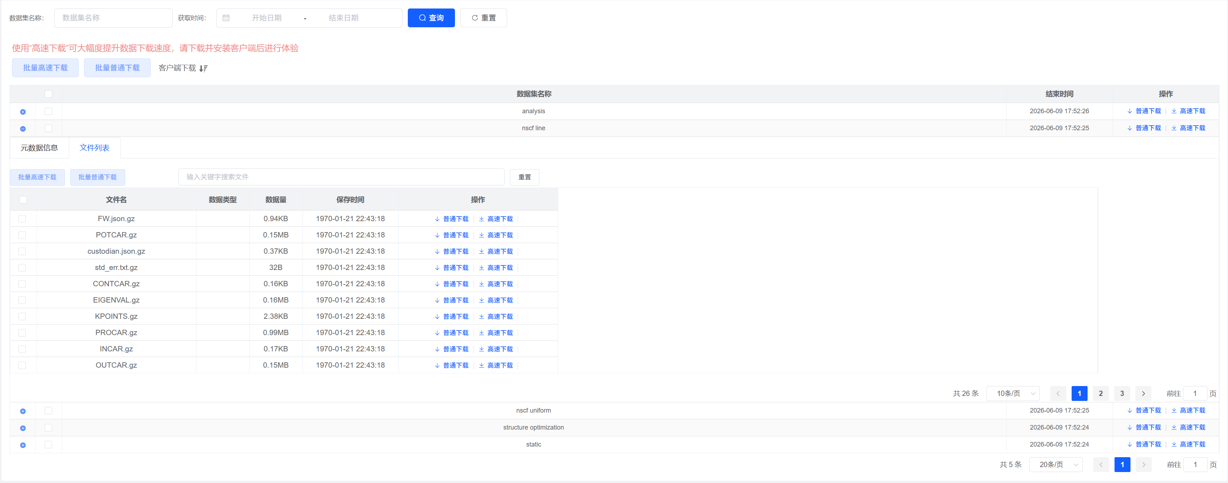
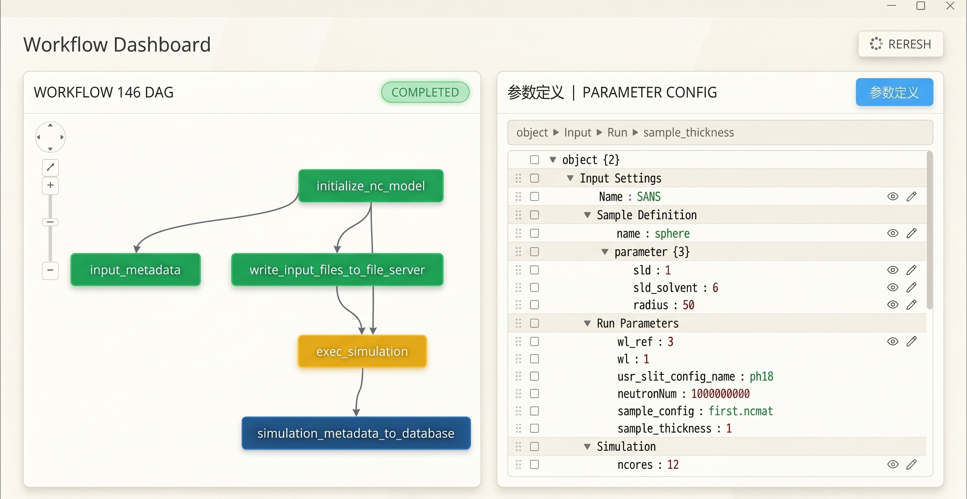
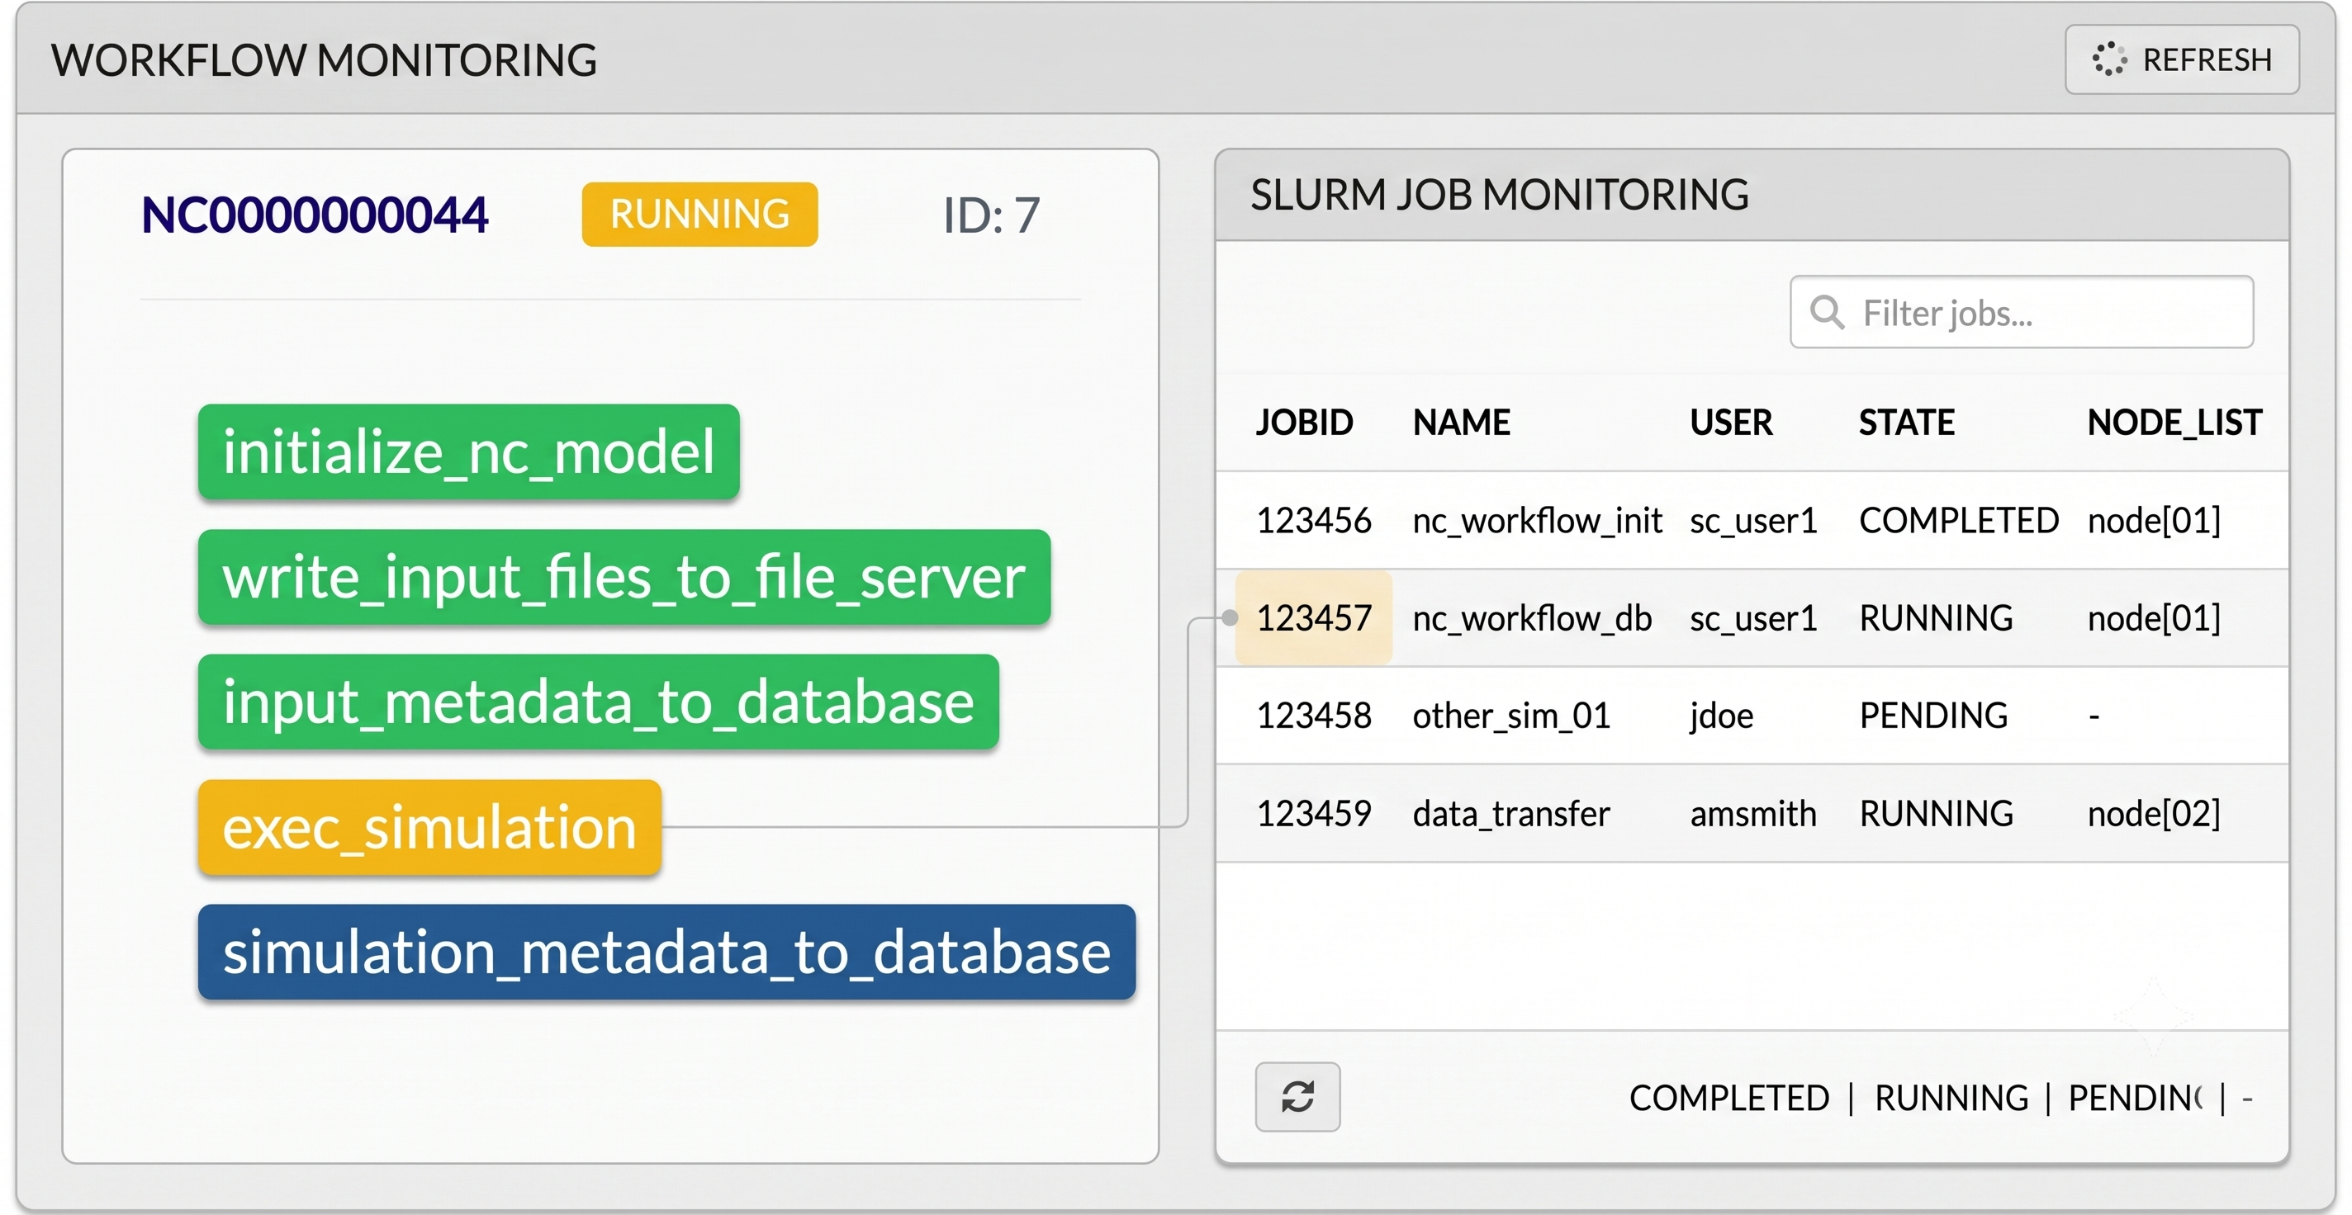
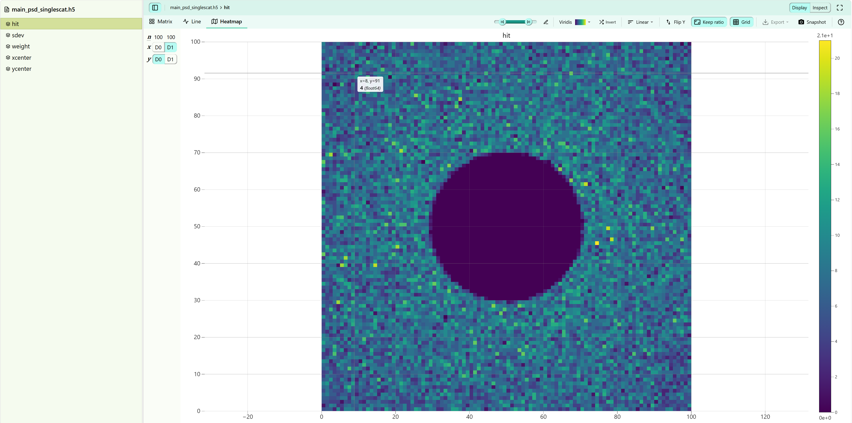
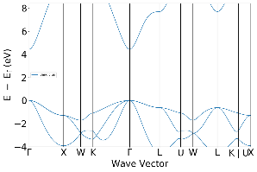
Simulation & Data System
Manage simulation data
over 800 TB:
CrySol – SAXS simulation data
VASP – Electronic structure simulation data including band structures and density of states
Neutron Cinema – SANS simulation data
Multiple simulation workflows are already supported:
CSNS: NC-SANS simulation
HEPS: VASP-BS/DOS simulation
BESIII: MC simulation (under integration)
Multiple access modes are supported:
General users: GUI web pages
Professional users: APIs interfaces for high-throughput simulations
Intelligent Q&A and agents: MCP services
BESIII Data Management System under construction
User Usage (GUI)
Step 1: Select, Edit & Submit
SANS Simulation Workflow
Step 2: Monitor Simulation Workflow
& Slurm Job
Step 3: Full-Life Cycle Simulation Data Management
Efficient, Low-Cost Solution for Simulation Data Generation & Management
Notes:
This system manages over 800 TB of simulation data. It already supports SANS and band structure simulations.
And, we are adapting it for BESIII as well.
For the users, they can use our GUI web pages, and they can also use APIs and MCP services.
This makes it very easy to integrate into other data analysis software and ai agents.

Slide 13
Knowledge Base System
Knowledge Base System
RAG/Vector Database
Knowledge Graph
Reduce LLM Hallucinations
Knowledge/Data Extraction
Complement exp data
Knowledge Base System
Notes:
With the rapid development of large language models, the domain knowledge bases are crucial because they can reduce hallucinations;
To achieve this, we develop the solutions for RAG and knowledge graphs.
Also, we use LLMs to extract knowledge and data from scientific papers. It helps get extra data to complement the experiment results.

Slide 14
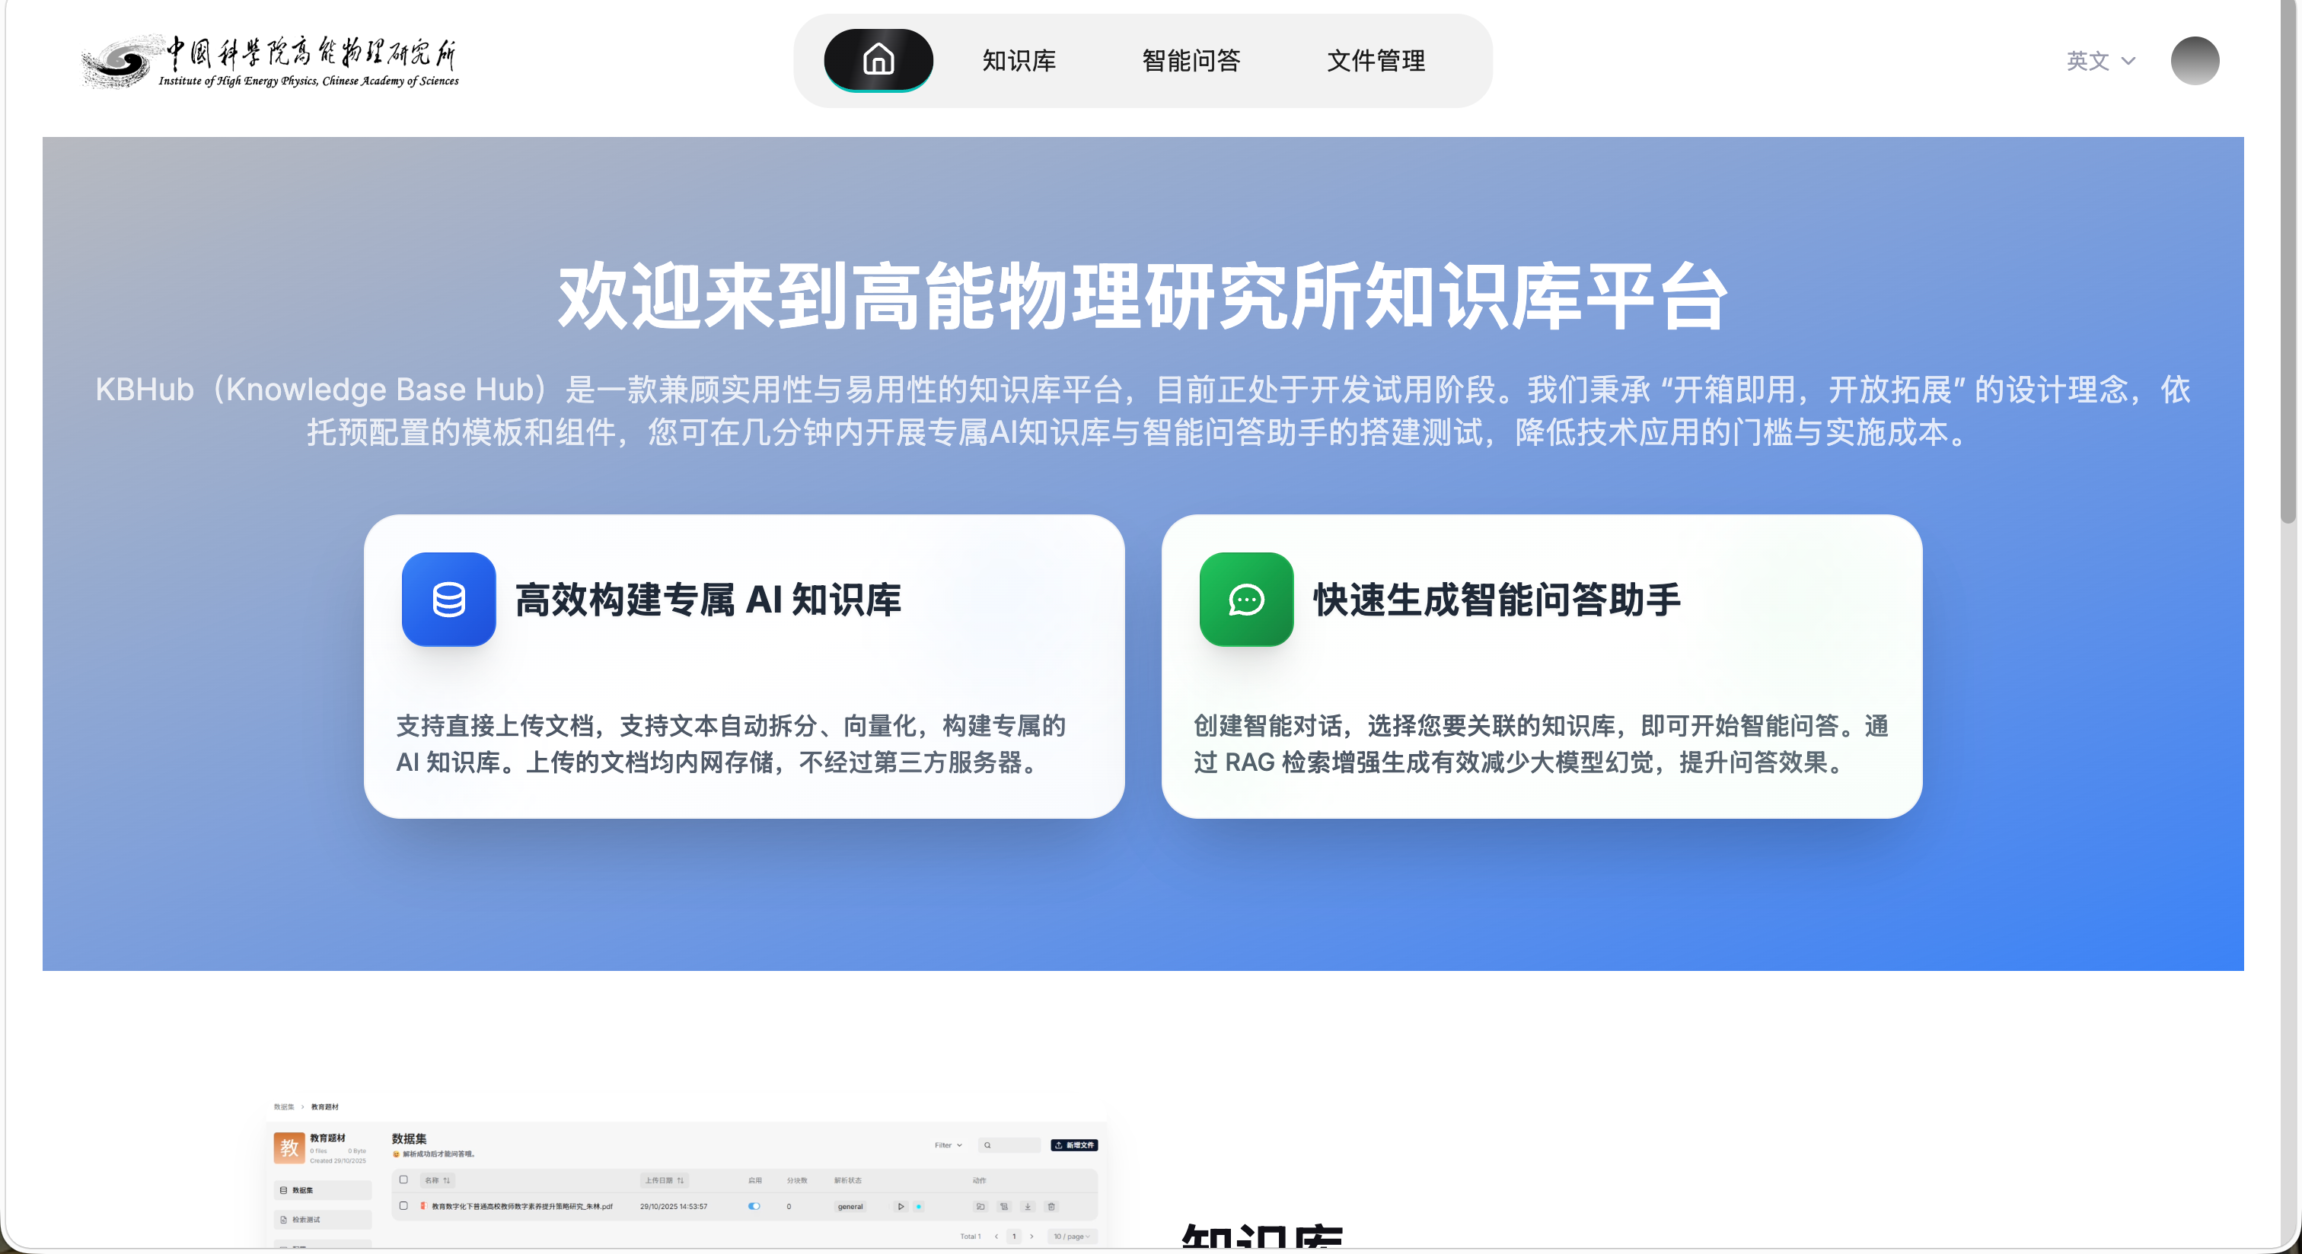
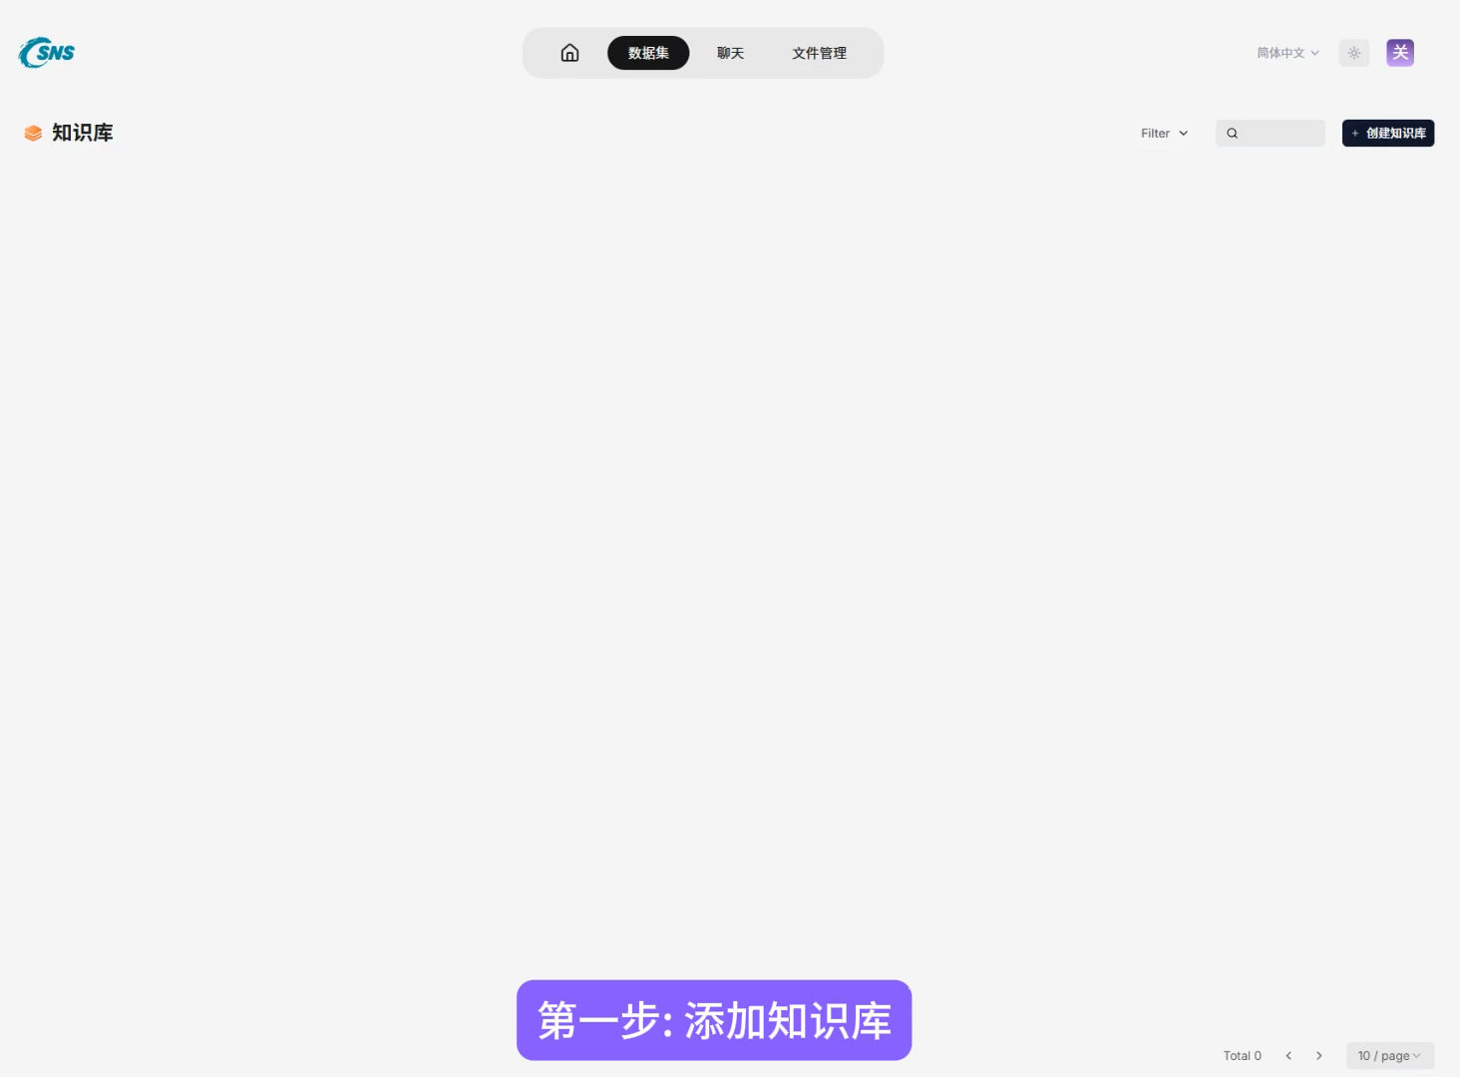
Knowledge Base System——RAG
AI Knowledge Base (from RAGFlow): https://ragflow.ihep.ac.cn/
Notes:
We adapt the open-source RAGFlow framework to build our own RAG platform.
Users can upload their own documents, call LLM api from our own AI platform, and build their own knowledge base.

Slide 15
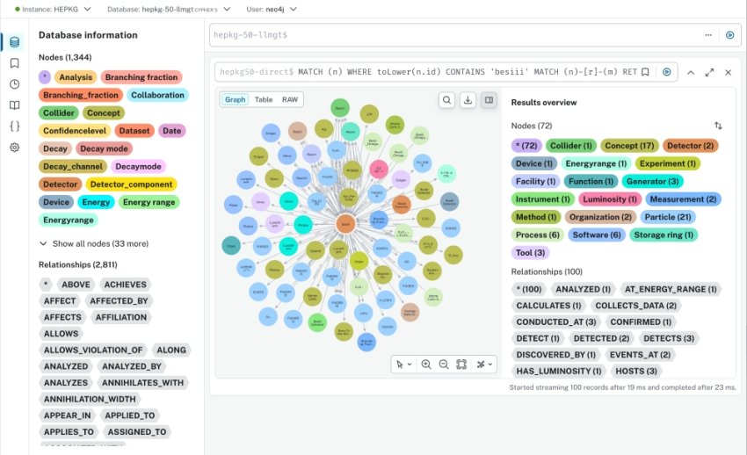







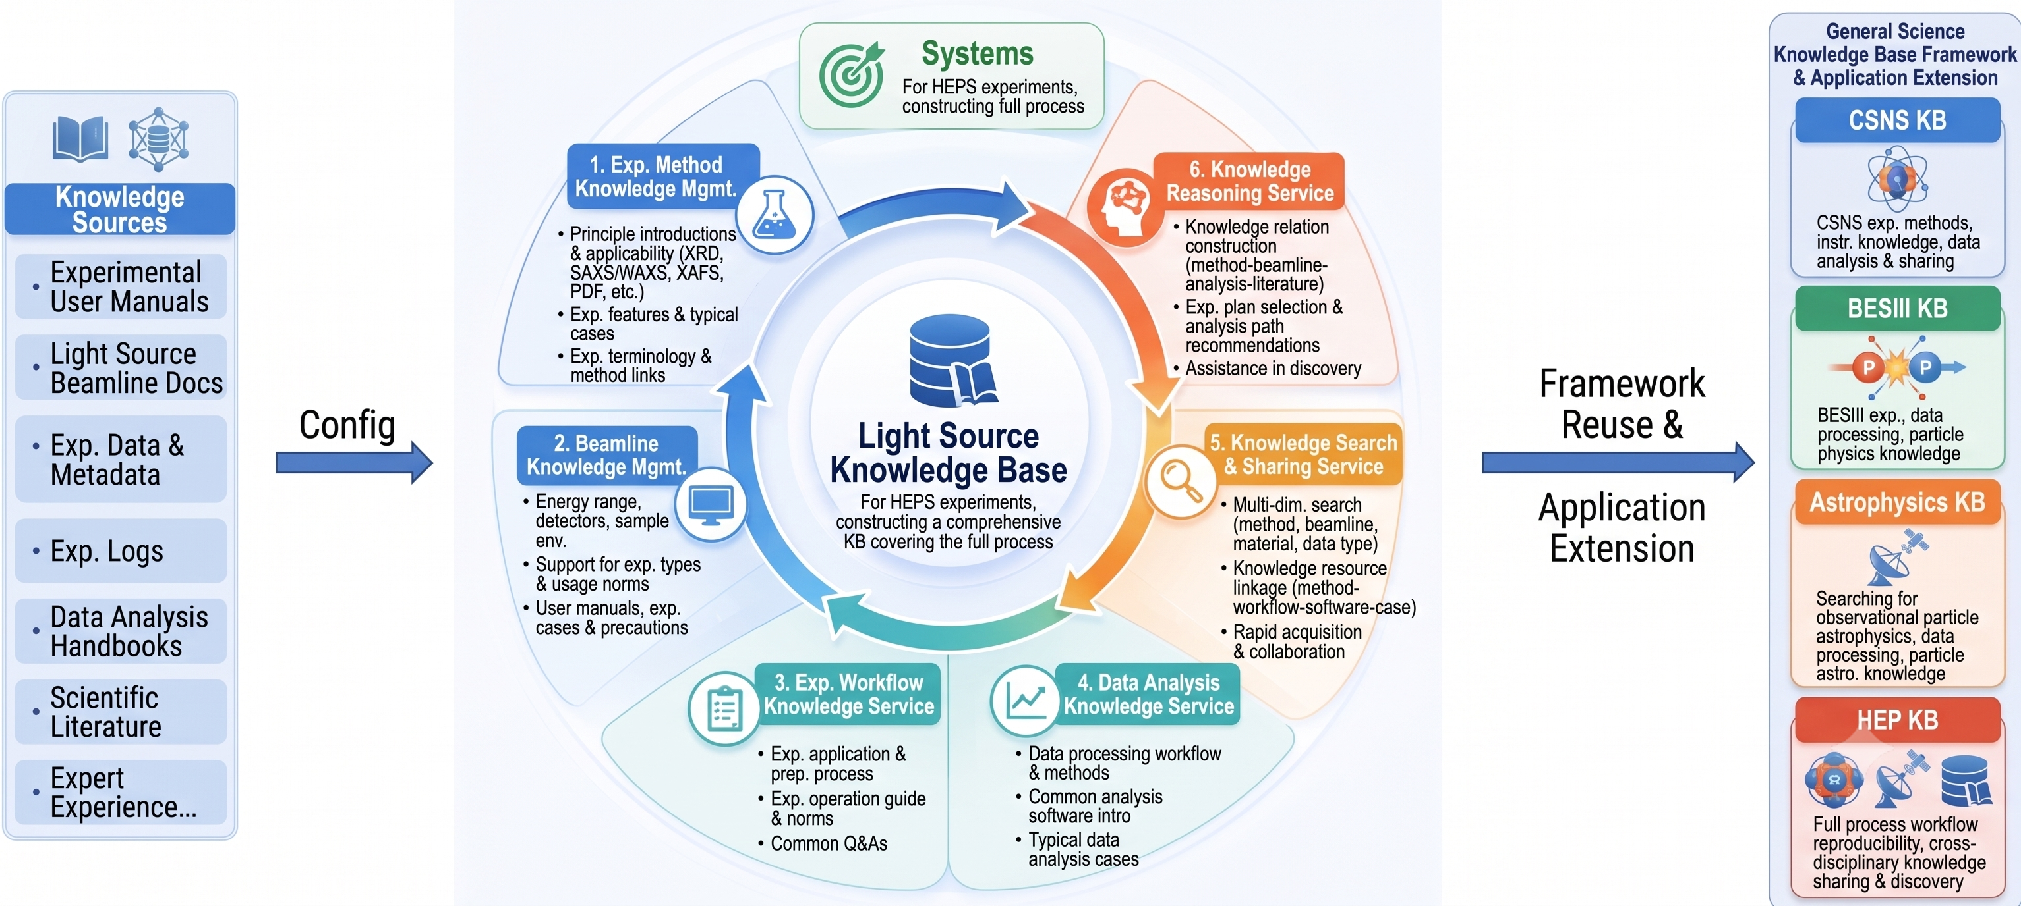
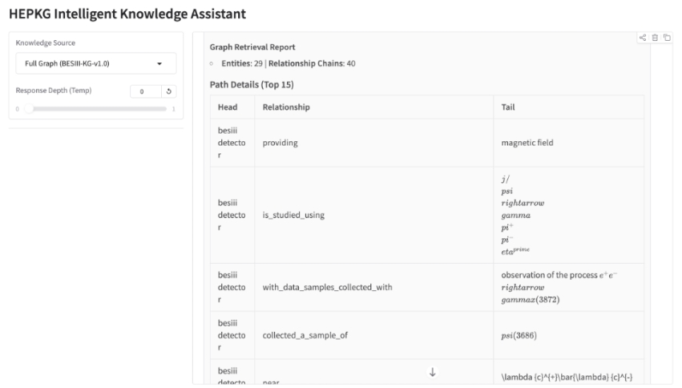
Knowledge Base System——KG
KG for BESIII Facility
An LLM-based Framework for KG Construction by Knowledge Extraction
Literature
Text Processing
LLM Extraction
Neo4j Graph
Smart APP
PDF / TXT / MD
Section Segmentation/ Cleaning
Entity/Relation/Evidence
Node/Edge/Paragraph
Q&A/Agent/
Reasoning
Evidence Graph: Entity–Relation–Entity with Source Paragraph Provenance
Scientific Problem Discovery:
Each relation preserves its provenance information, including the paper, section, paragraph, and link, to prevent unsupported answers and reduce hallucinations.
uncovering contradictions, uncertainties, and future experimental directions
Future:
HEPS KG
CSNS KG
Astrophysics KG
…
Smart Q&A
With BESIII KG
Notes:
To build the knowledge graph, we proposed an LLM-based framework.
It puts each step into a single pipeline—from text processing, knowledge extraction, knowledge fusion and graph storage.
This converts the complex scientific papers into structured and machine-readable knowledge.
Using this framework, we built the knowledge graph for BESIII. And next, we will build more knowledge graphs for other facilities.

Slide 16
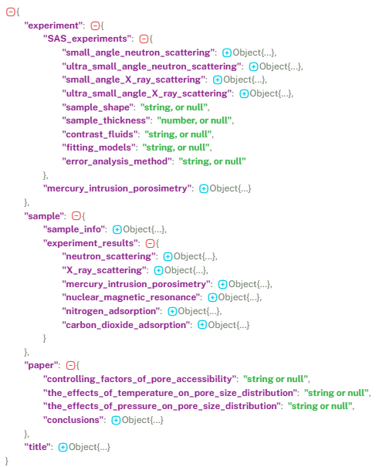
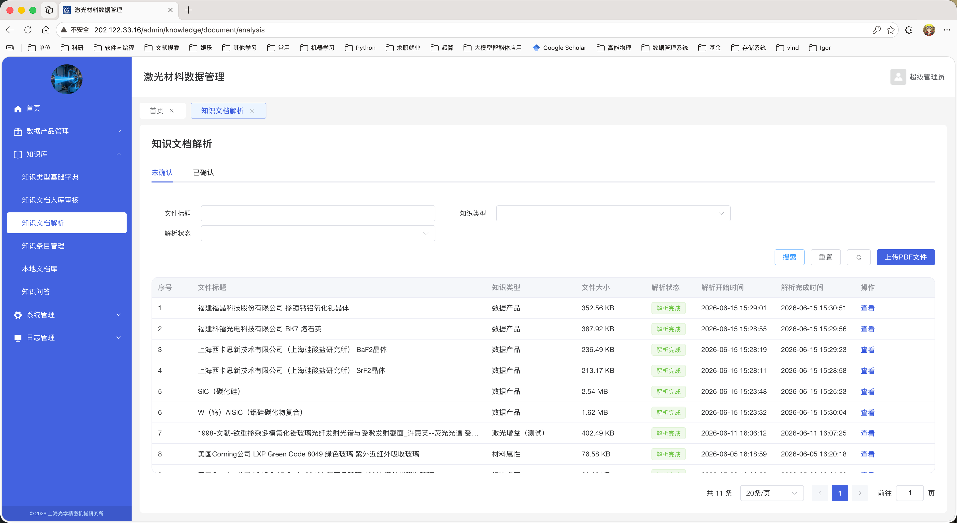
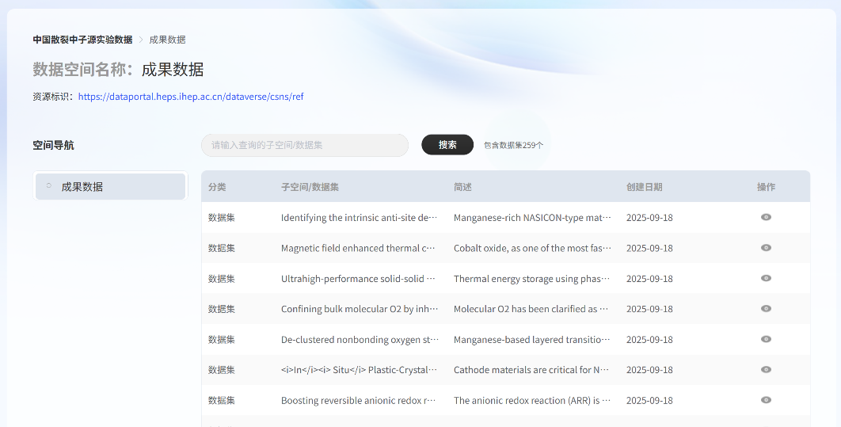
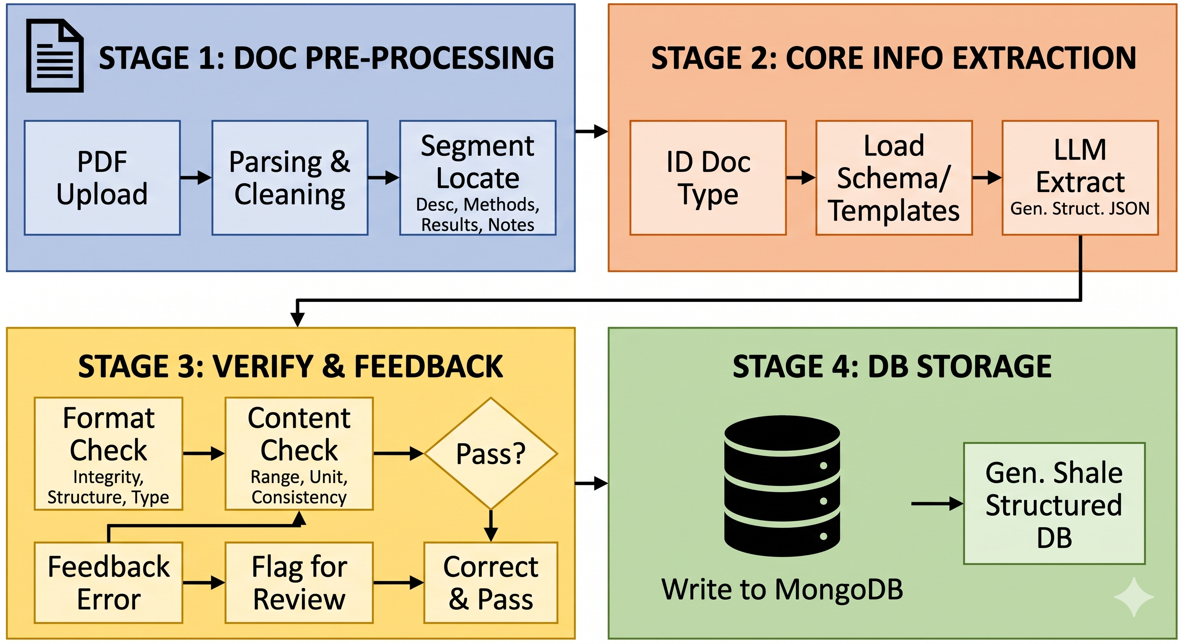
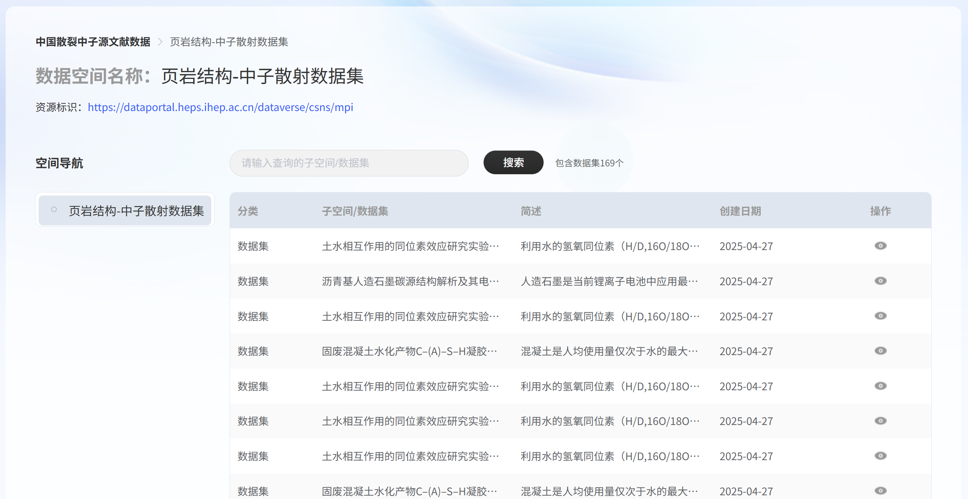
Knowledge Base System——Extraction
General Prompt Template:
Apply to SIOM, CAS
Develop 2 Dataset:
Role
Field
Constraint
CSNS Neutron Experiment Characterization Dataset
Extraction Framework：
Shale Structure – Neutron Scattering Dataset
Knowledge Extraction Framework & Application
Notes:
For structured knowledge extraction, we designed a general prompt template and extraction framework. The prompt template consists of the role, field, and constraint.
Based on this, we successfully built two datasets from scientific literature. One is a neutron experiment dataset for CSNS. And another one is a shale structure dataset.
Also, this framework has already been applied to SIOM, CAS.

Slide 17
Outline
1
Background
2
Data Ecosystem
3
Summary & Plan
Notes:
Finally, it‘s the summary and plan.

Slide 18
Summary & Plan
Data Ecosystem for HEP Facility has been Preliminary Established
  Multi-Source Data: Facility Experiment, Simulation & Text Data
  Strategy & Standard: Data Model/Metadata, Storage/Usage Strategy
  For Experiment Data: Data Management System, DOMAS
  For Simulation Data: Simulation & Data System, DOMAS/Workflow
  For Text Data: Knowledge Base System, DOMAS/RAG/KG/Extraction
Plan:
Keep focusing on data applications
Perfect data ecosystem
Notes:
Currently, we have successfully built the initial version of the data ecosystem for HEP facility.
Next, we will keep focusing on data applications and continue to perfect this system.

Slide 19
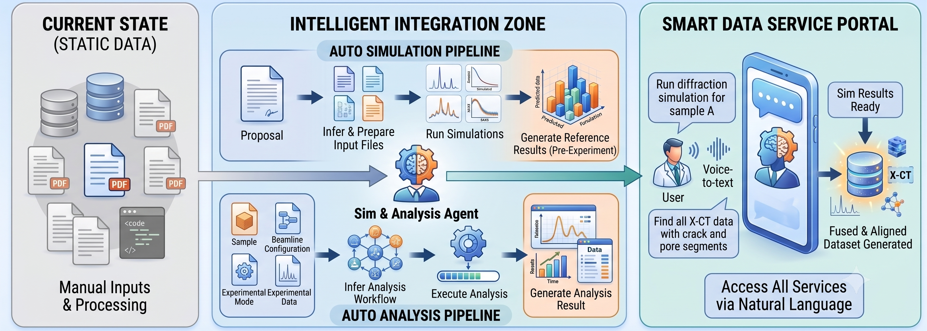
Plan: Towards Intelligent System
Integrate Simulation, Analysis Agent / Pipeline
Smart Data Service
Notes:
Another plan is to make the system much more intelligent.

Slide 20

Thanks for Your Listening!

