Slide 1
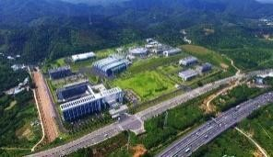
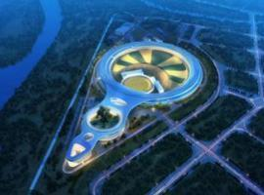

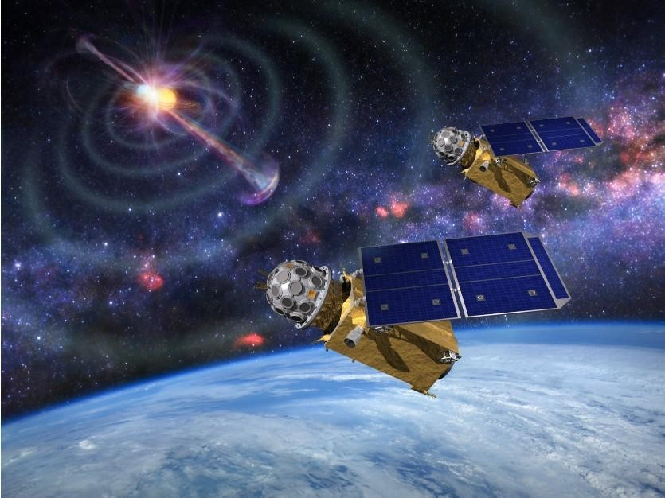
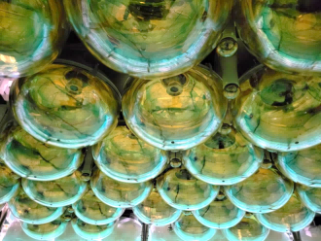
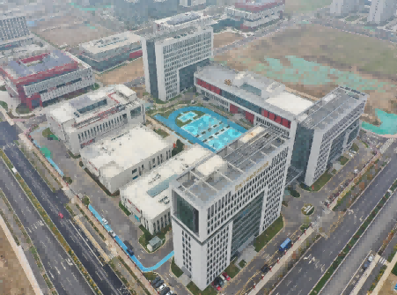
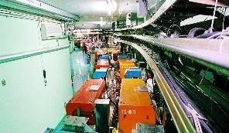
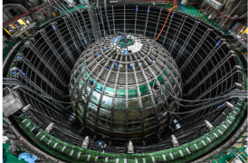
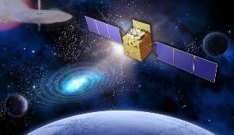
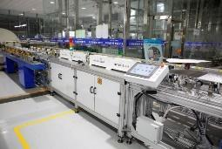
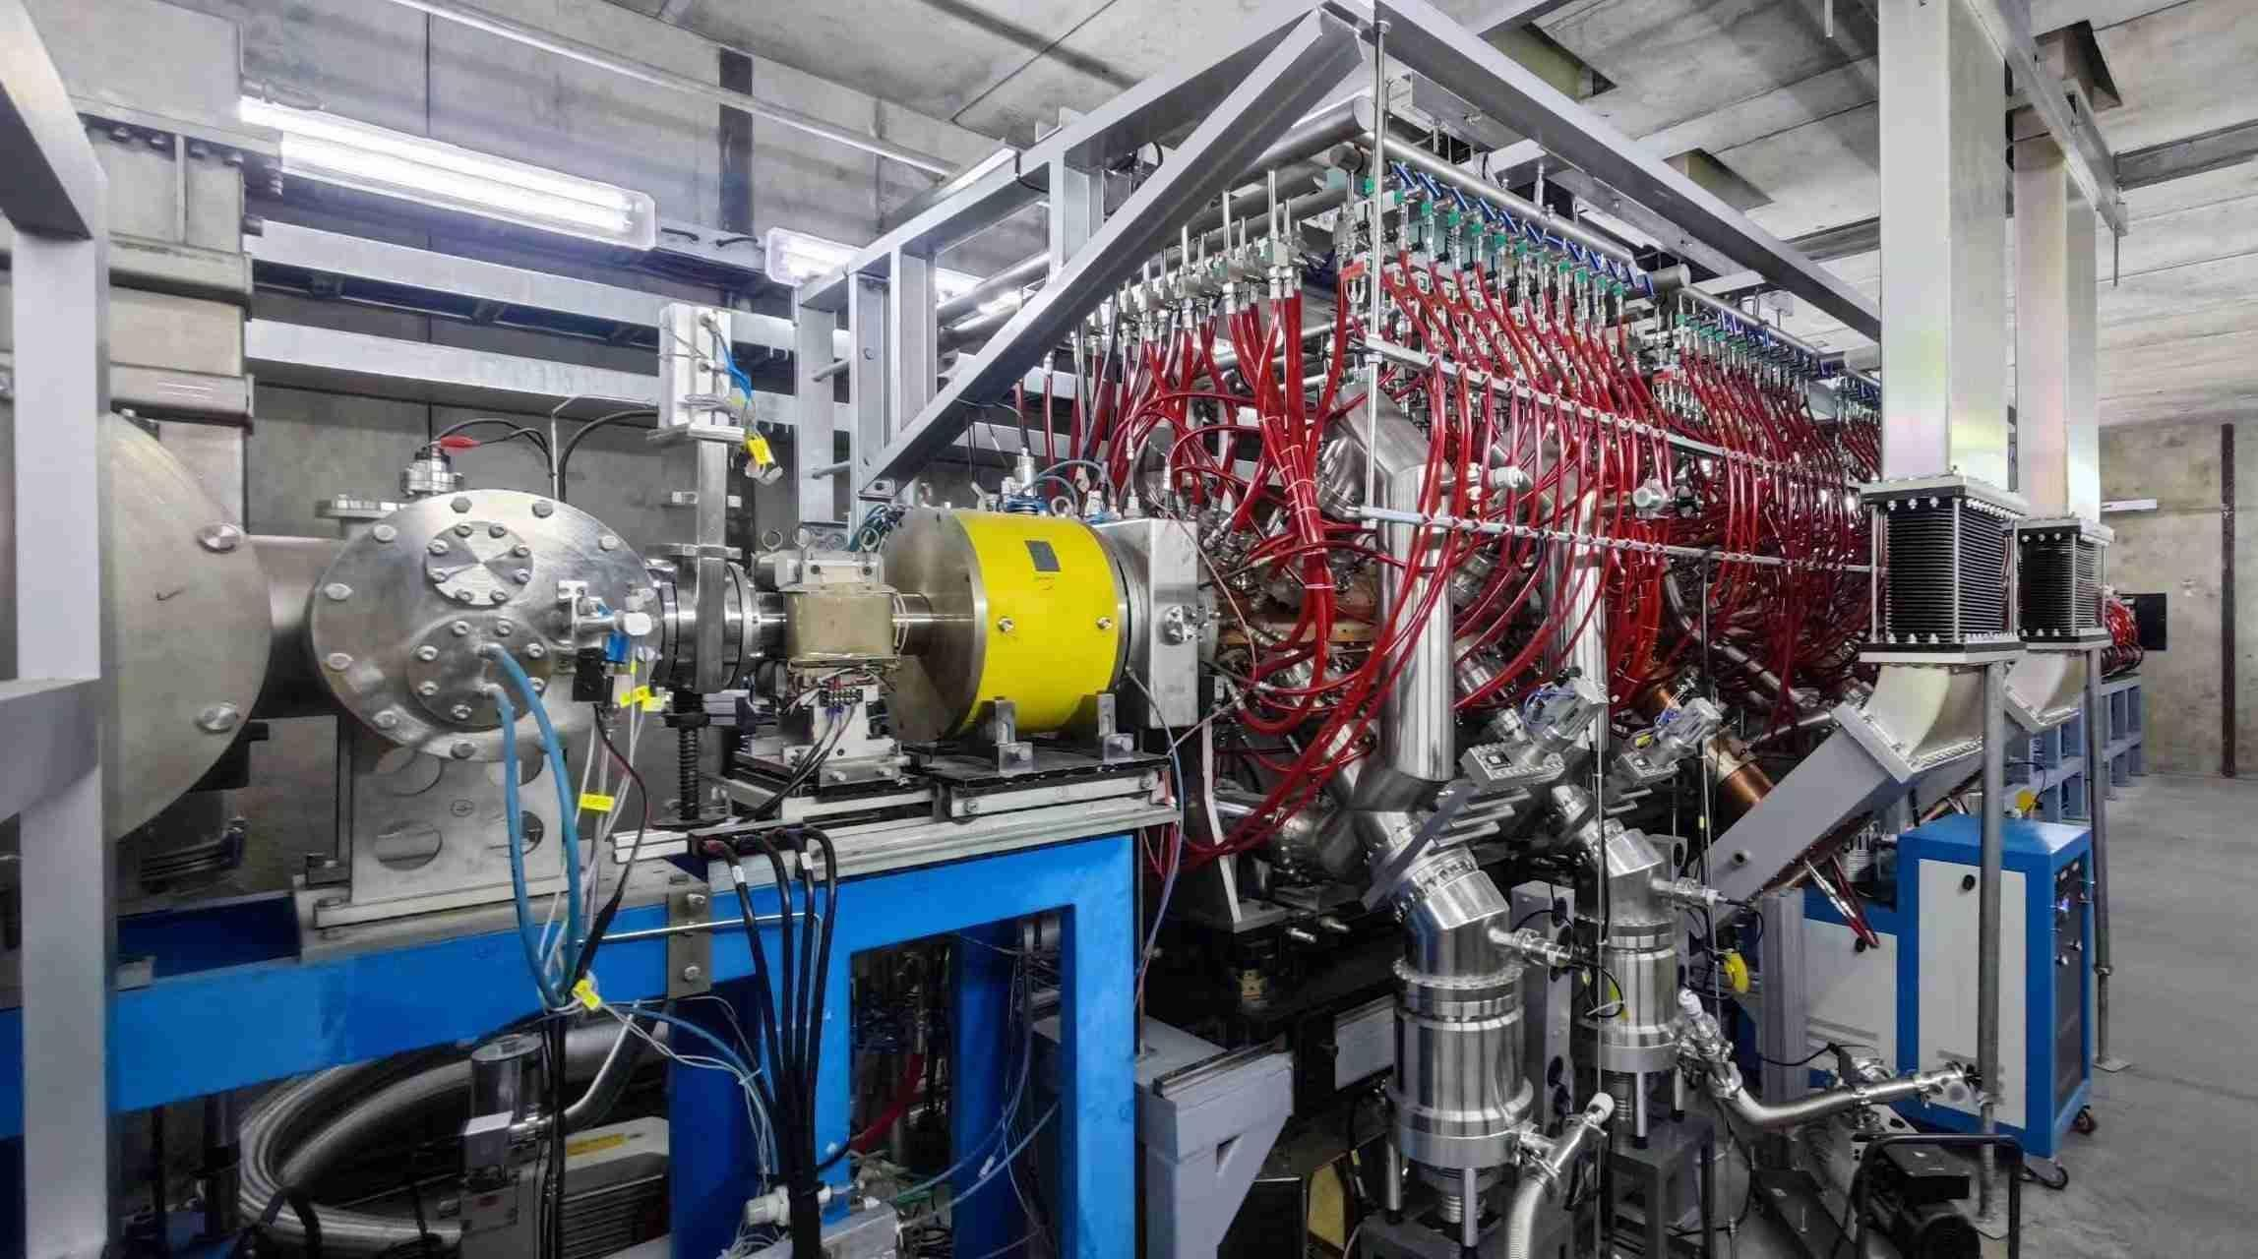
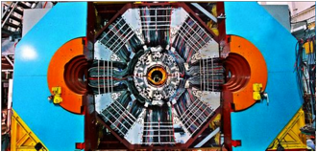
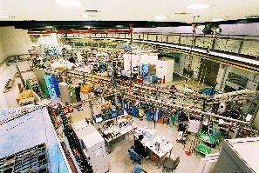
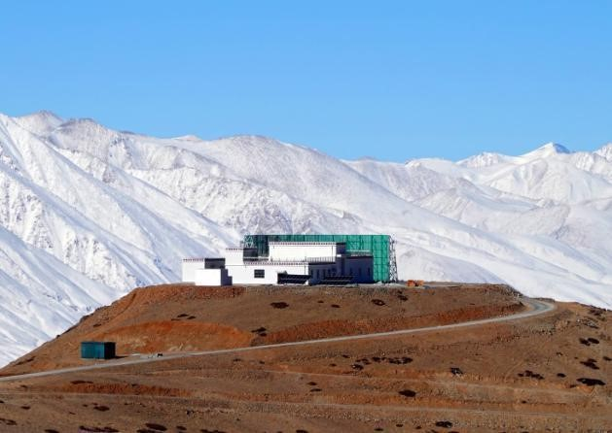
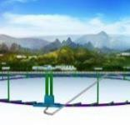
IHEP Vision
Jun Cao (IHEP)
17th FCPPN/L Workshop, Lyon, France
Notes:
Welcome. Today, I will present the vision of the Institute of High Energy Physics, or IHEP, of the Chinese Academy of Sciences. We will explore our strategic goals, core research areas, and future directions as we continue to push the frontiers of fundamental science.

Slide 2
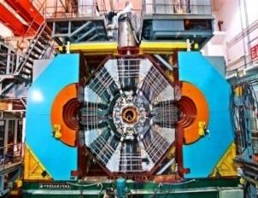
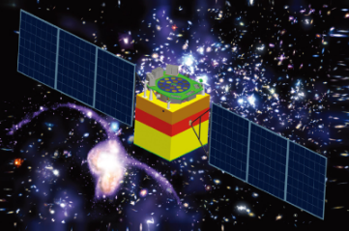
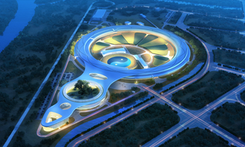
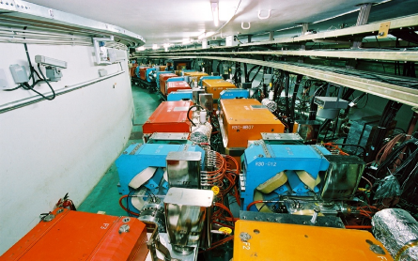
Overview of IHEP
4 campuses and several sites, 1530 employees, 230 postdocs, 780 students, 3.5b RMB/y
Particle Physics
Particle Astrophysics
Tau-Charm (BEPCII/BESIII)
Neutrino (Daya Bay, JUNO)
Higgs (LHC, CEPC)
Theoretical physics
X-rays in space (HXMT, eXTP)
Cosmic-rays (LHAASO, HERD)
CMB detection(AliCPT-1)
Multi-Disciplinary Research
Accelerator Physics & Tech.
Light source (BSRF, HEPS)
Neutron source ( CSNS)
Nuclear technology for trace analysis, Radiochemistry, etc.
Design and construction of e+e- collider (BEPC, CEPC)
Proton accelerator
Electron accelerator
Also:
Computing Tech.
Applications and Technology Transfer

Slide 3

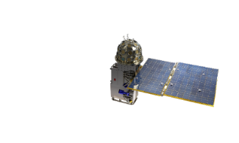

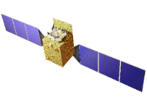
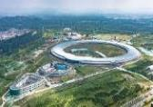
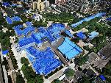
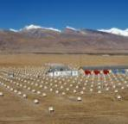
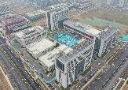

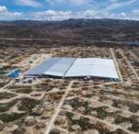
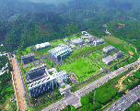
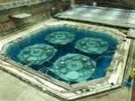
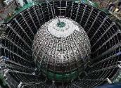
IHEP Large Science Facilities
SVOM/GRM, EP/FXT
CEPC, SAPS, HUNT
eXTP
Enhanced X-ray Timing and Polarimetry mission
GECAM
Gravitational wave EM Counterpart All-sky Monitor
HERD
HXMT
Insight Hard X-ray Modulation Telescope
Huairou Campus
HEPS High Energy Photon Source
  YBJ (retired)
  International Cosmic Ray Observatory
IHEP, Beijing Campus
BEPC Beijing Electron-Positron Collider
Jinan Campus
AliCPT
Ali CMB Polarization Telescope
LHAASO
Large High-Altitude Air Shower Observatory
Daya Bay (retired)
Daya Bay reactor Neutrino Experiment
JUNO
Jiangmen Underground Neutrino Observatory
Dongguan Campus
CSNS China Spallation Neutron Source

Slide 4
IHEP's 15th Five-Year Plan (2026-2030)
Becoming one of the world's leading particle physics research centers, and a large, world-class, comprehensive multidisciplinary research base
Area | Priorities (9) | Future Frontier/Tech (6)
Particle Physics | Physics in the Charm Energy Region | Higgs Physics
 | Neutrino Physics | CEPC Accelerator and Detector
 |  | BEPCII-UP
Astrophysics | Cosmic Ray & UHE Gamma-ray Astro. | MeV Gamma and UHE neutrino
 | Compact Objects & Cosmology
Multi-Disciplinary Research | Photon Science, Tech & Apps | Future Advanced light source
 | Neutron Science, Tech & Apps
Accelerator | Accelerator Key Technologies
Applications | Applications of Radiation Tech
AI and Quantum | AI on Large-Scale Facilities | Quantum Tech.
4
Notes:
Looking ahead to our 15th Five-Year Plan, our goal is to establish IHEP as a world-leading research center. To achieve this, we have identified nine key research directions. These directions cover the full spectrum of our activities, from the study of fundamental particles to the application of our technologies for societal benefit.

Slide 5
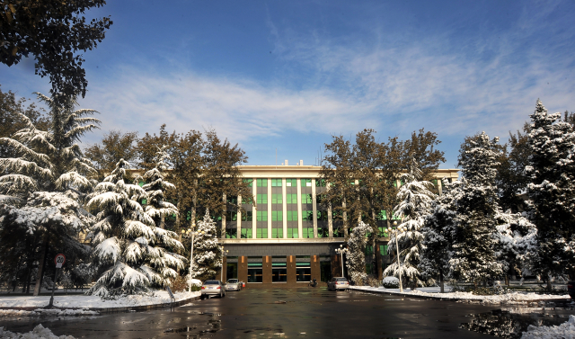
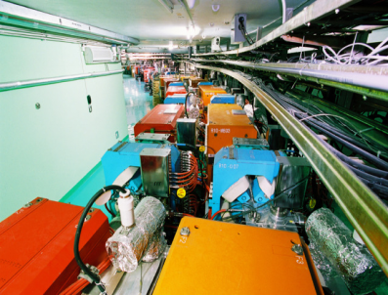
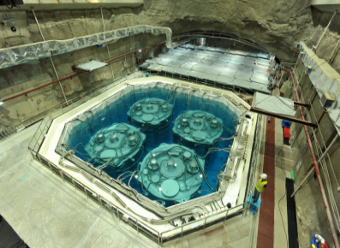
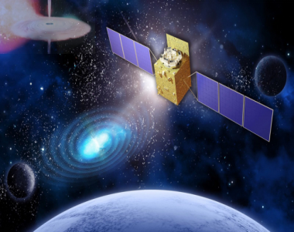
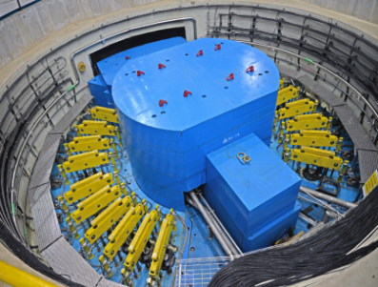
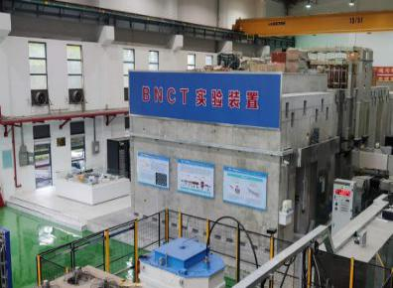
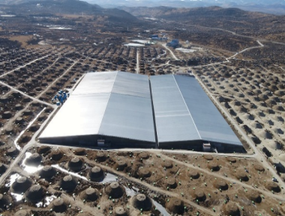
Priorities
in 15th FYP
Notes:
Beyond our core five-year plan, we are also exploring several frontier directions and future technologies that will shape the next generation of high energy physics research. These represent our long-term vision and commitment to exploring new frontiers.

Slide 6
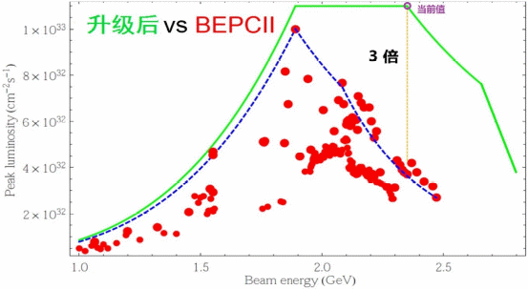
Hadron Physics at BEPCII/BESIII
The state-of-the-art facilities for hadron physics (2009--2030)
For hadron physics and precision test of the Standard Model
A new upgrade completed in 2024-2025
-- Luminosity increased by a factor of 3 @4.7 GeV
-- Maximum beam energy from 2.45 to 2.8 GeV
The BESIII Collaboration consists of more than 700 members from 86 institutions in 16 countries, in which ~130 members from outside of China
More than 700 papers published
Focus in 15th FYP on Glueball, hybrid, and exotic hadron physics.
Expected Outcomes
  Achieve breakthroughs in exotic hadrons and quantum states.
  Production and decay properties of hadrons.
  Measure CP violation in heavy meson decays with ultra-high precision.
Upgrade 2024-2025, reached Lumi goal in 2026 (x3）

Slide 7
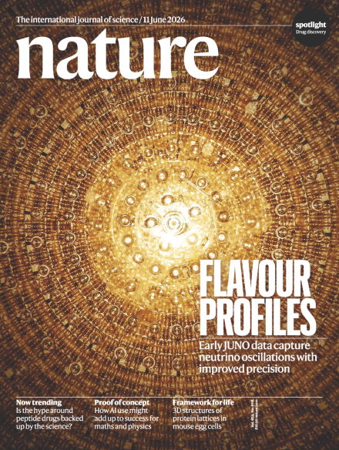
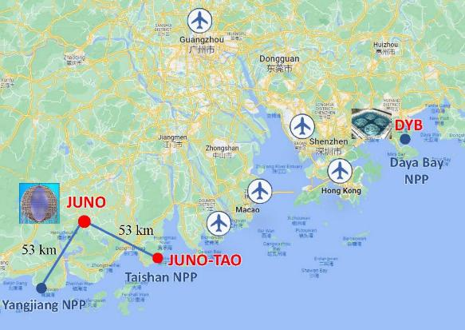
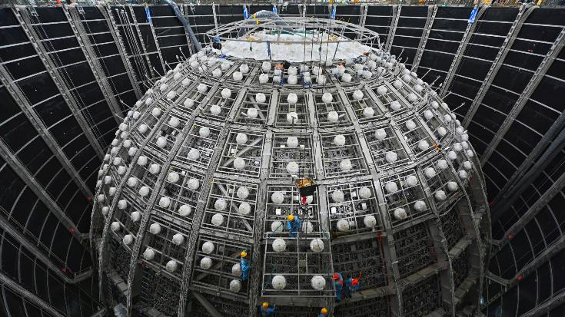
Jiangmen Underground Neutrino Observatory
JUNO, a 20 kton liquid Scintillator detector at 700 m underground
  Aug. 26, 2025 data taking; Nov. 19 first results → the most precise sin²θ₁₂, Δm²₂₁ measurement
  Jun. 2026: Precision of solar oscillation parameters improved by a factor of 1.3-1.5
  First measurement on Δm²₃₁ favors Normal Ordering at ~2.3σ with NuFit constraint
JUNO-TAO, a ton-level low-temperature liquid scintillator detector
  Data taking started since Feb. 15, 2026, light yield ~ 4,000 p.e./MeV (JUNO 1780 p.e./MeV)
Key Scientific Goals in 15th FYP
  Determine the neutrino mass ordering with high precision.
  Precisely measure oscillation parameters and search for new physics.

Slide 8

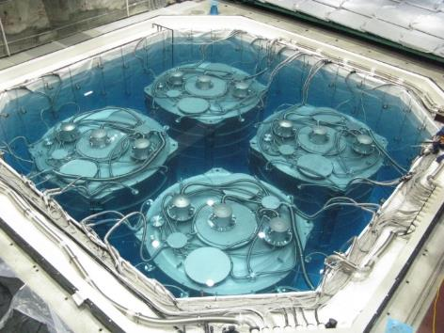
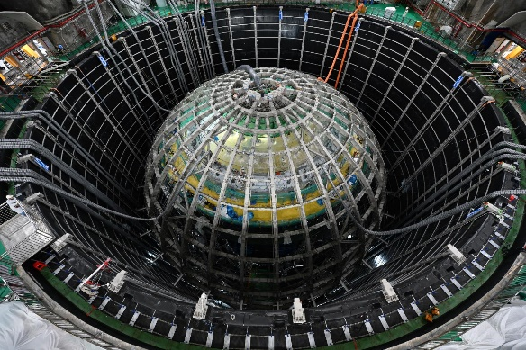
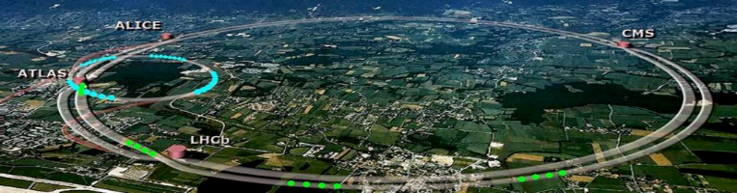
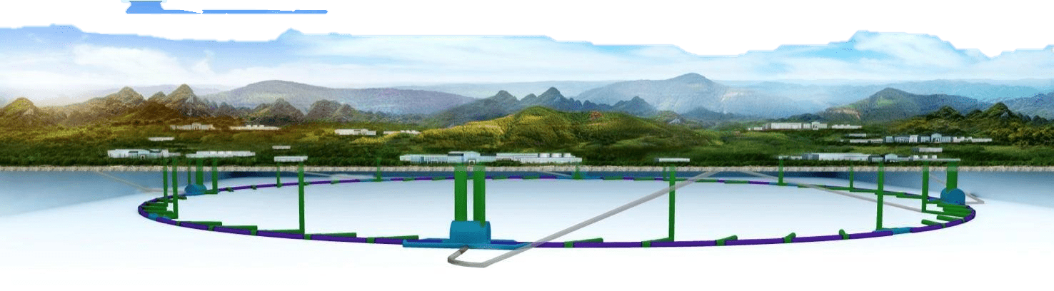
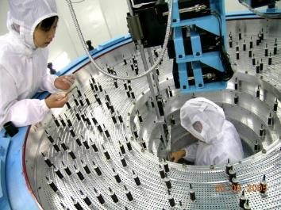
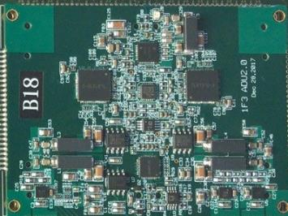
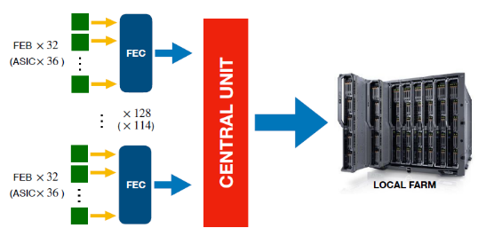
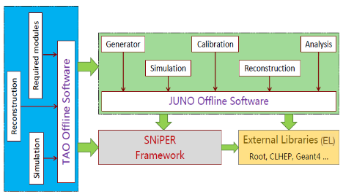
Particle Physics (Experimental Physics Center)
Charm Physics (39 FTE)
BESIII, BelleII, PANDA, GlueX
Neutrino Physics (60 FTE)
Daya Bay, JUNO, EXO, DarkSide, COMET
High Energy Frontier (54)
CEPC, LHC (ATLAS/CMS/LHCb)
Detector (48 FTE)
Electronics (24 FTE）
Trigger, DAQ, DCS (14 FTE)
Software (25 FTE)
Complete chain of design, construction, and operation of large-scale experiments, R&D of advanced technology
177 staff, 408 temporary (including postdoc, students), totaled 585 people

Slide 9
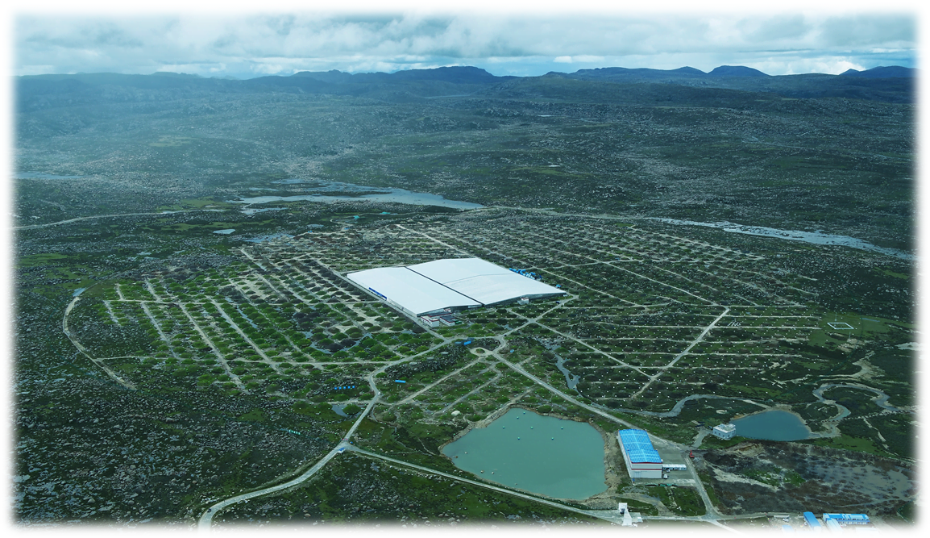
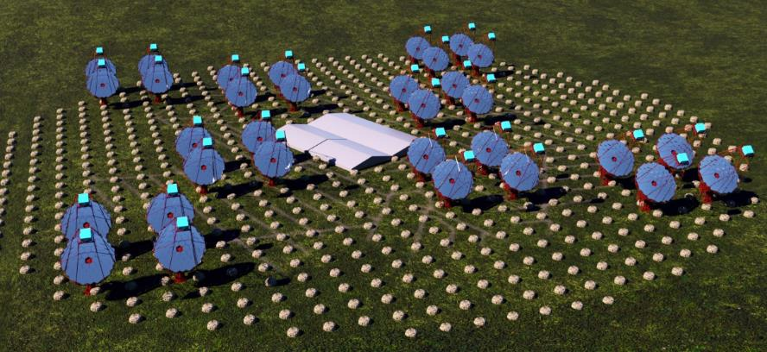
Exploring the Extreme Universe with LHAASO
Facility: LHAASO, the world's premier cosmic ray observatory, unlocking the century-old mystery of the origin of cosmic rays.
Key Research Goals:
Detect ultra-high-energy gamma-rays and map the universe.
Locate particle accelerators and solve the mystery of their origin.
Key Scientific Output & Goals:
  Discover and resolve PeV cosmic accelerators, revealing their acceleration mechanisms.
  Operate LACT for high-precision, full-sky monitoring of ultra-high-energy gamma-rays.
  Develop, launch, and operate the HERD instrument on China's space station.
LHAASO Observatory
LACT Array
03
Notes:
Our third direction is cosmic ray and gamma-ray astronomy with LHAASO. This groundbreaking observatory has already discovered dozens of PeVatrons, sources of the highest-energy photons ever detected. Our goals are to understand the origin of these cosmic rays, operate the LACT array, and prepare for the HERD mission in space.

Slide 10
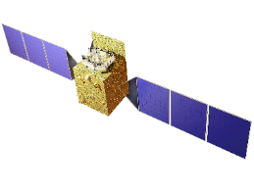



Probing the Extremes of Gravity: Compact Objects and Cosology
Leveraging Facilities
Leveraging Insight-HXMT, GECAM, eXTP, and HERD to explore the physics of extreme celestial bodies and unravel the nature of spacetime and cosmic expansion.
Key Scientific Goals
Study the physics of neutron stars and black holes via X-ray/gamma-ray emissions.
Measure gamma-ray burst polarization to explore extreme physics and spacetime properties.
Insight-HXMT
GECAM
Expected Outcomes
Develop the eXTP payload and precisely measure the fundamental parameters of black hole and neutron star systems.
Break through stellar astronomy geometric distance measurement techniques for an independent measurement of the Hubble constant.
Conduct CMB sky observations in the northern sky.
eXTP
2030+
2025Phase
High-Energy Astrophysics Cluster
04

Slide 11

The Power of Light: HEPS for Multidisciplinary
Facility: HEPS, a world-class high-performance synchrotron radiation light source, providing a "super microscope" for cutting-edge interdisciplinary research.
Expected Achievements & Applications
HEPS reaches its design specifications
Completes Phase II beamline construction.
Conduct research on aero-engine blade inspection (6 MeV HE light source, high value for commercial aviation) and solid-state batteries
Verify key technologies for next-generation storage ring light sources.
2026: Fully Open & Shared
Core Research & Technology Development
Improve high-brightness X-ray technology to support multidisciplinary research.
Develop advanced X-ray optical components, detectors, and experimental methods.
Achieve atomic-level imaging and characterization of matter with ultra-high precision.
Building a World-Class Photon Science Center
Driving frontier exploration and industrial upgrading with extreme light sources.
05

Slide 12

Probing the Inner Structure of Matter with CSNS
Facility: Using neutrons as a probe to explore the microscopic world of matter, driving innovation from basic science to industrial upgrading.
Expected Achievements & Applications
Fully construct and operate CSNS-II efficiently, achieving world-leading performance in pulsed spallation neutron sources.
In high-end manufacturing, nuclear data, and new energy sources, achieve a series of major results supporting industries
Achieve breakthroughs in applied technology research for life sciences and large biological macromolecule structure determination.
Core Research & Development
Explore the structure and dynamics of high-temperature superconductors, quantum materials, and biological macromolecules.
Develop key technologies for high-resolution neutron scattering spectrometers and detectors.
Promote the industrial application of advanced photon source technologies and new energy materials.

Slide 13
Advancing the Frontiers of Accelerator Science
Goal:Develop advanced accelerator technologies to build a world-leading advanced particle accelerator technology system.
Core Research Directions
Develop high-gradient superconducting and advanced beam diagnostic technologies.
Explore the application of accelerators in energy, medical, and national security fields.
Expected Breakthroughs
Achieve key technological breakthroughs in wakefield acceleration and beam-driven cascaded wakefield acceleration.
Build an autonomous and controllable intelligent physical modeling and simulation software system.
Comprehensively enhance the operational efficiency and reliability of large scientific facilities.
2026: Build a new-generation accelerator technology verification experimental platform
Notes:
Seventh, we focus on advancing the frontiers of accelerator science. This includes developing next-generation accelerator technologies, such as high-gradient superconducting cavities and novel acceleration concepts like wakefield acceleration. Our goal is to enhance the performance of existing facilities and explore new applications in energy, medicine, and national security, ensuring that the Institute of High Energy Physics remains at the forefront of accelerator technology.

Slide 14



Applying High-Energy Physics for Societal Benefit
Goal: Leverage high-energy physics capabilities to drive technological breakthroughs in medical, environmental, and safety fields.
Major Research Tasks:
Develop advanced radiation detection technology to aid medical diagnosis and treatment.
Apply accelerator technology and nuclear methods for environmental monitoring and resource exploration.
Expected Outcomes: From Lab to Application
Verify key medical isotopes with radionuclide purity≥99%.
Develop leading-edge nuclear technology for heritage protection, high-sensitivity detection, and imaging, achieving industrialization.
Science for the People, Innovation for Empowerment
08
Notes:
This slide focuses on applying high-energy physics for societal benefit. Our goal is to leverage these capabilities for breakthroughs in medical, environmental, and security fields. Major tasks include developing advanced radiation detection for medicine, applying accelerator tech for environmental and resource work, and building intelligent systems for national security. Expected outcomes are verifying high-purity medical isotopes (≥99%) and developing leading nuclear tech for heritage protection, detection, and imaging, achieving industrialization. Strategically, this builds a high-tech medical industry and drives upgrades in manufacturing, environment, and security sectors, ultimately serving people's livelihood and national security.

Slide 15

AI and Big Data
Goal:Integrate real-time computing with intelligent algorithms to unlock the high-value scientific potential of massive data.
Key Research Points
Research AI algorithms for real-time experimental data processing and utilization.
Apply big data analysis to efficiently manage and mine massive scientific datasets.
Optimize accelerator operation with intelligence to improve performance and reliability.
Expected Outcomes
Build DrSai, the world's first intelligent system for particle physics, capable of full-process intelligent control.
Construct a PB-level high-quality AI-Ready scientific dataset and lay a solid foundation for intelligent infrastructure.
Build the world's first intelligent software and hardware facility for light/neutron sources.
09
Notes:
This direction focuses on AI and big data applications in large-scale facilities. We aim to integrate real-time computing with intelligent algorithms to unlock massive data's value. Key research includes AI algorithms for real-time data processing, big data analysis for scientific datasets, and intelligent accelerator optimization. Expected outcomes are DrSai (the first particle physics intelligent system), a PB-level AI-Ready dataset, and the world's first intelligent light/neutron source facility. Our core vision is to promote "data-algorithm-model-tool" integration and lead the intelligent leap in high-energy physics research.

Slide 16


Dr.Sai: AI Agent for Big Science Data Analysis
Dr.Sai: pioneering autonomous physics discovery at BESIII (and beyond) through Agentic AI
Dr.Sai $≈$ LLM + Tools + Knowledge + Strategy
Autonomous for simple cases; Collaborative for complex ones
Previous analyses, “Skills” + Domain-Specific-Language (DSL) + RAG
DeepSeek (Qwen/GPT/Gemini)
HPC, BESIII Offline Software System, HTCondor, CERN ROOT, etc.
2023.07: Working Group formed at IHEP
2024.07: Version 1, proof-of-concept
  https://drsai.ihep.ac.cn
  talk at ICHEP2024
2025.07: Version 2, prototype
  Simple analysis with prior knowledge
  Validated by 10 analyses of J/psi decays
2026.07: Release the first practical Dr.Sai
  Scalable: automatic DSL extraction from papers by AI
  Continuously Learning: expert feedback standardized and stored as knowledge
  Several real analyses ongoing at BESIII
  Extend to: JUNO data production, ATLAS DQM, CMS ntuple analysis, neutron/light source analyses
Front. Phys., 2026, 21(9): 096401

Slide 17
Frontier Directions
and Future Technologies
Notes:
Beyond our core five-year plan, we are also exploring several frontier directions and future technologies that will shape the next generation of high energy physics research. These represent our long-term vision and commitment to exploring new frontiers.

Slide 18






Deciphering the Higgs Boson: The Key to Mass
Higgs physics at ATLAS and CMS
Hadron Spectroscopy and CPV at LHCb
Detector R&D
  HL-LHC upgrade
  ATLAS ITK and HGTD
  CMS Calorimeter and muon trigger electronics
  LHCb UT
CERN/LHC
27 km
LHC Accelerator
Expected Output
Discover evidence for the double Higgs production process, observe rare decay processes of the Higgs boson, and make pioneering contributions to revealing its nature and the origin of mass in the universe.
Higgs
Particle
15
Notes:
This slide outlines our strategic goals in Higgs boson research. We aim to prepare for future Higgs factories (e.g., CEPC) for precision measurements, search for rare decay channels to test the Standard Model, and use Higgs physics to explore new physics beyond the Standard Model, addressing dark matter and cosmic origin mysteries. The expected output includes discovering double Higgs production and rare decays, advancing our understanding of mass origin.

Slide 19



CEPC
IHEP will continue to pursue energy frontier particle physics research and technology development
CEPC is continuing the EDR activities both for accelerator and detector. Site geological study completed in Apr. 2026
Accelerator EDR (2024-2027). IARC2026 meeting will be held in Sep. 2026. Expected progress includes
  BEPCII injector-based plasma wakefield accelerator test facility for CEPC injector and future linear colliders. The first beam available to excite plasma experiments will start in April 2026
  Booster magnet and vac chamber NEG coating automatic fabrication lines completed by June 2026
  High efficiency energy recovery klystron with 85% efficiency will be fabricated by the end of 2026
  SppC Iron-Based Superconducting high field magnets development is ongoing.
CEPC booster magnet Automatic fabrication
line will be completed by May,2026
CEPC vacuum chamber NEG coating
fabrication line will be completed by June 2026
CEPC various klystrons all will be completed
by the end of 2026

Slide 20

Envisioning the Next Generation of Light Sources
Explore the feasibility of a new generation of light sources with significantly improved time resolution, spectral resolution, and brightness, providing strong support for the Southern Light Source project.
Advance accelerator physics and light source technology, develop new types of insertion devices and precision optical systems, and lay the engineering foundation for light source upgrades.
Respond to major national scientific and technological needs, providing core technical reserves and support for future devices such as the Southern Light Source.
Next-Gen Light Source (ERL-FEL) Conceptual Layout
Expected Output
Complete the overall design scheme for an oscillator-type light source based on a storage ring regular straight section and a design scheme for an ultra-high flux 5-100MeV gamma-ray source.
Achieve international leadership in the R&D and application of compact advanced light sources.
17
Notes:
We are envisioning the next generation of light sources, focusing on exploring concepts with enhanced time/spectral resolution and brightness to support the Southern Light Source. We will advance accelerator physics, develop new insertion devices and optical systems for upgrades, and provide core technical reserves for national big science projects like the Southern Light Source. The expected outcomes include completing design schemes for oscillator-type and gamma-ray sources, and achieving international leadership in compact advanced light sources R&D.

Slide 21


Interfacing Quantum Tech with Fundamental Physics
Explore the application of quantum sensors (e.g., atom interferometers)in ultra-high-precision measurements in particle physics and cosmology, refreshing the precision of fundamental physical constant measurements.
Tackle thequantum computing algorithm for lattice QCD, solving the simulation problem of strong interactions and empowering the analysis and processing of massive experimental data.
Build ahigh-security quantum communication encryption systemto realize trustworthy transmission and privacy protection of scientific research data across national boundaries and sites.
Expected Output
Complete the experimental verification of the quantum platform for at least one core physical process, establishing a precise mapping system between experiment and theory.
Achieve breakthroughs inTES/KID/SQUID technologiesand realize modular integration; achieve galaxy-scale weak lensing observations on a kilometer-scale quantum-enhanced optical array, with Hubble constant measurement precision better than 1%.
18
Notes:
This slide highlights the intersection of quantum technologies with fundamental physics. We focus on three key directions: applying quantum sensors for ultra-high-precision measurements in particle physics and cosmology, developing lattice QCD quantum computing algorithms to solve strong interaction simulation problems, and building secure quantum communication systems for trusted data transfer. The expected outputs include experimental verification of quantum platforms for core physical processes, breakthroughs in key detector technologies (TES/KID/SQUID) with modular integration, and galaxy-scale weak lensing observations to improve Hubble constant measurement precision to better than 1%.

Slide 22

Multi-Messenger Astronomy: The MeV and UHE neutrino Frontiers
Innovate detector experimental design:develop new observation methods for MeV gamma-ray lines and high-energy neutrinos, breaking through the sensitivity bottleneck of traditional detection technology and building a high-sensitivity observation system for exploring the extreme universe.
Decipher extreme astrophysics:using these two new messengers to decode the physical secrets of extreme processes such as black hole accretion and gamma-ray bursts, exploring frontier scientific issues such as the origin of cosmic rays and the evolution of compact celestial bodies.
Expected Scientific Output:
Realize TES array technology for pixelated 511keV photon detection, achieving an ultra-high energy resolution of better than one part in a thousand.
Complete the key technology research and principle verification for the next-generation neutrino astronomy observation device.
19
Notes:
We are also pushing the frontiers of multi-messenger astronomy by focusing on MeV photons and high-energy neutrinos. These are crucial messengers from the most extreme events in the universe. Our goal is to develop new detection technologies to open a new window on the high-energy universe.

Slide 23


BEPCII – Further Upgrade
Upgrade consideration: Crab Waist scheme to increase the peak luminosity by 10 times.
Design is ongoing.
Comparison of main parameters
between BEPCII and BEPCII-CW
 | BEPCII | BEPCII-CW
Circumference [m] | 237
Optimization beam energy [GeV] | 1.89
Peak luminosity [${10}^{33}cm^{−2}s^{−1}$] | 1 | 10
$β_{x}^{∗}/β_{y}^{∗}$ [m] | 1/0.0135 | 0.15/0.005
Total current [mA] | 910 | 1500
Bunch current [mA] | 8.3 | 12.5
Bunch number | 110 | 120
Beam-beam para. $ξ_{x}$/ $ξ_{y,lum}$ | 0.029/0.04 | 0.01/0.088
Emittance [nmrad] | 120/0.6 | 55/0.193
Damping time [ms] | 24.7/24.7/12.3 | 13.9/14.6/7.45
Longitudinal tune $ν_{s}$ | 0.032 | 0.040
Natural energy spread [%] | 0.05 | 0.082
Natural bunch length $σ_{z,0}$ [mm] | 11.5 | 13.3
Bunch length $σ_{z}$ [mm] | 13.5 | 16
Half crossing angle [mrad] | 11 | 18.1
Piwinski angle | 0.47 | 3.19
Tune | 7.509/5.575 | 8.550/7.576
--- Future upgrade (Crab Waist)
--- BEPCII-Upgrade (Present)
--- BEPCII

Slide 24

Roadmap of IHEP (To be updated)

Slide 25















Thanks!
Institute of High Energy Physics, Chinese Academy of Sciences
2026

