Slide 1
Feasibility study of future BEPCII upgrade with crab waist scheme
Dou Wang (IHEP)
On behalf of BEPCII-UP team
17th FCPPN/L Workshop 2026 June 29-July 3, 2026 Lyon - France

Slide 2
Outline
Crab waist scheme being considered for BEPCII
Benefits to BESIII Physics with CW
Design and development of BEPCII with CW (intended for a future upgrade)
Possible international collaborations
Summary
Notes:
2

Slide 3
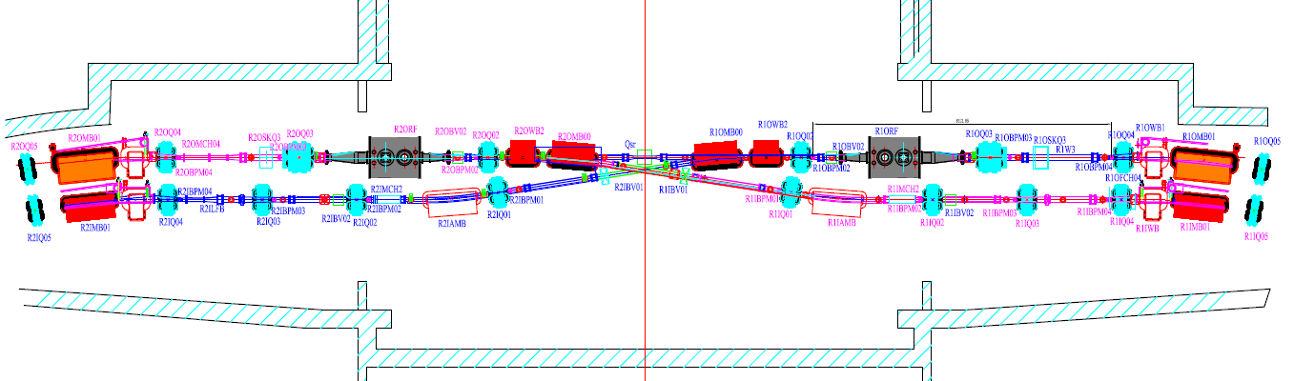
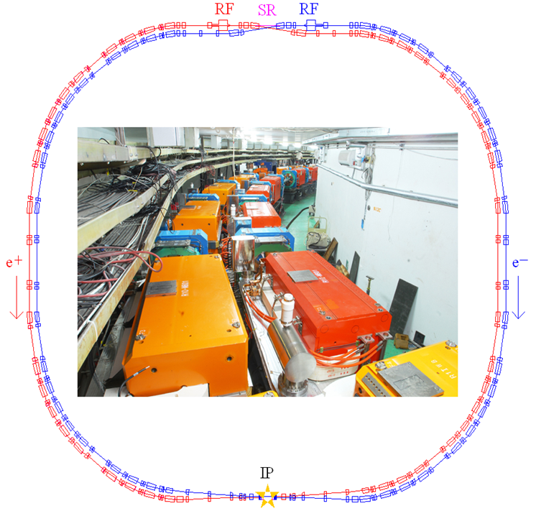
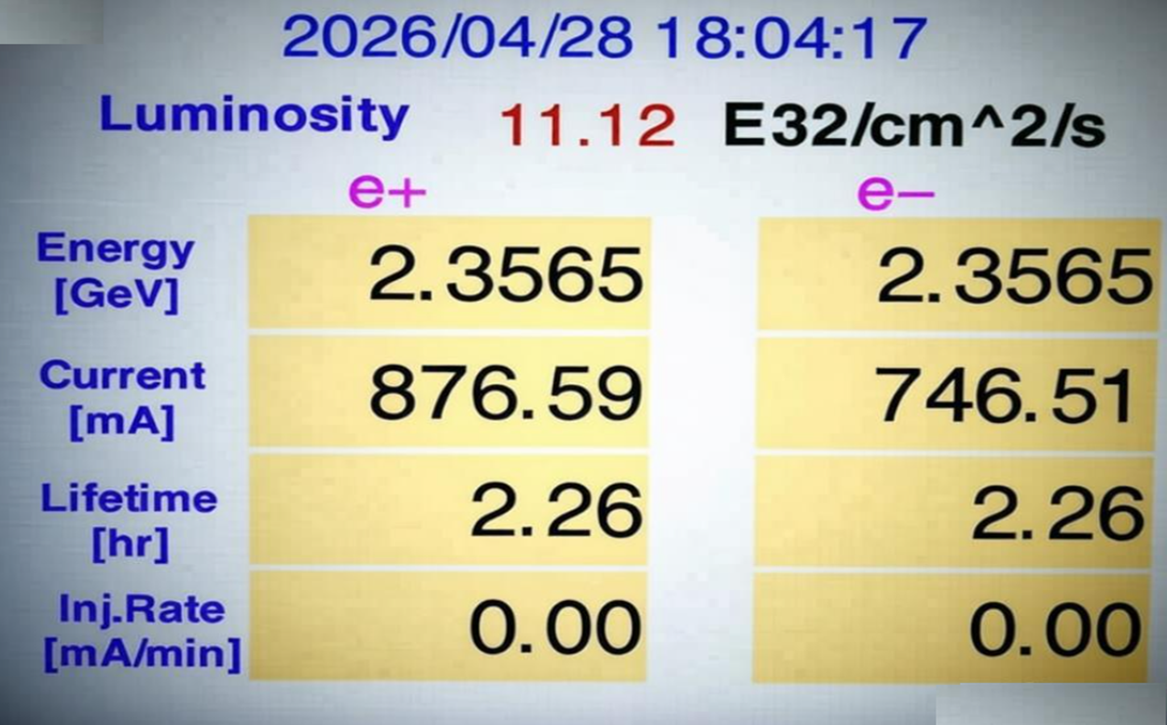
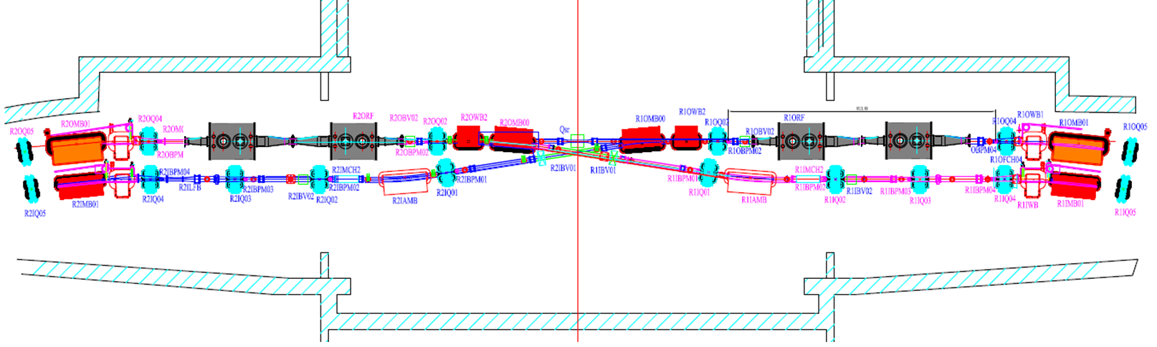
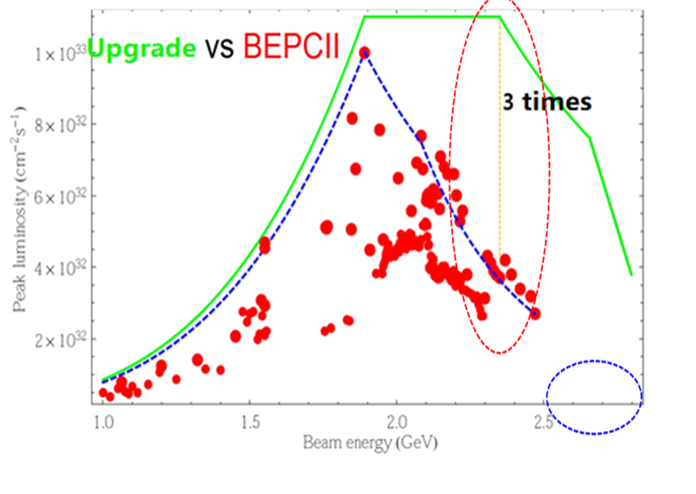


BEPCII
BEPCII：double ring e+e- collider (2005 -)
Performance upgraded at high energy (2021~2025)
0.92GeV~2.47GeV
C₀=237m
L×3 @ 2.35GeV
Max. beam energy: 2.47GeV → 2.80GeV
θ_{h} =11mrad

Slide 4
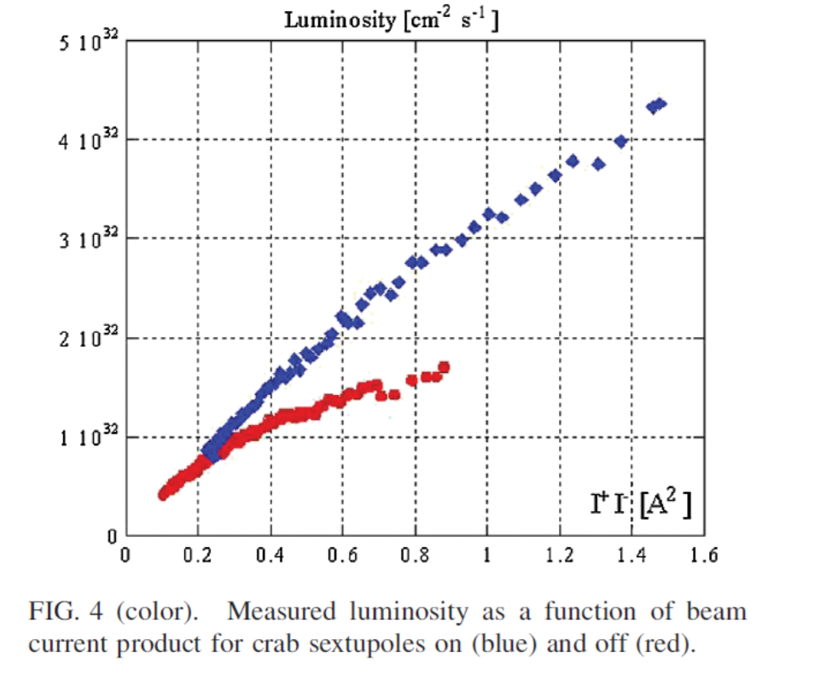
Why crab waist?
The Crab Waist collision concept was first tested and successfully demonstrated at DAFNE in Italy.
Test of “Crab-Waist” Collisions at the DA Φ NE Φ Factory, Physical review letters, 2010, Vol.104 (17), Article 174801
Crab waist has the potential to significantly enhance luminosity.
Large Piwinski angle
Small betay*
Crab sextupoles
Crab waist is the preferred scheme for achieving high luminosity in next-generation colliders (SuperKEKB, CEPC, FCC, STCF…).

Slide 5
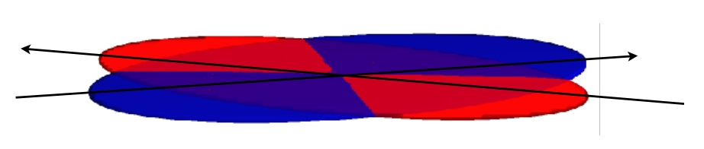
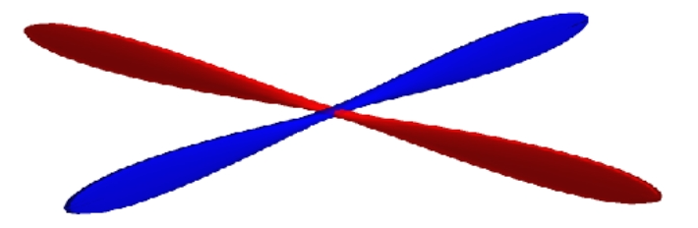
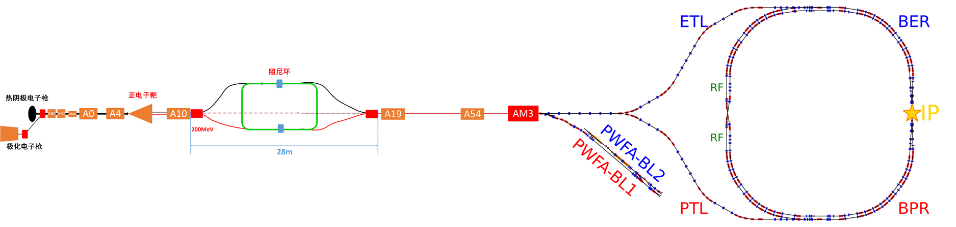
BEPCII crab waist scheme
BEPCII/U
Design study supported by IHEP Innovation funding since 2025.
1. IR: crab waist collision
2. Inner ring Inj. region: insert wigglers
3. Linac: Compact damping ring
BEPCII crab waist
PWFA TF

Slide 6
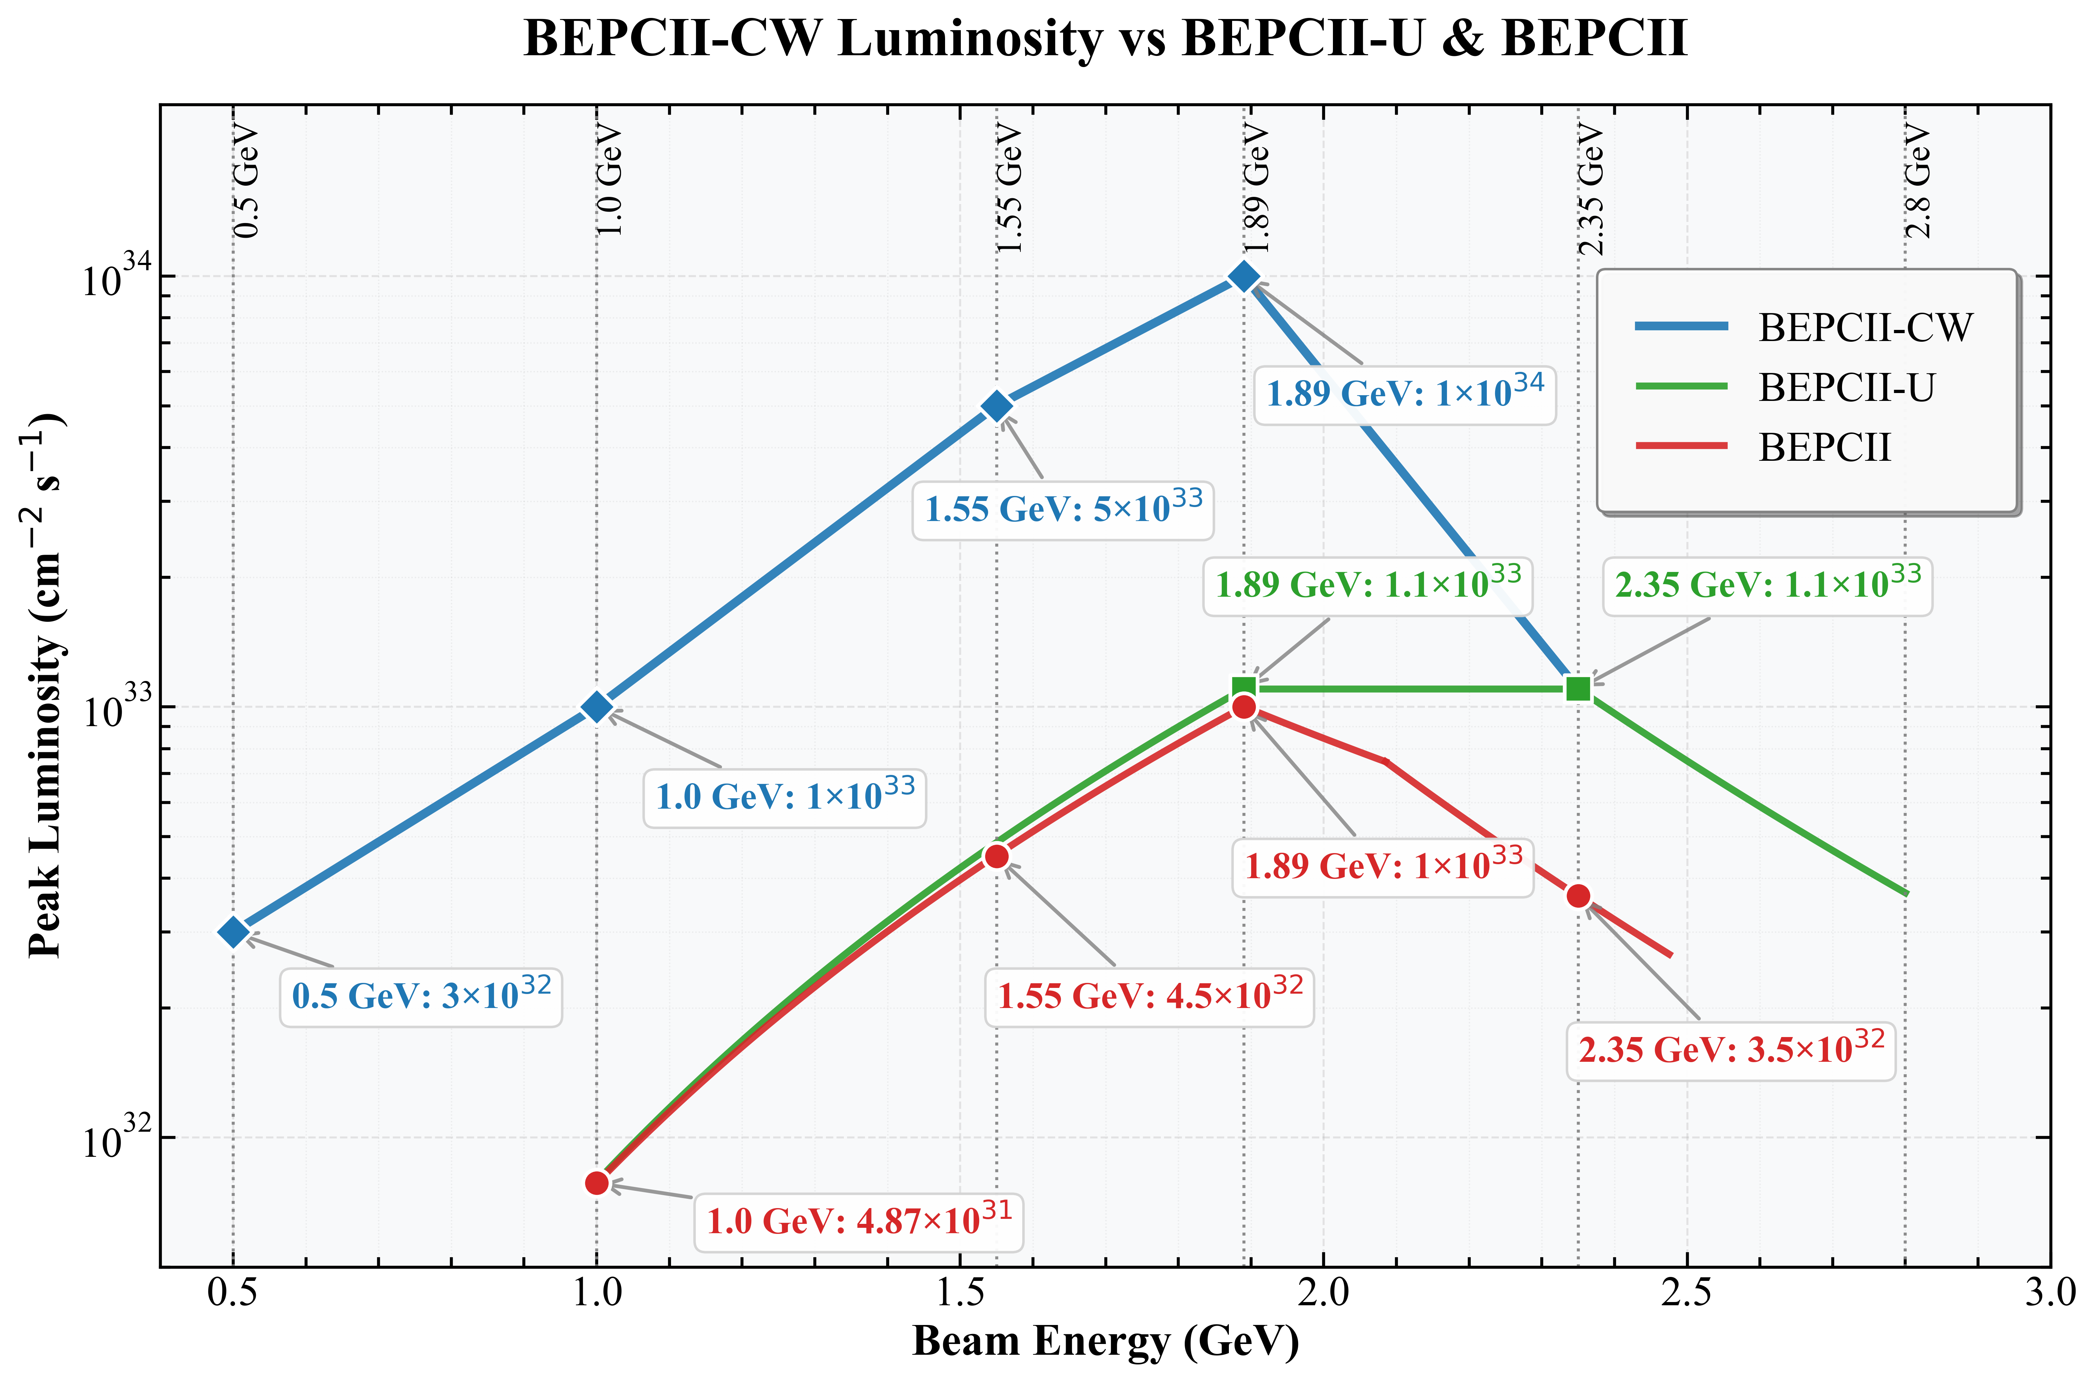
BEPCII crab waist performance outlook
The specifications at each energy are very preliminary.
Parameters and lattice design need to be carefully optimized for each energy.
Accelerator design is focusing on 1.89 GeV firstly.
Luminosity may increase by ×10 below 1.89GeV,.
Operation below 1GeV is enabled

Slide 7
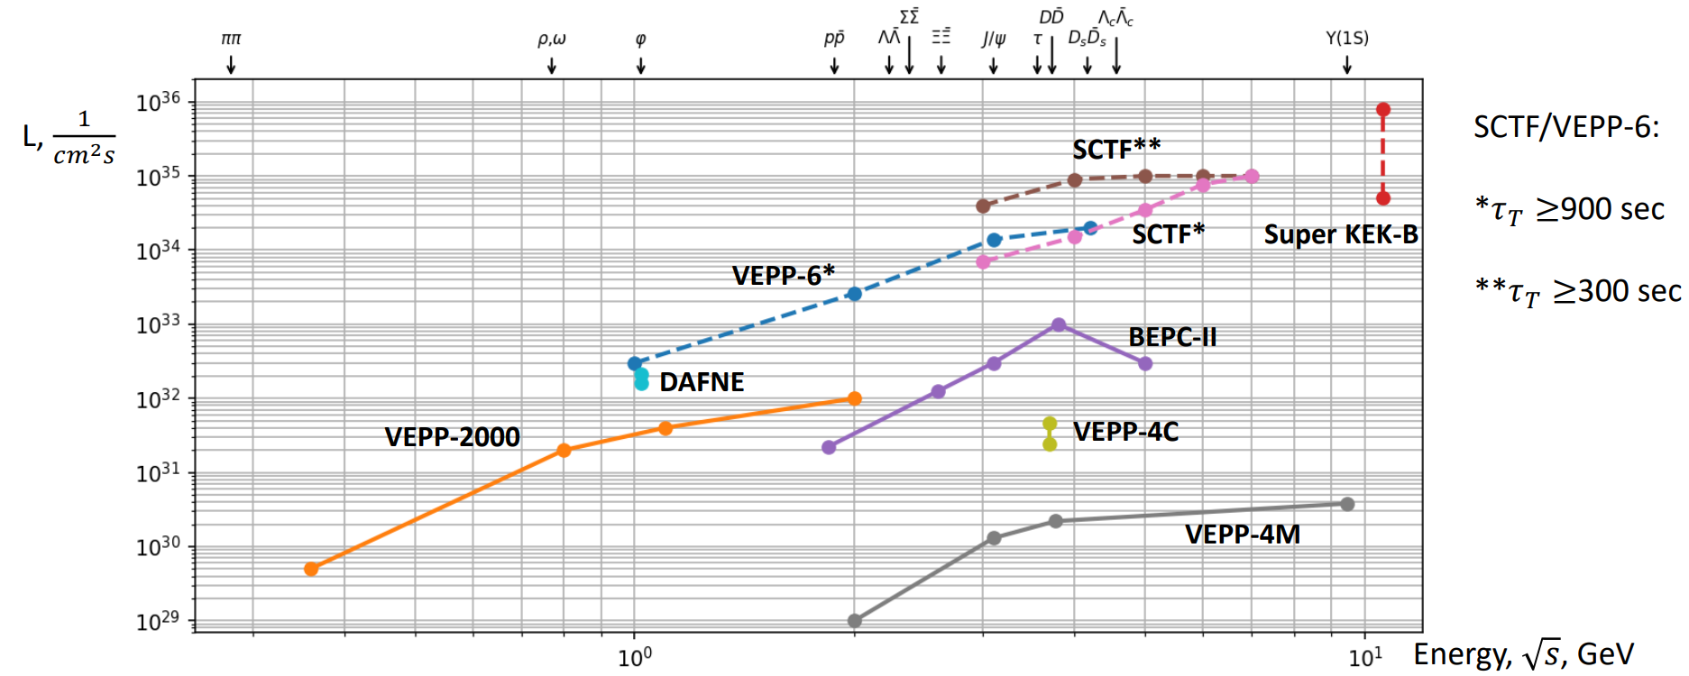
e+e- colliders at a glance
STCF
Ref: Ivan Logashenko @FTCF2025（November 24, 2025）

Slide 8
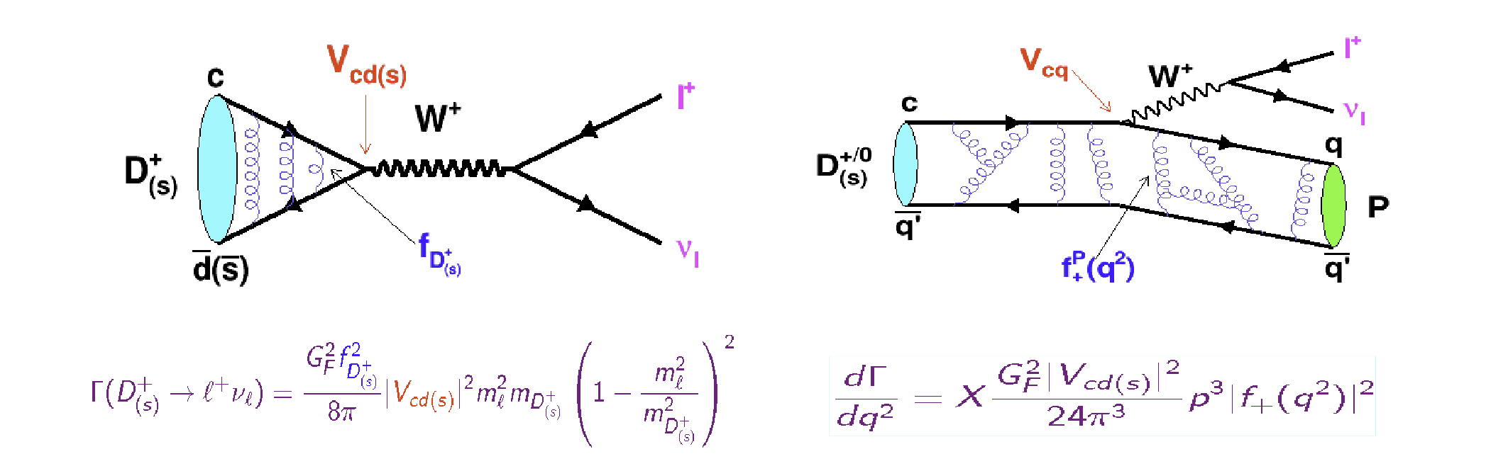

Benefits to BESIII Physics with CW
Charm physics with x10 data at 3.77 GeV
Haibo Li, Gang Li
With CW upgrade: 0.1 B $D\overline{D}$ pair → 1 B $D\overline{D}$ pair
Physics topics
  $Pure leptonic decay of D meson$：precision measurement of $|V_{cd}|$, $|V_{cs}|$, decay constants，search for lepton flavor violation, …
  Semi-$leptonic decay of D meson$： precision measurement of $|V_{cd}|$, $|V_{cs}|$, search LFV, and light hadron spectroscopy studies
  $Hadron decays of D meson$：CP violation ，strong phase, Quantum entanglement
  New physics searches: rare decay, radiative decay，invisible particles，FCNC, …
  … …

Slide 9






Benefits to BESIII Physics with CW
Physics potential at low energy region
Haibo Li, Gang Li
Nucleon Form Factors near Threshold
Strange Hadron Physics
Energy Range: 1.7 - 2.0 GeV
Energy Range: 1.5 - 3.0 GeV
Measurement of e+e- → ppbar/nnbar cross sections and extraction of nucleon form factors.
Precision study of hadrons containing strange quarks (e.g., Λ, Σ, Ξ).
High-Precision R-Scan
phi Vector Meson Line Shape
Energy Range: 1.0 - 2.0 GeV (Precision < 5%)
Energy Range: 0.9 - 1.3 GeV
Precision measurement of the R value (σ_had/σ_mumu) in the center-of-mass energy region.
Detailed line shape scan of the phi(1020) meson in the specified region.
Exclusive Hadronic Cross Sections
rho-omega Scan
Energy Range: 1.0 - 2.0 GeV
Energy Range: 0.4 - 1.0 GeV
Measurement of exclusive channels (e.g., pipi, KK, LambdabarLambda) and their form factors.
Precision scan focusing on the e+e- → pi+pi- cross section measurement.
Notes:
This slide summarizes the six core components of our research program. Each item represents a key measurement designed to address fundamental questions in hadron physics, from nucleon structure at threshold to the spectroscopy of vector mesons and strange baryons. Collectively, these measurements will provide a comprehensive and high-precision dataset for testing QCD and addressing the muon g-2 anomaly.

Slide 10
Strategy of luminosity upgrade with CW@1.89GeV
CW: small ε_{x} & DW: I_{b}=7.5mA ➔ 12.5mA, ξ_{y}=0.04 ➔ 0.09
CW:β_{y}* =13.5mm ➔ 5mm
(L_{CW}/ L_{BEPCII}) =(13.5/5) ×(0.09/0.04) × (12.5/7.5)=10.1
L_{BEPCII}=1.0×10 ³³ cm⁻²s⁻¹ ➔ L_{CW} ~10×10 ³³ cm⁻²s⁻¹

Slide 11
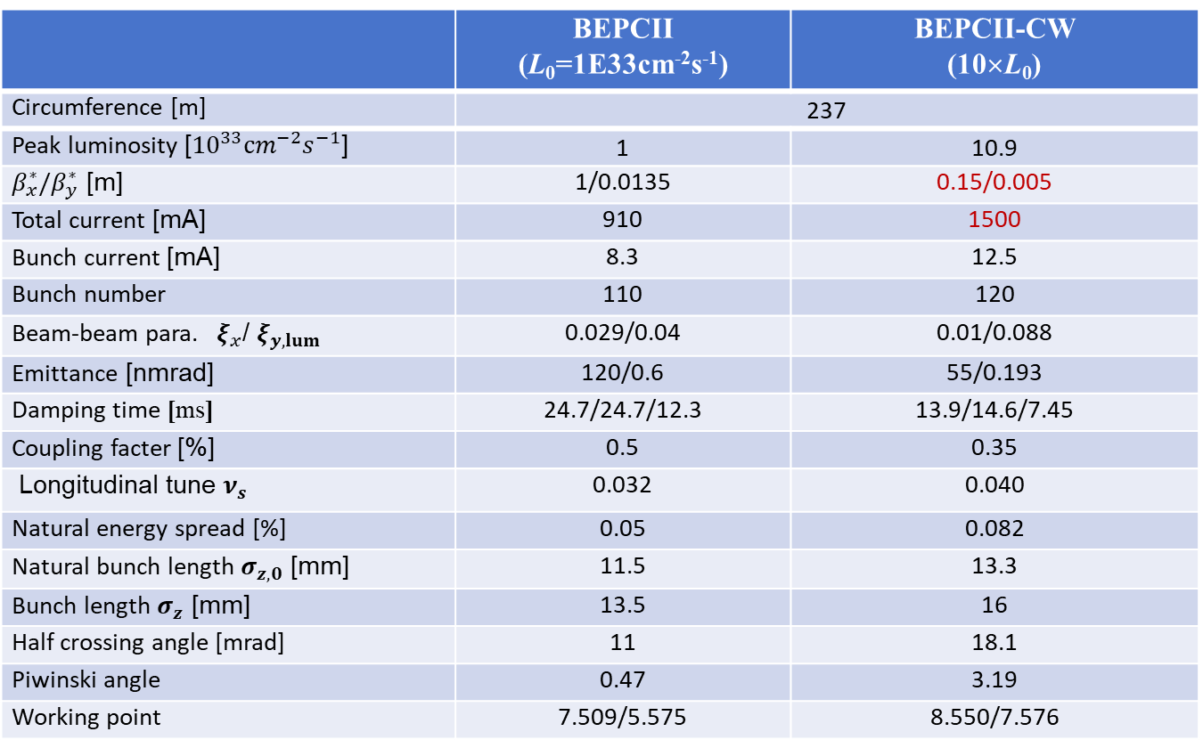
1.89GeV BEPCII crab waist parameters（w. 3.0T wiggler）
 | BEPCII (L₀=1E33cm⁻²s⁻¹) | BEPCII-CW (10×L₀)
Circumference [m] | 237
Peak luminosity [${10}^{33}cm^{−2}s^{−1}$] | 1 | 10.9
$β_{x}^{∗}/β_{y}^{∗}$ [m] | 1/0.0135 | 0.15/0.005
Total current [mA] | 910 | 1500
Bunch current [mA] | 8.3 | 12.5
Bunch number | 110 | 120
Beam-beam para. $ξ_{x}$/ $ξ_{y,lum}$ | 0.029/0.04 | 0.01/0.088
Emittance [nmrad] | 120/0.6 | 55/0.193
Damping time [ms] | 24.7/24.7/12.3 | 13.9/14.6/7.45
Coupling facter [%] | 0.5 | 0.35
Longitudinal tune $ν_{s}$ | 0.032 | 0.040
Natural energy spread [%] | 0.05 | 0.082
Natural bunch length $σ_{z,0}$ [mm] | 11.5 | 13.3
Bunch length $σ_{z}$ [mm] | 13.5 | 16
Half crossing angle [mrad] | 11 | 18.1
Piwinski angle | 0.47 | 3.19
Working point | 7.509/5.575 | 8.550/7.576

Slide 12
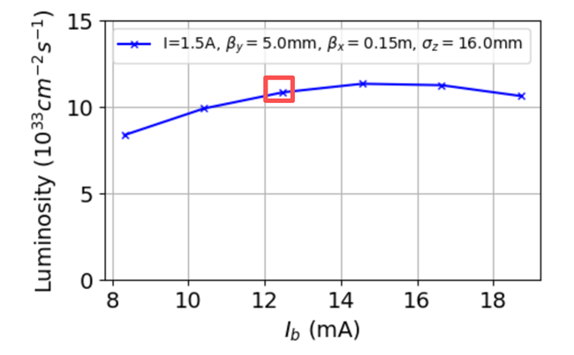
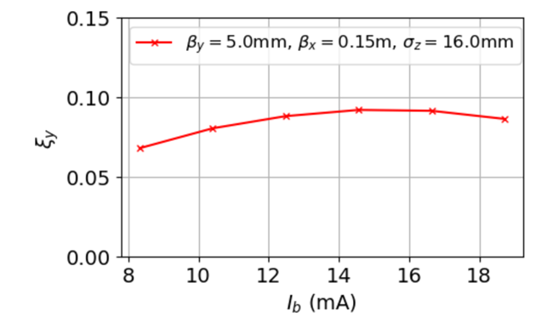
Beam-beam simulation
Luminosity vs. bunch current
Beam-beam para. vs. bunch current
I_{b}=12.5mA
Total current is fixed at 1.5A with different bunch current.
BEPCII: bunch current I_{b}=8.3mA, total current I=910mA

Slide 13
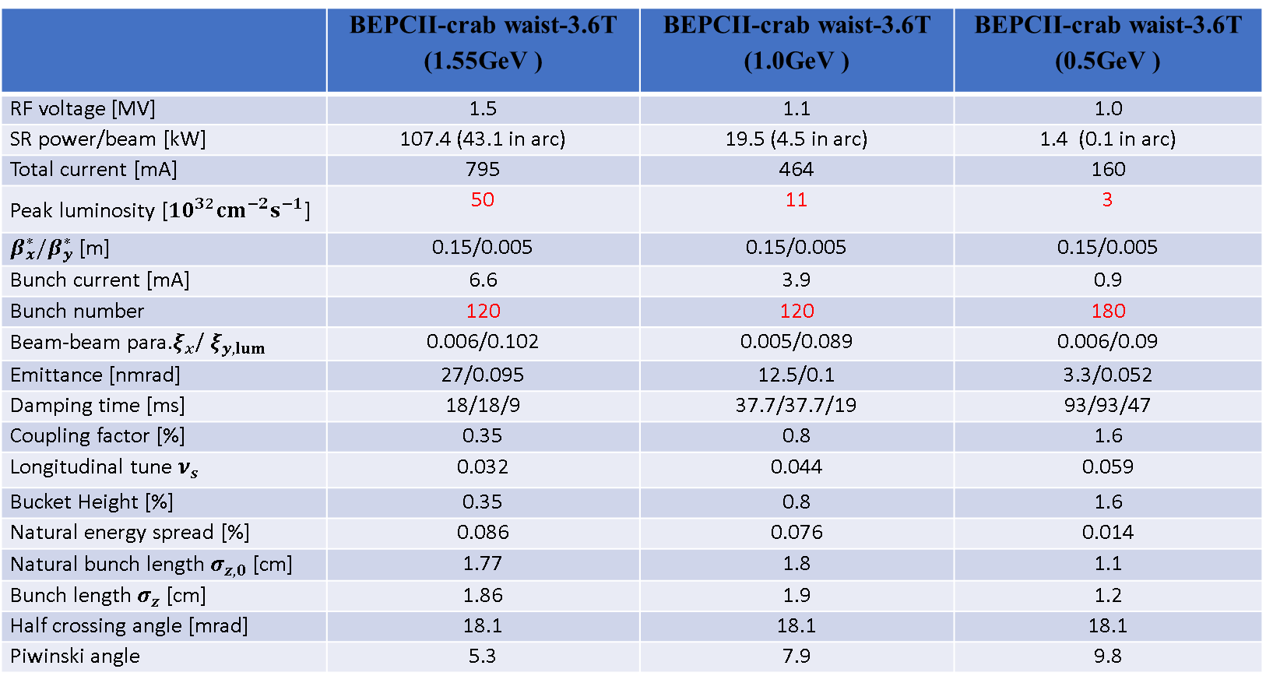
Lower energy parameters @ 1.55GeV/ 1.0GeV/0.5GeV
 | BEPCII-crab waist-3.6T (1.55GeV ) | BEPCII-crab waist-3.6T (1.0GeV ) | BEPCII-crab waist-3.6T (0.5GeV )
RF voltage [MV] | 1.5 | 1.1 | 1.0
SR power/beam [kW] | 107.4 (43.1 in arc) | 19.5 (4.5 in arc) | 1.4 (0.1 in arc)
Total current [mA] | 795 | 464 | 160
Peak luminosity [${10}^{32}cm^{−2}s^{−1}$] | 50 | 11 | 3
$β_{x}^{∗}/β_{y}^{∗}$ [m] | 0.15/0.005 | 0.15/0.005 | 0.15/0.005
Bunch current [mA] | 6.6 | 3.9 | 0.9
Bunch number | 120 | 120 | 180
Beam-beam para.$ξ_{x}$/ $ξ_{y,lum}$ | 0.006/0.102 | 0.005/0.089 | 0.006/0.09
Emittance [nmrad] | 27/0.095 | 12.5/0.1 | 3.3/0.052
Damping time [ms] | 18/18/9 | 37.7/37.7/19 | 93/93/47
Coupling factor [%] | 0.35 | 0.8 | 1.6
Longitudinal tune $ν_{s}$ | 0.032 | 0.044 | 0.059
Bucket Height [%] | 0.35 | 0.8 | 1.6
Natural energy spread [%] | 0.086 | 0.076 | 0.014
Natural bunch length $σ_{z,0}$ [cm] | 1.77 | 1.8 | 1.1
Bunch length $σ_{z}$ [cm] | 1.86 | 1.9 | 1.2
Half crossing angle [mrad] | 18.1 | 18.1 | 18.1
Piwinski angle | 5.3 | 7.9 | 9.8
To test luminosity performance at various Piwinski angles → b-b parameters & CW commissioning experience.

Slide 14
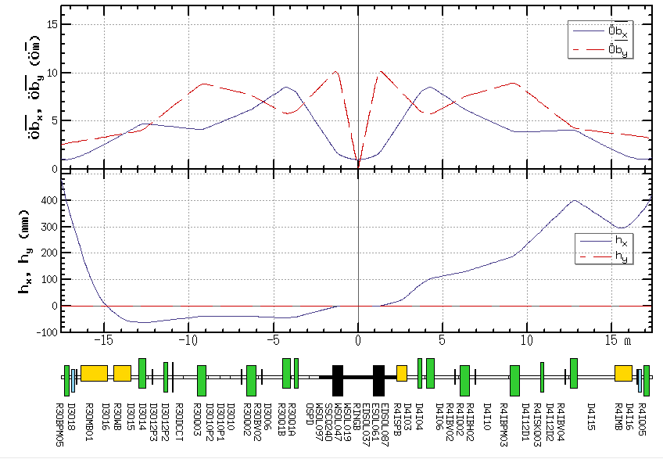
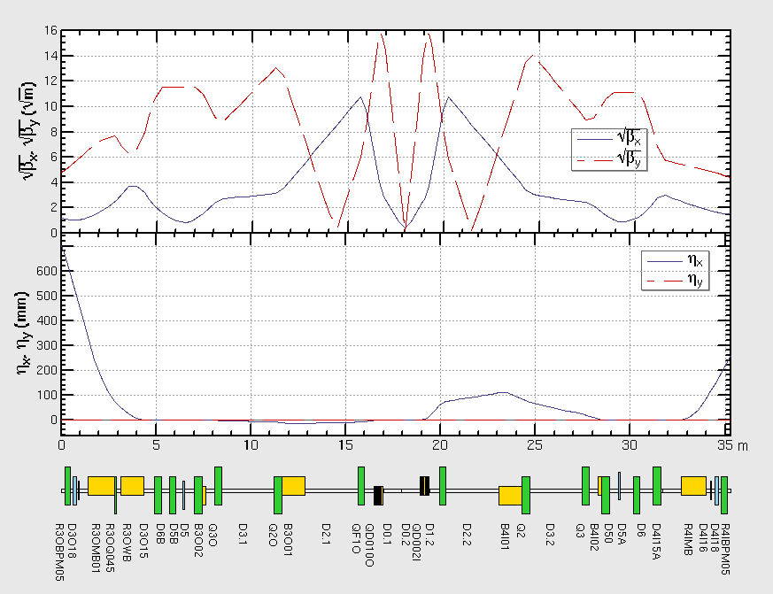
IR comparison@1.89GeV (1m/15mm → 0.15m/5mm)
BEPCII
BEPCII-CW
Crab sext.
Phase=(0.5,0.75)
The interaction region design has already taken into account the boundaries of the BESIII detector and the accelerator geometry.
The upgrade is localized to approximately ±23 meters on either side of IR.

Slide 15
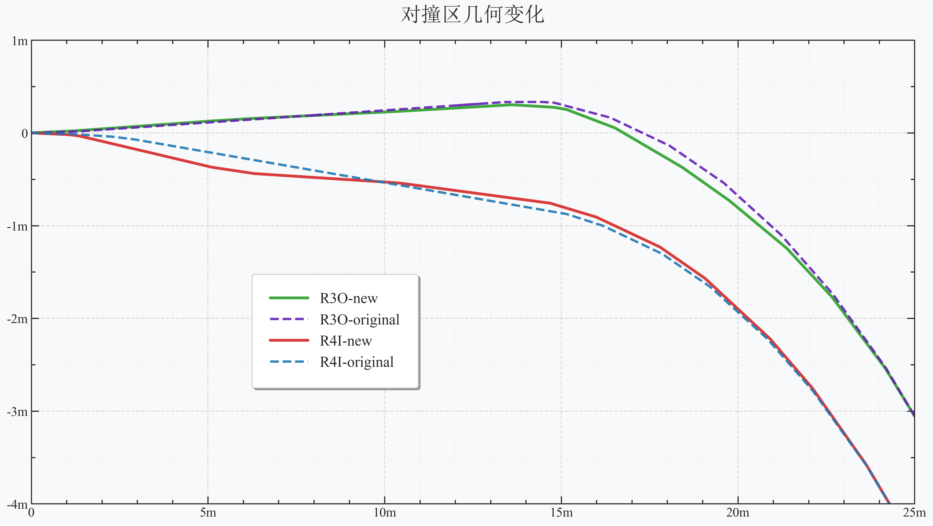
Geometry changes in the interaction region
The Geometry difference from BEPCII is localized in ±23 meters region.
The new accelerator geometry does not conflict with the existing BEPCII tunnel.
IP
Y (m)
X (m)
Half crossing angle=18.1 mrad (11mrad @BEPCII/BEPCII U)

Slide 16
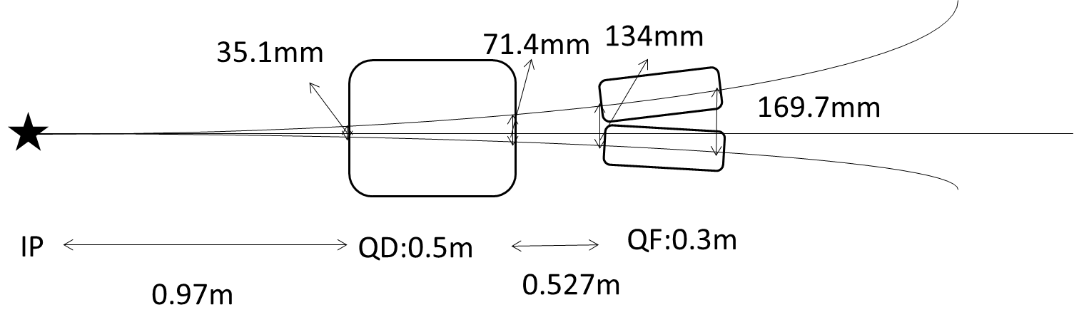
BEPCII-CW Asymmetric IR design
The new IR SC quadrupole magnet will replace the existing SCQ.
BII-CW（1.89GeV）:
QD(single aperture): B’= 21.5 T/m & B=0.34 T
QF(twin aperture): B’=21.0 T/m
BEPCII：QD （single aperture）
BEPCII-CW：QD （ single aperture ）+ QF（double aperture）
Correcting coils to cancel the alignment error：
-- skew quad & correctors
e-
Exit angle: 106.3mrad
Incident angle: 29.3mrad
e+
No direct SR light from the upstream will hit the central Beryllium pipe.

Slide 17
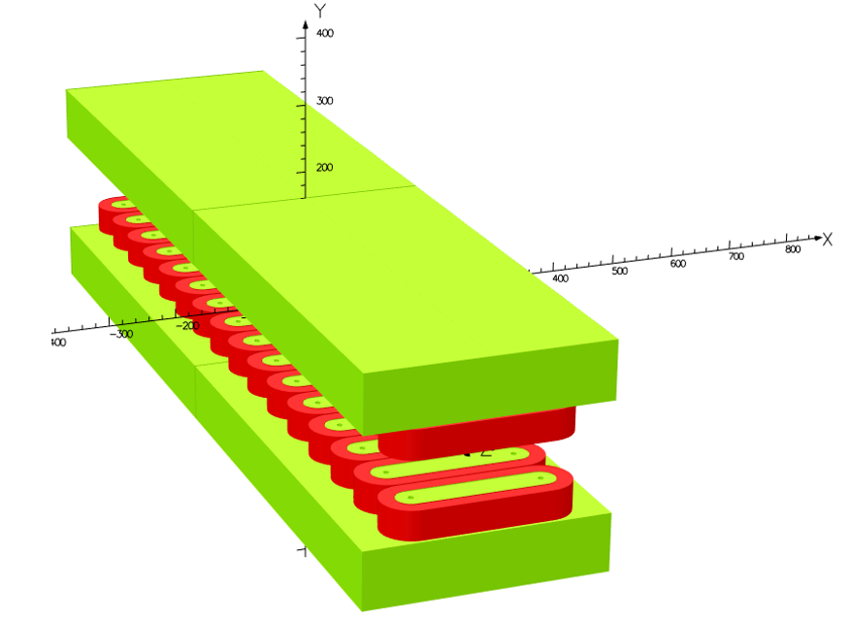

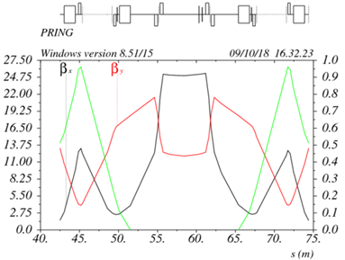
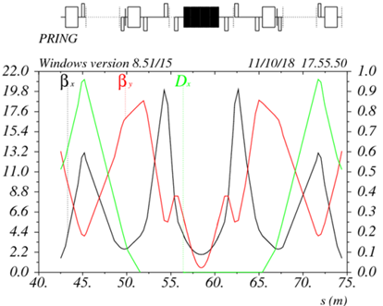
Insertion of SC wiggler at inj. region of inner ring
Increase SR damping → smaller emittance, larger Piwinski angle
shorter damping time → higher beam-beam limit
BEPCII
BEPCII-CW

Slide 18
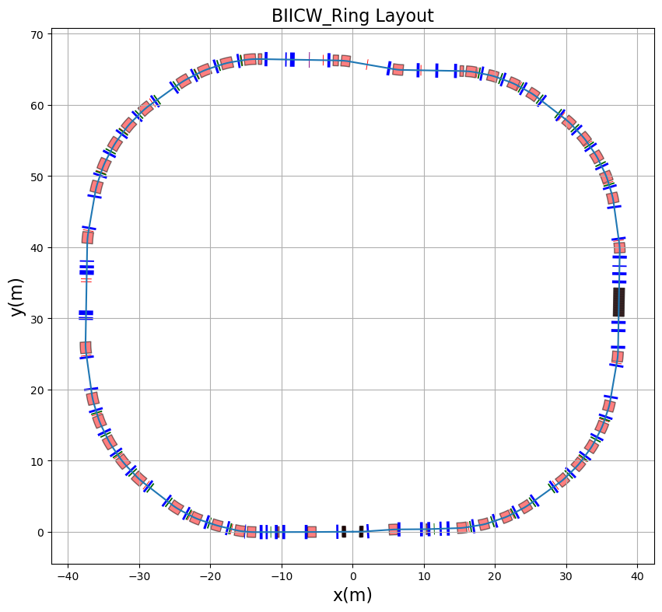
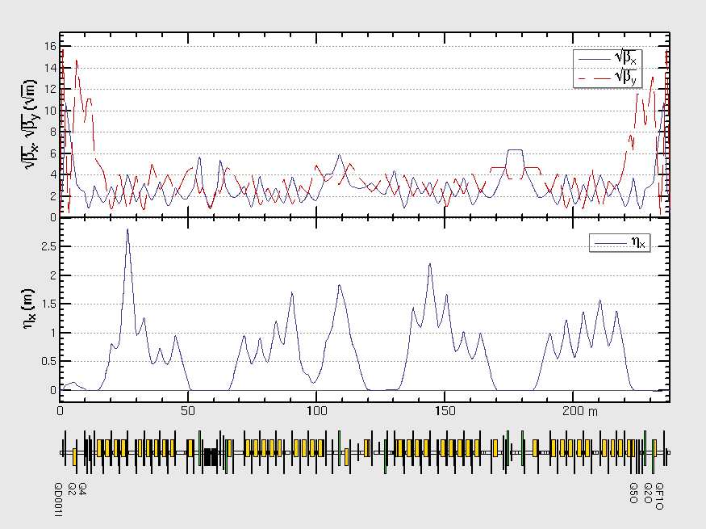
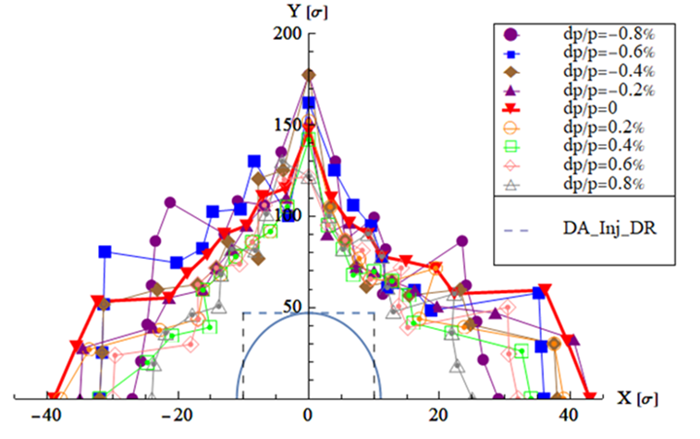
Whole ring lattice & dynamic aperture（β*=0.15m/5mm）
No local chromaticity correction due to limited space.
62% crab + 3T wiggler
wiggler
IR
DA requirement by injection @1.89GeV
Without DR: 14σx, 136σy (εy= 0.0035εx)
With DR : 10.5σx, 47σy (εy= 0.0035εx)
Working point: 8.55/7.58
Damping ring supports the achievement of the crab waist's high-luminosity goal.

Slide 19
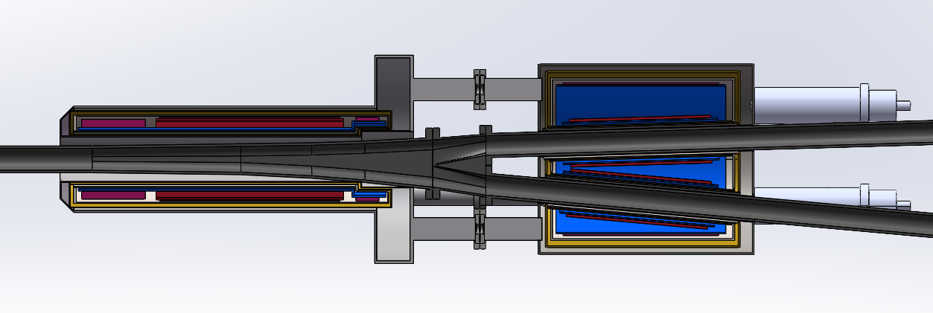
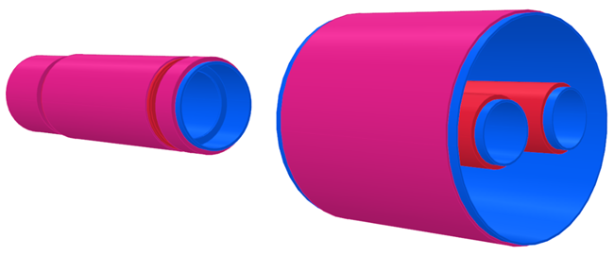
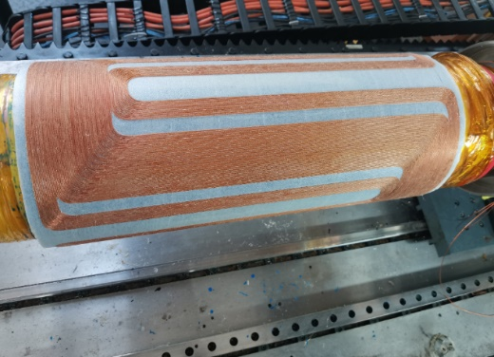
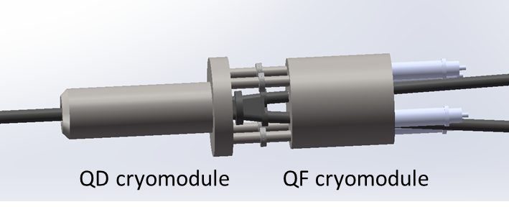
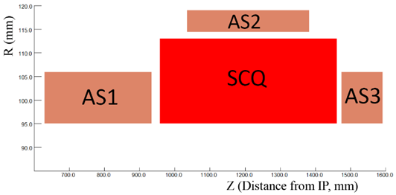
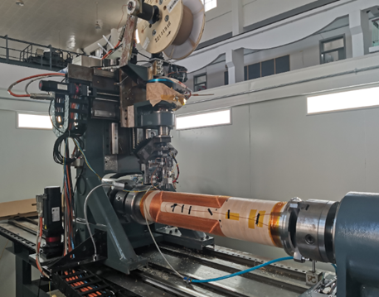
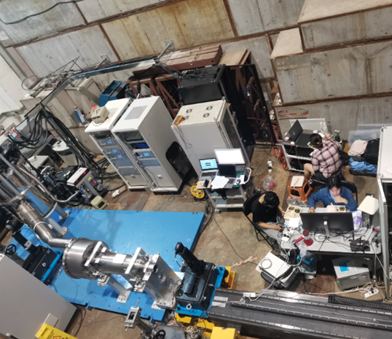
IR SCQ
Magnet baseline：NbTi technology
Separate cryomodule for QD & QF
QD：serpentine winding
QF：CCT
SCQ experience on BEPCII-U
Two SCQ was produced by IHEP, installed on BEPCII-U in 2025
The first domestically produced SCQ with operation.
R=190mm，B’=25T/m @ 2.8GeV
Anti-solenoid: 2.85T
BEPCII-U SCQ
Winding machine

Slide 20
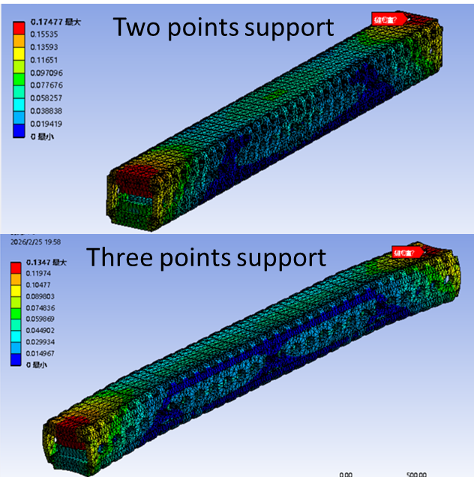
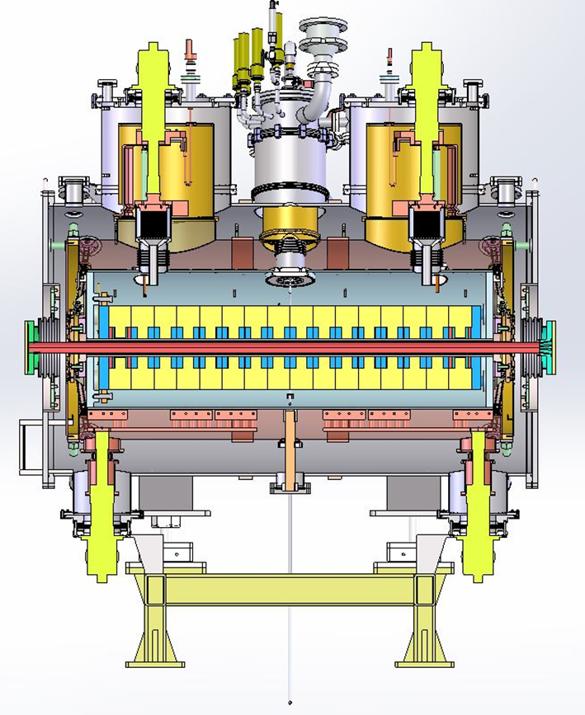
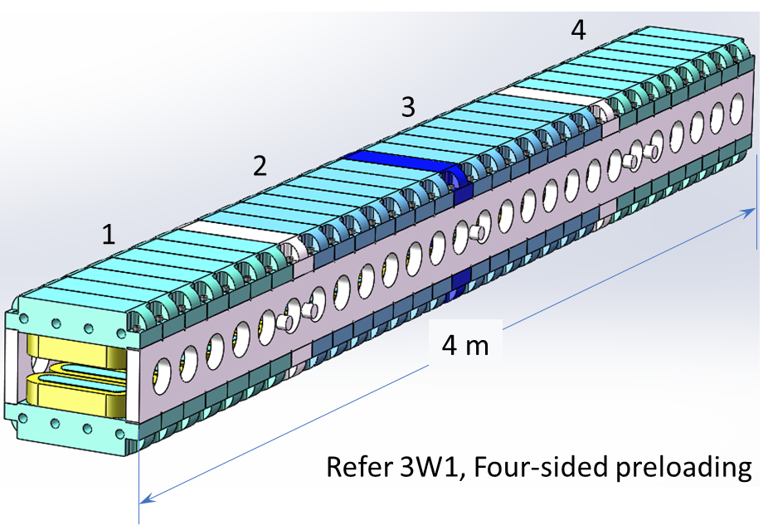
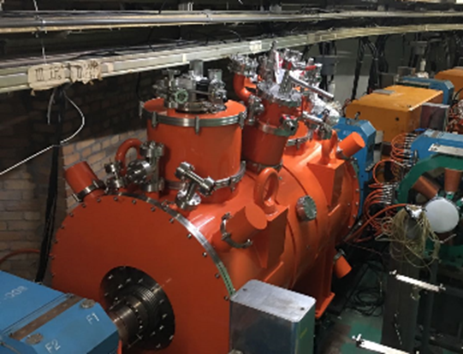
SC wiggler
SCW250 main parameters
  λu = 250 mm, L=4m
  Gap = 64 mm
  B = 3.6 T (Max: 4.4T)
3W1 experience on BEPCII
3W1 was produced by IHEP, installed on BEPCII in 2019
The first domestically produced SC wiggler with operation.
λu = 190mm，L=1.36m
Gap= 68mm
B= 2.6T
Cryostat based on the compact cryocooler
3W1 in BEPCII tunnel

Slide 21
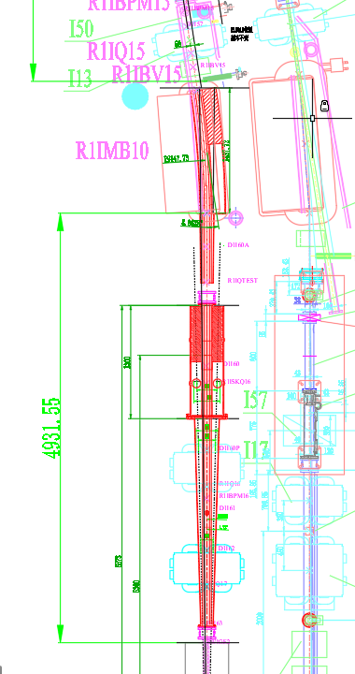
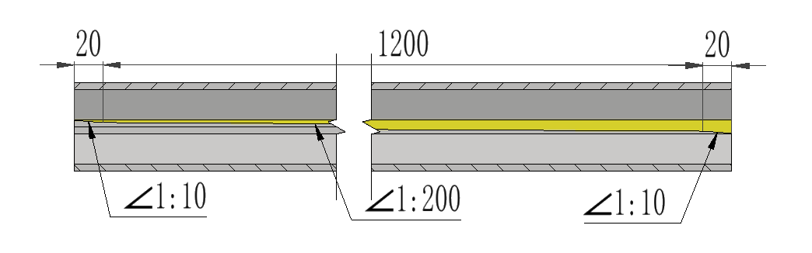
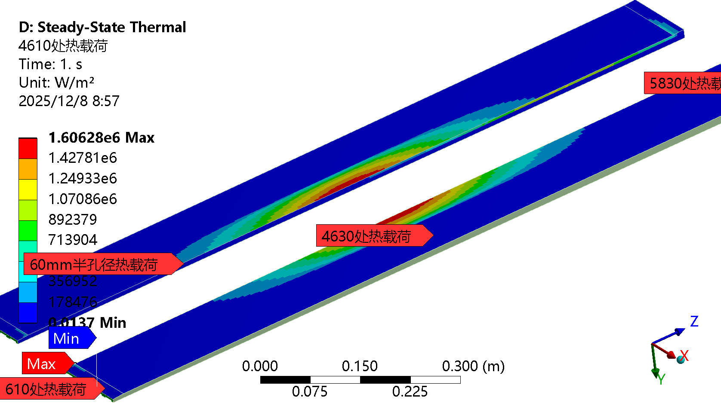
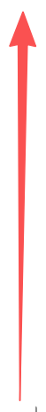
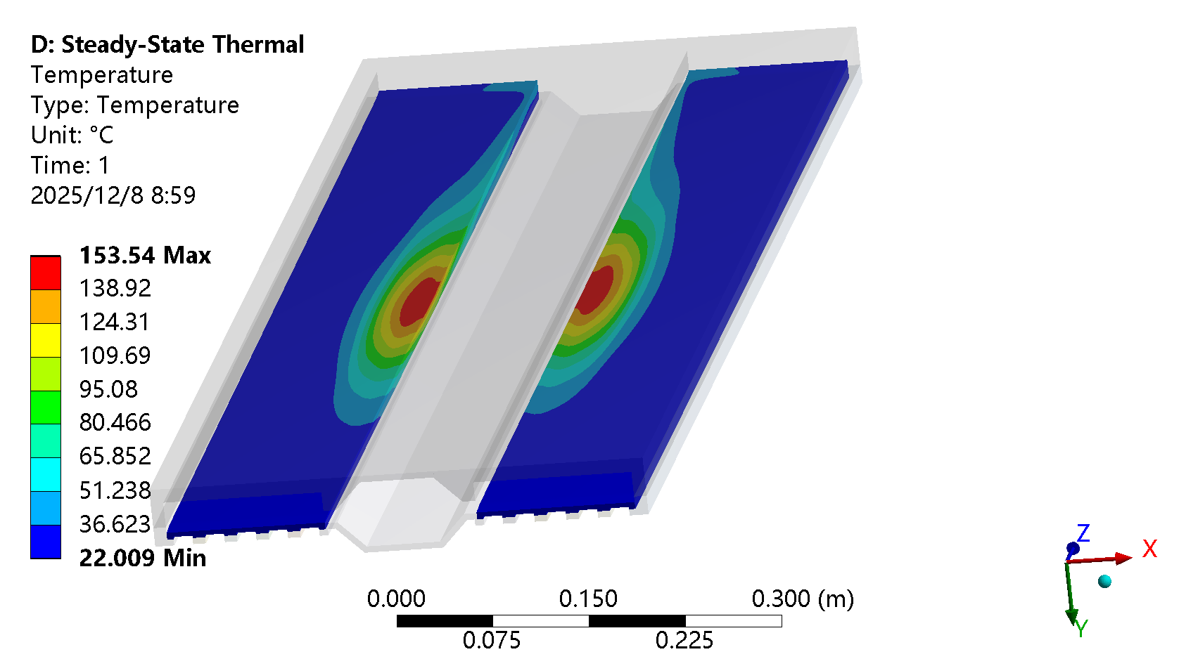
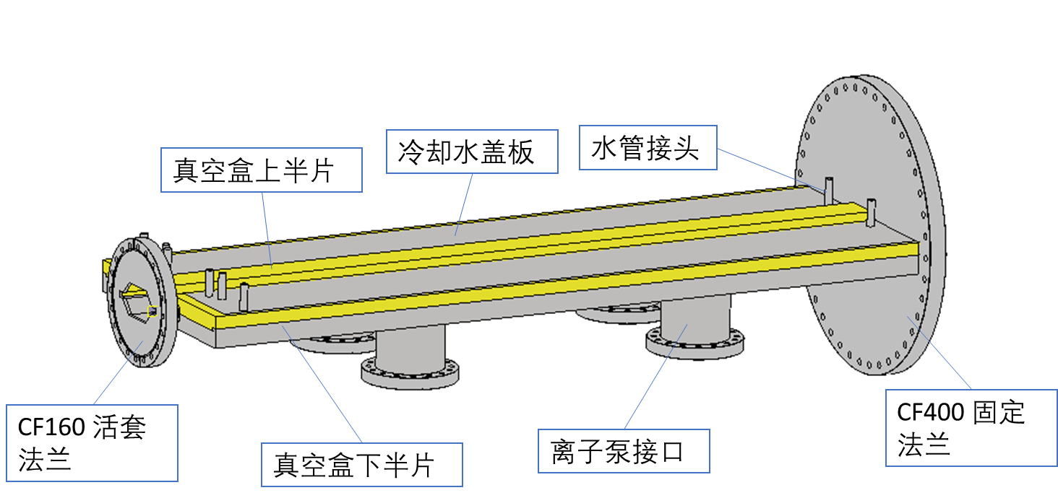
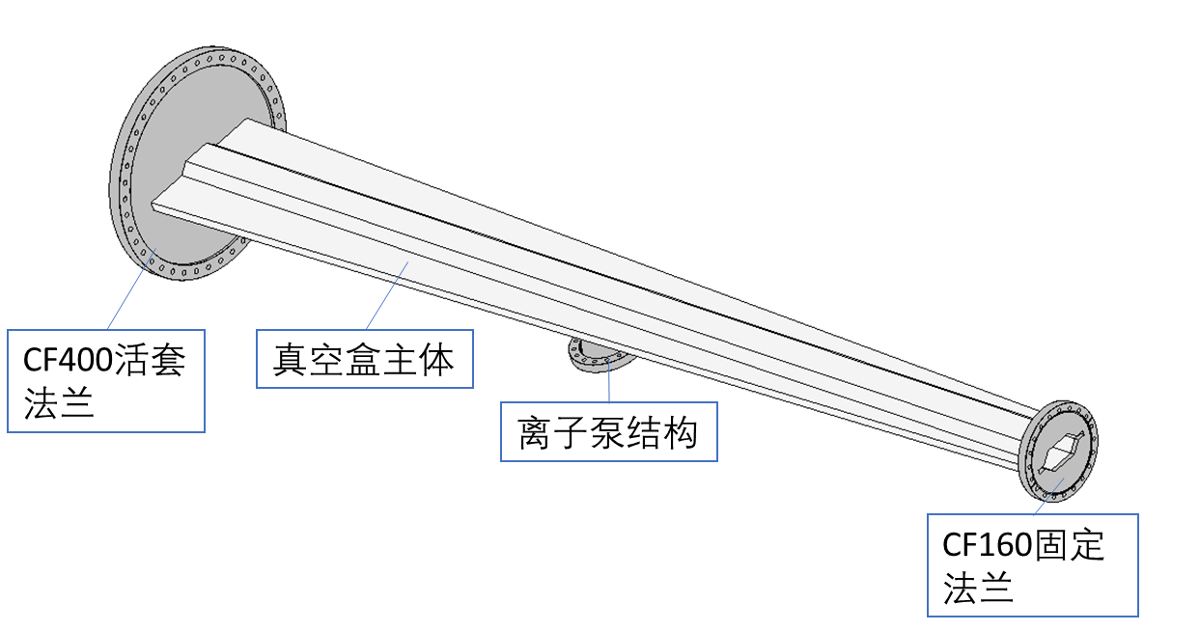
Wiggler synchrotron radiation absorber
Strong SR power downstream of wiggler may destroy the accelerator equipment, locally absorbed with a dedicated absorber.
2-stage absorber (with vertical beveled surface)
Total SR power：~142kw
Stage 2
Thermal load
Beveled structure
SR
light
Stage 1
Temperature distribution

Slide 22
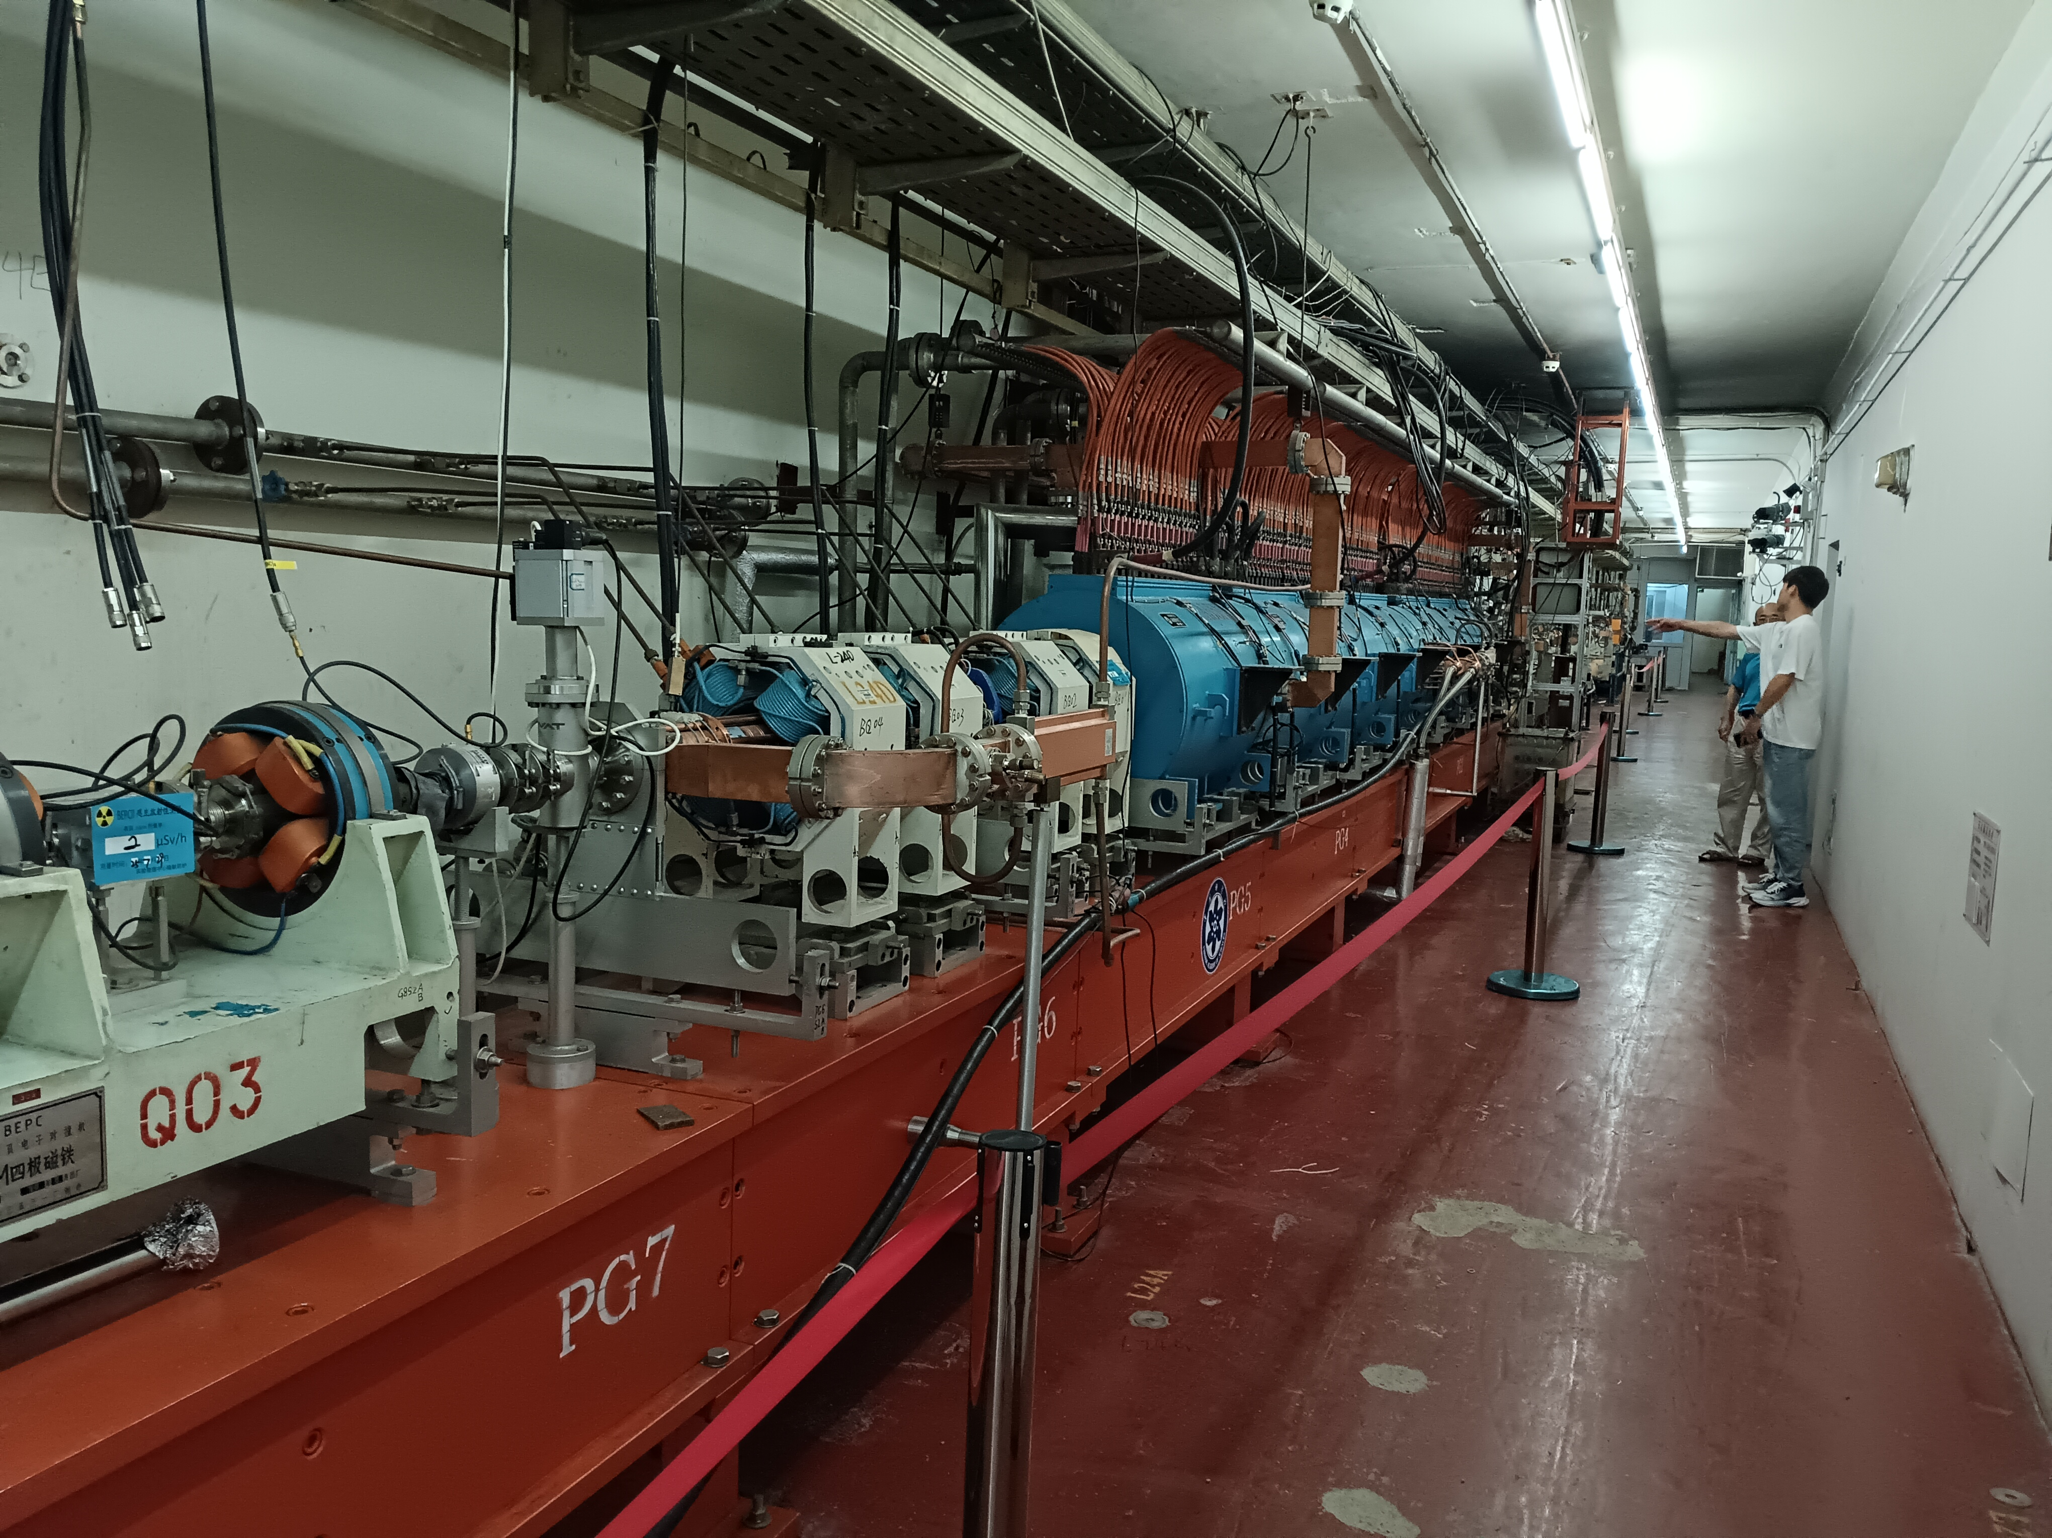
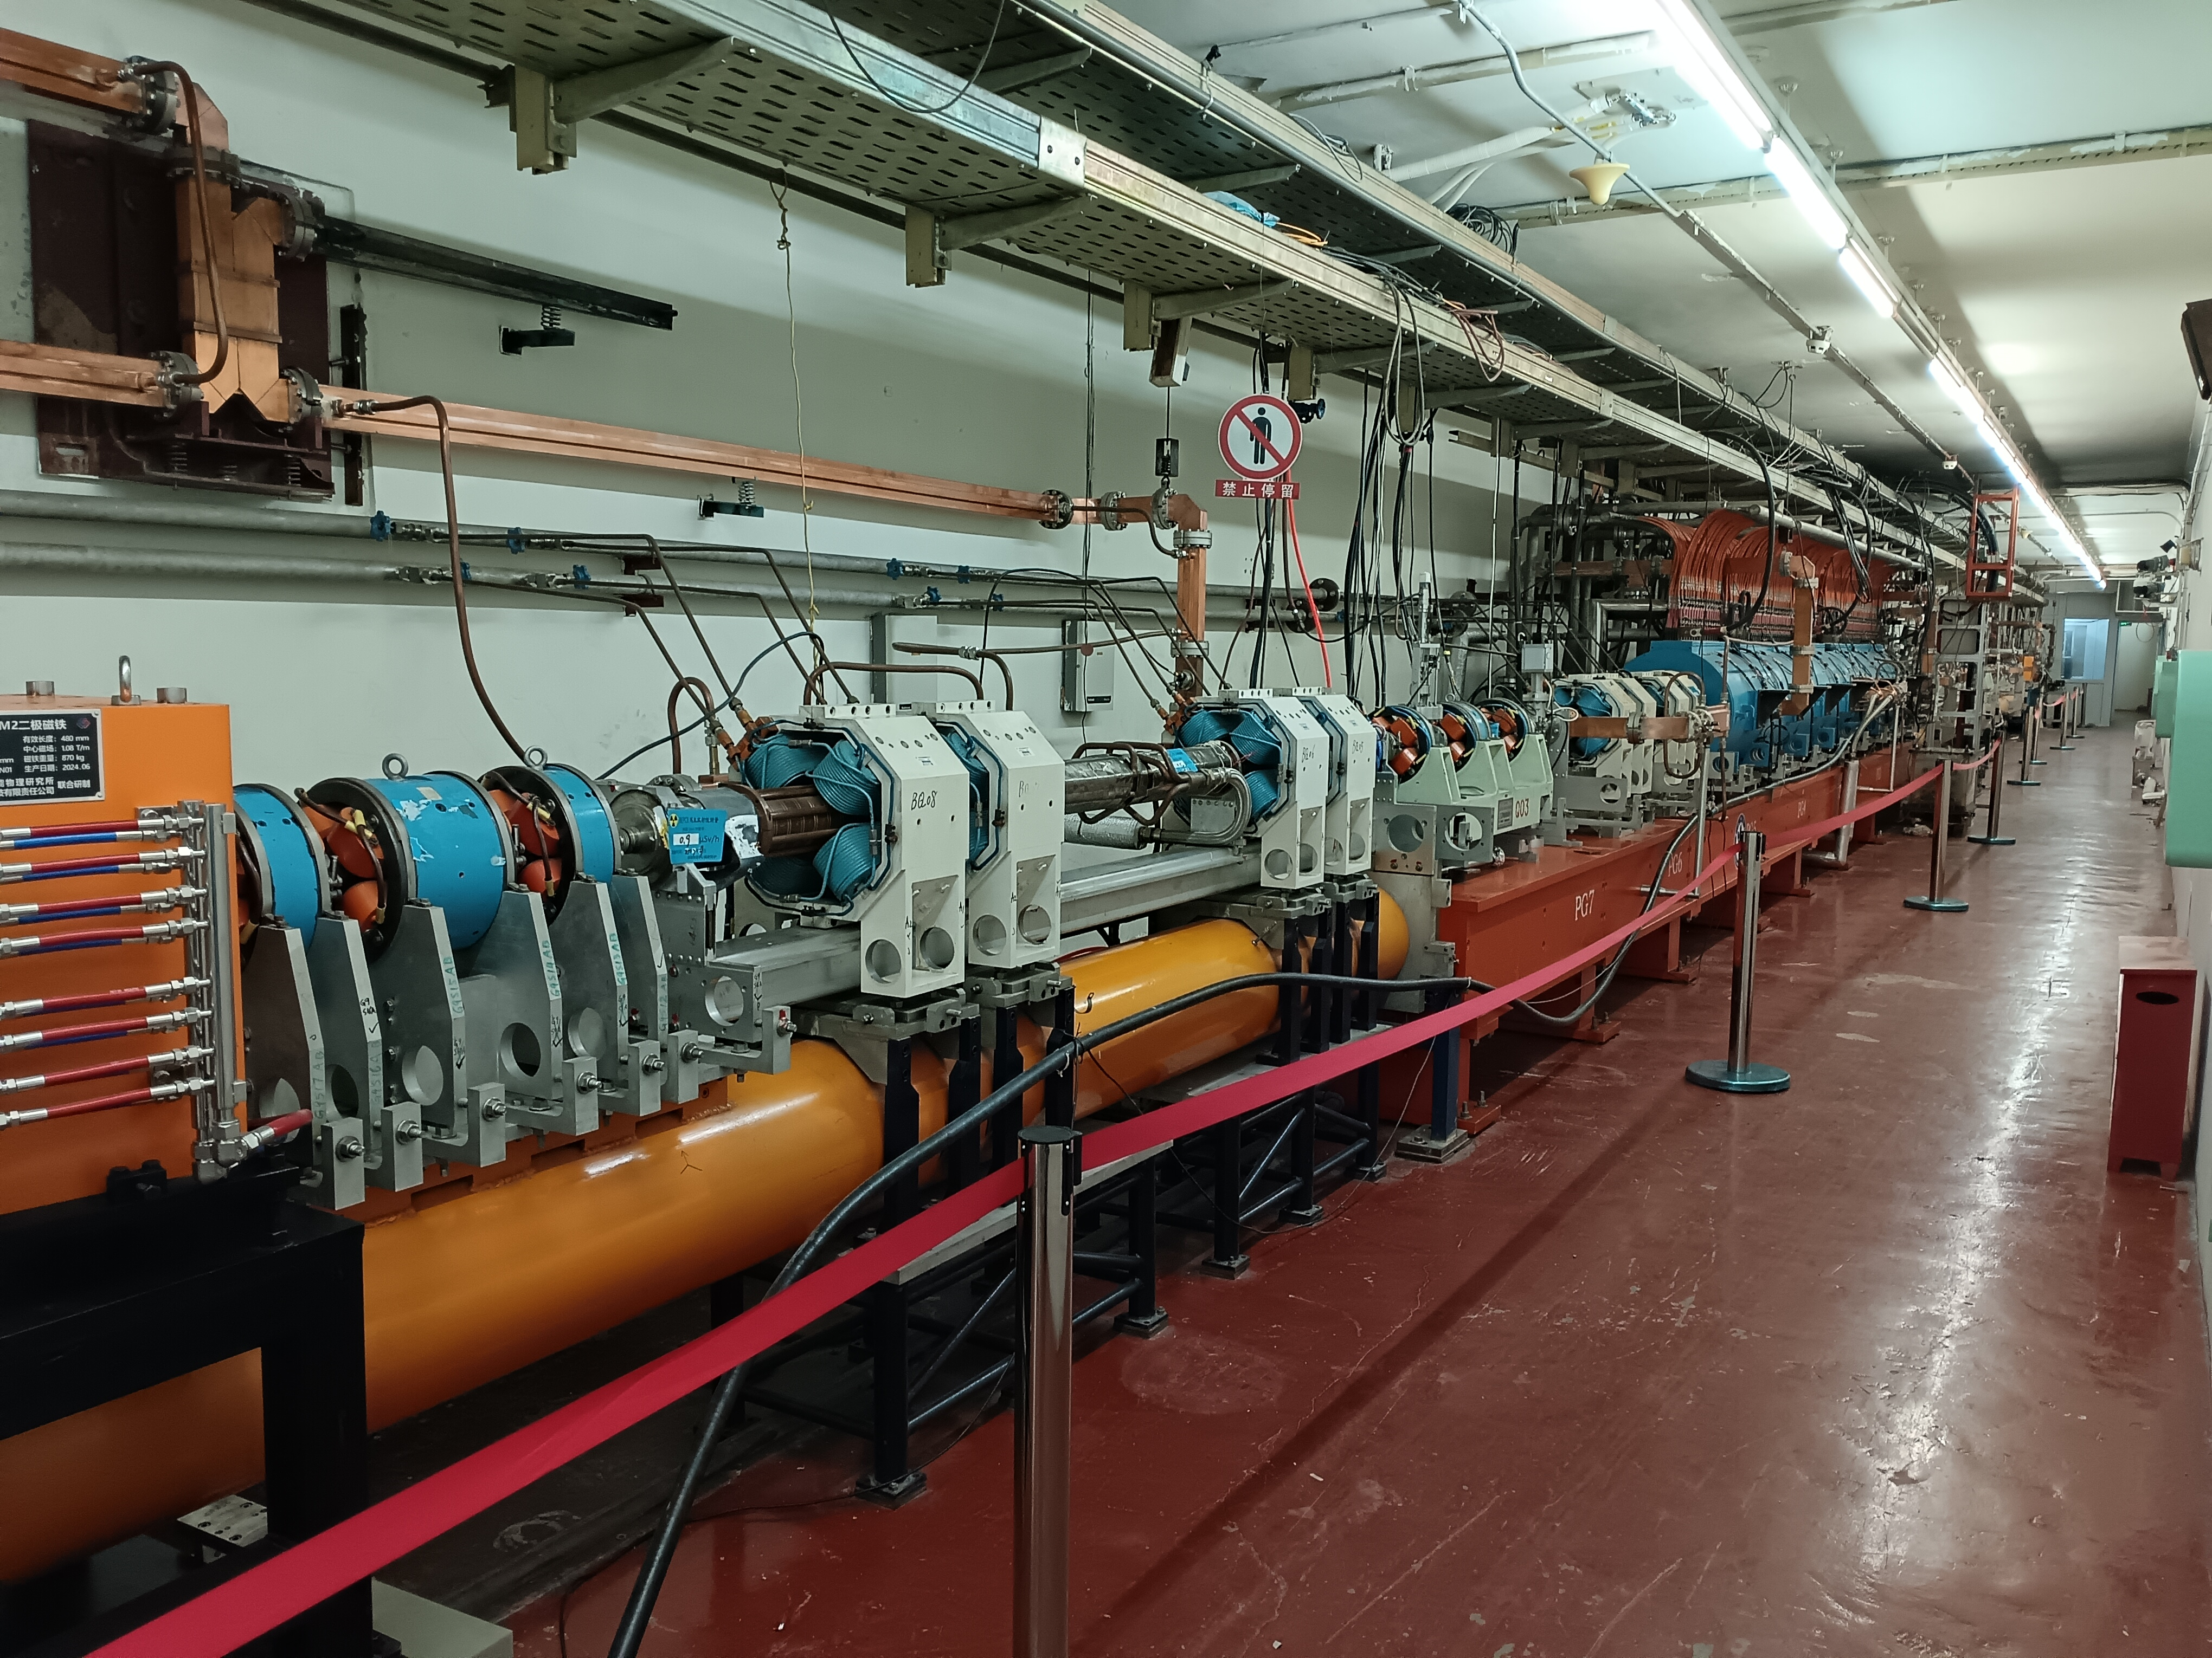
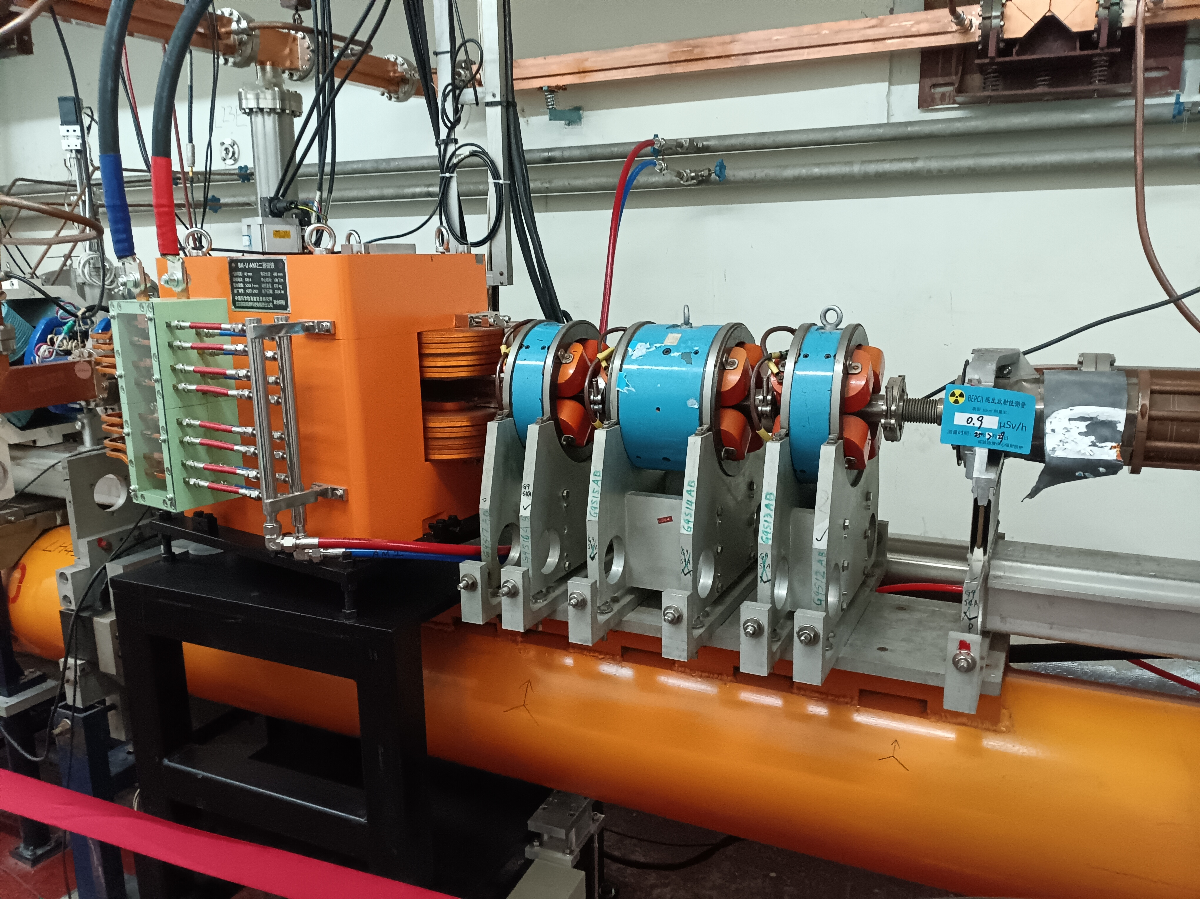

BEPCII Linac upgrade with damping ring
Damping ring reduces the emittance of linac injector — new highlight
Damping ring
High luminosity operation @1.89GeV.
Explore physics（R scan）at low energy region.
Improve performance of PWFA TF.
Top up injection @1.89GeV can be tested.
~ 34m @200MeV
Feasible in space based on the preliminary lattice design
PWFA TF
(tunnel width: 3.5m)

Slide 23
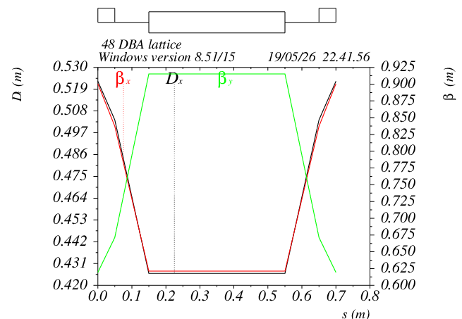
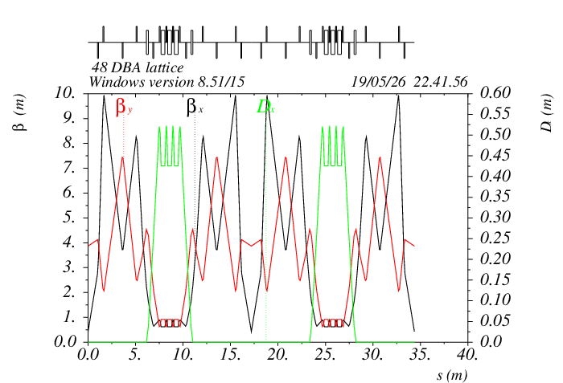



Preliminary damping ring lattice
B0=1.3T
μ_{x}=63°
μ_{y}=46°
Combined magnets – compact structure
B+QD+SD
QF+SF
DA requirement (blue ellipse): 2 times of e+ inj. beam size

Slide 24


Damping ring survey
Beam direction
e-
e-
RF
2.6m
e+
e+
BEPCII operation will not be disrupted during DR commissioning.

Slide 25
Possible collaborations
Tunning & Operation related with crab waist scheme
Beam-beam simulations based on APES
IP luminosity feedback and fast luminosity monitoring technics
ML-AI algorithms and realistic modelling (digital twins)
Monochromatization scheme on BEPCII/CEPC
Background & MDI
Upgrading injection systems (damping ring, PWFA injector)

Slide 26
Summary
A preliminary design for the BEPCII Crab-Waist upgrade has been presented.
Initial feasible approaches to addressing the key technical challenges have been identified.
The crab waist upgrade may enhance the performance (×10, enabling low energy operation) of the BEPCII.
Gaining valuable experience on crab waist scheme which is vital for future circular e+e- colliders.
We are working on …
Accelerator physics: error effects, DA, beam-beam effect, lattice optimization at different energy, beam lifetime, background, luminosity tuning, damping ring design, clock/timing …
Key technology: IR SC quadrupole (incl. installation/alignment), SC wiggler, wiggler SR absorber …
Detector: possible improvement
Thank you!

Slide 27
Back up

Slide 28

World's highest luminosity @ 1 GeV
Our goal: 1×10³³ cm⁻² s⁻¹ @1GeV
Ref: Ivan Logashenko @FTCF2025（November 24, 2025）

Slide 29

Russia's Next Plan (VEPP-6)
BEPCII-CW plan is highly similar to VEPP-6.
Ref: Ivan Logashenko @FTCF2025（November 24, 2025）

Slide 30


DAΦNE’s experience @ 0.5GeV
Highest luminosity： 4.5⋅10³² cm⁻² s⁻¹，Circumference：98m

Slide 31






Beam-beam simulations with lattice
BEAMBEAM : emity=416nm
weak strong+ lattice
bpr.ZXv4.lat
bpr.ZXv10.lat

Slide 32

Damping ring parameters
DR V2.0 | Collision mode |  | PWFA TF
 | e- | e+ | e- | e+
Energy (MeV) | 200
Circumference （m） | 34
Bunch charge (nC) | 1 | 0.07 | 1~2 | 0.5
Repetition （Hz） | 50 |  | 1
Bunch number | 15 |  | 1
Bending radius (m) | 0.51
B0 (T) | 1.3
U0 (keV/turn) | 0.28
Damping time x/y/z (ms) | 68/163/266
δ0 (%) | 0.044
ε0 (mm.mrad) | 4.5
Inj σz (mm) | 1.39 | 1.66 | 1.39 |  | 1.66
Extract σz (mm) | 2.0 | 2.0 | 2.1 |  | 2.1
εinj (mm.mrad) | 500 | 2500 | 500 | 2500 | 2500
εext x/y (mm.mrad) | 37/16 | 9/50 | 47/5 | 18/9 | 21/3
δinj /δext (%) | 0.5/0.10 | 0.9 /0.13 | 0.5 /0.044 | 0.9 /0.024 | 0.9 /0.044
Storage time (ms) | 300 |  | >1000
RF cavity：1.5m*0.6m*0.6m
RF parameters
RF frequency (MHz) | 500
RF voltage (MV) | 1.6
Energy acceptance by RF(%) | 3.9
harmonic | 56
Fast Kicker: 14 ns (bottom width)

