Slide 1


Collaborative study on Compton Polarimetry for future colliders
Zhe Duan and Aurélien Martens
on behalf of IHEP-IJCLab team
29 June-3 July, 2026, 17th FCPPN/L Workshop, Lyon, France, email: duanz@ihep.ac.cn

Slide 2
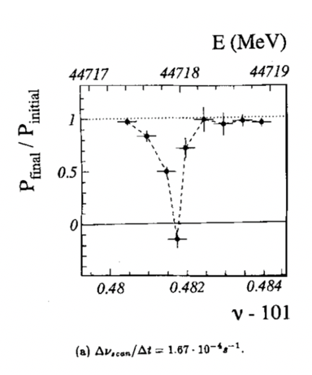
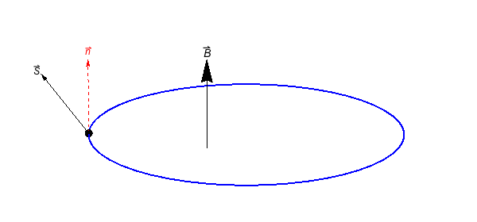



Polarized beams @ CEPC: transverse polarization
Precision beam energy calibration based on Resonant Depolarization (~1e-6 accuracy)
  Precision measurements of Z&W mass (FCC EPOL, arXiv:1909.12245, CDFII: Science 376, 6589)
  Fiducial for Higgs & ttbar mass measurements (LEP2 CM energy evaluation above 80 GeV, arXiv:9901002,)
Requirements:
  Transverse Compton polarimeter: statistical uncertainty ~1%/second
  RF depolarizer: specs similar to bunch-by-bunch feedback kicker
  RD measurements every ~ 10 mins
  At least 5%~10% vertical polarization for e+/e-
CEPC Z&W mass, CDR 2019
CEPC W mass: EJPC 80, 66 (2020)
CEPC ttbar, arXiv:2207.12177
IP/detector
$$P_{Y}$$
$$P_{X}$$
IP/detector
polarimeter
depolarizer
$$P_{Z}$$
LEP: Z. Phys. C 66, 45-62 (1995).

Slide 3
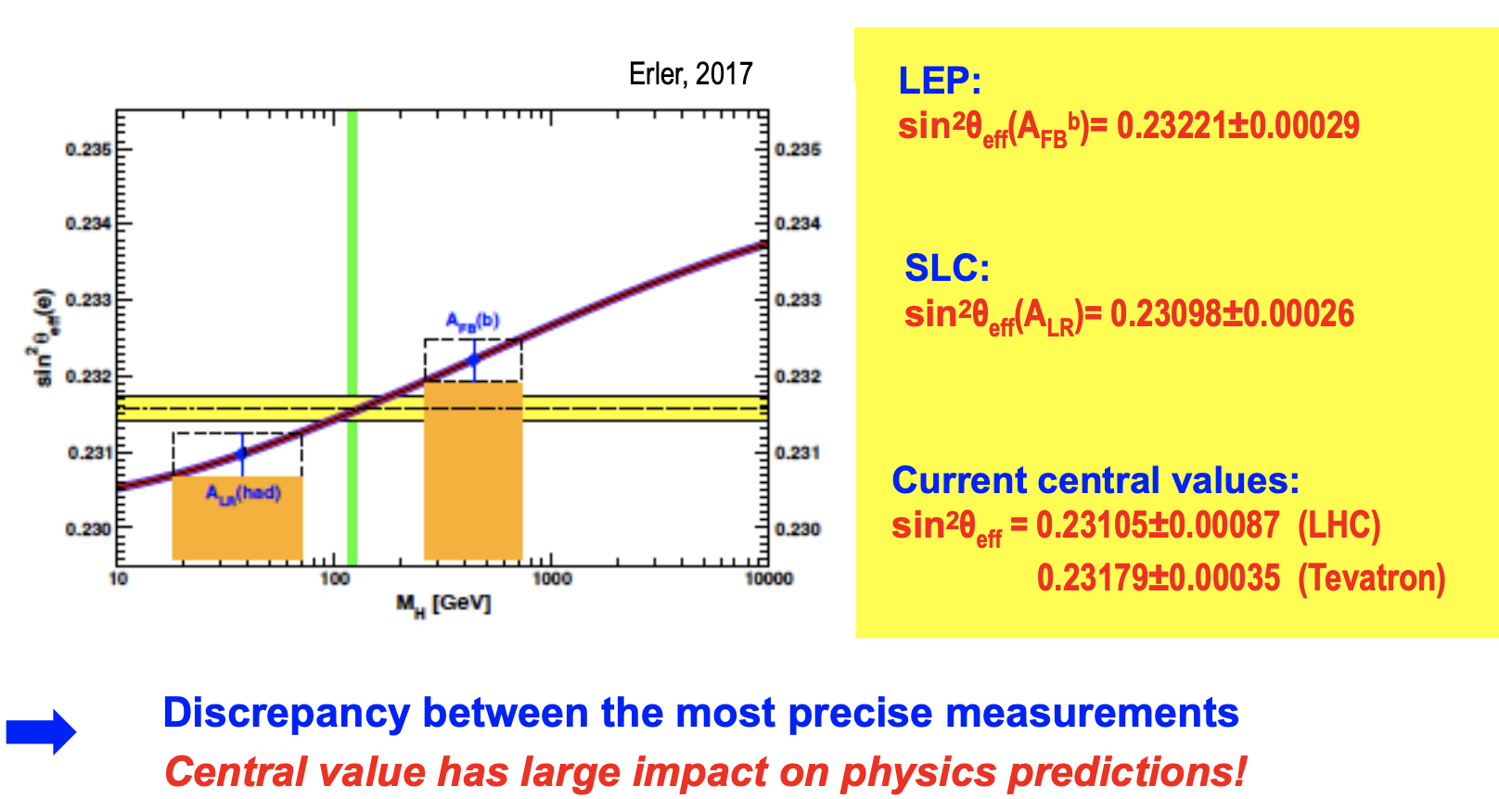
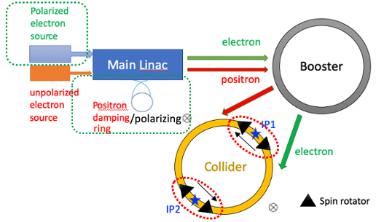
Polarized beams @ CEPC: longitudinal polarization
Measuring weak mixing angle from A_{FB}, A_{LR} @ Z-pole in the same experiment
G. Moortgat-Pick’s talk on CEPC Workshop EU @ Marseille, 2024 April
Solenoid spin rotators around each IP (~400 T$∙$m per IP per ring)
(Xia et al, RDTM 6, 490, 2022)

Slide 4
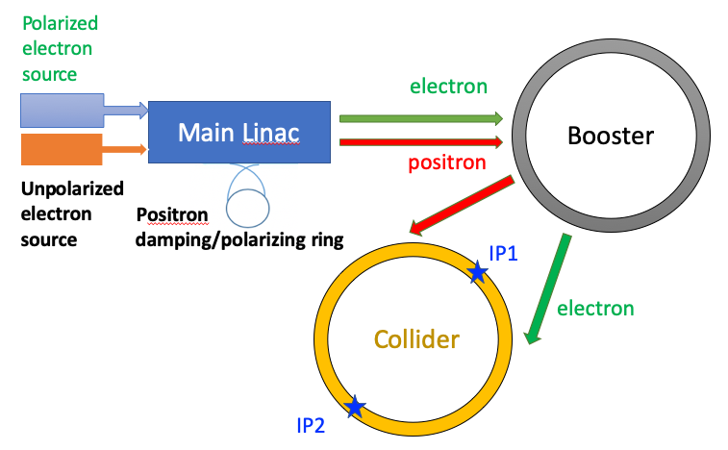
Injecting polarized beams from the source
Polarized source
  Polarized e- source (>85% polarization)
  e+ damping/polarizing ring (>20% polarization)
Booster
  free from intrinsic spin resonances
  polarization can be well maintained for Z & W
T. Chen, Z. Duan, D. H. Ji, D. Wang, Phys. Rev. Accel. Beams, 26, 051003 (2023).
Consistent results in recent FCC-ee studies (J. Wenninger, Polarization transport to the collider ring, FCC Week 2026)
Injecting polarized beams is under study for FCC-ee in the Reference Design Phase (M. Benedikt, FCC Status and Plans for Reference Design Phase,FCC Week 2026)

Slide 5
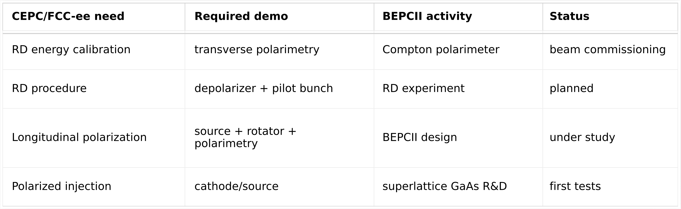
R&D items
The operating e+e- double-ring collider BEPCII is an ideal test bed of beam polarization R&D for future colliders

Slide 6
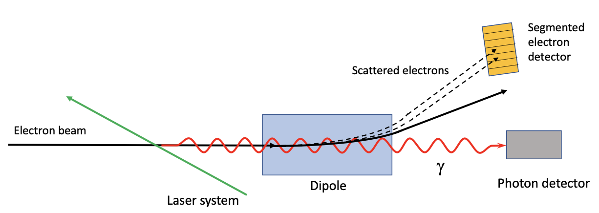
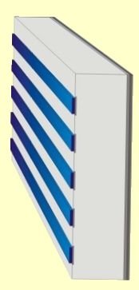
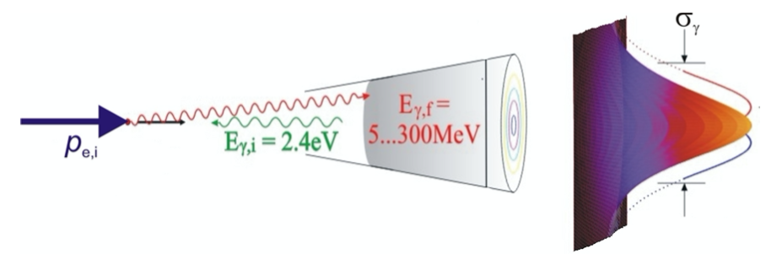
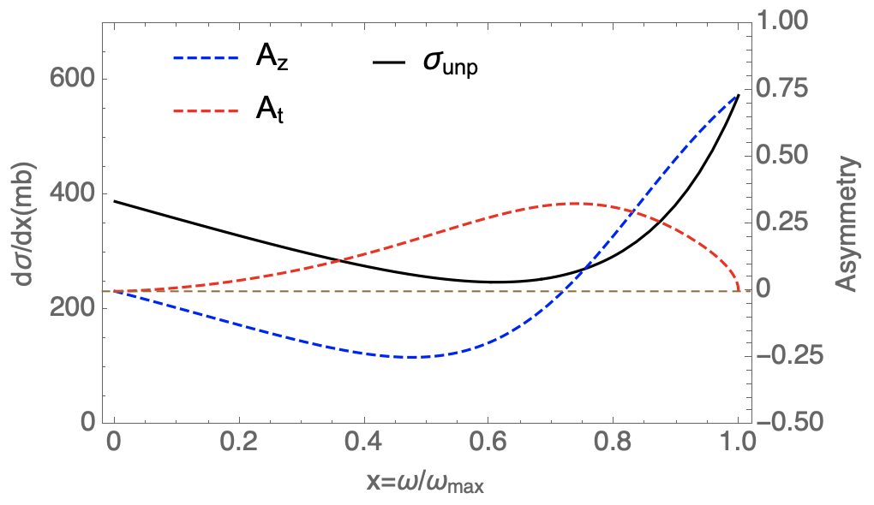

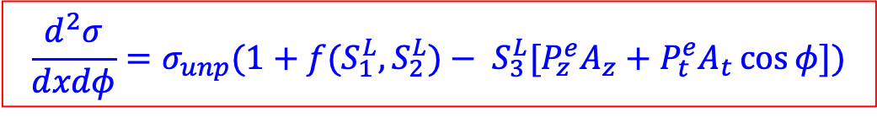
Introduction to Compton polarimeter
Muchnoi, FCC-ee polarimeter, arXiv:1803.09595
linear
polarization
circular polarization (helicity adjustable)
Eb=45.6 GeV, λlaser=515 nm
$$\frac{d^{2}σ}{dxdφ}=σ_{unp}(1+f(S_{1}^{L},S_{2}^{L})− S_{3}^{L}[P_{z}^{e}A_{z}+P_{t}^{e}A_{t}\cos{φ}])$$
Left-right (Counting rate) asymmetry
Up-down (Spatial distribution) asymmetry
${{(S}_{1}^{L})}^{2}+{{(S}_{2}^{L})}^{2}$+ ${{(S}_{3}^{L})}^{2}$=1
scattered γ energy/Compton edge

Slide 7
Compton polarimetry requirements for future colliders
3D Compton polarimeter
  vertical polarimeter for pilot bunches (RD): ~1%/~10s
  longitudinal/radial polarimeter for colliding bunches: ~0.1%
  coverage of Z, W and even Higgs energies
  7 * 24 robust operation
Experiments in operating machines would help address key systematic uncertainty sources
  advanced pixel detector
  laser polarization control and measurements
  helicity correlated asymmetries

Slide 8
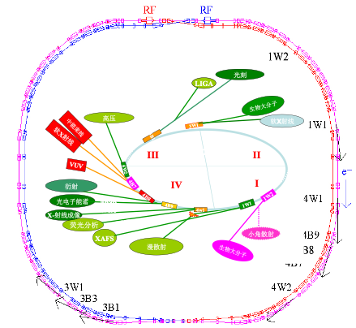
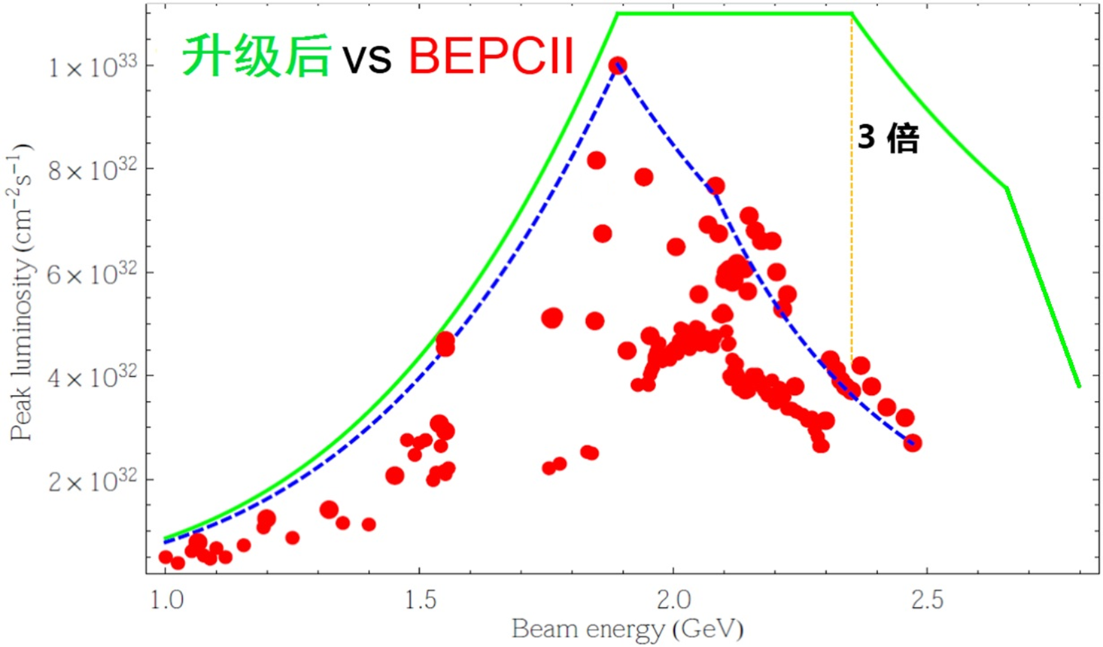
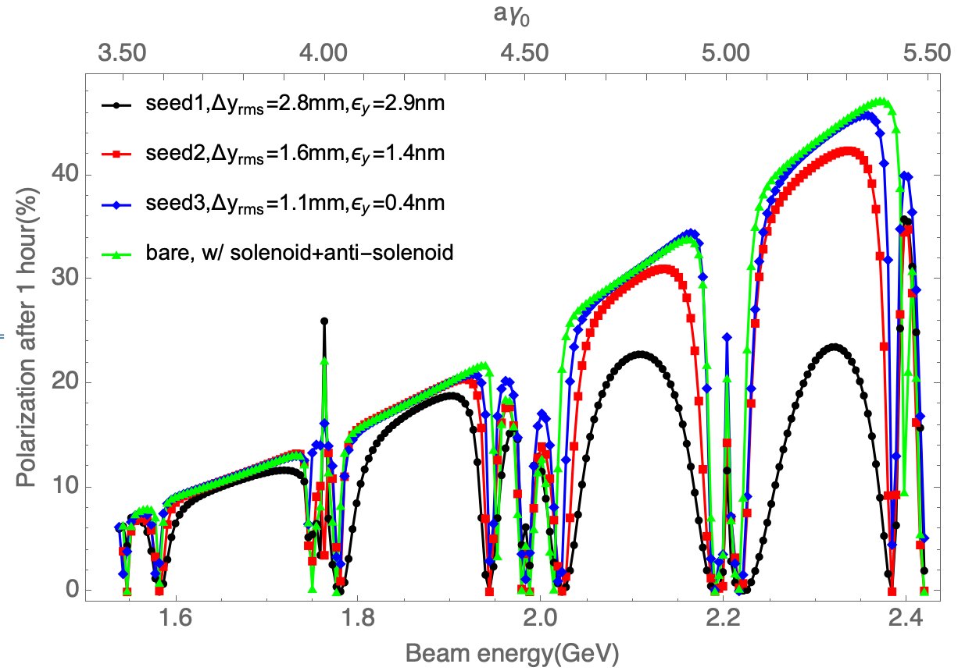

BEPCII and beam polarization
BEPCII is in a high-luminosity upgrade phase
e+/e- beams naturally develops sizable vertical polarization during operation, making it a realistic test environment
Simulated vertical polarization 1 hour after injection
Start tunnel installation
1.1$×$10³³cm⁻²s⁻¹ @ 2.35 GeV
2024.7
2025.5
2026.5
SR commissioning @ 1.84 GeV

Slide 9
Collaboration on Compton polarimetry
FCPPN/L grant in 2024 and 2025: Future Collider Compton Polarimeter
Team member
  IJCLab: A. Martens (Leader), F. Zomer, D. Nutarelli, F. Mawas, J. Tamazirt etc
    Laser technology, performance simulations & data analysis etc
  IHEP: Z. Duan (Leader), Zhijun Liang, Guangyi Tang, Dechong Zhu, Mengyu Su etc
    Machine implementation, detector technology and beam commissioning etc
Research goal
  demonstrate a Compton polarimeter at BEPCII
  design & analysis of Compton polarimeters for FCC-ee/CEPC
Bi-weekly Zoom meeting, joint training of graduate students.

Slide 10
More on collaboration
Personnel exchanges
  April 2024: visit of Zhe Duan to IJCLab
  December 2024: visit of Aurelien Martens to IHEP
  April 2026: 1-month visit of a student to IHEP, supported by “CAS International Visiting Student Program”
Joint funding acquisition
  2025 “PHC Cai Yuanpei -- Project”, approved
    IHEP: 6-month visit of a PhD student, 3-month visit of a staff to IJCLab
    IJCLab: awaiting official budget notification

Slide 11
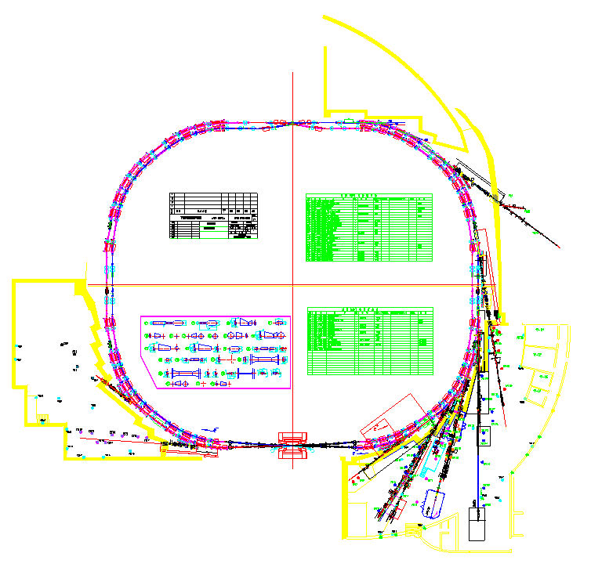
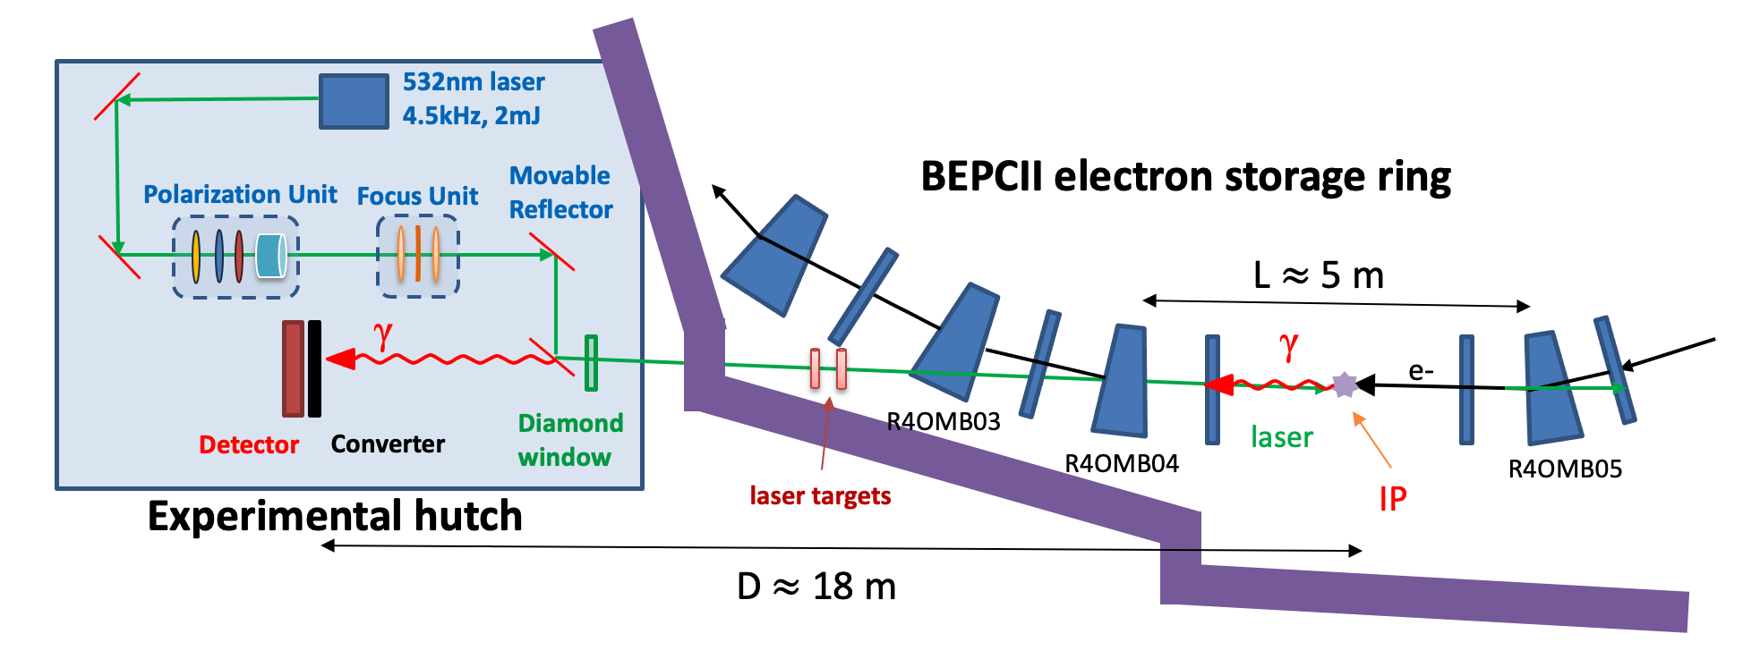
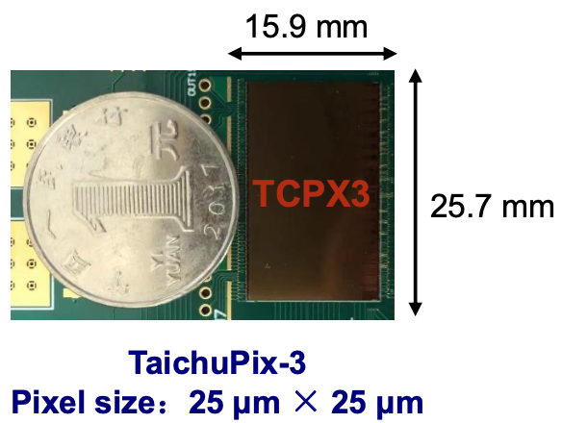
Compton polarimeter @ BEPCII
prototype of CEPC vertex detector
Location | beamline and experimental hall of 4W2 wiggler
Laser | 532nm, 4.5 kHz, 2 mJ, 1 ns
Observable | Vertical asymmetry of backscattered γ (up to 180 MeV)
Detector | Pb converter + silicon pixel detector
Signal | backscattered γ ~ 20kHz/mA/W
Background | bremsstrahlung γ ~ 1kHz/mA
Expected performance: ~1% statistical uncertainty in ~ 20 sec
11
11
Time step: 50 ns

Slide 12
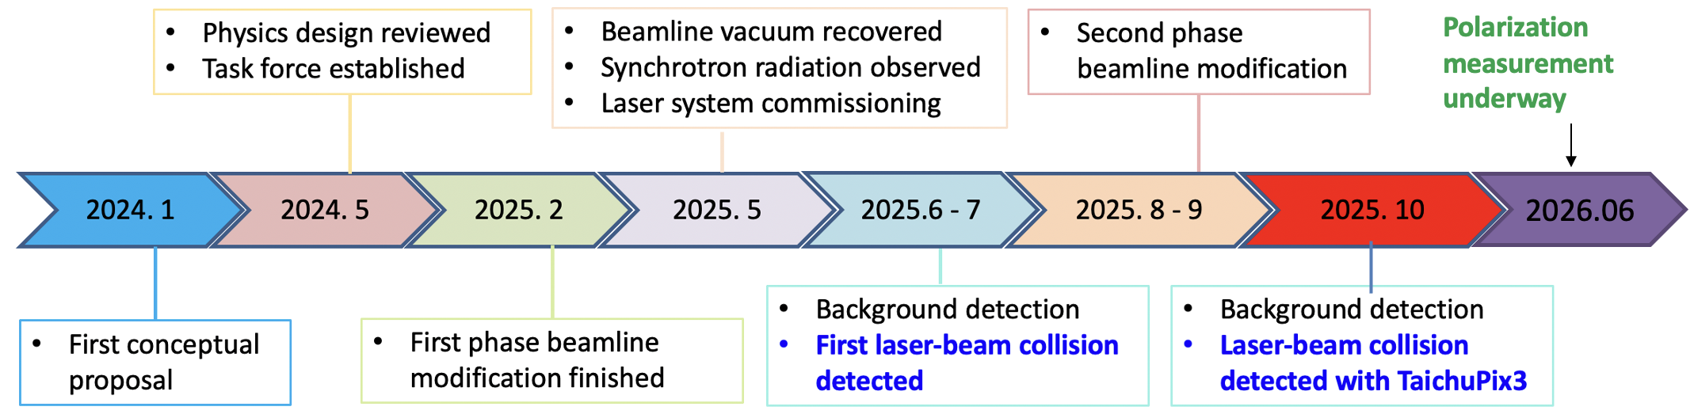
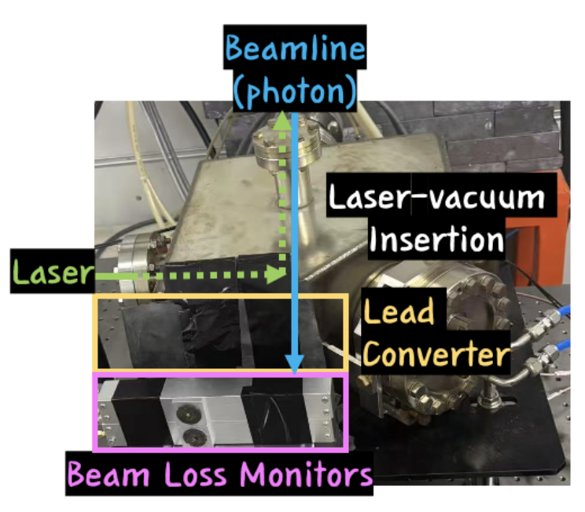
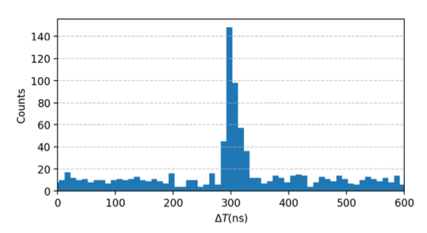
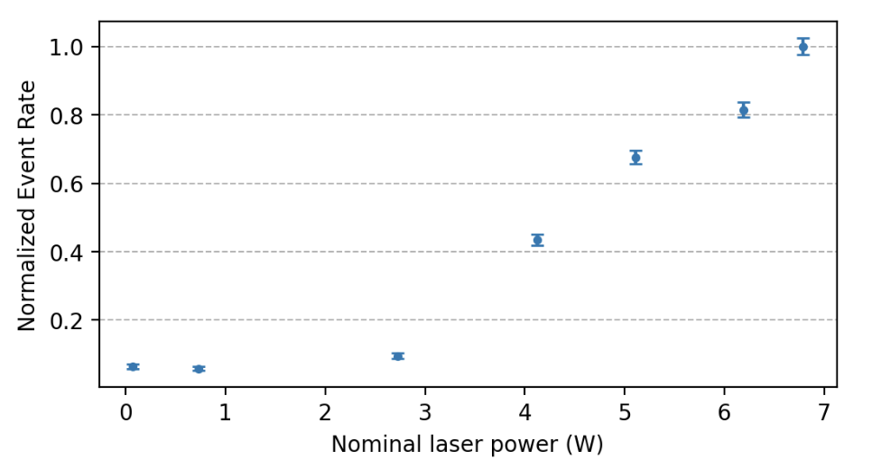
Overall progress
Signature of polarization build-up observed
Causality between laser & signal
Correlation between signal intensity and laser power
plastic scintillator + PMT
M. Su et al., Status report toward implementation of a Compton polarimeter at BEPCII arXiv:2605.09001

Slide 13
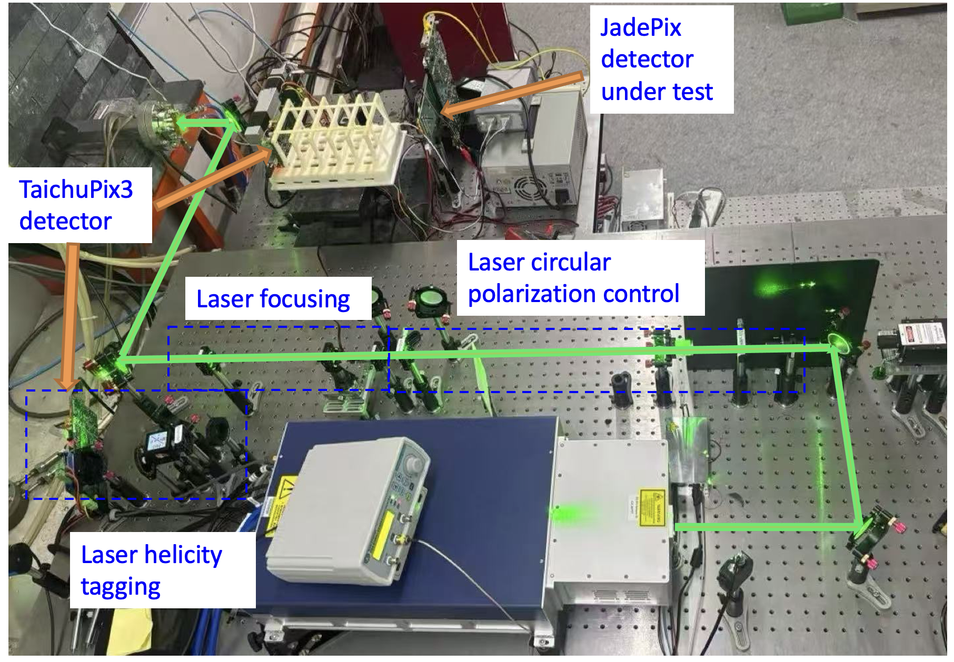
Experiment setup

Slide 14
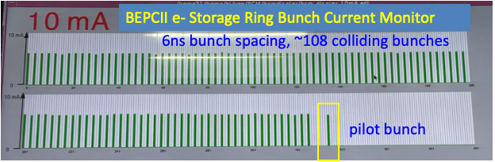
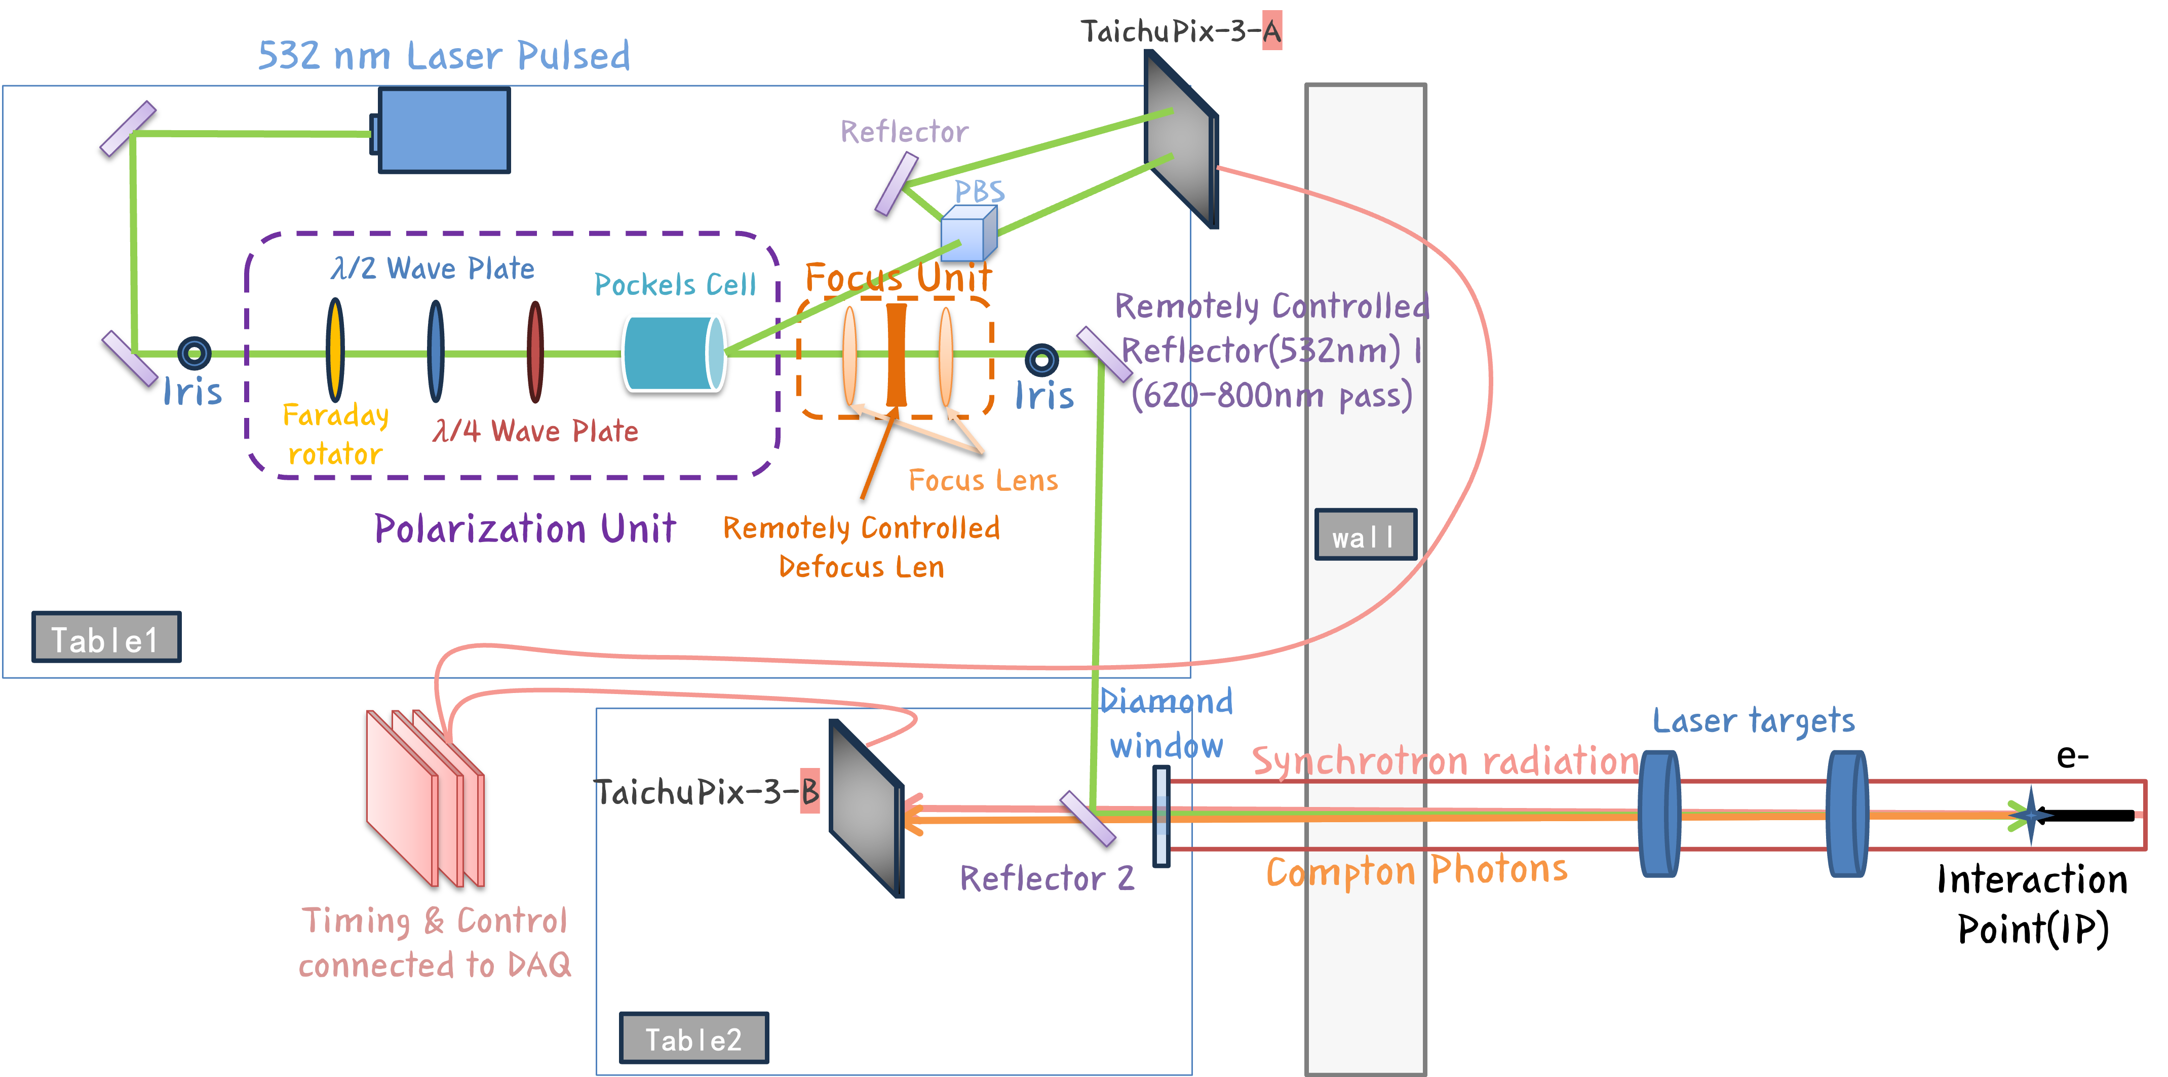
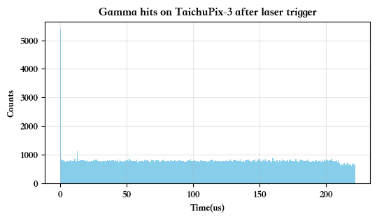
Laser tagging with dual TaichuPix detectors
The pulsed nature of gamma signal essential to improve signal-noise ratio
  TaichuPix detector in triggerless mode
  Synchronized dual TaichuPix detectors to facilitate laser tagging in offline analysis
signal
background

Slide 15
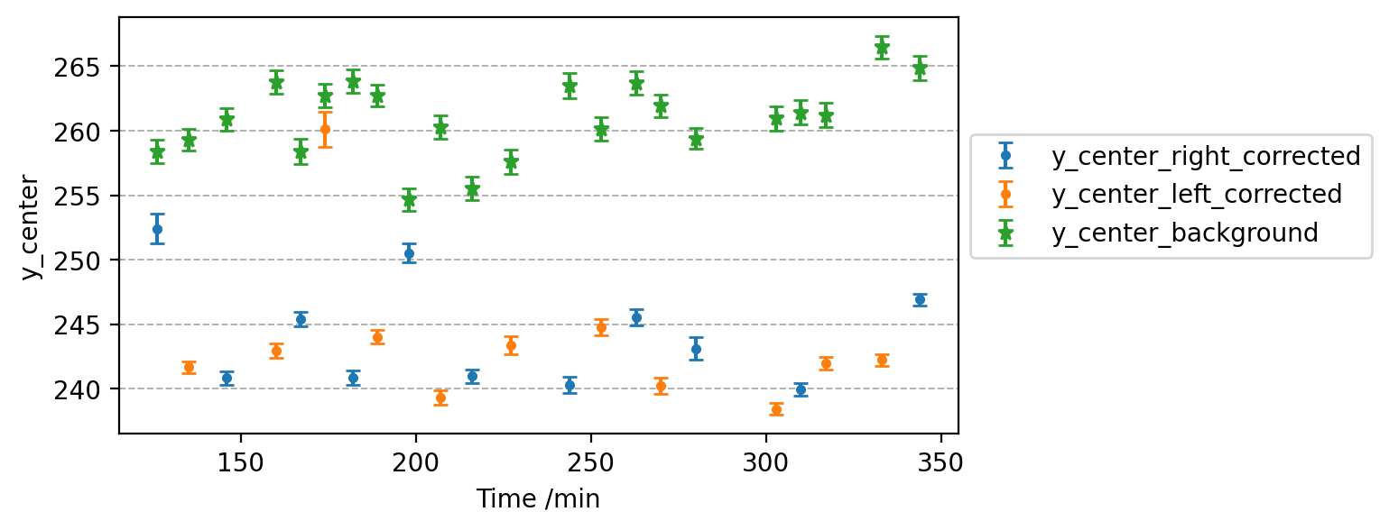
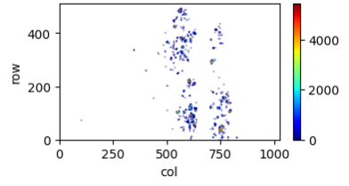
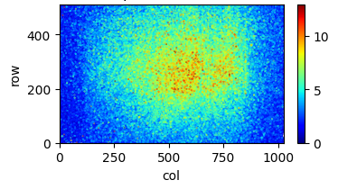
Mitigate the influence of electron beam orbit drift
  Gamma distribution perturbed by e- beam motion
  Laser helicity flipped at 10 Hz, tagged by the laser spot location on the detector
Chip A - Laser
Chip B - Gamma

Slide 16
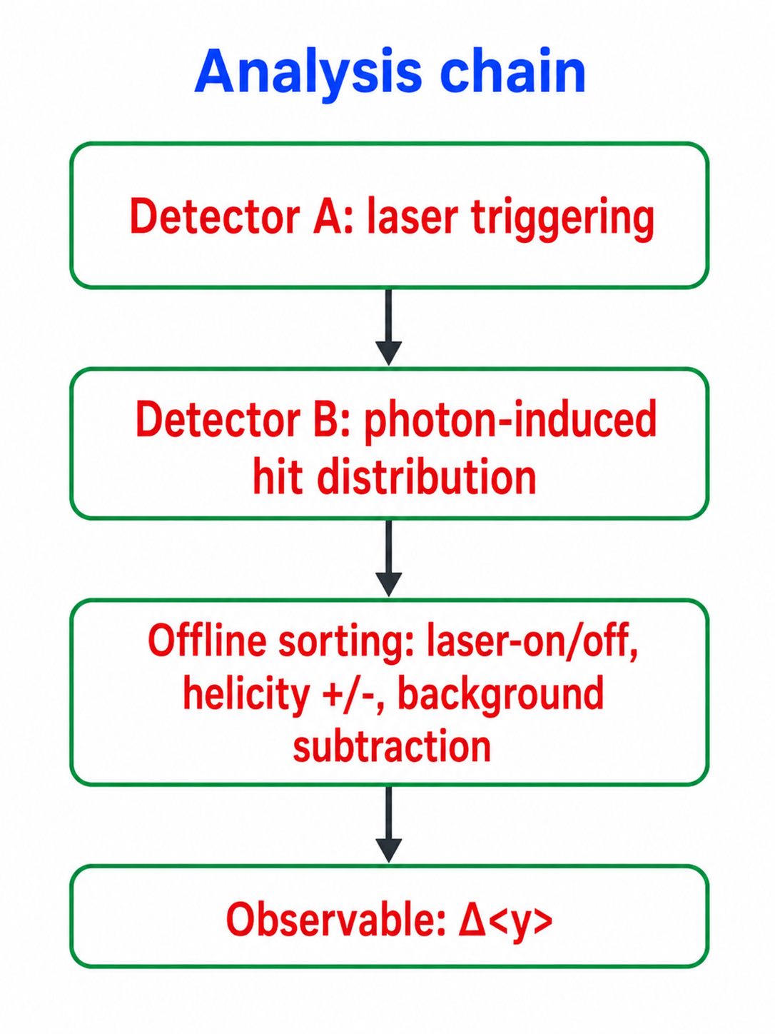
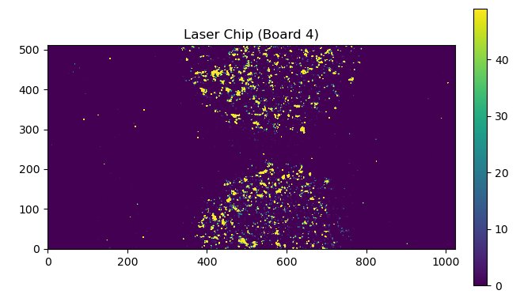
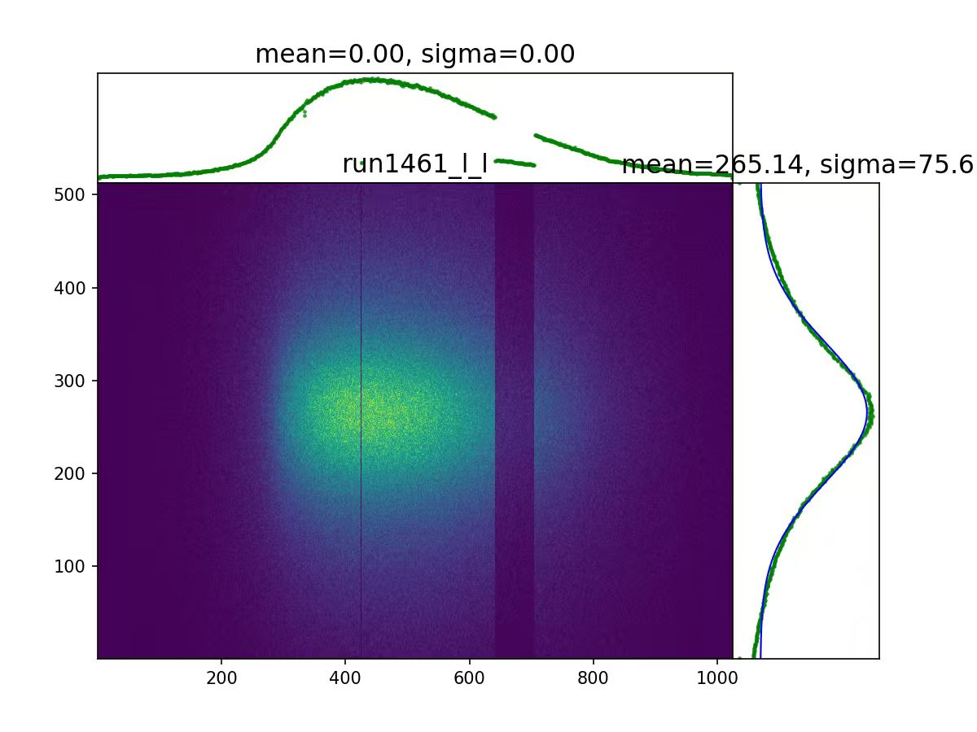
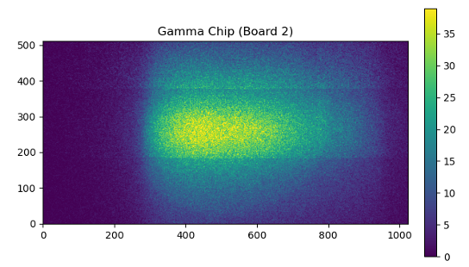
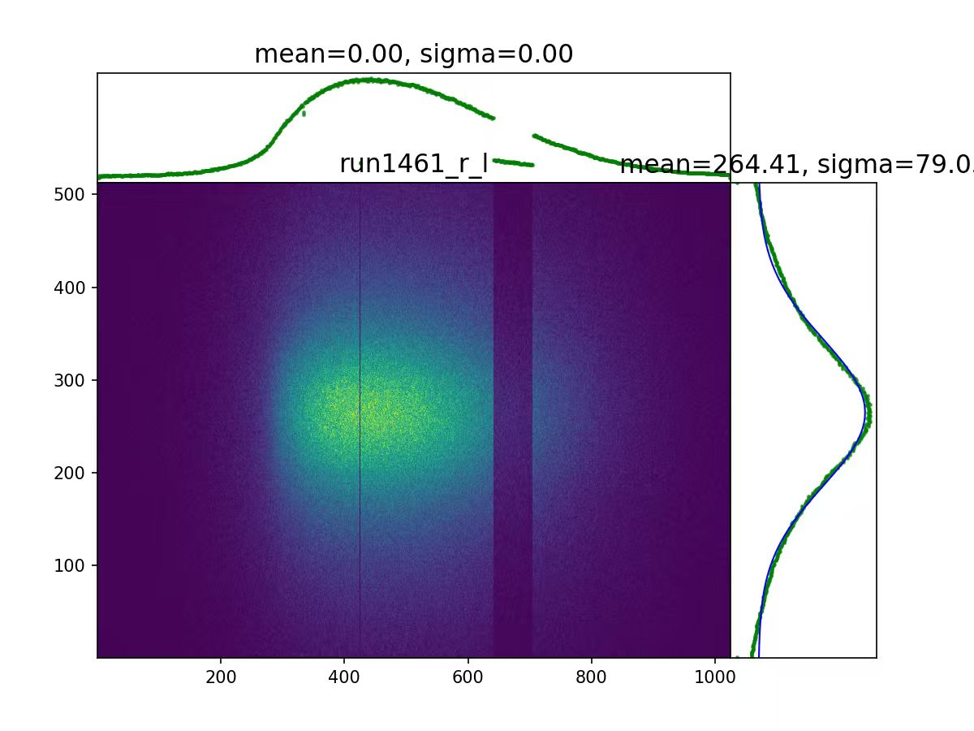
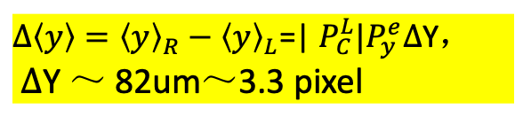
Data analysis chain
Denoising, triggering and grouping
Raw hit map
Left helicity
Chip A - Laser
Chip B - Gamma
$∆\left\langle y\right\rangle ={\left\langle y\right\rangle }_{R}−{\left\langle y\right\rangle }_{L}$=| $P_{C}^{L}|P_{y}^{e}∆$Y，
$∆$Y ～ 82um～3.3 pixel
Right helicity

Slide 17
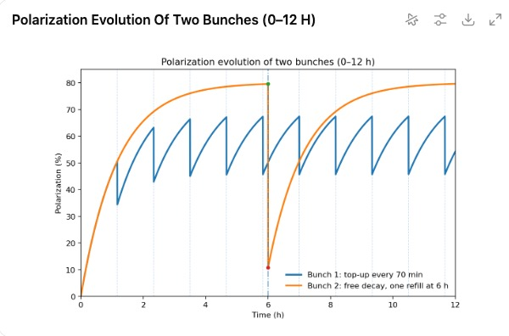
How to verify the beam polarization measurement?
Different behavior in the beam polarization evolution:
Normal bunches in collision, refilled every 70 min, polarization “saw-tooth”
Non-colliding pilot bunches, free decay, polarization exponential build-up

Slide 18
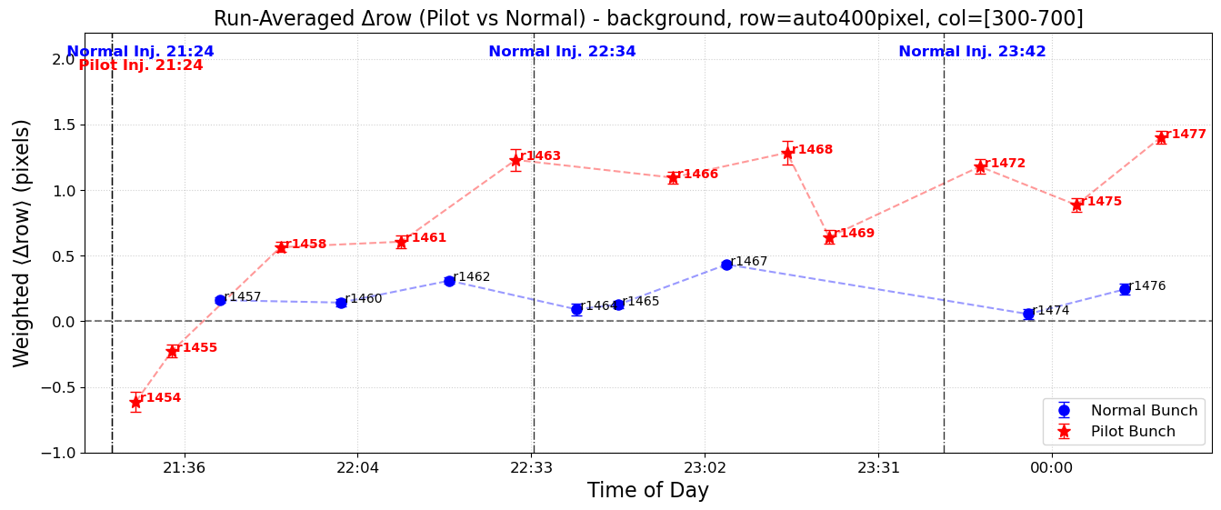
Signature of beam polarization build-up
Alternative measurements of the pilot bunch and normal bunches
Increase of asymmetry over time for pilot bunch, compared to the reference of normal bunches

Slide 19
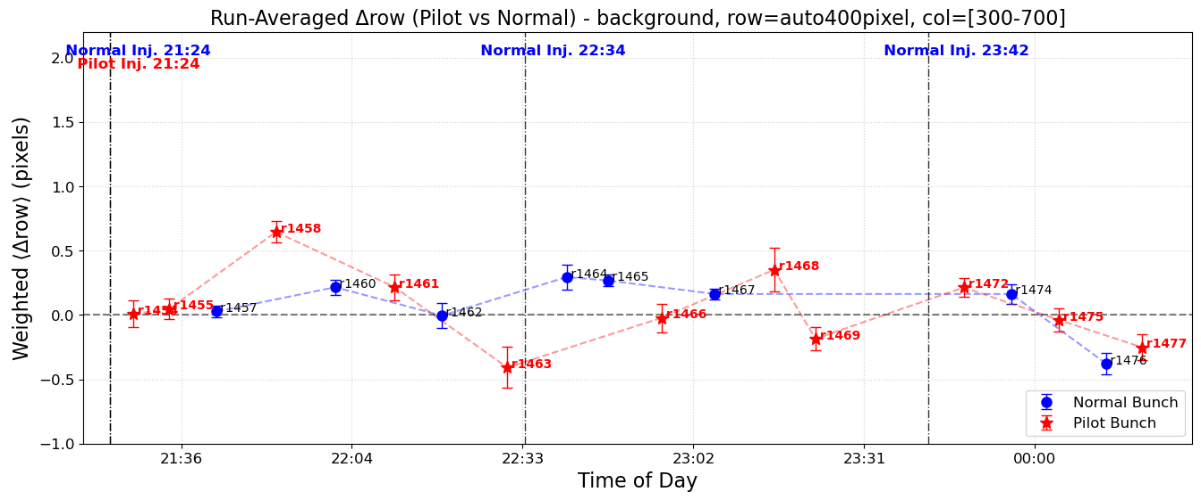
Signature of beam polarization build-up
Measured signal behavior differs from the background

Slide 20
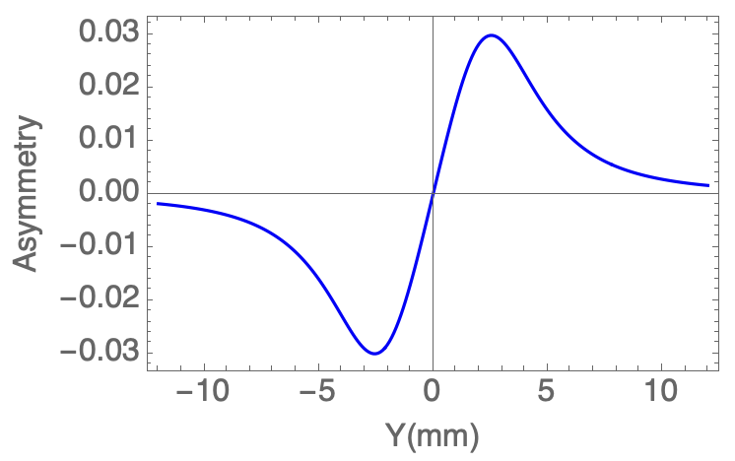
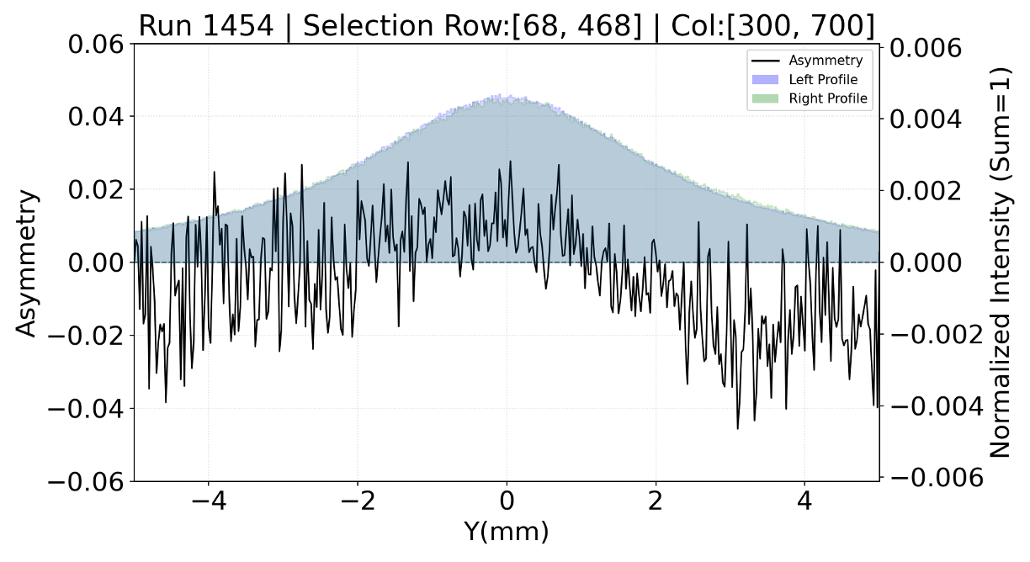
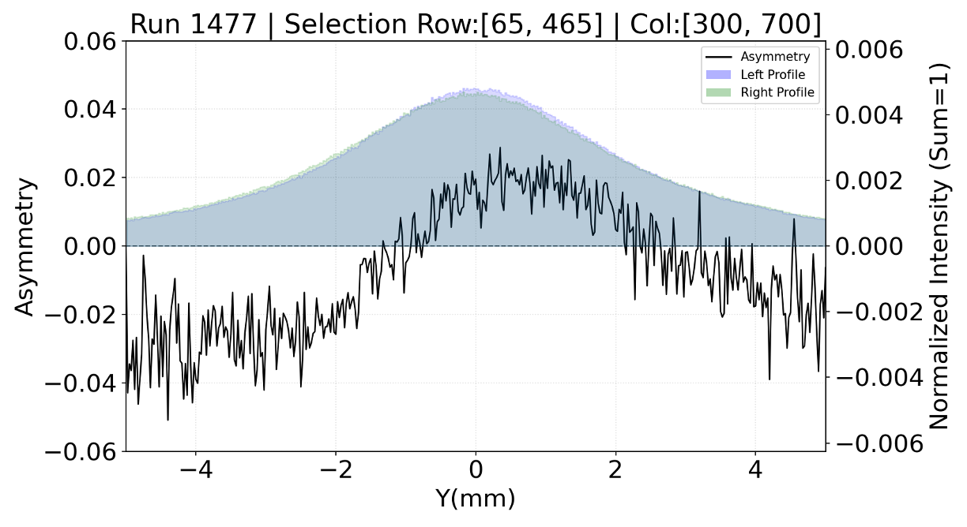
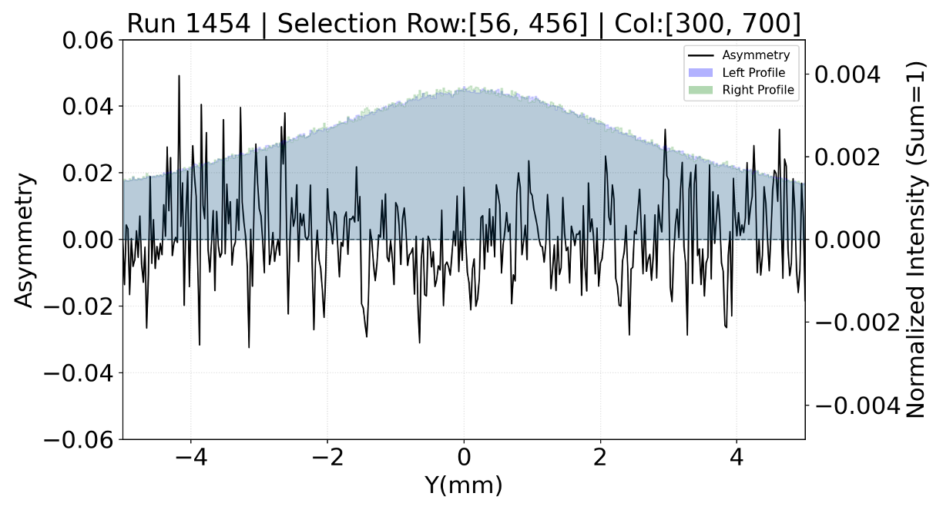
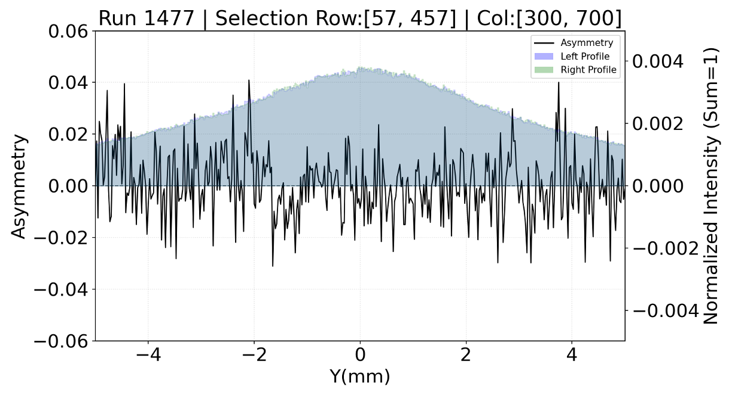
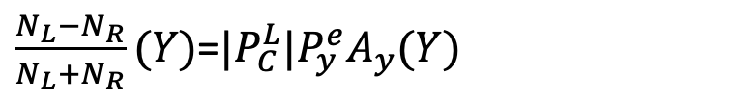
Measured asymmetry
$\frac{N_{L}−N_{R}}{N_{L}+N_{R}}(Y)$=$|P_{C}^{L}|P_{y}^{e}A_{y}(Y)$
Theoretical asymmetry for 100% electron & laser polarization
Measured asymmetry for different conditions
Just after injection
~3 hours after injection
Pilot bunch
Signal
Larger asymmetry for pilot bunch signal 3 hours after injection
Measured shape not yet match theoretical shape
Need to better understand potential sources of helicity-correlated asymmetry
Pilot bunch Background

Slide 21
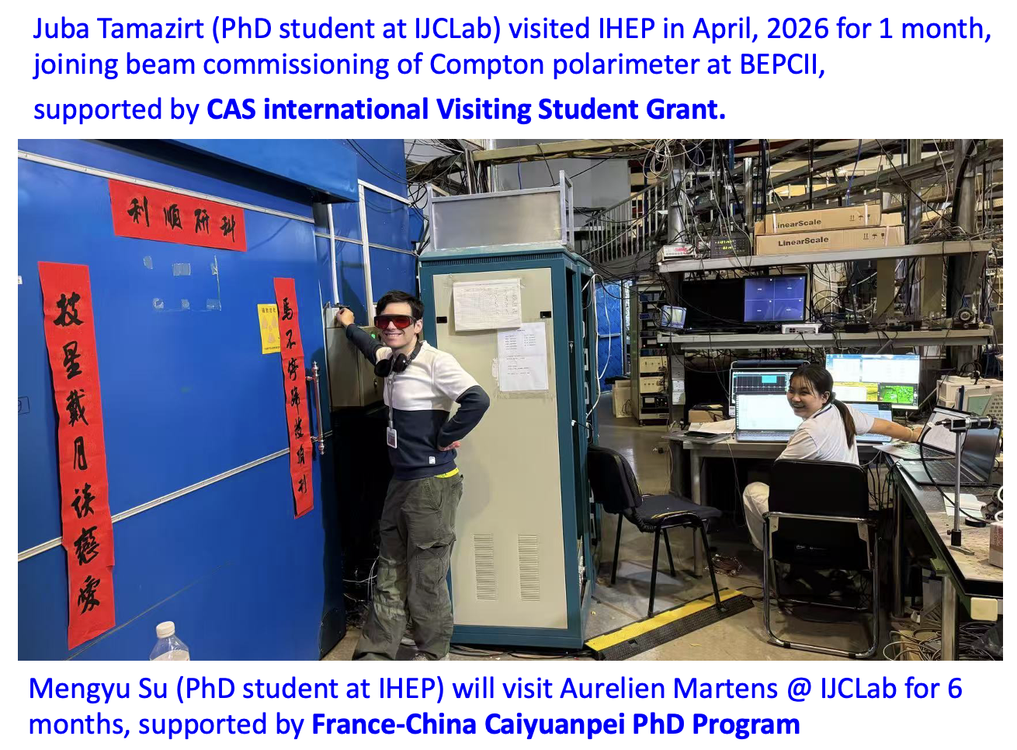
Summary
Direct synergy on beam polarization studies between CEPC and FCC-ee
BEPCII provides an operating collider test bed
Compton polarimeter has observed signature of beam polarization build-up
More refined error analysis and improvement of the instruments are planned
  Calibration of the analyzing power
  Sources of helicity correlated asymmetry
  External trigger to detector
  Real-time beam polarization measurement
International collaboration is highly beneficial!

Slide 22
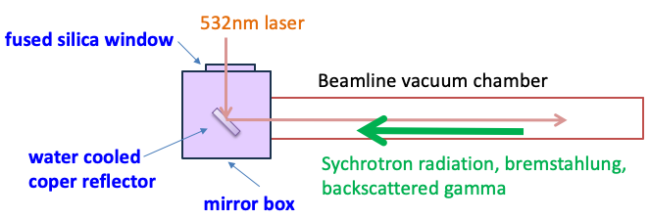
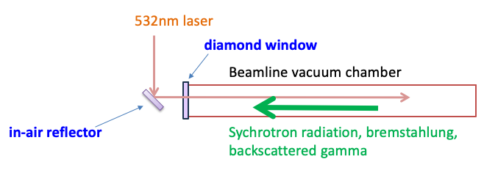
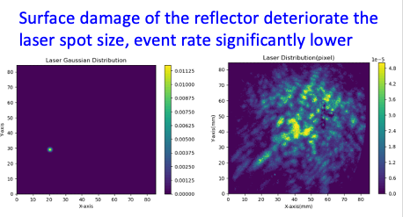
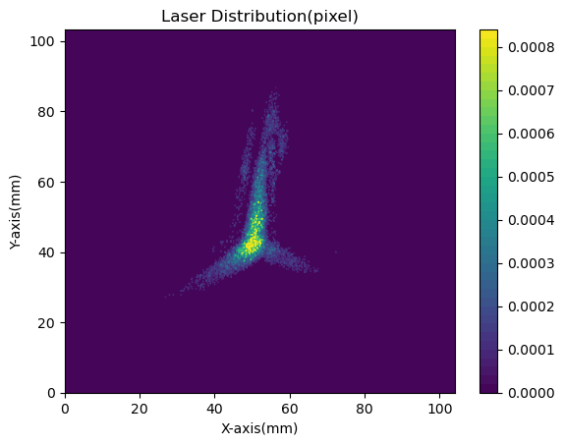

New solution to the laser-vacuum insertion
Driven by the need to improve laser focusing
  Replace the in-vacuum mirror with diamond window & in-air reflector
  Easier maintenance, less material in gamma pathway
borrowed from BEMS (BINP & IHEP)
Employ a single crystal diamond window with water cooling to seal the vacuum
measured

