Slide 1
Towards third generation ground-based gravitational wave detectors
Raffaele Flaminio
CNRS/LAPP, Annecy, France

Slide 2
Outline
Short introduction to GW detection
Noises in GW detectors (selection of)
The Cosmic Explorer and Einstein Telescope approach to noise reduction
The Chinese effort and present collaboration within FCPPN
Conclusion

Slide 3
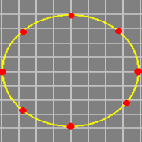
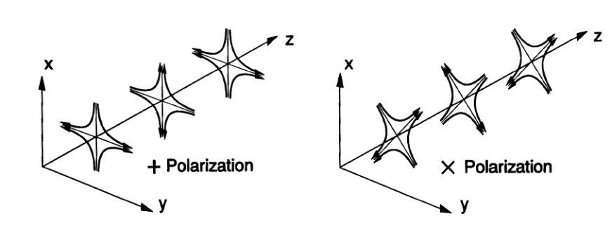

Gravitational waves effect
Oscillations of space-time curvature
  Quadrupolar wave
  Tidal force
  Wave amplitude h
  Two polarizations
$$δL=h L$$

Slide 4
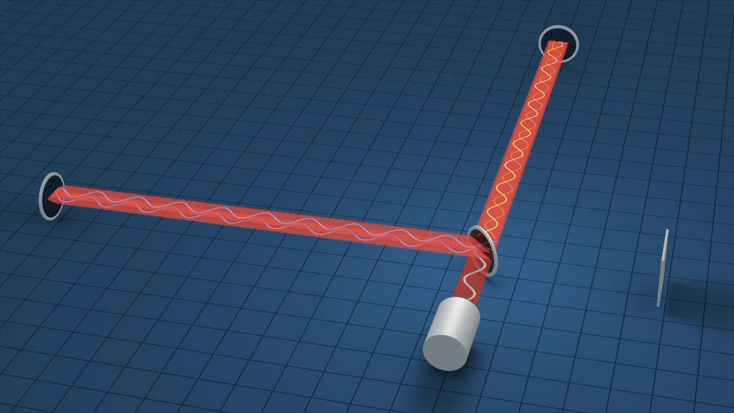

Gravitational wave detection
The principle
  Gravitational wave
  ↓
  Mirror displacement
  ↓
  Light phase shift
  ↓
  Light power variation
The devil is in the details
  With 3 km arm length
  displacement ~10⁻¹⁸ m
  Arm length is the key parameter
  It sets the interferometer class
$$δL=h L$$

Slide 5
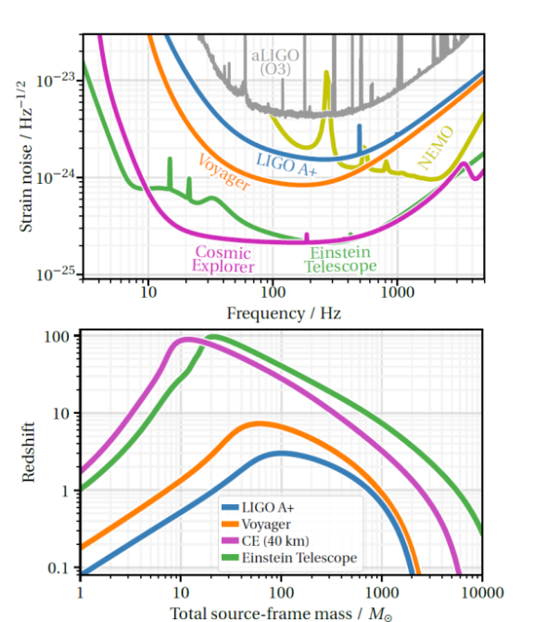
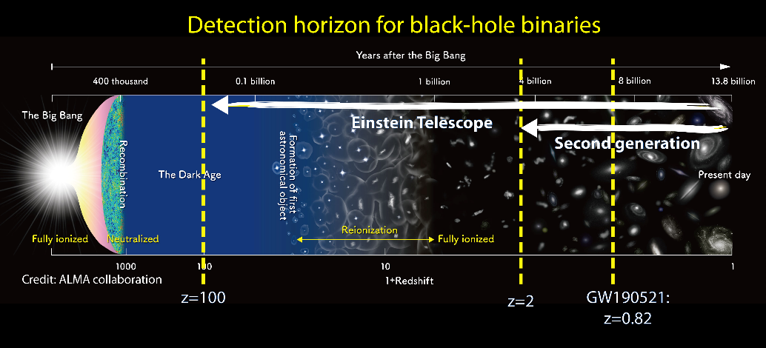
Sensitivity: nowadays and future
Floor noise as a function of frequency → Astrophysical reach

Slide 6
Main competing noises
Two families of noise
Sensing noises
  Noises due to the sensing without any mirror displacement
  Shot noise, Laser noises, Electronic readout noise, …
Displacement noises
  Noises producing a real displacement of the mirror
  Thermal noise, Mirror position control noise, Seismic noise, ….

Slide 7
Main competing noises
Two families of noise
Sensing noises
  Noises due to the sensing without any mirror displacement
  Shot noise, Laser noises, Electronic readout noise …
Displacement noises
  Noises producing a real displacement of the mirror
  Thermal noise, Mirror position control noise, Seismic noise, ….

Slide 8
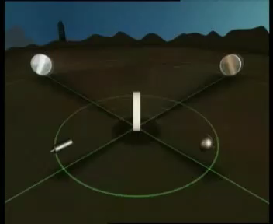
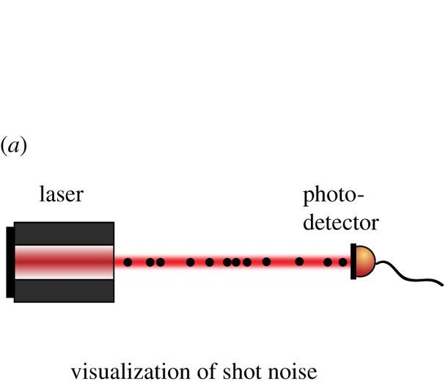



Shot noise
Measurement of flux of photons reaching the photodetector
  Shot noise
Signal
  Phase shift
Noise
  Heisenberg principle
Signal > Noise
Sensitivity improve when:
  Arm length L ↑
  Laser power P ↑
$$Δφ_{s}=\frac{4π}{λ} h L$$
λ = laser wavelength
$$Δφ_{n}>\frac{1}{\sqrt{N}}$$
N = number of
photons used
$$h>\frac{1}{L} \frac{λ}{4π} \sqrt{\frac{2ℏω}{P}}$$
P = laser power

Slide 9
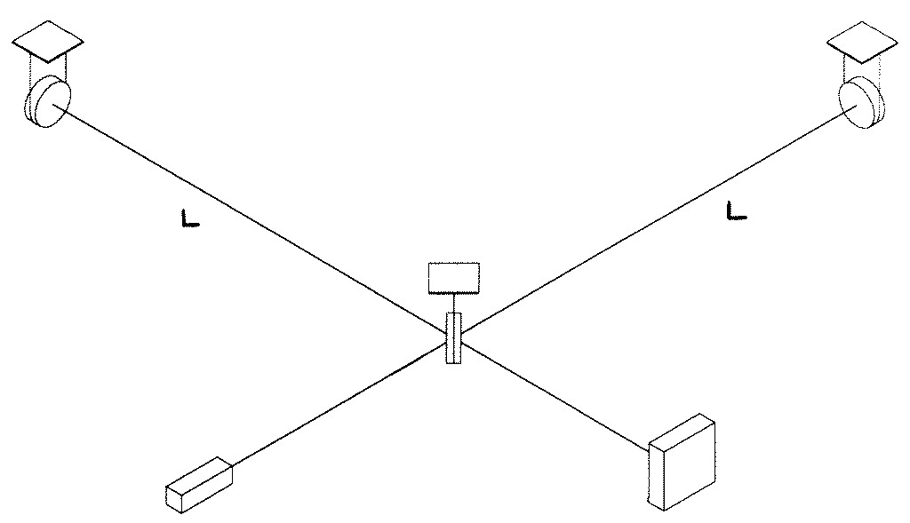
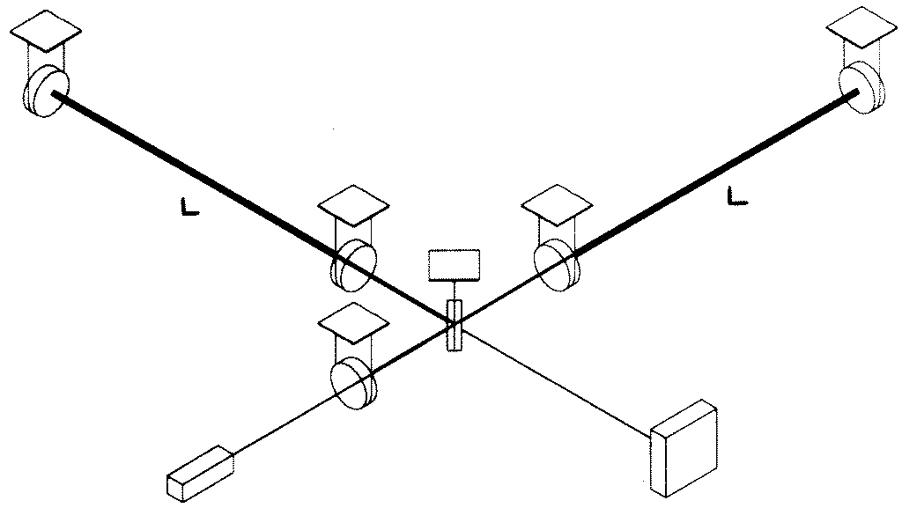

Optical amplification and its limitations
Optical Amplification of signal
  Fabry-Perot cavities in the arms
    Increase equivalent arm length
    Limitation?
      Optical losses in the arms
      Cavity finesse ↑ ⇒ Detector bandwidth ↓
  Power recycling
    Increase effective laser power
    Limitation?
      Optical losses in the arms
      Radiation pressure noise
Radiation pressure noise
    Due to fluctuations of number of photons impinging on the mirrors
    Increases with power stored in the arms
    An example of the “Heisenberg microscope”
      More photons → more sensitivity → more perturbations
Fabry-Perot
L
L
P’
$${\tilde{F}}_{n}=\sqrt{\frac{8Pℏω}{c^{2}}}$$
P
Recycling
mirror

Slide 10
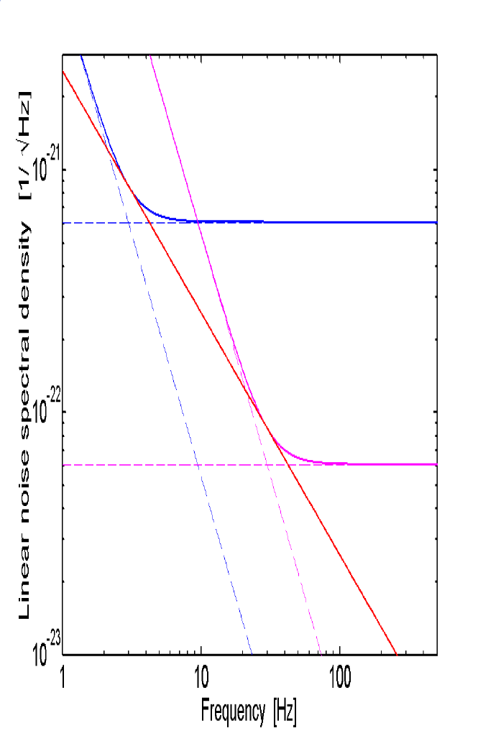
Quantum noise
Quantum noise =
Shot noise + Radiation Pressure noise
Solutions to reduce quantum noise
  Reduce optical losses (=better mirrors)
  Increase the mirror mass (currently 40 kg)
  Improve efficiency of squeezed vacuum states
  (already used, reduces shot noise by ~2)
  Longer arm length
shot noise
shot noise with
100x increased laserpower
radiation pressure noise
standard quantum limit

Slide 11
Main competing noises
Two families of noise
Sensing noises
  Noises due to the sensing without any mirror displacement
  Shot noise, Laser noises, Electronic readout noise …
Displacement noises
  Noises producing a real displacement of the mirror
  Thermal noise, Mirror position control noise, Seismic noise, ….

Slide 12
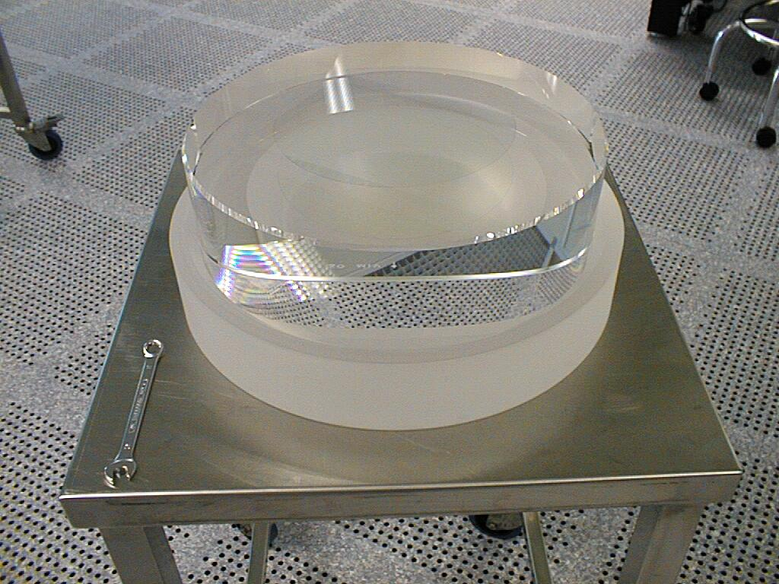
Thermal noise: mirrors
Thermal noise: thermal vibration of the mirror and its suspension
Mirrors made of:
  40 kg fused silica cylinders (substrate)
  Multi layers coatings to provide high reflectivity at the laser wavelength
Coatings are the main contributors to the mirror thermal noise
Solutions:
  Coatings with lower thermal noise (=lower mechanical losses)
  Larger beams (=noise averaging)
  Lower temperature (=less thermal excitation)
    Requires to change mirror material and laser wavelength
  Longer arm length (=increase S/N ratio)

Slide 13
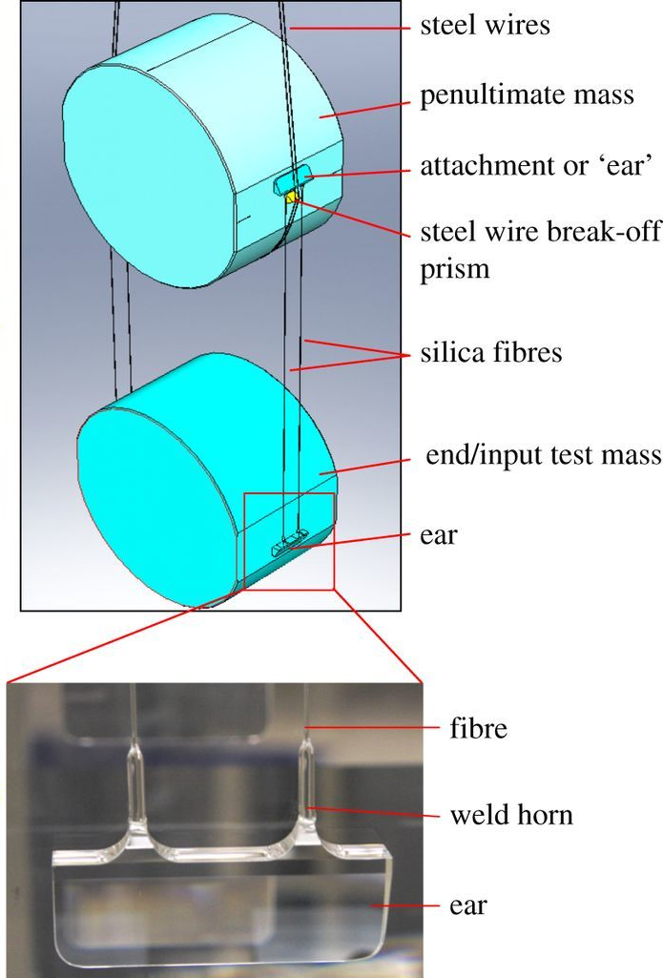
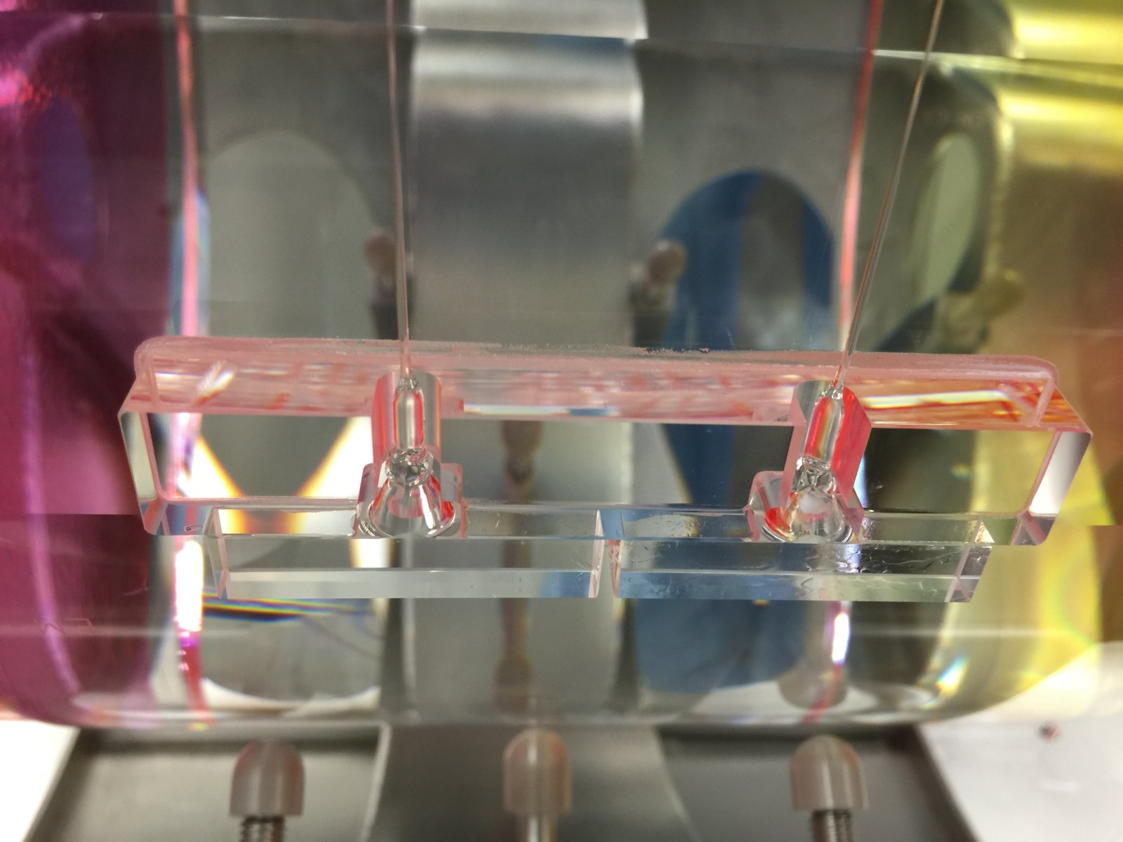
Thermal noise: suspensions
Thermal noise: thermal vibration of the mirror and its suspension
Mirror suspension wires
  Friction in the wires + Temperature → Mirror displacement
  Monolithic suspensions made of fused silica
Solutions:
  Wires with less internal friction
  Longer pendulum
  Larger mirror mass
  Lower temperature (=less thermal excitation)
    Requires to change mirror material and laser wavelength
    Cryogenic vibrations (silent cryogenics needed)
  Longer arm length

Slide 14
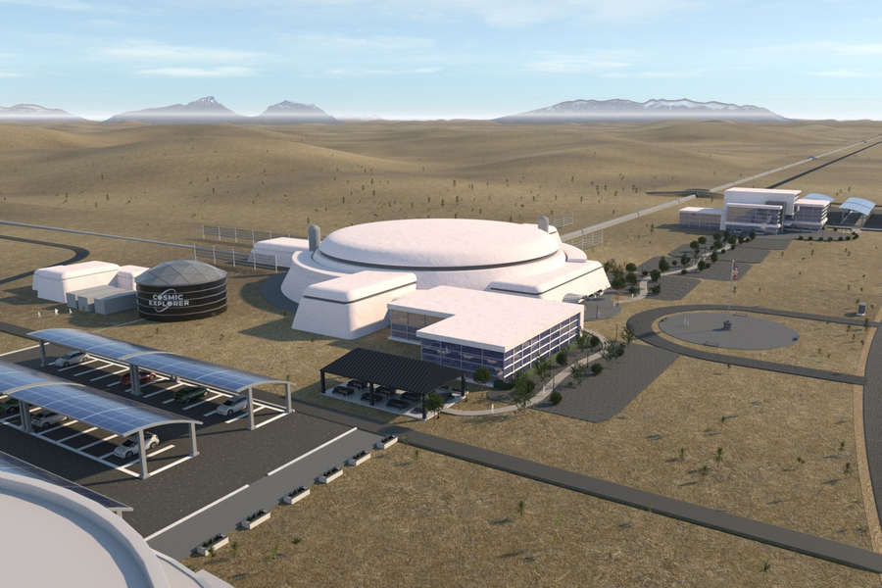
The Cosmic Explorer approach
Present technology but bigger (~10 times LIGO)
  On surface
  10x Longer arm length (40 km)
  11x Larger mirrors (440 kg) made of silica
  3.5x Longer last stage pendulum (2 m)
  2x Larger beam size (12 cm radius)
  4x Laser power in the arms (1.5 MW)
  Same laser wavelength
  Newtonian noise reduction (x2 to x10)
  Under discussion:
    2 observatories 40 km & 20 km or 1 observatory 40 km

Slide 15
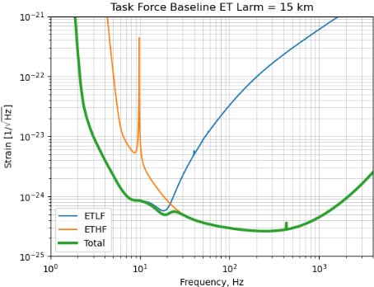
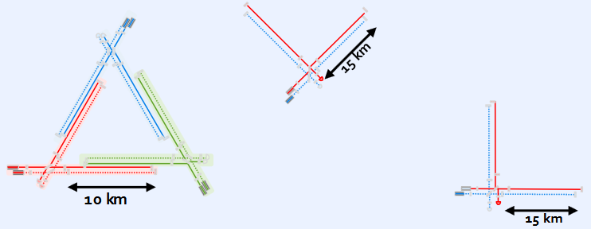
The Einstein Telescope approach
Two detectors: one for high frequencies (ET-HF) and one for low frequencies (ET-LF)
  Underground
  2.5x or 3.8x longer arm length (10 or 15 km)
  ET-HF similar to CE but shorter and 8x power in the arms (3MW)
  ET-LF
    Cryogenic
    Low laser power (only 15 kW)
    Sapphire or Silicon mirrors (200 kg)
    1.5 μm or 2 μm laser wavelength
  Under discussion:
    2L’s i.e. two separated observatories (as LIGO)
    or 1 triangle i.e. three nested observatories
- ET-LF
- ET-HF
Technologies
to be developed
“L”= interferometer with orthogonal arms

Slide 16

3G detectors in the 40’s
A world wide network made of O(10 km) scale long detectors
  Cosmic Explorer in the US
    One or two L’s
  Einstein Telescope in Europe
    One triangle or two L’s
  A third long detector in Asia would certainly improve the
  network capability
“L”= interferometer with orthogonal arms
Image: Earth seen
from the North Pole

Slide 17
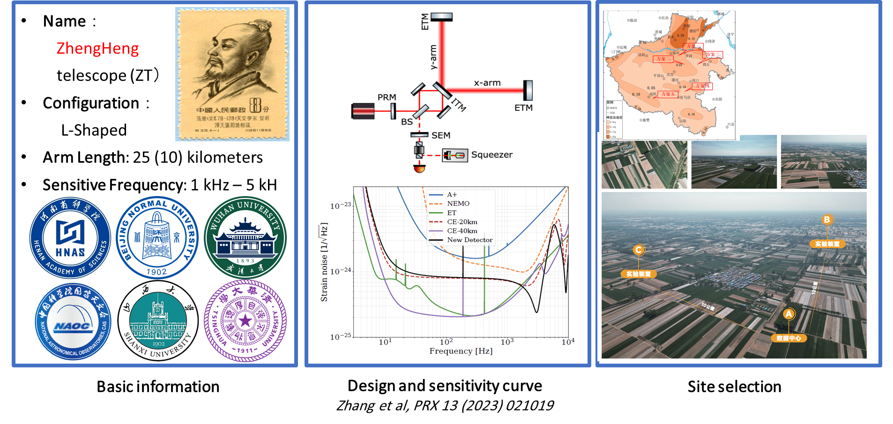
Zheng Heng telescope (ZT)
Proposal for a ground-based detector in China
  Still in a very early phase

Slide 18
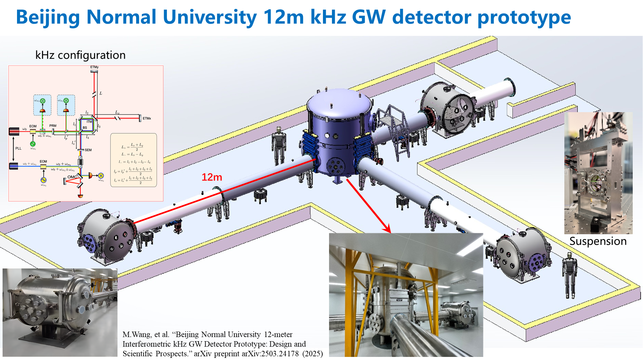
BNU 12m kHz GW detector prototype

Slide 19
France-China collaborations
N.B. Collaborations focused on instrumentation development
Optics technology
  Development of a new output mode-cleaner for Virgo-nEXT and for the BNU prototype (LAPP-BNU)
    Two visits of a BNU student to LAPP in 2024-2025 (10 months). New visit possible in 2026.
    1.5 month visit from LAPP to BNU in 2025. Funding requested for 2026.
  Thermal Deformation Reduction in High-Power Interferometry with Higher-Order Laser Modes (APC-HNAS)
    Paper submitted
Quantum noise reduction
  Frequency dependent squeezing (10 dB) for future detectors (APC-HNAS-BNU)
    Master thesis of a BNU student at APC in 2025
    Chinese postdoc at APC chairing the filter cavity design for ET-HF
    Investigate mode matching sensing and control strategy using machine learning (paper accepted)
Data acquisition
  Possible installation of Virgo-like DAQ in HNAS (LAPP-HNAS)

Slide 20
Summary
Third generation GW detectors have strong discovery potential
  e.g. Can observe the first black holes
Europe and the US have plans to build new infrastructures devoted to GW
  Best sensitivity improved by one order of magnitude
  Bandwidth extended below 10 Hz
  CE and ET have different approaches to the goal
China is developing a plan for a 25 km long interferometer
  Focus on high frequencies
A collaboration started between the Chinese team working on GW ground based detector and two IN2P3 groups
  Focus on instrumentation

