Slide 1


B_{c} studies and upgrade of ECAL for LHCb
Patrick Robbe, IJCLab Orsay, 29 June 2026

Slide 2
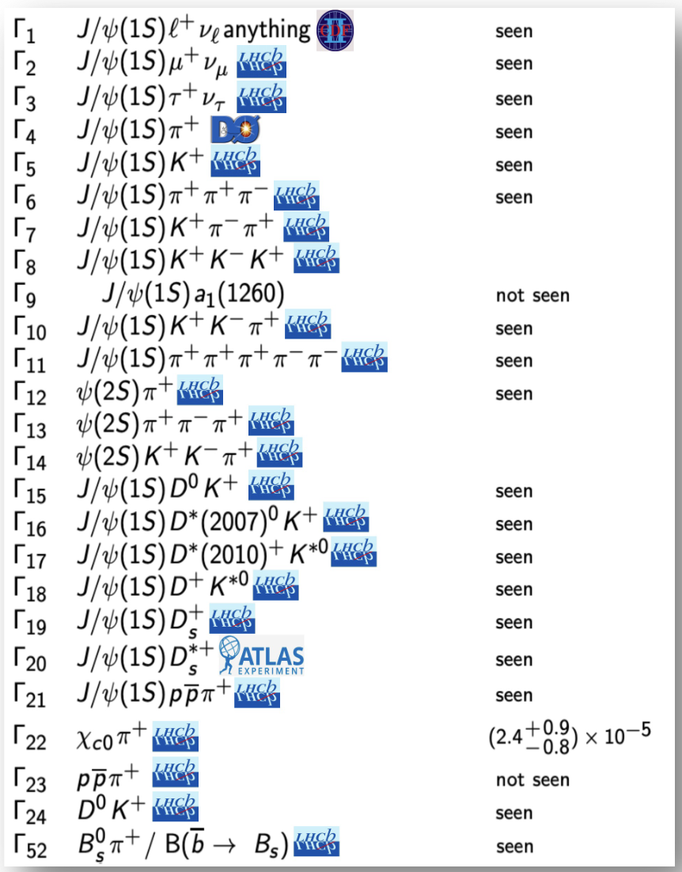
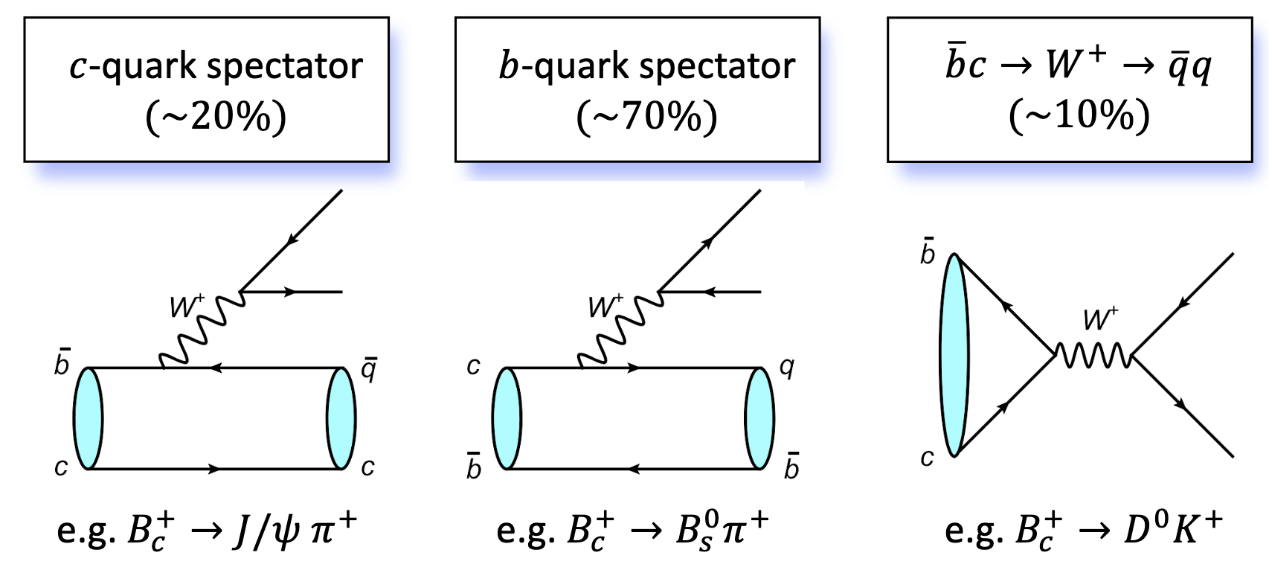
Study of the B_{c}⁺ meson
Heavy quarkonium: ideal system to probe QCD both theoretically and experimentally, well-studied
𝑩_{𝒄}⁺ meson: a unique system in standard model
  Nonrelativistic system composed two different heavy quarks (𝒃𝒄) with a mass of ~6.27 GeV
  It can decay only via the weak interaction, providing unique opportunities to extract information on both QCD dynamics and weak interactions.
  Decay time (~0.5 ps) three times shorter than 𝑩⁺, longer than quarkonia
Limited knowledge experimentally:
  Not produced in current e⁺e⁻ colliders
  Suppressed in hadronic colliders
Leading role of LHCb in the study of the B_{c}⁺ meson
  Dominating precision for mass and lifetime measurements
  Observation of new decay modes

Slide 3
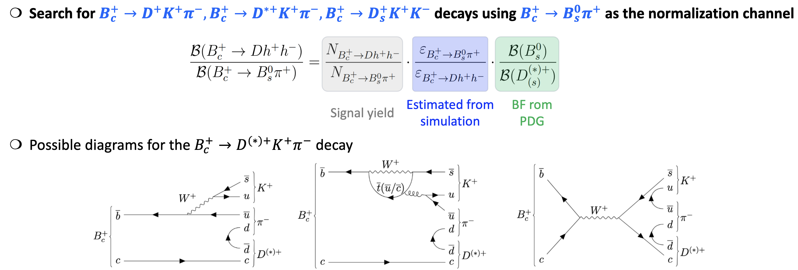
Observation of B_{c}⁺ → D h⁺ h⁻
[Phys. Rev. Lett. 136 (2026) 021804]
Investigate the role of annihiliation processes in B_{c}⁺ decays, observed to be dominant in B_{c}⁺→DX decays.
R=
Annihilation

Slide 4
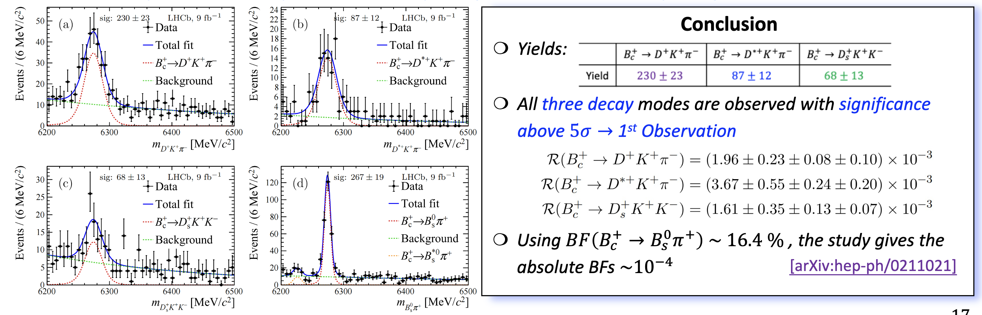
Observation of B_{c}⁺ → D h⁺ h⁻
[Phys. Rev. Lett. 136 (2026) 021804]
Analysis using Run 1+2 data = 9 fb⁻¹

Slide 5
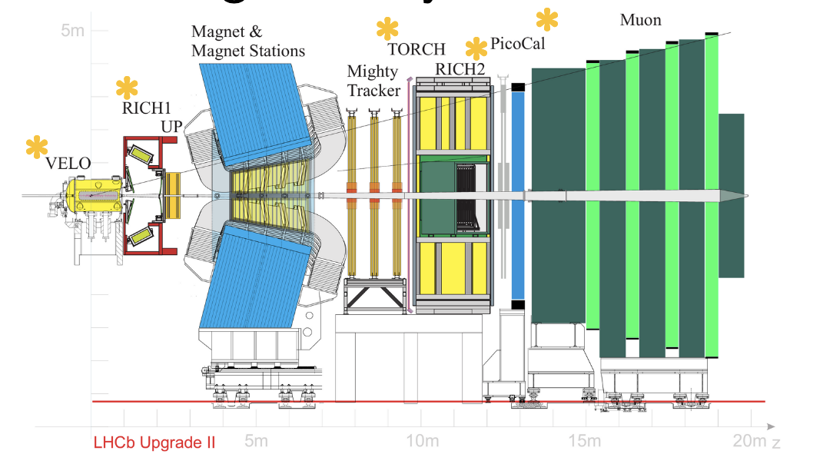
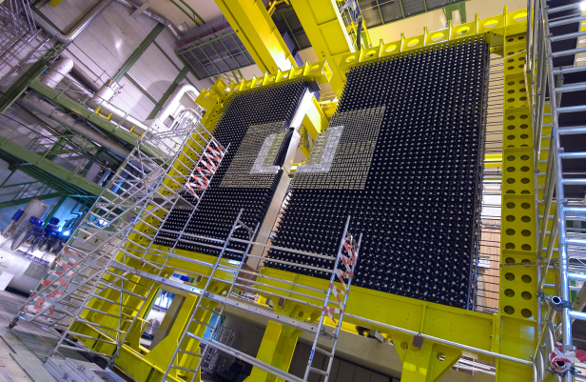
Calorimeter for Upgrade 2
LHCb is designing a new detector to replace the current one: ”LHCb Upgrade 2” which will start taking data in 2036.
It will contain an electromagnetic calorimeter: PicoCal, new detector built by institutes from China, France, CERN, Italy, Spain, USA, Kazakhstan.

Slide 6
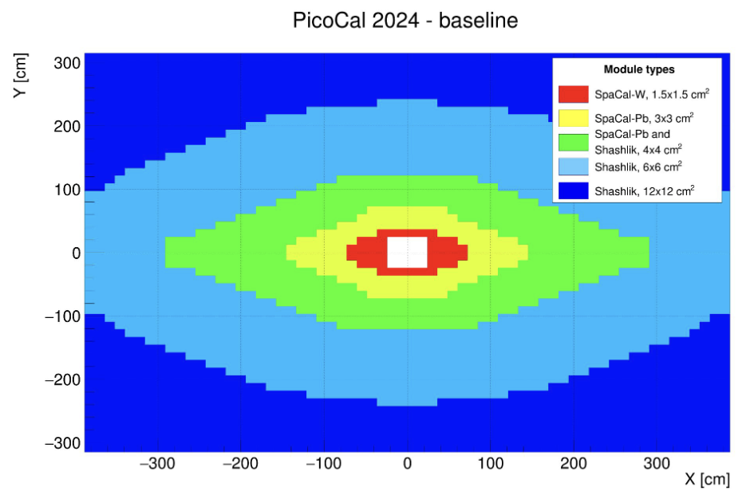
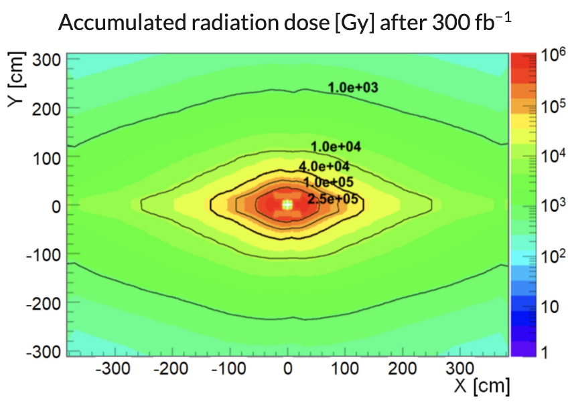
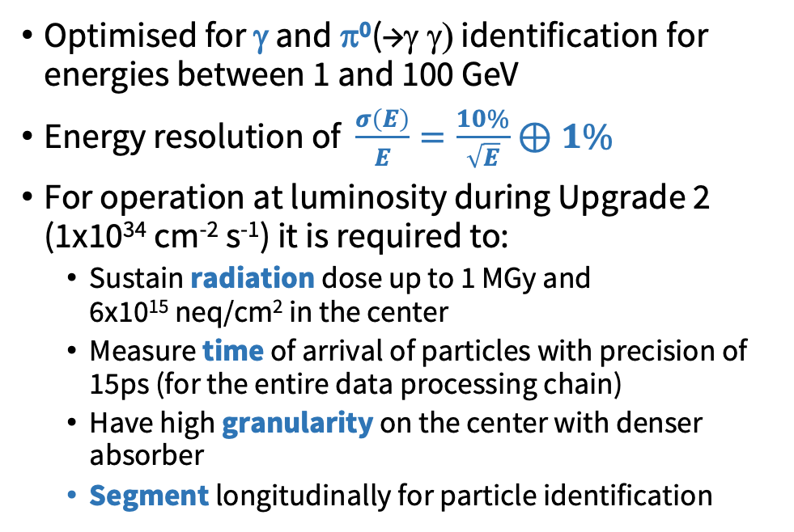
Electromagnetic Calorimeter in LHCb
Optimised for γ and π⁰(→γ γ) identification for energies between 1 and 100 GeV
Energy resolution of $\frac{σ\left(E\right)}{E}=\frac{10\%}{\sqrt{E}}⊕1\%$
For operation at luminosity during Upgrade 2 (1x10³⁴ cm⁻² s⁻¹) it is required to:
  Sustain radiation dose up to 1 MGy and 6x10¹⁵ neq/cm² in the center
  Measure time of arrival of particles with precision of 15ps (for the entire data processing chain)
  Have high granularity on the center with denser absorber
  Segment longitudinally for particle identification

Slide 7
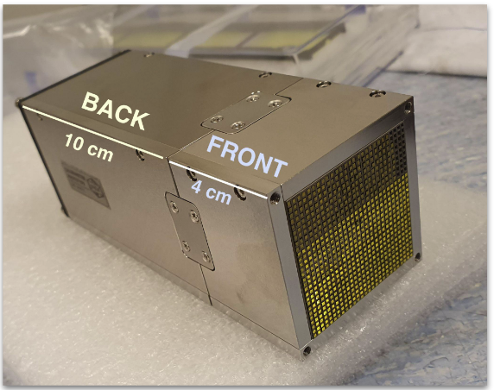
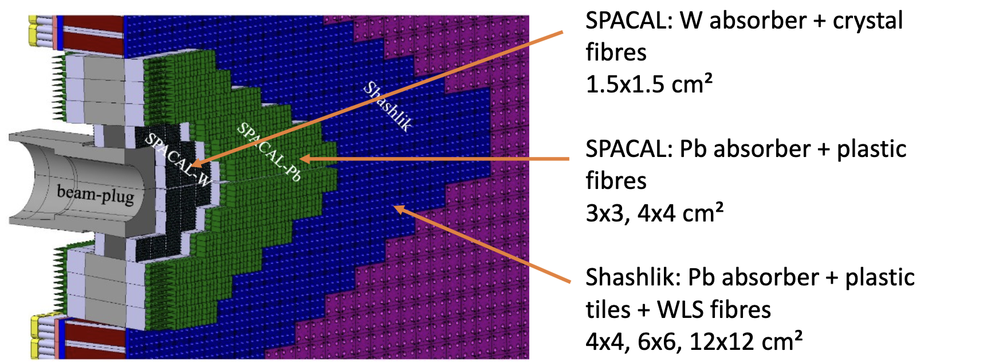
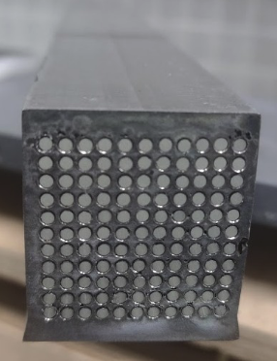
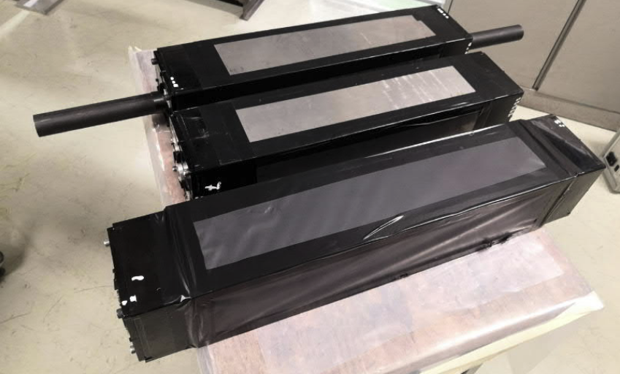
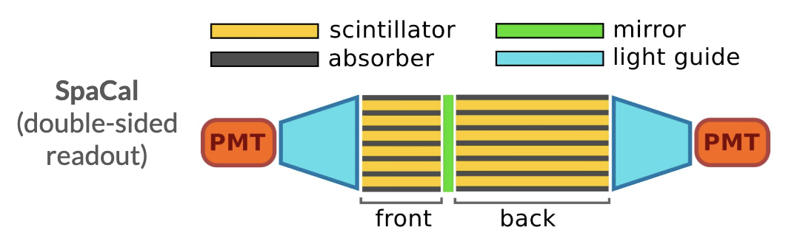
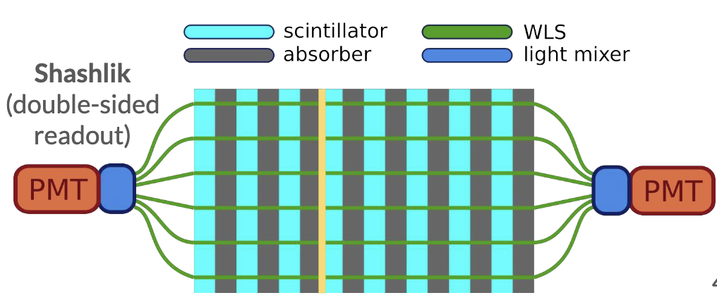
LHCb PicoCal
(GAGG = Gadolinium Aluminium Gallium Garnet)

Slide 8
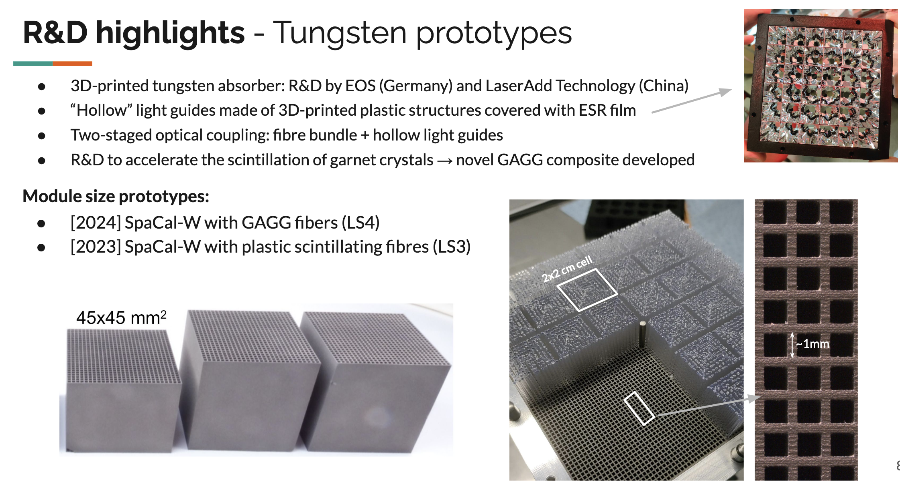
R&D - Tungsten prototypes

Slide 9
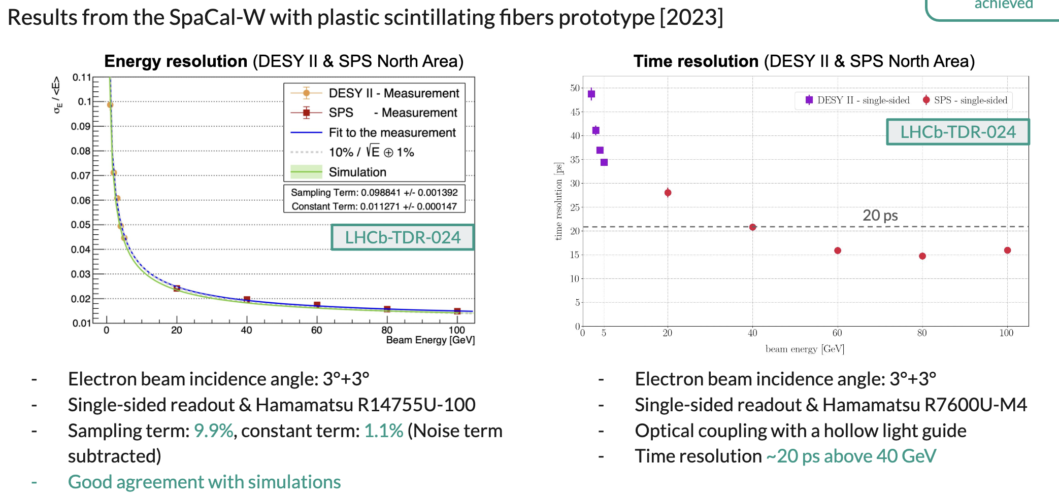
R&D – Tungsten prototype

Slide 10
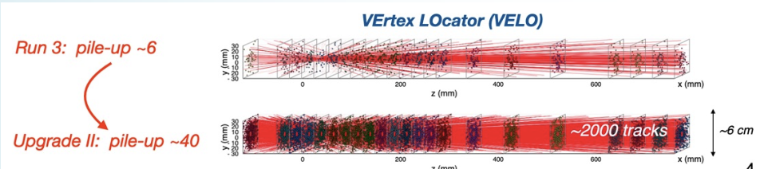
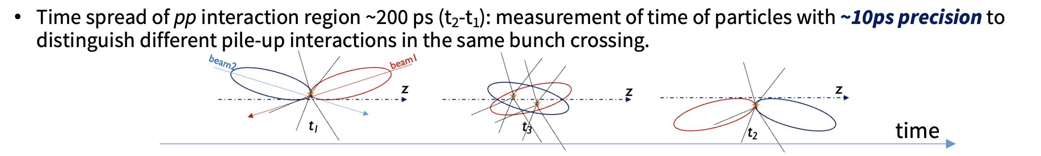
Time measurement
Pile-up = several proton-proton collisions when the beam cross each other
~15ps

Slide 11
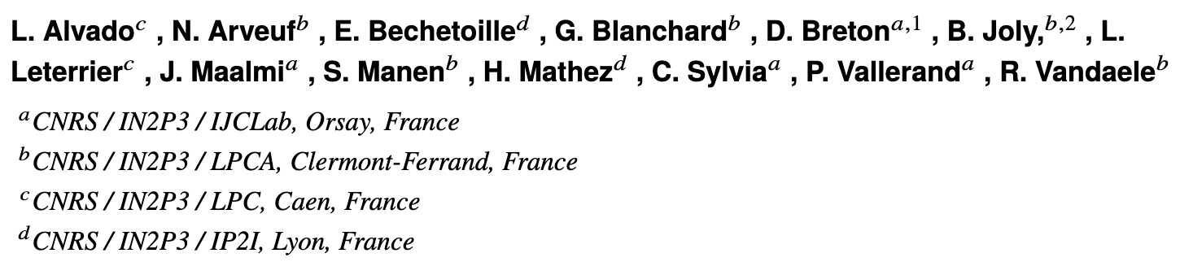
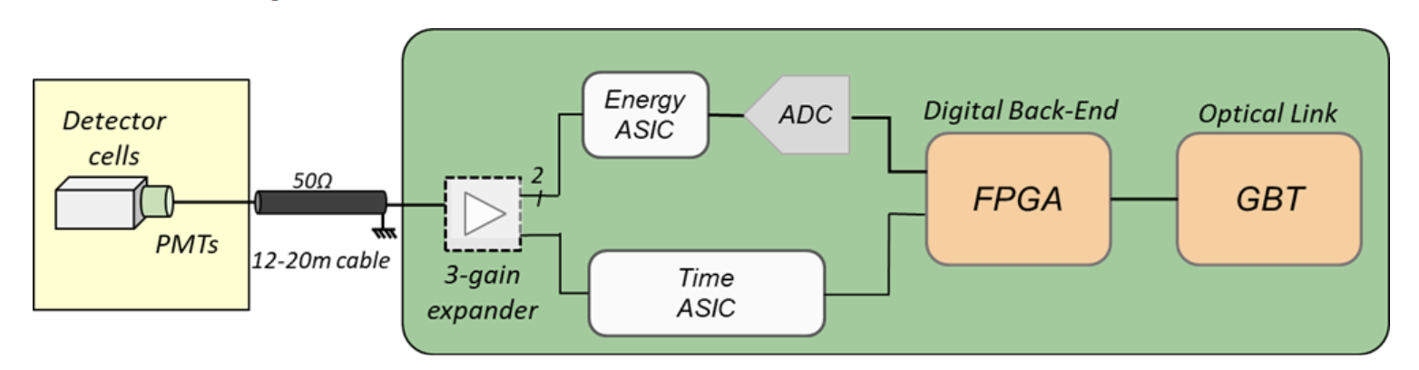
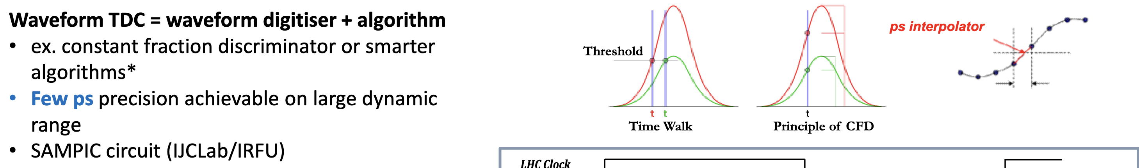
Time measurement
[arXiv:2512:17355]
A dedicated ASIC (Application-specific integrated circuit), SPIDER, is developed for the time measurement
Requirements for timing electronics
  Time measurement in range E_{T} = [50 MeV - 5 GeV]
  Time resolution target 15 ps for E_{T} = [1-5 GeV] (for the entire detector)
  Below 1GeV, time resolution as low as permitted by input signal and noise
  PMT signal rise time between 1.5 ns and 4 ns (R&D ongoing)
  Max occupancy up to ~30% per channel
ICECAL65
SPIDER

Slide 12
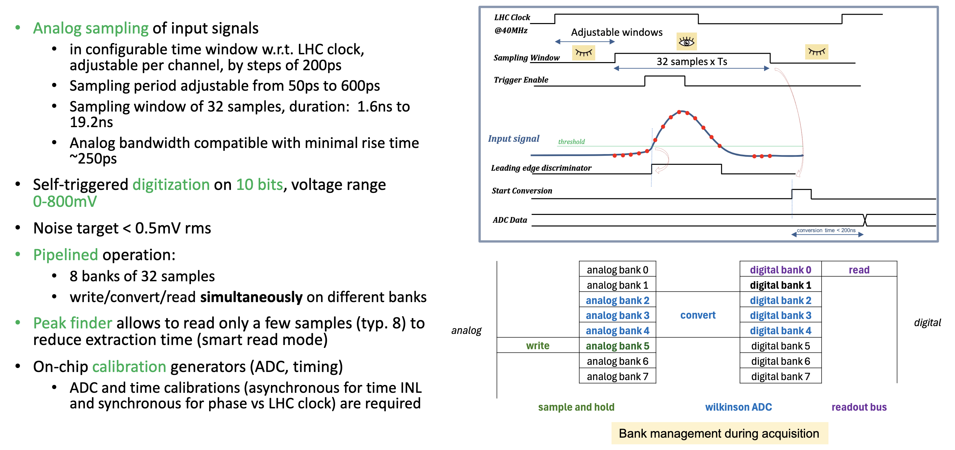
SPIDER – Swift Pipelined Digitizer
[arXiv:2512:17355]

Slide 13
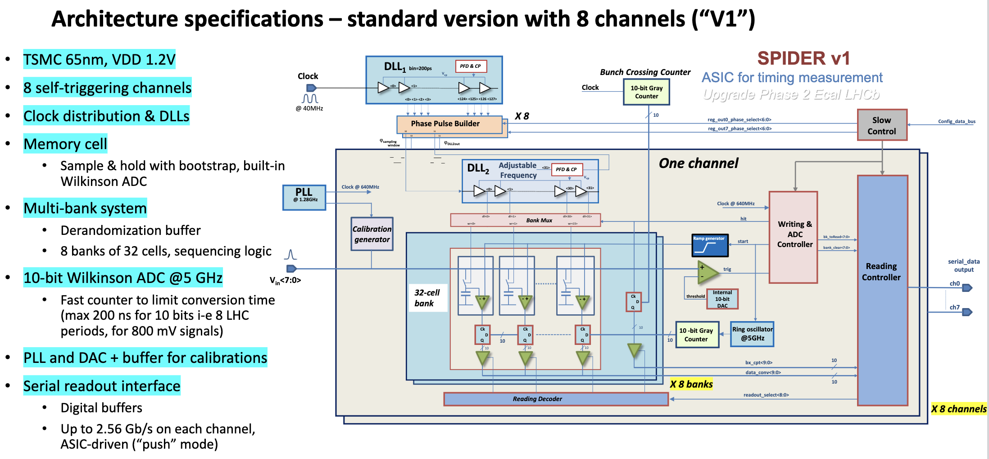
SPIDER architecture
[arXiv:2512:17355]

Slide 14
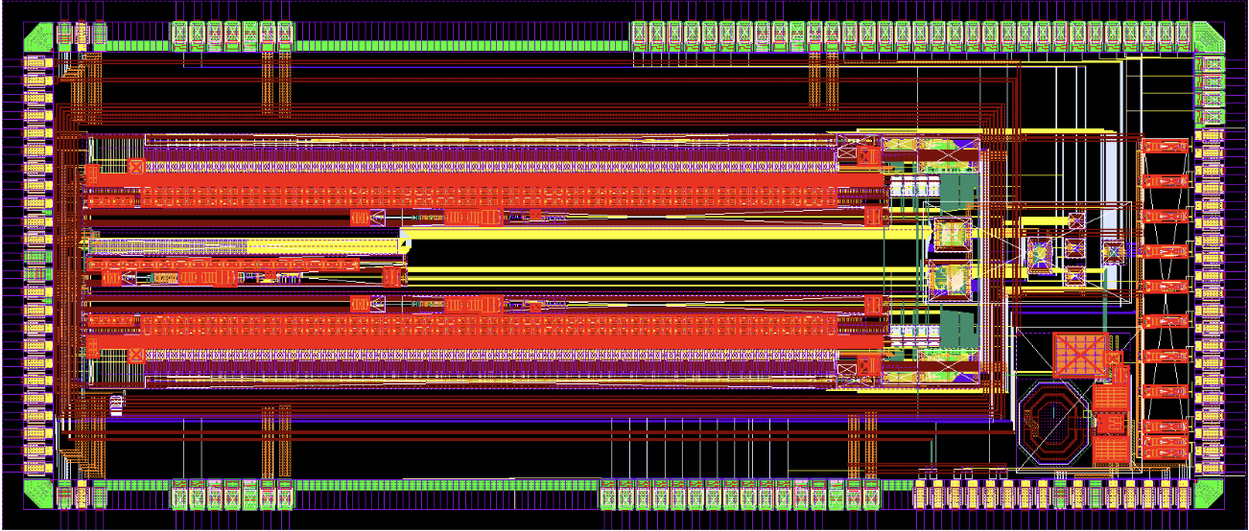
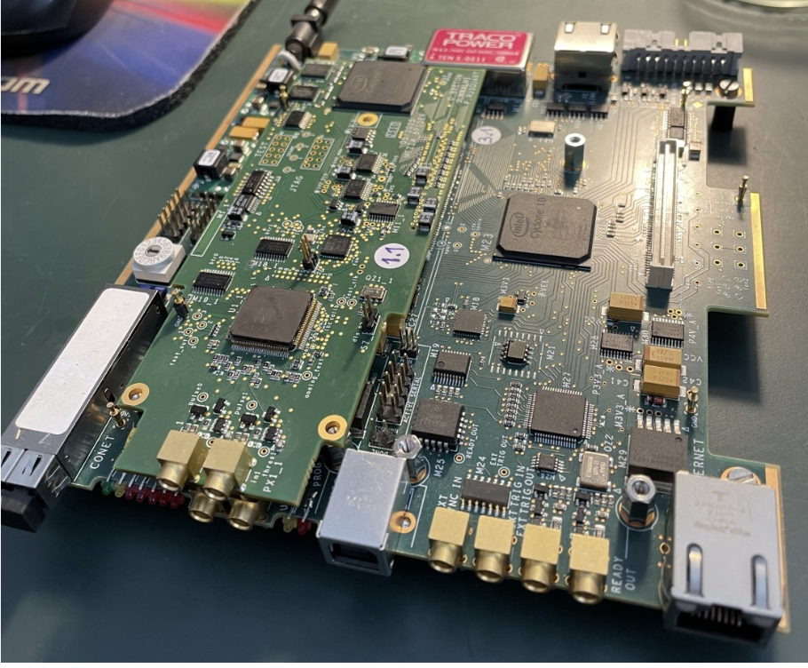
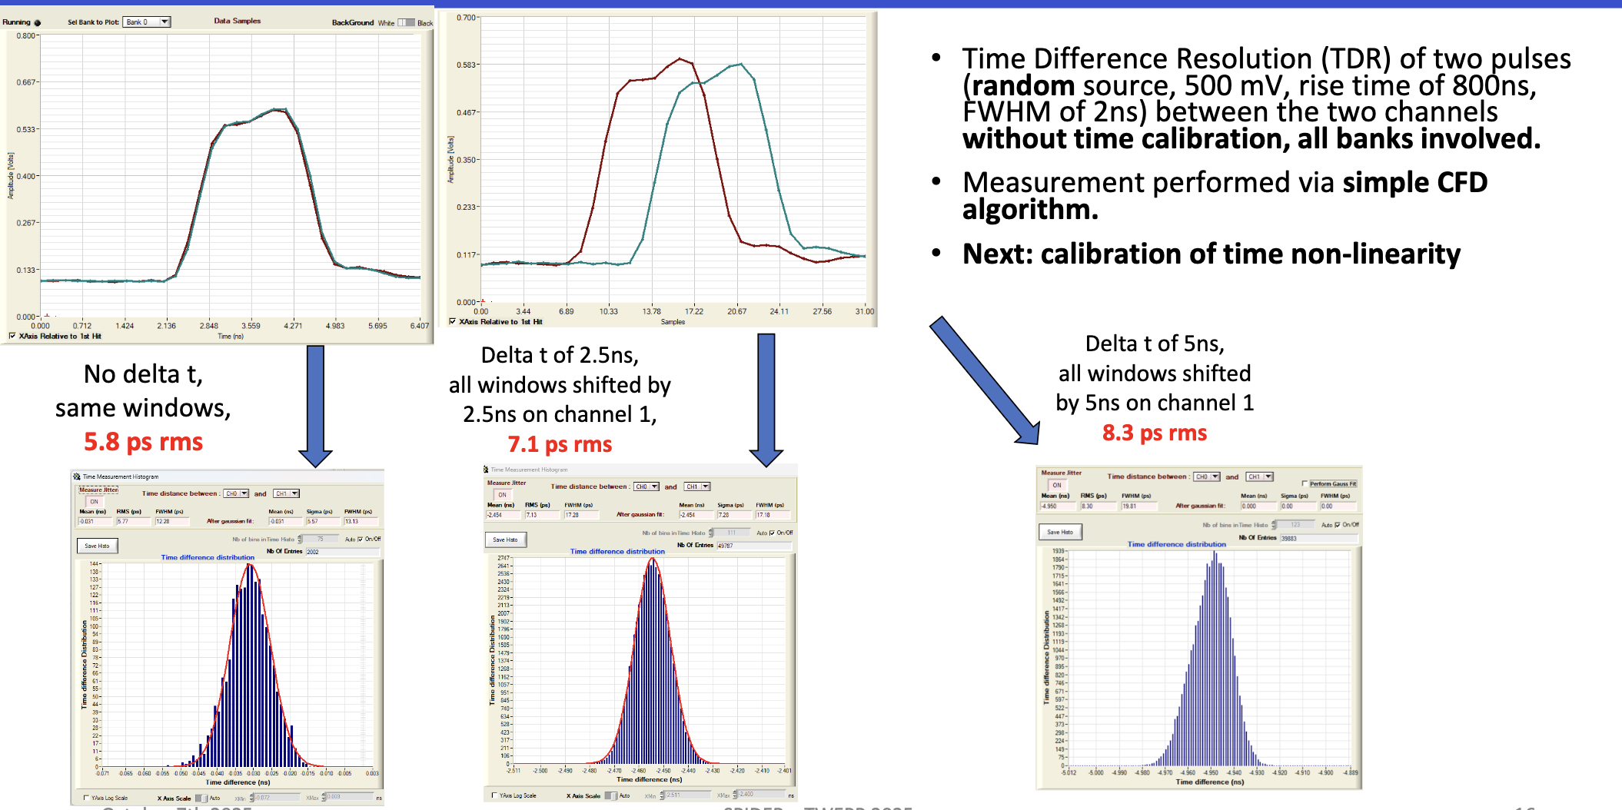
SPIDER tests
[arXiv:2512:17355]
First prototype produced in 2025 is functional
Giving expecting performances and used in test beams with PicoCal prototypes

Slide 15
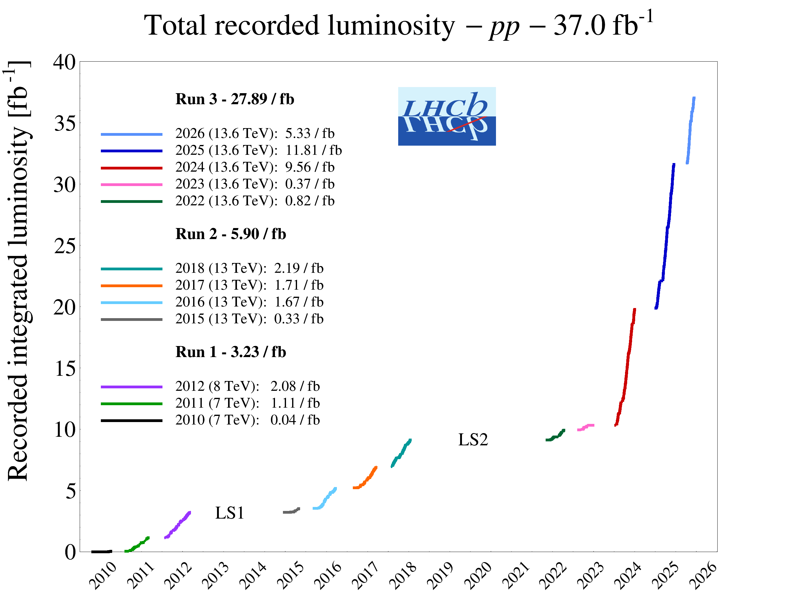
Conclusions
New measurements of B_{c}⁺ decay modes: large step forward expected with Run 3 dataset.
New calorimeter is under design for LHCb Upgrade 2 and the difficult environment during Run 5 of the LHC.
Intense R&D phase to have modules and electronics allowing to sustain radiation, have higher granularity and perform precise time measurements.
A large part of the new PicoCal modules will be installed already in 2029-2030 to operate during Run 4 (2030-2033) and will be kept for Run 5 (2036-2041).

Slide 16
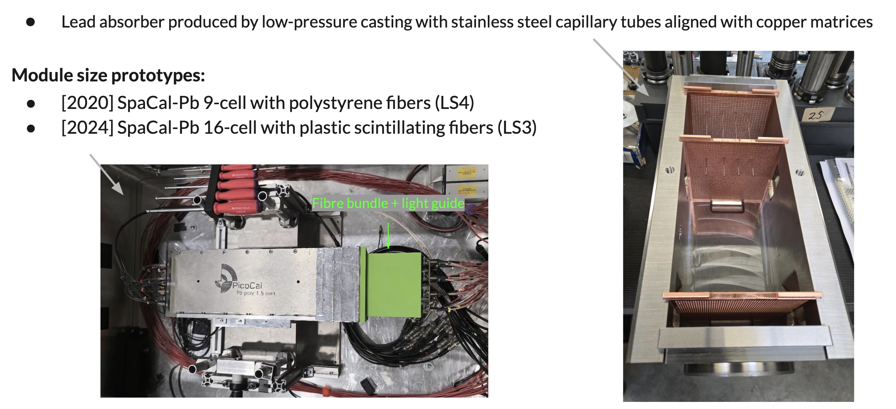
R&D – Lead prototypes

Slide 17
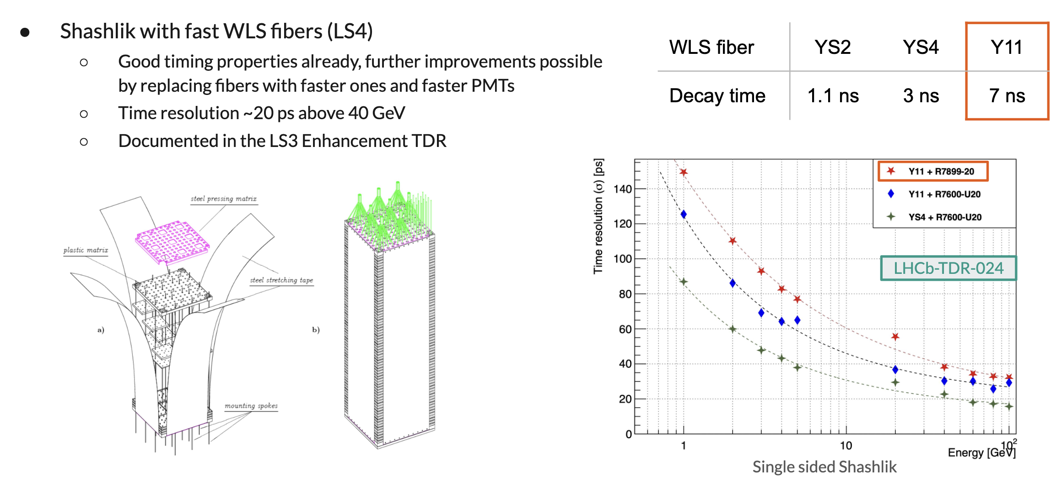
R&D – Shashlik modules

Slide 18
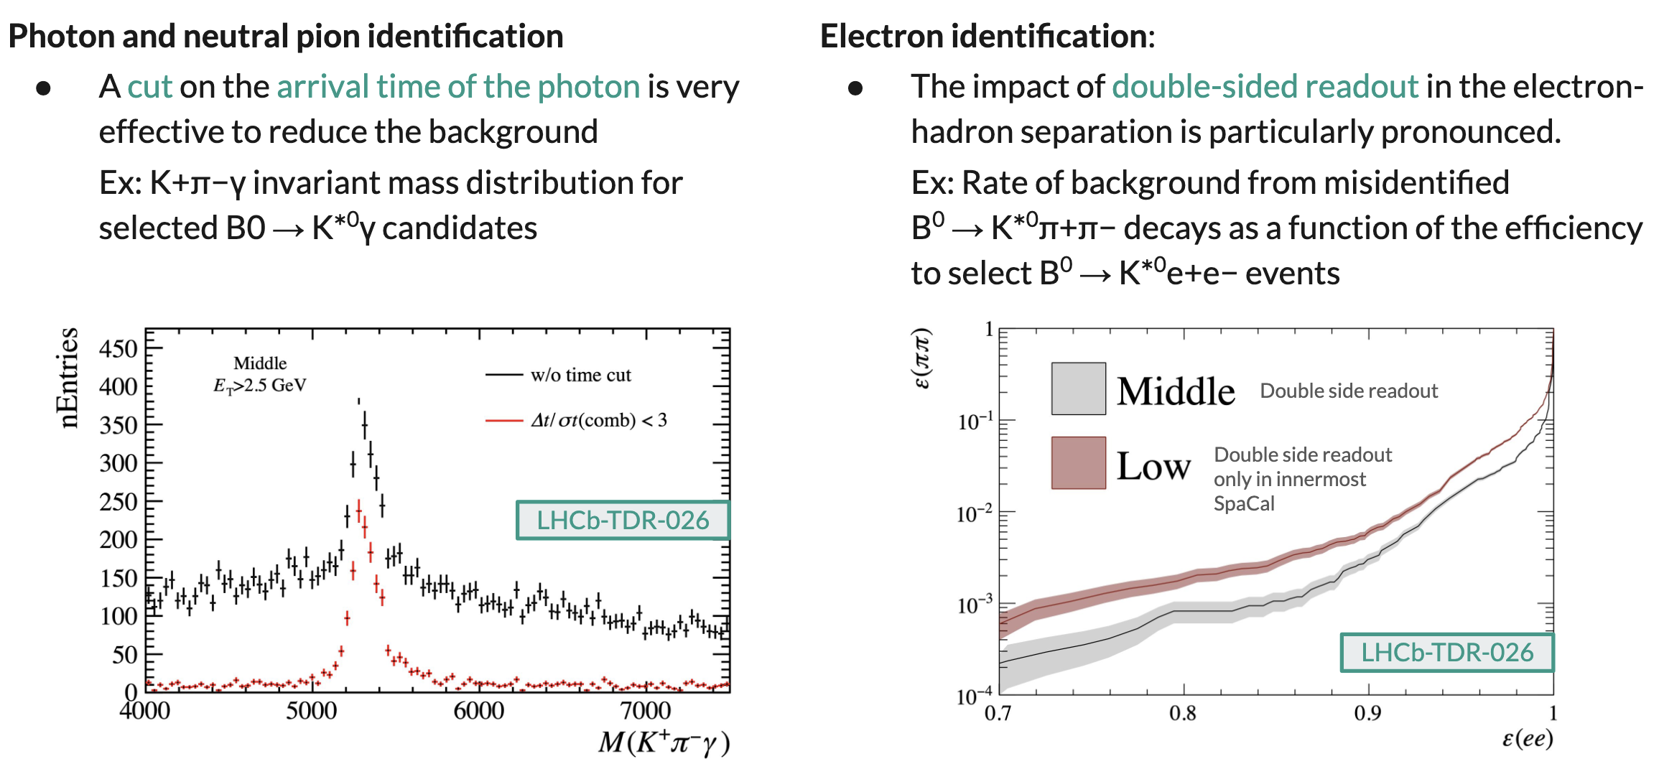
Performances
Expected performances of PicoCal are estimated with simulation for decays with photons

