Slide 1


COMET activities between China and France: Tracking and CRV
Ye YUAN
IHEP
2026-7-2

Slide 2

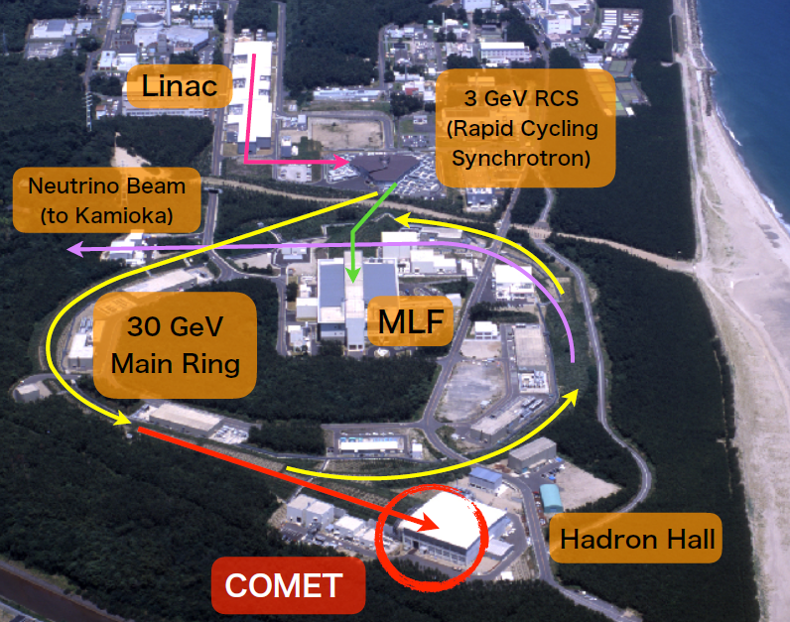
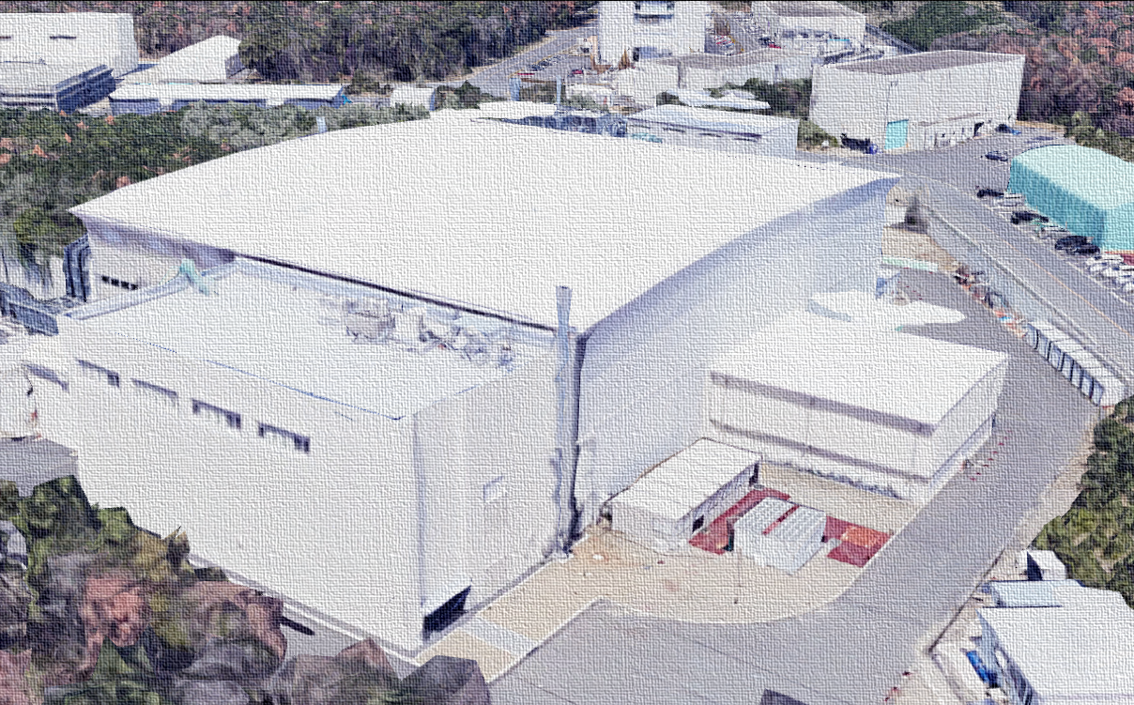
COMET
(COherent Muon Electron Transition)
@J-PARC,Japan. Search for Charged Lepton Flavor Violation(CLFV)

Slide 3
COMET collaboration
Spokes person: Masaharu Aoki (The University of Osaka)
Co-spokes person : Ye YUAN(IHEP)
6 Chinese institutes :
Institute of High Energy Physics (IHEP), Beijing
Institute of Modern Physics (IMP), Lanzhou
Nanjing University, Nanjing
Peking University, Beijing
Zhengzhou University
Sun Yat-sen University, Guangzhou
6 French institutes
Laboratory of Nuclear and High Energy Physics(LPNHE, Paris)
Laboratoire de Physique Corpusculaire, Caen(LPC-Caen)
LPC, Clermont-Ferrand
Institut de Physique des 2 Infinis de Lyon (IP2I)
CC-IN2P3, Lyon
Toshiko Yuasa Laboratory (CNRS&KEK)
43 institutes, ~200 collaborators

Slide 4
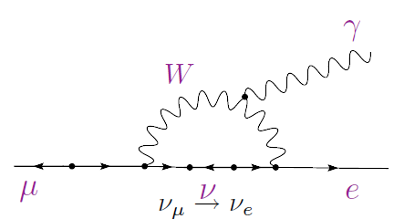
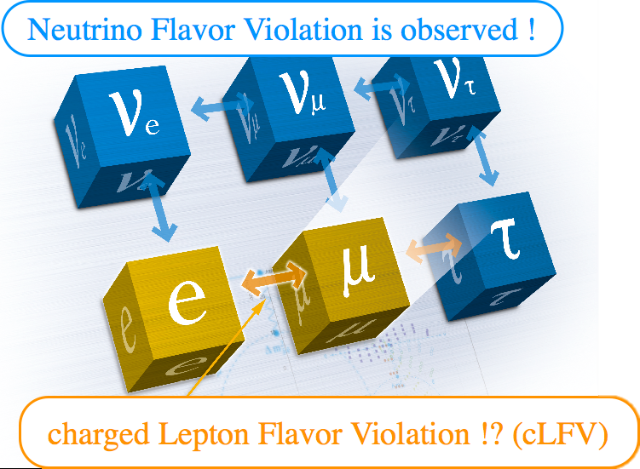

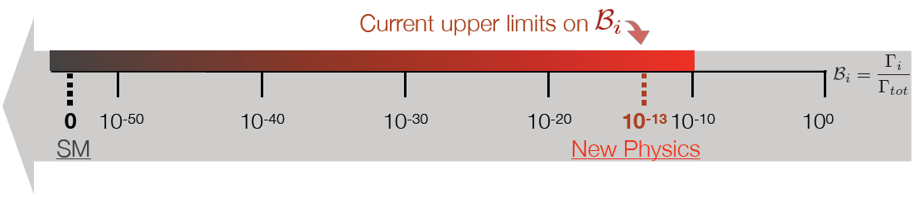
Charged Lepton Flavor Violation
An extremely sensitive probe to New Physics

Slide 5
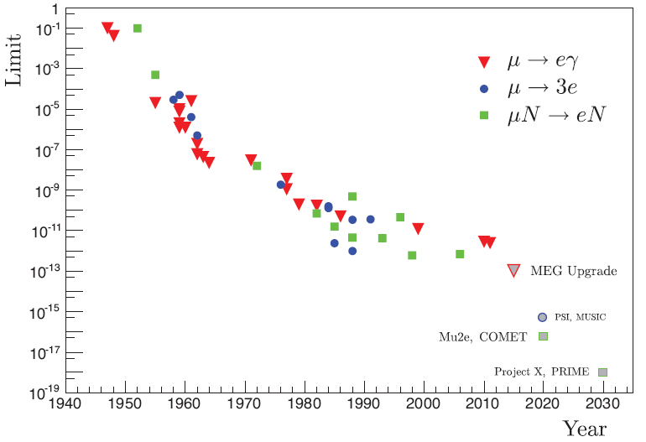
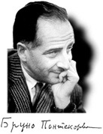
Current limit：
To an unprecedent sensitivity ~10⁻¹⁷
90% C.L.
Cosmic ray muon
Accelerator muon
MEG II <1.5x10⁻¹³ (90%C.L.)
2025-04-23
x100 per decade
Reboot:
a leap with 4 orders of magnitude
x10,000
Pontecorvo in 1947
COMET @KEK
Mu2e @FNAL

Slide 6

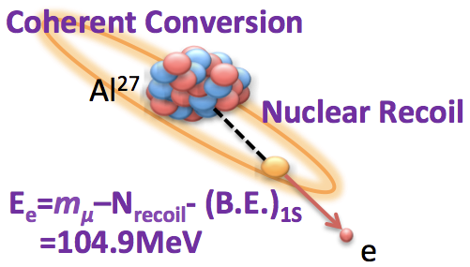
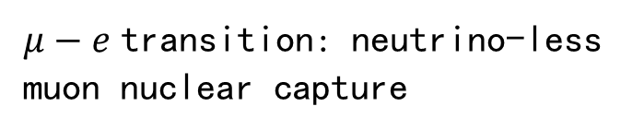
Muon Electron Transition μN → eN
$μ−e$ transition: neutrino-less muon nuclear capture
CLFV here
Mono-energetic electron ：
Simple and clean signal

Slide 7
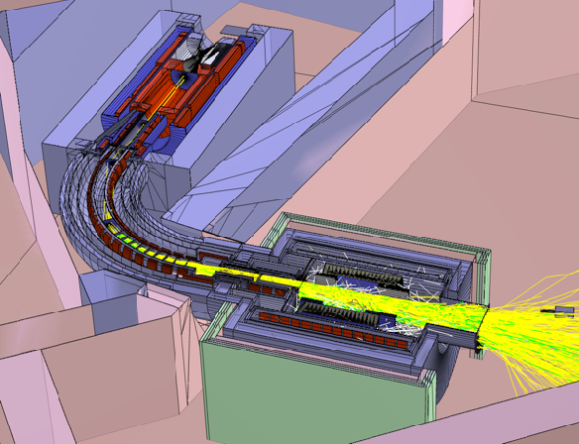
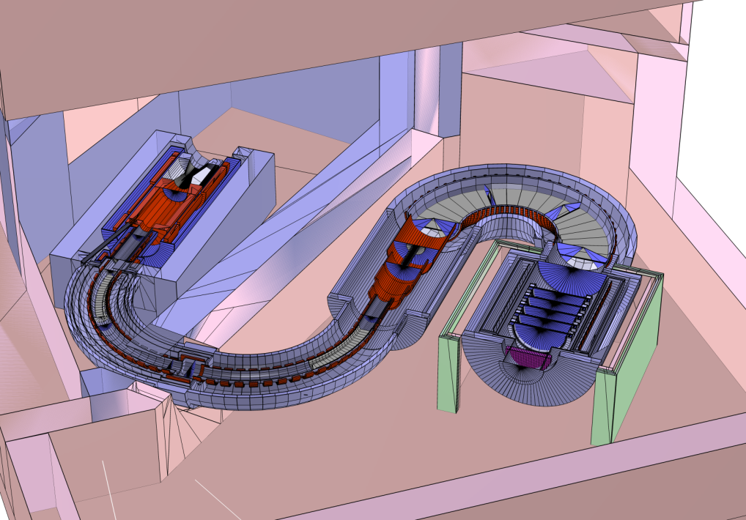
Key problem of single-sensitive high precise experiment:
Suppress and exclude background
The fundamental principle from the beginning of COMET design
Phase- I
1. Analyze beam background
2. Search for mu e transition by CDC to 3.1×10⁻¹⁵
Phase- II
Improve another two orders of magnitude to 2.6×10⁻¹⁷

Slide 8
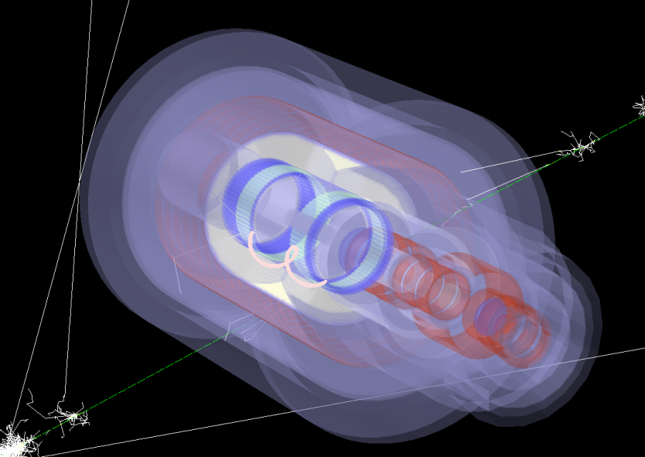
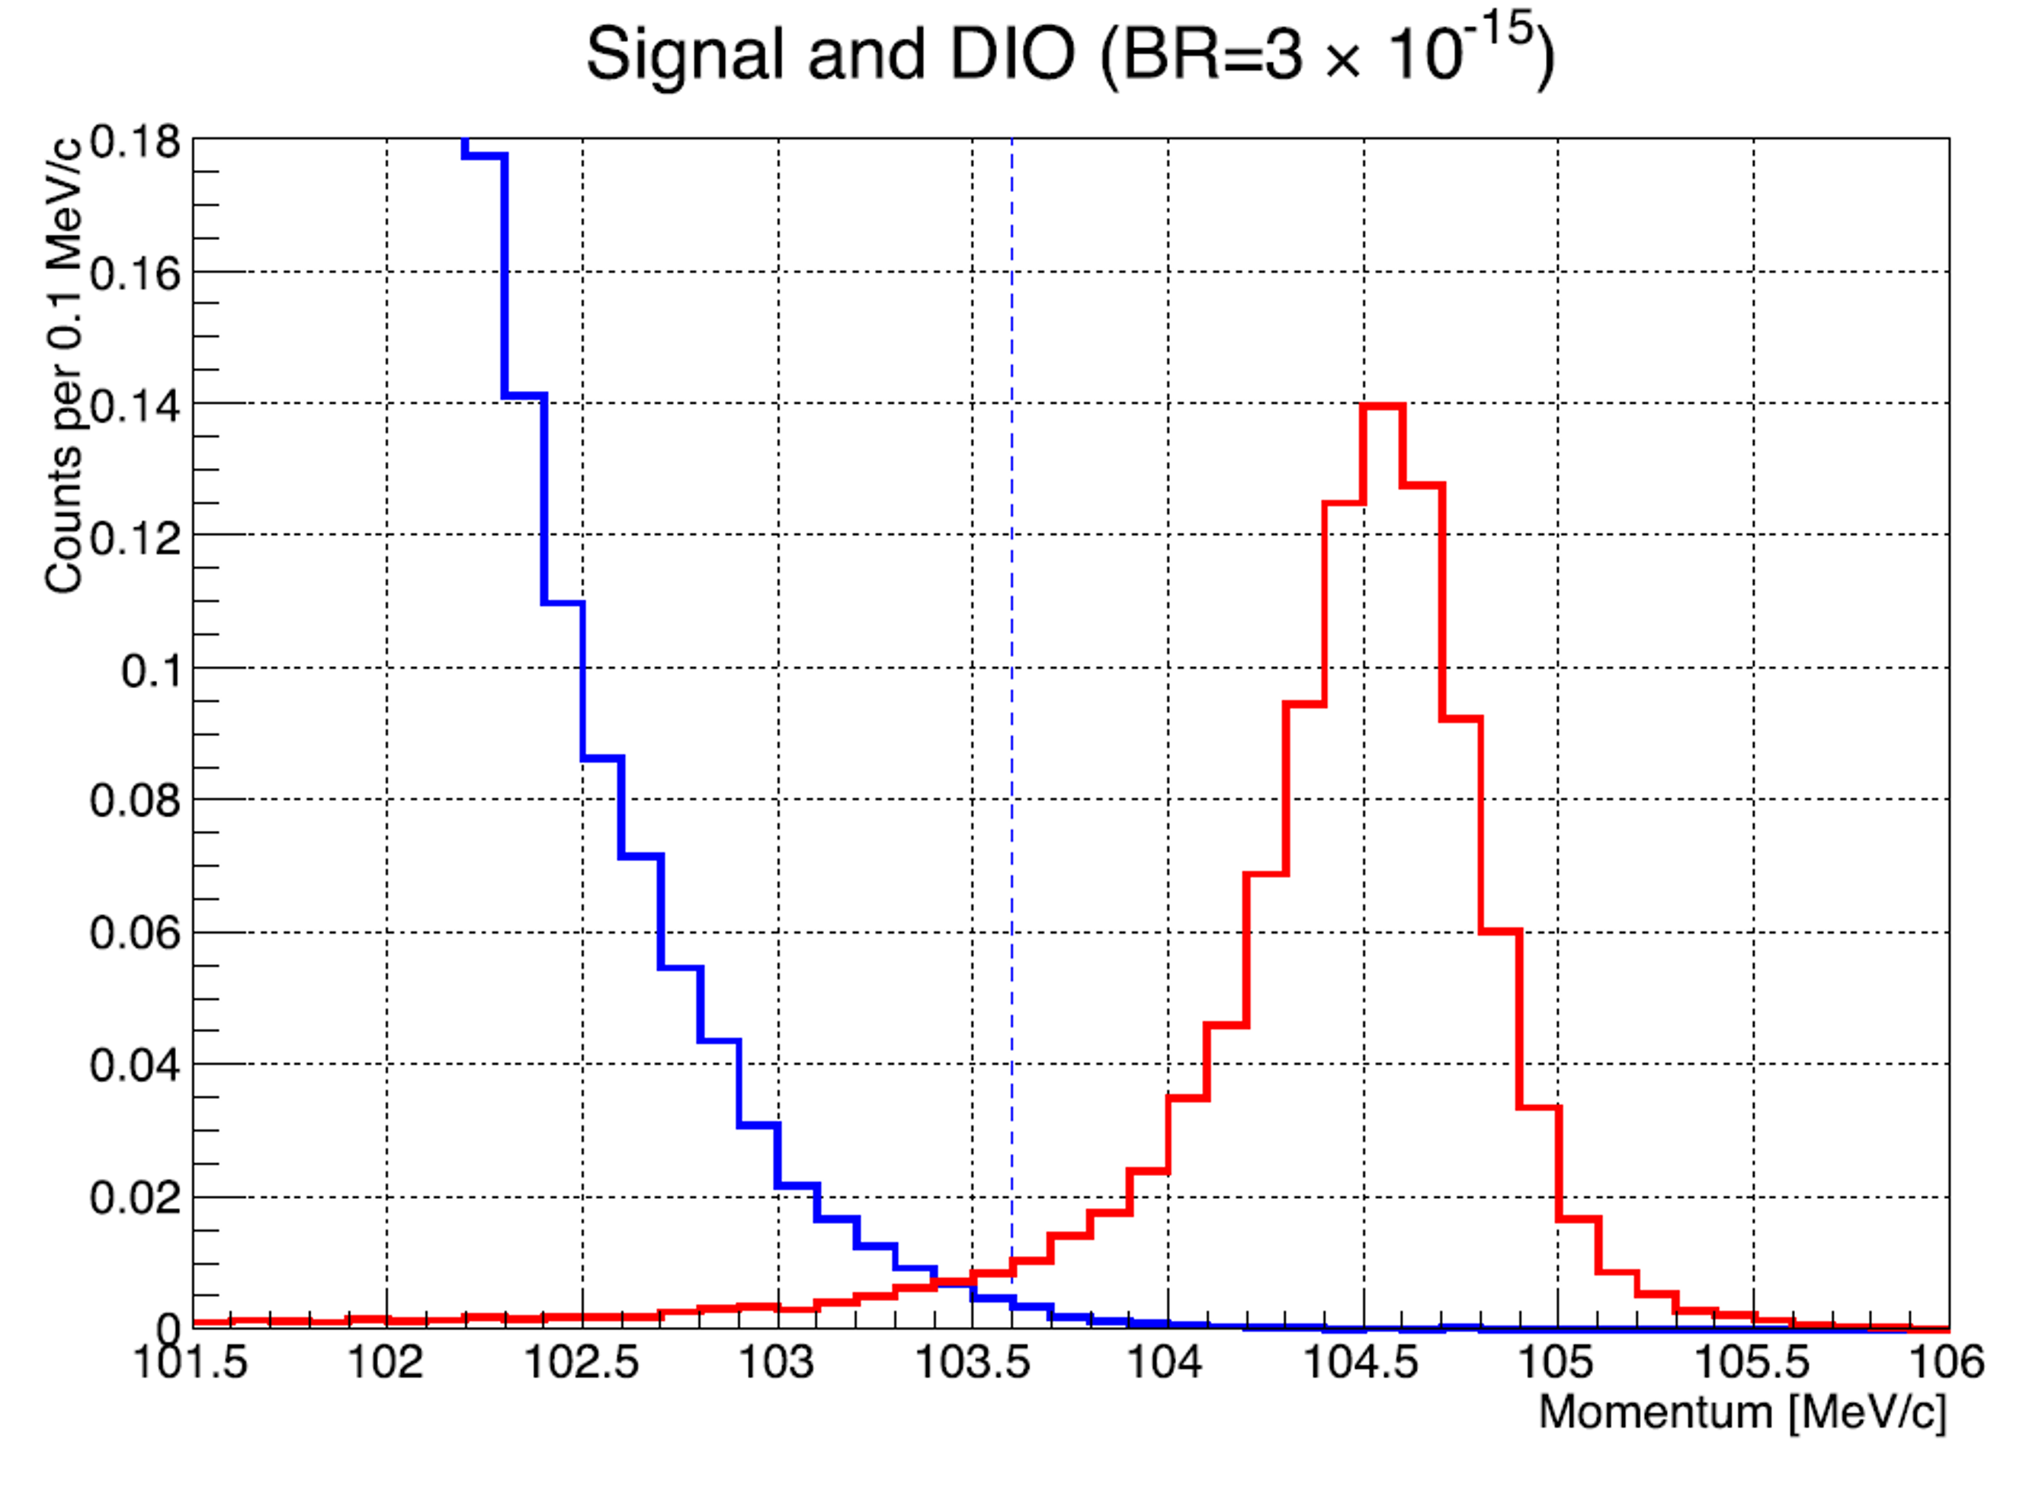
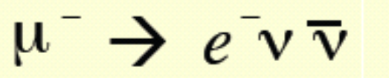
Collaboration between China & France
Two key background excluding problems to achieve Phase-I physics goal
1. Physics background 2. Cosmic ray background
muon
Sneak track
High quality drift chamber reconstruction
High efficiency cosmic ray veto(CRV)

Slide 9
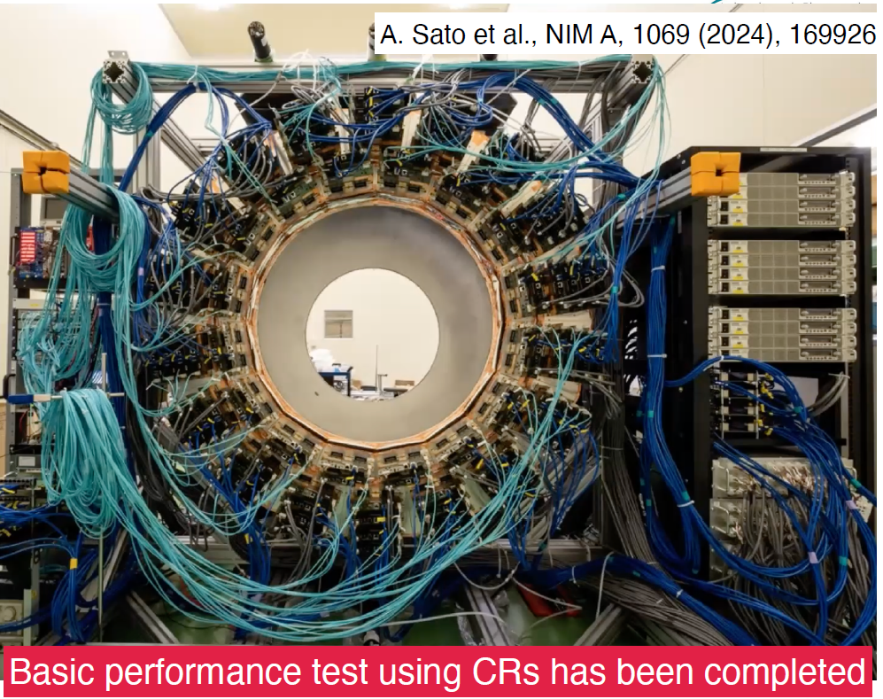
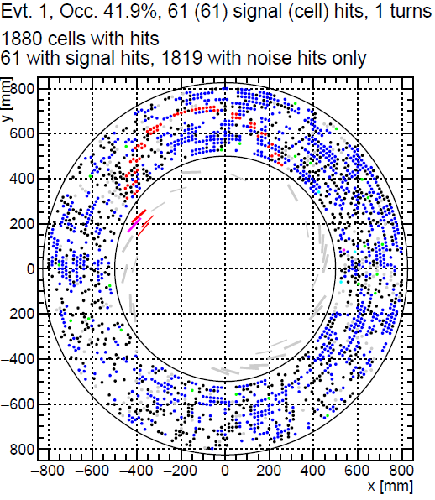
Tracking
CDC of COMET Phase- I
All stereo wires introduce track seed challenge
High occupancy up to 50%，far above normally <20%
COMET Track Finding and Fitting (FCPPN Team)
Haibo LI (IHEP)
Ye YUAN (IHEP)
Yao ZHANG (IHEP)
Zhaoke ZHANG (IHEP)
Liangwen CHEN(IMP)
Pei YU(IMP)
Wilfrid da SILVA (LPNHE-Paris)
Luigi DELBUONO (LPNHE-Paris)
Patrice LEBRUN (IP2I-Lyon)
Jean-Claude ANGELIQUE (LPC-Caen)

Slide 10
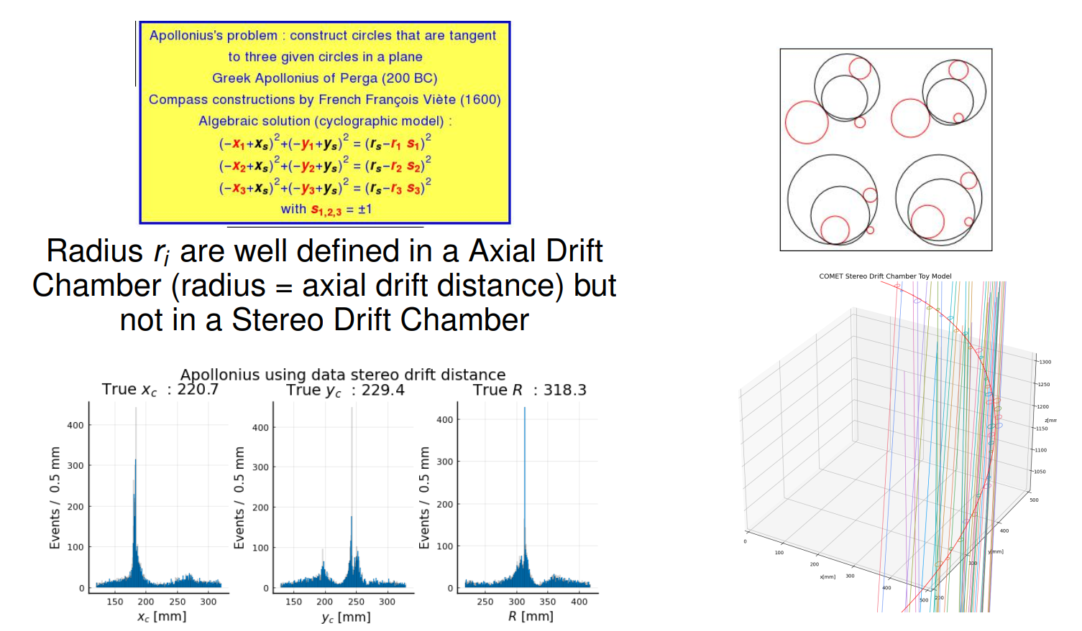
Classical "Hough Transform" for the Track finding in stereo drift chamber and link to Apollonius De Pergas’s Problem

Slide 11
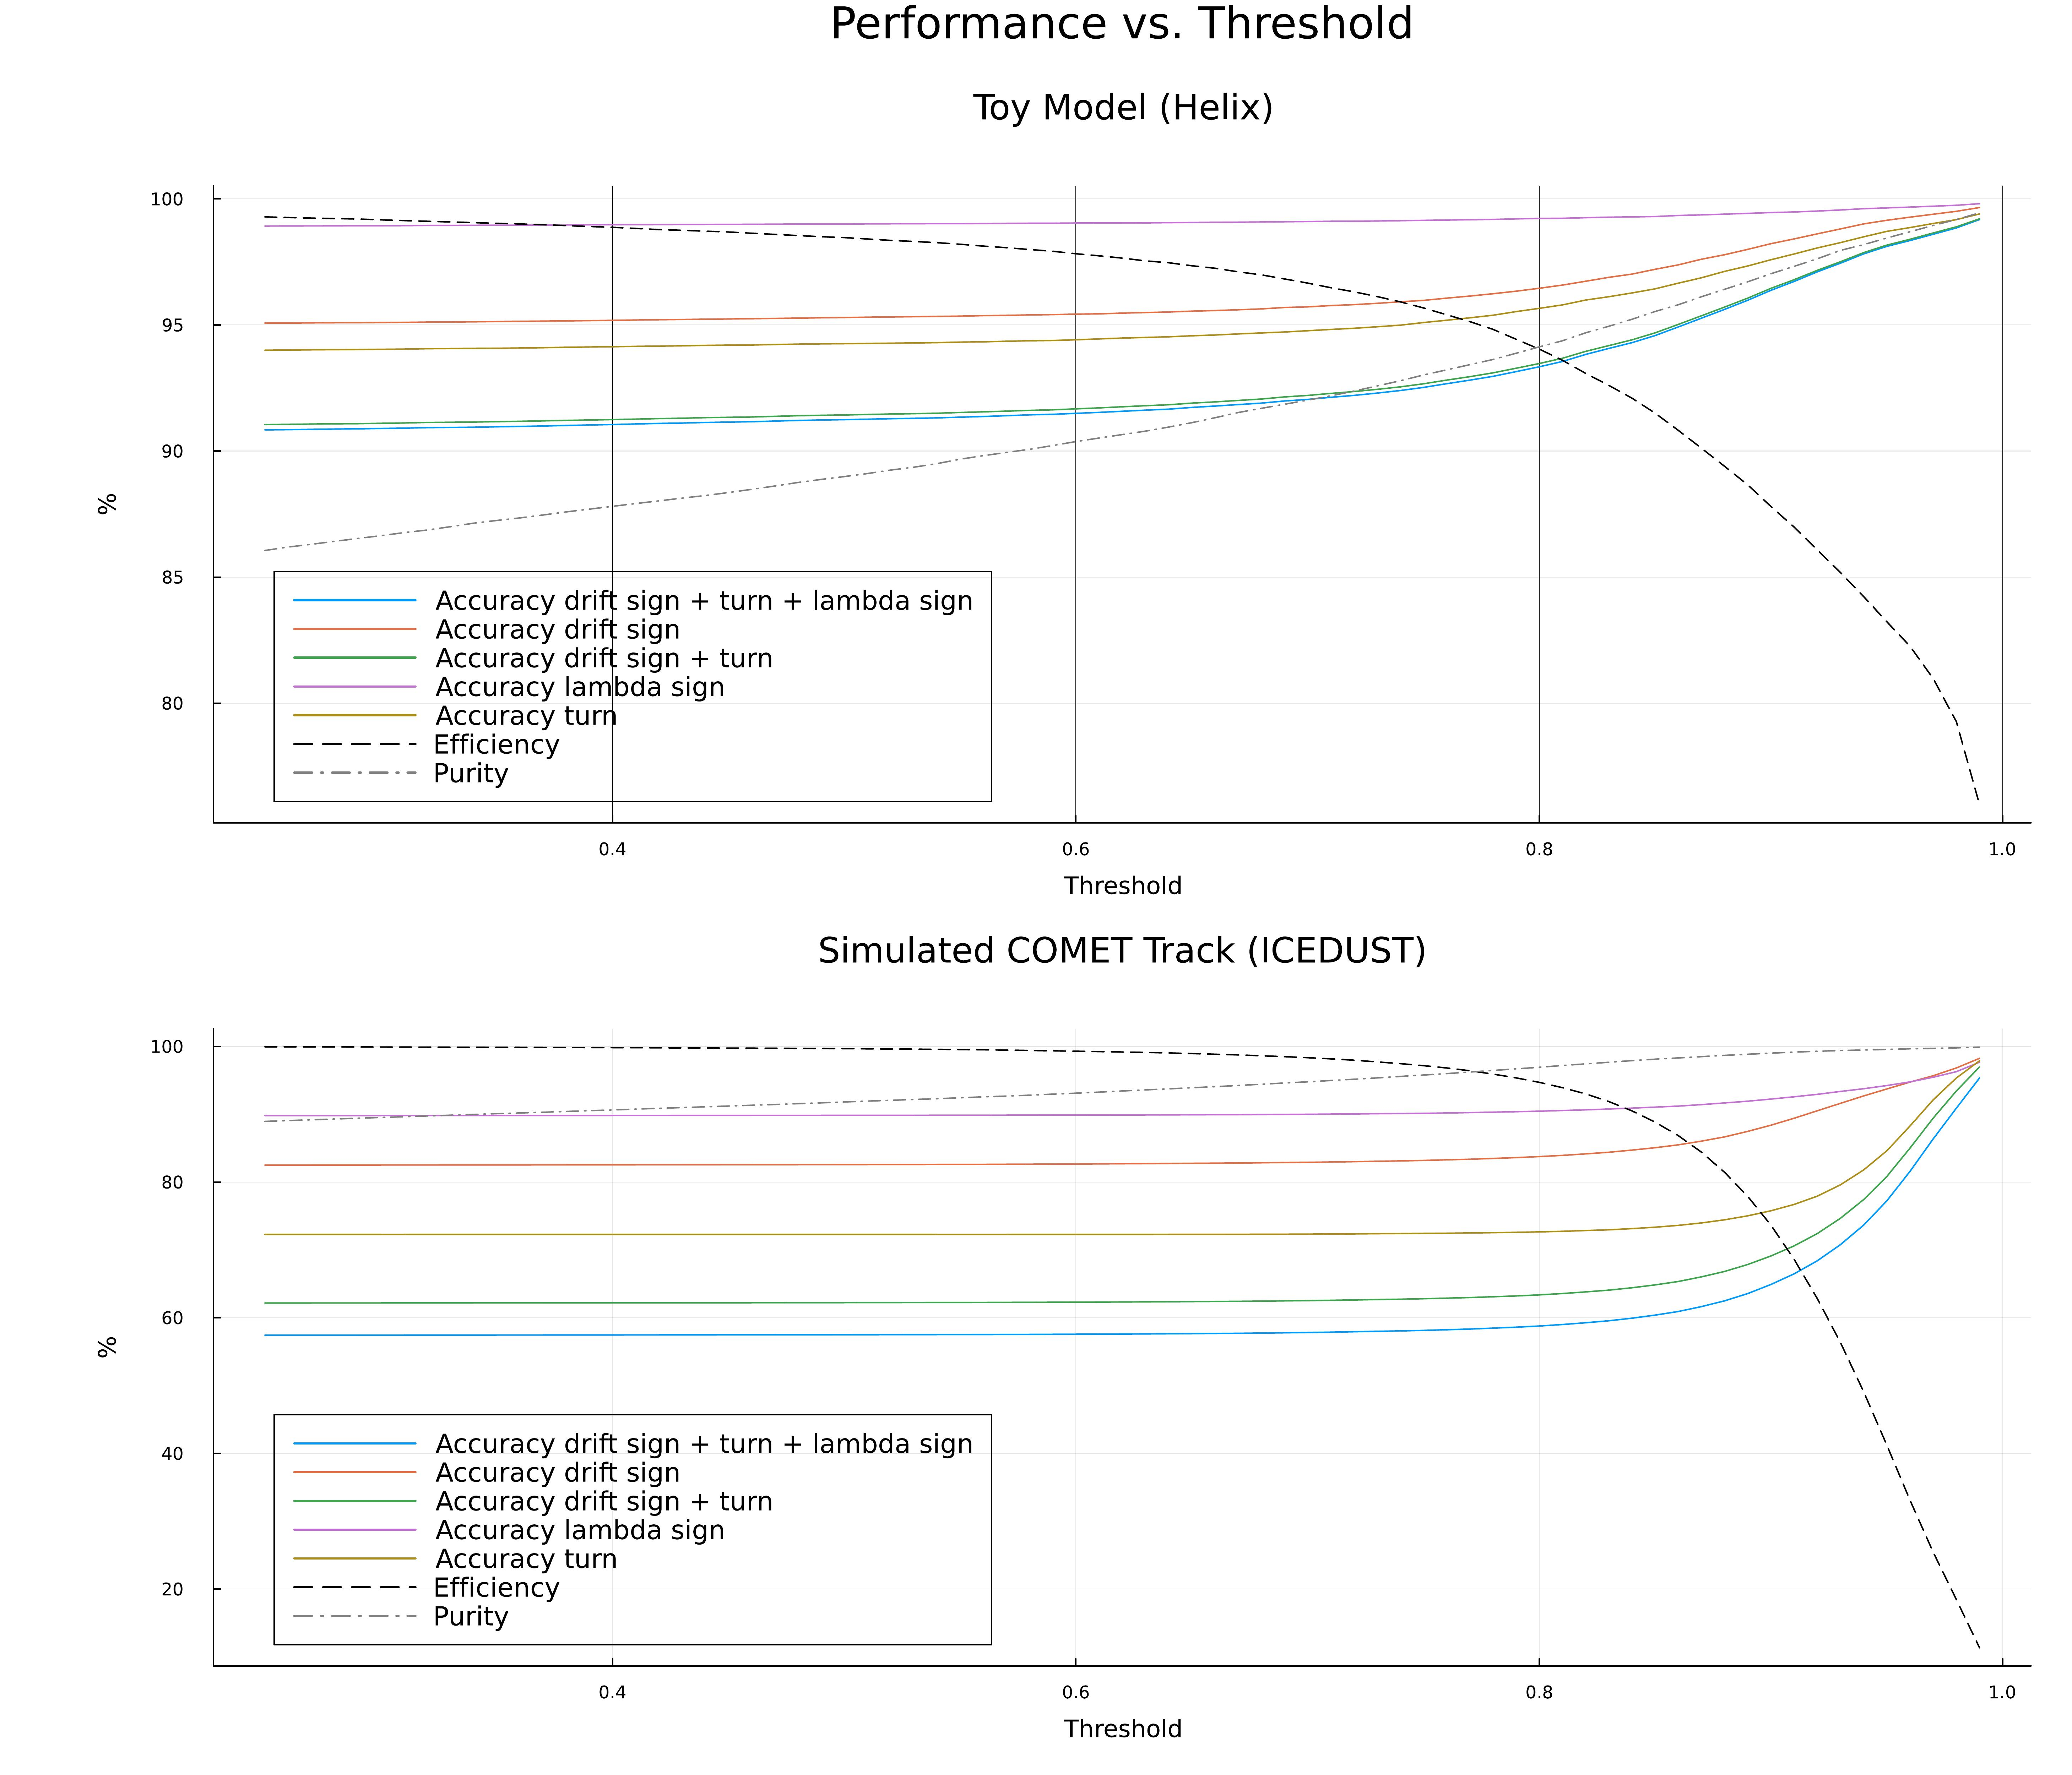
GPU-based Apollonius residuals as edge features for CGConv GNN track finding in COMET — work in progress
GNN node classification (CGConv [arXiv:1710.10324]) on 8-hypothesis expanded graph
Task: identify the correct hypothesis among 8 + reject background (Implemented in Julia)
Phase A — Graph construction & APO pruning
  KNN (K=8), each hit → 8 nodes (drift distance sign × turn × lambda sign) → ~3000 nodes/graph
  Apollonius [arXiv:2401.04576] edge residuals: edge (2 hits) + 4 random neighbors; parallel fits (x_c, y_c, R, z₀, |λ|) via LM GPU → residual-based 12D edge features
    ~90 ms/hit, L40S @ Jupyter-CC-IN2P3
  Top-K=6 pruning: keep 6 best edges per node (by residual)
Phase B — CGConv training (10D nodes, 12D edges)
  4 CGConv blocks + skip + GroupNorm, 3 losses (node BCE + edge BCE + ranking)
Phase C — Gumbel top-k refinement [arXiv:1903.06059]
  Hit-level prediction → Gumbel resampling (~30 ms/hit) → warm-start retraining
Preliminary results — reduced subset: all signal + 50% background hits
  Helix / ICEDUST (training: 2k / 8k graphs) — turn accuracy: ~94% / ~73%
W. da Silva
11
Performance vs. threshold curves — accuracy per parameter, efficiency & purity

Slide 12
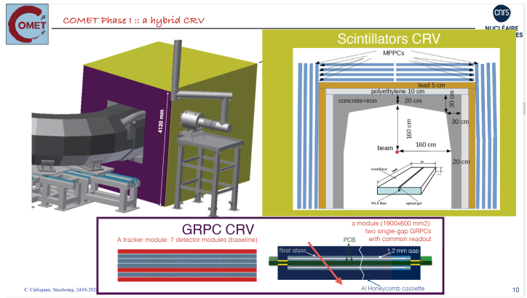
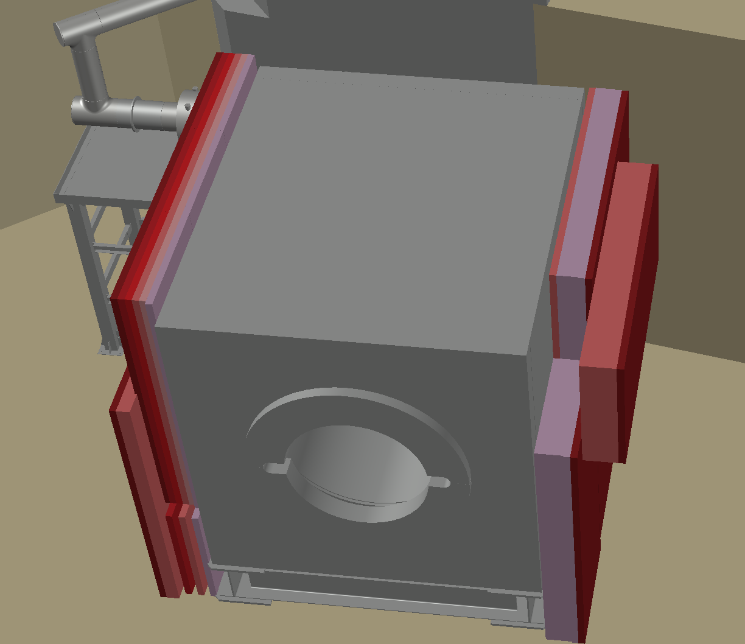
CRV
China，France，Georgia
RPCs from ARGO-YBJ
for left & right sides
COMET side CRV
Haibo LI (IHEP)
Ye YUAN (IHEP)
Zhaoke ZHANG (IHEP)
Zhe Ning(IHEP)
Xiaoshan Jiang(IHEP)
Jingzhou Zhao(IHEP)
Shenjian Chen(NJU)
Maxime Gouzevich (IP2I-Lyon)
Cristina Carloganu (TYL, CNRS&KEK)
G. Aielli: University and INFN Roma Tor Vergata, Italy
R. Cardarelli: University and INFN Roma Tor Vergata, Italy
S. Simsek: Istinye University, Istanbul, Turkey
ARGO RPC
12

Slide 13
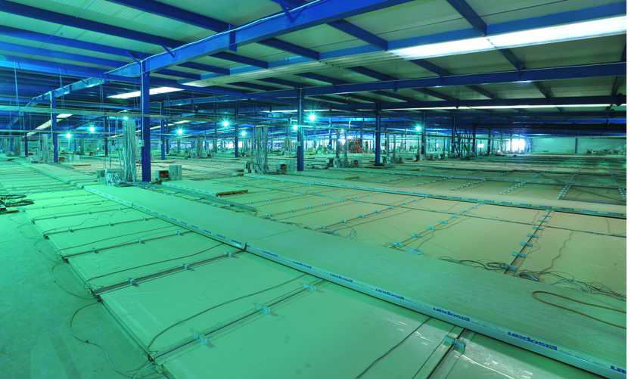
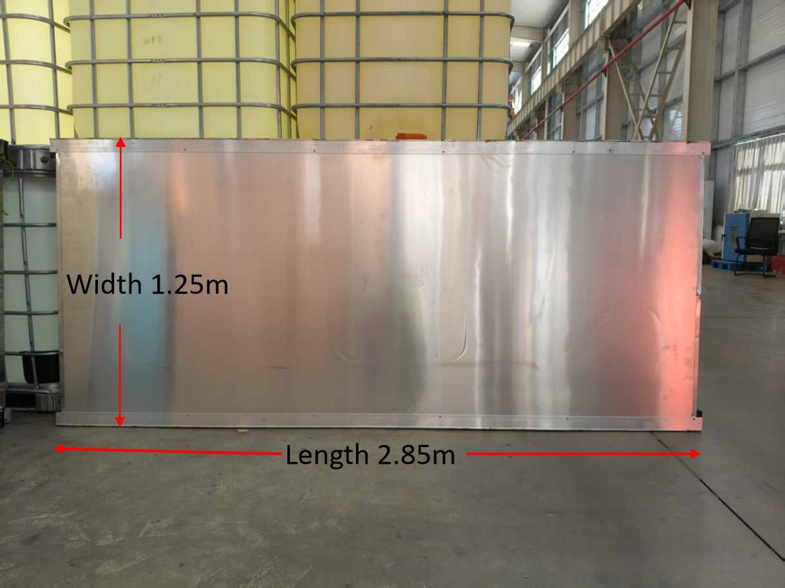
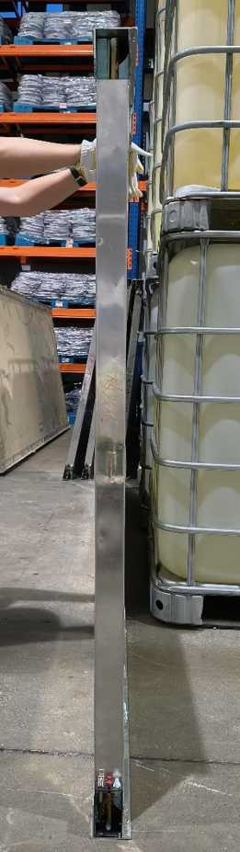
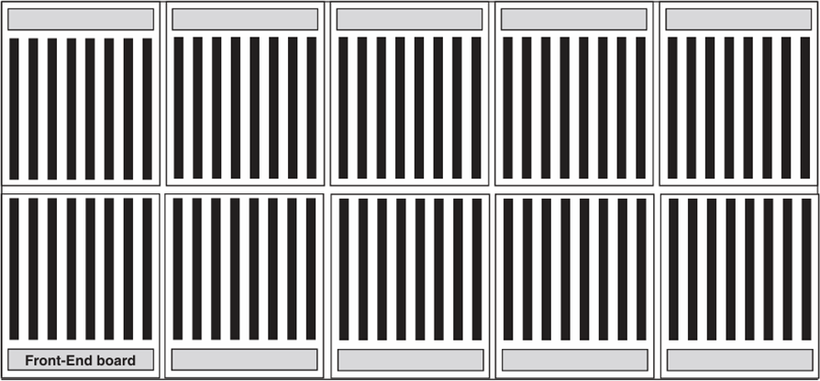
ARGO-RPCs
Single layer chambers → Efficiency = 98%
Time resolution 1 ns
Internal segmentation 80 strips 7x62 cm^2
Dead area about 1%
Originally operated in streamer mode
1836 RPCs have been operated in the ARGO-YBJ experiment in Tibet covering ~ 6700 m²
Covering ~ 6700 m² the RPCs are used as a cosmic ray telescope for gamma-ray astronomy
Width 1.25m
Weight ~ 60 kg
Thickness 50 mm
Thanks help from JUNO

Slide 14
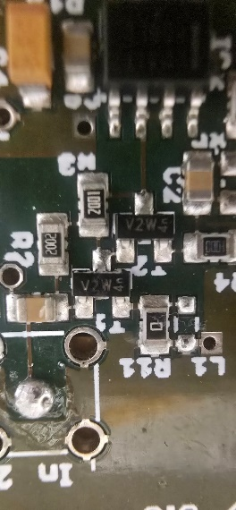
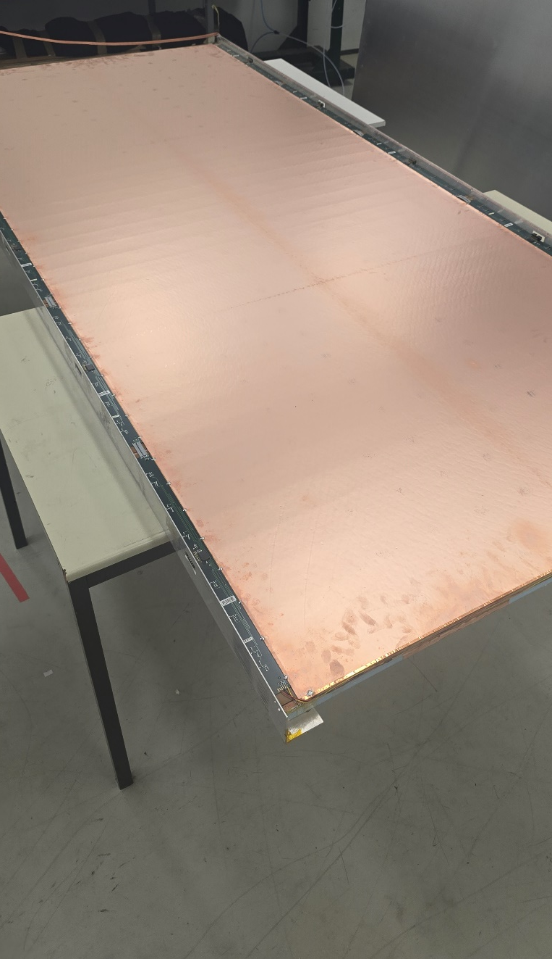
From streamer to avalanche
The streamer mode was adopted in ARGO to allow analog estimation of the simultaneous hit multiplicity
  It is easy to operate but it limits the chamber effective rate capability to a few tens of Hz/cm^2
The chamber built-in amplifier and discriminator are the same designed for the ATLAS RPC system, which is operated in avalanche mode, and adapted to the large streamer signals by a resistive divider.
We modified an ARGO chamber removing the divider, and enabling avalanche mode.

Slide 15
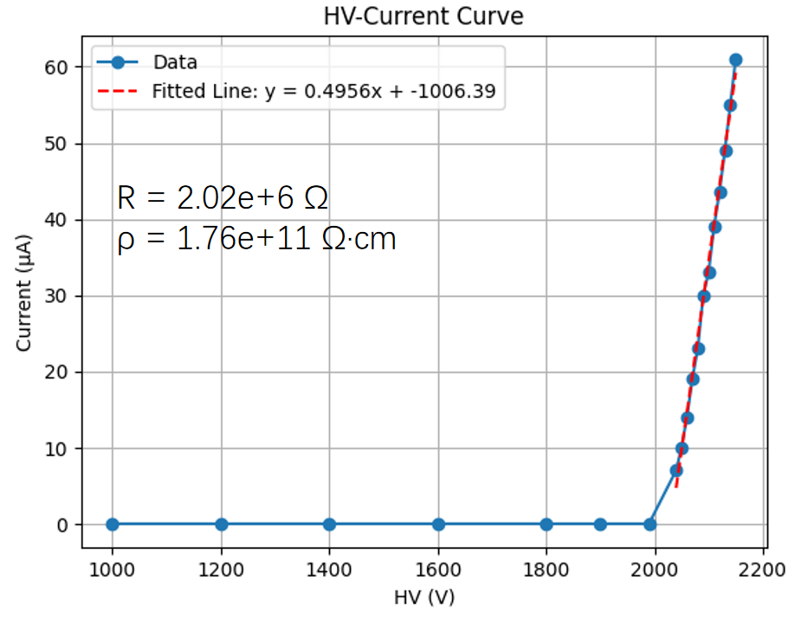
Argon Scan
Temperature: 26.1 ℃
Humidity： 66.1%
Measure from 1000V after passing pure argon gas at a flow rate of approximately 0.15L/min for 3 hours
Formula ρ= R*S/（L*2）
S = 1.25m * 2.80m L = 2mm
15

Slide 16
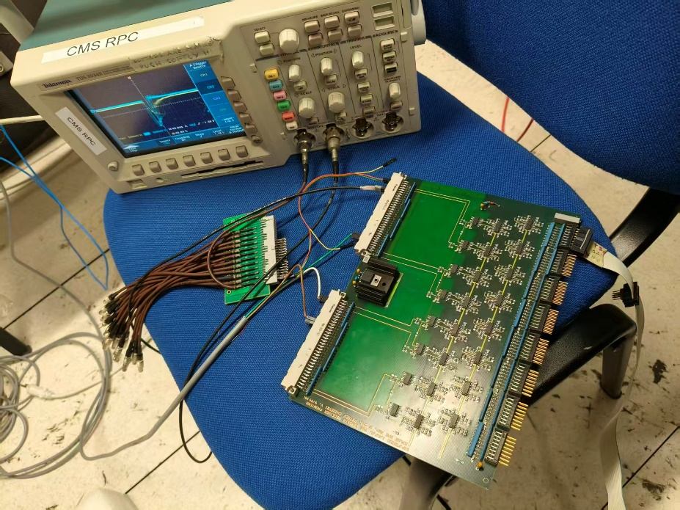
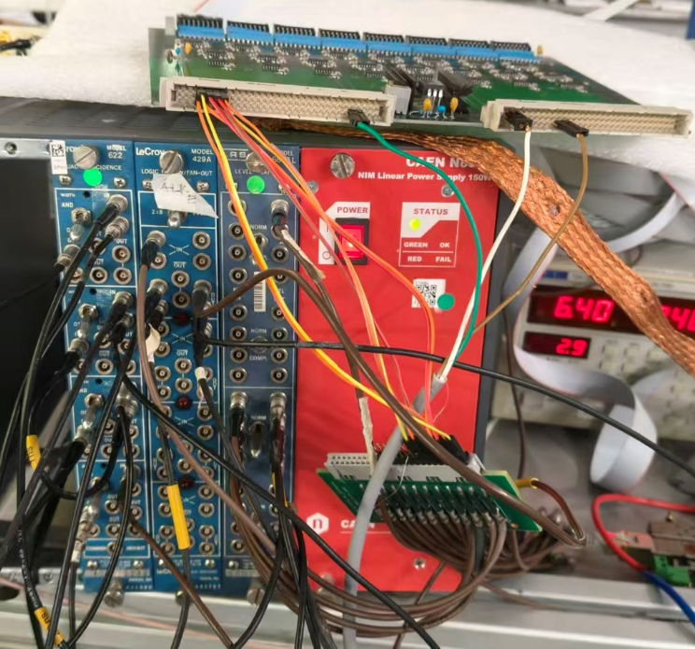
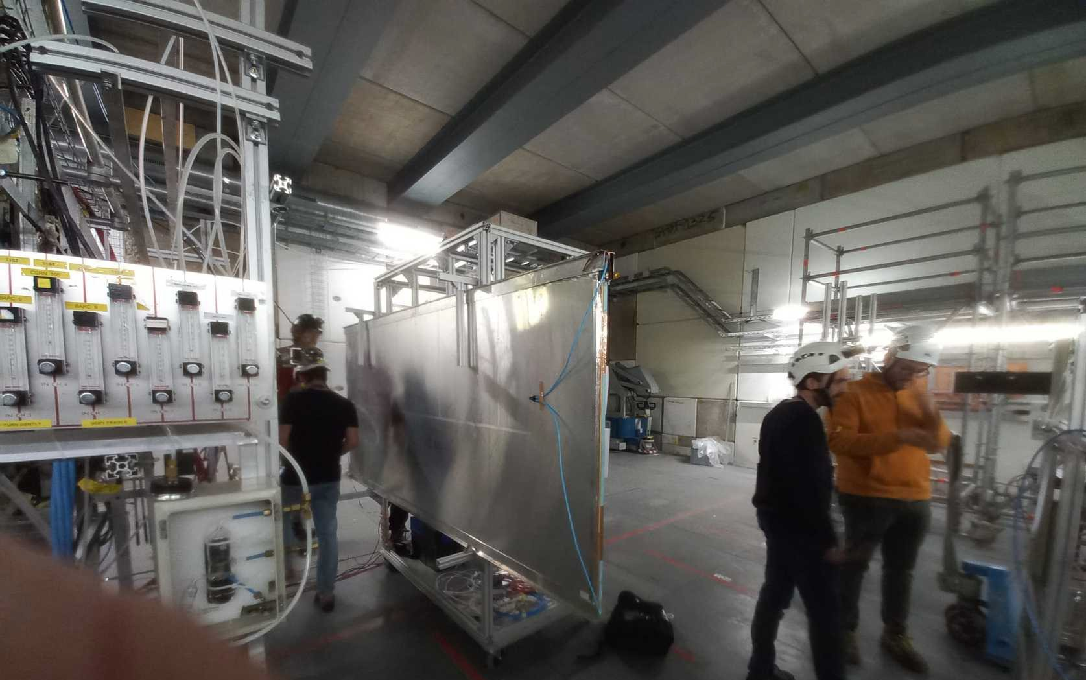
Tests in GIF++
Chamber readout through a special receiver designed by R. Cardarelli
Provides in output TTL signals of individual strips and fast-OR of 8 strips
We used the TTL signal after conversion in a NIM logic
Signals are discriminated and reformed to cleanout after-pulses
Single counts and coincidences with external scintillators scintillators are recorded
Threshold set in a conservative way to be immune from the noise

Slide 17
Efficiency under irradiation
Efficiency is limited by:
Electrode resistivity (voltage drop)
Discriminator Threshold (to reject r.f. noise)
Performance can be further improved by:
Adding a capacitance to increase the signal duration
Improve the Faraday cage to lower the threshold
Calculation of the electrode Resistivity
For R=2.85 MΩ the Efficiency vs. V-I*R for different filter absorption factors become invariant
ρ=R*S/d=2.8*10¹¹ Ω cm
The chamber is behaving as expected
17

Slide 18
Summary
Fruitful collaboration between China & France for COMET, thanks
FCPPN/L
Well improve of tracking, result is promising
RPC successfully tested under GIF++ photons and with a muon beam
Efficiency above 90% up to at least 150Hz/cm^2, higher counting rate and more accurate measurement will be done in the next coming test beam at the GIF++ this month

Slide 19
Backup

Slide 20
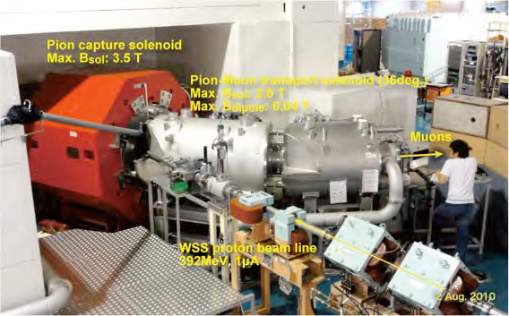
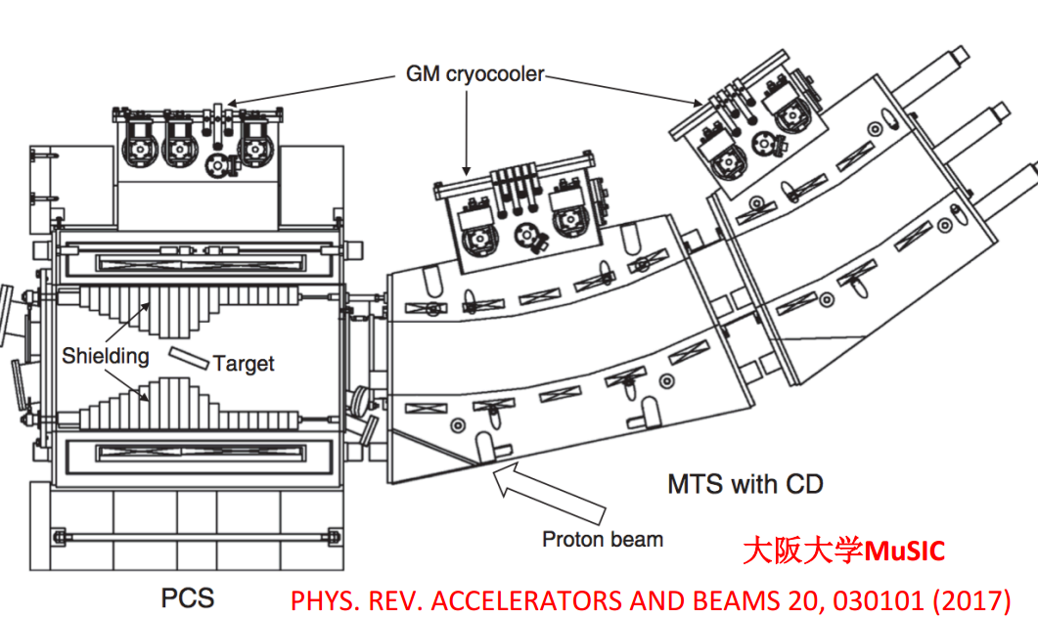
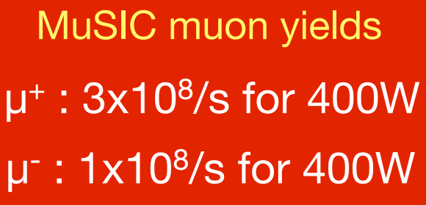
验证实验：MUSIC @2011
10⁸/s for 1MW @PSI
打开了通往单事例灵敏度
10⁻¹⁷
mu-e 转换实验的大门
大接受度，宽动量区间
传统方法1000倍的俘获效率

Slide 21

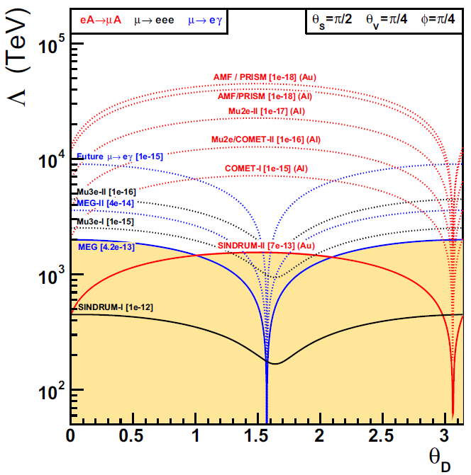

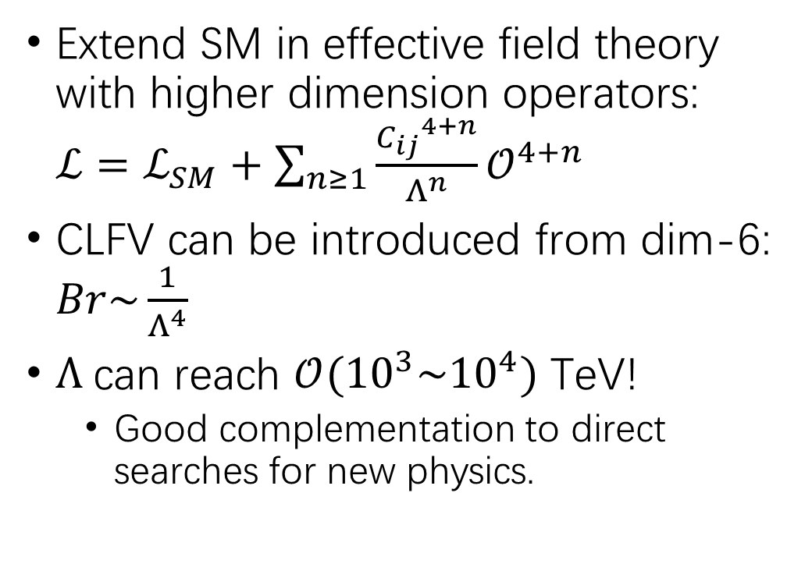
Model independent approach: EFT
Extend SM in effective field theory with higher dimension operators: $ℒ=ℒ_{SM}+\sum_{n≥1}{\frac{{C_{ij}}^{4+n}}{Λ^{n}}𝒪^{4+n}}$
CLFV can be introduced from dim-6: $Br\sim \frac{1}{Λ^{4}}$
$Λ$can reach $𝒪({10}^{3}\sim {10}^{4})$ TeV!
  Good complementation to direct searches for new physics.
Eur. Phys. J. C (2022) 82:836
$θ_{D}$ parameterizes the relative magnitude of dipole and
four-fermion coefficients

Slide 22
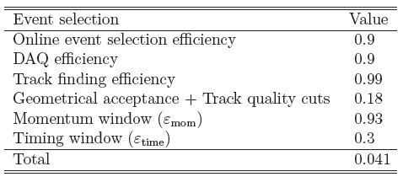
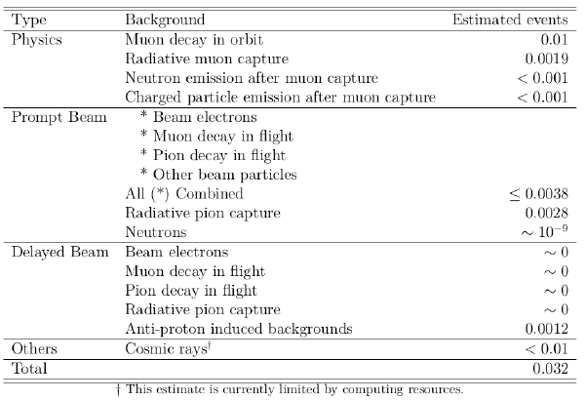
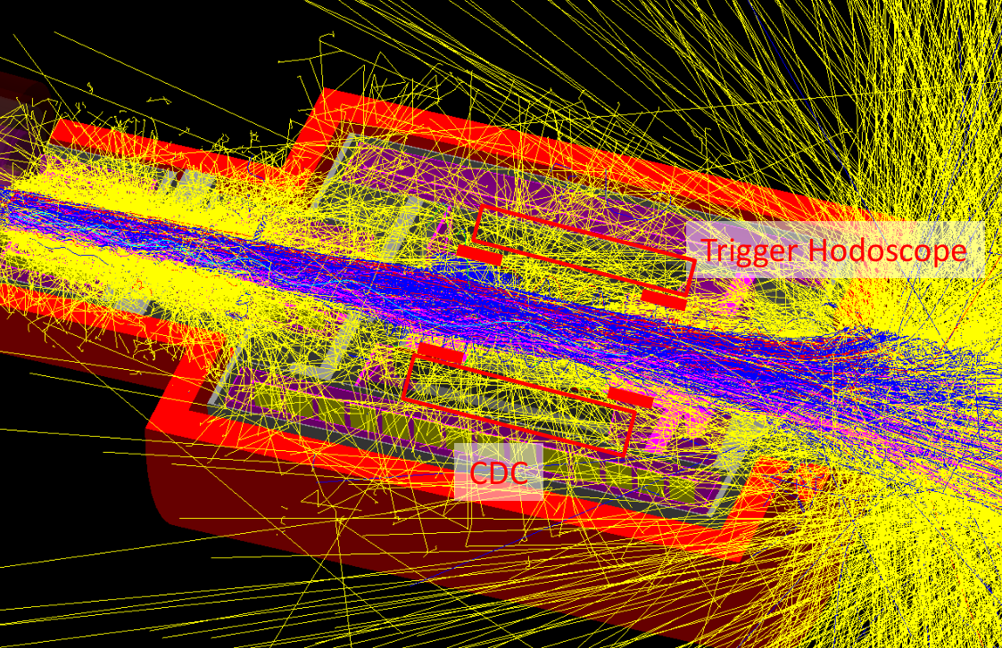
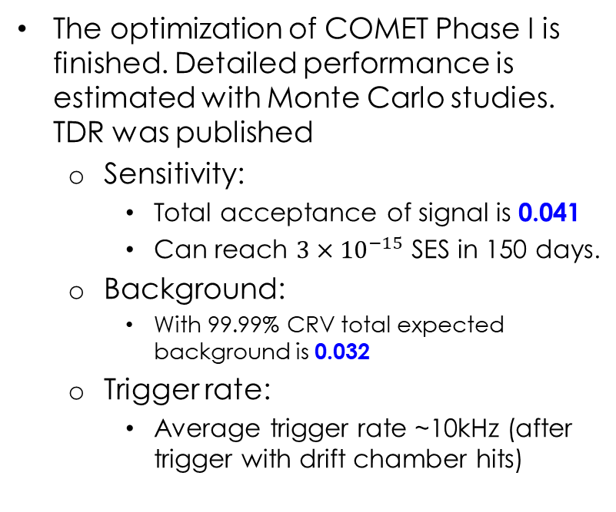
COMET Phase-I background study
The optimization of COMET Phase I is finished. Detailed performance is estimated with Monte Carlo studies. TDR was published
  Sensitivity:
    Total acceptance of signal is 0.041
    Can reach $3×{10}^{−15}$ SES in 150 days.
  Background:
    With 99.99% CRV total expected background is 0.032
  Trigger rate:
    Average trigger rate ~10kHz (after trigger with drift chamber hits)

Slide 23
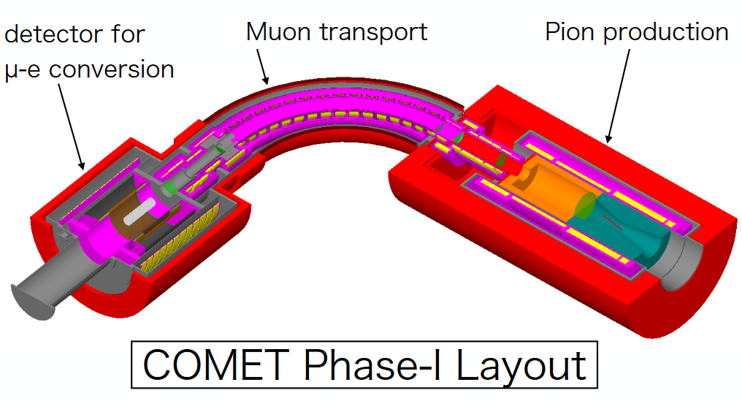
Overview of COMET Phase-I
1. Proton on production targets and produce pions
2. Pions decay to muons and transported to detector sections
3. Muons stopped and decay in the stopping target

Slide 24
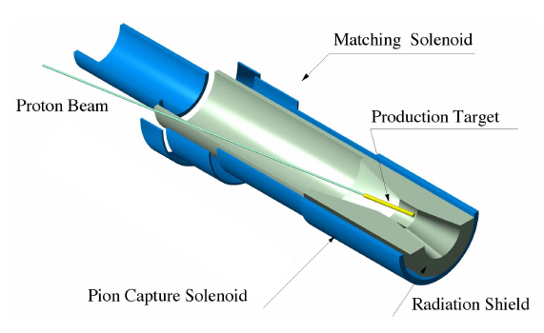
COMET Proton Beam
3kW proton prompt beam:
  ~ 10¹⁹ protons on pion targets (in 150 days running time)
Bunch structure of proton beam􀁍
  Bunch size ~ 10⁷ POT
  Bunch spill/width ~100ns
  Extinction factor 3x10⁻¹¹
  Bunch separation time = 1170ns.􀀁􀀸􀁊􀁏􀁅􀁐􀁘
Prompt beam
Delayed electrons (DIO)
Proton Pulse
Time Window
for Signal Search
number of particles
700 ns
time
1.17μs
Time structure of proton beam bunch

