Slide 1
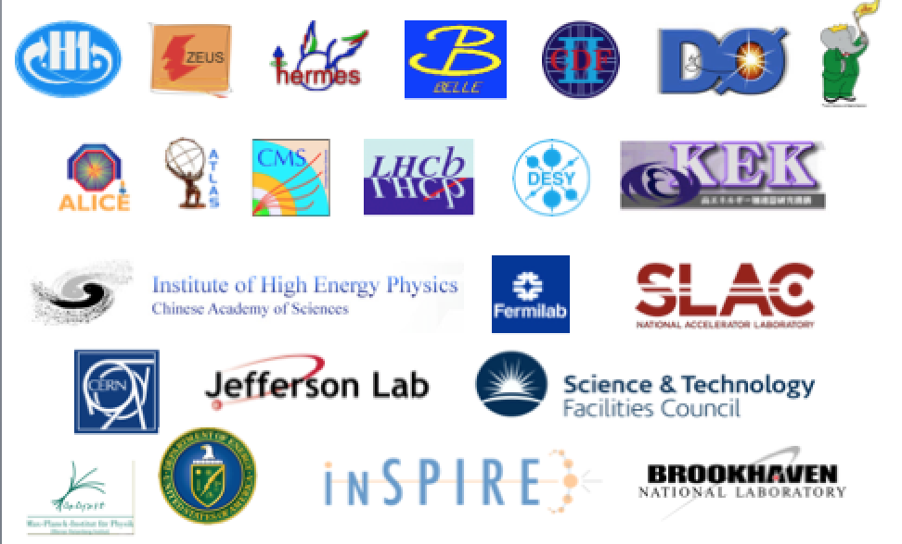



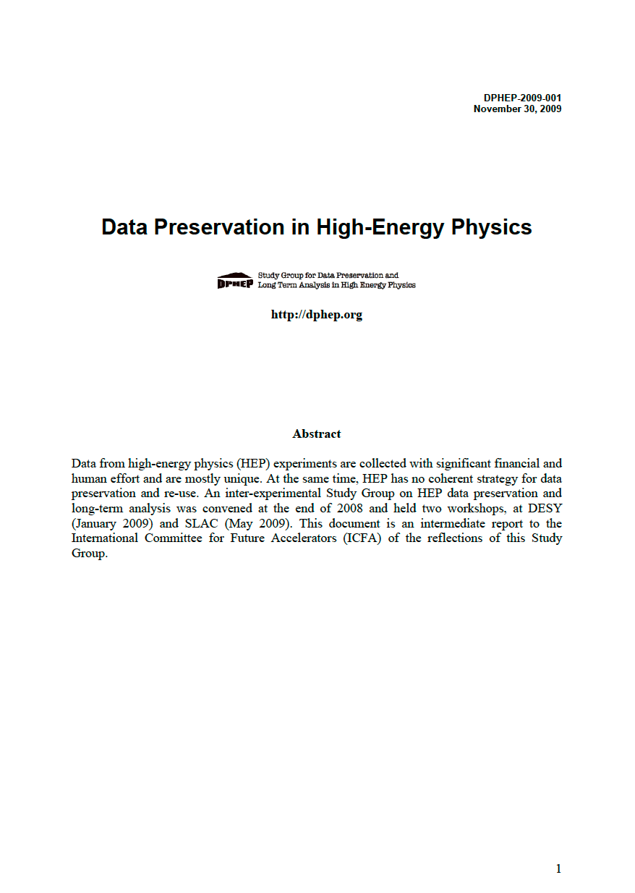
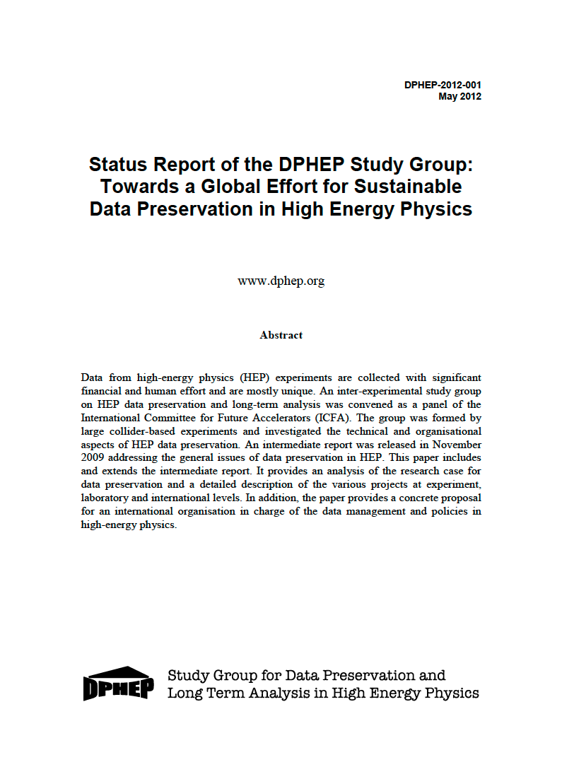
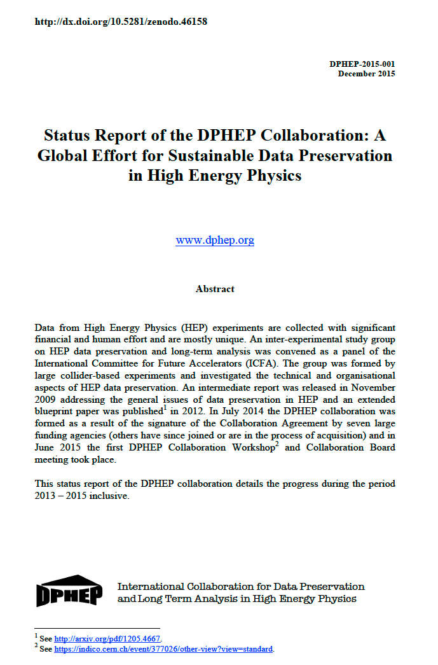
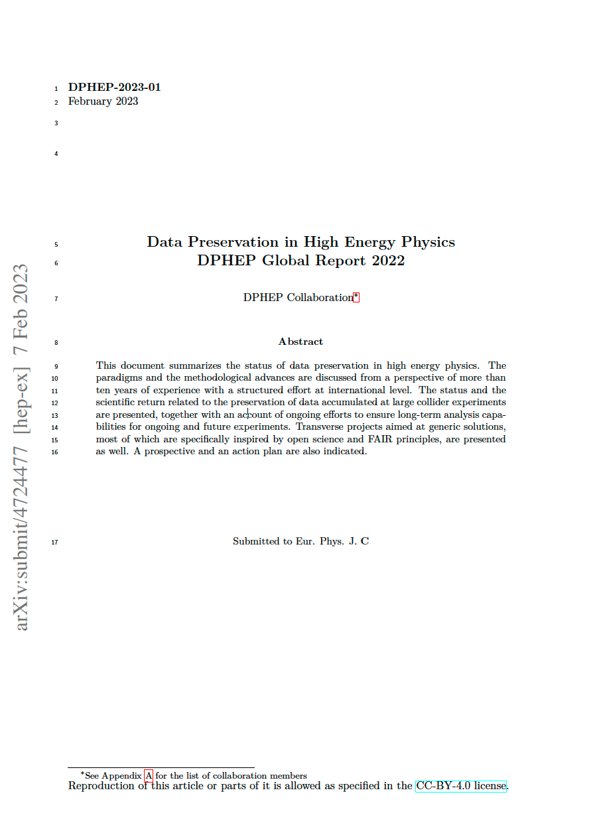
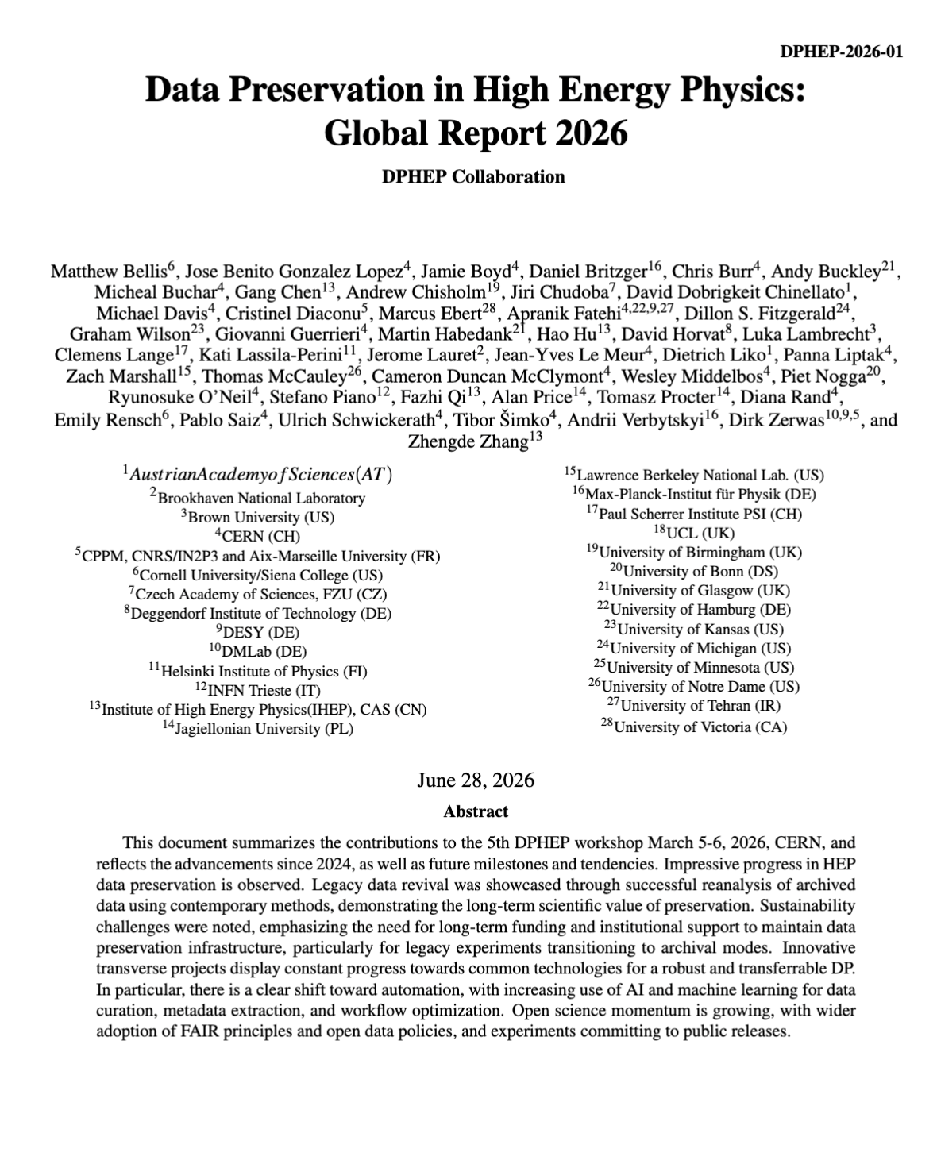
DPHEP Collaboration
http://dphep.org
ICFA Panel 2024: DPHEP joined ICFA Data Lifecycle Panel
2009
LoI
2012
Blueprint
2015
Collaboration MoU
2023
Decade report
2026
Global report
arXiv:0912.0255
arXiv:1205.4667
arXiv: 1512.02019
arXiv: 2302.03583
Arxiv: submitted
Eur. Phys. J. C 83, 795 (2023)

Slide 2
Publications on open/data preservation
In 2025: 2/3 are
use cases of
LHC open data
DP Gain momentum in 2025

Slide 3
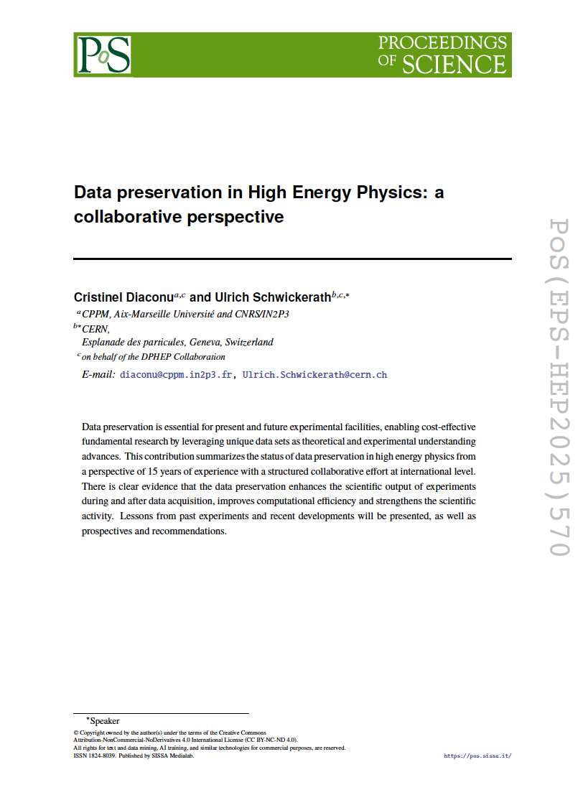
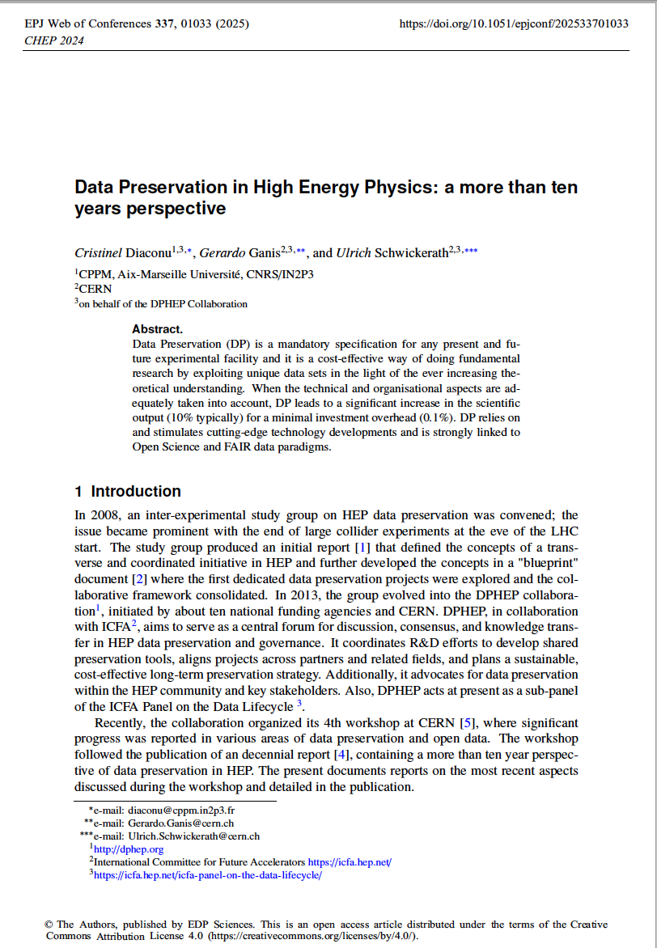
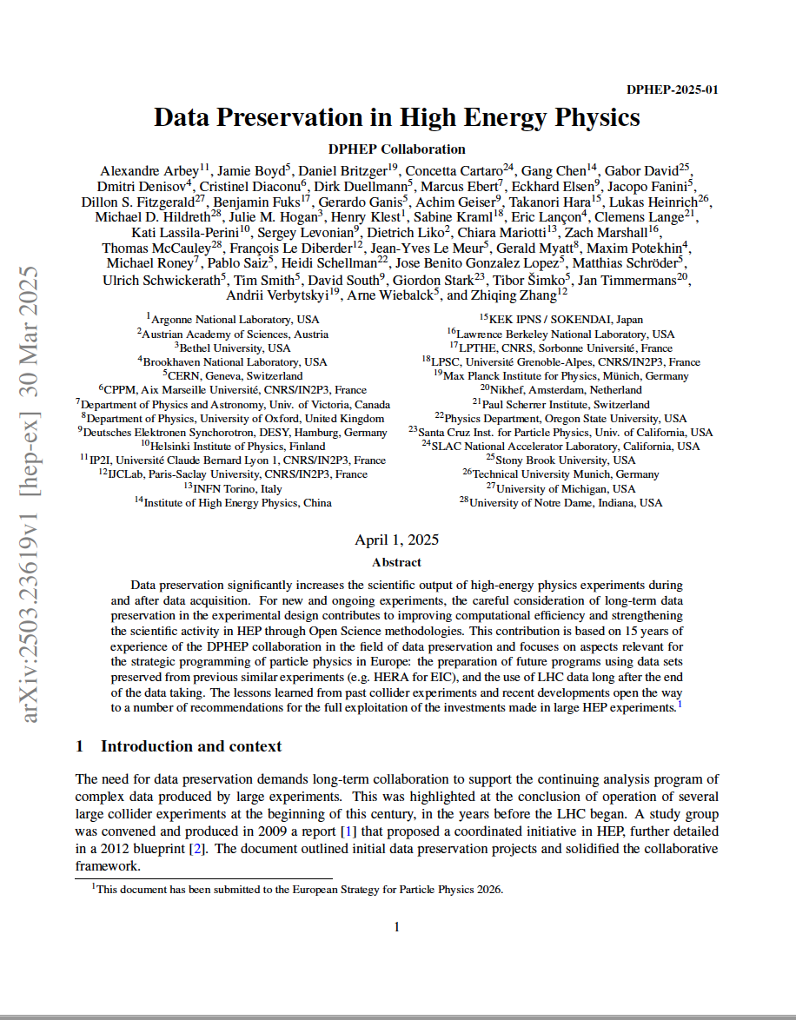
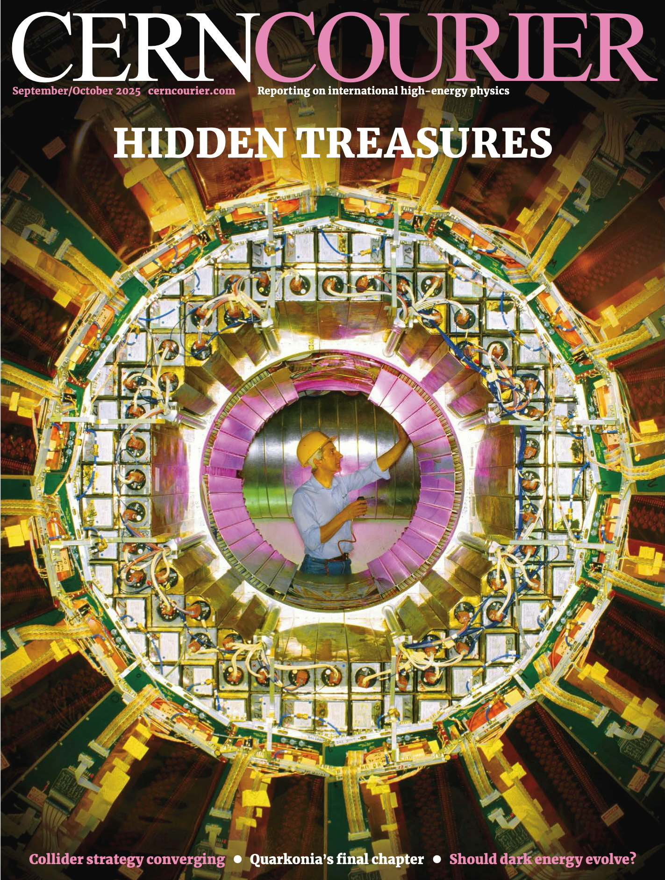

Publications DPHEP since Oct. 2024
Data Preservation in High Energy Physics: A more than ten years perspective, DPHEP Collaboration (Oct, 2025)
Published in: EPJ Web Conf. 337 (2025) 01033 Contribution to: CHEP 2024
Data Preservation in High Energy Physics: a collaborative perspective PoS(EPS-HEP2025)570
U. Schwickerath and C. Diaconu
Data Preservation in High Energy Physics, DPHEP (Mar 30, 2025) e-Print: 2503.23619 [hep-ex]
ESPP 2026 contribution
ESPP 2026
Contribution
EPS-HEP 2025
CHEP 2024

Slide 4
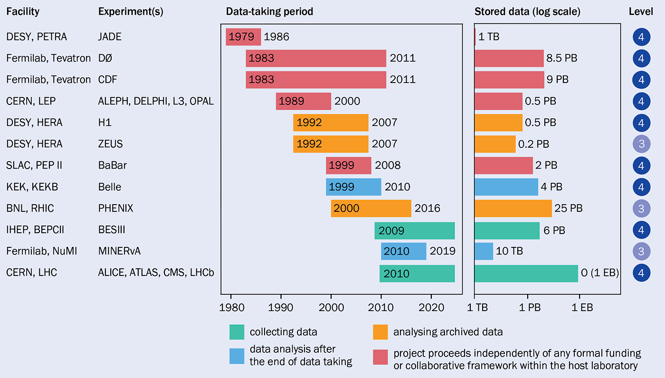

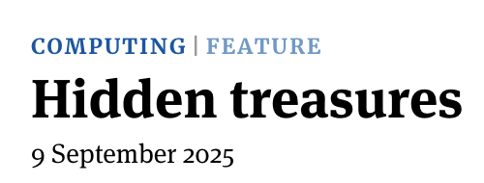
Overview

Slide 5
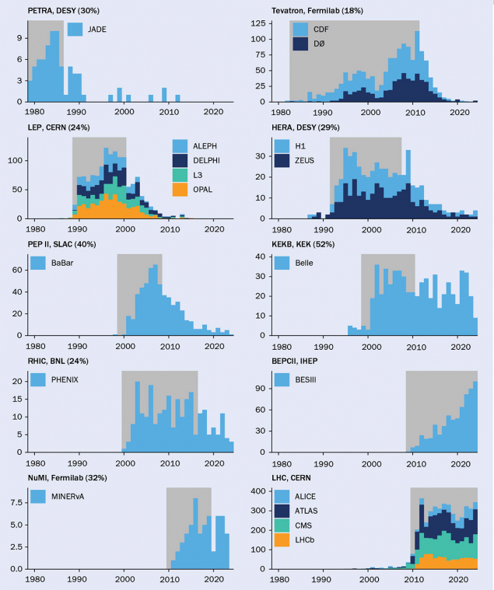
Credit: D De Biasio/M Rayner (thanks a lot!)
The publication record at experiments associated with the DPHEP initiative. Data-taking periods of the relevant facilities are shaded, and the fraction of peer-reviewed articles published afterwards is indicated as a percentage for facilities that are not still operational. The data, which exclude conference proceedings, were extracted from Inspire-HEP on 31 July 2025.

Slide 6
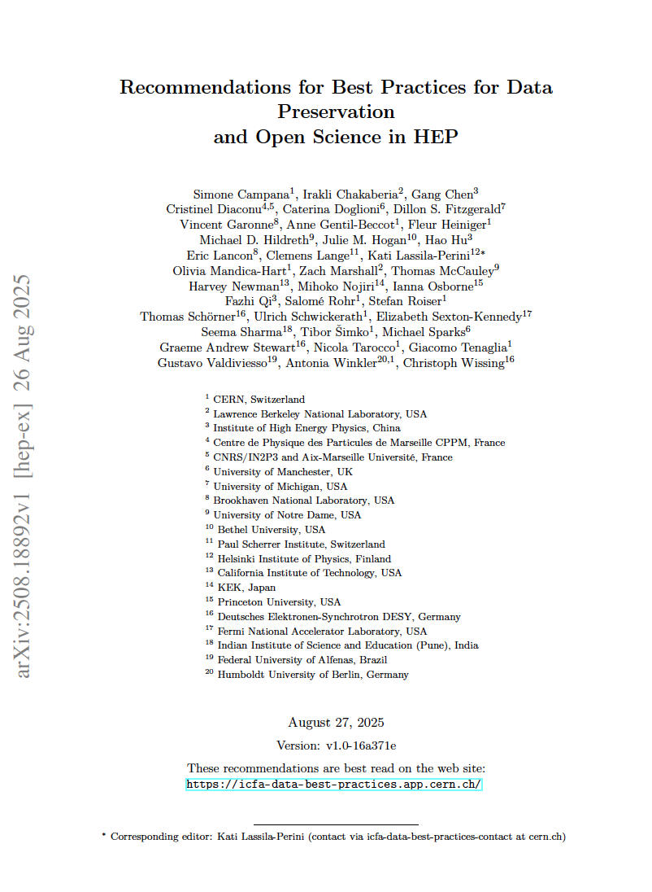
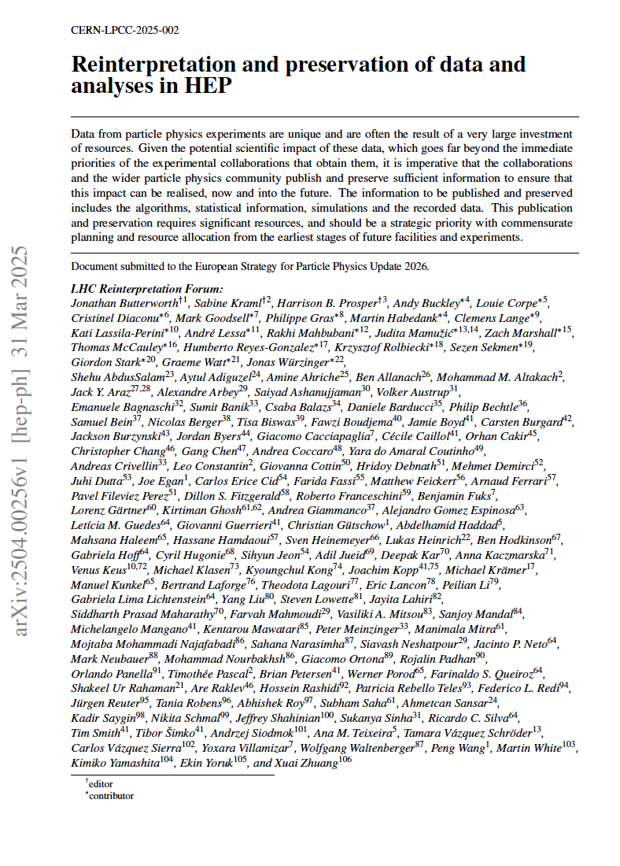
Related and important publications
Data Lifecycle panel of the International Committee of Future Accelerators (ICFA)
Reinterpretation and preservation of data and analyses in HEP
LHC Reinterpretation Forum (Mar 31, 2025)
e-Print: 2504.00256 [hep-ph]

Slide 7
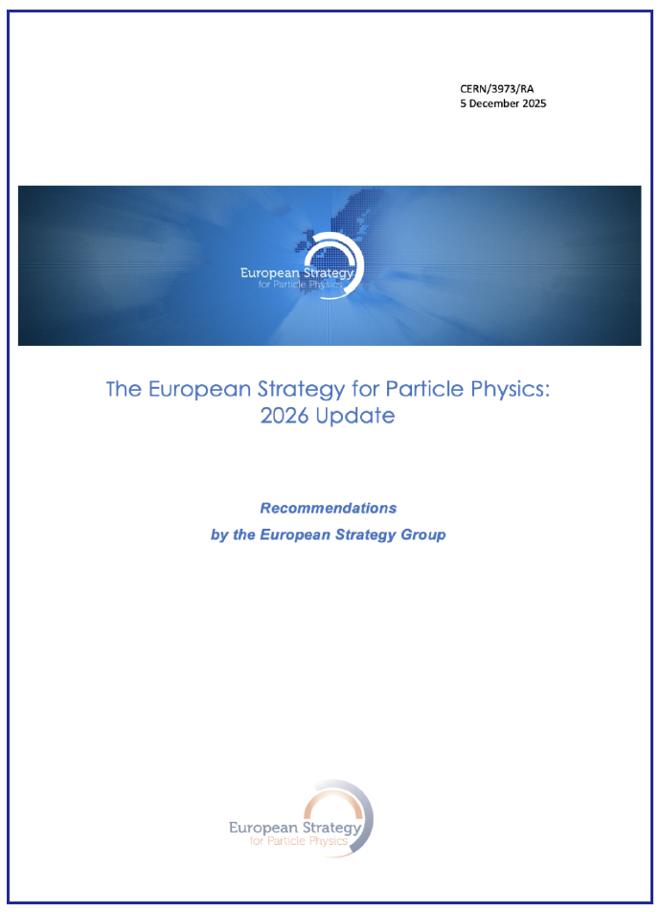
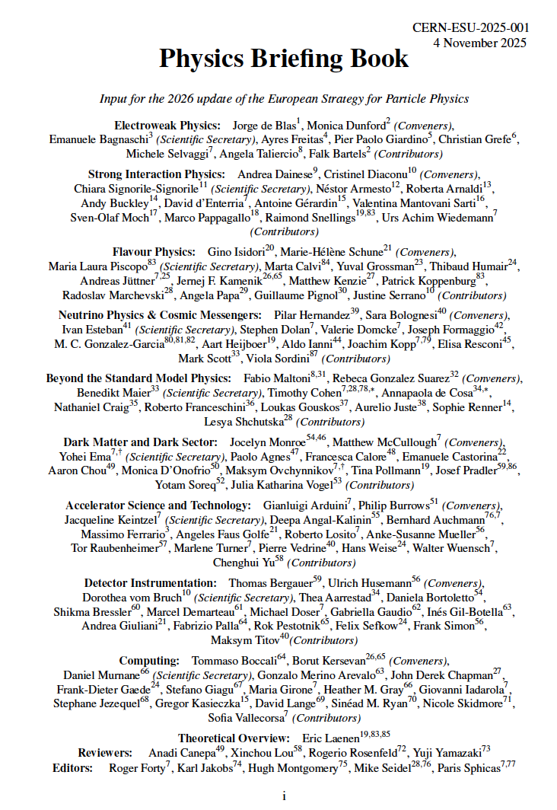
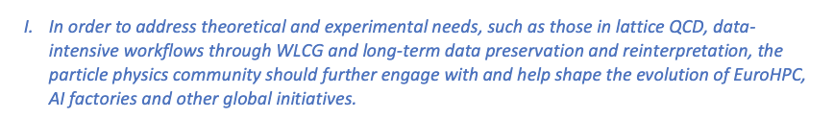
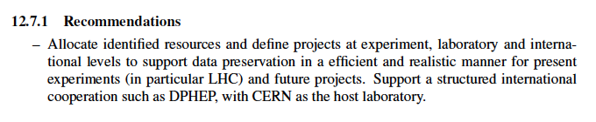
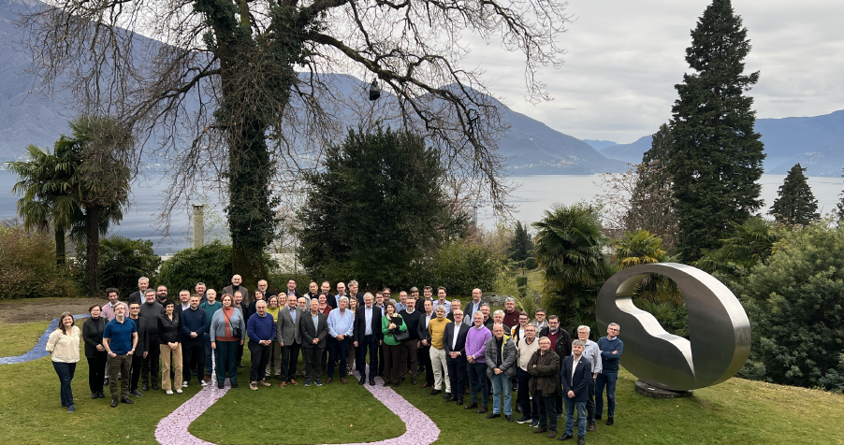
ESPP 2026
Phhysics Briefing Book:
  https://cds.cern.ch/record/2944678?ln=fr
  arXiv:2511.03883
High-Level Recommendations summarised in a short Recommendation Document
  https://cds.cern.ch/record/2950671

Slide 8

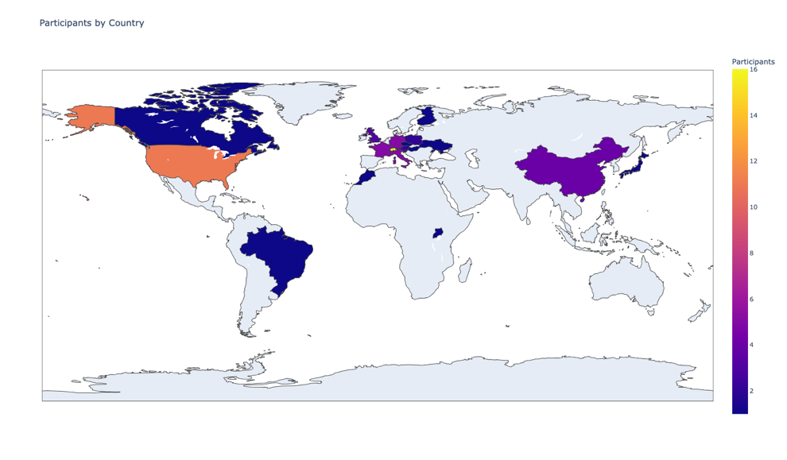
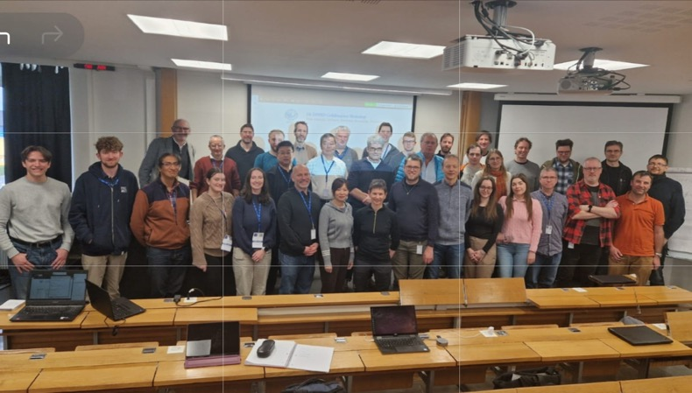
High participation increasing interest
  76 registrants, 26 abstracts
International coverage
Representation of ”known” experiments and sites

Slide 9
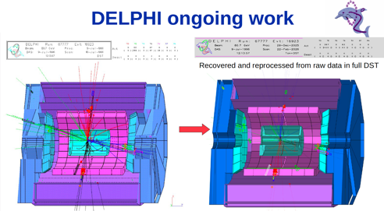
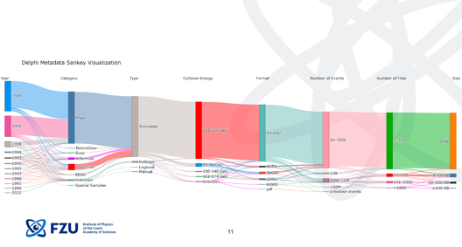
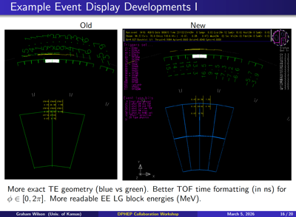
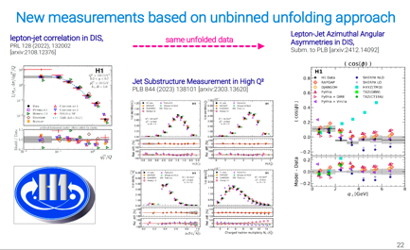
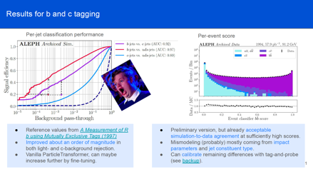
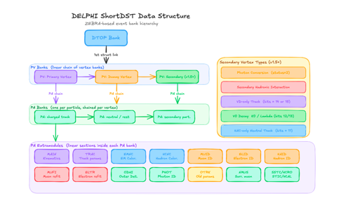
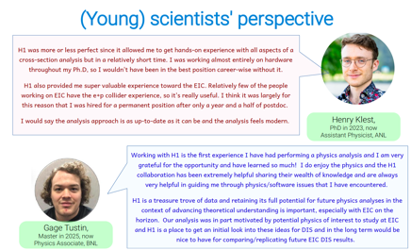
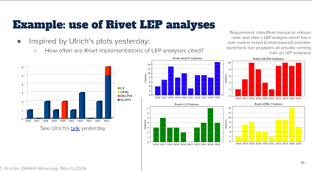
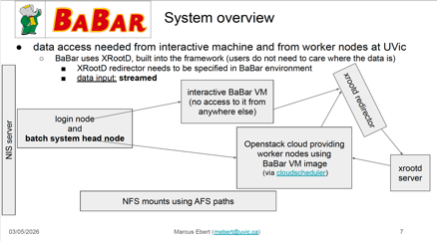
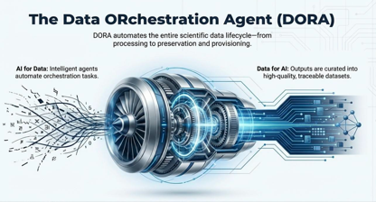
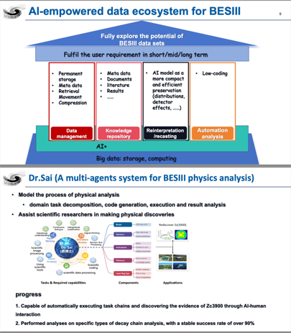
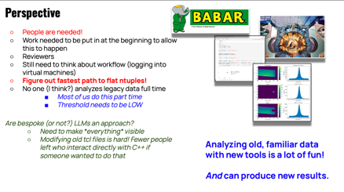
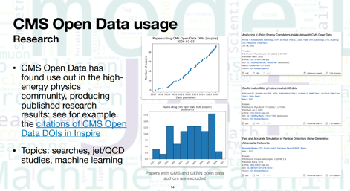
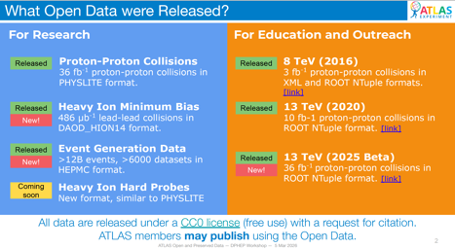
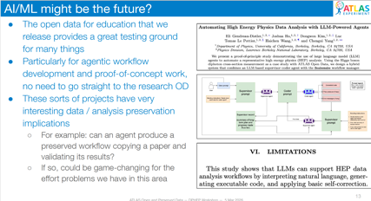

Slide 10
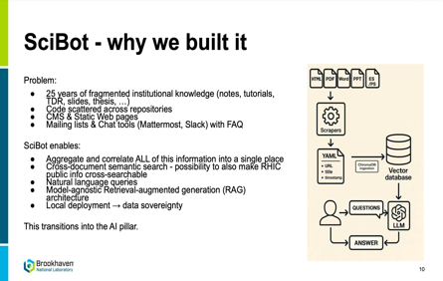
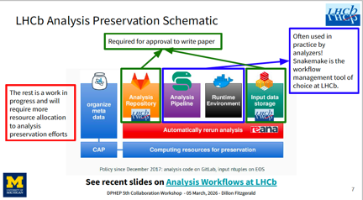
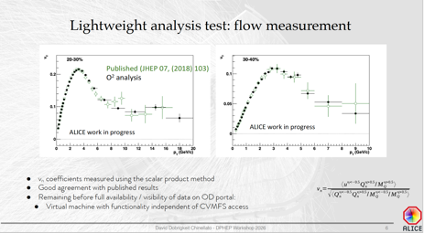

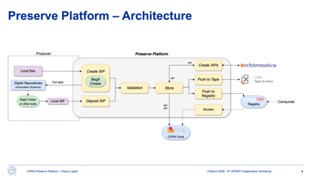
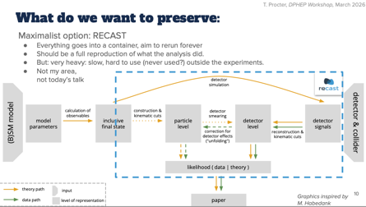
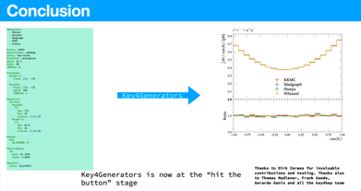
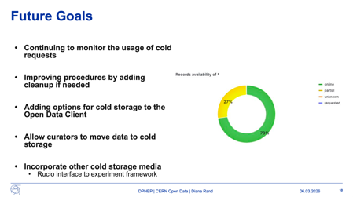
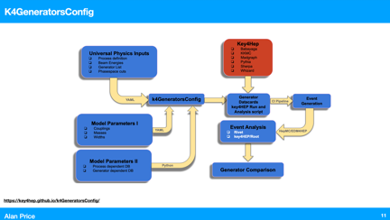
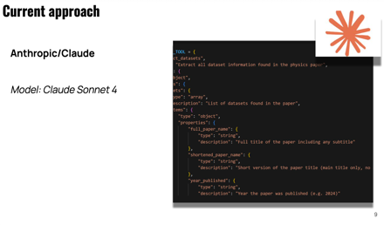
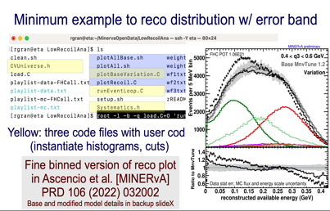
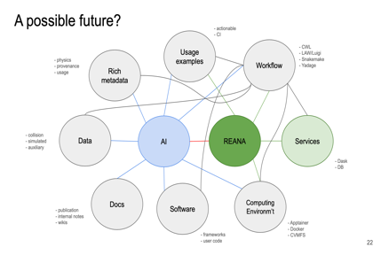
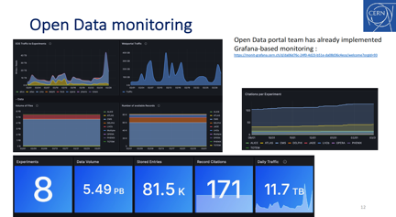
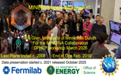








Slide 11
Trends and pathways in DP
Preserved legacy datasets continue to generate new scientific opportunities.
  Legacy data is proven to be valuable resources for new physics analyses.
AI is reshaping data preservation, it becomes standard for DP.
  automation, discoverability, reproducibility. metadata extraction, workflow automation, and data lifecycle management.
  Modern software enables reanalysis of legacy datasets, demonstrating continued scientific value of preserved data.
Open Science has become a central driver of HEP data preservation.
  Strong progress in CERN Open Data implementation and FAIR-aligned preservation.
  Long-term preservation across LHC and legacy experiments (ALICE, ATLAS, CMS, LHCb, BaBar, OPAL, DELPHI, BESIII, JUNO, LHAASO).
  Cross-disciplinary initiatives (EOSC EDEN, REANA, CERN Preserve) strengthening reproducibility and interoperability.
International collaboration and common standards are essential for sustainable preservation.
Long-term investment remains critical to ensure continued accessibility and reuse of scientific data.
Vision: Scientific data is a strategic institutional asset strengthening scientific excellence and Open Science leadership.

Slide 12
bckp

Slide 13
Agenda
March 6th
March 5th
09:00 | Jamie Boyd | CERN Open Data: Policy to implementation
09:20 | Hao Hu | Progress and Prospects for Data Preservation at IHEP
09:40 | Tomasz Procter | Analysis Preservation as a Pillar of Long-Term Knowledge Reuse in HEP
10:00 | Wesley Middelbos | EOSC EDEN
10:20 | Coffee
10:40 | Alan Price | K4GeneratorsConfig: A Unified Approach to MC Generator Benchmarking
11:00 | Panna Liptak | CERN Preserve Platform
11:20 | Diana Rand | Providing Cold Storage in the CERN Open Data portal
11:40 | Tibor Simko | Facilitating Open Data Reuse with REANA: From Scalable Workflows to AI-Assisted Analysis Authoring
12:00 | LUNCH
13:30 | Emily Rensch | Using generative AI to extract dataset information from journal articles
13:50 | Matthew Bellis | From tcl to awkward: analyzing old data with new tools
14:10 | Jerome LAURET | A Holistic Approach to Data, Analysis, and Knowledge Preservation at BNL
14:30 | Rik Gran | MINERvA neutrino experiment open data
14:50 | Andrew Stephen Chisholm | Digital preservation and reanalysis of raw photographic data from the CERN 2m bubble chamber
15:15 | Kati Lassila-Perini | ICFA recommendations on data preservation and open science and their assessment
15:35 | Cristinel Diaconu, Ulrich Schwickerath | Closing
10:00 | Zhengde Zhang | Data ORchestration Agent (DORA) for AI-Ready Scientific Data in Large-Scale Facilities
14:00 | Simone Campana | Welcome from CERN Management
14:10 | Cristinel Diaconu | Workshop Introduction and Goals
14:20 | Ulrich Schwickerath | DPHEP greetings from the past: news around LEP
14:40 | Michal Lukeš | A New Repository for DELPHI Data
15:00 | Luka Lambrecht | Advanced b-tagging with archived ALEPH data
15:20 | Dietrich Liko | Converting DELPHI Legacy Open Data to the EDM4HEP Format
15:40 | Graham Wilson | 26 years on: Experience with OPAL Data Re-analysis
16:00 | Coffee
16:15 | Thomas McCauley | CMS Data Preservation and Open Access: status and plans
16:35 | Zach Marshall | Status of Open and Preserved Data in ATLAS
16:55 | Dillon Fitzgerald | LHCb Data Preservation and Open Data
17:15 | David Dobrigkeit Chinellato | Long-term data preservation in ALICE: status and plans
17:35 | Daniel Britzger | Data preservation in the H1 experiment at HERA
17:55 | Marcus Ebert | Status of BaBar's Data and Analysis Preservation Efforts
Cristi’s train 17h00

Slide 14


Slide 15
Data Preservation in High Energy Physics
What is “data”?
  not (only) : “files”
  but : “every digitally encoded information that was created as a result of planning, running and exploiting an experiment”
What is “preservation”?
  not: a freezer, a herbarium, a museum, an album, a cellar….
  but: the process of transforming a "high intensity/ rapidly changing " computing system into a "low intensity / slowly evolving" computing system with conserving the capacity of extracting new science from the "data”.
  Requires clear plans and a long term organization
    Within each collaboration and at international level (DPHEP)

Slide 16

Guidance into data complexity
Preservation Model |  | Use Case
1 | Provide additional documentation | Publication related info search | Documentation
2 | Preserve the data in a simplified format | Outreach, simple analyses | Outreach, reanalysis
3 | Preserve the analysis level software and data format | Full scientific analysis, based on the existing reconstruction | Technical Preservation Projects
4 | Preserve the reconstruction and simulation software as well as the basic level data | Retain the full potential of the experimental data
CMS 2012

Slide 17
A matter of collaboration as well
The supervision and knowledge transfer/capture is essential at long term
Need to clarify the status and the rules
Various stages of organisation can be defined:
0: DP Organisation during experiment proposal.
1: DP Organisation during data taking.
2: DP Organisation after data taking and during analysis-only mode.
3: DP Organisation after the collaboration funding scheme.
4: DP Rescue organisational scheme. This organisation scheme is to be activated when:
  the host laboratory stops support and announce no long-term commitment.
  the official collaboration/data stewardship is stopped with no further plans (no step 3 is clearly defined).
Remarks:
Taking no action == decommissioning (deleting) the data.
  “Securely” storing/freezing the files and the latest version of the software is certainly not a substitute for a preservation project.

Slide 18
Costs and Benefits
C1. Host laboratories allocate person power and computing resources - specifically to DP.
in % to the construction/operation costs
C2. Collaborating laboratories participate in the effort: replicate or take over data and computing systems and provide technical assistance.
C3. Researchers and engineers participate outside their main research area.
C4. Innovative computing projects, including pluri-disciplinary open science initiatives, may
offer attractive opportunities for data preservation and are therefore an indirect source of support.
C5. The proximity of a follow-up experiment clearly helps in structuring and supporting a data preservation project.
B1. New publications – counting here those executed with a strong involvement of the dedicated DP systems.
B2. Publications made by other groups/people using the new publications produced at B1.
B3. Preserving the scientific expertise and the leadership in the field of the experiment, possibly
boosting the transition to a new experiment
B4. Technology expertise in robust data preservation. Improved ability to plan for new experiments
and preserve their scientific potential at long term.
FoM = B1/C1

Slide 19
DPHEP within ICFA minutes (2008- 2024)
Sep 2008: phone discussion of a provisional Steering Committee on "Data persistency" (DESY, SLAC, FNAL, KEK, IHEP,...) then workshop at DESY in Jan. 2009 etc.
Oct: 2008 ICFA Symposium in SLAC: Data Preservation in HEP is presented: the Study Group is mentioned for the first time.
2009 Hamburg (Lepton-Photon) ICFA Meeting
Cristinel Diaconu presented (Attachment II) the outcome of an International Study Group which examined the case for, and possible mechanisms to carry out, preservation of data from particle physics experiments. He made the request that ICFA:
· Support data preservation in particle physics
· Endorse the International Study Group as an ICFA subgroup
· Nominate a Chair for the subgroup
There was considerable discussion following Diaconu’s presentation, including which data should be included, who will be responsible for preserving the data, and considerations of who should have access to the data.
ICFA approved the above requests, and agreed to Diaconu being Chair of the subgroup for the first year.
2010 Paris (ICHEP) Cristi Diaconu (Attachment VI) described the 2009/1010 activities of the Data Preservation Study Group (including 4 workshops and 2 open symposia), and the current status of data preservation in the major collaborations. A Blueprint for Data Preservation in High-Energy Physics is in preparation, and it will give estimates of the resources needed. ICFA agreed to continue the mandate of the DPHEP Study Group and its Chair for 2010/2011.
2012 Oxford Up to now, reported Cristi Diaconu (Attachment VI), there have been 5 workshops and 3 open community sessions on HEP data preservation, where the goal is the preservation of the full analysis capability of an experiment. Dedicated projects have started at DESY and SLAC, and BaBar is moving to “archival mode”. Discussions have started at LHC, and are intensifying at CDF and D0; LEP data may also be considered. Diaconu noted that ICFA endorsement of the Panel’s activities has been essential to its progress.Study Group on Data Preservation
2013 Vancouver Jamie Shiers described the Study Group activities, and gave its priorities; the major urgent action is to preserve the full capacity to perform analysis on data from experiments that have completed data-taking. The DPHEP Blueprint was submitted to the European Strategy; the EU Commission has recommended access to, and preservation of, scientific information. CERN has proposed a DPHEP project management. Shiers noted the effort for data preservation is very scarse, but there are possibilities for future EU funding; failure to invest now would jeopardize the re-use of LEP data, as well as that of HERA, BaBar, Tevatron, etc.The DPHEP recommendations include adoption of the OAIS model for HEP long-term data preservation; ensure that sufficient resources exist through 2013/4 to reach the long-term solution; and a commitment is needed for true long-term data preservation. DPHEP believes that it would be useful for an ICFA Statement on data preservation, and a proposed Statement will be sent to ICFA members for their possible approval. Shiers’ presentation is in Attachment VIII. In the discussion that followed, Shiers said that DPHEP has been ongoing for five years, and CERN proposed to fund him as project manager for three years starting from 1 January 2013. He said that there is significant cooperation from other regions and experiments (Tevatron, Belle, etc.), but long term commitments are needed. It is not too early or too late for LHC experiments to think about data preservation, although it would have been better to consider this five years ago.
2014 DESY Cristinel Diaconu said that the collaboration agreement on data preservation (which followed from the 2013 ICFA Statement) has been signed by CERN, and more signatures are hoped for in the coming year. There are dedicated preservation projects at SLAC, DESY and Fermilab, while data preservation is included in LHC experiment computing models. The dominant cost for data preservation is for personnel. Diaconu gave a work plan for 2014. His presentation is in Attachment IX.
2017 Valencia Cristinel Diaconu reported on the DPHEP panel and showed the timeline, with the DPHEP group forming as an ICFA panel in 2009 to consolidation into the DPHEP project in 2012-­‐14, signing of the agreements in 2014 and leading to formation of the DPHEP collaboration. He also showed activities of the collaboration since then. Diaconu summarized the pre-­‐LHC experiments data preservation from various HEP labs in the world, the scientific results from those and remarked that the transition from experiments-­‐driven to lab-­‐supported data preservation (DP) systems has been mostly accomplished, but the DP system need to be supported.
Diaconu then discussed LHC data preservation, which is now a specification in the computing models for Phase-­‐I/II upgrades. The LHC open data service was launched in Nov. 2014 with the first large-­‐scale release of CMS data. Major update is planned for 2017. In addition, CERN analysis preservation (CAP) will save the materials and knowledge produced during analysis for future use.
Efforts are also underway for Interdisciplinary Data Preservation (collaborating with Astrophysics, in particular). The DPHEP project is also connecting with global and national initiatives for "Big-­‐data".
Diaconu summarized DPHEP vision for 2020 and beyond, and said that providing a new ICFA mandate up to 2020 is beneficial to this activity. A status report by DPHEP collaboration is available at http://arxiv.org/abs/1512.02019.
2018 Cambridge presented but panels presentations were not summarized to minutes
2021: Panel mandate was extended for another 3 years
2024: DPHEP panel was merged in a new Data Lifecycle panel (chair Kati Lasilla Perrini)

