Slide 1

Long Term Data Preservation
at FCPPN/L
Hao HU, Gang Chen (IHEP),
Cristinel Diaconu (CPPM)

Slide 2

The Imperative of HEP Data Preservation
Unique & Irreplaceable Data
  HEP experiments generate irreplaceable data at the Exabyte scale. Preserving these data allows future scientists to verify results, perform new analysis, and get new scientific discoveries.
High Return on Investment​
  A modest investment in preservation maximizes the long-term scientific value of the original experiment.
Plan from the Beginning
  Data preservation must be integrated to experimental design from the very conception phase, including not only the data itself, but also the software and documentation needed for future reuse.
Notes:
High-energy physics experiments produce huge amount of valuable data that cannot be reproduced. Preserving these data allows future scientists to verify results, perform new analysis, and get new scientific discoveries. A relatively small investment in data preservation can bring significant returns on scientific output. Therefore, data preservation should be considered from the very beginning, including not only the data itself, but also the software and documentation needed for future reuse.
Unique & Massive:​ HEP generates irreplaceable data at the Exabyte scale.
Huge Investment:​ Billions of dollars and decades of effort are poured into these experiments.
Future Discoveries:​ This data is the key to unlocking the universe's secrets.

Slide 3



International Collaborative Framework: DPHEP
Data Preservation in High Energy Physics — an ICFA initiative
Core Functions
Founded
Established in 2009 by ICFA (International Committee for Future Accelerators)
ICFA Panel 2024: DPHEP joined Data Lifecycle Panel
01
Define Preservation Levels
Establish the DPHEP L1–L4 classification framework,
providing a standardized framework for data preservation across experiments.
02
Community Coordination
Share best practices and preservation strategies
Foster collaboration across experiments and institutes
Mission
03
Long-term Sustainability
Promote sustainable data preservation beyond experiment lifecycles
Advocate for long-term institutional and funding support
Ensure long-term preservation of HEP data for future scientific reuse and open access
04
Standards & Infrastructure
Encourage common preservation policies and standards
Support interoperable preservation infrastructures
Secretariat hosted at CERN; collaborative agreements signed by major laboratories worldwide
Governance
DPHEP Collaboration · ICFA Initiative · Founded 2008 · Secretariat: CERN
Notes:
DPHEP is such an international Collaborative framework for the data preservation of high-energy physics. It brings together experiments and institutes to share best practices, promote common preservation standards, and support sustainable infrastructures. Through workshops and international collaboration, DPHEP helps ensure that HEP data remain accessible and reusable for future research even when the experiments are retired.
DPHEP, originally focused on data preservation, now it takes full life-cycle, open science to HEP data.

Slide 4
DPHEP: A Global Collaboration
DPHEP's strength lies in its broad international membership. The collaboration agreement, signed by major institutions worldwide, forms the backbone of this effort, uniting leading scientific organizations to advance the frontiers of data preservation in high-energy physics.
CERN
European Organization for Nuclear Research
DESY
Deutsches Elektronen-Synchrotron, Germany
HIP
Helsinki Institute of Physics, Finland
IHEP (China)
Institute of High Energy Physics, a cornerstone member from Asia.
IN2P3 (France)
National Institute of Nuclear and Particle Physics, a key European partner.
KEK
High Energy Accelerator Research Organization, Japan
MPP & IPP
Max Planck Institutes for Physics and Plasma Physics, Germany
STFC
Science and Technology Facilities Council, United Kingdom
This diverse coalition underscores the central, foundational role played by IHEP and IN2P3 from the very beginning, ensuring a truly global perspective in shaping the future of scientific data preservation.
Notes:
DPHEP has a very broad international collaboration. It brings together leading institutions from Europe, Asia, and beyond—CERN, DESY, KEK, and others. Notably, both IHEP from China and IN2P3 from France were among the original members. IHEP and IN2P3 collaborate from the very beginning, it ensures a truly global perspective in shaping the future of scientific data preservation.

Slide 5
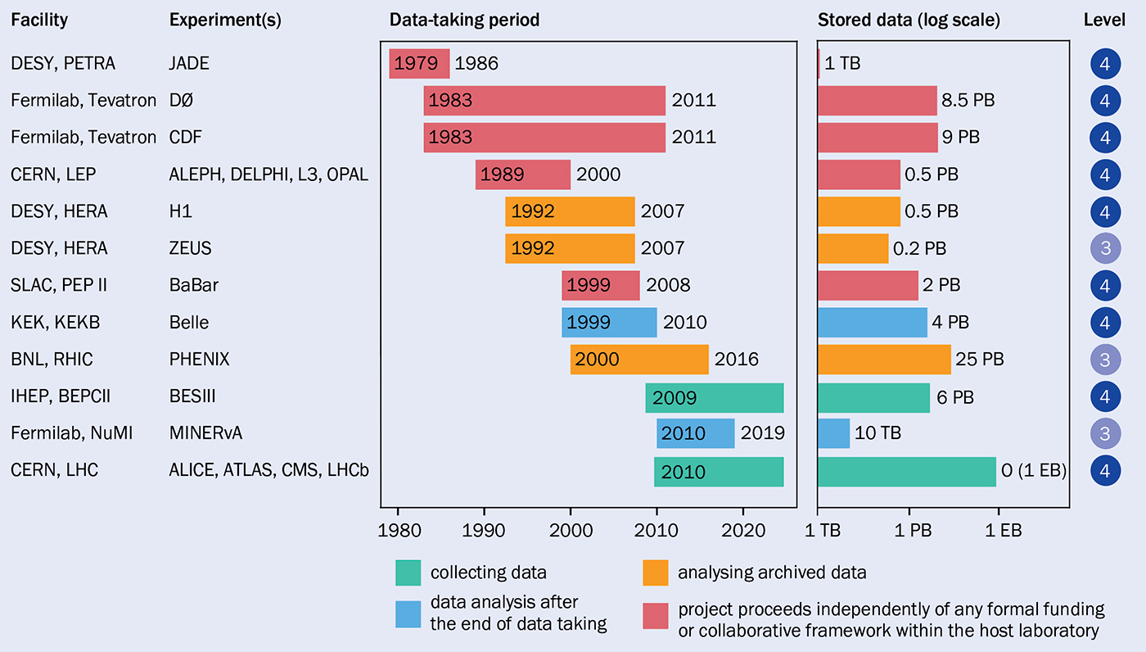


The Current Landscape of HEP Data Preservation
Notes:
Different color means the experiment are at different stage. These experiments need more attention
Most of the experiments are using DPHEP Level 4 Preservation Model，not only the reconstructed data and analysis software are preserved, but also store the raw data and reconstruction/simulation software.

Slide 6
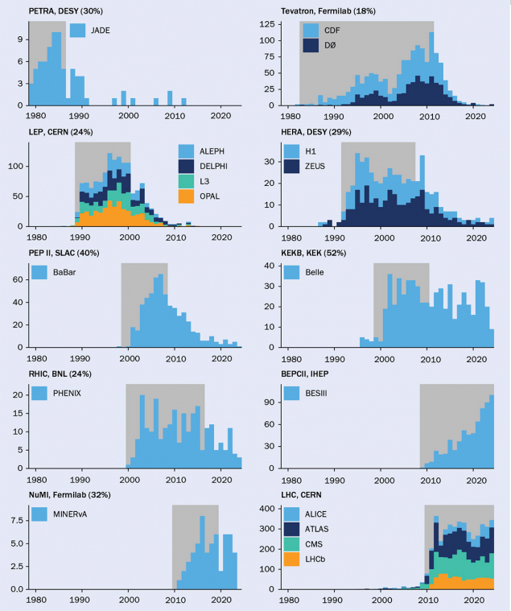
Publication Record at Experiments
Credit: D De Biasio/M Rayner
The publication record at experiments associated with the DPHEP initiative.
  Data-taking periods of the relevant facilities are shaded.
  The fraction of peer-reviewed articles published afterwards is indicated as a percentage for facilities that are not still operational.
The data, excluding conference proceedings, were extracted from Inspire-HEP on 31 July 2025.
It clearly indicates that the long-term data preservation is very essential for the continuing scientific output after an experiment is retired.
Notes:
The shaded area shows publications during the data-taking period of the experiment. The unshaded area corresponds to publications based on analysis of preserved data. This clearly indicates that the long-term data preservation is very essential for the continuing scientific output after an experiments ends.

Slide 7
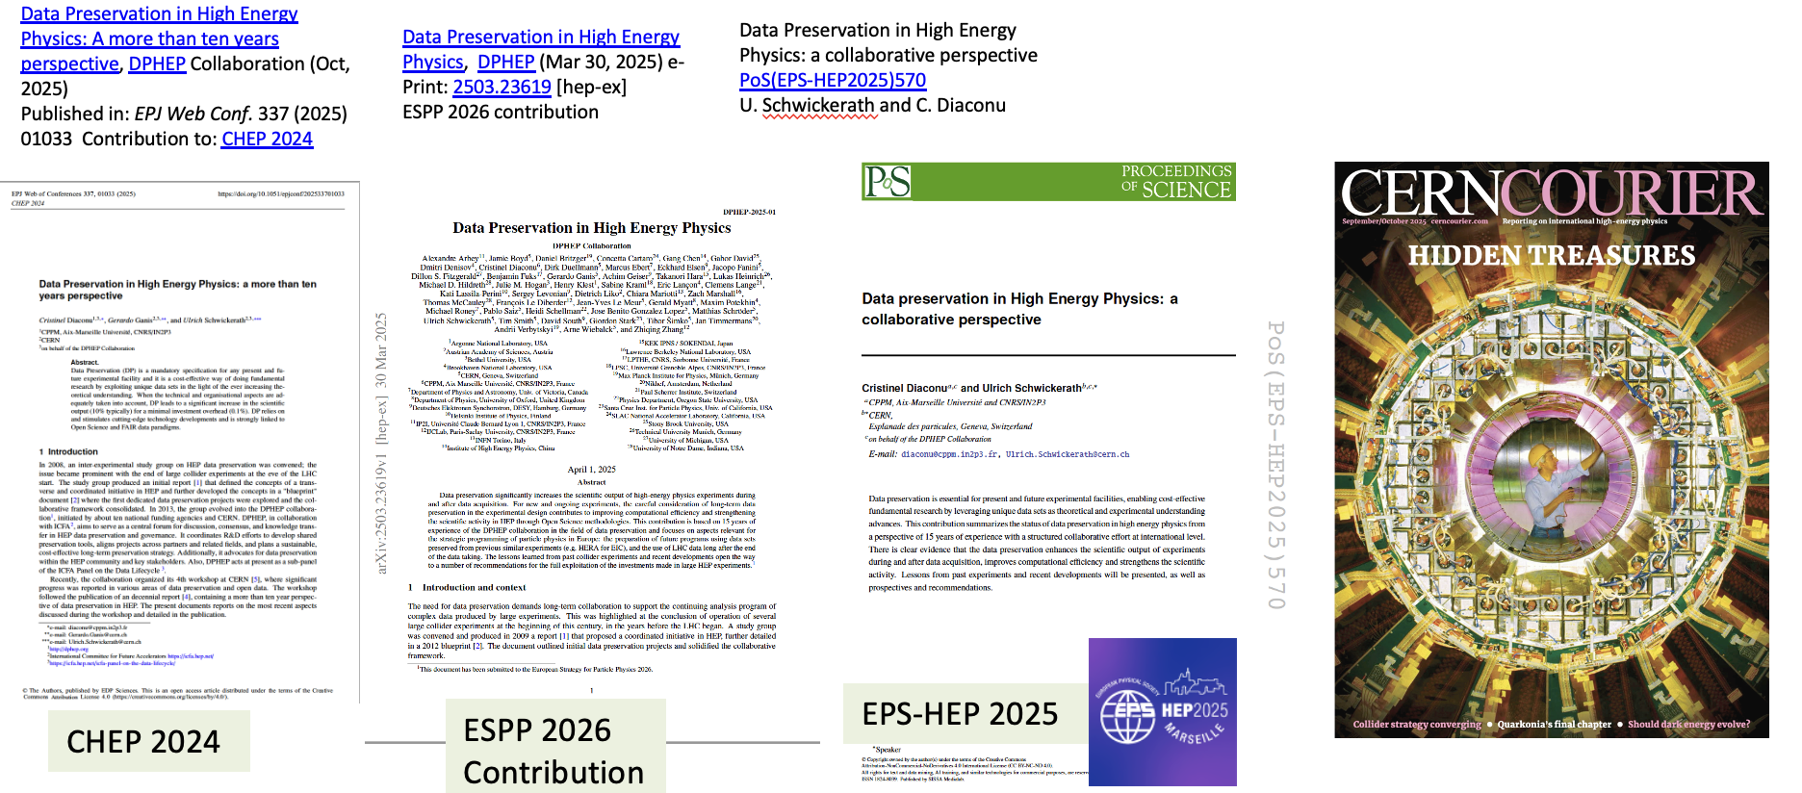
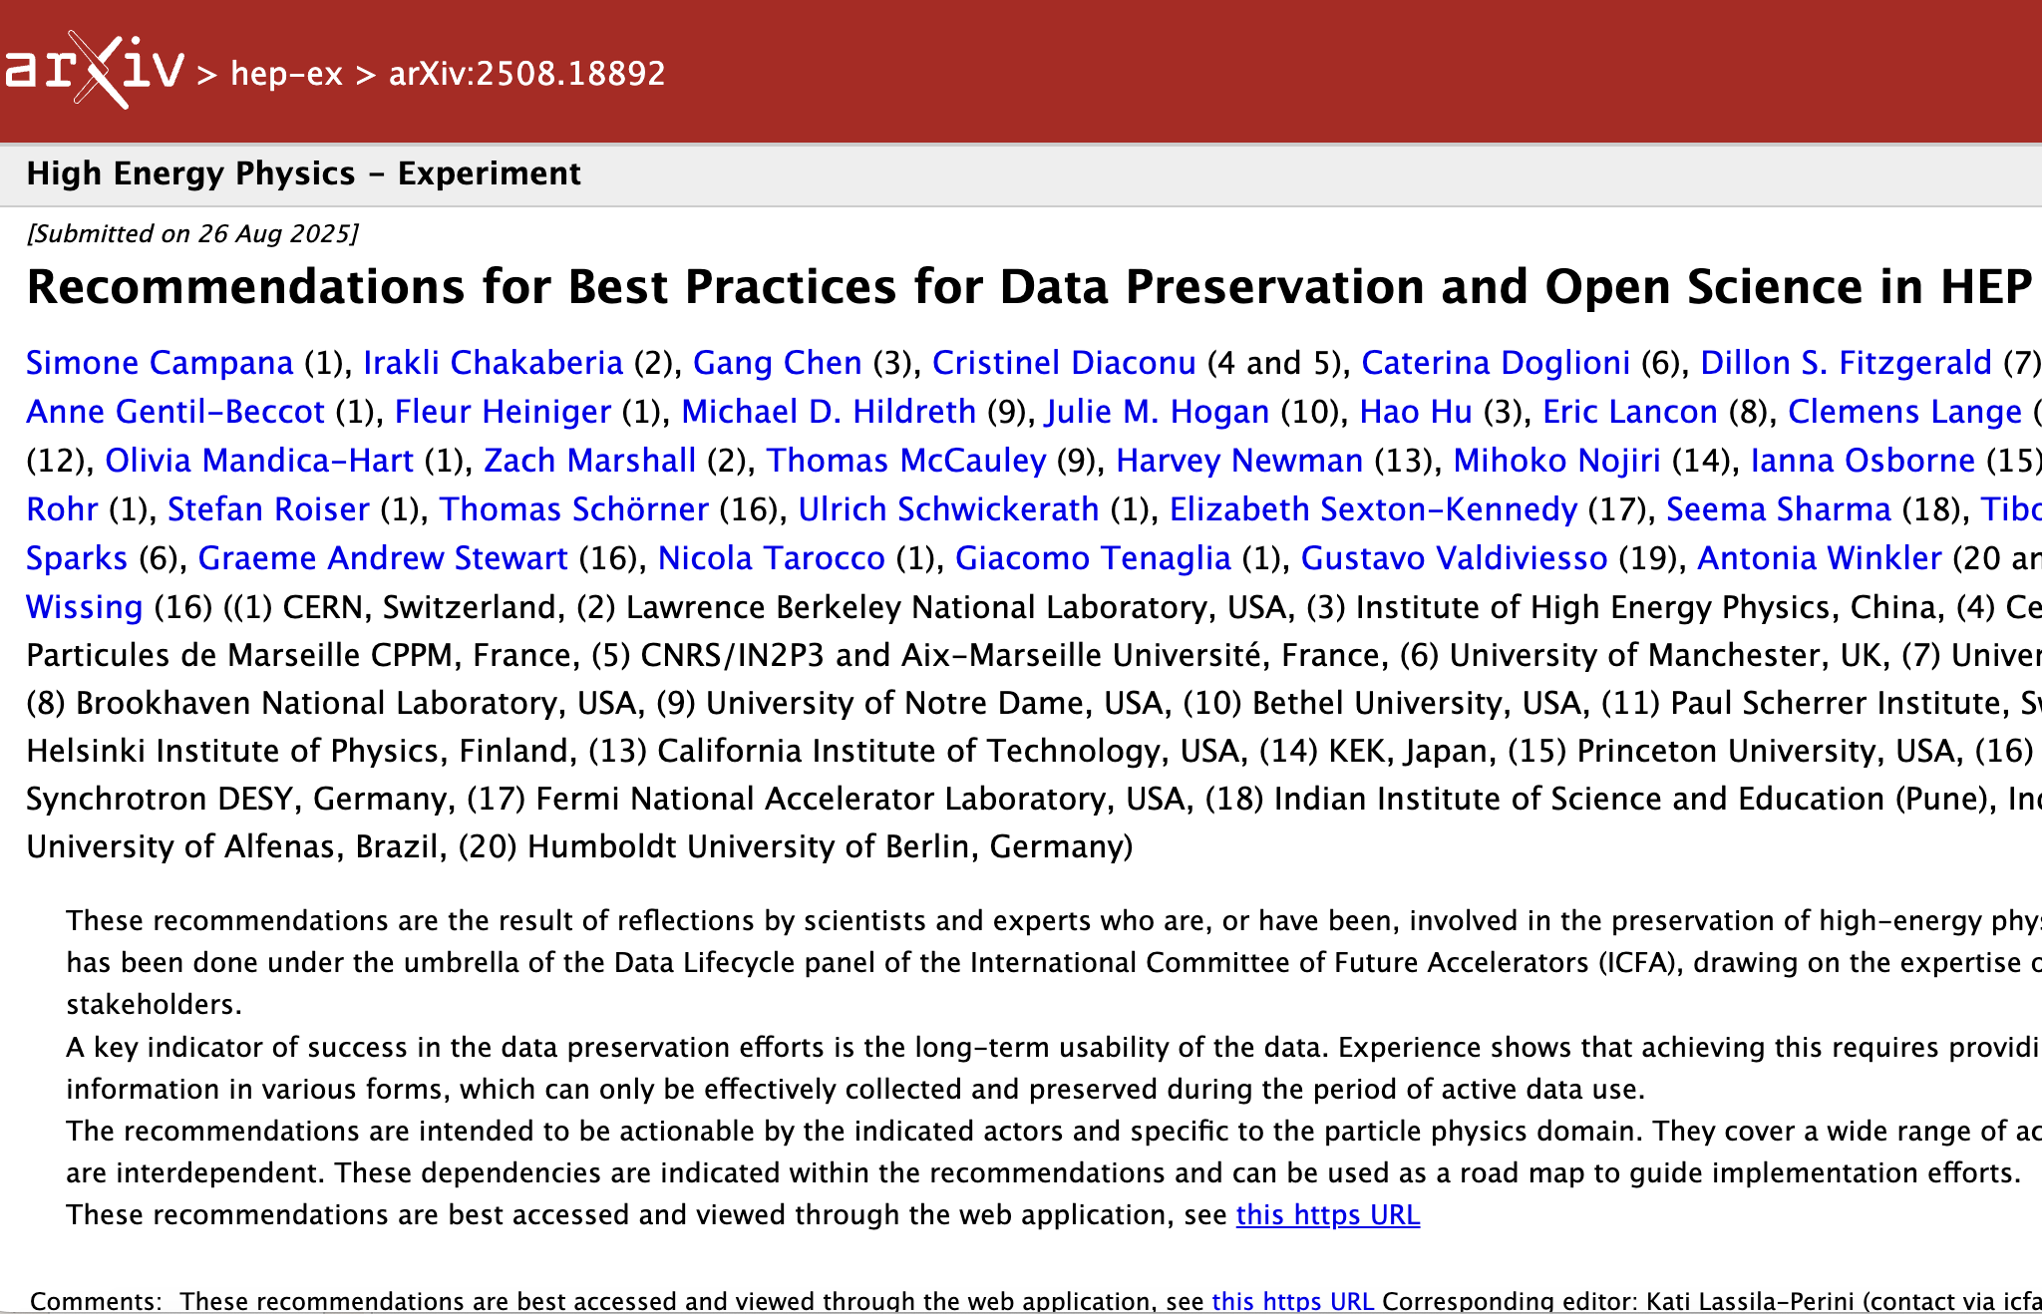
Sino-French Collaboration in Action
IHEP and CPPM are founding signatories of the DPHEP collaboration. This shared origin establishes a solid strategic partnership rooted in mutual trust and aligned scientific goals.
The partnership unites two major players in particle physics, creating a powerful, collaborative voice that shapes the future of data preservation policies and global scientific strategy at the highest levels.
Joint contributions to landmark documents like ICFA Best Practices Recommendations solidify the partnership's impact.
Notes:
how does our Sino-French collaboration actually work in practice
1.we started together. Both IHEP and CPPM are founding members of DPHEP. We have the trust and common goals
2. As two major players, China and France can have our joint voice to shape the future of data preservation policies and strategies.
3. We co-authored key documents like the ICFA Best Practices — turning our partnership into something benefits the whole field

Slide 8
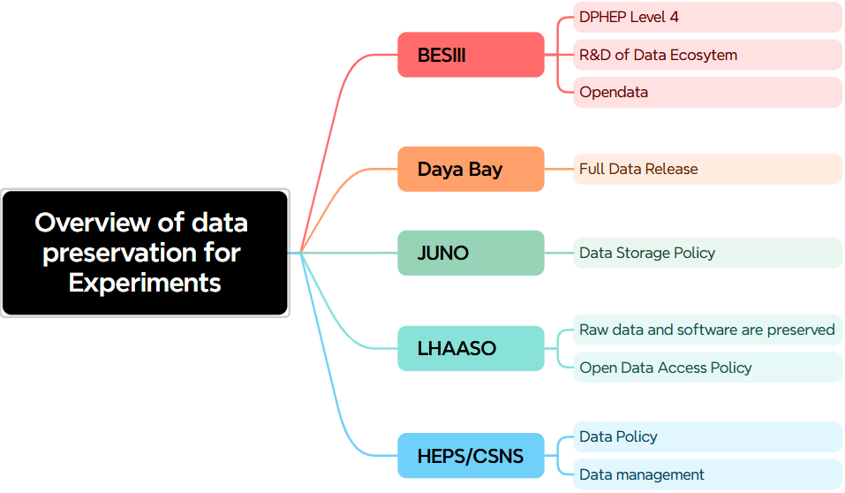
Data preservation for experiments at IHEP
IHEP actively advances the long-term preservation of data, software, and knowledge associated with these experiments.
2009-2030
2011-2020(Retired)
2025-2055
2023-2043
HEPS：2025-2055
CSNS：2018-2048
Notes:
IHEP constructs and operates quite a number of facilities and experiments, After joining DPHEP, IHEP actively advances the long-term preservation of data, software, and knowledge associated with these experiments.

Slide 9
Data preservation for experiments at IHEP
BESIII Data ecosystem (proposed in 2024)
To guarantee BESIII data’s Longevity and Usefulness
Core capabilities: storage, access, transfer, process, analysis
  Build with existing technologies while supporting new tech., e.g. AI
Seamless Data and Computing Infrastructure
  Flexibility with resources and support of time-critical tasks
Technical Concept
System services
Containers
Orchestration
User APIs
Data services
Data catalog
Data management
Storage interface
Interface to National Data Center
APIs
Network
Infrastructure
Storage
Composable
High-performance/hot data
Stable/cold data
Computing
CPU standard units
GPU standard units
Dynamical configuration
Notes:
We propose building a BESIII data ecosystem to enhance data preservation and reuse

Slide 10
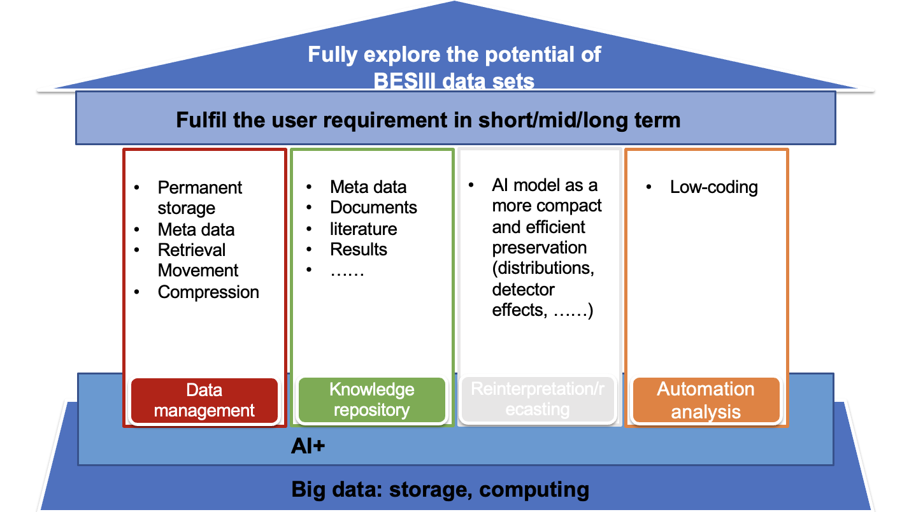
Data preservation for experiments at IHEP
BESIII Data Ecosystem Committee established in 2025
  Develop strategies and mechanisms to preserve the capacity to extract new science from the BESIII data in the long term.
To build an AI-empowered data ecosystem
Automation of traditional analysis workflow with Dr.Sai-BESIII
As a proof-of-concept: reproduce simple measurements (branching fractions of 10 J/ψ decay modes ) with limited prompts

Slide 11
Data preservation for experiments at IHEP
Daya Bay Experiment officially released the full datasets in December 2025.
  Full transparency with public availability of dataset and analysis tools.
JUNO Collaboration developed a data policy for long-term preservation.
  Raw data and reconstructed data are stored and distributed to all collaboration sites.
The LHAASO collaboration is committed to preserve and open its data, at different levels of complexity, and to allow their re-use by a wide community.
HEPS and CSNS are in the process of publishing their data policies, which will provide permanent storage for raw data and temporary storage for processed data.
Notes:
The full datasets of the Daya Bay experiment was officially released by the collaboration in December 2025.

Slide 12
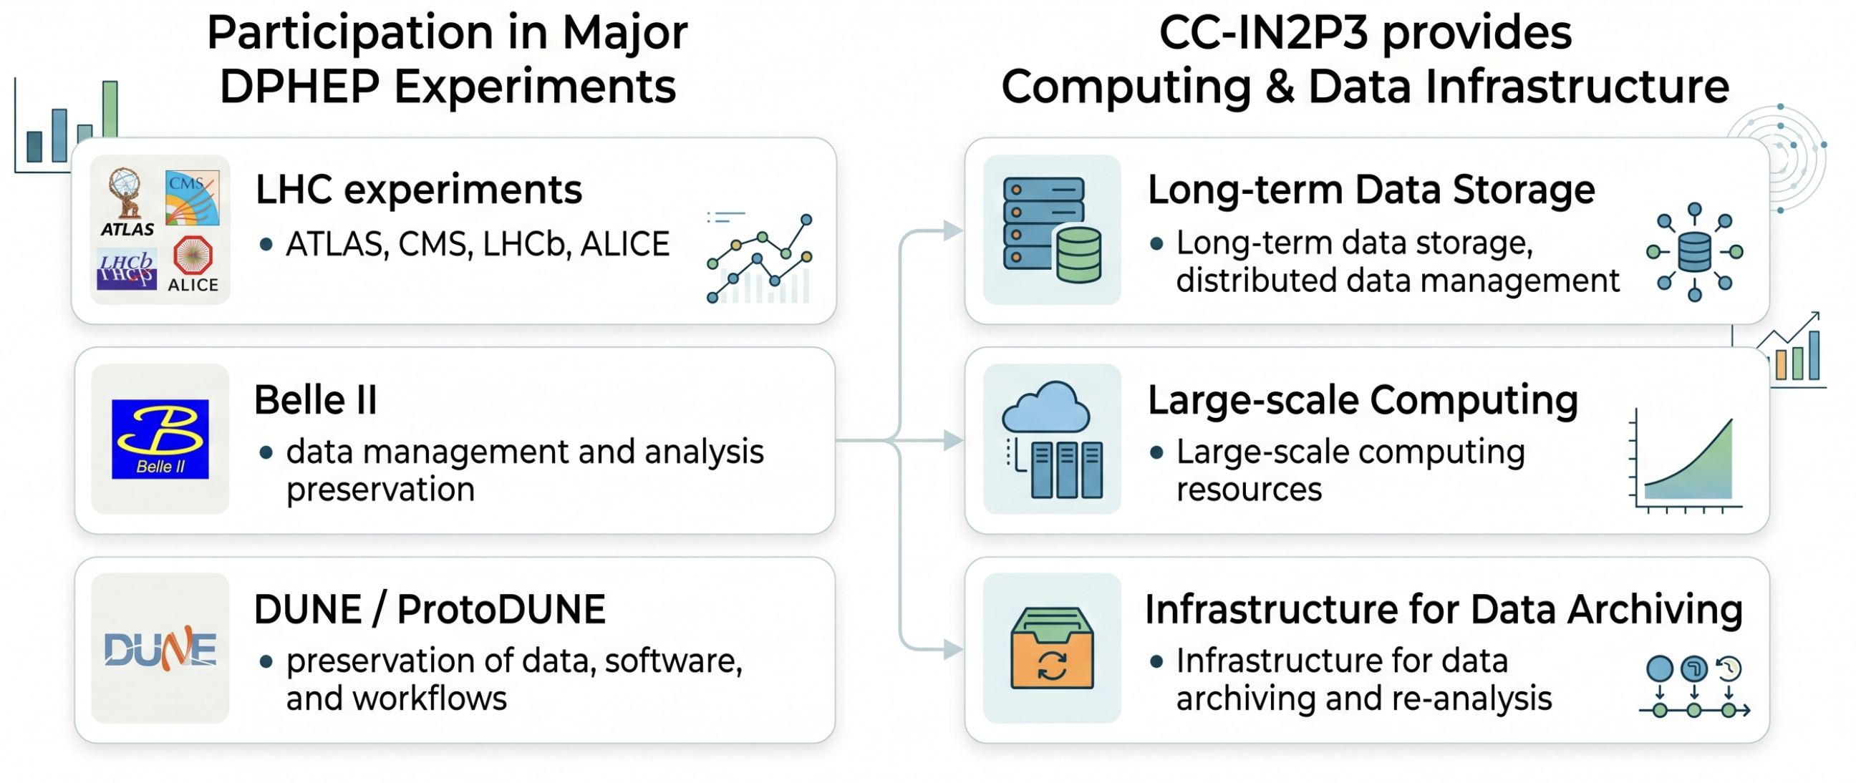
IN2P3 Contributions to DPHEP
Participation in Major flag Experiments
  LHC experiments: ATLAS, CMS, LHCb, ALICE
  Belle II: data management and analysis preservation
  DUNE / ProtoDUNE: preservation of data, software, and workflows
CC-IN2P3 provides Computing & Data Infrastructure
  Long-term data storage, distributed data management
  Large-scale computing resources
  Infrastructure for data archiving and re-analysis
Notes:
IN2P3 supports many of the world‘s flagship HEP experiments, including the LHC experiments, Belle II, and DUNE. Within DPHEP, IN2P3 contributes not only preserved datasets but also computing infrastructure, software preservation, reproducible analysis environments, and community standards, helping ensure that HEP data remain reusable and accessible for future research.

Slide 13
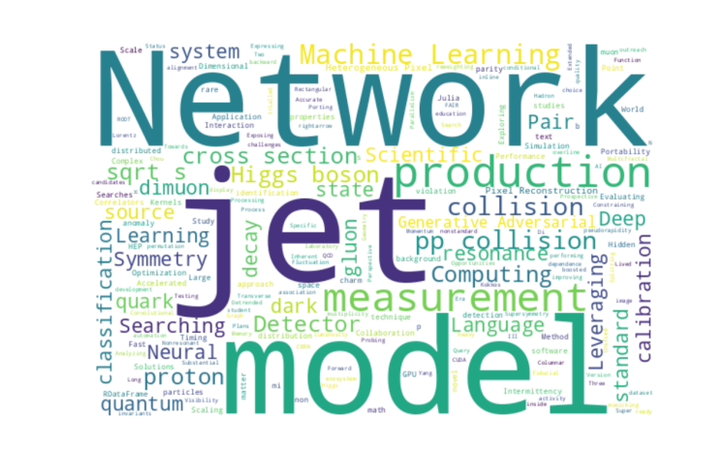
Future Trends: AI & Open Science
AI automates analysis workflows, prioritizes valuable data, and accelerates critical simulation and reconstruction processes.
CERN Open Data gives a lot of good practice of LHC experiments. These open data supports more valuable publications.
We hope that more and more experiments can join the open science and release open data to HEP field.
Notes:
CERN Open Data gives a lot of good practice of LHC experiments. These open data supports more valuable publications。We hope that more and more experiments can join the open science and release opendata to HEP field and even the public.

Slide 14
Future Outlook: Opportunities for Collaboration
Global Federated Data Preservation Network
  Establish a federated network to share resources, backup critical datasets, and unify access interfaces for seamless collaboration.
Joint Development of New Technologies
  R&D for Data Agent, construction of HEP knowledge base.
  Tools: AI-driven data compression, FPGA, computational storage etc.
Promoting Education and Training
  Post Doctor, Ph. D…
  Co-create specialized courses and training modules for early-career scientists.

Slide 15
Conclusion
It is essential for maximizing scientific output and ensuring turning raw data into enduring knowledge assets.
Frameworks like DPHEP and the ICFA Panel provide the critical structure for global coordination, ensuring interoperability and shared standards across borders.
Joint efforts between IHEP and IN2P3 demonstrate a successful partnership in shaping strategy, aligning practices, and implementing robust data stewardship workflows.
AI and Open Science are the keys to unlocking the full potential of preserved data, enabling new discoveries and broader access for the global research community.

Slide 16

Thank You

Slide 17
Data Volume of major experiments
The data generated from these experiments are crucial for driving discoveries and innovations in high-energy physics and related fields.
Research Area | Experiments /Facilities | Operation period | Storage | Data produced (per year)
Particle Physics | BESIII(BEPCII) | 2009-2030 | 10PB | 750TB
 | JUNO | 2025-2055 | 11PB | 3PB
 | DAYA BAY | 2011-2020(Retired) | 1.3PB | -
Astroparticle Physics | LHAASO | 2023-2043 | 45PB | 10PB
 | HXMT/GECAM/AliCPT | - | 4.7PB | 500TB
 | HERD | 2027-2037 | 140TB | 3PB
Light source /Neutron source | HEPS | 2025-2055 | 400TB | >300PB
 | CSNS | 2018-2048 | 800TB | 1PB
Notes:
Will be decommissioned in 2030. so the BESIII data preservation after its retirement requires more attention. besides these two, other experiments will be running for a long time. For these experiments, we can formulate the data policy and apply DPHEP level 4 model to data preservation。

