Slide 1




CPPM pixel developments
R&D On Future Colliders
Danwei Xu
CPPM, Aix Marseille Université, CNRS/IN2P3, Marseille, France
30/06/2026
xudanwei@cppm.in2p3.fr
1

Slide 2
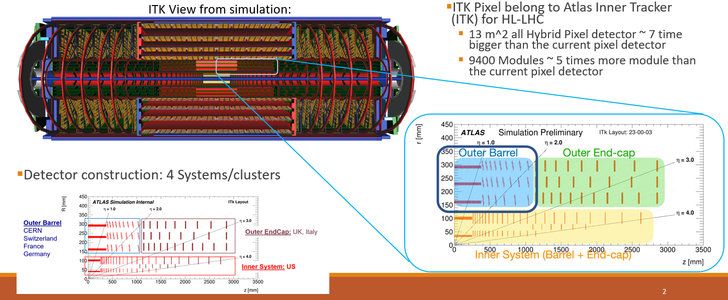
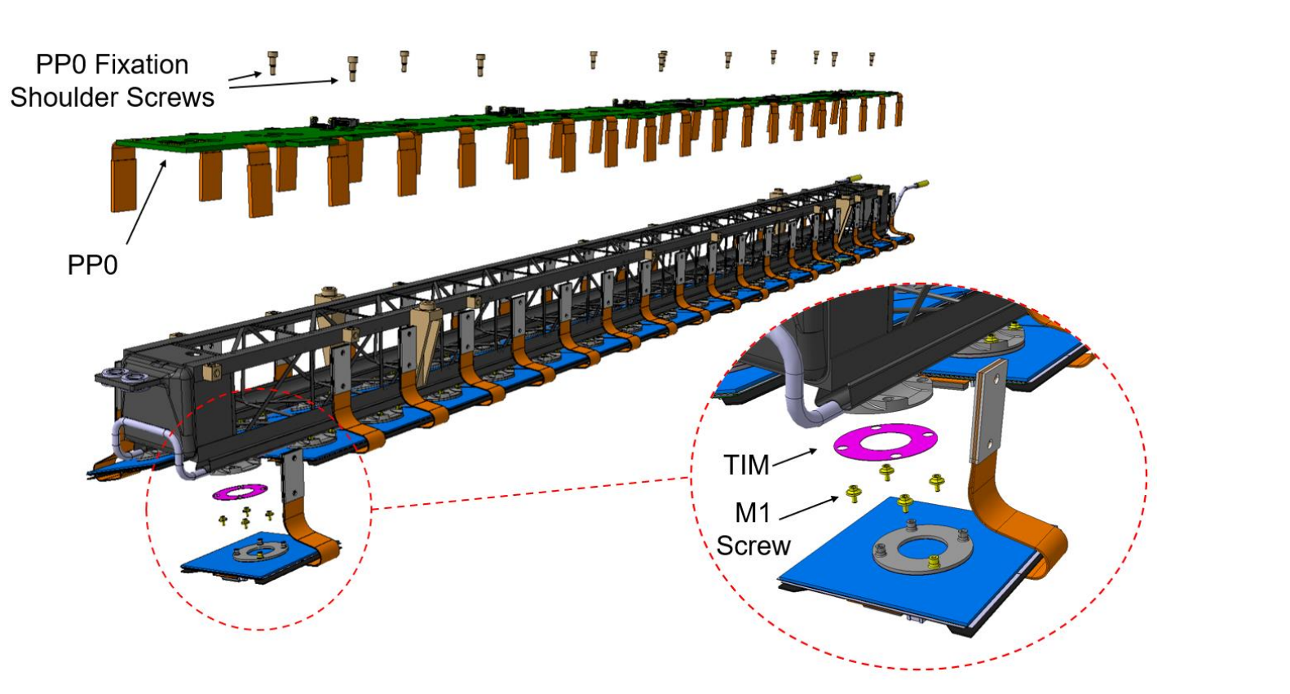
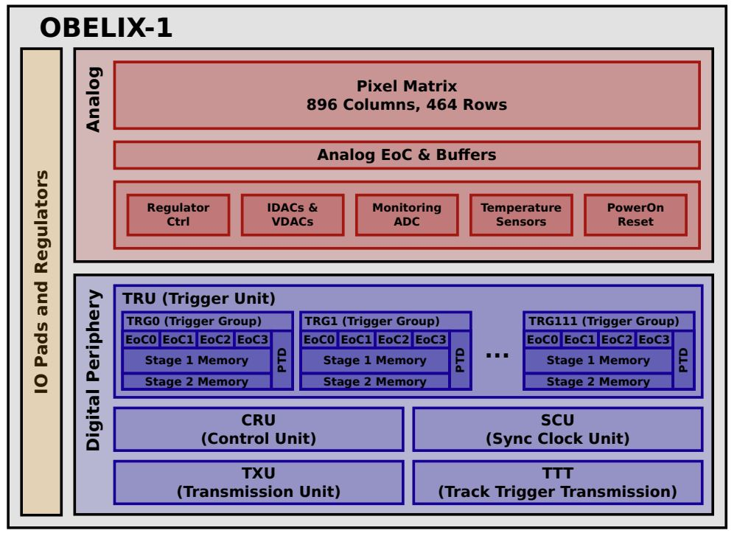
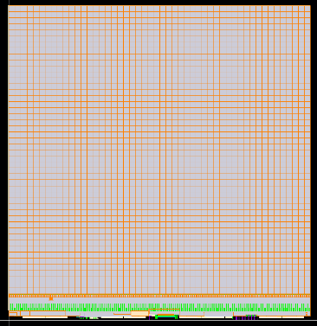
Pixels for HEP at CPPM
ATLAS and ITk project
Future Colliders and Future Projects
Architecture
Review
Internal Design
Review
2025 2026
APR
MAY
JUN
JUL
AUG
SEP
OCT
NOV
DEC
JAN
FEB
MAR
APR
MAY
JUN
JUL
DEC
1
2
3
4
5
6
7
8
9
10
11
12
13
14
15
16
17
18
19
20
21
22
23
24
25
26
27
28
29
30
31
32
34
35
36
37
38
39
40
41
42
43
44
45
46
47
48
49
50
51
52
53
54
55
56
57
58
59
60
61
62
63
64
65
66
?
?
?
?
Keys Dates
T0
33
DESIGN REVIEW
Tape Out??
Architecture definition
Requirements & Architecture
Requirement Freeze
FE Freeze
FE
Readout
Pixel dimension Freeze
Frontend
Frontend
Analog blocks
Analog blocks implementation
RTL
RTL / Schematic
DIGITAL Design and Physical Implementation
RTL Freeze
Physical Implementation / STA
Digital Macro Freeze
Verification
All activities related to verification
TOP Integration
Pinout Freeze
TOP Layout & Simulation
TPSCo 65nm OCTOPUS plan
Module Loading
ITkPix-v1 on PCB
R&D activity for TSMC 28nm
Layout ITkPix-v1
TID tests in Marseille
OBELIX for Belle-II upgrade
30/06/2026
xudanwei@cppm.in2p3.fr
2

Slide 3
VTX Upgrade for Belle II
OBELIX-1 - TowerJazz 180nm
30/06/2026
xudanwei@cppm.in2p3.fr
3

Slide 4

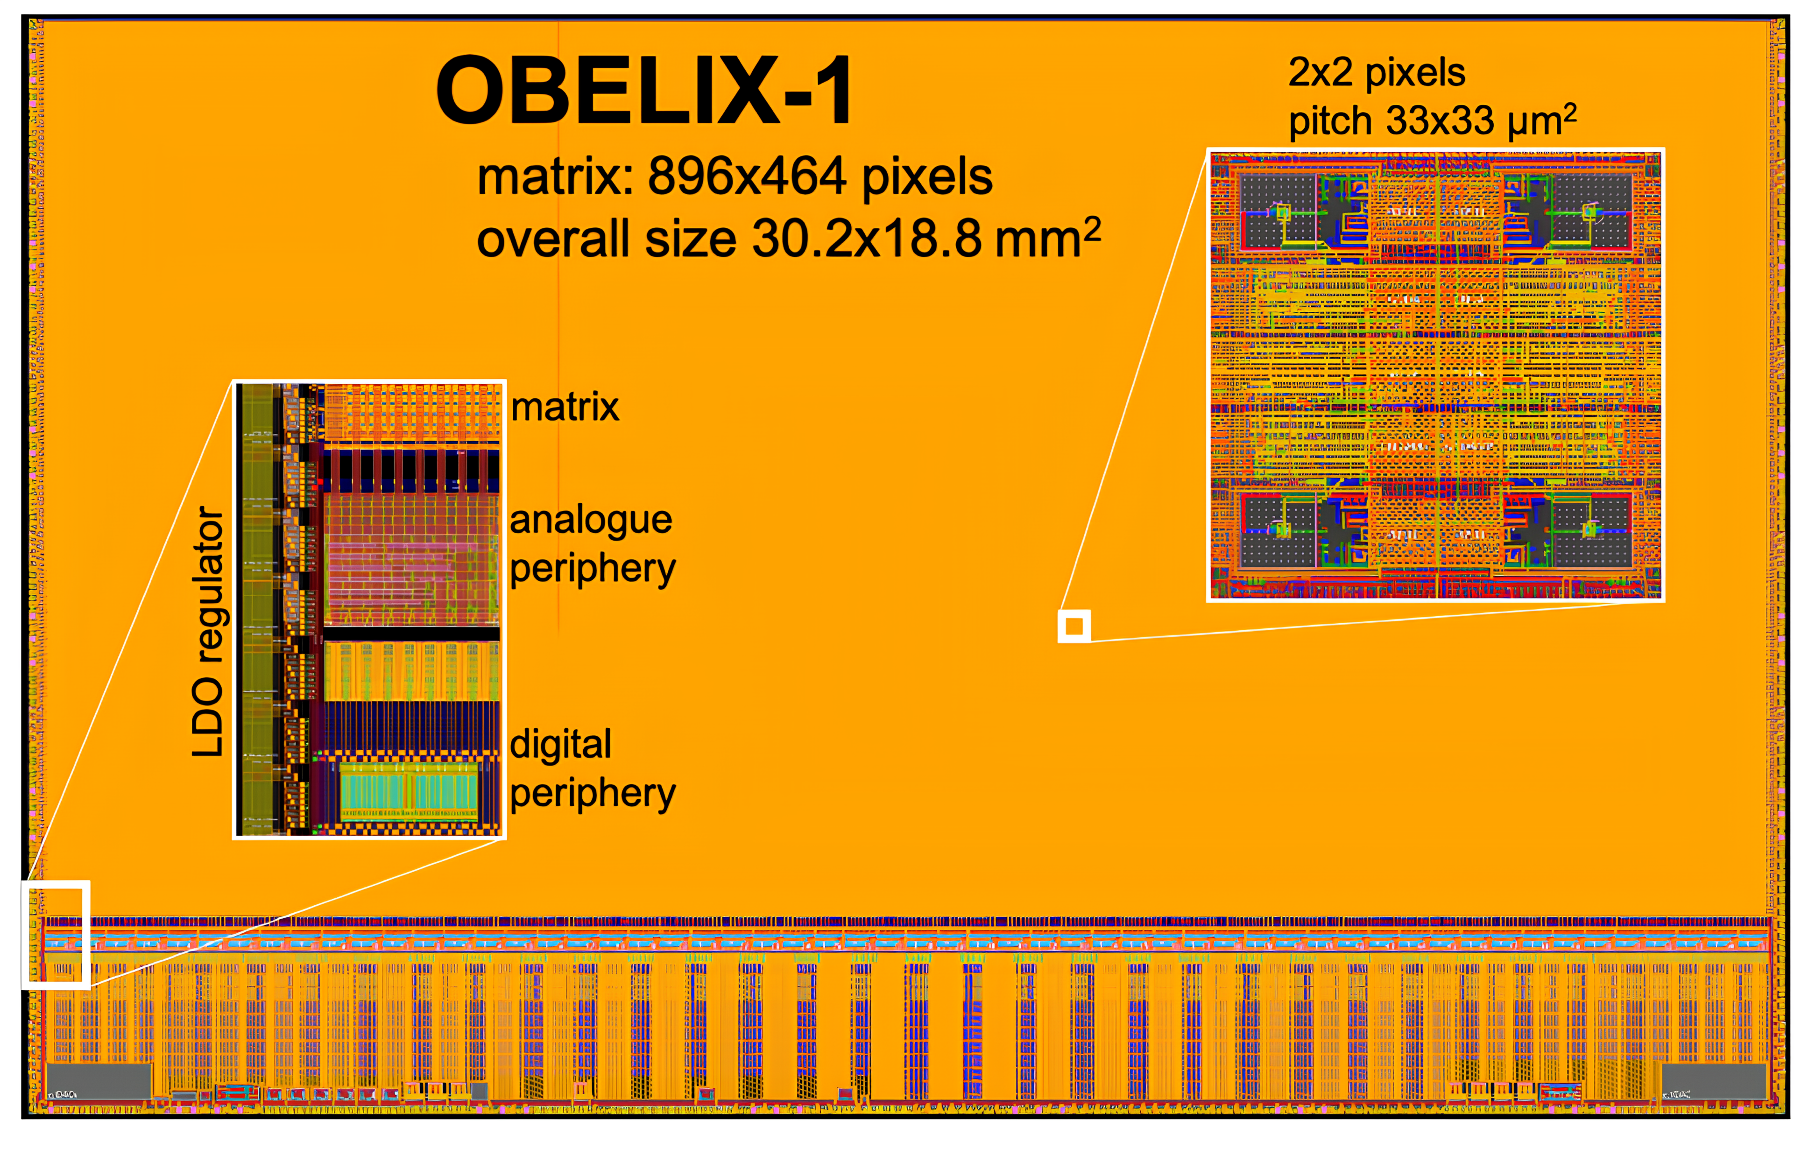
OBELIX for VTX upgrade
The Optimized BELle II pIXel sensor
Main design based on the TJ-Monopix2 chip in TJ180 technology
Pixel Matrix
  Hit rate up to 120MHZ/cm²
  TID tolerance : 10 MRad/year, NIEL tolerance: 5x10¹³n_{eq}/cm²/year
  Power < 200mW/cm²
  464 rows and 896 columns, active area 29.60 x 15.33 mm²
New digital periphery -- CPPM
  New EoC adapted to Belle II trigger – average frequency 30KHz
  Trigger latency 5-10µs
  Main Clk at 160MHz, Single output at 320Mb/s
  Signal digitization: ToT (7 bits, 20 MHz)
Power Pads
  Power management system added – LDO -- CPPM
  Overall sensor dimensions around 30.2x18.8mm²
OBELIX-1 is submit in May, and it supposed to be back in October
Documents under preparation for TDR at the beginning of 2027
OBELIX-2 design task list under discussion.
IHEP will join the OBELIX-2 design.
30/06/2026
xudanwei@cppm.in2p3.fr
4

Slide 5
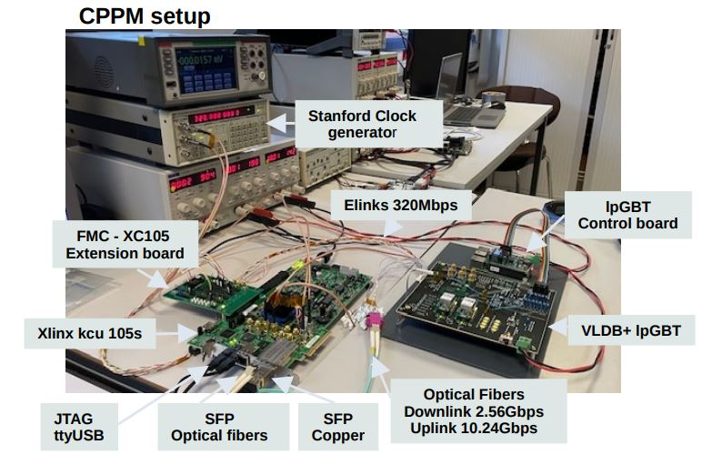
VTX DAQ Organization
Belle II VTX WG5: System Integration
CPPM participates to:
  Work Packages: Readout
  LpGBT evaluation HEPHY + CPPM
  iVTX LpGBT integration CPPM + QMUL(?)
    Chip location, PCB, cables and connectors, mechanical integration
Test work for OBELIX-1
  Joined the test training at Pisa
  Re-test all the scripts & setting at CPPM
  More engineers and institutions are still needed
  TB for OBELIX-1 is in the planning stage
More details, look at Patrick BREUGNON’s presentation
LpGBT setup status at CPPM
30/06/2026
xudanwei@cppm.in2p3.fr
5

Slide 6
R&D For Future Monolitic Collider
OCTOPUS - TPSCo 65nm
30/06/2026
xudanwei@cppm.in2p3.fr
6

Slide 7

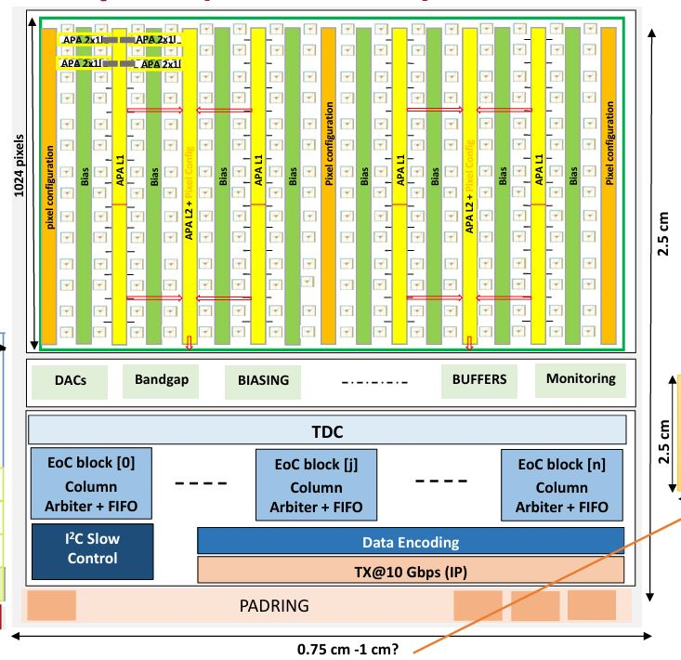
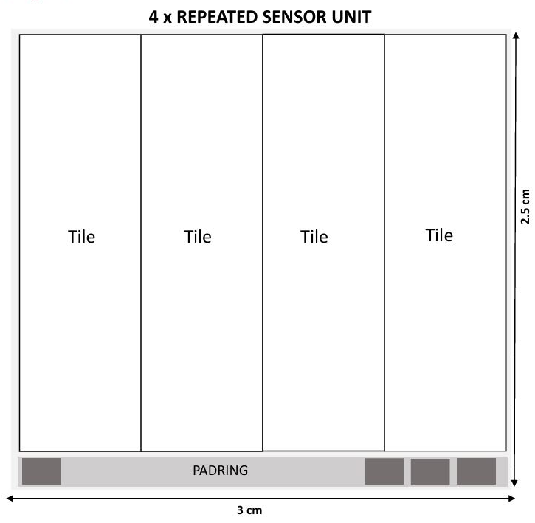
DRD3.1 Project: OCTOPUS
Optimized CMOS Technology fOr Precision in Ultra-thin Silicon
Concerns monolithic fine-pitch pixel sensors implemented in the TPSCo65 process (DRD7.6), targeting the vertex-detector requirements of future Lepton Colliders
Key final development goals include:
  3µm single-point resolution
  Down to 5ns time resolution
  Average power consumption below 50 mW/cm²
  Minimal inactive periphery area
Architecture (Designs for reference):
First prototype:
  Full reticle chip: 2.5cm x O (3cm)
  3-side buttable
  Divided to 4 tiles
    A tile feeds 1-high speed link TX@10Gbps
    Better IR drop management
    Tile: fully independent sensor
  OCTOPUS-1 : MPR2, Q4 2027
  Size: ? X Tile unit
  For each tile:
    Matrix max: 1024 rows * 360 columns
    In-pixel APA matrix
    Digital periphery
CPPM: new FE & EoC Design
xudanwei@cppm.in2p3.fr
7

Slide 8
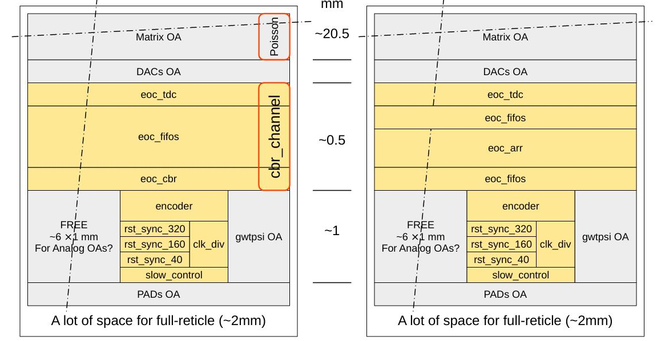
EoC & Periphery
General parameters
Active matrix: 3 * 2 cm
Pixel size: 20 * 20 µm , 1024 rows * 1440 clmns
Pixel rate : 100MHz/cm² , 600MHz/chip
  Rising and falling edge ~ 1.2GHz/chip
Two different EOC
  CBR: Column Bitmap Readout
  ARR: Asynchronous Round Robin
Raw data rate
  CBR: 21 bit/event ~ 25.2 Gbps
  ARR: 18 bit/event ~ 21.6 Gbps
RO efficiency ~ 80%
Coding efficiency ~ 80%
On-chip lpGBT Encoder & TX@10G24
  Some problem with IP sharing
ARR_EOC -- CPPM
30/06/2026
xudanwei@cppm.in2p3.fr
8

Slide 9

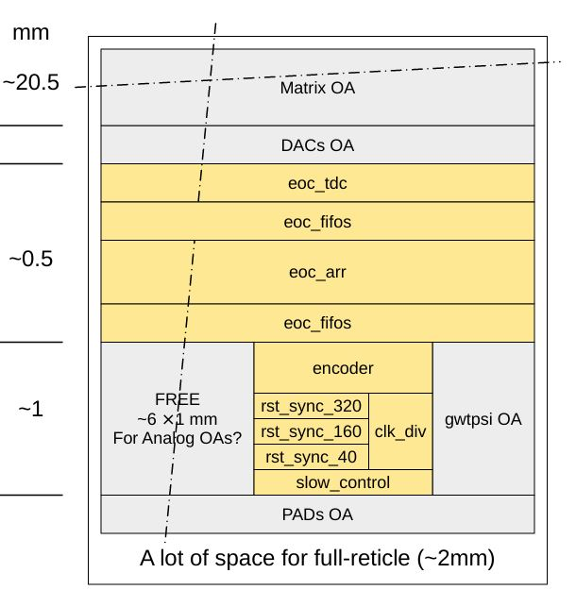
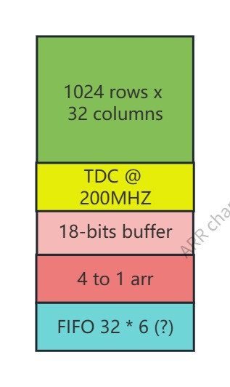

ARR_channel
ARR_channel
Module basic: 1 subframe
Matrix 1024*32
TOTAL_ROWS: 1024
NUM_ARR_CLMN: 32
TDC: 200MHz? 160MHz?
18-bits Buffer
4 to 1 ARR EOC
Sync FIFO 32bits * 6 (need sim)
Data path
ARR_Channel
30/06/2026
xudanwei@cppm.in2p3.fr
9

Slide 10
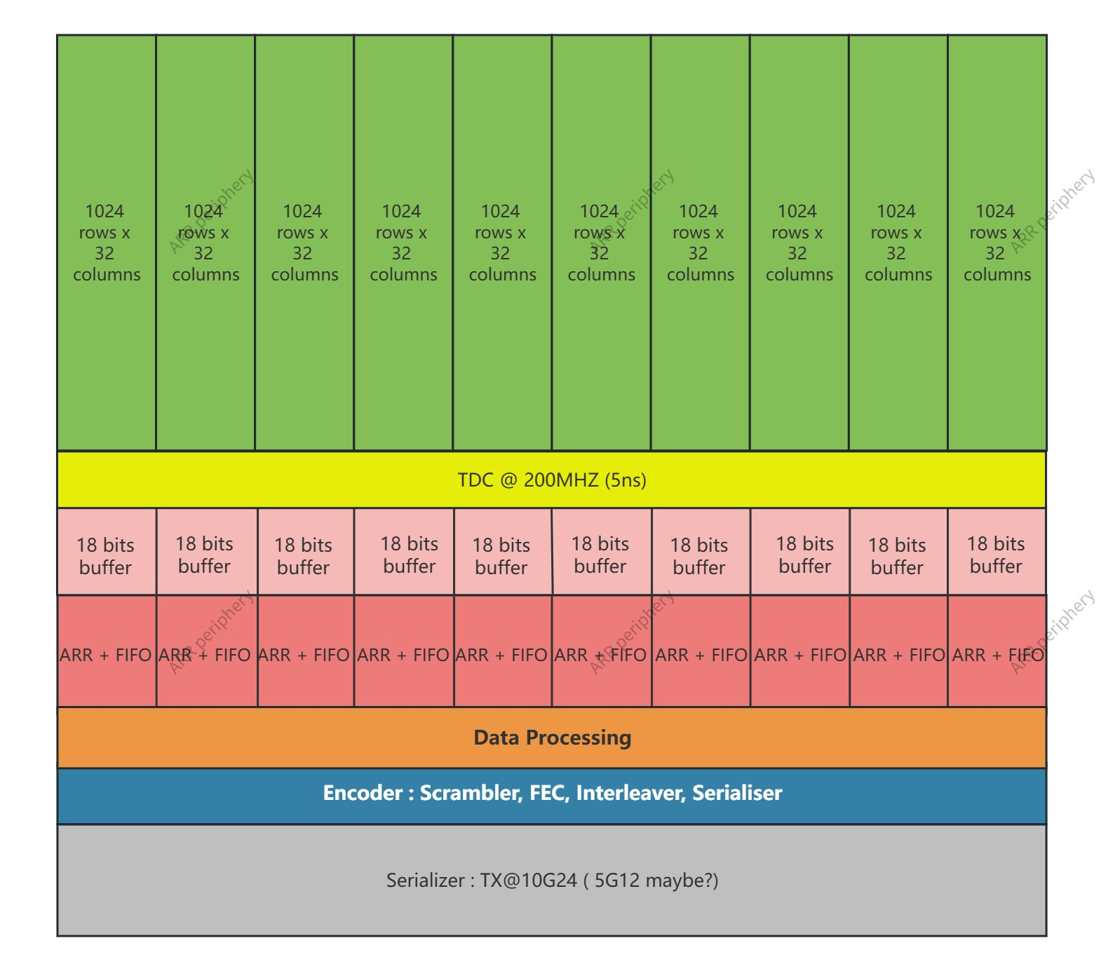
OCTOPUS – ARR EOC
My work so far:
OCTOPUS: ARR_EOC channel
RTL codes writing, simulation
Asynchronous Priority Arbiter
In-pixel APA, 4*2 to 1 used
Async Buffer size – 18bits (reserved more?)
TDC use common module
Round-Robin Arbiter used
First combine column data ( 4 to 1 )
Sync FIFO after EOC : 32 *6 (not fix)
Adapted to lpGBT protocol
Output TX@10G24 (5G12 maybe, need sim)
Matrix clk
CDC
System clk
30/06/2026
xudanwei@cppm.in2p3.fr
10

Slide 11
Developments for future pixel hybrid detectors
TSMC 28nm R&D
30/06/2026
xudanwei@cppm.in2p3.fr
11

Slide 12
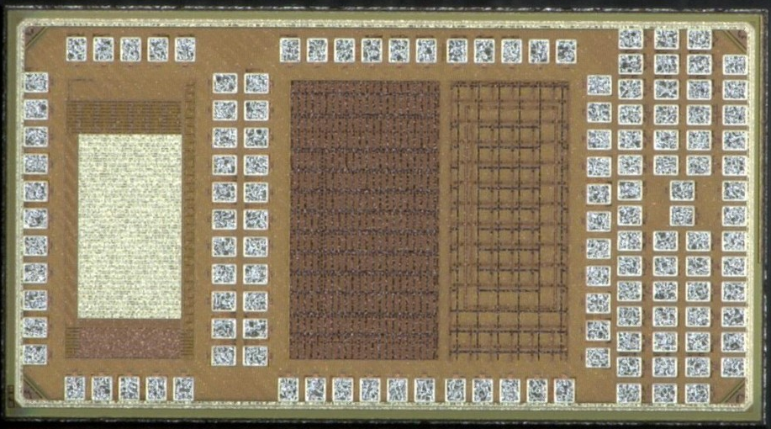
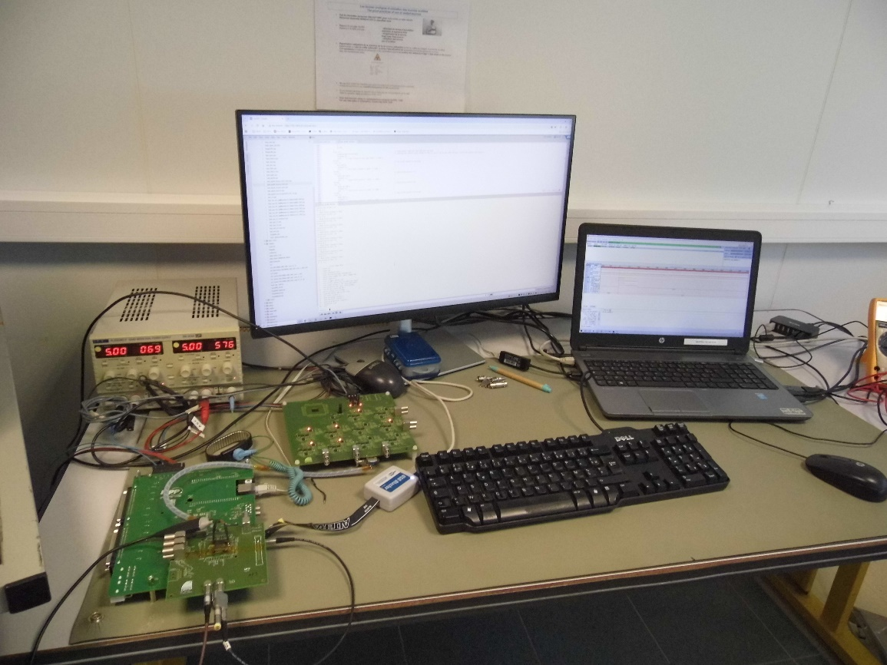
Latest test setup
Single
devices
Latest test started from July, 2025
The test set-up based on a mini PC board
    An FPGA deals with the low level interface (clock, IO. . . )
    16 bit DAC, 14 bit ADC implemented
    High level programming framework (C++)
    Easy Ethernet interface
    Up to 50 m link
16 bit DAC controlled by the nano PC board
    The threshold voltage
    Feedback transistor bias
    Injection charge level
The injection circuit is integrated in the DAQ board
The bias currents for the chip are generated from a dedicated card
Large bandwidth oscilloscope used for jitter measurements
Pixel array
SET
RO - TID
Bias currents card
Acquisition board
Pixel Chip
30/06/2026
xudanwei@cppm.in2p3.fr
12

Slide 13
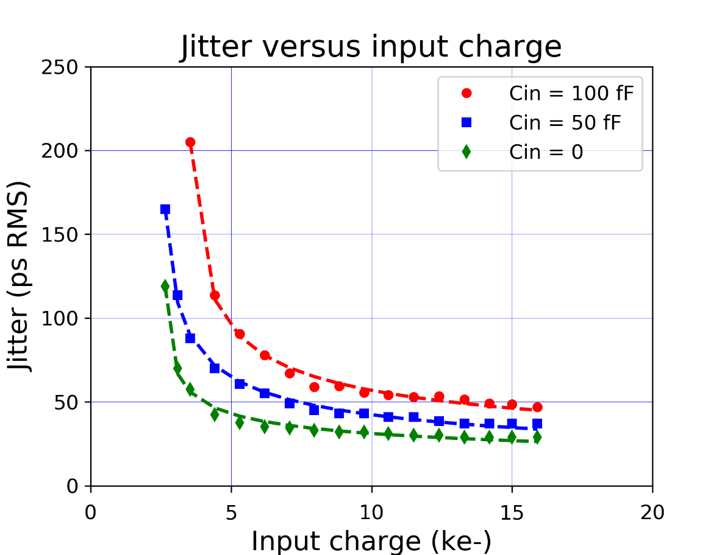
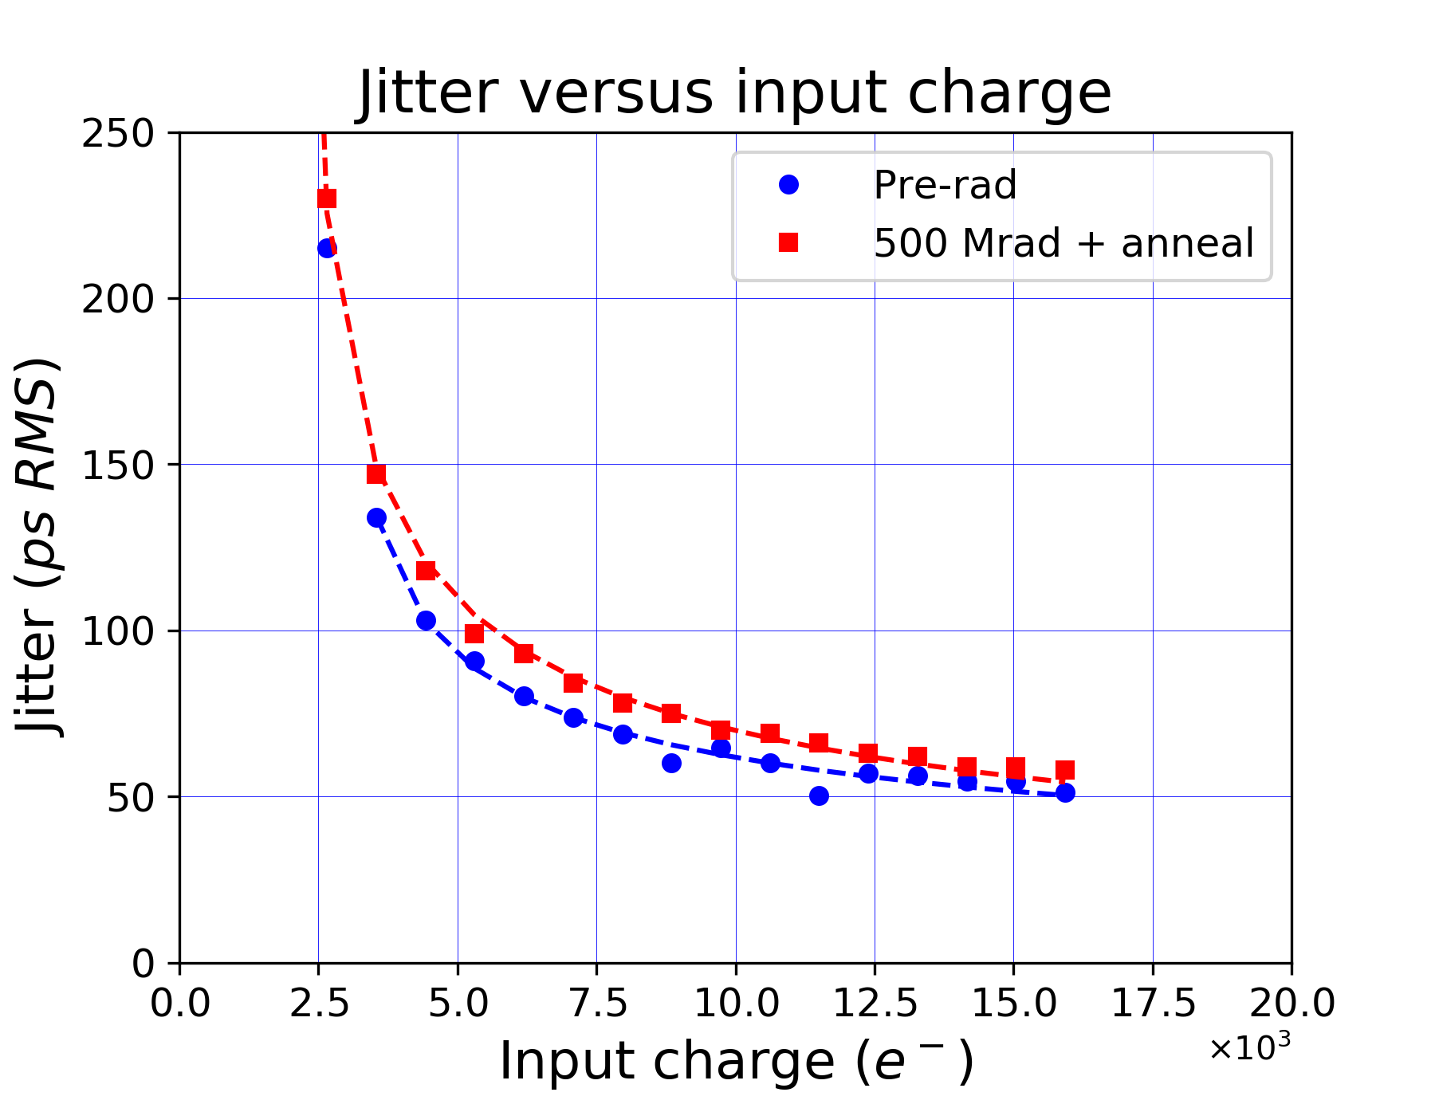
Pixel array test
The measurements based on the histogram of the time delay between the injection charge and the pixel output
For large charge (> 15 ke-),
  the jitter level is lower than 50 ps RMS for Cin = 100 fF
  The jitter is 37 ps RMS for Cin = 50 fF
Measurements showed that the jitter level depends substantially on the applied threshold especially for small charges
TID tests was done in close collaboration with TU-Graz
Tests carried out at ambient temperature
Total dose of 500 Mrad reached
Good recovery during the annealing time
Shift of ~ 10ps after irrad + annealing
Comparison of timings between different charged chip
Continuation of the project :
A new 28 nm large pixel array under design and focused on :
  TDCs implementation for time measurements (ToA and ToT)
  Digital pixel
  Bump bond the readout chip with sensor array
  Submission of a 2nd pixel matrix including TDC in pixels (end of 2026)
Comparison of timings between pre-rad and irradiated chip
30/06/2026
xudanwei@cppm.in2p3.fr
13

Slide 14
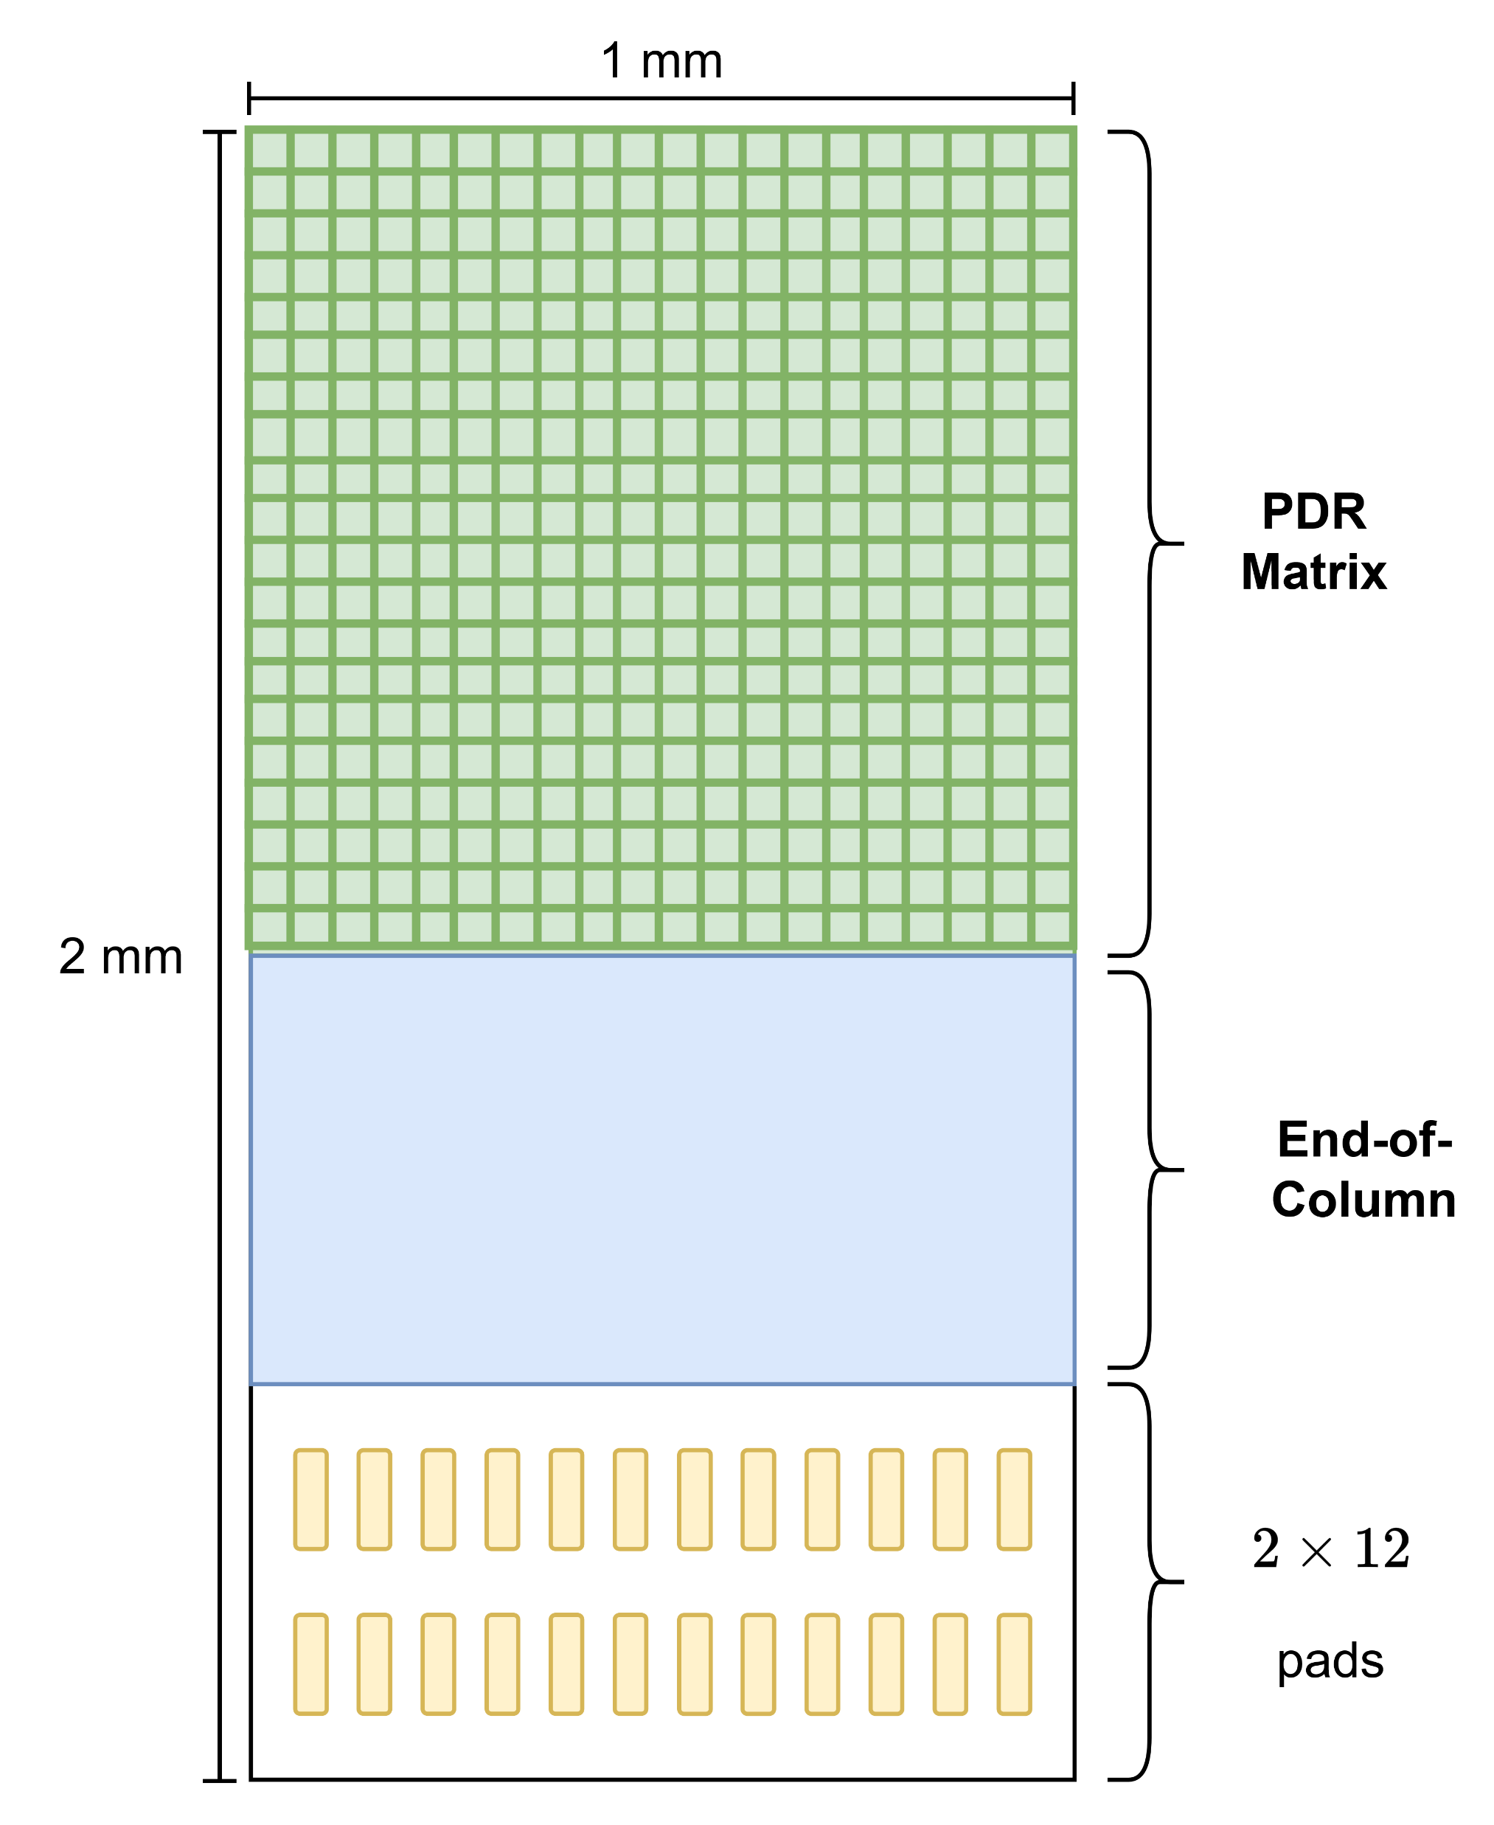
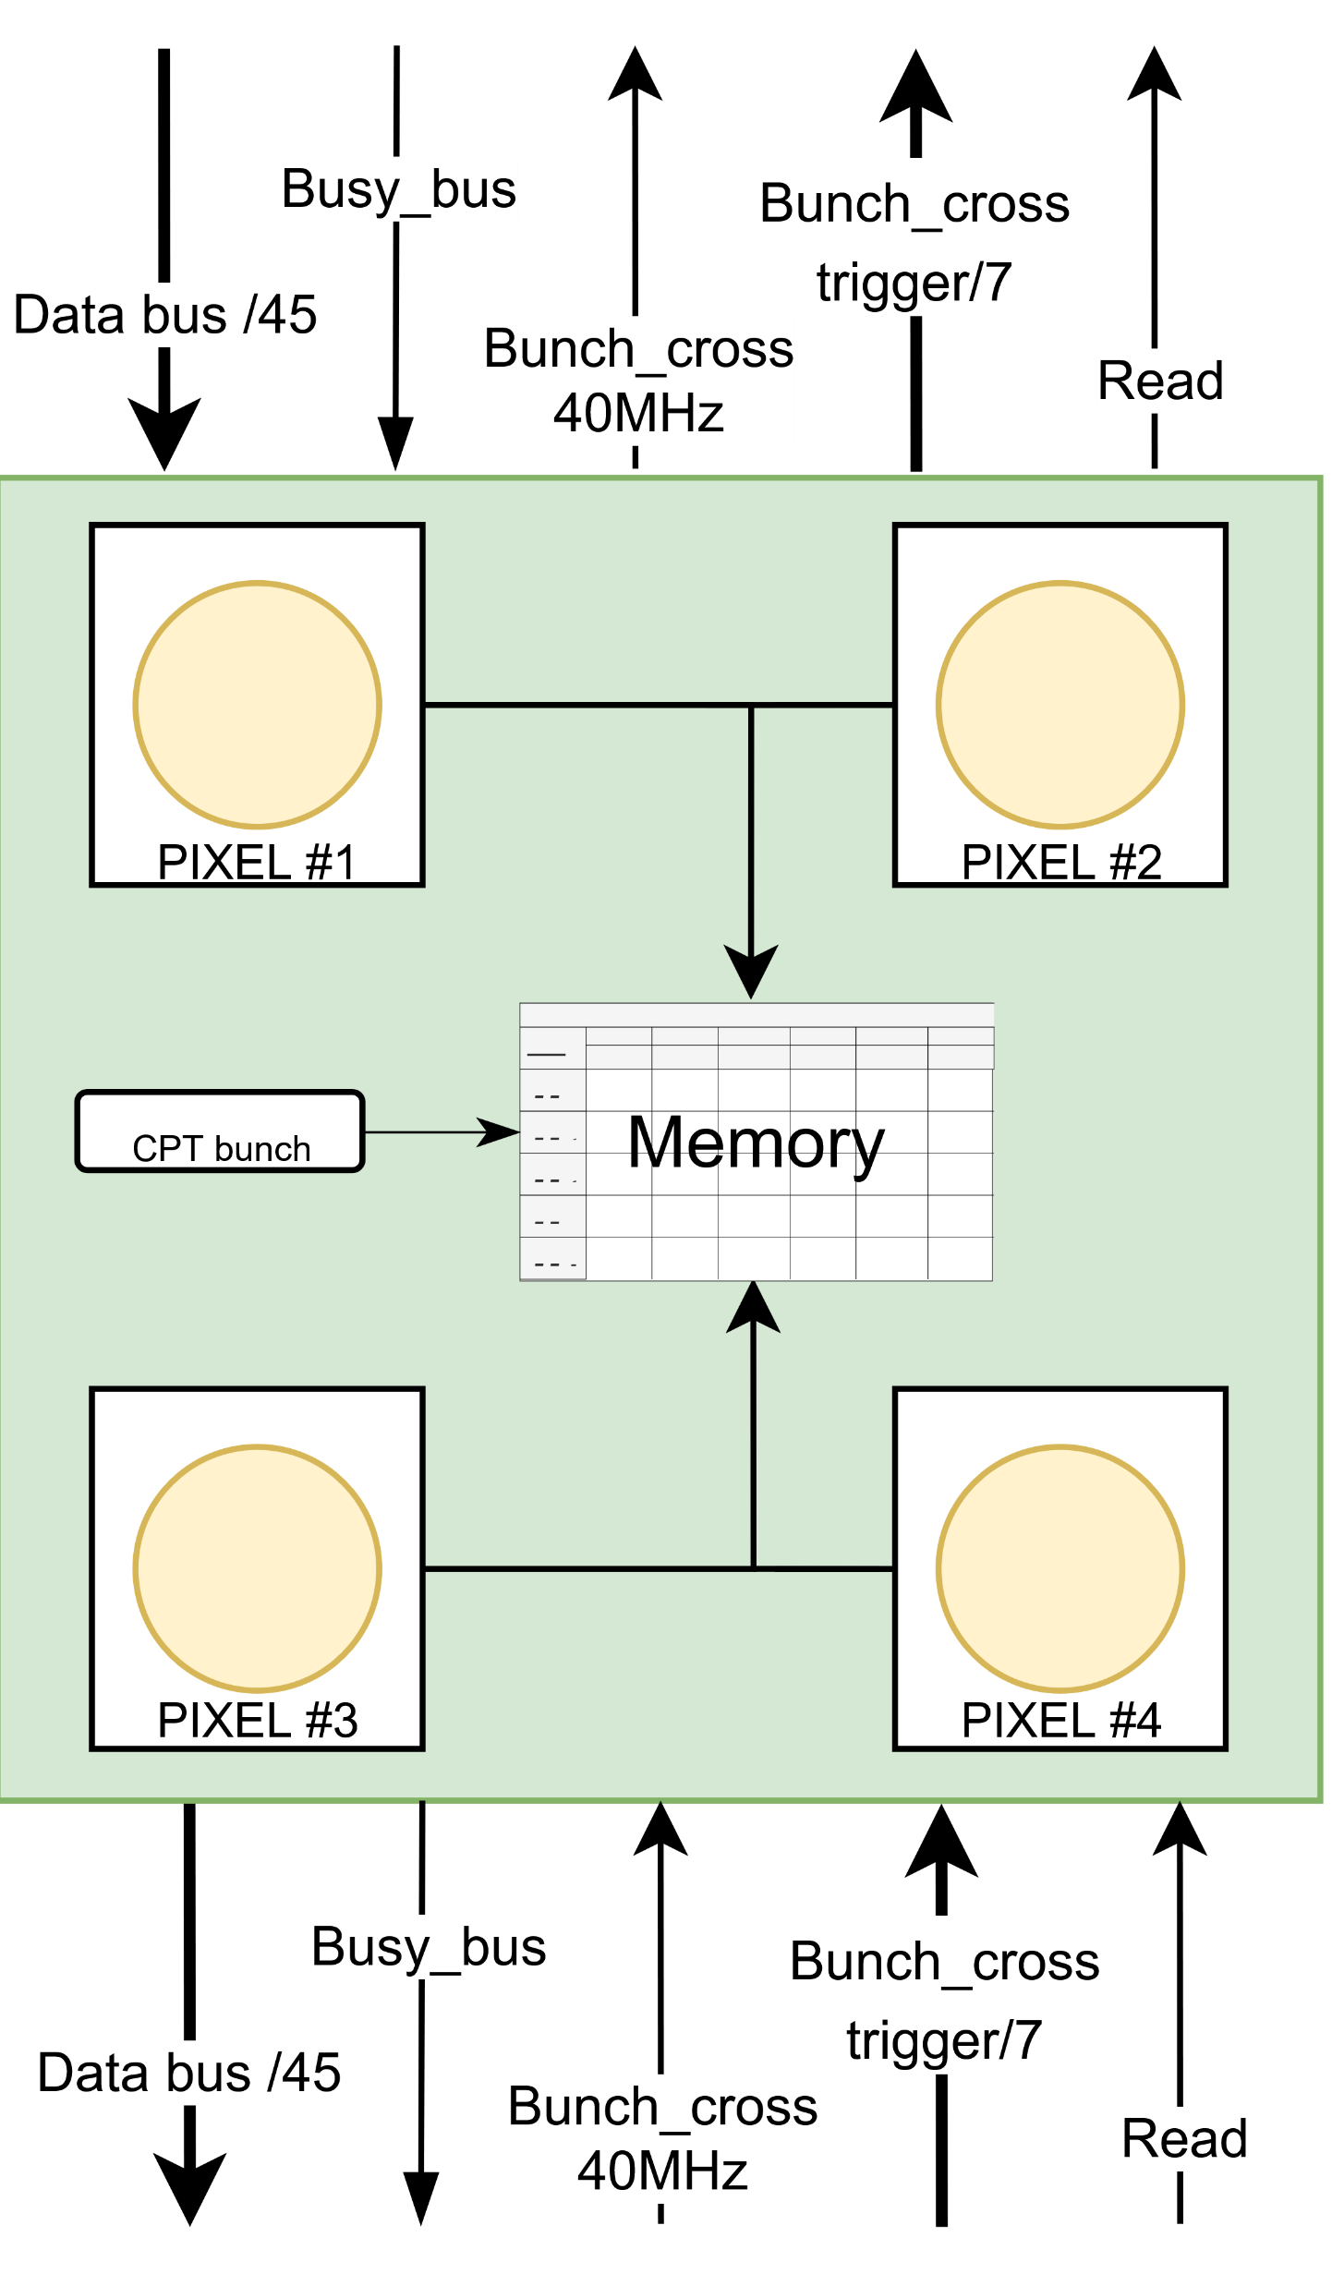
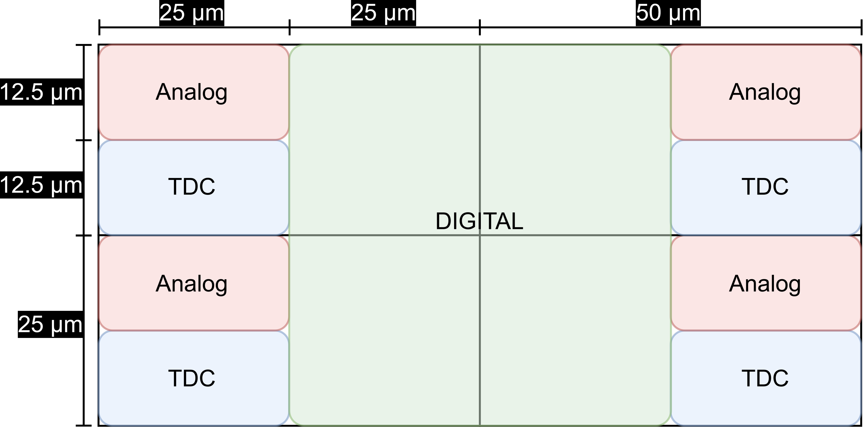
Prototype Pixel Reader 28nm
Digital Architecture
Digital Architecture 28nm:
Goal: For Extract, filter, and temporarily store precise timing (TOA) and energy (TOT)
Mutualized digital logic (Pixel Digital Region - PDR) managing 4 pixels (50x25 µm each) simultaneously to save space
6-bit Time of Arrival (TOA) at 50 ps precision and 8-bit Time Over Threshold (TOT) at 1ns.
Local FIFO buffering designed to hold up to 5 events during the 12.5 µs trigger latency, statistically validated via Poisson distribution to cover >99.9% of cases
For now current RTL synthesis occupies only 1071.7 µm², utilizing less than half of the 2500 µm² allocated budget
Physical Layout Overview
Functional Block Diagram of the PDR
Next Steps:
Physical Implementation: Transition to the Back-end flow (Place & Route) using Cadence Innovus and the CERN Flowkit
Sign-off: Perform post-layout simulations, parasitic extraction, and physical verifications (DRC/LVS)
Tape-out: Generate the final GDSII file for foundry submission
Floorplan of a 50 µm × 50 µm Pixel Digital Region (PDR)
30/06/2026
xudanwei@cppm.in2p3.fr
14

Slide 15
Conclusions
The CPPM team works on hybrid pixel technologies, either for the ATLAS ITk project (RD53), the upgrade of BeIIe II proposal (TJ 180nm) or in R&D for future colliders in TPSCo 65 nm & TSMC 28 nm
Beautiful developments have occurred in Depleted MAPS technologies in CPPM, with prototypes produced in 10 different technologies
CPPM is now focusing on monolithic prototype with TJ 180nm, TPSCo 65nm technology
Good developments and progress made by the CPPM group and others on DRD3.1, DRD7.6, TPSCo 65 nm
Obtained good results for future hybrid pixel developments by the CPPM group and in TSMC 28nm
CPPM has always had very close cooperation with China. Exchange activities were resumed in 2024, and there will be more cooperation plans in the future
30/06/2026
xudanwei@cppm.in2p3.fr
15

Slide 16
Thanks for your attention
xudanwei@cppm.in2p3.fr
16

Slide 17
Back up slides
xudanwei@cppm.in2p3.fr
17

Slide 18
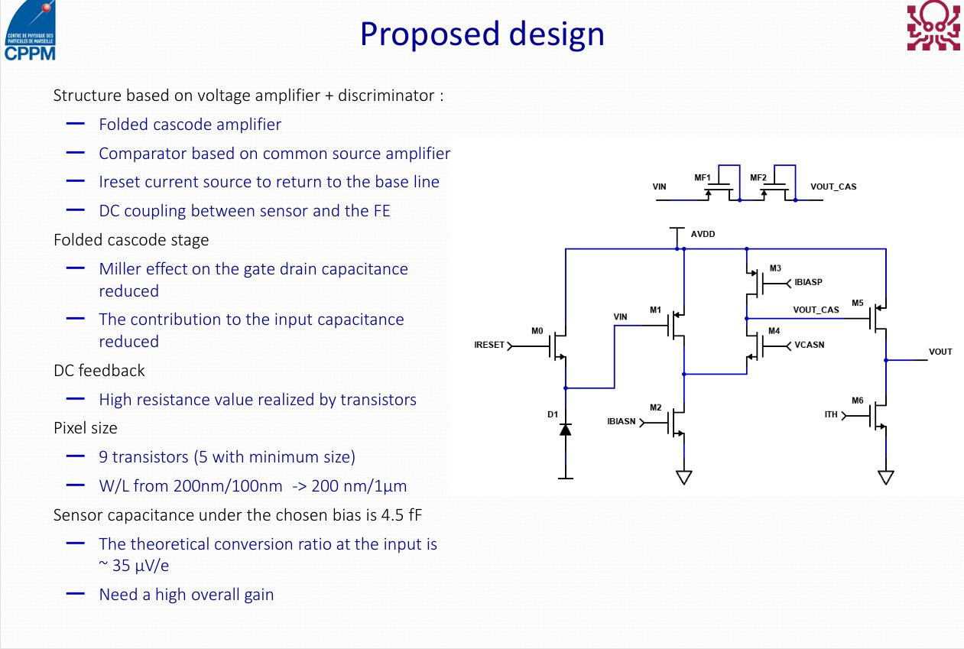
xudanwei@cppm.in2p3.fr
18

Slide 19
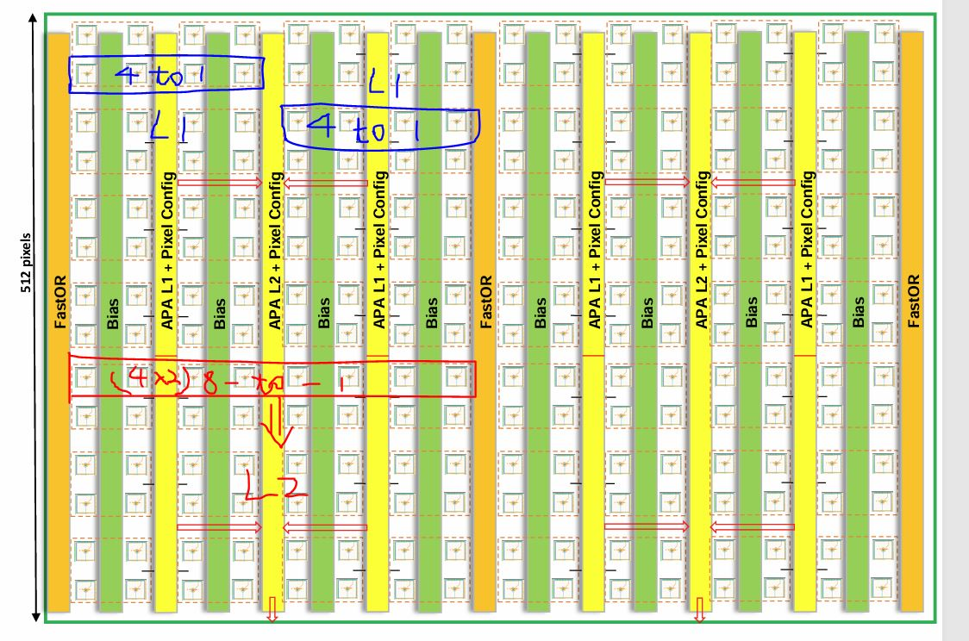
xudanwei@cppm.in2p3.fr
19

Slide 20
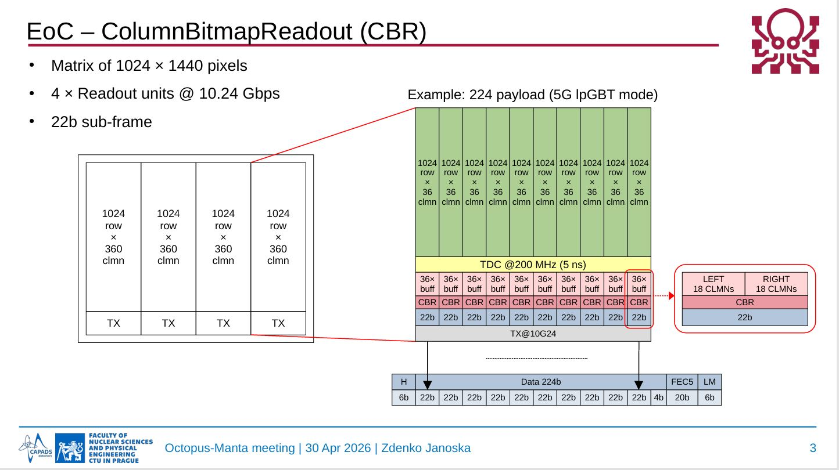
xudanwei@cppm.in2p3.fr
20

Slide 21
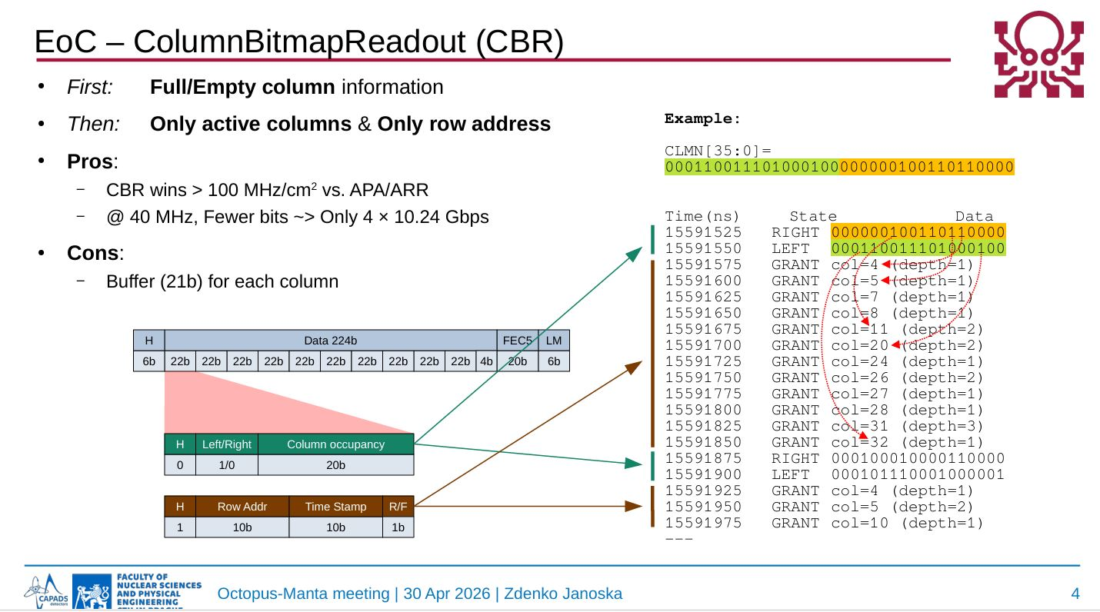
xudanwei@cppm.in2p3.fr
21

Slide 22
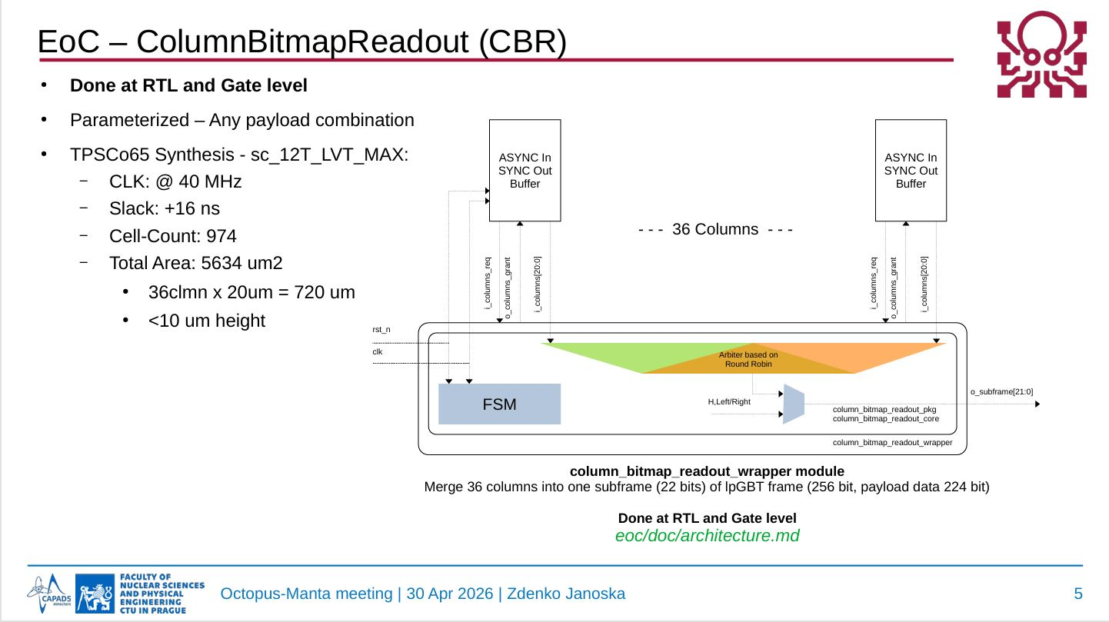
xudanwei@cppm.in2p3.fr
22

Slide 23
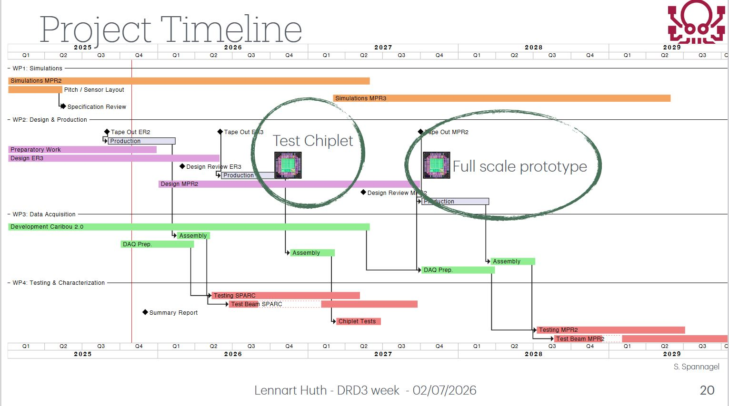
xudanwei@cppm.in2p3.fr
23

Slide 24
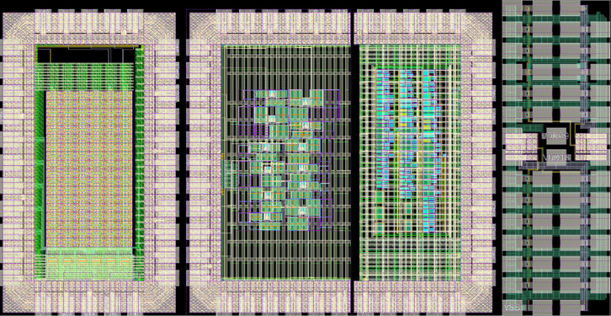
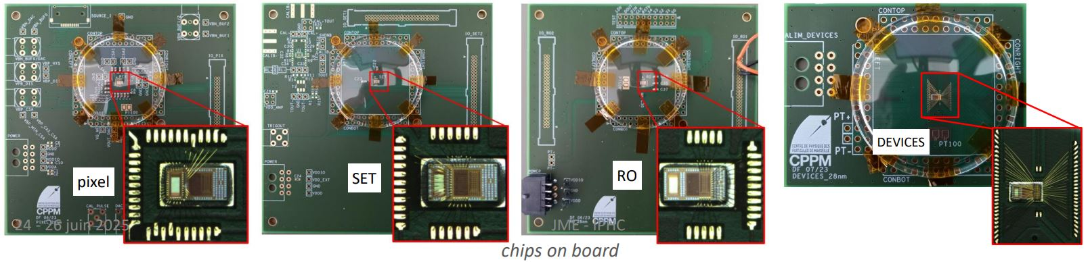
TSMC 28nm activity
Analog Pixels
SET
RO - TID
DEVICES
Done with the CERN R&D Program on technologies for Future Experiments
CPPM is a member of two working groups within the DRD (ECFA) projects: WG 7.3a & WG 7.4b
For future upgrades and future colliders
Higher requirements:
  Time resolution,
  High hit rate,
  Larger data links,
  Small pixel size, etc
  New technologies need to be applied
4 sub-chips of 2×1 mm² submitted December 22
Implemented Structures:
Pixel_28nm
RO_28nm
SET_28nm
DEVICES_28nm
Each chip is bonded on its own board (ball bonding)
The 28nm prototype was received in June, 2023
xudanwei@cppm.in2p3.fr
24

Slide 25
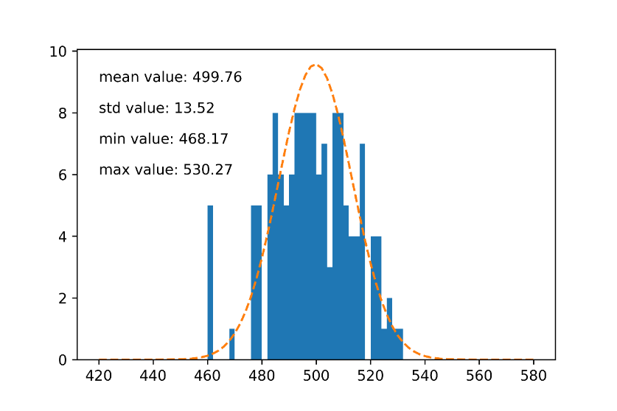
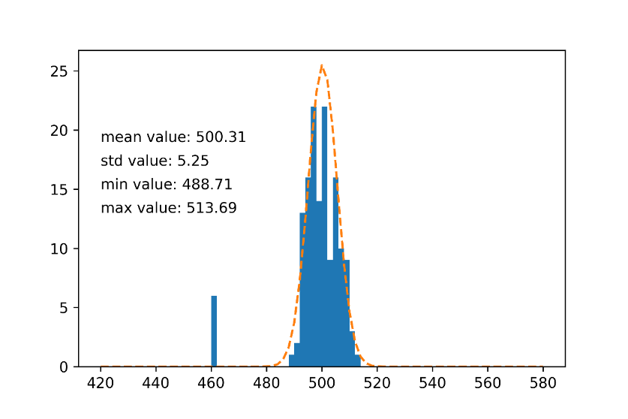
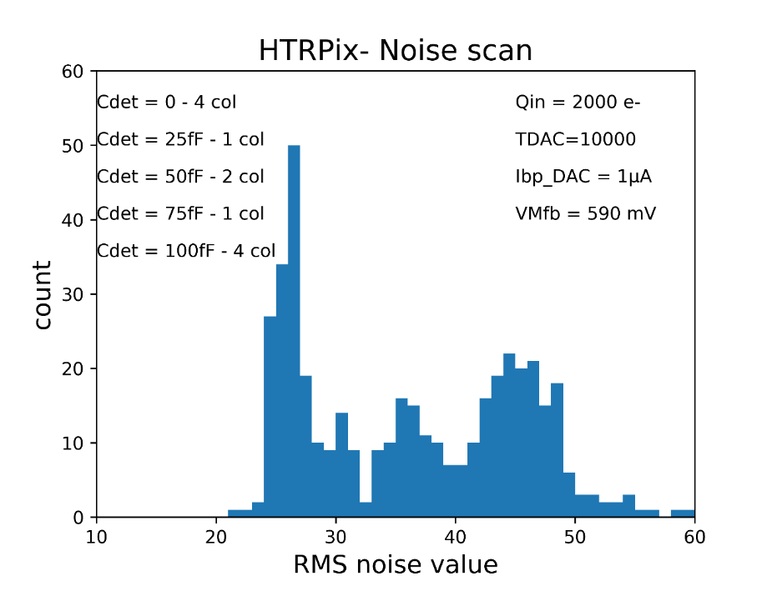
Test results for 28nm
Pixel_28nm
Process qualification in terms of performance for analog, low power and low noise circuits
Goals of this pixel matrix design
  Study the limits to time resolution in analog front
  Bandwidth, Noise, Current bias, power supply
Threshold scan and tuning
  CSA base line ~ 300 mV
  After tuning : RMS value = 130 e⁻ -> 52 e⁻
Noise and time resolution measurement
Before tuning
After tuning
charge | Jitter (simulated) | Jitter (measured)
Q > 4 ke- | < 100 ps | < 150 ps^{(*)}
Q > 10 ke- | < 50ps | < 100 ps^{(*)}
Test Results for Pixel_28nm
SET_28nm
2 different parts in the SET chip: Target cells & Width measurement
Same architecture used in the RD53_SEU chip
Need a beam time ( 3 ~ 4 hours ), test bench is ready now
Goal: define a time width to mask on sensitive nodes
Pixel test bench
xudanwei@cppm.in2p3.fr
25

Slide 26
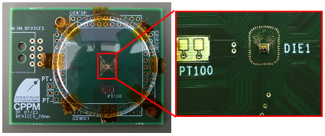
Test results for 28nm
RO_28nm
Goal: For TID effect Study of Digital Technology Cells
INV, NAND, NOR, and DELAY are implemented
Bug on enable management: can’t test it in static mode
Each cell is connected to its proper counter
DEVICES_28nm
Goal: automatic extraction of transistors parameters for each channel valid
Transistors test bench includes:
  4 SMU’s (Keithley - 4201+PA)
  4 switches matrix boards (Keithley-7174A)
Devices implemented on the chip without ESD protections
New test just started from July, 2025
28 chips will be tested
Test objects:
Cell Size 7T / 9T / 12T
Flavours SVT / HVT / LVT
Time Propagation
Measurements on 10 chips
All digital cells: propagation time 5~20 ps
12T more faster than 7T (SVT)
Temperature variation
Measurements on 1 chip
Temp setting : -20 ~+50°C (step of 5 °C)
LVT cells show a higher variation
No difference between size
TID measurements
Measurements on 1 chip
10 keV X-ray source calibrated with a PIN diode
HVT cells are more sensitive than others
Redo TID tests in 2025 on another chip
VDD variation
Measurements on 1 chip
HVT cells more sensitive than LVT
7T cells show a VDD dependence higher than 12T
xudanwei@cppm.in2p3.fr
26

Slide 27
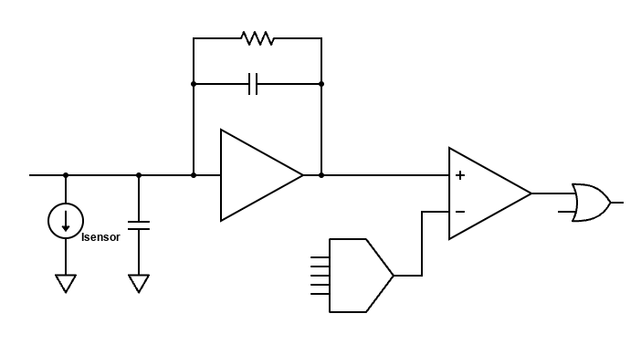
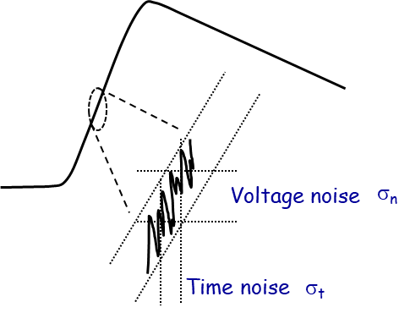
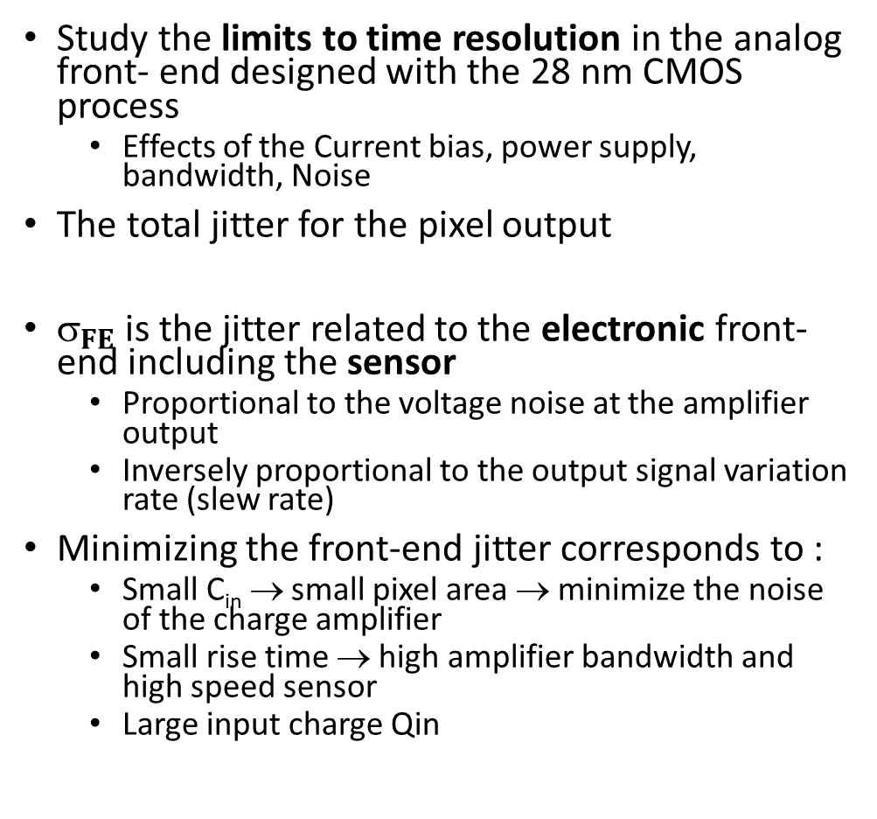

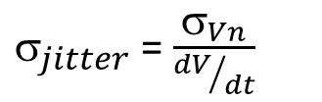
Pixel array prototype
Study the limits to time resolution in the analog front- end designed with the 28 nm CMOS process
  Effects of the Current bias, power supply, bandwidth, Noise
The total jitter for the pixel output
$_{FE}$is the jitter related to the electronic front-end including the sensor
  Proportional to the voltage noise at the amplifier output
  Inversely proportional to the output signal variation rate (slew rate)
Minimizing the front-end jitter corresponds to :
  Small C_{in} → small pixel area → minimize the noise of the charge amplifier
  Small rise time → high amplifier bandwidth and high speed sensor
  Large input charge Qin
$_{jitter}$= $\frac{σ_{Vn}}{{dV}/{dt}}$
$_{jitter}$= $\frac{C_{in}}{Q_{in}} \sqrt{\frac{t_{r}^{2}+t_{s}^{2}}{t_{r}}}$
t_{r} : the amplifier rise time
t_{s} : the drift time of the charge in the sensor
Q_{in} : input charge
C_{in} = C_{s} + C_{CSA-input}
xudanwei@cppm.in2p3.fr
27

Slide 28
xudanwei@cppm.in2p3.fr
28

