Slide 1
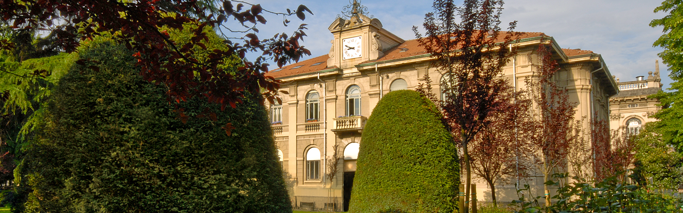


Prompt gamma detectors for
Hadrontherapy and BNCT
Carlo Fiorini
Politecnico di Milano and INFN, Milano, Italy
CNAO-IN2P3 Meeting 05-03-26

Slide 2
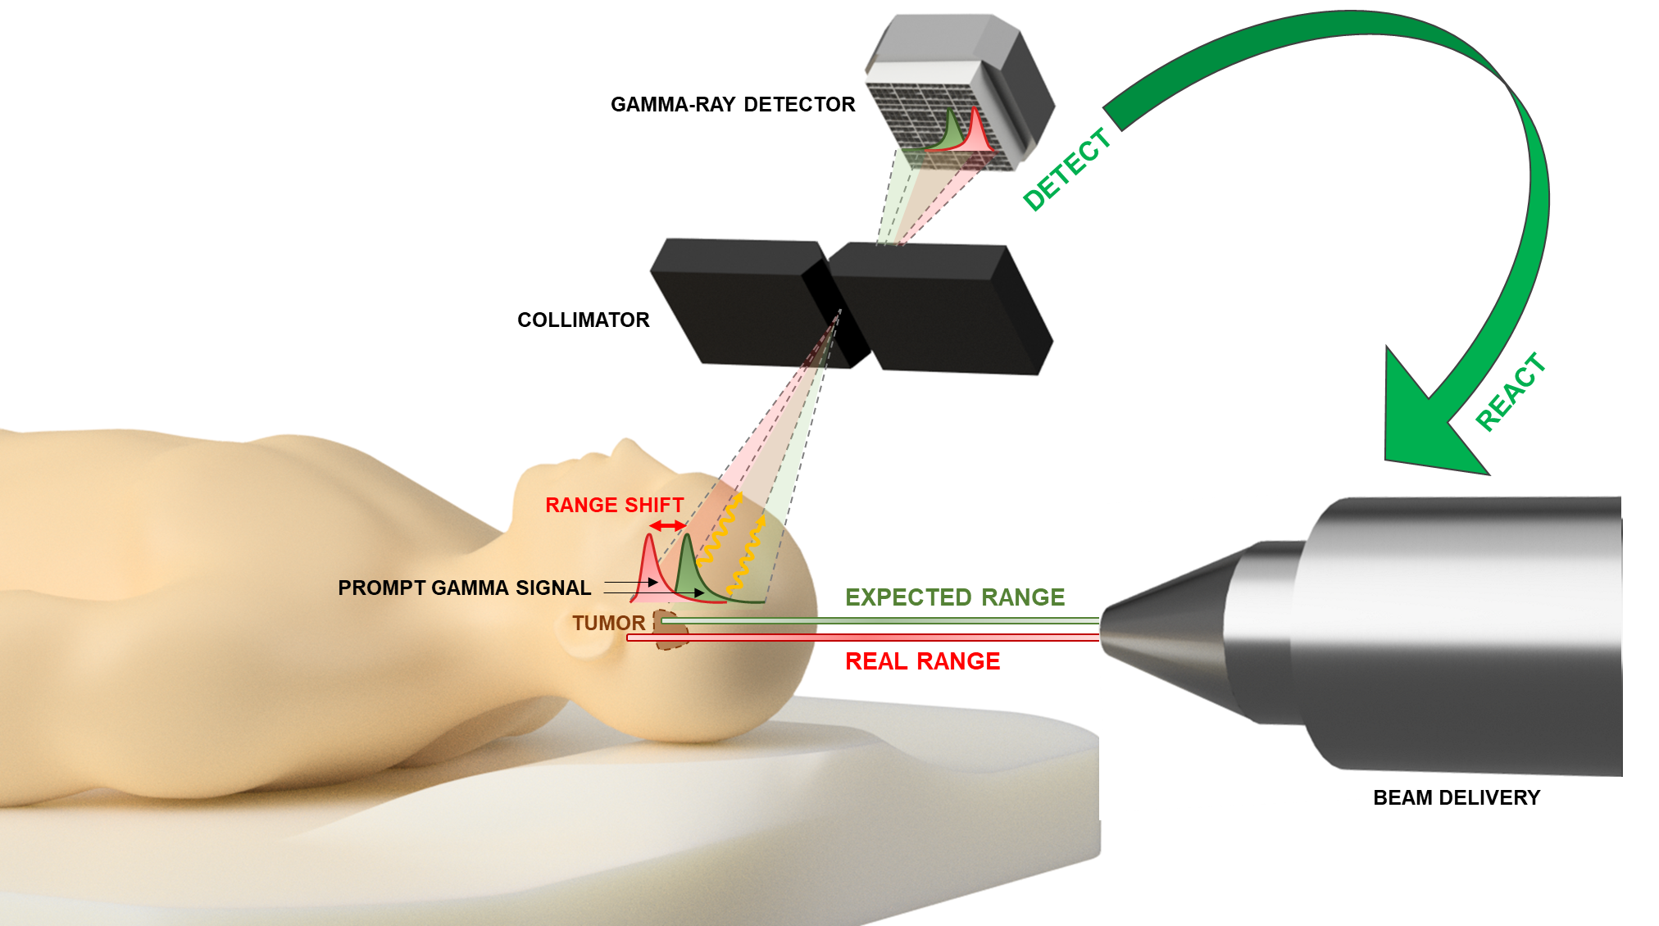
The REALPATH project
REALPATH - A Real-Time Range Verification System for Hadron Therapy
Mechanically collimated camera, pushing for a compact detector paylod
High-speed electronics platform to cover different accelerator types
Integration in the treatment room (including software and safety aspects)
Clinical validation (possibly in both fixed-line and gantry-based facilities)
2

Slide 3
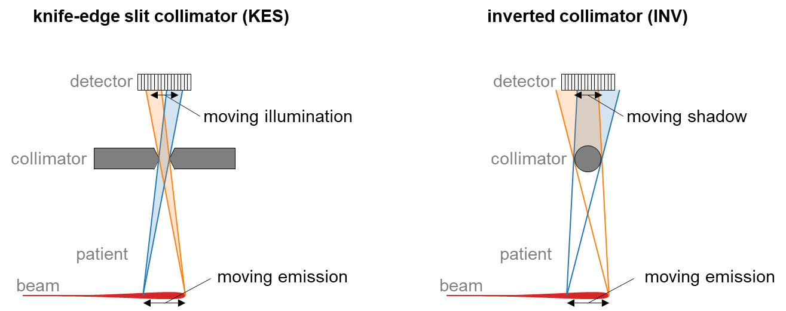
Idea of inverted collimator
3

Slide 4
Validation of the inverted collimator
Features:
Falloff Retrieval Precision (@10⁸ protons) similar to KE collimator
Much smaller collimator weight (7kg vs. 25kg)
4

Slide 5
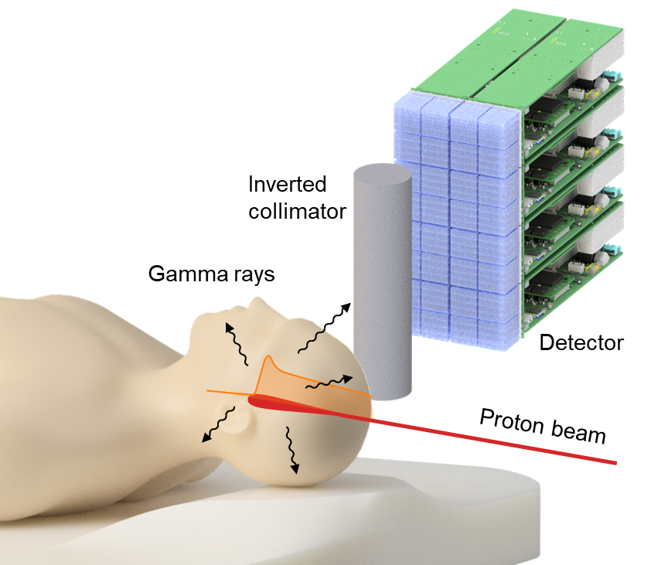
Camera geometry and expected Falloff Retrieval Precision (FRP)
Experimental measurements scalded to the final PGI Camera detection area:
10cm x 20cm
5

Slide 6
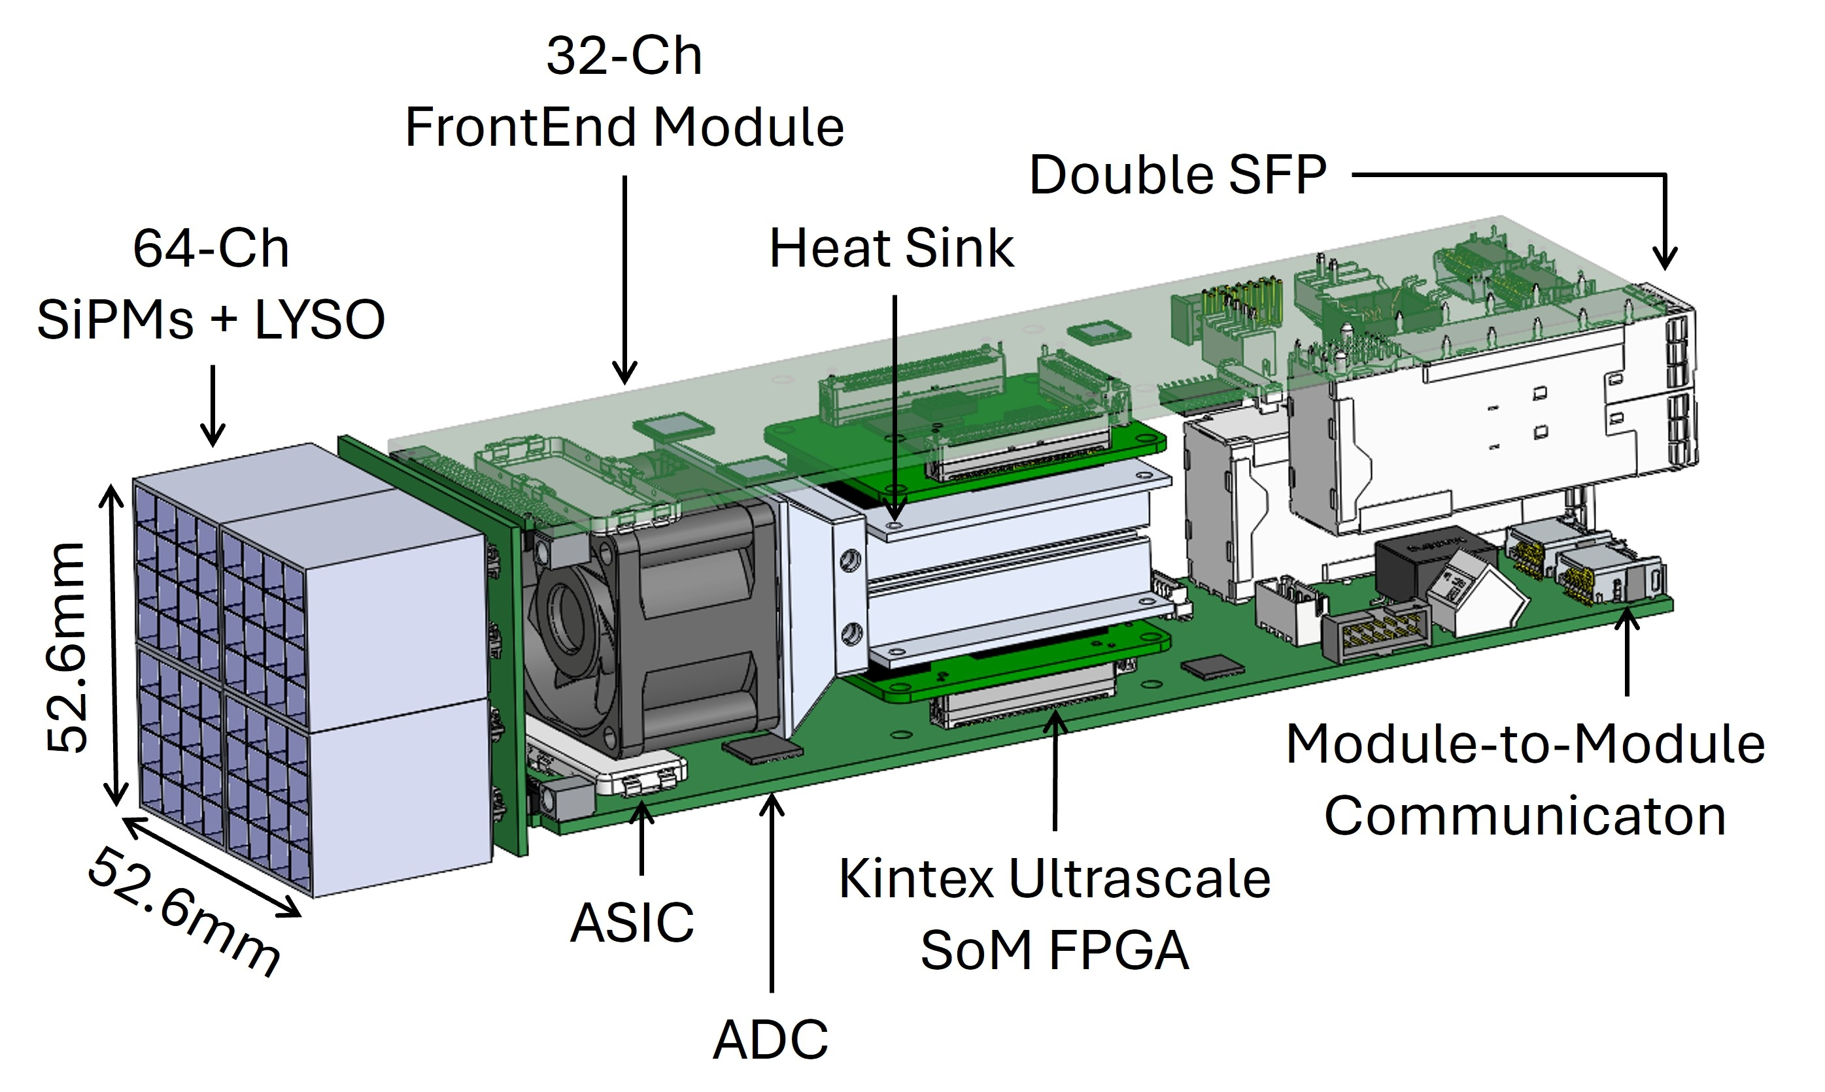

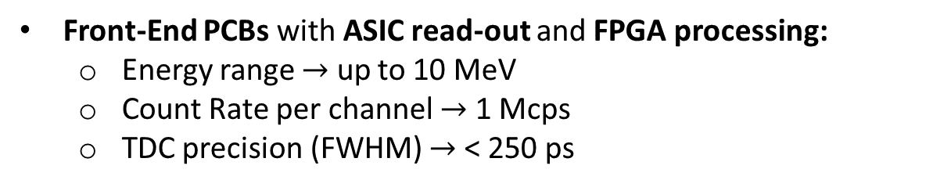
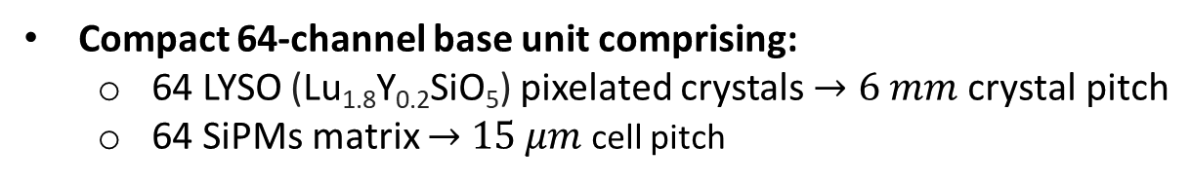
Detection Module Design
Compact 64-channel base unit comprising:
64 LYSO (Lu_{1.8}Y_{0.2}SiO₅) pixelated crystals $→6 mm \text{crystal} \text{pitch}$
64 SiPMs matrix $→$ $15 μm$ cell pitch
Front-End PCBs with ASIC read-out and FPGA processing:
Energy range $→$ up to 10 MeV
Count Rate per channel $→$ 1 Mcps
TDC precision (FWHM) $→$ < 250 ps
Flexible Configuration
Modular, Compact, and Scalable design
Linear and angled arrangements
Overall FOV (Field Of View) > 5 cm
Compatible design for future channel expansion: 64ch $→$ 256ch $→$ 512ch
C. Riboldi et al., " Design of a 64-channel modular platform for high-speed readout of scintillator-based detectors for range monitoring in hadrontherapy“, JINST 2025.
6

Slide 7
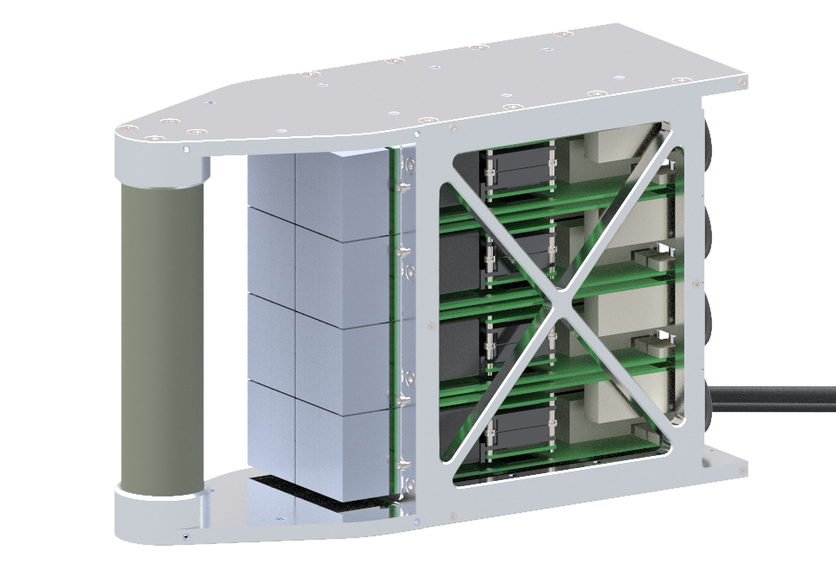
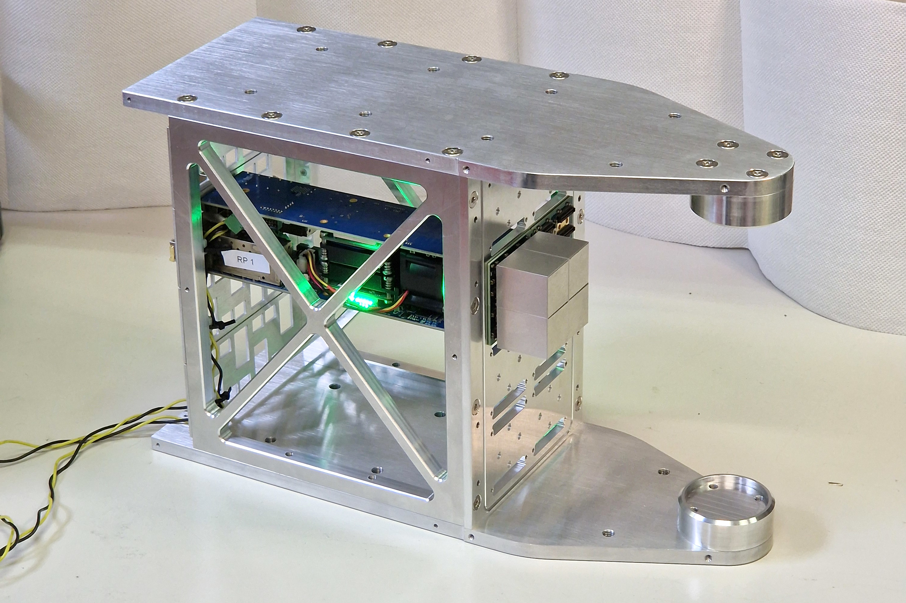
First camera prototype (under construction)

Slide 8
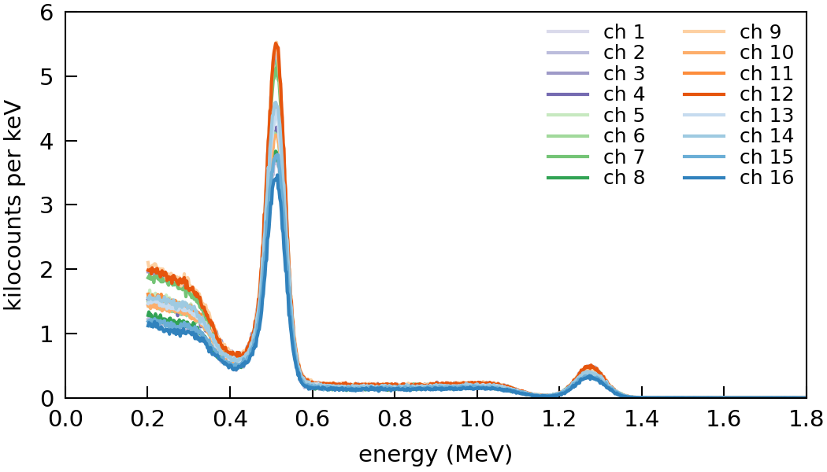
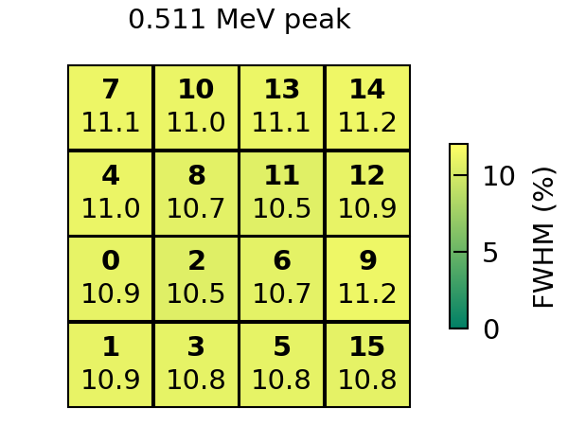
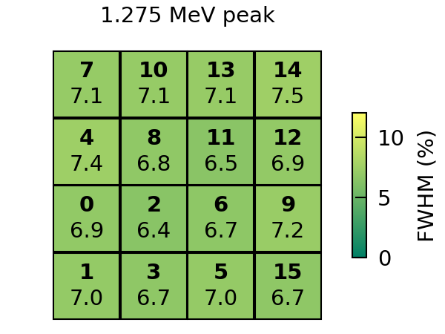
First spectroscopy tests
Measurements with a 16-channel detector tile and ²²Na source:
excellent energy resolution
10.7% average FWHM at 0.511 MeV
6.7% average FWHM at 1.275 MeV
homogeneous resolution of all pixels

Slide 9
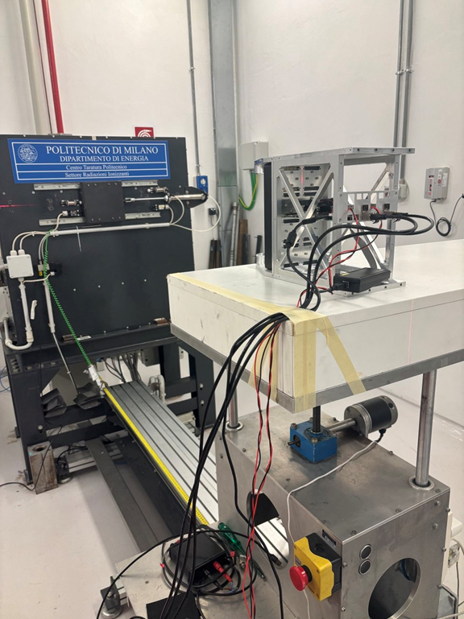
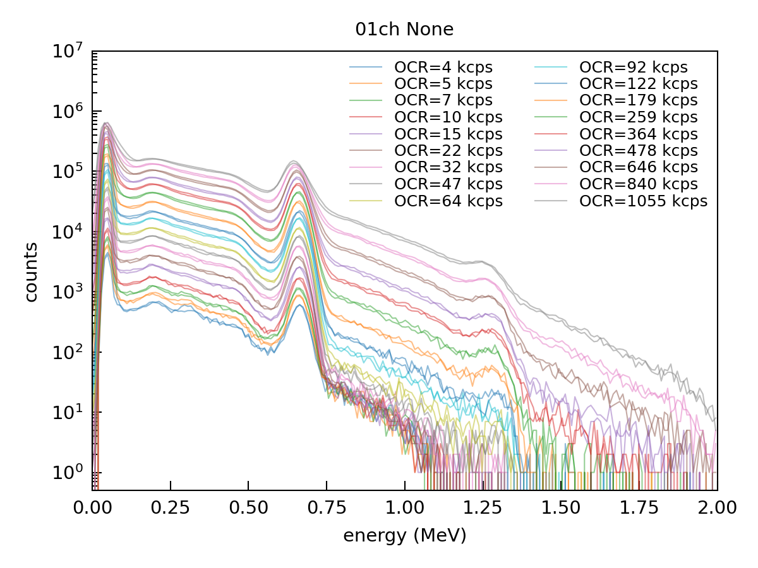
High rate measurements (last week!)
662keV
Succesful tests (¹³⁷Cs source) up to 1Mcps/channel!

Slide 10
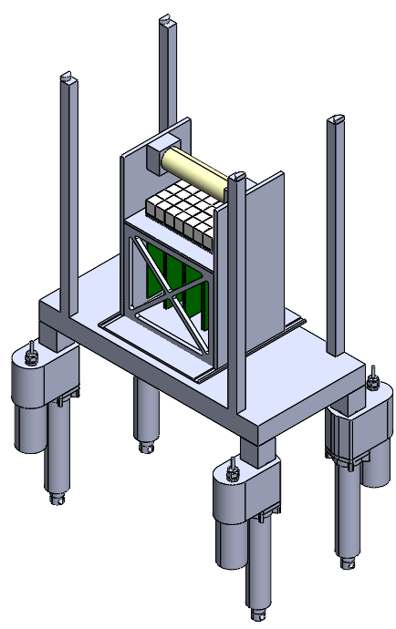
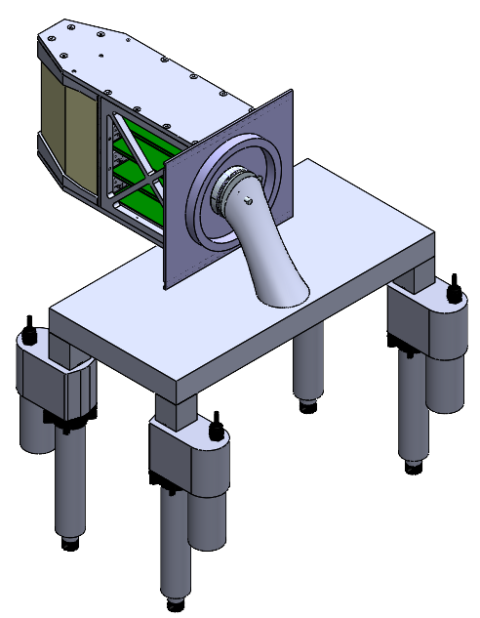
REALPATH instrument positioning system
Fixed-beamline systems
(e.g. CNAO)
Gantry-based systems
(e.g. IBA systems)
L.Santini, et al., «Towards a novel positioning system for a real-time prompt gamma imaging detector in hadrontherapy», to be submitted to JINST.
Trolley
Suspended
10

Slide 11
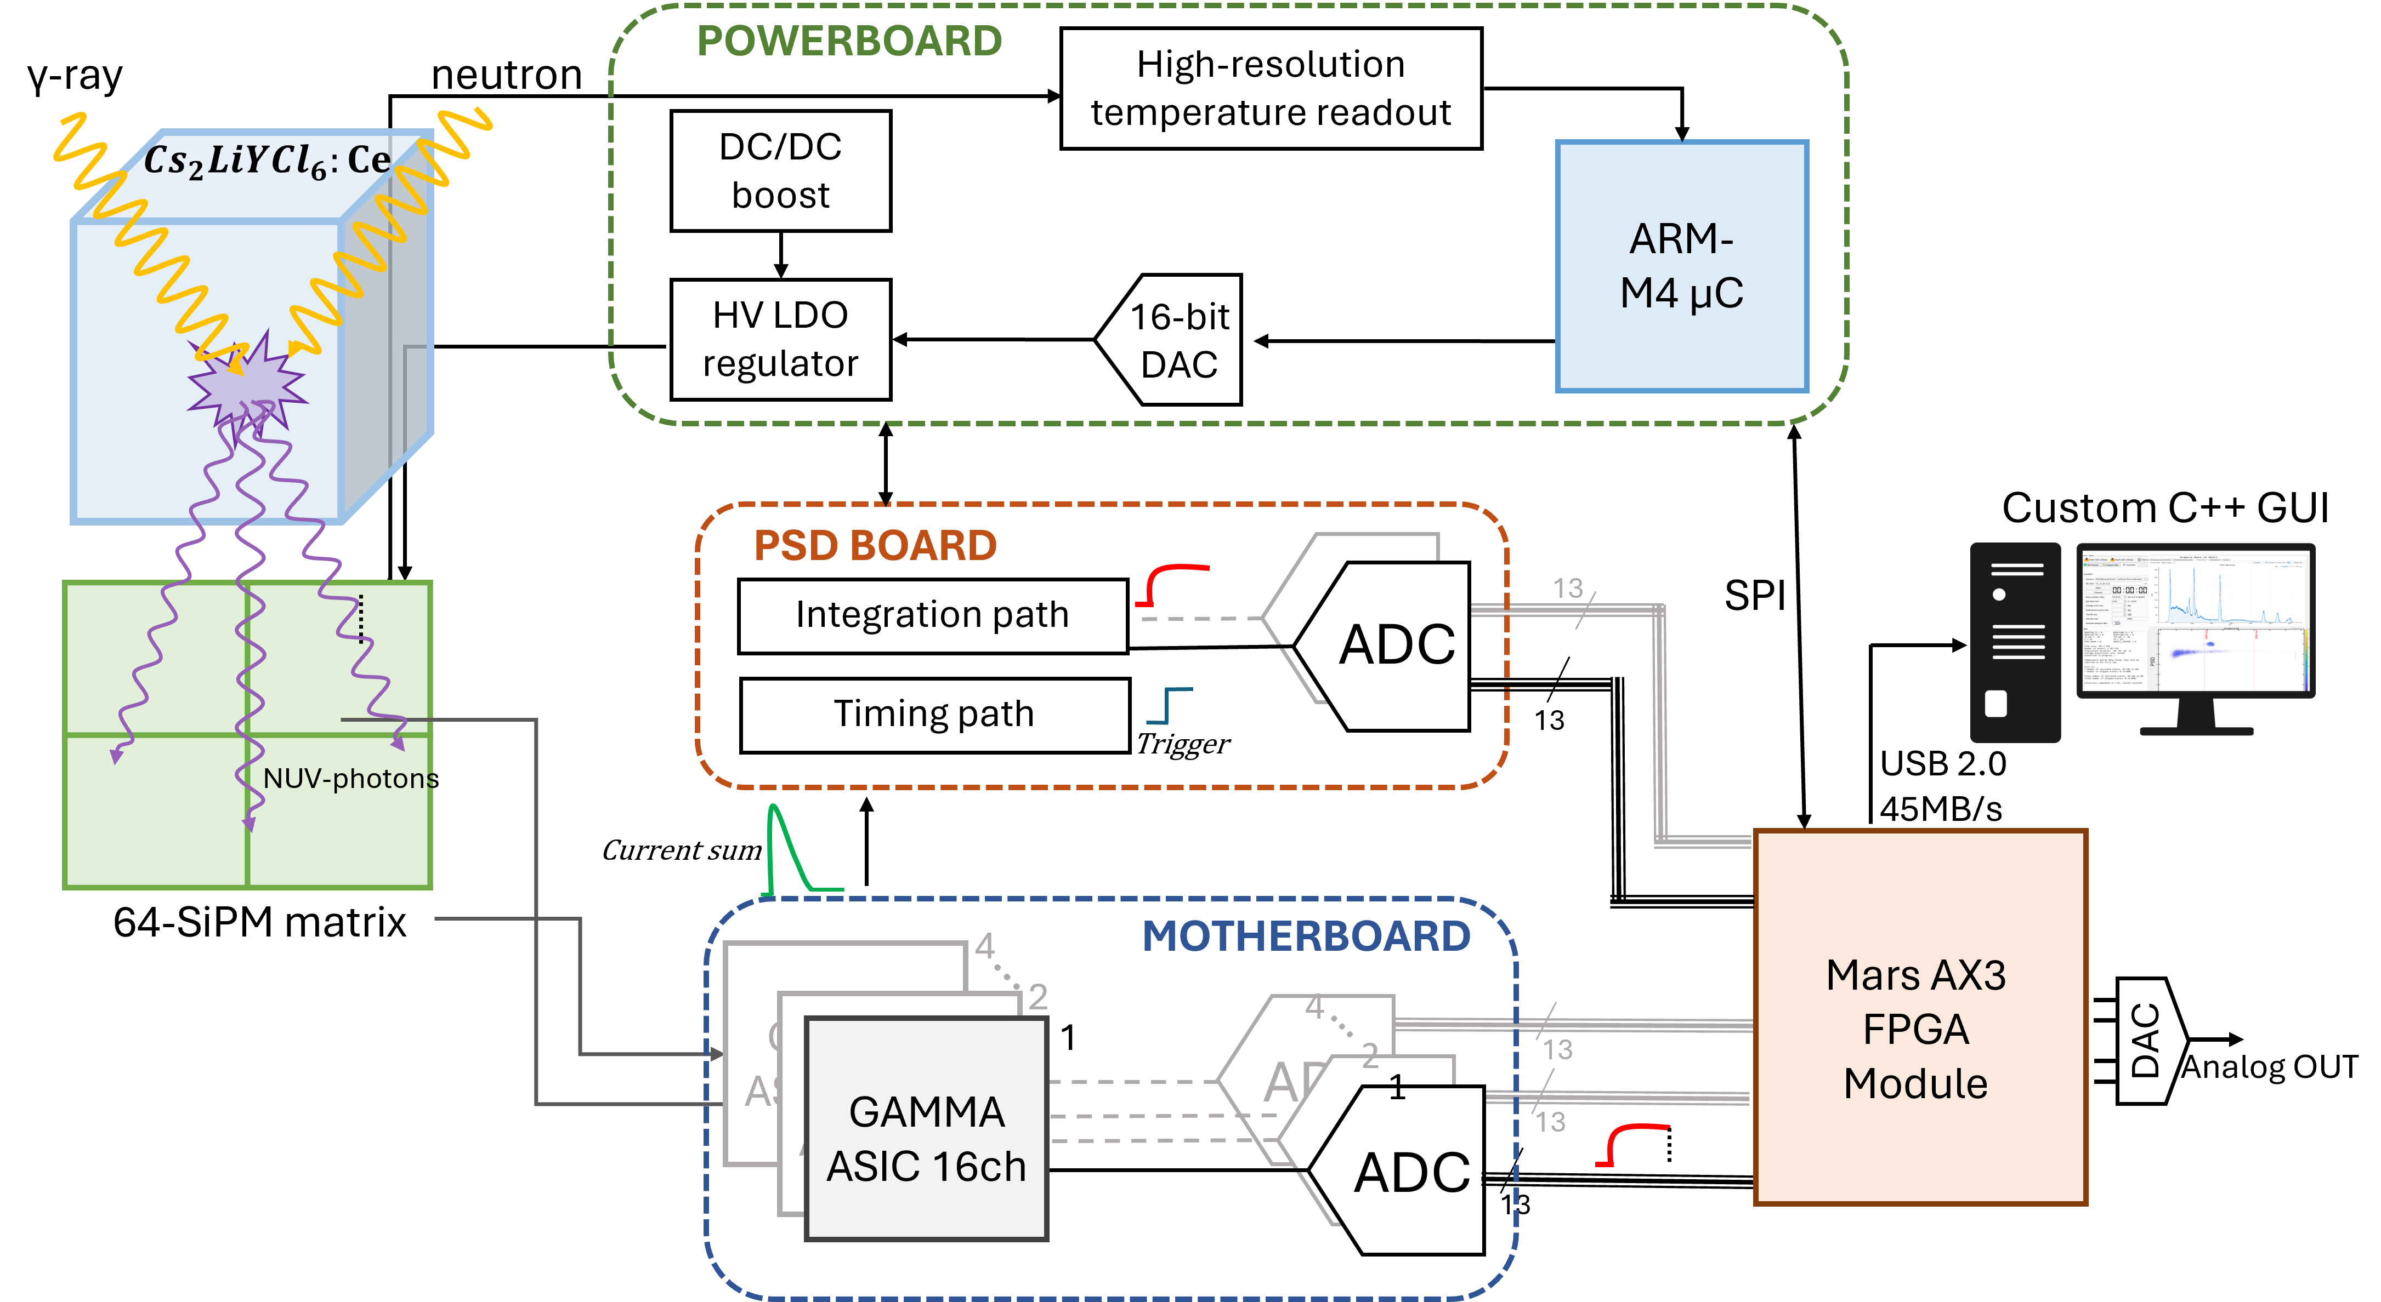
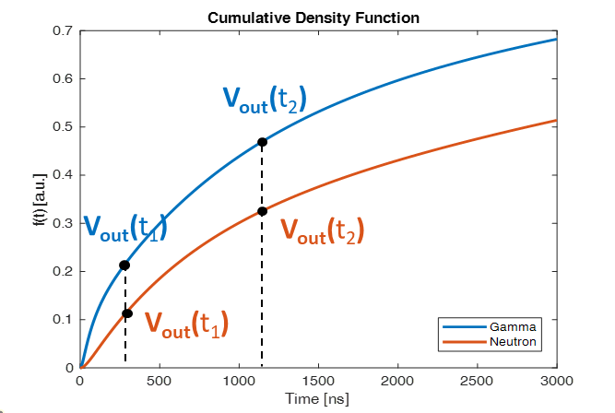

Gamma/Neutron Discrimination by means of CLYC and PSD
Pulse Shape Discrimination (PSD) :
CLYC scintillator and readout electronics:
PSD $=\frac{Vout\left(t2\right)−Vout(t1)}{Vout(t2)}$
O.Halfon, et al., IEEE TNS, VOL. 72, NO. 7, JULY 2025.

Slide 12
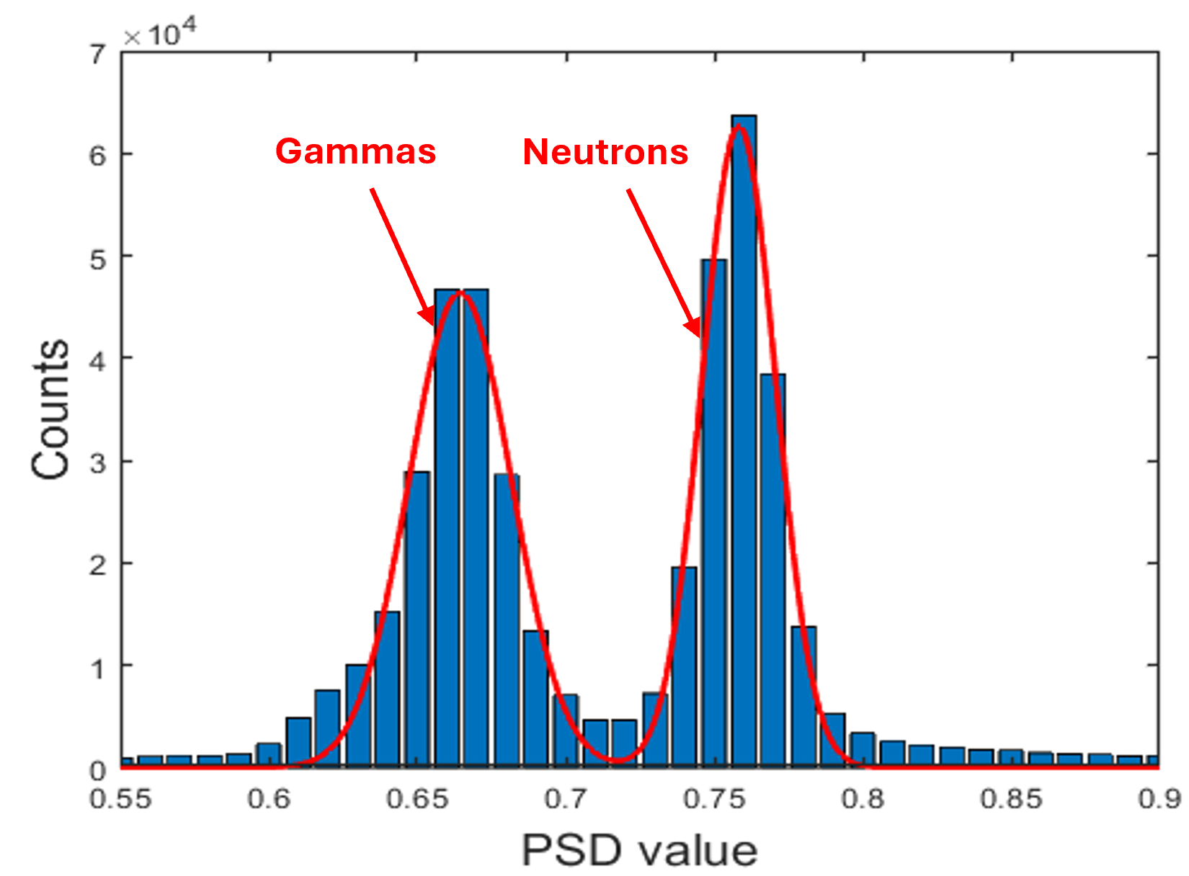
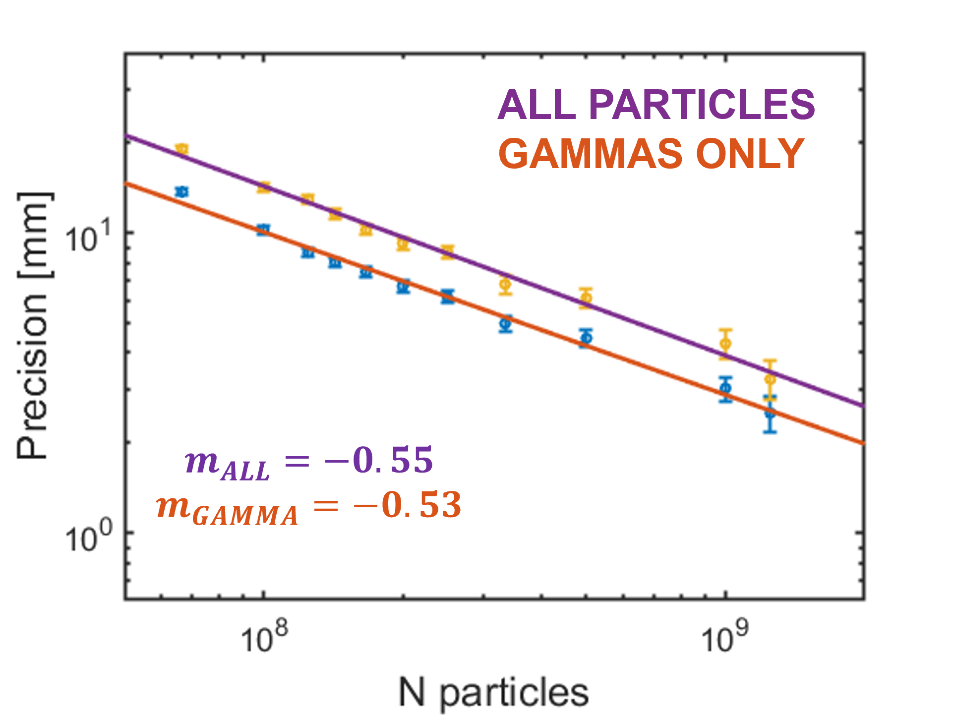
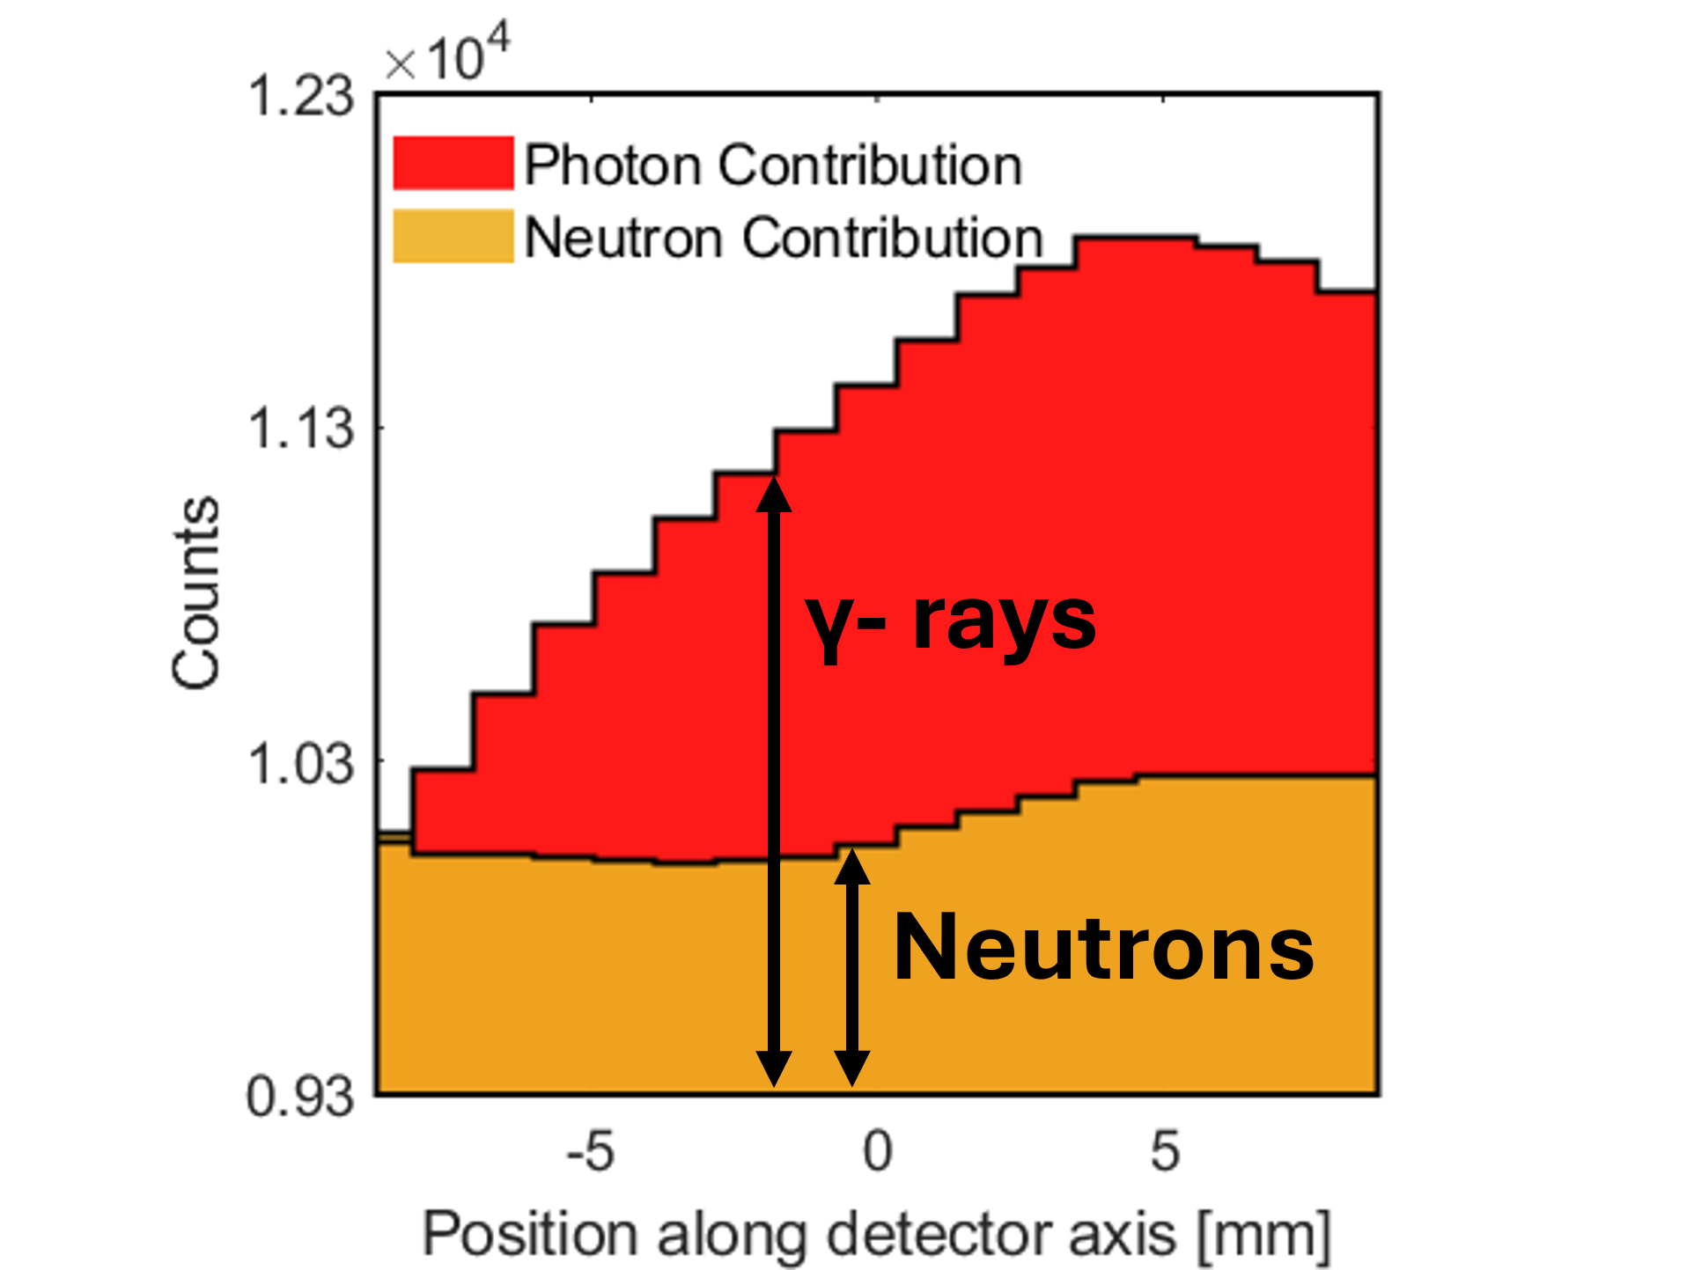
PGI measurements with real-time neutron-gamma discrimination
O.Halfon, et al., “First Experimental Measurement of Prompt Gamma Imaging with Real-Time Neutron Rejection via Pulse Shape Discrimination”, IEEE TRPMS, 2026.

Slide 13
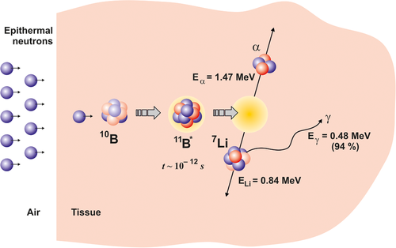
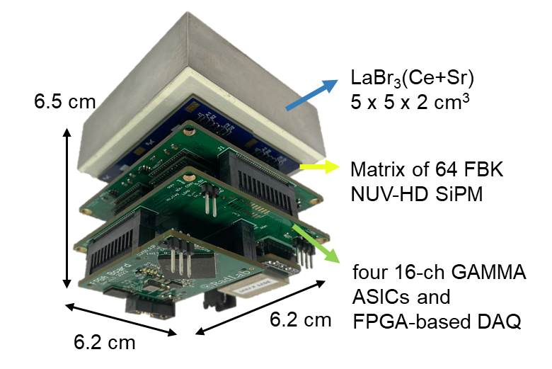
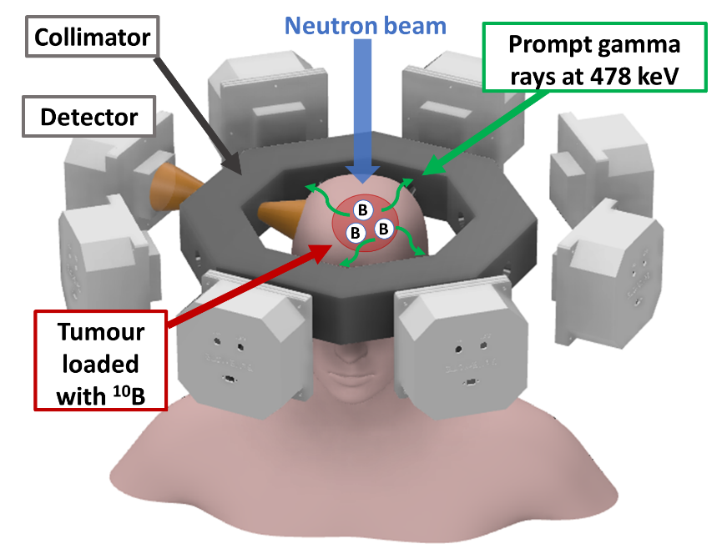
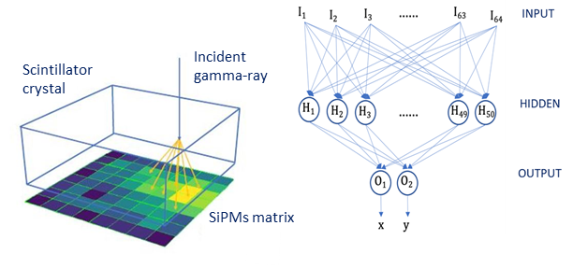
Boron Neutron Capture Therapy
Detection of emitted 478keV gamma photons may let to estimate ¹⁰B neutron captures and support therapeutic outcome (personalized dosimetry).
Goal: Development of a SPECT (Single Photon Emission Thomography) system) for BNCT
Scintillator/SiPMs-based gamma-ray detector
Neural-Network for event reconstruction
BeNEdiCTE (Boron NEutron CapTurE) detector

Slide 14
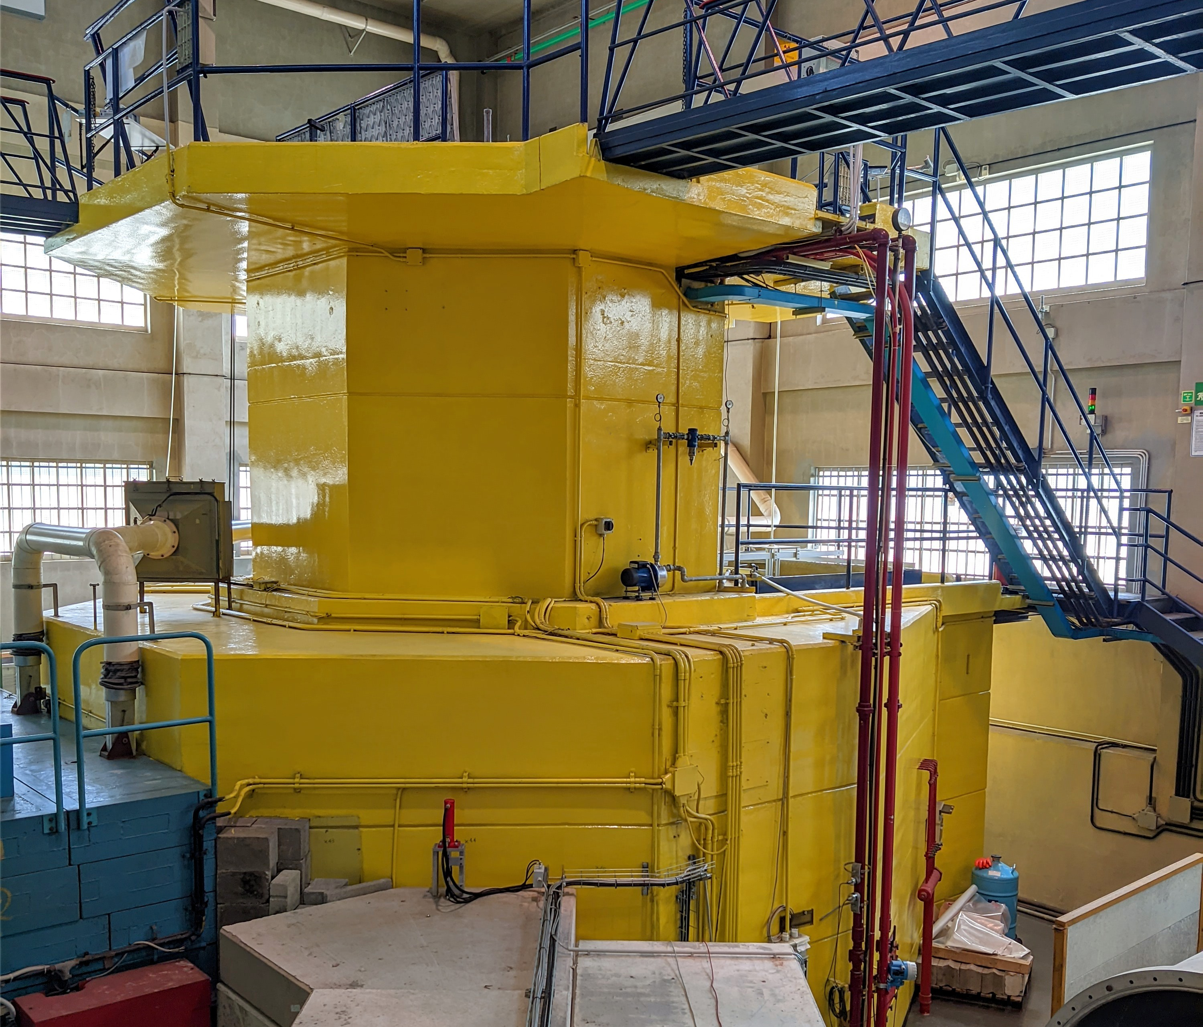

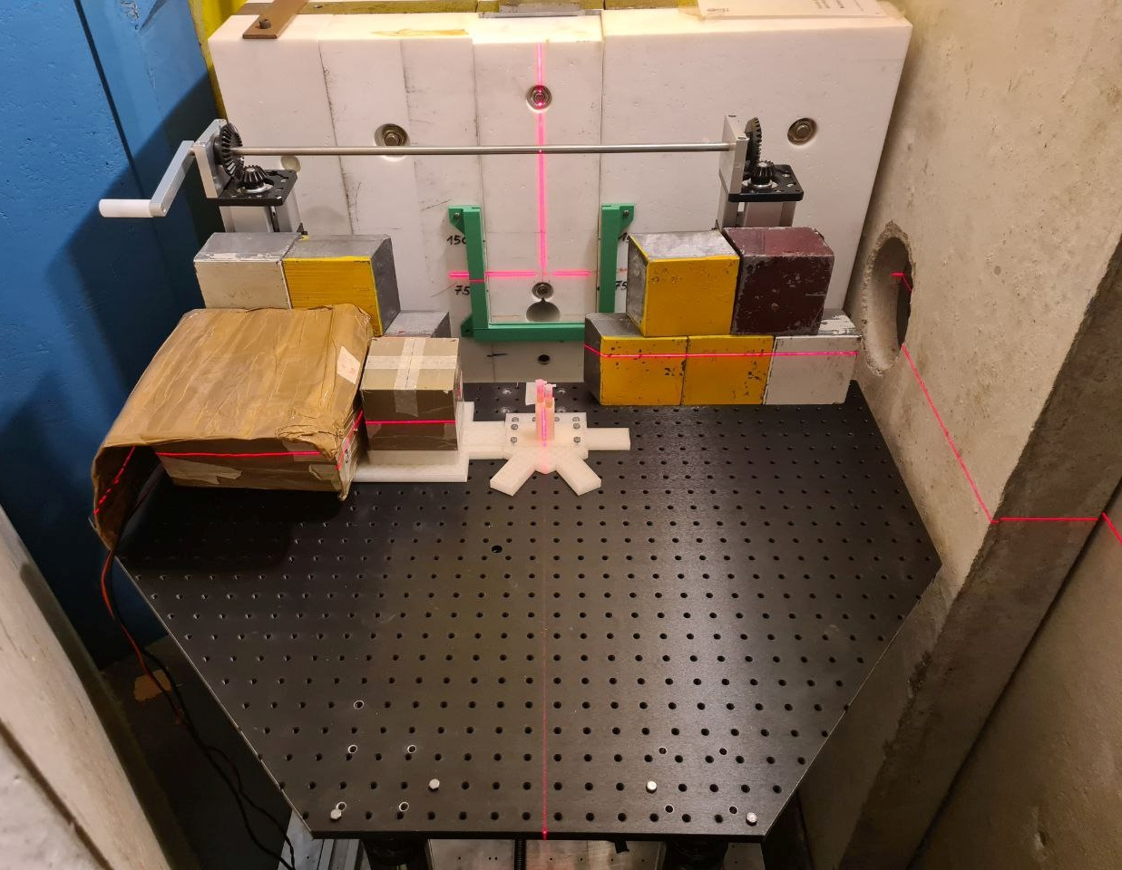
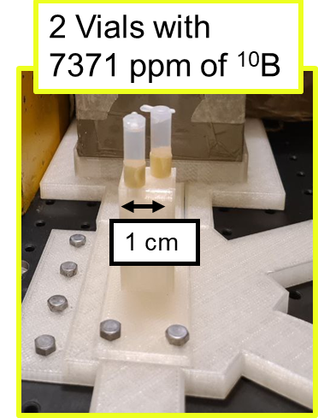
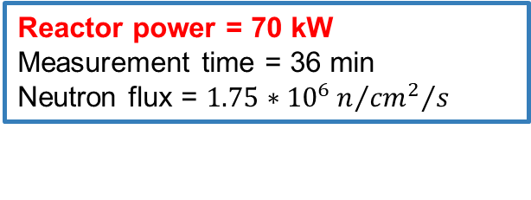
LENA
Pavia (Italy)
Tomographic Measurements
Reactor power = 70 kW
Measurement time = 36 min
Neutron flux = $1.75∗{10}^{6}n/{{{cm}^{2}}/s }$
The 3D reconstruction was obtained using STIR and 10 iterations of the OSEM algorithm.
0° Projection
Neutron Flux
180° Projection
60° Projection
120° Projection
T. Ferri et al., “Design and Validation of a SPECT Prototype for Treatment Monitoring in BNCT and First Experimental Tomographic Results,” IEEE Transactions on Radiation and Plasma Medical Sciences.

Slide 15
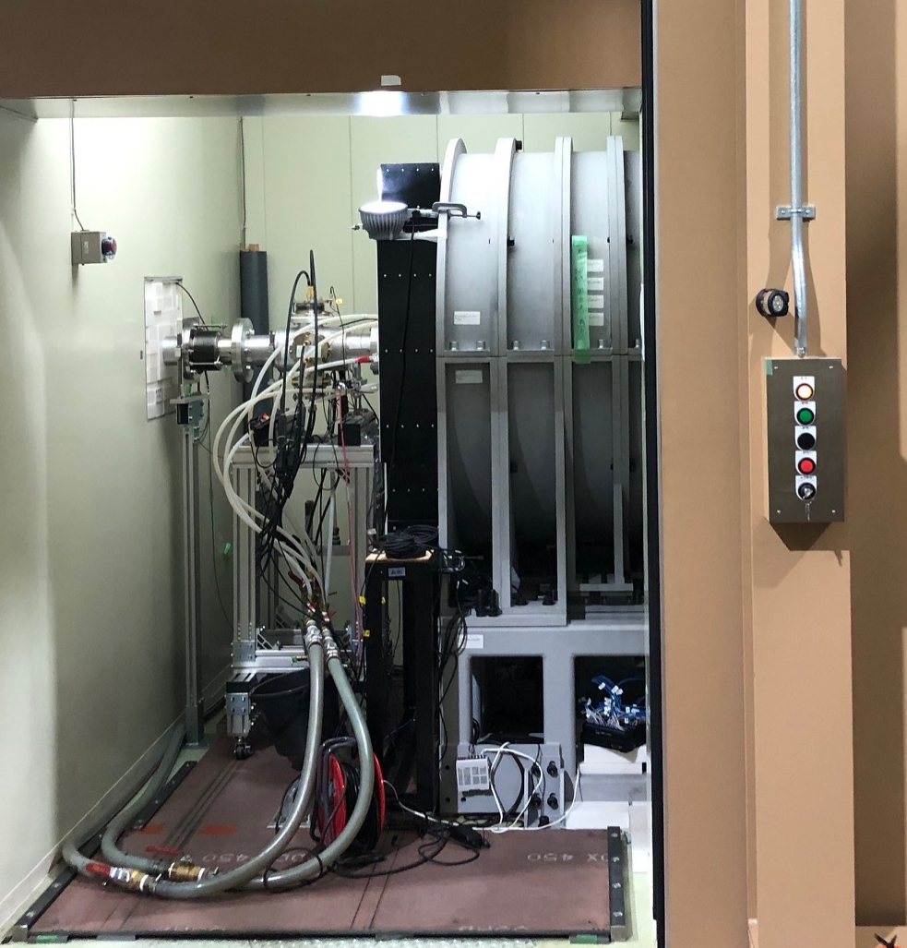
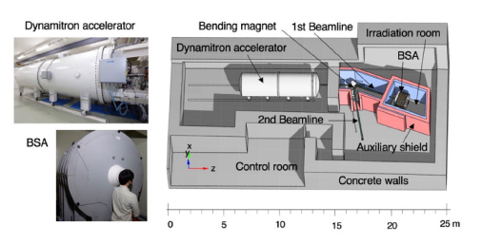
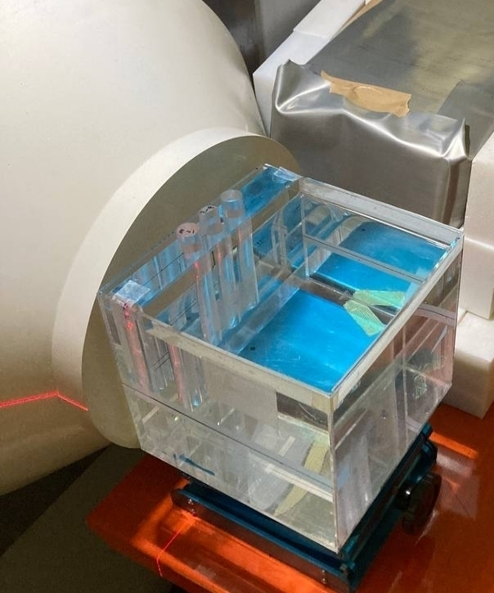
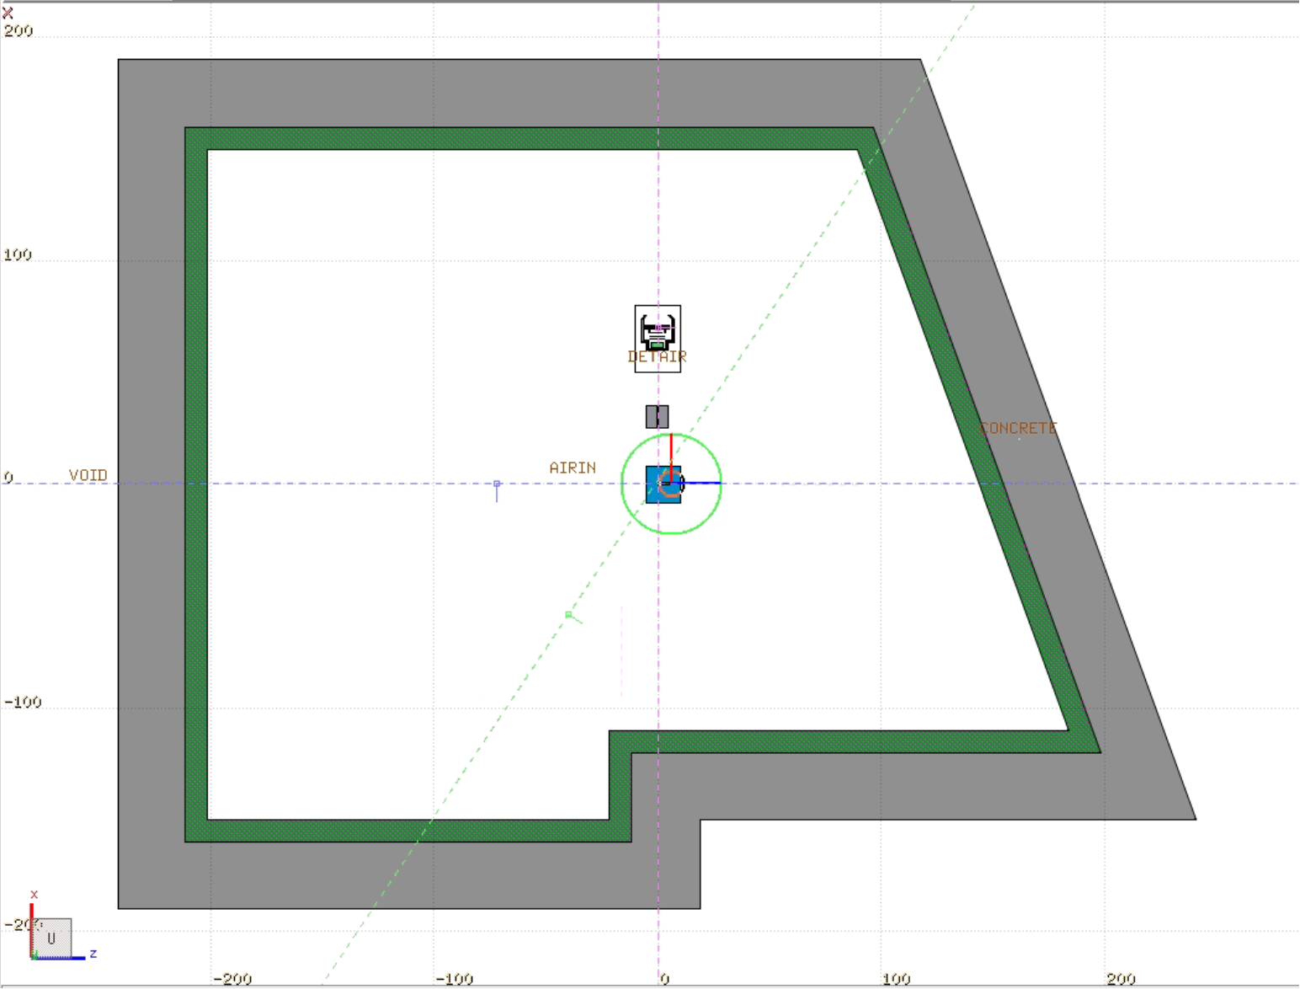
Toward BNCT clinical environment
Nagoya
University (Japan)
The NUANS (Nagoya University Accelerator-driven Neutron Source) is composed by a dynamitron accelerator, a lithium target assembly and a BSA.
Epithermal neutron flux that fulfils IAEA standards;
Measurements with a water-filled phantom;
Boron background due to the walls.
Phantom
Portland cement
Irradiation room
Nishitani, Takeo, et al. "Neutronics Analyses of the Radiation Field at the Accelerator-Based Neutron Source of Nagoya University for the BNCT Study." Journal of Nuclear Engineering 3.3 (2022): 222-232.
Borated polyethilene

Slide 16
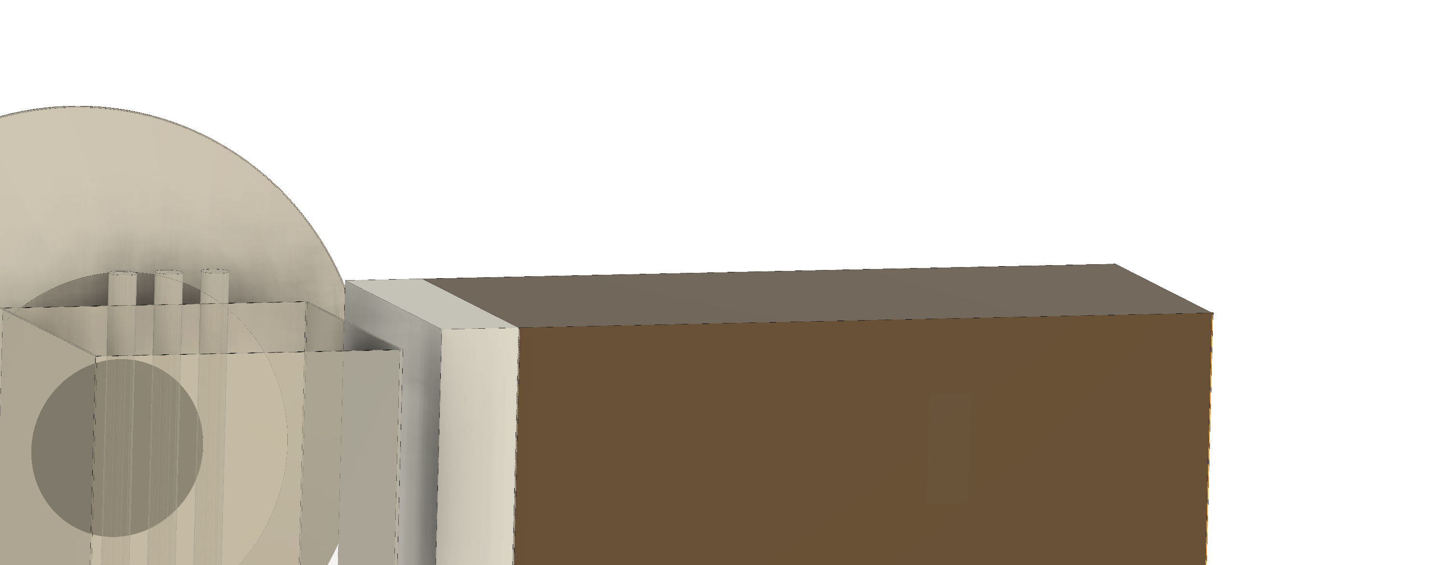
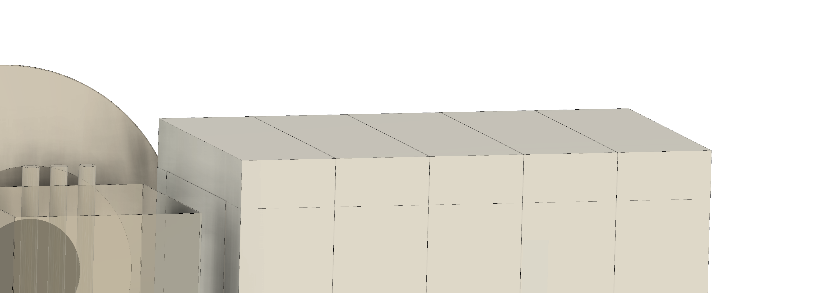
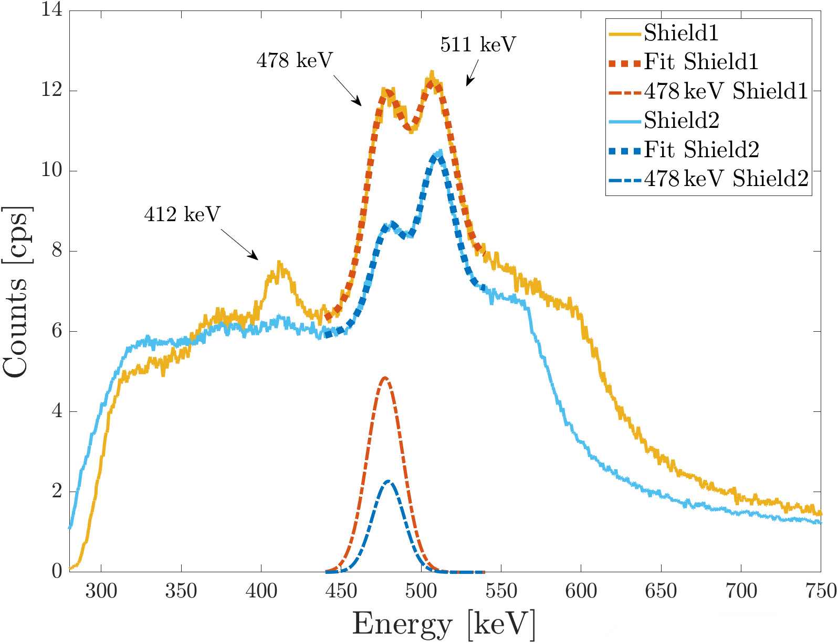

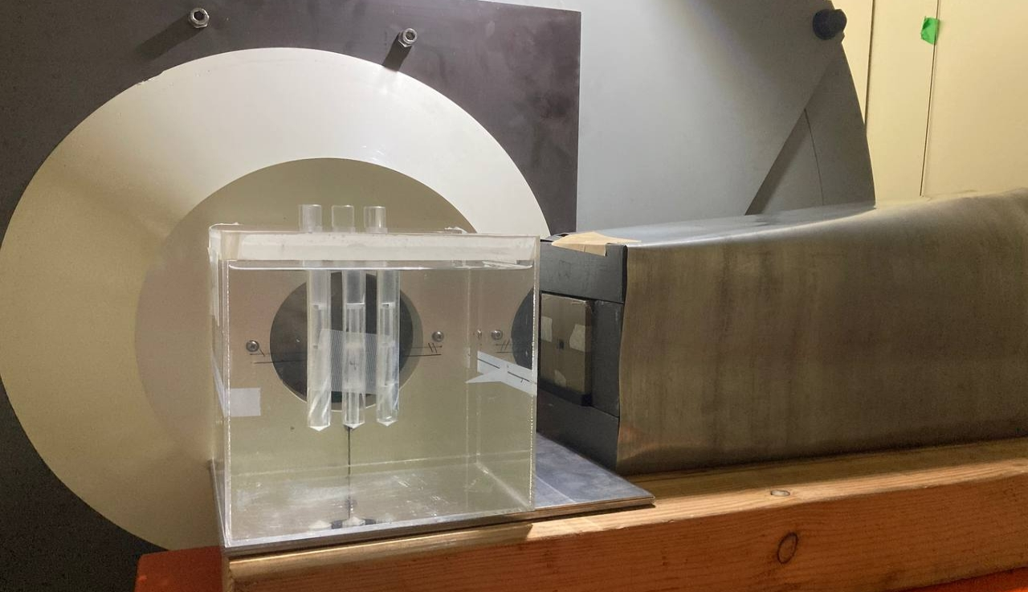
Toward BNCT clinical environment
Nagoya
University (Japan)
Shield1
Polyethylene
Shield2
Polyethylene
Cadmium
20x20x20 cm³ water-filled phantom with an inserted vial containing different boron concentrations
Neutron flux of approx 1x10⁷n/cm²/s
Water
Nozzle
Lead
Cadmium
145 cps
60 cps
Vial
Phantom
Collimator
Epthermal neutrons are thermalised interacting with the shielding and are captured by the ¹⁰B inside the system electronics

Slide 17
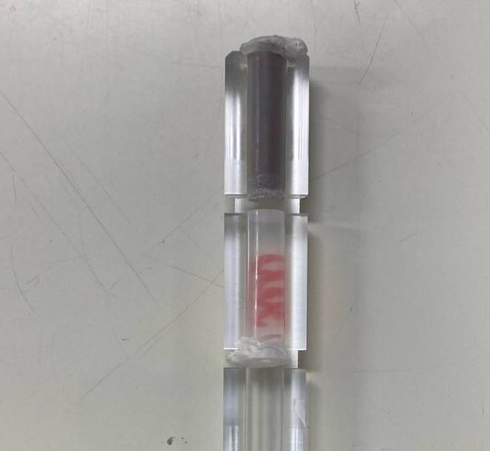
Toward BNCT clinical environment
Nagoya
University (Japan)
Neutron flux ~ 1x10⁷n/cm²/s
Decreasing ¹⁰B concentration
3686 ppm of ¹⁰B + boron powder
Vial filled with 3686 ppm of ¹⁰B
~ 2.7 cm
~ 2.7 cm
Vial filled with boron powder
y
Despite the high background, we were able to image vials with varying ¹⁰B concentrations down to 1500 ppm
A. Caracciolo, D. Mazzucconi, T. Ferri, L. Grisoni, F. Ghisio, et al., “Prompt gamma-ray imaging in realistic background conditions of a boron neutron capture therapy facility”, Scientific Reports.

Slide 18
Acknowledgments
REALPATH
Politecnico di Milano, DEIB: K.Urban, M.Piroddi, L.Santini, C.Riboldi, A.Forgione, O.Halfon, F.Garzetti, A.Geraci, E.Ronconi, G.Borghi, M.Carminati, G.Baroni
Polimi di Milano, ENG/CeSNEF: E.Bellotti, D.Mazzucconi, D.Bortot, S.Agosteo
CNAO (Pavia, Italy): M.Ciocca, M.Donetti, M.Pullia, A.Pella
BNCT
Politecnico di Milano, DEIB: F.Ghisio, T.Ferri, Pandocchi, G.Borghi, M.Carminati
Polimi di Milano, ENG/CeSNEF: G.Mocerino, L.Grisoni, D.Mazzucconi, S.Agosteo
Università di Pavia: N.Protti, S.Altieri, V.Pascali
Università di Bari: D.Ramos, G.Iaselli, G.Pugliese
Fundings: PRIN-MUR, INFN CSN5

