Slide 1



BNCT @ CNAO
Saverio Altieri
CNAO Foundation Pavia, Italy

Slide 2
BNCT principle
α
1.47 MeV
thermal
neutron
Range in tissues
¹⁰B
⁷Li
0.84 MeV
shorter than
a cell diameter
γ
0.48 MeV

Slide 3
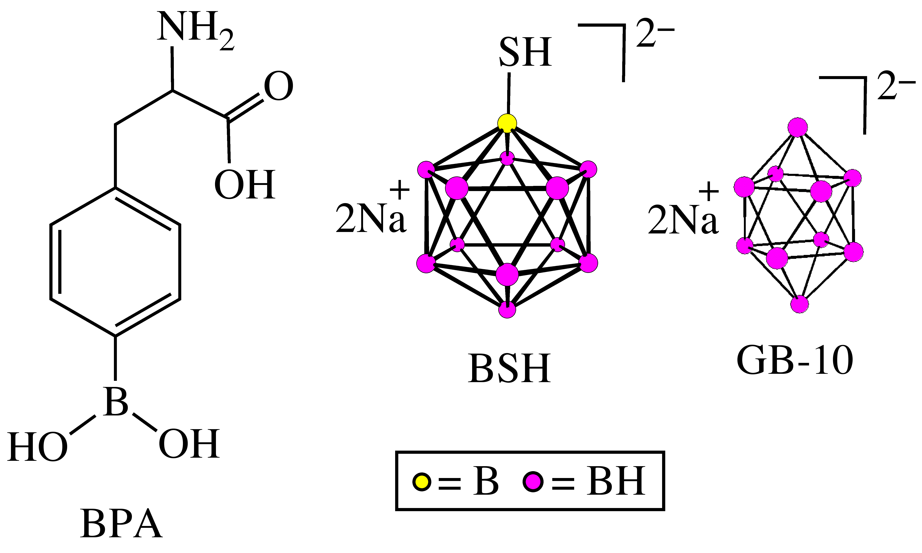
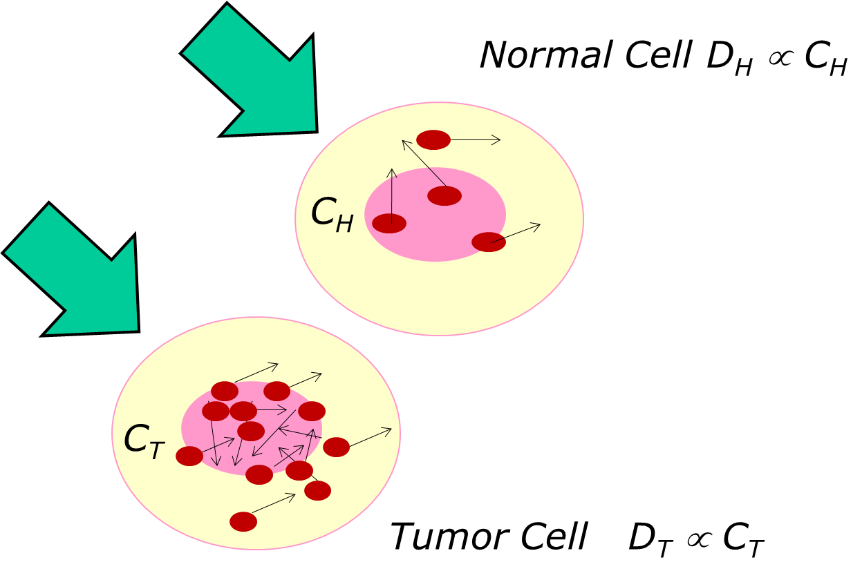
BNCT selectivity at cellular level

Slide 4
Boron concentration
from 2 to 6 tracks
in the nucleus
a letal lesion
in the cell
Tumour cells with boron
neutron fluence
Boron concentration
number of reactions

Slide 5

Boron concentration
from 2 to 6 tracks
in the nucleus
a letal lesion
in the cell
Tumour cells with boron
neutron flux
Boron concentration
number of reactions

Slide 6
BNCT absorbed dose ratio
Tumour cells with boron
Healthy cells without boron
healthy cells with boron

Slide 7
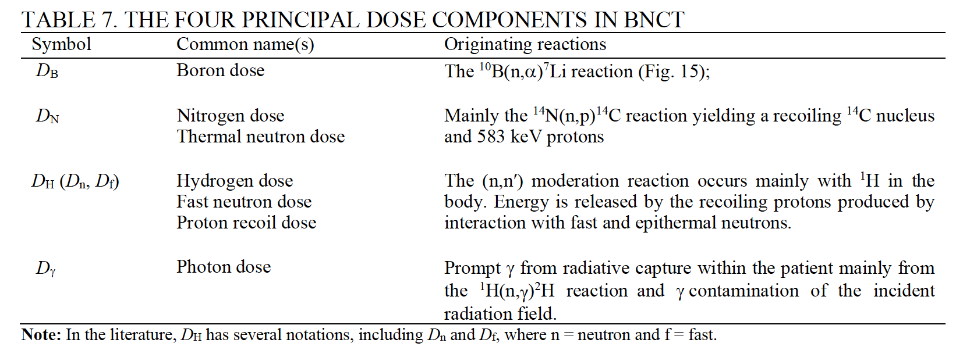

BNCT dose components
$D_{tot}=$ $D_{B}+D_{N}+D_{H}+D_{γ}$

Slide 8


Photons Isoeffective dose
Dose from
Compound Biological Efficacy
CBE
Radiation Biological Efficacy
RBE
Photons IsoEffective Dose Gy (IsoE)
$D_{Gy (IsoE)}=$ $w_{1}D_{B}+{w_{2}D}_{N}+w_{3}D_{H}+{w_{4}D}_{γ}$
Tumour Control Probability
Normal Tissue
Complication
Probability

Slide 9
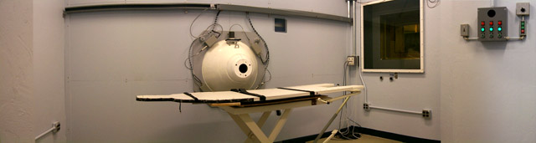
Neutron beam: thermal or epithermal
neutrons
NEUTRON BEAM
by
epithermal
beam
THERMAL
EPITHERMAL
Shallow
tumours
Deep seated
tumours
by
thermal
beam
Thermal neutron distribution into the phantom

Slide 10
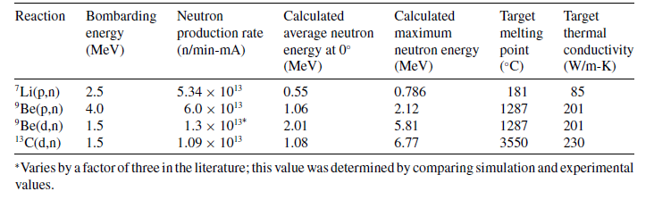

Neutron sources: accelerators
10-20 mA
Thermal conductivity
Melting point
Gas permeability
power on the target: kW/cm²

Slide 11
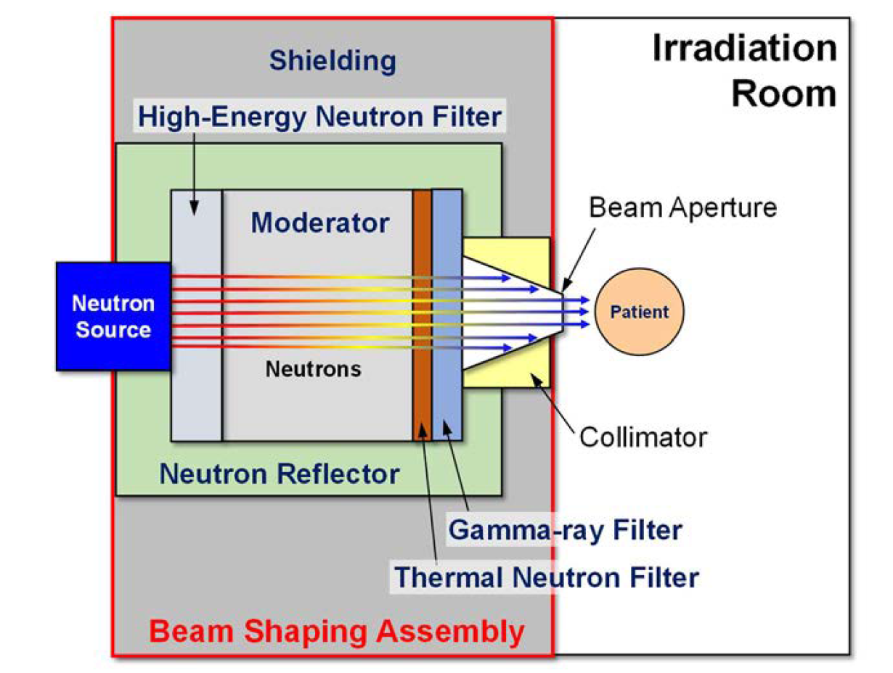
Beam Shaping Assembly (BSA)
Notes:
Starting from the neutron spectrum at the reactor core, with BSA using inelastic cross section we can move fast neutron in the epithermal range useful for BNCT

Slide 12
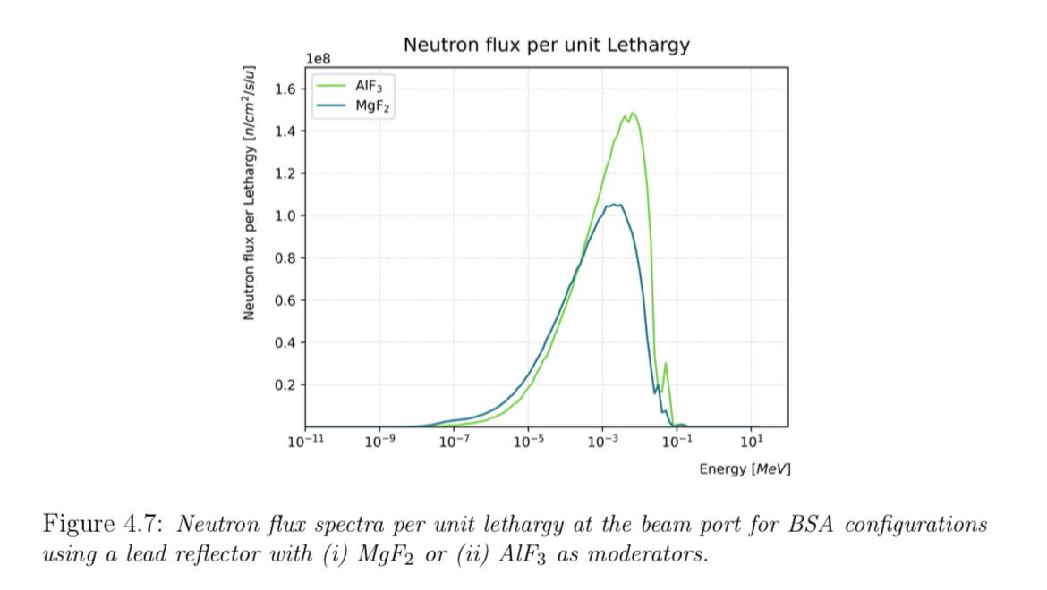
Beam Shaping Assembly (BSA)
Courtesy of V. Pascali and N. Protti
Notes:
Starting from the neutron spectrum at the reactor core, with BSA using inelastic cross section we can move fast neutron in the epithermal range useful for BNCT

Slide 13
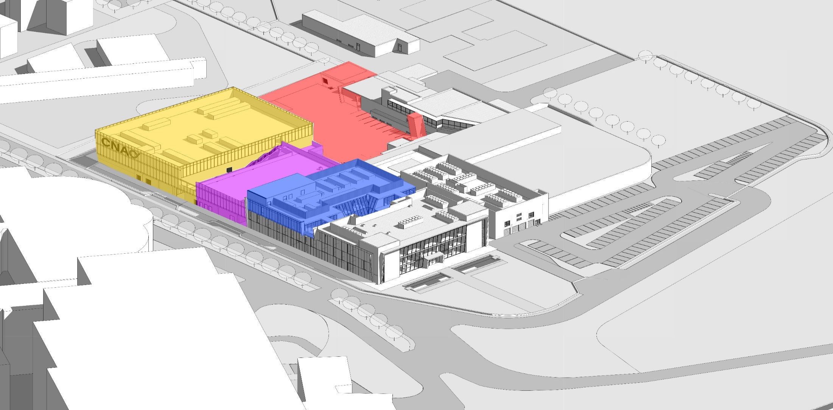
CNAO Expansion Project
NEW BUILDING FOR HIGH TECH
NEW BUILDING FOR RESEARCH
NEW 2ND FLOOR IN CLINICAL INFRASTRUCTURE
Synchrotron vault

Slide 14
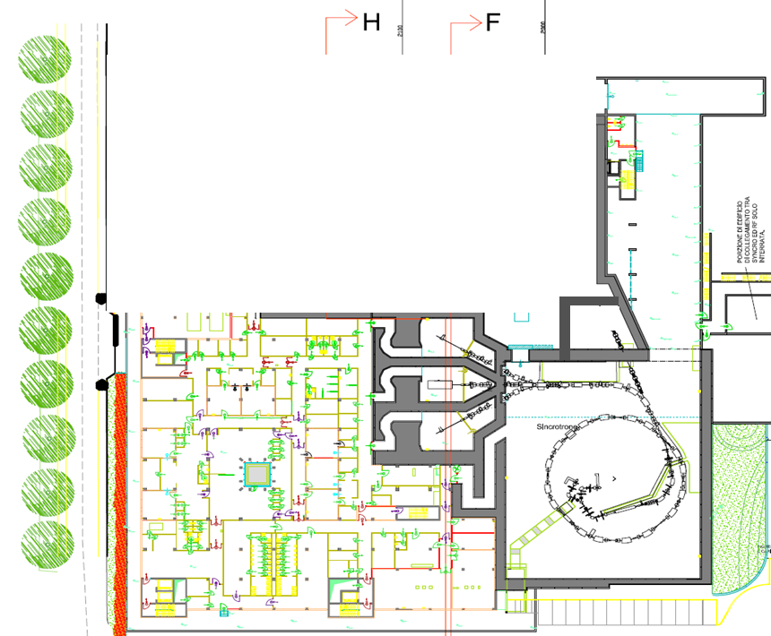
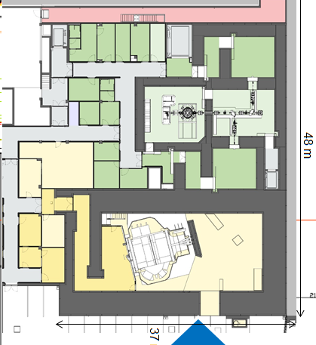
CNAO Expansion Project
AB-BNCT
facility
New protontherapy
with a gantry
New block footprint ~1800 m²

Slide 15
CNAO Expansion Project
The CNAO will be the first centre in the world to have on the same site the possibility of using protons and/or C, He, Li, O, Fe ions for the treatment of well-localised tumours and BNCT for diffuse tumours;
Also making it easy to combine the two treatments

Slide 16
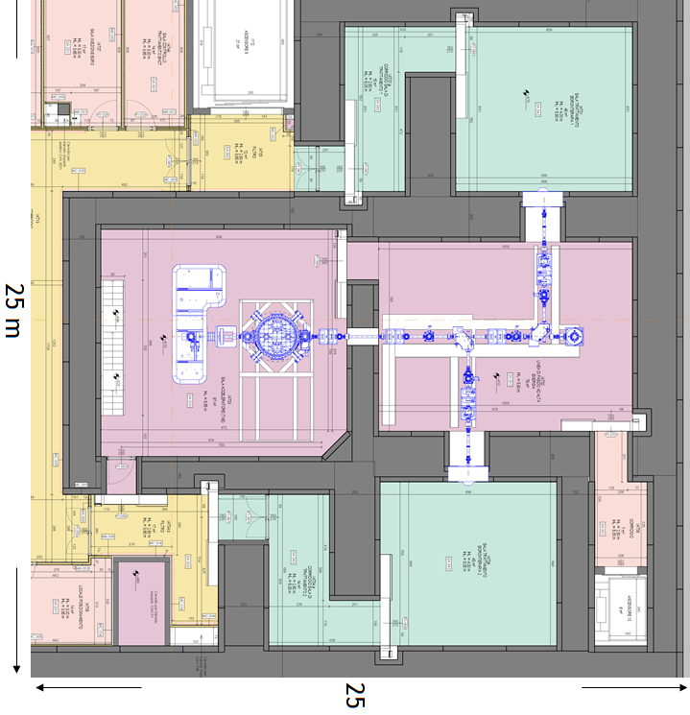
AB-BNCT facility
Treatment
room 1
In October 2020
a research and clinical collaboration was established between CNAO and TAE Life Sciences (TLS) for the implementation of an AB-BNCT facility
TLS proton
accelerator
Treatment
room 2

Slide 17

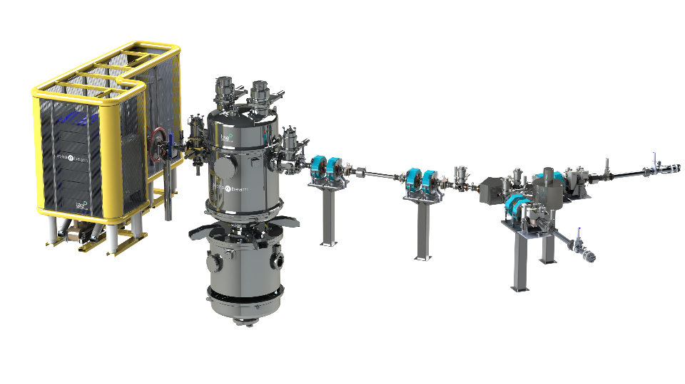
BNCT technology
The proton accelerator is an electrostatic tandem based on the VITA (Vacuum Insulated Tandem Accelerator) created at the Budker Institute of Nuclear Physics
E_{proton} = 2.5 MeV
Current = 10-15 mA
Target: Lithium
Notes:
The accelerator’s voltage gradient is created with a series of nested electrodes and a high voltage power supply, connected by a high voltage feedthrough column. The power supply and lower portion of the feedthrough are housed in an electrostatic vessel (ELV) that extends below the tandem accelerator. Electrostatic breakdown in the accelerator and ELV is prevented using a combination of vacuum and dielectric gas (SF6). The design of the tandem accelerator and ELV is an expansion of the Vacuum Insulated Tandem Accelerator, or VITA, created at the Budker Institute of Nuclear Physics [1].

Slide 18
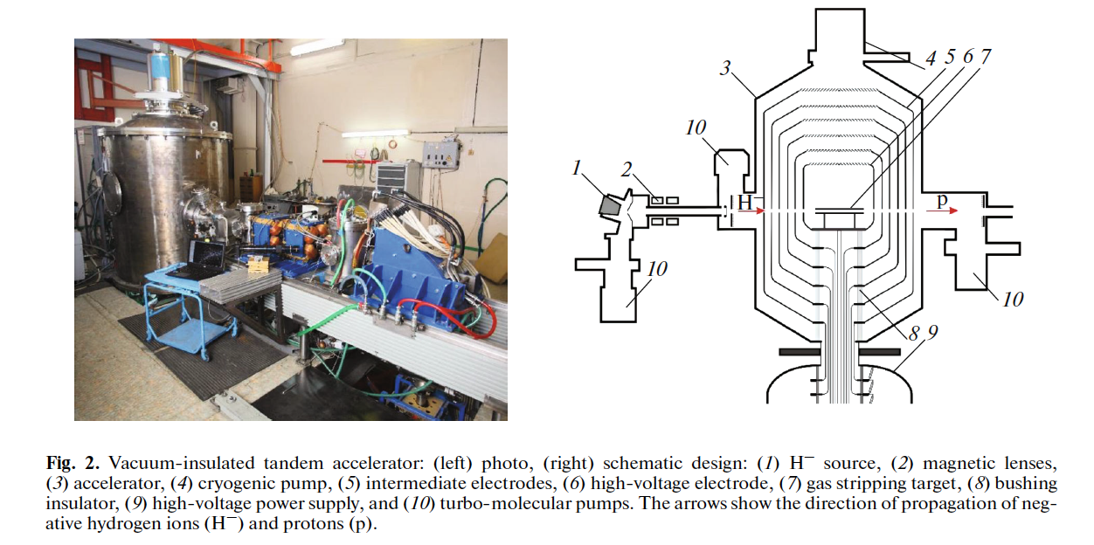
BNCT technology
Tandem: 2,5 MeV – 10 mA
Target: Lithium
ISSN 1063-7796, Physics of Particles and Nuclei, 2019, Vol. 50, No. 5, pp. 569–575. © Pleiades Publishing, Ltd., 2019.
Russian Text © The Author(s), 2019, published in Fizika Elementarnykh Chastits i Atomnogo Yadra, 2019, Vol. 50, No. 5.

Slide 19
BNCT technology
The target assembly consists of a layer of natural lithium deposited onto a copper backing disk with cooling channels.
The inner core of the BSA has layers of low-Z, non-hydrogenous scattering material, , e.g. magnesium, aluminum and fluorine, alternating with layers of compounds with a combination of high-Z elements.
The open beam port diameter of the BSA is 25 cm, and circular collimators ranging from 8 to 20 cm nominal diameter are available for patient treatments.
An additional, movable photon shield is used to block the BSA when treatments are not being performed to reduce personnel radiation exposure.
Patient positioning for treatment utilizes a 6 degree of freedom robot that is ceiling-mounted to a linear rail.

Slide 20









White Book
TECHNOLOGY AND INFRASTRUCTURE
EXPERIMENTAL AND ENVIRONMENTAL DOSIMETRY
DEVELOPMENT OF NEW BORATE COMPOUNDS
BORON MEASUREMENT AND CLINICAL DOSE VERIFICATION
COMPUTATIONAL DOSIMETRY AND TREATMENT PLANNING
RADIOBIOLOGY
CLINICAL TRIAL PROCEDURE FOR BNCT
MEDICAL DEVICE AND DRUG REGULATORY ASPECTS
Notes:
While waiting for the building to be ready and the machine to be installed, a collaboration was established between various institutions:
...
To develop strategies for...
Some of these institutions—UNIPV, S. Matteo, and INFN—had launched the Taormina project.
Now, thanks to the presence of CNAO, it will be possible to use BNCT in the clinic with an AB-BNCT facility.
Under construction at CNAO.
The collaboration has been extended to explore key BNCT topics,
as reported here...

Slide 21







Progress BNCT@CNAO

Slide 22
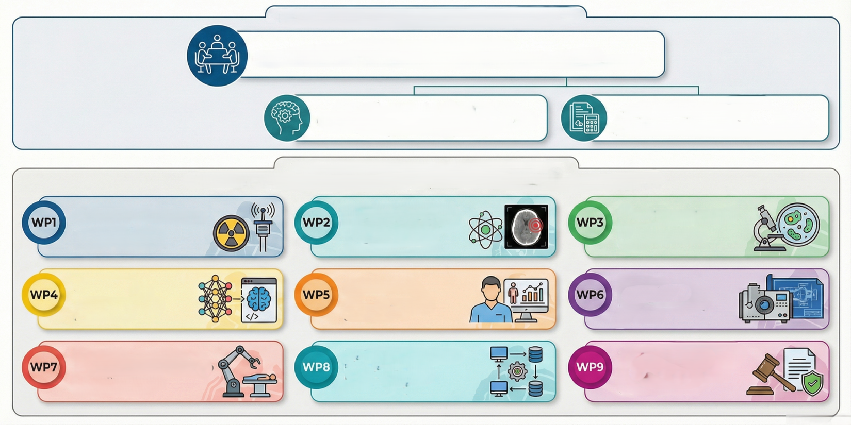




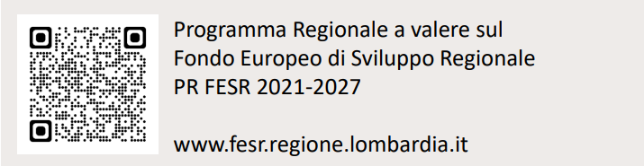
Progress BNCT@CNAO
GOVERNANCE and PROJECT STRUCTURE
Partners Committee
strategic steering body
Project coordination
Administrative WP
operational management by WP managers
Ambiental dosimetry
Clinical dosimetry
boron quantification
Biological validation
CNAO - ELSE SOLUTION
CNAO - UNIPV - INFN
CNAO - UNIPV - INFN
AI development
Clinical studies
Instrumentation
development
HIFUTURE
SAN MATTEO - CNAO
RAYLAB
Positioning systems
Systems and interface
integration
Regulatory compliance
VISIOROBOTICS - CNAO
HIFUTURE - CNAO
CNAO - HIFUTURE
Courtesy of Lisa Demartini

Slide 23
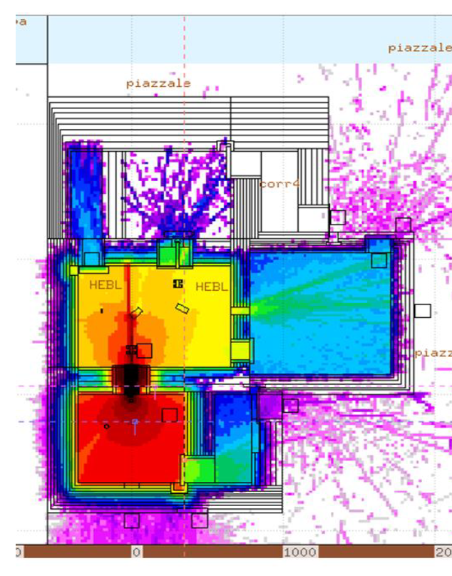
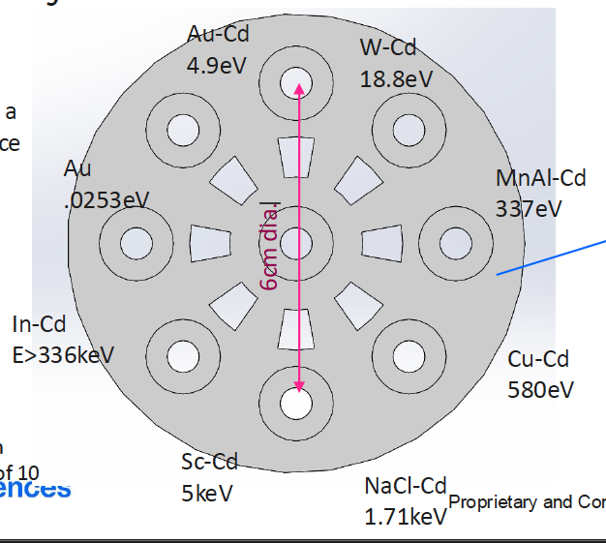

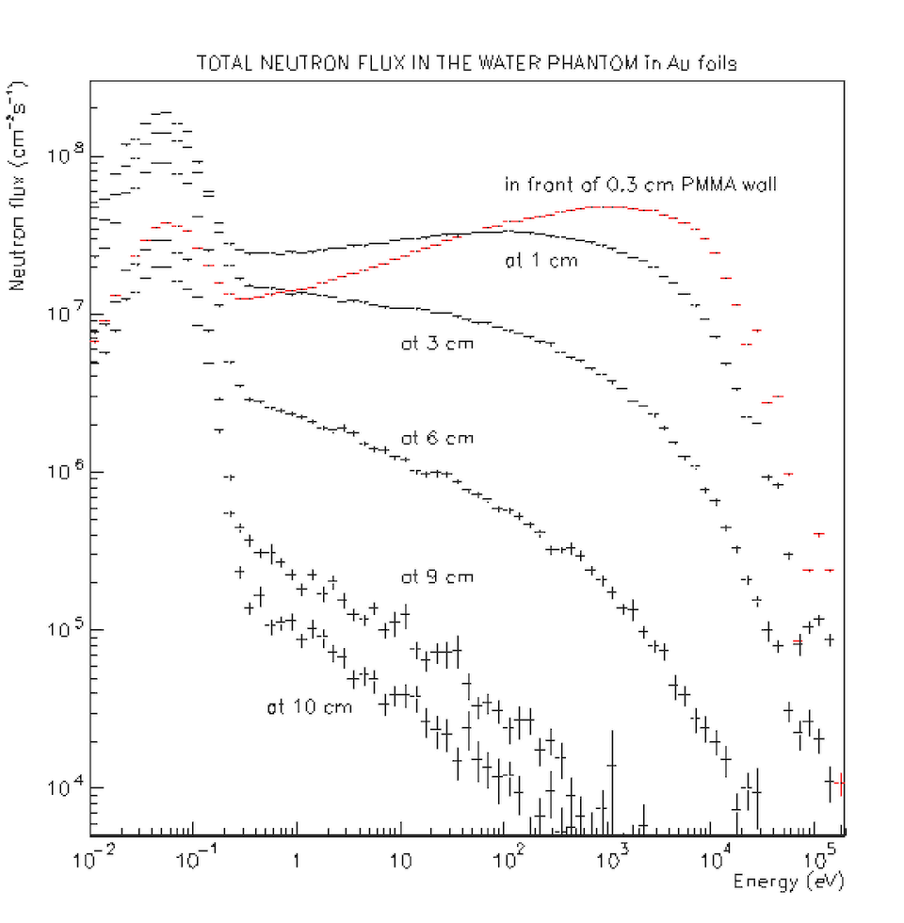
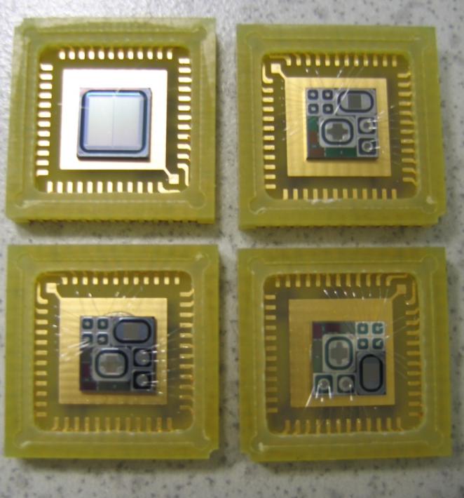
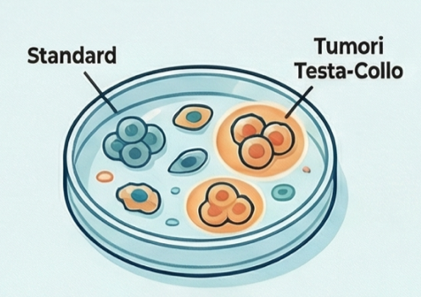
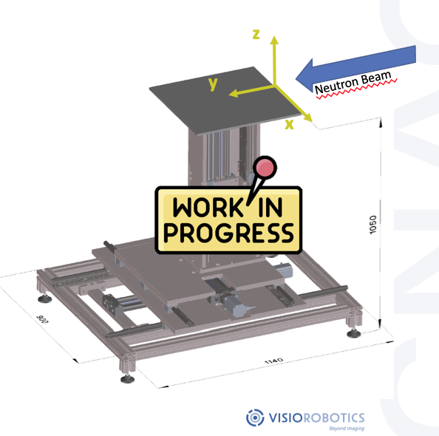
Progress BNCT@CNAO
WP1 Radiation Protection and Environmental Dosimetry
WP2 Clinical Dosimetry and Quantification of B-10
Spectrometric Characterization of the Neutron Beam with foil activation and deconvolution systems
Neutron and Gamma Dosimetry in a Tissue-Equivalent Phantom at Various Levels and Depths (Activation foils, BeO OSL Dosimeters, Twin Ionization Chambers, etc.)
B-10 Measurement with ICP-OES and PGNAA
WP3 Biological Validation of the System
In Vitro and In Vivo Measurements in Air and in a Phantom
WP4 AI Development
WP5 Clinical Studies
WP6 Solid-State Microdosimeter Development
WP7 Positioning System
WP8 Systems and Interface Integration
WP9 Regulatory Compliance and Regulatory Study

Slide 24
BNCT work is progressing
Building: completed
AB-BNCT facility installation starts by summer 2026
Preclinical activities (dosimetry and radiobiology test) start by the end of 2026 – beginning of 2027
Notes:
Nel frattempo il lavoro è proseguito
Qui vediamo lo stato dei lavoro al marzo del 2024
Oggi i lavori sono più avanti
E quello che si prevede per il prossimo fututo è:
…
…
….

Slide 25





THANK YOU!
saverio.altieri@cnao.it
www.cnao.it
Address
@FondazioneCnao
Fondazione CNAO
Via Erminio Borloni, 1
27100 Pavia
Centro Nazionale di
Adroterapia Oncologica
Email
info@cnao.it
@Fond_CNAO
Telephone
+ 39 0382-0781
Fondazione CNAO

