Slide 1


Neutron Field Spectral and Fluence Characterization and BSA optimization for AB-BNCT
Daniel Santos, Sébastien Chabod, Oliver Guillaudin,
Nadine Sauzet, Alexandre Bes
Laboratoire de Physique Subatomique et de Cosmologie (LPSC)
(Université Grenoble-Alpes -CNRS/IN2P3)
Enya Mobio, Amokrane Allaoua
Laboratoire de Métrologie et Dosimétrie Neutronique (LMDN)
ASNR(ex-IRSN)-France

Slide 2
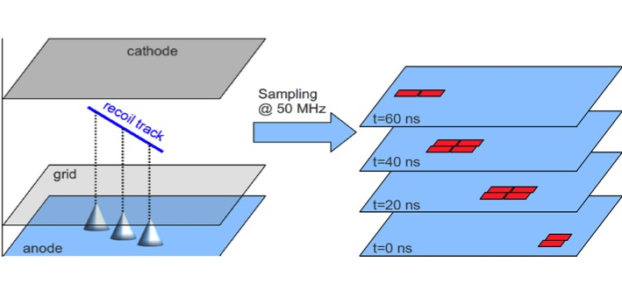
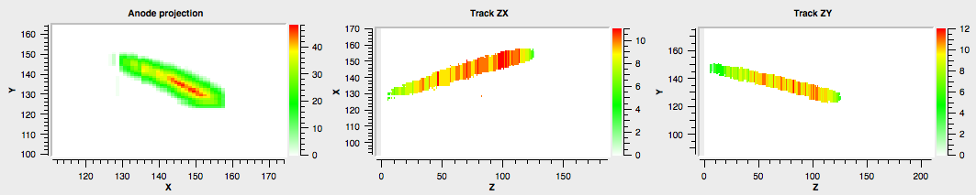
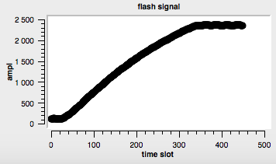
How can we measure a neutron energy produced by a non-pulsed beam ?
3D-nuclear recoil camera + Ionization Quenching Factor (IQF)
20 ns sampling :
Pixelated anode
Cathode
Grid
Neutron
En
θ
e ⁻
e ⁻
3D recoil track θ
e ⁻
e ⁻
Nuclear recoil
HV1
Energy deposited in ionization : IQF
Field cage
HV2
From θ, E_{ion}, and the IQF,
we get the neutron energy En
Eion

Slide 3
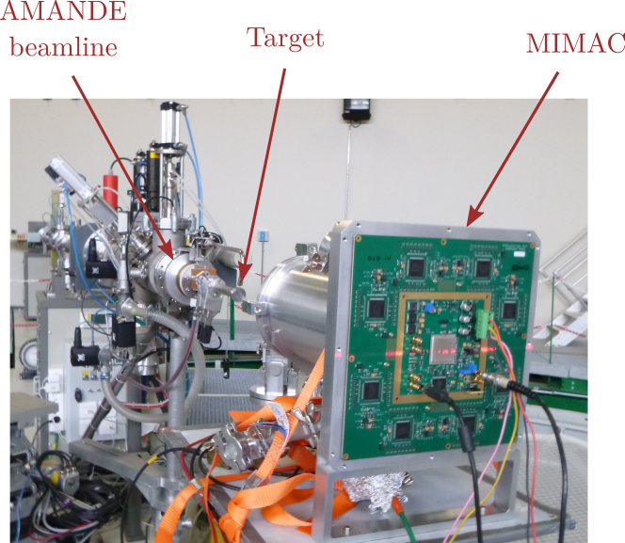
Demonstration of the directional detection with mono-energetic neutron fields
- The AMANDE facility (ASNR (ex-IRSN)-Cadarache)
provides mono-energetic neutron fields
- The energy of a mono-energetic neutron field is
defined by the angle of each nuclear recoil track with
respect to the neutron direction…
But the ionization energy of the recoil is different of its
kinetic energy…
It is quenched !!

Slide 4
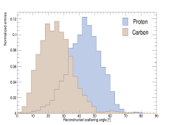
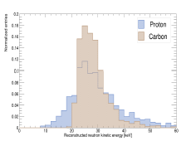
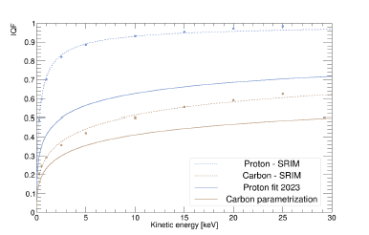
At low energies… 27 keV neutron field Proton and carbon recoils give the same neutron energy ! C. Beaufort et al 2024 JINST 19 P05052, arXiv:2312.12842
Neutron spectrum
Angular distribution
The kinetic energy is reconstructed with the Ionization quenching factor measured by COMIMAC

Slide 5
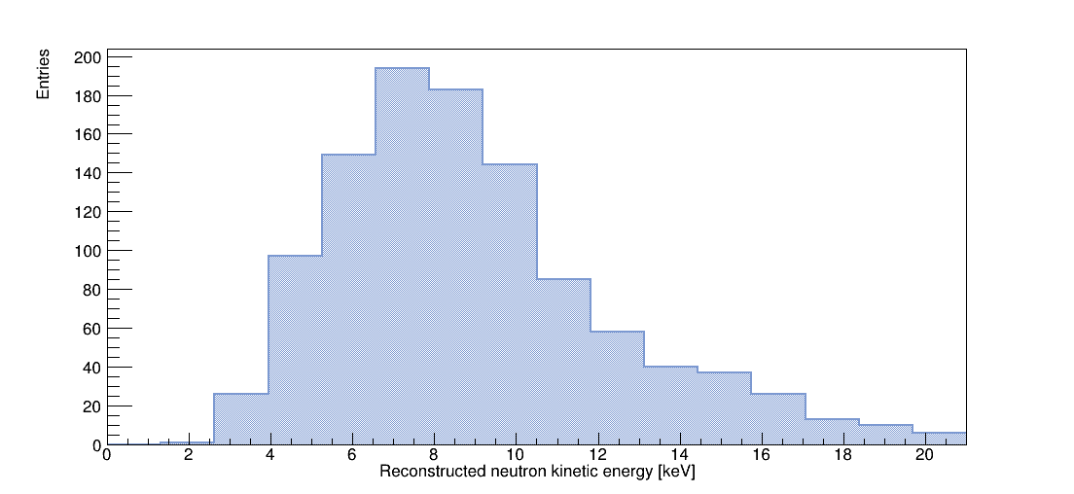
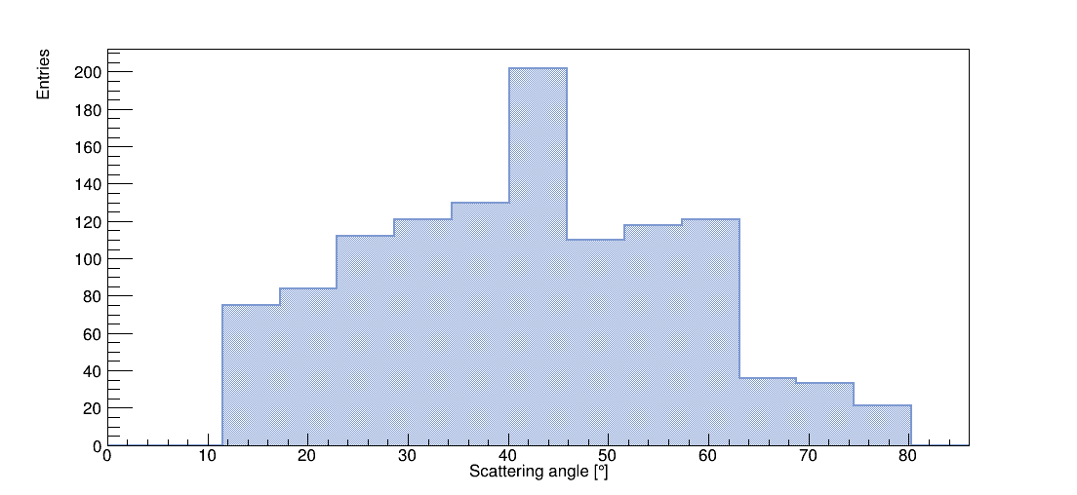
A mono-energetic Epithermal neutron field (8 keV) Neutron spectrum reconstruction from proton recoils
Angular distribution
Directional performances at 8 keV
Neutron spectrum
Cyprien Beaufort et al. JCAP08(2022)057

Slide 6
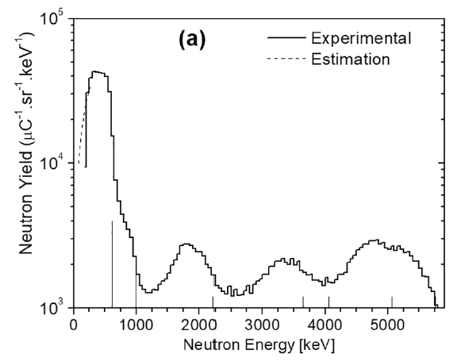
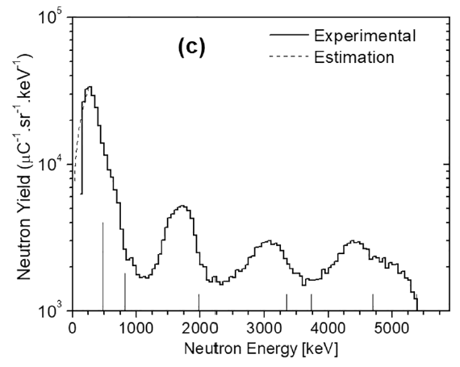
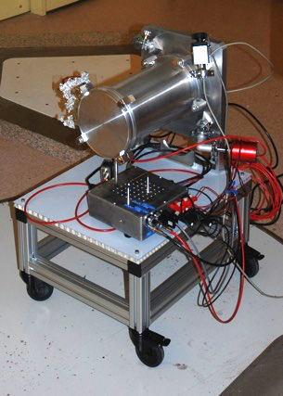
MIMAC-FastN - Polyenergetic measurement of ⁹Be(d(1.45 MeV),n)
Angular distribution
for an AB-BNCT nuclear reaction
700 mbar
He/CO₂ (5%)
INFN LNL
(Legnaro - Italy)
Spectrum measured at 0 deg
Spectrum measured at 60 deg
Collaboration with TANDAR (CNEA-Argentina)
M.E. Capoulat, N.Sauzet et al.
« Neutron spectrometry of the ⁹Be(d(1.45 MeV),n)¹⁰B reaction for accelerator-based BNCT » NIM B, vol. 445, pp. 57-62, 2019

Slide 7
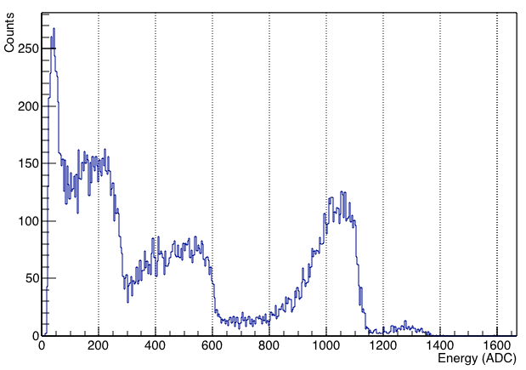
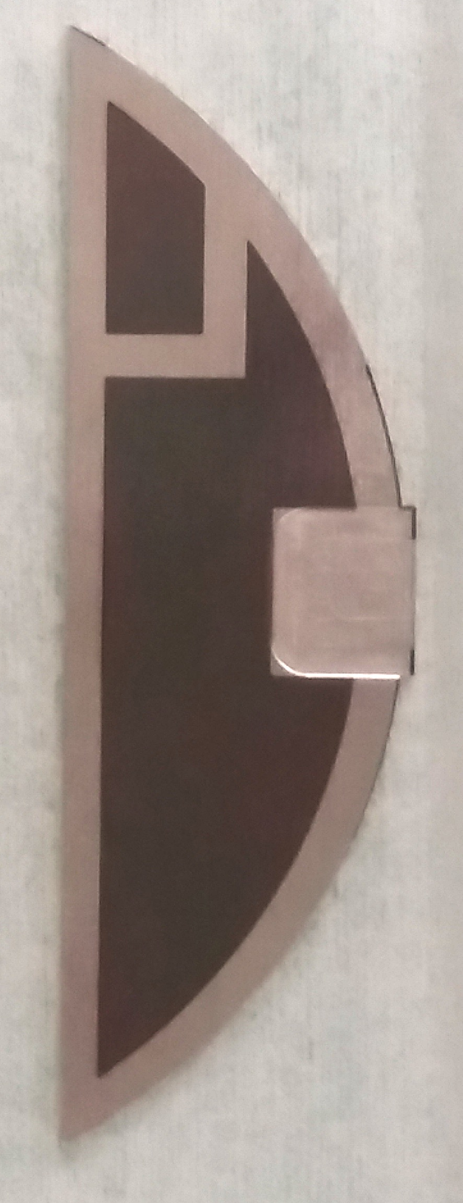
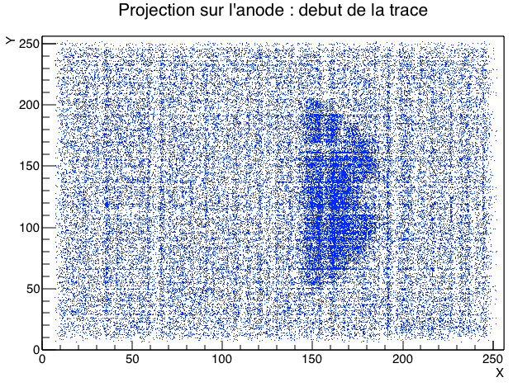
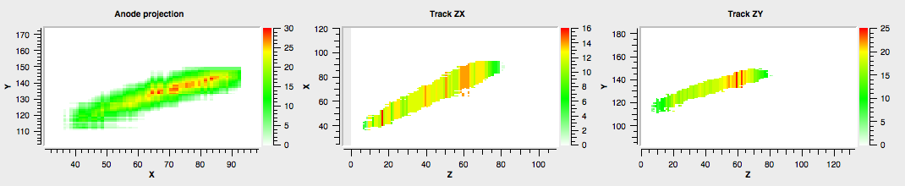
Energy calibration, Thermal neutron fluence and Active BNCT Phantom
Detection of α and ⁷Li, resulting from thermal neutron capture on a B₄C layer
α
1,47 MeV
Li
840 keV
B₄C layer
on the cathode
(500 nm thick)
α
1,78 MeV
Li
1,16 MeV
Anode projection : track start
Alpha track

Slide 8
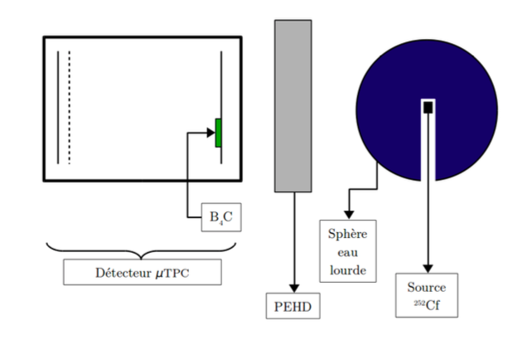
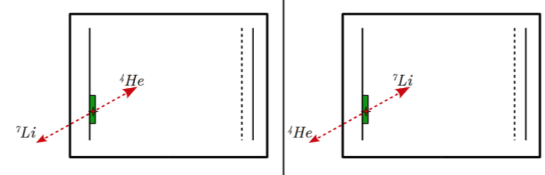
Experimental Set-up (schematic) to test the Active-Phantom Mode
D₂O-15cm radius Sphere
Moderator
MIMAC-FastN
5 cm thick

Slide 9
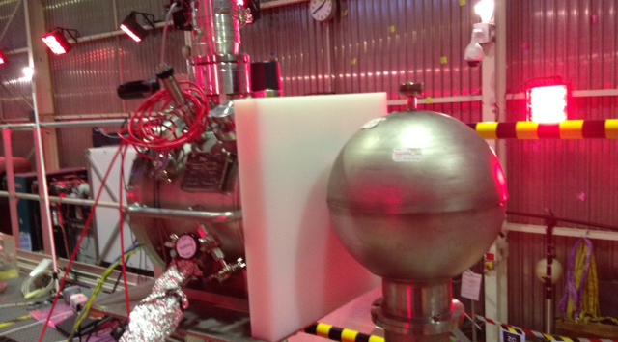
Experimental Set-up with a ²⁵²Cf source modered by a sphere of D₂O
Set-up at the IRSN-Cezane facility at Cadarache (France)
Bruno Asselineau, Michaël Petit, Thibaut Vinchon

Slide 10
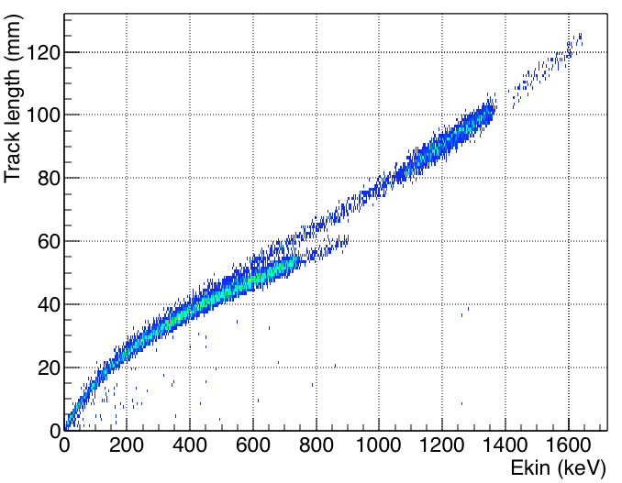
Geant4 Simulation of the MIMAC-FastN-Active Phantom
Clear separation of the alpha and ⁷Li branches with the both components each
Track length totally included in the C₄H₁₀ + 50% CHF₃ at 30 mbar
⁴He
⁷Li

Slide 11
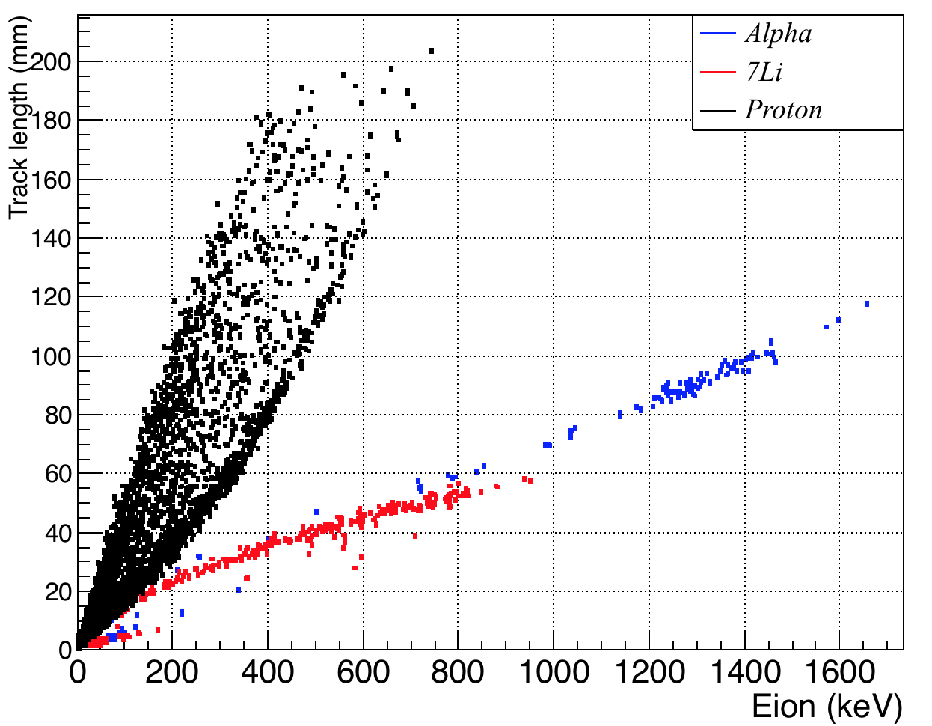
Geant4 Simulation showing all the recoils produced and stopped inside the active volume
The proton background is easily discriminated with respect to the alpha and lithium nuclear recoils in C₄H₁₀ + 50% CHF₃ at 30 mbar
¹H

Slide 12
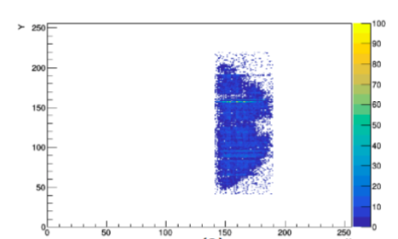
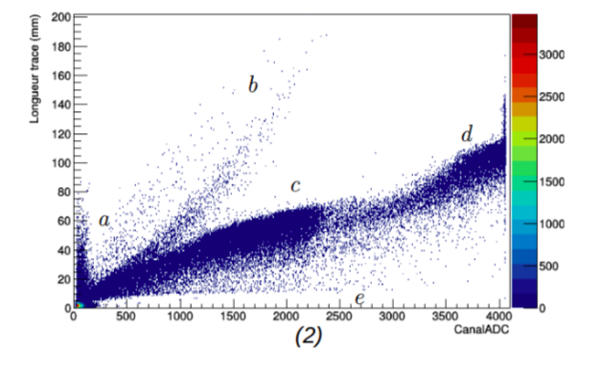
Neutron Capture on ¹⁰B with MIMAC-Active Phantom mode
Data from the MIMAC-Active Phantom using the
Experimental Set-up shown before with
C₄H₁₀ + 50% CHF₃ at 30 mbar
Track length (mm) vs. Ionization Energy (ADC channel)
¹H
⁴He
⁷Li
e⁻
Ionization Energy

Slide 13
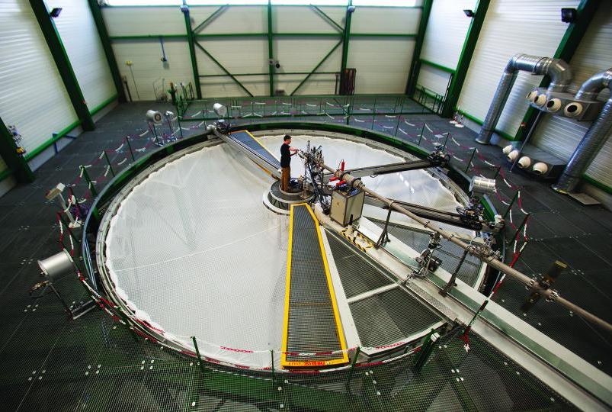
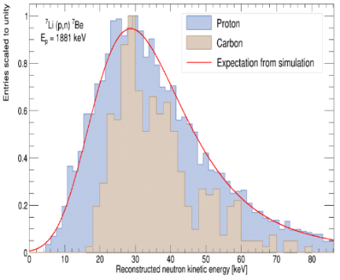
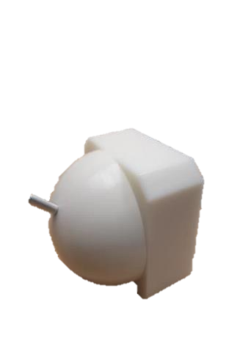
A complex epithermal neutron field characterization
At AMANDE facility, with a near threshold ⁷Li (p (E=1.881 MeV),n) reaction
C. Beaufort et al.
JINST, P05052 (2024)

Slide 14
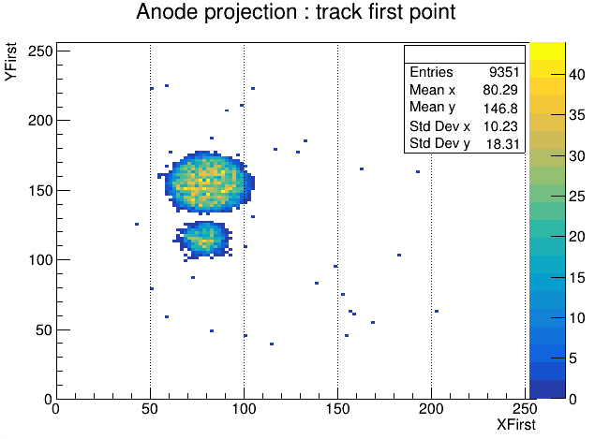
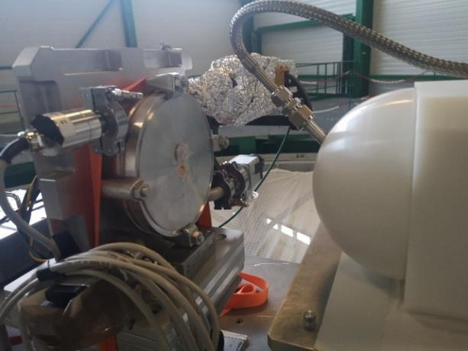
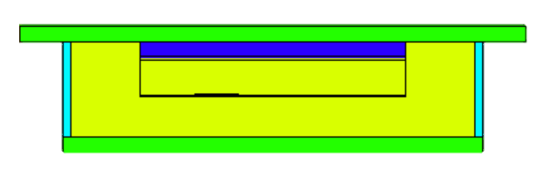
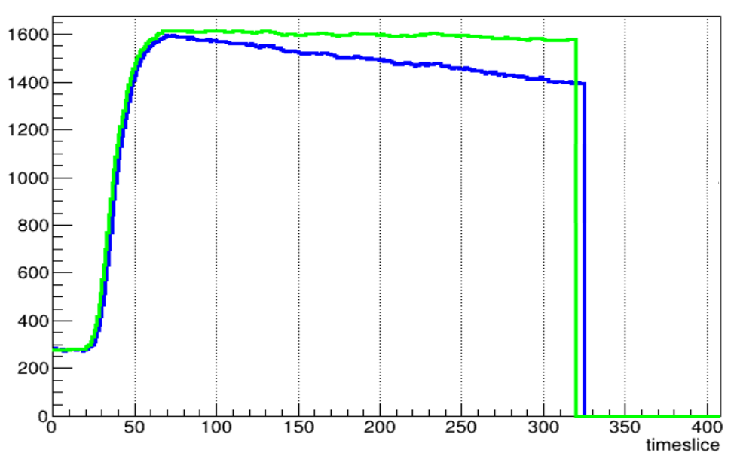
Neutron flux measurements by the Gold foil Activation method and by the Neutron Flux Monitor (NFM) detector
Dépôt de ¹⁰B
Foil of ¹⁹⁷Au + Cd
Distribution of the first measurement of the 3D-tracks
13 mm
Foil of ¹⁹⁷Au
NFM detector
FADC profile of an alpha (1.24 MeV)
event as a function of the
sampling (20 ns)

Slide 15
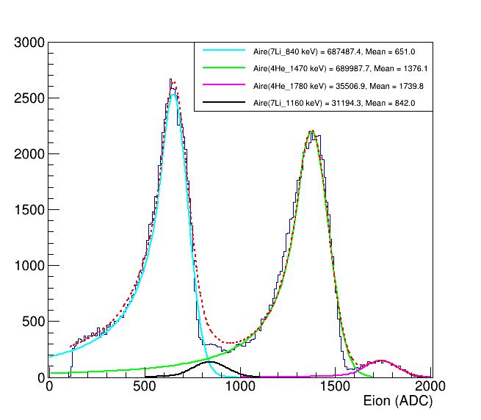

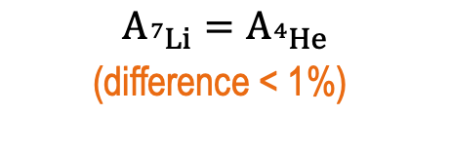



Alpha and ⁷Li energies measured with the NFM
$$E_{Li}(840 keV)$$
Enya Mobio, Ph.D. Thesis (April 2025)
$$E_{He}(1,47 MeV)$$
$$E_{He}(1,78 MeV)$$
$$A_{{}_{ }^{7}{Li}}=A_{{}_{ }^{4}{He}}$$
(difference < 1%)
$$E_{Li}(1,06 MeV)$$

Slide 16
Thermal and Epithermal Fluence Results
From the Activation of Gold foils and the Neutron Flux Monitor detector
compared with the MCNP simulation calculation
 |  | Ф_{th} (n.cm⁻².s⁻¹) | C/E | Difference | Ф_{epi} (n.cm⁻².s⁻¹) | C/E | Diff
¹⁹⁷Au | Calcul | (7,52 ± 0,32).10² | 0,68 | - 46% | (1,06 ± 0,05).10³ | 1,25 | +20%
 | Exp. | (1,10 ± 0,08).10³ |  |  | (8,53 ± 0,84).10²
NFM | Calcul | (5,66 ± 0,25) .10² | 0,94 | - 6 % | (9,08 ± 0,40).10² | 0,94 | - 6 %
 | Exp. | (6,03 ± 0,34).10² |  |  | (9,64 ± 0,55).10²
Enya Mobio (LMDN (ASNR)), PhD thesis (April 2025)

Slide 17
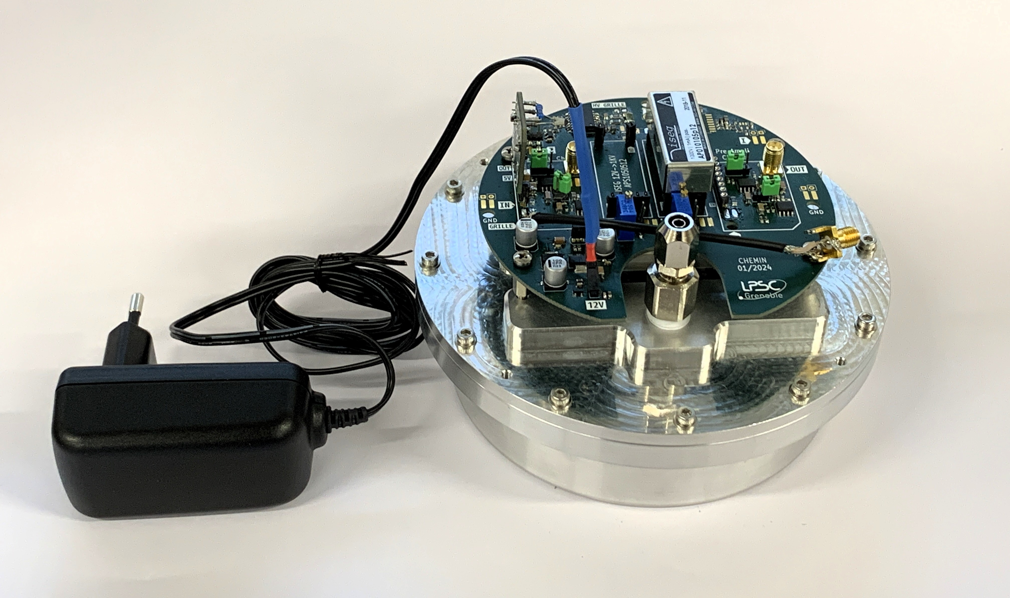




NFM (Neutron Flux Monitor) Detector
Giving the neutron flux (up to 10¹²n/s)
as a function of time, with an evaluation of the dead time
$$E_{Li}(840 keV)$$
$$E_{He}(1,47 MeV)$$
$$E_{He}(1,78 MeV)$$
$$E_{Li}(1,06 MeV)$$
Including a Boron layer very well measured (thickness, surface and homogeneity !!
Multi-layer deposition PAPVD (plasma-assisted)
LPSC – Alexandre BES, Ana LACOSTE

Slide 18
Topology Optimization of Neutron Moderators
BSA design methodologies
What criteria does the community use to design BSAs?
Method 1: in the past, BSA often designed so that the neutron field at its exit verified some
in-air FOMs. E.g. φ_{epi} > 5e8 cm⁻²s⁻¹ (intensity), D_{fast}/φ_{epi} < 2e-13 Gy.cm² (purity), etc.
Issue: in-air FOMs found too restrictive, can eliminate BSAs with best therapeutic performance
IAEA TECDOC 2001: in-air FOM “values […] are specifically not suggested as ‘requirements’
or ‘recommendations’ that have to be achieved by a system provider’
➔ method 1 becoming obsolete
Method 2: a therapeutic target is chosen, often a GB of a few cm³ placed at a depth of ∼3-4 cm
in a patient’s head. BSA then designed to maximize D_{tum}/D_{brain} or a TCP.
Issue: arbitrariness of the choice of tumor configuration
➔ expected design suboptimality for treating other tumor configuration
Method 3: BSA designed to maximize dosimetric FOMs, most often AD
(Advantage Depth) or TD (Treatment Depth).
TD gives a range of depth in body where tumor tissue receives at
least 2 times the max. dose in normal tissue
➔ common methodology, extensively explored in literature

Slide 19
Modern BSA design calculation methods
S. Chabod et al., Phys. Med. Biol. 2025, 70 (3), pp.035008
Breakthrough in recent years: recent developments in algorithms (machine learning, topology
optimization, etc.) now allow unbiased computations of the structures of BSAs.
Ex of result: TopOpt computation of the best BSA structure that max TD s.t. TT < 1h for GB
Optimization result
⁷Li( p(2,5 MeV) ,n) metallic source
Topology optimization
= compute the best
material distribution
in each voxel of a BSA

Slide 20
State of the art of BSA design using method 3
Progress in the dosimetric performance of BSAs over the past 30 years
Results: AD increased by only 1.1 cm in 20+ years, TD by only 0.05 cm.
Study | Source | C_{B} (ppm) | AD (cm) | TD (cm)
Bleuel et al. 1998 | BMR Reactor ⁷Li(p(2.4 MeV),n) | 13 13 | 8.4 9.9 | NA NA
Riley et al. 2003 | MIT Reactor | 18 | 9.7 | 7.8
Kononov et al. 2004 | ⁷Li(p(2.3 MeV),n) | 18 | 9.1 | 7.0
Kim et al. 2009 | ⁷Li(p(2.5 MeV),n) | 10 | 8.1 | 6.0
Tanaka et al. 2009 | KU Reactor KU Reactor ⁹Be(p(30 MeV),n) ⁹Be(p(30 MeV),n) | 15 18 15 18 | 8.4 8.6 8.9 9.1 | NA NA NA NA
Inoue et al. 2014 | ⁹Be(p(8.0 MeV),n) | 10 | 7.5 | 5.0
Minsky et al. 2014 | ⁷Li(p(2.3 MeV),n) | 15 | 9.5 | 7.0
Capoulat et al. 2014 | ⁹Be(d(1.45 MeV),n) | 15 | 9.6 | 7.8
Capoulat et al. 2017 | ¹³C(d(1.45 MeV),n) | 15 | 10.0 | 7.8
Koay et al. 2018 | W(p(50 MeV),n) | 18 | 9.3 | NA
Torres‑Sánchez et al. 2021 | ⁷Li(p(2.1 MeV),n) | 18 | 9.74 | 7.85
Bae et al. 2022 | ⁹Be(p(10 MeV),n) | 18 | 9.0 | 7.2
Zhang et al. 2023 | ⁷Li(p(2.3 MeV),n) | 18 | 11 | NA
Rong et al. 2024 | ⁷Li(p(2.8 MeV),n) | 18 | 8.24 | 6.5
Verdera et al. 2024 | ⁴⁵Sc(p(2.918 MeV),n) | 18 | 9 | 7
Chabod et al. 2025 | ⁷Li(p(2.5MeV),n) | 18 | 12.7 | 10.3
C_{B} = Boron-10 concentration in blood
NA = value not published and cannot be
reconstructed in the absence of published
dose profiles

Slide 21
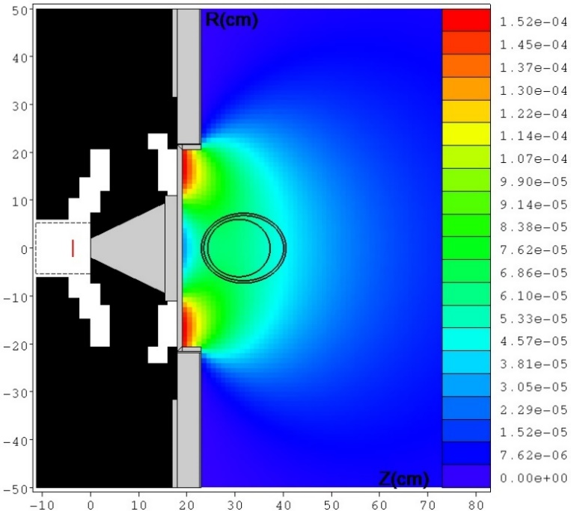
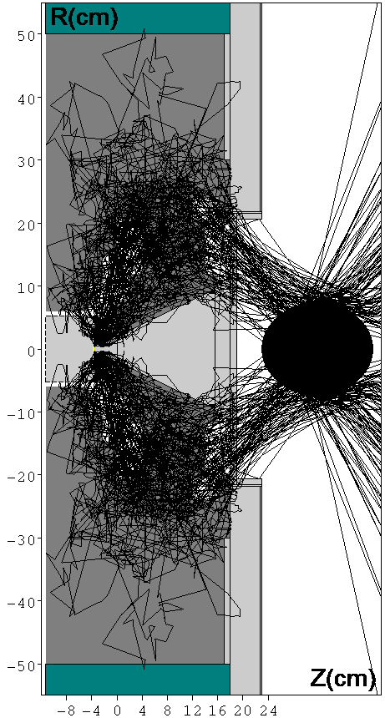
Characterization of advanced neutron fields
Modern BSAs generate complex neutron fields ϕ(r,E,Ω), that combine directionality (Ω),
space (r) and energy (E) distribution of neutrons to better control tumors & side effects.
Ex: field generated by a BSA that max TD for a 30 mA ⁷Li(p(2,5 MeV),n) source
General problem: how to characterize such BNCT neutron fields?
Field directionality
Field performances
Field intensity
AD = 12.7 cm
Previous best value
obtained so far : 11 cm
TD = 10.3 cm
Previous best value
obtained so far : 7.8 cm
D_{tum} @ 4 cm depth
= 206 Gy-Eq/h
Ring neutron
collimator
Neutron
Filter
Neutron
Tunnel
S. Chabod et al., Phys. Med. Biol. 2025, 70 (3), pp.035008

Slide 22
Neutron Field (NF) characterization (E, flux) and the BSA used to define it are now possible !
1- Spectral and fluence measurements of the NF produced by a non-pulsed particle beam
2- Monitoring the fluence as a function of time giving access to the eventual degradation of the target and a real-time dose calculation
3- Standardization of measurements will give access to the comparison of the different NF produced by the different facilities and the doses delivered
4- An active phantom allowing measurements of the number of captures on a controlled amount of ¹⁰B at different “depths” is available
5- Optimal Moderators (BSA) are now possible…
A new generation of AB-BNCT can start !!

Slide 23

Total absorbed dose (D_{T} ) in Gy (Joule/kg) = (Total Ionization released in a volume of mass m) / (mass m)
Each dose component of the total dose is associated to a different nuclear reaction:
¹⁰B(n,α)⁷Li a neutron capture reaction to the called boron dose D_{B},
considering the ionization energy released by the alpha particle and lithium nucleus
¹H(n,n’)¹H an elastic collision reaction to the called neutron dose D_{n},
considering the ionization energy released by the hydrogen resulting from
the elastic neutron scattering,
¹⁴N(n,p)¹⁴C a neutron capture reaction to the called proton dose D_{p},
considering the ionization energy released by the proton and the carbon nucleus,
¹H(n,γ) ²H a radiative capture reaction on ¹H plus the residual gamma from ¹⁰B capture reaction
and all the gamma rays coming out from the BSA…
to the called gamma dose Dγ, considering the energy transferred by the photon by pair production, Compton, and photoelectric processes.

Slide 24
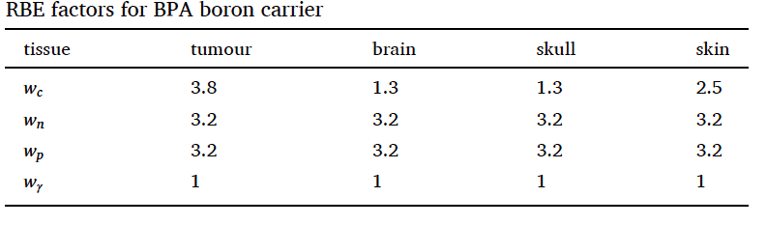
Biological Dose in Gy[RBE]
Taking into account the Relative Biological Effectiveness (RBE)
Jeffrey A Coderre et al, Derivations of relative biological effectiveness
for the high-let radiations produced during boron neutron capture irradiations of the
91 rat gliosarcoma in vitro and in vivo.
International Journal of Radiation Oncology* Biology* Physics, 27(5) :1121–1129, 1993.

Slide 25
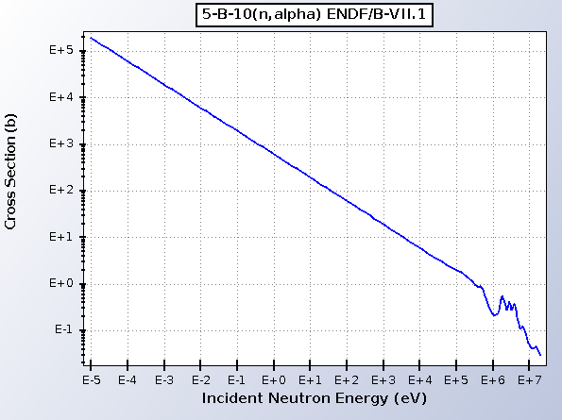
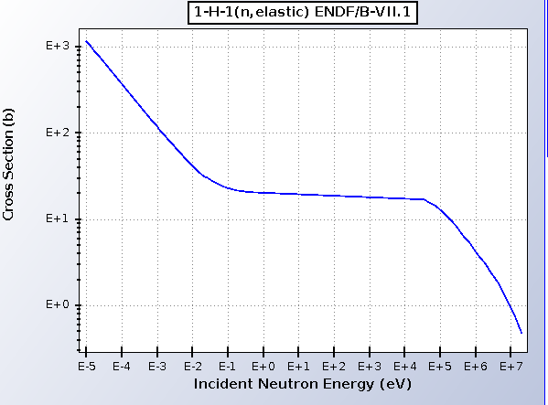
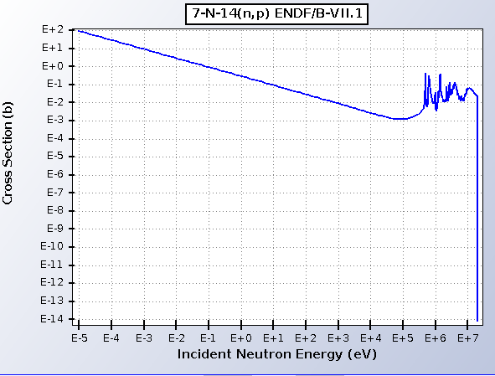
Dose [Gy]= Ionization Energy released [Joule] / mass unit [kg]
« Total absorbed dose »
¹⁰B (n, ⁴He)⁷Li
Neutron Capture
Eγ = 2.2 MeV
Elastic collisions !!
¹⁴N (n, p) ¹⁴C
Neutron Capture

Slide 26
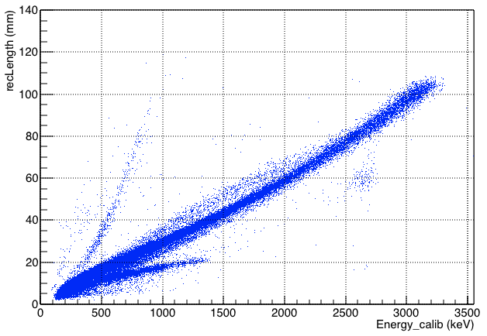
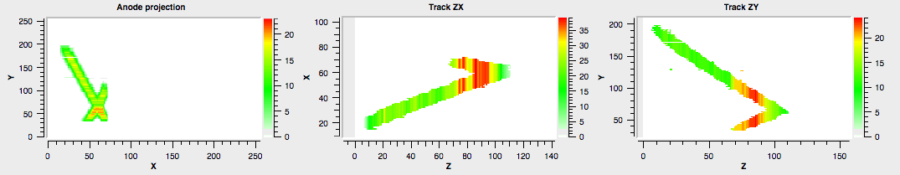
Selection of ⁴He nuclear recoils : D(d(1.8 MeV),n)
Discrimination from protons, ¹²C, ¹⁶O, and (n,α) reactions
700 mbar He/CO₂ (5%)
Protons
⁴He recoils
¹⁶O(n,α)¹³C
¹²C and ¹⁶O recoils
IRSN /AMANDE (Cadarache)

Slide 27
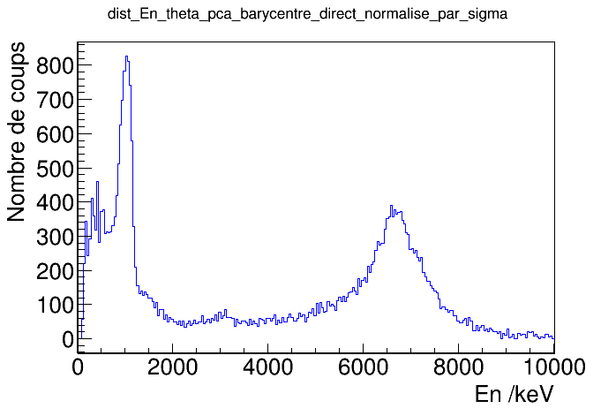
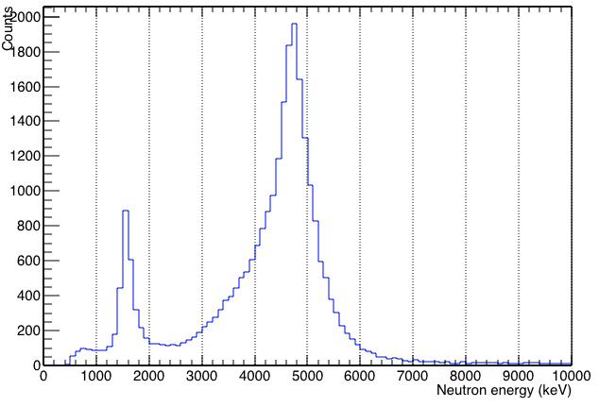
Monoenergetic measurements : detection of target pollutions
D(d(1.8 MeV,n) : neutrons of 5 MeV
D(d(3.2 MeV,n) : neutrons of 6.5 MeV
D(d(1.8 MeV),n)
¹⁶O(d,n)
Counts
D(d(3.2 MeV),n)
¹²C(d,n)
¹²C(d,n)
Neutron energy (keV)
NPL /(UK)
IRSN / AMANDE (Cadarache)
700 mbar He/CO₂ (5%)
The targets have in general pollutions not well determined generating neutrons not taken into
account in simulations… We have to characterize the neutron field produced at the target

Slide 28
Spectral distribution after neutron moderation
Spectral distribution (MCNP simulation) of the neutron flux
coming out the moderator (3,5 cm thickness)
Thermal
Epithermal
Fast
26%
44%
30%
E. Mobio et al.( 2025)

Slide 29
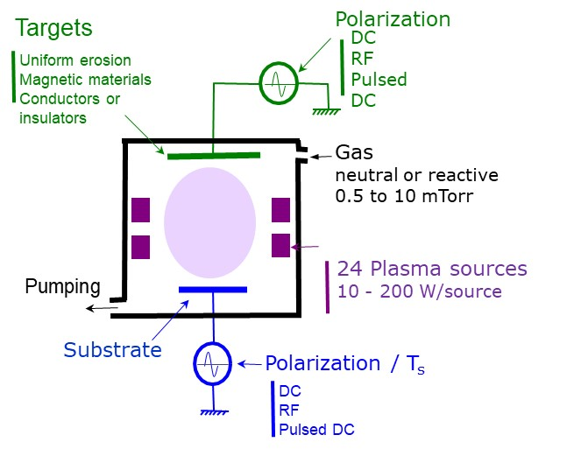
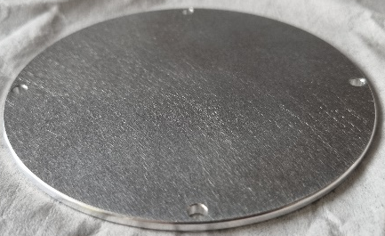
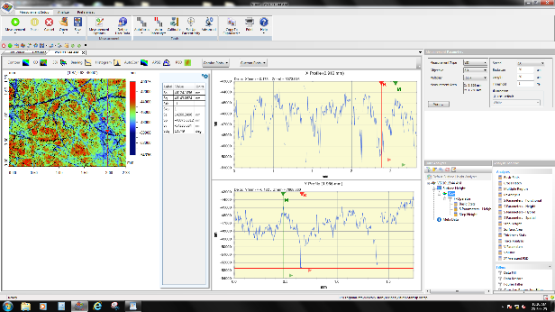
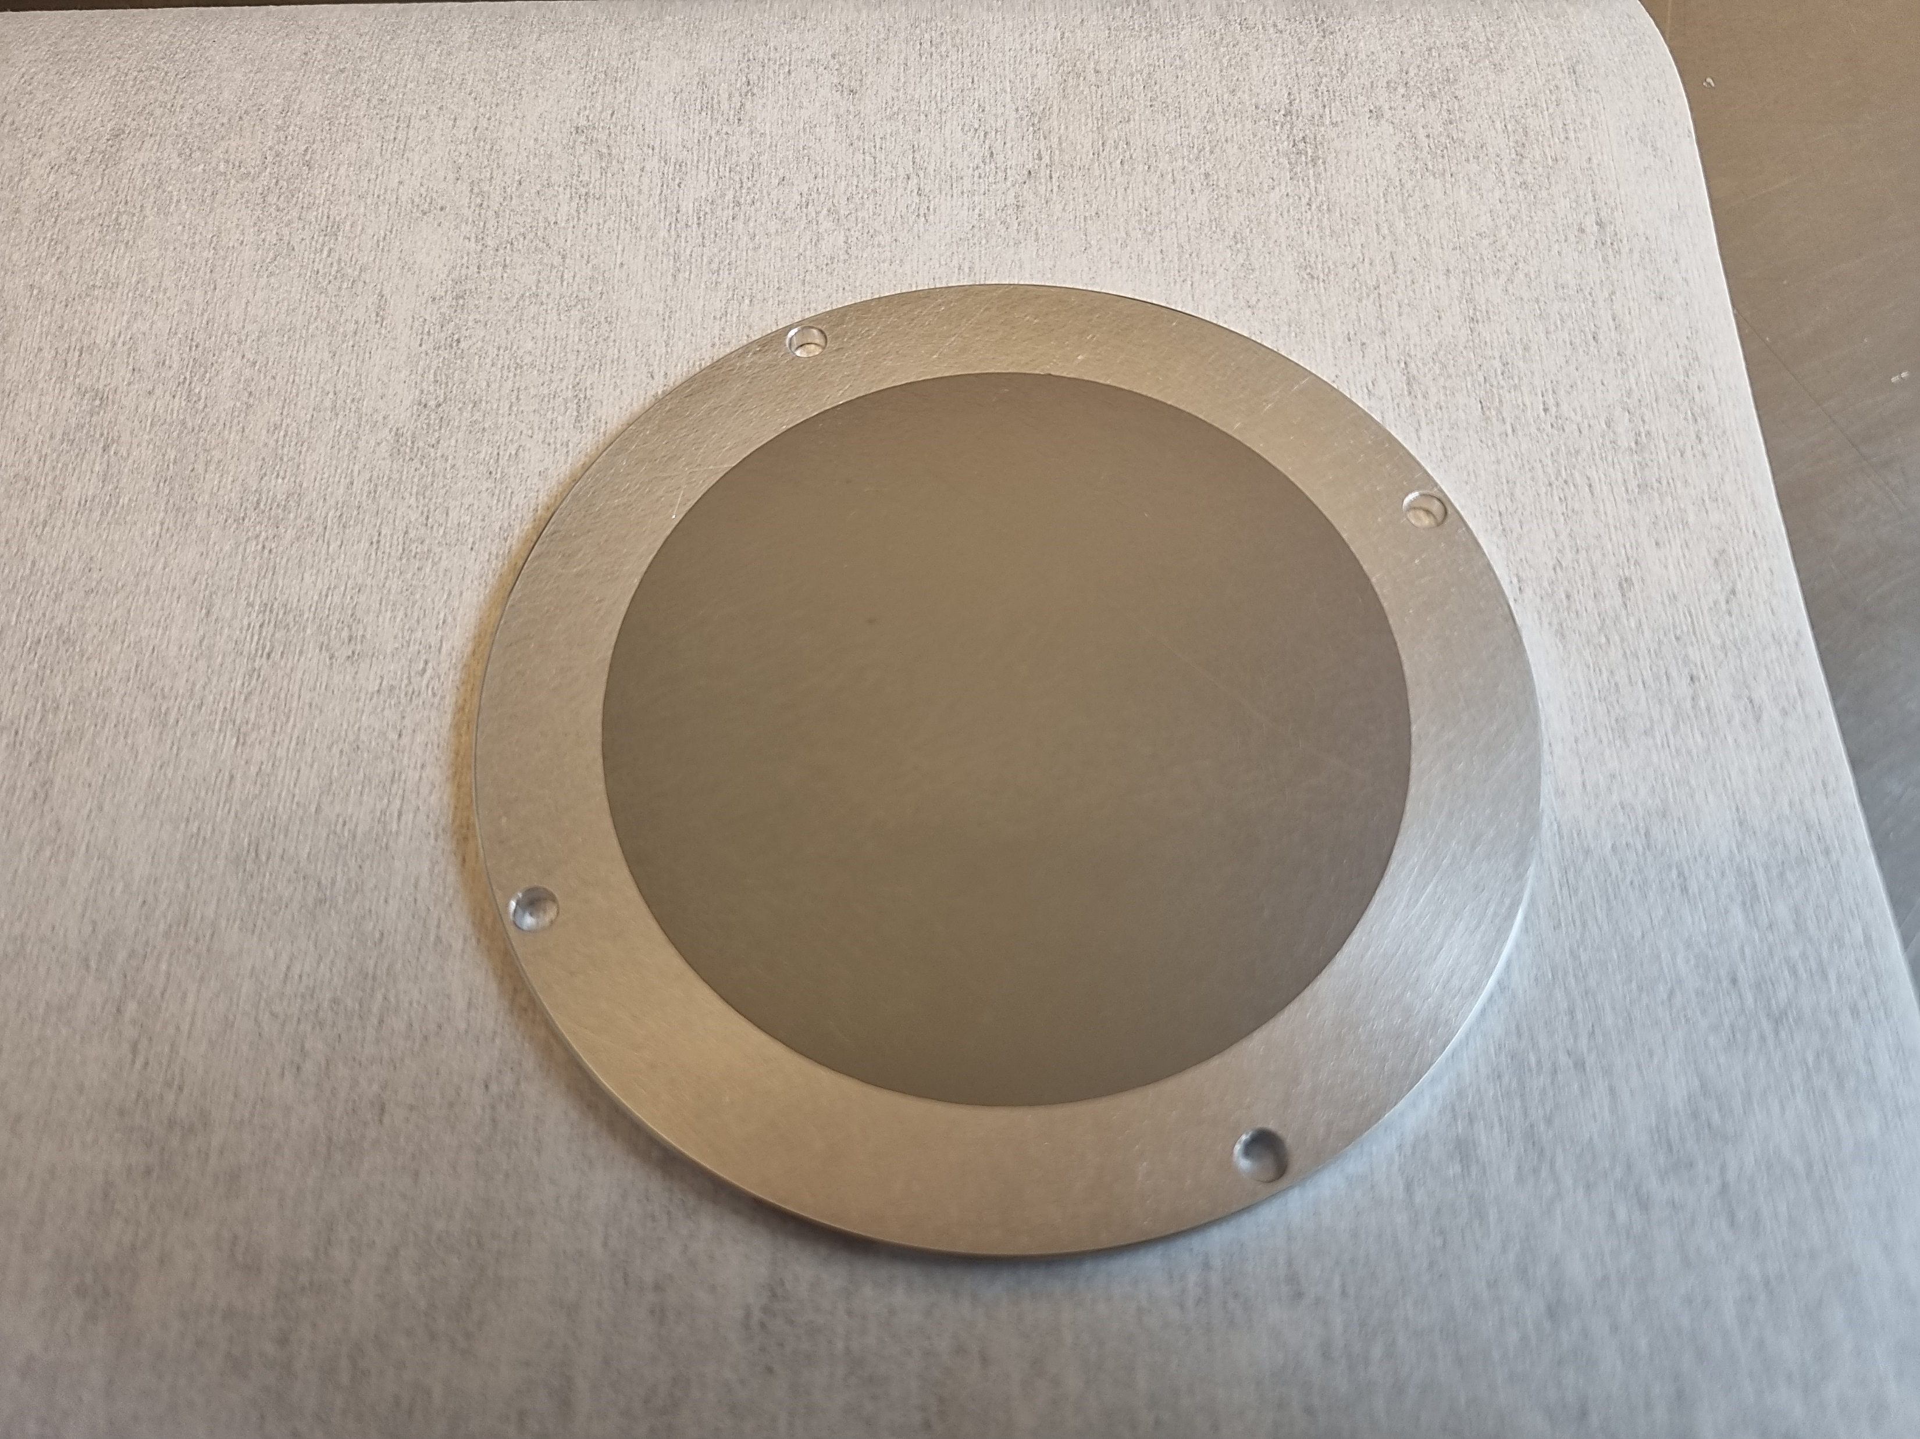
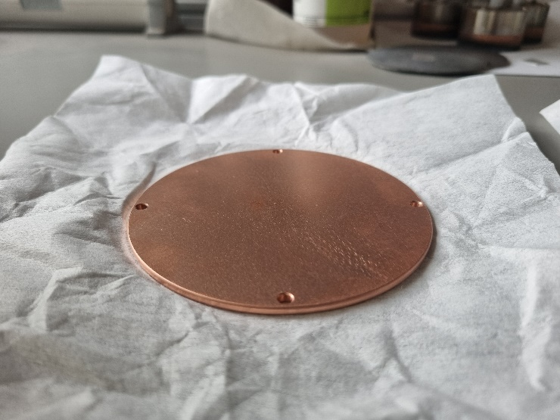
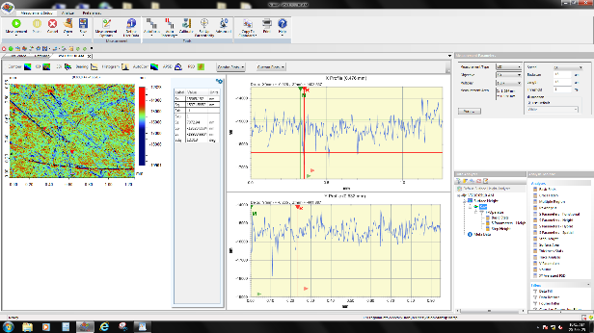
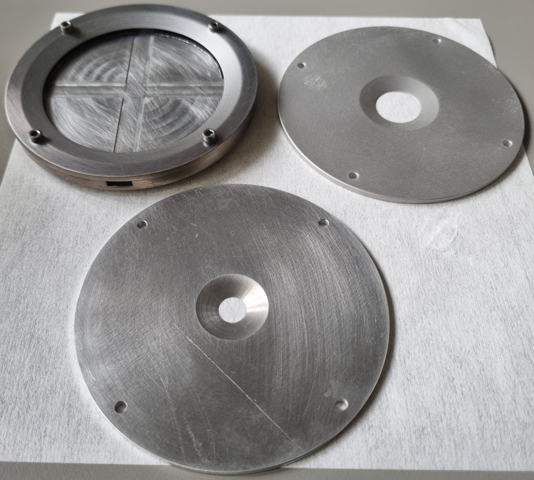

Multi-layer deposition PAPVD (plasma-assisted)
LPSC – Alexandre BES, Ana LACOSTE
Experimental Set-up
Cathode availables Al et Cu
Roughness between 1 et 3 µm
Ø 80 mm
Production of a layer of 200 ± 5 nm of ^{nat}B
+ 10 nm of Ti on an Aluminium cathode
Masks of 10, 20 and 80 mm diameter
Ø 80 mm
Ø 20 mm
Ø 10 mm

