Slide 1


A FLASH in the UNIVERSE?
Prof. Dr. Andrea Mairani & Dr. Celine Karle
Scientific Director at the Heidelberg Ion Beam Therapy Center (HIT)
Medical Faculty, Heidelberg University
Department of Radiation Oncology, University Hospital Heidelberg
National Center for Tumor Diseases (NCT)
German Cancer Research Center (DKFZ)

Slide 2
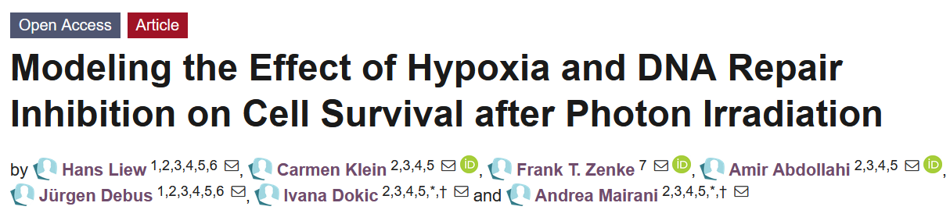
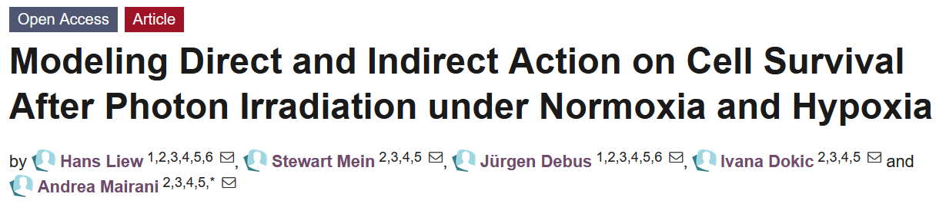
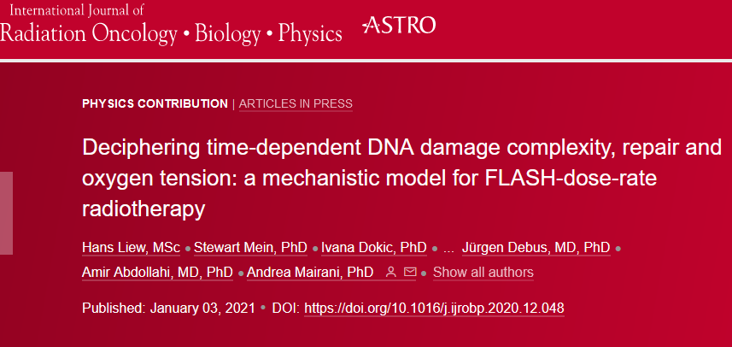
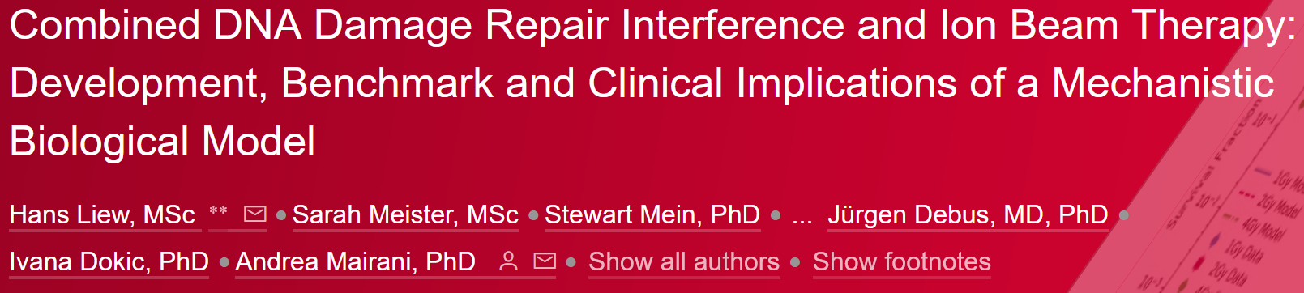
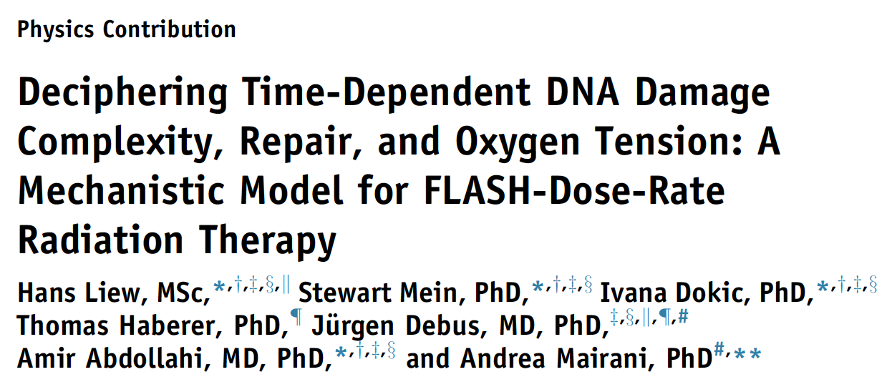
The „UNIfied and VERSetile bio response Engine“ - UNIVERSE
UNIVERSE: multipurpose mechanistic modelling framework of radiation action
Goal: Translating the action of “effect-modifiers” (e.g., DNA damage inhibition) from readily available photon data to charged particle scenarios

Slide 3
The „UNIfied and VERSetile bio response Engine“ - UNIVERSE
UNIVERSE

Slide 4
The „UNIfied and VERSetile bio response Engine“ - UNIVERSE
UNIVERSE
Cell Cycle
Radiation Quality
Dose Rate
Radiation Effect
…
Radical Scavengers
DNA Damage Repair Interference
O2 Levels

Slide 5
The „UNIfied and VERSetile bio response Engine“ - UNIVERSE
UNIVERSE
Cell Cycle
Radiation Quality
Dose Rate
Rarely considered in treatment plans for any radiation quality!
Radiation Effect
…
Radical Scavengers
DNA Damage Repair Interference
O2 Levels
Need: Versatile framework able to describe and predict effect of modifiers under unified model of radiation action for all radiation qualities to give patients the best personalized care.

Slide 6
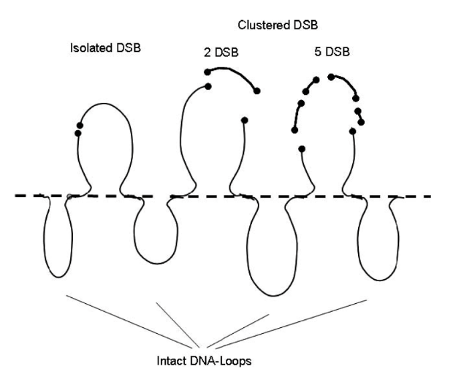
Building blocks of UNIVERSE – Giant Loops
Giant Loops:
Chromatin substructure containing ≈ 2 Mbp, with either side attached to a backbone
Double strand breaks most lethal: 30 DSB per Gy in a cell
Isolated DSB (iDSB):
one DSB inside loop
associated with fast repair kinetics
Clustered/Complex DSB (cDSB):
two or more DSB inside loop
associated with slow repair kinetics
associated with high risk of chromatin loss

Slide 7
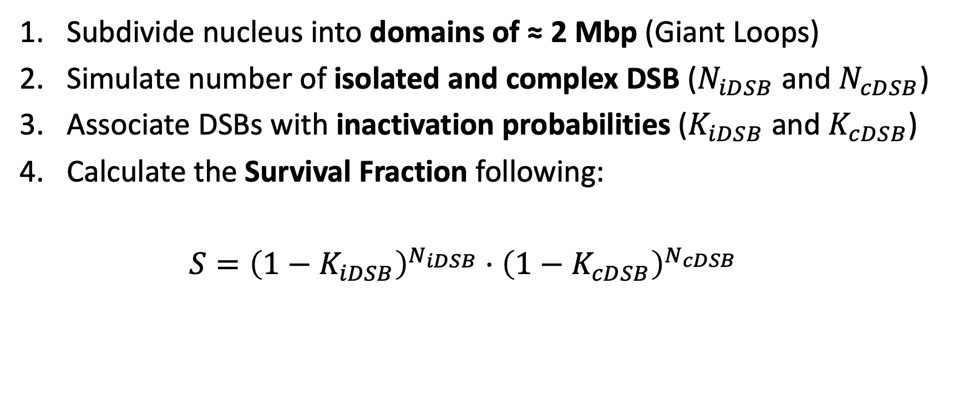
Cell Survival Calculation
Subdivide nucleus into domains of ≈ 2 Mbp (Giant Loops)
Simulate number of isolated and complex DSB ($N_{iDSB}$ and $N_{cDSB}$)
Associate DSBs with inactivation probabilities ($K_{iDSB}$ and $K_{cDSB}$)
Calculate the Survival Fraction following:
$S={\left(1−K_{iDSB}\right)}^{N_{iDSB}}⋅{\left(1−K_{cDSB}\right)}^{N_{cDSB}}$

Slide 8
The „UNIfied and VERSetile bio response Engine“ - UNIVERSE
UNIVERSE
Cell Cycle
Radiation Quality
Dose Rate
Radiation Effect
…
Radical Scavengers
DNA Damage Repair Interference
O2 Levels

Slide 9
The „UNIfied and VERSetile bio response Engine“ - UNIVERSE
UNIVERSE
Cell Cycle
Radiation Quality
Dose Rate
Radiation Effect
…
Radical Scavengers
DNA Damage Repair Interference
O2 Levels

Slide 10
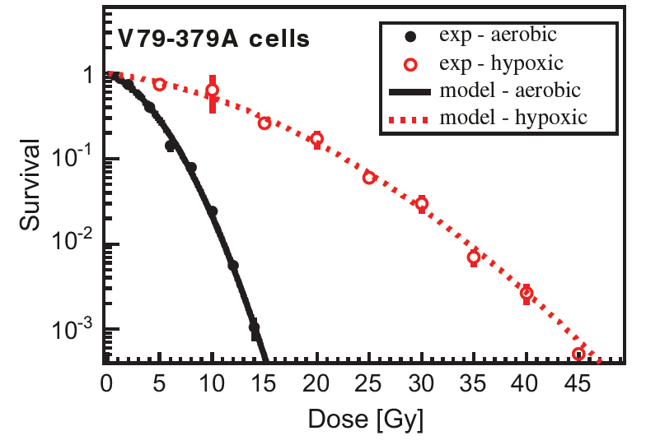
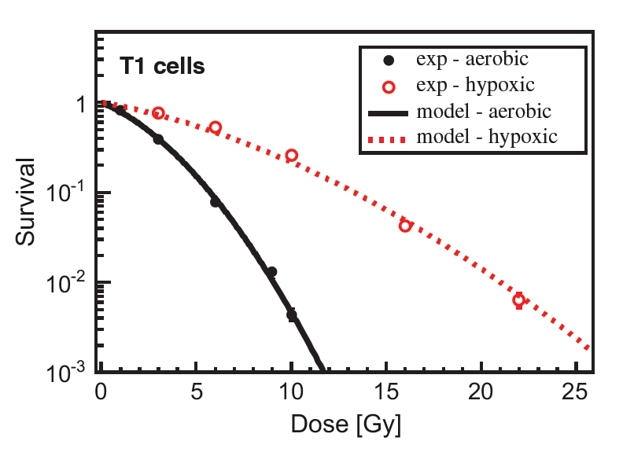
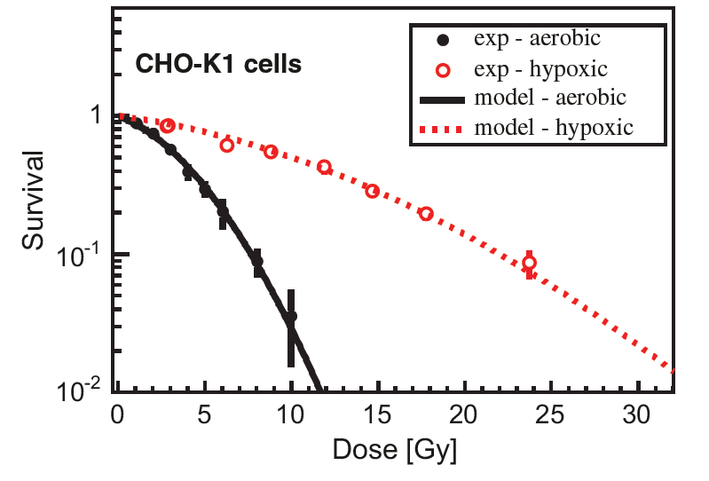
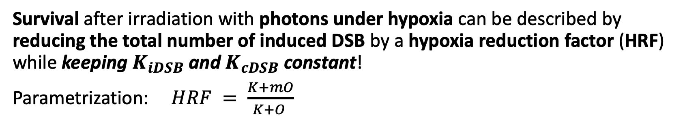
Hypoxia in UNIVERSE
Adapted from Mairani et al. 2013
Survival after irradiation with photons under hypoxia can be described by reducing the total number of induced DSB by a hypoxia reduction factor (HRF) while keeping $K_{iDSB}$ and $K_{cDSB}$ constant!
Parametrization: $HRF = \frac{K+mO}{K+O }$

Slide 11
The „UNIfied and VERSetile bio response Engine“ - UNIVERSE
UNIVERSE
Cell Cycle
Radiation Quality
Dose Rate
Radiation Effect
…
Radical Scavengers
DNA Damage Repair Interference
O2 Levels

Slide 12
UNIVERSE for Ion Beam Radiation

Slide 13
UNIVERSE for Ion Beam Radiation
Hypoxia
100+ years of experience and data!
Radiosensitizing Drugs & Mutations
Sparse data and understanding!
Effect of Photon Irradiation
Cell Cycle
Effect of Ion Irradiation
Dose Rate
.
.
.
MISSION:
Based on a mechanistic model extend the established model to high LET

Slide 14

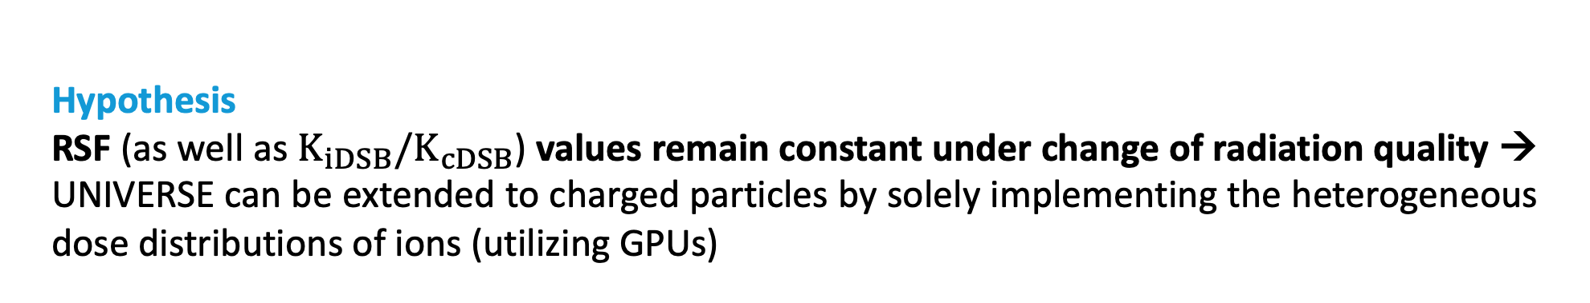
UNIVERSE for Ion Beam Radiation
Hypothesis
RSF (as well as $K_{iDSB}/K_{cDSB}$) values remain constant under change of radiation quality → UNIVERSE can be extended to charged particles by solely implementing the heterogeneous dose distributions of ions (utilizing GPUs)

Slide 15
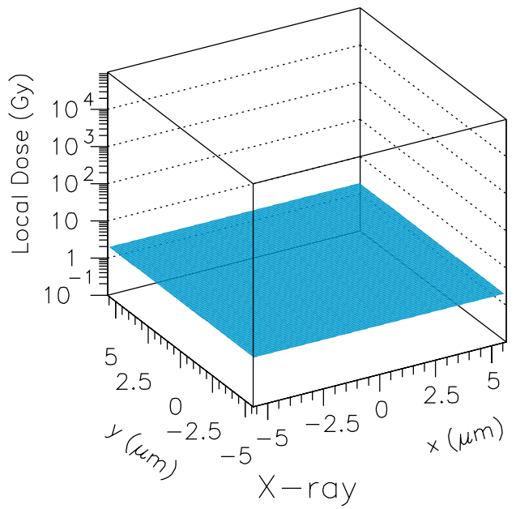
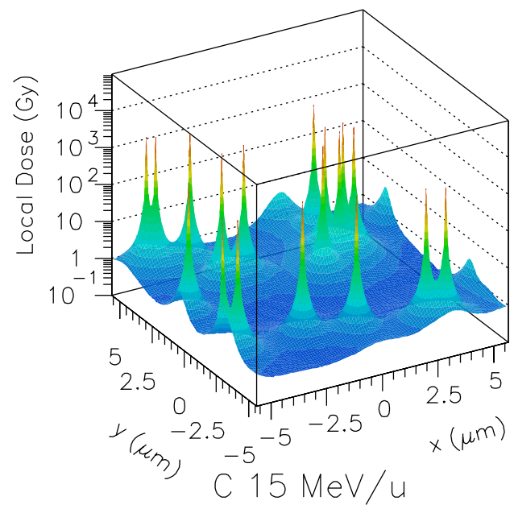
UNIVERSE for Ion Beam Radiation
„The cell does not care what induced the damage“

Slide 16
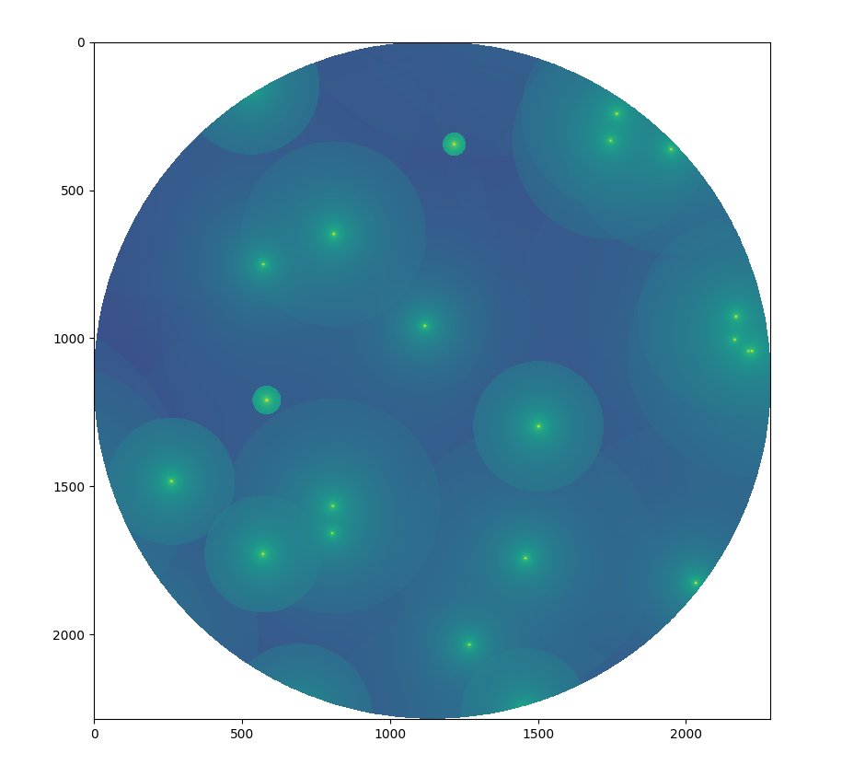
UNIVERSE for Ion Beam Radiation
„The cell does not care what induced the damage“

Slide 17
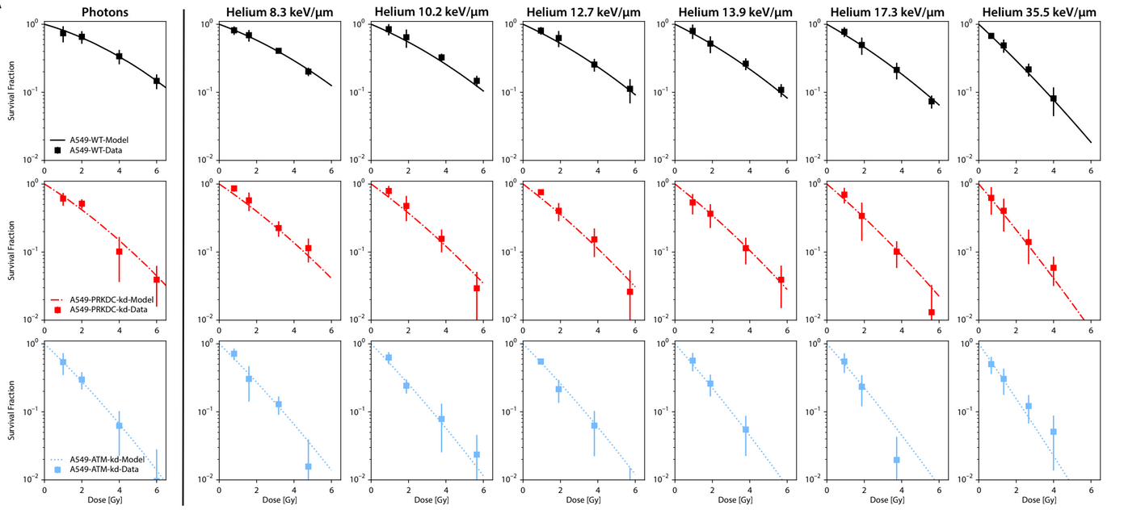
UNIVERSE for Ion Beam Radiation
UNIVERSE Helium Benchmark – in Vitro

Slide 18
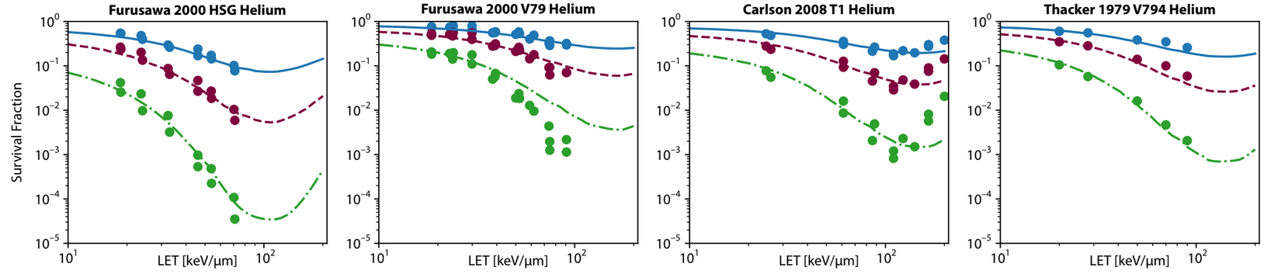
UNIVERSE for Ion Beam Radiation
UNIVERSE Helium Benchmark – in Vitro

Slide 19
The „UNIfied and VERSetile bio response Engine“ - UNIVERSE
UNIVERSE
Cell Cycle
Radiation Quality
Dose Rate
Radiation Effect
…
Radical Scavengers
DNA Damage Repair Interference
O2 Levels

Slide 20
How to “FLASH” in UNIVERSE
Timing matter
Repair:

Slide 21
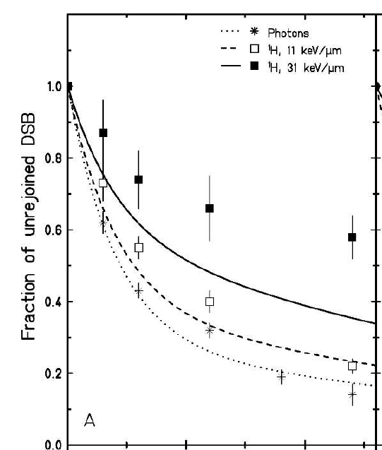

How to “FLASH” in UNIVERSE
Timing matter
Repair:
Rejoining-Kinetics of DSB can be described by double-exponential decay (fast and slow component)
Tommasino et al. succesfully predicted ratio of fast and slow component by associating $N_{iDSB}$ with fast and $N_{cDSB}$ with slow repair
$τ_{iDSB}\sim minutes$
$τ_{cDSB}\sim hours$
Tommasino 2013

Slide 22
How to “FLASH” in UNIVERSE
Timing matter
Repair: different repair kinetics
Oxygen Concentration:
Timing matter
Repair:

Slide 23

How to “FLASH” in UNIVERSE
Timing matter
Repair: different repair kinetics
Oxygen Concentration:
Timing matter
Repair:
$\frac{ⅆO}{ⅆt}=−g \dot{D} O$ oxygen depletion g: depletion rate constant (0.053 $Gy^{−1}$)
$\frac{ⅆO}{ⅆt}=λ (O_{env} −O)$ re-oxygenation λ : oxygen recovery rate (1 $s^{−1}$)
$O_{env}$ : environmental oxygen level
→ $\frac{ⅆO}{ⅆt}=−g \dot{D} O$ + $λ (O_{env} −O)$
$O\left(t\right)=O_{env}\left(\frac{λ}{γ}+\left(1−\frac{λ}{γ}\right)e^{−γt}\right)$ with: $γ=g\dot{D}+λ$
→ $HRF(t)= \frac{K+mO(t)}{K+O }$ m = 3.1 K = 0.27
Petersson et al. 2020

Slide 24

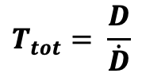

How to “FLASH” in UNIVERSE
Timing matter
Repair: different repair kinetics
Oxygen Concentration: different oxygen kinetics
Timing matter
Repair:
Check Possible Repair (& Misrepair)
Check Possible Repair (& Misrepair)
Check Possible Repair (& Misrepair)
Set HRF +
Simulate Damage + Sample Life Times
Calculate HRF(t) +
Simulate Damage +
Check Transitions +
Sample Life Times
Calculate HRF(t) +
Simulate Damage +
Check Transitions +
Sample Life Times
1
2
3
…
i
…
N
$$ΔT=\frac{T_{tot}}{N}$$
$$ΔT=\frac{T_{tot}}{N}$$
$$T_{tot}= \frac{D}{\dot{D}}$$

Slide 25
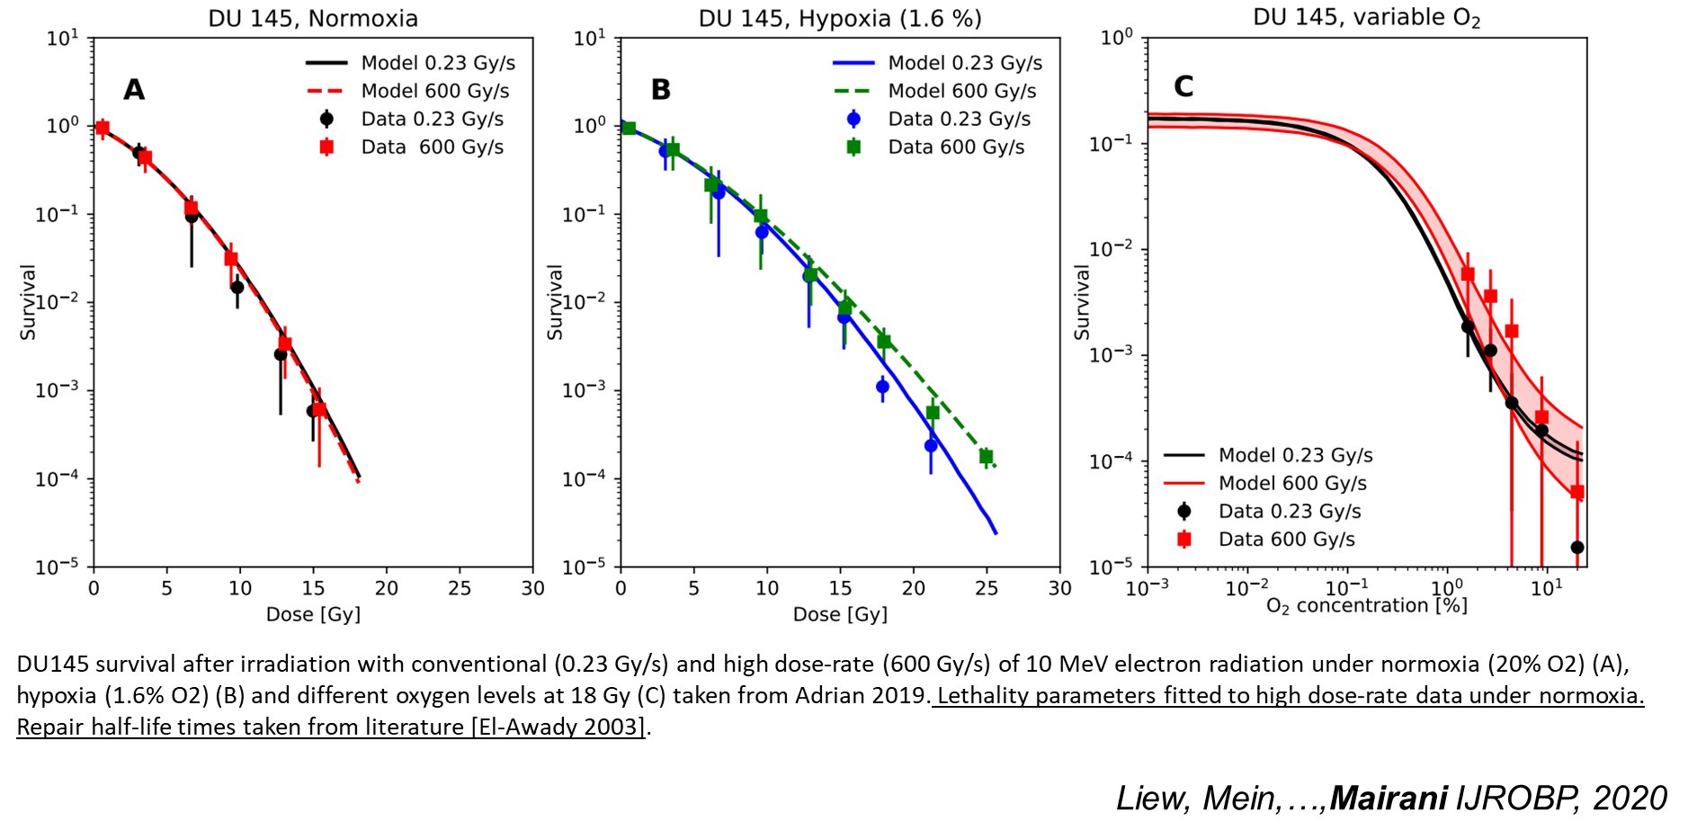
How to “FLASH” in UNIVERSE
In Vitro Results for Electron UHDR:

Slide 26
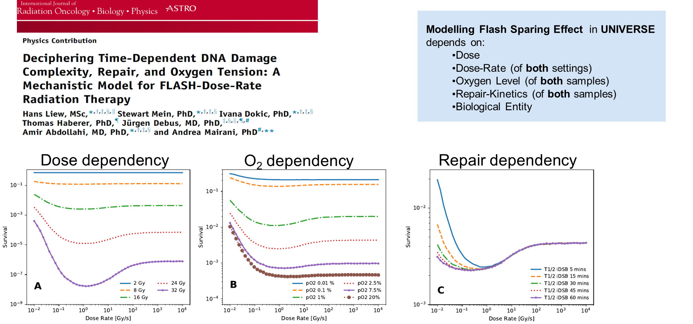
How to “FLASH” in UNIVERSE
In Vitro Results for Electron UHDR:

Slide 27
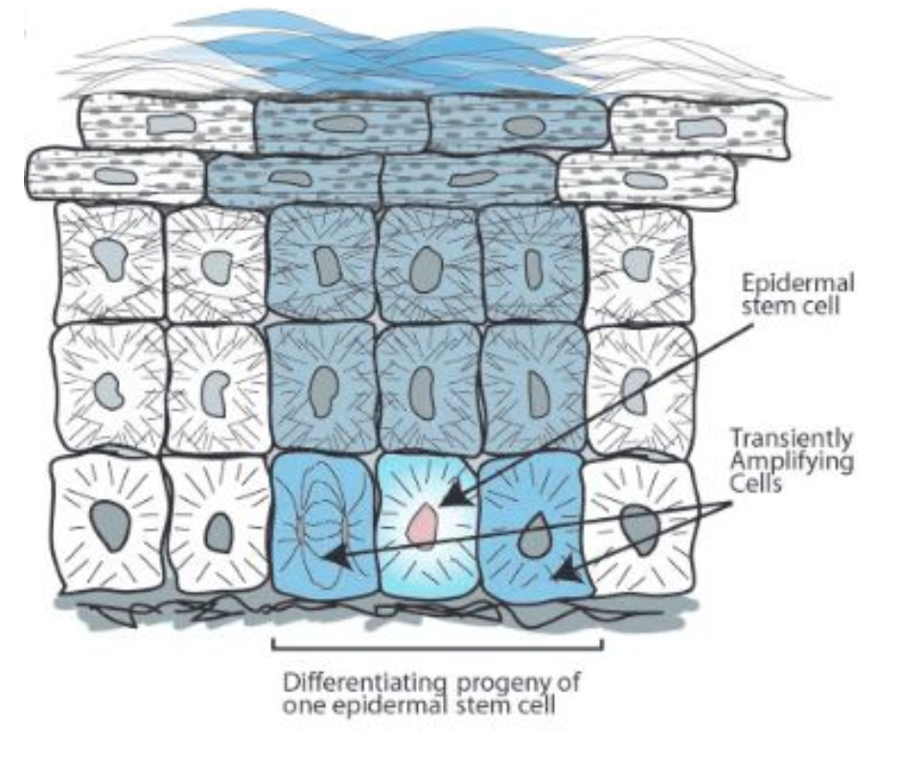
How to “FLASH” in UNIVERSE
Translation to In Vivo Modeling:
Skin Toxicity Modeling:

Slide 28
How to “FLASH” in UNIVERSE
Translation to In Vivo Modeling:
Skin Toxicity Modeling:
Simplified the approach with a single stem cell per EPU
Defined O₂ = 10 mmHg from skin measurements
Survival of the stem cell described by UNIVERSE (dose, dose-rate, particle, LET, O₂)
Neighboring stem cells can replace the central stem cell over time following its loss, ensuring tissue homeostasis and regeneration
Danish Skin Tox grade scale implemented using % of dead EPU

Slide 29
How to “FLASH” in UNIVERSE
Skin Toxicity Modeling:

Slide 30
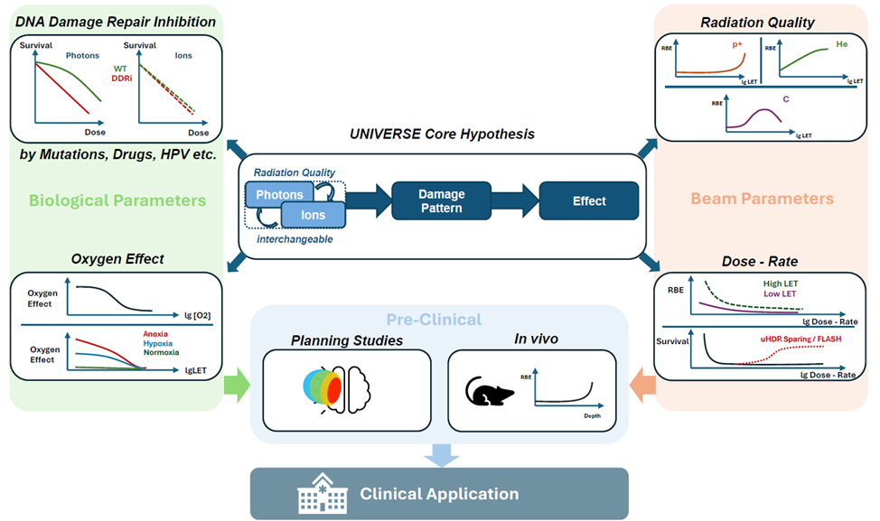
The „UNIfied and VERSetile bio response Engine“ - UNIVERSE
Liew,…,Mairani IJMS 2022a
Liew,…,Mairani IJMS 2022b
Liew,…,Mairani IJMS 2023
Liew,…,Mairani Med Phys 2024
Liew,…,Mairani PMB 2024
Liew,…,Mairani IJMS 2019
Liew,…,Mairani IJMS 2020
Liew,…,Mairani IJROBP 2021
Liew,…,Mairani IJROBP 2022

Slide 31
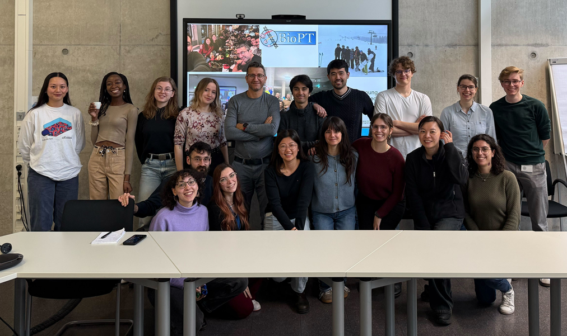





Acknowledgments

