Slide 1


Radiobiology activities at CNAO
05.03.2026

Slide 2
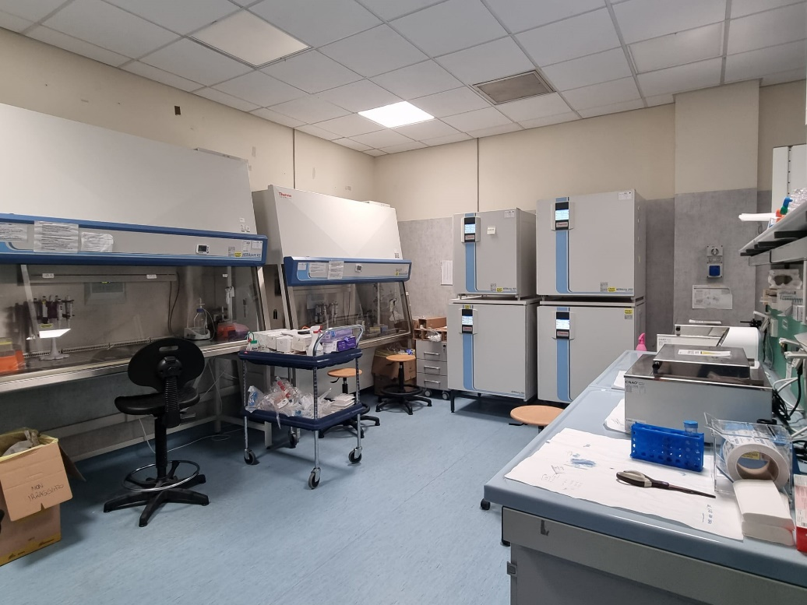
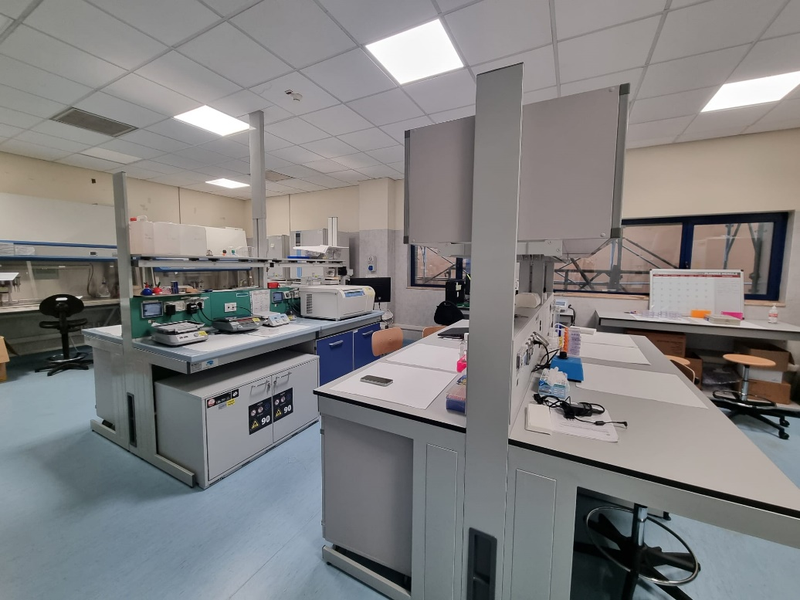
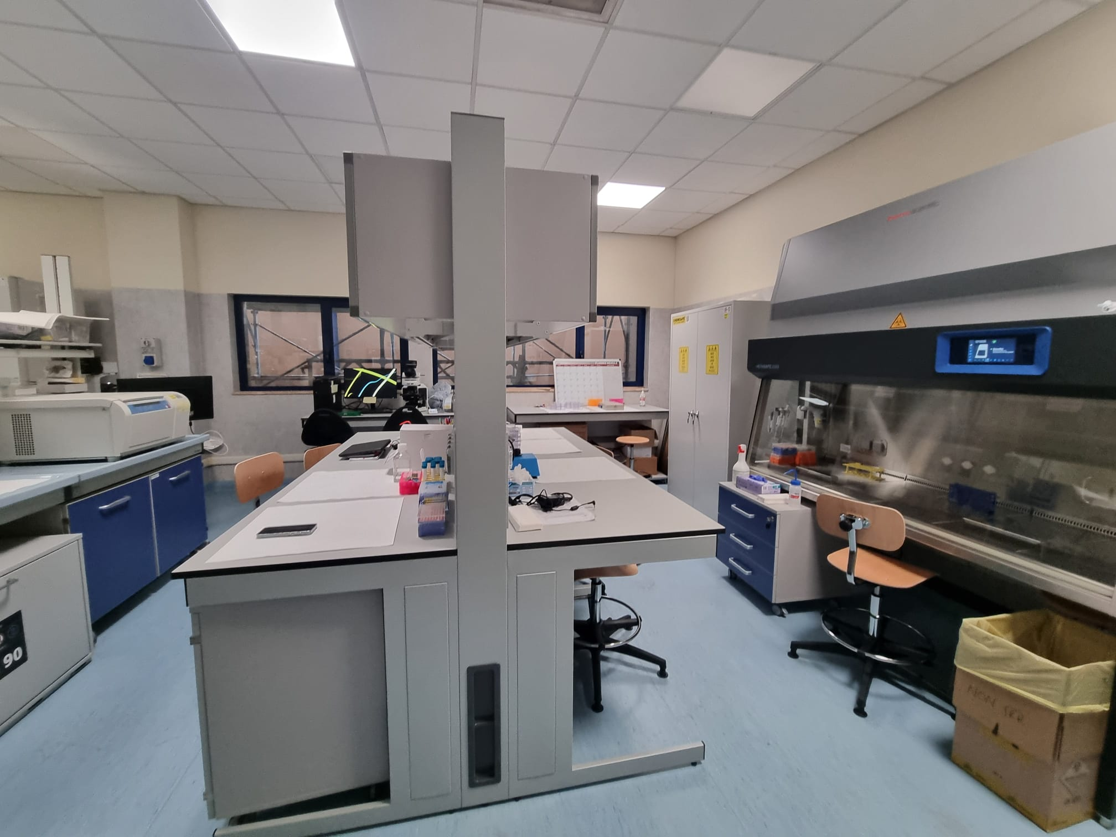

CNAO radiobiology laboratory

Slide 3
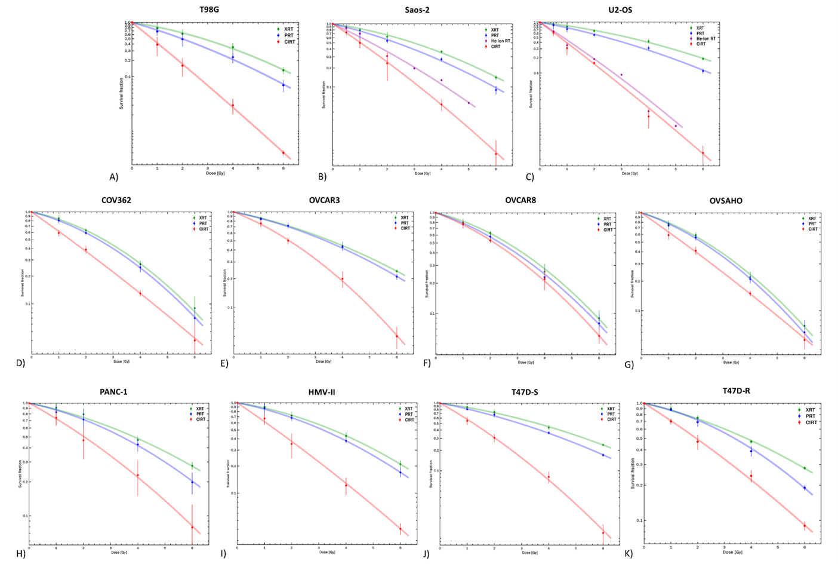
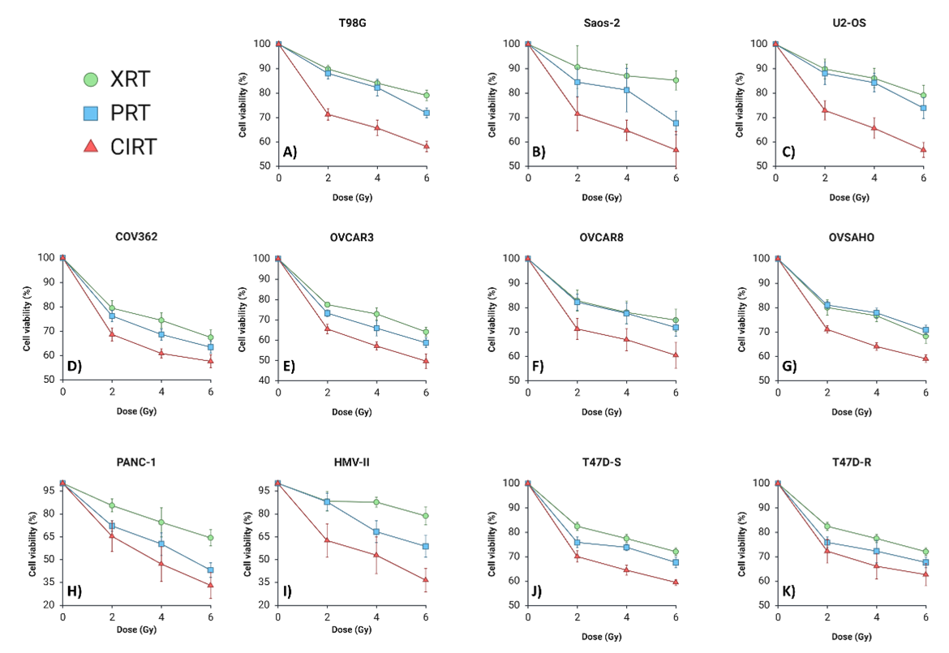
What we do?
Radioresistance → in vitro experiments on clonogenic survival, vitality
PhD thesis of A. Charalampopoulou

Slide 4
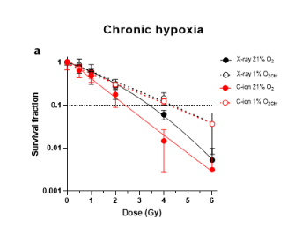
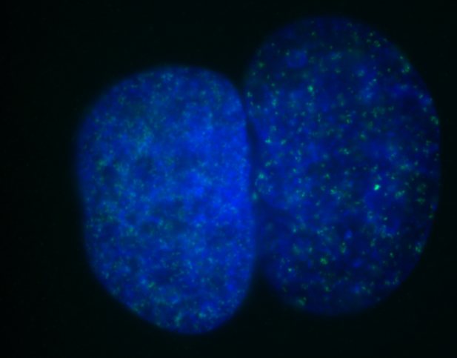
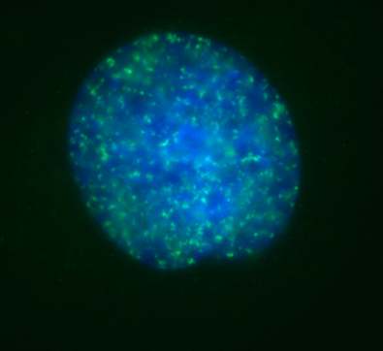
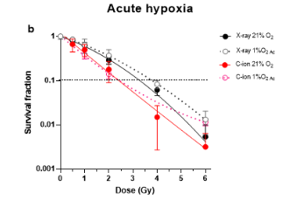
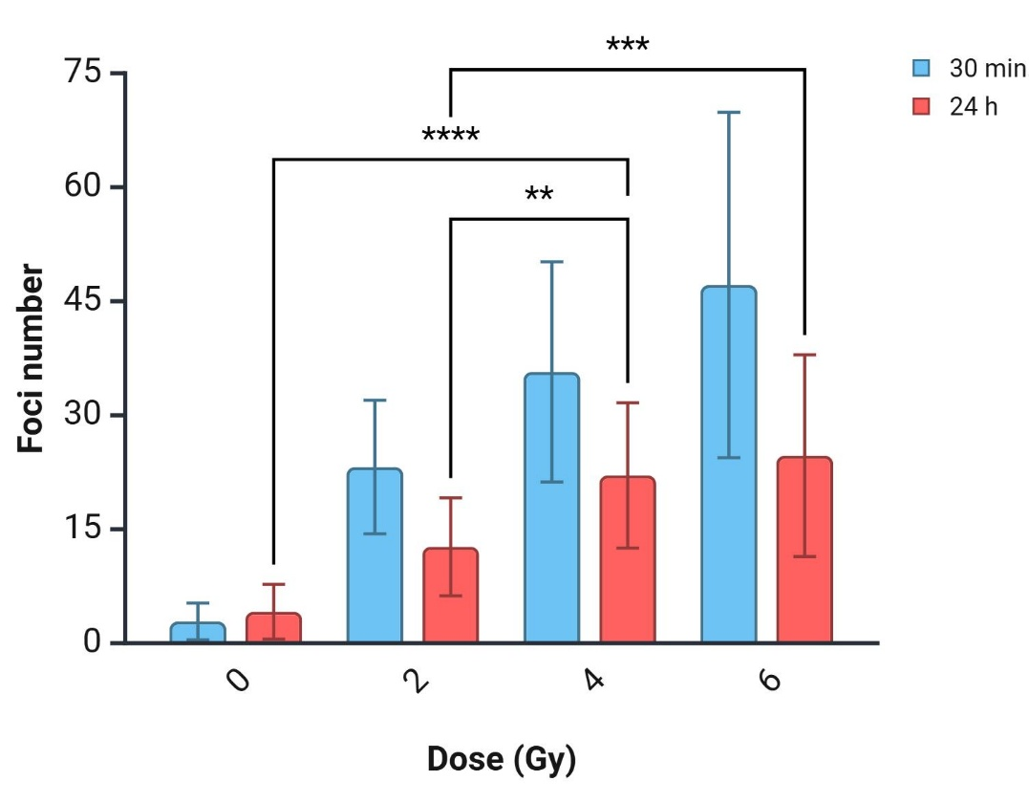
Oxygen effect
What we do?
Cell cycle and DNA damage
γH2AX foci
Courtesy of N. Matoor
PhD thesis of G. Volpi

Slide 5
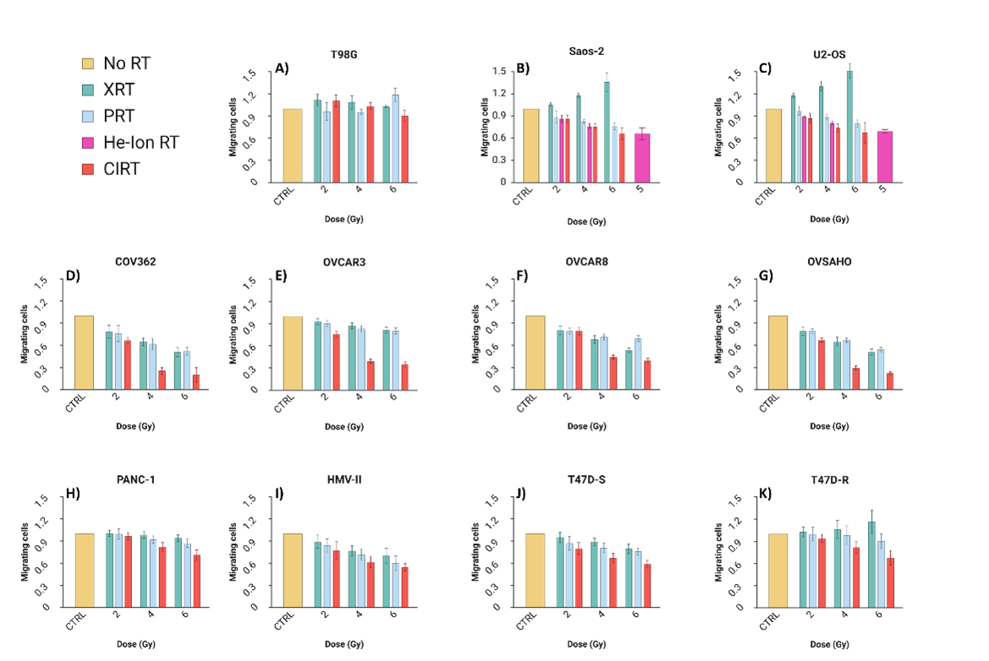
What we do?
Migration & Invasion
PhD thesis of A. Charalampopoulou

Slide 6
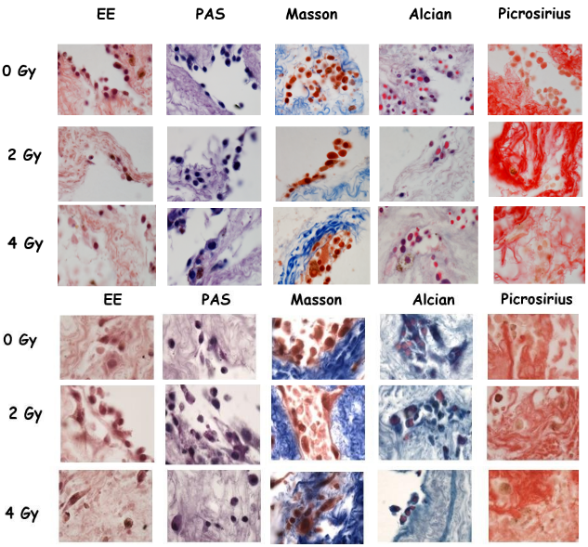
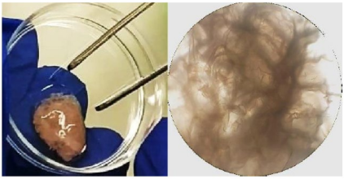
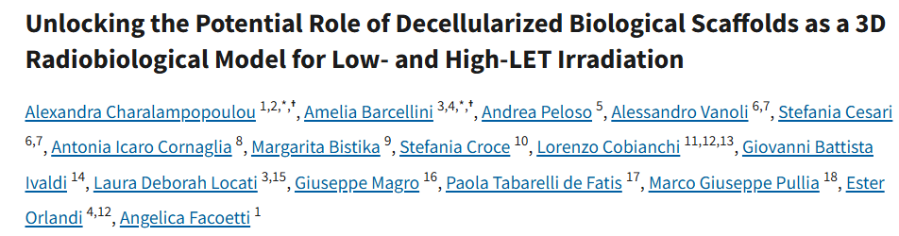
What we do?
3D in vitro models
Biological scaffolds

Slide 7



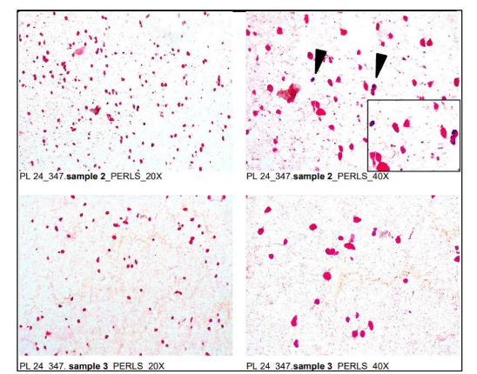
What we do?
3D in vitro models
Biological scaffolds
Mather3D – focused on combining radiotherapy/hadrontherapy (photons, protons, carbon ions) with magnetic hyperthermia on pancreatic cancer cell (BxPc-3) scaffolds containing magnetic nanoparticles (MNPs)
Federica Carnevale
Susanna Leva

Slide 8
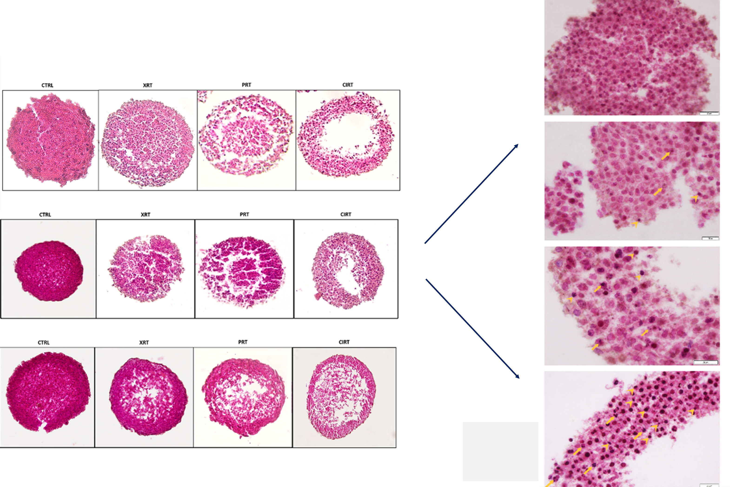
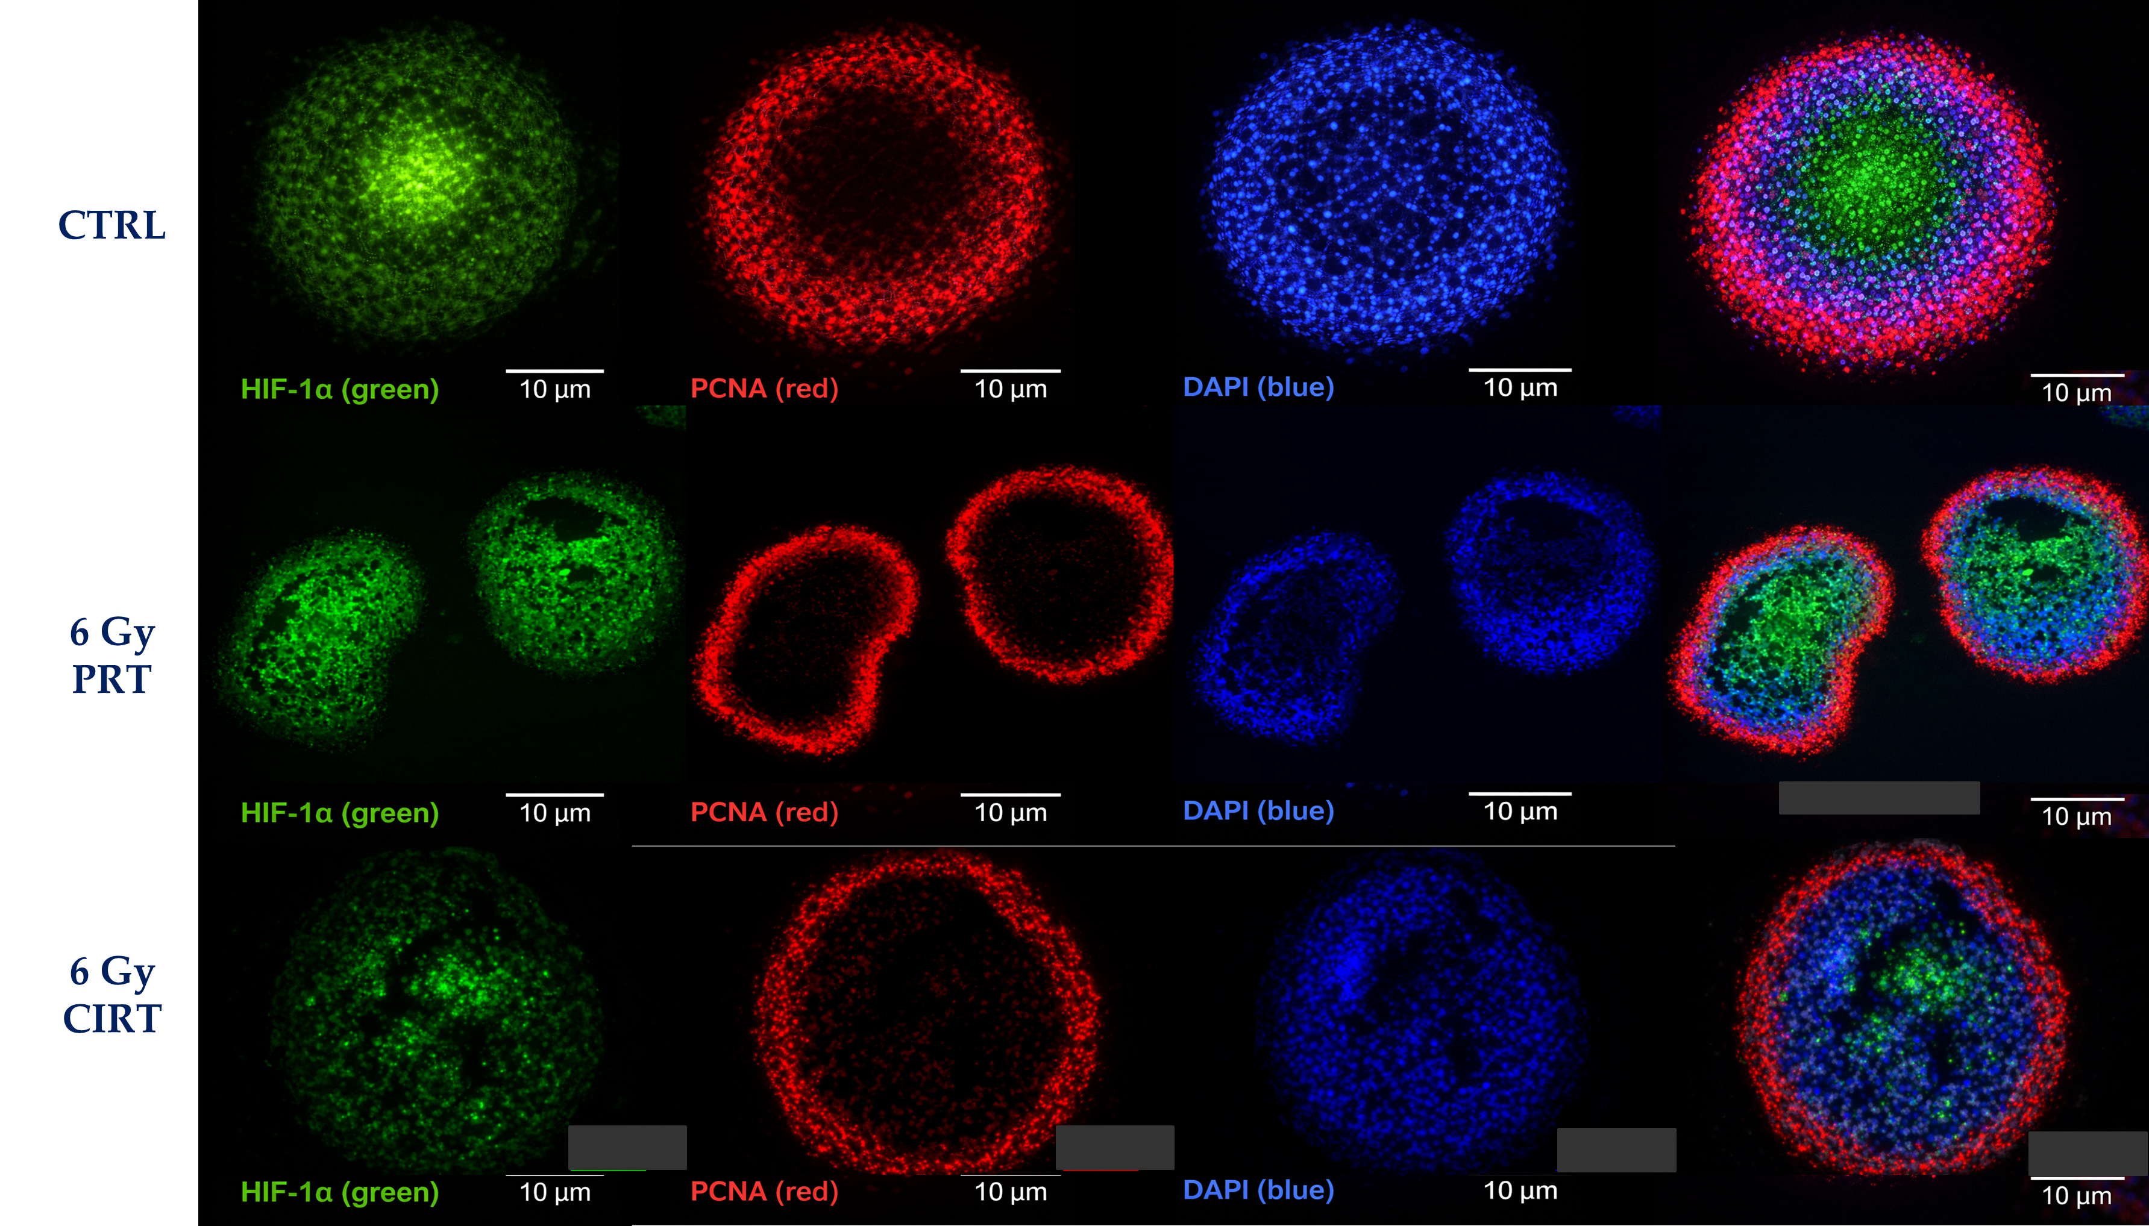
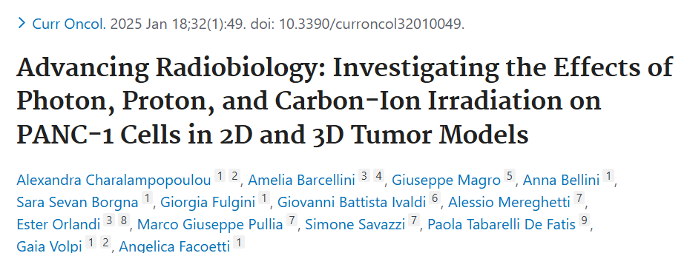
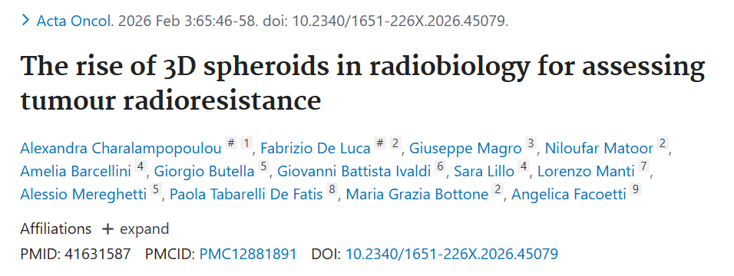
What we do?
3D in vitro models
Multicellular Tumour Spheroids

Slide 9


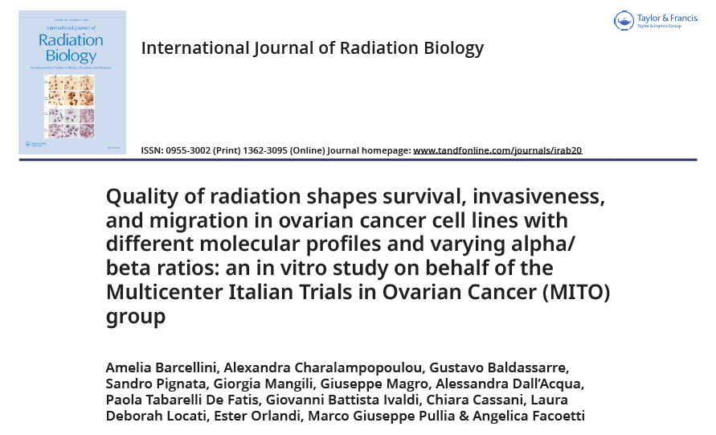
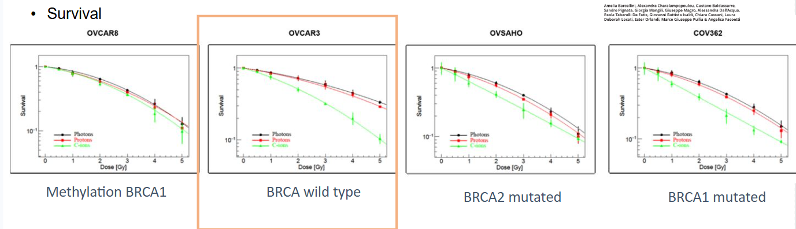
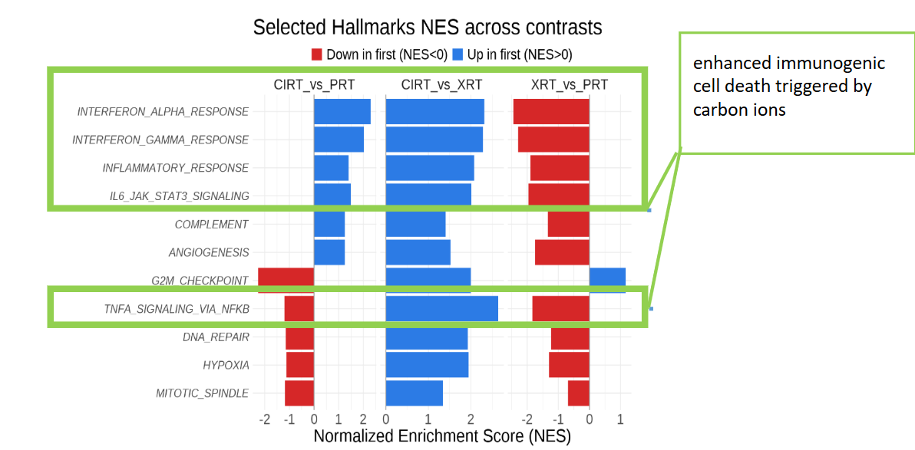
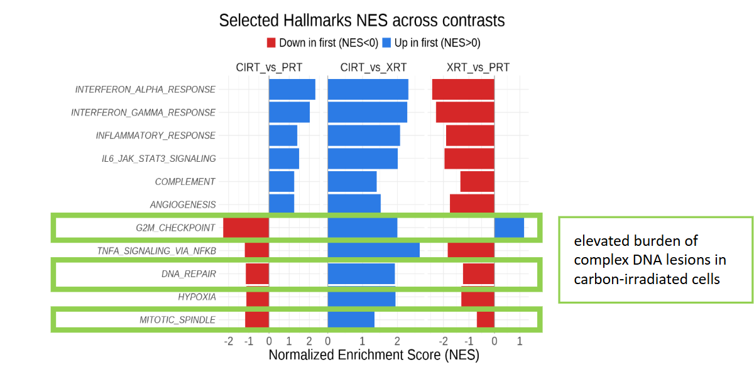
ΜΙΤΟ
A. Barcellini

Slide 10

CROSS
Objective → Evaluate whether CIRT followed by XRT offers superior tumor control, tumor biology response, and immunological effects compared to the reverse sequence
Tumour Volume: Both treatments reduced tumor growth, but only CXXX showed a consistent post-treatment tumor volume decrease, though not statistically significant.
Lung metastasis: No significant differences observed in metastatic spread between treatment groups.
Leukocytes counts: in the CXXX group we observed a less lymphocyte-depleting intra-treatment effect, indicating a more favorable immunological profile during treatment.
Hypoxia: CXXX progressively reduced hypoxia-related signaling, pointing to improved tumor oxygenation over time
Angiogenesis: A marked, time-dependent reduction in angiogenic activity was observed in the CXXX group.
Cancer stem cells CD133: the XXXC group maintained significantly lower CD133 levels, suggesting a reduction in stem-like, treatment-resistant cell populations.
Proliferation Ki67: Proliferation was nearly undetectable in the CXXX group, highlighting a sustained inhibition of tumor cell division.
Fibrosis: The CXXX treatment induced a marked increase in tumor fibrosis at day 21, significantly higher compared to the other groups.
A. Bellini,
S. S. Borgna,
Gaia Volpi,
A. Charalampopoulou

Slide 11



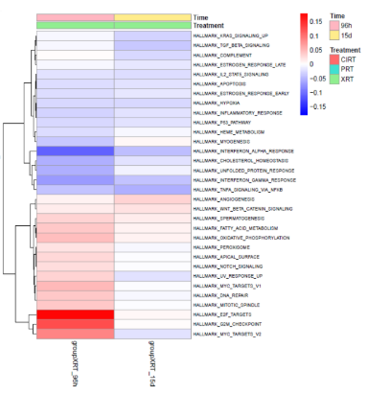
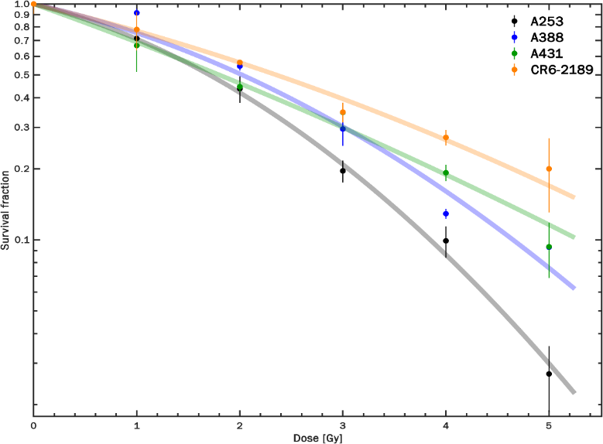
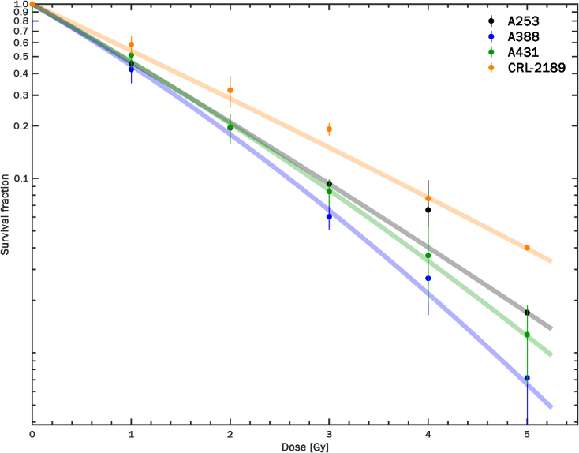
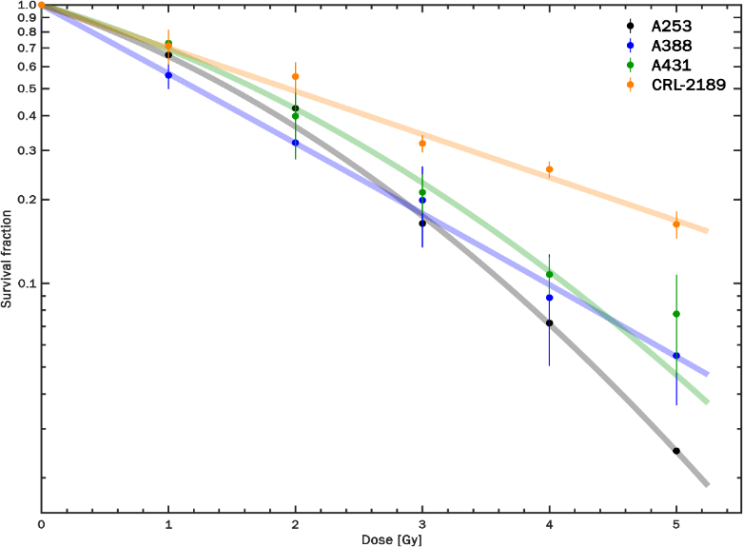

INDAGA
Cell lines from aggressive SGCs were tested with photons, protons, and carbon ions.
Clonogenic assay used to measure cell survival
MTT assay used to assess cell viability. Carbon ion irradiation showed greater effectiveness in reducing cell survival and viability compared to photons and protons
SGC cell lines demonstrated varying levels of radioresistance, depending on histotype and radiation type
Results support the potential benefit of carbon ion therapy for aggressive, radioresistant SGCs
XRT
PRT
CIRT
A. Charalampopoulou

Slide 12
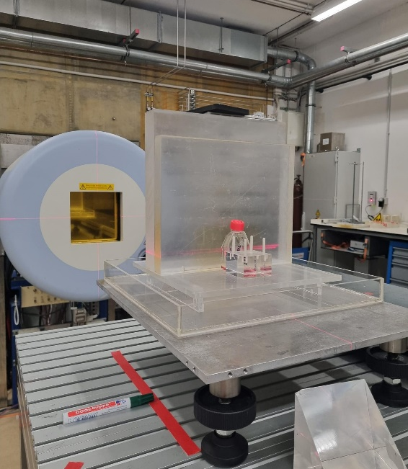
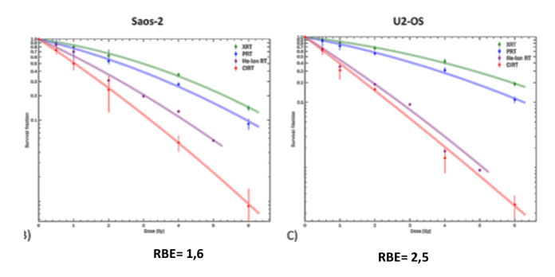
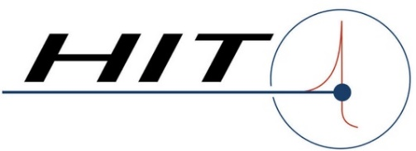



BIOHOT - BIOphysical characterization of Helium and Oxygen ion beams for hadronTherapy
Modelling and Microdosimetry
Radiobiology
Techniques to be used for cancer cells (osteosarcoma and pancreas):
Clonogenic assay (RBE determination)
Apoptosis (cancer cell death)
Migration
Techniques to be used for normal cells (fibroblasts and endothelial)
m-FISH for chromosome aberrations (risk of secondary cancer)
Premature senescence, oxidative stress, inflammation markers (late adverse reactions)
Experimental room HIT
Manuscript in preparation

Slide 13

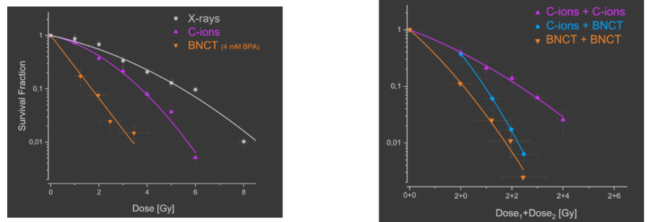
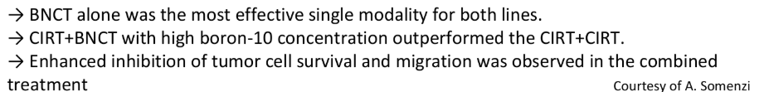
COMBINING CARBON-IONS RADIOTHERAPY AND BORON NEUTRON
CAPTURE THERAPY: FIRST IN VITRO EXPLORATION OF AN
INNOVATIVE STRATEGY FOR RADIORESISTANT TUMORS

Slide 14
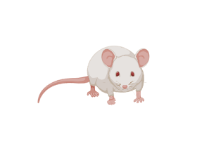

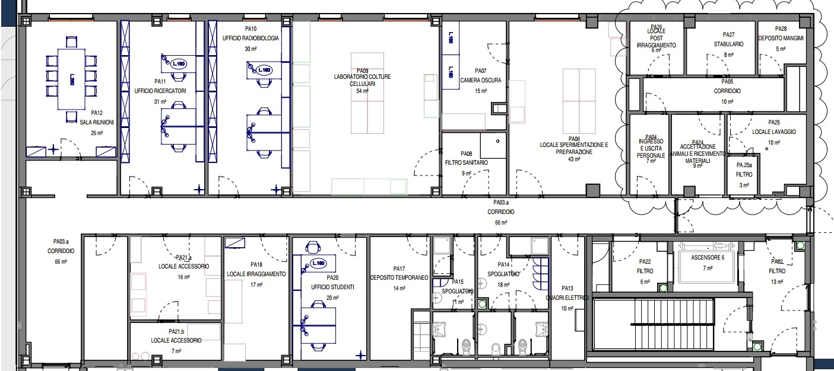
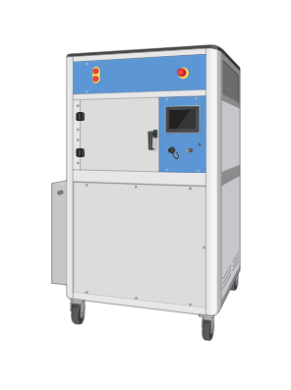
CNAO radiobiology laboratory 2.0
Animal facility
X-Ray irradiator

Slide 15
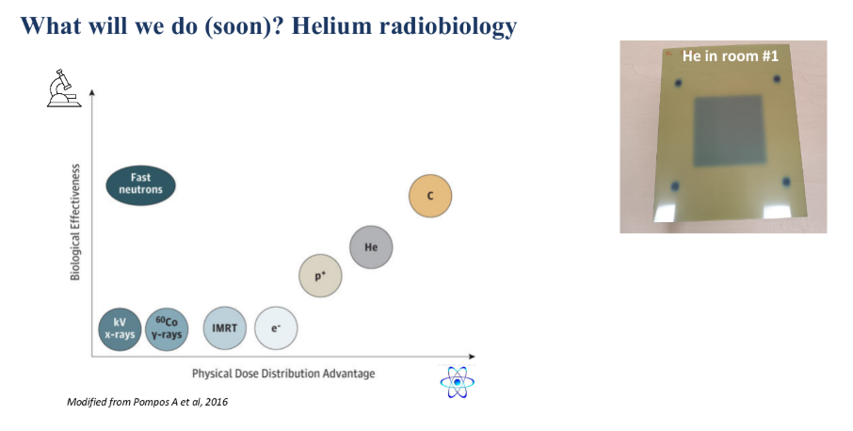

Slide 16
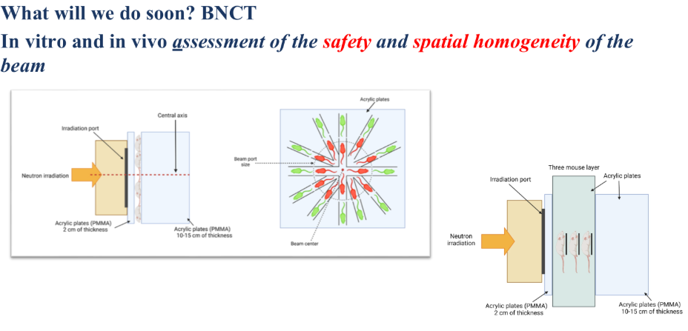

Slide 17
Thank you for your attention !
Angelica Facoetti
Amelia Barcellini
Alexandra Charalampopoulou
Federica Carnevale
Gaia Volpi
Sara Sevan Borgna
Susanna Leva
Niloufar Matoor
Chiara Vercellone

