Slide 1













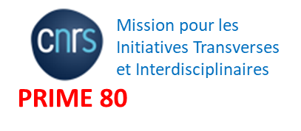





Diamond : a suitable material for detecting particles in a highly radiative environment
M-L. Gallin-Martel*, Y. Arnoud, A. Bes, T. Bettio, J. Collot, D. Dauvergne, R. Delorme,
L. Gallin-Martel, L. Gesson, O. Guillaudin, C. Hoarau, A. Lacoste, E. Lagorio, C. Léonhart,
J. Livingstone, S. Marcatili, M. Marton, R. Molle, JF Muraz, P. Paris, N. Ponchant, F. Rarbi, M. Reynaud, O. Rossetto, J. Waquet
A. Guertin, F. Haddad, R. Jbara, C. Koumeir,
V. Métivier, F. Poirier, N. Servagent
P. Barberet, J. Jouve, S. Sorieul
Ph. Laniece, AM Leite, Q. Mouchard
JF Adam, R. Serduc, S. Keshmiri
F. Vianna Legros
L. Abbassi, T. Crozes, F. Donatini, E. Gheeraert, J. F. Motte, J. Pernot
J. Bousquet, E. Corne, J. Letellier, R. Molle, D. Nusimovici
P. Everaere, T-N. Tran-Caliste
J. Herault, JP. Hofverberg, D. Maneval, R. Trimaud, M.Vidal
mlgallin@lpsc.in2p3.fr

Slide 2

Context
New challenges at accelerators:
Medical applications: hadrontherapy, flash therapies and X-ray or synchrotron radiation therapy
Precise beam monitoring with fast counting at high dose rate in a highly radiative environment.
The intrinsic qualities of diamond:
speed, low leakage current, excellent SNR, resistance to radiation, high thermal conductivity
⇒ an excellent candidate to meet such monitoring requirements over a wide dynamic range from a fraction of pA (single particle) up to µA.

Slide 3
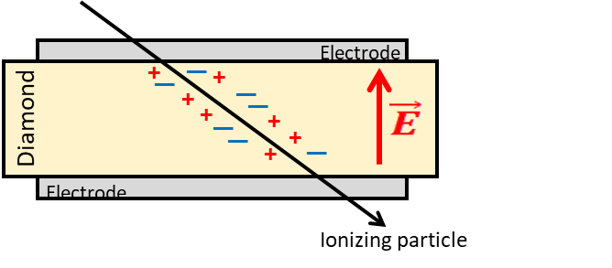
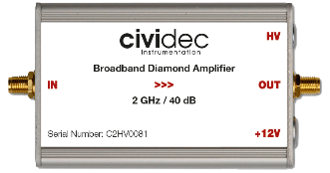
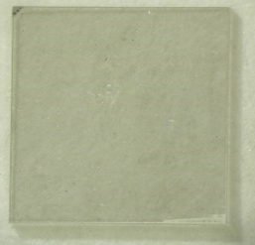

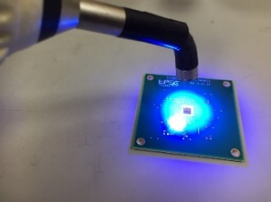
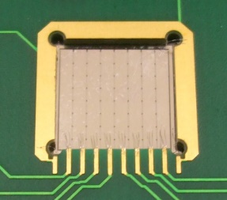
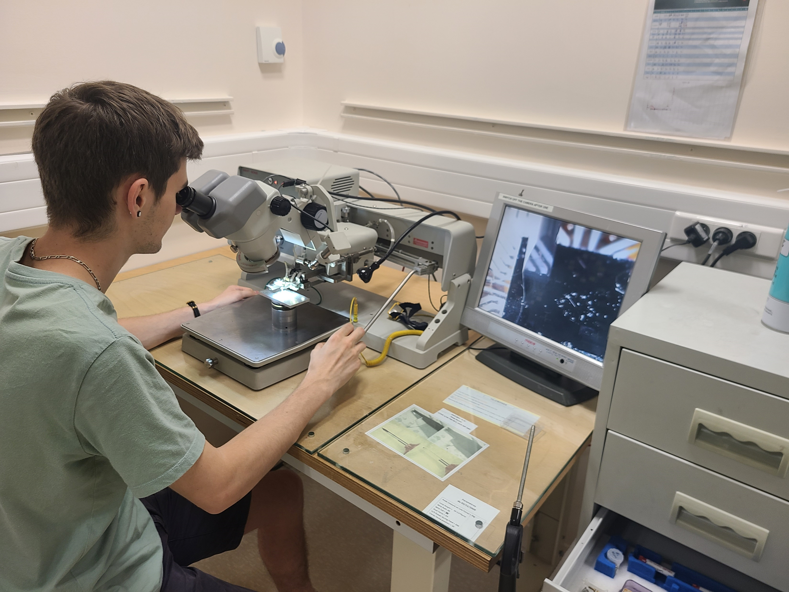
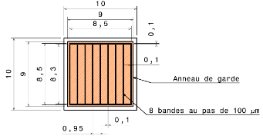
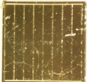
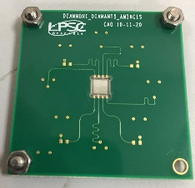
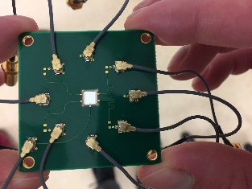
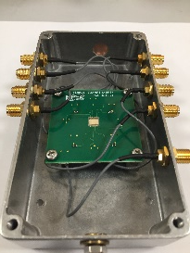
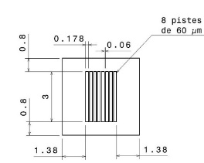
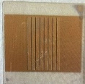
Diamond as beam monitors
Solid state ionization chamber
Read-out electronics
Fast current preamplifier
Charge preamplifier
QDC
HT
Diamond metallisation
Detector assembly
Band Width: 2 GHz
Gain: 40 dB
Impedance: 50 Ω
Dynamic range: ~ +/- 1 V
Power Supply: 12 V / 100 mA

Slide 4
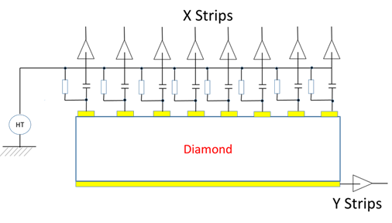
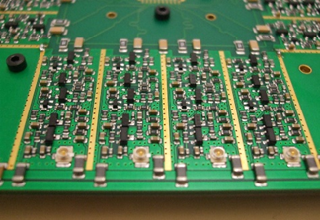
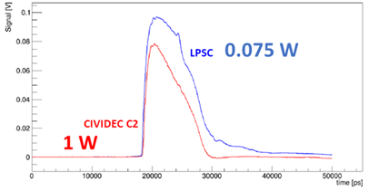
Diamond as beam monitors
Solid state ionization chamber
Read-out electronics
Fast current preamplifier
Charge preamplifier
QDC
HT
Read out electronics @ LPSC
Diamond metallisation
Detector assembly
Discrete
C. Hoarau et al 2021 JINST 16 T04005
https://doi.org/10.1088/1748-0221/16/04/T04005

Slide 5
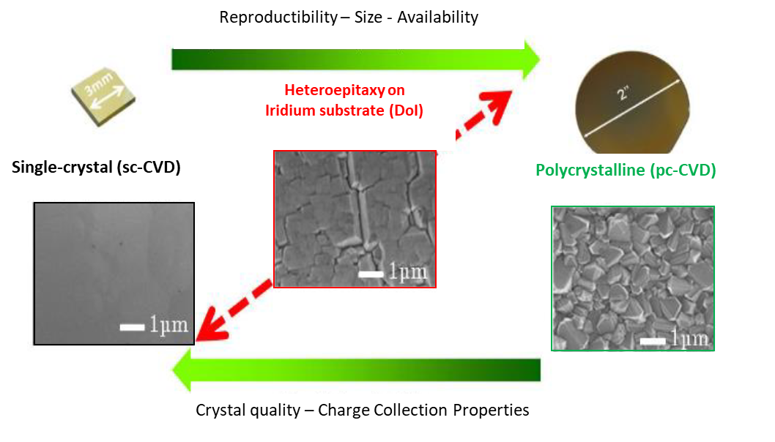
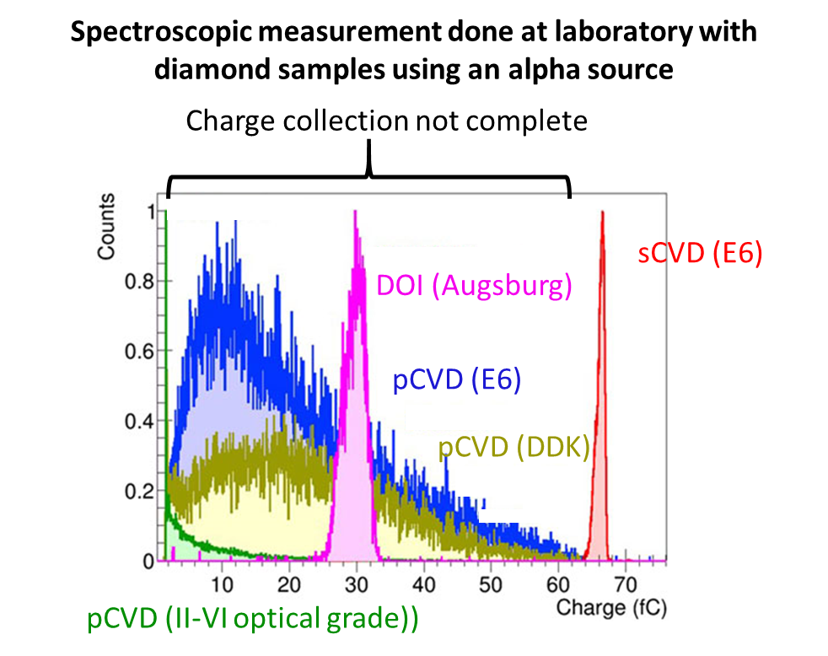
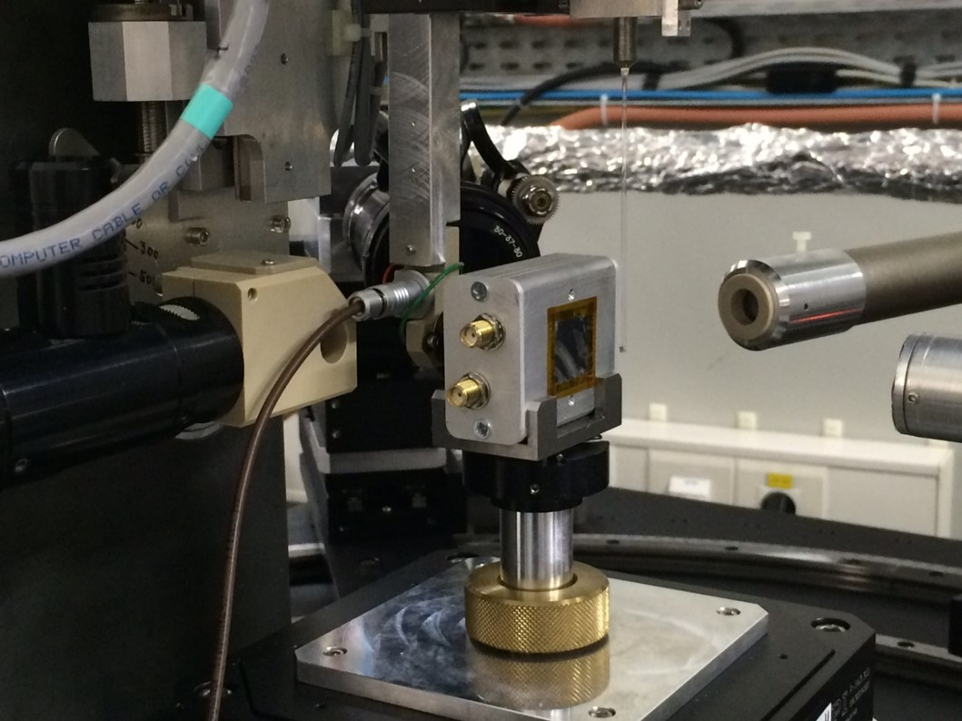
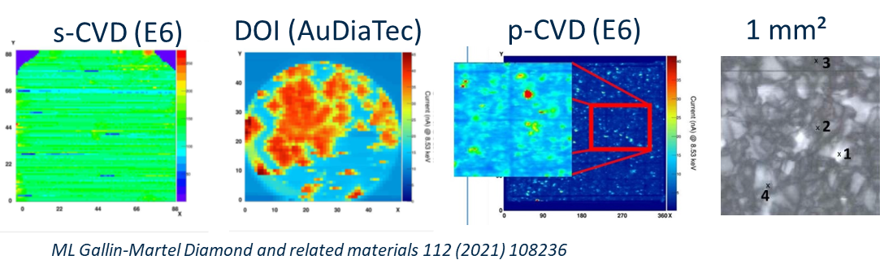
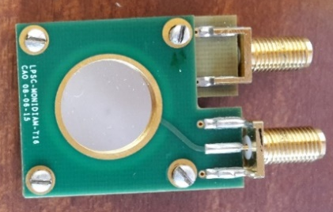
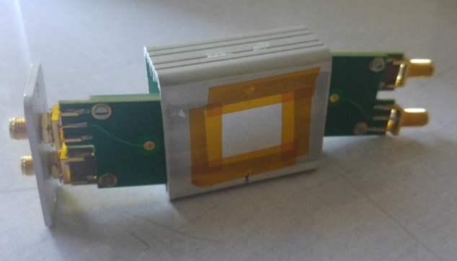
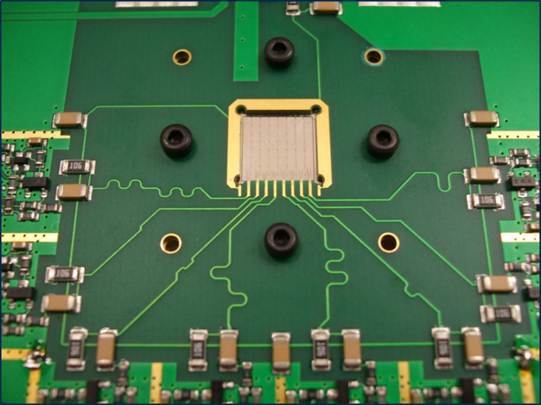
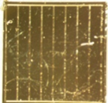
Diamond detector for beam monitoring: sCVD? pCVD? DOI?
N. Vaissiere CEA PhD (2014)
S. Curtoni PhD (2020)
XBIC = X rays Beam Induced Current
@ ESRF (France) : Photons 8.5 keV
=> 2D « current maps » with CVD diamonds
https://doi.org/10.1016/j.diamond.2020.108236

Slide 6
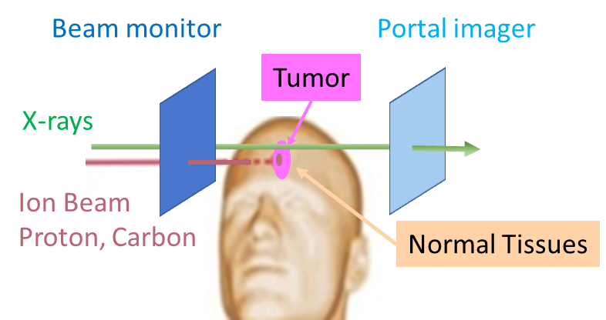
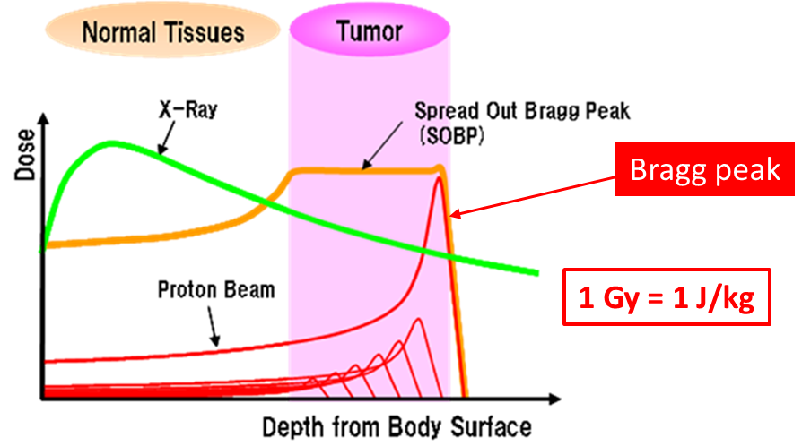
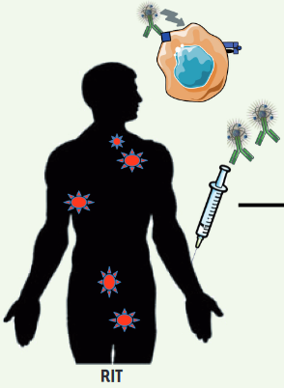
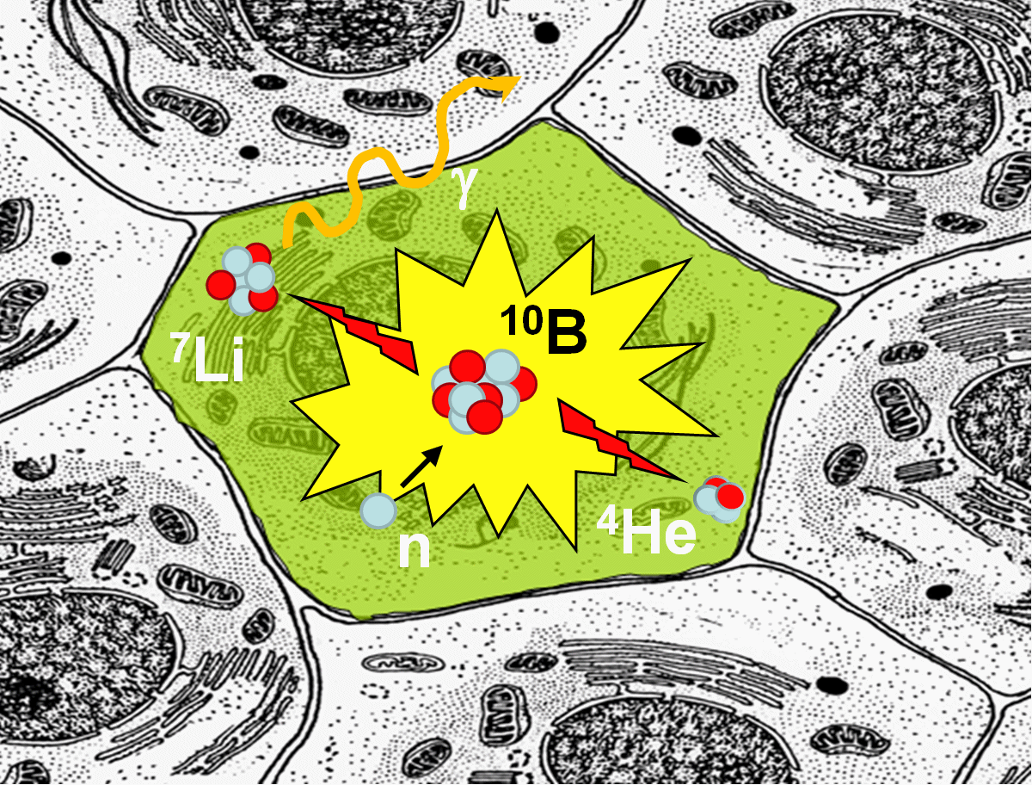
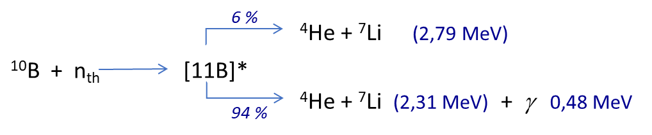
Beam monitors for on-line control of innovative radiotherapies
X-rays / hadrontherapy
Beam intensities
Proton-therapy ~ 10⁹⁻¹⁰ p/s
Carbon-therapy ~10⁷⁻⁸ C/s
Challenge for ion counting at clinical intensity
Flash therapy / conventional => high doses in a very short time
Conventional X-rays
or hadrontherapy → Gy/mn
Flash therapies → > 100 Gy/s for ions
Short pulses to be monitored at high beam intensity !
High particle counting rate capabilities to be demonstrated
Bunch or train of bunches time stamps
Targeted Alpha Therapy (TAT) and Boron Neutron Capture Therapy (BNCT)
Radionuclides α : 223Ra, 225Ac, 212/213Bi, 211At…
Energy α : 5 – 9 MeV
Objectives: improve dose predictions and biological effects for targeted radiotherapy
monitor low-energy ion beams for in vitro biology experiments

Slide 7
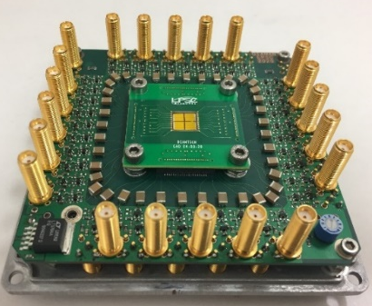
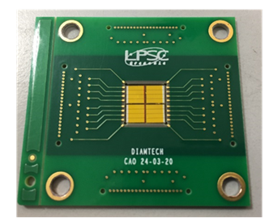
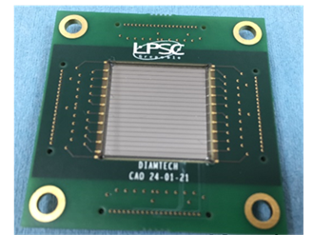
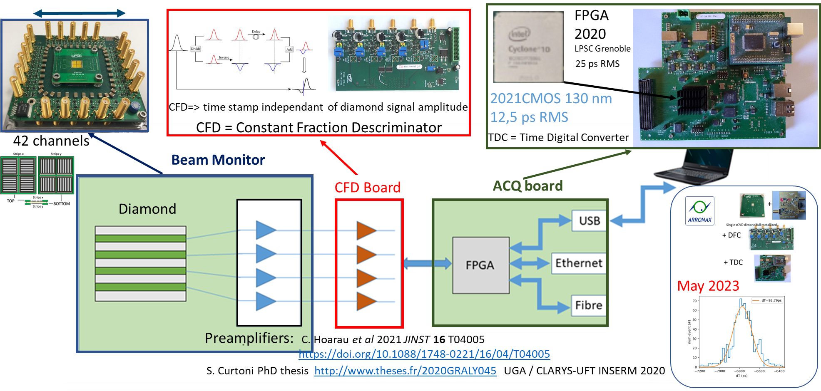
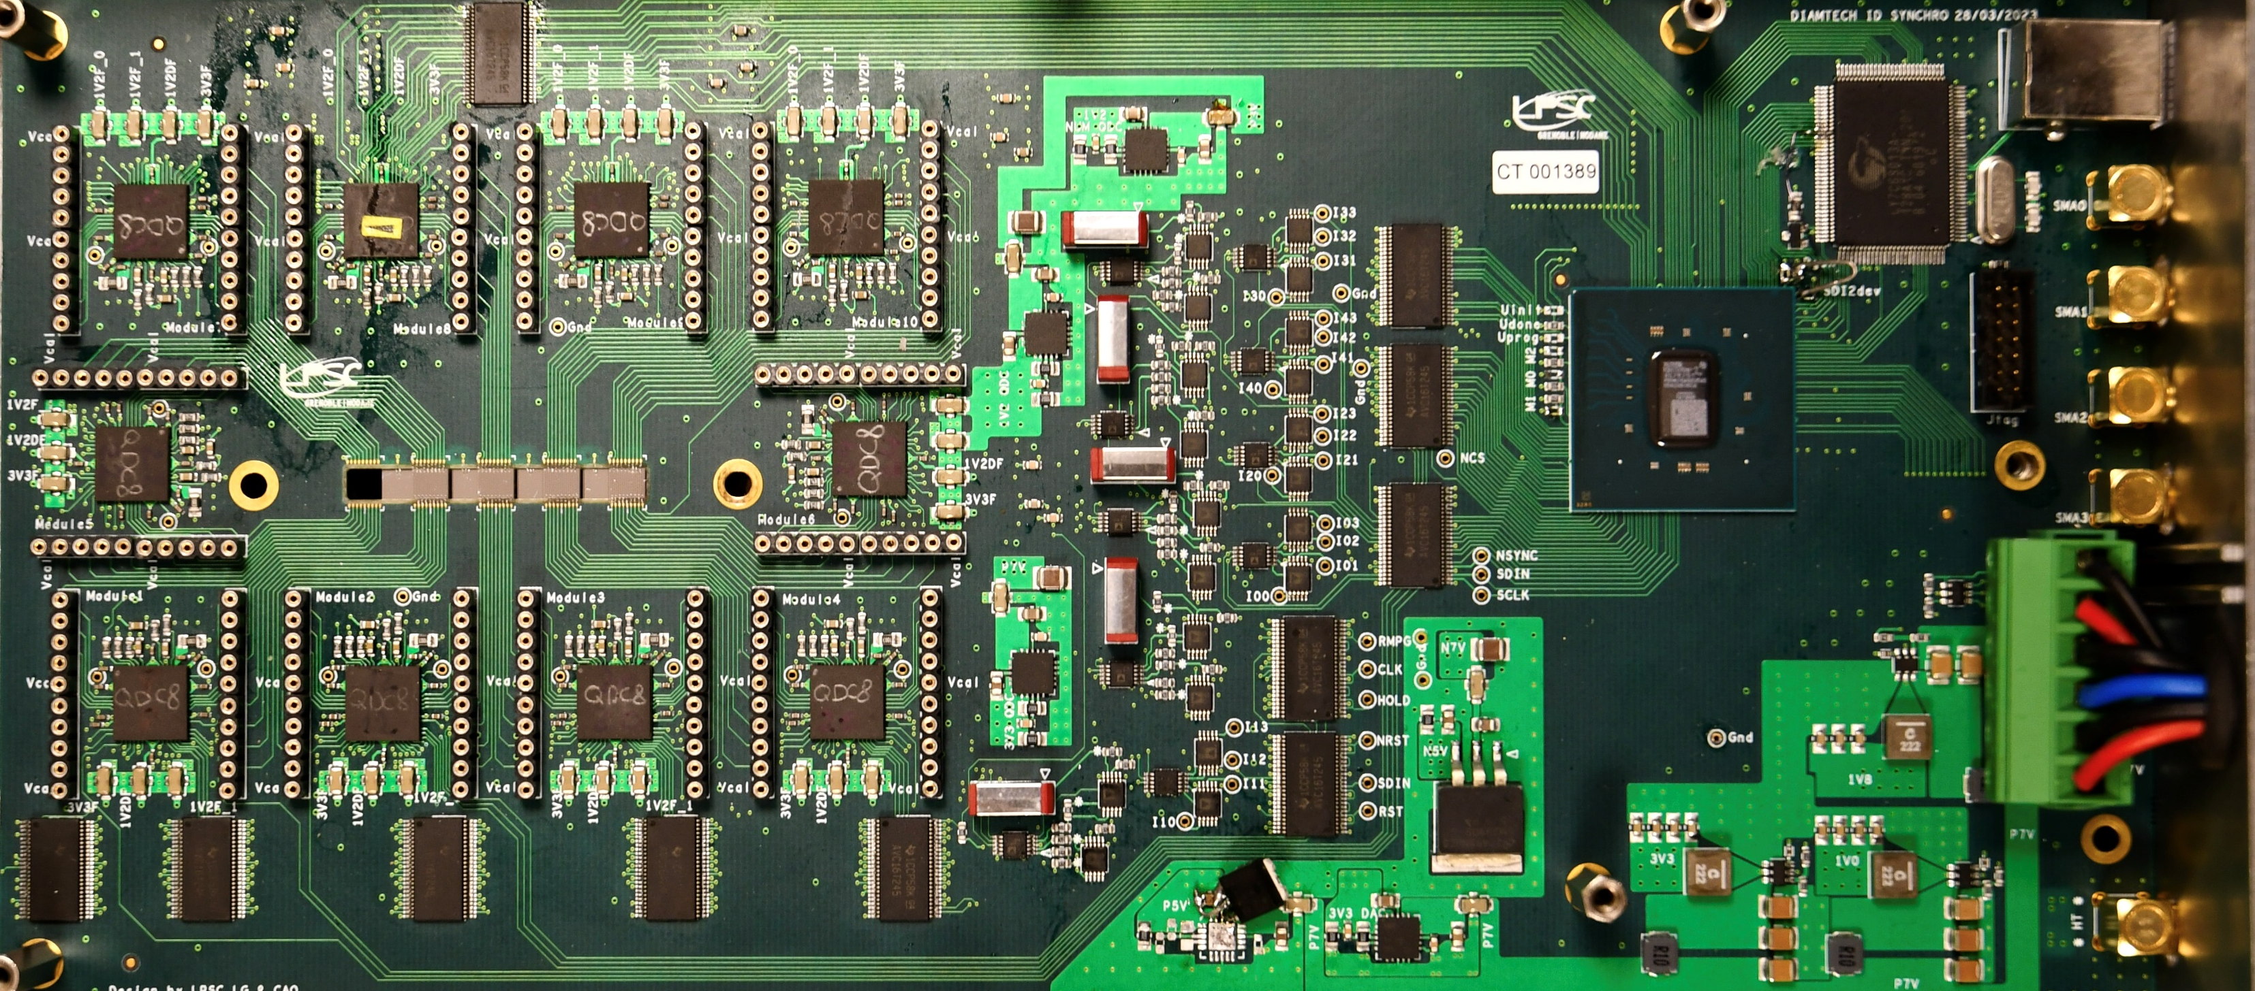
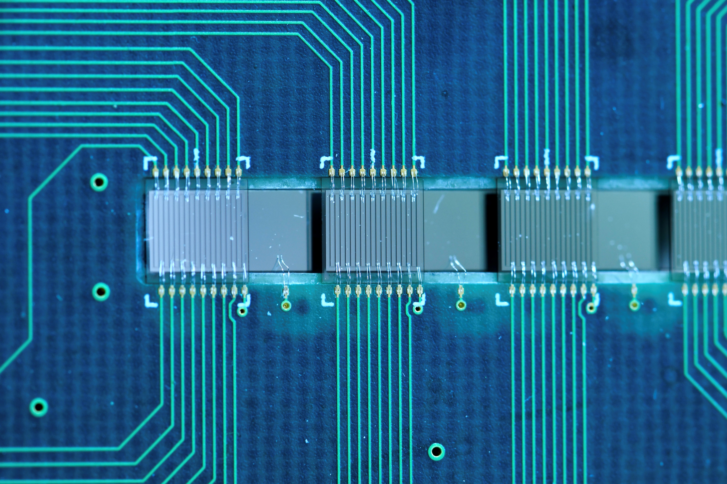
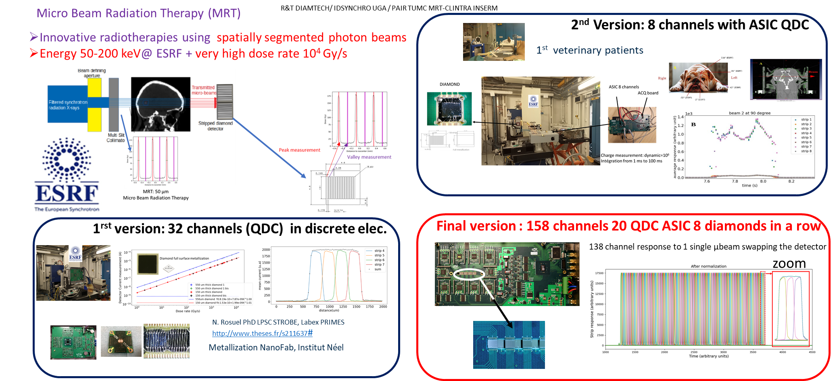

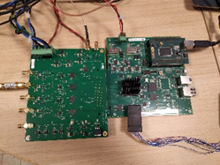
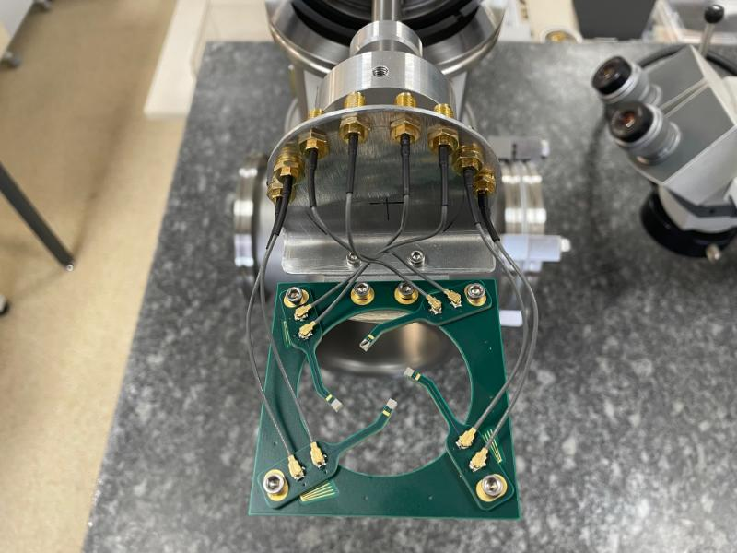
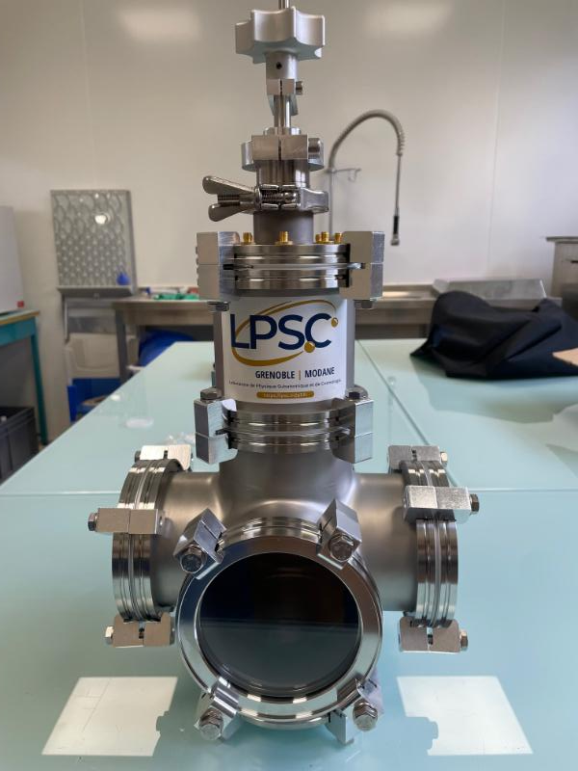
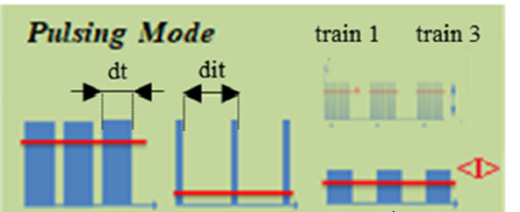
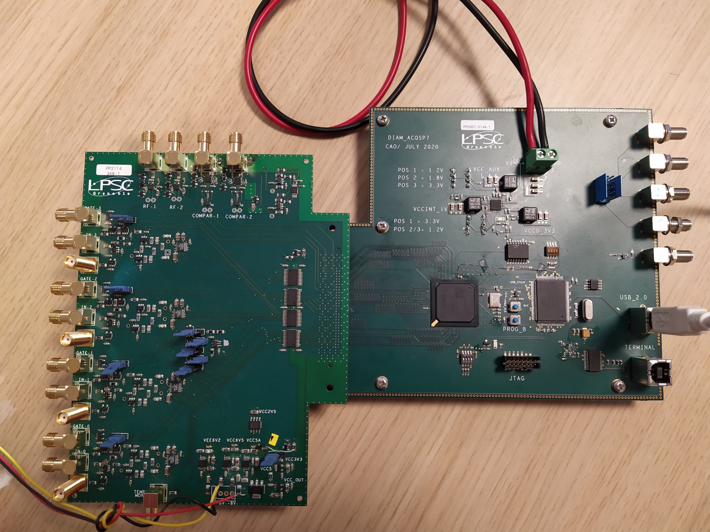
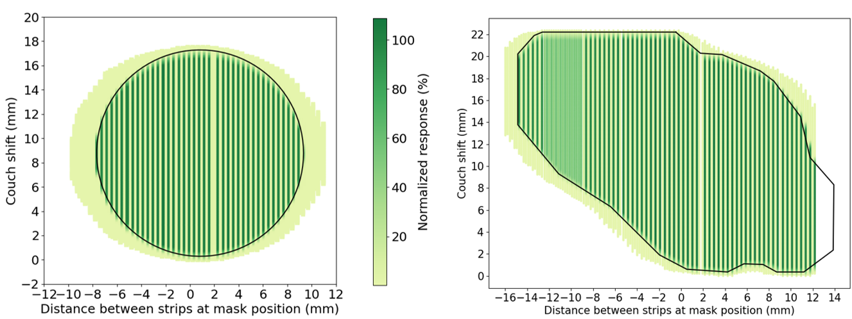
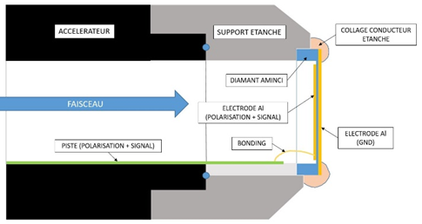
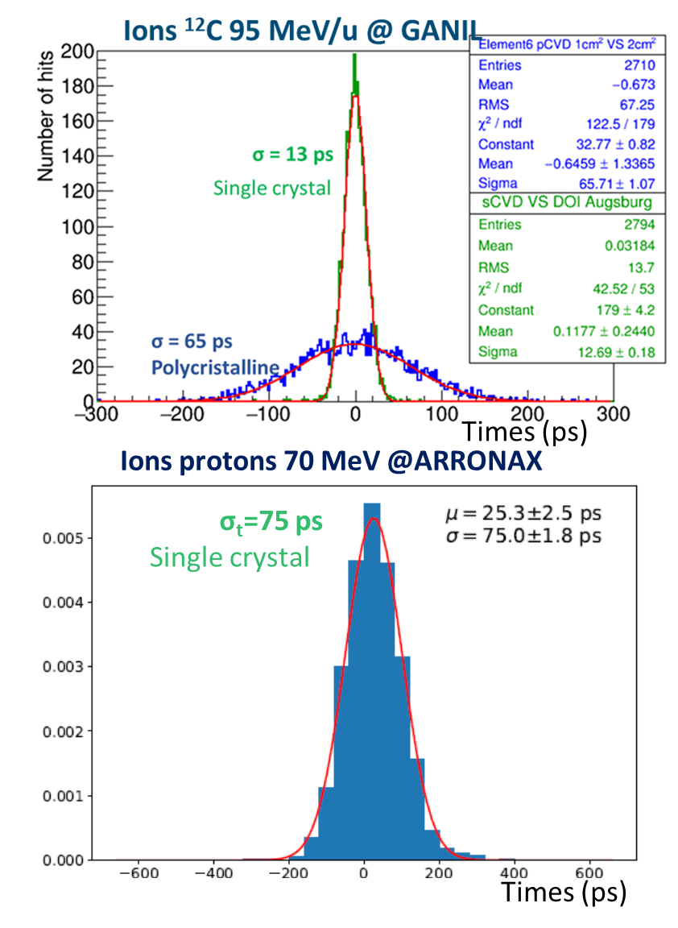
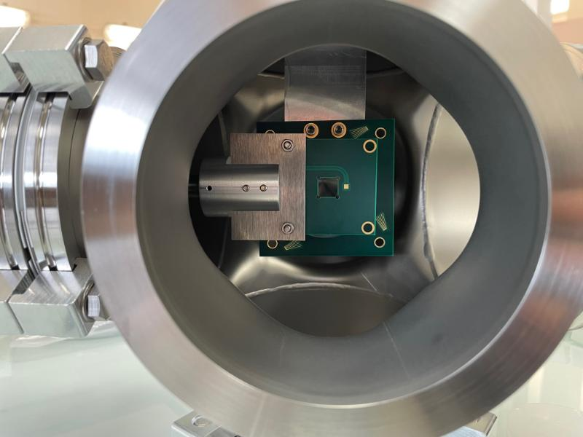
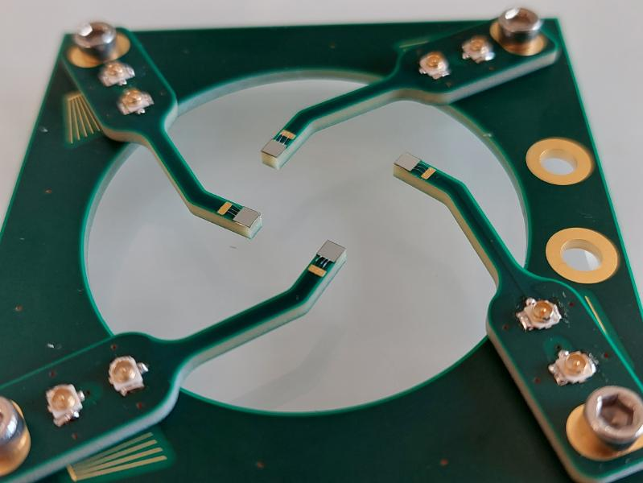
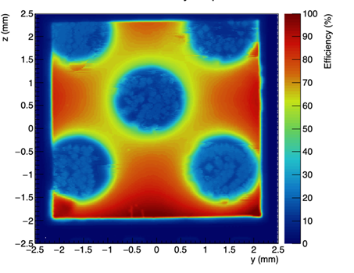
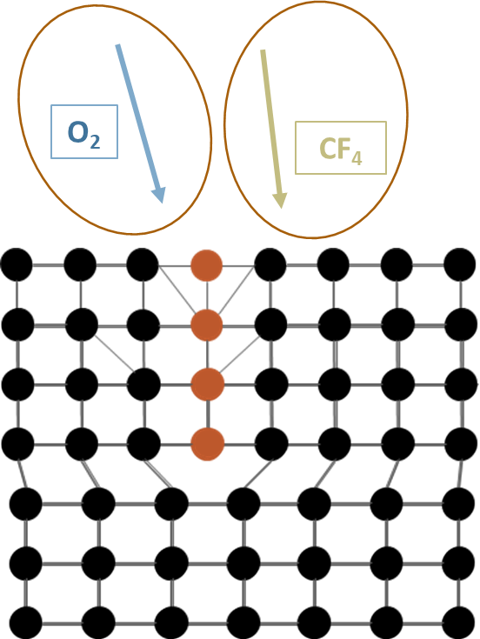
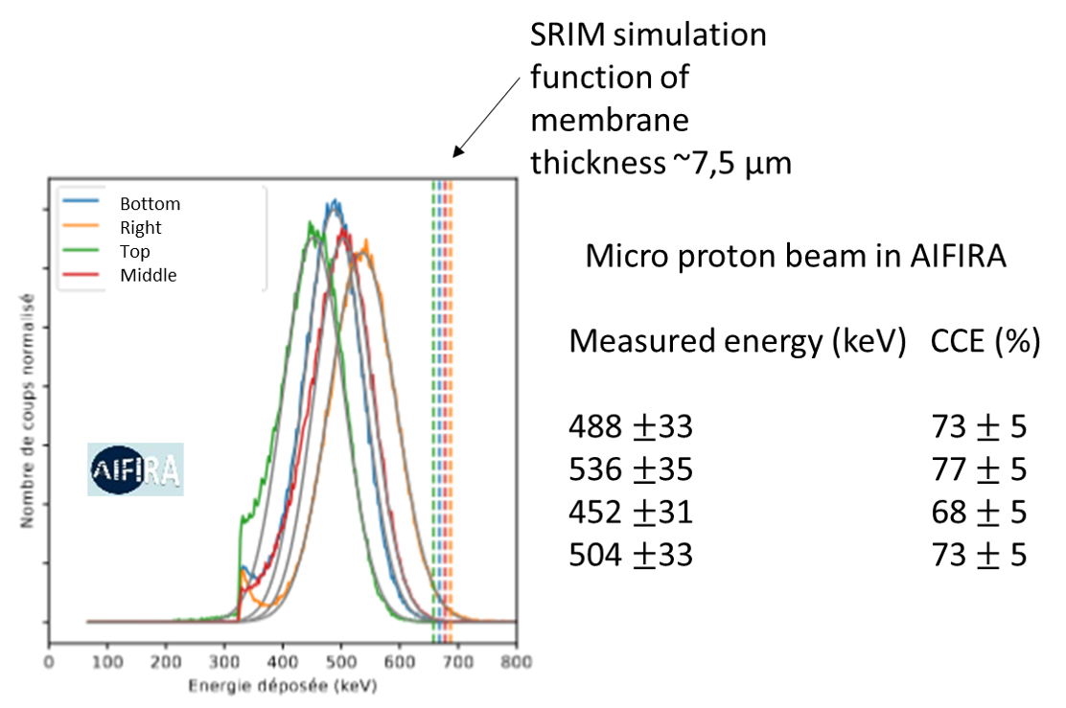



DIAMOND – Beam monitoring @IN2P3 and for medical application : various specification lists!
40 preamps + DFC + TDC 4 diamond sCVD in mosaic or 1 pCVD
Proton beam monitoring in hadrontherapy (CAL)
Coll. Clarys UFT / Coll. ClaRyS - LaBeX PRIMES (P. Everaere PhD thesis)
Single particle
XY spatial resolution ~1 mm Beam monitor to set up treatment plan
Time resolution ~100 ps
Micro-Xrays beam monitoring application to Microbeam Radiation Therapy (ESRF + Australian Synchrotron)
R&T DIAMTECH / IDSYNCHRO / PAIR TUMC - Coll. LPSC – STROBE (Inserm) (C. Milewski and T. Bettio PhD thesis)
Current integration (dynamic=10⁶) F. Di Franco et al. J Synchrotron Radiat. 2023 hal−04217250t
Integration from 10 ms up to 100 ms
138 QDC channels : 20 ASIC + 8 Diamonds in 1 row
Pulsed proton beam monitoring – application to Flash Therapy (ARRONAX)
R&T DIAMTECH / ANR – DIAMMONI Coll. LPSC SUBATECH ARRONAX (R. Molle PhD thesis)
Current integration (dynamic=10⁵)
Train Counting => Time stamps ~3 ns
Bunch Counting
QDC : Train counting
4 sCVD +1 sCVD diamond
DIAMMONI
Fast preamp + 500 MHz ADC : Bunch counting
Micro - ion beam monitoring (LP2I Bordeaux/AIFIRA - IRSN/ MIRCOM)
Coll. LPSC Institut Néel-Grenoble LP2I-Bordeaux IRSN (C. Léonhart PhD thesis)
To be crossed by protons with energy up to 4 MeV, alpha particles up 6 MeV and B, C, O, … ions up to 8 - 10 MeV.
Diamond deep etching => diamond menbrane of ~1 µm (Institut Néel)
Integration on the µ beam line = extraction window
Detector response to a circular beam shape (left) and a complex beam shape (right). The bold black line printed of each figures corresponds to the theoretical shape of the collimator.
DéFI DiaMs
Next step: synchronised upstream quasi‑transparent diamond monitor for simultaneous incident + transmitted beam measurements (improved transit dosimetry).
Monitoring low energy ion beam (ALTO)
Coll. LPSC IP2I Lyon IJC lab via PICTURE (MP Diamant & BioALTO)
4 diamonds (2x2x0.1mm³) placed in the halo of the beam for irradiation monitoring (beam energy) and beam alignment.
Need for dislocation free sCVD !
Stress is layed on the etching method based on the Knowhow of Institut Néel
Need for large area sCVD to cover the beam surface !
The challenge is to cope with diamond radiation hardness when bombarded with ions cumulating huge fluences (nb particles/surface unit)

Slide 8


DIAMOND – Beam monitoring @IN2P3 and for medical application : various specification lists!
40 preamps + DFC + TDC 4 diamond sCVD in mosaic or 1 pCVD
Proton beam monitoring in hadrontherapy (CAL)
Coll. Clarys UFT / Coll. ClaRyS - LaBeX PRIMES (P. Everaere PhD thesis)
Single particle
XY spatial resolution ~1 mm Beam monitor to set up treatment plan
Time resolution ~100 ps
Micro-Xrays beam monitoring application to Microbeam Radiation Therapy (ESRF + Australian synchrotron)
R&T DIAMTECH / IDSYNCHRO / PAIR TUMC - Coll. LPSC – STROBE (INSERM) (C. Milewski and T. Bettio PhD thesis)
Current integration (dynamic=10⁶) F. Di Franco et al. J Synchrotron Radiat. 2023 hal−04217250t
Integration from 10 ms up to 100 ms
138 QDC channels : 20 ASIC + 8 Diamonds in 1 row
Pulsed proton beam monitoring – application to Flash Therapy (ARRONAX)
R&T DIAMTECH / ANR – DIAMMONI Coll. LPSC SUBATECH ARRONAX (R. Molle PhD thesis)
Current integration (dynamic=10⁵)
Train Counting => Time stamps ~3 ns
Bunch Counting
QDC : Train counting
4 sCVD +1 sCVD diamond
DIAMMONI
Fast preamp + 500 MHz ADC : Bunch counting
Micro - ion beam monitoring (LP2I Bordeaux/AIFIRA - IRSN/ MIRCOM)
Coll. LPSC Institut Néel-Grenoble LP2I-Bordeaux IRSN (C. Léonhart PhD thesis)
To be crossed by protons with energy up to 4 MeV, alpha particles up 6 MeV and B, C, O, … ions up to 8 - 10 MeV.
Diamond deep etching => diamond membrane of ~1 µm (Néel)
Integration on the µ-beam line = extraction window
DéFI DiaMs
Monitoring low energy ion beam (ALTO)
Coll. LPSC IP2I Lyon IJC lab via PICTURE (MP Diamant & BioALTO)
4 diamonds (2x2x0.1mm³) placed in the halo of the beam for irradiation monitoring (beam energy) and beam alignment.
∆E-E monolithic detector Coll. LPSC - Néel (C. Léonhart PhD thesis)
P++ and P- layers
Epitaxic on sCVD substrate

Slide 9
Conclusion
The developments are in connection with collaborations established at IN2P3 and INP, Inserm, CAL, IRSN and ESRF
Interdisciplinary research: IN2P3 - INP skills exchanges
characterization: sources (labs) + accelerator beams @ IN2P3 AIFIRA / GIP - ARRONAX, XBIC @ ESRF
Instrumentation (IN2P3 labs, Institut Néel, etc.)
Diamond beam monitors + FE electronics and DAQ have been developed
Various specifications (time resolution, continuous or pulsed beams, single particle counting up to 10⁶ particle/bunch)
Diamond beam monitoring satisfies the FLASH therapy conditions (linear response in the range 1 – 4x10⁵ Gy/s with X-rays and proton beams)
=> the proposed systems will bring significant added value to the transfer of FLASH radiotherapy to clinical trials
Simulation + aging studies are ongoing for a better understanding of the signal formation and the impact of very high fluences on charge collection

Slide 10


THANKS FOR YOUR ATTENTION !
©
Diamond Jokes Quotes

