Slide 1
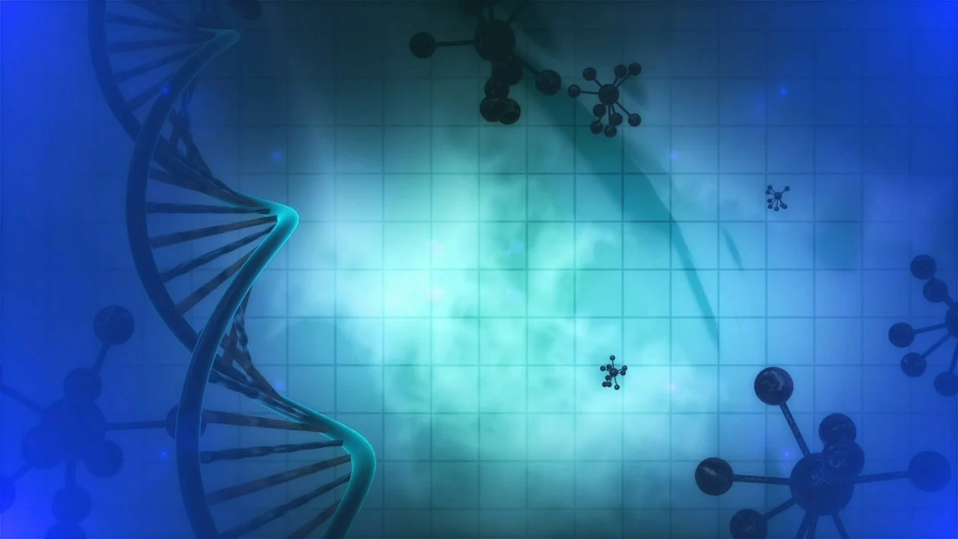


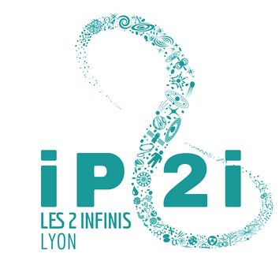








BIOHADRON: Unraveling the Radiobiological Basis of Carbon-Ion Clinical Superiority
Pr Claire Rodriguez-Lafrasse
Cellular and Molecular Radiobiology
UMR CNRS 5822 - IP2I
Lyon-Sud Faculty of Medicine
CNAO/IN2P3 workshop - 5 March 2026

Slide 2
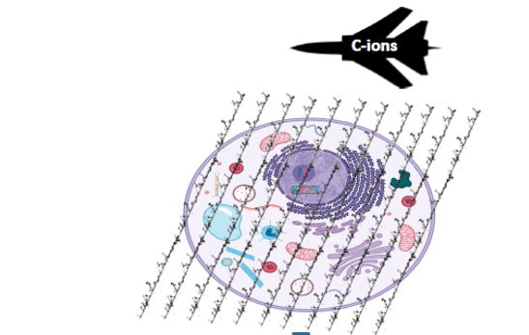
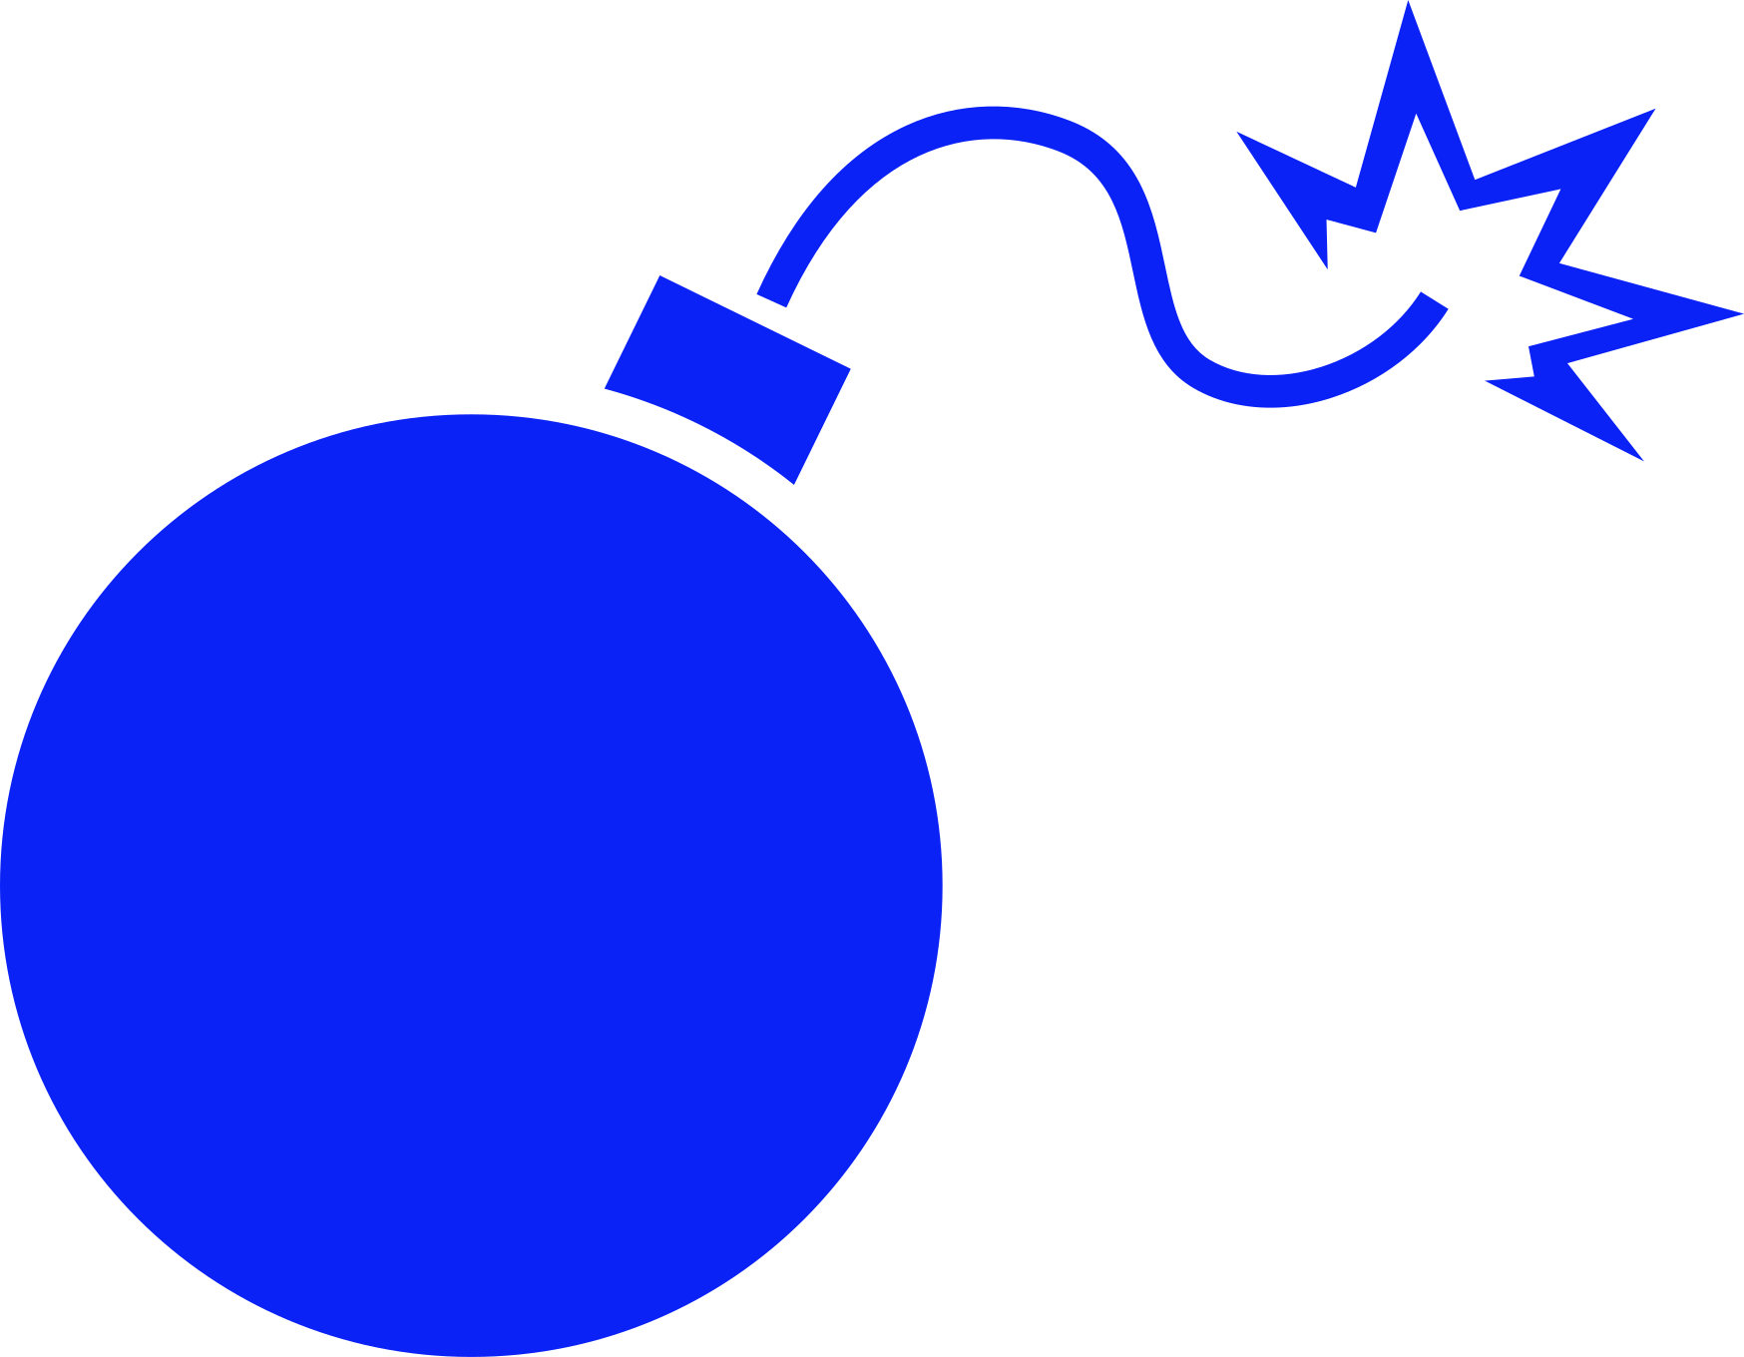

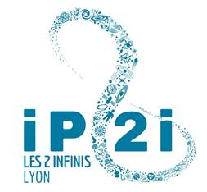
Paradigm of the stealth bomber: previous results
Subcellar targets on the trajectory of C-ions
Very low production of ROS out of the C-ion tracks
ROS-induced complex damage at the DNA and molecular levels
Absence of triggering of cellular alarms and defense mechanisms outside areas hit by ROS
The Bomber effect
The Stealth effect
Complex & clustered DNA damage
Chromosome loss (distinct signature)
Telomere-lenght independent killing
Impaired proteostasis
More cell death (including CSCs)
Low oxygen & dose-rate dependence
Reduced/delayed DNA damage sensing, signaling and repair
No HIF-1α stabilization
No/reduced tumor cell migration and invasion
No stress granule formation
No/reduced activation of ROS-driven pro-survival signaling pathways
explains the high RBE and ability to overcome radioresistance
prevents unwanted side effects typically associated with photon radiotherapy
Wozny AS, Rodriguez-Lafrasse C. The 'stealth-bomber' paradigm for deciphering the tumour response to carbon-ion irradiation.
Br J Cancer. 2023 Apr;128(8):1429-1438. doi: 10.1038/s41416-022-02117-6.

Slide 3
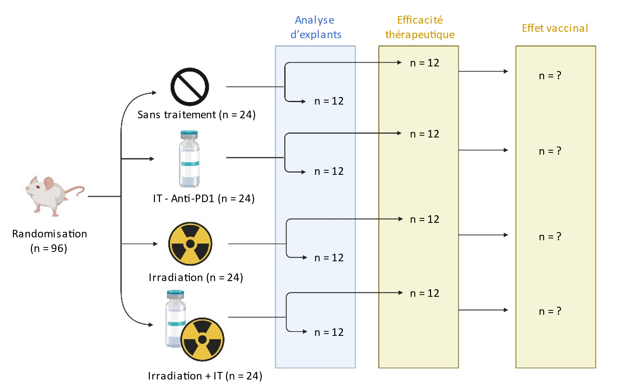
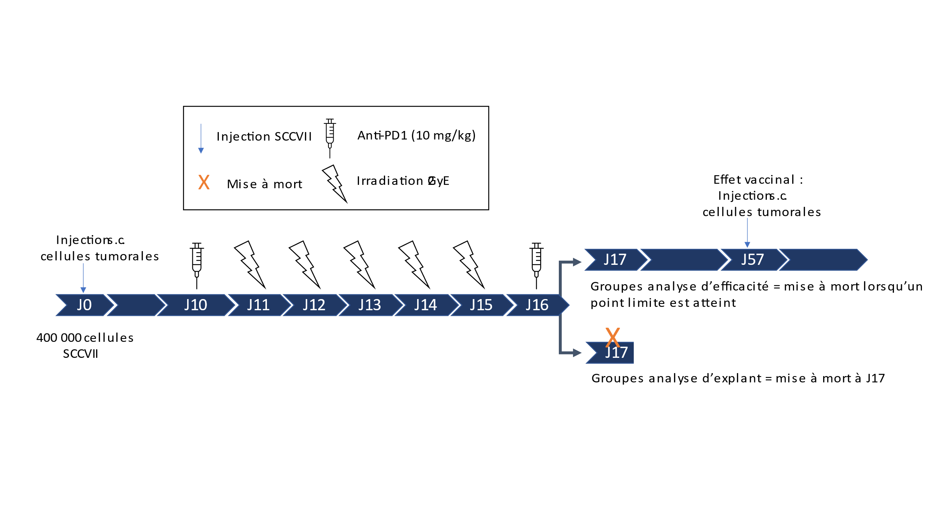
Preclinical study in an immunocompetent syngeneic mouse model
Therapeutic efficacy and impact on the tumor microenvironment of carbon ions, protons, and photons +/- immunotherapy
Heterotopic graft of SCCVII cells (HNSCC)
Photons (320 kV; 2 Gy/min)
→ UMR CNRS 5822, Faculty of Medicine Lyon Sud
Protons (65 MeV/n; 12 Gy/min)
→ Centre Antoine Lacassagne (Nice), Coll B. Cambien
Carbon ions (SOBP 290 MeV/n; 1 Gy/min)
→ NIRS, Chiba (Japan), Coll T.Nakajima
Fractionation: 5 × 2 GyE (biologically equivalent doses)
Anti-PD1 (10 mg/kg)
Anti-PD1
Vaccinal effect
Tumor cell injection
Tumor growth and survival
Tumor analyses
Gauthier, Alphonse et al., submission pending

Slide 4
Efficacy of combining of carbon ions, protons, and photons +/- immunotherapy
Photons (5 x 2Gy)
Protons (5 x 2 Gy)
Carbon Ions (5 x 1 Gy)
More pronounced tumor regression with carbon ions; greater efficacy of RT + immunotherapy across all modalities
Tumor immune escape
Immunogenic cell death
Pro-inflammatory M1 macrophages
Immunosuppressive M2 macrophages
Bomber effect → Immunogenic cell death
Stealth effect → No activation of immunosuppressive programs
Gauthier, Alphonse et al., submission pending

Slide 5
Collaborative project with CNAO
Preclinical evidence in the mouse model:
Carbon ions (and to a lesser extend protons)
→ Shift tumor microenvironment toward immune activation
→ Improved synergy with checkpoint blockade (anti–PD-1)
Key question:
What are the early molecular triggers that drive these distinct immune outcomes across beams?
→ hypothesis: cytosolic DNA sensing and innate immune activation differ between ions and photons
CNAO project: Decoding immune activation and scaling beam comparisons
Project 1 — Cytosolic DNA sensing (cGAS–STING) and negative regulation by TREX1
To understand how different radiation beams initiate immune activation through distinct molecular pathways
Project 2 — CAM screening platform: tumor grafting onto the chorioallantoic membrane of embryonated eggs
To compare beams/ions/dose-rates and quantify upstream readouts
Notes:
From innate danger signaling to in vivo immune validation

Slide 6
Overview of CNAO irradiation experiments
Date | Hours | HITRI Plus | Experiments
29/02/2024 – 04/03/2024 | 8h | No | Cell survival curves Boyden chamber Protein extracts
24/04/2024 – 28/04/2024 | 8h | No | Cell survival curves Boyden chamber Protein extracts Cytosolic DNA
28/08/2024 – 01/09/2024 | 8h | Yes | Cytosolic DNA Cell cycle
03/04/2025 – 04/04/2025 | 6h | Yes | In ovo irradiation
16/09/2025 – 17/09/2025 | 6h | Yes | In ovo irradiation Cell survival curves
14/10/2025 – 15/10/2025 | 2h30 (beam arrest) | No | In ovo irradiation Protein extracts
17/02/2026 – 18/02/2026 | 6h | Yes | In ovo irradiation Protein extracts
10/03/26 – 11/0326 | 6h | No
14/04/26 – 15/05/26 | 6h | No

Slide 7
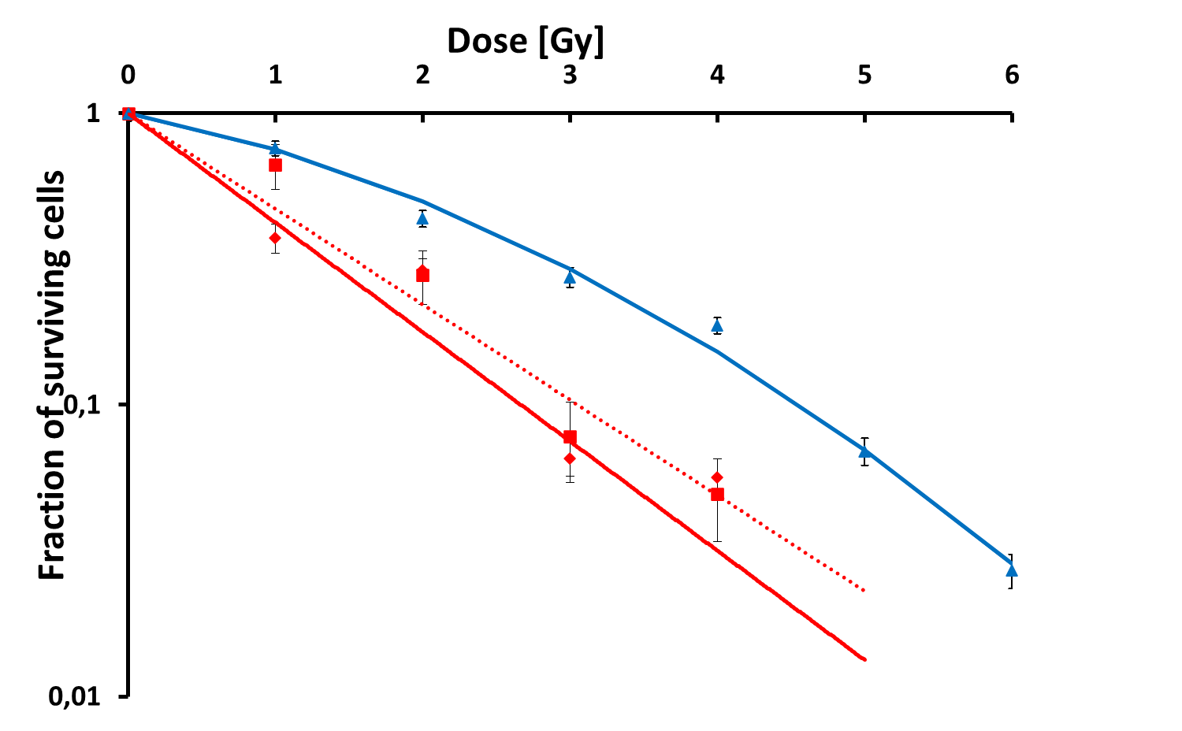
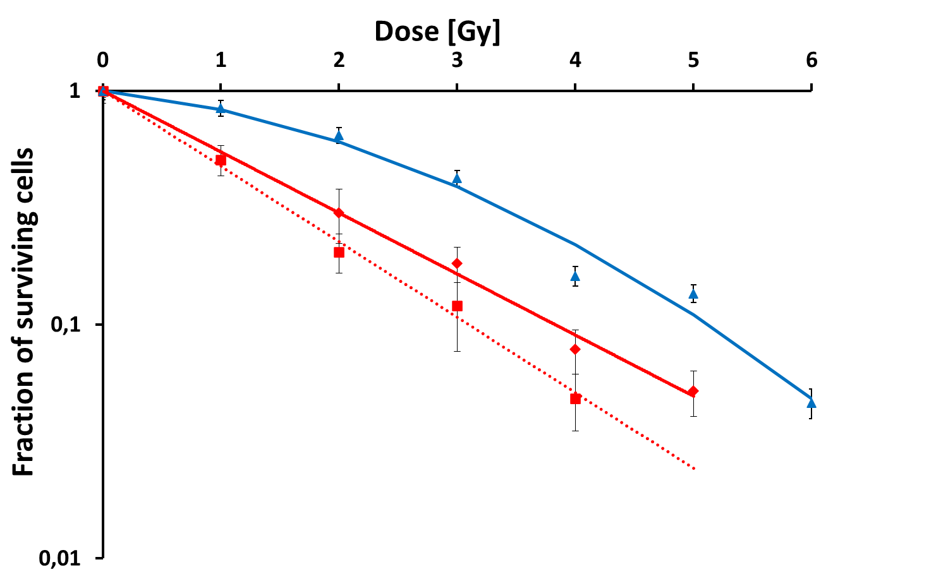
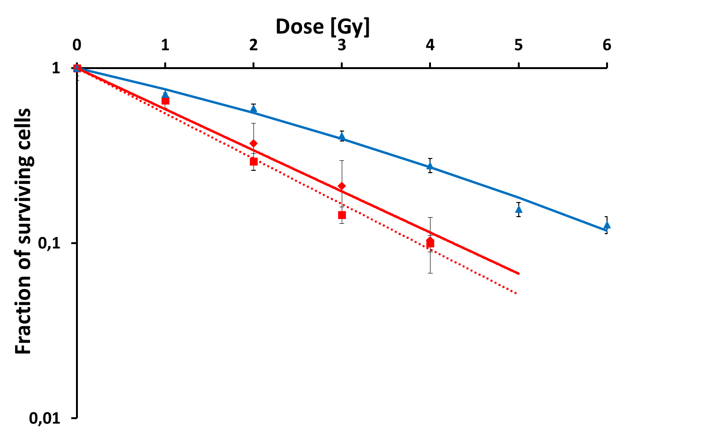
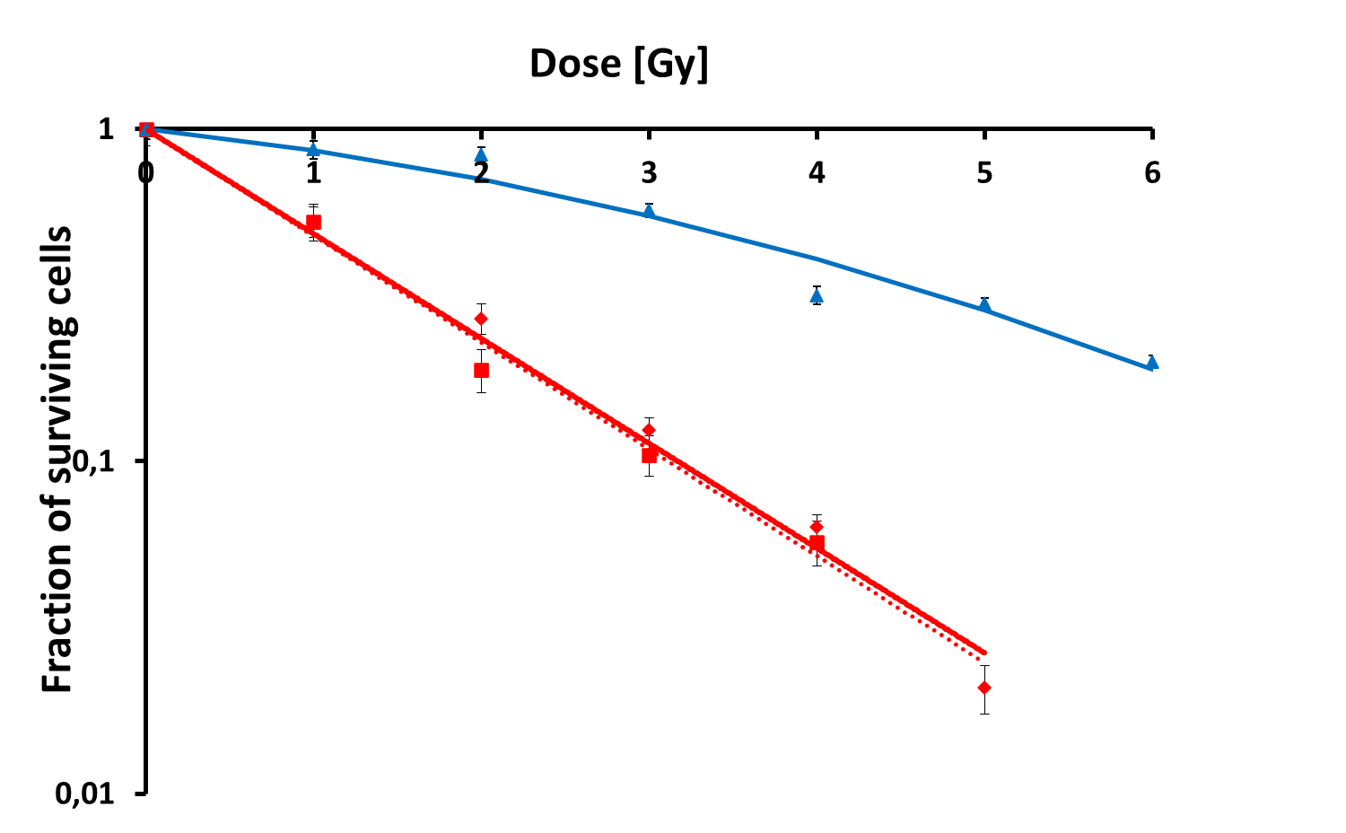
Radiobiological characterization of the CNAO carbon-ion beam
Based on well-established endpoints:
Cell survival curves and RBE calculation for Head & Neck Squamous Cell Carcinoma (HNSCC)
Cells | Irradiation | SF2 | D10 | RBE
FaDu – non CSC | Photons | 0.49 | 4.56 | /
 | SOBP CNAO | 0.18 | 2.66 | 1.71
 | 50MeV/n GANIL | 0.22 | 3.05 | 1.5
FaDu –CSC | Photons | 0.61 | 5.12 | /
 | SOBP CNAO | 0.30 | 3.83 | 1.34
 | 50MeV/n GANIL | 0.23 | 3.10 | 1.65
SQ20B – non CSC | Photons | 0.55 | 6.36 | /
 | SOBP CNAO | 0.34 | 4.26 | 1.49
 | 50MeV/n GANIL | 0.30 | 3.86 | 1.65
SQ20B - CSC | Photons | 0.71 | 7.36 | /
 | SOBP CNAO | 0.23 | 3.17 | 2.32
 | 50MeV/n GANIL | 0.23 | 3.11 | 2.37
FaDu – non CSC
FaDu – CSC
Photons
Carbon ions SOBP CNAO
Carbon ions 50MeV/n GANIL
SQ20B – CSC
Unpublished data
SQ20B – non CSC

Slide 8
Radiobiological characterization of the CNAO carbon-ion beam
Functional test: migration capacities of HNSCC cells after carbon ion and photon irradiation
GANIL
CNAO
Unpublished data

Slide 9
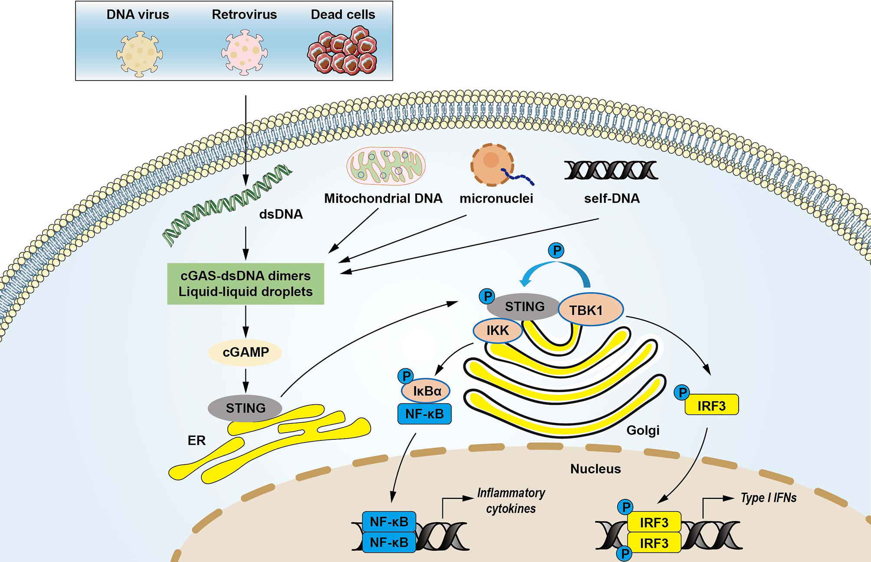
Project 1 — Cytosolic DNA / cGAS–STING axis and TREX1
Rationale: type I IFN signaling and antigen-presenting cell priming depend on cytosolic DNA → cGAS–STING pathway, while excessive DNA processing (TREX1) can dampen immunogenicity
v
v
1. Cytosolic DNA→ cGAS activation
2. cGAS produces cGAMP (second messenger)
3. STING activation
4. Activation of TBK1 and IRF3 kinases
5. Production of interferon-β (IFN-β)
6. Induction of interferon-stimulated genes (ISGs)
TREX1
Adapted from Xu et al Front. Immunol. 2021

Slide 10
Project 1 — Cytosolic DNA / cGAS–STING axis and TREX1
Objectives
Quantify cytosolic dsDNA (time course)
Measure pathway activation: cGAS–STING → TBK1/IRF3 → IFN-β / ISGs (interferon stimulated genes)
Assess TREX1 induction/activity as a potential
“immunogenicity brake”
Evaluating the impact of TREX1 inhibition
Link with functional readouts: PD-L1 regulation,
macrophage polarization markers, ICD markers
v
v
TREX1
Adapted from Xu et al Front. Immunol. 2021

Slide 11
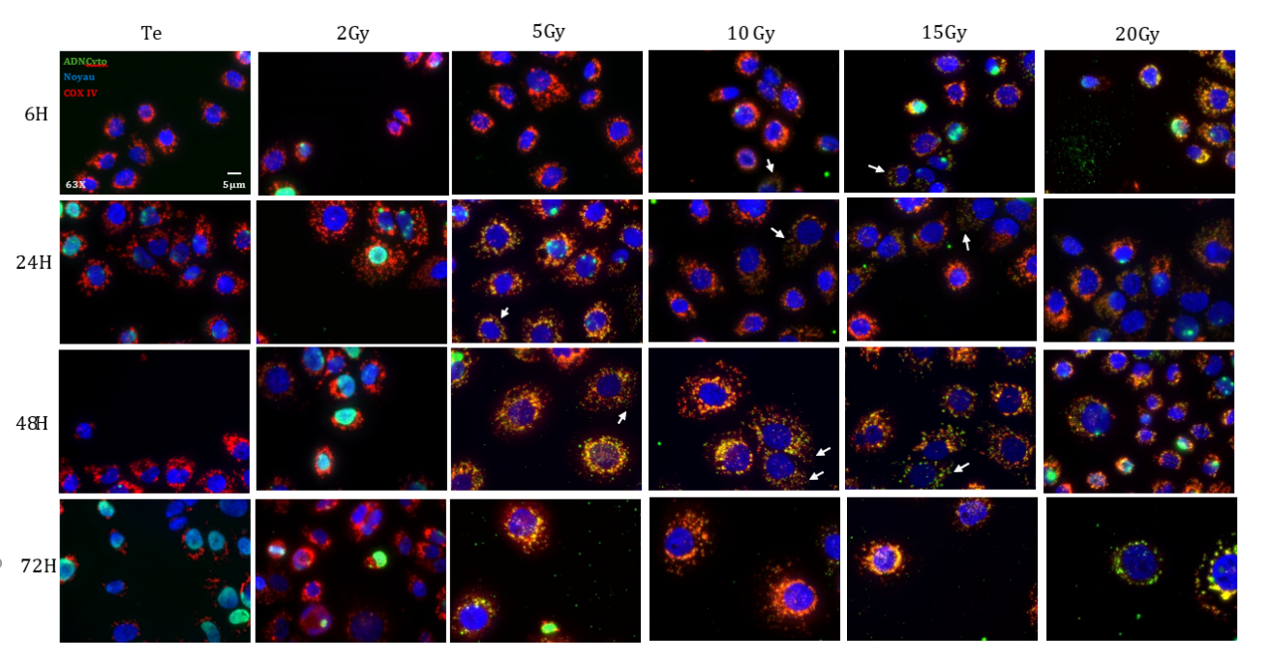
Cytosolic DNA and cGAS–STING activation: key drivers of immunogenic signaling
Quantify cytosolic dsDNA (time course):
Cytosolic DNA production in SCC61 cells after photon irradiation
Cytosolic DNA in green, mitochondrial marker Cox IV in red, and nuclear DNA counterstained with DAPI (blue)
.
Unpublished data

Slide 12
Cytosolic DNA and cGAS–STING activation: key drivers of immunogenic signaling
Quantify cytosolic dsDNA (time course):
Preliminary results:
Carbon ions are as effective as photons at inducing cytosolic DNA release…
More micronuclei formation?
v
v
TREX1
Adapted from Xu et al Front. Immunol. 2021
Unpublished data

Slide 13
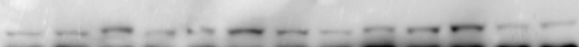
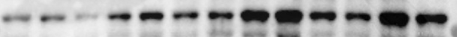
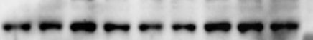
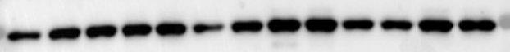

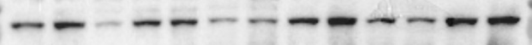

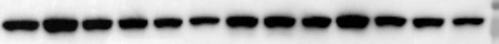

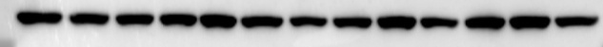
Cytosolic DNA and cGAS–STING activation: key drivers of immunogenic signaling
Measure pathway activation: cGAS–STING → TBK1/IRF3 → IFN-β / ISGs
SCC61 photons
SCC61 carbon ions
2 Gy
5 Gy
10 Gy
15 Gy
20 Gy
1 Gy
2,5 Gy
5 Gy
7,5 Gy
10 Gy
CTL
72H
48H
6H
24H
24H
48H
72H
24H
6H
CTL
6H
72H
6H
6H
48H
24H
48H
72H
48H
CTL
24H
24H
48H
24H
72H
48H
72H
24H
6H
72H
6H
48H
6H
24H
48H
72H
72H
6H
24H
6H
48H
72H
CTL
cGAS (62kDa)
0,73 1,44 0,67 0,31 0,18 2,19 0,70 0,23 0,08 0,30 0,92 0,21 0,32
1,14 0,32 0,44 0,08 1,01 1,30 0,34 0,77 0,32
0,08 0,14 0,17 0,10 0,05 0,17 0,17 0,08 0,12 0,28 0,19 0,05 0,08
0,04 0,06 0,09 0,05 0,11 0,25 0,12 0,06 0,01
p-STING (40kDa)
STING (33-35kDa)
2,35 0,97 2,04 3,55 1,31 1,47 1,57 1,58 1,11 1,36 0,99 0,79 0,97
0,97 0,75 0,72 0,98 0,57 1,42 1,05 1,10 0,87
0,12 0,07 0,02 0,10 0,14 0,21 0,14 0,27 0,36 0,21 0,19 0,55 0,28
p-TBK1 (84kDa)
0,23 0,14 0,13 0,06 0,13 0,11 0,13 0,09 0,12
TBK1 (84kDa)
0,81 0,80 0,32 0,55 0,35 2,01 0,65 0,53 0,63 0,54 0,34 0,02
0,39 0,46 1,15 1,17 0,48 1,04 1,04 0,67 0,97
0,04 0,03 0,01 0,04 0,05 0,03 0,02 0,05 0,09 0,02 0,03 0,11 0,19
0,02 0,02 0,05 0,12 0,04 0,09 0,14 0,17 0,19
Actine
→ Carbon ions induce faster, stronger, and more sustained cGAS-STING activation compared with photons
Assess TREX1 induction/activity as a potential “immunogenicity brake” and evaluate TREX1 inhibition
Link with functional readouts: PD-L1 regulation, macrophage polarization markers, ICD markers
Unpublished data

Slide 14
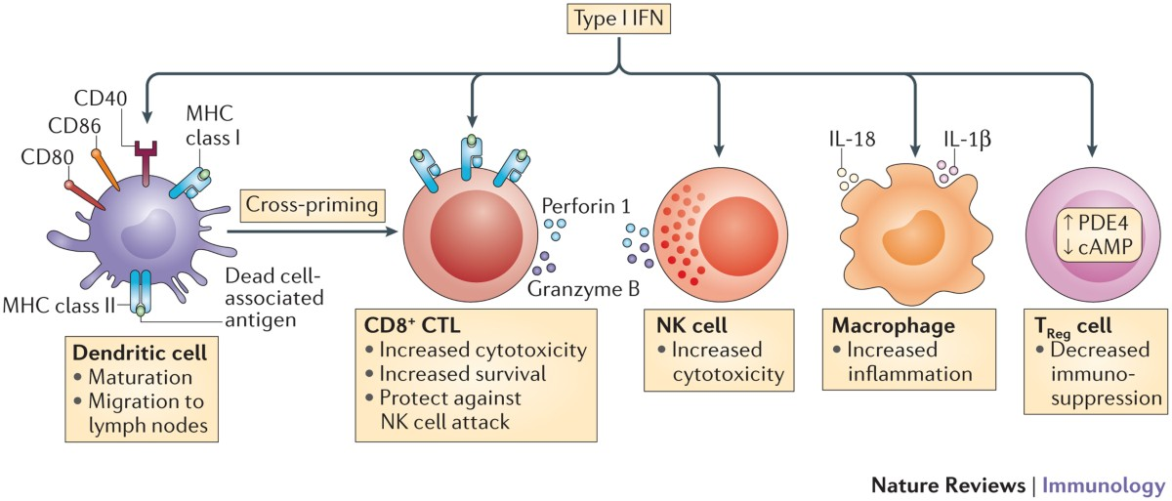
Cytosolic DNA and cGAS–STING activation: key drivers of immunogenic signaling
Measure pathway activation: cGAS–STING → TBK1/IRF3 → IFN-β / ISGs
→ Carbon ions induce faster, stronger, and more sustained cGAS-STING activation compared with photons
cGAS–STING activation leads to type 1 Interferon antitumor immunity:
Dendritic cell maturation
CD8⁺ T-lymphocytes activation
Chemokine production (CXCL9/10/11) → T-cell recruitment
Enhanced antigen presentation (MHC-I)
Activation of innate immunity (NK cells)
Assess TREX1 induction/activity as a potential “immunogenicity brake” and evaluate TREX1 inhibition
Link with functional readouts: PD-L1 regulation, macrophage polarization markers, ICD markers
Unpublished data

Slide 15
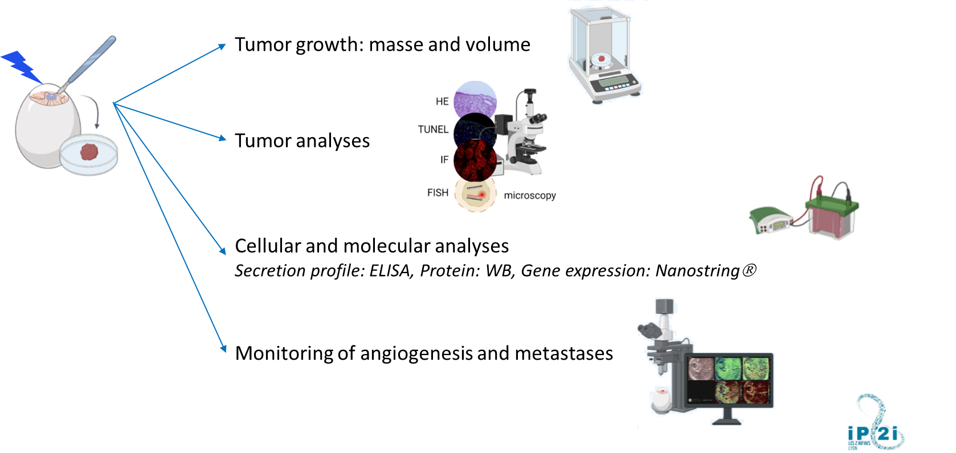
Project 2 — CAM Tumor Grafting Platform at CNAO
HNSCC tumor grafting onto the chorioallantoic membrane (CAM) of embryonated eggs
Alternative to mammalian tumor models: no ethics committee approval required, easy handling, multiple readouts
Limitation: high embryo mortality during the experiment, requiring large starting sample sizes
Rationale
Develop a scalable in vivo screening system to:
Compare photons, protons, carbon ions, (and helium)
Test fractionation strategies or combined strategies (immunotherapy)
Explore dose-rate effects
Identify the most immunogenic irradiation conditions
Immunology-focused readouts
ICD/DAMP markers (e.g., calreticulin exposure)
Cytosolic DNA / micronuclei
STING-associated / IFN-response signatures (as feasible)
Vascular/microenvironmental remodeling
Future validation in an animal model (as soon as possible at CNAO)

Slide 16
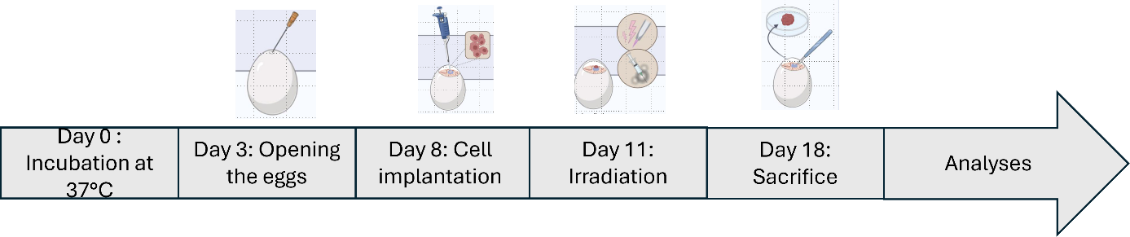

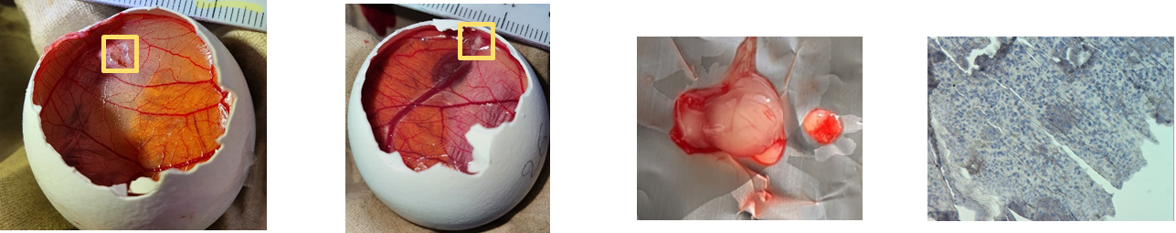
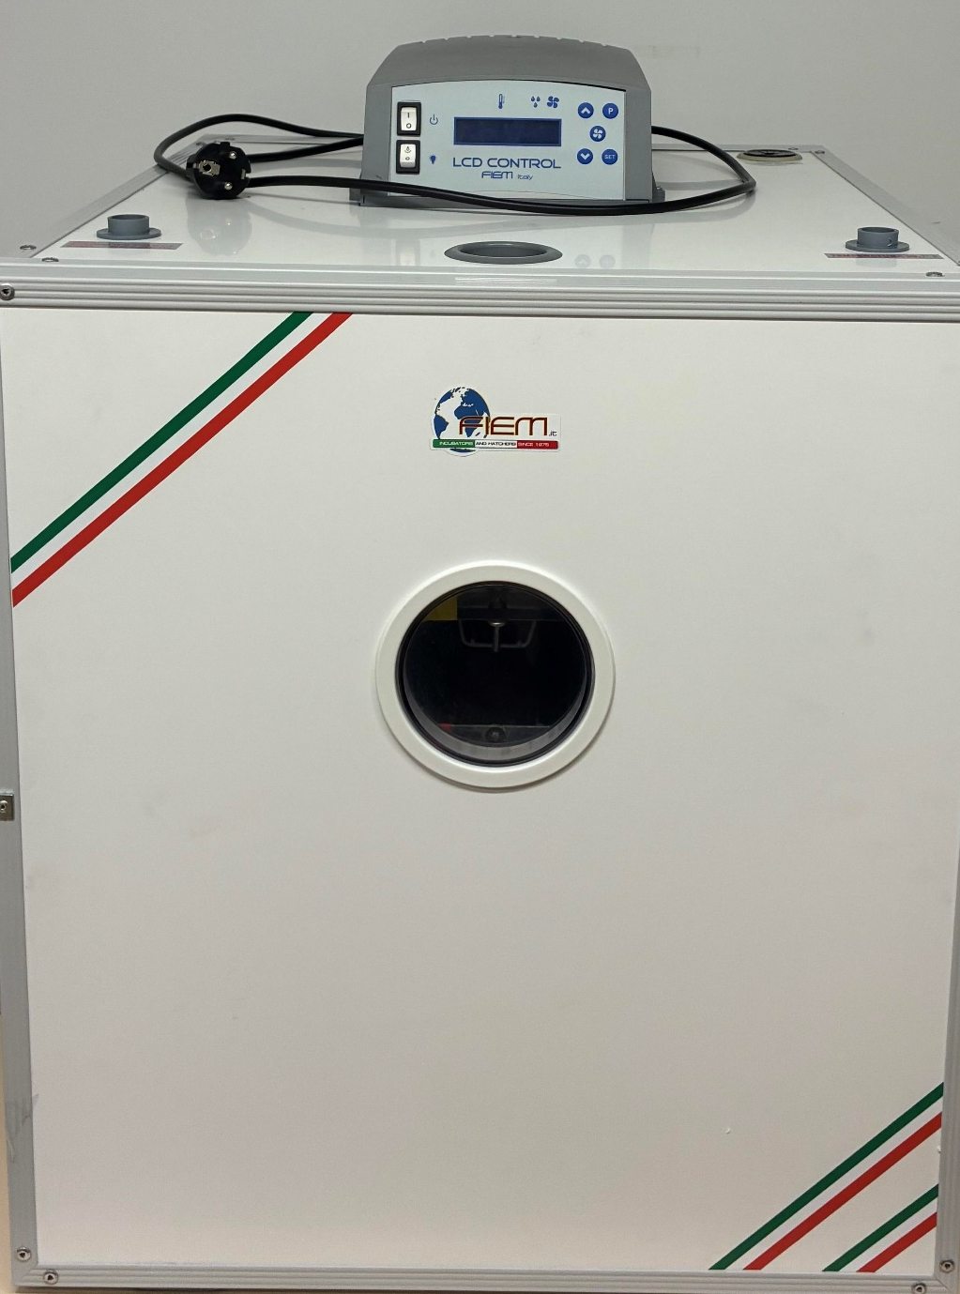
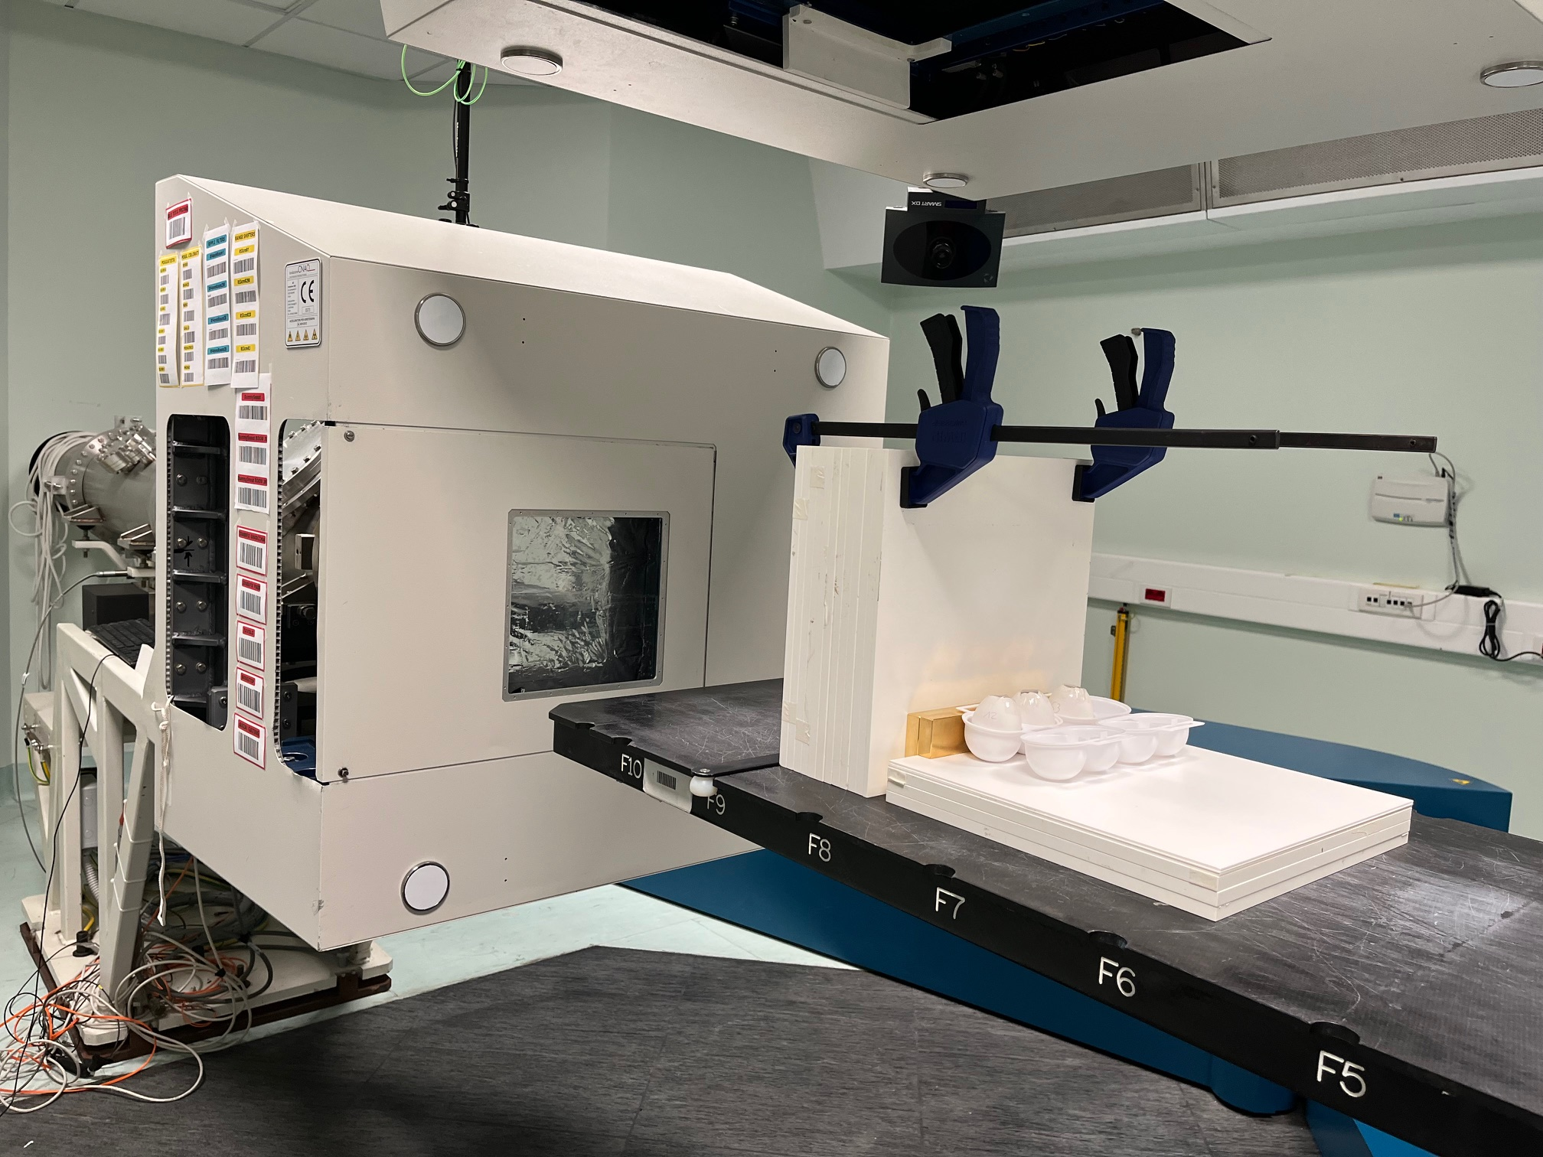
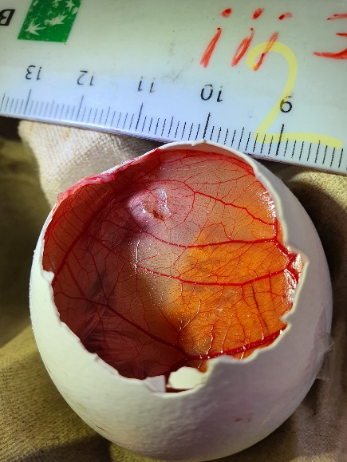
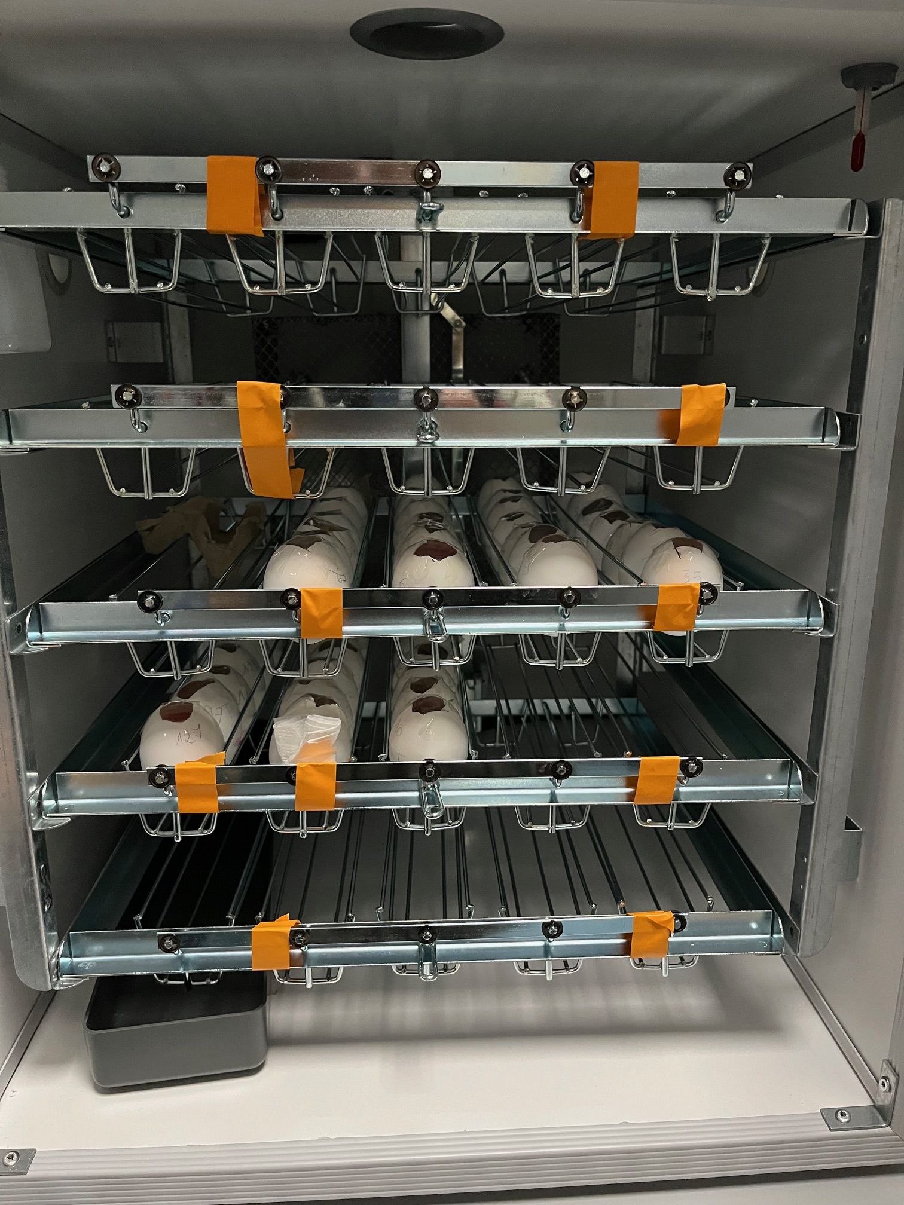
CAM tumor model: irradiation with photons, protons and carbon ions
A
Coll. A. Facoetti, M. Pullia (CNAO)

Slide 17
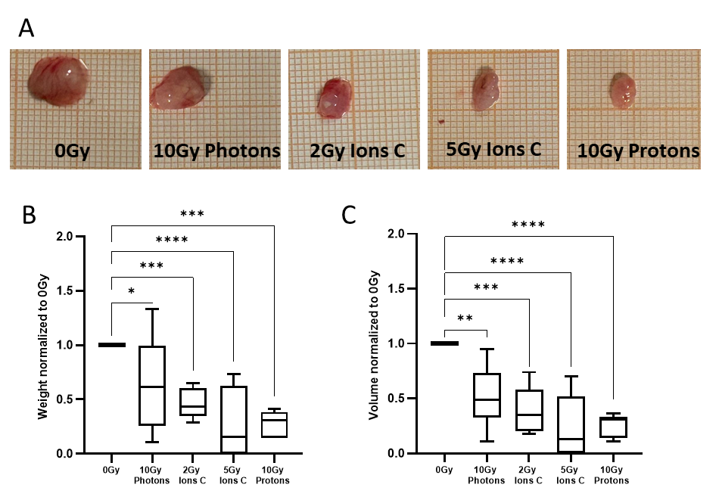
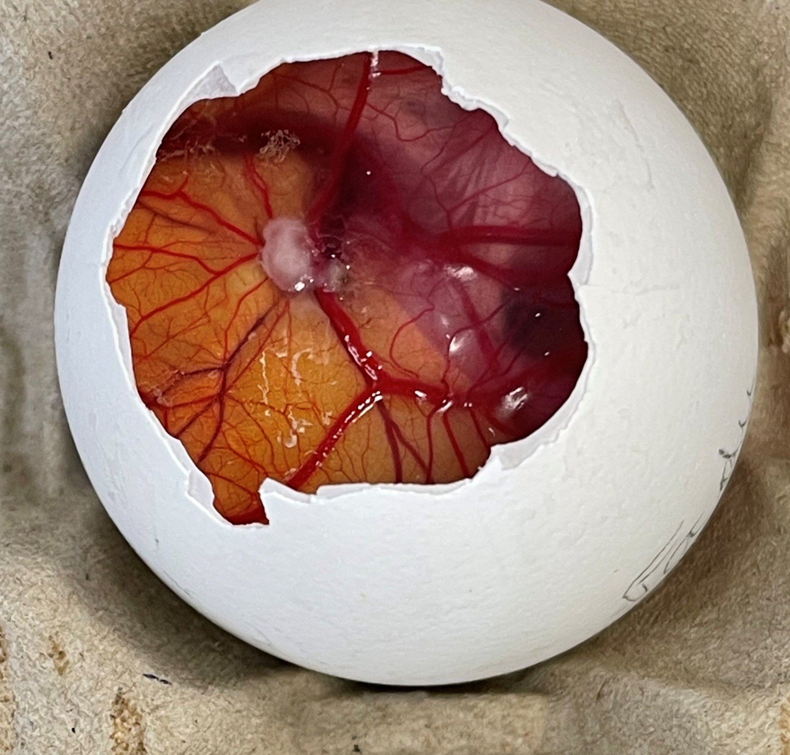
Scientific project
CAM tumor model: irradiation with photons, protons and carbon ions
Coll. A. Facoetti, M. Pullia (CNAO)
Unpublished data
Higher efficacy of carbon ions and protons at photon-equivalent biological doses (defined from in vitro survival), highlighting the key role of the microenvironment!

Slide 18
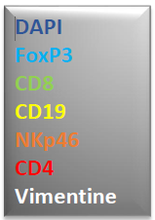
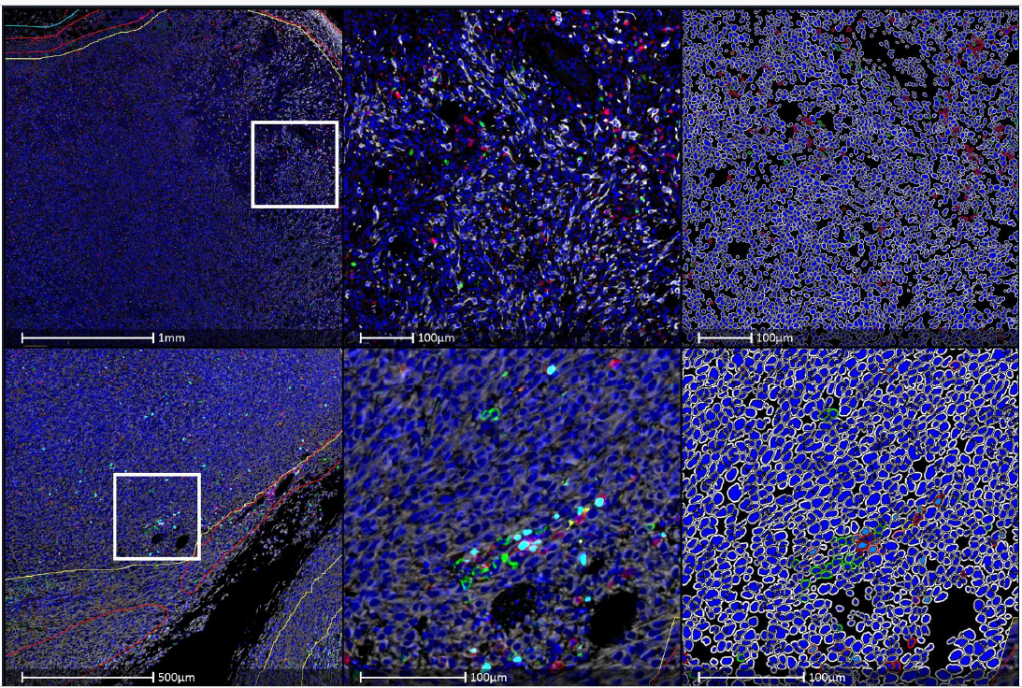
CAM tumor model
Ongoing experiments:
Tumor analysis by multispectral microscopy
Testing other tumor models (glioblastoma, chondrosarcoma)
Comparing different ions (He) and dose rates (UHDR)!
An abstract submitted to the PTCOG 2026 conference:
Carbon-ion radiotherapy outperforms photons and protons, including in combination with anti–PD-1, in murine HNSCC and CAM xenograft models
M Tissot, A Gauthier, B Cambien, T Nakajima, A Facoetti,
M Pullia, C Malésys, V Varoclier, G Saade, G Alphonse, Anne-Sophie Wozny, Claire Rodriguez-Lafrasse
Courtesy of Dr N. Gadot, C. Leneve, tumor xenograft
A publication expected in 2026

Slide 19
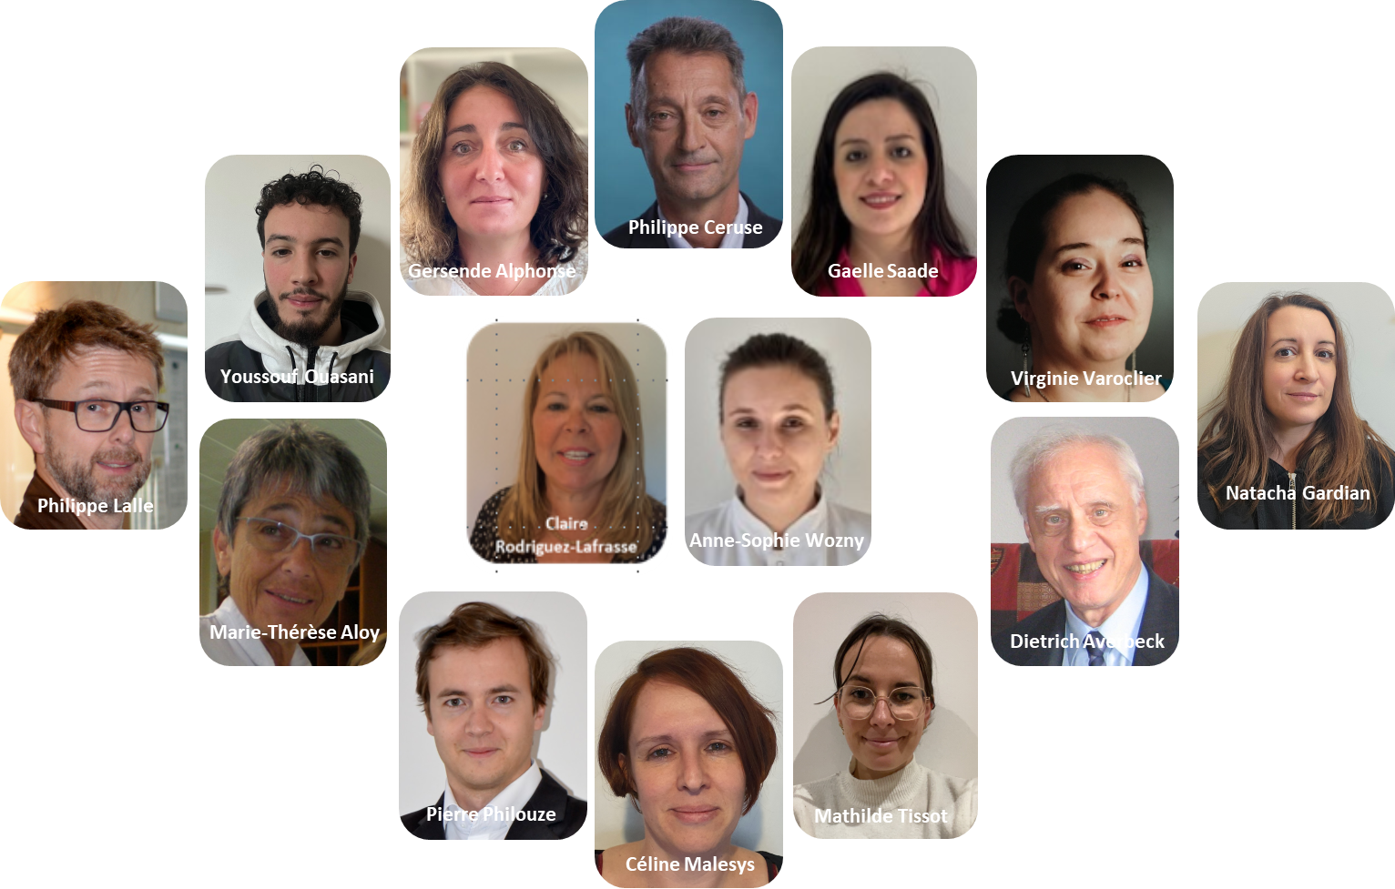
Acknowledgment
Acknowledgment
Cellular and Molecular Radiobiology Lab UMR CNRS 5822
Collaborations
M. Beuve (CNRS 5822)
E. Testa (CNRS 5822 )
A. Facoetti (CNAO, Pavia)
M. Pullia (CNAO, Pavia)
T. Nakajima (NIRS, Chiba)
A. Alet (CIUNR, Rosario)
M. Galassi (CIUNR, Rosario)
E. Scifoni (TIFPA, Trento)
A. Bisio (TIFPA, Trento)
B. Cambien (CAL, Nice)
F. Chevalier GANIL, Caen)
F. Haddad (Arronax, Nantes)
L. Sancey (IAB, Grenoble)
J. Balosso (GIN, Grenoble)
F. Milliat (IRSN, Paris)
C. Tomasetto (IGBMC, Strasbourg)
O. Tillement (ILM, Lyon)
S. Mebarek (ICBMS, Lyon)

