Slide 1

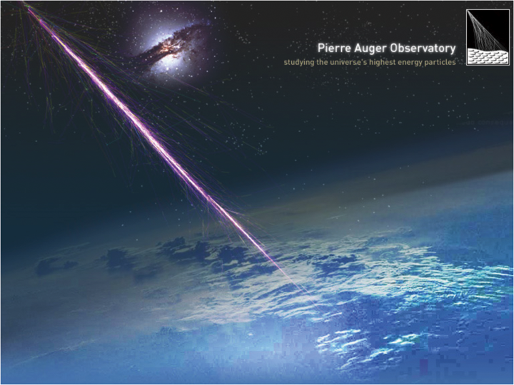
Management of the Data in Auger
Jean-Noël Albert
LAL – Orsay
IN2P3 - CNRS
ASPERA – Oct 2010 - Lyon

Slide 2
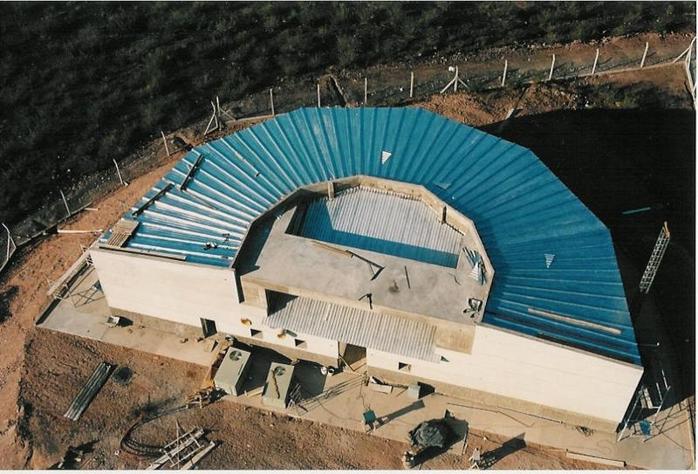
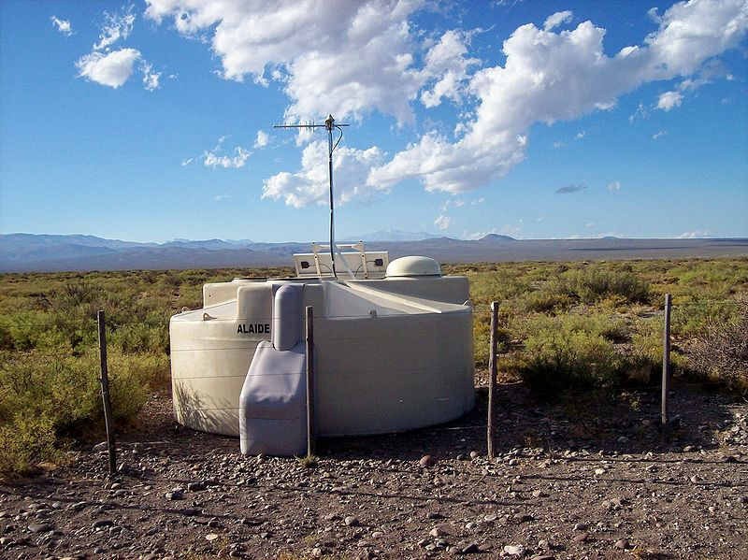
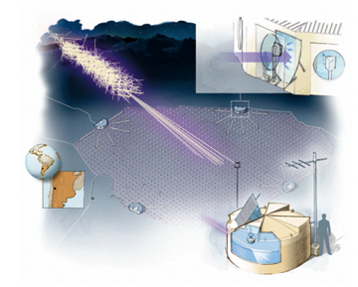
The Auger Experiment
The largest Cosmic Rays Observatory
  3 000 km² – in the Argentina Pampa
  1 600 Surface Detectors (Cherenkov)
  4 Fluorescence Telescopes
    6 x 4 Fluorescence Cameras
    10 % of the time (night – no moon)
  Hybrid Events : SD + FD
    Better determination of the energy
High Energy Cosmic Ray
  Energy 10²⁰
  1 / km² / century
  Expected : 30 events/year
Pierre Auger Observatory
  Experimental Array : 2001-2004
  Production Area : 2004-2010
    Full production : 2006-2010
  Observed UHECR : 50 (GZK effect)
Fluorescence Telescope
Surface Detector

Slide 3

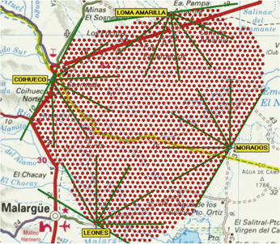
Data Taking
Paris
Mendoza
Local Data Taking
  Radio transfer from the thanks and telescopes to the Cdas main building (Malargüe)
To Paris : 15 hours
To Mendoza : 5 hours
  Merged in Events
    Root format
    Immediate reconstruction
    of the event parameters
    Streaming (Level 4 triggers): Hybrid, Gold Events
  Copied to a data server for export
Daily transfer to Lyon
  1 – 3.5 GB/day (no calibration)
  Poor Pampa BW ~ 50KB/s
  Calibration data send by disk every 2 months
1 hour by the road

Slide 4
Data Transfer
IN2P3 Computer Center is the Main Repository for the Auger Data (Tier 0)
  The Pierre Auger Observatory data files are copied every nights from
  the Malargüe server to CCIN2P3 by batches running at Lyon
  The files are imported on a GPFS large disk (20 TB)
  The files are duplicated in SRB (Storage Resource Broker)
  for external access by the collaboration sites
  Double backup by the CC team (one kept in a separated building)
Oracle Database
Large Files (> 100 MB)
Restricted Access
HPSS
Cdas Builder
Daily Event Building and Export
Every Night
SRB
Files
Batch
Data Server
External Users
Access reserved to the data transfer
GPFS Disk
Malargüe Area
Lyon Area
3

Slide 5
Import Manager
Manage the daily transfers of the data
  Run the import batches every night
  Duplicated the imported files to SRB
  Checks the MD5 keys of the imported files
  Registers the status of the files in the Oracle database
  Registers the status of the import batches in the database
Xpir - Expert system supervisor
  Checks for the submitted transfer batches
  Stars transfers if new files available at Malargüe
  Fixes usual errors (stopped batches, not saved files, …)
Implementation
  Part of the AugerDb project
  Java
  Hibernate framework to access the database (Object Relational Bridge)
  Jargon – SRB Java API
  CLIPS: a rules oriented language from NASA

Slide 6
SRB
A Data Grid distributed files manager
  Developed by the San Diego Supercomputer Center (SDSC)
  Semi-transparent integration of the HPSS tape robot and of pools of disks
    Transparent for the readers
    Driven by resources for the writers (small files // large files)
  Gives a network wide access to the data files
  Stable, reliable, quite fast
  Protection by password
  Cross platform implementation : Linux, Windows, Mac OS X
  VERY simple to install (only few executables to download)
Auger usage
  Read-only access for the Auger collaborators
  Need a CC account to get the authorization parameters

Slide 7
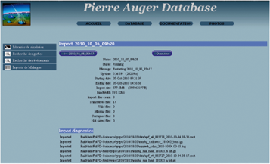
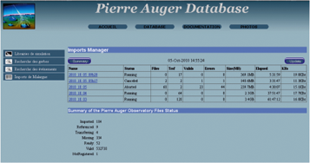
Web Pages for the Data Transfers
Features
  List of the most recent imports
  Status of the imports
  Status of the data files
  Details of each imports
Implementation
  Dynamic web pages build
  from database queryies
  AugerDb core
  Java, JSP, Struts

Slide 8
Calibrations
Calibration transferred by IDE Hard Disk every 2 months
  Too large for the network
    Limitation to 50 KB/s of the link in the Pampa (or less)
    Experimental limit : 3.5 GB / day
  Send to the LAL by UPS
  Copied to Lyon by the network
  Copied to SRB, checked, registered in Oracle by Import Manager
Data size
  9.3 TB of data since 2001
  8 TB since 2006 (full activity of the observatory)
    1.2 TB of reconstructed data
  Average :
    Reconstructed data: 850 MB/day
    Raw data + Calibration: 4.8 GB/day
  Fluctuations related to the fluorescence activity (Moon periods)

Slide 9
Simulations
2 simulation activities
  Simulation of the atmospheric showers
    2 Fortran programs: Aires and Corsika
  Simulation of the answer of detector to a simulated showers
    Auger analysis framework: C++ & Root
Initially performed at Lyon
  Still used by user productions
Official libraries simulated on the Grid since 2008
  100 000 simulated showers
      50 000 user shower simulations
      50 000 Corsika Grid showers (official libraries)
    Large files - Total of 20 TB (~ 250 MB/file)
      Mainly Iron and Proton primaries
      Ranges of energy and angles
  150 000 simulated events [3 events / shower] (only for the official libraries)
    Small files - Total of 0.85 TB (~ 2 x 3 MB / files [simulation + reconstruction])
    Support for the Hybrid events since 2009

Slide 10
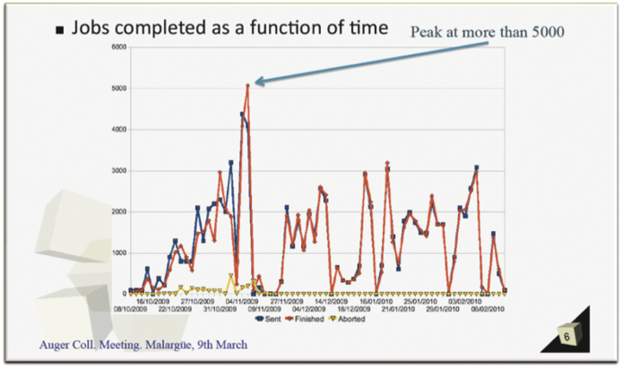
Grid Activity
Julio LOZANO BAHILO
  Granada
  (Malargue, March 2010)

Slide 11
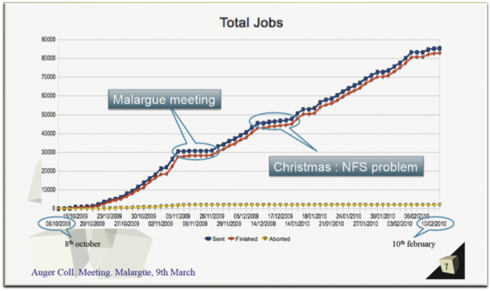
Grid Activity
Julio LOZANO BAHILO
  Granada
  (Malargue, March 2010)

Slide 12
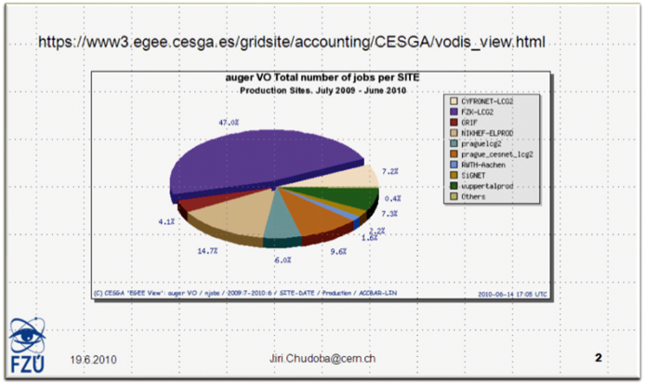
Distribution of the Grid Jobs
Jiri CHUDOBA
  Prague
  (Leche, June 2010)
Main Contributor
(Karlsruhe)

Slide 13
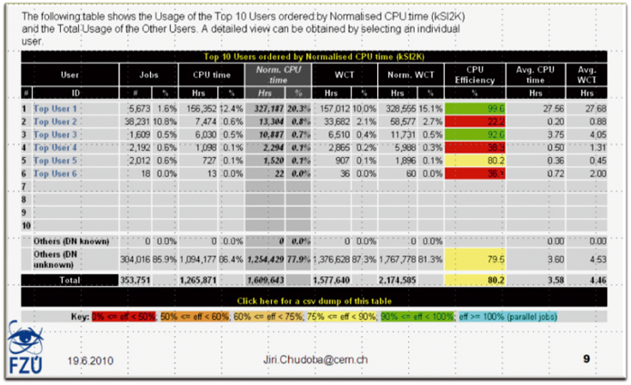
Production Efficiency
Jiri CHUDOBA
  Prague
  (Leche, June 2010)
Poor Efficiency of the Simulation Jobs
Too many IO {?}

Slide 14
Simulation Issues
Production issues
  Difficulties in the deployment of the analysis environment
  Data management (lost files, ownership [DN changes])
  Manpower needed to follow the productions
  and perform quality checking
Usage issues
  Difficulties in accessing the files
    Need of a Grid certificate
    Access to a UI (User Interface: a station with the Grid environment)
    Complexity of the commands to check and get the files
Work around
  Mirror the Grid files to SRB

Slide 15
SRB Simulation Mirror
Copy of the simulation files to SRB at Lyon
  Performed by batches running at Lyon
  Allow to regulate the transfer flow using BQS resources
  Indexation of the simulations (Showers and Events) in the database
  Easy network wide access using SRB clients
Duplication of the Simulated Events files to the GPFS disk
  Immediate access for the CC users performing analysises

Slide 16
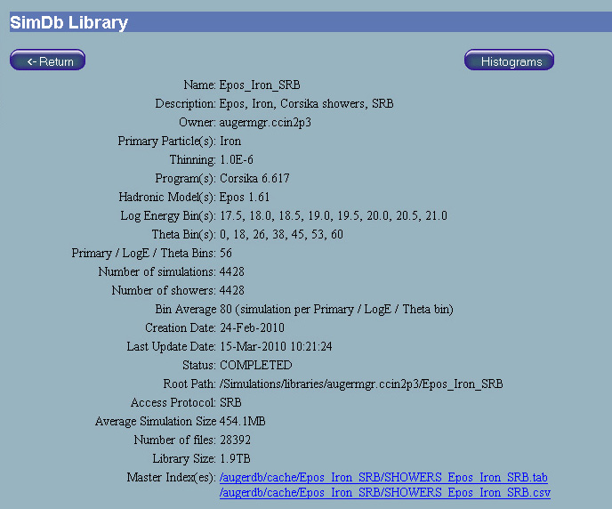
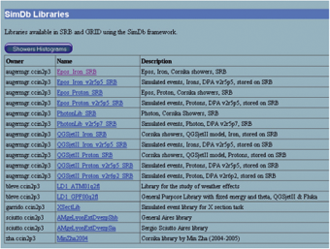
Simulation Library Pages
List of the Libraries
  Details of the simulation libraries
    Number of simulations
    Program and Model
    Date
    Location
  Loaded from the database
  Updated every 2 hours
Implementation
  AugerDb core
  Java, JSP, Struts

Slide 17
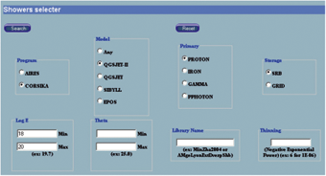
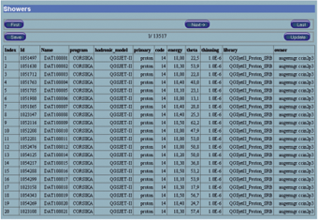
Simulation Search Pages
Searches by simulation parameters from the database
  Simulation Program
  High Energy Model
  Energy
  Primary
  Angles
Support for shower simulations and simulated events
Selection between Grid Simulations or SRB Mirrors

Slide 18
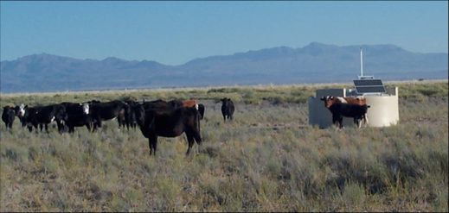
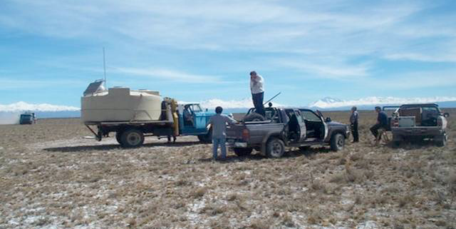
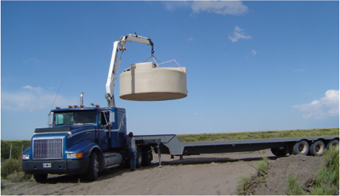
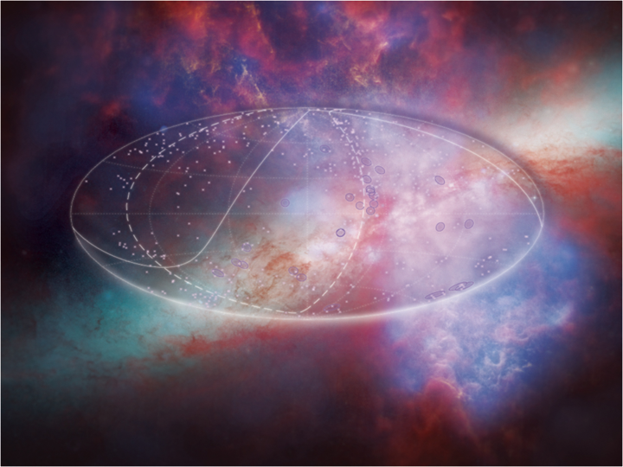
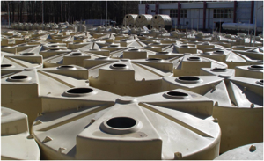
Aspera - 7 Oct 2010, Lyon

