Slide 1
Superconducting Array for Low-Energy Radiation (SALER)
Driss GUILLET
for the SALER collaboration
LPC Caen

Slide 2
I. Introduction and Motivations

Slide 3
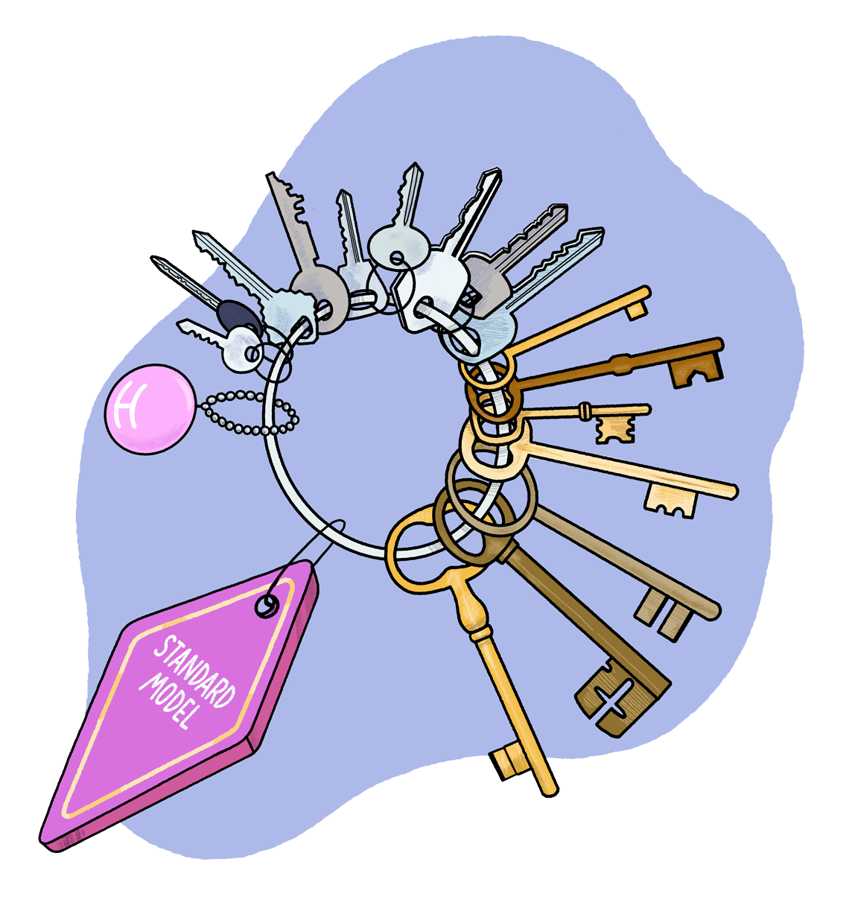
Beta decay to probe BSM physics
Standard Model provides the most robust predictions to date
Artwork by Sandbox Studio

Slide 4
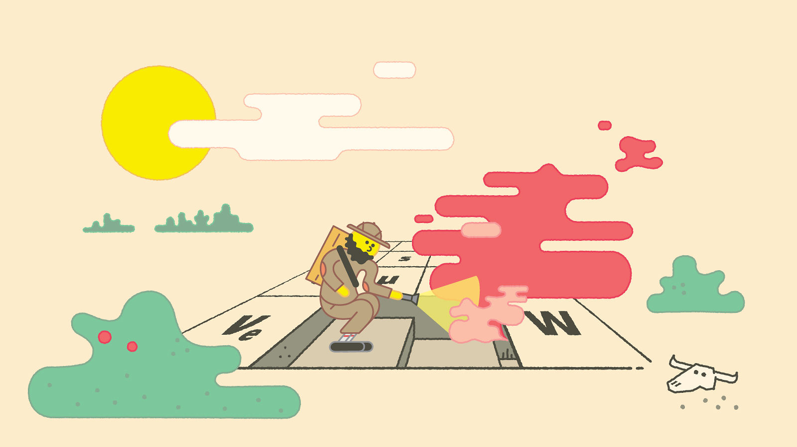
Beta decay to probe BSM physics
Standard Model provides the most robust predictions to date
Weak interactions studies are especially interesting for BSM searches
Artwork by Sandbox Studio

Slide 5
Beta decay to probe BSM physics
Standard Model provides the most robust predictions to date
Weak interactions studies are especially interesting for BSM searches
Beta decay is competitive, with several probes for high precision measurements
Artwork by Sandbox Studio

Slide 6
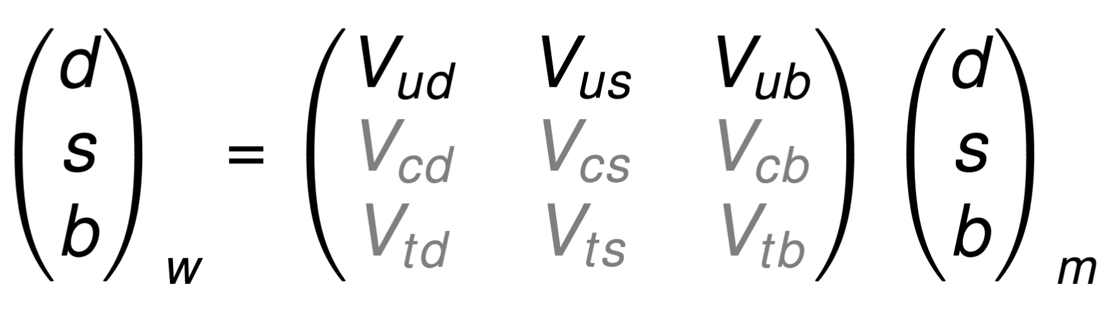
Probing CKM matrix unitarity
Study beta decay spectra to test CKM matrix unitarity

Slide 7
Probing CKM matrix unitarity
Study beta decay spectra to test CKM matrix unitarity
$$\left|Vud\right|2+\left|Vus\right|2+\left|Vub\right|2=1$$

Slide 8


Probing CKM matrix unitarity
Study beta decay spectra to test CKM matrix unitarity
Largest element in the row : V_{ud}
$$\left|Vud\right|2+\left|Vus\right|2+\left|Vub\right|2=1$$
$$\sim 0.973$$
$$\sim {10}^{−5}$$

Slide 9
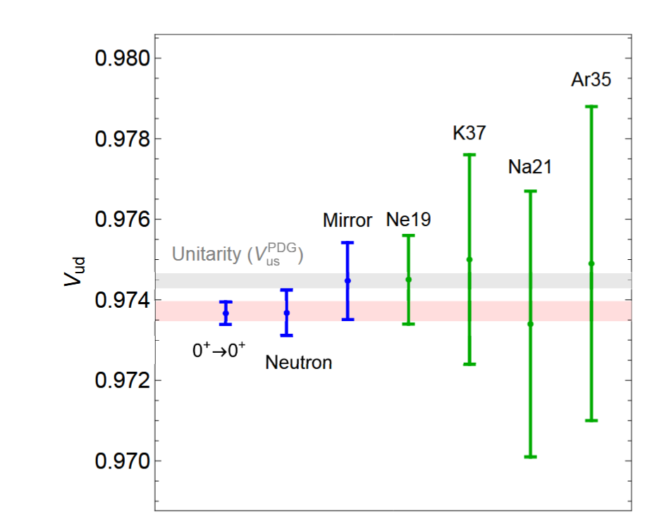
Probing CKM matrix unitarity
Study beta decay spectra to test CKM matrix unitarity
Largest element in the row : V_{ud}
1σ deviation from unitarity
Adam Falkowski, Martín González-Alonso and Oscar Naviliat-Cuncicc, 2021

Slide 10
Why recoil spectroscopy ?
How to access V_{ud} using beta decay ?

Slide 11
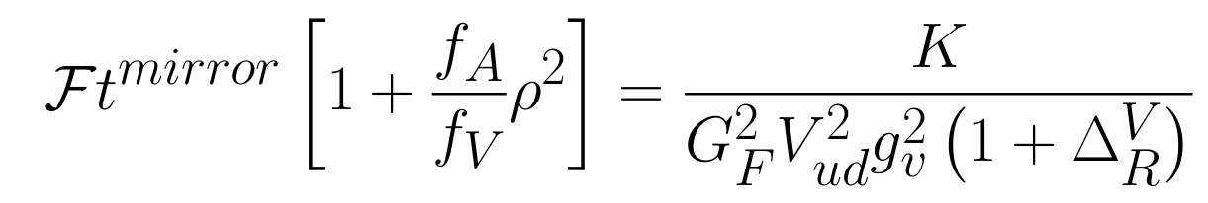
Why recoil spectroscopy ?
How to access V_{ud} using beta decay ?
Obtain V_{ud} through the mixing ratio for mirror decays

Slide 12
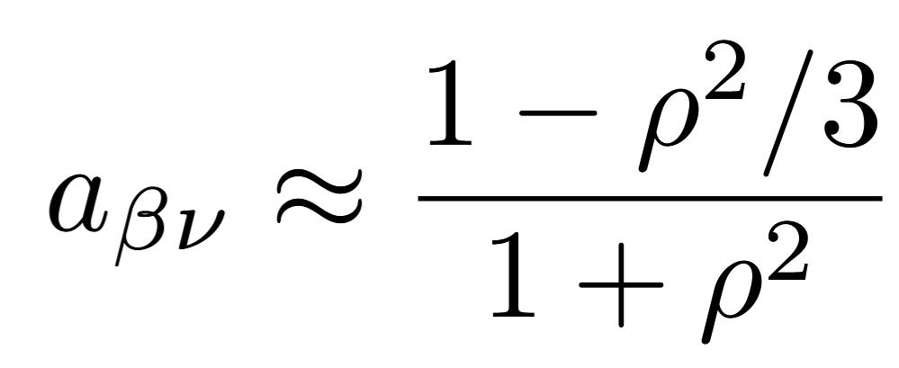
Why recoil spectroscopy ?
How to access V_{ud} using beta decay ?
Obtain V_{ud} through the mixing ratio for mirror decays
Then use mixing ratio to get α the angular correlation parameter

Slide 13
Why recoil spectroscopy ?
How to access V_{ud} using beta decay ?
Obtain V_{ud} through the mixing ratio for mirror decays
Then use mixing ratio to get α the angular correlation parameter
Recoil spectrum sensitive to α → recoil spectroscopy
α>0
ϐ
^{A}X
𝑣
ϐ
α<0
^{A}X
𝑣

Slide 14

Why recoil spectroscopy ?
How to access V_{ud} using beta decay ?
Obtain V_{ud} through the mixing ratio for mirror decays
Then use mixing ratio to get α the angular correlation parameter
Recoil spectrum sensitive to α → recoil spectroscopy
α>0
ϐ
^{A}X
𝑣
ϐ
α<0
^{A}X
eV-scale spectrum
$$\sim 100 eV$$
𝑣

Slide 15
II. Superconducting Tunnel Junctions

Slide 16

Superconducting Tunnel Junctions (STJ)
Josephson Junction with multi layers
$$\sim 500 nm$$

Slide 17
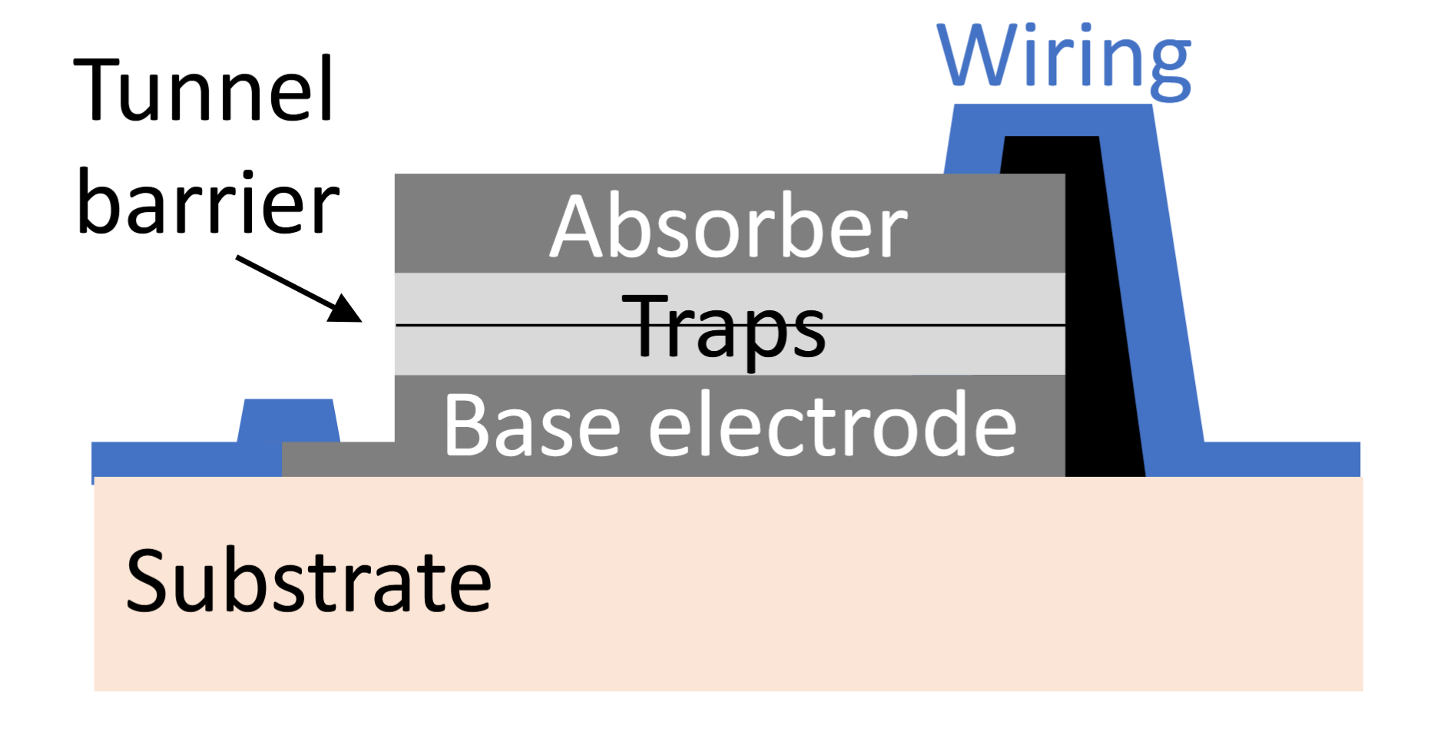
Superconducting Tunnel Junctions (STJ)
Josephson Junction with multi layers
$$\sim 500 nm$$

Slide 18

Superconducting Tunnel Junctions (STJ)
Josephson Junction with multi layers
$$\sim 500 nm$$

Slide 19
Superconducting Tunnel Junctions (STJ)
Josephson Junction with multi layers
$$\sim 500 nm$$

Slide 20
Superconducting Tunnel Junctions (STJ)
Josephson Junction with multi layers
Current in the biased barrier → recompose the momentum
$$\sim 500 nm$$

Slide 21
Superconducting Tunnel Junctions (STJ)
Josephson Junction with multi layers
Current in the biased barrier → recompose the momentum
eV scale resolution
> 10³ counts/s per pixel
Low threshold
$$\sim 500 nm$$

Slide 22
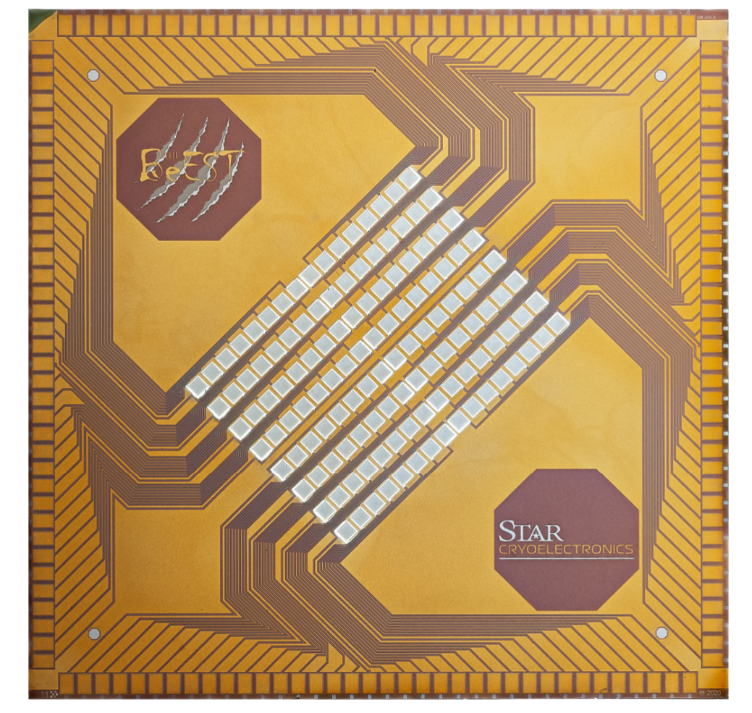
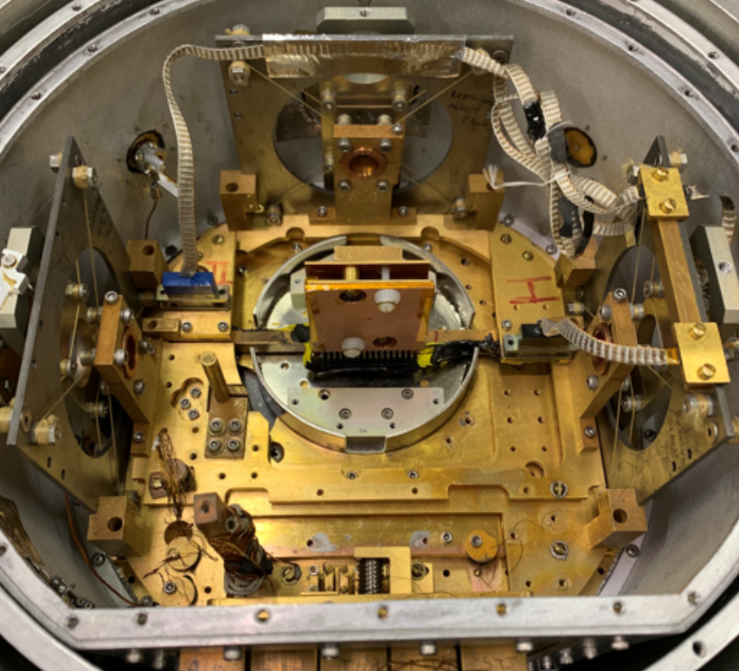
Superconducting Tunnel Junctions
Josephson Junction with multi layers
Current in the biased barrier → recompose the momentum
eV scale resolution
> 10³ counts/s per pixel
Low threshold
128-pixel STJ
Cooled to 40 mK (ADR)

Slide 23
BeEST experiment
BeEST experiment used 7Be (T_{1/2}= 53 days) to search for keV-scale sterile neutrinos, with competitive results

Slide 24
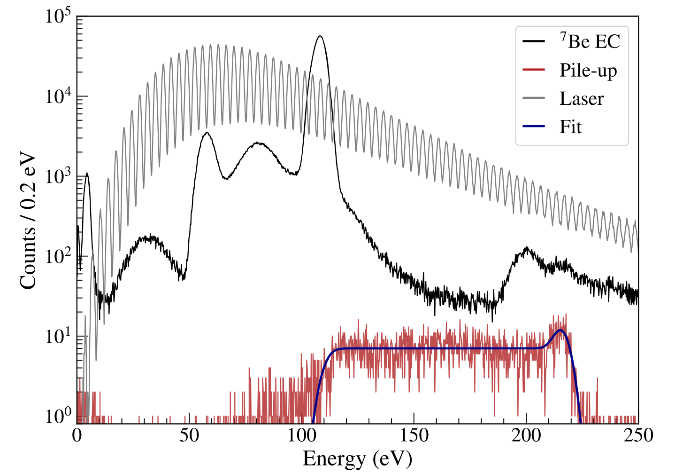
BeEST experiment
BeEST experiment used 7Be (T_{1/2}= 53 days) to search for keV-scale sterile neutrinos, with competitive results

Slide 25
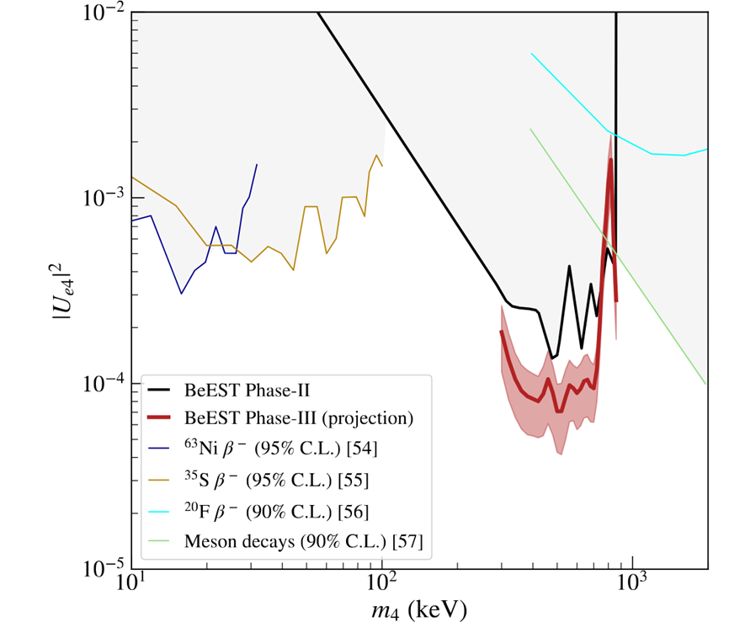
BeEST experiment
BeEST experiment used 7Be (T_{1/2}= 53 days) to search for keV-scale sterile neutrinos, with competitive results

Slide 26
BeEST experiment
BeEST experiment used 7Be (T_{1/2}= 53 days) to search for keV-scale sterile neutrinos, with competitive results

Slide 27
How to use short-lived nuclei ?
Use STJs with short lived nuclei for nuclear recoil spectroscopy

Slide 28
How to use short-lived nuclei ?
Use STJs with short lived nuclei for nuclear recoil spectroscopy
Couple STJs detectors to a beamline (on-line)

Slide 29
How to use short-lived nuclei ?
Use STJs with short lived nuclei for nuclear recoil spectroscopy
Couple STJs detectors to a beamline (on-line)
Aim of the SALER experiment based at FRIB

Slide 30
How to use short-lived nuclei ?
Use STJs with short lived nuclei for nuclear recoil spectroscopy
Couple STJs detectors to a beamline (on-line)
Aim of the SALER experiment based at FRIB
With mirror decays for ρ : ¹¹C and ¹⁹Ne

Slide 31
III. SALER Set up

Slide 32
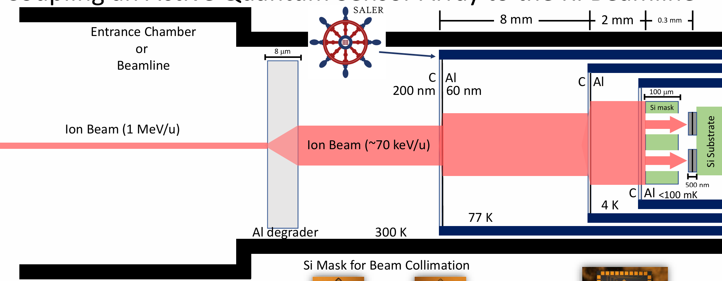
SALER Experiment

Slide 33
SALER Experiment
Stable beam commissionning in April/May !

Slide 34
SALER Experiment
Dress rehearsal /testing calibration procedure last week !

Slide 35
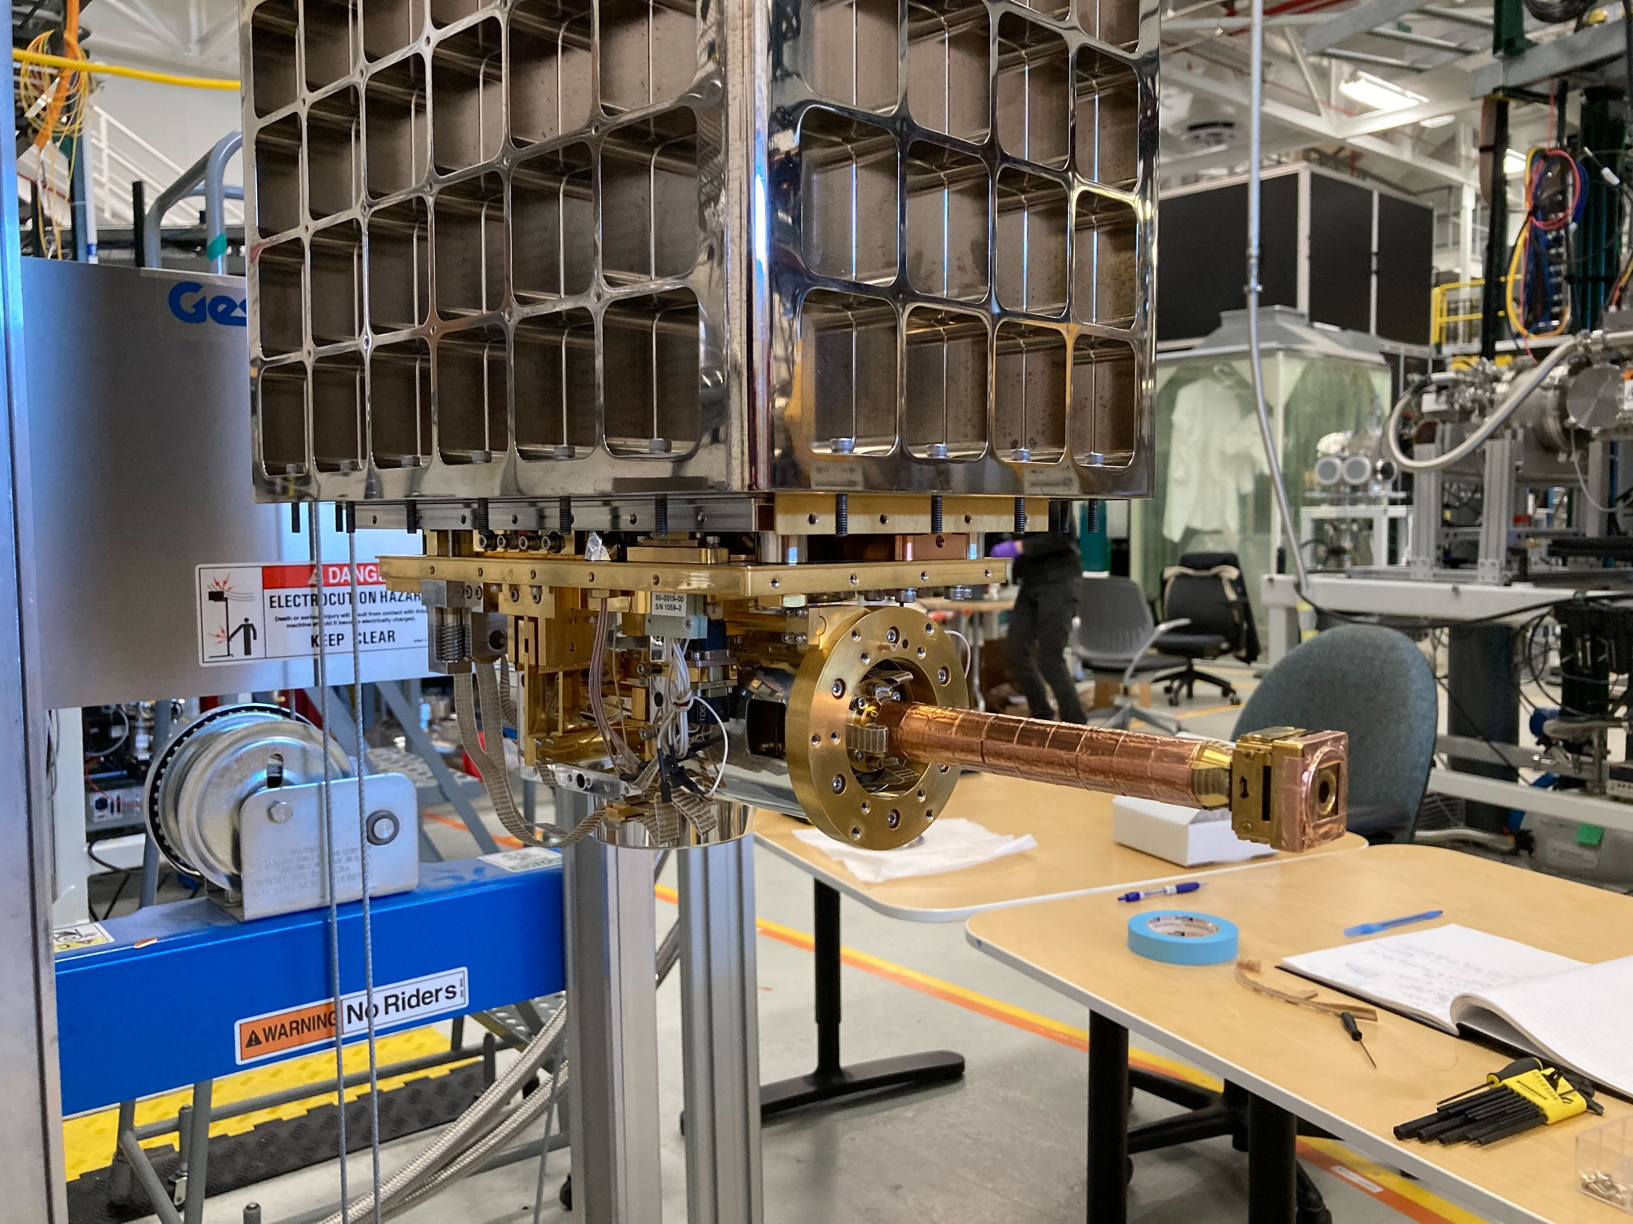
Unshielded device

Slide 36
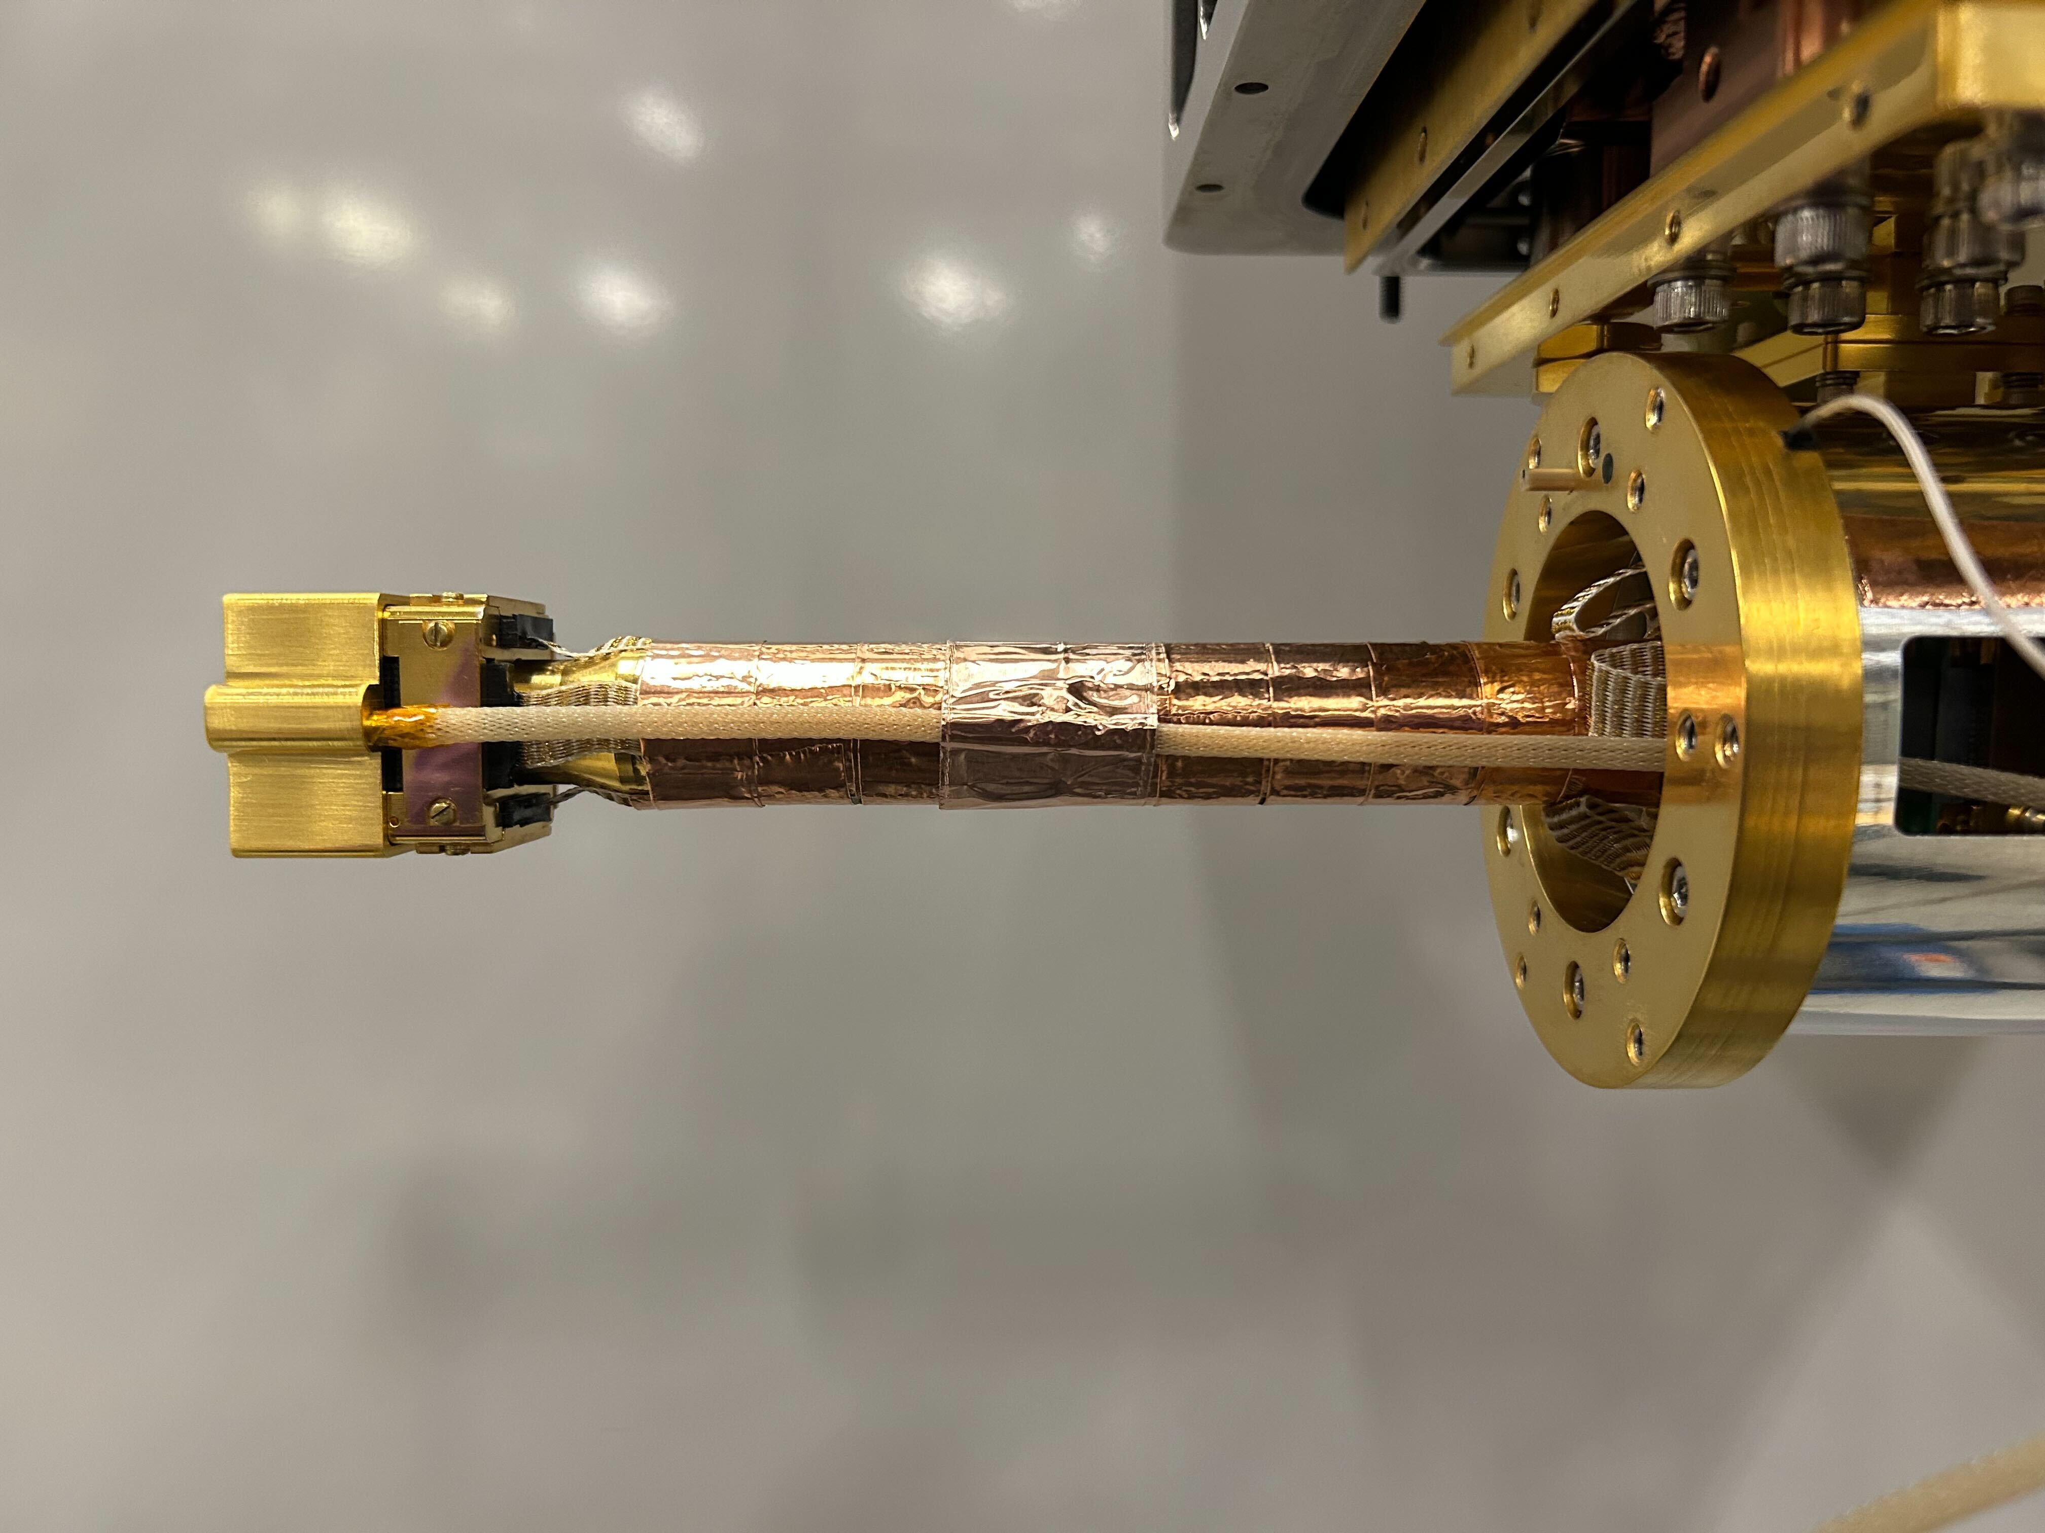
Unshielded device

Slide 37
Unshielded device
STJ
Laser fiber

Slide 38
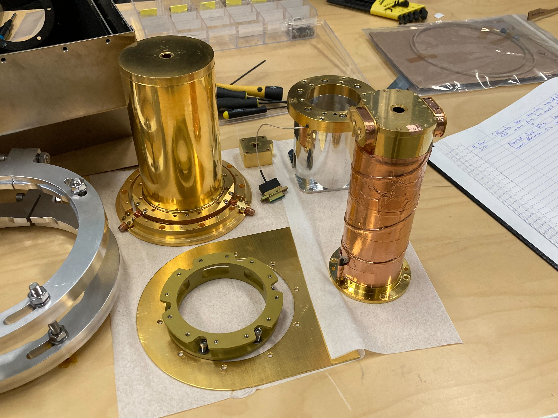
Shielding

Slide 39
Shielding
50K
4K
4K

Slide 40
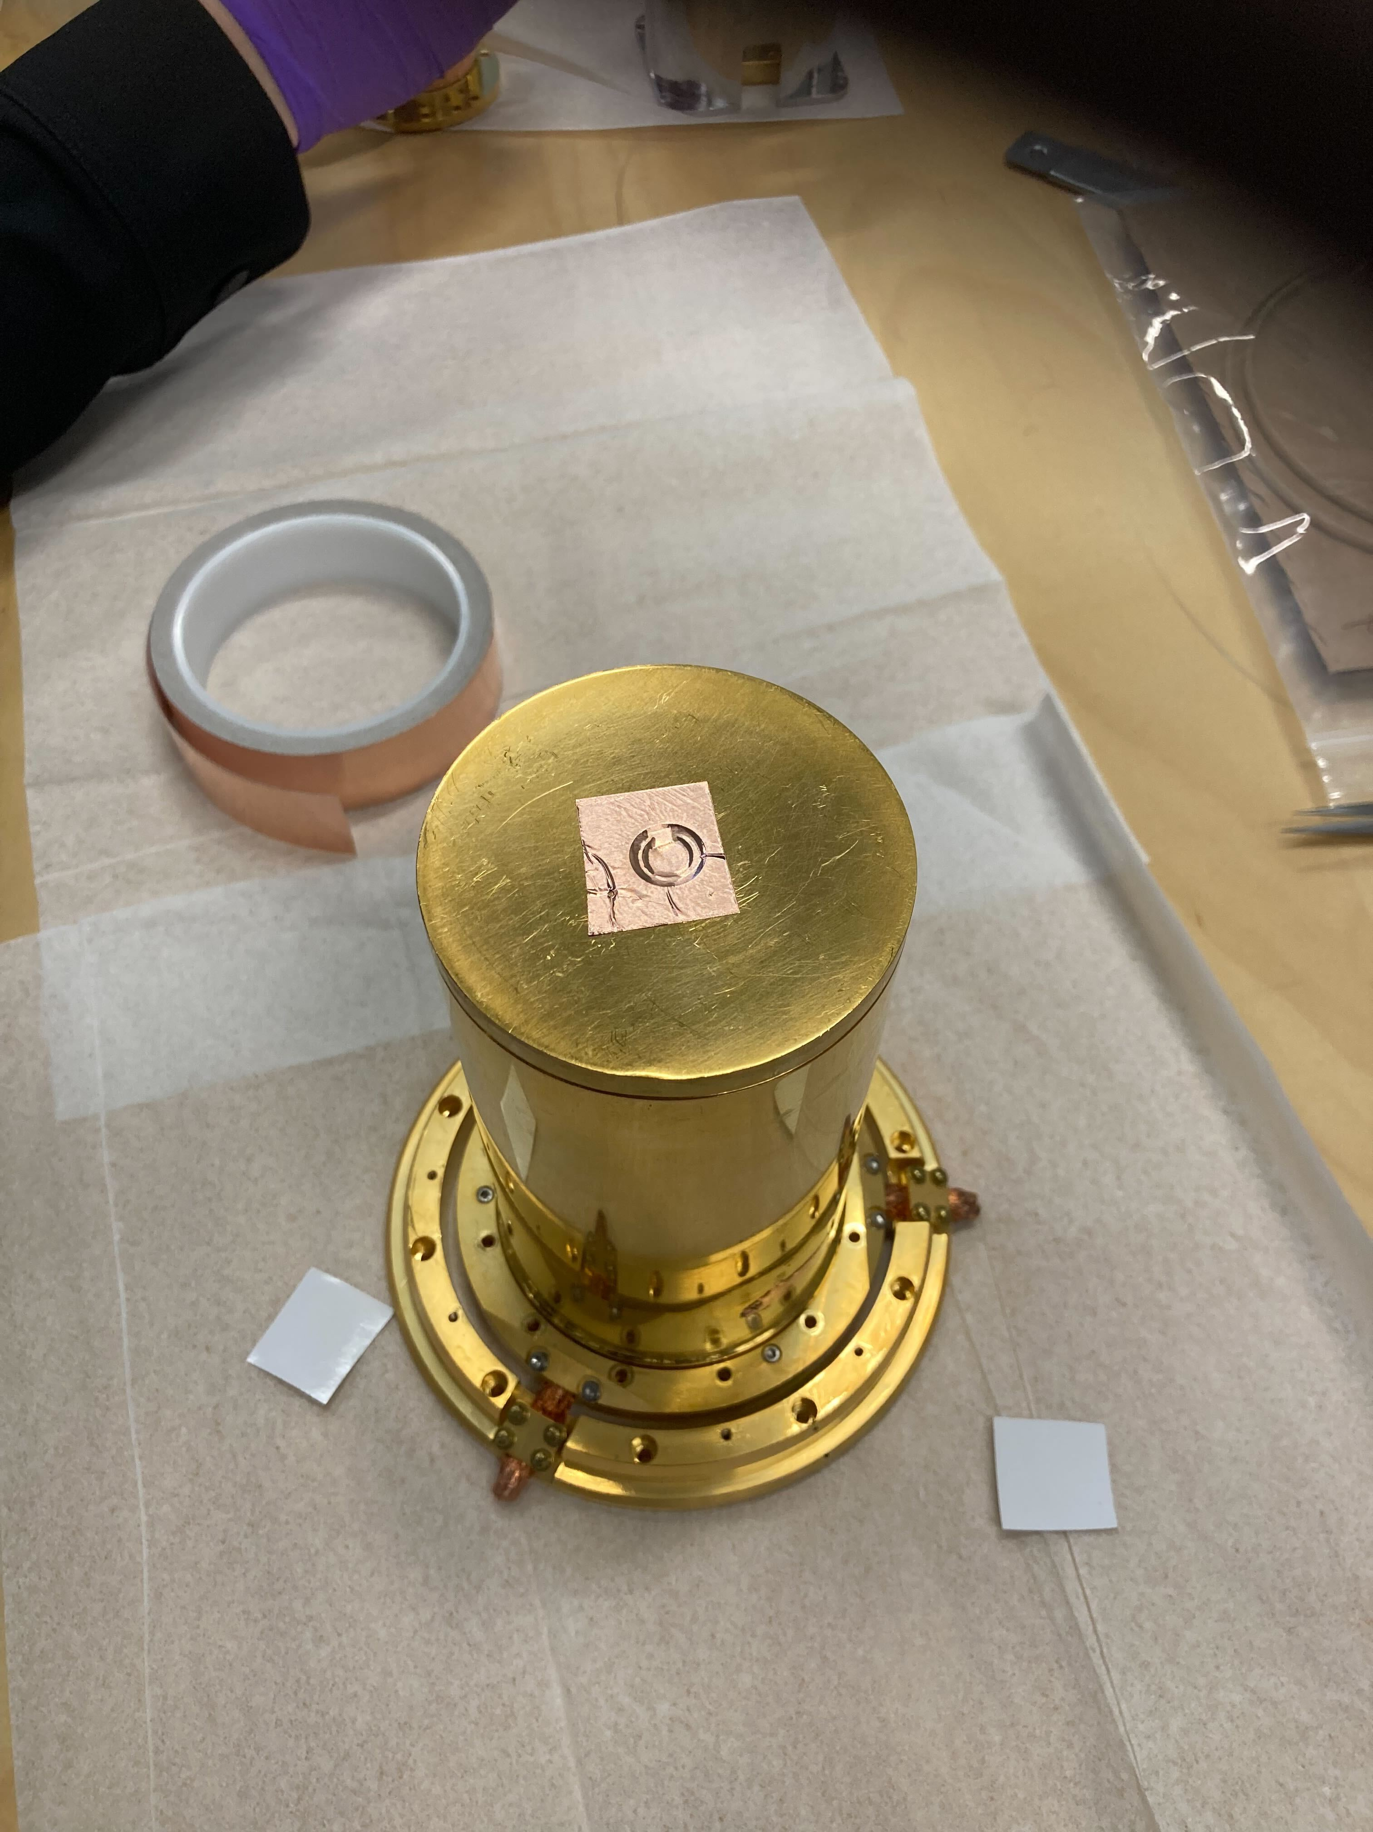
Shielding
50K
4K
4K

Slide 41
Shielding
Window IR
50K
4K
4K

Slide 42
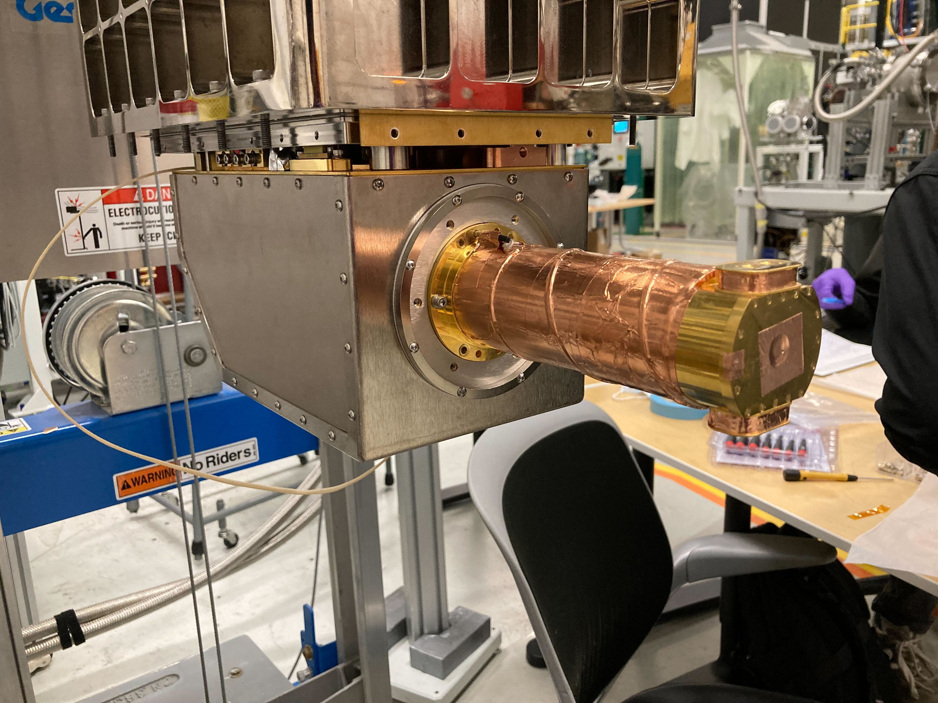
Assembling
With the 4K shield

Slide 43
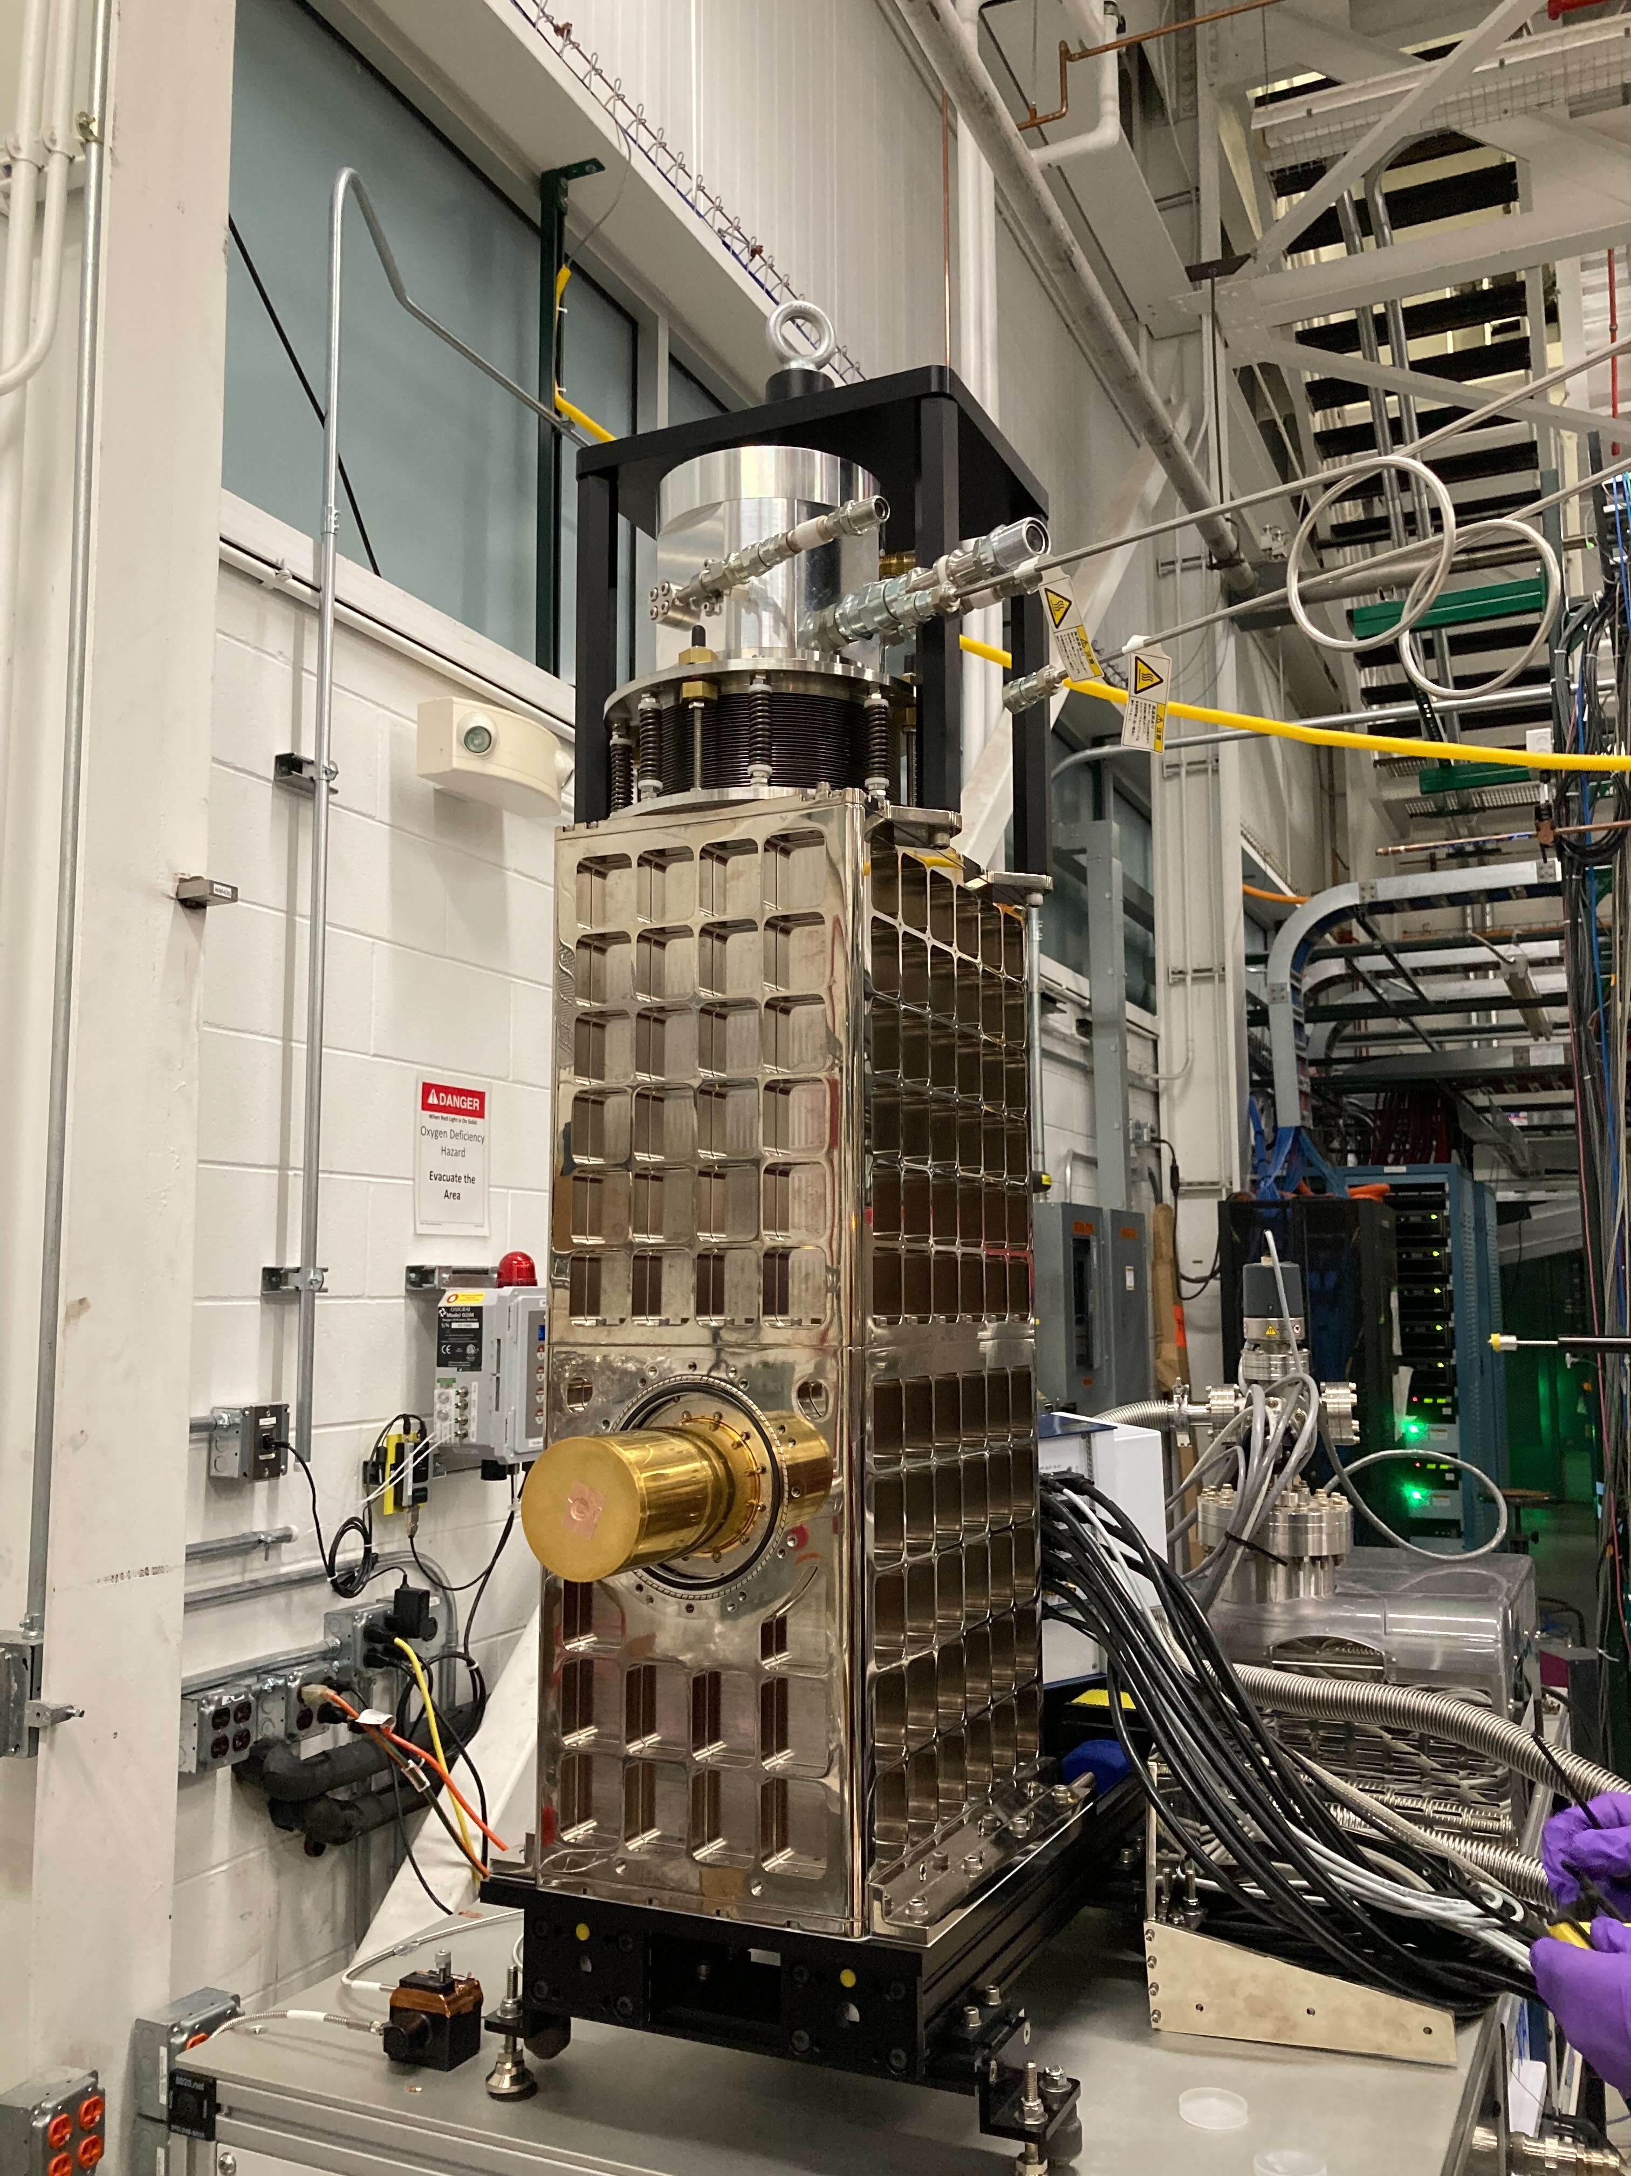
Assembling
With the 4K shield
With the 50K shield

Slide 44
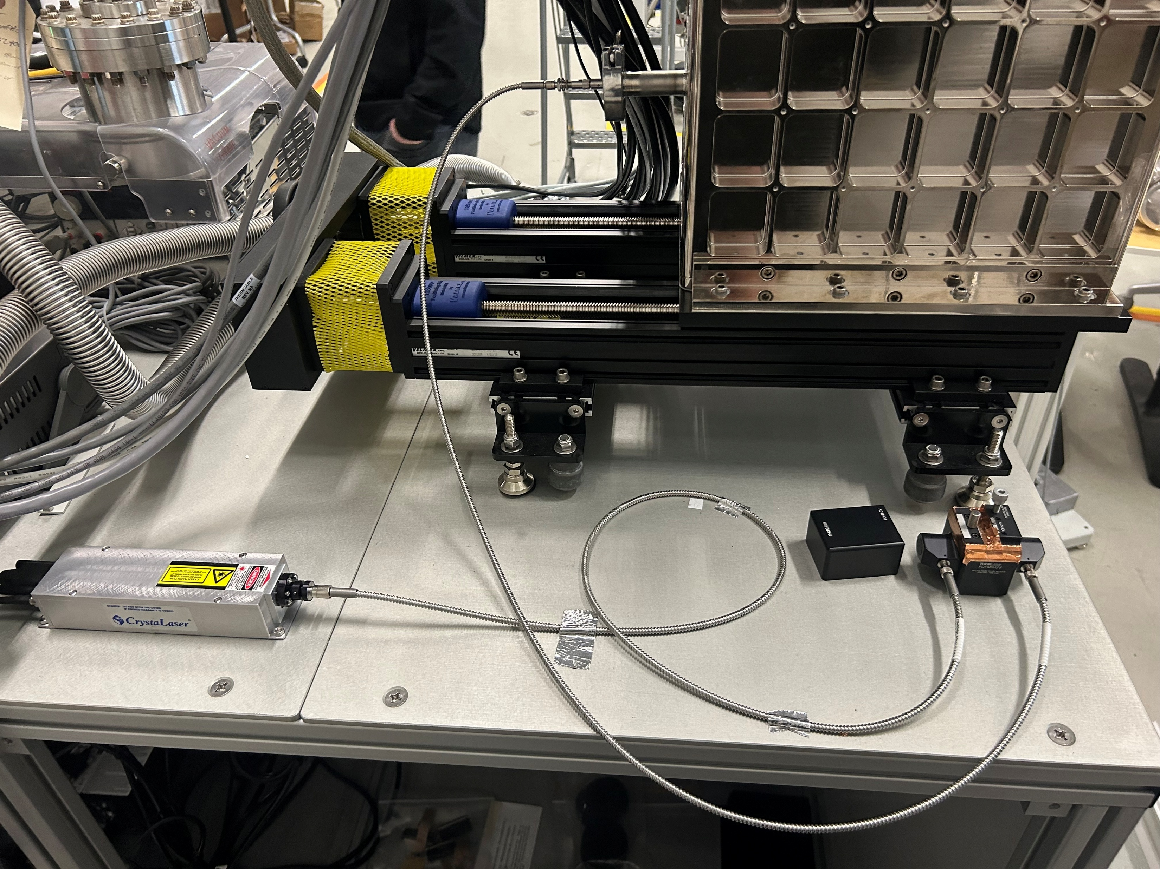
Laser calibration
262 nm laser – 4.7 eV

Slide 45
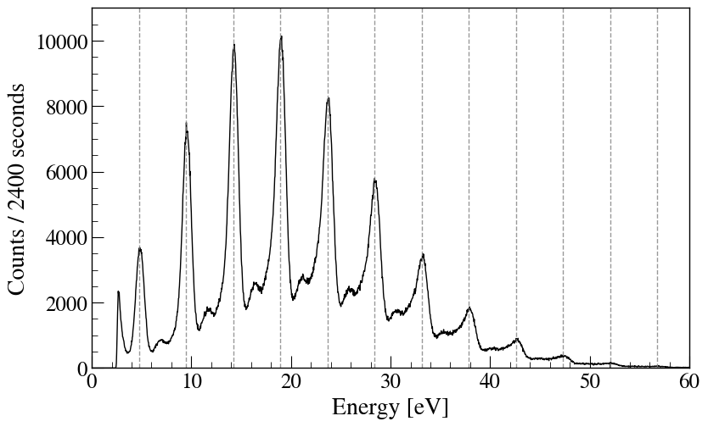
Laser calibration
262 nm laser – 4.7 eV
Spectrum for one pixel

Slide 46
Laser calibration
262 nm laser – 4.7 eV
Spectrum for one pixel
1 photon

Slide 47
Laser calibration
262 nm laser – 4.7 eV
Spectrum for one pixel
2 photons
1 photon

Slide 48
Laser calibration
262 nm laser – 4.7 eV
Spectrum for one pixel
2 photons
1 photon
Best one : 1.25 eV FWHM !

Slide 49
Conclusion and outlook
STJs able to perform at 1 - 4 eV resolution in the range of interest

Slide 50
Conclusion and outlook
STJs able to perform at 1 - 4 eV resolution in the range of interest
Stable beam in May, radioactive beam in late 2026

Slide 51
Conclusion and outlook
STJs able to perform at 1 - 4 eV resolution in the range of interest
Stable beam in May, radioactive beam in late 2026
Study electron scattering background for uncertainty budget

Slide 52
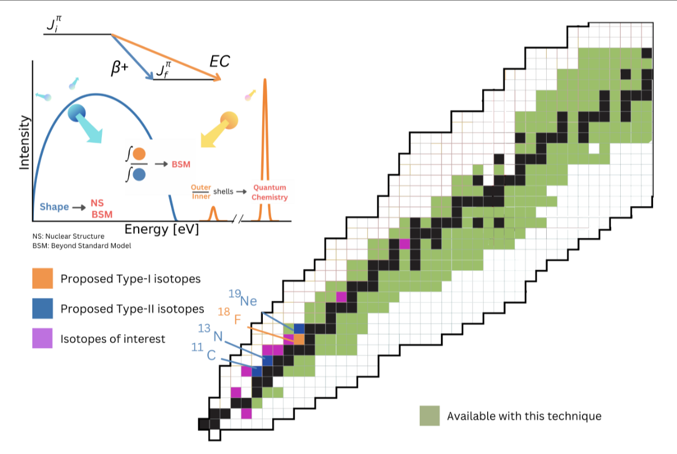
Conclusion and outlook
STJs able to perform at 1 - 4 eV resolution in the range of interest
Stable beam in May, radioactive beam in late 2026
Study electron scattering background for uncertainty budget
Pave the way for ASGARD (at DESIR)

Slide 53


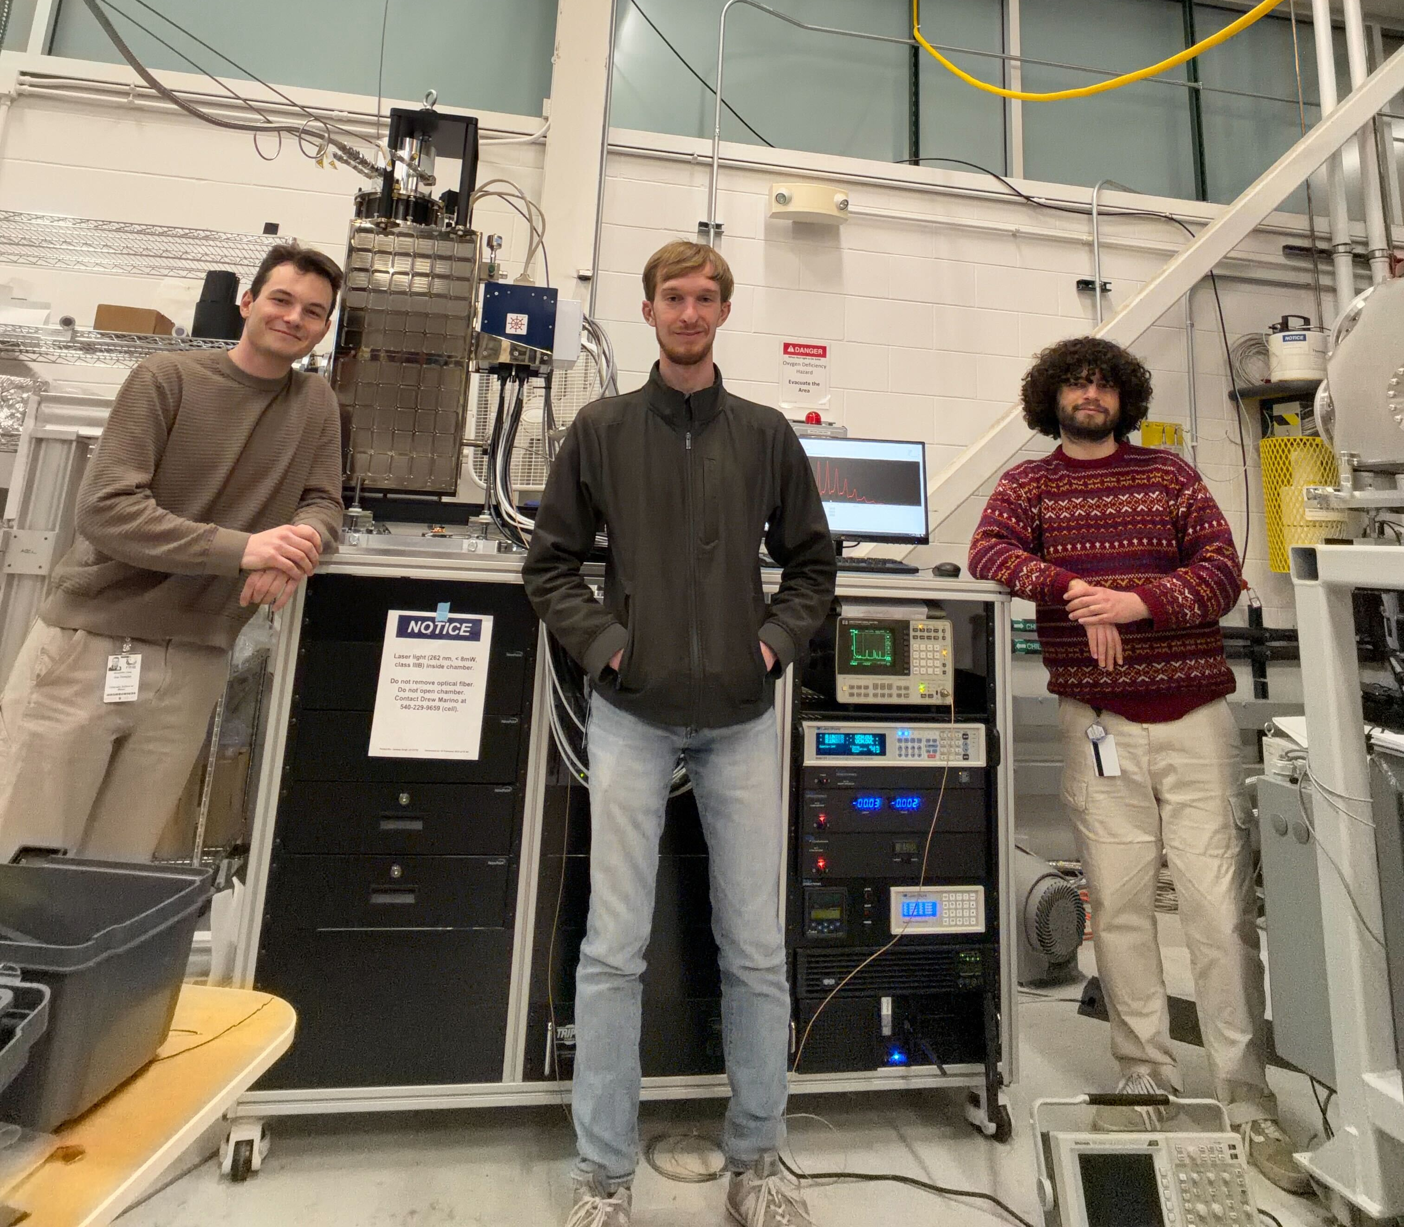



Collaboration

Slide 54
Thanks for listening !

Slide 55
Back-up

Slide 56
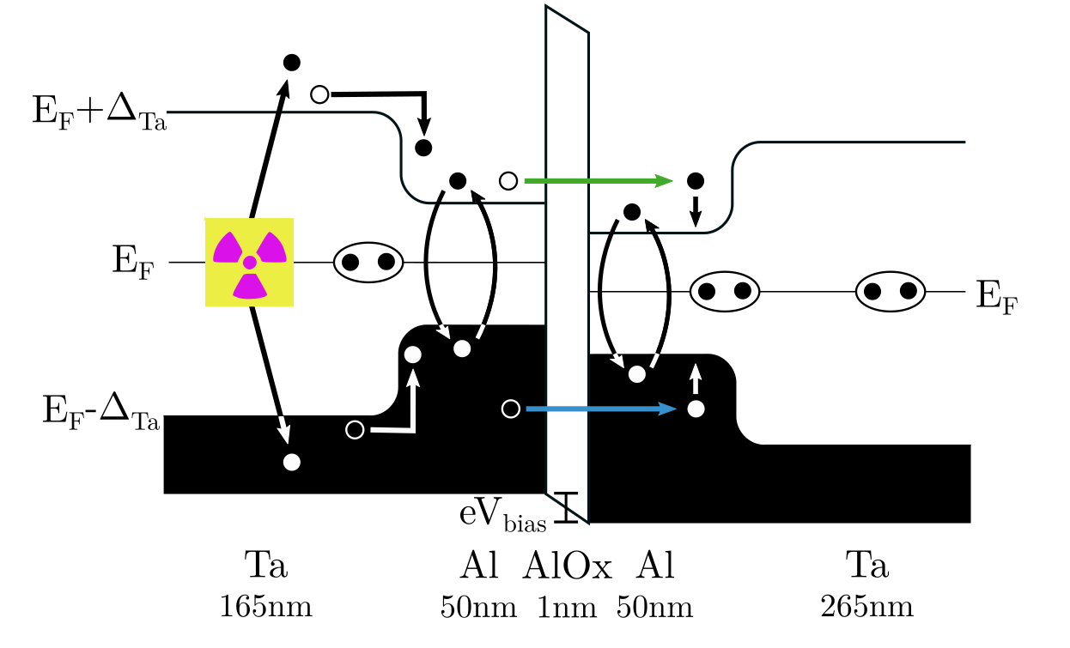
Superconducting Tunnel Junctions
Five layers detector : absorber, trapping layer, biased insulator, trapping layer and final layer
Onset of superconductivity : formation of Cooper pairs

Slide 57
Superconducting Tunnel Junctions
Five layers detector : absorber, trapping layer, biased insulator, trapping layer and final layer
Onset of superconductivity : formation of Cooper pairs
Recoil breaks Cooper pairs and create a quasiparticle in the absorber
Quasiparticles scatter down into the trapping layers, breaking other pairs in the process

Slide 58
Superconducting Tunnel Junctions
Five layers detector : absorber, trapping layer, biased insulator, trapping layer and final layer
Onset of superconductivity : formation of Cooper pairs
Recoil breaks Cooper pairs and create a quasiparticle in the absorber
Quasiparticles scatter down into the trapping layers, breaking other pairs in the process
Measuring the tunneling current to recompose the momentum of the nucleus

Slide 59
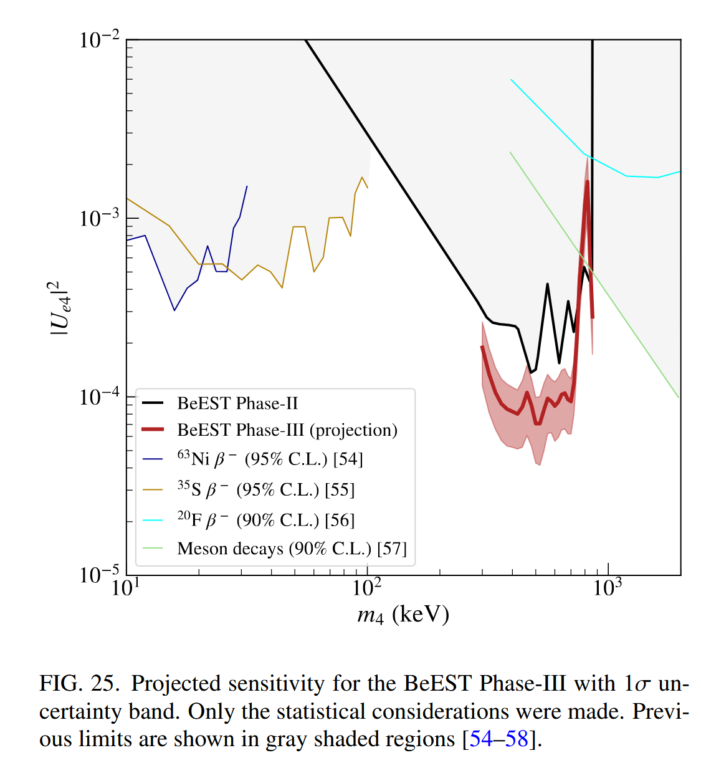
About BeEST results

Slide 60
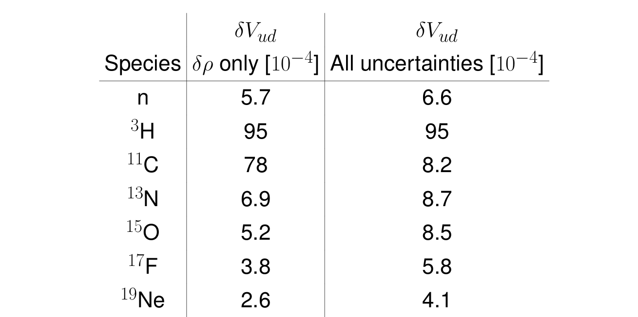
Stastical Uncertainties (from Andrew Marino’s poster)

Slide 61
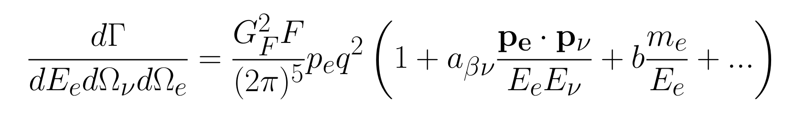
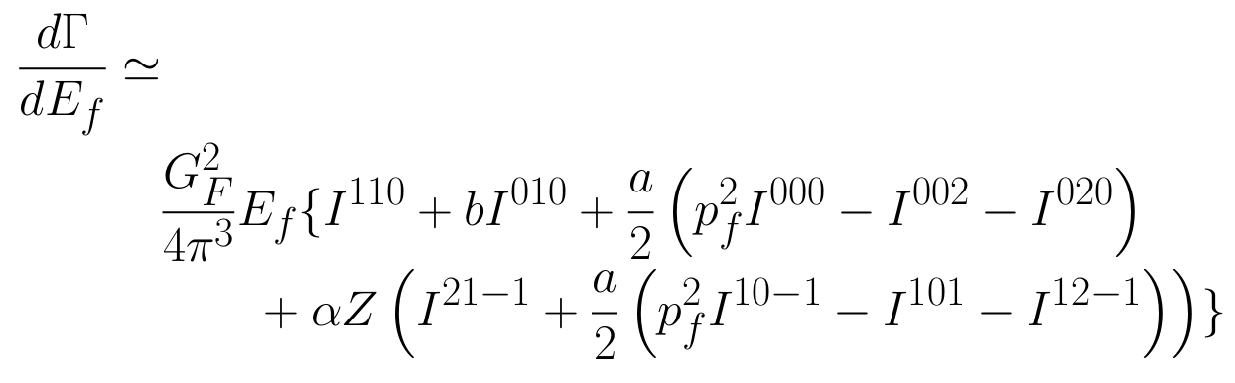
Beta decay spectrum
Integrate the angles

Slide 62
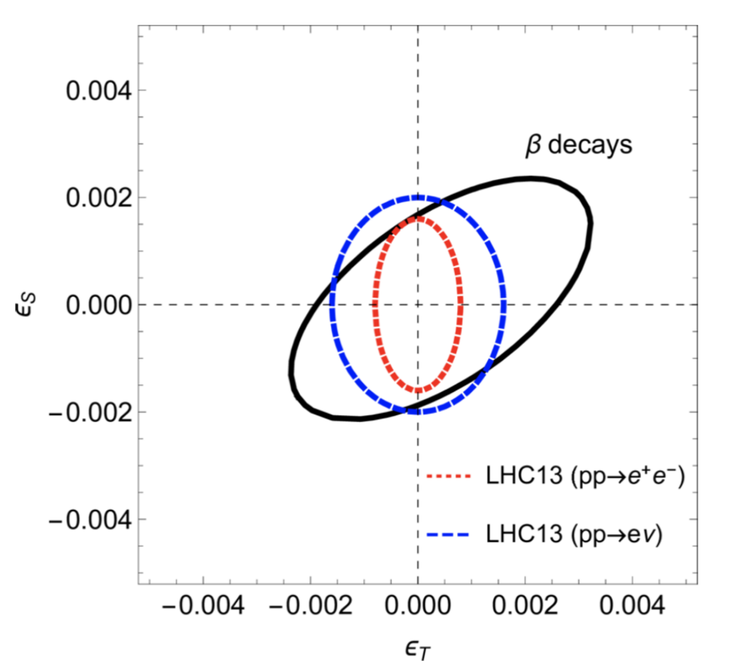
Beta decay to probe BSM physics
High precision measurements at low-energies → explore TeV-scale physics
In the search of exotic currents for the Standard Model, beta decay is competitive with LHC

Slide 63
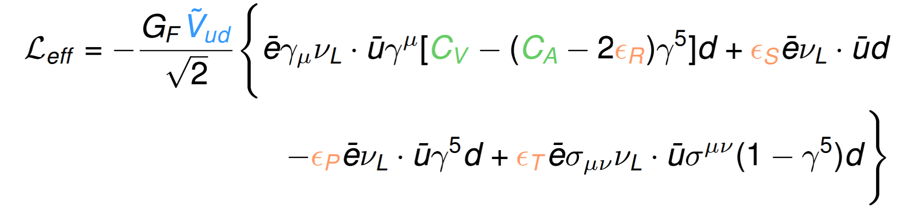
Extension of SM Lagrangian (V.Dumenil)
ϵ_{i} correspond to Right, Scalar, Pseudo-scalar
and Tensor contribution respectively

Slide 64
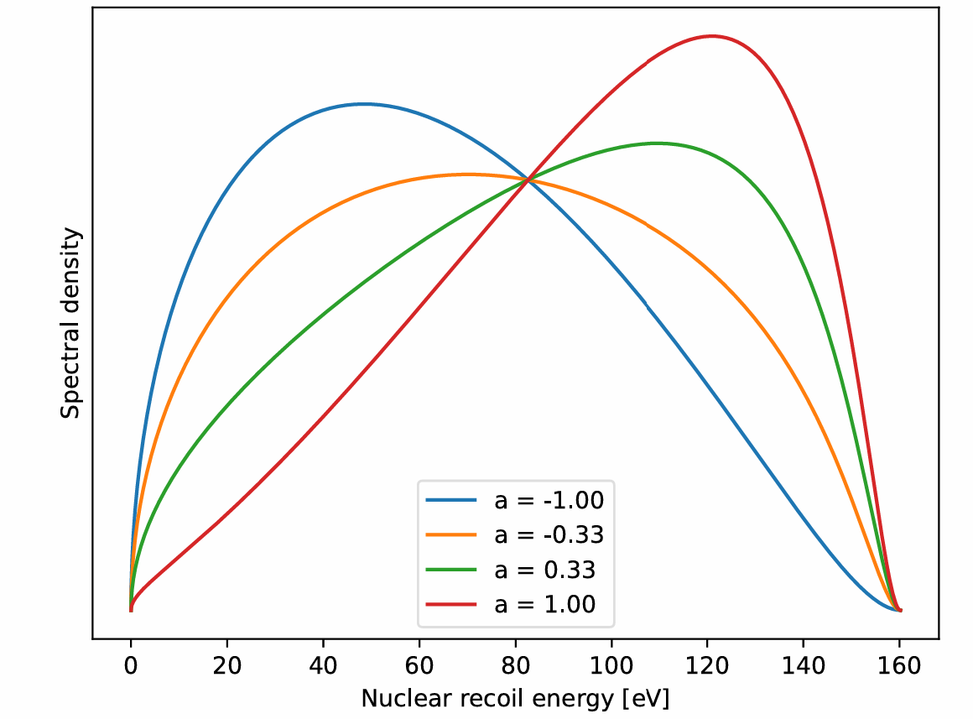
Effects on the recoil spectrum

Slide 65
ASGARD

Slide 66
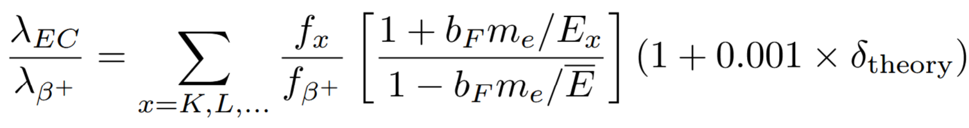
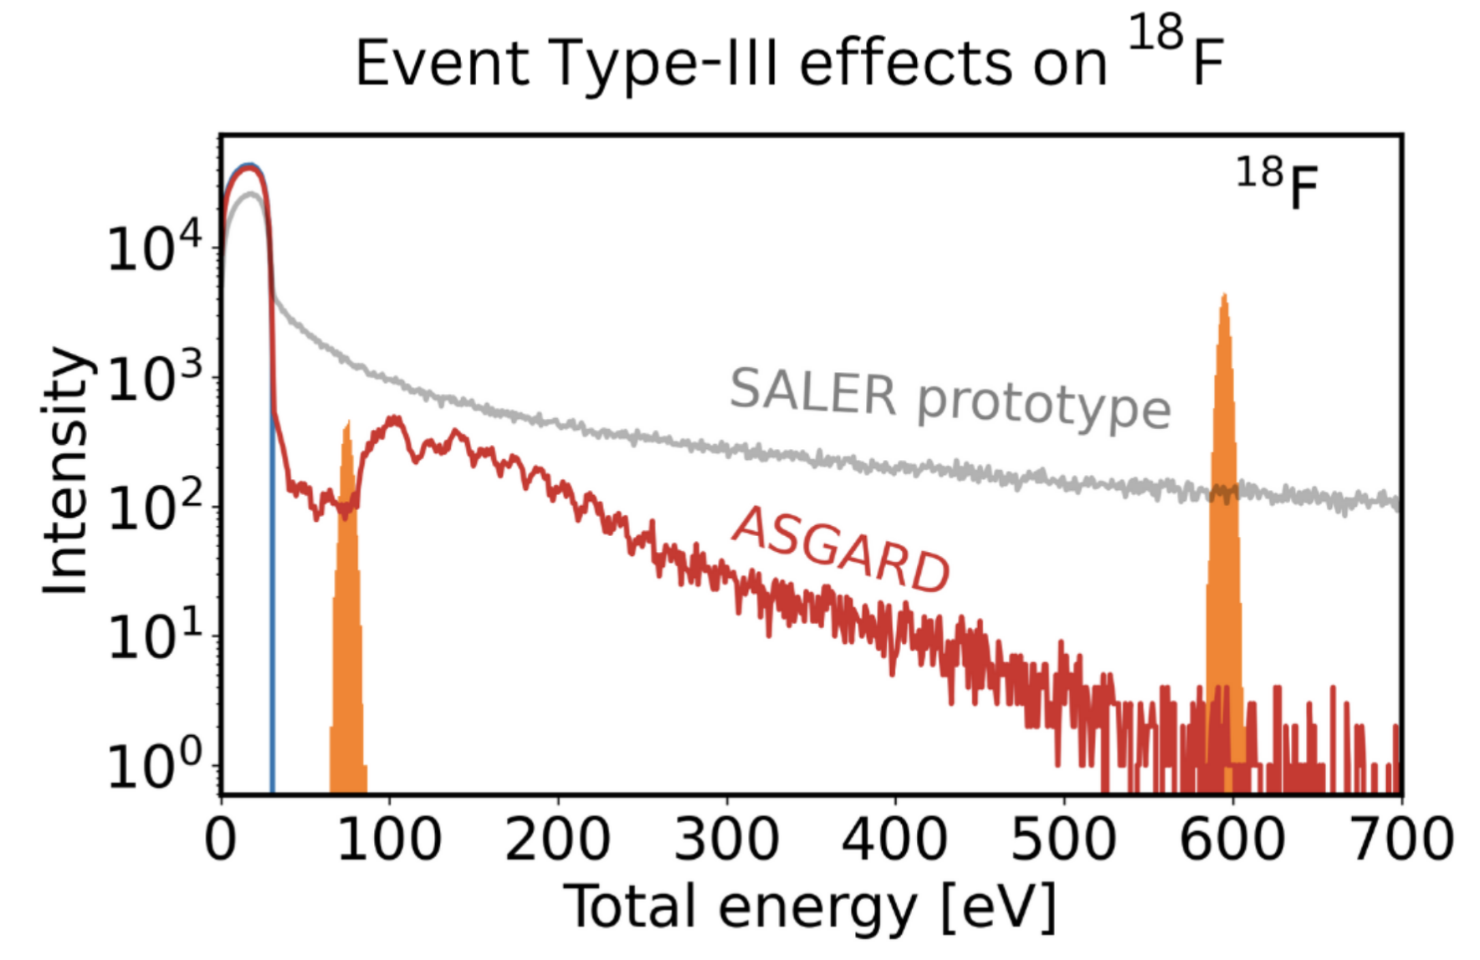
What about fierz interference term ?

Slide 67
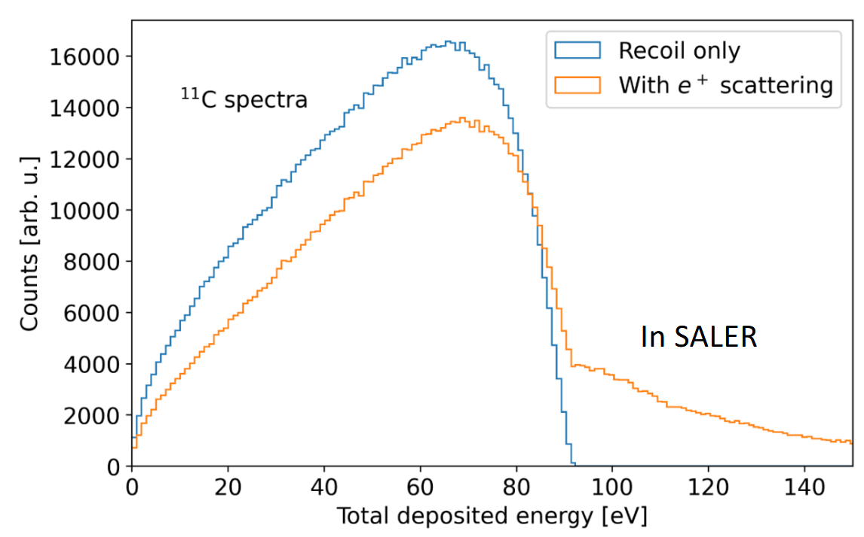
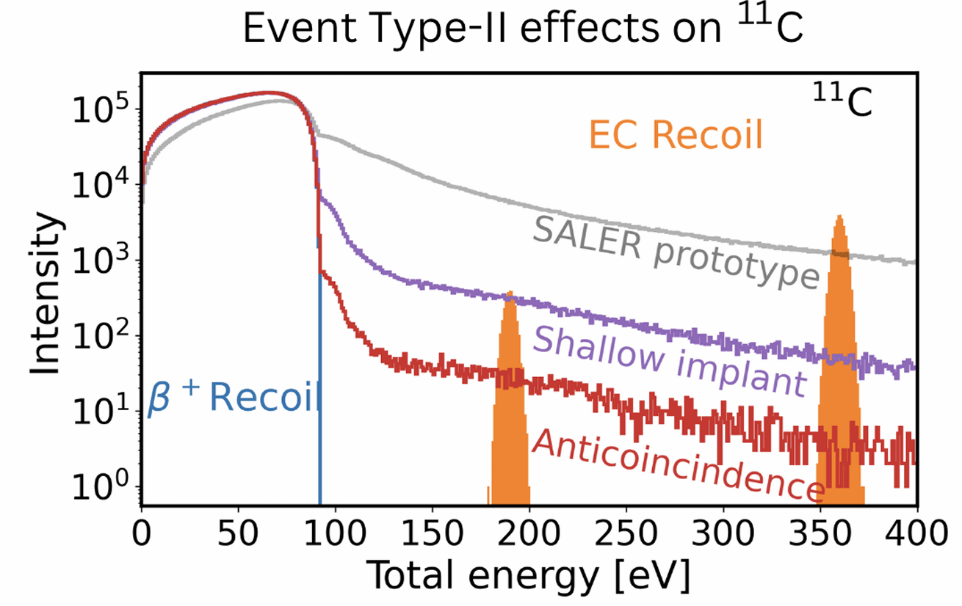
Material effects

Slide 68
The importance of background

Slide 69
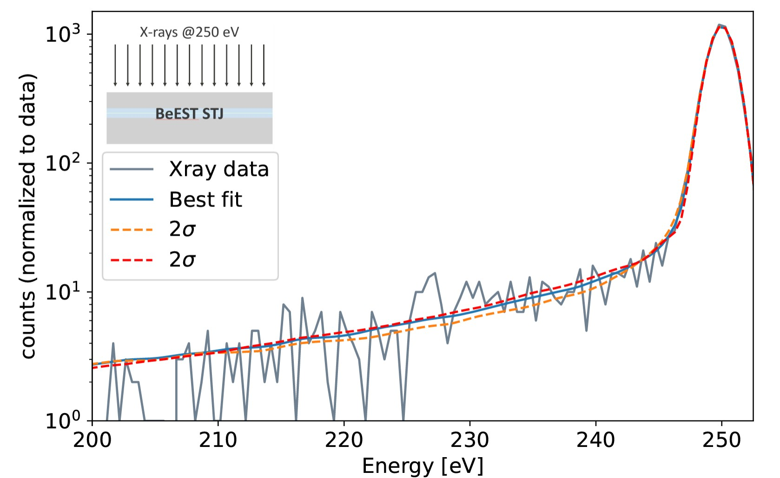
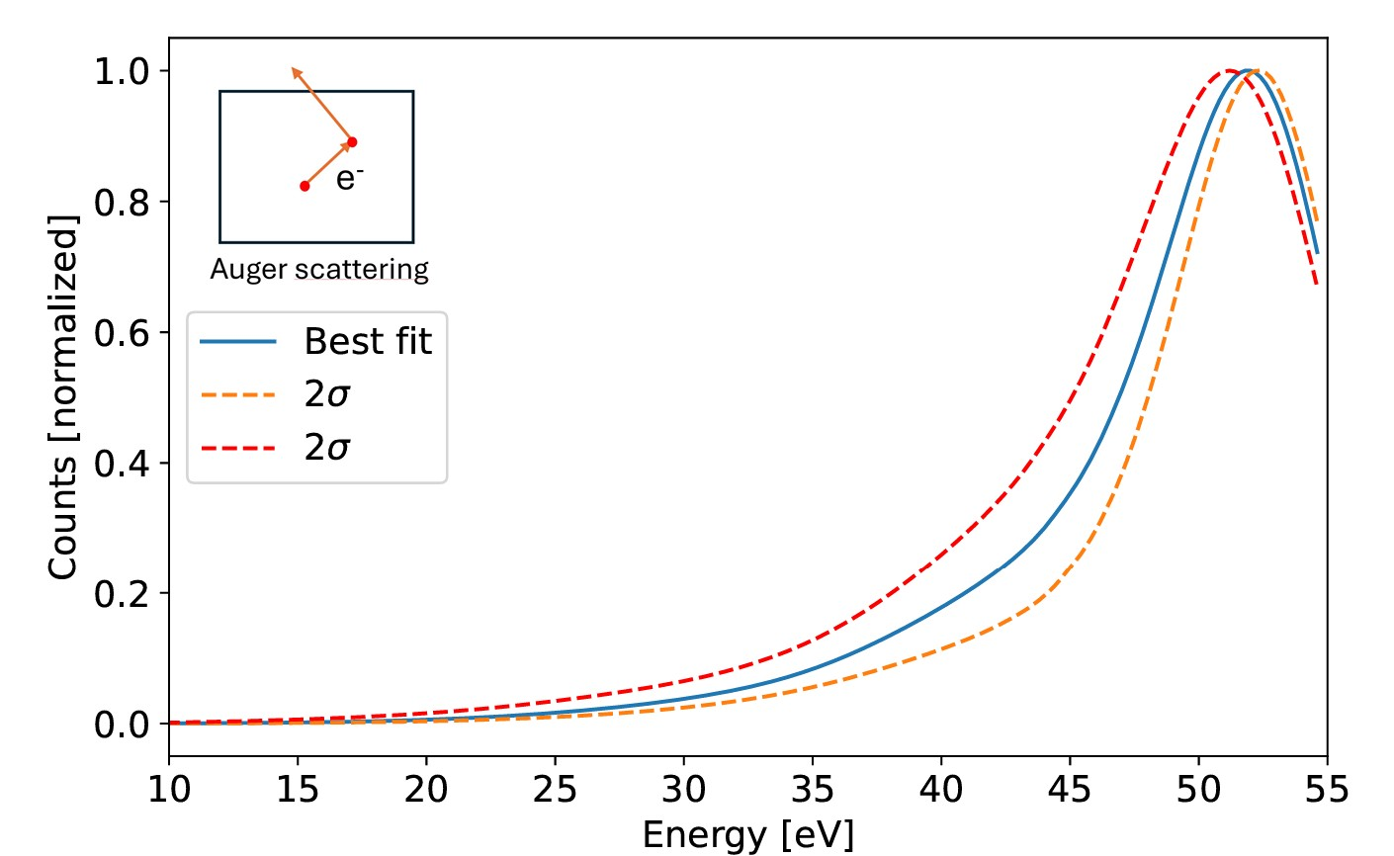
Elastic cross-section studies

Slide 70
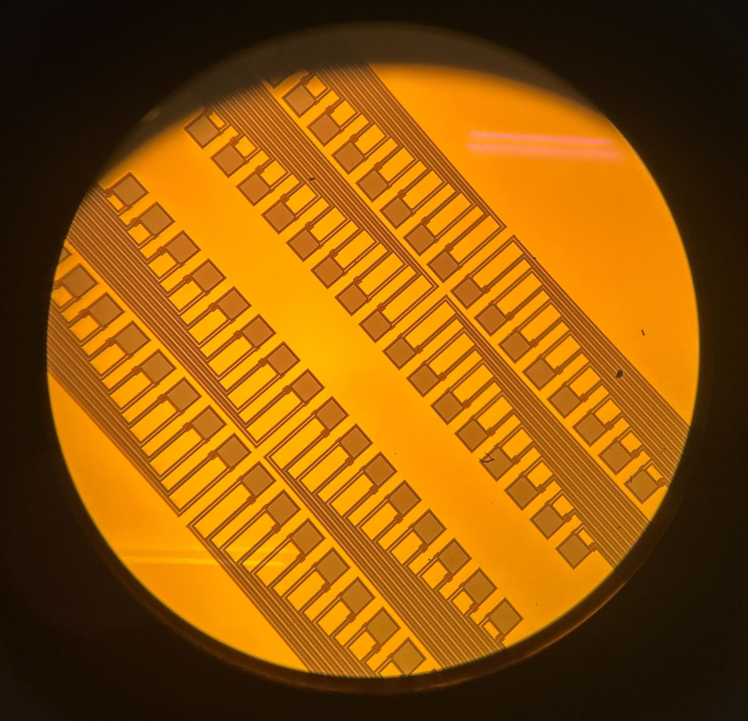
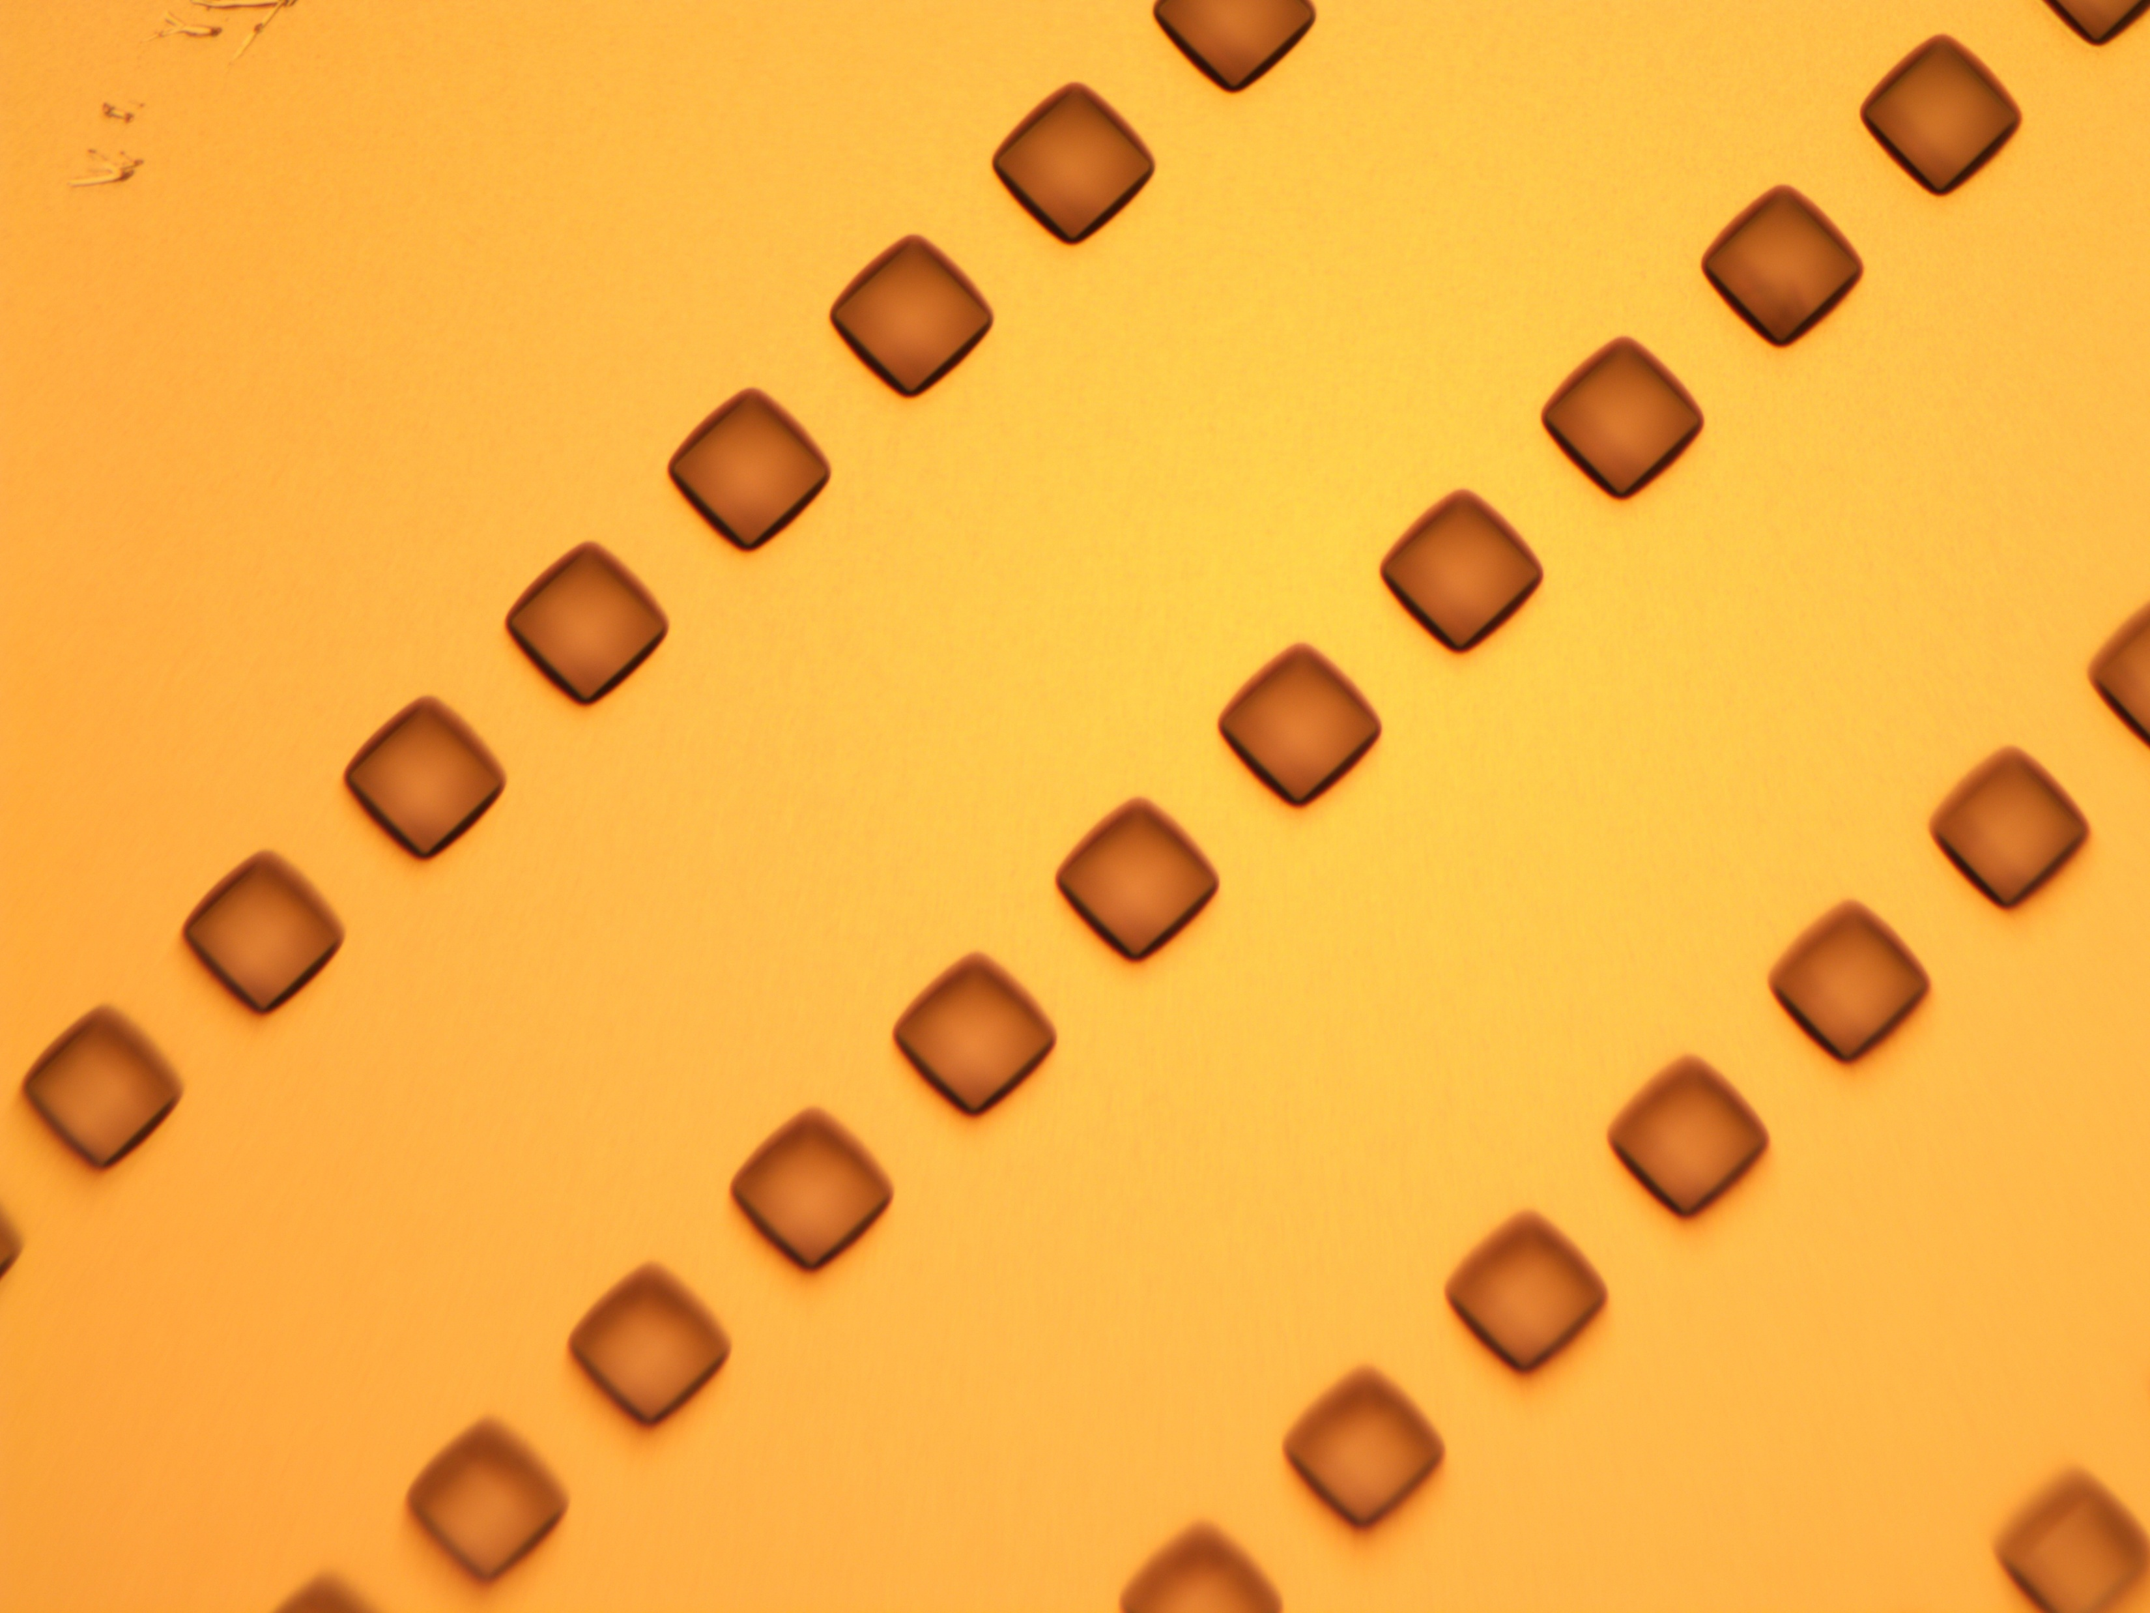
STJs for SALER

Slide 71
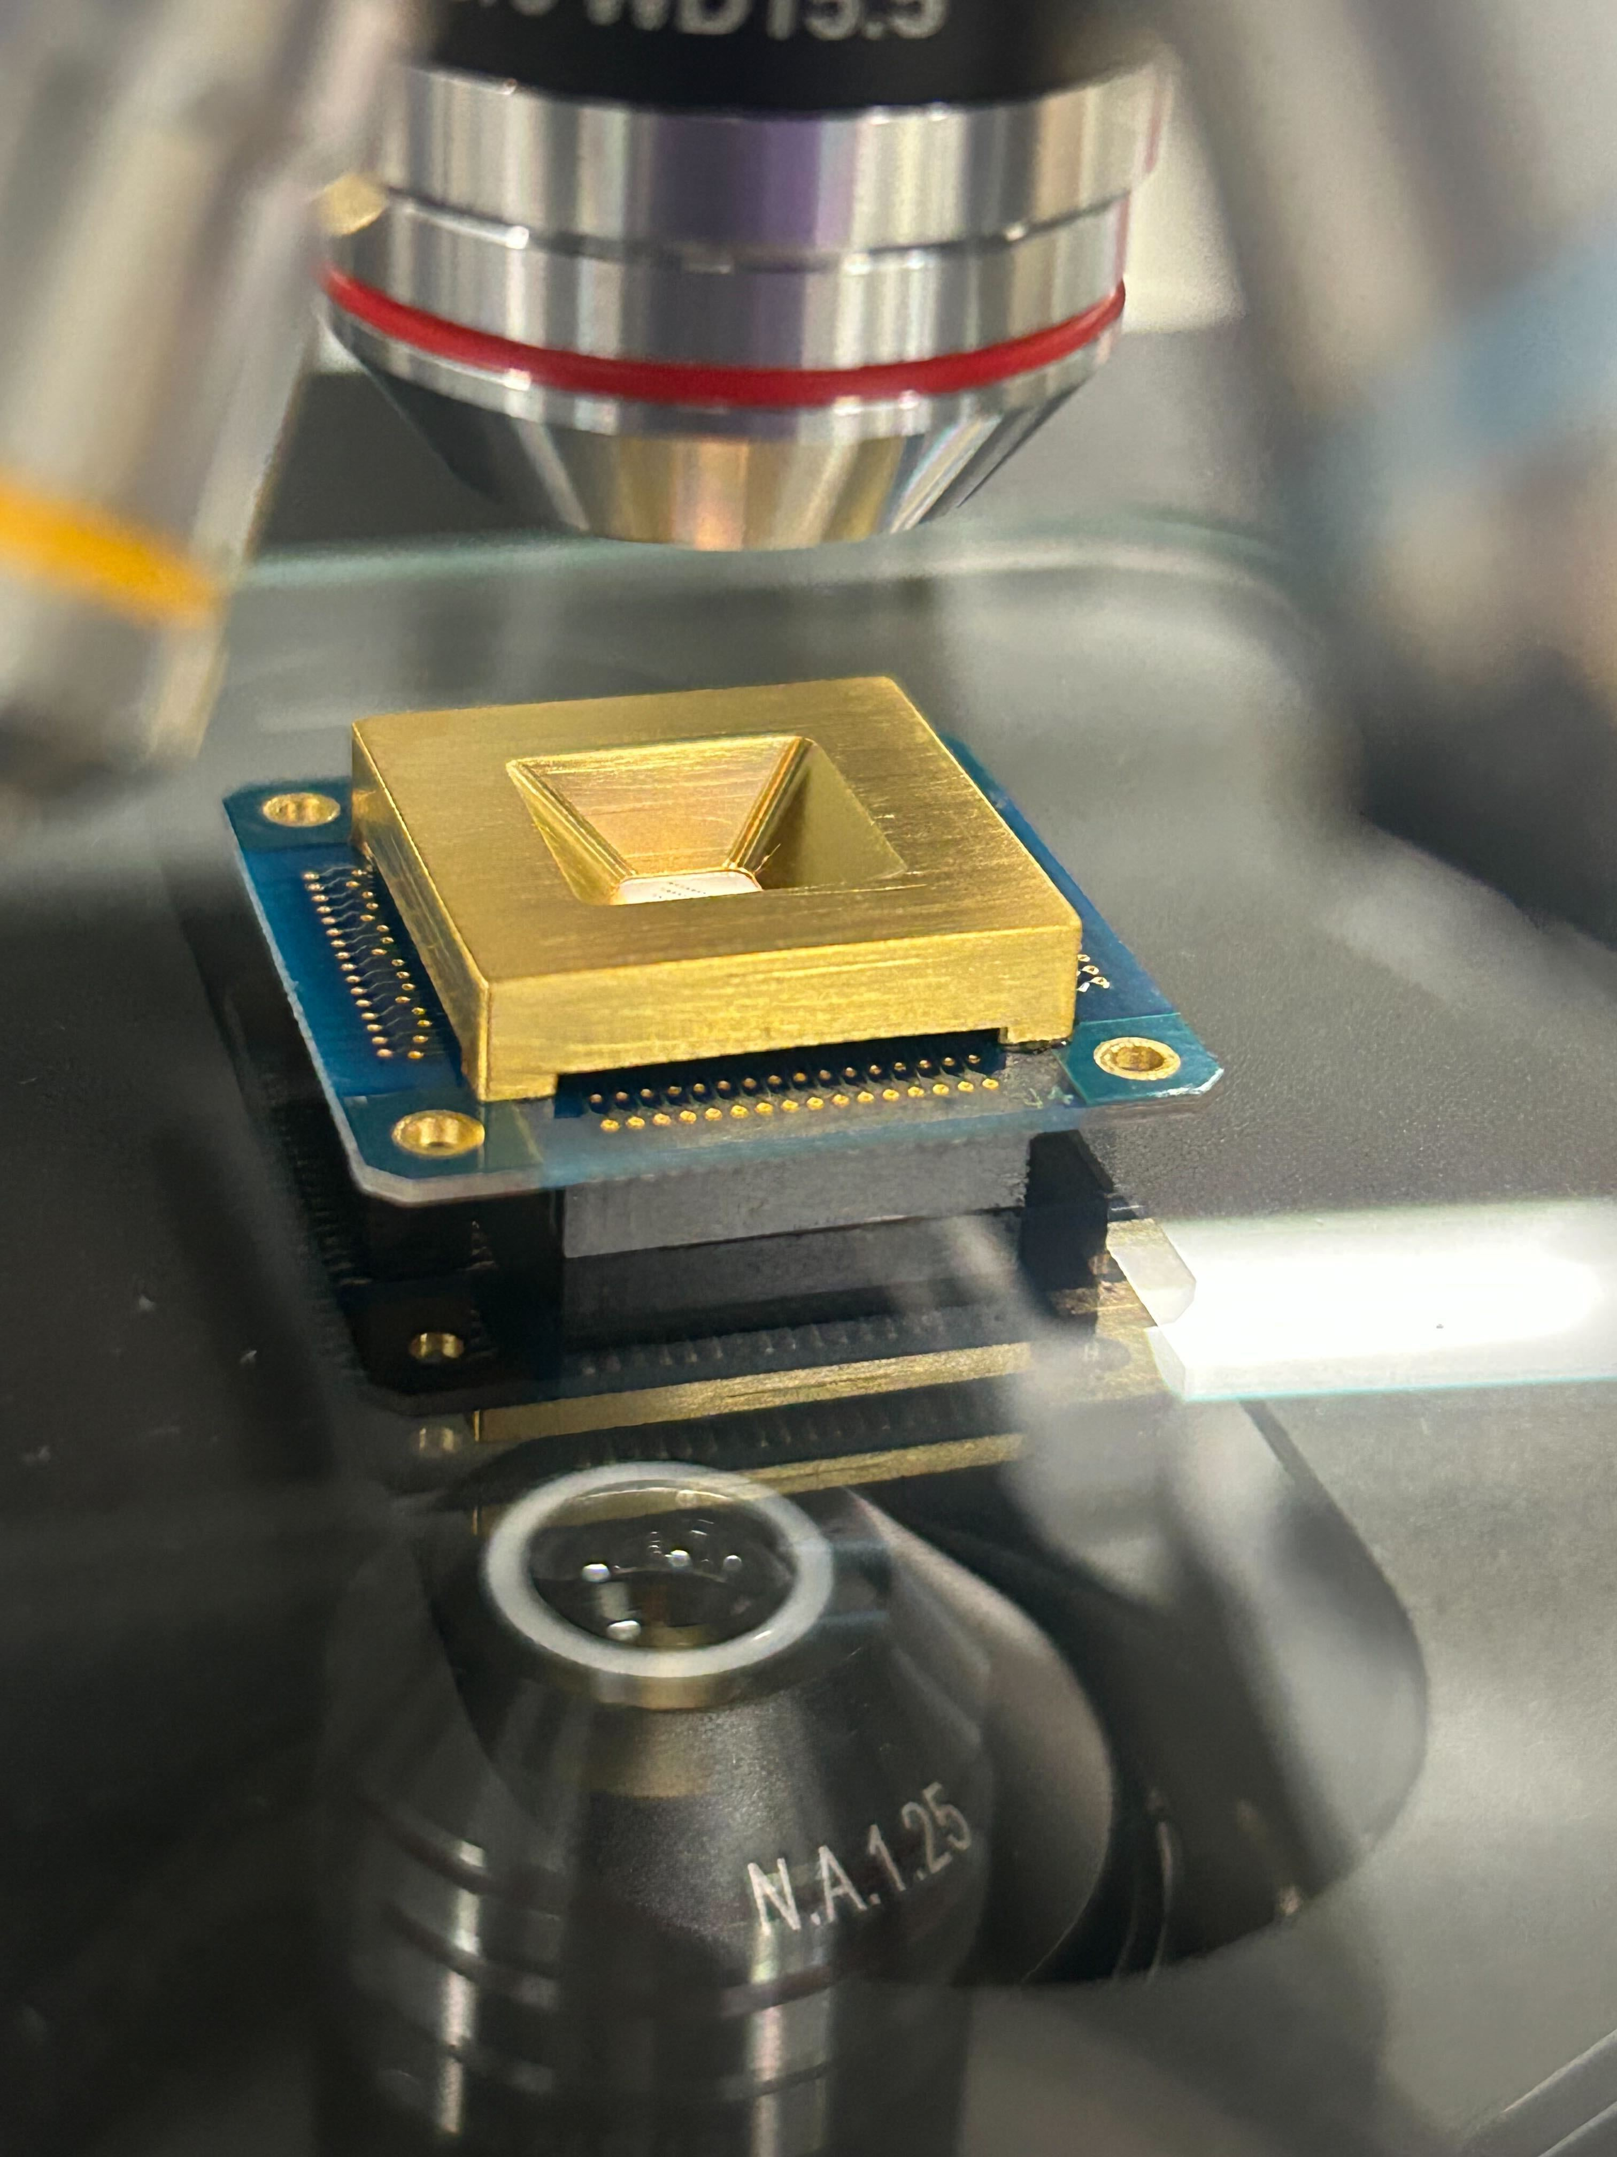
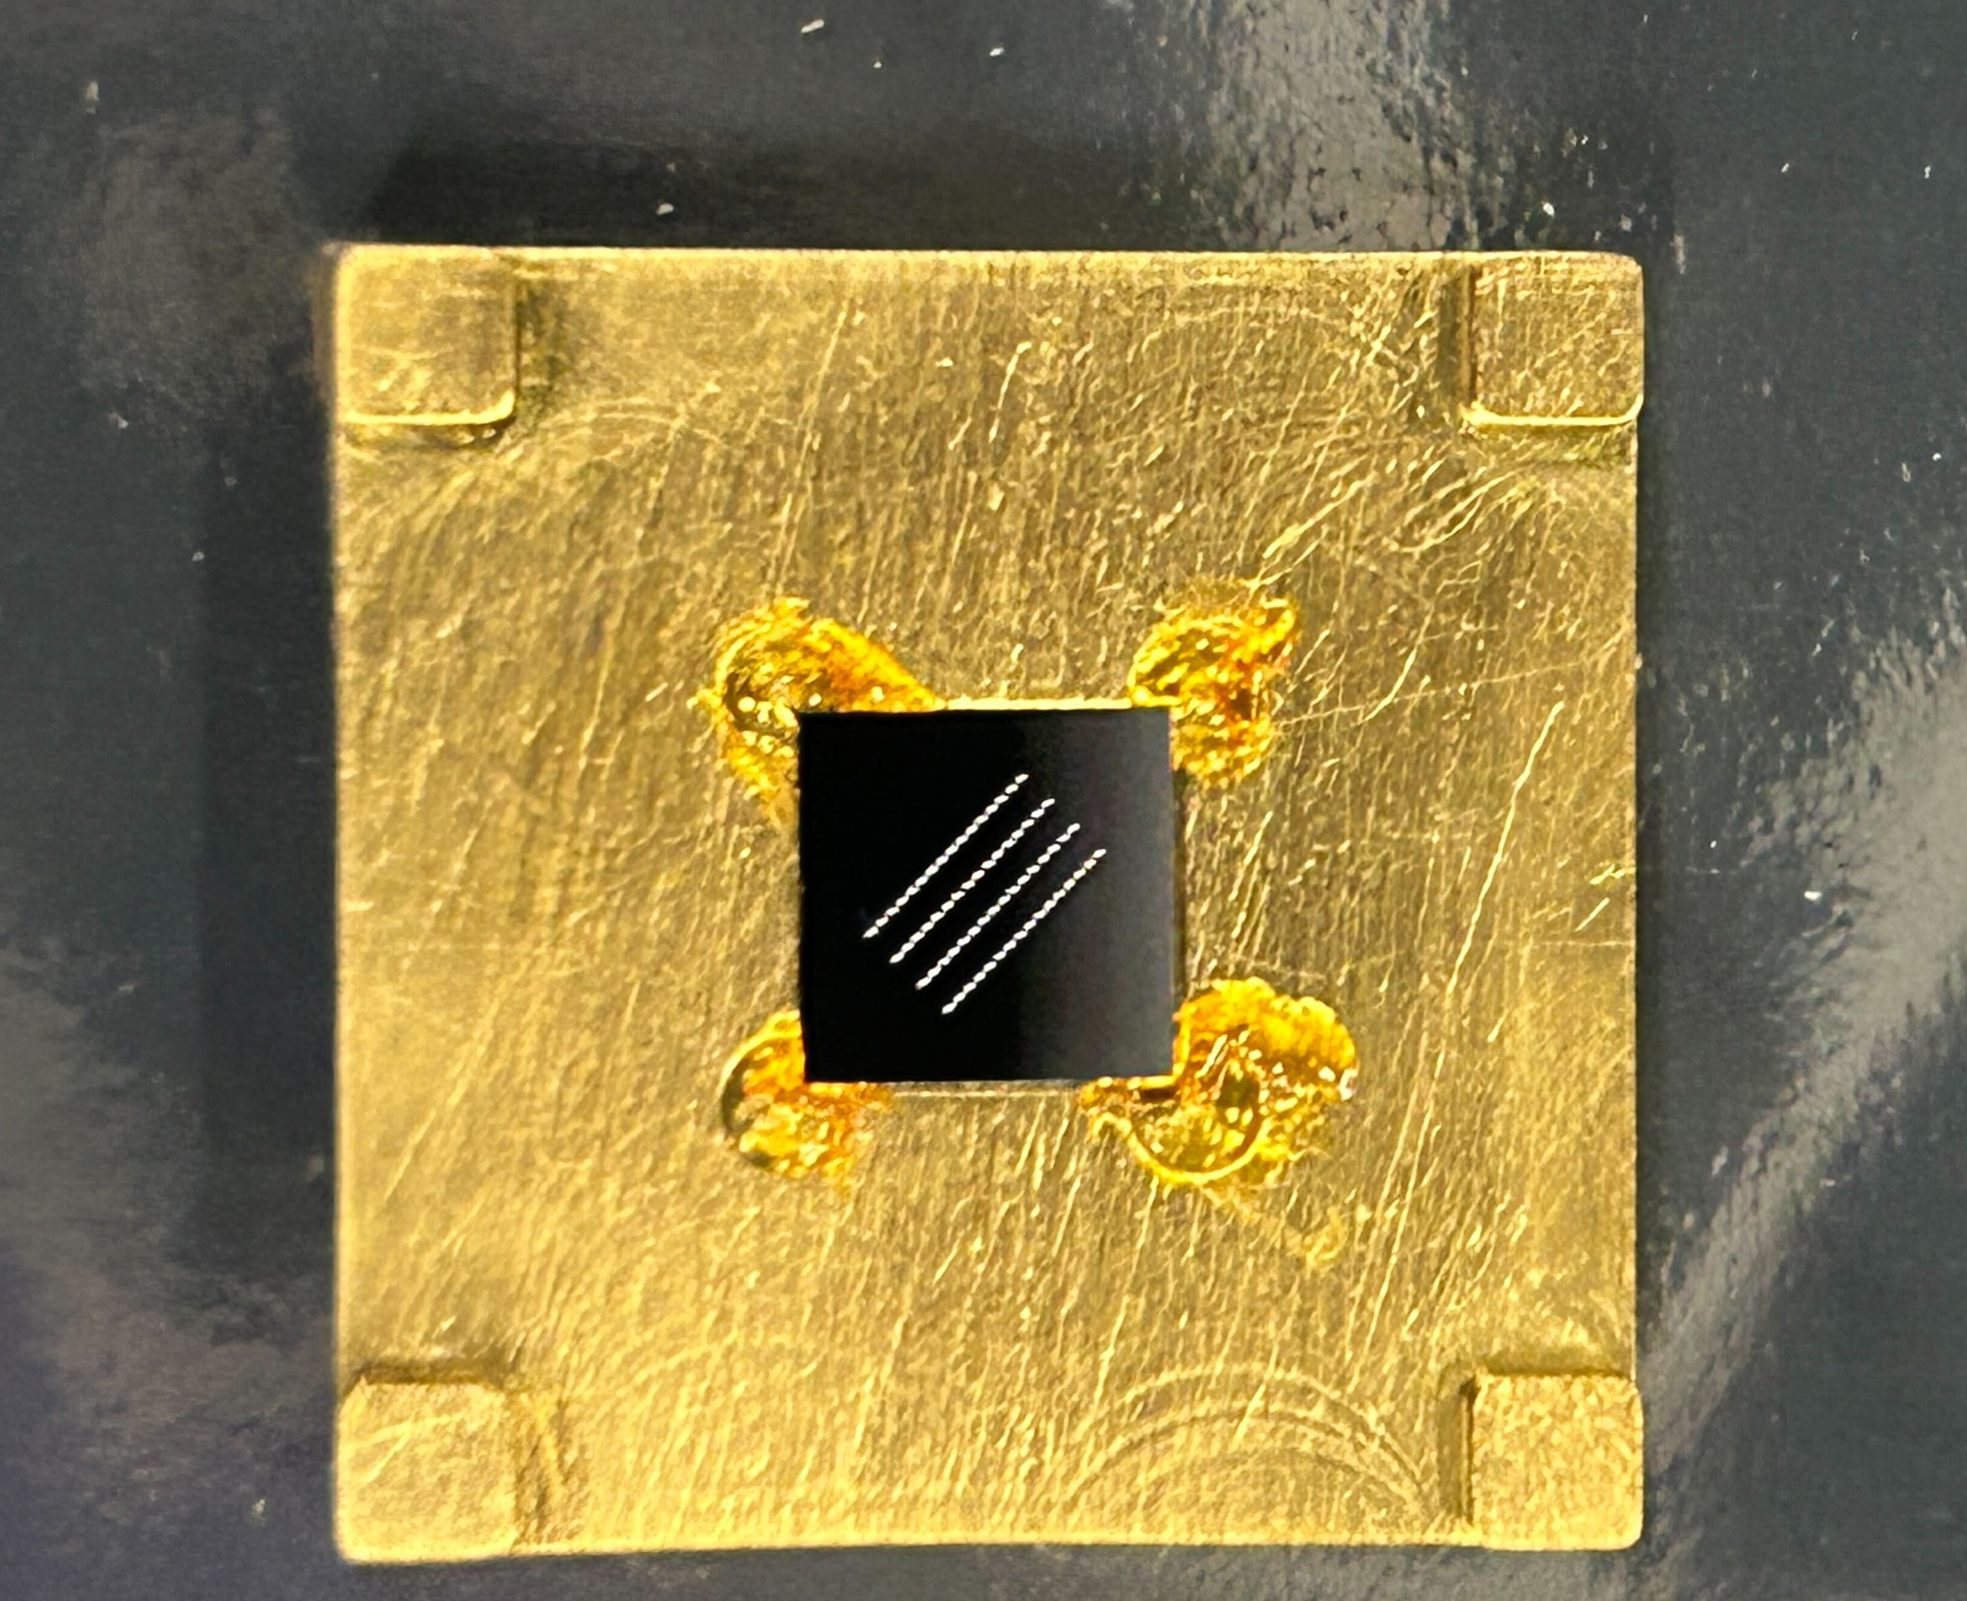
STJs for SALER

Slide 72
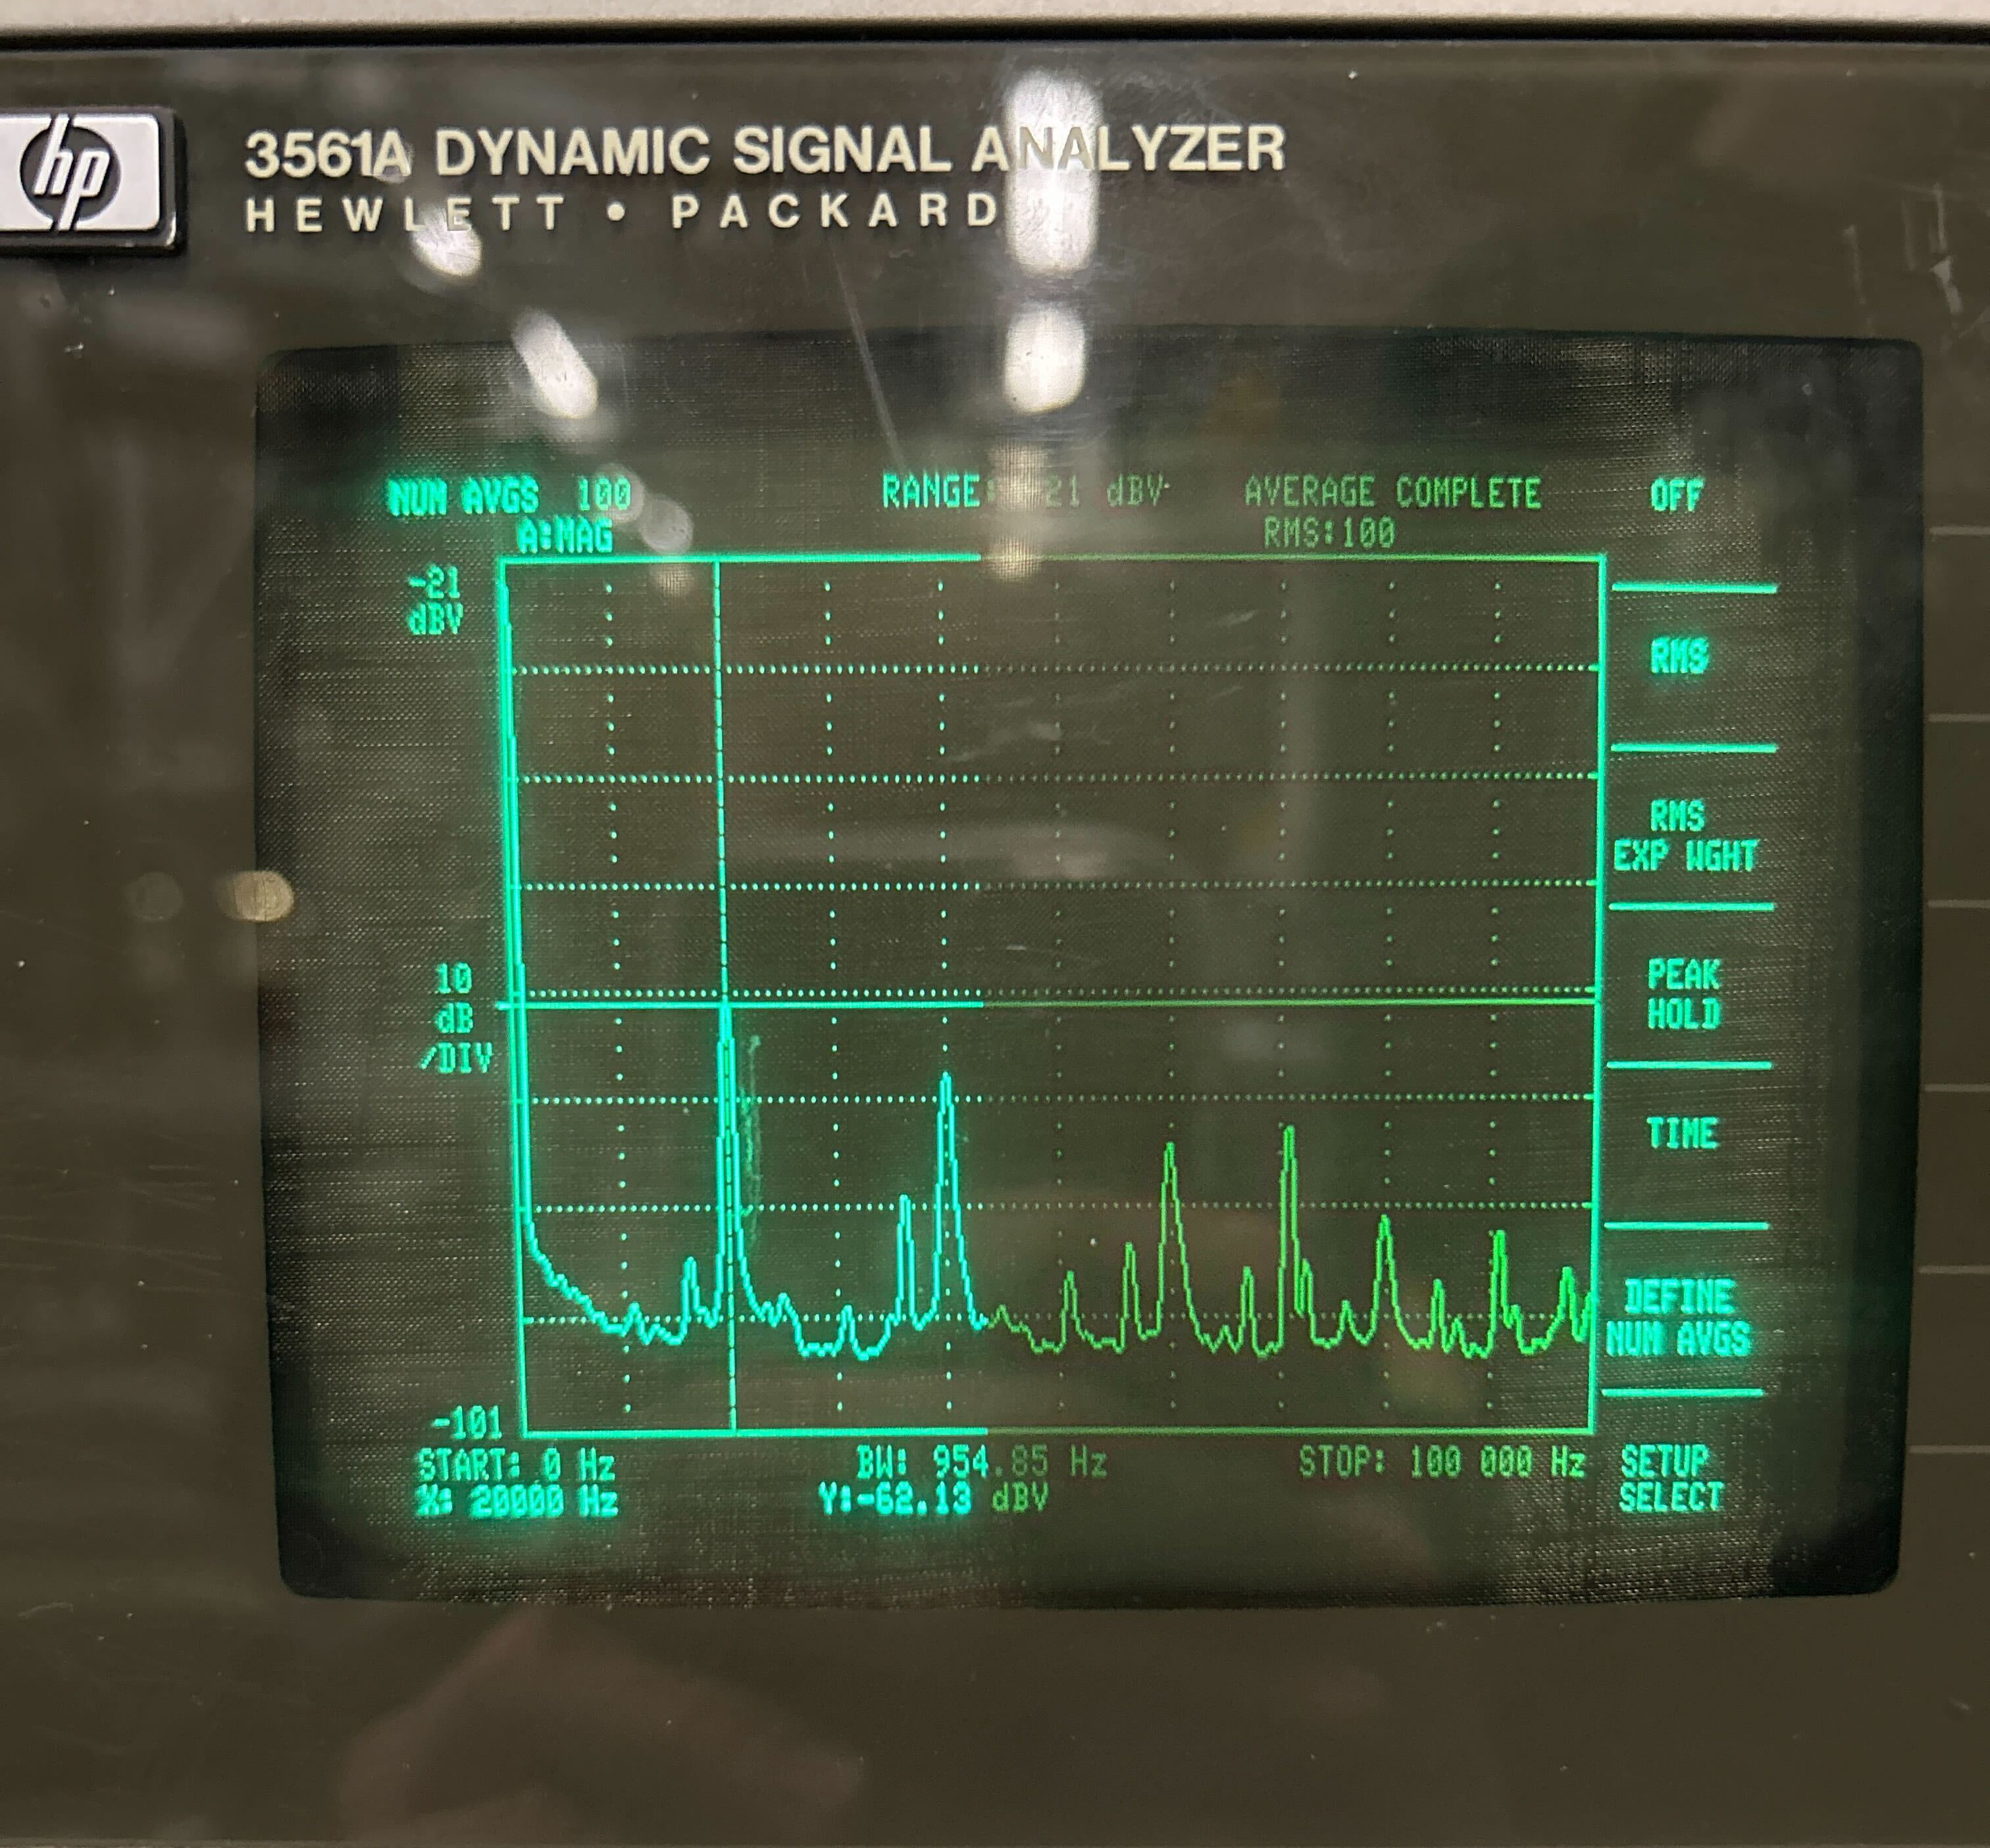
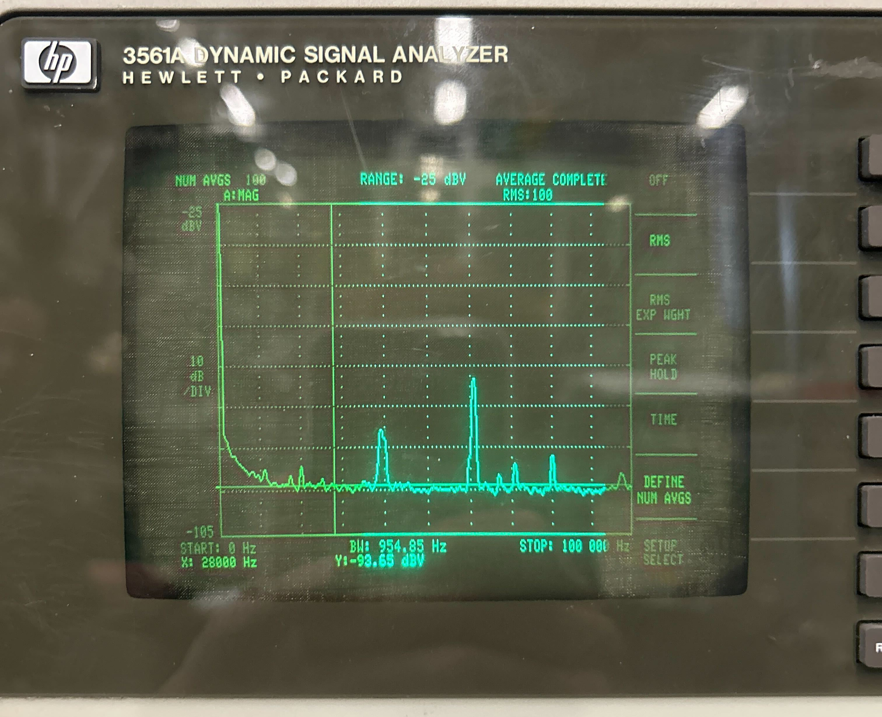
Electronic pickup
20 kHz noise

Slide 73
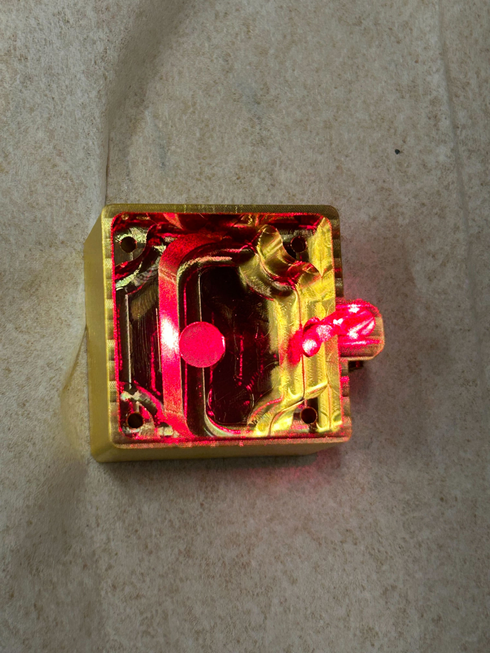
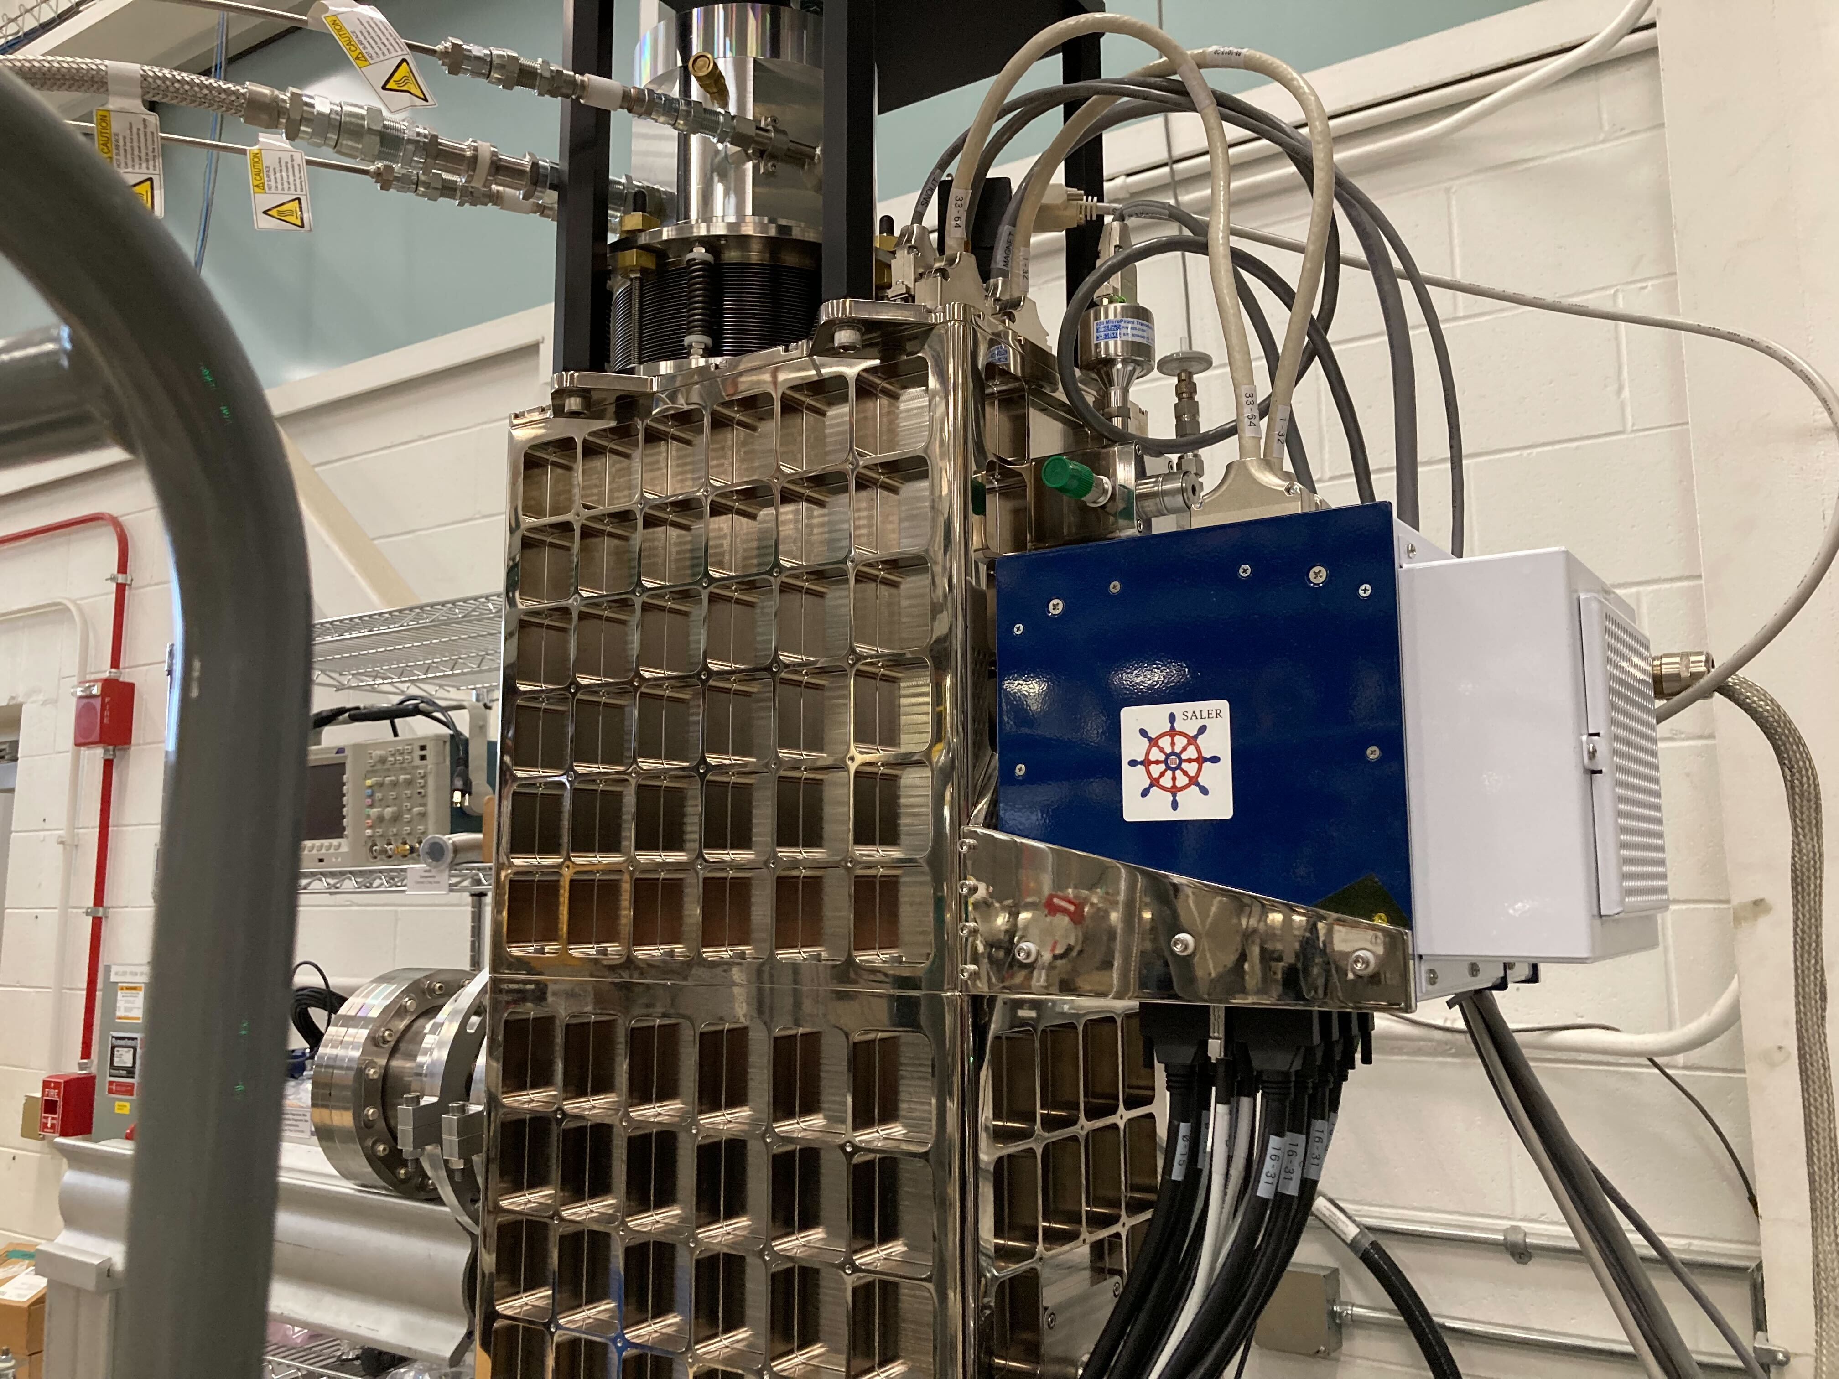
Additional photos

Slide 74
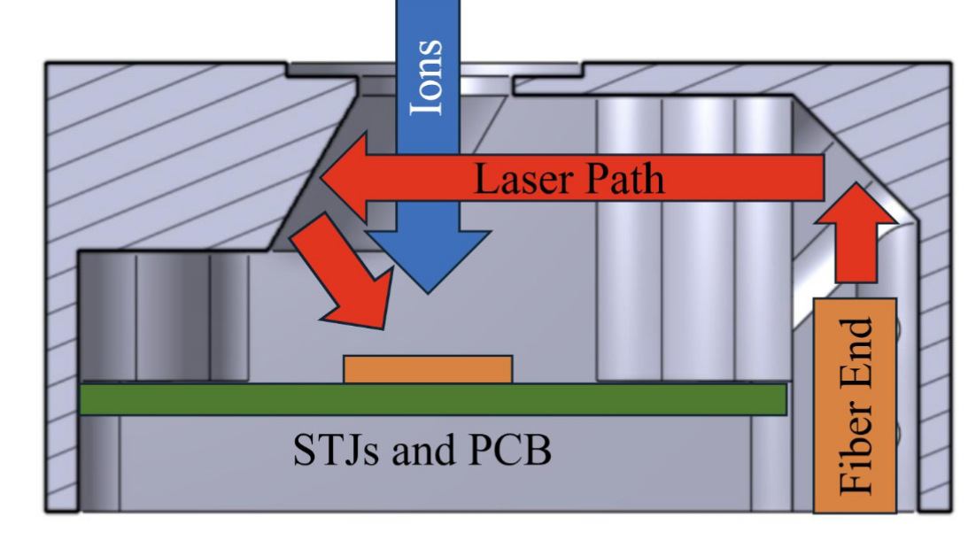
Laser calibration

Slide 75
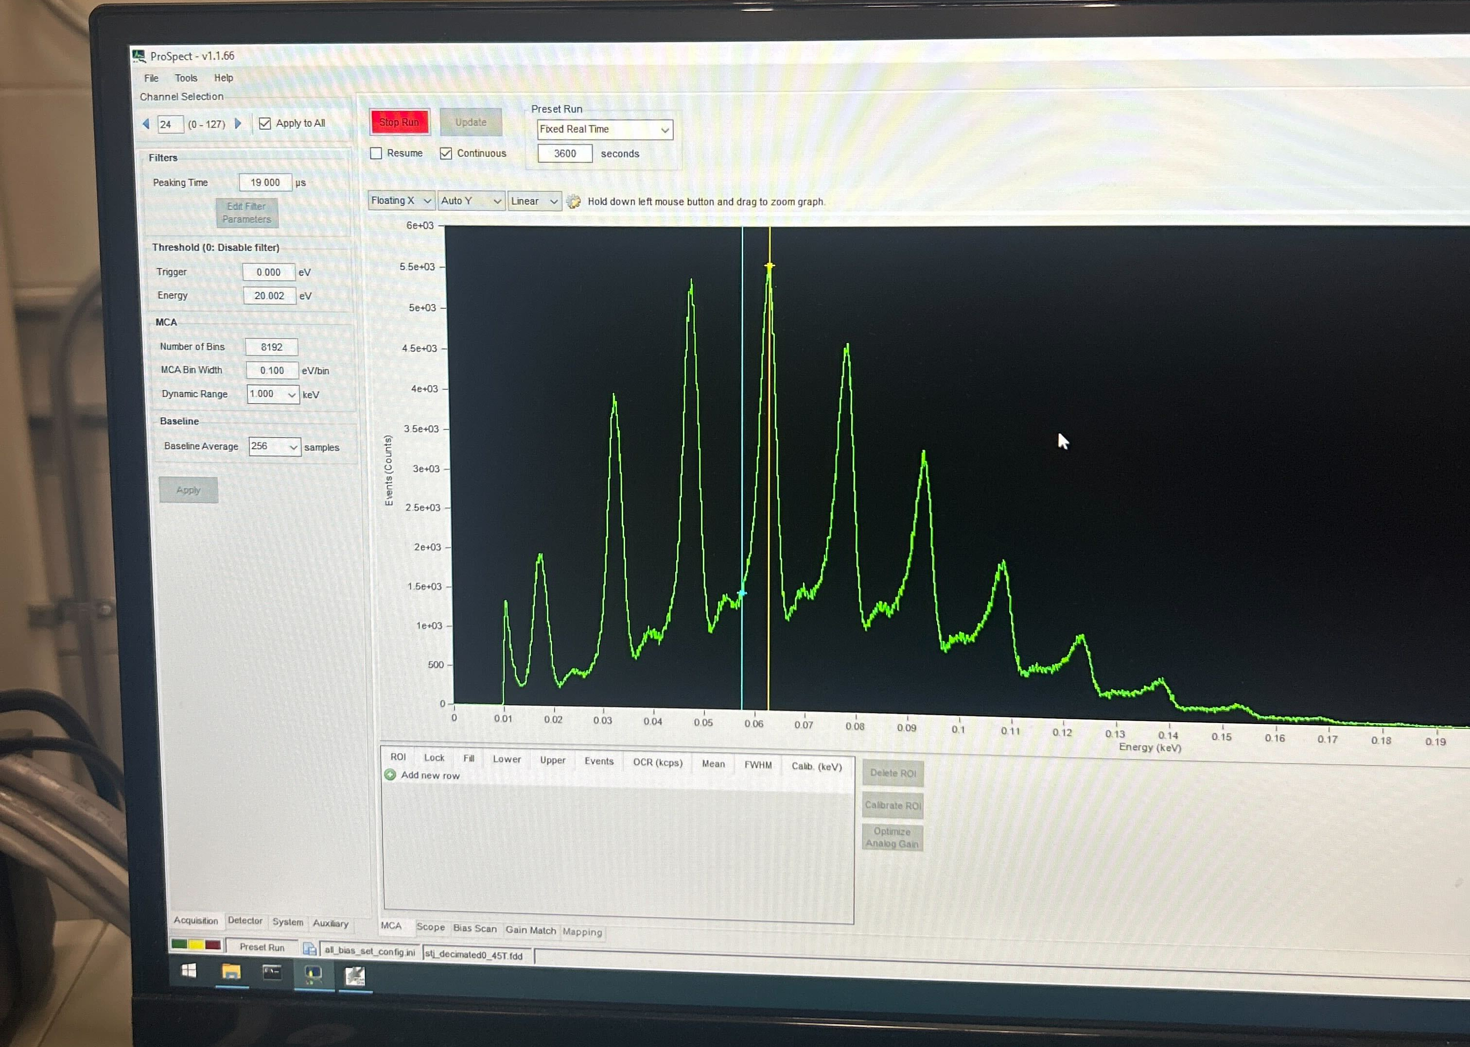
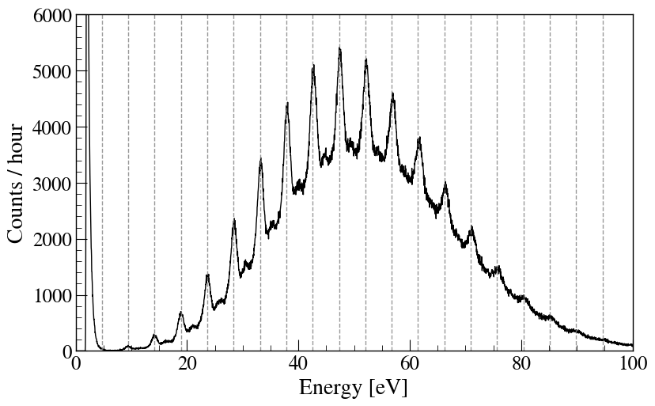
Additional laser photos

Slide 76
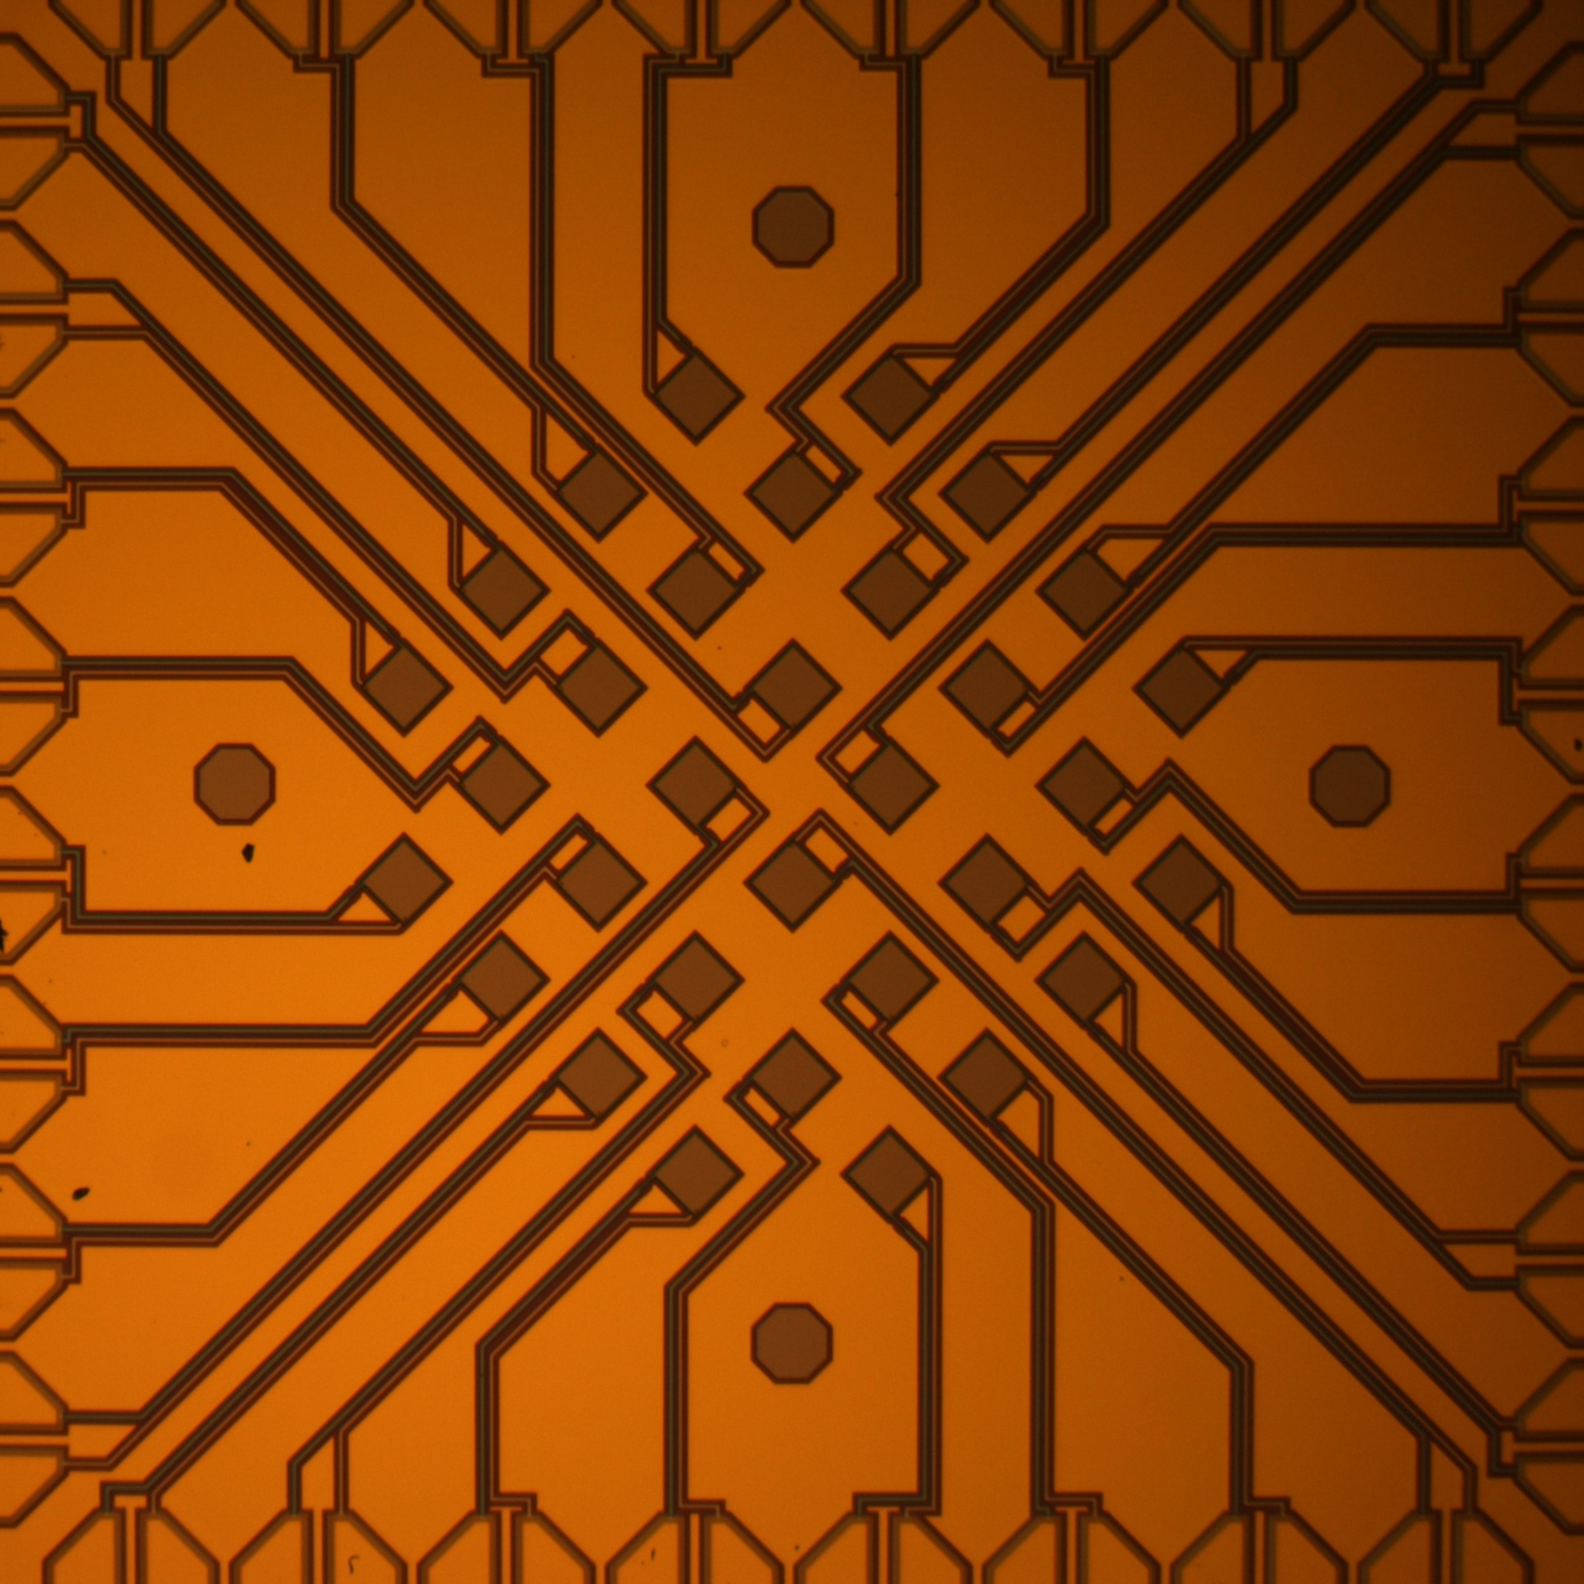
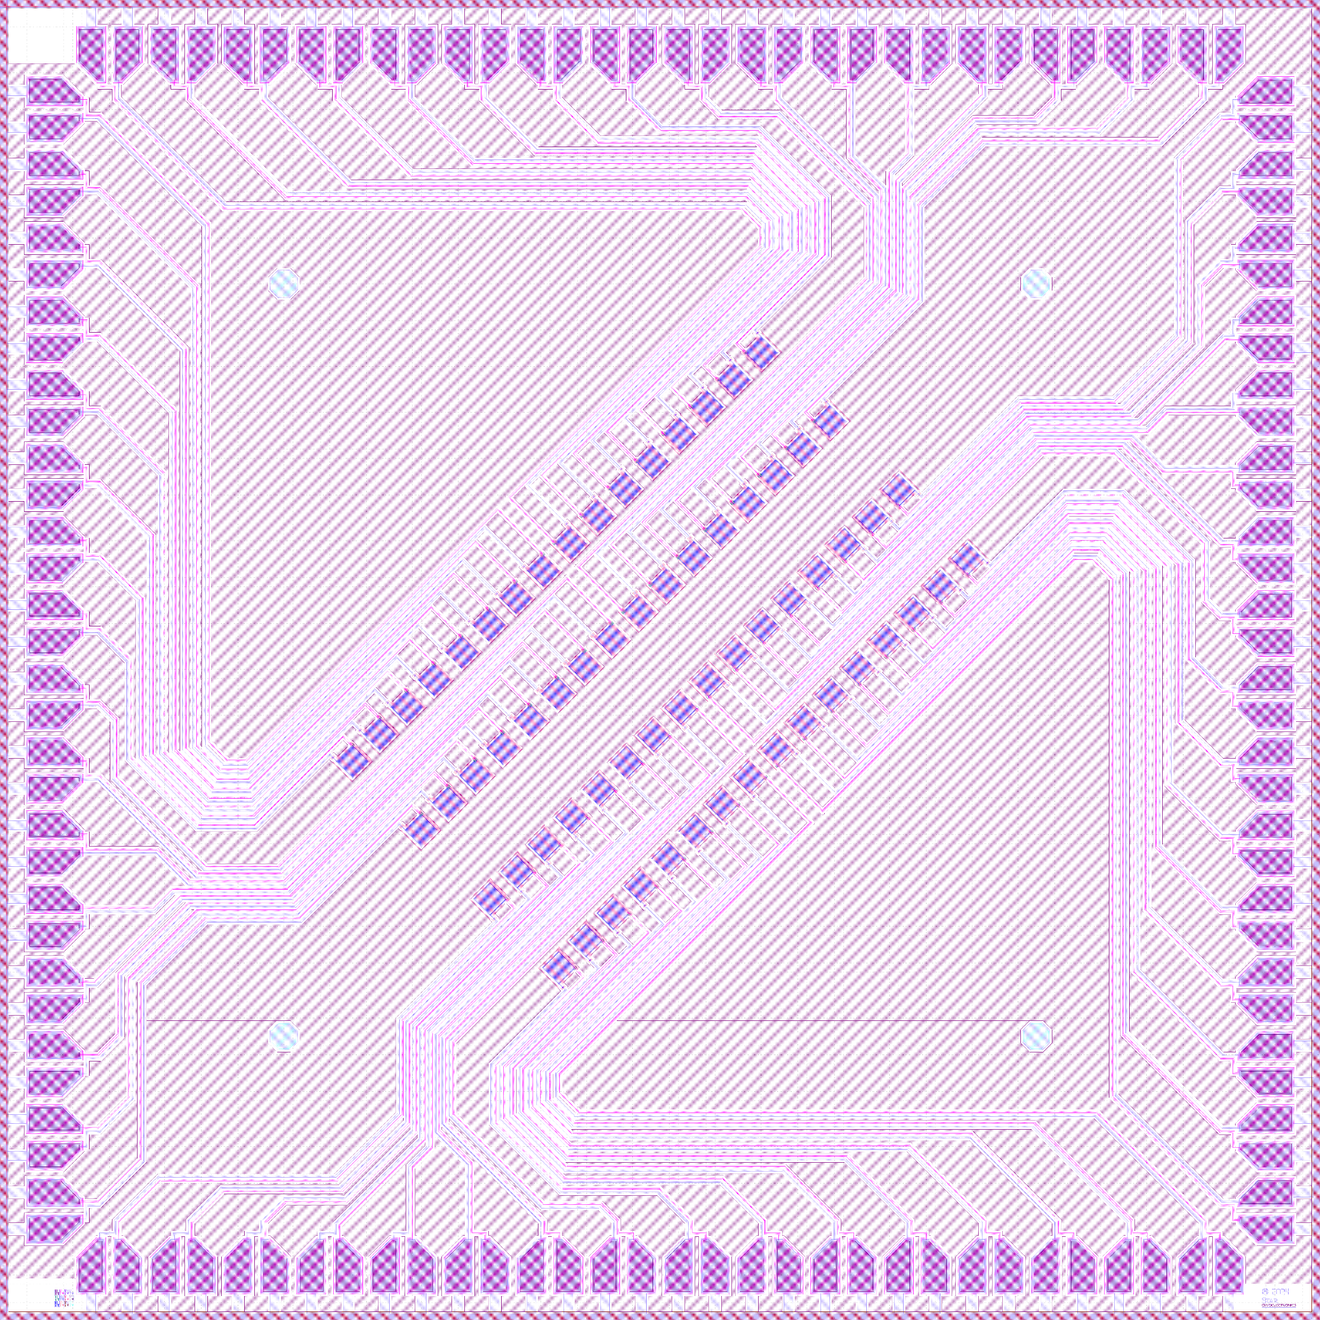
STJs masks

