Slide 1


Trapping and polarization of ²³Mg ions for CP violation searches in nuclear beta decay
MORA
Matter’s Origin from RadioActivity
Marah Jbayli

Slide 2
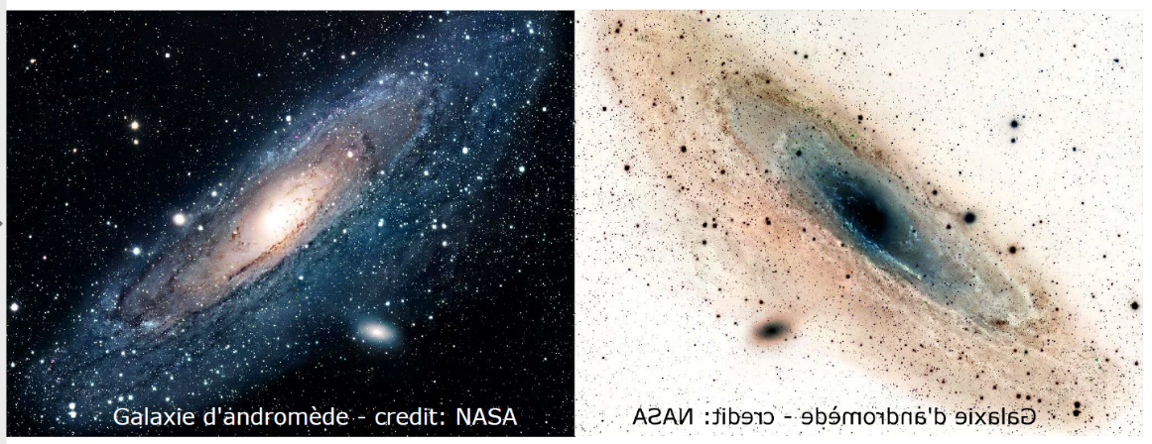
CP violation and the Matter-antimatter imbalance in the Universe
Why is there more matter than antimatter in the universe?
Big Bang → equal matter & antimatter expected
To explain the matter–antimatter asymmetry in the universe, three conditions must be satisfied (Sakharov, 1967):
- Violation of baryon number
- Violation of C and CP symmetries
- Departure from thermal equilibrium
A. D. Sakharov, «Violation of CP invariance, C asymmetry, and baryon asymmetry of the universe,» JETP Letters, vol. 5, p. 24, 1967.
CP violation is observed in K, B, and D mesons within the Standard Model.
It is insufficient to explain the matter–antimatter asymmetry.
Indicates the need for new physics beyond the Standard Model.

Slide 3
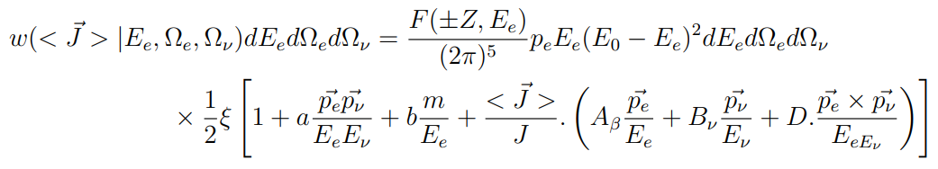
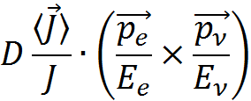
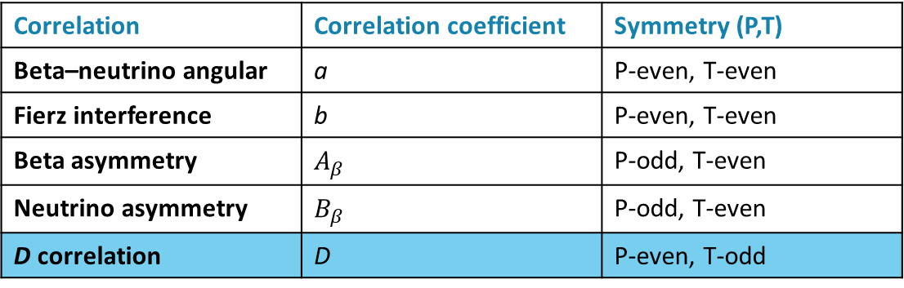
Search for new physics via the D correlation measurement
D is T-odd → non-zero D implies CP violation
Correlation | Correlation coefficient | Symmetry (P,T)
Beta–neutrino angular | a | P-even, T-even
Fierz interference | b | P-even, T-even
Beta asymmetry | $$A_{β}$$ | P-odd, T-even
Neutrino asymmetry | $$B_{β}$$ | P-odd, T-even
D correlation | D | P-even, T-odd
Search for New Physics
Direct constraints on CP-violating Wilson coefficients in the nucleon-level EFT ~10⁻⁴ measurement
Probe specific BSM Models, like L-R symmetric model and Leptoquark model ~ 10⁻⁵ measurement
Measure Final State Interactions, predicted by the SM

Slide 4


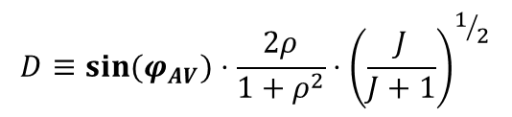
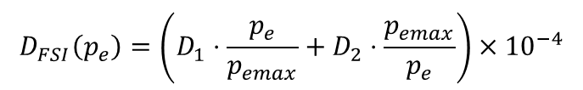
MORA: Best candidates for D measurement
$$D≡sin(φ_{AV})⋅\frac{2ρ}{1+ρ^{2}}⋅{\left(\frac{J}{J+1}\right)}^{1/2}$$
$$ρ\sim \frac{C_{A}M_{GT}}{C_{V}M_{F}}$$
$\text{From} \text{neutron} \text{measurement}\text{ (}\text{emiT}\text{):} φ_{AV}=180.013°±0.028°$ (68% CL)
T. E. Chupp, R. L. Cooper, K. P. Coulter, et al. Phys. Rev. C 86, 035505 (2012)
$$F\left(X\right)$$
Neutron and mirror nuclei (N=Z-1): strong mixed (GT+ Fermi) transitions between analog states
 | n | ¹⁹Ne | ²³Mg | ³⁵Ar | ³⁹Ca
Sensitivity F(X) | 0,43 | -0,52 | -0,65 | 0,41 | 0,71
D₁ (x10⁻⁴) | 0,11 | 2,31 | 2.64 | 0,43 | -0,47
D₂ (x10⁻⁴) | 0,02 | 0,17 | 0,16 | 0,01 | -0,02
$$D_{FSI}\left(p_{e}\right)=\left(D_{1}⋅\frac{p_{e}}{p_{emax}}+D_{2}⋅\frac{p_{emax}}{p_{e}}\right)×{10}^{−4}$$
D_{n}= (−0.94 ±1.89±0.97)∙10⁻⁴
D_{19Ne}=(1 ±6)∙10⁻⁴
emiT collaboration, PRL 107, 102301 (2011),
Calaprice, Hyp. Int. 22(1985)83
Callan and Treiman, Phys. Rev. 162(1967)1494. Chen, Phys. Rev. 185(1969)2003.
Best measurement so far, statistics limited
Notes:
2 candidats à la mesure de D pour MORA

Slide 5
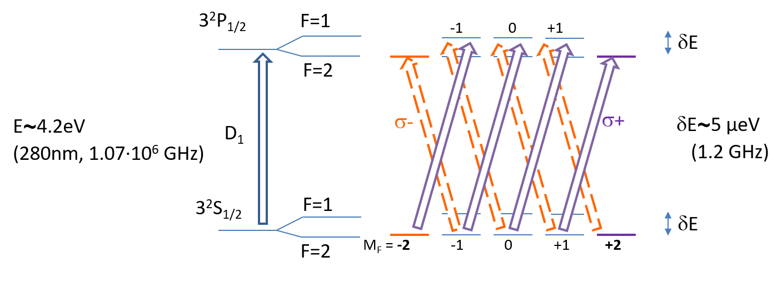
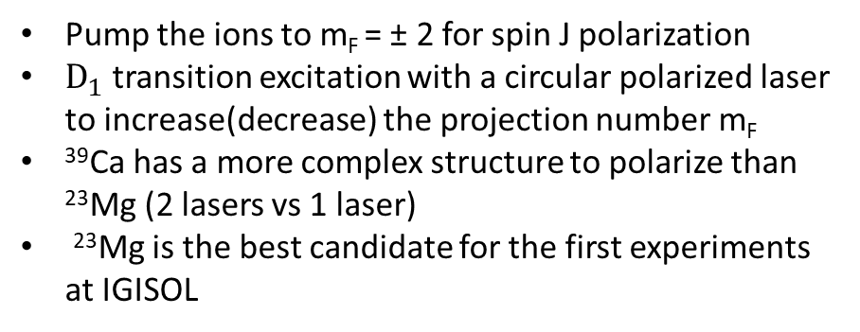
MORA: in-trap laser polarization
Proof of principle is the first objective at JYU
The nuclear spin I interacts with the atomic one J → F=I+J
σ+ or σ- light to scan the hyperfine structure forces ions in the m_{F}=±F state
²³Mg hyperfine structure
^{F= I+J}
Pump the ions to m_{F} = ± 2 for spin J polarization
$D_{1}$ transition excitation with a circular polarized laser to increase(decrease) the projection number m_{F}
³⁹Ca has a more complex structure to polarize than ²³Mg (2 lasers vs 1 laser)
²³Mg is the best candidate for the first experiments at IGISOL
Easy to produce and polarize
High sensitivity to FSI and new physics

Slide 6
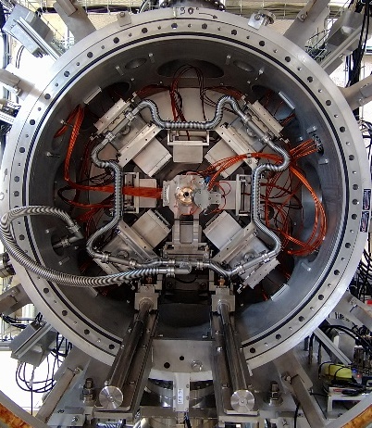
MORA apparatus

Slide 7
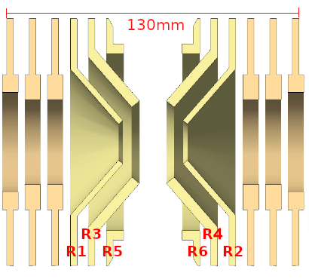
MORA Trap
Paul Trap developed in LPC caen
Trap Setup
  6 electrodes: R1–R2 (RF end caps), R3–R4 (injection/ejection), R5–R6 (correction)
  Einzel lenses only for injection/extraction
  Buffer gas: ⁴He (~10⁻⁵ mbar) for cooling & Doppler effect reduction for better trapping efficiency

Slide 8
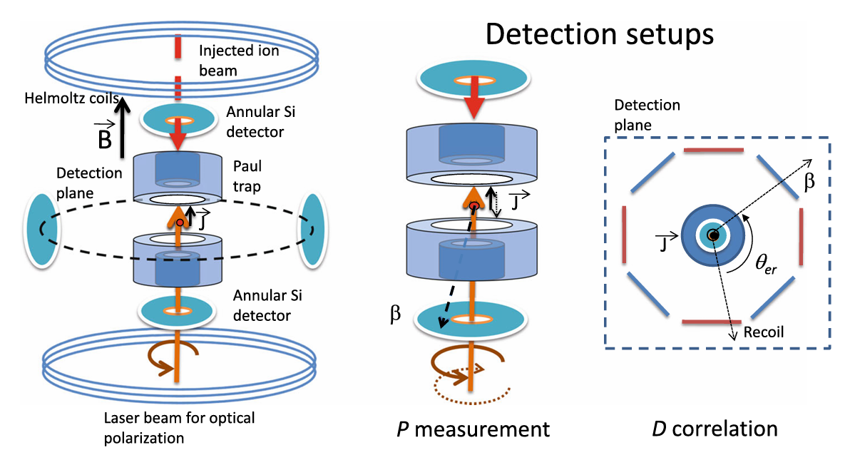
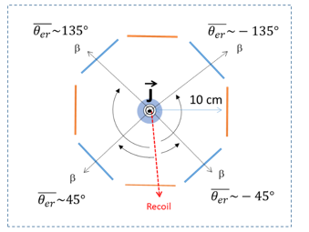
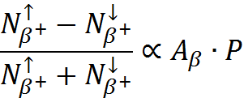

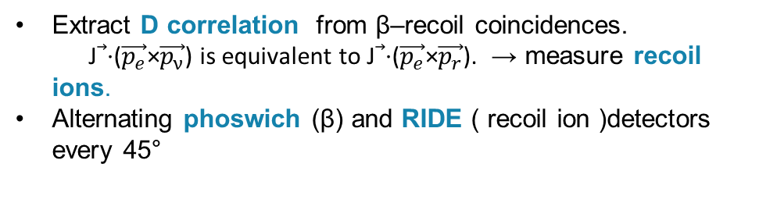
Detection setup
Polarization monitoring thanks to β assymetry: A_{β}
Extract D correlation from β–recoil coincidences.
J⃗⋅($\vec{p_{e}}$×$\vec{p_{ν}}$) is equivalent to J⃗⋅($\vec{p_{e}}$×$\vec{p_{r}}$). → measure recoil ions.
Alternating phoswich (β) and RIDE ( recoil ion )detectors every 45°
2 annular Si detectors in the line axis for polarization measurement
  ~10² ions / cycle
  ~10⁴ ions / cycle

Slide 9
Experimental Status

Slide 10
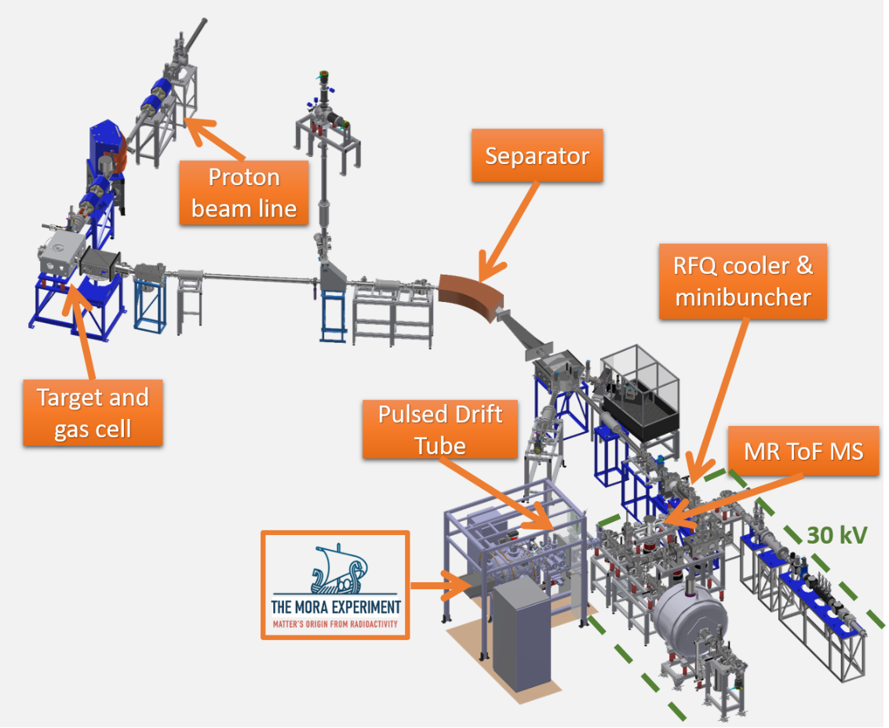
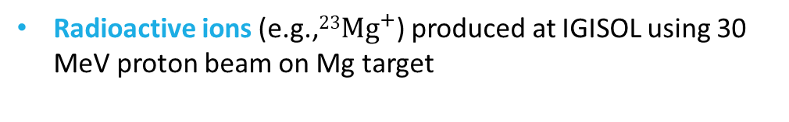
Ion production & manipulation ( IGISOL)
Radioactive ions (e.g.,${23Mg}^{+}$) produced at IGISOL using 30 MeV proton beam on Mg target
Ions’ path : Gas cell ( stops & thermalizes) → SPIG → mass separator → minibuncher (bunches & cools, saturates ~10⁵ ions/bunch).
Up to 5x10⁵ pps ²³Mg⁺ from gas cell
Beam comes with ²³Na⁺ as isobaric contaminant after separator
  Initially up to 10⁴ more ²³Na⁺ than ²³Mg⁺
  But cross section calculations give a factor of 2
Polarization proof-of-principle not possible!
Investigation revealed the issue came from the SPIG: Helium ions sputtered sodium residues from the SPIG during beam time.
SPIG cleaned with deionized water to remove residual sodium

Slide 11
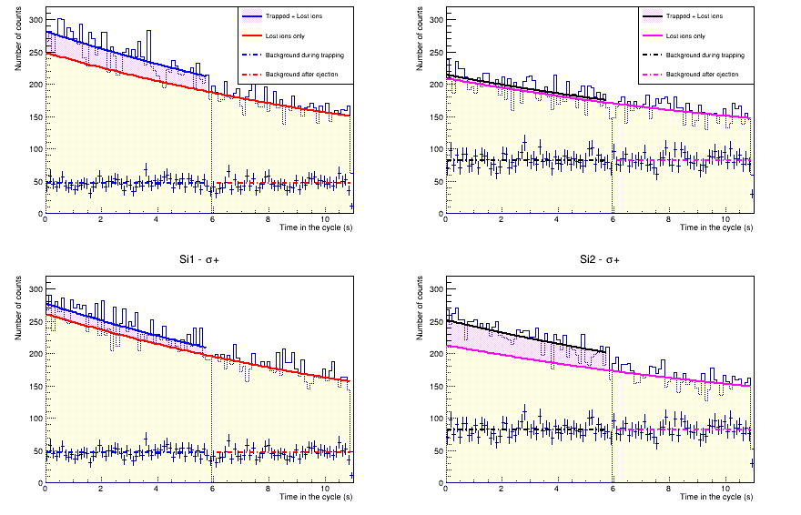

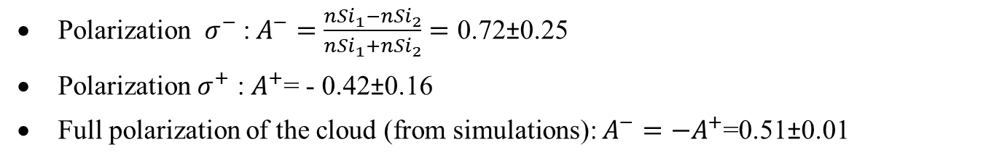
Experimental breakthrough
March 25
Si1
Si2
σ−
σ+
Trapped ions/cycle
90±9 from Si detectors
145±55 from coincidences
N. Goyal et al, Performance of the MORA Apparatus for
Testing Time-Reversal Invariance in Nuclear Beta Decay,
arXiv:2504.16957, accepted by EPJ A
First polarization measurement
Polarization $σ^{−}$ :$A^{−}=\frac{{nSi}_{1}−{nSi}_{2}}{{nSi}_{1}+{nSi}_{2}}=$ 0.72±0.25
Polarization $σ^{+}$ : $A^{+}$= - 0.42±0.16
Full polarization of the cloud (from simulations): $A^{−}=−A^{+}$=0.51±0.01
$\left|A\right|$= 0.51±0.14
55%<P<100% at 90% C.L.

Slide 12
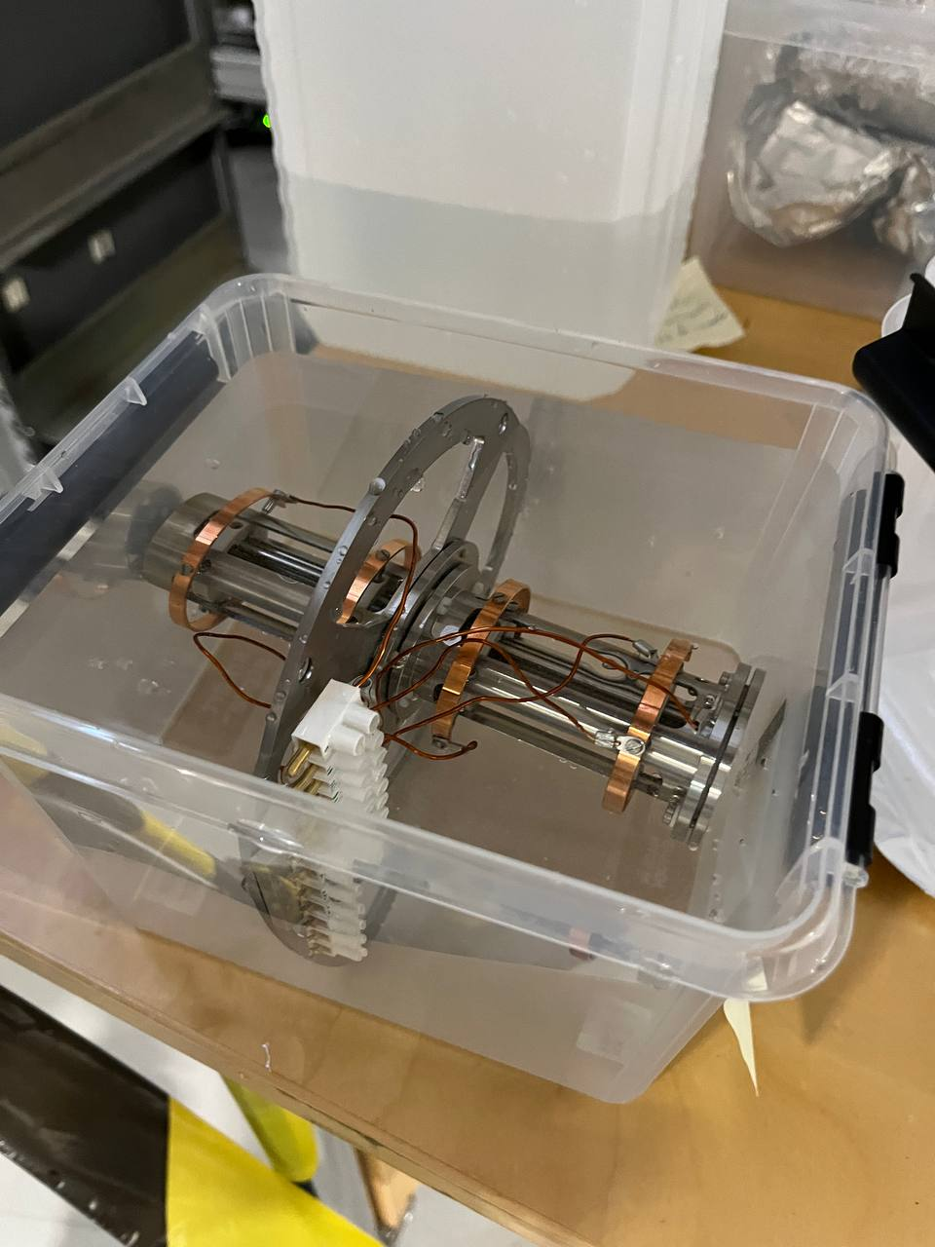
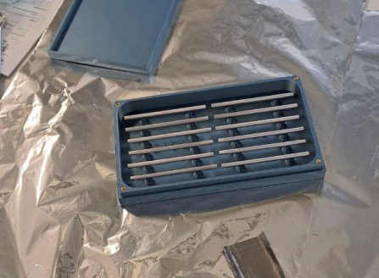
Beam time updates
Na contamination resolved using new SPIG (baked rods to remove Na).
First test with ³⁹Ca performed.
³⁹Ca yield sufficient for D-correlation measurement.
³⁹K contamination (beam purity problem).
Polarization not yet attempted for ³⁹Ca due to limited preparation time.
Low trap efficiency due to reliability issues at the IGISOL beamline (malfunctioning minibuncher and steering problems).
1 week of data acquisition scheduled (27 April – 5 May 2026)
Proof-of-principle beam polarization of ³⁹Ca later this year.

Slide 13
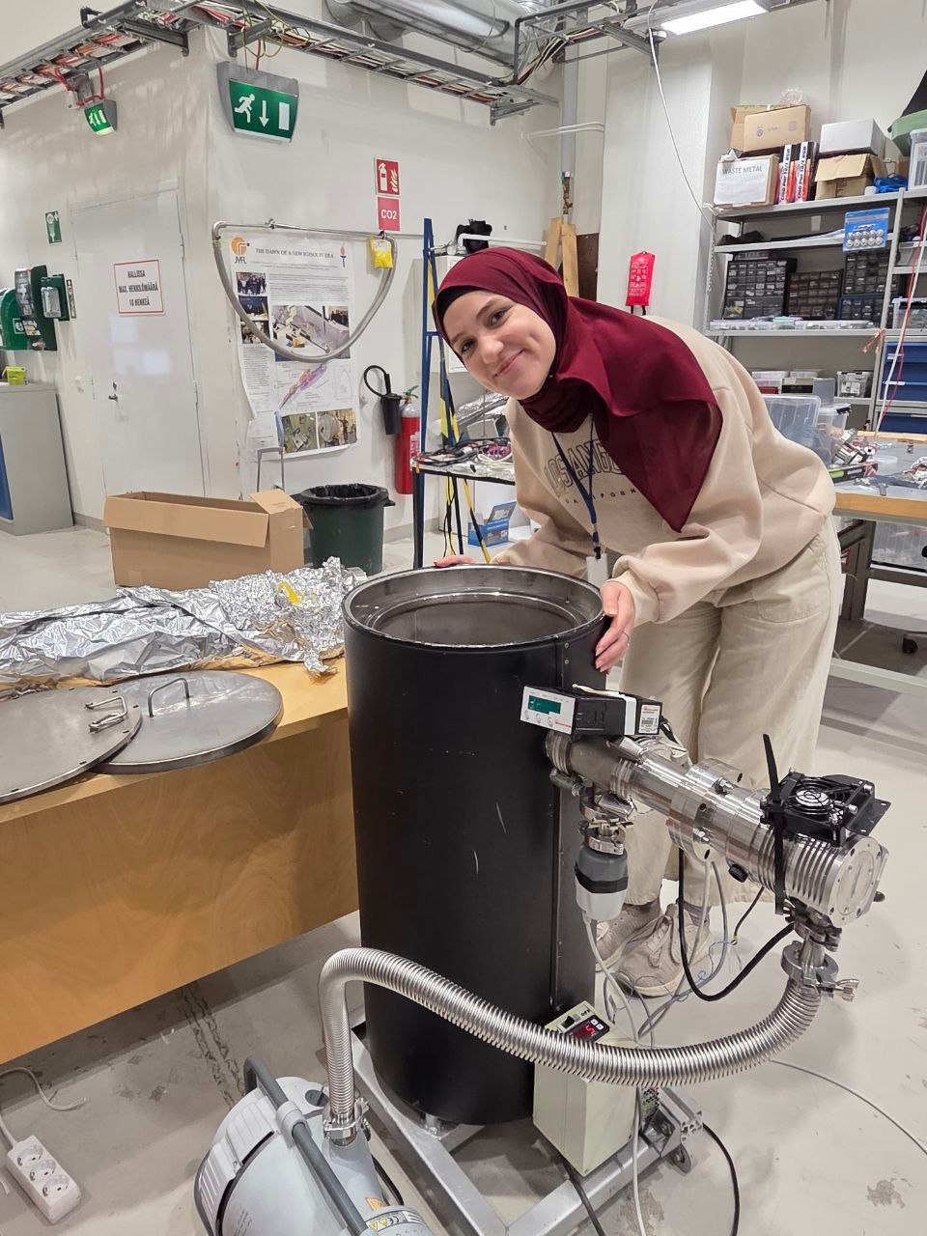
Conclusion, outlook
MORA aims to measure the D-correlation parameter in nuclear β decay to shed light on the matter–antimatter asymmetry in the universe.
Polarization proof of principle successfully achieved with ²³Mg⁺ ions.
Further work needed to purify the ³⁹Ca beam from ³⁹K contamination.
Reliability issues in the IGISOL beamline delayed the D-correlation measurement, but the problems have since been identified and are currently being resolved.
We are almost ready for the D-correlation measurement — at least with ²³Mg!

Slide 14
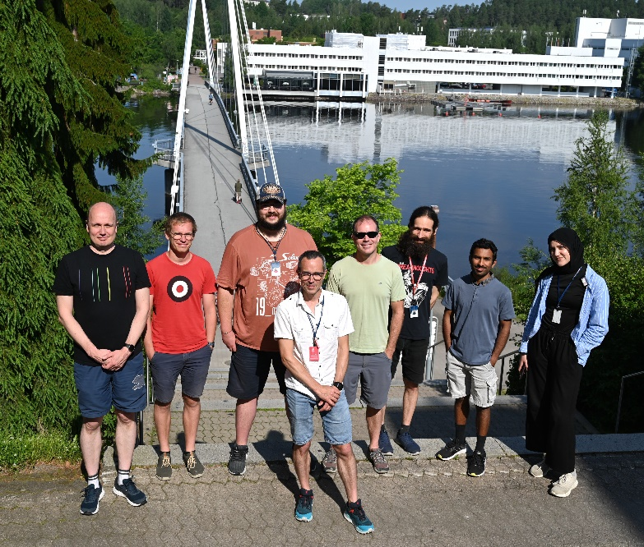




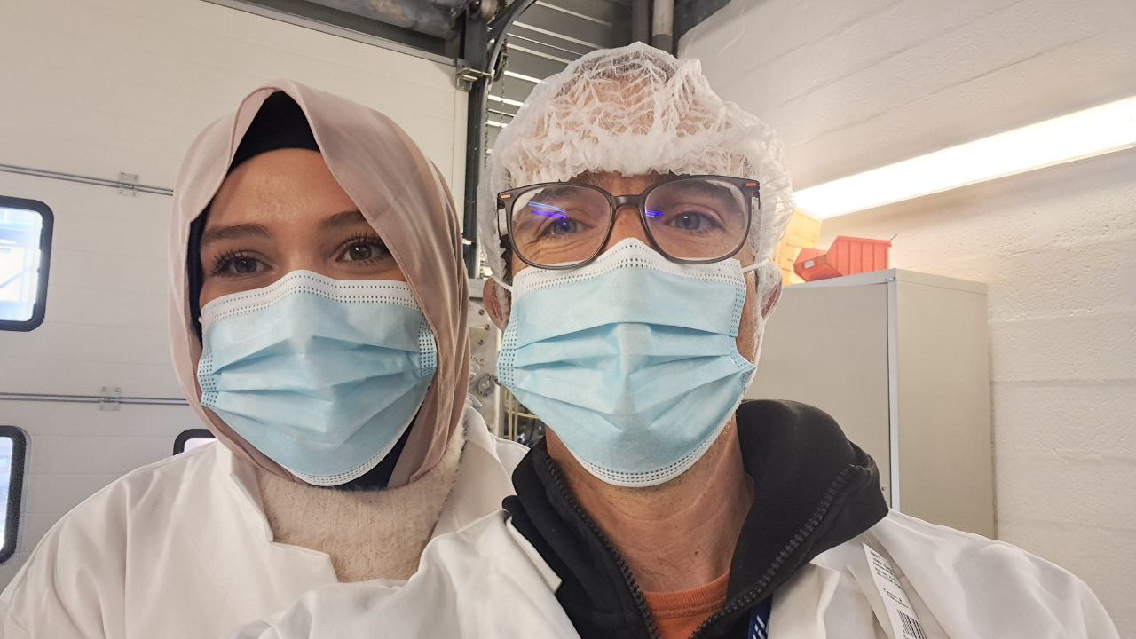




MORA collaboration
Thank you for your attention!
P. Delahaye - P.I.
S. K. Chithakayala
F. De Oliveira
C. Fougères
G. Frémont
N. Goyal
M. Jbayli
N. Lecesne
R. Leroy
L. M. Motilla
B.M. Retailleau
A. Singh
J. C. Thomas
V. Virtanen
C. Pfeffer
I. Moore
T. Eronen
M. Reponen
Z. Ge
M. Mougeot
B. Kotte
W. Gins
J. Romero
A. Raggio
A. Jaries
A. Jokinen
A. Kankainen
S. Kujanpää
M. Stryjczyk
S. Rinta-Antila
E. Liénard
M. Benali
V. Bosquet
S. Daumas-Tschopp
L. Hayen
Y. Merrer
X. Fléchard
G. Quéméner
A. De Roubin
N. Severijns
R.P. De Groote
G. Neyens
S. Vanlangendonck
A. Falkowski
A. Rodriguez – Sanchez
M. Kowalska
M. Gonzalez-Alonso
M.L. Bissel

