Slide 1


RF-laser double-resonance spectroscopy in a gas jet : results and perspectives
Pierre Lassègues

Slide 2
Motivation

Slide 3
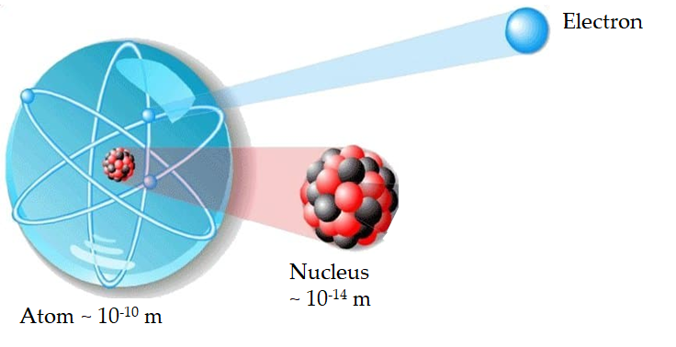
Atomic nuclei
Atomic nuclei are complex objects to understand
Many-body problem
Non-central, strong, unknown intern-nucleon force
Complexity results in emergent and intricate behaviors
The electrons bound to the atom are perfect ‘spies’
Overlap of electron wf with nuclear wf => information on the nucleus!
Binding energies of these electrons can be measured with exquisite precision => Tests of standard model of particle physics!

Slide 4
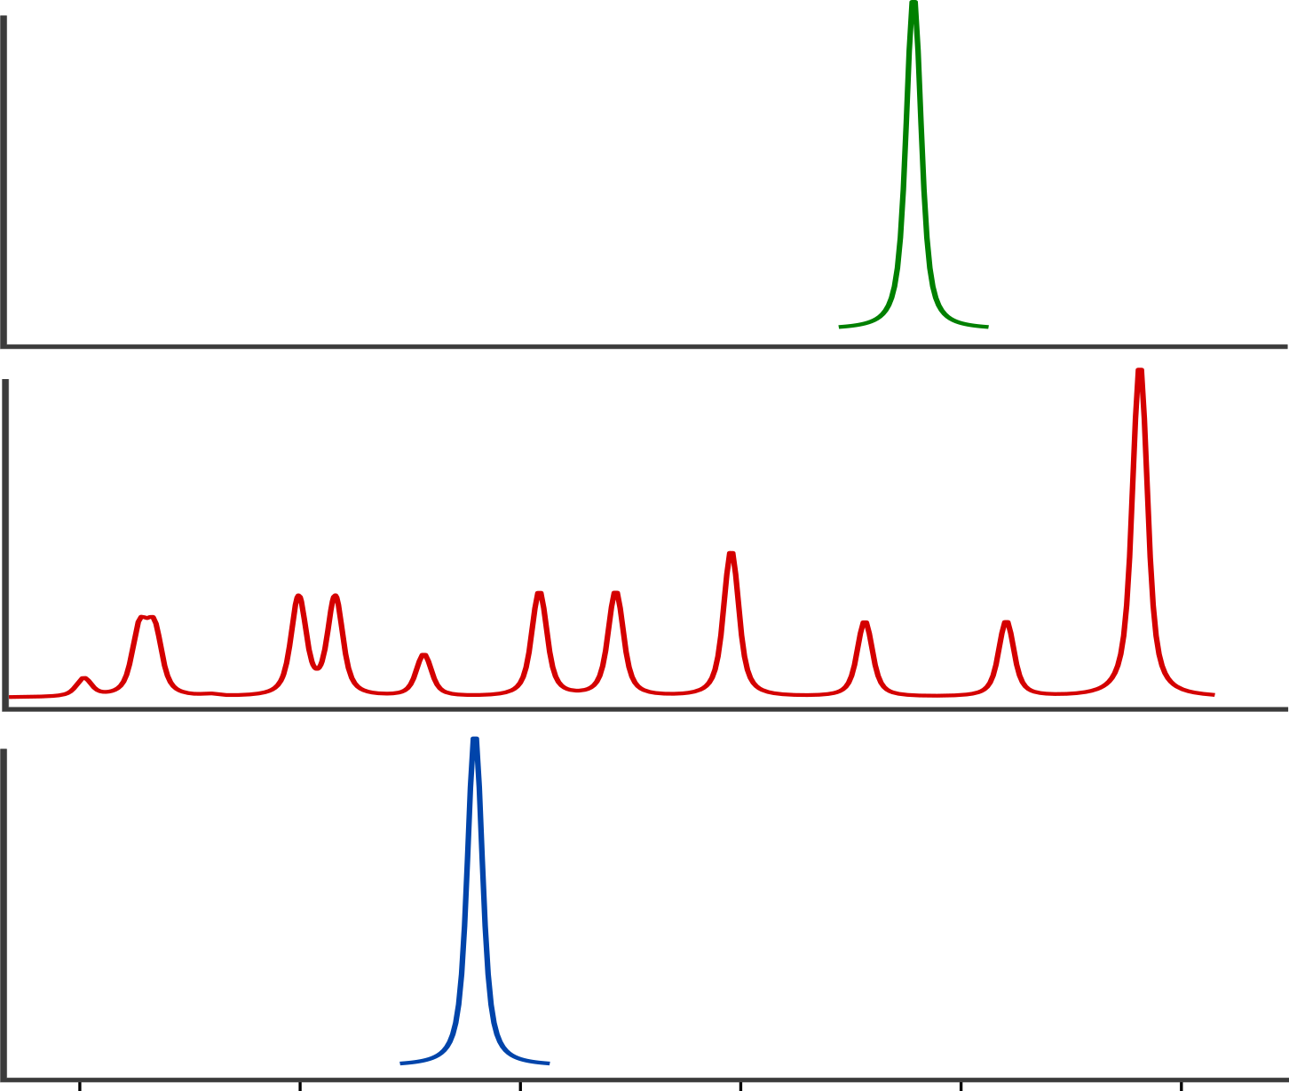
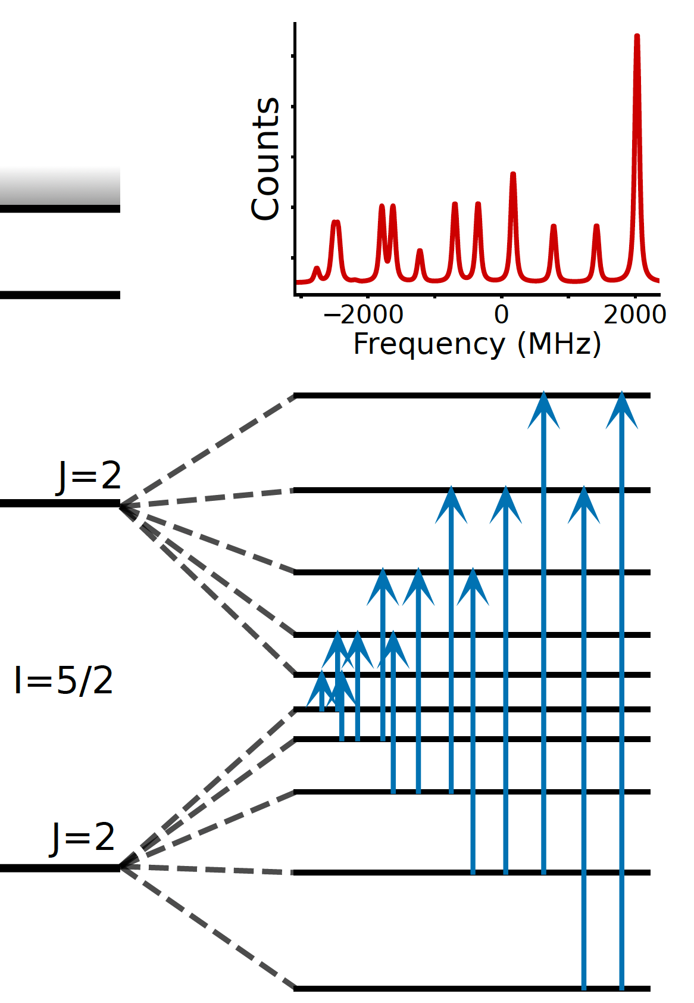
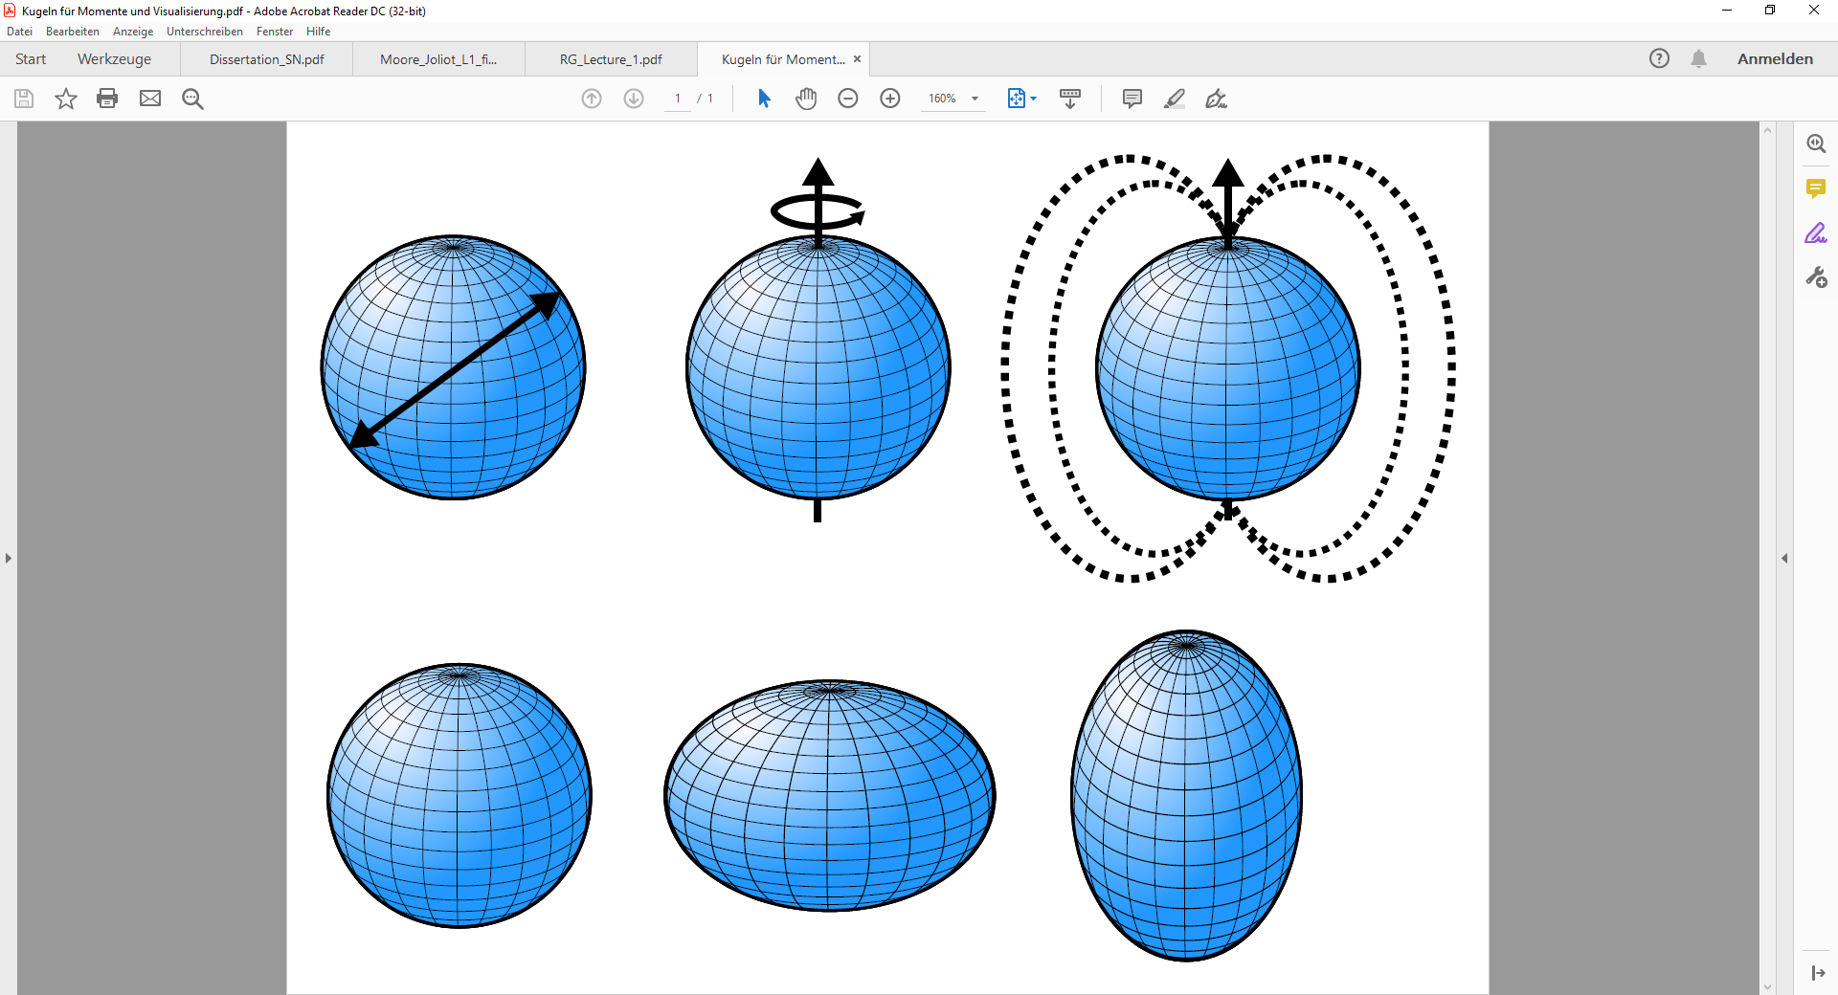
Laser spectroscopy for nuclear structure
Resonant ionisation spectroscopy
Isotope shift and structure
Isotope A
E
E_{IP}
Isotope B
Isotope B
E_{n}
Isotope C
Laser frequency detuning
E₀
Size
I
µ
Q_{s}

Slide 5
Context : Precision frontier in RIB studies
Magnetic dipole moments
Electrical quadrupole moments and charge radii
provides a measure of the deformation and shape of the proton distribution of the nucleus
Hyperfine anomaly
Relates to the distribution of magnetization inside nuclear volume
Higher-order moments
Magnetic octupole, electric hexadecapole, …
GHz
In-source optical spectroscopy
Collinear, in-gas-jet, …
Current state-of-the-art
Laser-rf methods on fast ion beams and thermal beams in traps
Feasible on RIB
Atom/ion traps + laser cooling + ultra-narrow lines
Currently only on stable species
sub-Hz
Notes:
]. The magnetic dipole moment µ provides a fingerprint of the shell model orbit the valence nucleon(s) occupy [deG22]. The electric quadrupole moment, Q, provides a measure of the deformation and shape of the proton distribution of the nucleus, thus complementing the information provided by measurements of the nuclear mean-squared charge radius. These are all well-established as exceedingly potent observables to test and guide the development of nuclear theory [Pas13, Co15, Ver22, Sas22, Soh23, Seu23].

Slide 6
An exemple : Nuclear magnetic octupole moment

Slide 7
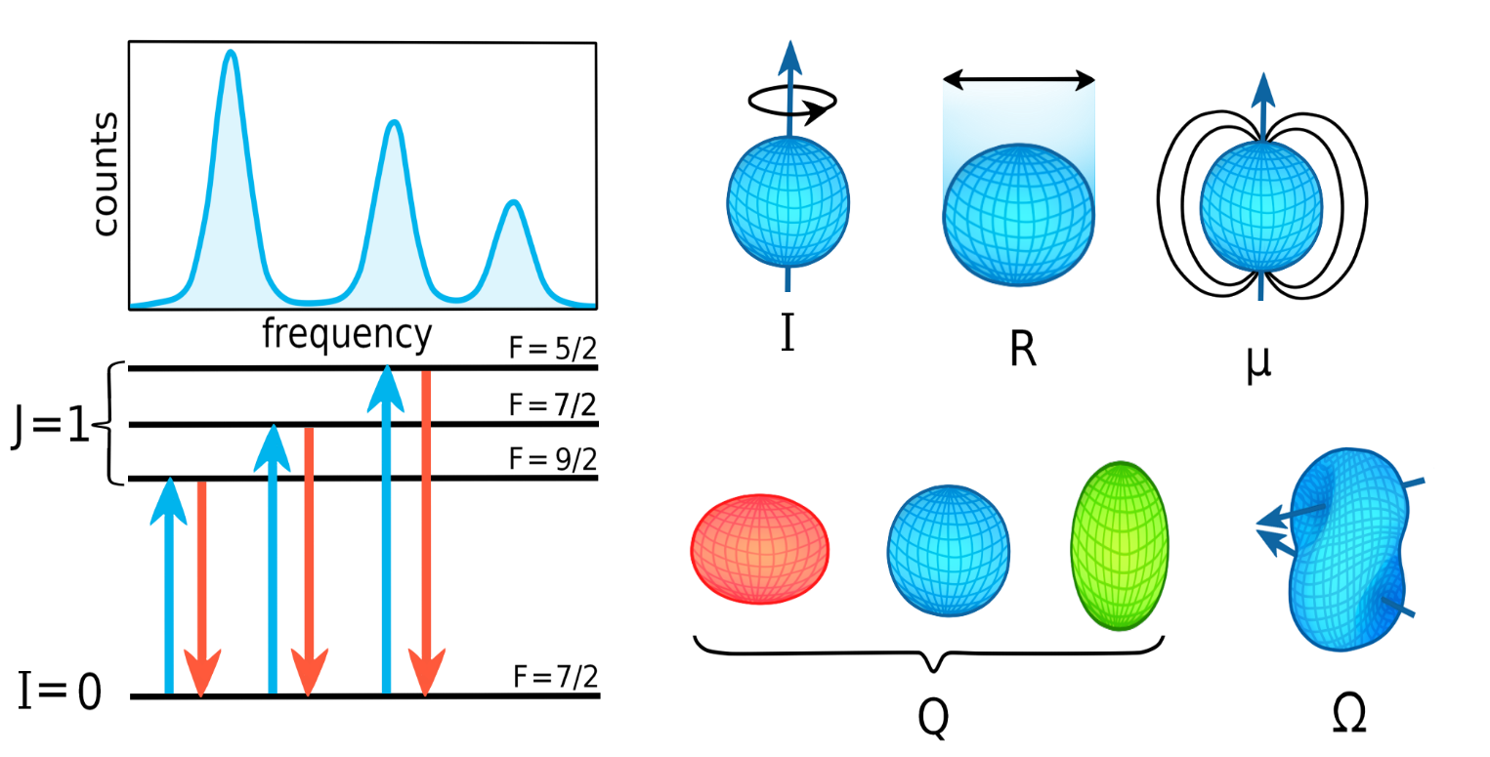
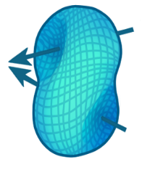
Electromagnetic multipole moments
=
+
+
+…
Nucleus
electromagnetic properties
Magnetic Dipole
μ
Electric Quadrupole
Q
Magnetic Octupole
Ω
Notes:
The electromagnetic properties could be described completely by specifying the charge and current densities of this assembly. Only the protons can contribute to the former while, in addition to the proton.
currents, the spin currents of both neutrons and protons can contribute to the latter. f Such a description is unwieldy, however, and it is more convenient to describe the electromagnetic properties in terms of the electromagnetic multipole moments.
The magnetic dipole moment primarily provides information about the spin structure and the overall magnetic properties of the nucleus. It doesn't directly describe the shape but rather the angular momentum distribution.
Electric moments characterize the distribution of charge in the nucleus. As is known, the charge distribution can be expanded into multipoles and represent the distribution as a superposition of model combinations of electric charges: dipole, quadrupole, etc.
The dipole moment of the nucleus is zero. This means that there is no spatial separation of the proton (charged) and neutron (neutral) components in the nucleus, and the center of the charge distribution coincides with the center of gravity of the nucleus. This does not contradict the fact that these distributions may have different, but symmetrical, external boundaries (Section 2.3).
For nuclei, the quadrupole moment characterizes the deviation of the charge distribution from sphericity. In spherically symmetric nuclei, it is zero. However, in nonspherical nuclei the quadrupole moment is nonzero. Thus, for a nucleus in the form of a prolate ellipsoid elongated along the spin, the quadrupole moment has a positive value, and for a nucleus in the form of an oblate ellipsoid with respect to the direction of the spin, it is negative.
Deviations from spherical symmetry in most cases do not exceed 10

Slide 8
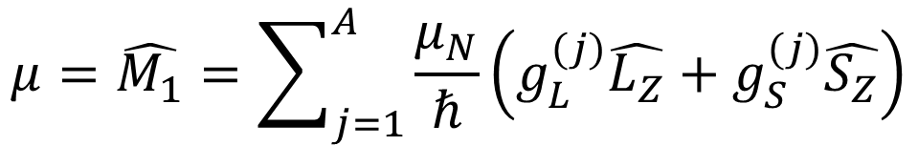
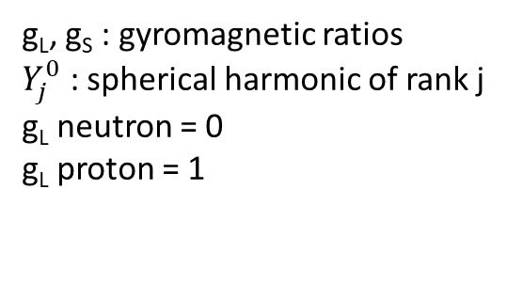

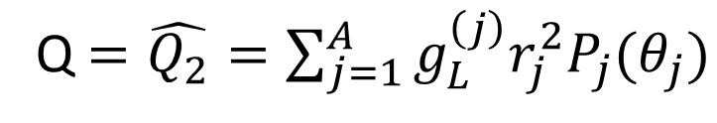
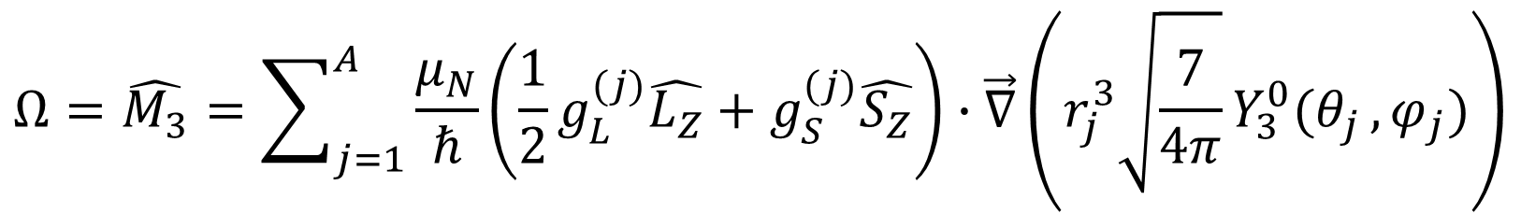
Electric and magnetic moment operators
g_{L}, g_{S} : gyromagnetic ratios
$Y_{j}^{0}$ : spherical harmonic of rank j
g_{L} neutron = 0
g_{L} proton = 1
Operators
$$μ=\hat{M_{1}}=\sum_{j=1}^{A}{\frac{μ_{N}}{ℏ}\left(g_{L}^{(j)}\hat{L_{Z}}+g_{S}^{(j)}\hat{S_{Z}}\right)}$$
Magnetic dipole
Q$=\hat{Q_{2}}=\sum_{j=1}^{A}{g_{L}^{\left(j\right)}r_{j}^{2}P_{j}(θ_{j})}$
No $g_{S}^{(j)}$, Proton only
Electric quadrupole
$$Ω=\hat{M_{3}}=\sum_{j=1}^{A}{\frac{μ_{N}}{ℏ}\left(\frac{1}{2}g_{L}^{(j)}\hat{L_{Z}}+g_{S}^{(j)}\hat{S_{Z}}\right)∙\vec{∇}\left(r_{j}^{3}\sqrt{\frac{7}{4π}}Y_{3}^{0}(θ_{j },φ_{j})\right)}$$
Magnetic octupole
Same g-factors!
Spatial wf information
Blin-Stoyle, R. J. Theories of Nuclear Moments. Rev. Mod. Phys. 28, 75–101 (1956).
Notes:
For a proton gl=1 and gs=5.587 while for a neutron gl=0 and gs= 3.826.
orbital angular momentum (usually denoted L), and spin angular momentum (S)

Slide 9
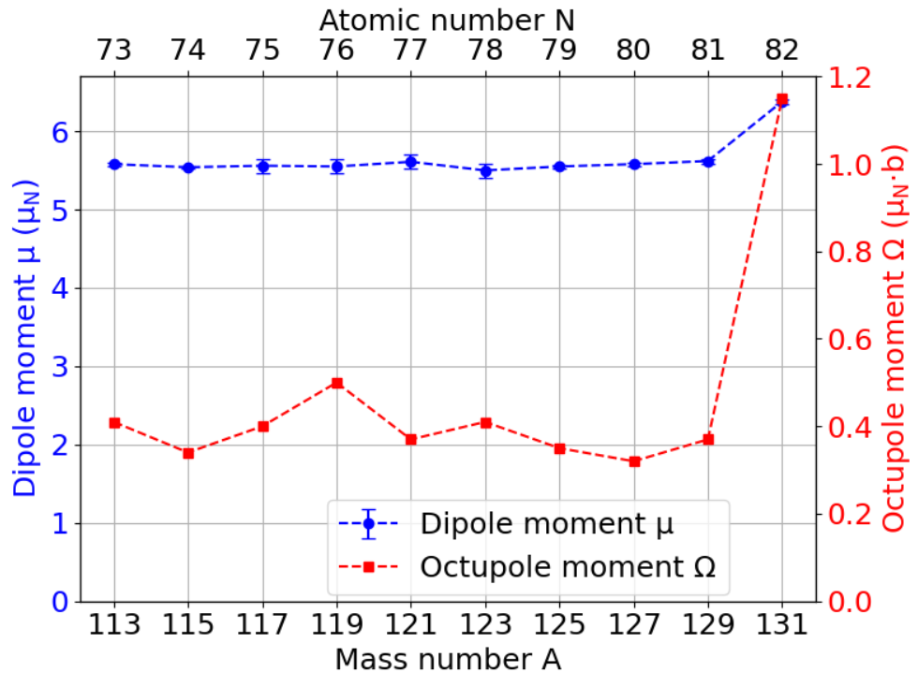
Magnetic octupole moments: sensitive probe
~15%
Theoretical work based on density functional theory (DFT) calculations, for the Indium (Z=49) isotopic chain
µ only drops 15% away from the closed N=82 (¹³¹In) shell, Ω drops by 70%
Vernon et al. 2022
de Groote RP, Dobaczewski J,
et al. (2025), to be published
~70%
Vernon, A. R. et al. Nuclear moments of indium isotopes reveal abrupt change at magic number 82. Nature 607(2022).
Notes:
Indium Z= 49

Slide 10
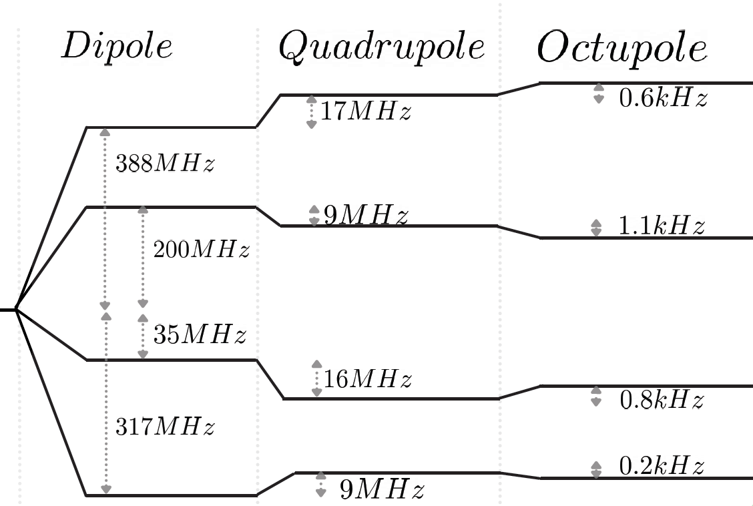

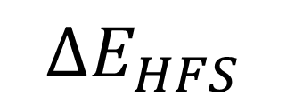
How ? : Spectroscopy
$$∆E_{HFS}$$
=
+
+
Schwartz, C. Theory of Hyperfine Structure. Phys. Rev. 97, 380–395 (1955).
Nuclear moments lead to shift and splitting of fine structure levels (hyperfine structure)
Contribution of higher-order magnetic octupole moment is three or more orders of magnitude smaller
$$D_{3/2}$$
Example: D_{3/2} state in 87Sr⁺. Theoretical
[B.K. Sahoo].

Slide 11
How ? : Spectroscopy
$$∆E_{HFS}$$
=
+
+
Schwartz, C. Theory of Hyperfine Structure. Phys. Rev. 97, 380–395 (1955).
To resolve magnetic Octupole moment contribution we need a sub kHz resolution
$$D_{3/2}$$
Example: D_{3/2} state in 87Sr⁺. Theoretical
[B.K. Sahoo].

Slide 12
In-gas jet Laser-Radiofrequency double resonance

Slide 13
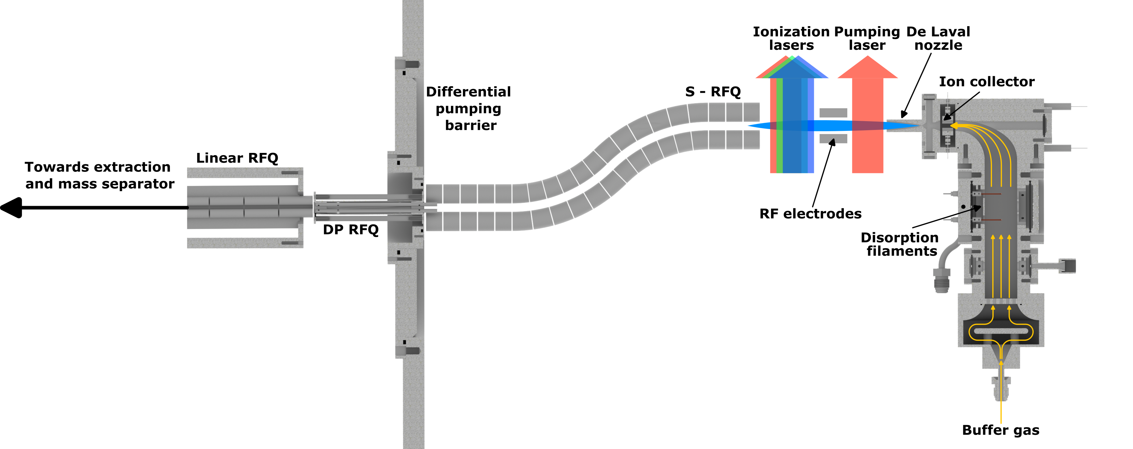
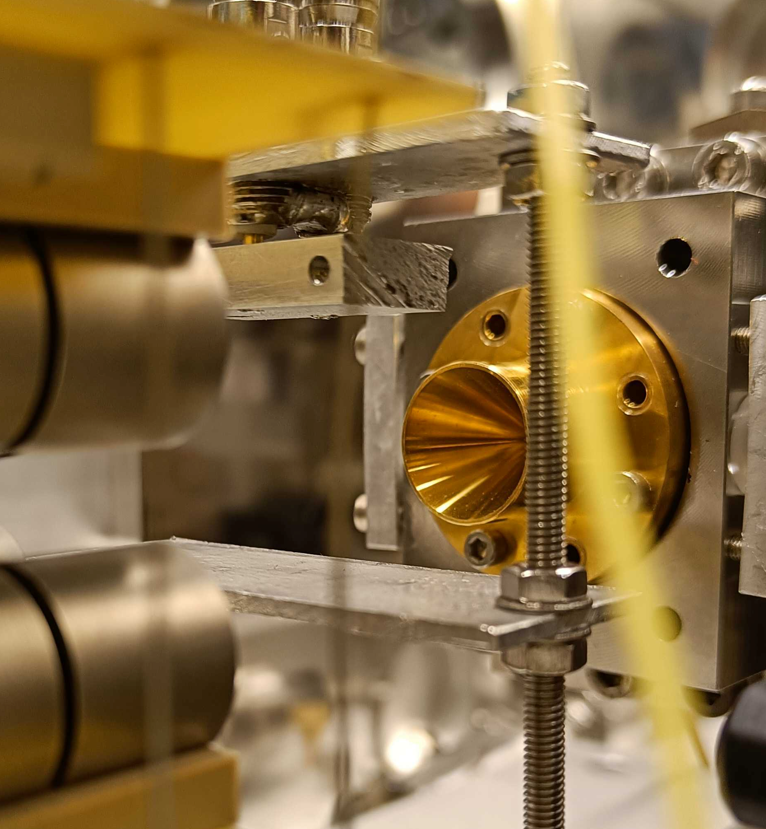
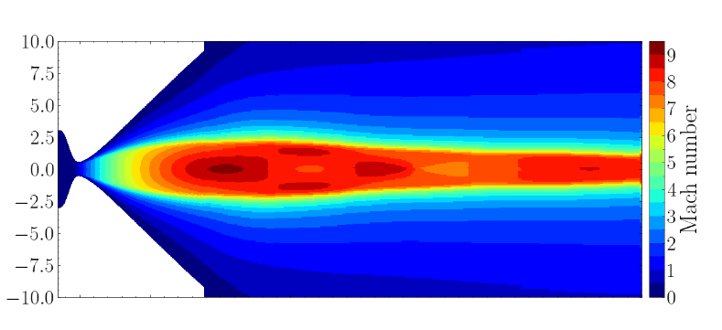
State of the art
IP
F = 2
F = 1
F = 2
F = 1
Sonde

Slide 14
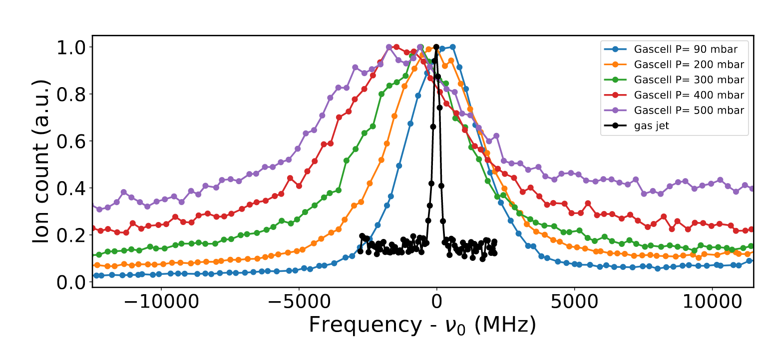
State of the art
Method | Spectral width (FWHM)
In-gas-cell | ~1.8 GHz
In-gas-jet | ~15 MHz
Ajayakumar, A. et al. In-gas-jet laser spectroscopy with S3-LEB. Nuclear Instruments and Methods in Physics Research Section B: Beam Interactions with Materials and Atoms 539, 102–107 (2023).

Slide 15


Laser - RF
F = 2
$${}_{}^{2}{P_{1/2}}$$
F = 1
F = 2
Method | Spectral width (FWHM)
In-gas-cell | ~1.8 GHz
In-gas-jet | ~15 MHz
$${}_{}^{2}{S_{1/2}}$$
F = 1
Pump
Laser-RF | ?

Slide 16
Laser - RF
F = 2
$${}_{}^{2}{P_{1/2}}$$
F = 1
F = 2
$${}_{}^{2}{S_{1/2}}$$
Method | Spectral width (FWHM)
In-gas-cell | ~1.8 GHz
In-gas-jet | ~15 MHz
F = 1
RF
Laser-RF | ?

Slide 17
Laser - RF
IP
F = 2
$${}_{}^{2}{P_{1/2}}$$
F = 1
F = 2
Method | Spectral width (FWHM)
In-gas-cell | ~1.8 GHz
In-gas-jet | ~15 MHz
$${}_{}^{2}{S_{1/2}}$$
F = 1
Probe
Laser-RF | ?

Slide 18
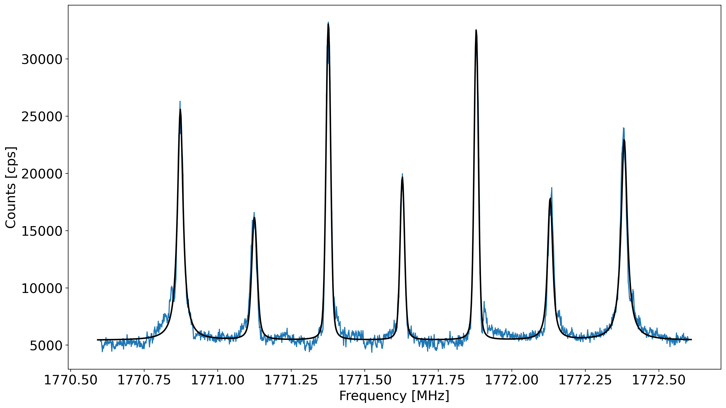
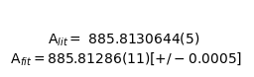
Proof of concept
Preliminary results :
Measurements on Na
Spectral width: 20-30 KHz
Accord to literature :
ΔAHFS = 200Hz
Systematics : ~100Hz

Slide 19
Proof of concept
Preliminary results :
Measurements on Na
Spectral width: 20-30 KHz
Accord to literature :
ΔAHFS = 200Hz
Systematics : ~100Hz

Slide 20
Proof of concept
Preliminary results :
Measurements on Na
Spectral width: 20-30 KHz
Accord to literature :
ΔAHFS = 200Hz
Systematics : ~100Hz
Preliminary results:
Coherent excitation

Slide 21
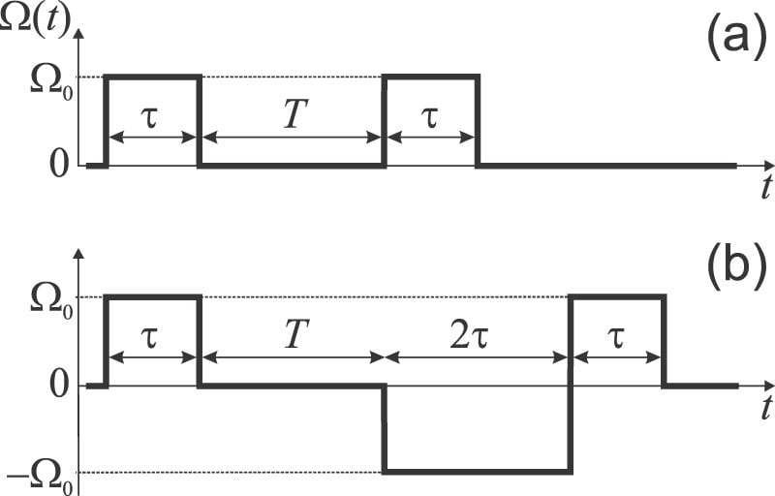
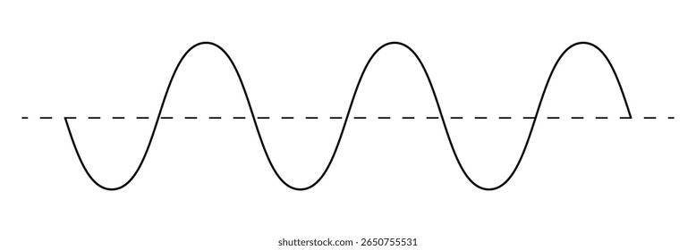
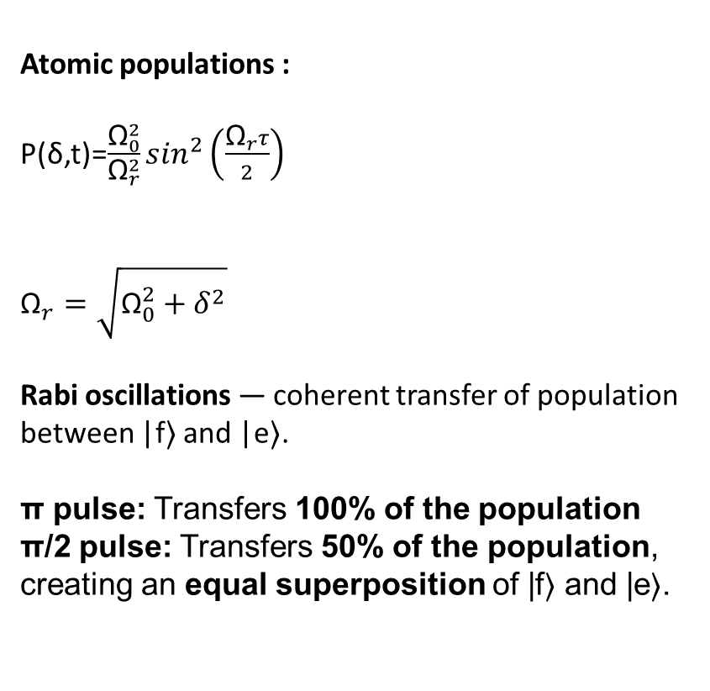
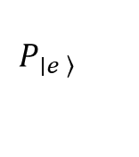
Coherent excitation
Atomic populations :
P(δ,t)=$\frac{{\text{Ω}}_{0}^{2}}{{\text{Ω}}_{r}^{2}}\sin^{2}\left(\frac{{\text{Ω}}_{r}τ}{2}\right)$
${\text{Ω}}_{r}=\sqrt{{\text{Ω}}_{0}^{2}+δ^{2}}$​
Rabi oscillations — coherent transfer of population between |f⟩ and |e⟩.
π pulse: Transfers 100% of the population π/2 pulse: Transfers 50% of the population, creating an equal superposition of |f⟩ and |e⟩.
|e⟩
|f⟩
$$P_{\left.∣e \right\rangle }$$
Time

Slide 22
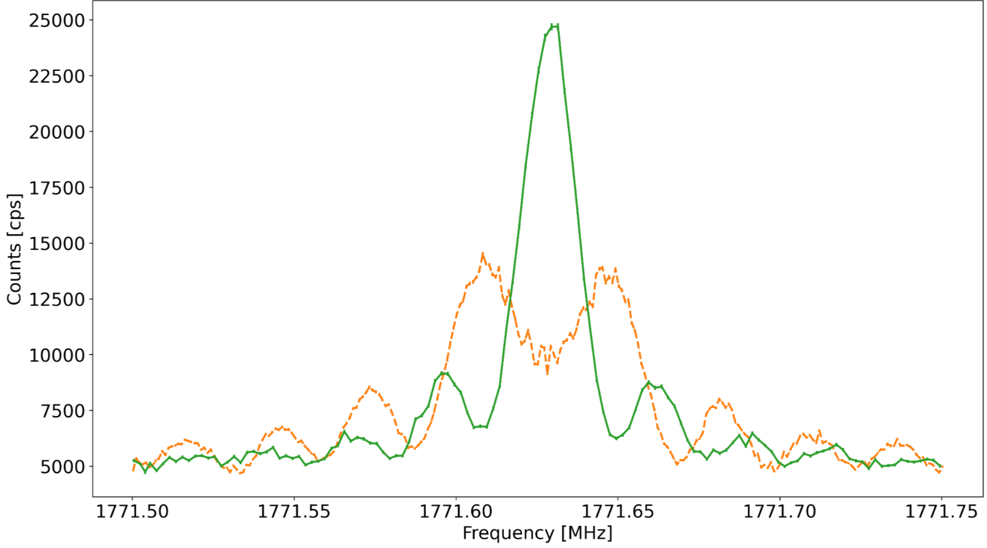


Proof of concept
Preliminary results :
Measurements on Na
Spectral width : 20-30 KHz
Accord to literature :
ΔAHFS = 200Hz
Systematics : ~100Hz
Rabi oscillation:
Coherent excitation
Spectral width : ~10 KHz
P(δ,t)=$\frac{{\text{Ω}}_{0}^{2}}{{\text{Ω}}_{r}^{2}}\sin^{2}\left(\frac{{\text{Ω}}_{r}τ}{2}\right)$
${\text{Ω}}_{r}=\sqrt{{\text{Ω}}_{0}^{2}+δ^{2}}$​

Slide 23
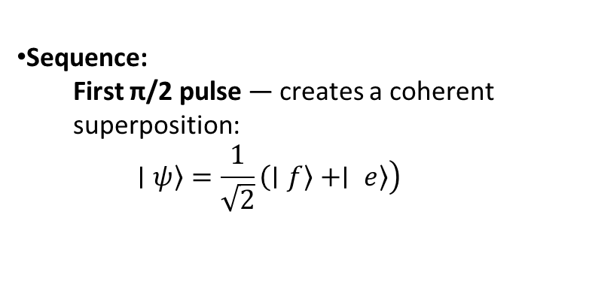
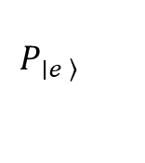
Ramsey Interferometry
Sequence:
First π/2 pulse — creates a coherent superposition: $$\left.∣ψ\right\rangle =\frac{1}{\sqrt{2}}\left(∣f\right\rangle +∣ \left.\left.e\right\rangle \right)$$
π/2
|e⟩
|f⟩
$$P_{\left.∣e \right\rangle }$$
Time

Slide 24
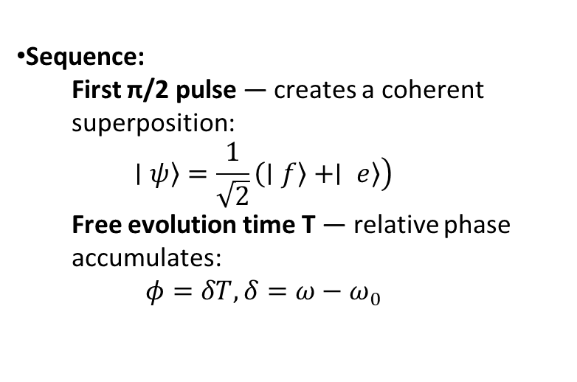
Ramsey Interferometry
Sequence:
First π/2 pulse — creates a coherent superposition: $$\left.∣ψ\right\rangle =\frac{1}{\sqrt{2}}\left(∣f\right\rangle +∣ \left.\left.e\right\rangle \right)$$
Free evolution time T — relative phase accumulates: $$φ=δT, δ=ω−ω_{0}$$
π/2
T
|e⟩
|f⟩
$$P_{\left.∣e \right\rangle }$$
Time

Slide 25
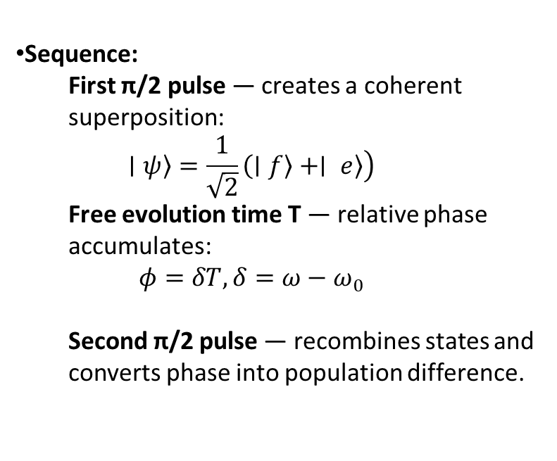
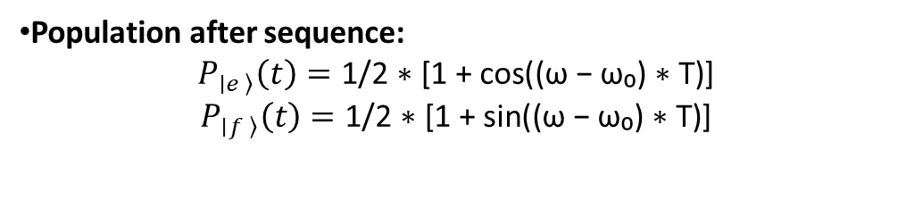
Ramsey Interferometry
Sequence:
First π/2 pulse — creates a coherent superposition: $$\left.∣ψ\right\rangle =\frac{1}{\sqrt{2}}\left(∣f\right\rangle +∣ \left.\left.e\right\rangle \right)$$
Free evolution time T — relative phase accumulates: $$φ=δT, δ=ω−ω_{0}$$
Second π/2 pulse — recombines states and converts phase into population difference.
π/2
T
π/2
|e⟩
|f⟩
$$P_{\left.∣e \right\rangle }$$
Population after sequence:
$$P_{\left.∣e \right\rangle }\left(t\right)=\text{1/2 ∗ [1 + }\text{cos}\text{((}\text{ω}\text{ − }\text{ω}\text{₀) ∗ }\text{T}\text{)]}$$
$$P_{\left.∣f \right\rangle }\left(t\right)=\text{1/2 ∗ [1 + }\text{sin}\text{((}\text{ω}\text{ − }\text{ω}\text{₀) ∗ }\text{T}\text{)]}$$
Time

Slide 26
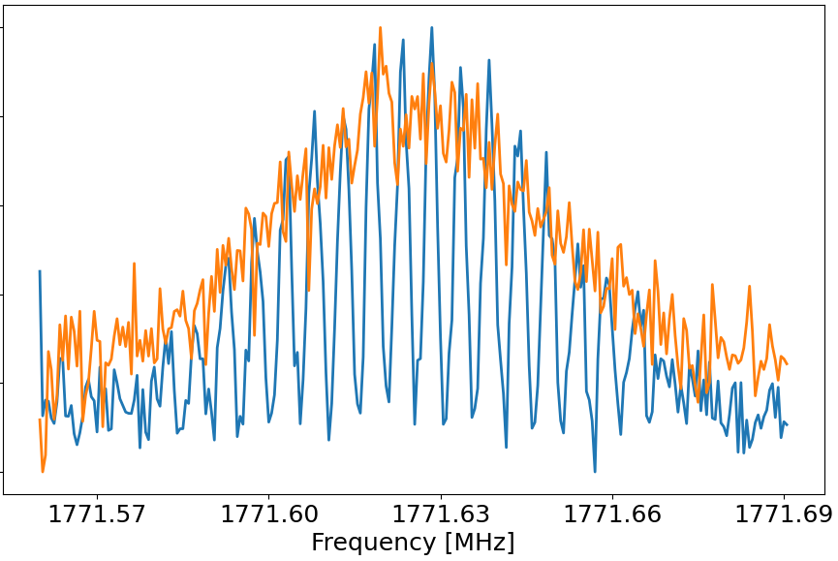

Proof of concept
Preliminary results :
Measurements on Na
Spectral width : 20-30 KHz
Accord to literature :
ΔAHFS = 200Hz
Systématics : ~100Hz
Rabi oscillation:
Coherent excitation
Spectral width : ~10 KHz
Ramsey interferometry:
2 pulses separated by time T
Spectral width : ~2,5 KHz
P(δ,t)=$\frac{{\text{Ω}}_{0}^{2}}{{\text{Ω}}_{r}^{2}}\sin^{2}\left(\frac{{\text{Ω}}_{r}τ}{2}\right)$
${\text{Ω}}_{r}=\sqrt{{\text{Ω}}_{0}^{2}+δ^{2}}$​
P(δ,t)=$\frac{{\text{Ω}}_{0}^{2}}{{\text{Ω}}_{r}^{2}}\sin^{2}\left(\frac{{\text{Ω}}_{r}τ}{2}\right)$ $\cos^{2}\left(\frac{\text{δ}\text{T}}{2}\right)$

Slide 27
Proof of concept
Method | Spectral width (FWHM)
In-gas-cell | 1.8 GHz
In-gas-jet | 15 MHz
Laser-RF | 25 KHz
Rabi-Laser-RF | 10 KHz
Ramsey-Laser-RF | 2,5 KHz
Laser-RF | 25 KHz
Rabi-Laser-RF | 10 KHz
Ramsey-Laser-RF | 2,5 KHz

Slide 28
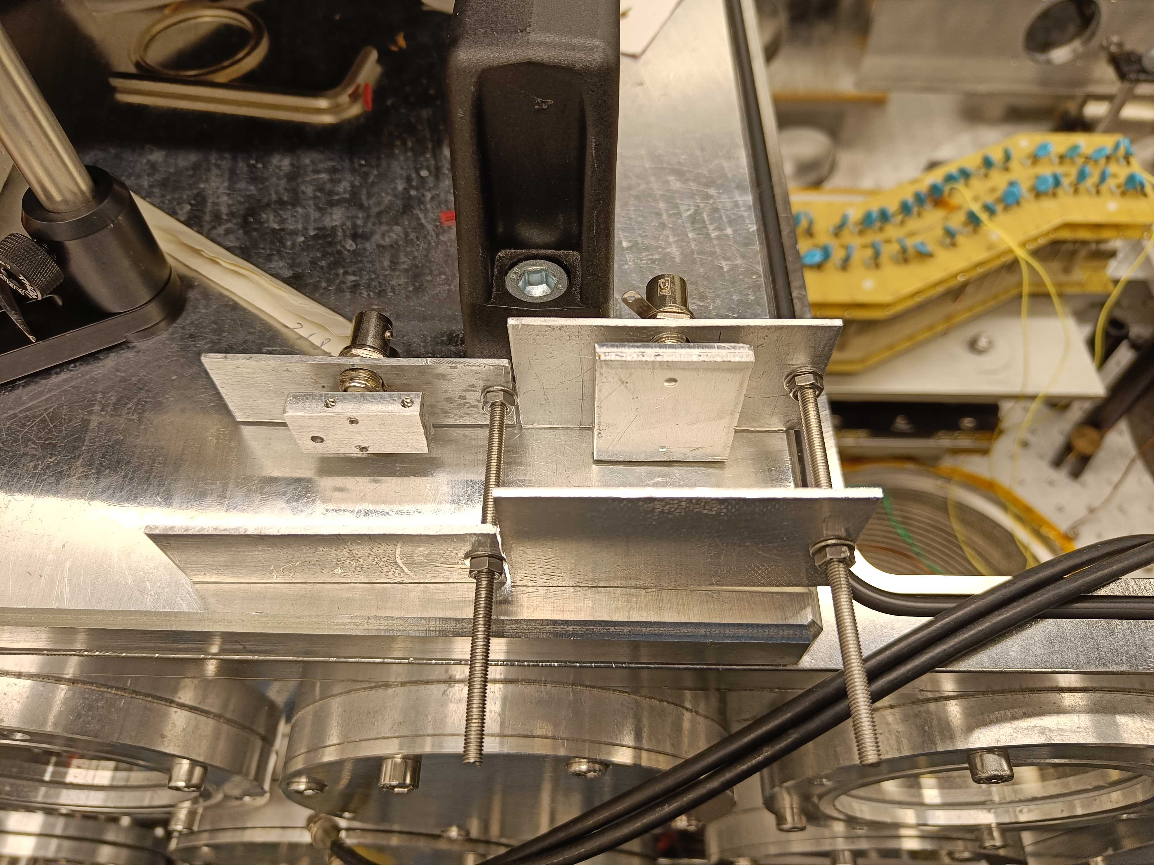
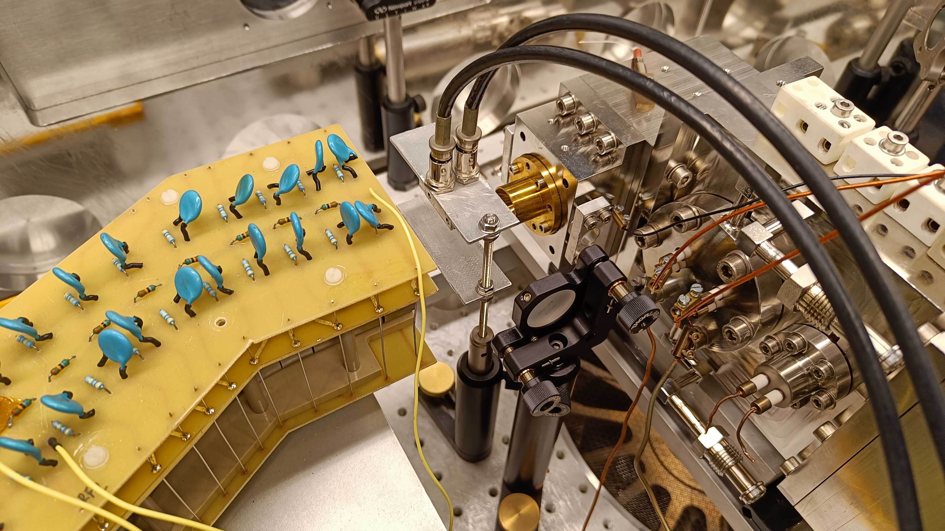
Future of the experiment
Improved connections and dimensions

Slide 29
Future of the experiment
Cancellation of Zeeman splitting
Enhance signal-to-noise ratio :
In exotic or rare isotope beams maximizes detectable signal.
Simplify spectra: Reduced line broadening and overlap
Experimental implementation:
dedicated coil system (saddle coils for transverse components and Helmholtz or Maxwell coils for longitudinal field compensation).

Slide 30
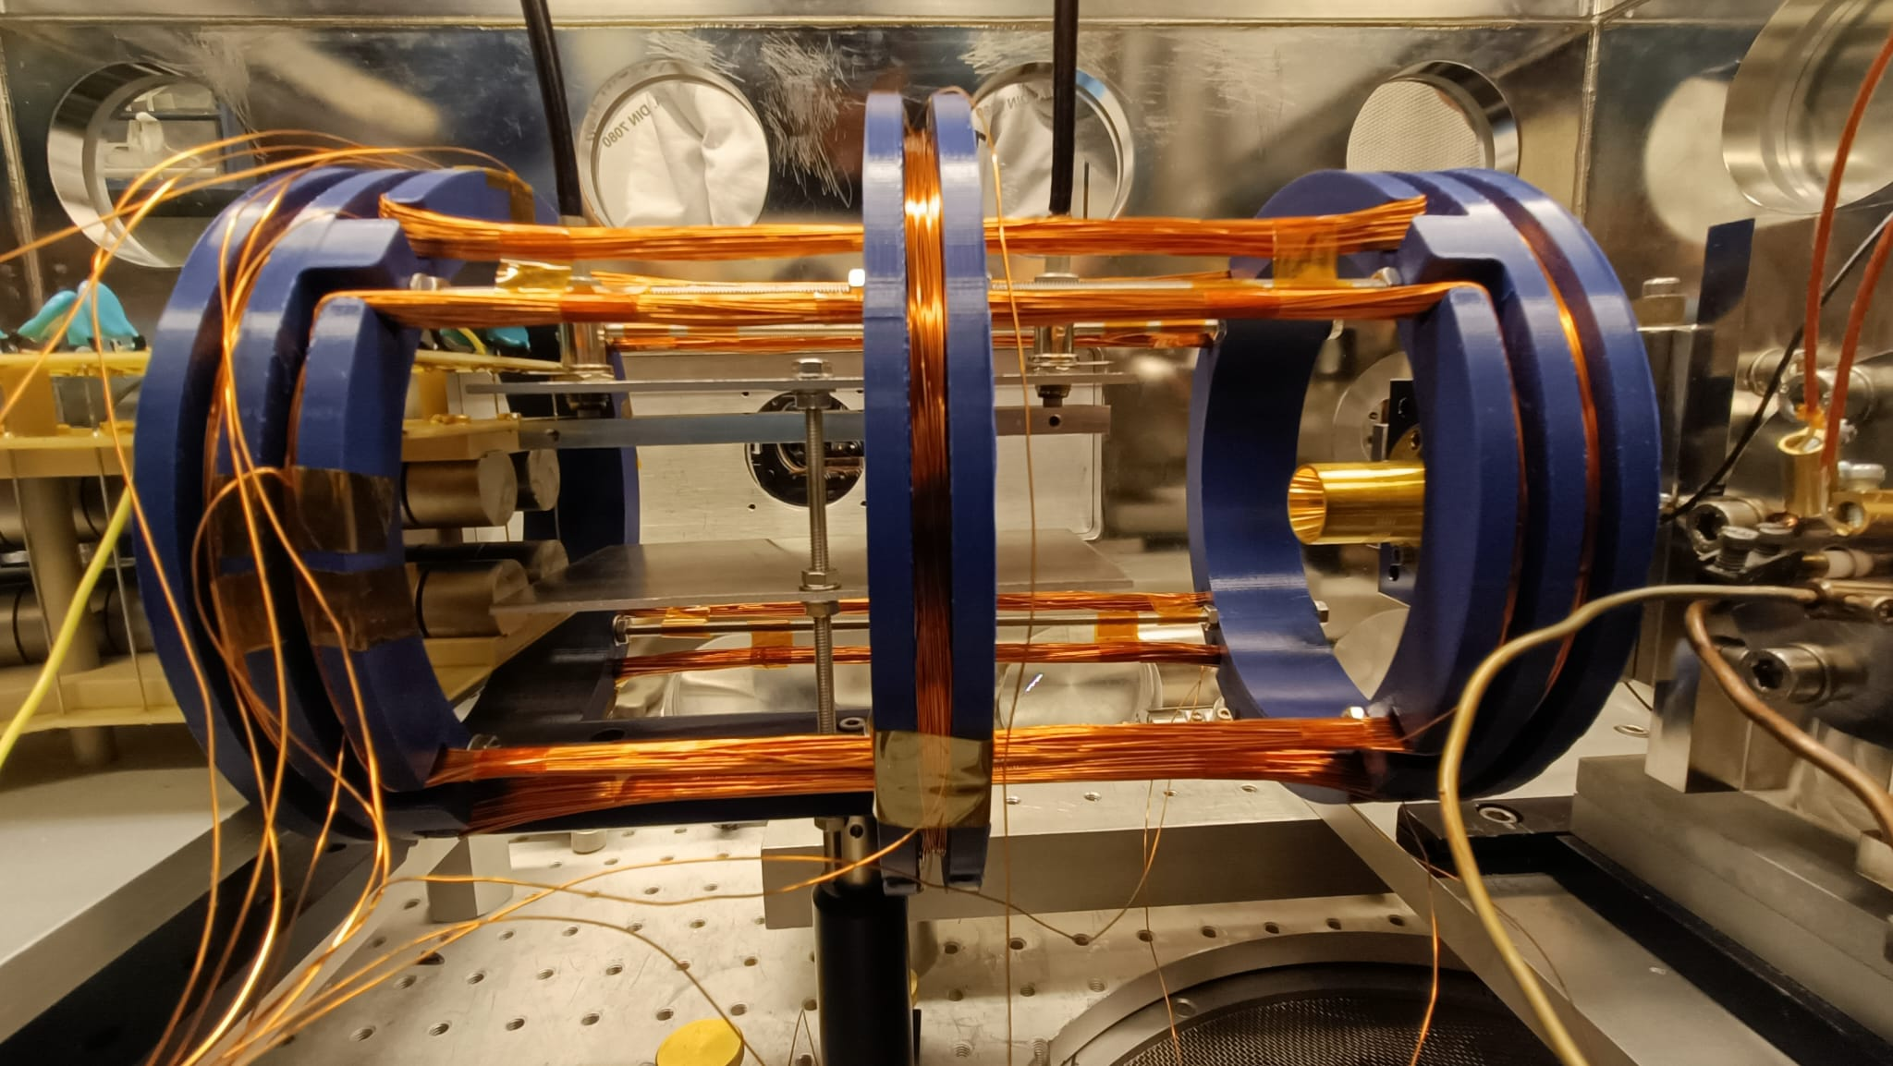
Future of the experiment
Cancellation of Zeeman splitting
Enhance signal-to-noise ratio :
In exotic or rare isotope beams maximizes detectable signal.
Simplify spectra: Reduced line broadening and overlap
Experimental implementation:
dedicated coil system (saddle coils for transverse components and Helmholtz or Maxwell coils for longitudinal field compensation).

Slide 31
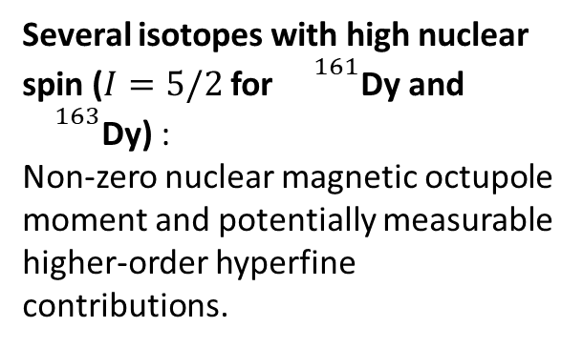
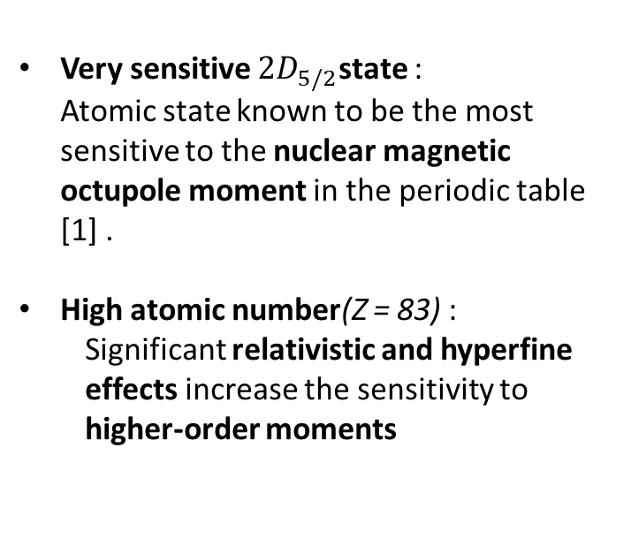
Future of the experiment
83
66
Bi
Dy
64
Gd
Bismuth
Dysprosium
Gadolinium
Very sensitive $2D_{5/2}$state : Atomic state known to be the most sensitive to the nuclear magnetic octupole moment in the periodic table [1] .
High atomic number(Z = 83) :
Significant relativistic and hyperfine effects increase the sensitivity to higher-order moments
Several isotopes with high nuclear spin ($I=5/2$ for ${}^{161}$Dy and ${}^{163}$Dy) : Non-zero nuclear magnetic octupole moment and potentially measurable higher-order hyperfine contributions.
Historical measurements on ¹⁵⁵Gd show that the octupole moment is higher than predicted by simple models, revealing relativistic effects and complex electronic correlations [2].
Produced from the first day at S3-LEB → immediately accessible for measurements..
[1] Li, J., et al., “Re-Evaluation of the Nuclear Magnetic Octupole Moment of 209Bi”, Atoms 10 (2022).
[2] Unsworth, P. J. “Nuclear dipole, quadrupole and octupole moments of 155Gd by atomic beam magnetic resonance”. J. Phys. B: At. Mol. Phys. 2, 122–133 (1969).

Slide 32
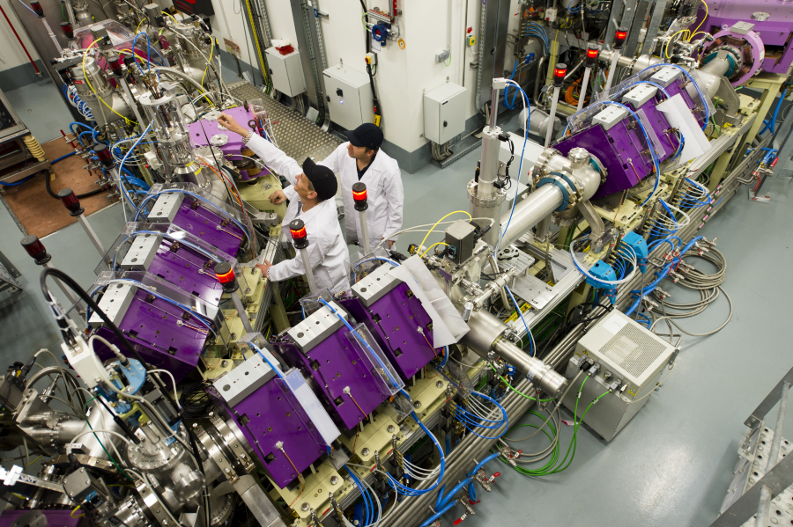

Future of the Experiment
Caen
Laboratoire de Physique Corpusculaire de Caen (LPC)

Slide 33
Conclusion
Objective is to provide data on unexplored properties of radioactive isotopes using measurement of magnetic octupole moments
New methodology, which relies on In-gas jet Laser-Radiofrequency double resonance
High precision spectroscopy
open studies on other nuclear
observables: Electric quadrupole,
hyperfine anomaly…
Method | Spectral width (FWHM)
In-gas-cell | 1.8 GHz
In-gas-jet | 15 MHz
Laser-RF | 25 KHz
Rabi-Laser-RF | 10 KHz
Ramsey-Laser-RF | 2,5 KHz
Laser-RF | 25 KHz
Rabi-Laser-RF | 10 KHz
Ramsey-Laser-RF | 2,5 KHz

Slide 34






Thank You

Slide 35
Supplemental

Slide 36
An example: isotope shifts of electronic energies probe nuclear and fundamental physics

Slide 37
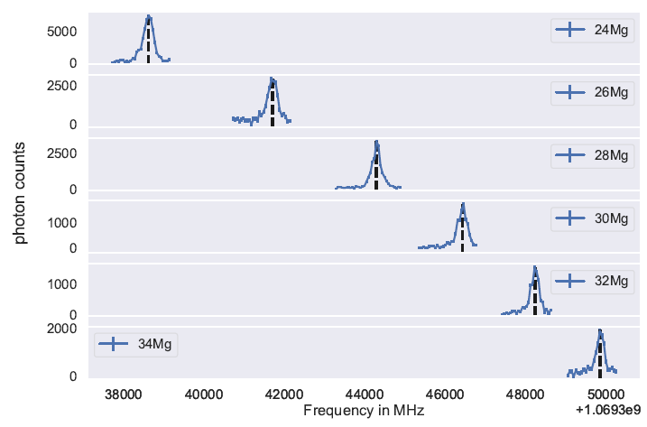
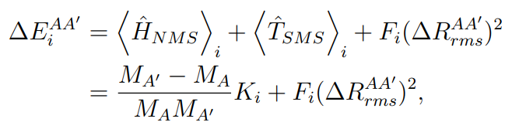


Atomic structure as a probe for nuclear structure
Isotope shift: optical transition frequency shifts from isotope to isotope.
Change in nuclear mass
Change in nuclear size

Slide 38
Wider context: higher-precision spectroscopy of radioactive ions
Charge radius: <r²> - bulk ‘size’ of the nucleus
Higher-order moments of the charge radii
E.g. <r⁴> relates to surface thickness of nuclear density
Beyond-standard model physics from Hz-level isotope shift spectroscopy
MHz
Current methods in radioactive ion laboratories (accelerator-driven labs)
100 kHz
1 kHz
Atom/ion traps + laser cooling + ultra-narrow lines
QUANTUM TOOLBOX
sub-Hz

Slide 39
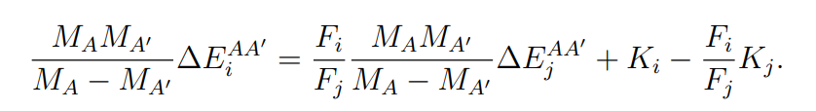
King plots
Two transitions:
y = m x + b

Slide 40
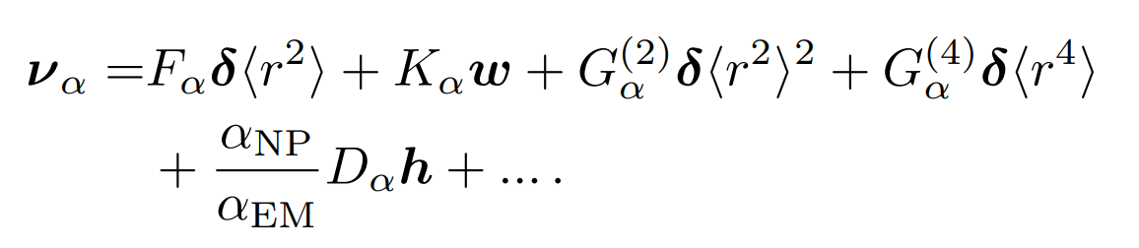
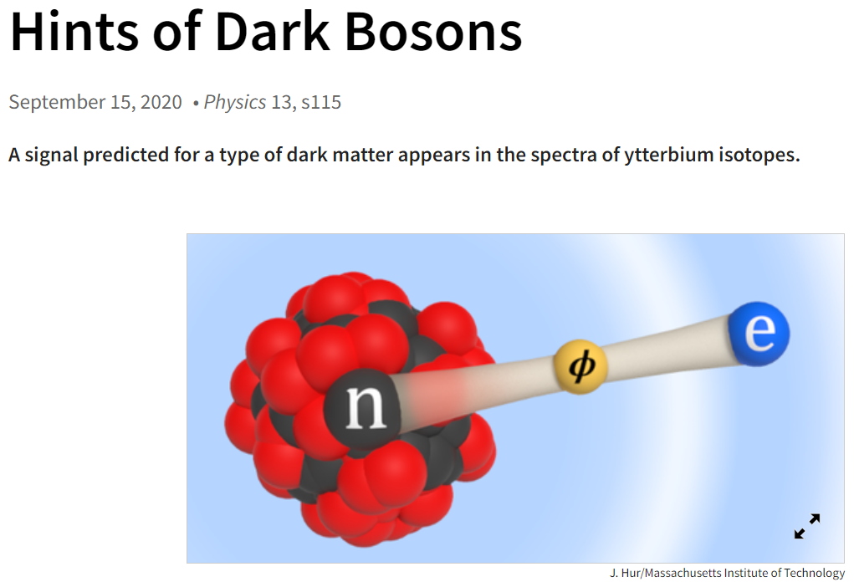
Isotope shifts in more detail…

Slide 41
Isotope shifts in more detail…
Well-understood (for some definition of ‘well’)
Known, but poorly understood
‘New’, so far only constrained

Slide 42
Non-linear king plots
King plot will no longer be linear
Hunt for non-linearities!
G⁽²⁾: Purely atomic physics; second-order field shift
G⁽²⁾ d<r⁴ >: nuclear physics information as well
‘h’: new boson

