Slide 1


High-precision optical spectroscopy of trapped radioactive ions: from Leuven, to Finland, to DESIR
Trapped ${Sr}^{+}$ in our trap BICEPS
R. Van Duyse¹, J. Grondin¹, B. Hendrickx¹, P. Imgram^{1,2}, A. Karadimas¹, S. Kraemer¹, S. Kunnen¹, P. Lassègues³, S. Lechner⁴, N. Libeer¹, S. Pelonis¹, R. de Groote¹
¹ Institute for Nuclear and Radiation Physics, KU Leuven
² Facility for Antiproton and Ion Research (FAIR)
³ LPC Caen
⁴ LP2i-Bordeaux
ISOL@France workshop, 17/03/2026
Notes:
Hello everyone, I’m Robbe and I am a PhD student at the institute of nuclear and radiation physics at KU Leuven. For a couple years, our group has been developing two linear Paul trap setups aimed at high precision optical spectroscopy of radioactive atoms in our labs in Leuven, in Belgium and today I will report you on how far we have come and what the plans are for the future, for Belgium, Jyvaskyla in Finland and finally here in Desir. I know I will

Slide 2
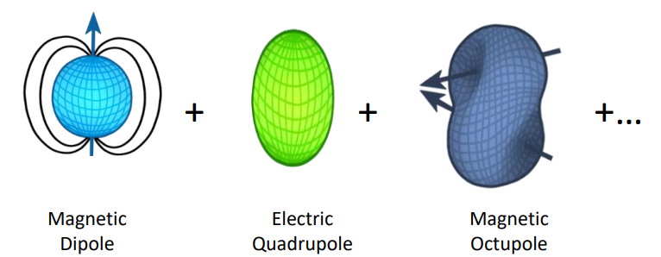



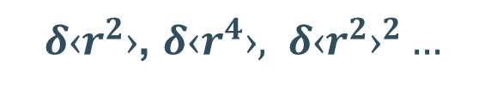

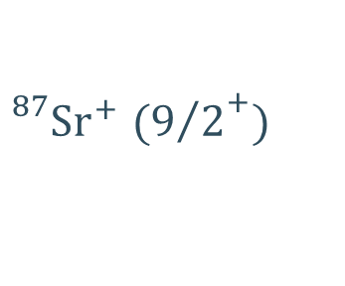
Laser spectroscopy to probe the nucleus
But how??
Isotope Shifts (ISs)
Nuclear charge distribution
$δ‹r^{2}›$, $δ‹r^{4}›, {δ‹r^{2}›}^{2}…$
Hyperfine Structure (HFS)
$${}_{}^{88}{{Sr}^{+}} (0^{+})$$
${}_{}^{87}{{Sr}^{+}}$ $({9/2}^{+})$
$${}_{}^{2}{D_{5/2}}$$
Nuclear electromagnetic moments
Nuclear Spins
IS
$$ν_{α, i, j}$$
HFS
$${}_{}^{2}{S_{1/2}}$$
Robbe Van Duyse
Notes:
First of all a short intro to laser spectroscopy. Since we use Sr ions in our trap, this is the example I present. As you know, the nucleus has a finite size and therefore a certain charge distribution and also electromagnetic moments. This leads to hyperfine structure and isotope shifts on top of these levels which in turn can be exploited to study the nucleus. On the right you can see a schematic of what the HFS would look like, of an 88Sr ion and an 87Sr ion. So which nuclear observables can we get out of this structure? An isotope shift is the difference in the absolute frequency of transition alpha between 2 different ions, call them I and j. From the isotope shifts we can extract radial moments in the charge distribution, starting with the biggest contribution the root mean square charge radii, the quadratic charge radii and the fourth radial moment. From the hyperfine structure we can extract the electromagnetic moments of the nucleus, from large to smaller influence is the magnetic dipole moment, the electric quadrupole moment and then the magnetic octupole moment. A common way to probe this atomic structure is using laser spectroscopy. Very crudely put, scanning a laser over a range of frequencies, we can observe resonances between hyperfine levels allowing us to map the structure of each level in the transition. Using conventional collinear laser spectroscopy we can access the rms charge radii, the magnetic dipole moments and the quadrupole. But the goal of our research is to go beyond, to measure the smaller moments and on top of that to do this on radioactive isotopes. The question remains, how actually do you achieve this precision??

Slide 3
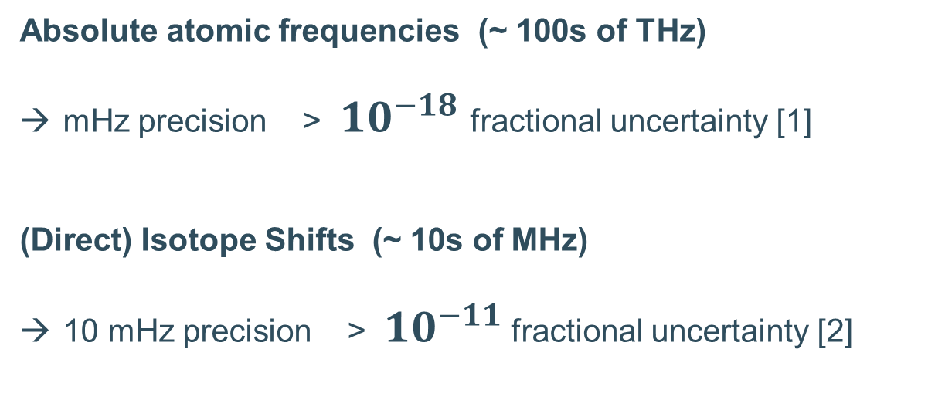


High precision optical spectroscopy
Linear Paul trap
$$V_{DC}$$
Absolute atomic frequencies (~ 100s of THz)
mHz precision > ${10}^{−18}$ fractional uncertainty [1]
(Direct) Isotope Shifts (~ 10s of MHz)
10 mHz precision > ${10}^{−11}$ fractional uncertainty [2]
$$V_{RF}\cos{Ωt}$$
Trapping
+
Laser cooling
→ Single ion laser spectroscopy
Robbe Van Duyse
[1] Irene Goti et al 2023 Metrologia 60 035002
[2] Manovitz, T., Shaniv, R., Shapira, Y., Ozeri, R. & Akerman, N., Phys. Rev. Lett., 123 (2019).
Notes:
The only/preferred way of achieving the necessary precision is of course using trapping and laser cooling. There are different types of traps, ion and atom traps, but the most easy to use and most commonly used ion trap is the linear Paul trap. In its simplest form this consists of 2 radiofrequency electrodes and 2 DC electrodes and some form of radial trapping. By trapping and cooling we can reduce the ions kinetic energy so drastically, reaching mK temperatures, making these traps perfect to perform extremely high precision laser spectroscopy. To put this into perspective with some numbers, absolute frequencies of atomic transitions are some of the if not the most accurately measured quantities in physics, have reached mHz precision. That is a staggering 10 to the power -18 fractional uncertainty. Isotope shifts have been directly measured with an impressive 10 mHz precision. This does not only require trapping and laser cooling but true single ion laser spectroscopy.
Perhaps put a picture of one ion in our trap in here, where you can see the structure of the electrodes and put zoom in a bit on the one ion

Slide 4


Pros and cons of trapping VS collinear laser spec. (CLS)
Long interaction times
  µs in collinear laser spec → 100s of ms or much longer
Complex experiment/setup
Negligible Doppler broadening
  Few MHz → laser-linewidth limited in Lambe-Dicke regime (<kHz)
Currently only possible for 1 valence-electron ions (earth-alkali, Yb)
Signal per ion
  Max 1 event per atom → Many thousands/s
Small interaction region = Better control of external parameters
Robbe Van Duyse
Notes:
There are of course pros and cons to performing such high precision experiments using trapping and laser cooling. I start with the pros since they much outweigh the cons. We have very long interaction times, especially in comparison with collinear laser spec or in source laser spec, and we’re able to interact many seconds if we want, and able to trap the same ion for hours. This means for example, the isotope shift of one isotope can be fully measured on a single ion. You will have negligible doppler broadening due to the reduction in kinetic energy that results are laser linewidth limited in the lambe dicke regime. We can have multiple thousands of events per ion, going trough full frequency scans with just one ion, plus the advantage of a small interaction region is that controlling things like magnetic fields and other external parameters is much easier.
Of course the cons are that the experiment and the setup itself get considerably more complex and currently laser cooling of ions in particular is only really feasible for 2 valence-electron atoms.

Slide 5
Ion trapping at KU Leuven
High precision spectroscopy of radioactive ions
BICEPS
STRIPE
(Bespoke Ion Cooling Experiment for Precision Spectroscopy)
(Stopping and Trapping Radioactive Ions for Precision Experiments)
Small trap
Offline lab
Thermal neutral beam
Larger trap
Online conditions
10 keV ionic beam
Focus on development of precision spectroscopy methods and precision trap control
Focus on development of deceleration/trapping of fast beams and RIB implementation
Robbe Van Duyse
Notes:
With these advantages in mind, we built two very different ion trapping setups at KU Leuven, I will discuss both today. On the one hand we have biceps. This is a small trap, for now fully offline where we really focus on the precision spectroscopy and trap control to get to the highest level of precision. This is the experiment I am personally most involved with. Here we have shown we can trap ions for hours at a time and are currently developing precision spectroscopy methods. The other trap is called stripe. This is a larger trap where we really try to simulate the conditions in an online facility to then implement it in a RIB facility, I will explain more on this later. Both traps make use of laser cooling of Sr ions

Slide 6
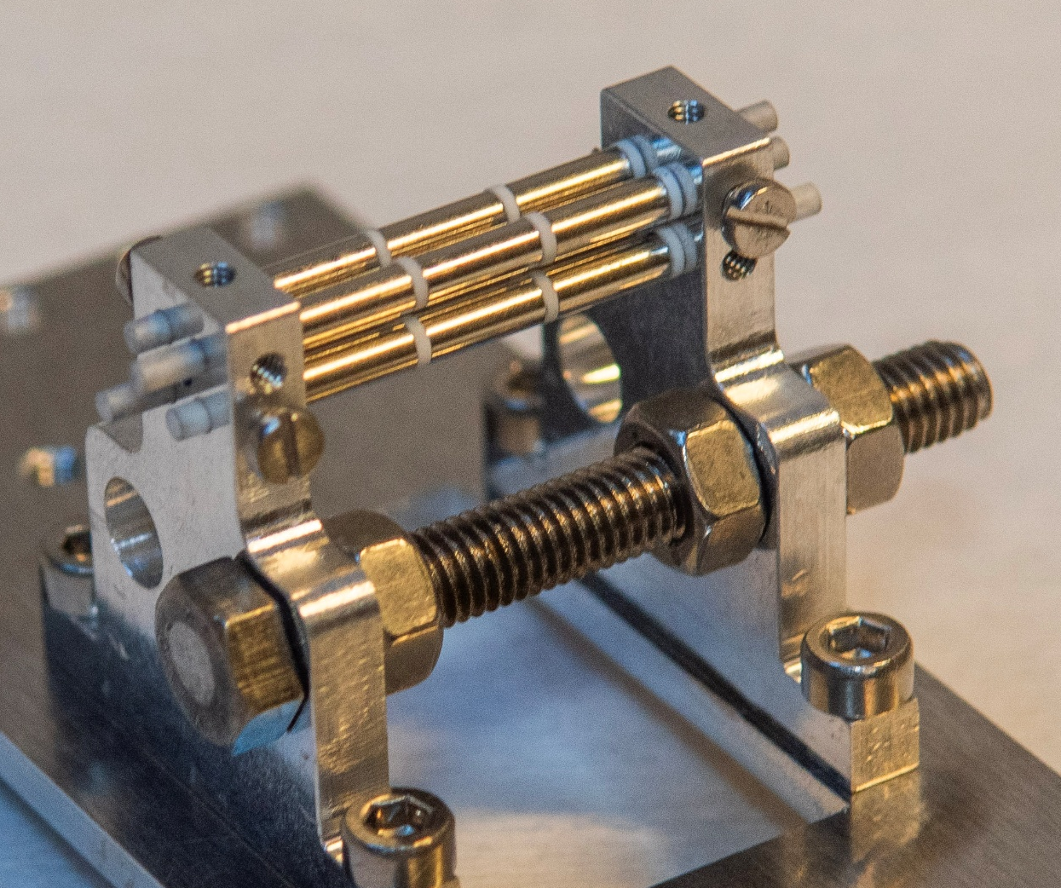
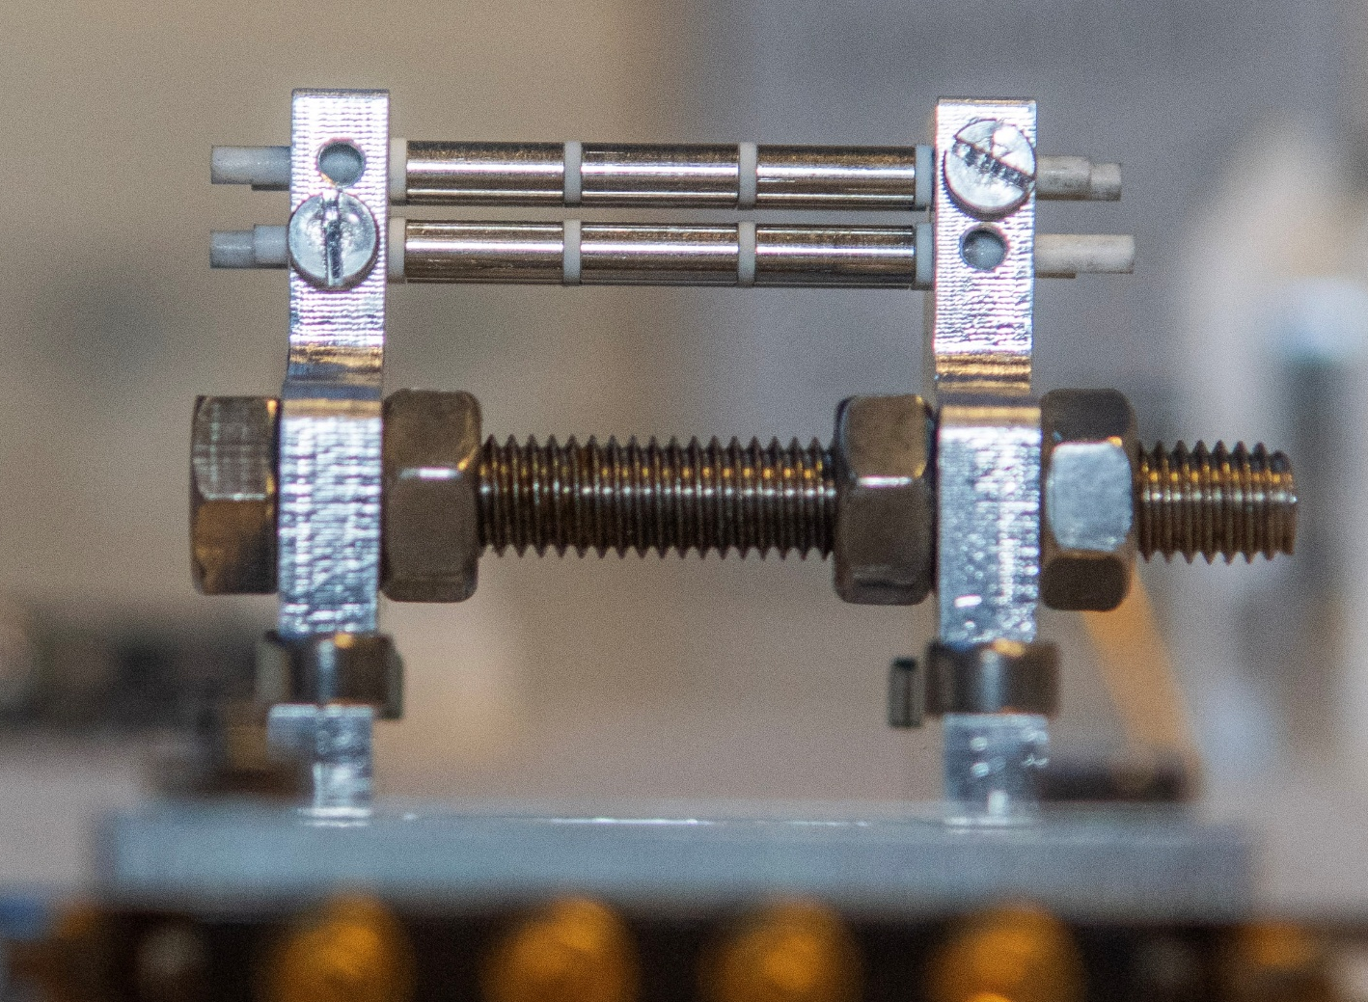







Need for trapping and cooling
BICEPS
$$2.2cm$$
$${Sr}^{+}$$
$${}_{}^{2}{P_{1/2}}$$
Repump
1092nm
$${}_{}^{2}{D_{5/2}}$$
Cooling
422nm
$${}_{}^{2}{D_{3/2}}$$
$$\sim 10 µm$$
Linear Paul Trap + Doppler Cooling
$${}_{}^{2}{S_{1/2}}$$
Robbe Van Duyse
Notes:
So I will start with biceps. Biceps is a small linear Paul trap and currently we are using Doppler cooling on these two transitions. The combination of these two methods has allowed us to study single ions for hours at a time, cooled to mK temperatures. This is a picture of a Coulomb crystal. Our trapping research currently is focused on Sr ions since it is an excellent laser coolable ion and has a lot of promising aspects in terms of scientific output.

Slide 7
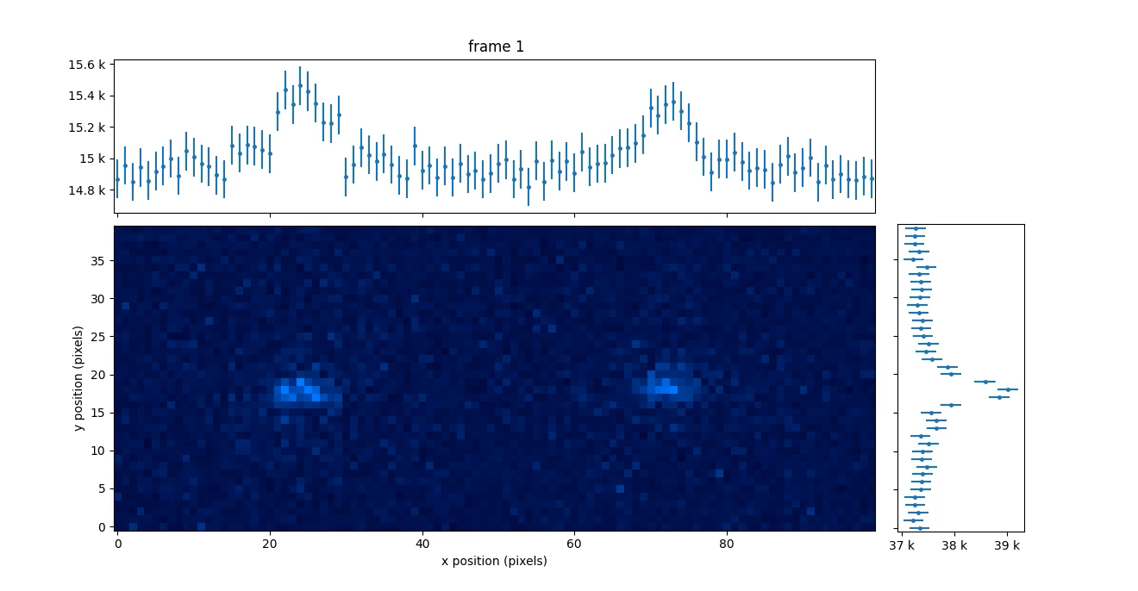




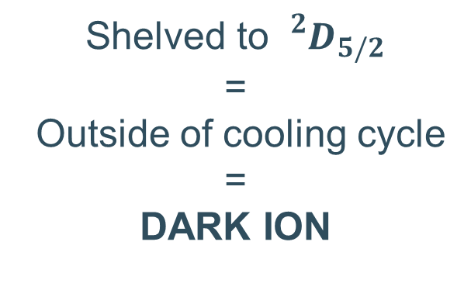
Driving clock transition
$${}_{}^{2}{P_{1/2}}$$
Repump
$${}_{}^{2}{D_{5/2}}$$
Cooling
422nm
$${}_{}^{2}{D_{3/2}}$$
674nm, Γ ~ 2Hz
$${}_{}^{2}{S_{1/2}}$$
Shelved to ${}_{}^{2}{D_{5/2}}$
=
Outside of cooling cycle
=
DARK ION
Robbe Van Duyse
Notes:
A while ago already we have been able to drive a first order forbidden transition, from the ground state s1/2 to the d5/2. This transition is a very narrow transition, natural linewidth around 2 Hz, which makes it fit for precision spectroscopy. Since you drive the ion out of the cooling cycle, it goes dark when the transition is successful. This is what you can see in the video of the ion crystal. This principle of dark and bright ions is also what is used as the detection principle behind the precision spectroscopy.
Tpo drive the forbidden transition you need lots ofinteraction time due to the linewidth

Slide 8
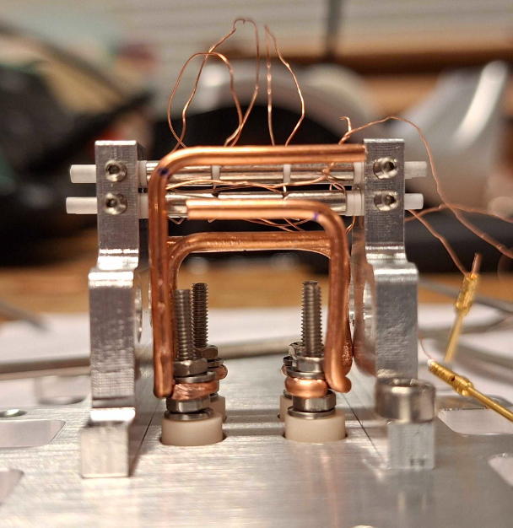




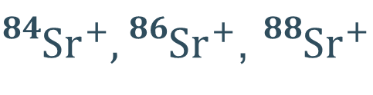
Current focus BICEPS
First Isotope Shift measurements
${}_{}^{84}{{Sr}^{+}},{}_{}^{86}{{Sr}^{+}}$, ${}_{}^{88}{{Sr}^{+}}$
$${}_{}^{88}{{Sr}^{+}}$$
$${}_{}^{86}{{Sr}^{+}}$$
(Bosonic stable isotopes)
$${}_{}^{2}{D_{5/2}}$$
Example
IS
→ In meantime, working out precision spectroscopy methods
$${}_{}^{2}{S_{1/2}}$$
Robbe Van Duyse
Notes:
Secondly, we are doing our first measurements of isotope shifts on the bosonic stable isotopes, 84 86 and 88 Sr

Slide 9
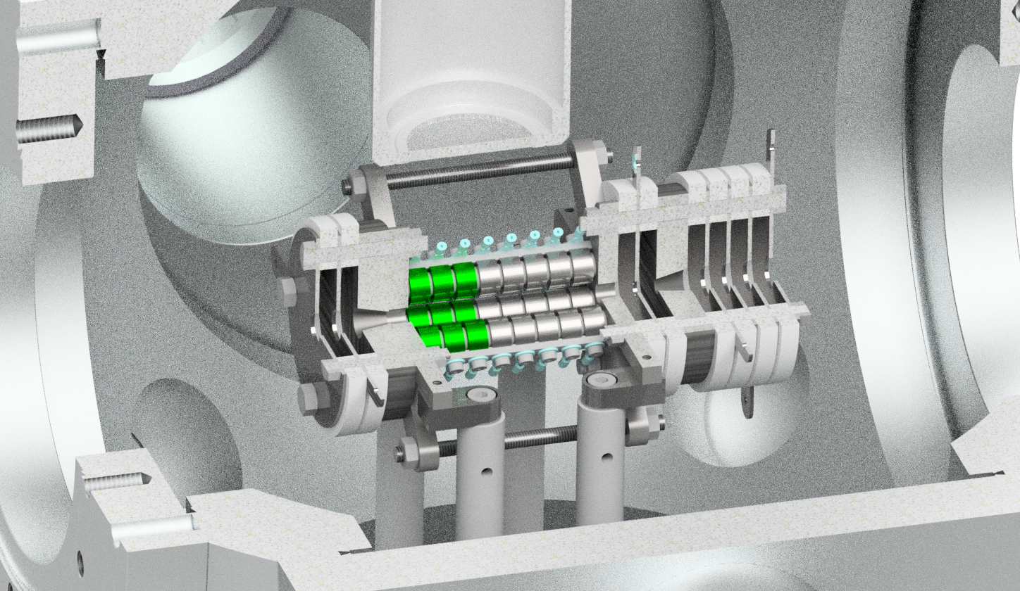
STRIPE
Focus on development of deceleration/trapping of fast beams and RIB implementation
Robbe Van Duyse
Notes:
Next up is our STRIPE trap which, as I said, is focused on decelerating and trapping of fast beams for implementation in RIB facilities

Slide 10

Working Principle
Ion Source
Ions of interest
Contaminant
Bunching
Cooler-buncher
PMT
10s of keV
few eV ~ 1000s of K
Spectroscopy
laser
CAMERA
Deceleration
Few eV
Buffer gas cooling: 300K -> hot
Cryogenic buffer gas: few K -> hot
Trapping
Doppler laser cooling
Segmented ion trap
Notes:
The working principle of the trap is as follows. Ions are produced by some source, naturally together with some contaminants. You do a first step of mass separation and go through a first bunching and cooling. Afterwards you have a bunches at 10s of keV. To get down to a couple eV’s we have a first stage of deceleration using electrostatic plates. But the ions are still left with a few eV of energy which is many thousands of Kelvin. You could do buffer gas cooling, getting you down to room temperature or cryogenic cooling getting you to a few Kelvin but we decided to take a completely different route, only using laser cooling to lose this energy.

Slide 11
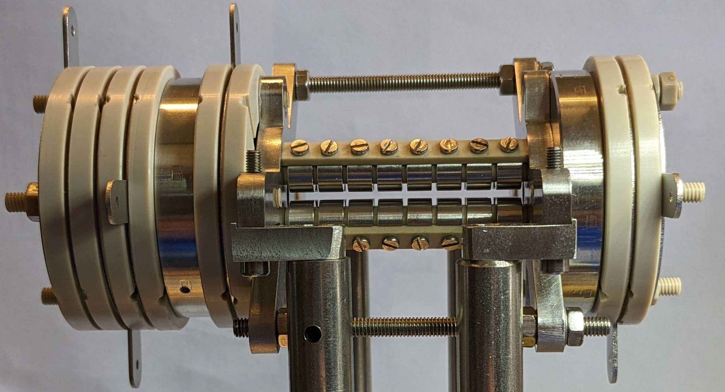
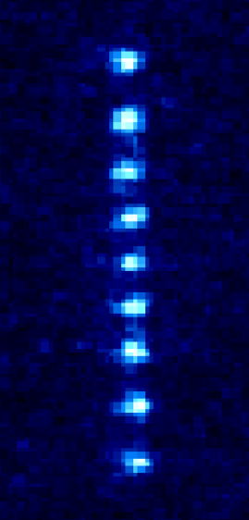
Working Principle
Ion Source
Ions of interest
Contaminant
Bunching
Cooler-buncher
5.5 cm
PMT
10s of keV
Spectroscopy
laser
CAMERA
Deceleration
Few eV
Trapping
Cooling to 10s of mK in few seconds !!!
Segmented ion trap
Notes:
And we have shown this works extremely well, and we are able to create ion crystals in the trap after just a couple of seconds of cooling, which means we have a temperature of a few 10s of mK.

Slide 12
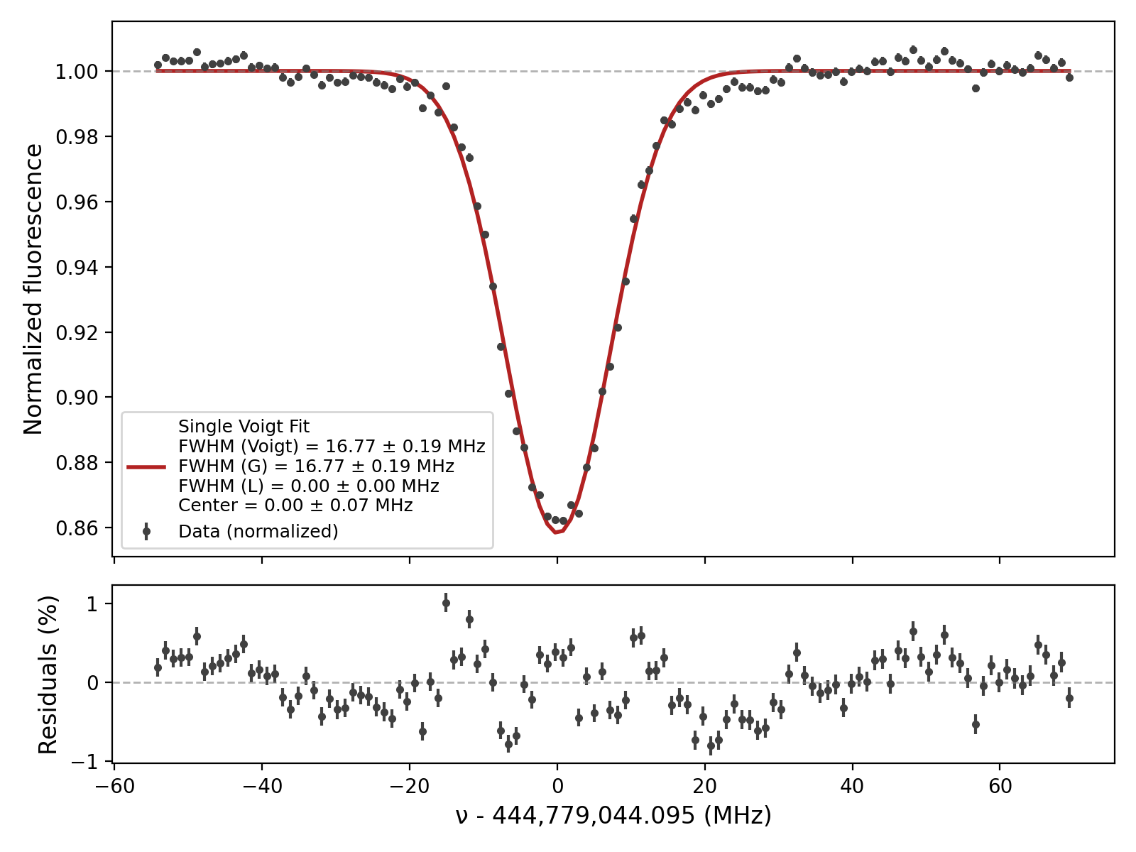




Data from Leuven STRIPE
Also able to drive the first order forbidden transition
$${}_{}^{2}{P_{1/2}}$$
Repump
$${}_{}^{2}{D_{5/2}}$$
$${}_{}^{2}{D_{3/2}}$$
674nm
$${}_{}^{2}{S_{1/2}}$$
Robbe Van Duyse
Notes:
Before leaving for finland, some data was taken using the trap, also showing the ability to drive this first order forbidden transition.

Slide 13
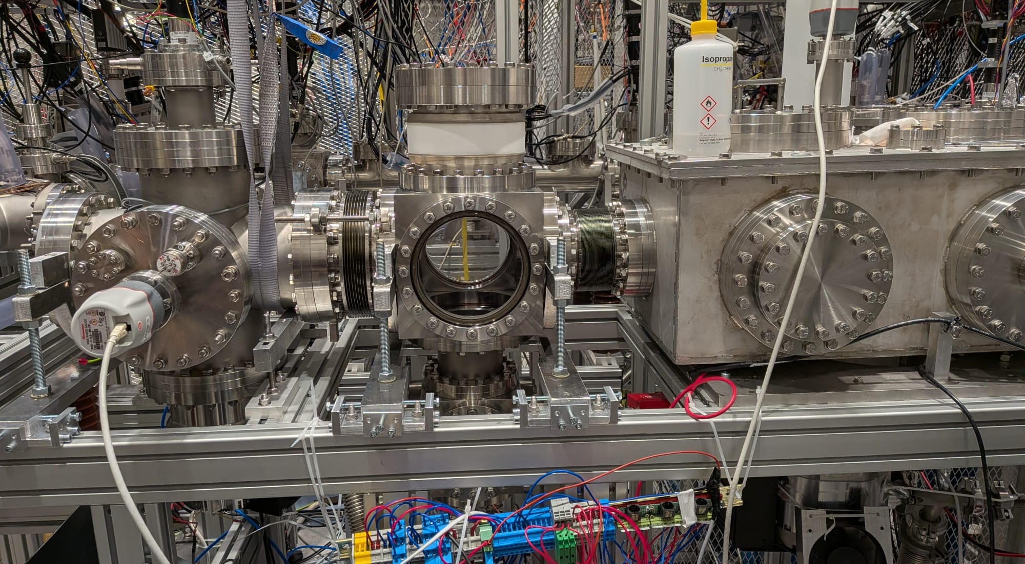
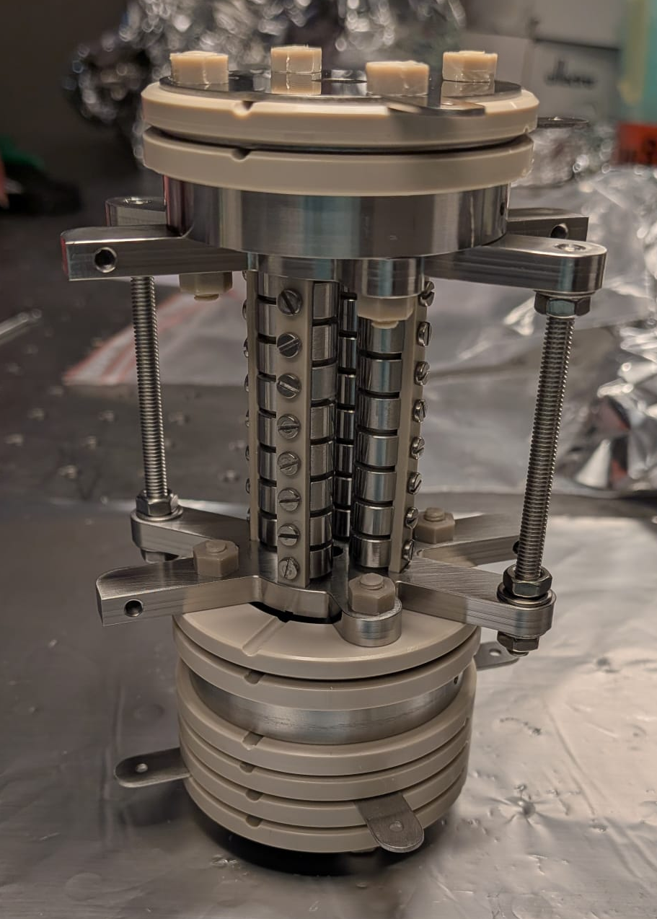

Installation in IGISOL @ Univ. of Jyvaskyla
Trap chamber under vacuum - Feb 2026
Copy of STRIPE @ JYU
Credits: Stefanos Pelonis
Notes:
The next natural step forwards is to install this device in an actual RIB facility and since February this year, one of my colleagues, Stefanos, is exactly doing that, making a copy of the trap in IGISOL, at the university of Jyvaskyla. After building, we will prove we can trap and laser cool from a new offline SIS installed for the trap and then repeat the process with fast ions coming from the IGISOL frontend. These are some pictures of the copy of the trap and the installation in the beamline there

Slide 14
Long-term plan
STRIPE
BICEPS
- Installation in IGISOL
- First in trap isotope-shift measurements of radioactive Sr isotopes
- Measurement of the magnetic octupole moment of Sr-87
- Measurement of direct isotope shifts using entanglement
Robbe Van Duyse
Notes:
What does is the long term-plan for the experiments though? I will start with STRIPE Later in the year, we plan to perform an offline campaign for isotope shifts of stable Sr+ from the IGISOL frontend and we will use this for a proposal for radioactive Sr+ between A=76-100
ion trap (correct r0/r_rod ratio) and with better amplifier etcx

Slide 15
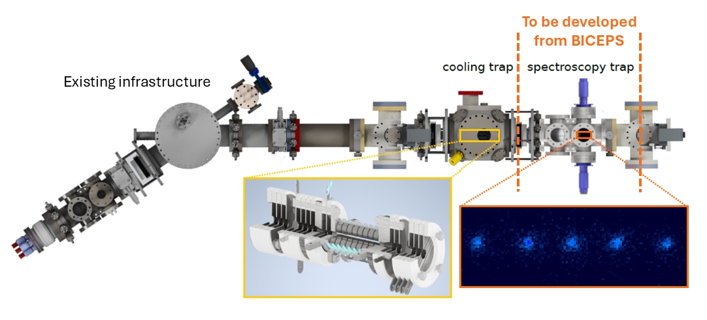
LongER-term plan
Currently, NO ion trap for precision optical spectroscopy at Isotope Separator Online (ISOL) facility
STRIPE
Currently M.Sc. student working on ion guide design between traps
Robbe Van Duyse
Notes:
To give you a bit of an idea of the longer term plan for both traps, I show you this setup. So as I said, each trap is designed for a goal, the stripe trap for fast deceleration and cooling and biceps for high precision spectroscopy. The idea of course is not to only develop the two separately, even though that has to happen first, but to combine the two. Currently we already have a master student working on designing an ion guide between the two traps. That means that we will be able to produce ion crystals in stripe, and then afterwards transport them to biceps to perform precision spectroscopy.

Slide 16
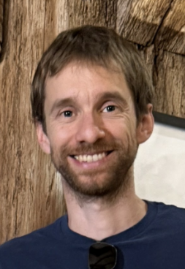
DESIR Plans
New setup planned in close collaboration with Simon Lechner from LP2iB
Design based on STRIPE
More info → LOI Talk by Simon
Credits: Simon Lechner
Robbe Van Duyse
Notes:
All of this development work in Leuven and Jyvaskyla also has application here in DESIR. A laser cooling setup, using a trap based on the stripe trap, will be installed in the entrance of the desir hall for precision spectroscopy experiments. Because of its location, laser cooled beams can also be sent to other experiments downstream as well as profit from the mass separation capabilities of the mr tof and or the piperade penning trap. If you’d like to hear more about this project, be sure to check out Simons LOI talk this xxxxxxx at xxh.

Slide 17

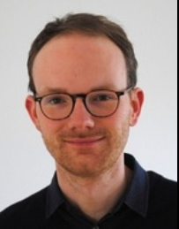

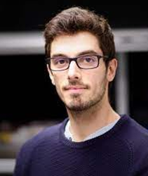
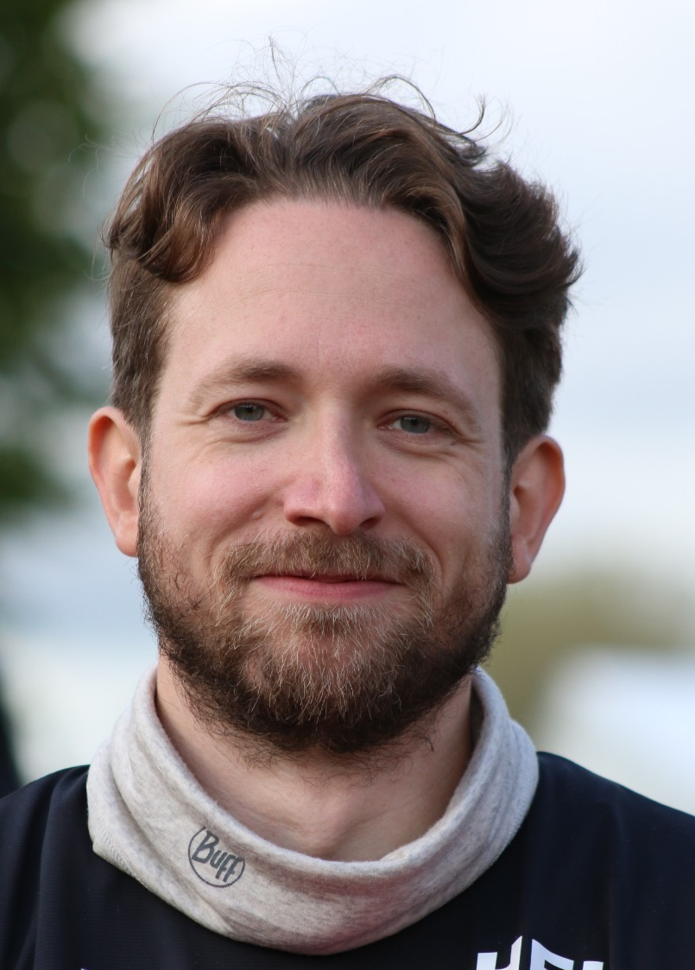

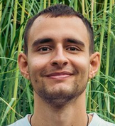
Thank you for listening!
BICEPS
STRIPE
Sandro Kraemer,
PD
Phillip Imgram,
PD
Ruben de Groote, PI
Stefanos
Pelonis
PhD
Pierre Lassegues, PD
Angelos Karadimas,PhD
Julien Grondin,
PhD
Wouter Gins,
Technical

Slide 18


Slide 19

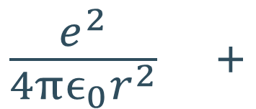



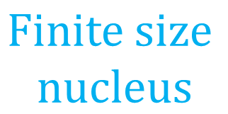




Electronic levels to probe the nucleus
${Sr}^{+}$ example
$$\frac{e^{2}}{4πϵ_{0}r^{2}} +$$
$$Relativistic$$
$$effects$$
$$Finite size$$
$$nucleus$$
Charge distribution and Electromagnetic (EM) Moments
$$+$$
➔
Coulomb interaction
E
$${}_{}^{2}{D_{5/2}}$$
Atomic
$${4p}^{6}4d$$
$${}_{}^{2}{D_{3/2}}$$
Hyperfine Structure
Isotope Shifts
and
$${}_{}^{2}{S_{1/2}}$$
$${4p}^{6}5s$$
Configurations
Fine Structure
Hyperfine Structure
Robbe Van Duyse
Notes:
First of all, I’ll start with a short intro to the structure of electronic levels looks like, why we study it and why and how we use optical, more specifically laser spectroscopy. Since we use Sr ions in our trap, this is the example I present. As you know, the electronic levels of an atom are formed as a result of the Coulomb interaction between the electrons and the nucleus. Taken together with some relativistic effects such as the spin-orbit interaction and electronic levels will look something like this. BUT, one big oversight in this approach is that the nucleus is assumed to be pointlike and of course it is not. The nucleus has a finite size and therefore a certain charge distribution and also electromagnetic moment. This leads to hyperfine structure and isotope shifts on top of these levels which in turn can be exploited to study the nucleus.

Slide 20
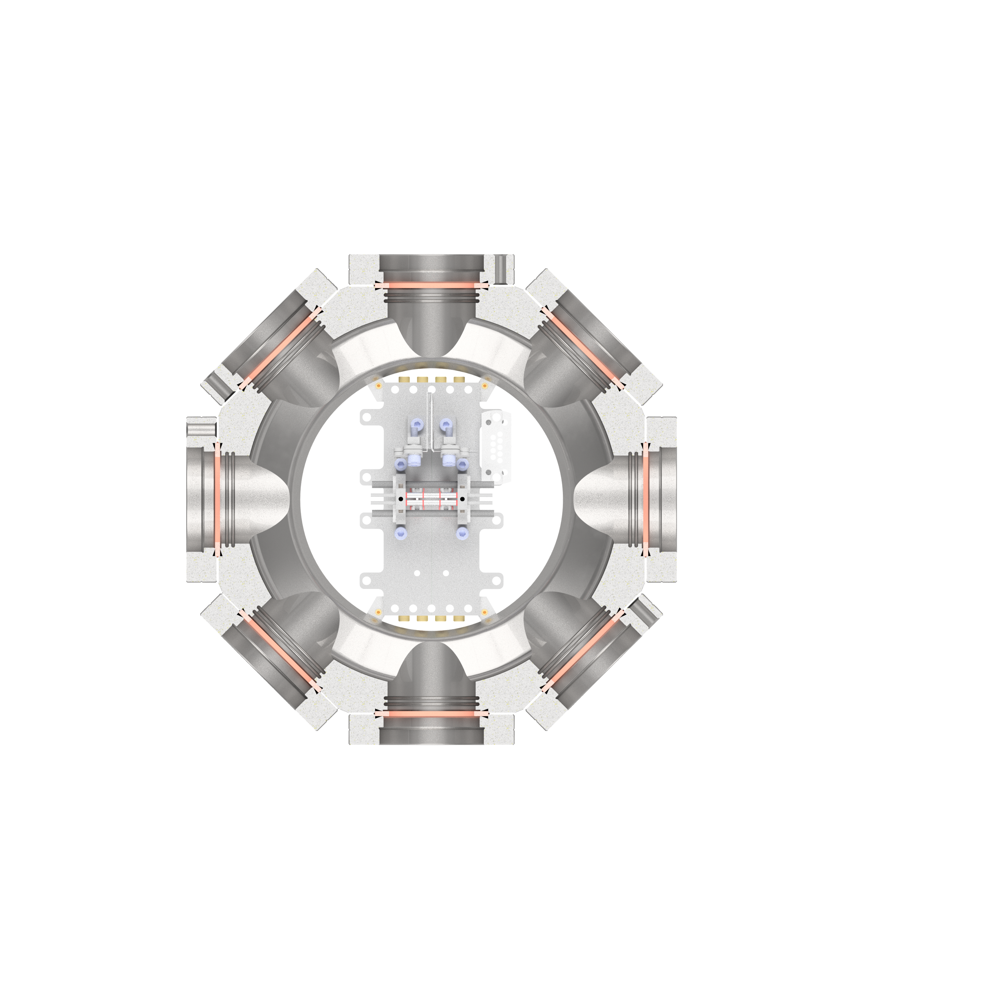








Setup
$${Sr}^{+}$$
Repump
1092nm
$${}_{}^{2}{P_{1/2}}$$
$${}_{}^{2}{D_{5/2}}$$
Cooling
422nm
$${}_{}^{2}{D_{3/2}}$$
Clock
674nm
$${}_{}^{2}{S_{1/2}}$$
Sr
IP
405nm
$$Sr$$
$$5s, 5p$$
Repump
1092nm
461nm
Ionization lasers
Ionization lasers
$$5s^{2}$$
Robbe Van Duyse
Notes:
Recently we have added a red laser to directly excite the first order forbidden clock transition in Sr+. This you can see on this schematic here. This transition is a very narrow transition which makes it fit for precision spectroscopy. A allowed transition such as the cooling transition is several tens of MHz wide or even more while the clock transition is only around 3Hz wide.
Maybe make it coherent and not say clock transition

Slide 21
Current focus BICEPS
Mismatch RF and DC center of trap causes huge micromotion → Can easily add 1000s of K
Focus on micromotion compensation → off-axis compensation electrodes for DC center
Linear Paul trap
Compensation electrodes
Robbe Van Duyse
Notes:
Our current development focus in biceps lies on 3 things. The first thing is micromotion compensation. There are many potential reasons for excess micromotion in the trap but most likely the biggest one is an offset in the DC and RF centers. Micromotion in general will limit the temperature to which we can cool and therefore also the linewidth of our spectra. We can compensate for this using DC compensation electrodes, and we are doing so currently.

Slide 22

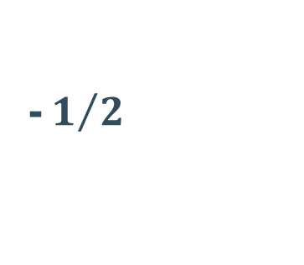
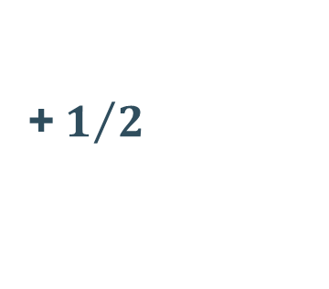

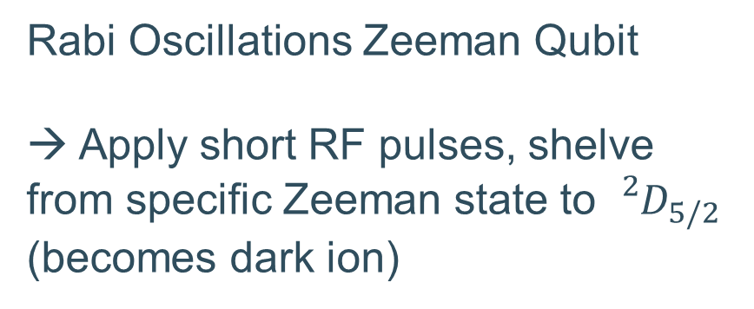
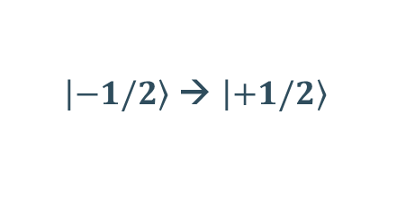
Current focus BICEPS
Rabi Oscillations Zeeman Qubit
→ Apply short RF pulses, shelve from specific Zeeman state to ${}_{}^{2}{D_{5/2}}$
(becomes dark ion)
$$m_{j}$$
$\left|\left.−1/2\right\rangle \right.$ → $\left|\left.+1/2\right\rangle \right.$
transfer rate
+${ 1}/2$
1
$${}_{}^{2}{S_{1/2}}$$
B-field
Ground state
0
-${ 1}/2$
RF Interaction time
Robbe Van Duyse
Notes:
Lastly, we will be performing Rabi oscillations on the Zeeman states of the ground state S1/2 by applying short radiofrequency pulses with different lengths of time. We should observe an oscillating behaviour in the transfer rate from one state to the other as a function of pulse length. This measurement will serve as a first proof for our ability of performing coherent state control paving the way for precision spectroscopy.

Slide 23
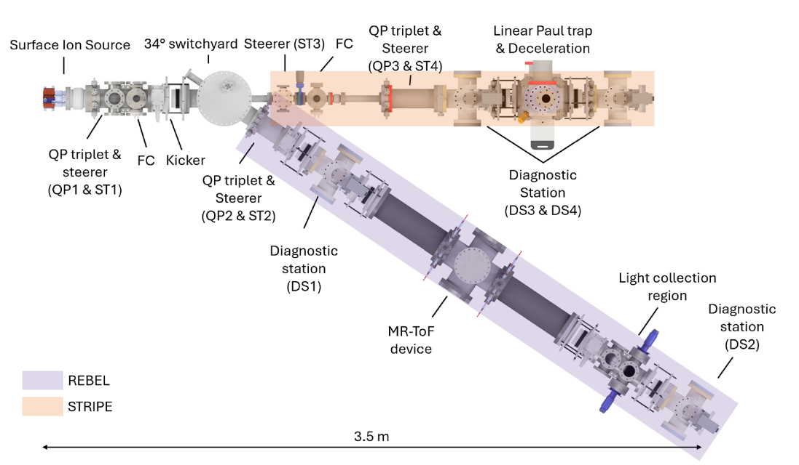
Plan
Stopping and Trapping Radioactive Ions for Precision Experiments (STRIPE)
REBEL & STRIPE:
Light Collection Region
MagneToF
Adapted from [1]
P. Imgram et al. Review of Scientific Instruments 96 (2025) 093302

Slide 24
Plan
Ion trap:
V

Slide 25




Plan
Ion trap:
422nm: cooling transition
1092nm: repump
Χ: spectroscopy laser
1092nm
V
$${}_{}^{2}{P_{1/2}}$$
Repump
1092nm
Χ
$${}_{}^{2}{D_{5/2}}$$
422nm
$${}_{}^{2}{D_{3/2}}$$
Cooling
422nm
$${}_{}^{2}{S_{1/2}}$$
Notes:
Show lasers properly

Slide 26
Plan
Ion trap:
PMT + CAMERA
V

Slide 27
Future
Currently, NO ion trap for precision optical spectroscopy at Isotope Separator Online (ISOL) facility
Robbe Van Duyse
Notes:
What does the future hold for the experiment though? Currently our research is done on stable Sr isotopes at KU Leuven but the purpose is to extend our reach to radioactive isotopes. Currenlty there is no ion trap for precision optical spectroscopy at an ISOL facility. Being able to measure absolute transition frequencies in short lived isotopes would open up many opportunities, allowing us to study many nuclear variables that have so far only been studied on stable isotopes. In order to make this happen though, we need on one hand to develop a trap, like BICEPS, to perform precision optical spectroscopy for an ISOL facility and furthermore our group has developed a cooler buncher, stripe, that does not use a buffer gas but instead doppler cooling. This cooler buncher will inject the ions into the precision trap.

Slide 28
Further Improvements
Few things related to precision
STRIPE
4 months ago: FWHM = 150 MHz
3 months ago: FWHM = 10 MHz
Near future: < 1 MHz
Is it enough?
-> Maybe not
BICEPS2
Timeline for merging:
~ 2 years

Slide 29
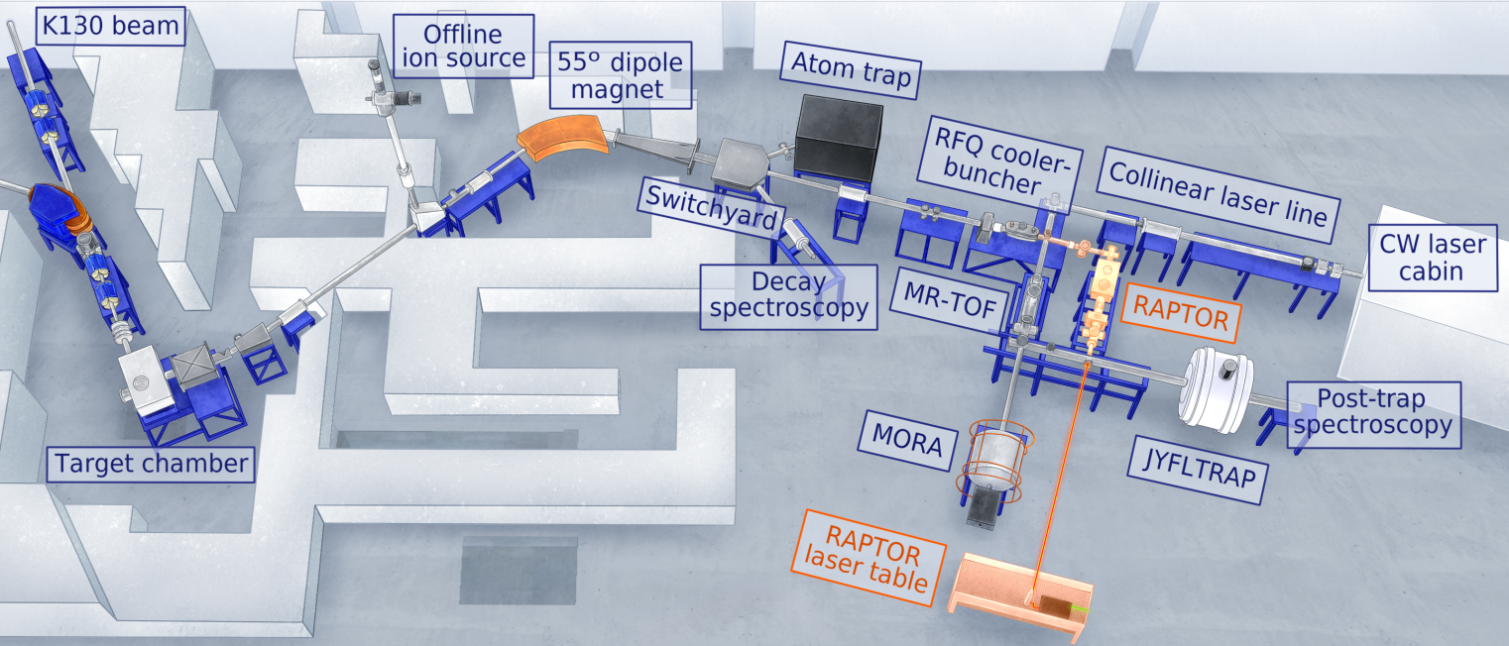



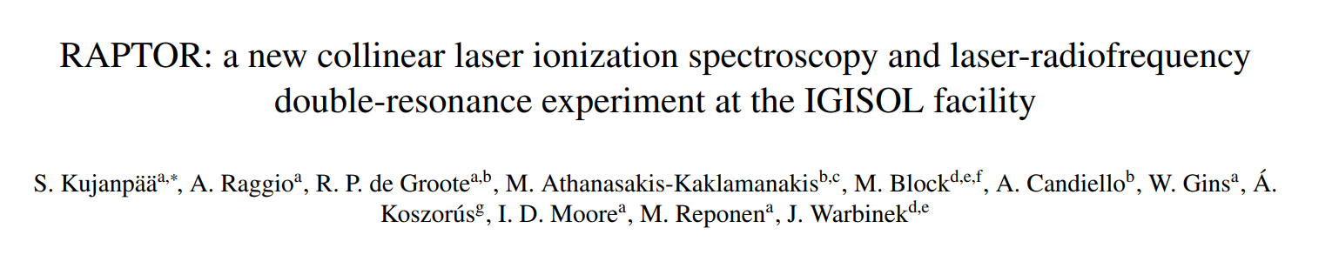
Installation in IGISOL @ Univ. of Jyvaskyla
STRIPE

Slide 30
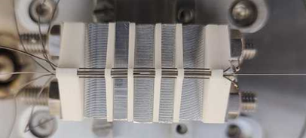
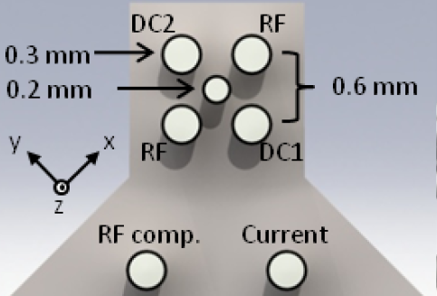
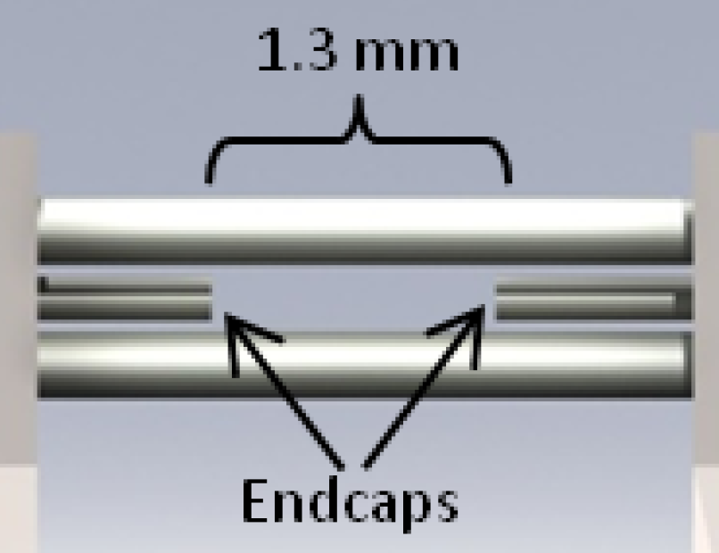

Need for trapping and cooling
BICEPS
Long interaction times
  µs in collinear laser spec → many seconds or more
Negligible Doppler broadening
  Few MHz → laser-linewidth limited in Lambe-Dicke regime (<kHz)
Currently only possible for 2 valence-electron atoms (earth-alkali, Yb)
Linear Paul Trap + Doppler Cooling
$${Sr}^{+}$$
$${}_{}^{2}{P_{1/2}}$$
Signal per ion
  1 event per radioactive atom → Many thousands/s
Repump
1092nm
$${}_{}^{2}{D_{5/2}}$$
Cooling
422nm
$${}_{}^{2}{D_{3/2}}$$
BICEPS
Small interaction region = Better control of external parameters
(Bespoke Ion Cooling Experiment for Precision Spectroscopy)
$${}_{}^{2}{S_{1/2}}$$
Robbe Van Duyse
Akerman, N. & Ozeri, R., Thesis for the Degree Doctor of Philosophy, Trapped Ions and Free Photons (2012).
Notes:
Ion trapping relies on electromagnetic fields to confine an ion and laser cooling, specifically Doppler cooling, will reduce the kinetic energy of the ions even further by exploiting the force of a laser beam. The combination of these two techniques will allow us to study single ions for hours or even days at a time, cooled to mK temperatures. The biggest benefits are of course long coherence times and the long interaction times this allows. And the low temperature means that the ion is well confined in space with very little kinetic energy which means there is basically no Doppler broadening of our atomic lines. In combination with narrow transitions we can reach the high precision I have been talking about. In our lab we have designed a linear Paul trap, called BICEPS where we use Doppler cooling on Sr+ ions. Most of our trapping research is focused on Sr ions since it is an excellent laser coolable ion and has a lot of promising aspects in terms of scientific output.

Slide 31
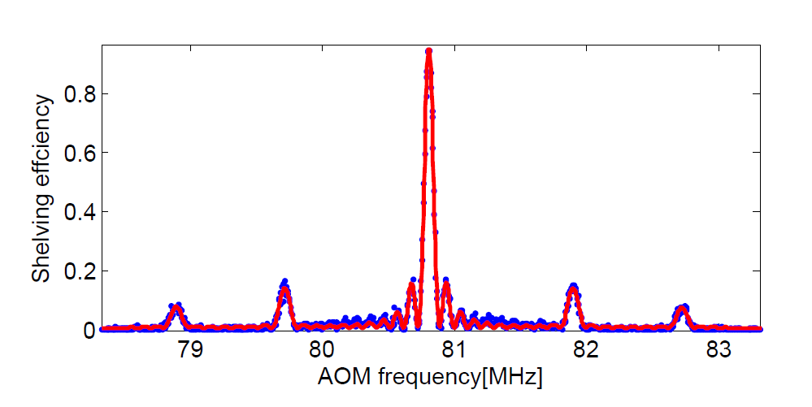
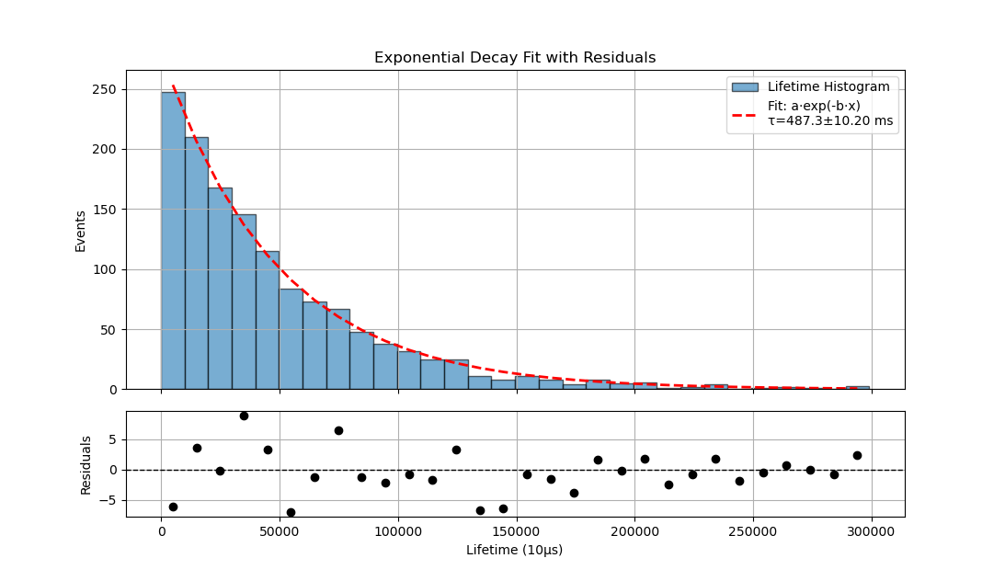
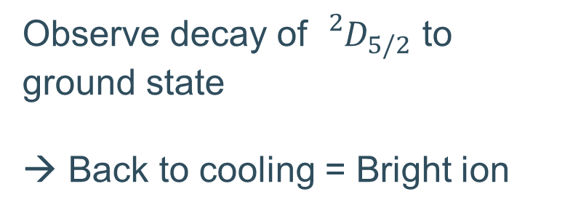
Lifetime of ${}_{}^{2}{D_{5/2}}$
Observe decay of ${}_{}^{2}{D_{5/2}}$ to ground state
→ Back to cooling = Bright ion
PRELIMINARY
Signal
Cooling
Lasers
Laser on ~ 1 s
Power ~ 100 µW
Signal ~ couple thousand
Akerman, N. & Ozeri, R., Thesis for the Degree Doctor of Philosophy, Trapped Ions and Free Photons (2012).
Spokesperson: Dr. Pierre Lassègues
Clock laser
t=0
Lifetime τ
Robbe Van Duyse
Mazurian Lakes Conference on Physics 2025
Notes:
Using this principle, we have taken data to measure the lifetime of this D5/2 state, the research is lead by one of our postdocs Dr. Lassegues. The measuring principle is relatively simple. You pulse the red laser and once you observe the ion go dark, you measure how long it takes for the ion to go bright again, meaning it decayed to the ground state and entered the cooling cycle again. This is of course repeated many times and an exponential is fit to the data as you can see on the right.
The next step for us is to do a proper laser scan and replicate a spectrum something like this, where you can see the carrier frequency that is very narrow linewidth and the motional sidebands. This will require us to control the full system much better, the power and laser on time need to go down drastically to be able to get a coherent measurement.
FIGURE OUT WHAT TO SAY ABOUT THIS FIGURE FROM NITZANS THESIS

Slide 32







BICEPS (Bespoke Ion Cooling Experiment for Precision Spectroscopy)
$${}_{}^{2}{P_{1/2}}$$
Repump
1092nm
$${}_{}^{2}{D_{5/2}}$$
422 + 1092
$${Sr}^{+}$$
Cooling
422nm
$${}_{}^{2}{D_{3/2}}$$
674
Clock
674nm
$${}_{}^{2}{S_{1/2}}$$
IP
Paul trap
Sr beam
405nm
$$5s, 5p$$
Ionization lasers
461nm
405 + 461
$$5s^{2}$$
Robbe Van Duyse
Mazurian Lakes Conference on Physics 2025
Notes:
So what does our ion trapping setup look like at KU Leuven. This setup contains a linear Paul trap and currently holds 5 lasers consisting of the following. We have 2 lasers to ionize the Sr atoms coming from an oven. Once ionized the ions are laser cooled with one cooling laser and one repump laser, since in the cooling process the ion can decay to the D3/2 metastable state. For spectroscopy we have recently added a red laser that can directly excite the first order quadrupole clock transition from the ground state to the D5/2 state

Slide 33
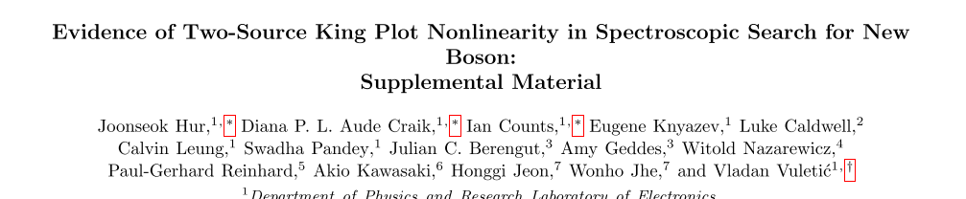
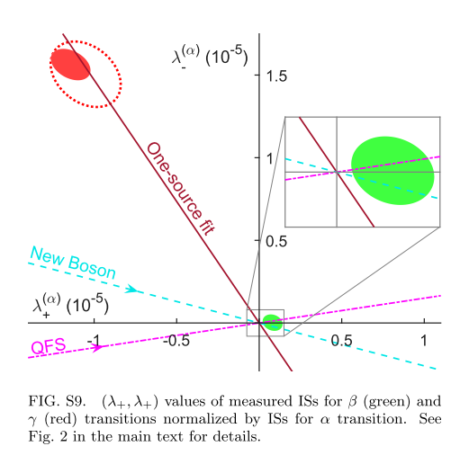
King Plot Nonlinearities
Robbe Van Duyse
Mazurian Lakes Conference on Physics 2025
Notes:
So what does our ion trapping setup look like at KU Leuven. This setup contains a linear Paul trap and currently holds 5 lasers consisting of the following. We have 2 lasers to ionize the Sr atoms coming from an oven. Once ionized the ions are laser cooled with one cooling laser and one repump laser, since in the cooling process the ion can decay to the D3/2 metastable state. For spectroscopy we have recently added a red laser that can directly excite the first order quadrupole clock transition from the ground state to the D5/2 state

Slide 34
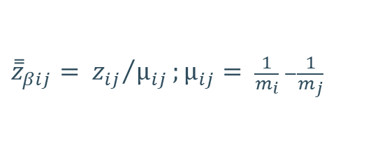
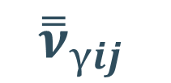


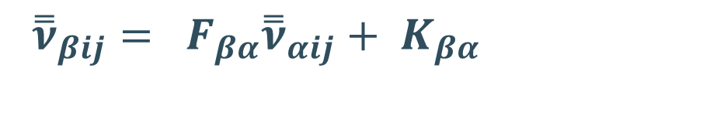
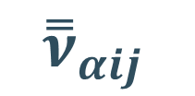
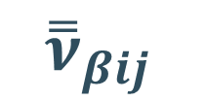
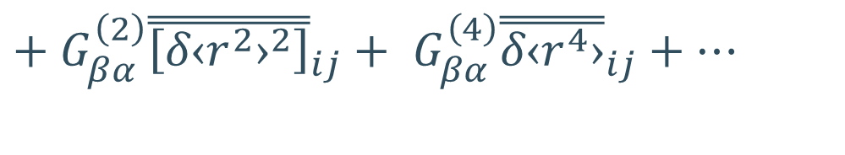
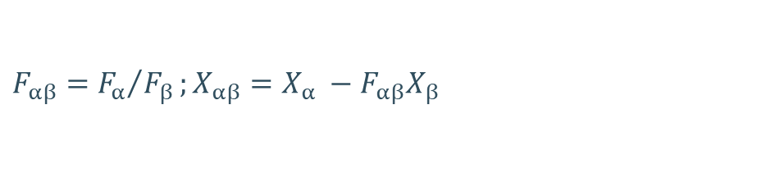
Precision IS Spectroscopy
$${\overset{̿}{ν}}_{βij }$$
$${\overset{̿}{ν}}_{βij}= F_{βα}{\overset{̿}{ν}}_{αij}+ K_{βα}$$
$${(\overset{̿}{ν}}_{βij }, { \overset{̿}{ν}}_{αij})$$
Field + mass shift
$$+ G_{βα}^{\left(2\right)}{\overset{̿}{\left[{δ‹r^{2}›}^{2}\right]}}_{ij}+ G_{βα}^{\left(4\right)}{\overset{̿}{δ‹r^{4}›}}_{ij}+…$$
Higher order nuclear effects
$${\overset{̿}{ν}}_{αij }$$
$${\overset{̿}{ν}}_{γij }$$
$$+ w_{ne}D_{βα}{\overset{̿}{a}}_{ij}$$
BSM Physics
2 or more NARROW transitions
As many isotopes as possible
$${\overset{̿}{z}}_{βij}= {z_{ij}}/{µ_{ij}};µ_{ij}= \frac{1}{m_{i}} −\frac{1}{m_{j}}$$
$$F_{αβ}={F_{α}}/{F_{β}};X_{αβ}=X_{α} −F_{αβ}X_{β}$$
Robbe Van Duyse
Mazurian Lakes Conference on Physics 2025
Notes:
Now imagine that we took 2 transitions, alpha and beta, and say we found 5 stable isotopes of a certain element so we measured 4 isotope shifts. We can plot them as so. To first order, these ISs have a linear relation using their field and mass shifts. This allows us make a so called linear King plot and extract the field and mass shifts. But that is only to first order, beyond that there are higher order contributions in the nuclear charge distribution and possibly even beyond standard model physics that will induce nonlinearities. The bsm physics in this case is a potential boson that mediates a force between neutrons and electrons, modeled with a yukawa type potential. By quantifying the pattern of nonlinearity carefully, we can extract estimates for each contribution. However, as you can see, there are many contributions so this is no trivial feat. So a couple things would help this. Adding more transitions and therefore make a 3 dimensional King plot. Or adding many points would mean that we can eliminate certain nonlinarity contributors from the equations and quantify others better. It also means we can cross nuclear magic numbers. So we have come to the essence of this research, building an experiment that can do such high precision isotope shift spectroscopy using ion trapping on radioactive isotopes at an isol facility
Maybe add the transitions that we will use for Sr already to this slide or the next one
Measuring the IS in 2 different transitions allows you to produce a King Plot like shown on the right. Currently this is being done on stable isotopes and studying the pattern of nonlinearity, you can try to put bounds on certain beyond standard model physics and extract higher order contributions in the nuclear charge distribution. However, in order to do that you need to quantify the pattern of nonlinearity in this King plot very carefully. Adding many points to this plot would mean that we can eliminate certain nonlinarity contributors from the equations and quantify the nonlinearity better. It also means we can cross nuclear magic numbers.
Mention Yukawa type potential
Mention normalized frequencies and put the definition somewhere on the slide

Slide 35




Clock transition
$${}_{}^{2}{P_{1/2}}$$
Repump
1092nm
$${}_{}^{2}{D_{5/2}}$$
Cooling
422nm
$${}_{}^{2}{D_{3/2}}$$
Clock
674nm
$${}_{}^{2}{S_{1/2}}$$
Robbe Van Duyse
Mazurian Lakes Conference on Physics 2025
Notes:
Recently we have added a red laser to directly excite the first order forbidden clock transition in Sr+. This you can see on this schematic here. This transition is a very narrow transition which makes it fit for precision spectroscopy. A allowed transition such as the cooling transition is several tens of MHz wide or even more while the clock transition is only around 3Hz wide.
Maybe make it coherent and not say clock transition

Slide 36
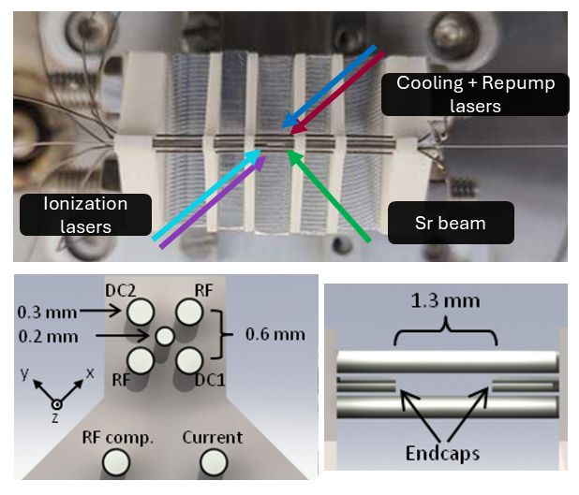
BICEPS
Robbe Van Duyse
Mazurian Lakes Conference on Physics 2025
Notes:
In practice the setup looks something like this. On the left you can see a schematic of the linear Paul trap, which is rather small, and of how the lasers overlap the trap. On the right is a recent picture of the setup, whosing on the right the oven, on the left the vacuum chamber holding the trap, many pumps and the optical setup surrounding the vacuum chamber.

