Slide 1




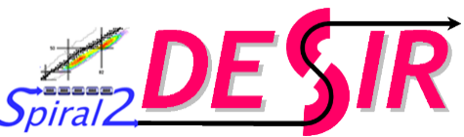




BRIoCHe
ISOL-France VIII – 16/03/2026
“GPIB”
commissioning for DESIR
Corentin Roumegou

Slide 2

BRIoCHe
ISOL-France VIII – 16/03/2026
?
?
“GPIB”
commissioning for DESIR
Corentin Roumegou

Slide 3
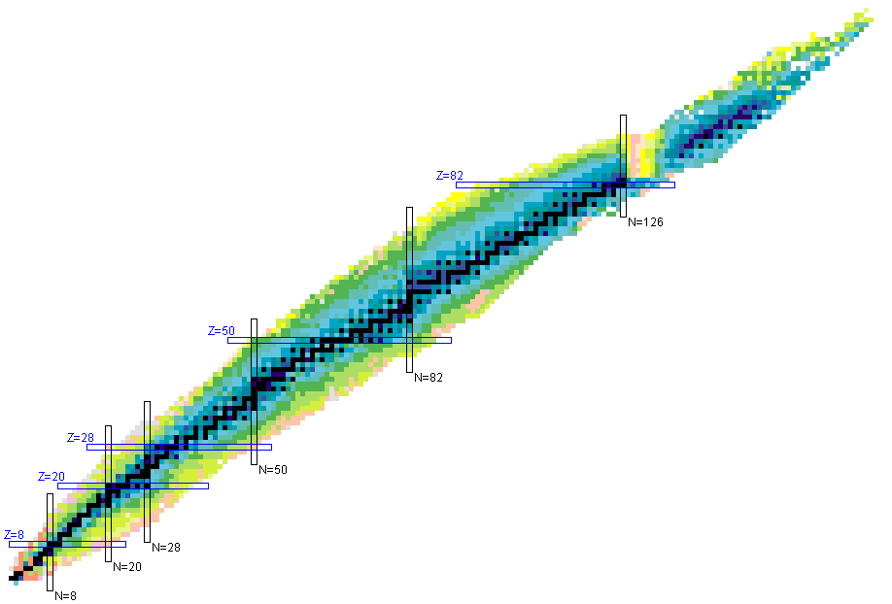
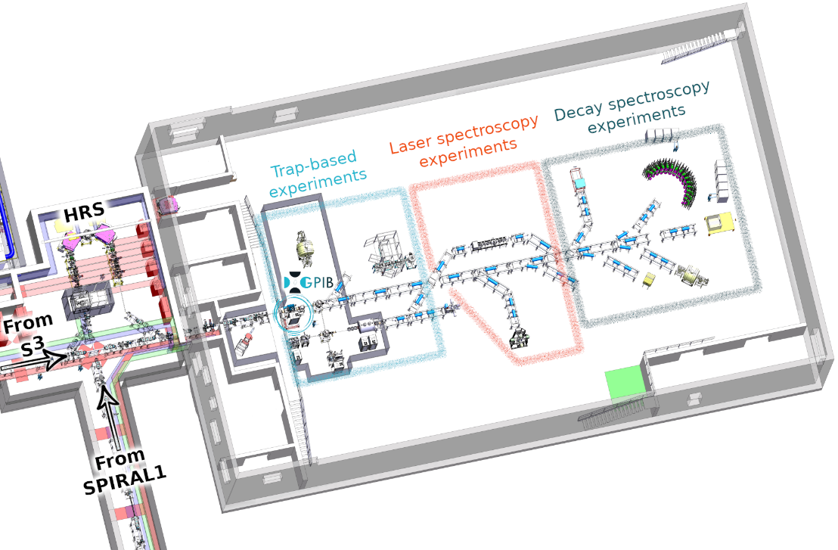


The DESIR facility
Décroissance, Excitation et Stockage d’Ions Radioactifs
Low-energy RIB from SPIRAL1 and S3
Beam is possibly:
S3
Contaminated
Continuous
High-emittance
fusion-evaporation
SUSHI ?
« GPIB »
SPIRAL1
fragmentation
fusion-evaporation
BESTIOL
LUMIERE
DETRAP
@

Slide 4


Beam preparation: cooling & bunching
(
)
Bunching Radioactive Ions To DESIR
(
BRIoCHe
)
General Purpose Ion Buncher
Buncher of Radioactive Ions Cooled with Helium
RadioFrequency Quadrupole Cooler - Buncher (RFQCB)
Reduce beam emittance
Bunch the beam

Slide 5






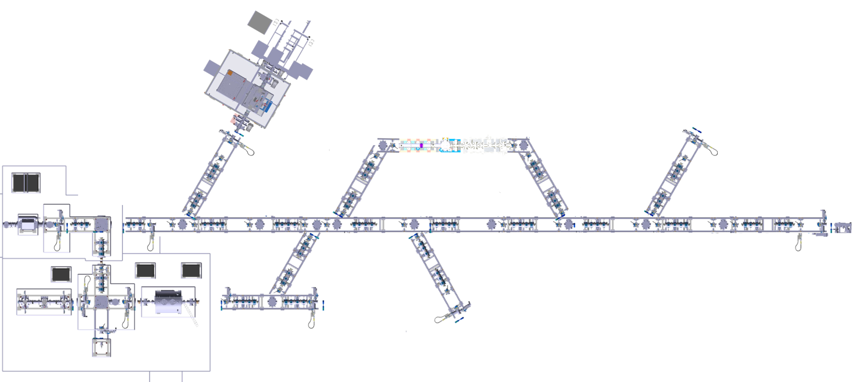

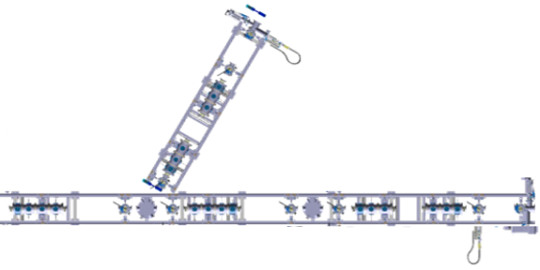


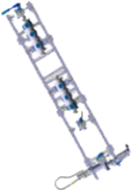
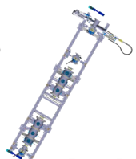
Bunching Radioactive Ions To…
BRIOCHe
MR-ToF-MS
(NA)²STARS
PO-ToF-E
RFQCB
* Non-exhaustive list. The exact location of each setup may change.
** The beam could also pass through PIPERADE, Laser Cooling, etc.

Slide 6
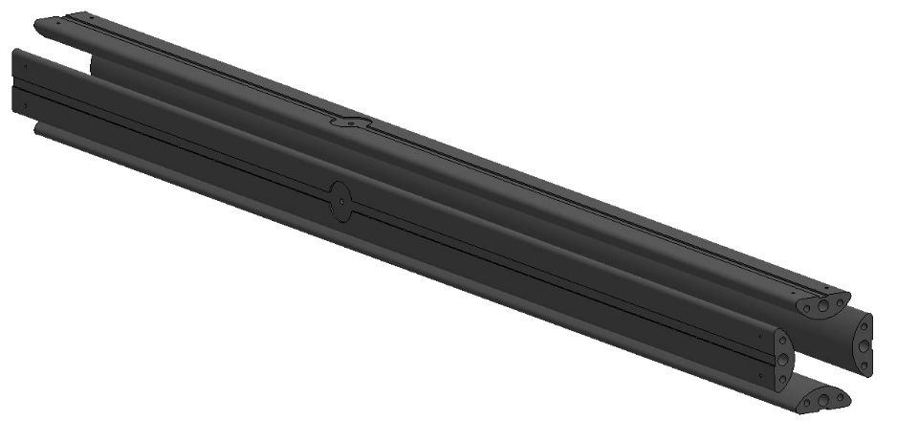
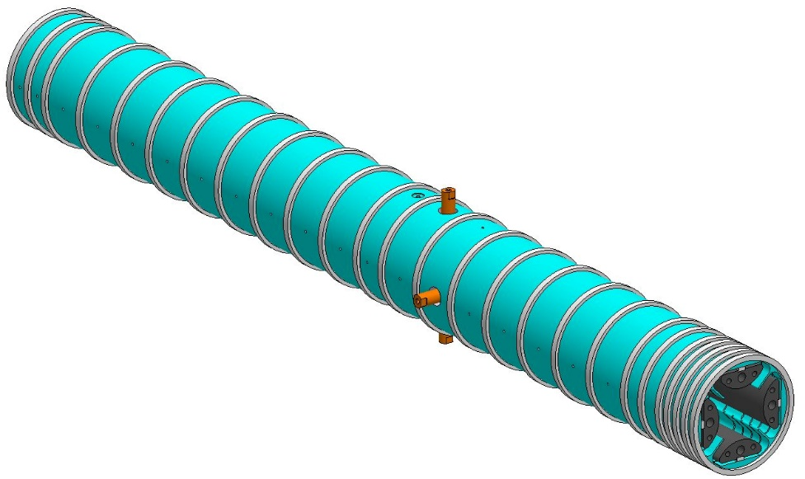
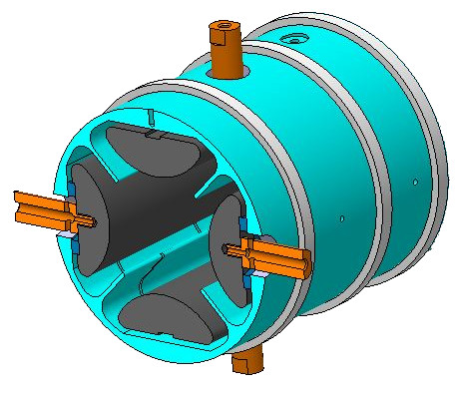
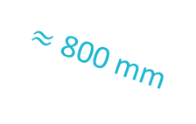
“GPIB”
ions
General Purpose Ion Buncher
$≈$ 800 mm
RFQ: Paul Trap
Mechanical design based on ISCOOL (ISOLDE RFQCB)
Transverse trapping with 4 unsegmented RF rods
Longitudinal trapping with 25 independent DC segments
DC
RF

Slide 7
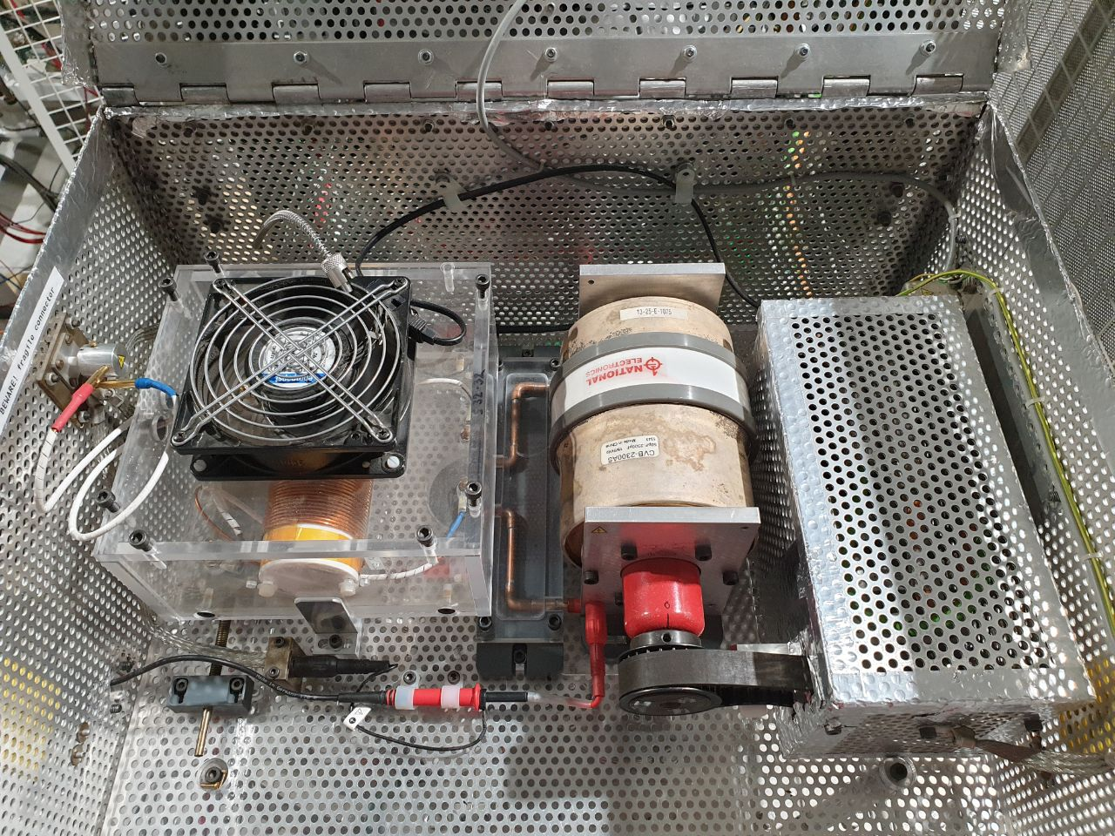
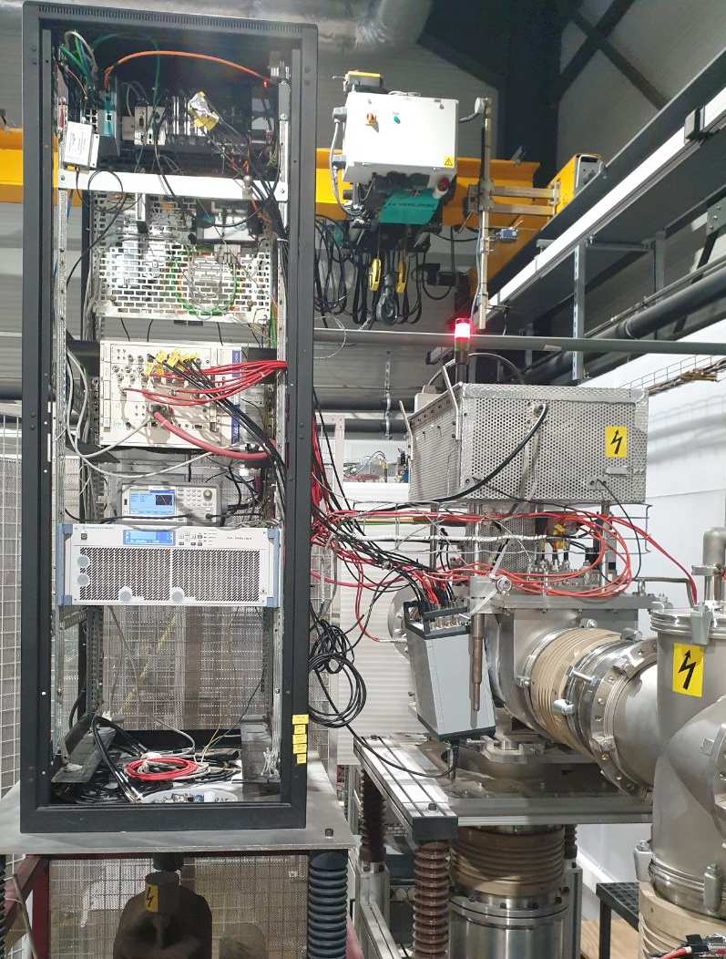
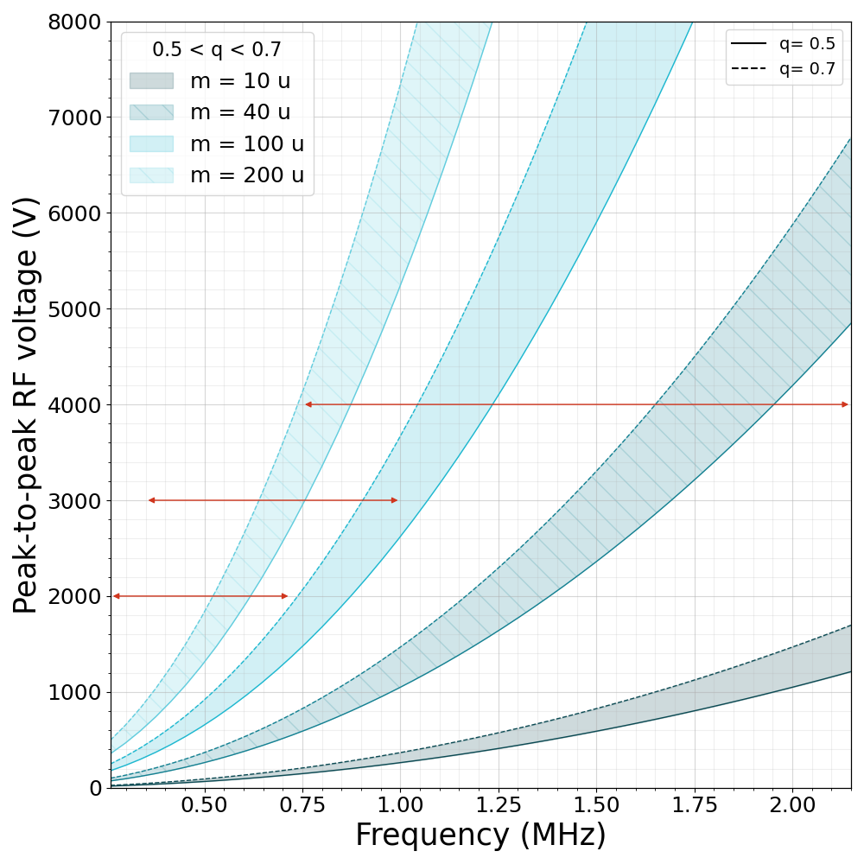
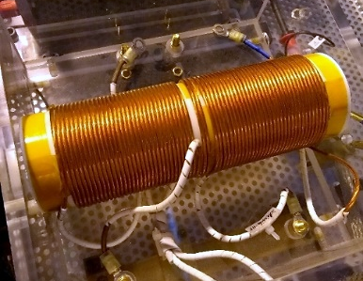
Trap RF system
Balun-transformer circuit
Tunable capacitor
Waveform generator
S24-24
S32-32
400W RF amplifier
S38-38
S32-32 windings
(exchangeable)

Slide 8
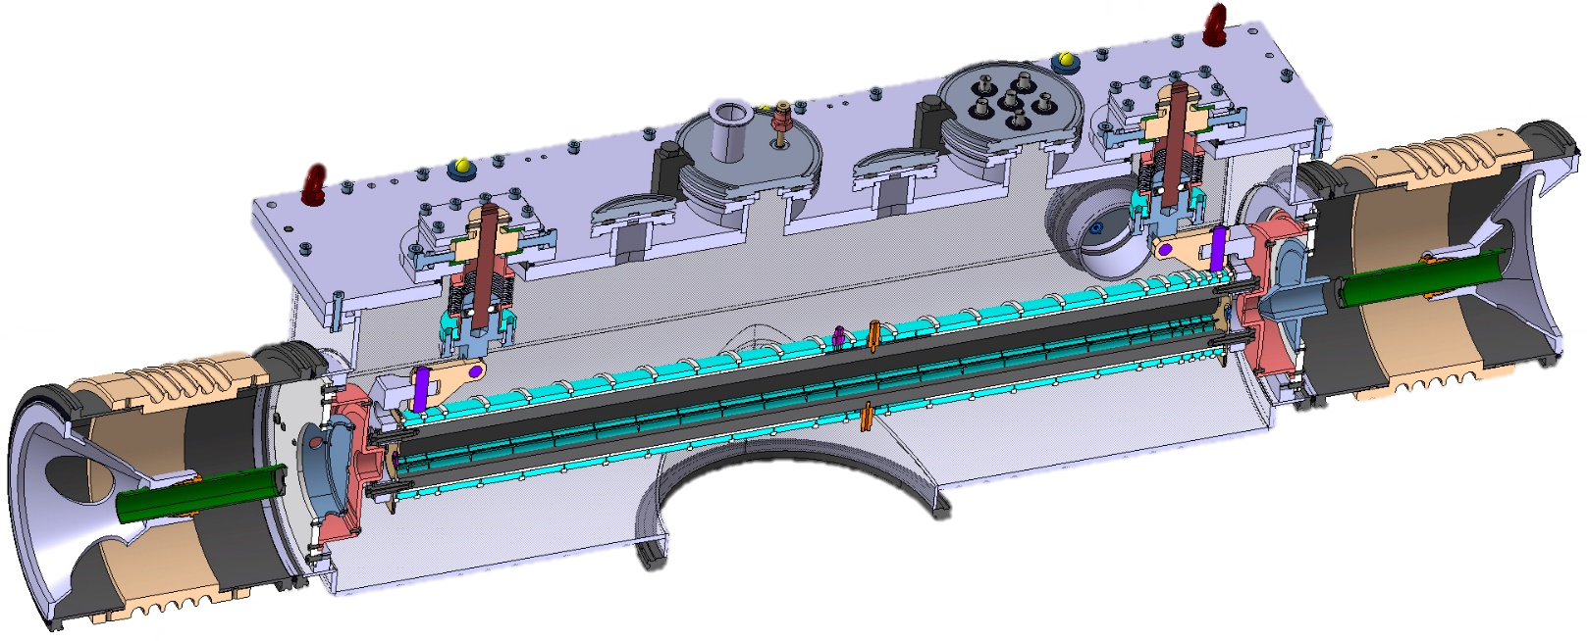
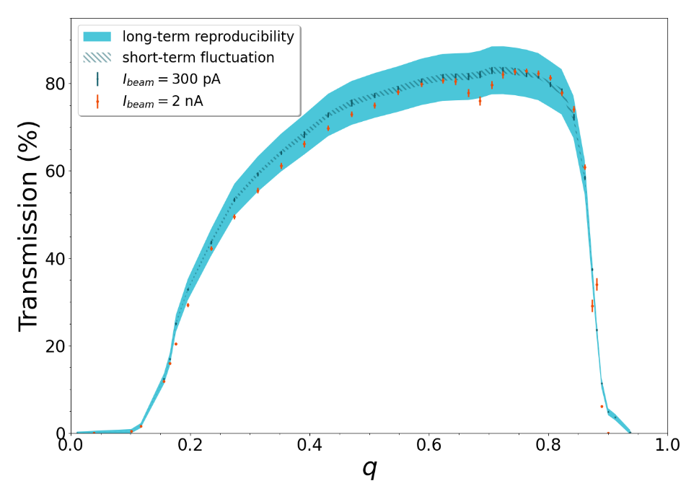
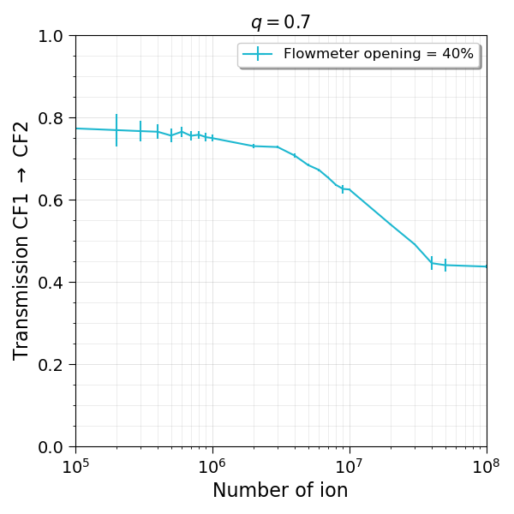


Cooling
He
Cooled beam
to DESIR
Radioactive ions
From SPIRAL1/S3
BuRI-To mode (Bunched)
MoRI-To mode (Continuous)
$$\sim {10}^{−2} mbar$$
$${}_{}^{nat}{K^{+}}$$
“Buffer-gas cooling” with He (highly purified!)
Up to 90% transmission

Slide 9
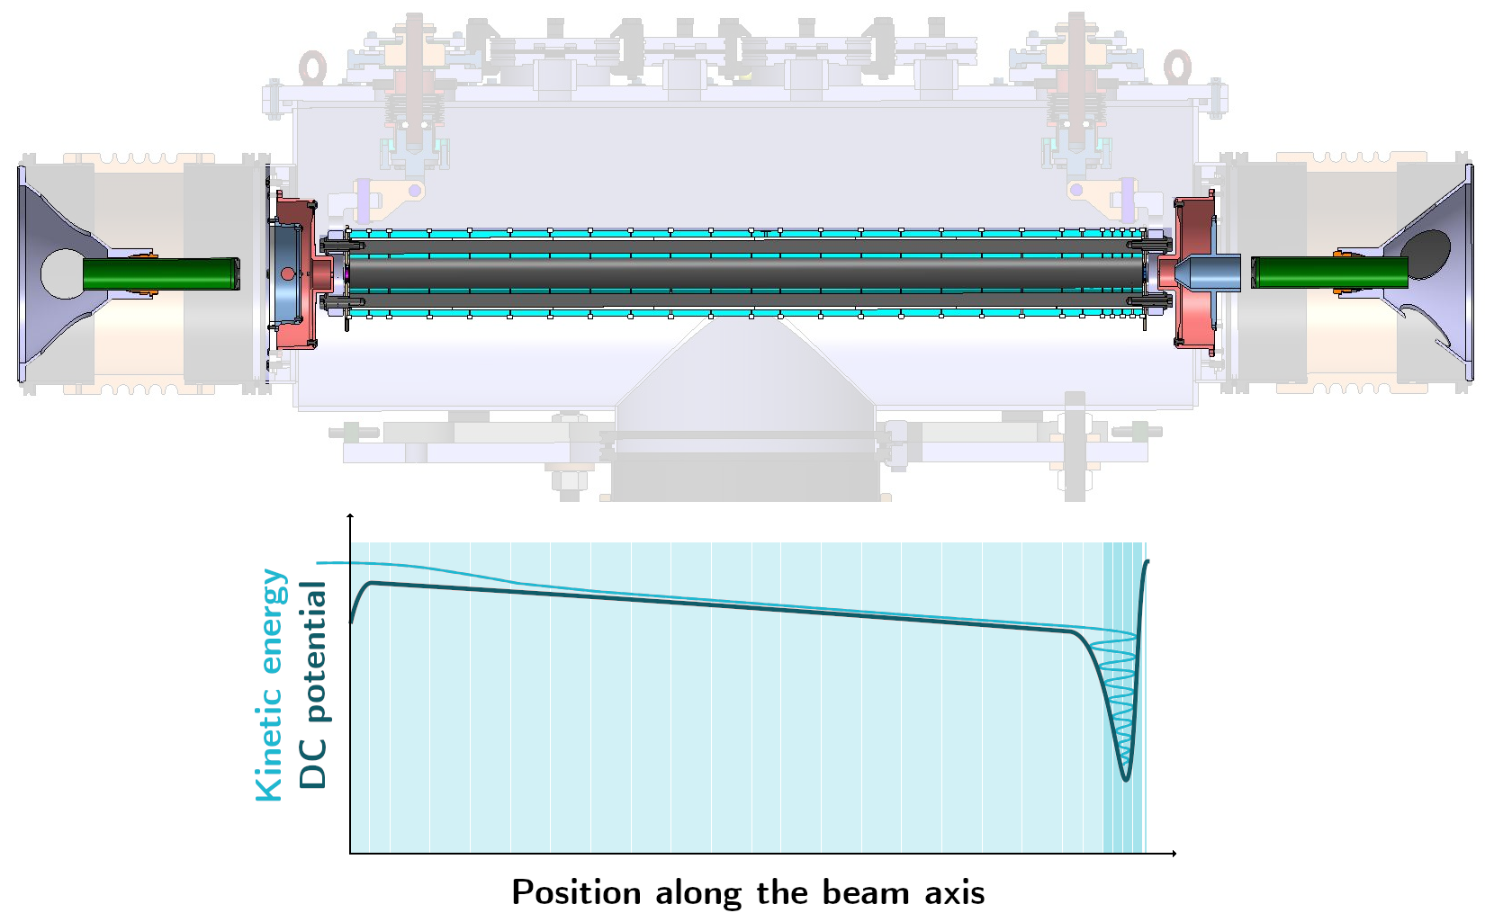
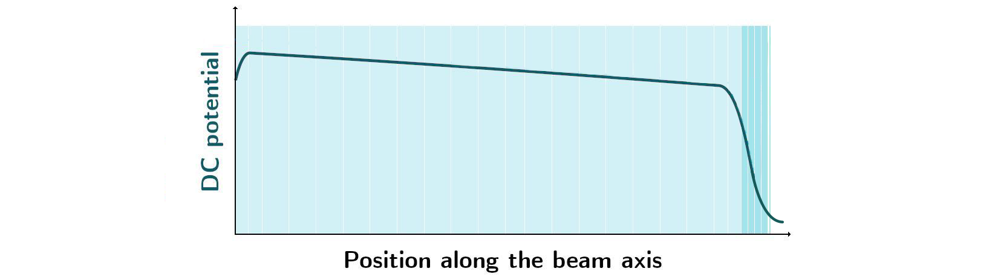
Bunching
5 last electrodes can be switched
switchable
Continuous beam
from HRS
Cooled & Bunched
ions to DESIR
ions

Slide 10


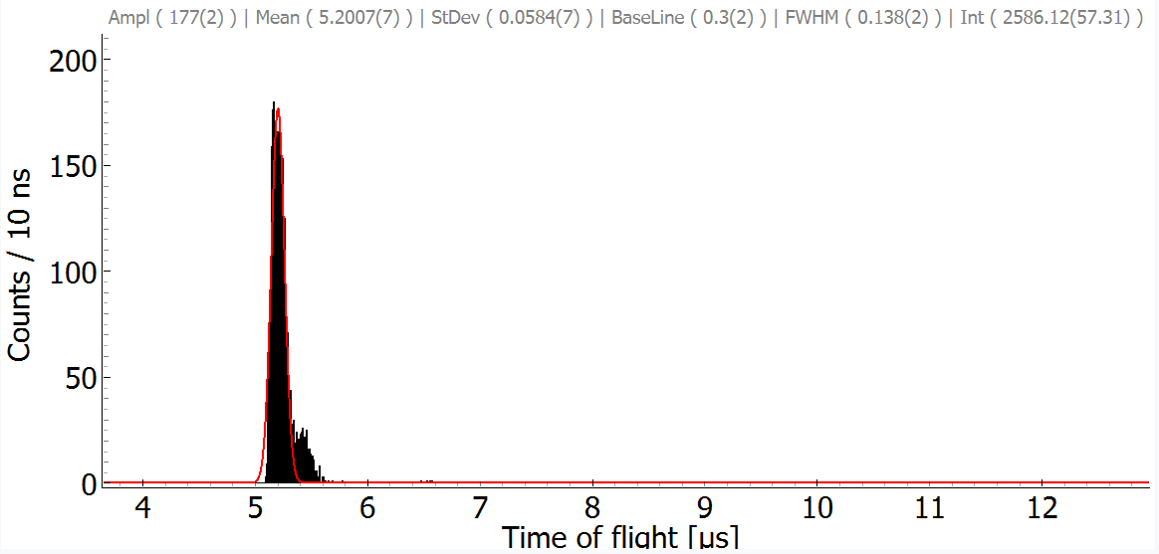
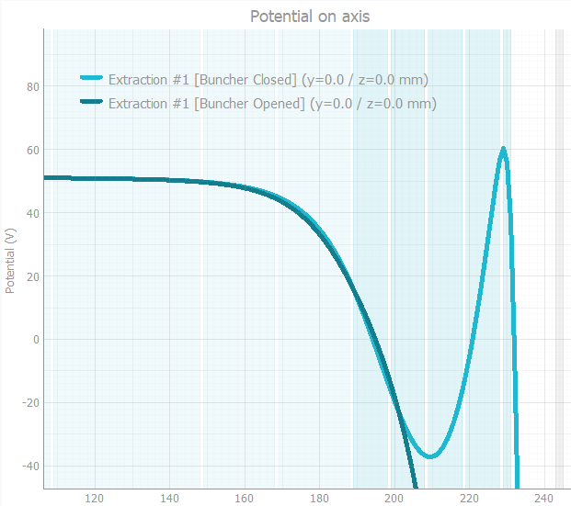
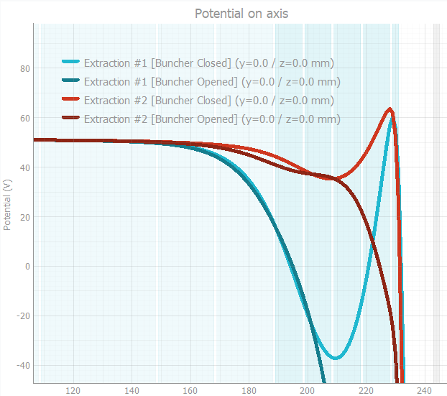
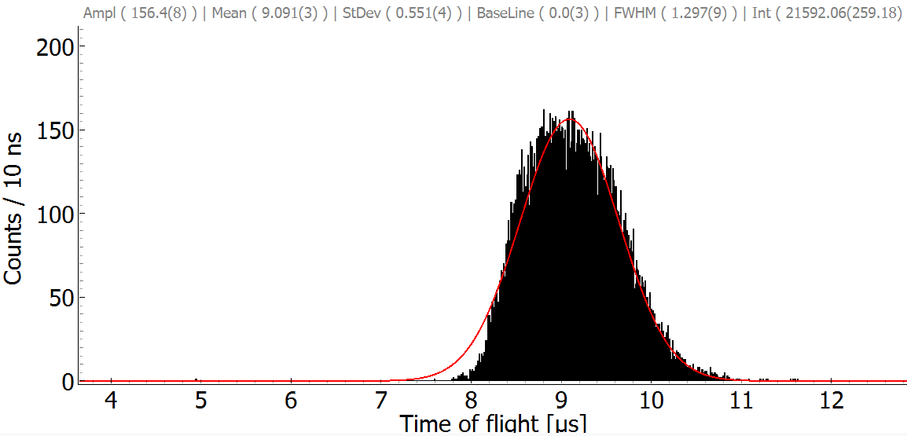
Bunching
made with
and
Ions on MCP detector
Modular trapping/extraction curves
Favor either time or energy dispersion
σ < 60ns
(FWHM < 140ns)
σ > 500ns
(FWHM > 1µs)

Slide 11
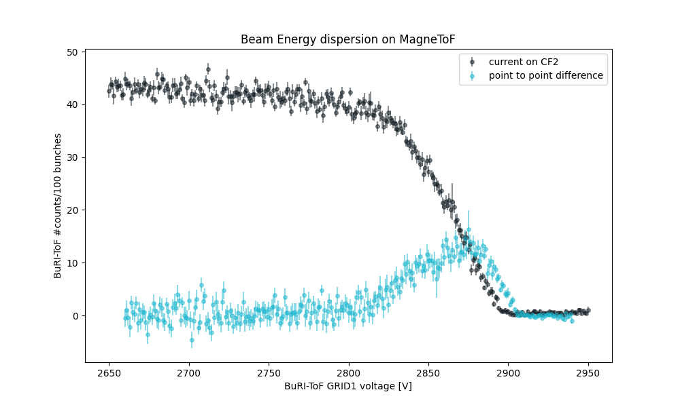
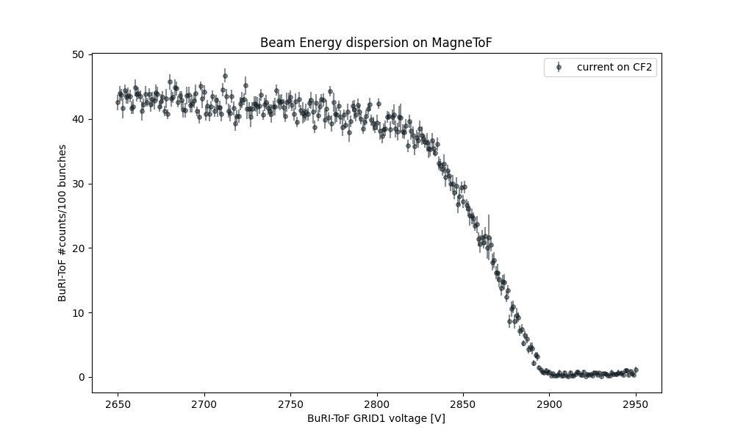
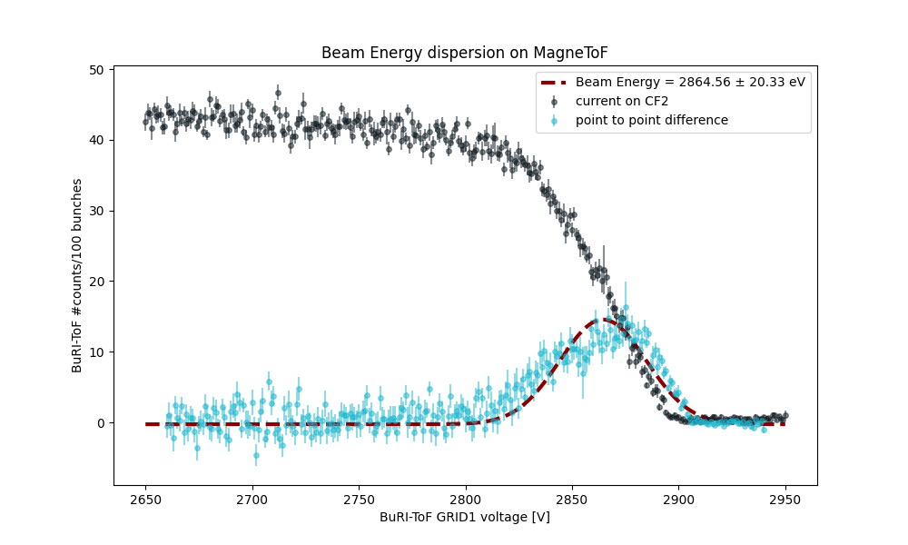
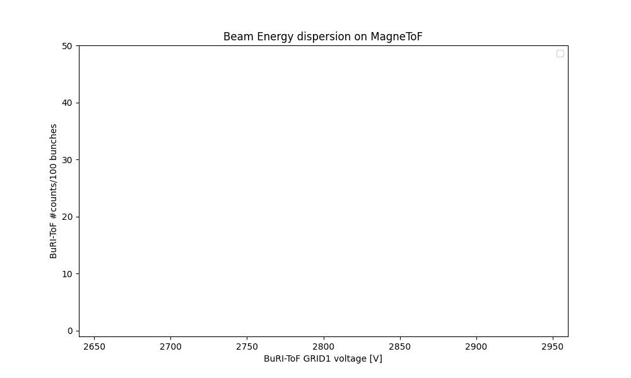
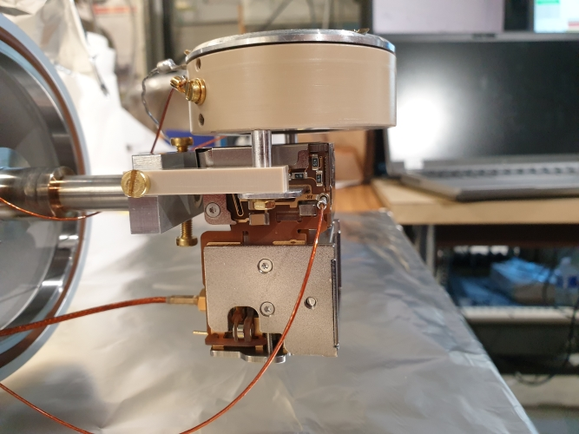
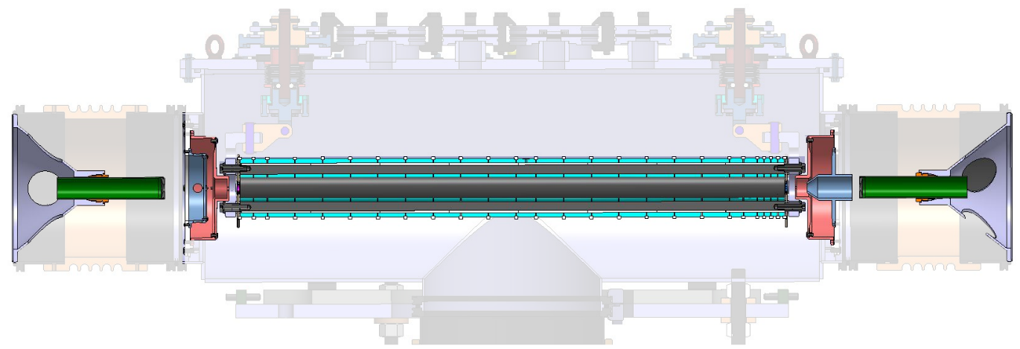

Energy dispersion measurement
Made with
MagneTOF with retarding grid
Scan GRID1 voltage
Counts vs Grid Voltage
Derivative ($∼$point to point difference)
COUNTS ->
Gaussian Fit
VOLTAGE ->
Grid1
GND
Grid2
MagneTOF

Slide 12
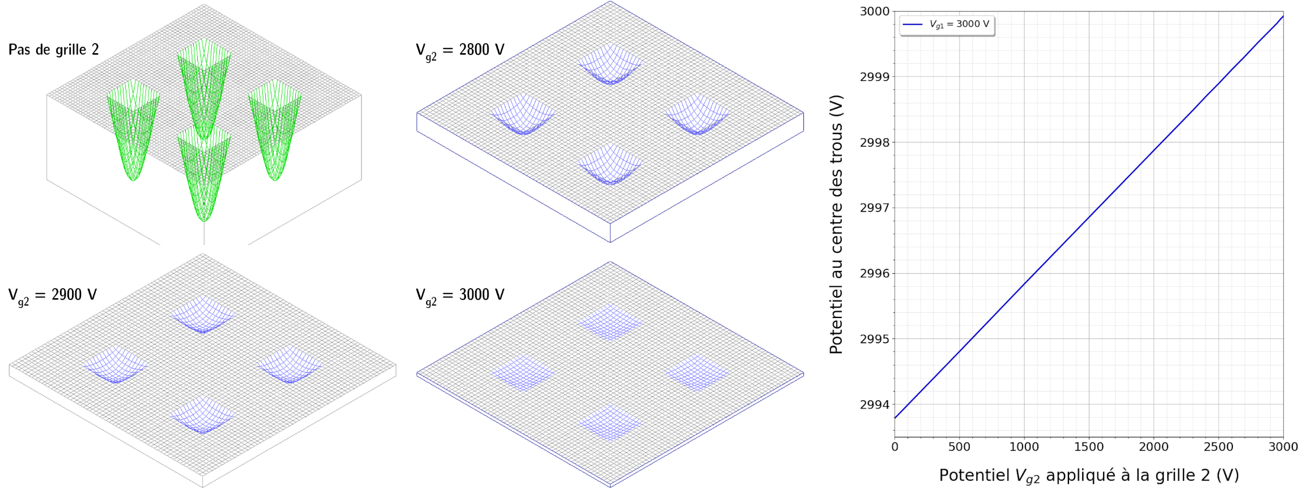
Remark…
MagneTOF
( )
Energy dispersion measurements: GRID2
NB: GRID2 is used to limit “micro-lensing” effects on GRID1

Slide 13


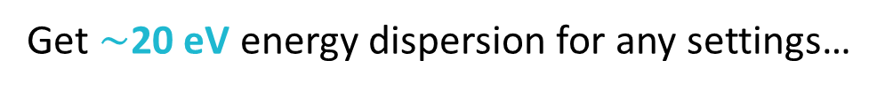

Energy dispersion measurement : Issues
Made with
Difficulties with MagneTOF measurements
$$∼7 ions/bunch$$
Get $∼$20 eV energy dispersion for any settings…
and measure with the
Faraday Cup downstream
$$ΔE=20.3eV$$
Take out MagneTOF
Needs higher source current !
17x attenuation
Grid1
GND
Grid2
Faraday Cup
MagneTOF
$$∼10cm$$

Slide 14
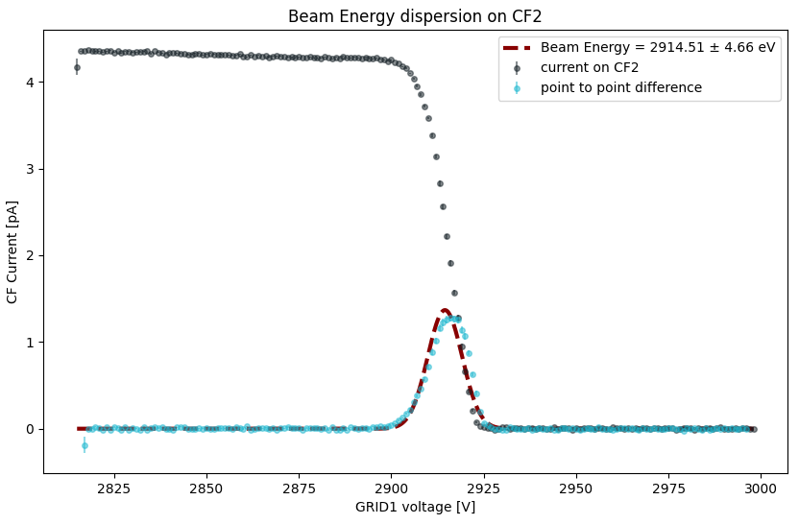
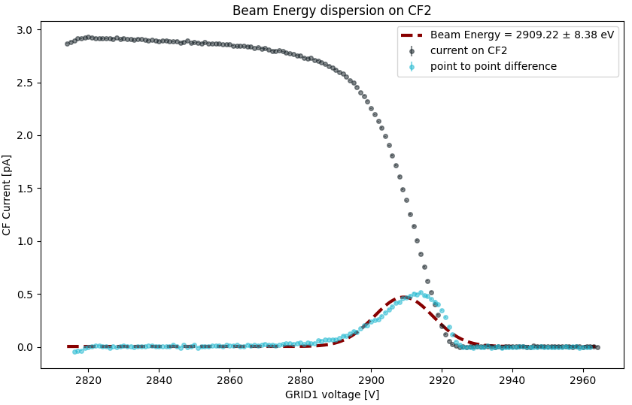
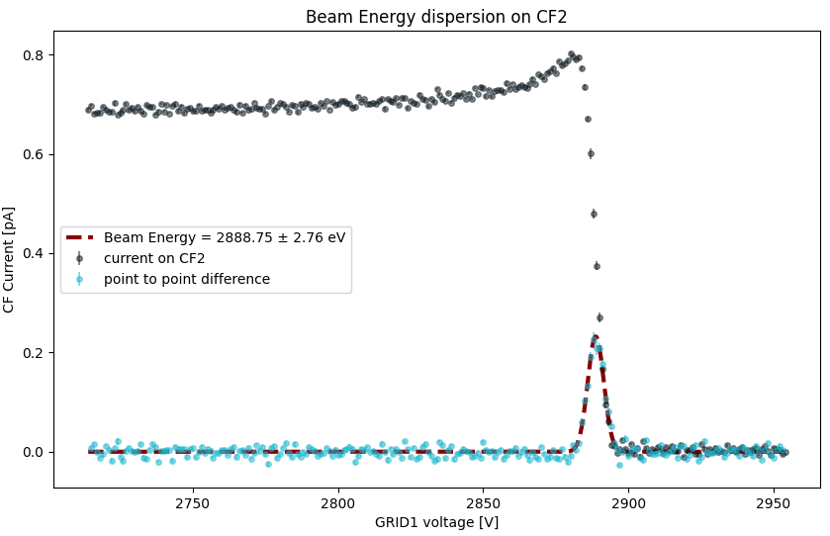
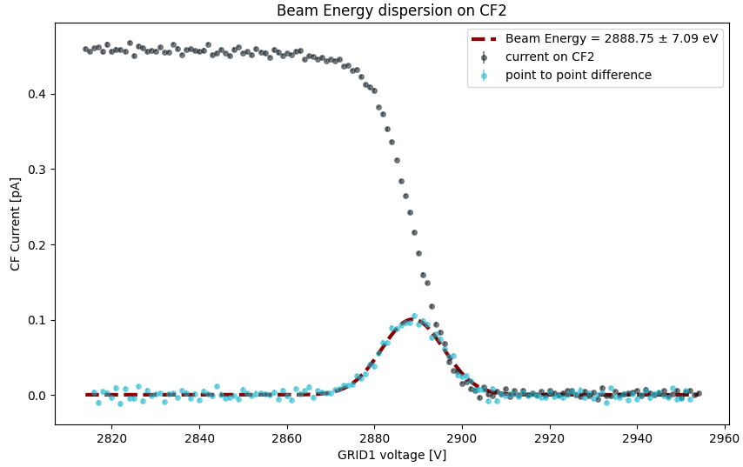
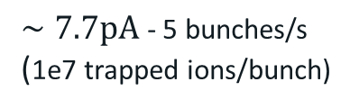


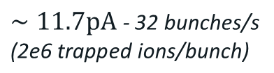


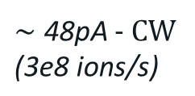
Energy dispersion: measurements with FC
Made with
Much better, but still large dispersions…
MoRI-To mode
(Continuous Beam)
Shapes not gaussian, Low energy tail, …
$$ΔE=4.7eV$$
$∼\text{48}\text{pA}$ - CW
$$\text{(}\text{3}\text{e}\text{8} \text{ions}\text{/}\text{s}\text{)}$$
$∼7.7pA$ - 5 bunches/s
(1e7 trapped ions/bunch)
$∼11.7pA$ - 32 bunches/s
$$\text{(}\text{2}\text{e}\text{6} \text{trapped} \text{ions}\text{/}\text{bunch}\text{)}$$
BuRI-To mode
(Bunched Beam)
Grid1
GND
Grid2
Faraday Cup
$$ΔE=8.4eV$$
$$ΔE=7.1eV$$
$$ΔE=2.8eV$$
$$∼10cm$$

Slide 15
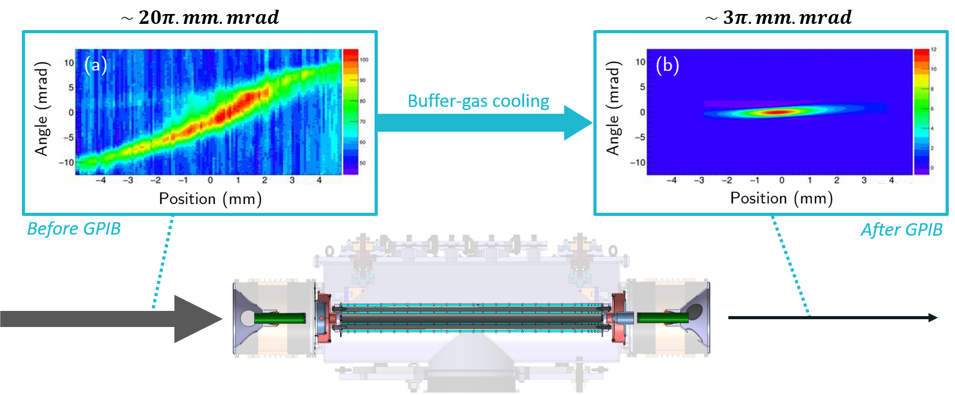
Cooling: transverse emittance reduction
Measured in Bordeaux with electrical sweep type emittance scanner, for a 30keV continuous beam
Work in progress for bunched beam measurements with a “Pepper-Pot” emittance-meter (<-> HRS)
Hardware: new 2D mask installed, camera trigger, …
Software: produce emittance figures, analysis for absolute emittance value, bunches/images accumulation… [A. Balana]

Slide 16

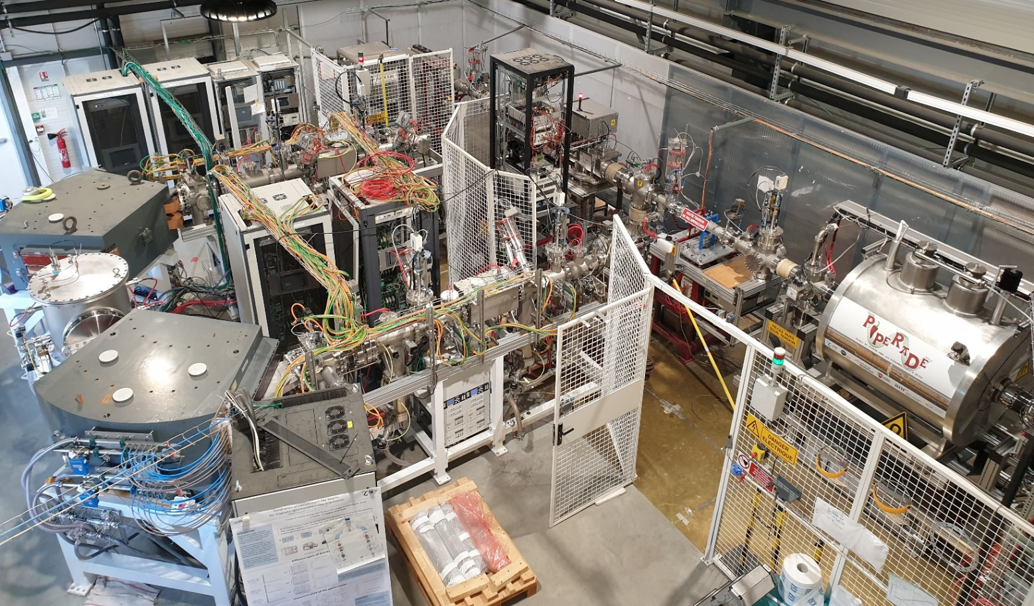

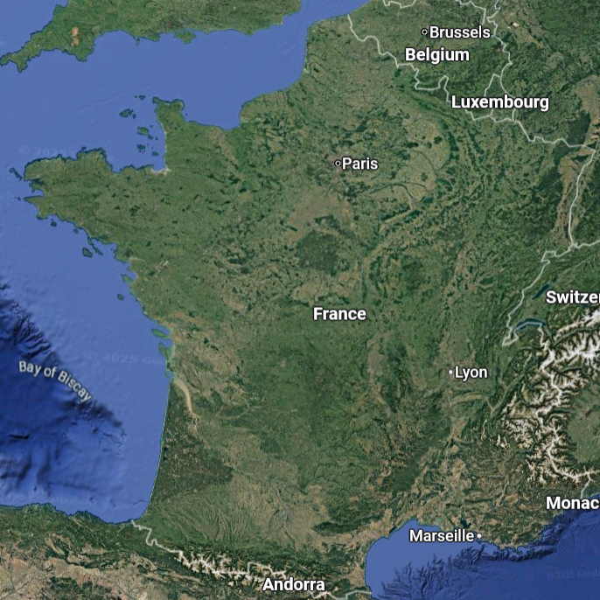


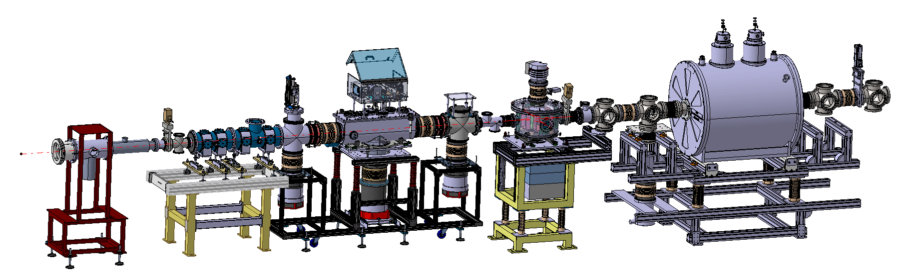

Conclusion & Perspectives
Stable-ion source
The RFQCB is fully operational
Delivers bunched beam 24/7 @LP2iB
for PIPERADE commissioning
Work is ongoing to finish full characterization and improve bunched beam performance
Caen
Working on DESIR upgrade: HV platforms, mechanical support, automation, …
Bordeaux
[GPIB]
Stable-ion source
(Alkali)
soon...
Moving to GANIL
New place, New life, New Name…

Slide 17


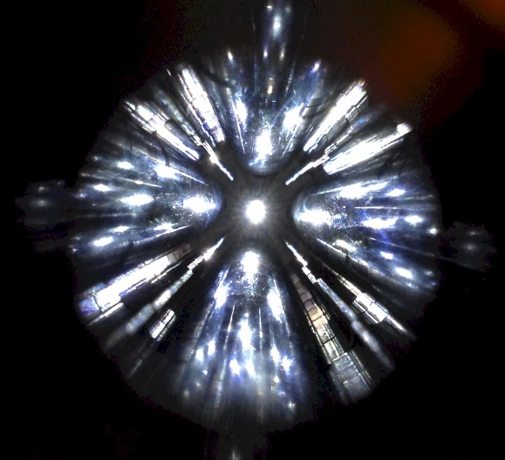
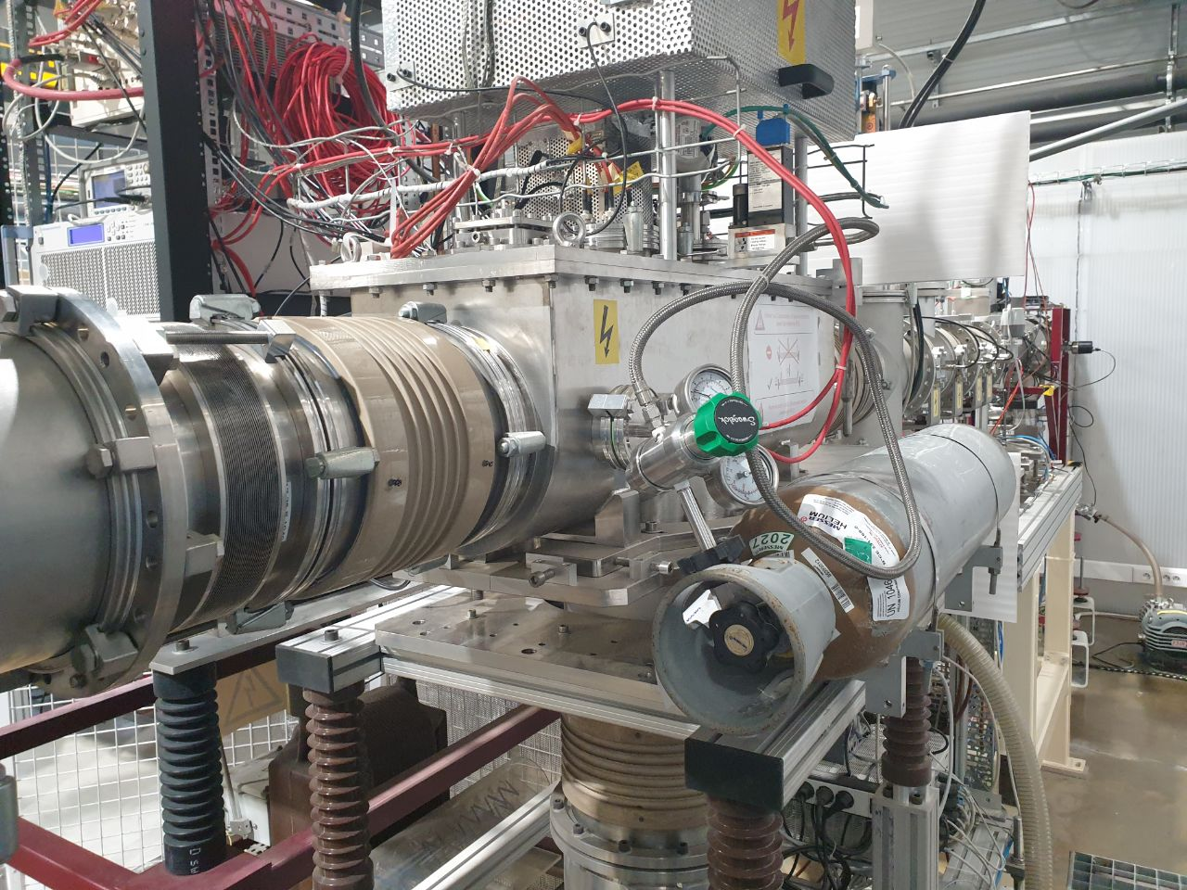
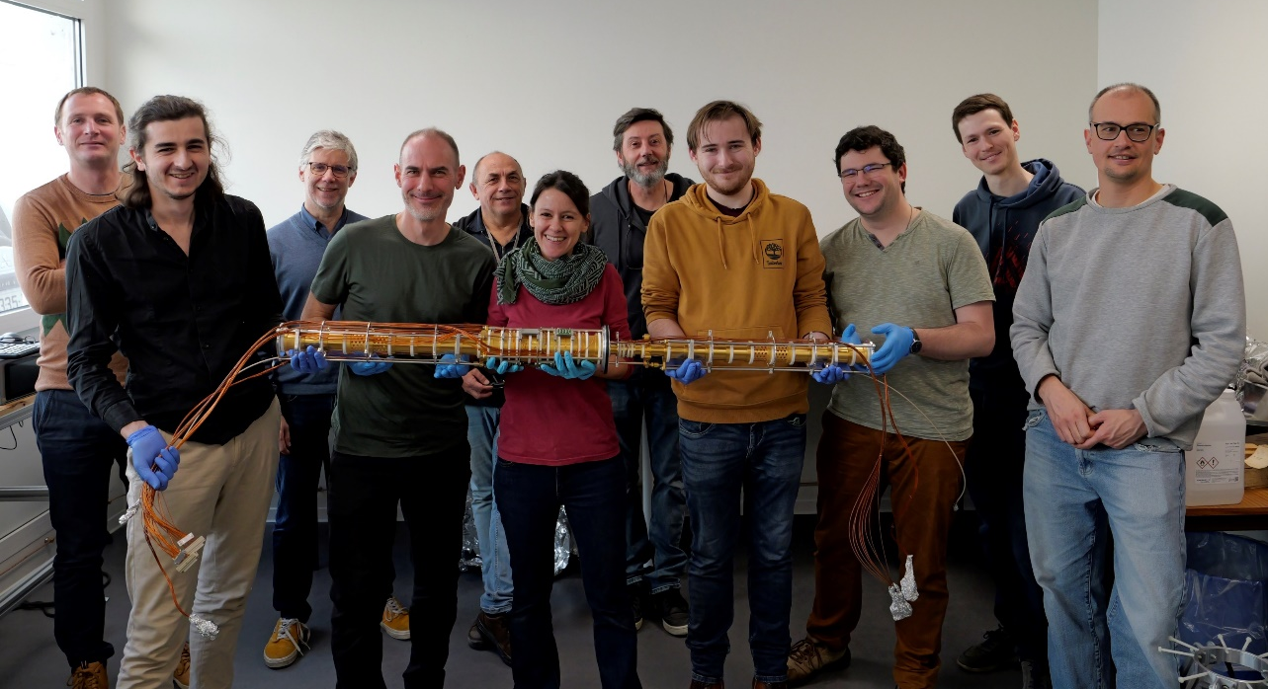
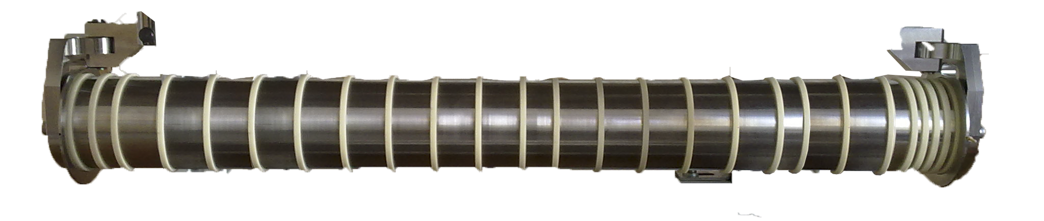
Thank you !
BRIoCHe
GPIB-PIPERADE Team
P. Alfaurt, P. Ascher, D. Atanasov, A. Balana, B. Blank, L. Daudin, M. Flayol, M. Gerbaux, S. Grévy, G. Guignard, M. Hukkanen, A. Husson, G. Jevelot, B. Lachacinski, S. Lechner, E. Rey-herme, M. Roche, K. Ronxin, A. de Roubin, C. Roumegou
No AI in this picture ;)

Slide 18
BACKUP SLIDES

Slide 19
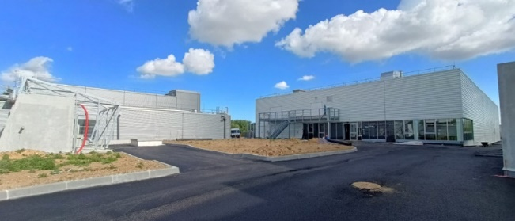
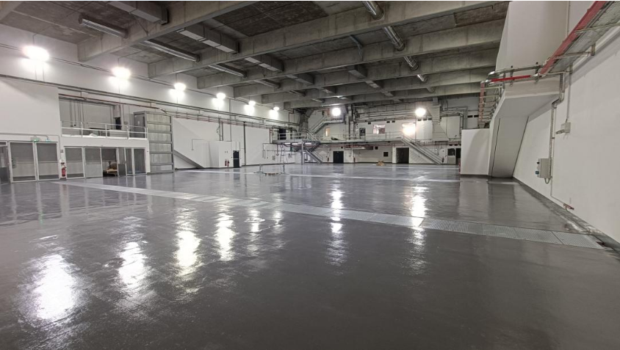
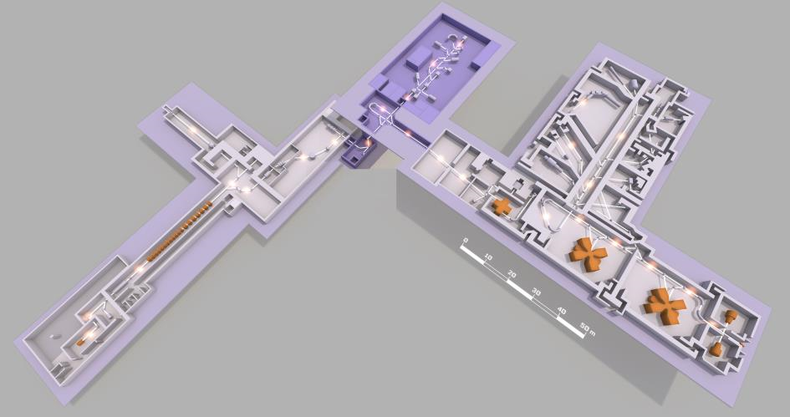
The DESIR facility
@
09-2025
New experimental hall in GANIL
Now…
S3
Low-energy RIB
from SPIRAL1
and S3
fusion-evaporation
DESIR
S3
SPIRAL1
fragmentation
fusion-evaporation
SPIRAL2
SPIRAL1
…and in the future

Slide 20
Physics at DESIR
Décroissance, Excitation et Stockage d’Ions Radioactifs
Decay, Excitation and Storage of Radioactive Ions
Decay Spectroscopy
LASER Spectroscopy
Traps
Exotic decay modes
High-precision β-decay studies
TAS measurements
Charge radii
Nuclear moments
Spins
Mass measurement
Fundamental interactions
Trap-assisted spectroscopy
BESTIOL
LUMIERE
DETRAP

Slide 21






Beam preparation: mass separation
[HRS] SUSHI : SPIRAL U-shape Separator for Heavy Ions
U-shape mass separator
Currently commissioning in Bordeaux
$$\frac{M_{0}}{ΔM}\sim 20 000$$
J. Michaud et al., Nucl. Instrum. Methods Phys. Res. B (2023)

Slide 22



The “GPIB”: an RFQ Paul Trap
Transverse trapping with 4 unsegmented RF rods
y
z
$≈$ 800 mm
Longitudinal trapping with 25 independent DC segments

Slide 23



GPIB RF system
Adjustable
ground
20 dB
Directional
coupler
6 dB
Primary
winding
Power
amplifier
Secondary
windings
attenuator
attenuator
Tunable
capacitor
Function generator
Osc. ch1
Osc. ch2
Osc. ch3
RFQ
Osc. ch4

Slide 24

GPIB mechanical design
Alignment system
Grounded
electrode
He
RF feeding
RF rods
Grounded
electrode
DC segments
Pumping

Slide 25


P3: PythonPlotPot
Interface with SIMION python PA library
Adjust electrodes voltages
Plot potential curve on a given axis of beamline
Check current beamline settings and create new ones

Slide 26


PTSD
Python Trap Scanner for DESIR
Scan all EPICS variables
Control trapping sequence
Signal acquisition
Position reconstruction
Data gating and fitting
Adaptable to various DESIR detector type
Already compatible with 2 MCP types (simple ToF signal or position-sensitive with delay lines), Faraday Cups and MagneToF - For Continuous or Bunched beam.

