Slide 1






PIPERADE status 2026
PIèges de PEnning pour RAdionucléides à DESIR.
Gauthier Guignard
LP2iB

Slide 2
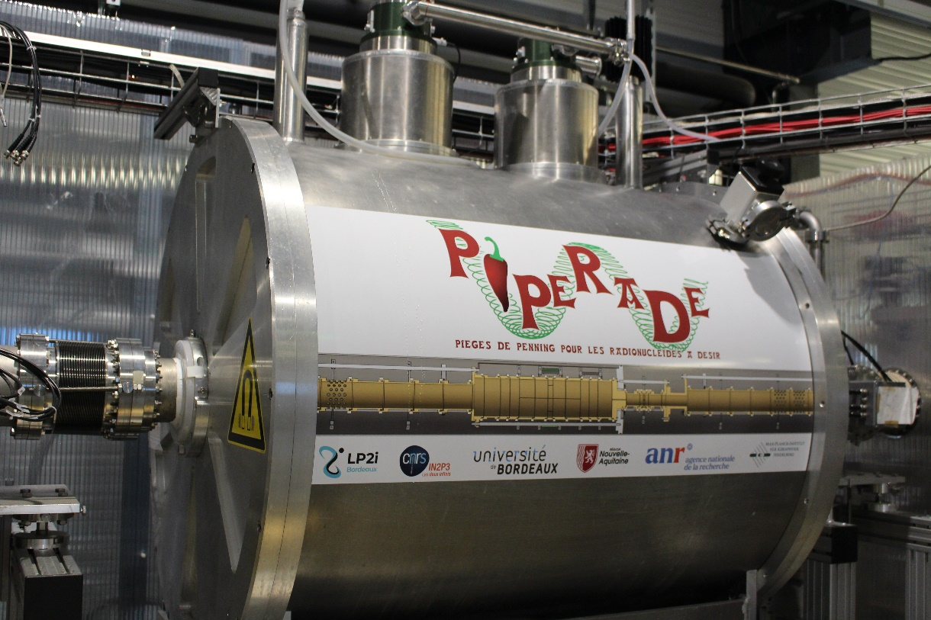
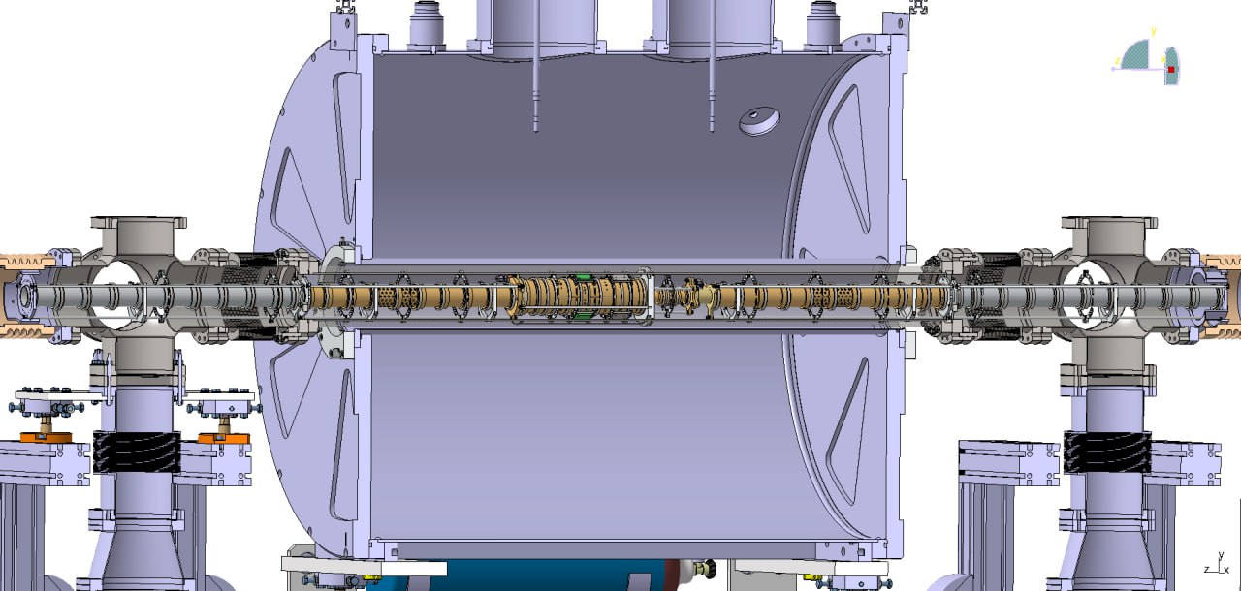

PIPERADE
P. Ascher et al., PIPERADE: A double Penning trap for mass separation and mass spectrometry at DESIR/SPIRAL2, Nucl. Instrum. Methods Phys. Res. A 1019 (2021) 165857
Diaphragm (1mm Ø)
From
GPIB
MCP
Counting
ToF
Position
Injection optics
Purification trap (64mm Ø)
Measurement
trap (20mm Ø)
Extraction optics
Designed and machined at MPIK Heidelberg
Notes:
-> here we have a view inside PIPERADE : he a double penning trap with : Magnet of 7 tesla field and multiple electrode stacking
-> Red dot : simulate ion ->[….PT…MT…] -> MCP : count the numbers of ions, measure the time of flight of each and reconstruct the position of each
-> Now we will see what happen inside the two traps ?

Slide 3
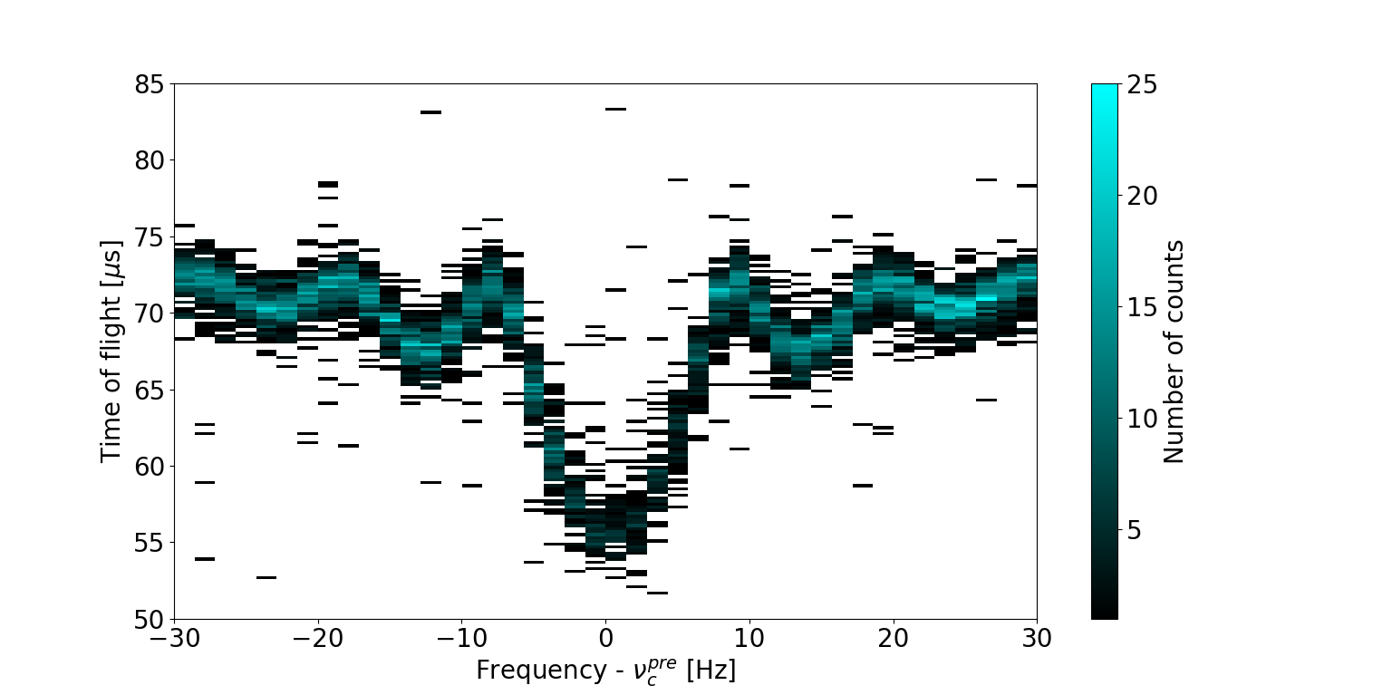
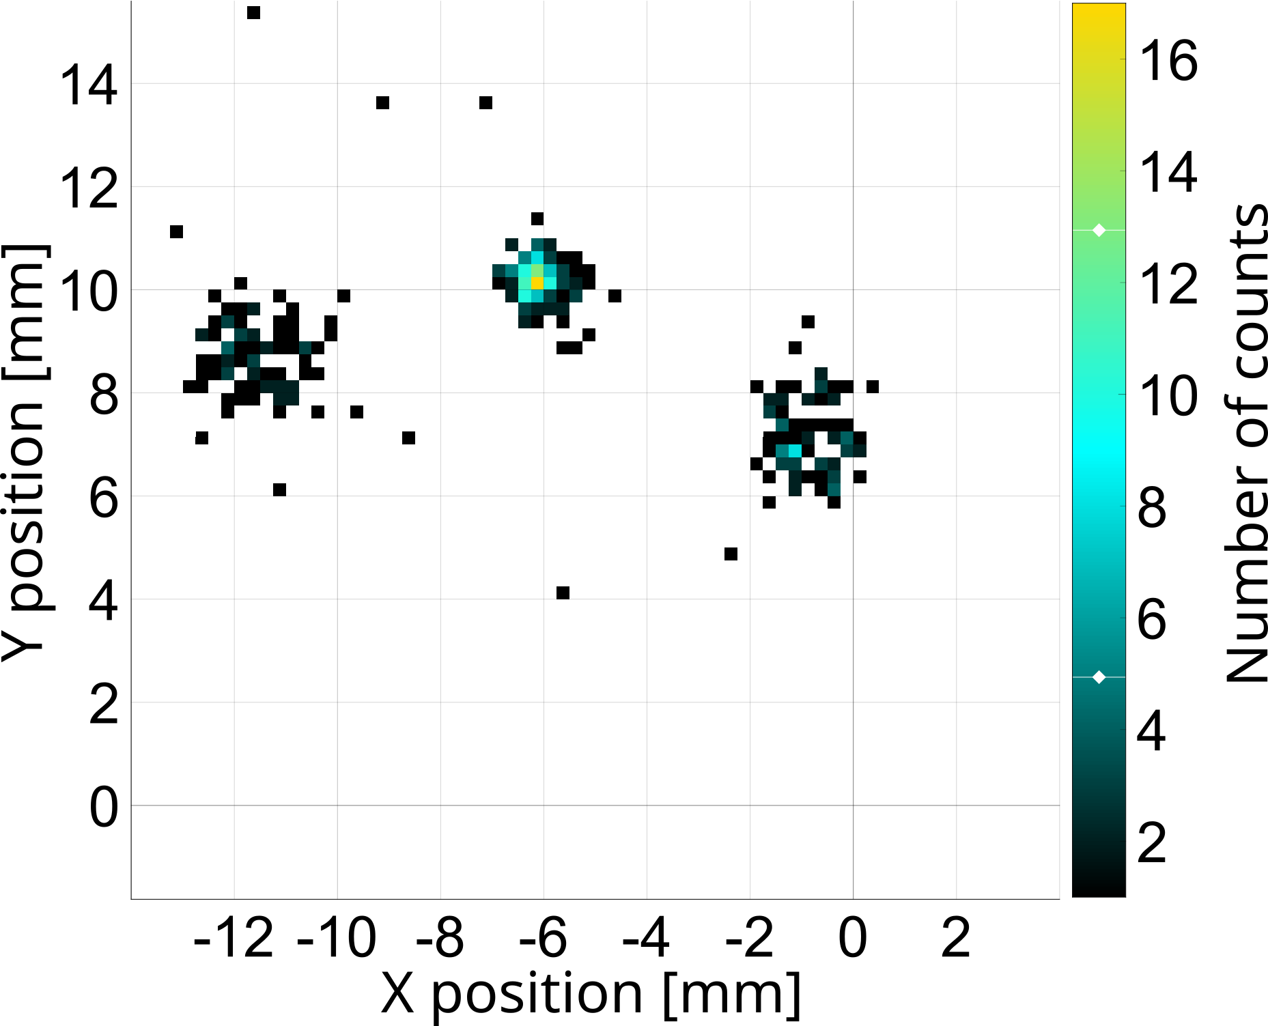
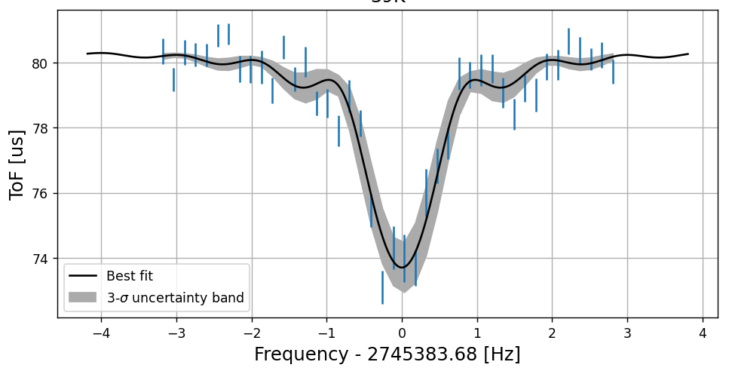
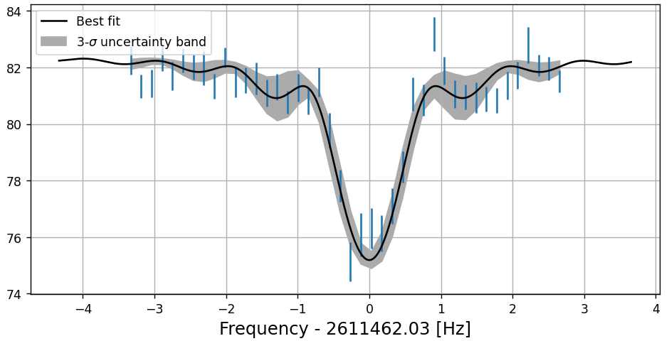
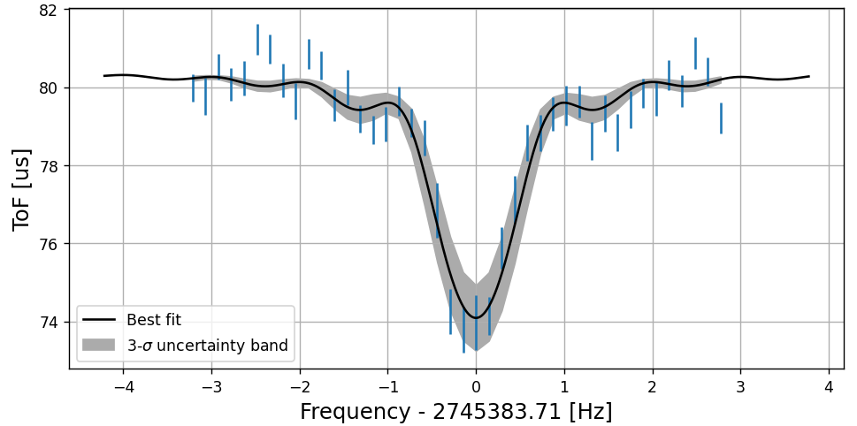
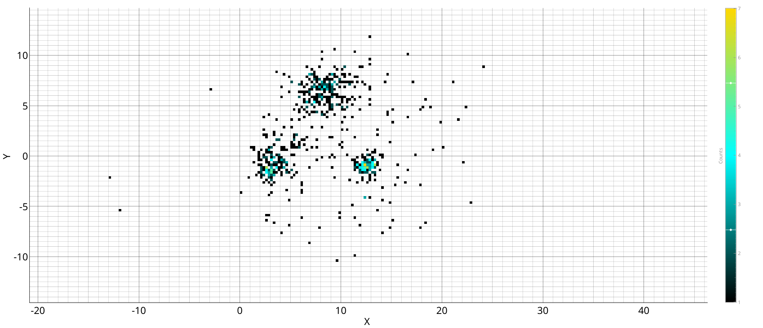
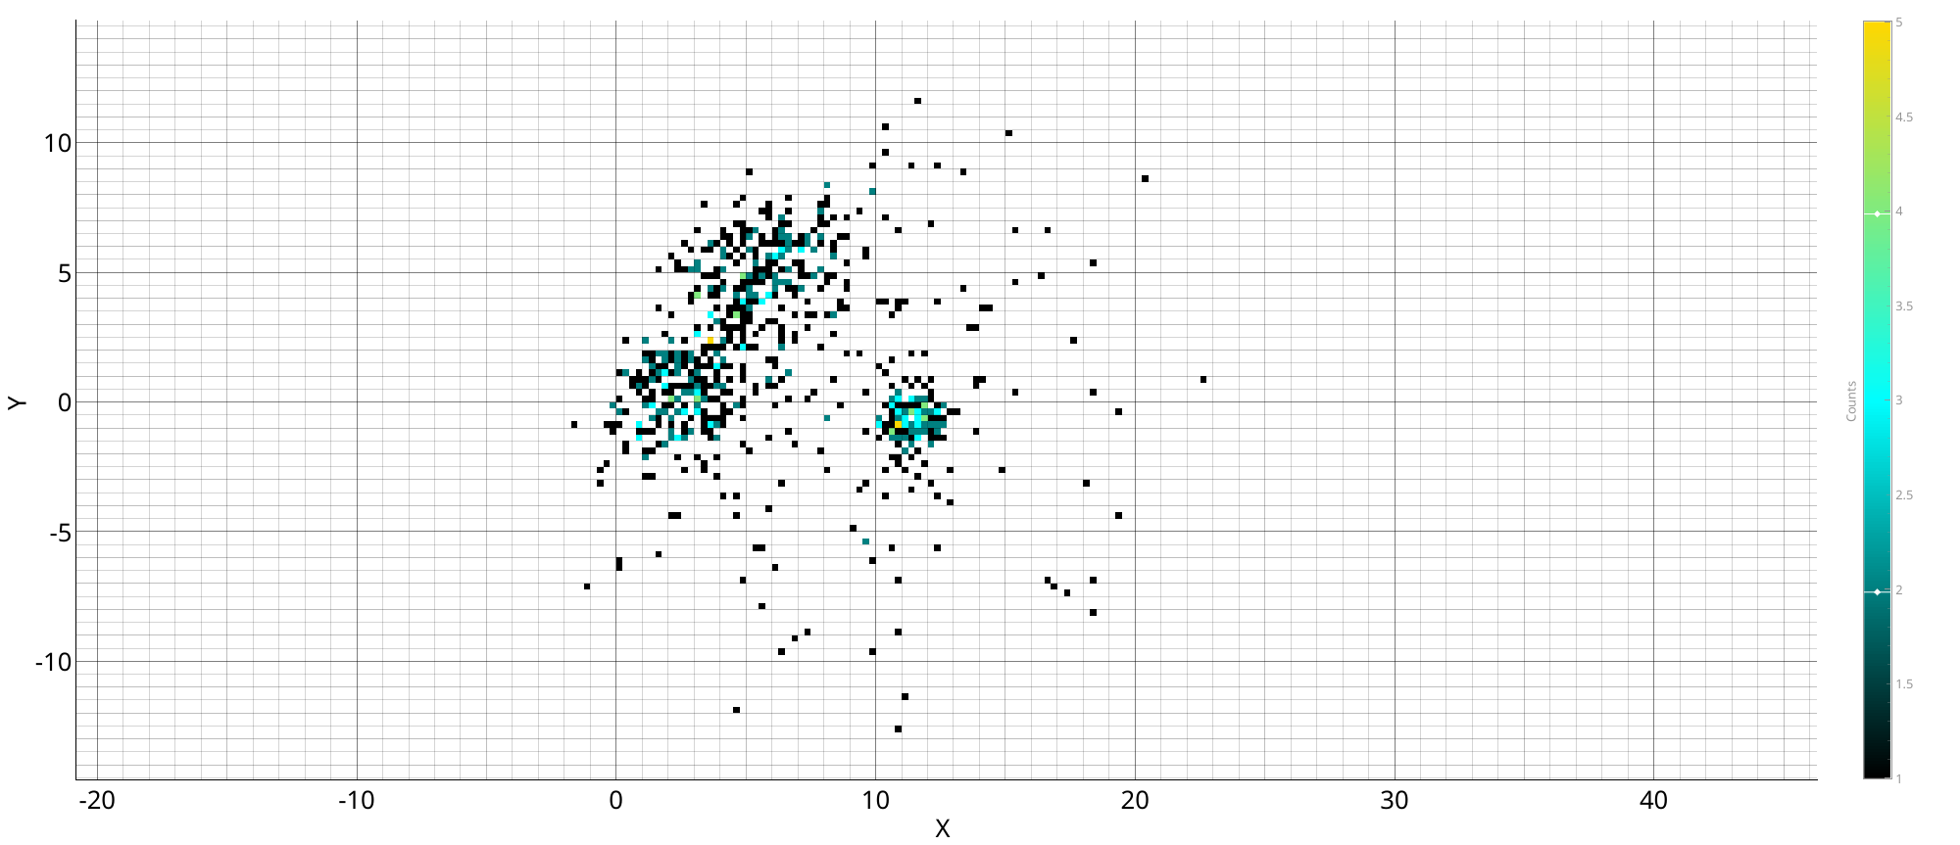






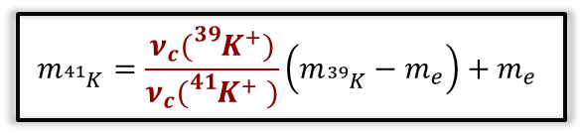





Mass measurement techniques
ToF-ICR
PI-ICR
$$υ_{c}$$
Center
$φ_{c}={2ν}_{C}πt_{acc}$- $2π$n
$$Φ_{c}$$
Reduced cyclotron
Magnetron
$$ν_{c}= \frac{qB}{2πm}$$
$$m_{{}_{}^{41}K}=\frac{ν_{c}({}_{}^{39}{K^{+}})}{ν_{c}({}_{}^{41}{K^{+}} )}\left(m_{{}_{}^{39}K}−m_{e}\right)+m_{e}$$
$${}_{}^{39}{K^{+}}$$
$${}_{}^{41}{K^{+}}$$
$${}_{}^{39}{K^{+}}$$
$${}_{}^{39}{K^{+}}$$
$${}_{}^{41}{K^{+}}$$
$${}_{}^{39}{K^{+}}$$
M. Flayol, PhD Thesis (2024)
Notes:
-> ToF-ICR : see a resonance around nu_c (value in the center) -> find m with this equation -> with multiple ToF-ICR measurement -> mass plot (longer excitation time give smaller error bar) -> we routinely use it
-> PI-ICR: this method use position of 3 spot : center {reduced cyclotron and magnetron} which constitute the cyclotron motion in the traps -> extract the angle between the two -> obtain nu_c with this equation -> same as ToF-ICR after that multiple Pi-ICR -> mass plot -> need more development for the moment
-> both need systematics studies -> I will add a little more explanation on the ToF-ICR analysis

Slide 4
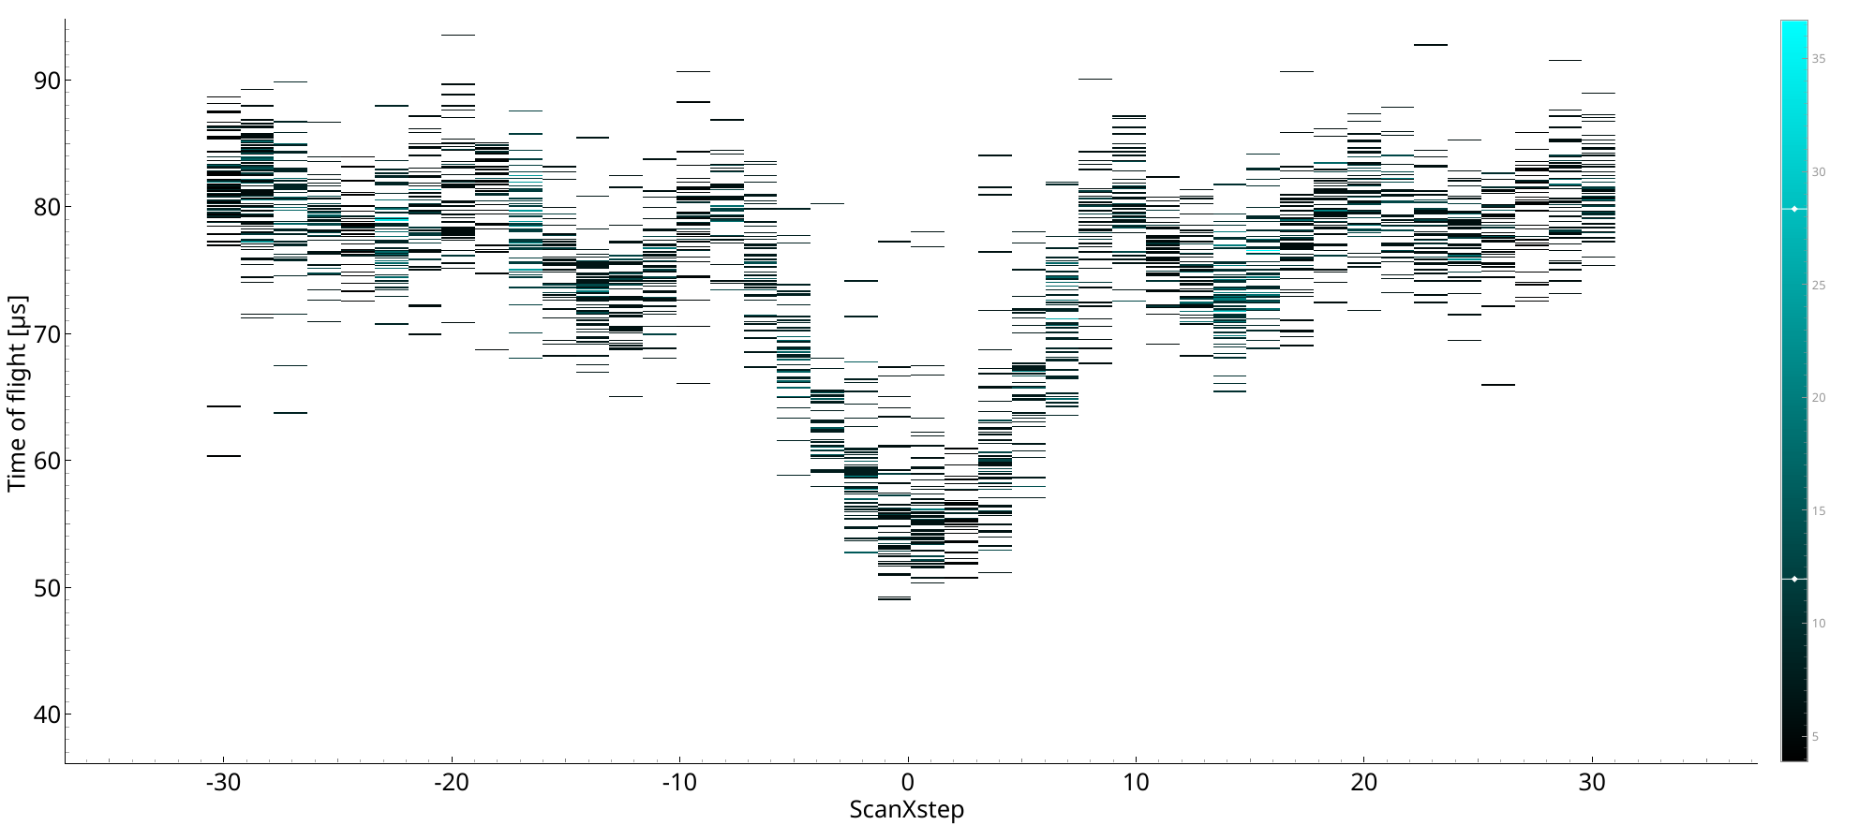
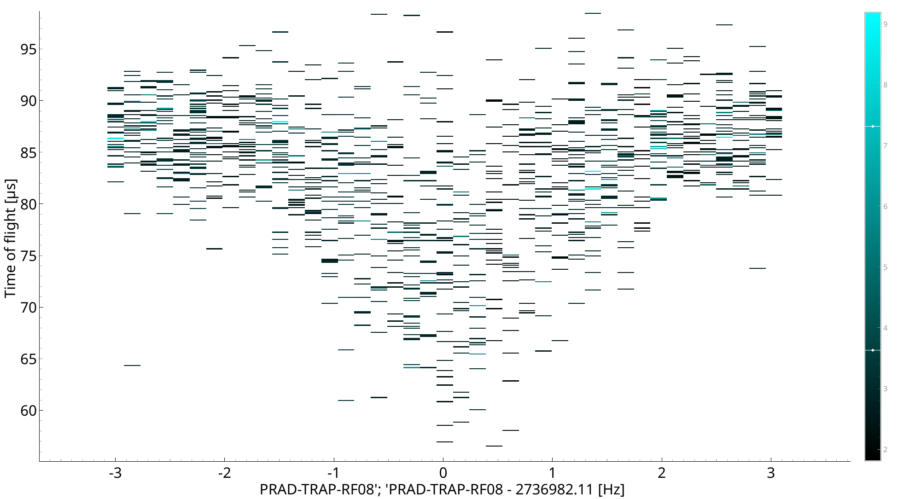
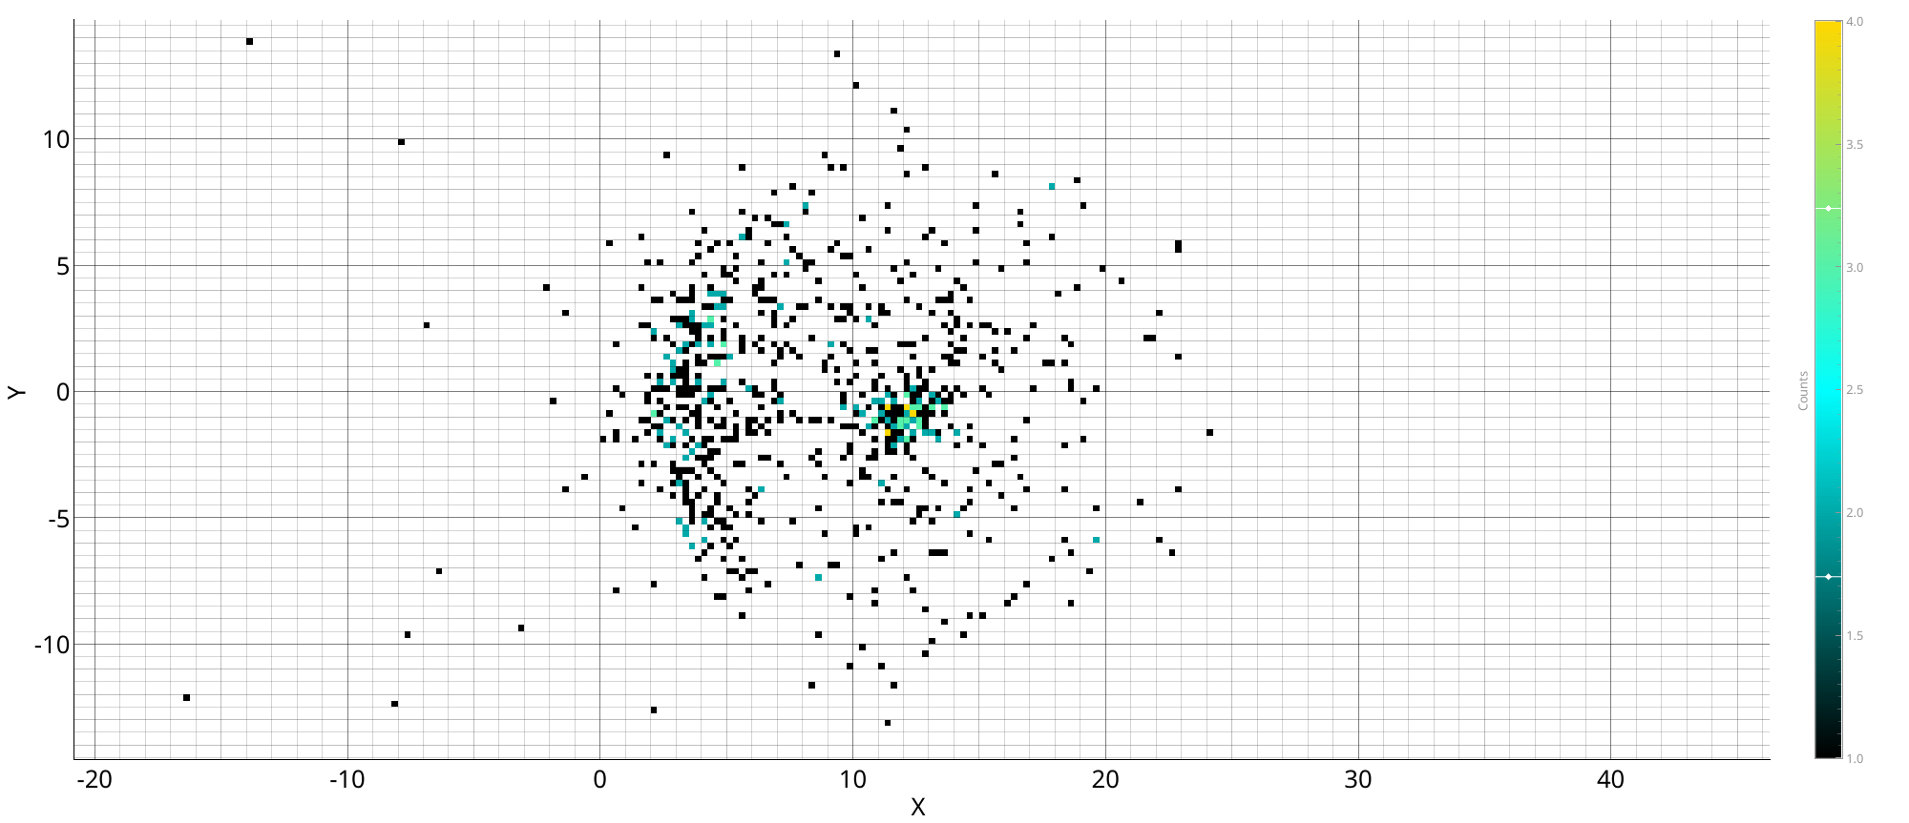
Main issue reported in ISOL2025
Issues with long trapping times
100 ms
1 s
100 ms
1 s

Slide 5
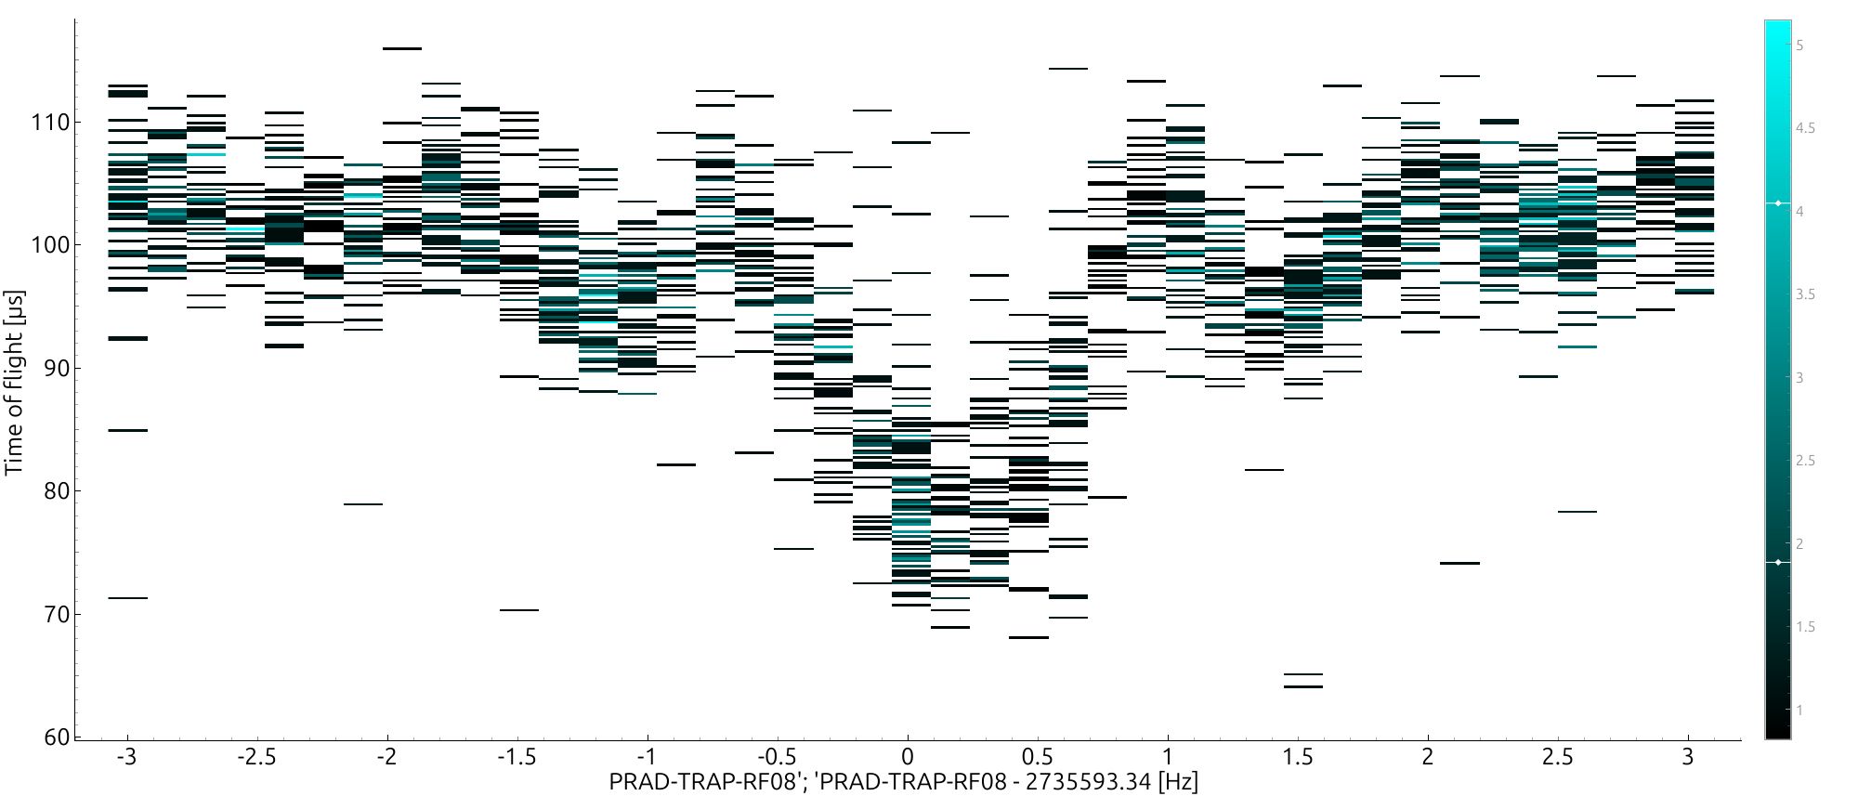
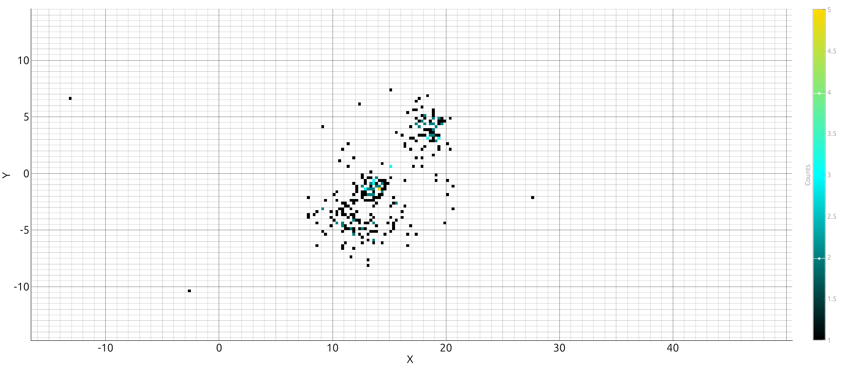
Issues with long trapping times
Improved vacuum in MCP chamber from 1e-7 mbar to 8e-9 mbar
Before
Now
ToF-ICR conversion 1 s
ToF-ICR conversion 1 s
PI-ICR accumulation 1 s
PI-ICR accumulation 1 s

Slide 6
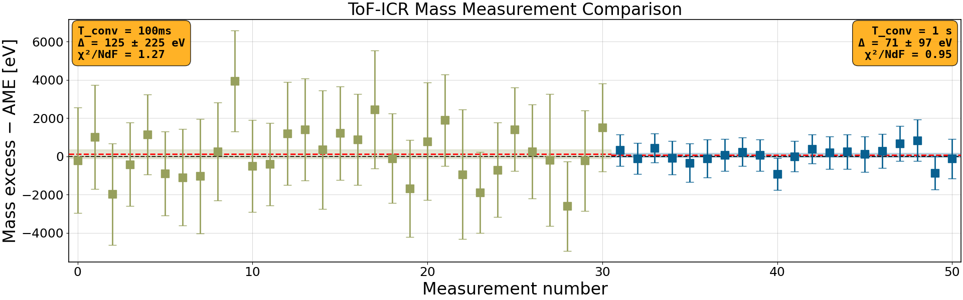
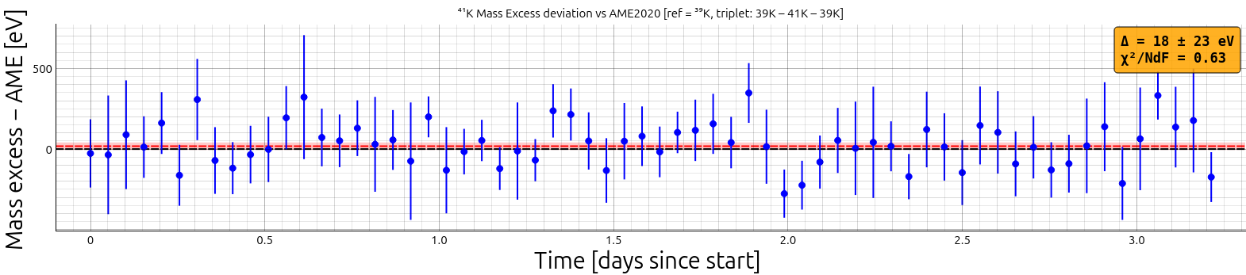
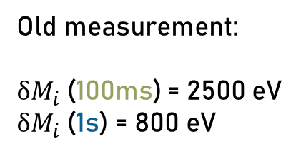
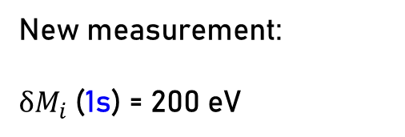
Last mass measurement performed
ToF-ICR measurement 1s
${}_{}^{41}{K^{}}$mass excess with${}_{}^{39}{K^{}}$as reference
Old measurement:
$δM_{i}$(100ms) = 2500 eV
$δM_{i}$(1s) = 800 eV
New measurement:
$δM_{i}$(1s) = 200 eV

Slide 7
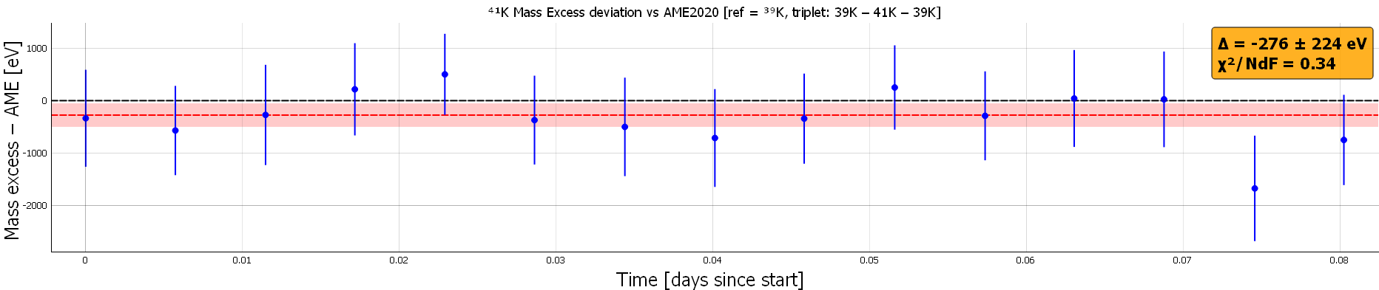
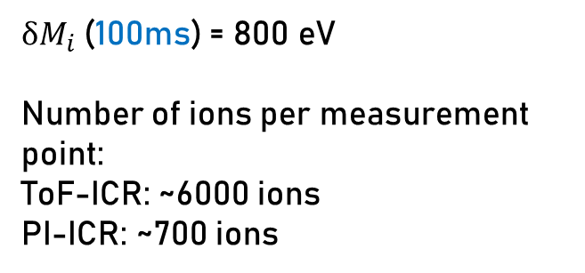
Last mass measurement performed
PI-ICR measurement 100ms
${}_{}^{41}{K^{}}$mass excess with${}_{}^{39}{K^{}}$as reference
$δM_{i}$(100ms) = 800 eV
Number of ions per measurement point:
ToF-ICR: ~6000 ions
PI-ICR: ~700 ions
With 1 s PI-ICR spot we go further in:
Parameter optimization
Systematics probing

Slide 8
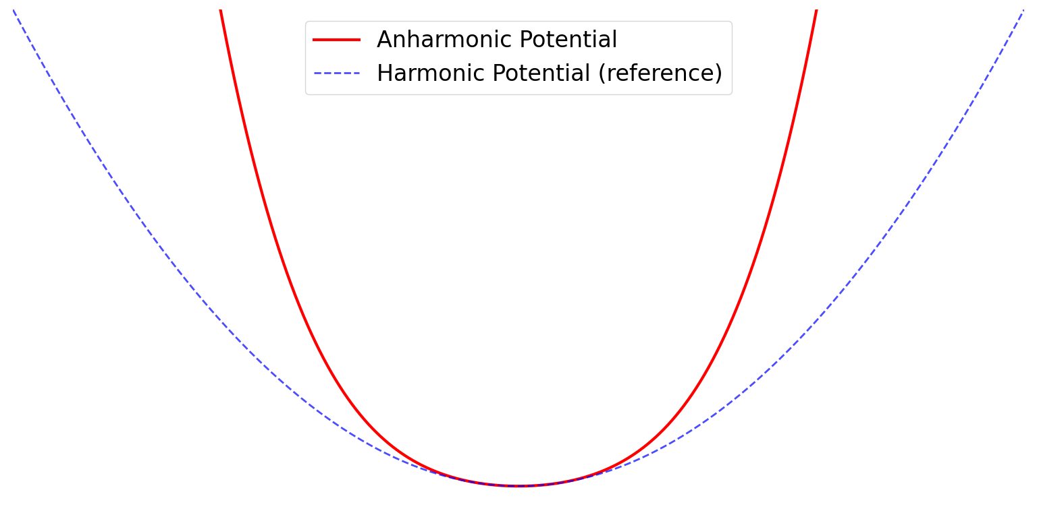
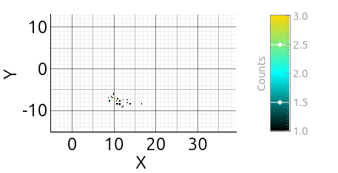
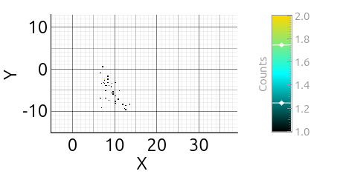
Optimization of correction potential
For a magnetron spot with 1 s of accumulation time
Correction: -70.65V
Correction: -70.70V
In PI-ICR, the dispersion of a spot is greatly affected by the trap harmonicity.
Endcap
C
R
C
Endcap
Increase of 3.5 in global dispersion for a 0.05 V difference

Slide 9
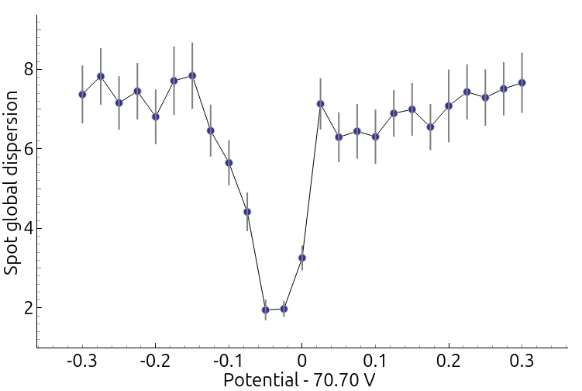
Optimization of correction potential

Slide 10
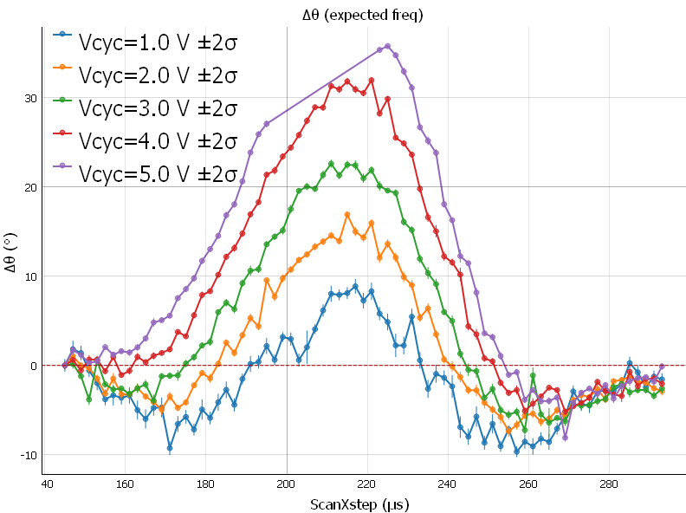
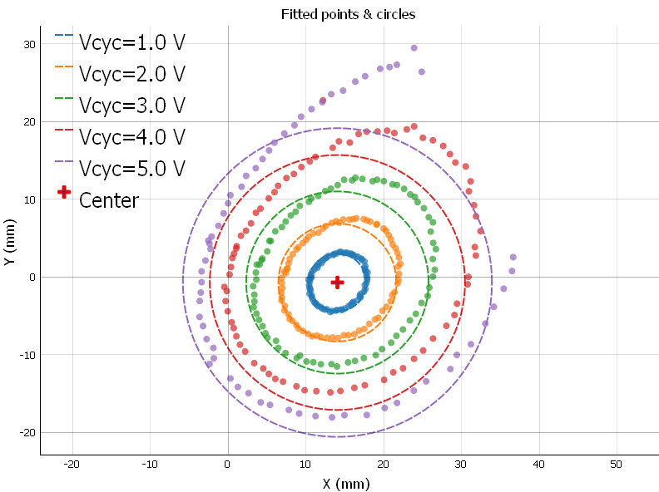
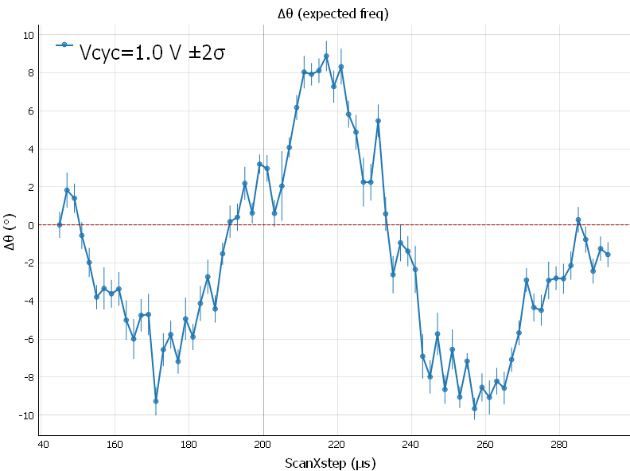
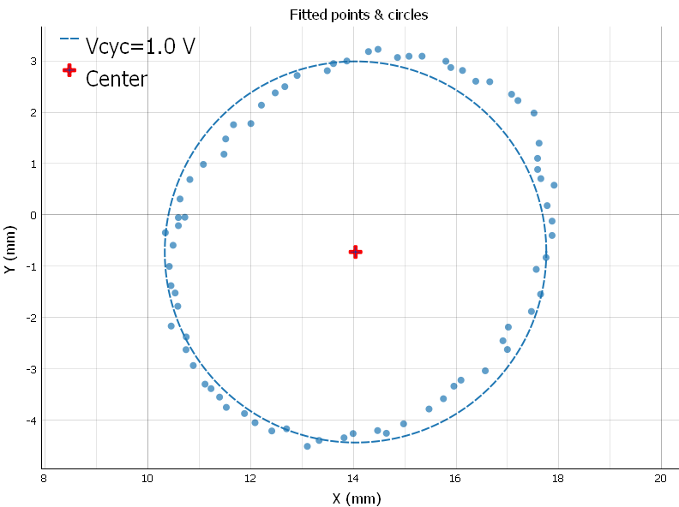


PI-ICR study: image distorsion
$φ_{c}={2ν}_{C}πt_{acc}$- $2π$n
Y (mm)
Y (mm)
ΔΘ (°)
ΔΘ (°)
X (mm)
X (mm)
The precision of 𝝓_𝒄 increases with the radius.
We have a small misalignment in our extraction electrodes.
$φ_{c}={2ν}_{C}πt_{acc}$- $2π$n
Extraction phase (µs)
Extraction phase (µs)
Precision wanted for a measurement PI-ICR 1s of 39K δΘ < 0,5 ° ($\frac{δν_{c}}{ν_{c}}=5e^{−10}$ ).
We need to determine the position shift of our spot caused by our fields.

Slide 11
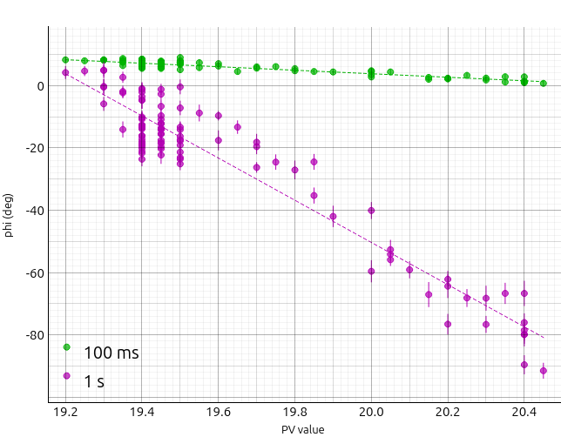
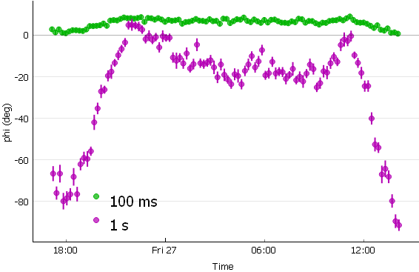
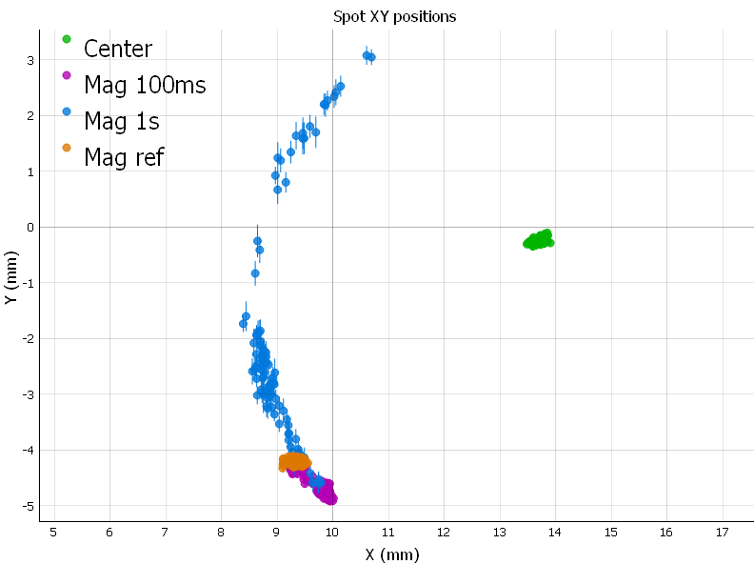
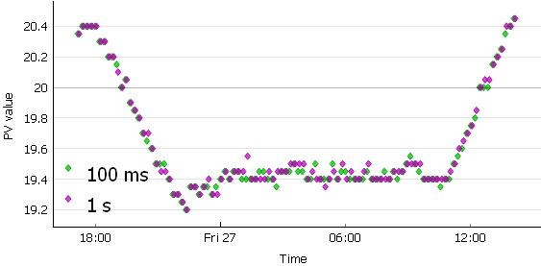
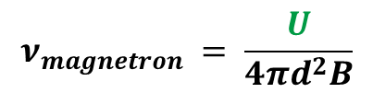
Study of the electric field drift
Measurement of two spots magnetron with an accumulation time of 100 ms and 1 s
$$ν_{magnetron} = \frac{U}{{4πd}^{2}B}$$
We can probe the electric field drift by studying the magnetron spot.
Φ (°)
Φ (°)
Y (mm)
Temperature (°C)
Temperature (°C)
High correlation with the temperature
Φ vs Temp slope 100ms: -5.633 ± 0.227 °/°C
Φ vs Temp slope 1s: -67.689 ± 2.063 °/°C
X (mm)
Time (UTC)

Slide 12
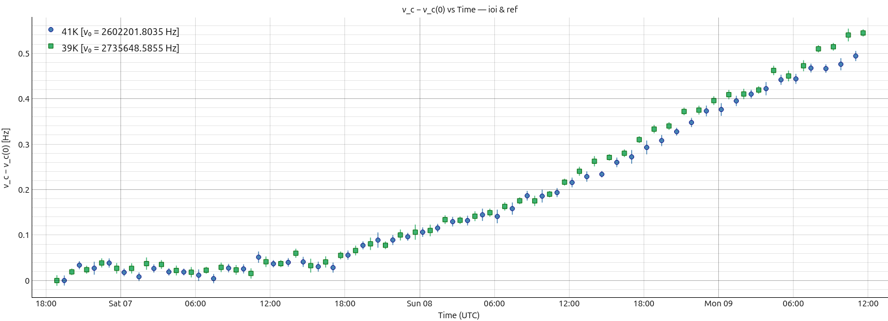
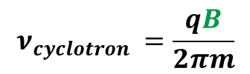

Study of magnetic field drift
When we observe a ToF-ICR mass measurement frequency evolution
$$ν_{cyclotron} =\frac{qB}{2πm}$$
We can probe the magnetic field drift by studying the evolution of the cyclotron frequency.
Δνc [Hz]
Time (UTC)
We observe a frequency shift of around 10 mHz/h during measurement:
Identical for the two species
Uncorrelated to the temperature
This shift doesn’t affect
But it does affect $φ_{c}$.

Slide 13
Conclusion
With our vacuum improved, we obtain:
Very clean ToF-ICR shape
Less dispersed PI-ICR spots
We obtained promising results for our two measurement methods.
With our improved sensitivity, we were able to probe even smaller systematics.
Our acquisition software now supports modularity with other potential setups.
Perspective
Perform reproducible 1s PI-ICR mass measurements:
Optimize the extraction to minimize angular deviation, then create a deviation map.
Determine how to compensate for the fields drifts observed.
Quantify the maximum ion purification capacity of the first trap.
Quantify the phase cleaning capacity of the second trap.
Move PIPERADE to DESIR at GANIL next year.

Slide 14


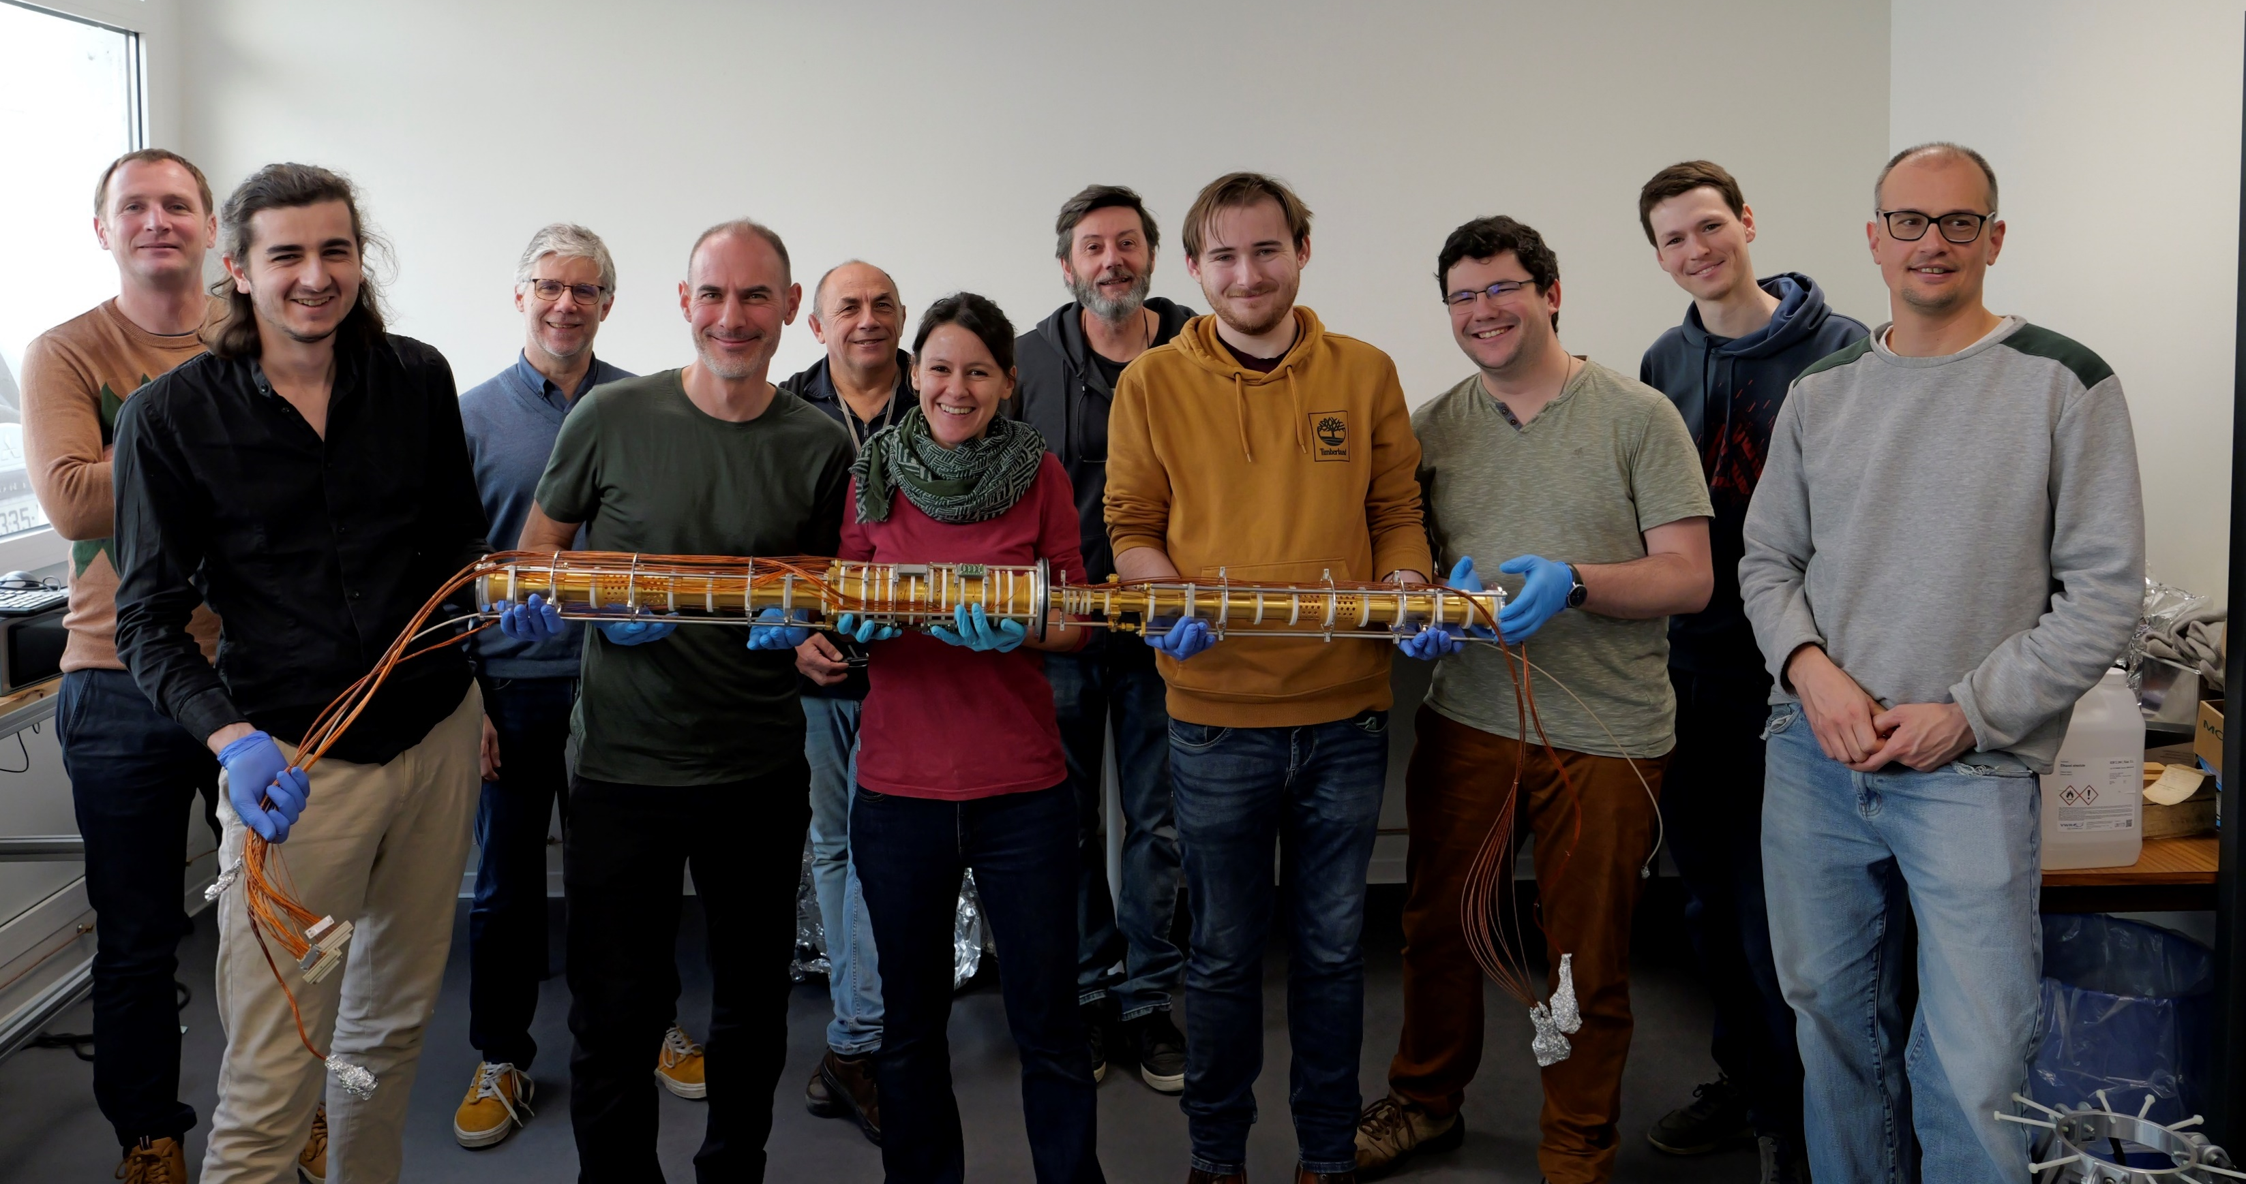


Thank You
GPIB-PIPERADE TEAM
P. Alfaurt, P. Ascher, D. Atanasov, B. Blank, L. Daudin, M. Flayol, M. Gerbaux, S. Grévy, G. Guignard, M. Hukkanen, A. Husson, B. Lachacinski, S. Lechner,
S. Perard, E. Rey-herme, M. Roche, K. Ronxin, C. Roumegou, A. de Roubin
Questions?
Exotic Nuclei Group | LP2iB Laboratory
guignard@lp2ib.in2p3.fr

Slide 15
Annexe

Slide 16
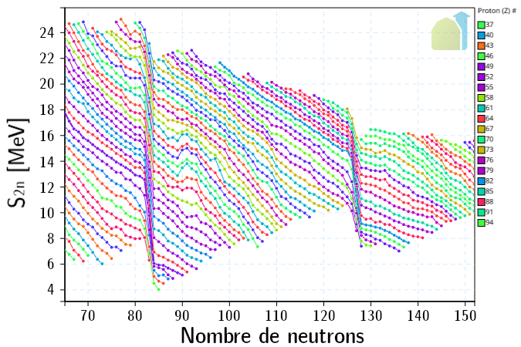

Interest of mass measurement
High-precision mass measurements:
Obtain nuclear binding energy to study :
Shape transitions & shape coexistence
Evolution of shell closures
Isospin symmetry (IMME, …)
Location of drip-lines & search for exotic radioactivities
Q value (rp-process, …)
$$B\left(Z,N\right)=[Z×M_{p}+N×M_{n}−M\left(Z,N\right)]c^{2}$$
Number of neutrons

Slide 17
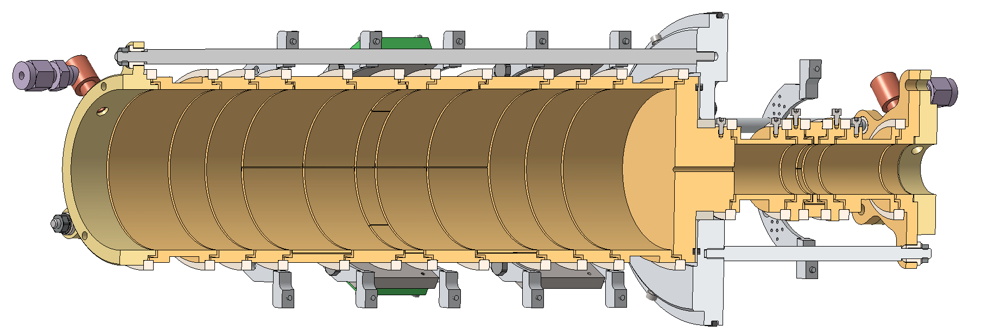
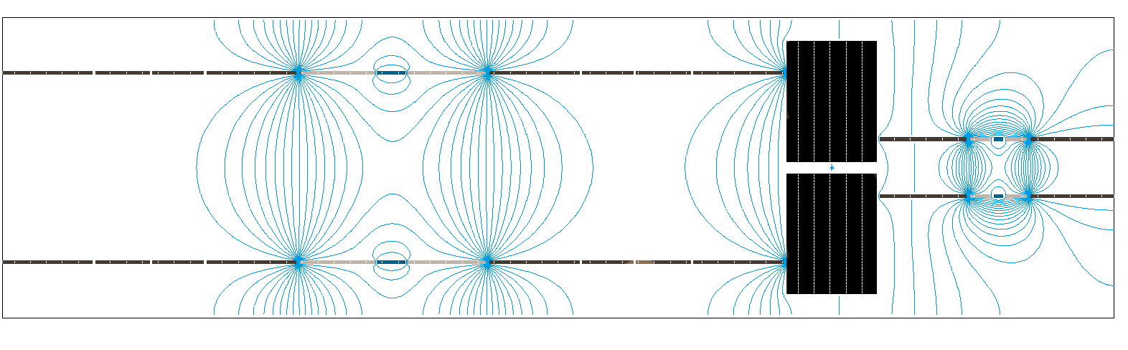

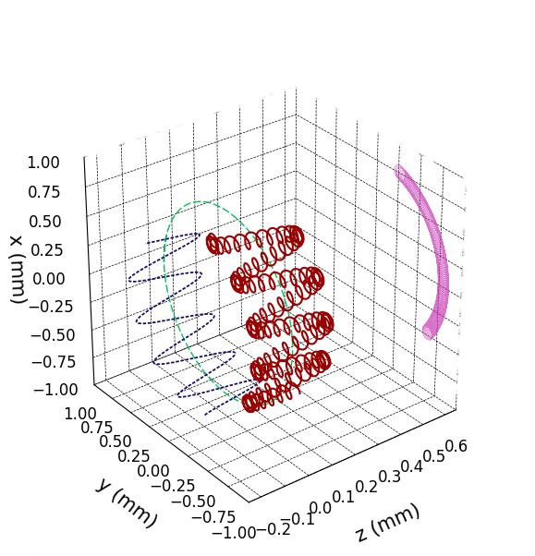
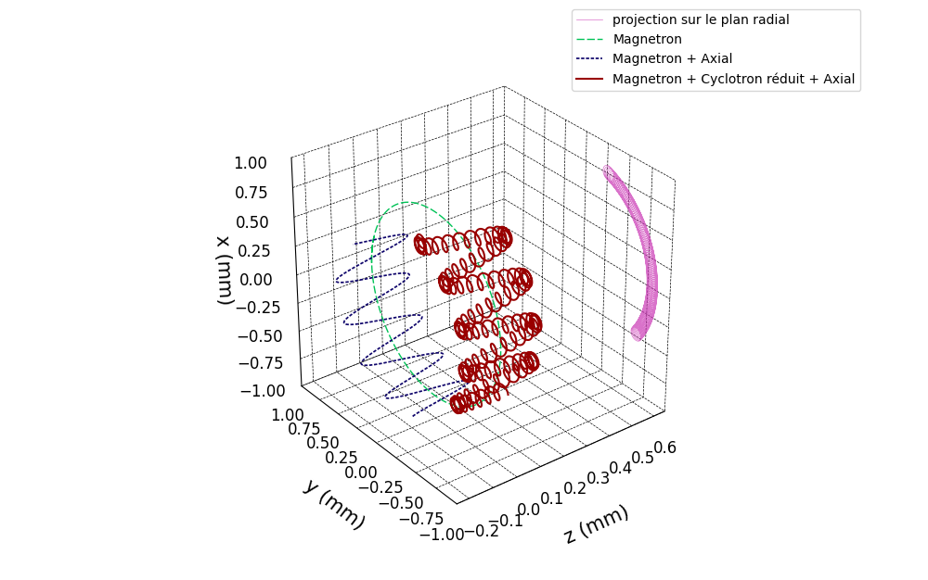
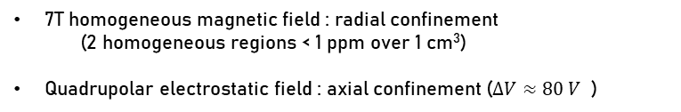
Ion motions in a Penning trap
7T homogeneous magnetic field : radial confinement
  (2 homogeneous regions < 1 ppm over 1 cm³)
Quadrupolar electrostatic field : axial confinement ($ΔV≈80 V$ )
n₋ : Magnetron motion (~ 700 Hz for PT, ~ 7 kHz for MT)
n_{z} : Axial motion ( ~100 kHz)
n₊ : Reduced cyclotron motion (~ MHz)
Radial projection
Reduced by the gas
Magnetron
Magnetron + Axial
Magnetron + Axial + Reduced Cyclotron
Cyclotron frequency$ν_{c}= \frac{qB}{2πm} ν_{c}≈ν_{+}+ ν_{−}$
Amplitude of these motions can be modified by buffer gas or RF-excitations
    Dipolar to increase/decrease a motion
    Quadrupolar to convert one motion into another one
Three main purification/measurement techniques :
- Buffer gas cooling
- Time-of-Flight Ion-Cyclotron-Resonance (ToF-ICR)
- Phase-Imaging Ion-Cyclotron-Resonance (PI-ICR)

Slide 18
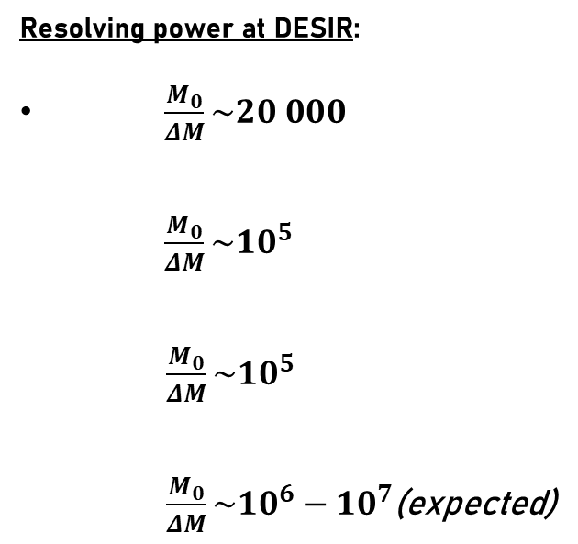
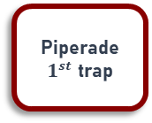
Beam purification with PIPERADE
Resolving power at DESIR:
$\frac{M_{0}}{ΔM}\sim 20 000$
  $\frac{M_{0}}{ΔM}\sim {10}^{5}$
  $\frac{M_{0}}{ΔM}\sim {10}^{5}$
  $\frac{M_{0}}{ΔM}\sim {10}^{6}−{10}^{7}$(expected)
HRS
Clean most of isobars
MR-ToF
Clean almost all isobars
Piperade
$1^{st}$ trap
PIPERADE goal : purify 10⁴-10⁵ ions per bunch
Piperade
2nd trap
Clean isomeric state separated by a few 10 keV
Notes:
Example of experiment where it matters:
total absorption spectrometry
collinear laser spectroscopy
Precision decay measurements

Slide 19
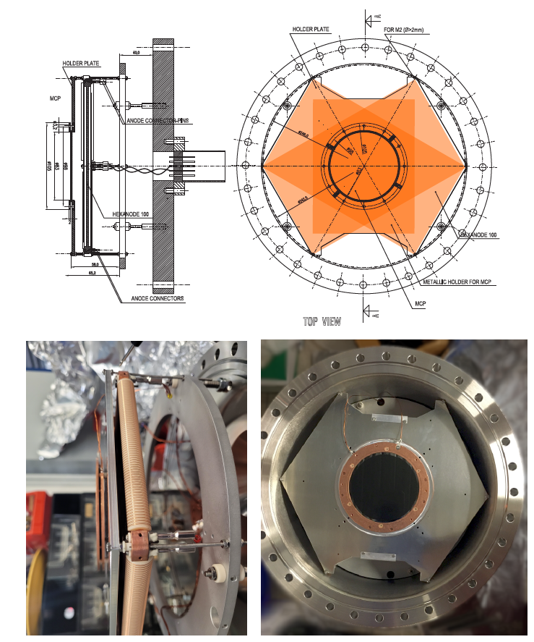
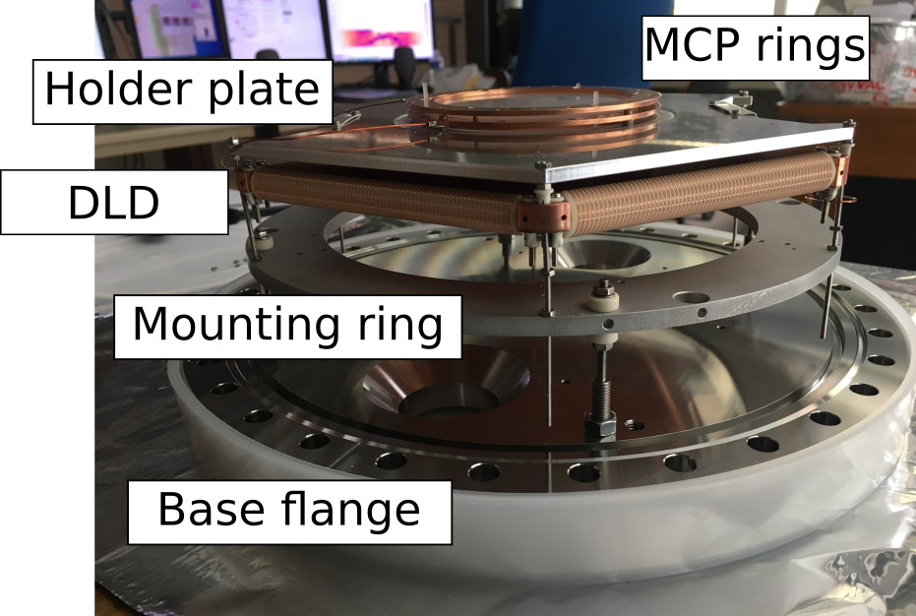
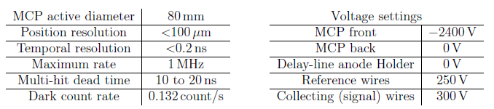
MCP delay line HEX80
MCP rings
Holder plate
DLD
Mounting ring
Base flange 250 mm

Slide 20
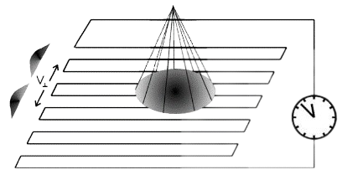

Principle of delay line
$$T_{sum}=u_{1}+u_{2}=c$$
U
u1
u2
Multiple Hit Readout of a Microchannel Plate Detector With a Three-Layer Delay-Line Anode
Isometric view

Slide 21









ToF-ICR mass measurements
+1
Measured thanks to a reference (well-known mass)
Experimentally, we measure$r = \frac{ν_{c}({}_{}^{39}K)}{ν_{c}({}_{}^{41}K)}$
Mass determination
$$ToF\left(ν_{rf}\right)=f(r_{−}, { r}_{+}, p, E_{0}, N_{c}, t_{ex},ν_{c},φ)$$
$$ν_{c}= \frac{qB}{2πm}$$
$$m_{{}_{}^{41}K}=r \left(m_{{}_{}^{39}K}−m_{e}\right)+m_{e}$$
$${}_{}^{39}{K^{+}}$$
$${}_{}^{41}{K^{+}}$$
$${}_{}^{39}{K^{+}}$$
Precision : $\frac{δm}{m}≈{3∗10}^{−9}$
Studies of systematical uncertainties in progress (magnetic field fluctuations, number of ions, mass of the reference, etc…)

Slide 22






PI-ICR technique
Initial conditions
Magnetron damping
ν₊ excitation
Conversion magnetron
Step 1
Step 2
Step 3
Step 4
Step 5
Eliseev, S et al. Appl. Phys. B 114 (2014) 107–128

Slide 23






PI-ICR (Phase-Imaging Ion-Cyclotron-Resonance)
$$ν_{c}=ν_{+}+ν_{−}=\frac{qB}{2πm}$$
Projection of radial motion phases on a position-sensitive detector
$$ν=\frac{Φ+2πn}{2πt}$$
c
c
2
M. Hukkanen et al. Phys. Rev. C 107 (2023) 014306
2
1
1
High sensitivity (“non scanning method”)
Gain of a factor of 5-10 in precision and 40 in resolution compared to ToF-ICR (up to R = 10⁷)
Measurement of ground state masses and isomer excitation energies
Capable of separate isomers → high-resolution purification for DESIR

