Slide 1


Design of a new laser-resonance chromatography setup for S3-LEB
ISOL France - 16 March 2026
Tudor Stefan for the S3 and S3-LEB collaborations

Slide 2

Background and motivation – LRC experiment
Superheavy element optical spectroscopy:
Laatiaoui and Lauth, Atom-at-a-time laser resonance ionization spectroscopy of nobelium, Nature 538, 495 (2016).
Lantis and Claessens, In-gas-jet laser spectroscopy of254No with jetris, Phys. Rev. Res. 6, 023318 (2024).
Laatiaoui and Buchachenko, Laser resonance chromatography of superheavy elements, Physical Review Letters 125
1.
Notes:
A potential solution is the novel technique of laser resonance spectroscopy, or LRC, which will be implemented at the S3 facility

Slide 3
Background and motivation – LRC experiment
Superheavy element optical spectroscopy:
Superheavy elements are of interest for understanding radionuclides at limit of existence
Laatiaoui and Lauth, Atom-at-a-time laser resonance ionization spectroscopy of nobelium, Nature 538, 495 (2016).
Lantis and Claessens, In-gas-jet laser spectroscopy of254No with jetris, Phys. Rev. Res. 6, 023318 (2024).
Laatiaoui and Buchachenko, Laser resonance chromatography of superheavy elements, Physical Review Letters 125
1.
Notes:
A potential solution is the novel technique of laser resonance spectroscopy, or LRC, which will be implemented at the S3 facility

Slide 4
Background and motivation – LRC experiment
Superheavy element optical spectroscopy:
Superheavy elements are of interest for understanding radionuclides at limit of existence
Optical spectroscopy:
electronic structure characterization
element fingerprinting (e.g. observational astronomy)
nuclear properties through hyperfine spectroscopy
Laatiaoui and Lauth, Atom-at-a-time laser resonance ionization spectroscopy of nobelium, Nature 538, 495 (2016).
Lantis and Claessens, In-gas-jet laser spectroscopy of254No with jetris, Phys. Rev. Res. 6, 023318 (2024).
Laatiaoui and Buchachenko, Laser resonance chromatography of superheavy elements, Physical Review Letters 125
1.
Notes:
A potential solution is the novel technique of laser resonance spectroscopy, or LRC, which will be implemented at the S3 facility

Slide 5
Background and motivation – LRC experiment
Superheavy element optical spectroscopy:
Superheavy elements are of interest for understanding radionuclides at limit of existence
Optical spectroscopy:
electronic structure characterization
element fingerprinting (e.g. observational astronomy)
nuclear properties through hyperfine spectroscopy
Current status & limitations:
Optical spectroscopy up to No (Z=102) with resonance ionization spectroscopy
Laatiaoui and Lauth, Atom-at-a-time laser resonance ionization spectroscopy of nobelium, Nature 538, 495 (2016).
Lantis and Claessens, In-gas-jet laser spectroscopy of254No with jetris, Phys. Rev. Res. 6, 023318 (2024).
Laatiaoui and Buchachenko, Laser resonance chromatography of superheavy elements, Physical Review Letters 125
1.
Notes:
A potential solution is the novel technique of laser resonance spectroscopy, or LRC, which will be implemented at the S3 facility

Slide 6
Background and motivation – LRC experiment
Superheavy element optical spectroscopy:
Superheavy elements are of interest for understanding radionuclides at limit of existence
Optical spectroscopy:
electronic structure characterization
element fingerprinting (e.g. observational astronomy)
nuclear properties through hyperfine spectroscopy
Current status & limitations:
Optical spectroscopy up to No (Z=102) with resonance ionization spectroscopy
Challenges:
reduced production rates
short half-lives
Challenging for fluorescence and for resonance ionization spectroscopy
Laatiaoui and Lauth, Atom-at-a-time laser resonance ionization spectroscopy of nobelium, Nature 538, 495 (2016).
Lantis and Claessens, In-gas-jet laser spectroscopy of254No with jetris, Phys. Rev. Res. 6, 023318 (2024).
Laatiaoui and Buchachenko, Laser resonance chromatography of superheavy elements, Physical Review Letters 125
1.
Notes:
A potential solution is the novel technique of laser resonance spectroscopy, or LRC, which will be implemented at the S3 facility

Slide 7
Background and motivation – LRC experiment
Superheavy element optical spectroscopy:
Superheavy elements are of interest for understanding radionuclides at limit of existence
Optical spectroscopy:
electronic structure characterization
element fingerprinting (e.g. observational astronomy)
nuclear properties through hyperfine spectroscopy
Current status & limitations:
Optical spectroscopy up to No (Z=102) with resonance ionization spectroscopy
Challenges:
reduced production rates
short half-lives
Challenging for fluorescence and for resonance ionization spectroscopy
Potential solution:
Laser resonance chromatography (LRC) at S3
Laatiaoui and Lauth, Atom-at-a-time laser resonance ionization spectroscopy of nobelium, Nature 538, 495 (2016).
Lantis and Claessens, In-gas-jet laser spectroscopy of254No with jetris, Phys. Rev. Res. 6, 023318 (2024).
Laatiaoui and Buchachenko, Laser resonance chromatography of superheavy elements, Physical Review Letters 125
1.
Notes:
A potential solution is the novel technique of laser resonance spectroscopy, or LRC, which will be implemented at the S3 facility

Slide 8
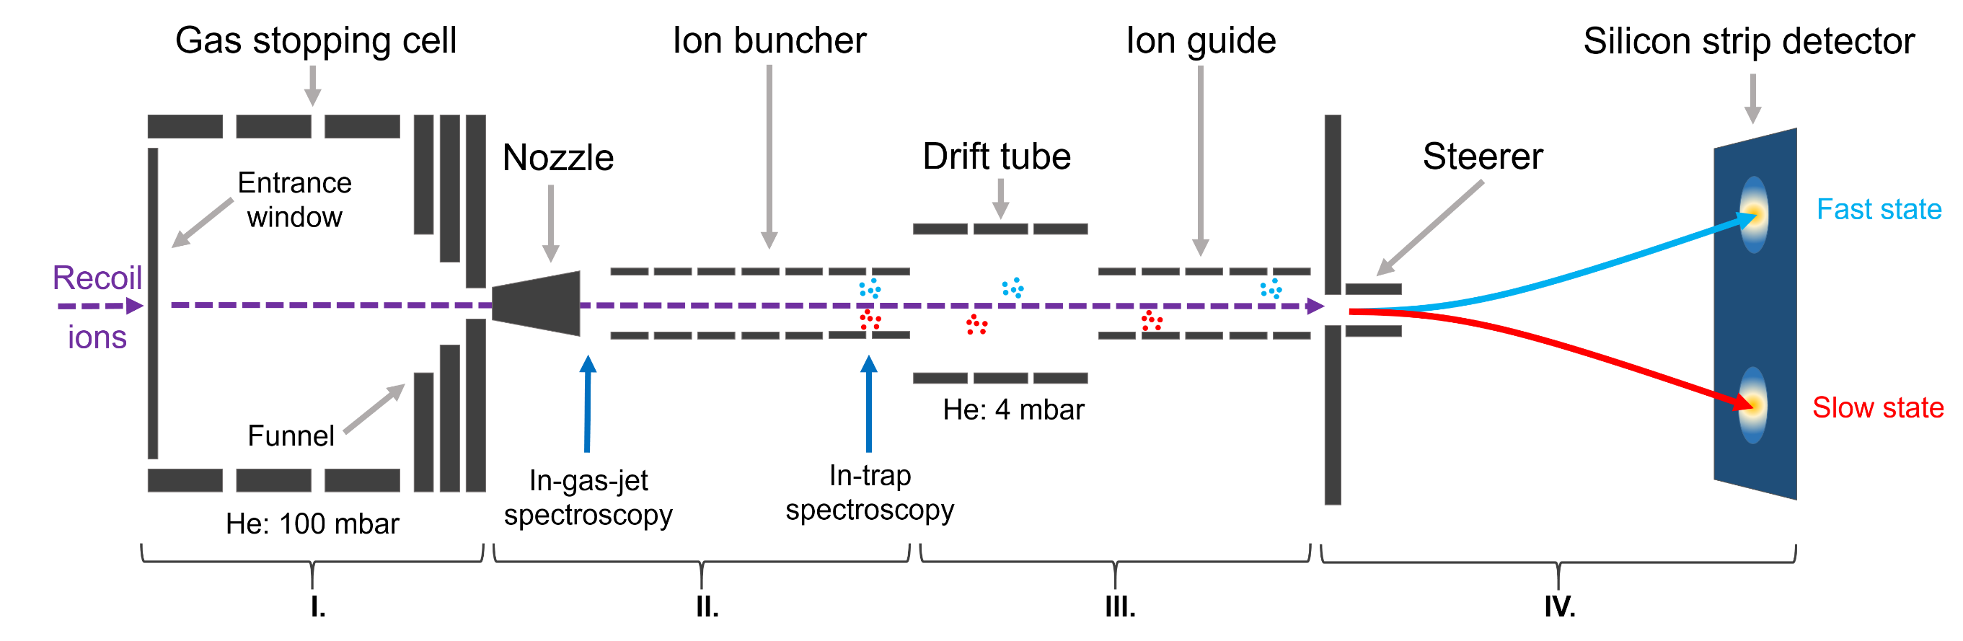
LRC experimental setup – General overview
Production
& stopping
Spectroscopy
& bunching
Electronic-state
chromatography
Deflection
& detection
Laatiaoui and Lauth, Atom-at-a-time laser resonance ionization spectroscopy of nobelium, Nature 538, 495 (2016).
Laatiaoui and Buchachenko, Laser resonance chromatography of superheavy elements, Physical Review Letters 125
Kim and Jana, Laser resonance chromatography: First commissioning results and future prospects, Nuclear Instruments and Methods in Physics Research Section B 555,165461 (2024).
2.
Notes:
To better understand this method, one can look at the experimental setup, which can be divided into 4 sections. Production and stopping, spectroscopy, electronic state chromatography and detection

Slide 9
LRC experimental setup – General overview
Production
& stopping
Superheavy elements produced in fusion-evaporation reactions
Slowing down, thermalization in +1 states and collection in gas stopping cell
Ions funneled into rest of setup through nozzle
3.
Laatiaoui and Buchachenko, Laser resonance chromatography of superheavy elements, Physical Review Letters 125
Notes:
The first section is concerned with the production and stopping of the SHE ions. Superheavies from S3 are produced in fusion-evaporation reactions and sent to the LRC experiment.
Here, they are slowed down and thermalized in +1 states in a He gas cell, befire being funnelled into the rest of the setup via a nozzle

Slide 10
LRC experimental setup – General overview
Spectroscopy
& bunching
³P₁
Ions exit nozzle in a jet and enter ion buncher
Laser probing in-jet (fine level search) or in trap (broad level search)
Excited ions either fall back to ground state or populate metastable state
³D₁
¹S₀
¹⁷⁵Lu⁺ laser excitation scheme
4.
Laatiaoui and Buchachenko, Laser resonance chromatography of superheavy elements, Physical Review Letters 125
Notes:
Ions emerge from the nozzle in a gas jet before entering an ion buncher, with Paul trap geometry.
It is in this second sections that the laser probing takes place, either in jet, for a fine level search, or in trap, when the ions are bunched at the end of the section, for the broad level search.
The laser light excites the ions from a ground state, shown here for Lu-175, to an excited state. From here, the ions can either decay back to the ground state or populate a metastable state.
The two states are shown here as ion bunches at the end of the section in red and blue.
One can see here two ion bunches of different electronic states, in red and blue.

Slide 11
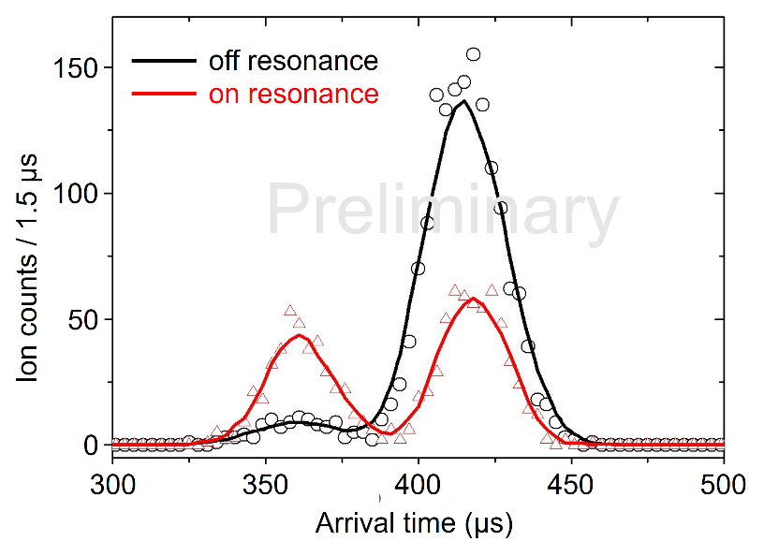

LRC experimental setup – General overview
Electronic-state
chromatography
State-dependent mobility in He gas
Mobility difference leads to change in arrival times for ground and metastable states
¹⁷⁵Lu⁺ arrival time distribution
5.
Laatiaoui and Buchachenko, Laser resonance chromatography of superheavy elements, Physical Review Letters 125
Notes:
The bunched ions are then sent into the third section, where the electronic state chromatography takes place. They enter a drift tube, with a He pressure of 4 mbar, where they interact differently with the gas based on their state-dependent mobilities. This leads to a different drift time of the ions through this tube, from which they are further guided by an ion guide, again Pual trap in design. Due to the different mobilities, the two states will then arrive at the end of the ion guide, and different arrival times. This is exemplified here for Lu-175

Slide 12
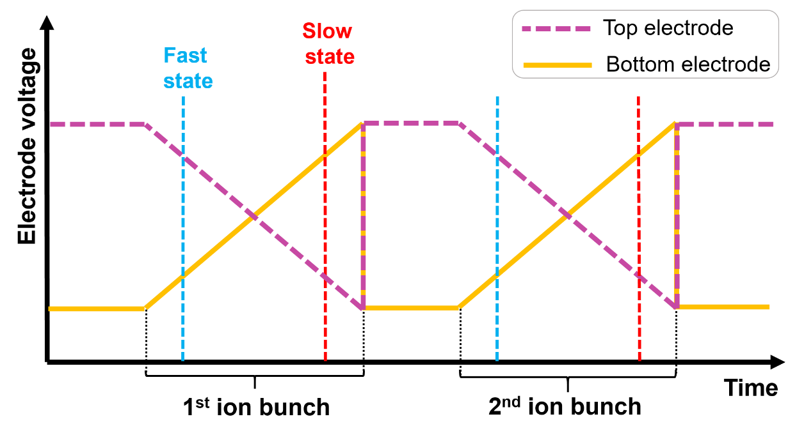
LRC experimental setup – General overview
Deflection
& detection
Ions with different arrival times (states) steered onto different parts of silicon strip detector
State-specific alpha-decay hot spots reveal resonance and identify ion species
6.
Laatiaoui and Buchachenko, Laser resonance chromatography of superheavy elements, Physical Review Letters 125
Notes:
The fourth, and last section is the detection section. This consists of an electrostatic steerer and a Silicon strip detector. This steerer consists off a set of opposing plates set to mirrored voltages ramped over time. As the ions arrive at this section at differet times, based on their mobilities, and hence on their electronic states, thy will experience a different steerer voltage and be projected onto different part of the detector. The implanted ions undergo alpha decay, producing state-specific hot spots on the DSSD. The recorded decay spectrum acts as an identification method for the ions, while the location of the hot spot reveals the electronic state.

Slide 13

Current efforts – SIMION simulations & steerer design
Ion steerer and detection development
Goal: Maximize resolution of ion spots on silicon strip detector
7.
Notes:
Current efforts are devoted to the development of this detection section, and to maximizing the resolution of the hit spots on the detector to ensure the highest detection efficiency of successful laser resonance.

Slide 14
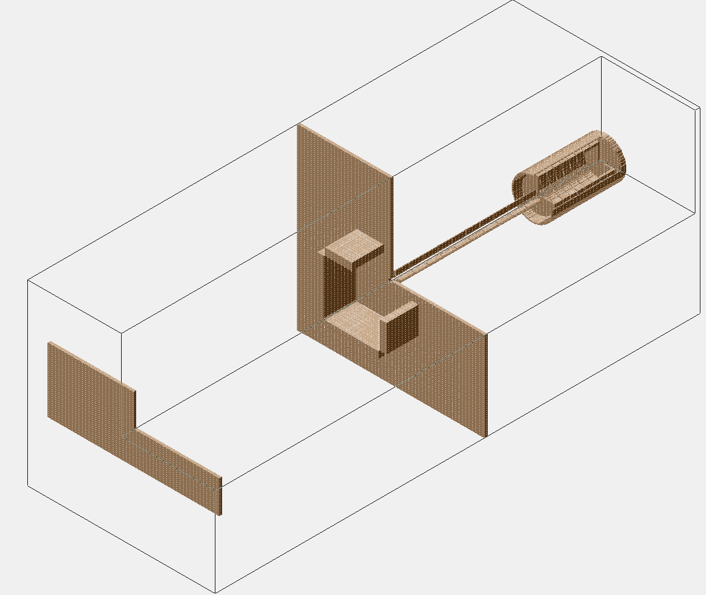
Current efforts – SIMION simulations & steerer design
Ion steerer and detection development
Goal: Maximize resolution of ion spots on silicon strip detector
Approach: SIMION simulations
Ion guide
Steerer
Drift tube
Fast state
Slow state
Silicon strip detector
7.
Notes:
The approach taken was the development of SIMION simulations

Slide 15
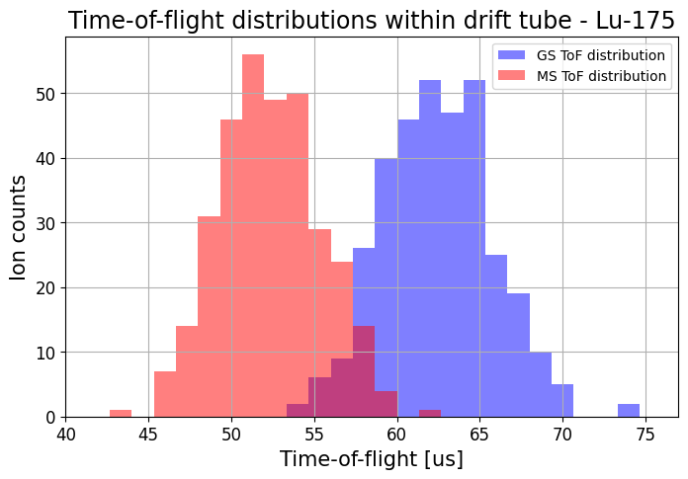
Current efforts – SIMION simulations & steerer design
Ion steerer and detection development
Goal: Maximize resolution of ion spots on silicon strip detector
Approach: SIMION simulations
Simulate electronic state chromatography for time-of-flight distributions
Ion guide
Steerer
Drift tube
Fast state
Slow state
Silicon strip detector
7.
Notes:
These allowed for the arrival time distributions of the different states to be simulated, as shown here for Lu-175

Slide 16
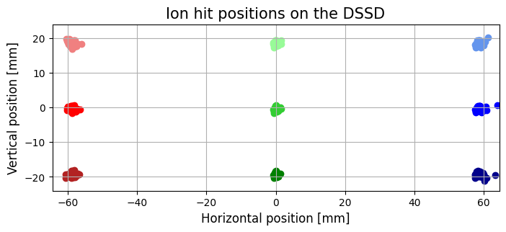
Current efforts – SIMION simulations & steerer design
Ion steerer and detection development
Goal: Maximize resolution of ion spots on silicon strip detector
Approach: SIMION simulations
Simulate electronic state chromatography for time-of-flight distributions
Ion guide
Steerer
Drift tube
Fast state
Optimize steerer geometry and operating voltages by maximizing spot resolution
Slow state
Silicon strip detector
7.
Notes:
These ions could then be used to test the optimal geometry and steering voltages for the steerer by maximizing the resolution of the hit spots on the DSSD.

Slide 17
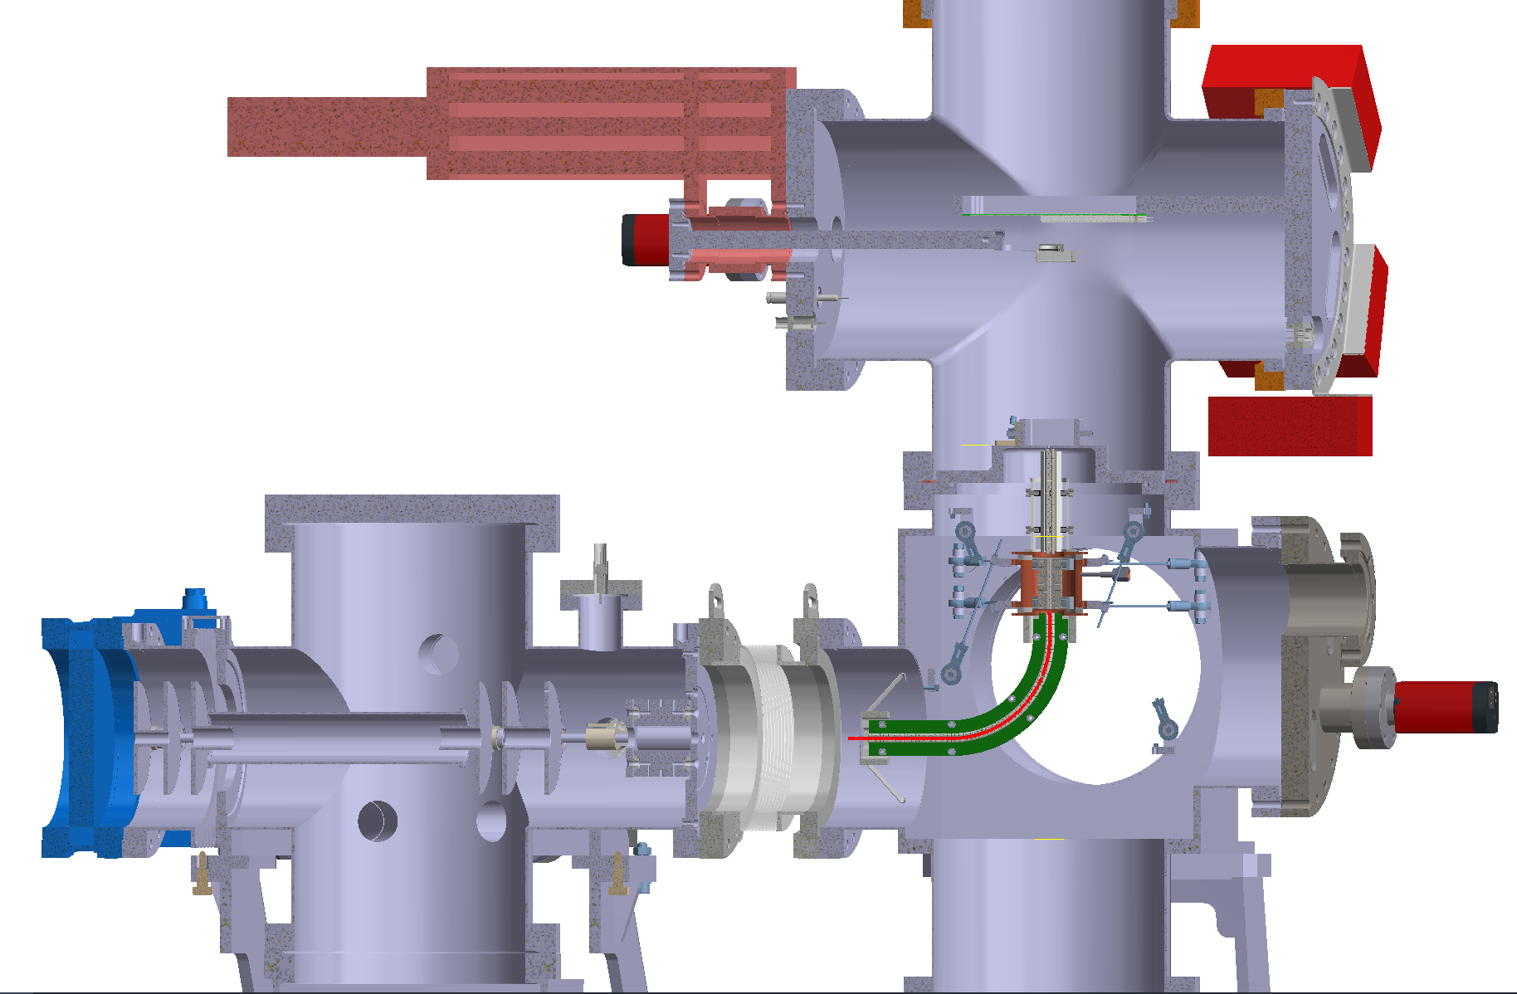
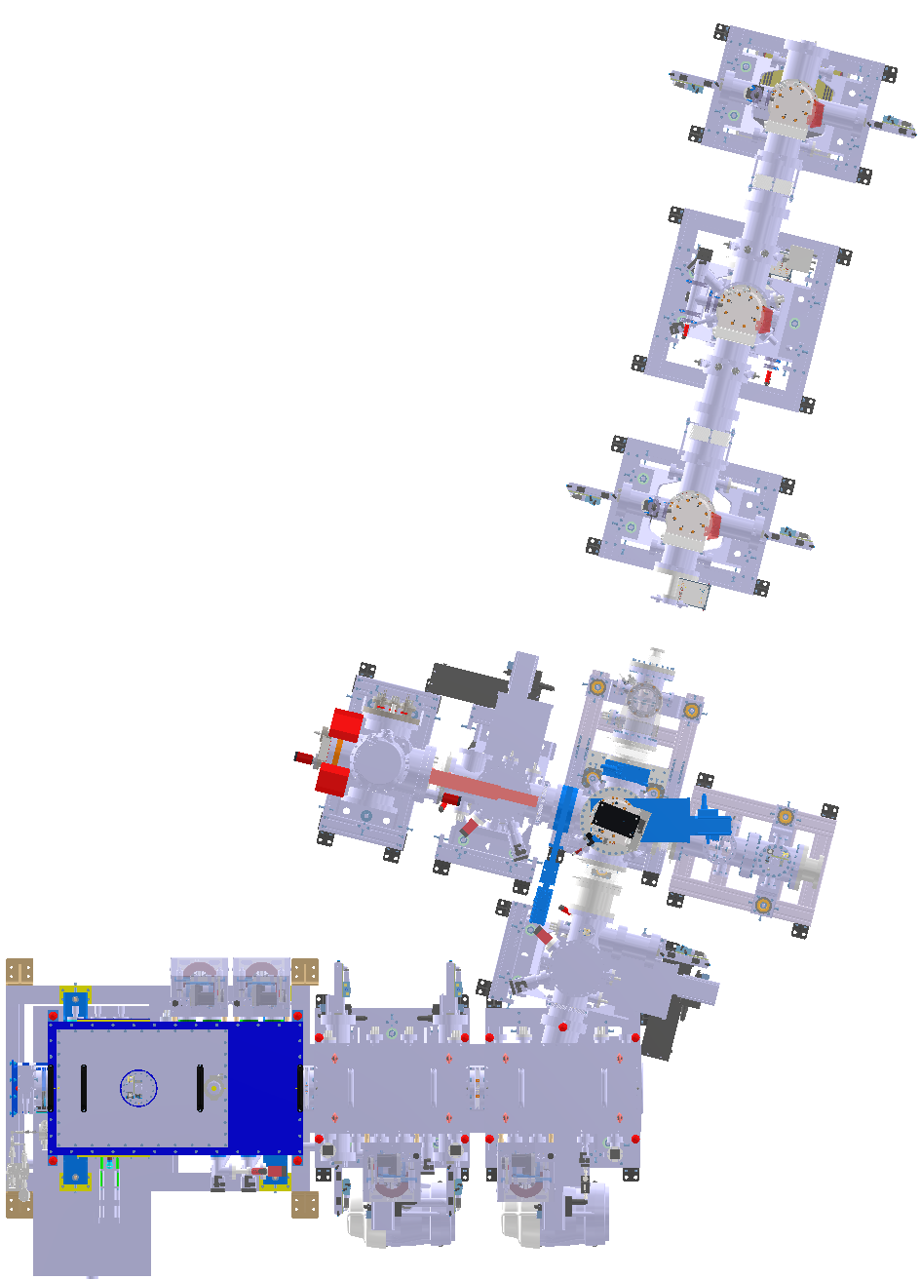
LRC timeline – Phase 1: S3-LEB
Silicon
strip detector
PILGRIM
MCP detector
Ion steerer
Ion guide
Drift tube
LRC at
S3-LEB
Quadrupole
bender
S3-LEB
beam
S3
beam
DESIR
Pulse down
slowing from
3 KeV
Quadrupole steerer
Ion
buncher
In parasitic mode after quadrupole deflector before PILGRIM
LRC connected to S3-LEB via pulse down for slowing ions from 3 KeV
Objective: online optimization with ²⁰⁸Ac⁺ to ²¹⁵Ac⁺ laser-resonance chromatography
Gas cell, S-shape RFQ
QMF, cooler buncher
8.
Notes:
And eventually, inaugurated at S3 LEB for the end of 2026.

Slide 18
LRC timeline – From development to Lr spectroscopy
Projected timeline of LRC:
Phase 1: Parasitic ²⁰⁸Ac⁺ to ²¹⁵Ac⁺ spectroscopy at S3-LEB
9.
Notes:
And eventually, inaugurated at S3 LEB for the end of 2026.

Slide 19
LRC timeline – From development to Lr spectroscopy
Projected timeline of LRC:
Simulations and experimental setup design
Offline setup construction and testing
Connection and inauguration at S3-LEB
Phase 1: Parasitic ²⁰⁸Ac⁺ to ²¹⁵Ac⁺ spectroscopy at S3-LEB
Sep 2025 – Apr 2026
Summer 2026
End 2026 onwards
9.
Notes:
And eventually, inaugurated at S3 LEB for the end of 2026.

Slide 20
LRC timeline – From development to Lr spectroscopy
Projected timeline of LRC:
Simulations and experimental setup design
Offline setup construction and testing
Connection and inauguration at S3-LEB
Phase 1: Parasitic ²⁰⁸Ac⁺ to ²¹⁵Ac⁺ spectroscopy at S3-LEB
Sep 2025 – Apr 2026
Summer 2026
End 2026 onwards
Phase 2: Lr⁺ spectroscopy at S3 focal point
Dedicated He gas cell to replace pulse down
Target: ²⁵⁴Lr⁺ and ²⁵⁵Lr⁺ spectroscopy
9.
Notes:
And eventually, inaugurated at S3 LEB for the end of 2026.

Slide 21
Thank you for your attention!

Slide 22







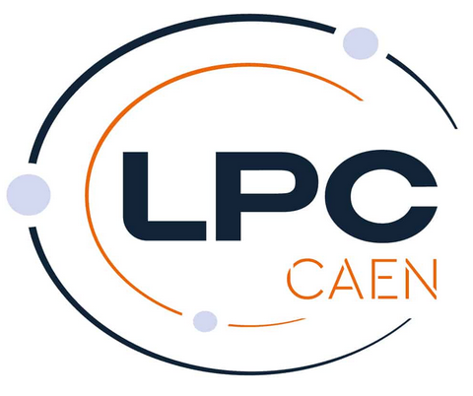





References
[1] M. Laatiaoui and W. Lauth, Atom-at-a-time laser resonance ionization spectroscopy of nobelium, Nature 538, 495 (2016).
[2] J. Lantis and A. Claessens, In-gas-jet laser spectroscopy of254No with jetris, Phys. Rev. Res. 6, 023318 (2024).
[3] M. Laatiaoui and A. A. Buchachenko, Laser resonance chromatography of superheavy elements, Physical Review Letters 125, 10.1103/physrevlett.125.023002 (2020).
[4] E. Kim and B. Jana, Laser resonance chromatography: First commissioning results and future prospects, Nuclear Instruments and Methods in Physics Research Section B 555,165461 (2024).
[5] E. Romero Romero and M. Block, A progress report on laser resonance chromatography, Atoms 10,10.3390/atoms10030087 (2022).
Notes:
Try to make use of setup symmetries for modelling with lower resources. Especially for the ion guide before this.

