Slide 1
Development of a new continuous-wave laser cavity
& perspectives for FRIENDS3 project
On behalf of : S³-LEB & FRIENDS³ collaboration
V. Marchand¹
¹IJCLab, Université Paris-Saclay & CNRS/IN2P3, 91405 Orsay, France
Notes:
Hello everyone, My name is Valentin Marchand, I am a PhD student at IJCLab.
Today, on behalf of the S3-LEB & FRIENDS3 collaboration I’m going to present the topic of my research :
The development of a new continuous wave laser cavity & the perspectives for FRIENDS3 project.

Slide 2
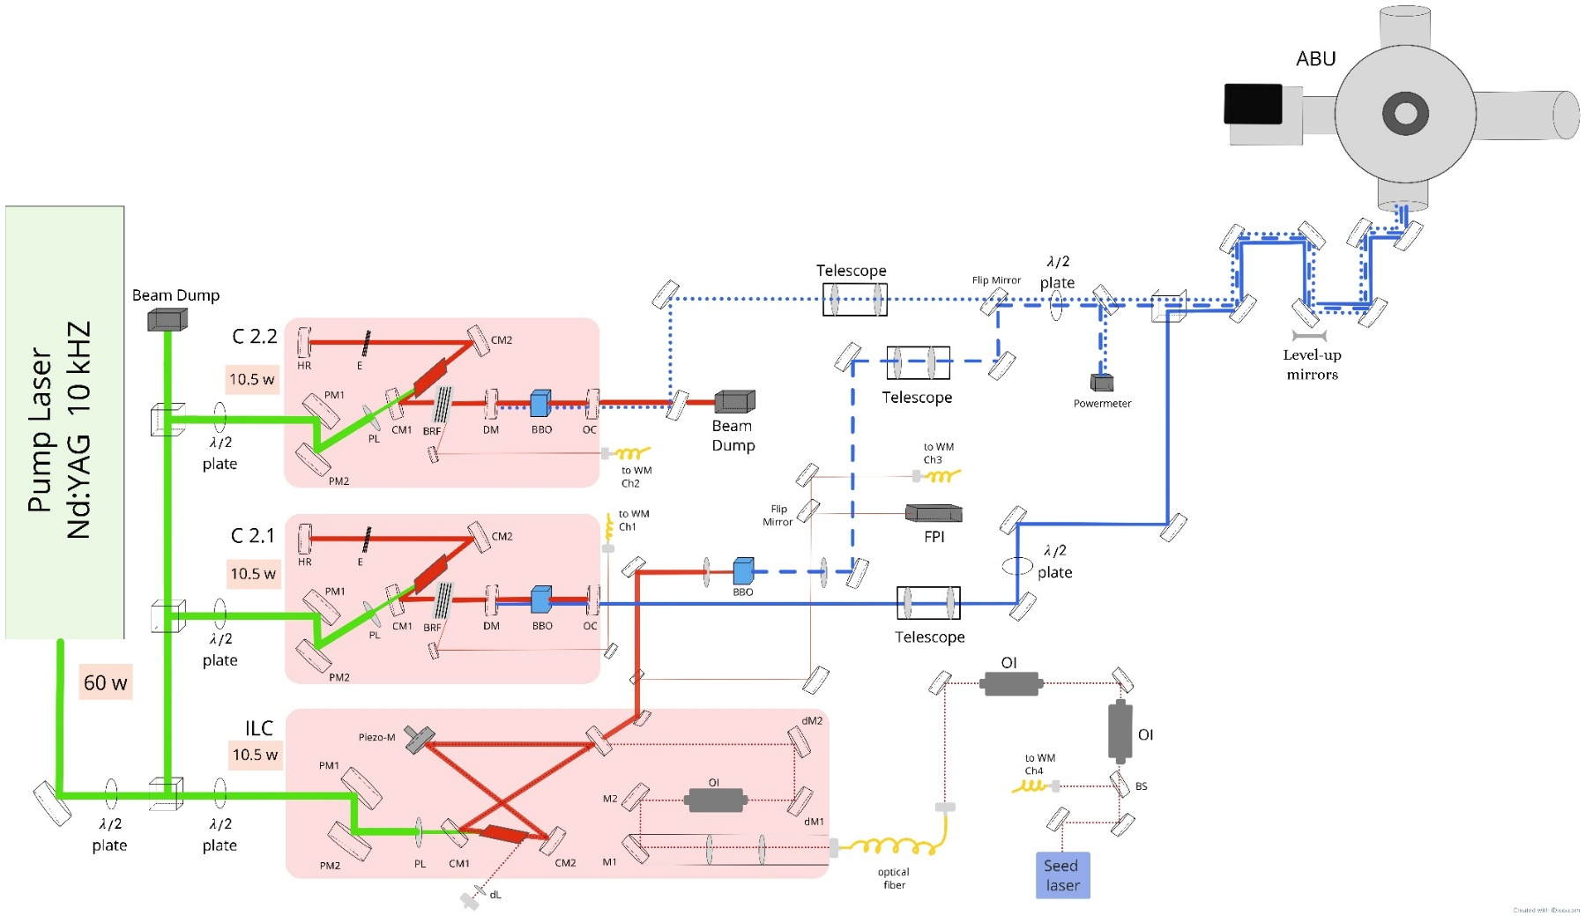
GISELE Laboratory
Goals :
Development of new laser/laser system.
Development of ionization scheme.
Send beam towards off-line experimental area such as FRIENDS³ & LRC.
Laser layout at GISELE,
Notes:
The GISELE Laboratory is an laser room at GANIL.
It has 3 main goals :
Development of new laser/laser system.
Development of ionization scheme for laser spectroscopy.
And the lasers are also send to other bench test such as FRIENDS3 that I will mention later.

Slide 3
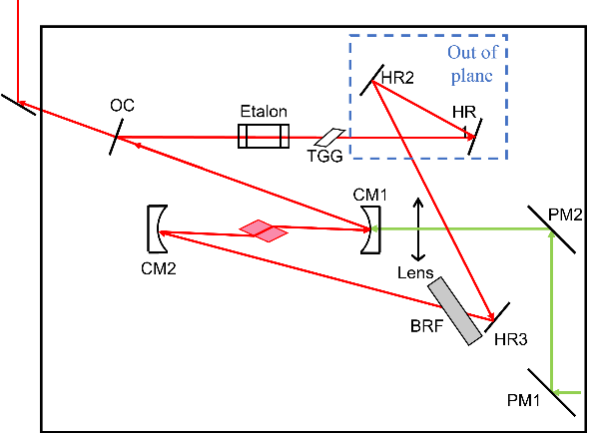
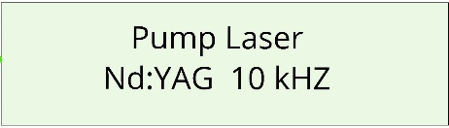
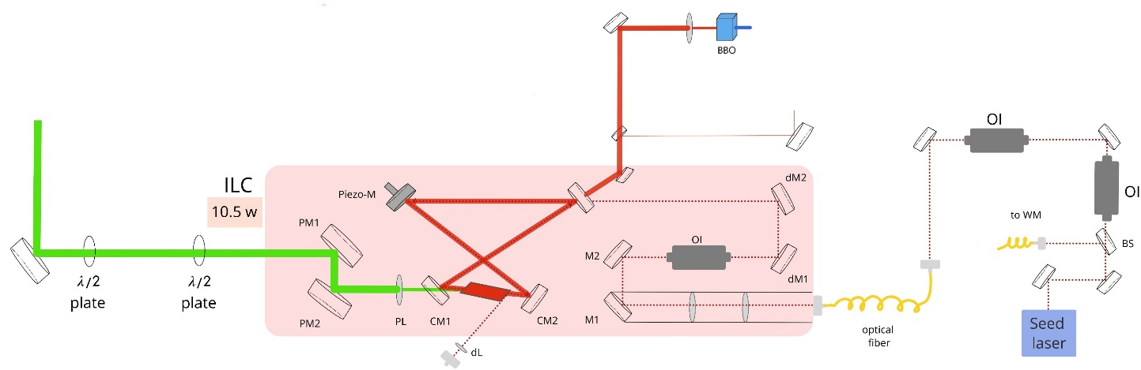

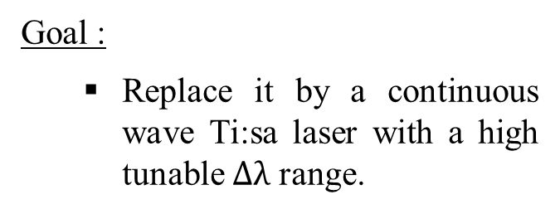
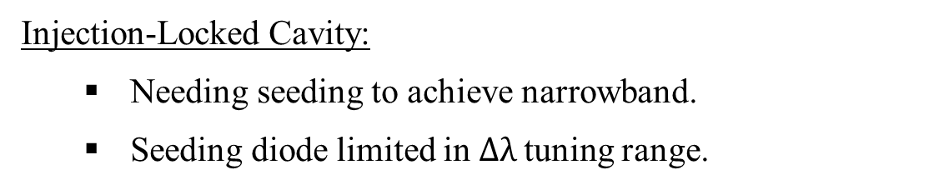
My work : CW Ti:sa
CW Ti:sa laser
Injection-Locked Cavity:
  Needing seeding to achieve narrowband.
  Seeding diode limited in $Δλ$tuning range.
ABU
Goal :
  Replace it by a continuous wave Ti:sa laser with a high tunable $Δλ$ range.
Seeding diode
Notes:
We use a Narrowband Injection-Locked Cavity (also called ILC) to realize the high resolution laser spectroscopy.
Show on slides :
The ILC is over here, pumped by a pulsed Nd:YAG laser.
There is several things to note in this cavity.
First, it is a bow-tie geometry. This geometry allows to distinguish the 2 directions of emissions and later to remove one in order to reduce the linewidth of the laser and to double its power.
Secondly, you can see that there is no optics inside the cavity to select the wavelength.
So how the wavelength is selected ?
To constrain the emission of the ILC we are currently using a narrowband diode.
The light of this diode is injected into the ILC crystal and its emission will go from broadband to narrowband. This process is called « seeding ».
In addition, due to the seeding, one direction of emission will be supress and the other direction will double its emitted power.
Then, to realize spectroscopy we only have to scan the wavelength of the diode and the one of the ILC will follow.
However, the tunability of the diode is limited in range.
To solve this issue, we aim to replace the diode by a continuous wave Ti:sa laser with a high tunable range.
The laser was designed by Dr. Sonnenschein
Go to => Next slide

Slide 4
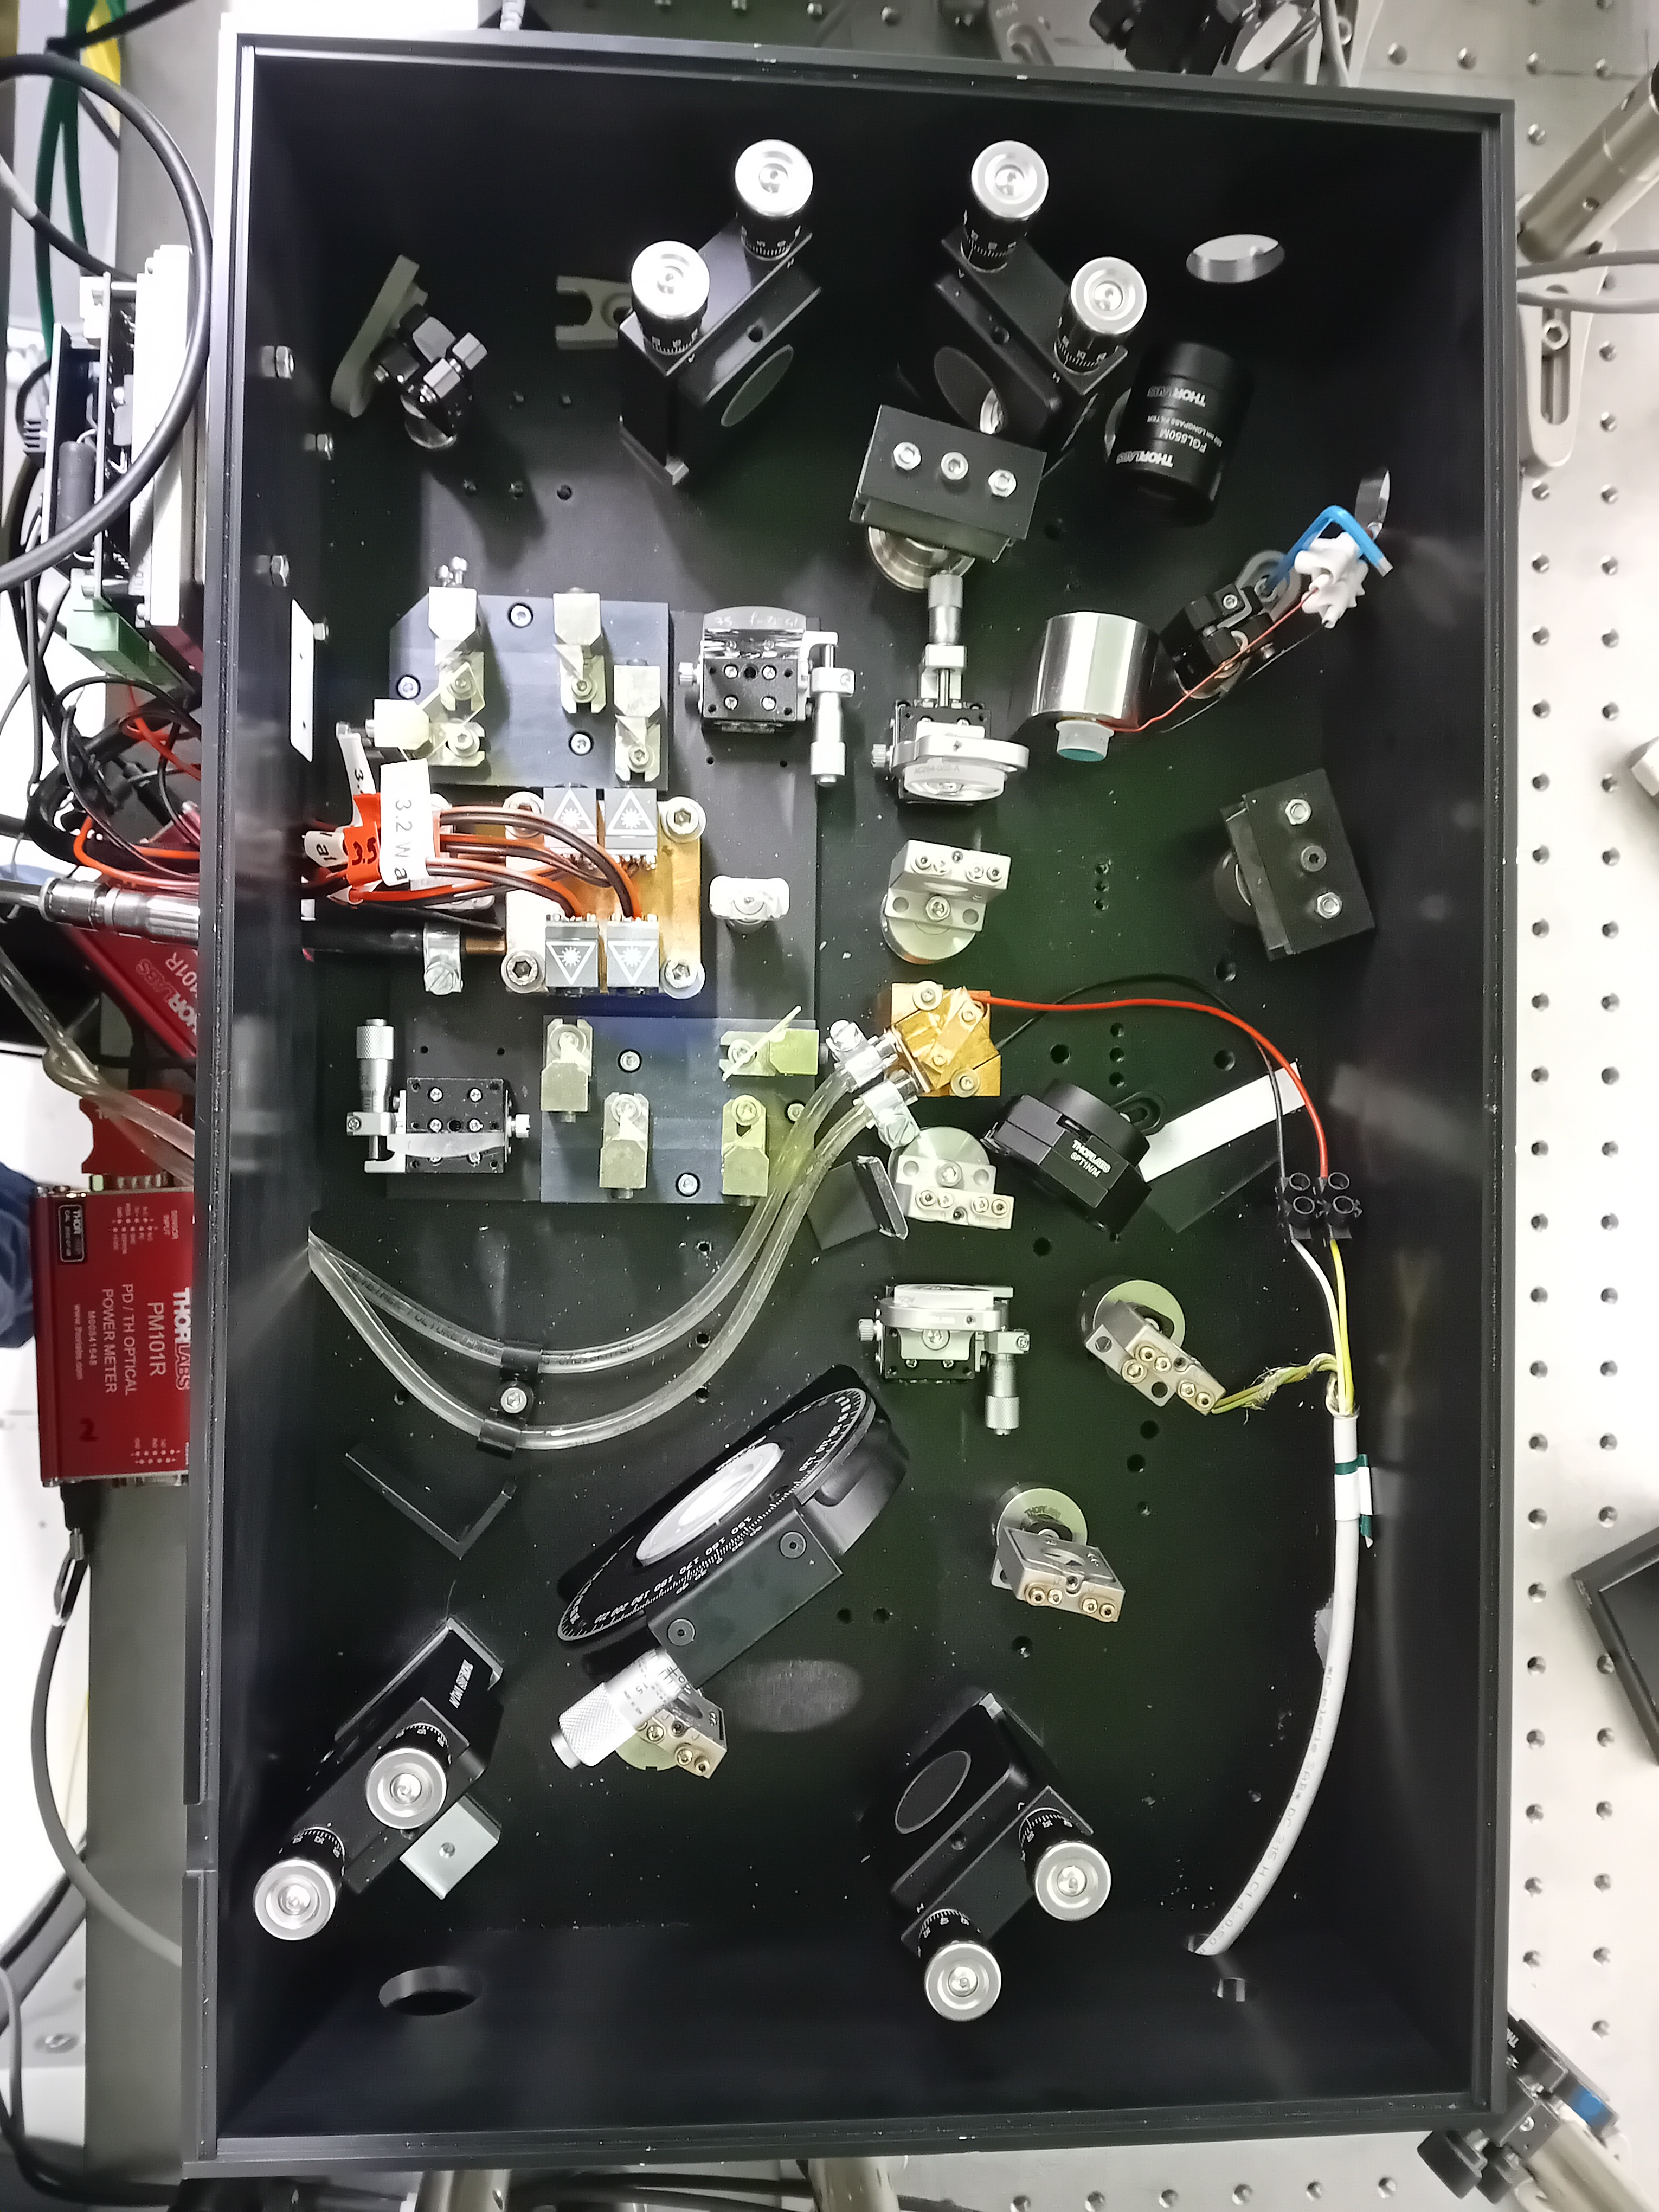
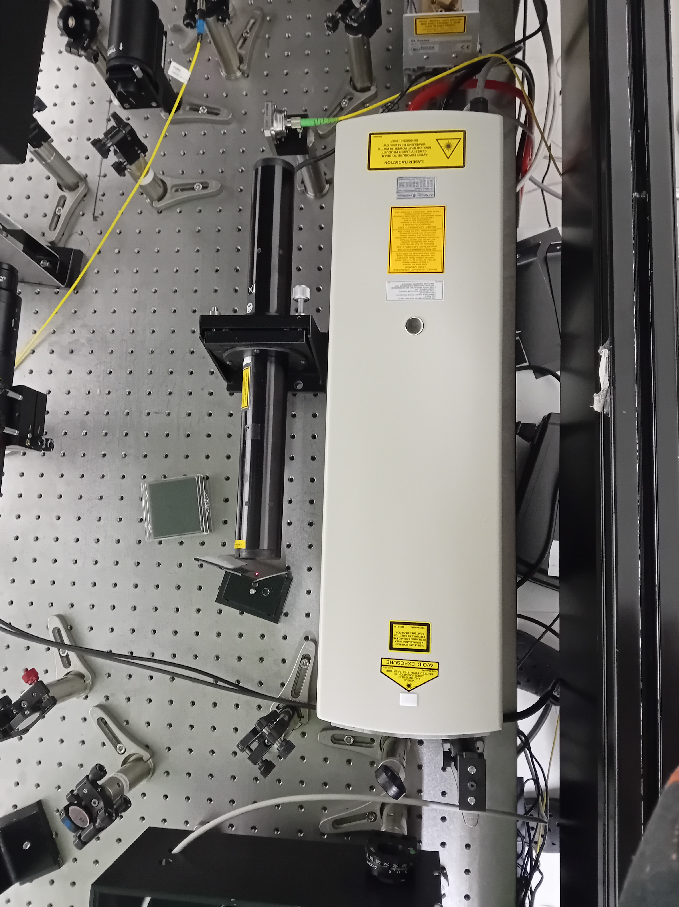
CW Ti:sa : IRL layout
Pump :
  CW Nd:YAG (532 nm)
Optics :
  Wavelength selection :
    BRF
    Air-spaced etalon
    Direction of emission :
      TGG crystal
CW Ti:sa cavity
Millennia eV
pump laser (CW 532 nm)
Notes:
Here you have pictures of the cavity and its pump.
In the current version of this laser cavity,
It is pumped by a continuous ND:YAG laser
As you can see, it is crowded, so let’s convert it into a scheme for better vizualisation.

Slide 5
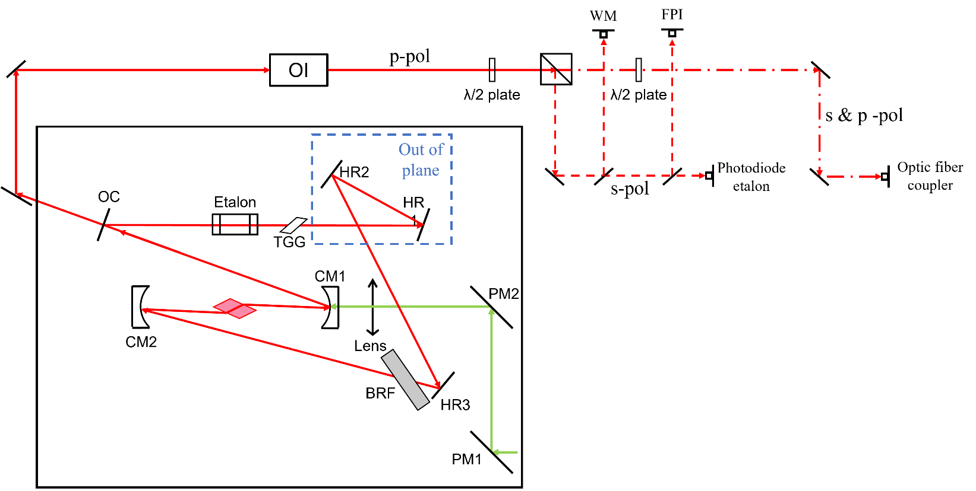
CW Ti:sa : simplified layout
Pump :
  CW Nd:YAG (532 nm)
Optics :
  Wavelength selection :
    BRF
    Air-spaced etalon
    Direction of emission :
      TGG crystal
Notes:
In the current version of this laser cavity,
It is pumped by a continuous ND:YAG laser
For the optics :
The wavelength selection is done by a BRF for the wide tuning and an air-spaced etalon for the fine tuning.
The direction of emission is chosen using a TGG crystal (Terbium Gallium Garnet).
To be noted for later, the OC (partially reflective mirror) & the etalon are mounted on a piezo-actuator.
The first work on this cavity was to make it lase with all the optics inside which was a first time.
Then, the second part of the work was to make it scannable in frequency.

Slide 6
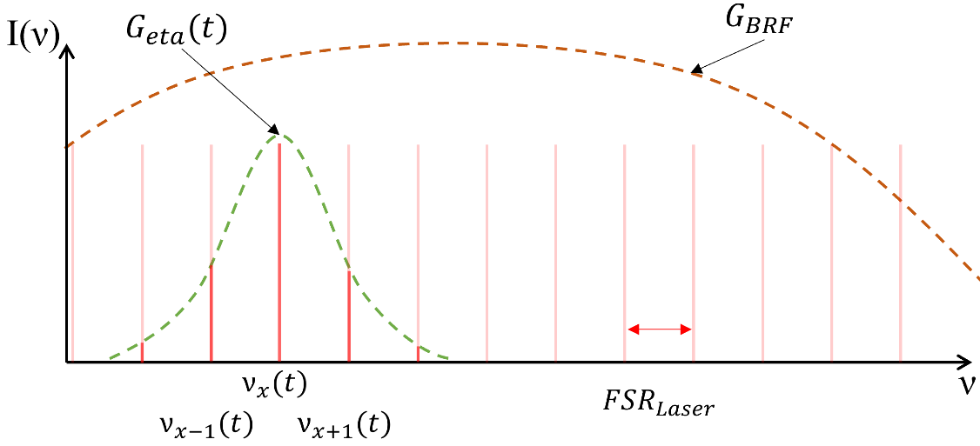
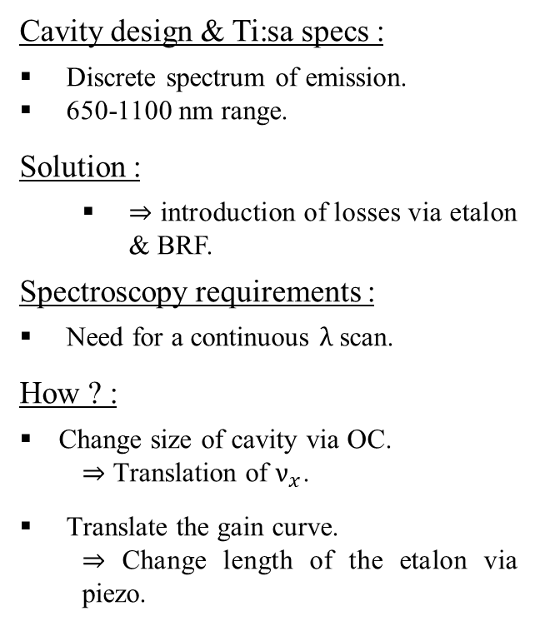
CW Ti:sa : Wavelength selection
Cavity design & Ti:sa specs :
Discrete spectrum of emission.
650-1100 nm range.
Solution :
  ⇒ introduction of losses via etalon & BRF.
Spectroscopy requirements :
Need for a continuous $λ$ scan.
How ? :
  Change size of cavity via OC.
    ⇒ Translation of $ν_{x}$.
        Translate the gain curve.
          ⇒ Change length of the etalon via piezo.
Notes:
Let’s dive in the wavelength selection theory.
First the wavelengths emitted by a laser are constrained by 2 elements:
First, the laser is an optical cavity which means that due to the properties of resonance cavities, the spectrum allowed is discrete as shown on this image where the frequency is the x-axis.
Each of the vertical red line represents a mode of emission, a wavelength and each mode is separated by what we call the FSR which depends directly on the cavity design.
Secondly, among all the modes allowed by the cavity, only the one produced by the crystal can exist, from 650 to 1100 nm.
Consequently, to be narrowband we have to destroy a lot of them.
To do so, we are introducing losses via an etalon and a BRF. The losses are represented by the gain curves of both optics.
On slides : As you can see the gain curve of the BRF is wide because we are using it for the gross selection. Here you have the gain curve of the etalon used for fine selection.
(If question, using both because etalon gain curve if periodic along x).
Only the mode present under the etalon curves will remain. But now for spectroscopy, we need to scan the frequency.
To do so, we will change the size of the cavity via a piezo mounted on the OC and it will result in the translation of the whole spectrum along its axis.
In addition, for the scan to be continuous, we have to translate the etalon gain curve at the same time as the modes, to keep it centered.

Slide 7
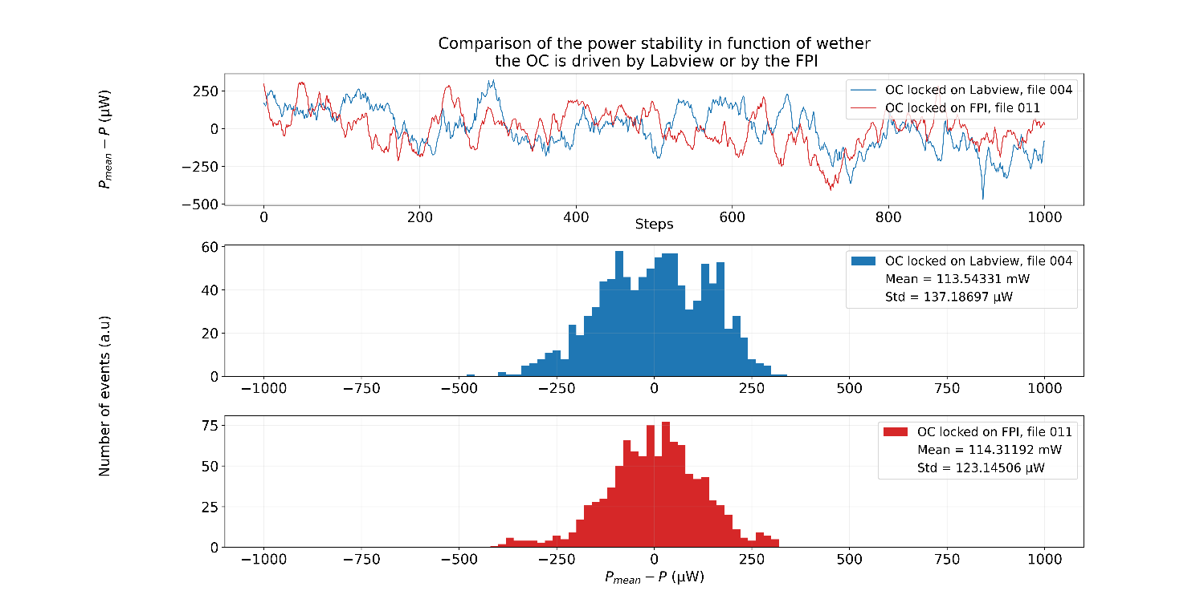
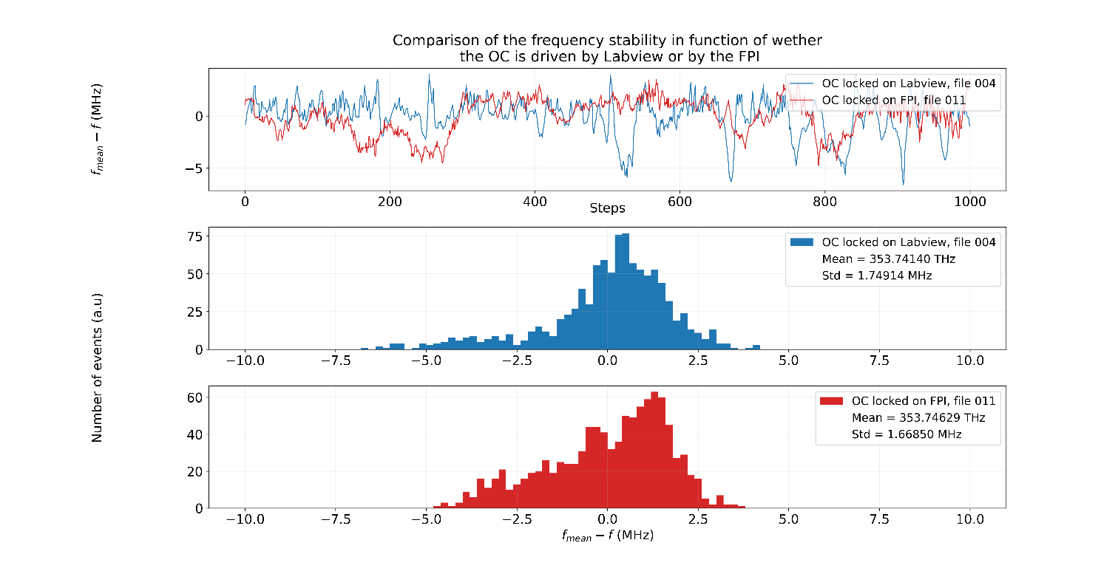
Wavelength & power stabilization
Conclusion :
  Frequency variation below wavemeter relative accuracy (3MHz).
  OC locking works !
Notes:
To characterize the laser, we measured & recorded the power and frequency stability along time.
We set a fixed wavelength into Labview and told it to keep it.
For each plot, you have on the top the evolution around the mean value, (shown image left for power & right for wavelength).
The bottom plot represent the dispersion of power & wavelength around the mean value.
What can we conclude from them ?
First, the power variation is in the order of 100 uW which is irrelevant in our case, it wont impact the seeding.
Secondly, the frequency variation is around 1,5 MHz.
It is a good thing because the relative accuracy of our wavemeter is 3 MHz which means that the fluctuations read can be inherited from the wavemeter itself.
From there we decided to scan the laser to see if we were able to do laser spectroscopy.

Slide 8
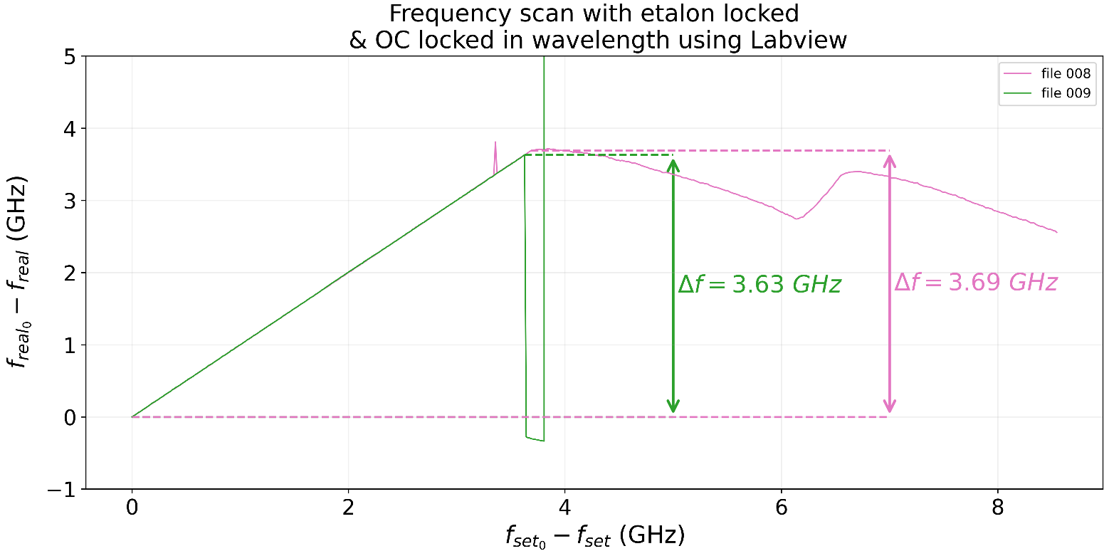
Wavelength scan
    Conclusion :
    Scanning range is relatively low, 5 GHz would be better for laser spectroscopy.
    With frequency doubling, possible to scan for 7 GHz, which make laser spectroscopy possible for low isotope shift.
Notes:
On the right image, you can see frequency scan done with the etalon locked and the OC scanned in frequency.
This plot shows that the laser frequency follows the linear scan asked by the user.
In the best configuration, we were able to scan the laser over 3.6 GHz around 10 times the FSR.
For laser spectroscopy we would prefer to be at 10 GHz because we want to measure the biggest Isotope shift possible.
But still, because we can double the frequency at the exit of the ILC, it means that we have 7 GHz of range in the blue.

Slide 9
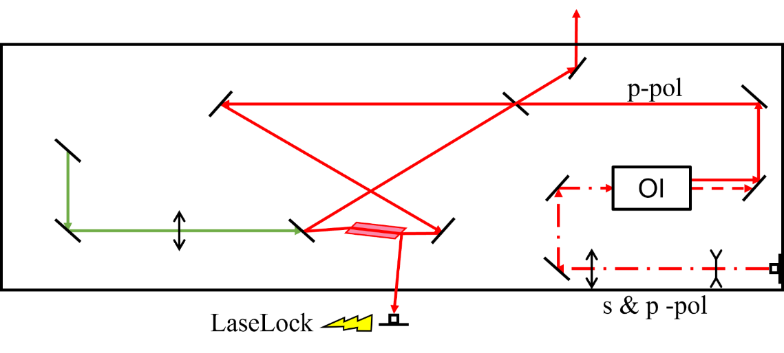
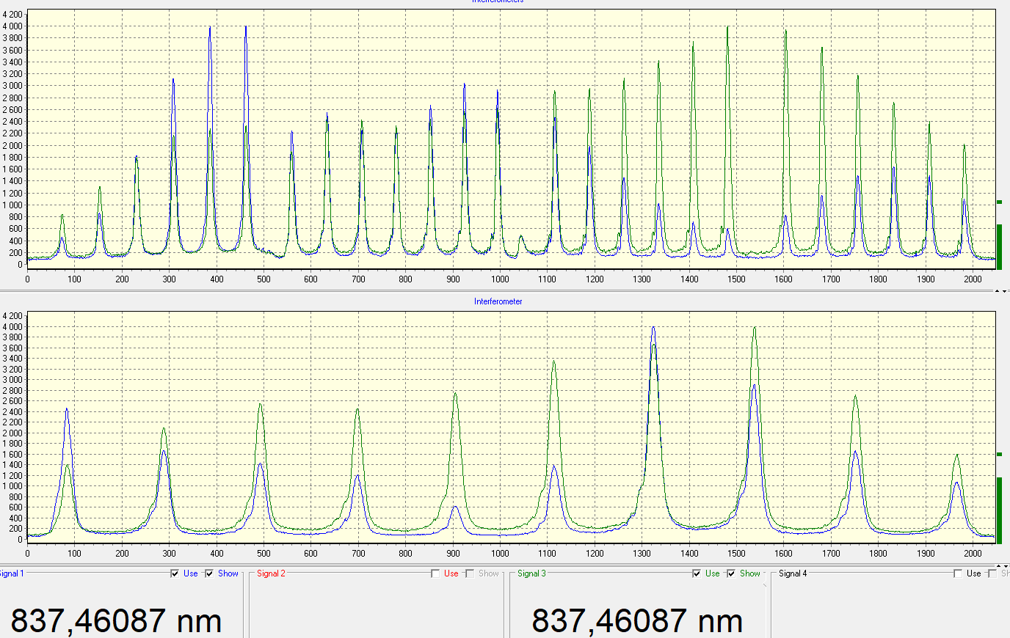
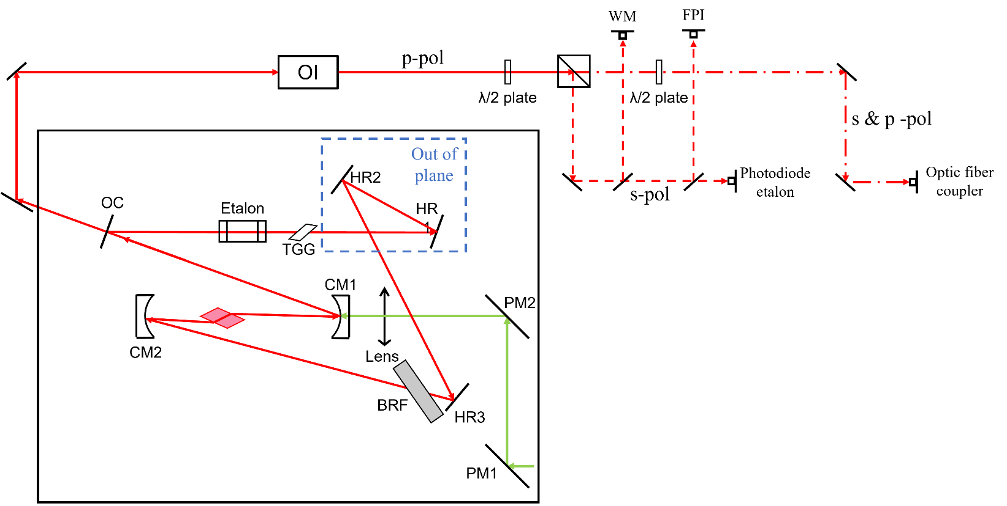
Proof-of concept : Seeding CW Ti:sa
    Injection-Locked Ti:sa Cavity (ILC) :
      Realized that optic fiber generates huge losses via s-polarisation.
      But seeding work perfectly.
Notes:
Next logical step was to seed the ILC with our laser.
You can see on the bottom picture, the software of the wavemeter. Both wavelength read matches which is good and in addition the interferences pattern read by the wavemeter are identical which is also a good sign.

Slide 10
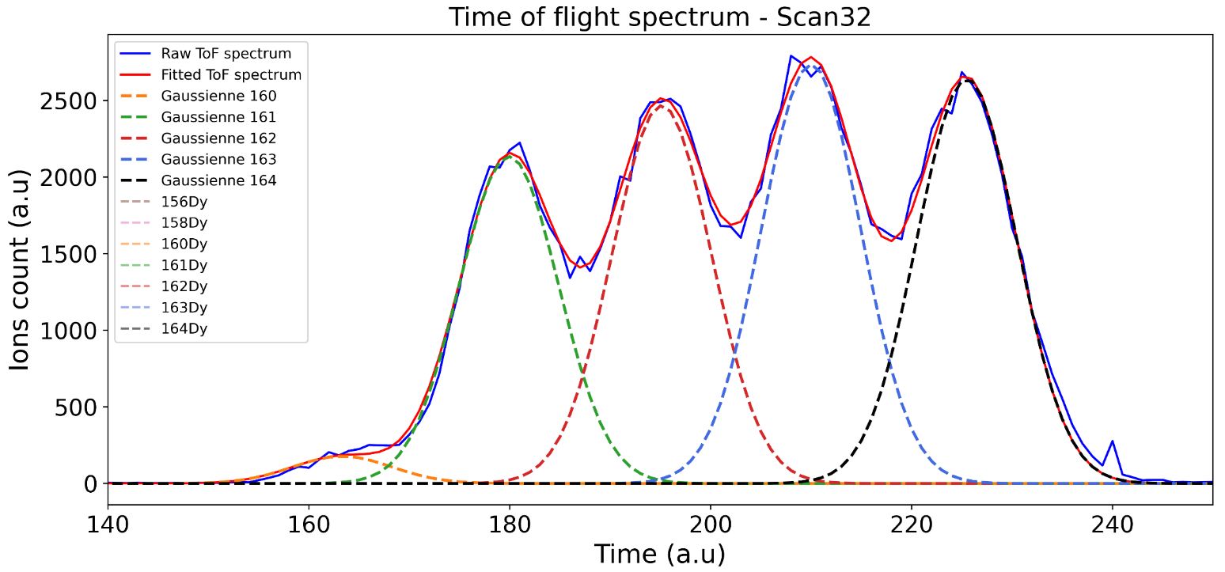
Proof-of concept : Stable Dysprosium spectroscopy
48 343,96 cm⁻¹
A.I
47 900,5 cm⁻¹
408,727 nm, 24 466,221 cm⁻¹
23 877,739 cm⁻¹
418,8 nm
0 cm⁻¹
Notes:
Now that our narrowband scannable laser is ready, we can do some laser spectroscopy as a proof-of concept.
We choose to do it on stable Dysprosium, we knew it was easy and the parameters of the ABU were know from a previous experiment done in GISELE.
We set the CW to 418,8 nm which is the transition that we are probing and one broadband laser to 408 nm to reach a know Autoionizing state.
This plot represents a Time of Flight spectrum (ToF spectrum) for a scan obtained by the laser spectroscopy of the stable Dysprosium.
In the best case, we are able to detect 7 isotopes.
As you can see, the mass separation in our ABU is not perfect and doesn’t allow to fully exploit the statistics because we will have to cut the data to remove as much as possible the presence of contaminants.

Slide 11
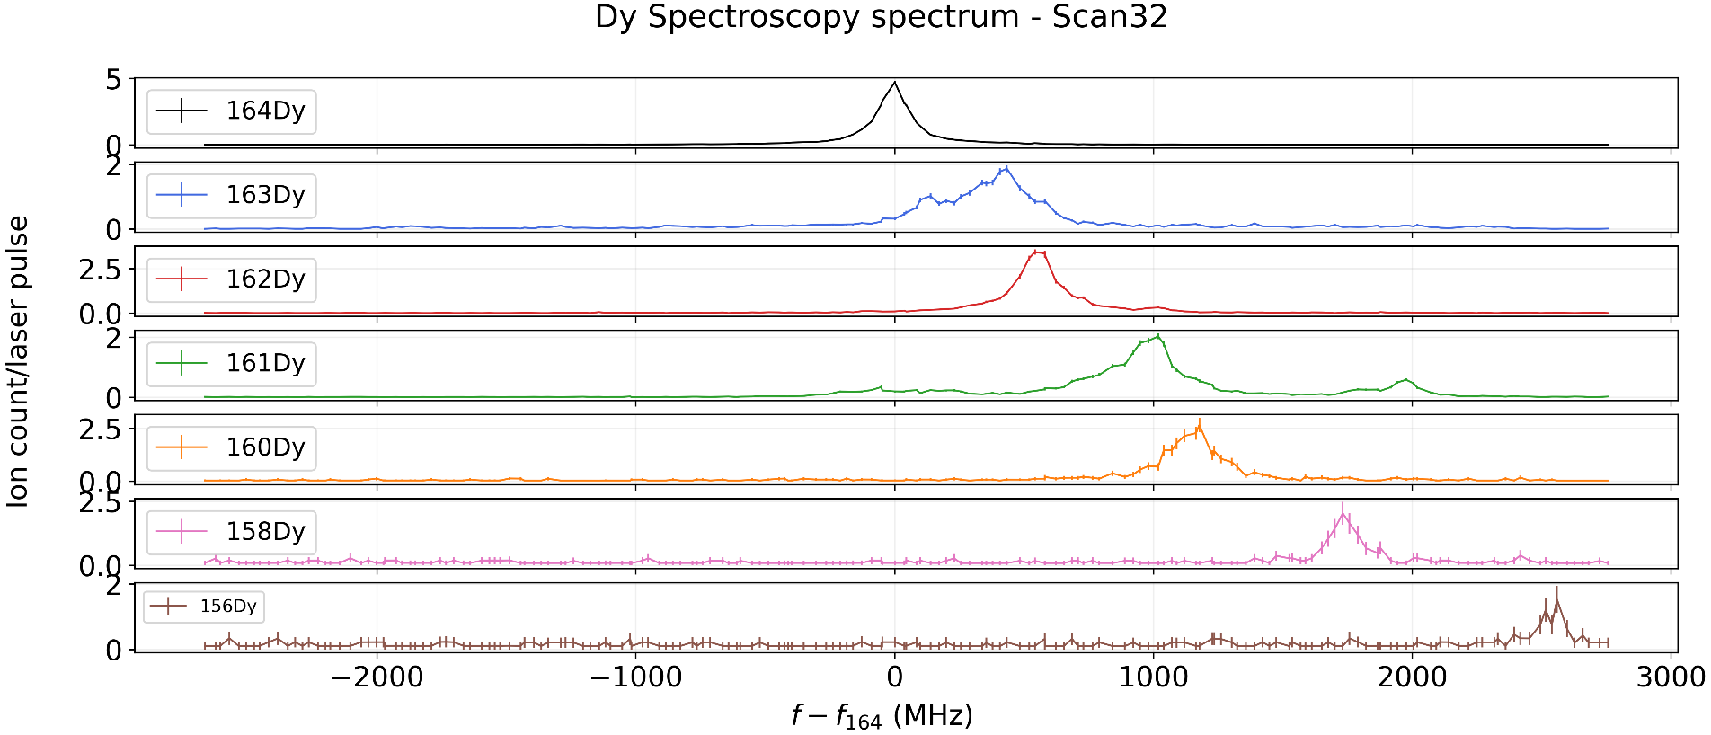
Proof-of concept : Stable Dysprosium spectroscopy
Natural abundances :
156Dy : 0,056 %
158Dy : 0,095 %
160Dy : 2,329 %
161Dy : 18,889 %
162Dy : 25,475 %
163Dy : 24,896 %
164Dy : 28,260 %
Notes:
This plot offer a better vizualization of the isotope between the isotope.
First thing to note, the isotope shift increase with respect to 164Dy.
And the 2nd thing : for 163Dy & 161Dy there is a clear splitting of the hyperfine structure which is coherent due to an even number of protons and an odd number of neutrons.

Slide 12
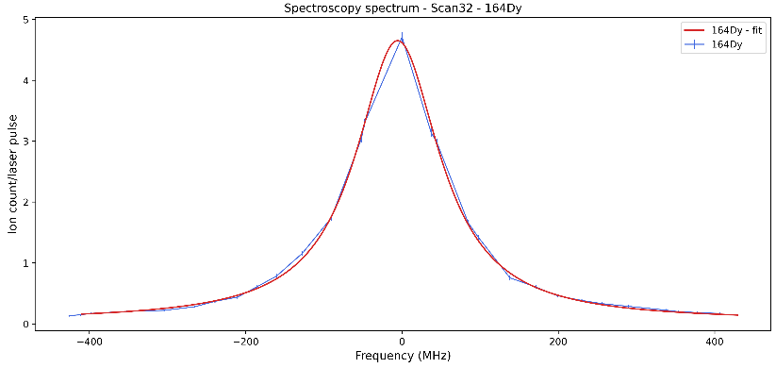
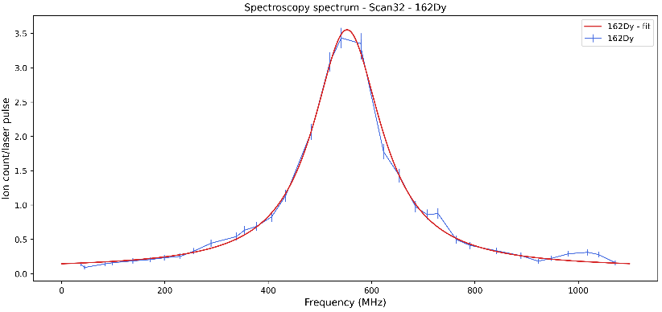
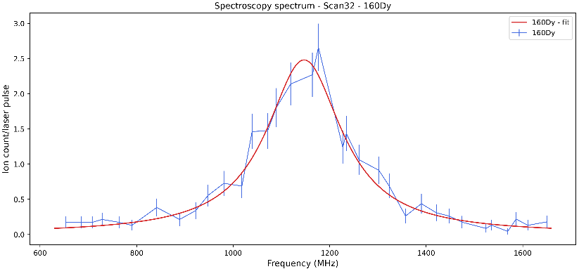
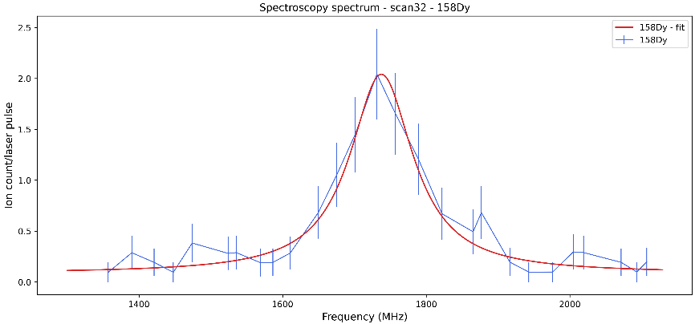
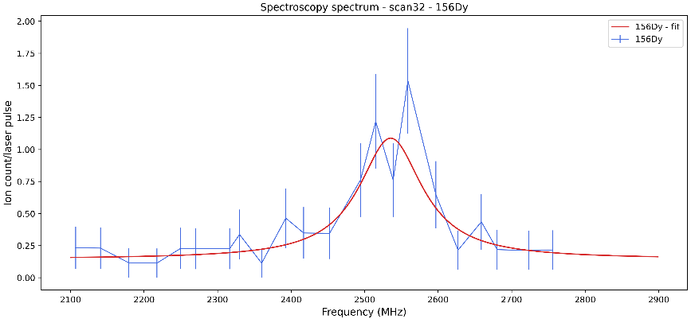
Proof-of concept : Stable Dysprosium spectroscopy
Notes:
Here I show the fitting realized on the even-even isotopes. You can clearly see that the quality of the spectrum is drastricly lower for 156Dy.
These fits allow us to evaluate the centroid which will be necessary for the determination of the isotope shift.

Slide 13
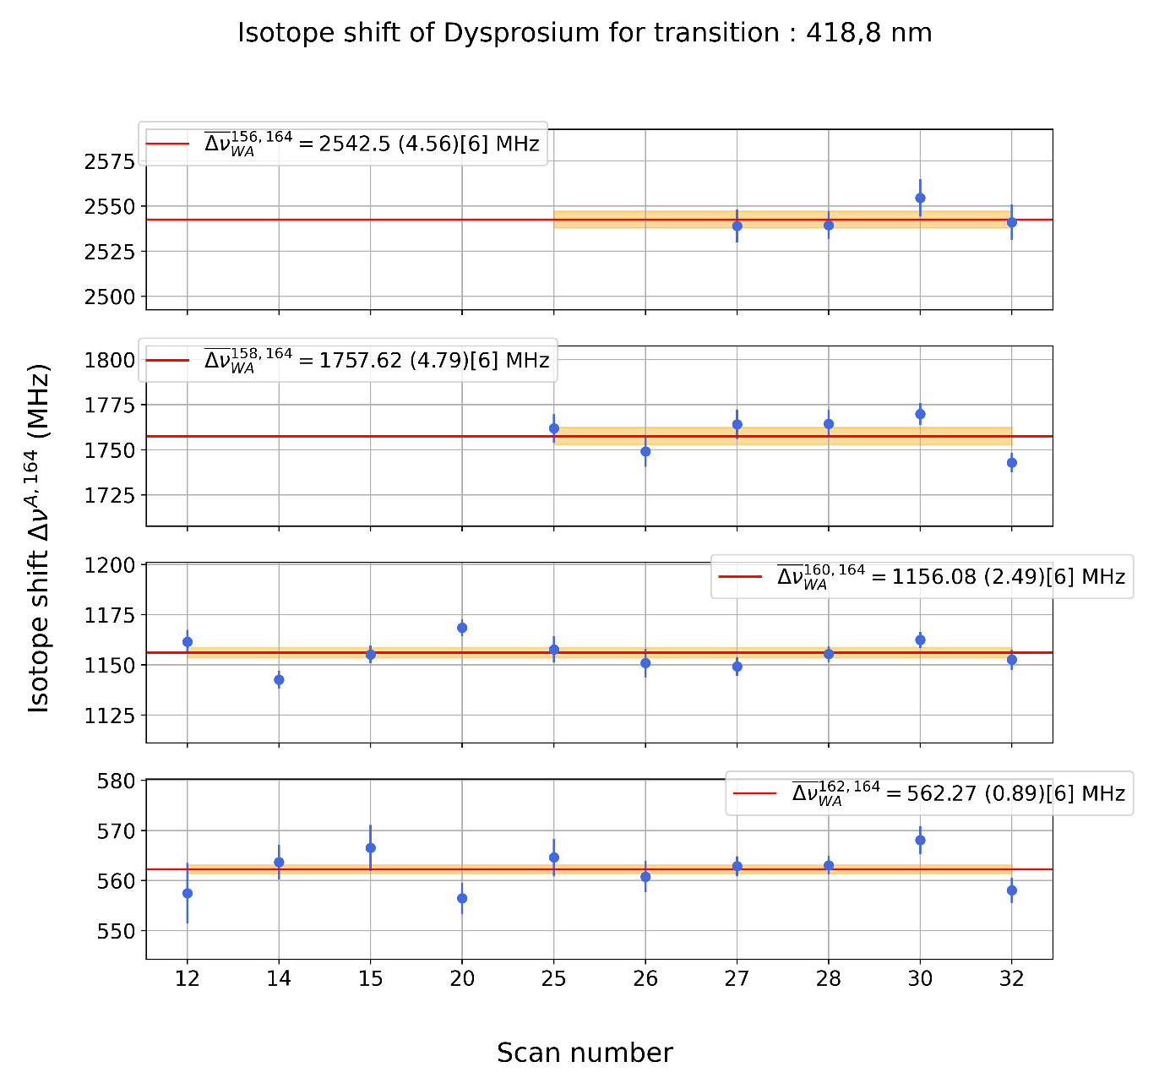
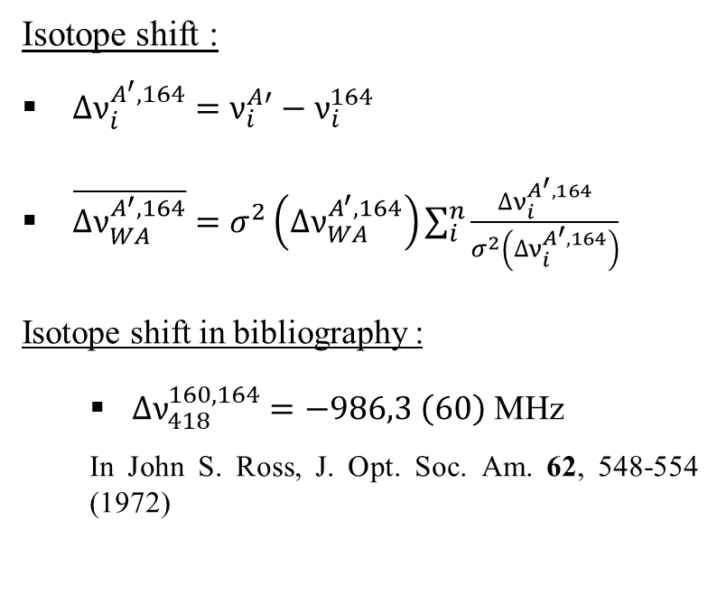
Proof-of concept : Stable Dysprosium spectroscopy
    Isotope shift :
    $∆ν_{i}^{A^{′},164}=ν_{i}^{A′}−ν_{i}^{164}$
    $\overline{∆ν_{WA}^{A^{′},164}}=σ^{2}\left(∆ν_{WA}^{A^{′},164}\right)\sum_{i}^{n}{\frac{∆ν_{i}^{A^{′},164}}{σ^{2}\left(∆ν_{i}^{A^{′},164}\right)}}$
    Isotope shift in bibliography :
      $∆ν_{418}^{160,164}=−986,3 \left(60\right)$ MHz
      In John S. Ross, J. Opt. Soc. Am. 62, 548-554 (1972)
PRELIMINARY RESULTS
Notes:
Show equation : For the evaluation of the isotope shift, we are computing them with respect to 164Dy, its a choice done bcz it is the most abundant.
During the experiment, we are doing several scans, so in order to have one single reference value for each isotope pair,
we can compute a weighted average Isotope shift which takes into account the Isotope shift of each scans and their respective standard deviations.
These are preliminary results but they seem reliable, we can see that the data errorbars are always within the weigthed average value or its errorbar.

Slide 14
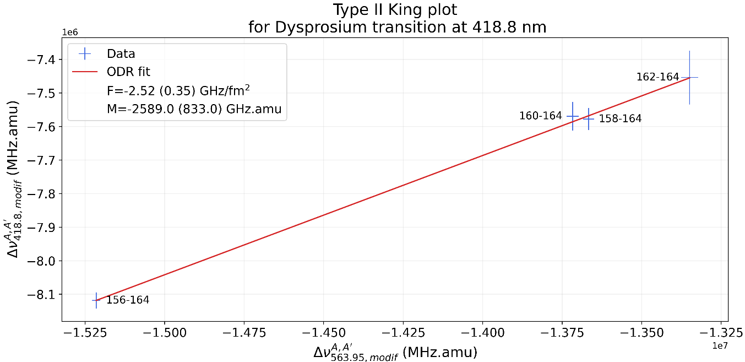
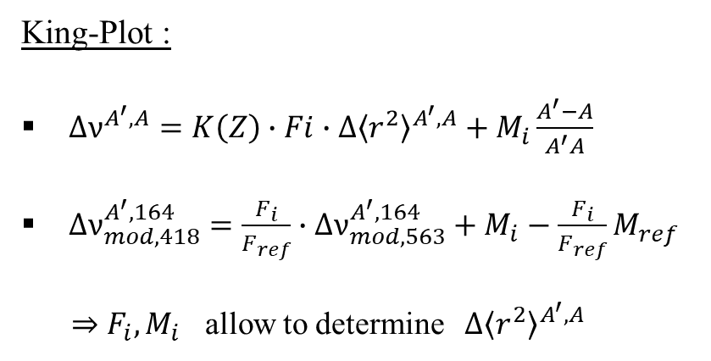
Proof-of concept : Stable Dysprosium spectroscopy
    King-Plot :
    $∆ν^{A^{′},A}=K\left(Z\right)∙Fi∙{∆\left\langle r^{2}\right\rangle }^{A^{′},A}+M_{i}\frac{A^{′}−A}{A^{′}A}$
    $∆ν_{mod,418}^{A^{′},164}=\frac{F_{i}}{F_{ref}}∙∆ν_{mod, 563}^{A^{′},164}+M_{i}−\frac{F_{i}}{F_{ref}}M_{ref}$
    ⇒ $F_{i},M_{i}$ allow to determine ${∆\left\langle r^{2}\right\rangle }^{A^{′},A}$
PRELIMINARY RESULTS
Notes:
Thank to the previous result, we can connect the isotope shift with the difference in mean square radii between 2 isotopes using the following equation.
In this equation, we have K(Z) a correction facteur dependent to the atomic number.
Fi is the field shift factor representing the change in the electron density for the considered atomic transition.
Mi is the mass shift factor, it represents the change in the nuclear mass between isotopes of the same specie.
By manipulating this equation for 2 differents transitions, we can express the isotope shift of one transition in function of the other.
It is usefull to deduce the field & mass shift factor of our transition if we already have their values for a reference transition which is in our case 563nm.
Then we just have to fitting our data by using a linear model and we are inderectly able to determine Fi & Mi which will later be used to determine the
Difference in mean square radii.
Ans that’s all for the results so far.

Slide 15
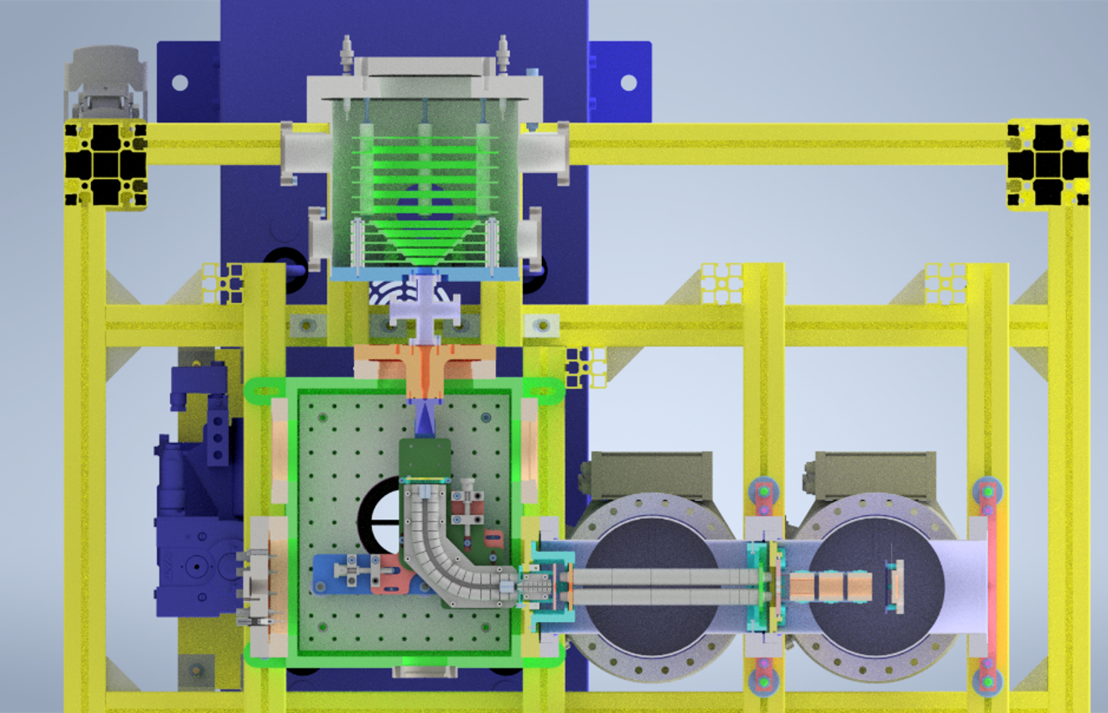
Perspectives - FRIENDS³ setup
Fast
Radioactive
Ion
Extraction
Neutralization
Device
S3
3D drawing of FRIENDS3 experimental setup,
E. Morin et al., NIMB 573 (2026).
Notes:
I’m going to mention briefly the FRIENDS3 project.
FRIENDS3 stands for Fast Radioactive Ion Extraction & Neutralization Device for S3.

Slide 16
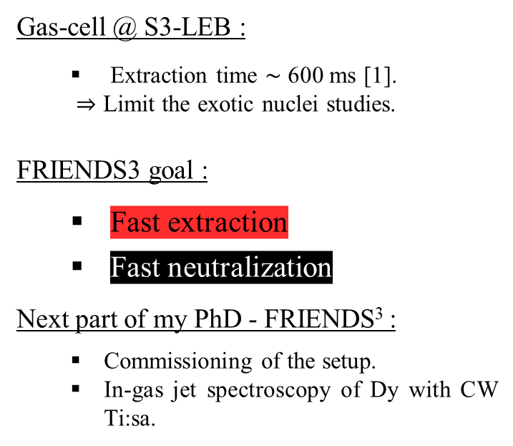
Perspectives - FRIENDS³ setup
Gas-cell @ S3-LEB :
  Extraction time $\sim$ 600 ms [1].
  ⇒ Limit the exotic nuclei studies.
  FRIENDS3 goal :
    Fast extraction
    Fast neutralization
    Next part of my PhD - FRIENDS³ :
      Commissioning of the setup.
      In-gas jet spectroscopy of Dy with CW Ti:sa.
3D drawing of FRIENDS3 experimental setup,
E. Morin et al., NIMB 573 (2026).
[1] W. Dong et al., arXiv:2601.12009 [physics.ins-det] (2026)
Notes:
The current gas cell @S3-LEB is limited by its extraction time which is around 550 ms.
The extraction time is important because it limits the exotic nuclei which can be studied due to their half-life.
The FRIENDS3 setup which is a reduced & simplified version of S3-LEB aims to
improve the gas cell design by reducing the extraction time via the use of electrodes which are going to accelerate our exotic ions once they pass through the window.
Then, several studies will be conducted in order to determine the most efficient way to neutralize those ions. The first method of neutralization will be the recombination
Thanks to electrons produced by photo-ionization.

Slide 17
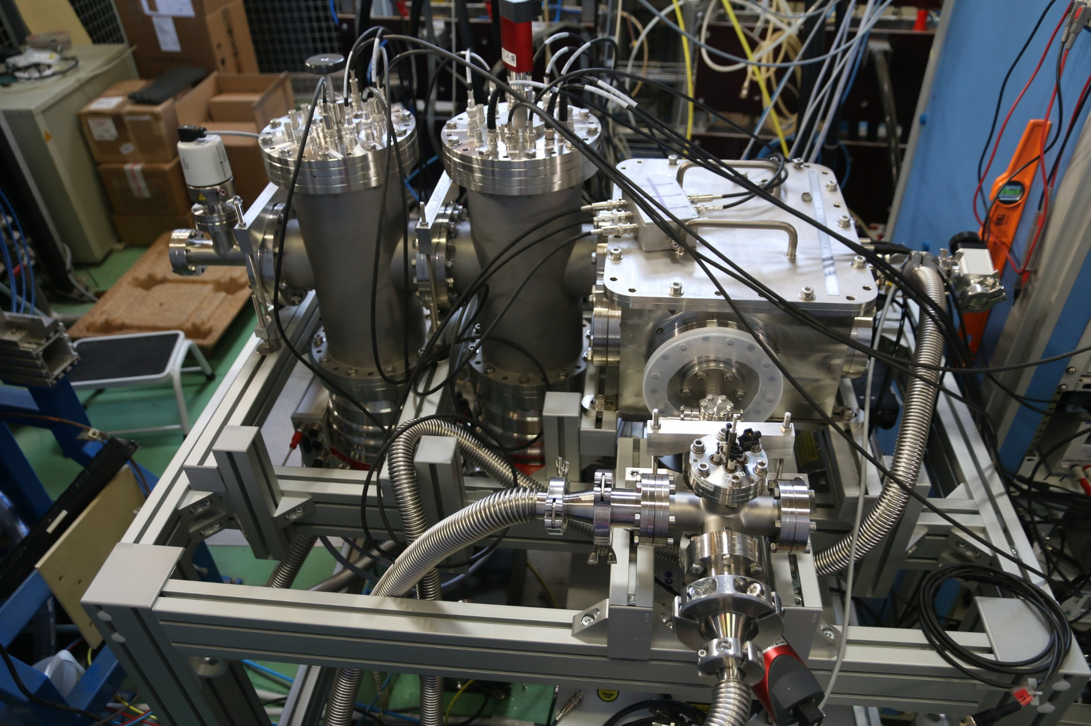
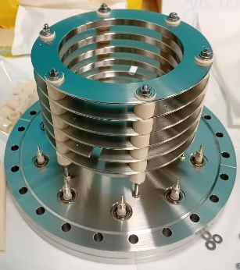
FRIENDS³ setup IRL
Notes:
Here you have some pictures of the setup as it is now in GANIL

Slide 18










The S³-LEB collaboration & FRIENDS³ project team
GANIL:
Anjali Ajayakumar; Dieter Ackermann; Alexandre Brizard; Lucia Caceres; Samuel Damoy; Pierre Delahaye; Hemanth Dinesan;
Sai Kumar Chinthakayala; Patrice Gangnant; Sarina Geldhof; Johan Goupil; Nathalie Lecesne; Andrés Lopez;
Thierry Lefrou; Renan Leroy; Franck Lutton; Alejandro Ortiz; Benoit Osmond; Julien Piot;
Blaise-Maël Retailleau; Hervé Savajols; Gilles Sénécal; Tudor Stefan
LPC:
Frédéric Boumard; Maylis Brun; Jean-François Cam; Hugues de Préaumont; Antoine de Roubin;
Philippe Desrues; Xavier Fléchard; Clément Gautier; Pierre Lassegues
Julien Lory ; Yvan Merrer; Skyy Pineda; Christophe Vandamme
IJCLab:
Wenling Dong; Patricia Duchesne; Serge Franchoo; Vladimir Manea; Valentin Marchand;
Elodie Morin; Olivier Pochon; Afonso Vicente
KU Leuven:
Arno Claessens; Ruben de Groote; Rafael Ferrer; Mark Huyse; Fedor Ivandikov; Sandro Kraemer ; Yuri Kudriavtsev;
Jekabs Romans; Simon Sels; Paul Van den Bergh; Piet Van Duppen; Matthias Verlinde ; Elise Verstraelen
JGU:
Sebastian Raeder; Dominik Studer; Klaus Wendt
JYU:
Iain Moore; Michael Reponen; Juha Uusitalo
IPHC:
Emil Traykov
IRFU:
Martial Authier; Olivier Cloué; Antoine Drouard; Thomas Goigoux;
Mathilde Ragot; Emmanuel Rey-Herme; Damien Thisse; Marine Vandebrouck
and the RESIST network in ENSAR2

Slide 19
Perspectives - FRIENDS³ setup
3D drawing of FRIENDS3 experimental setup,
E. Morin et al., NIMB 573 (2026).
Notes:
I’m going to mention briefly the FRIENDS3 project.
FRIENDS3 stands for Fast Radioactive Ion Extraction & Neutralization Device for S3.

Slide 20
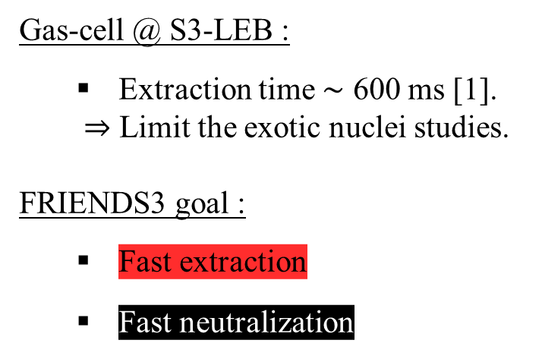
Perspectives - FRIENDS³ setup
Gas-cell @ S3-LEB :
  Extraction time $\sim$ 600 ms [1].
  ⇒ Limit the exotic nuclei studies.
  FRIENDS3 goal :
    Fast extraction
    Fast neutralization
3D drawing of FRIENDS3 experimental setup,
E. Morin et al., NIMB 573 (2026).
[1] W. Dong et al., arXiv:2601.12009 [physics.ins-det] (2026)
Notes:
The current gas cell @S3-LEB is limited by its extraction time which is around 550 ms.
The extraction time is important because it limits the exotic nuclei which can be studied due to their half-life.
The FRIENDS3 setup which is a reduced & simplified version of S3-LEB aims to
improve the gas cell design by reducing the extraction time via the use of electrodes which are going to accelerate our exotic ions once they pass through the window.
Then, several studies will be conducted in order to determine the most efficient way to neutralize those ions. The first method of neutralization will be the recombination
Thanks to electrons produced by photo-ionization.

Slide 21

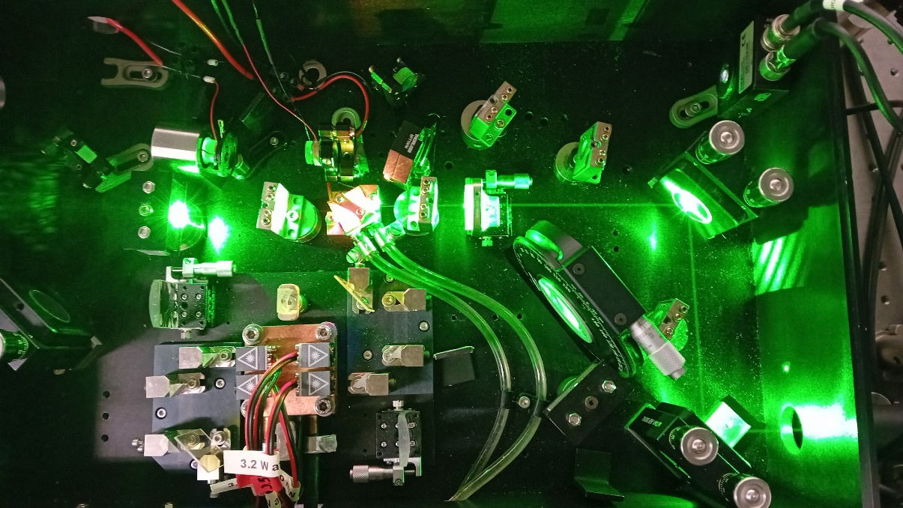
Perspectives
    CW Ti:sa :
      Solve scanning & stability problems.
      ⇒ Change OC, eventually study real behaviour
      of etalon/BRF.
    2nd part of my PhD - FRIENDS³ :
      Commissioning of the setup.
      In-gas jet spectroscopy of Dy with CW Ti:sa.
    Spectroscopy :
      Finish analysis for odd-even isotopes.
Notes:
The futur .
Concerning the CW Ti:sa, we have to change the OC to reduce its reflectivity in the hope that its solves some of our scanning & stability problems.
If it changes nothing we could eventually measure the real BRF & etalon gain curves via a new laser received for the S3-LEB project.
For FRIENDS3, the new gas cell will be ready in a near future, it will allows us to start the commissioning of the full setup & the endgame
would be to realize In-gas jet spectroscopy of Dy using the CW Ti:sa.
Concerning the analysis, I still have corrections to apply to the even-even isotopes & I will have to deal with the even-odd after.
That is all for me. Thanks for your attention & do not hesitate if you have any questions.

Slide 22
Conclusions
    S³-LEB :
      Installation is finished.
      Commissioning nearing completion.
    FRIENDS³ :
      1st off-line tests soon.
    GISELE :
      New seeding laser for narrowband laser spectroscopy.
Notes:
To conclude,
S3-LEB is installed & soon ready for offline experiments.
FRIENDS3 will start its first off-line tests in April when the new gas cell arrive.
And a new seeding laser for narrowband laser spectroscopy is available.

Slide 23
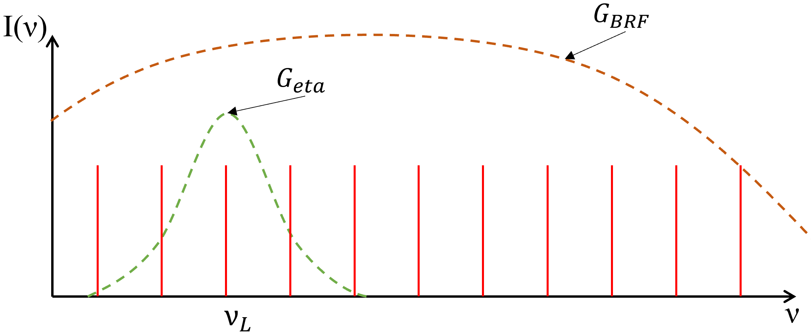
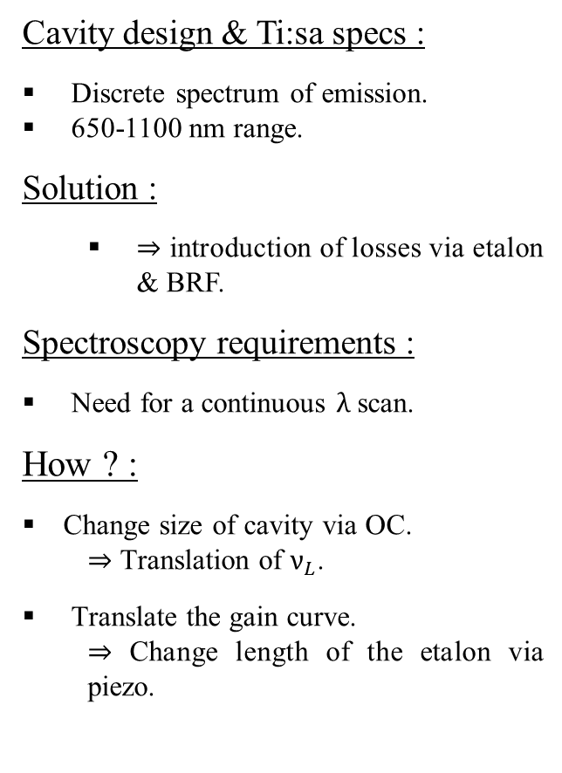
Wavelength selection theory
Cavity design & Ti:sa specs :
Discrete spectrum of emission.
650-1100 nm range.
Solution :
  ⇒ introduction of losses via etalon & BRF.
Spectroscopy requirements :
Need for a continuous $λ$ scan.
How ? :
  Change size of cavity via OC.
    ⇒ Translation of $ν_{L}$.
        Translate the gain curve.
          ⇒ Change length of the etalon via piezo.
FSR
Notes:
Let’s dive in the wavelength selection theory.
First the wavelength emitted by a laser are constrained by 2 elements:
First, the laser is an optical cavity which means that due to the properties of resonance cavities, the spectrum allowed is discrete as shown on this image where the frequency is the x-axis.
Each of the vertical red line represents a mode of emission, a wavelength and each mode is separated by what we call the FSR which depends directly on the cavity design.
Secondly, among all the modes allowed by the cavity, only the one produced by the crystal can exist, from 650 to 1100 nm.
Consequently, to be narrowband we have to destroy a lot of them.
To do so, we are introducing losses via an etalon and a BRF. The losses are represented by the gain curves of both optics.
On slides : As you can see the gain curve of the BRF is wide because we are using it for the gross selection. Here you have the gain curve of the etalon used for fine selection.
(If question, using both because etalon gain curve if periodic along x).
Only the mode present under the etalon curves will remain. But now for spectroscopy, we need to scan the frequency.
To do so, we will change the size of the cavity via a piezo mounted on the OC and it will result in the translation of the whole spectrum along its axis.

Slide 24
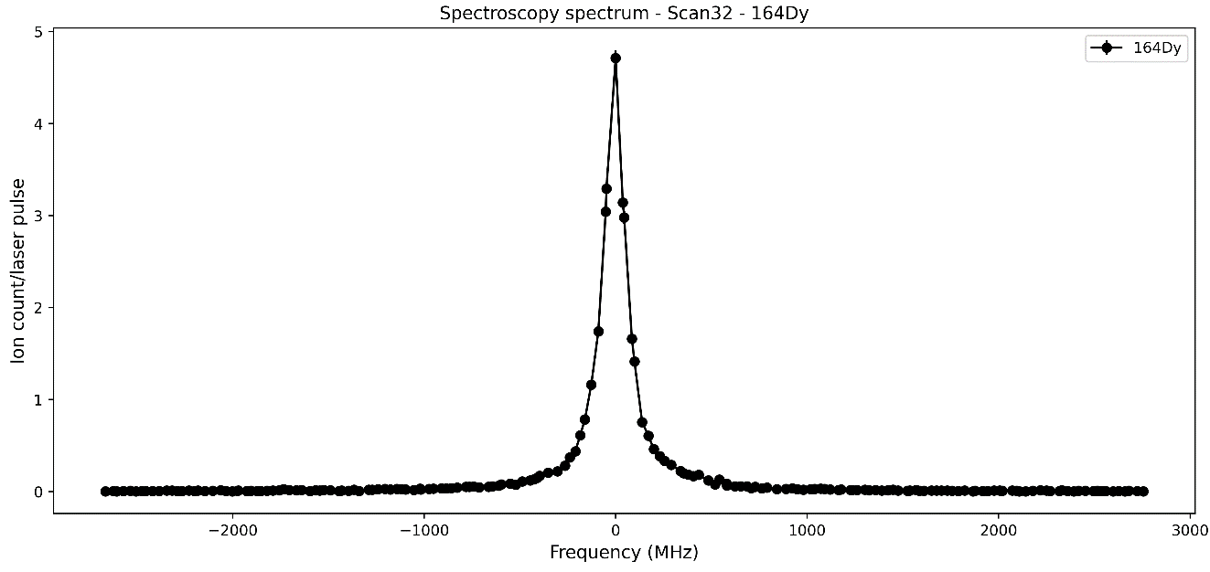






What is laser spectroscopy ?
NR.I ($σ\sim {10}^{−17} {cm}^{2})$
A.I ($σ\sim {10}^{−15} {cm}^{2})$
IP
Rydberg ($σ\sim {10}^{−12} {cm}^{2})$
MCP
$$E_{k}$$
$$E_{g}$$
$$λ_{1}$$
Notes:
Let’s begin by explaining what is laser spectroscopy ?
It is a really simple idea, we have an atom with an electron at the groundstate.
We send a first laser with a know frequency in order to realize a first excitation.
Then, we send a second laser with a particular wavelength to ionize it.
The ion is later extracted towards an MCP to be counted.
Then, u might ask yourselves, why two laser ?
Our goal is to determine precisely the energy of the transition and to do so we are scanning the frequency of the first step laser.
You can see on the image bottom right the number of counts for each isotopes in function of the frequency.
It is the kind of spectrum we are looking for.

Slide 25


What is laser spectroscopy ?
NR.I ($σ\sim {10}^{−17} {cm}^{2})$
A.I ($σ\sim {10}^{−15} {cm}^{2})$
IP
Rydberg ($σ\sim {10}^{−12} {cm}^{2})$
MCP
$$E_{k}$$
$$λ_{1}$$
Laser $λ_{1}$
$$E_{g}$$
Notes:
Let’s begin by explaining what is laser spectroscopy ?
It is a really simple idea, we have an atom with an electron at the groundstate.
We send a first laser with a know frequency in order to realize a first excitation.
Then, we send a second laser with a particular wavelength to ionize it.
The ion is later extracted towards an MCP to be counted.
Then, u might ask yourselves, why two laser ?
Our goal is to determine precisely the energy of the transition and to do so we are scanning the frequency of the first step laser.
You can see on the image bottom right the number of counts for each isotopes in function of the frequency.
It is the kind of spectrum we are looking for.

Slide 26




What is laser spectroscopy ?
$$e^{−}$$
$$λ_{1}$$
$$e^{−}$$
$$e^{−}$$
$$e^{−}$$
NR.I ($σ\sim {10}^{−17} {cm}^{2})$
A.I ($σ\sim {10}^{−15} {cm}^{2})$
IP
Rydberg ($σ\sim {10}^{−12} {cm}^{2})$
MCP
Laser $λ_{2}$
$$E_{k}$$
Laser $λ_{1}$
$$E_{g}$$
Notes:
Let’s begin by explaining what is laser spectroscopy ?
It is a really simple idea, we have an atom with an electron at the groundstate.
We send a first laser with a know frequency in order to realize a first excitation.
Then, we send a second laser with a particular wavelength to ionize it.
The ion is later extracted towards an MCP to be counted.
Then, u might ask yourselves, why two laser ?
Our goal is to determine precisely the energy of the transition and to do so we are scanning the frequency of the first step laser.
You can see on the image bottom right the number of counts for each isotopes in function of the frequency.
It is the kind of spectrum we are looking for.

Slide 27





What is laser spectroscopy ?
$$e^{−}$$
$$e^{−}$$
+1 counts
+1 counts
+1 counts
NR.I ($σ\sim {10}^{−17} {cm}^{2})$
+1 counts
+1 counts
A.I ($σ\sim {10}^{−15} {cm}^{2})$
+1 counts
$$e^{−}$$
+1 counts
IP
$$λ_{1}$$
+1 counts
+1 counts
Rydberg ($σ\sim {10}^{−12} {cm}^{2})$
+1 counts
MCP
Laser $λ_{2}$
$$e^{−}$$
$$E_{k}$$
Laser $λ_{1}$
$$E_{g}$$
Notes:
Let’s begin by explaining what is laser spectroscopy ?
It is a really simple idea, we have an atom with an electron at the groundstate.
We send a first laser with a know frequency in order to realize a first excitation.
Then, we send a second laser with a particular wavelength to ionize it.
The ion is later extracted towards an MCP to be counted.
Then, u might ask yourselves, why two laser ?
Our goal is to determine precisely the energy of the transition and to do so we are scanning the frequency of the first step laser.
You can see on the image bottom right, the number of counts for each isotopes in function of the frequency.
It is the kind of spectrum we are looking for.

Slide 28
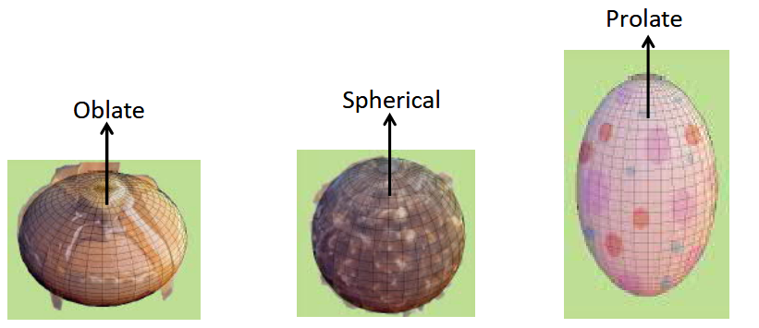
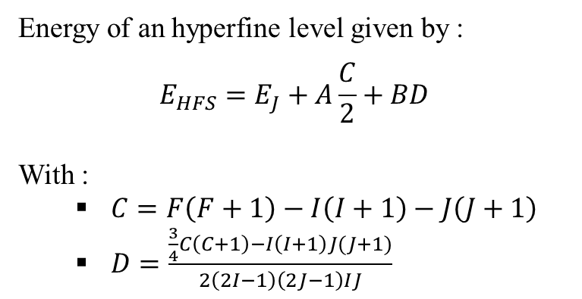
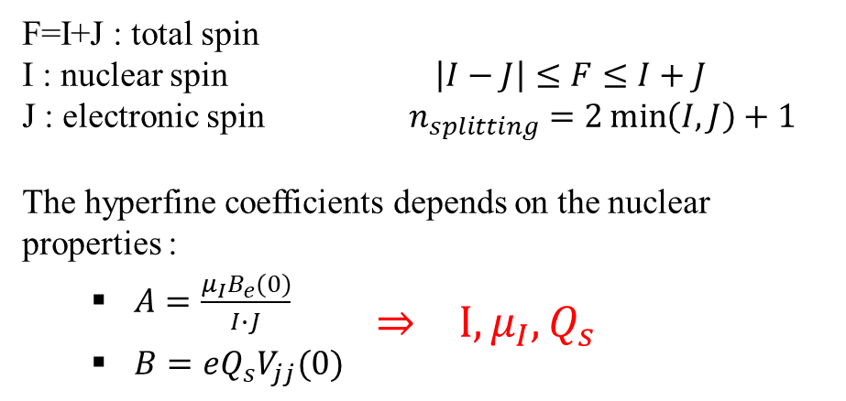
Why laser spectroscopy ?
Energy of an hyperfine level given by :
$$E_{HFS}=E_{J}+A\frac{C}{2}+BD$$
With :
  $C=F\left(F+1\right)−I\left(I+1\right)−J\left(J+1\right)$
  $D=\frac{\frac{3}{4}C\left(C+1\right)−I\left(I+1\right)J(J+1)}{2\left(2I−1\right)\left(2J−1\right)IJ}$
Fine
structure
Hyperfine structure
F=1
n=1
1S_{1/2}
F=0
F=I+J : total spin
I : nuclear spin $\left|I−J\right|≤F≤I+J$
J : electronic spin $n_{splitting}=2\min\left(I,J\right)+1$
The hyperfine coefficients depends on the nuclear properties :
  $A=\frac{μ_{I}B_{e}(0)}{I∙J}$
          $⇒ I, μ_{I}, Q_{s}$
  $B=eQ_{s}V_{jj}(0)$
Possible shapes for nuclei,
Image from Iain Moore
X.F. Yang et al., PPNP 129 (2023)
Notes:
Why are we doing laser spectroscopy in nuclear physic.
As shown in the previous slide, we are probing the position of electronic transition, which means somehow the electron orbital is affected by the nucleus.
If we start from the fine structure (over here) and zoom in, it appears that there is a shift in energy & splitting due to the coupling of the nucleus with the electronic orbital (ueV splitting).
To refer to an hyperfine level, we use the total spin F which is the sum of the nuclear spin and the electronic spin.
One thing to note, if the atom has the same number of neutrons and protons the nuclear spin will be 0 and there will be no splitting of the level.
Secondly, the number of level induced by the coupling is equal to 2min(I,J)+1.
The following equation (top right) describes the energy of an hyperfine level in function of the energy of the fine structure and some coefficients.
The coefficients C & D depend directly on the value of I & J.
The coefficients A & B, called hyperfine coefficients depend on the nucleus and are unique for a given isotope and J.
A describes the interaction between the nuclear magnetic moment and the magnetic field from the electron at the nucleus.
So from A we can deduce the magnetic moment & the nuclear spin
B describes the interaction between the gradient of the electric fied at the nucleus & the electric quadrupole moment.
For example, we can deduce from the electric quadrupole the shape of the nucleus.
Now, lets link that with the optical measurements. During our experiments because we measure the energy of the transition, we are able to evaluate A & B by fitting our spectrum and deduce these coefficients (show I, mu_I, Qs).

Slide 29
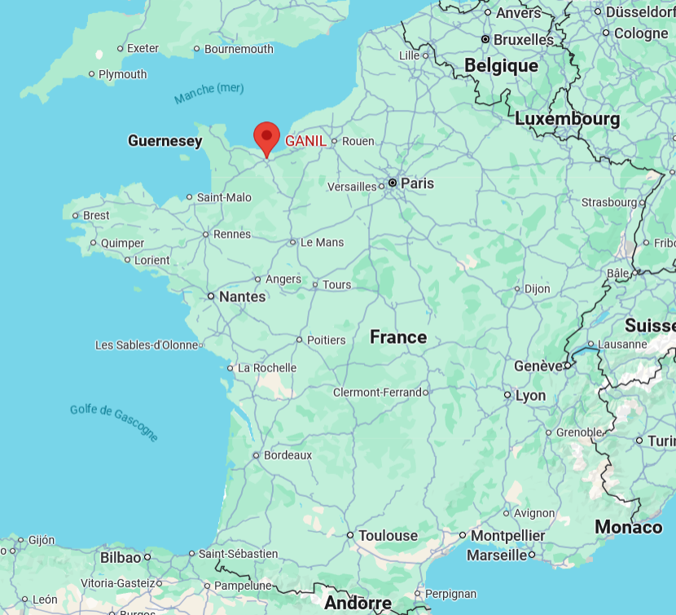
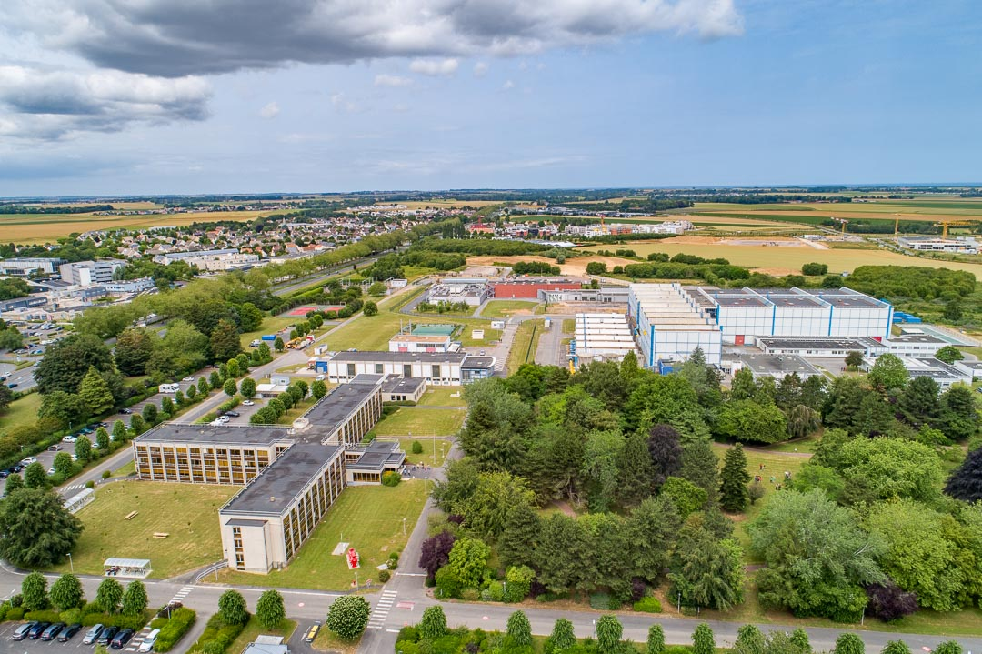
Where are we performing laser spectroscopy ?
GISELE &
FRIENDS3
S³-LEB@S³
aerial view of GANIL,
image from GANIL
France,
Google maps
Notes:
So where are doing laser spectroscopy ?
Our setups are located at GANIL in Caen. We have GISELE & FRIENDS3 which are offline setups dedicated to R&D.
We also have S3-LEB that will allows us in a near future to do laser spectroscopy on radioactive isotopes.

Slide 30
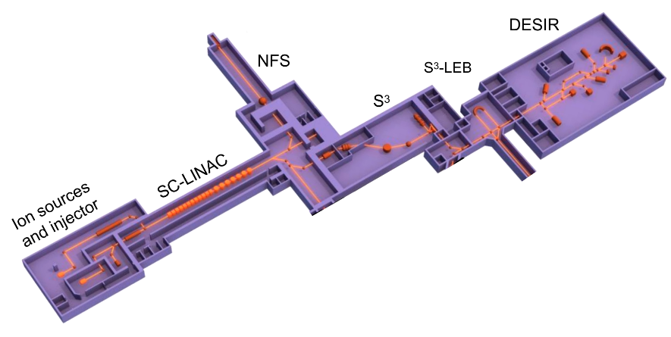
Where are we performing laser spectroscopy ?
Overview of the SPIRAL2 facility
Notes:
Here you have an overview of the SPIRAL2 facility at GANIL.
From the left, we have the ions sources followed by a superconducting linac. From there, the ions can go either towards a neutron experimental area or towards the Super Separator Spectrometer (S3) which will then delivers the beam to S3-LEB or DESIR.

Slide 31
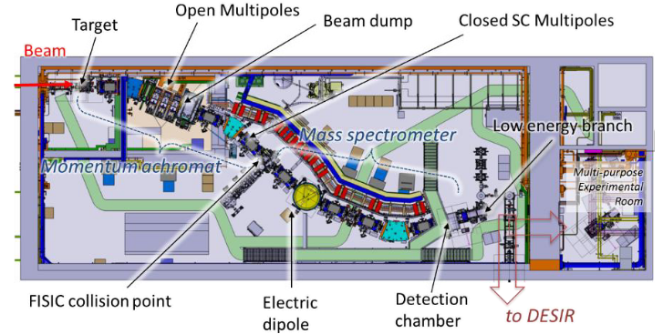
Where are we performing laser spectroscopy ?
Super Separator Spectrometer S³,
A. Drouart et al., J. Phys, 1643 (2020)
Notes:
In S3, the ions impact the target and the collisions produce radionuclides via fusion-evaporation. Then the secondary beam undergoes several stages of mass separation and focusing to be finally delivered at the focal plane of S3-LEB;

Slide 32

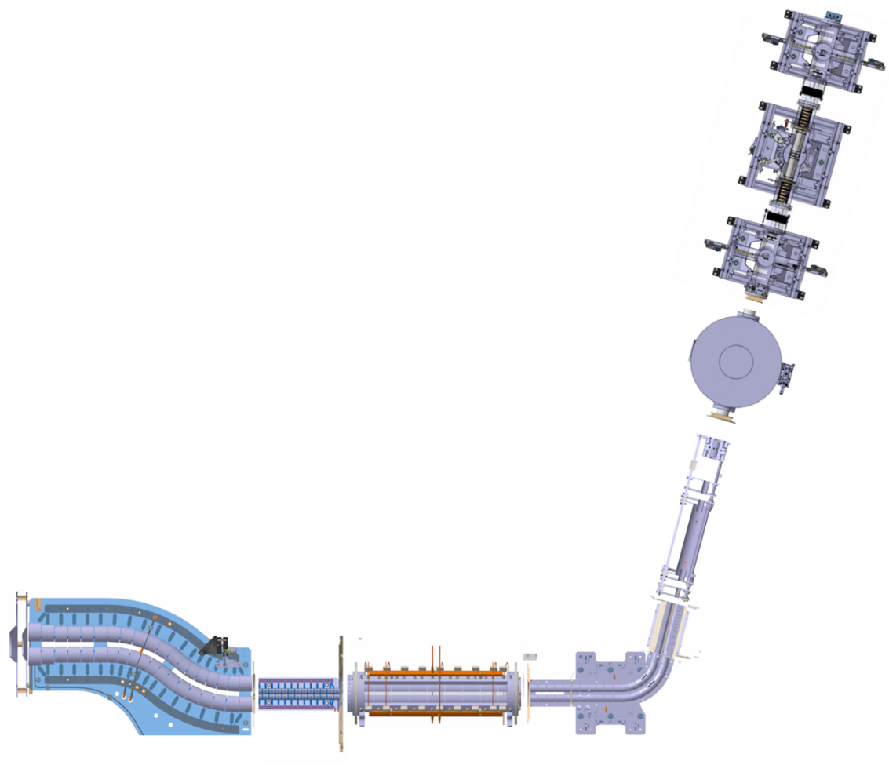
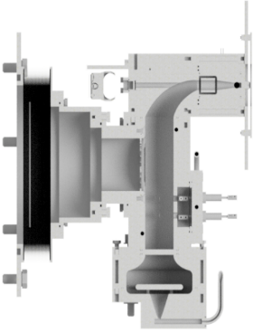


S³-LEB Overview
MagneToF
S³-Low Energy Branch :
  Goals : probe structure of exotic nuclei
  Technique : In-Gas Laser Ionization Spectroscopy
PILGRIM
(MR-TOF-MS)
MCP1
MCP2
MCP3
Gas cell
$$λ_{1}$$
$$λ_{2}$$
Pulse-up
S³
exotic ions
Cooler-buncher
S-RFQ
miniRFQ
QMF
A. Ajayakumar et al., NIMB 539 (2023)
Notes:
S3-LEB stands for S3-Low Energy Branch, it is a low energy experiment dedicated to the study of nuclides using the In-Gas Laser Ionization technique.
As you can see there is several components, but lets start by focusing ourselves on one of the most critical, the gas cell which give its name to the technique.

Slide 33
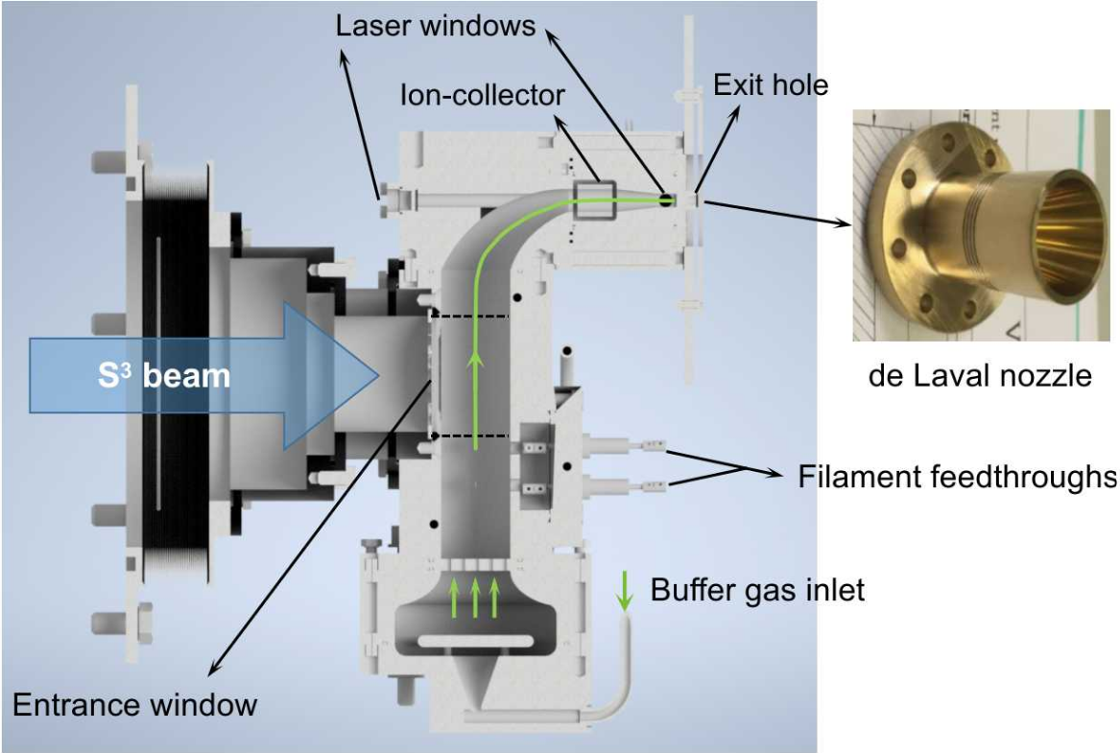
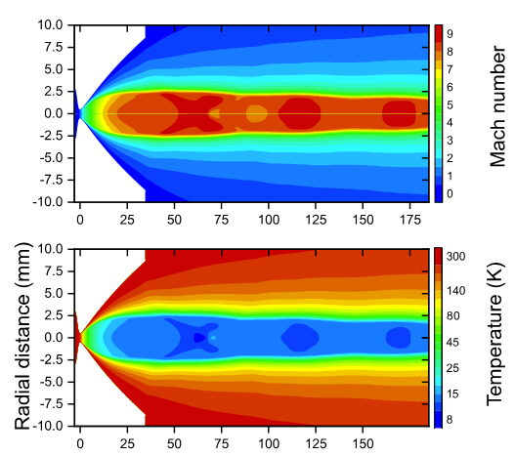
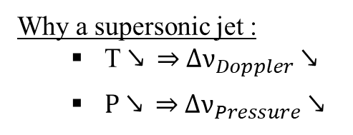
S³-LEB : Gas cell principle
Why a supersonic jet :
  T ↘ ⇒ $∆ν_{Doppler}$ ↘
  P ↘ ⇒ $∆ν_{Pressure}$ ↘
Characterization of the gas jet,
R. Ferrer et al., Phys. Rev. Research. (2021)
Gas cell,
W.Dong., PhD thesis (2024)
Notes:
How does it works ?
Animations starts :
The radionuclides enter into the gas cell by passing through a thin window. Then, they will be thermalized and neutralized by collision with Argon gas.
During this process they will go towards the de Laval Nozzle at the exit. An ion-collector is located before the nozzle in order to remove charged particle and avoid false positive.
Thanks to the de Laval nozzle, the ions & the argon are going to form a supersonic jet.
You can see on the following picture that in the jet the mach number is around 8.
It has 2 advantages :
First, the temperature decreases drasticaly in the jet.
And the lower the temperature of our ions, the narrower the Doppler linewidth is in our spectrum.
Secondly, the pressure also decreases in the jet, which reduces the linewidth due to pressure broadening.

Slide 34














S³-LEB Overview
+1 counts
+1 counts
+1 counts
MagneToF
$$T=40,3 \%$$
$$e^{−}$$
S3-Low Energy Branch :
  Goals : probe structure of exotic nuclei
  Technique : In-Gas Laser Ionization Spectroscopy
$$e^{−}$$
PILGRIM
(MR-TOF-MS)
$$P \sim {10}^{−8} mbar$$
MCP_{inj}
$$T=64,8 \%$$
MCP1
MCP2
$$T=80 \%$$
MCP3
$$T=80 \%$$
Gas cell
$$λ_{1}$$
$$λ_{2}$$
$$e^{−}$$
$$e^{−}$$
Pulse-up
$$e^{−}$$
$$e^{−}$$
S³
exotic ions
He
Cooler-buncher
Ar
S-RFQ
miniRFQ
QMF
$$P \sim {10}^{−2} mbar$$
$$P \sim 350 mbar$$
$$P \sim {10}^{−1} mbar$$
$$P \sim {10}^{−3} mbar$$
$$P \sim {10}^{−8} mbar$$
A. Ajayakumar et al., NIMB 539 (2023)
Notes:
Now, lets go back to the complete setup.
Animation !
Our atoms are ionized by the 2 step-ionization scheme, then 2 radiofrequency quadrupole transmit the ions towards a quadrupole mass filter which will allow for a low resolution mass filtering.
After that, they arrive in the cooler-buncher. There, the ions are trapped in a potential well where they are cooled by collision with helium gas.
Due to the cooling, the ions are going to form a bunch with a low energy & spatial spread which are key factors for the resolution of PILGRIM the MR-TOF-MS.
Such device will separate in mass the particle by trapping them and forcing them to do several trips back forth.
When, the trap is finally opened, the lightest particle will be the first to be detected and the heaviest the last.

Slide 35


S³-LEB Overview
+1 counts
+1 counts
+1 counts
MagneToF
$$T=40,3 \%$$
$$e^{−}$$
Status :
  S³-LEB fully connected from S³ to PILGRIM.
  Commissioning until deflector done.
  Trapping test in PILGRIM ongoing.
$$e^{−}$$
PILGRIM
(MR-TOF-MS)
$$P \sim {10}^{−8} mbar$$
MCP_{inj}
$$T=64,8 \%$$
Towards SEASON
MCP1
MCP2
$$T=80 \%$$
MCP3
$$T=80 \%$$
Gas cell
$$λ_{1}$$
$$λ_{2}$$
Pulse-up
S³
exotic ions
He
Cooler-buncher
Ar
S-RFQ
miniRFQ
QMF
$$P \sim {10}^{−2} mbar$$
$$P \sim 350 mbar$$
$$P \sim {10}^{−1} mbar$$
$$P \sim {10}^{−3} mbar$$
$$P \sim {10}^{−8} mbar$$
A. Ajayakumar et al., NIMB 539 (2023)
Notes:
Currently, the setup is fully connected from S3 to PILGRIM.
The commissioning until the deflector is done & Transmission measurements were made from MCP1 to the MagneToF after PILGRIM.
It allowed us to establish the transmission efficiency with respect to MCP1. We measured 100% until MCP3.
Then, 80 % at PILGRIM injection to arrive at 50 % at the MagneToF after the trap.
Trapping test are occuring in PILGRIM to improve the trapping efficiency & the mass resolution.

Slide 36
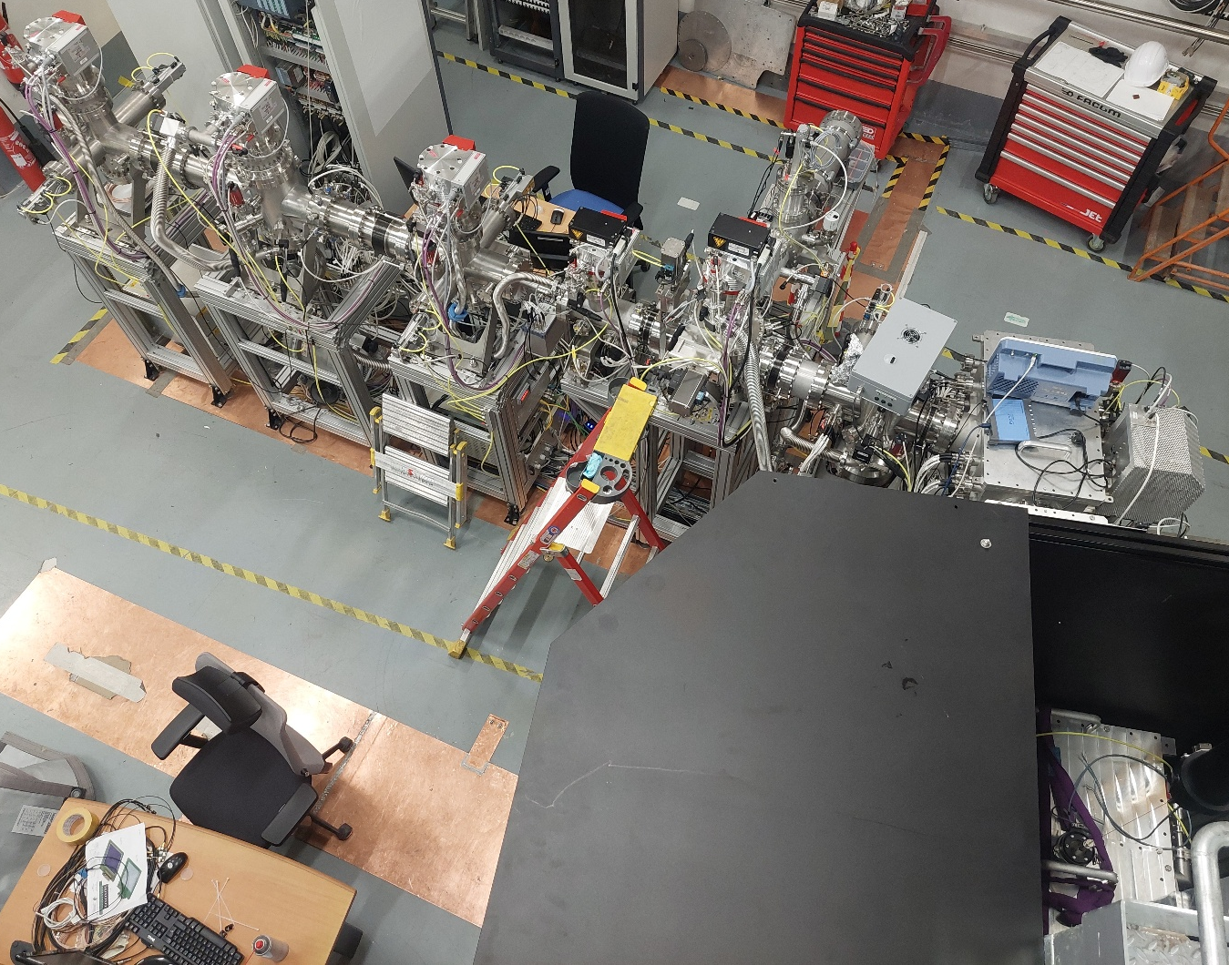

S³-LEB Overview
Notes:
Here, you have 2 pictures of the setup.

Slide 37

GISELE Laboratory

Slide 38

GISELE Laboratory
Lasers systems :
1 Nd:YAG pulsed pump laser (532nm, 60 W)
2 pulsed broadband Ti:sa laser (650-1100 nm, 2W)
1 pulsed narrowband Injection-Locked (ILC) Ti:sa laser (650-1100nm, 2W)
1 Narrowband diode to seed the ILC.
Frequency doubling achieve via BBO/BiBO crystals
  ⇒ $\sim$ 390-450 nm
Notes:
The laboratory is equipped with :
1 Nd:YAG pulsed pump laser
2 pulsed BB Ti:sa laser
1 pulsed Narrowband Injection-Locked Ti:sa laser also called ILC
And 1 Narrowband diode used to seed/constrain the wavelength of the ILC
Most of our transitions require wavelength around 400 nm, so we double the frequency with BBO or BiBO crystals.

Slide 39
GISELE Laboratory
Atomic Beam Unit (ABU) :
Goal : Laser spectroscopy
How ?
  Evaporation of the atomic sample.
  2-steps ionization.
  Accélération via 2 electrodes ⇒ MCP
Notes:
In order to do laser spectroscopy, we have an Atomic Beam Unit.
It heats and evaporate an atomic sample.
Then the gaz is ionized by the lasers and 2 electrodes send the ions towards an MCP.

Slide 40

FRIENDS³ setup IRL
Notes:
Here you have somes pictures of the setup as it is now in GANIL

Slide 41


Wavelength selection theory
Mode position at rest (t) :
  $ν_{x}$ centered.
  Mode position if $∆ν<FSR$ :
    $ν_{x}$ not centered.
    Not ideal but ok !
Notes:
Let’s break down what happens when we change the size of the cavity.
At the beginning the mode that we are going to scan with the OC is centered with the etalon.
Once we start scanning, our mode is going to translate and lose its centering. As long as the scanning is below the FSR the laser is scanned. ==>Next slide
We will start scanning in frequency the cavity, so the length of the cavity will change and the mode will translate along the axis.
In result, the mode nu_x isn’t centered anymore with the etalon gain because the etalon remains untouched.
Not ideal but it still works, the laser is being scanned.
However, if frequency scan is in the order of the FSR which happens in real situation.
We arrive at the following situation => Next slide.

Slide 42


Wavelength selection theory
  Mode position if $∆ν<FSR$ :
    $ν_{x}$ not centered.
    Not ideal but ok !
    Mode position if $∆ν>FSR$ :
      $ν_{x−1}\left(t+1\right)=ν_{x}(t)$
      « Mode Jumps »
Notes:
However, if the scanning is over the FSR value.
The mode that we are scanning isn’t preponderant anymore under the etalon curve.
The wavelength jumps back to the initial value and this sudden change is called a mode jump.
=> Next slide.

Slide 43


Wavelength selection theory
    Mode position if $∆ν>FSR$ :
      $ν_{x−1}\left(t+1\right)=ν_{x}(t)$
      « Mode Jumps »
Notes:
The botton image represent the variation of the wavelength during a scan of the output coupler.
The mode jumps are represented by the vertical lines.
One can note that the scanning amplitude represented in diagonal is equal to the FSR, here 354 MHz.

Slide 44


Wavelength selection theory
    Mode position if $∆ν>FSR$ :
      $ν_{x−1}\left(t+1\right)=ν_{x}(t)$
      « Mode Jumps »
      Solution :
        Translate the gain curve.
          ⇒ Change length of the etalon via piezo.
    Mode position after correction of the etalon :
      $G_{eta}$(t+1) centered with $ν_{x}$(t+1).
      « Etalon locked to the OC »
Notes:
To solve this situation, we need to translate the gain curve of the etalon during the scan.
We are doing this by modifying the etalon length through a piezo.
Theoretically, we should have the gain of the etalon centered at all time on the initial mode.
In this case, we say that the etalon is locked on the OC.

Slide 45


Wavelength selection in practice, 1st step : OC scan
    Locking of the OC, 1st method :
      Simple feedback loop.
      User set $λ_{set}$.
      Labview use its P-loop, $λ_{set}$ & $λ_{real}$ to drive the OC.
Notes:
Now let’s see in practice how wavelength selection is done.
First let’s focus on the wavelength scan with the OC.
Whave a simple feedback loop, where the user set the required wavelength.
Then we substract it to the real wavelength read by the wavemeter over there (shown on image).
Then Labview insert the result in a proportionnal loop and send it to the piezo of the OC. (For simplicity & efficiency mentionning the amplifier isnt relevant)
This way Labview continuously adapt the size of the cavity during the scan to follow the user need.
It is simple & it works.

Slide 46
Wavelength selection in practice, 2nd step : etalon locking
    Etalon locking :
      Laser sampled by photodiode.
      Use of the Dither-locking technique via LaseLock device.
      LaseLock PID loop drive the etalon piezo to bring the error signal at 0.
Notes:
How the etalon locking is done ?
First the laser is sampled by the photodiode over here.
Next slide

Slide 47


Wavelength selection in practice, 2nd step : etalon locking
    Etalon locking :
      Laser sampled by photodiode.
      Use of the Dither-locking technique via LaseLock device.
      LaseLock PID loop drive the etalon piezo to bring the error signal at 0.
Notes:
Then the Dither-locking technique is applied to the piezo of the etalon.
It results in local variation of the amplitude which isn’t obvious to see here.
But once derived this amplitude gives a triangular signal, the LaseLock PID loop will drive the etalon piezo in order to keep this error signal at 0.
Here you have an error signal that we obtained after 3 months of struggling.
It appears that we have a lot of instabilities in our cavities combined with an imperfect etalon, hence why it took us this time.
These factors constrain so much the alignment of the cavity and etalon that it makes the laser very challenging to use and unreliable.
But with this we can continue to the next step.
Next slide

Slide 48

Proof-of concept : Stable Dysprosium spectroscopy
Natural abundances :
156Dy : 0,056 %
158Dy : 0,095 %
160Dy : 2,329 %
161Dy : 18,889 %
162Dy : 25,475 %
163Dy : 24,896 %
164Dy : 28,260 %
Notes:
On the left, you can see the natural abundance of the stable isotopes of Dysprosium.
As you can see, 158Dy et 156Dy are less than 1% which explains to measure them & why the « quality of the data » degrade.
On the right, you have the full frequency spectrum where each color represents an isotope.

Slide 49


Wavelength selection in practice, 1st step : OC scan
    Locking of the OC, 2nd method :
      User set $λ_{set}$.
      Labview use its P-loop, $λ_{set}$ & $λ_{real}$ to drive the FPI length $l_{FPI}(λ_{set})$.
      The FPI drives the OC to maximise its signal.
Notes:
The 2nd method we tried is much more complex to understand and less direct from a technical point of view.
Again the user set the wavelength, it is compared with the real one and processed by the proportionnal loop of Labview.
However in this case, Labview drive a FPI. It is an optical cavity in which a sample of our laser light go through.
If the laser wavelength matches the cavity size then photodiode at the exit of the cavity pick up a signal.
In our case Labview will change the size of the FPI to match the required wavelength using its internal piezo.
The signal read by the photodiode of the FPI will be send to a device called « LaseLock » which will adapt the tension applied to the
cavity piezo and so its wavelength.
The reason we tried 2 different method, is that the perhaps the FPI would be a much more stable & precise device than the wavemeter.

Slide 50
Wavelength selection in practice, 1st step : OC scan
Conclusion :
  Frequency variation below wavemeter relative accuracy (3MHz).
  Easiest OC locking method taken.
Notes:
To characterize the 2 methods, we measured the power and frequency stability.
We set a fixed wavelength into Labview and told it to keep it.
Then we recorded the evolution of the power & wavelength.
For each plot, you have on the top the evolution around the mean value, (shown image left for power & right for wavelength).
On each plot, the blue are the result obtained with the OC locked only to Labview, the first method, the easiest.
The red are the result for the second locking method with the FPI.
What can we conclude from them ?
First, the power variation is in the order of 100 uW which is irrelevant in our case, it wont impact the seeding.
Secondly, the frequency variation is around 1,5 MHz for both cases.
It is a good thing because the relative accuracy of our wavemeter is 3 MHz which means that fluctuations read can be inherited from the wavemeter defects.
And so both method can be considered indentical for our use.
Naturally, we decided to use the 1st method, the easiest.

Slide 51

Wavelength selection in practice, 2nd step : etalon locking
    Etalon locking :
      Laser sampled by photodiode.
      Use of the Dither-locking technique via LaseLock device.
      LaseLock PID loop drive the etalon piezo to bring the error signal at 0.
V. Sonnenschein et al., Hyp. Inter., 241 (2020)
Notes:
Then the Dither-locking technique is applied to the piezo of the etalon.
It results in local variation of the amplitude as you can see on the picture from an article of Dr. Sonnenschein.
Once derived this amplitude gives a triangular signal, the LaseLock PID loop will drive the etalon piezo in order to keep this error signal at 0.
Next slide

Slide 52
Proof-of concept : Stable Dysprosium spectroscopy
48 343,96 cm⁻¹
A.I
47 900,5 cm⁻¹
    Improvments to be made :
    BRF continuous tuning.
    Etalon stabilty.
    Multimoding.
    ⇒ CW Ti:sa is unreliable, its use is time consuming. Nevertheless, several measurements were performed.
408,727 nm, 24 466,221 cm⁻¹
23 877,739 cm⁻¹
418,7 nm
0 cm⁻¹
Notes:
Now that our narrowband scannable laser is ready, we can do some laser spectroscopy as a proof-of concept.
We choose to do it on stable Dysprosium, we knew it was easy and the parameters of the ABU were know from a previous experiment done in GISELE.
We set the CW to 418,8 nm which is the transition that we are probing and one broadband laser to 408 nm to reach a know Autoionizing state.
We had & still have some setbacks, the BRF jumps from several 10th of nm, which is huge.
The etalon alignment is complicated and its use to scan a nightmare due to several etalon effects in the cavity.
To conclude, the CW is unreliable, its use time consuming.
We manage after 1 or 2 weeks to set it at the correct range and do scans for a week, but after that time, it detuned itself outside of the operating range.

Slide 53

Proof-of concept : Stable Dysprosium spectroscopy
PRELIMINARY RESULTS
Notes:
In the following slides, I will present the preliminary result.
This plot represents a Time of Flight spectrum (ToF spectrum) for a scan obtained by the laser spectroscopy of the stable Dysprosium.
You have on the y-axis the number of counts & on the x-axis the time in arbitrary unit.
In the best case, we are able to detect 7 isotopes.
As you can see, the mass separation in our ABU is not perfect and doesn’t allow to fully exploit the statistics
because we will have to cut the data to remove as much as possible the presence of contaminants.

Slide 54


Proof-of concept : Stable Dysprosium spectroscopy
    Isotope shift :
    $∆ν_{i}^{A^{′},164}=ν_{i}^{A′}−ν_{i}^{164}$
    $\overline{∆ν_{WA}^{A^{′},164}}=σ^{2}\left(∆ν_{WA}^{A^{′},164}\right)\sum_{i}^{n}{\frac{∆ν_{i}^{A^{′},164}}{σ^{2}\left(∆ν_{i}^{A^{′},164}\right)}}$
    $σ^{2}\left(∆ν_{WA}^{A^{′},164}\right)=\frac{1}{\sum_{i}^{n}{1/σ^{2}\left(∆ν_{i}^{A^{′},164}\right)}}$
PRELIMINARY RESULTS
Notes:
Show equation : For the evaluation of the isotope shift, we are computing them with respect to 164Dy, its a choice done bcz it is the most abundant.
During the experiment, we are doing several scans, so in order to have one single reference value for each isotope pair,
we can compute a weighted average Isotope shift which takes into account the Isotope shift of each scans and their respective standard deviations.
These are preliminary results but they seem reliable, we can see that the data errorbars are always within the weigthed average value or its errorbar.

