Slide 1
Ion bunching optimization in S³-LEB and commissioning of the new quadrupole bender
Maylis Brun
PhD supervisor :
Antoine de Roubin
Outline :
Status of S³-LEB
Ion bunching optmization
Commmissioning of the new quadrupole bender
Perspectives

Slide 2
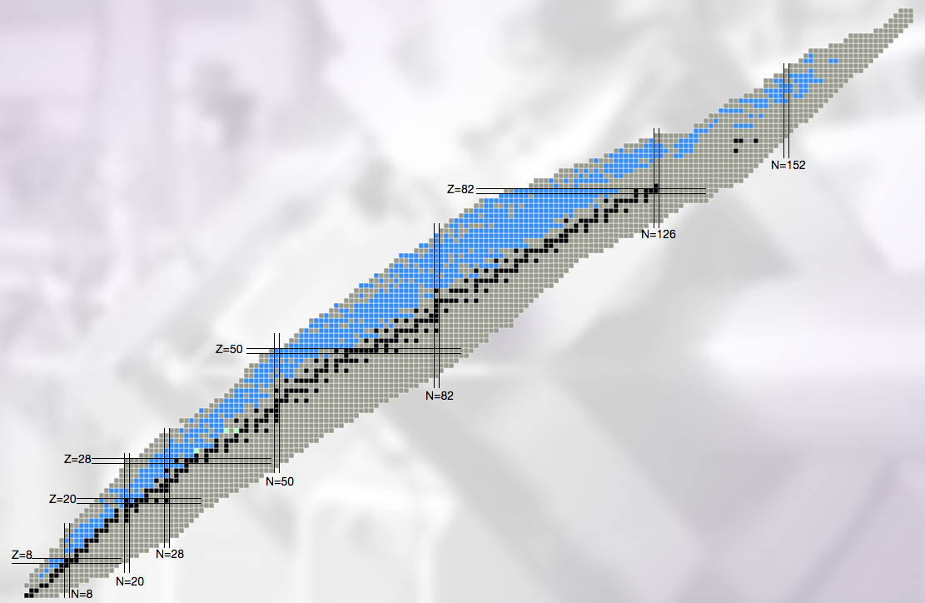
S³-LEB commissioning perspectives
Heavy neutron-deficient refractory element region
Shape-coexistence
High-spin isomers
N = 82 shell closure
Exotic decay modes
Heavy (and Super Heavy) element region
Single-particle vs deformation
Octupole deformation
SHE structure (Fm, No, Lr)
Close to the N=Z line
N=Z / Symmetries
Shell evolution
Nucleosynthesis
http://u.ganil-spiral2.eu/chartbeams/
Notes:
The S3-LEB setup will be dedicated to performing laser spectroscopy, mass spectrometry and decay spectroscopy to address different topics of nuclear structure and astrophysics, as can be shown on this slide

Slide 3
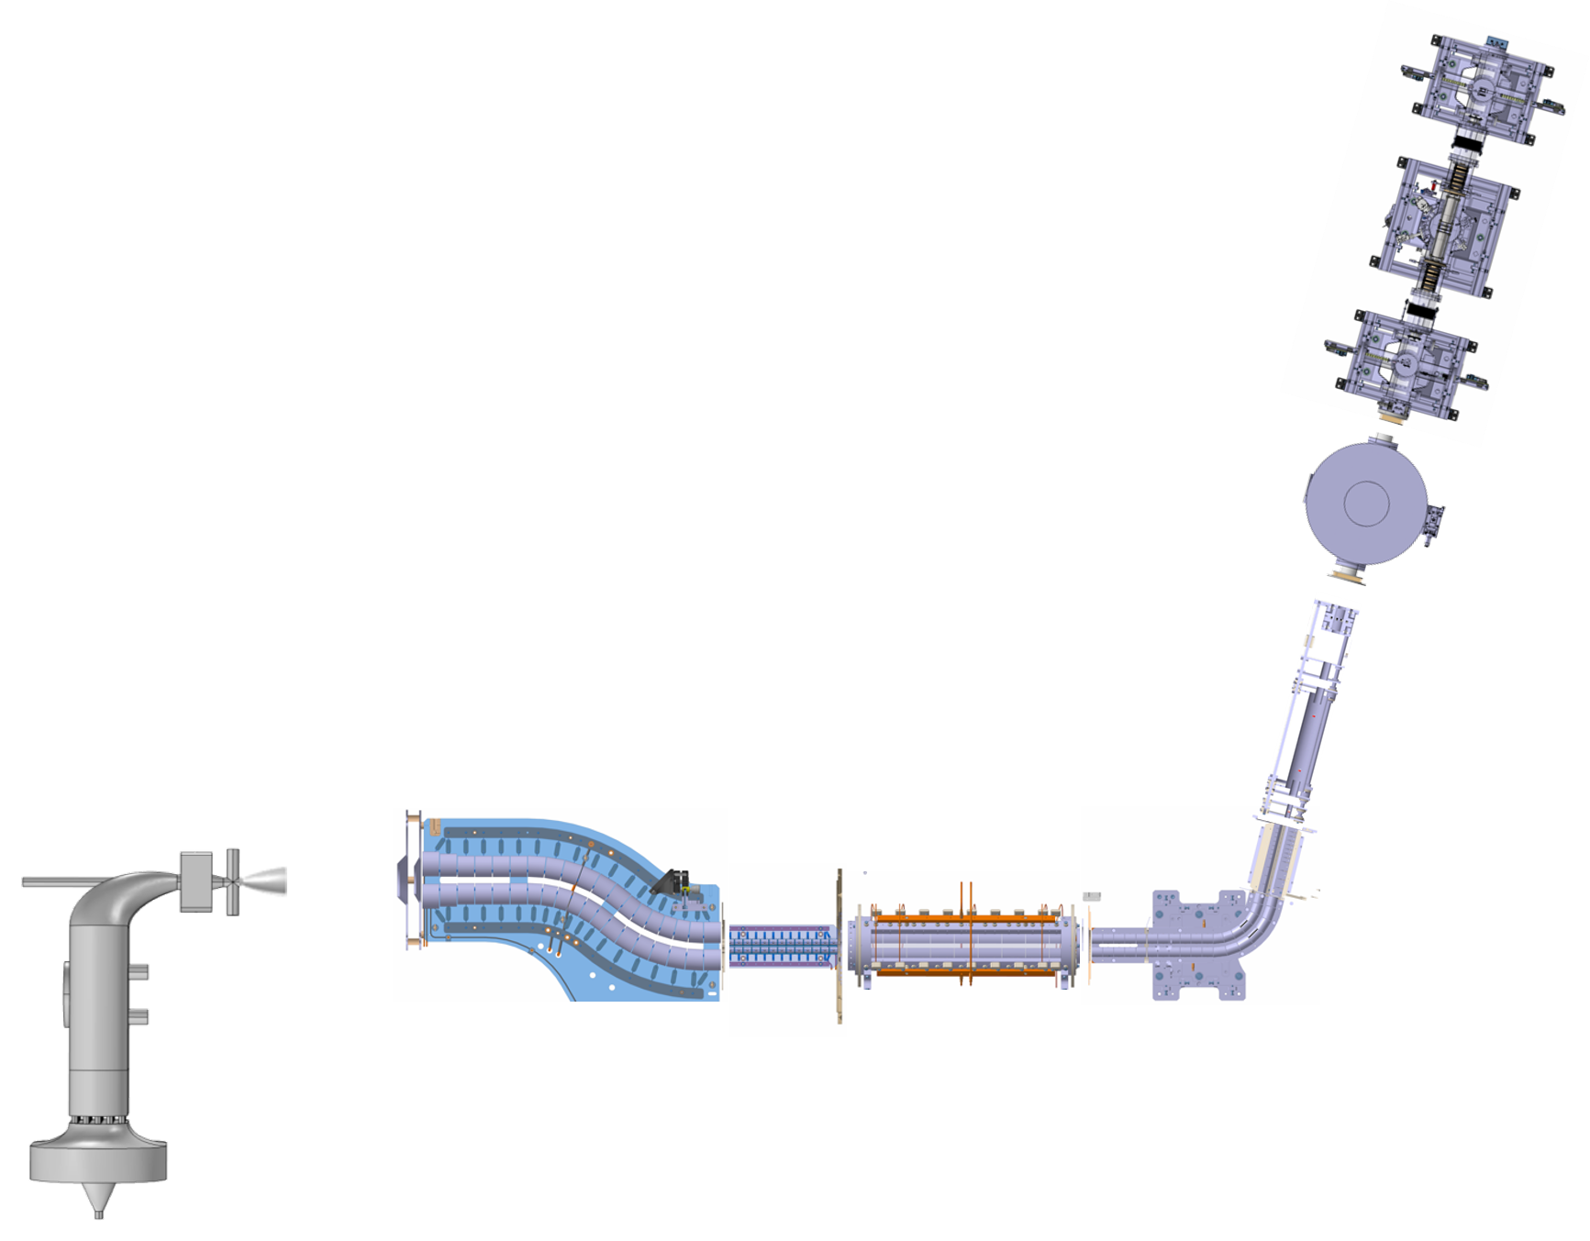


S³-LEB description
PILGRIM
(MR-TOF-MS)
E
A : Gaz cell to neutralize and thermalize ions coming from S³
B : Radio frequency quadrupole (RFQ) chain that guide the ions, purify and prepare the beam
C : Pulse up, to speed up ions
D : Quadrupole bender, to deliver ions to different experiments
D
To SEASON
Deflector / quadrupole bender
C
E : PILGRIM : electrostatic ion trap for high resolution mass spectrometry
$$λ_{1}$$
B
$$λ_{2}$$
MCP1
MCP2
MCP3 + Camera
A
Exotic ions coming from S³
Pulse-up
Gas cell
S-RFQ
Mini-RFQ
QMF
Cooler-buncher
Schéma de S³-LEB

Slide 4
S³-LEB
PILGRIM
(MR-TOF-MS)
E
A : Gaz cell to neutralize and thermalize ions coming from S³
B : Radio frequency quadrupole (RFQ) chain that guide the ions, purify and prepare the beam
C : Pulse up, to speed up ions
D : Quadrupole bender, to deliver ions to different experiments
D
To SEASON
Deflector / quadrupole bender
C
E : PILGRIM : electrostatic ion trap for high resolution mass spectrometry
$$λ_{1}$$
B
$$λ_{2}$$
MCP1
MCP2
MCP3 + Camera
A
Exotic ions coming from S³
Pulse-up
Gas cell
S-RFQ
Mini-RFQ
QMF
Cooler-buncher
Schéma de S³-LEB

Slide 5
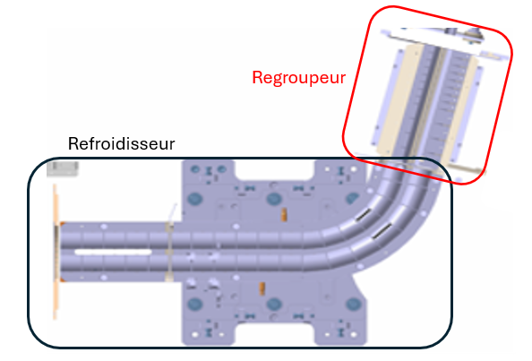
Cooler-buncher RFQ
Pulse up
Cooler thermalize ions with buffer gas injection (Helium)
Helium (gas)
Cooler
Buncher
S³-LEB cooler buncher
Notes:
Le test 1 s’intéresse à la mise en paquet des ions que je présente plus en détails
Thermalise : met à température de l’hélium (équilibre thermodynamique) – collisions inélastiques
Pourquoi en deux étapes : pilgrim très sensible au gaz donc on peut pas le mettre au niveau du regroupeur (pour que le gaz fuite tôt pour garder un gaz de bonne qualité)

Slide 6
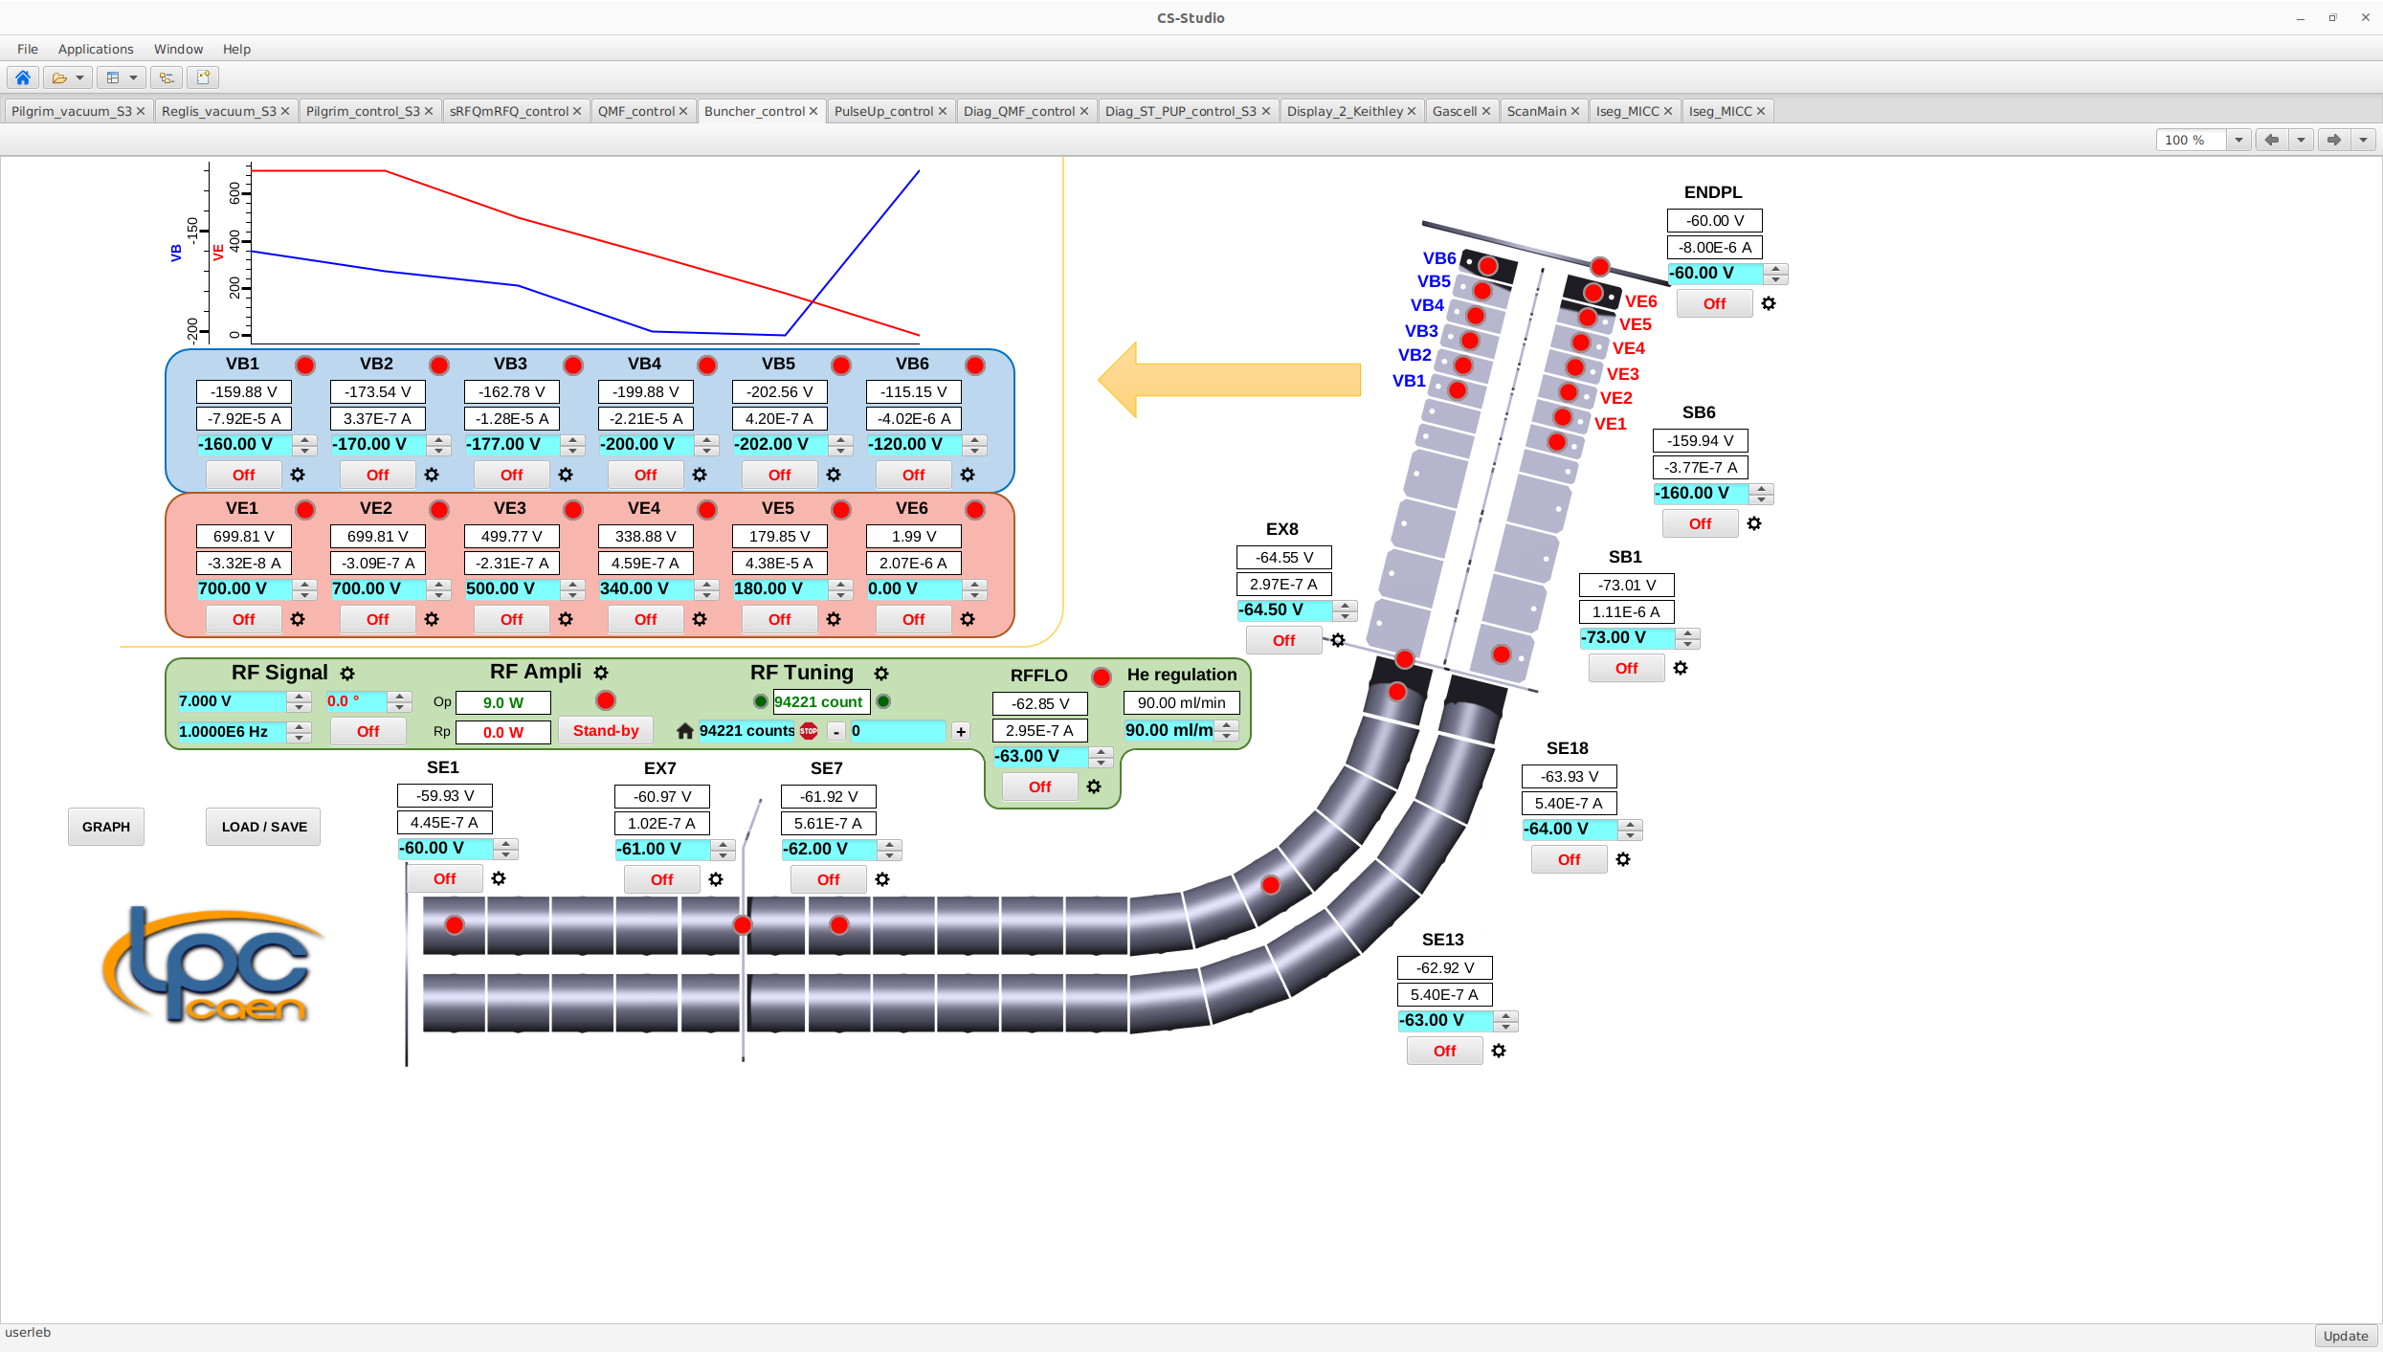
Cooler-buncher RFQ
Pulse up
Cooler : thermalize ions with buffer gas injection (Helium)
Buncher : creates bunches in potentiel well
ToF dispersion : ToF FWHM
Helium (gas)
Cooler
Buncher
Potentiels applied to the buncher
Buncher electrodes
S³-LEB cooler buncher

Slide 7
Cooler-buncher RFQ
Pulse up
Cooler : thermalize ions with buffer gas injection (Helium)
Buncher : creates bunches in potentiel well
ToF dispersion : ToF FWHM
Helium (gas)
Cooler
Buncher
Potentiels applied to the buncher
Buncher electrodes
S³-LEB cooler buncher
Notes:
Dispersions of the bunch at different points of the line

Slide 8

Motivation : PILGRIM’s resolving power
 | PILGRIM’s optimal dispersions values [1] | Simulated results [1] | Experimental results [2]
Time-of-flight dispersion (ns) | 50 | 64 | 157(6)
Energy dispersion (eV) | 15-20 | 42 | 13(1)
Resolving power for PILGRIM | 300 000 | ≈230 000 | ~80 000
$$R=\frac{T}{2Δt}$$
Table of time and energy dispersions for S³-LEB bunches
[1] :HAL Id: tel-01469429, https://in2p3.hal.science/tel-01469429v1
[2] : HAL Id: tel-04483471, https://theses.hal.science/tel-04483471v1
Notes:
Dispersion attendue autour de 100 ns (entre simulation et exp préc),
PILGRIM encore + compétitif
Autres : ISOLTRAP 300 k

Slide 9


Ion bunching optimization
PILGRIM
(MR-TOF-MS)
$$λ_{1}$$
$$λ_{2}$$
Helium
MCP3
Buncher
Cooler
Trapping zones in S³-LEB

Slide 10
Ion bunching optimization
PILGRIM
(MR-TOF-MS)
Proposition
Pre bunching before the buncher
Why ? : identical time spent in the buncher and no more continuous composante of the beam through the buncher when open
Mesurements for different duty cycle duration
$$λ_{1}$$
$$λ_{2}$$
Helium
MCP3
Buncher
Cooler
Trapping zones in S³-LEB

Slide 11
Ion bunching optimization
PILGRIM
(MR-TOF-MS)
Proposition
Pre bunching before the buncher
Why ? : identical time spent in the buncher and no more continuous composante of the beam through the buncher when open
Mesurements for different duty cycle duration
$$λ_{1}$$
$$λ_{2}$$
Helium
MCP3
Buncher
Cooler
Trapping zones in S³-LEB

Slide 12
Ion bunching optimization
PILGRIM
(MR-TOF-MS)
Proposition
Pre bunching before the buncher
Why ? : identical time spent in the buncher and no more continuous composante of the beam through the buncher when open
Mesurements for different cycle duration
$$λ_{1}$$
$$λ_{2}$$
Helium
MCP3
Buncher
Cooler
Trapping zones in S³-LEB

Slide 13
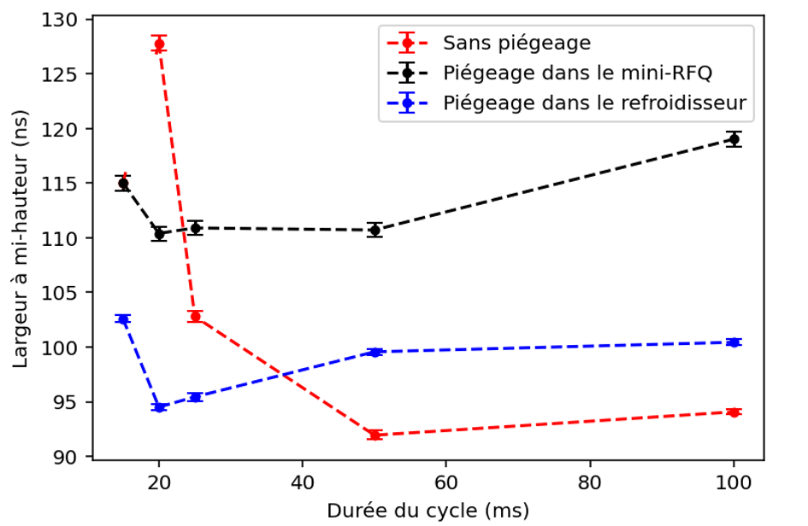
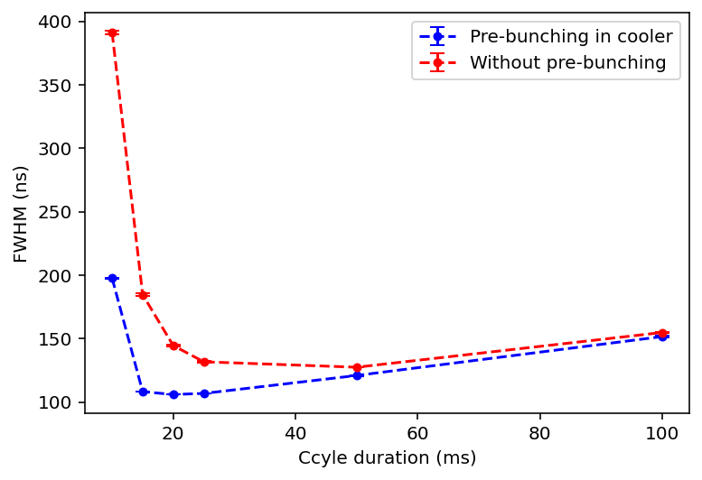
Results : ToF dispersion
FWHM with cycle duration
Comparison of the different trapping methods
Without pre bunching : Time-of-flight dispersion decrease with cycle duration
Pre bunching in cooler : lower fwhm average : longer cooling with gas : ions are better prepared to be bunched
No pre bunching
Pre bunching in MRFQ
Pre bunching in cooler
ToF FWHM (ns)
Cycle duration (ms)

Slide 14
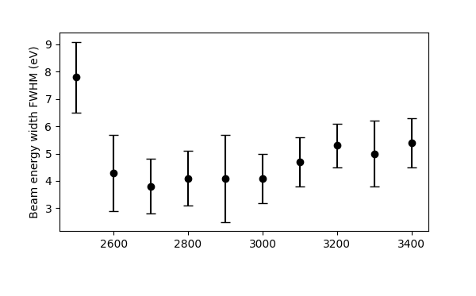
Results : Energy dispersion
Evolution of the energy FWHM with the ions’ energy
Comparison of the energy FWHM for different bunches energy.
Energy of the ions (V)
Skyy Pineda analysis

Slide 15
Results
50 ms cycle duration
 | PILGRIM’s optimal dispersions values [1] | Simulated results [1] | Experimental results [2] | Pre bunching results
Time dispersion (ns) | 50 | 64 | 157(6) | 124,1(0,29)
Energy dispersion (eV) | 15-20 | 42 | 13(1) | 4(1)
Resolving power for mass measurements | 300 000 | ≈230 000 | ~80 000 | ≈120 000
Table of time and energy dispersions for S³-LEB bunches
Notes:
Gagne peu en temps de vol à 50 ms mais plus en énergie

Slide 16
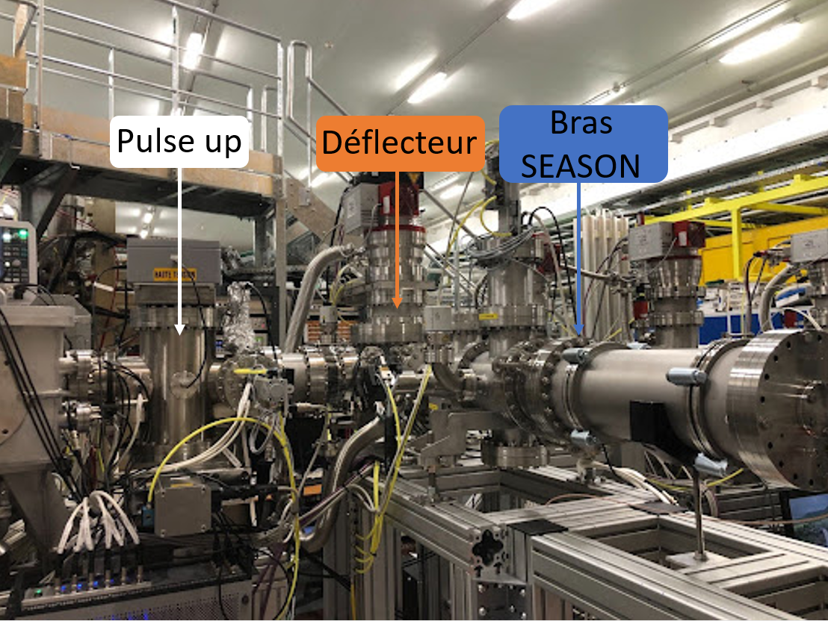
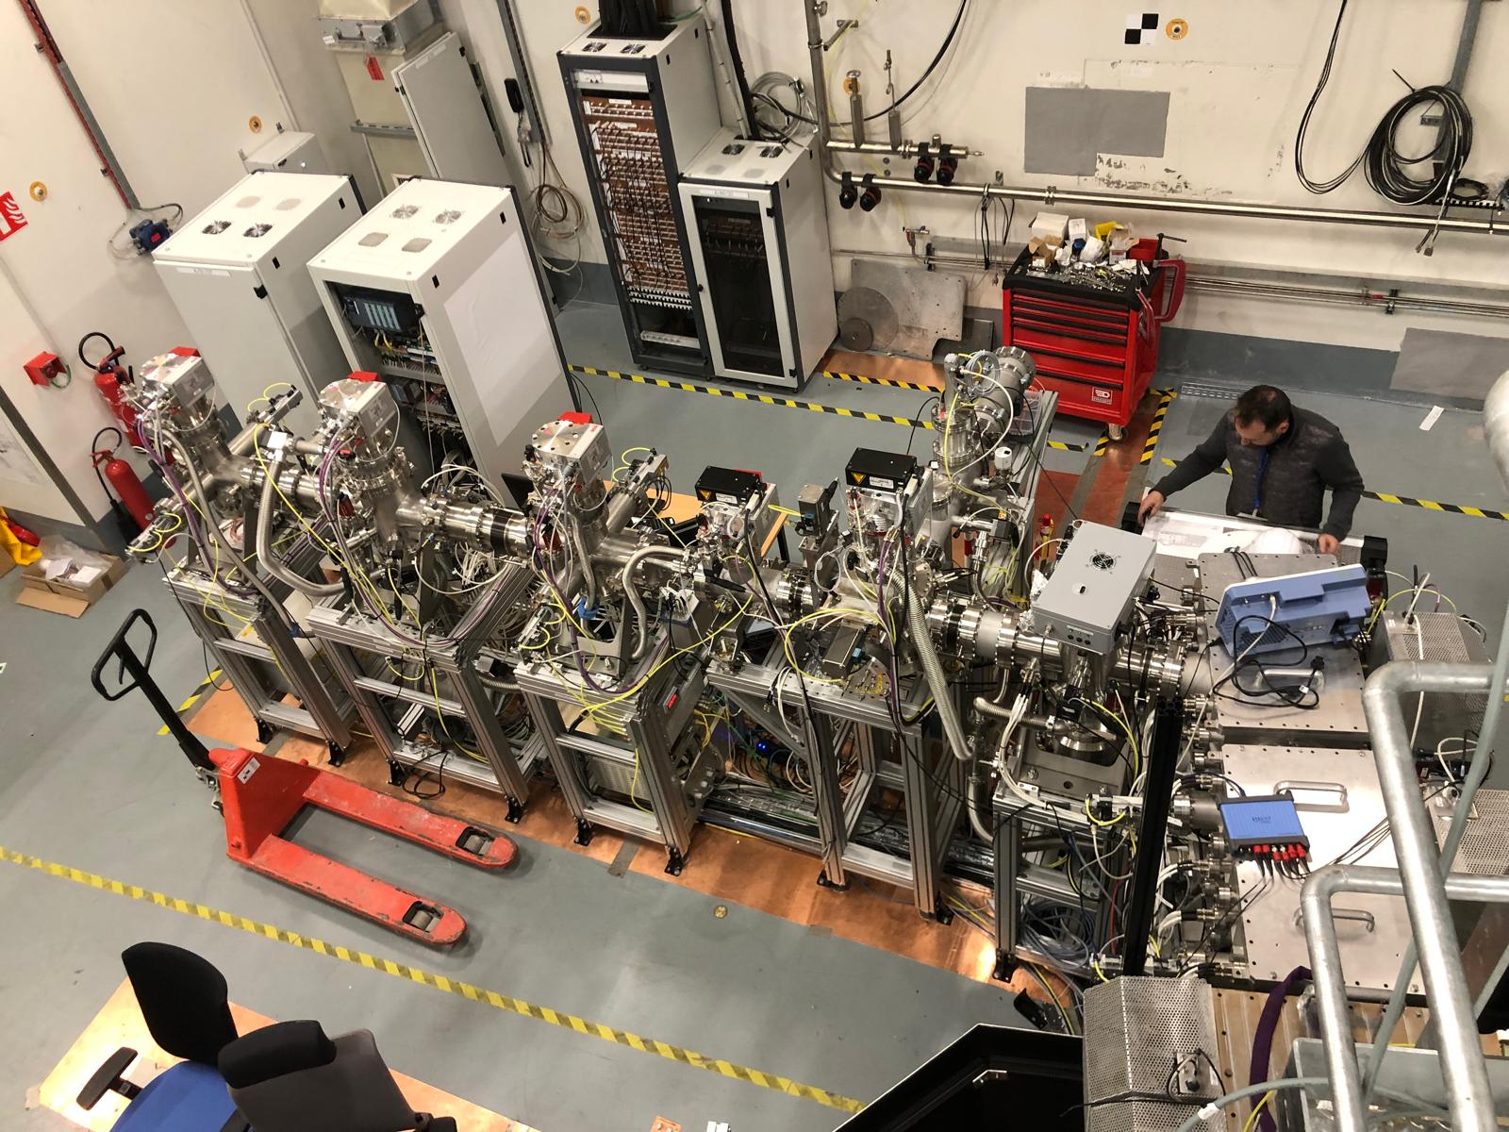
Quadrupole bender (deflector) installation
SEASON Arm
Quadrupole bender
SEASON Arm
Quadrupole bender
Pictures of the quadrupole bender installed in S3-LEB beam line

Slide 17
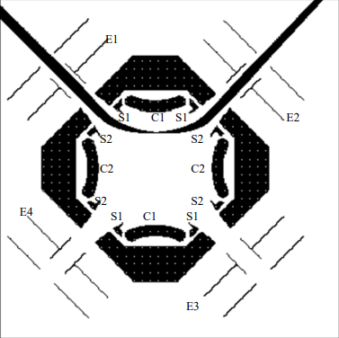
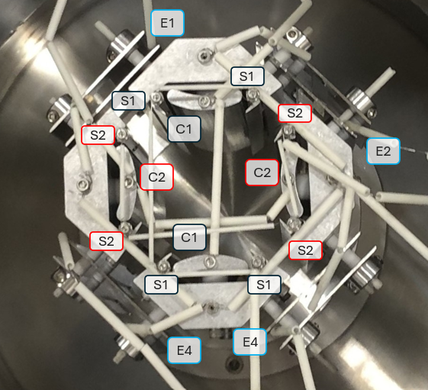
Quadrupole bender current design
Arm SEASON
Deflector
Representation of the deflector, Beam Imaging Solutions, Instructions _ Quadrupole deflector

Slide 18
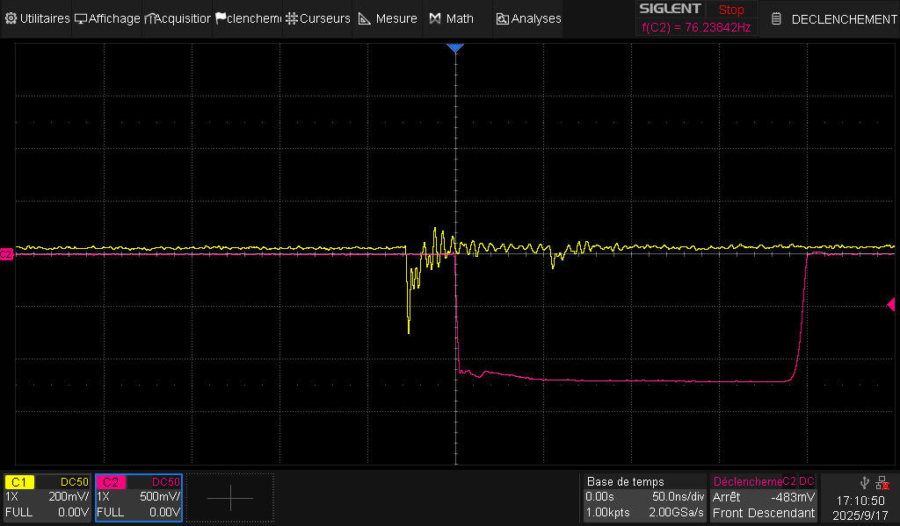
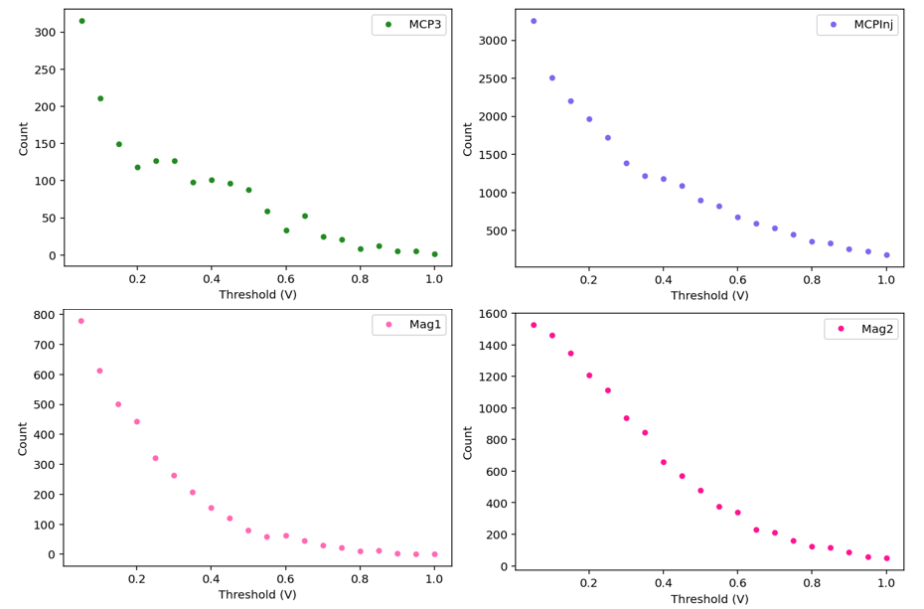
Transmission efficiency measurement
Installation of discriminators on MCP1 and MCP2
Installation of new *40 amplifiers for all detectors
Setting of the acquisition threshold at 0,2V for all detectors
Notes:
Discriminators : prevent double counting in continuous beam without reducing the resolution (not bunched). It was installed carrefully to suppress noise from the count (trigger outside the noise)
*40 amplifiers to reduce the ion count on the acquisition system
200 threshold : no obvious plateau in the curve presented so it was set according to was was seen on the oscilloscope and previous experience with the detectors.

Slide 19

Transmission efficiency measurement
50%
PILGRIM
(MR-TOF-MS)
MagneToF Pil
81%
MCP injection
100%
MCP3
1
2
100%
MagneToFs SEASON
$$λ_{1}$$
$$λ_{2}$$
70%
MCP1
MCP2
Buncher
Cooler
Mini-RFQ
Notes:
Qualitative / relative estimation of transmission efficiency : study with radioactive source to be done later in the year.

Slide 20
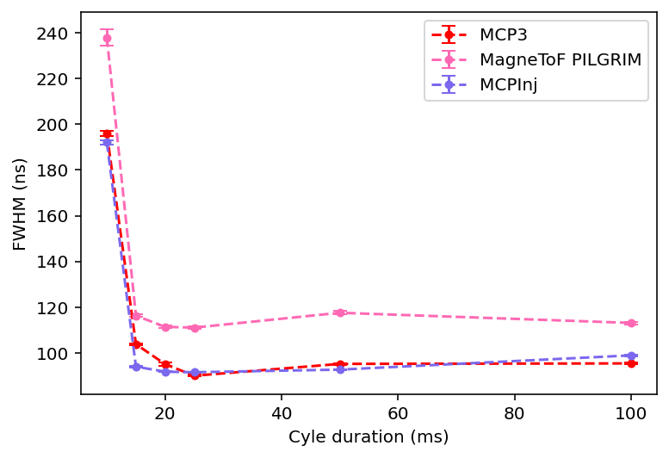
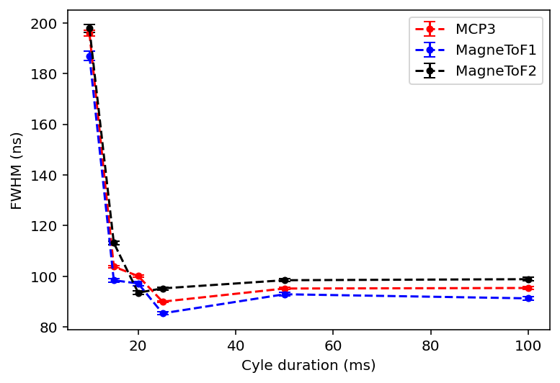


Bender’s influence on ToF FWHM
Going straight to PILGRIM
Bending towards SEASON
ToF
ToF
Cycle duration (ms)
Notes:
No bunch deformation for ToF (can measure energy)
FWHM wider after pilgrim

Slide 21
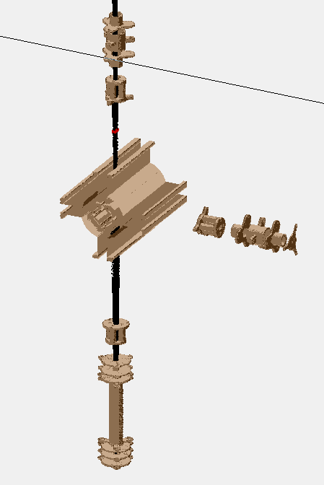
Perspectives
Working towards the real transmission efficiency
Buid a complete SIMION simulation of S3-LEB
Confirm the bender’s design

Slide 22
Thank you for your attention

Slide 23
Appendices

Slide 24
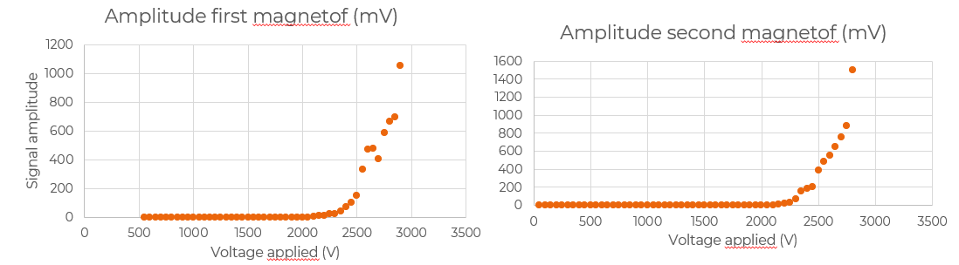
Appendice 1 Detectors installation

Slide 25
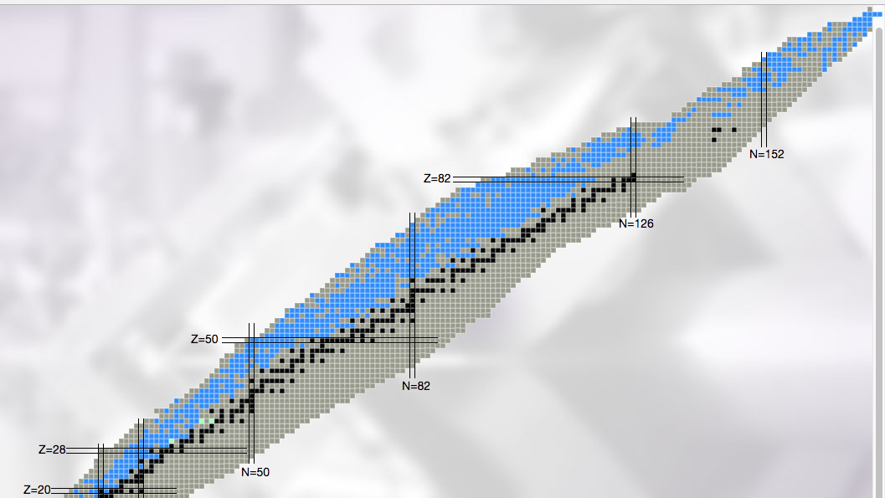
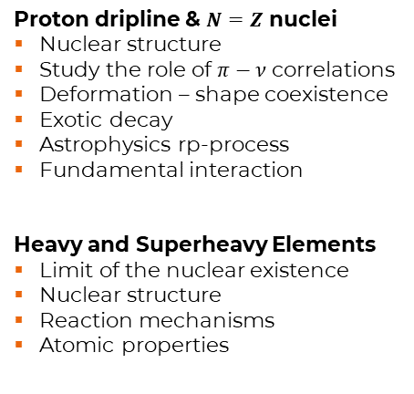

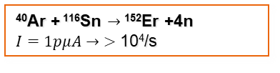


S³ – Super Separator Spectrometer
Proton dripline & $N=Z$ nuclei
Nuclear structure
Study the role of $π−ν$ correlations
Deformation – shape coexistence
Exotic decay
Astrophysics rp-process
Fundamental interaction
Heavy and Superheavy Elements
Limit of the nuclear existence
Nuclear structure
Reaction mechanisms
Atomic properties
Fusion-evaporation products
(with refractory elements)
⁴⁰Ar+²⁰⁹Bi→²⁴⁴⁻²⁴⁷Md+xn
$I=1pμA→$4evt/day (²⁴⁴Md)
²⁰Ne+¹⁹⁷Au $→$²¹⁰Ac + 7n
$I=1pμA→ >$ 200/s
⁴⁰Ar + ¹¹⁶Sn $→$¹⁵²Er +4n
$I=1pμA→ >$ 10⁴/s
⁵⁸Ni+⁵⁰Cr $→$¹⁰⁰Sn + 𝛂 + 4n
$I=1pμA→$1/s
Courtesy H. Savajols
http://u.ganil-spiral2.eu/chartbeams/

Slide 26
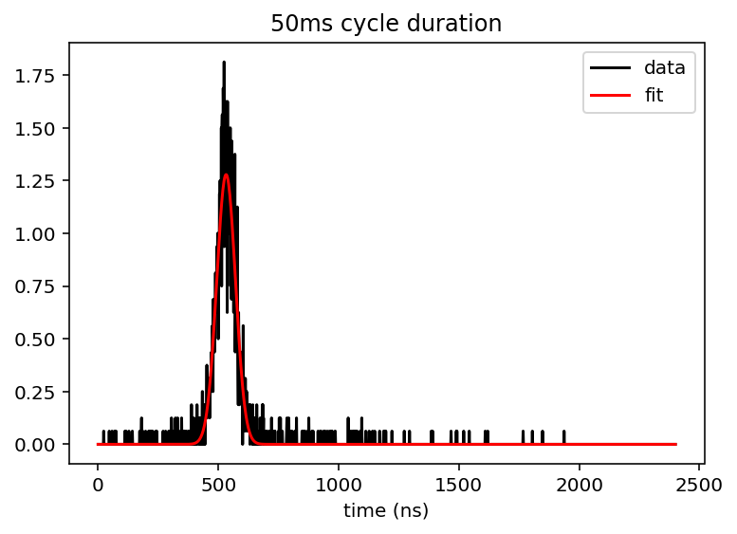
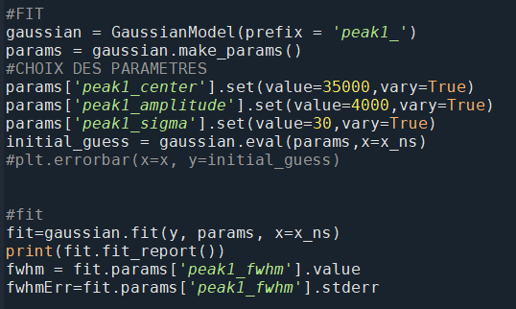
Annexe 4 Fit de données sur python

Slide 27
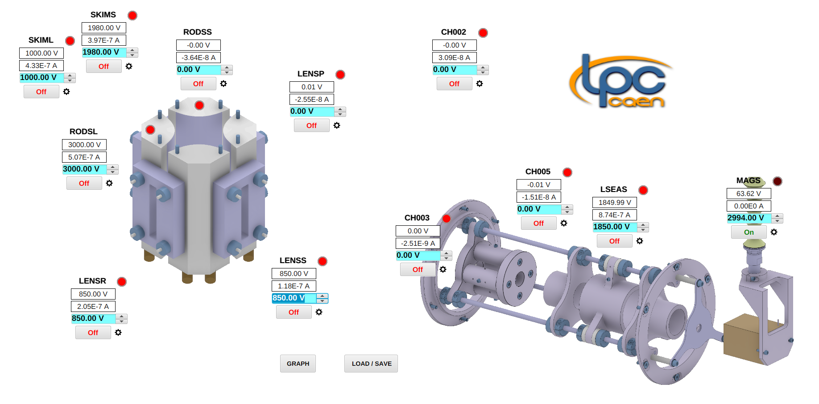
Annexe 6 Interface EPICS

Slide 28
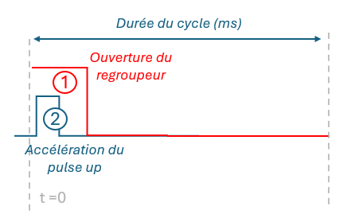
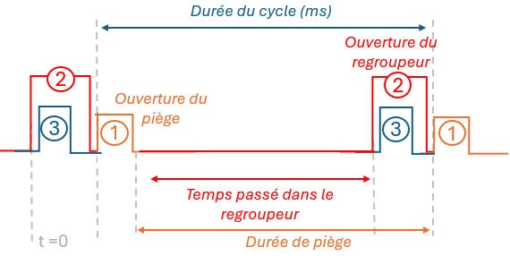
Bunching cycle optimization
Animation
Without trapping
With trapping
Cycle duration (ms)
Cycle duration (ms)
Buncher opening
Buncher opening
Trap opening
Pulse up acceleration
Time spent in the buncher
S³-LEB duty cycle illustrated without trapping
Trapping duration
S³-LEB duty cycle illustrated with trapping

