Slide 1
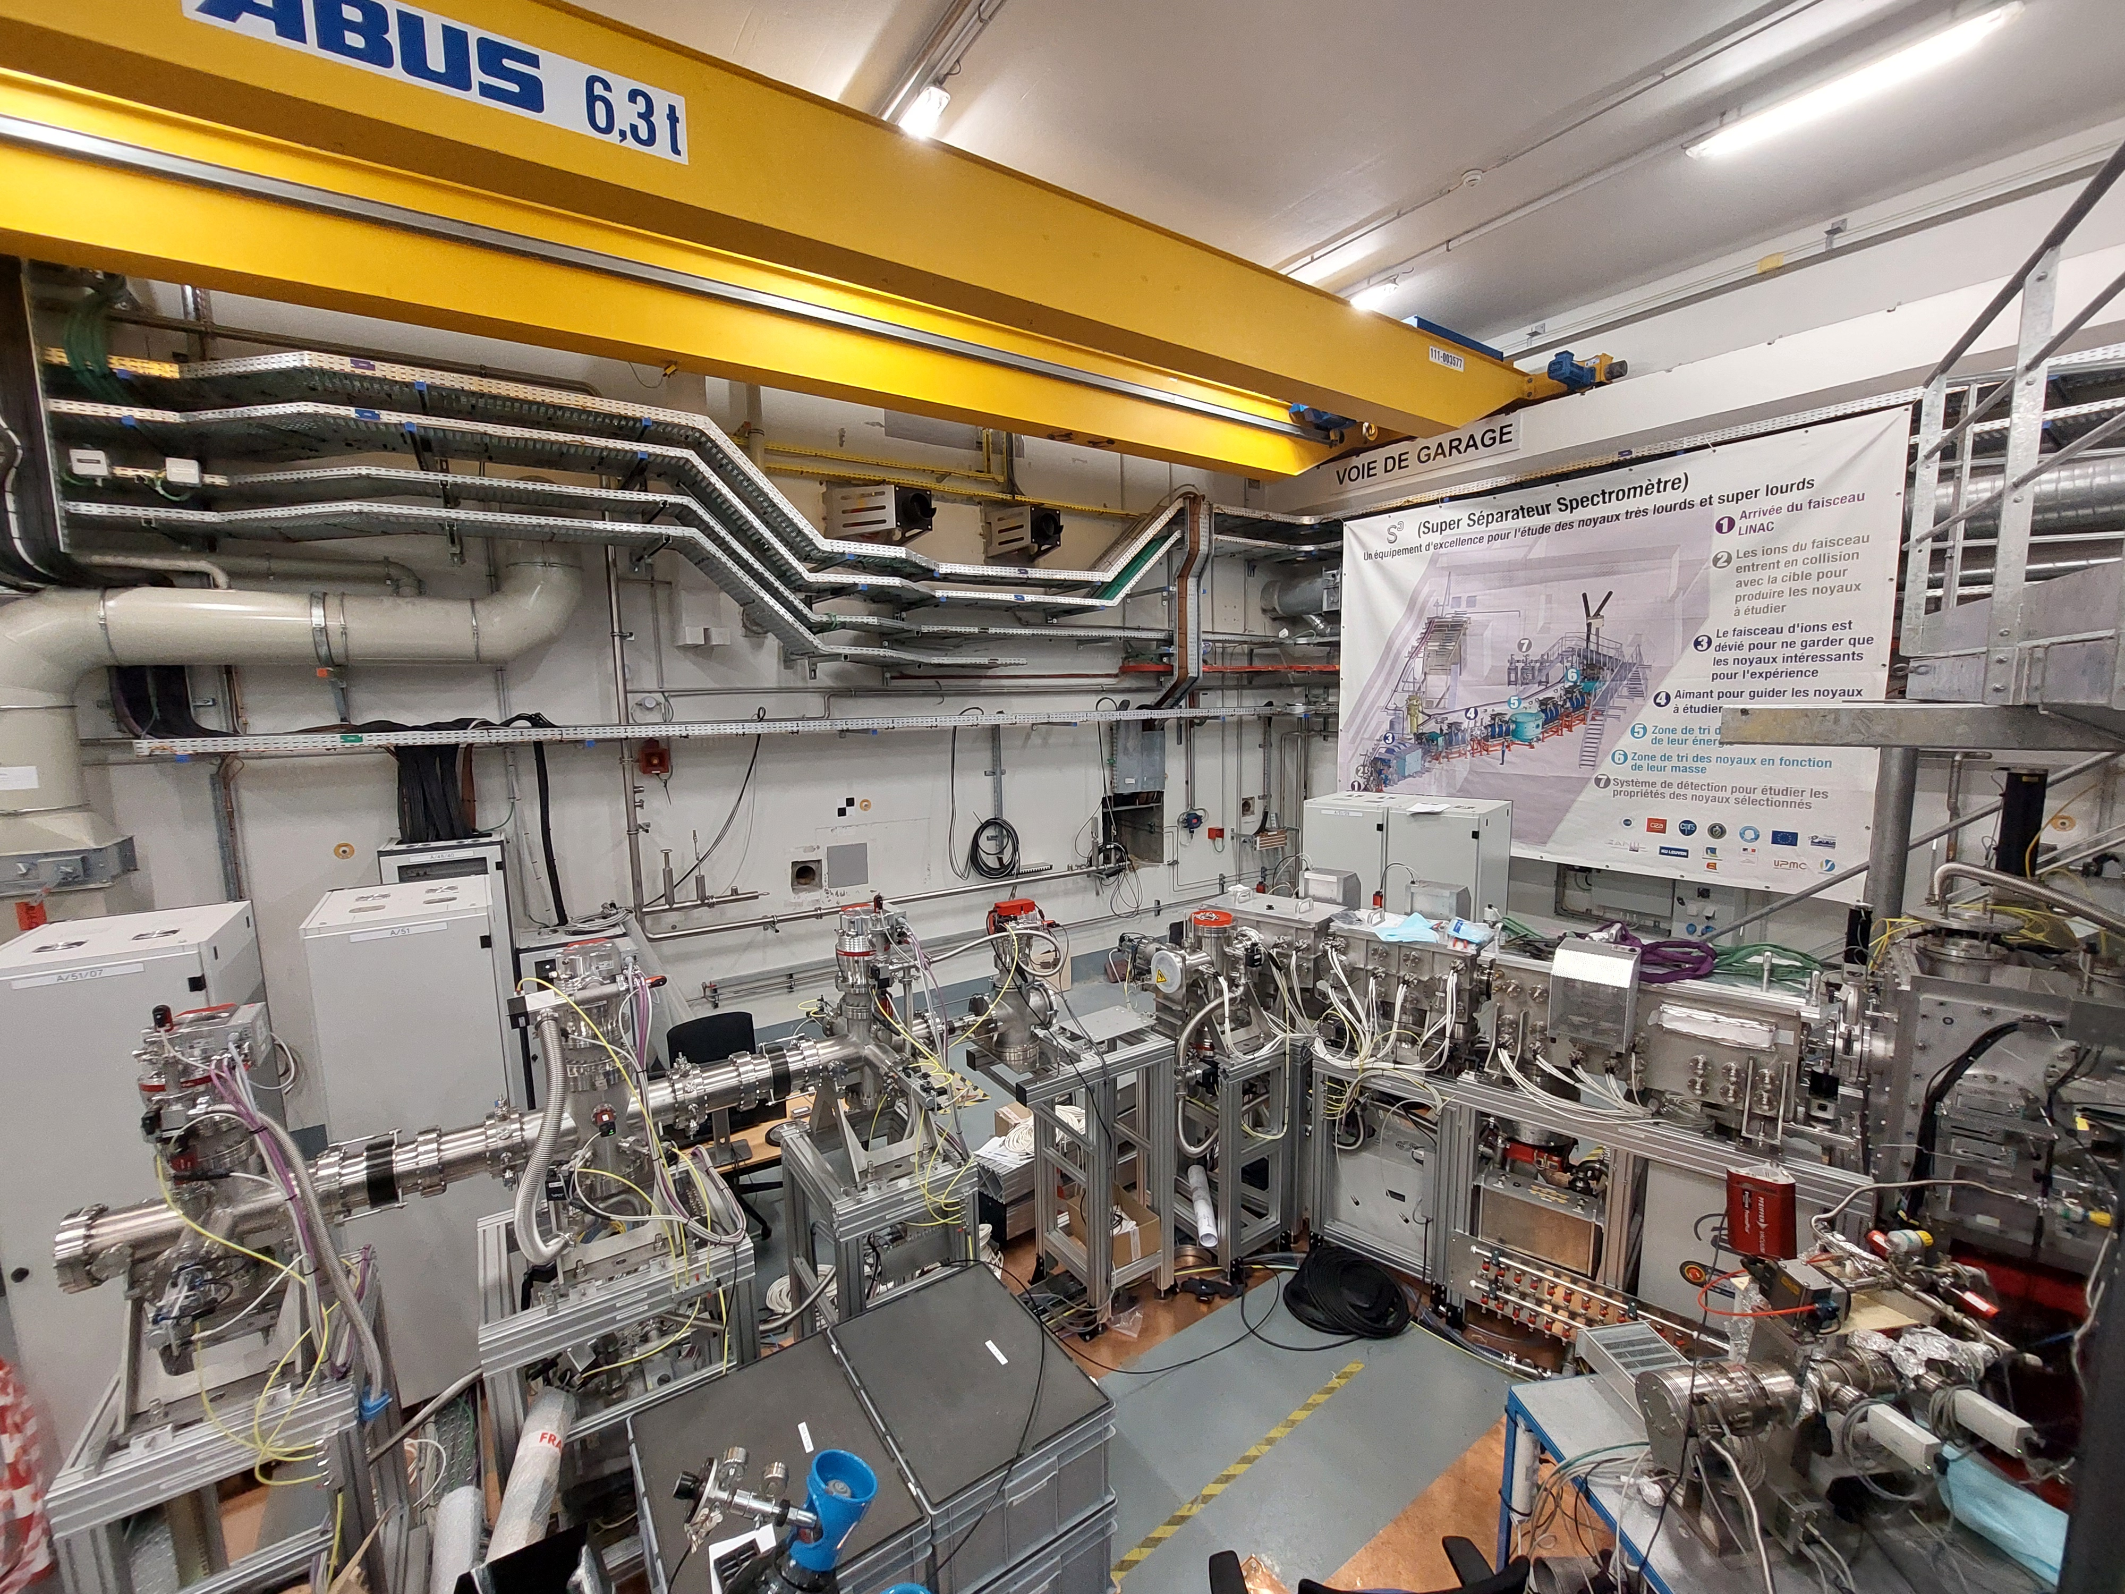

News about GISELE lab
and PILGRIM mass spectrometer
Andres Lopez

Slide 2
Content
Resonance Ionization Spectroscopy (RIS)
Dy studies at GISELE lab
MR-TOF-MS: PILGRIM commissioning

Slide 3
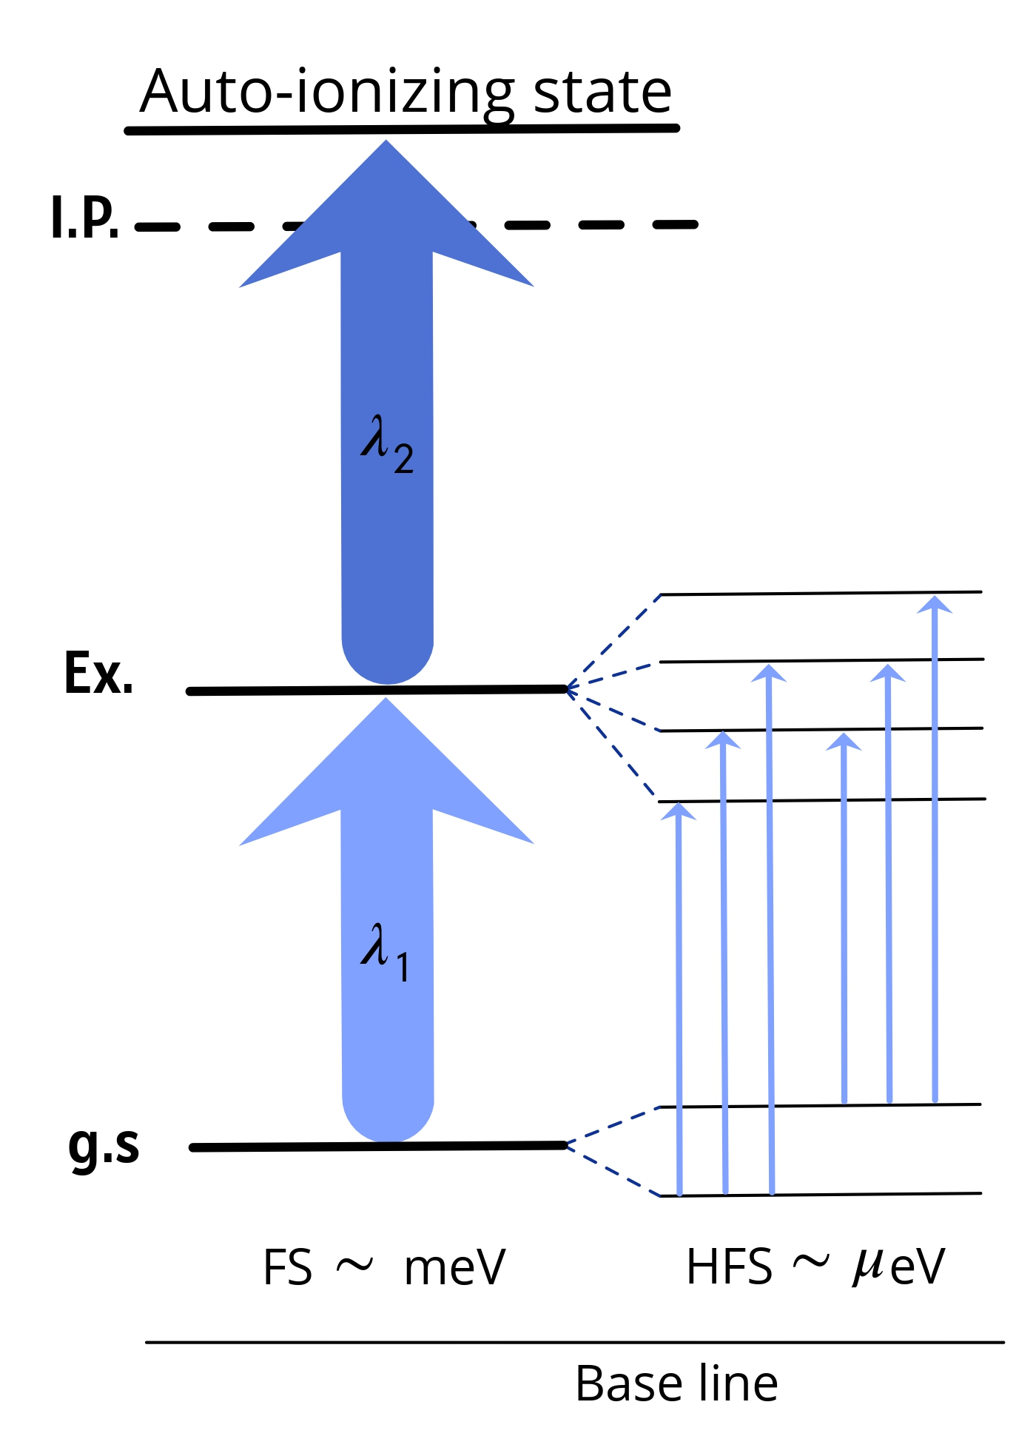
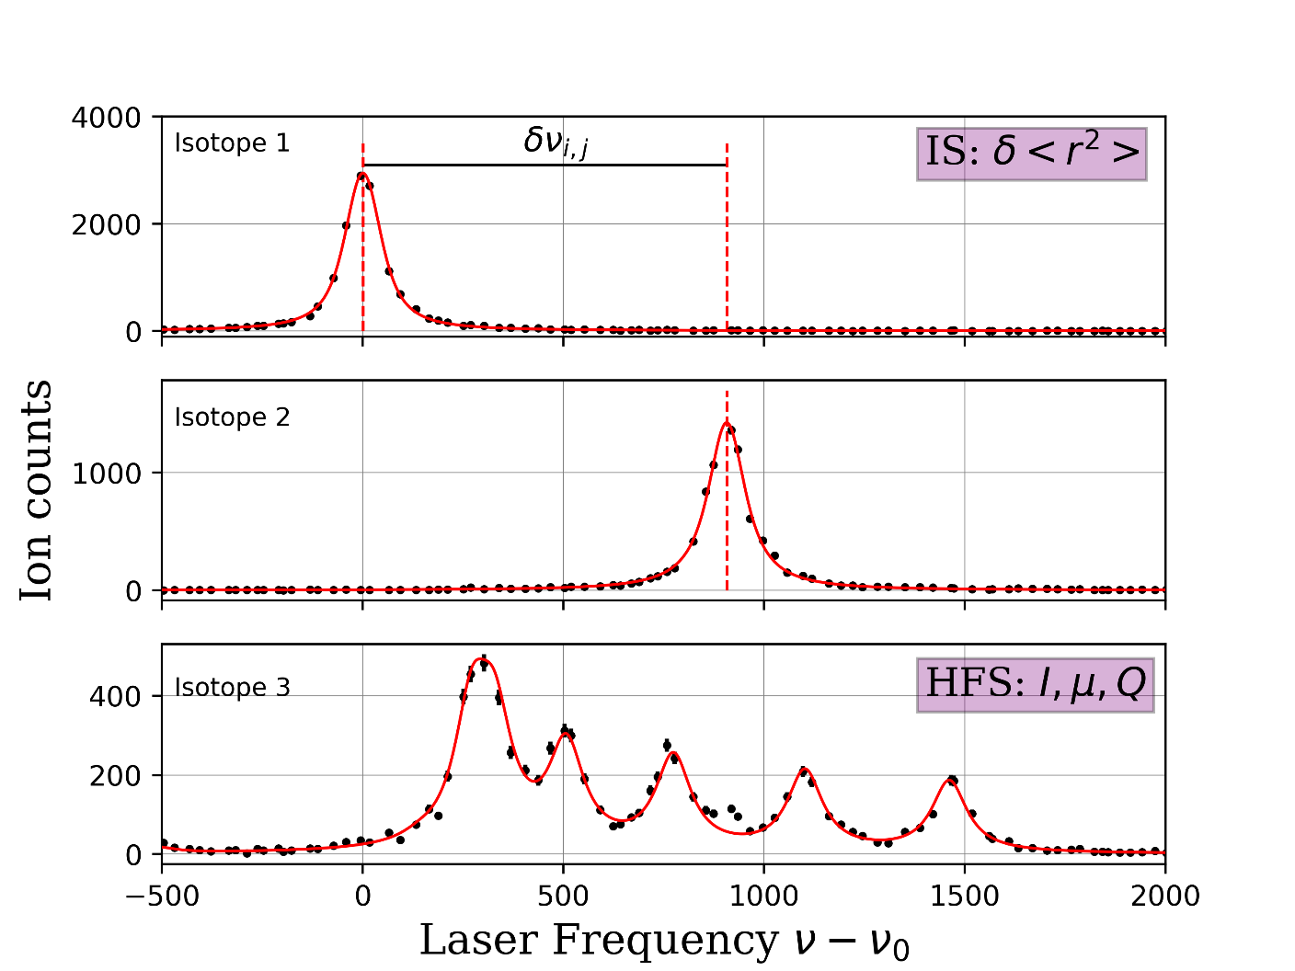


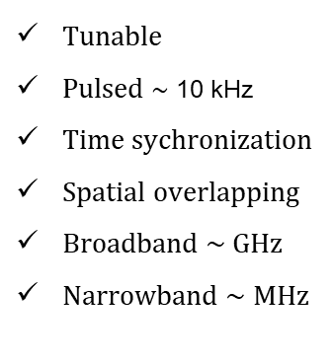


Tunable
Pulsed $∼$ 10 kHz
Time sychronization
Spatial overlapping
Broadband $\sim$ GHz
Narrowband $\sim$ MHz
λ₂
λ₁
$$I,δ\left\langle r^{2}\right\rangle ,μ_{I},Q$$
$$δν_{i}^{A,A^{′}}=F_{i}λ\left(δ\left\langle r^{2}\right\rangle \right)+\frac{m^{A}{−m}^{A^{′}}}{m^{A}m^{A^{′}}}M_{i}$$
$$A=\frac{μ_{I}B_{j}(0)}{|\vec{J}||\vec{I}|}$$
$$B=eQ{\left(\frac{∂^{2}V_{ext}}{∂z^{2}}\right)}_{z=0}$$
[MHz]

Slide 4
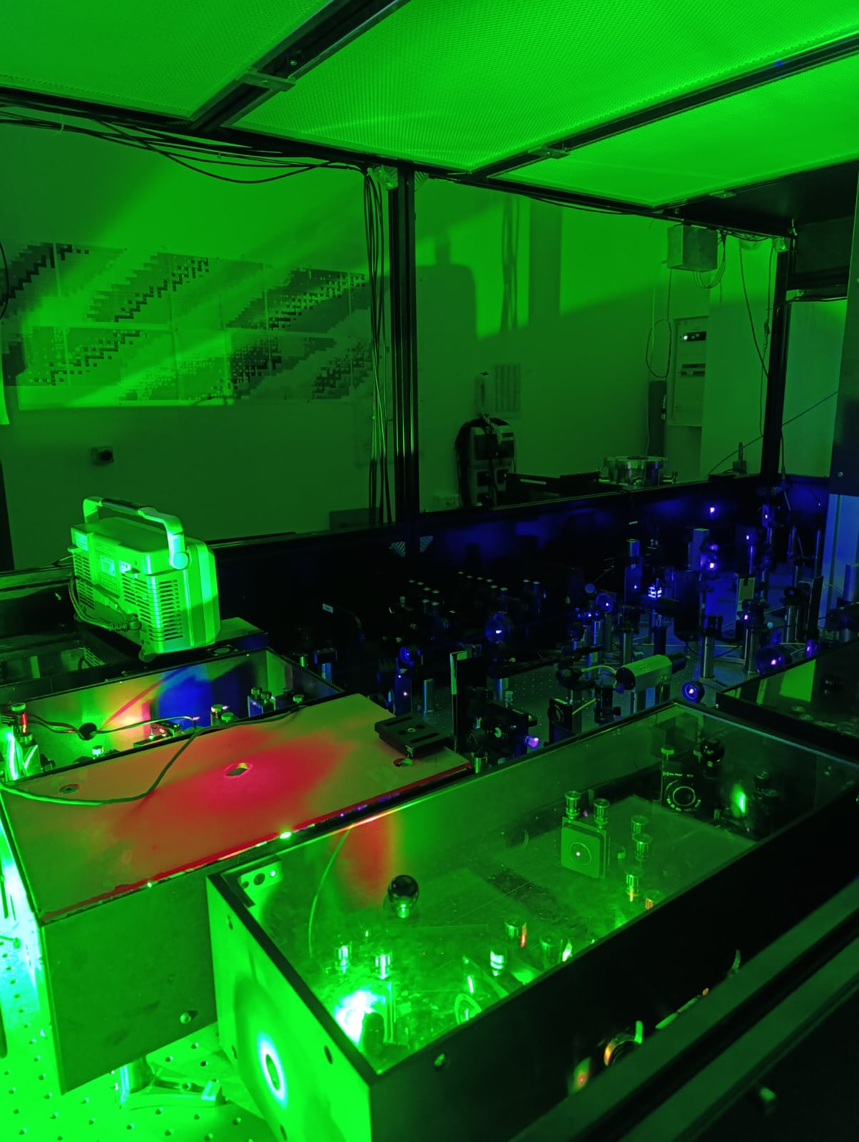
Dy spectroscopy in GISELE laser laboratory

Slide 5
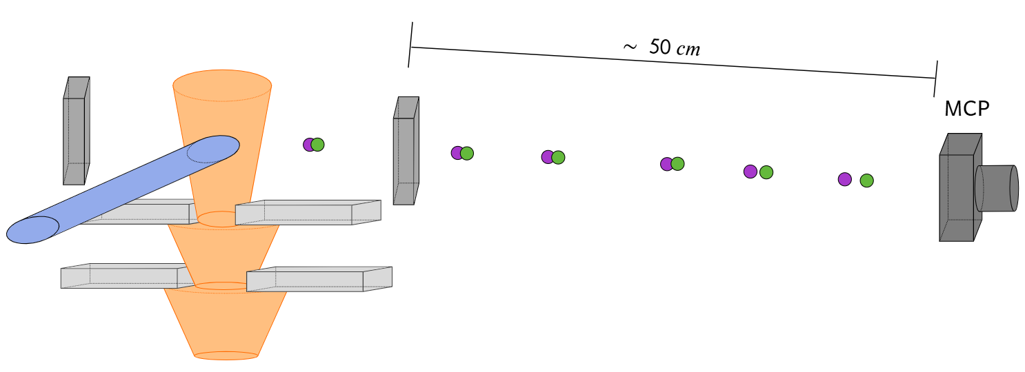
GISELE
MCP

Slide 6
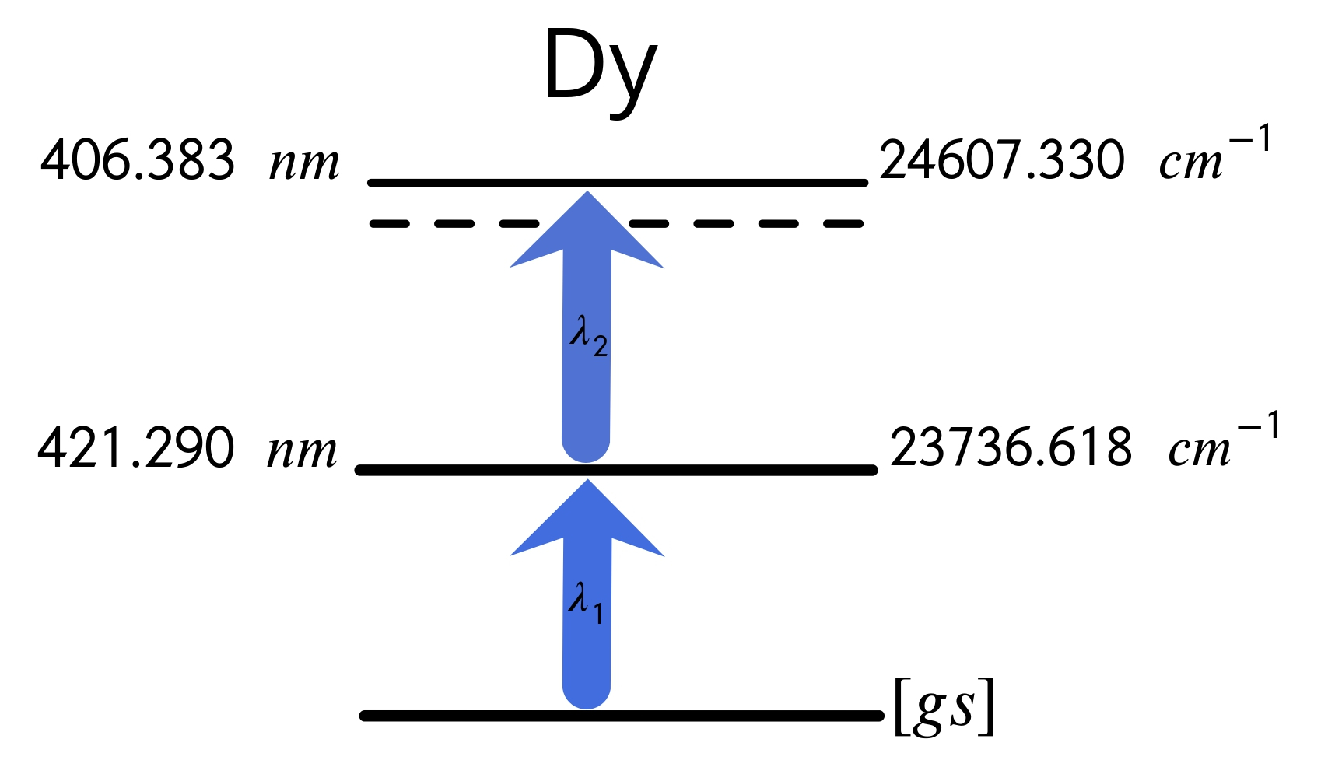
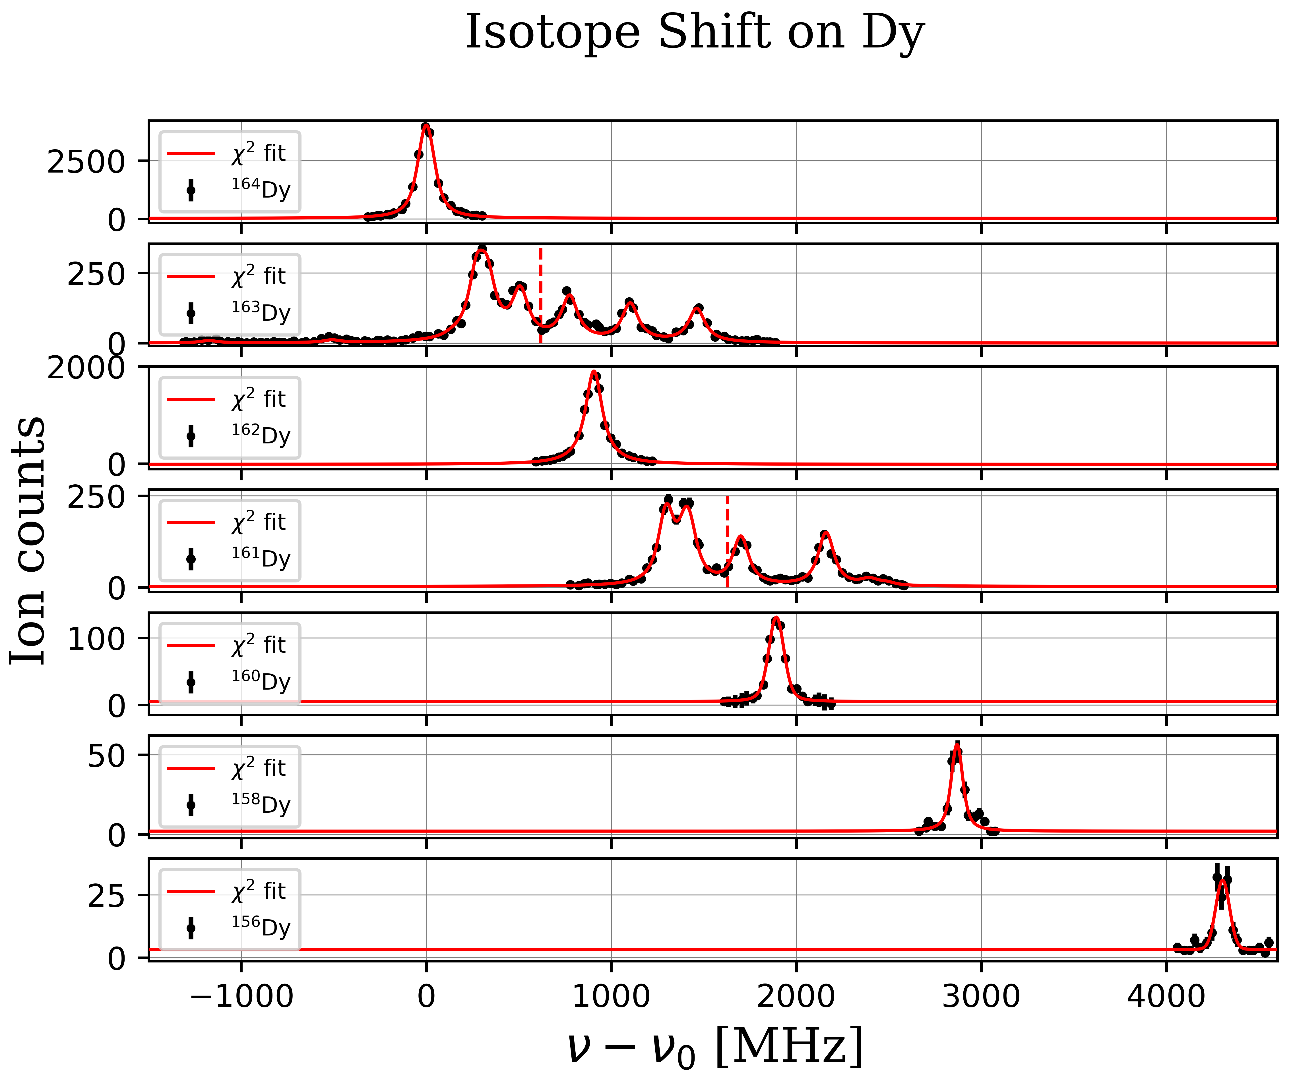
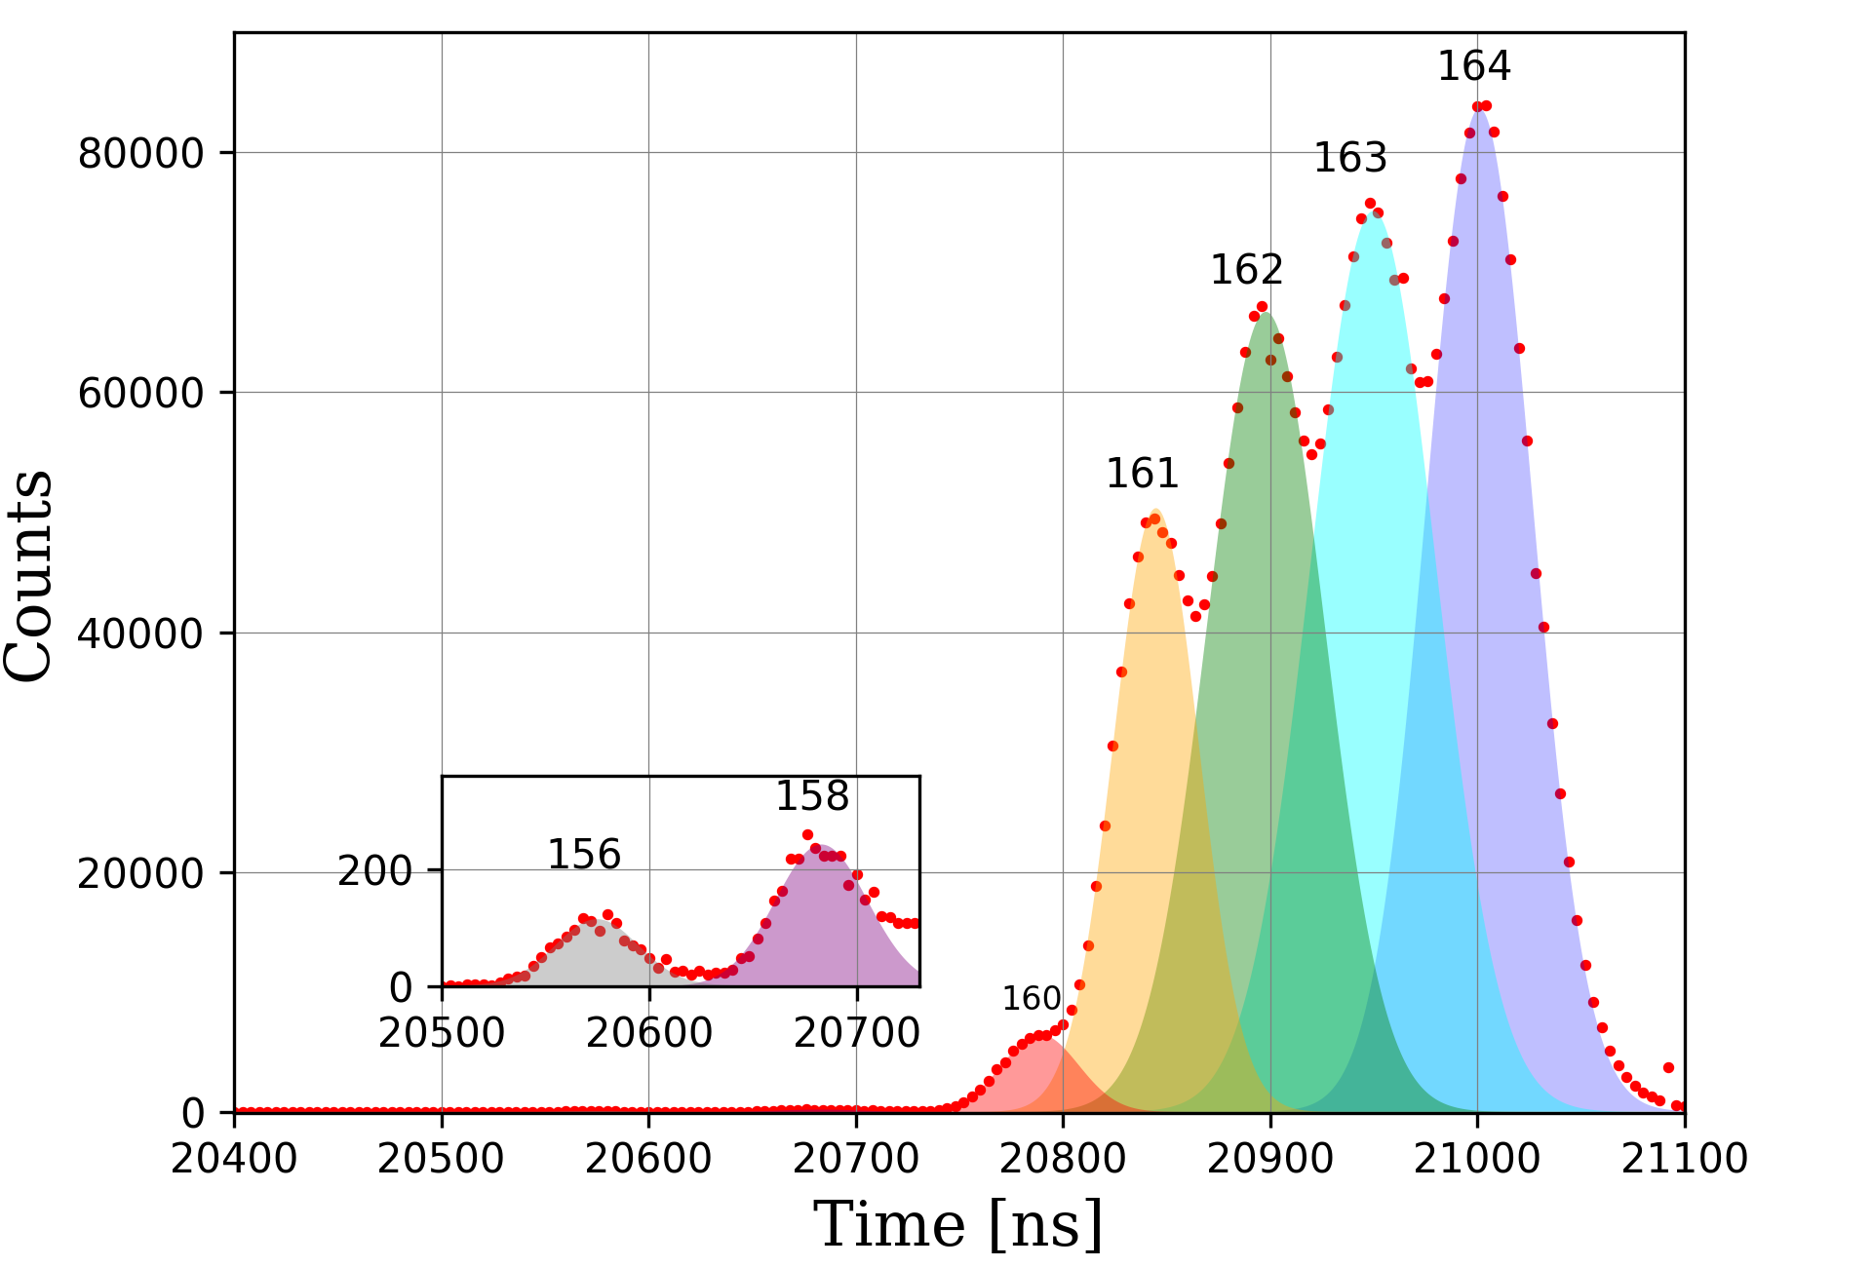
ToF Spectrum

Slide 7
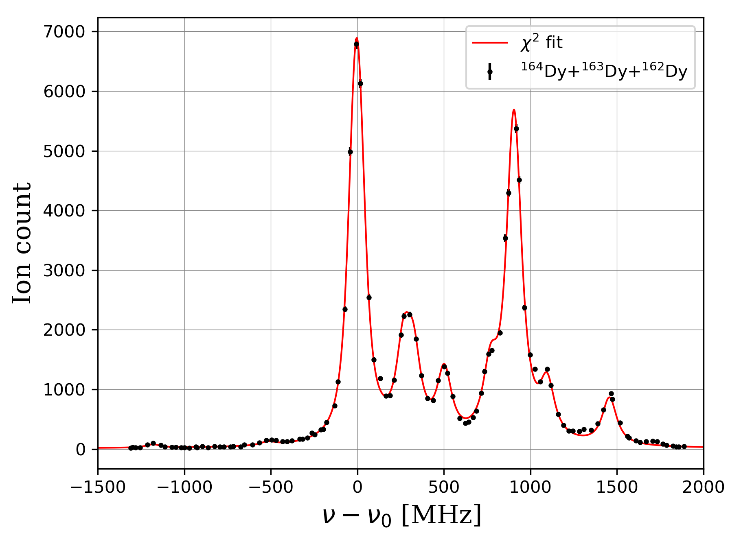
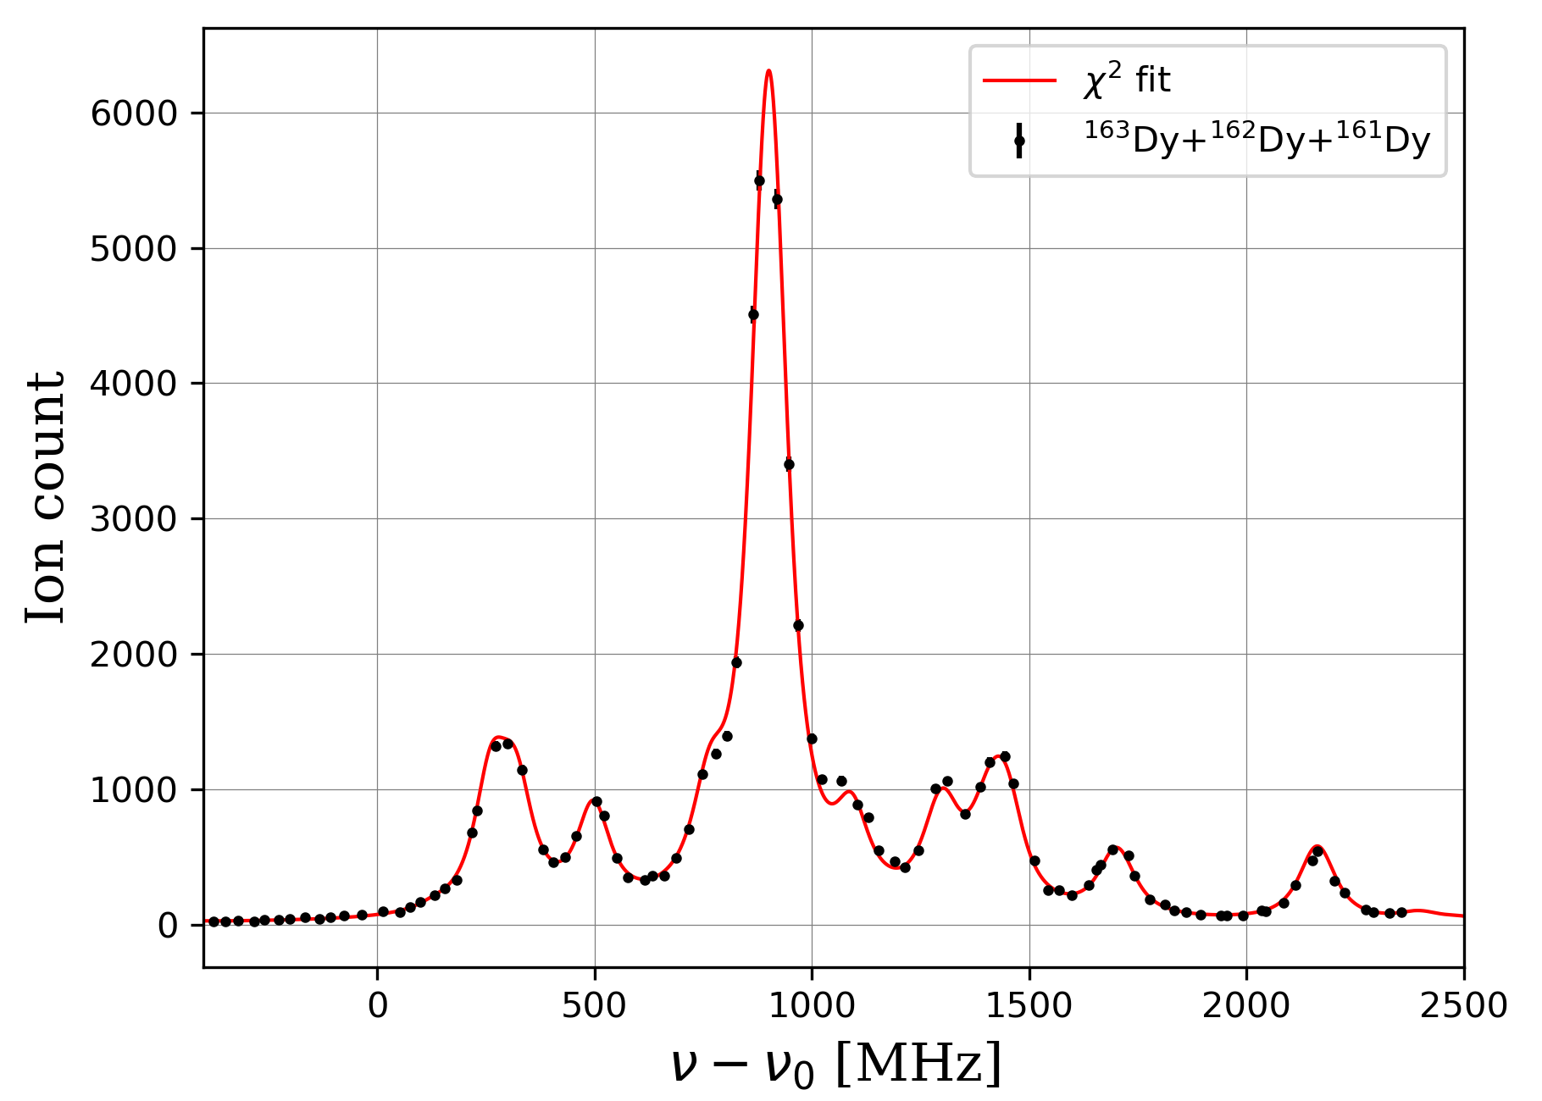
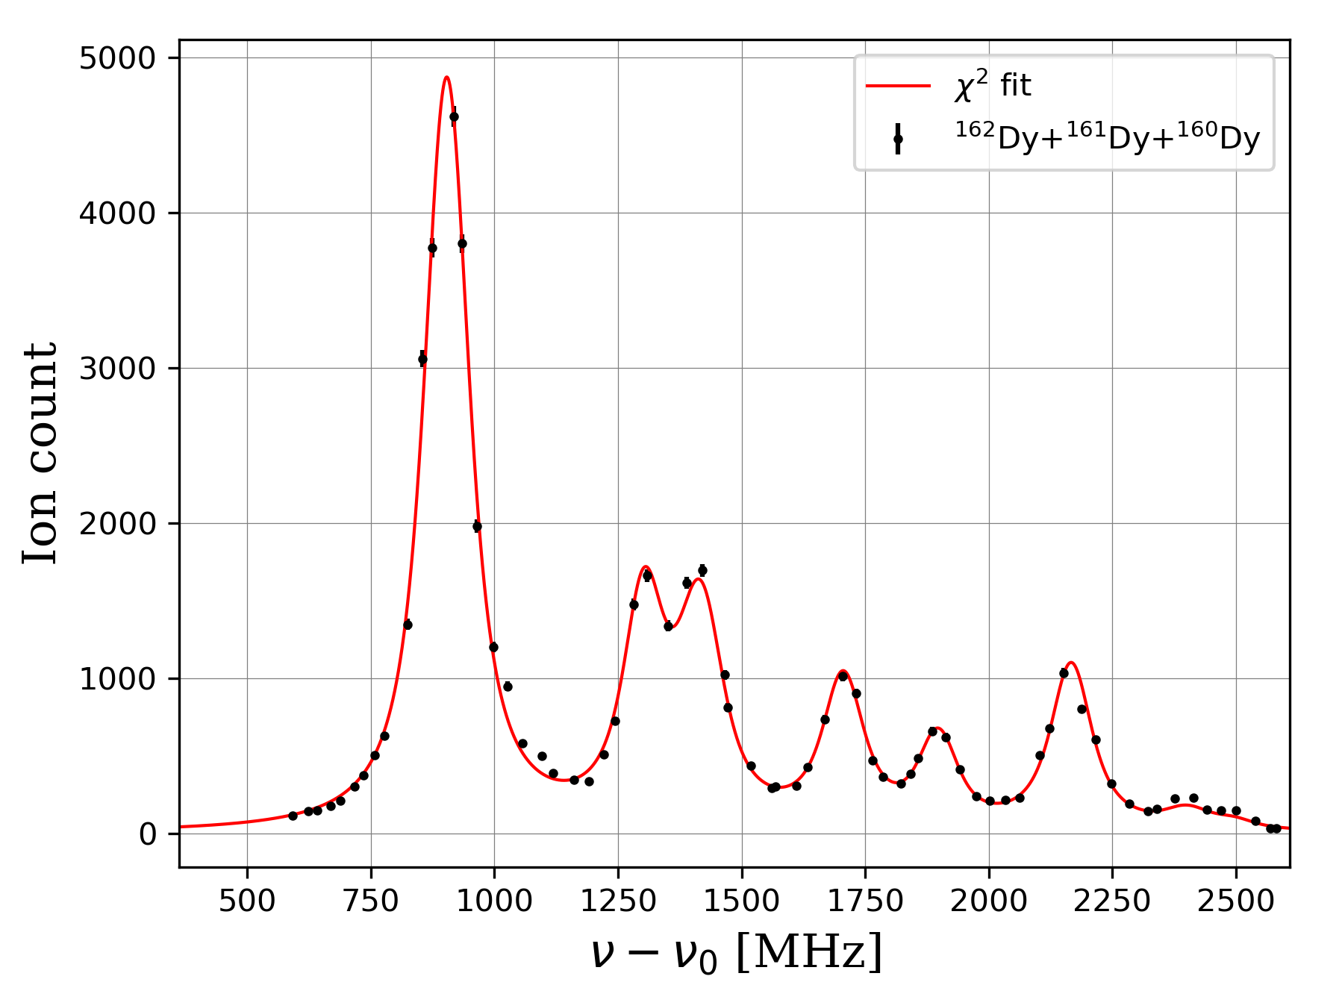
¹⁶⁴Dy + ¹⁶³Dy +¹⁶²Dy
¹⁶³Dy + ¹⁶²Dy +¹⁶¹Dy
ToF Spectrum
¹⁶²Dy + ¹⁶¹Dy +¹⁶⁰Dy

Slide 8
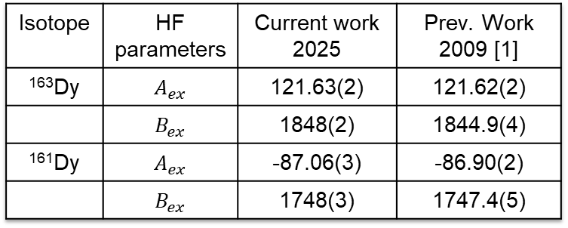
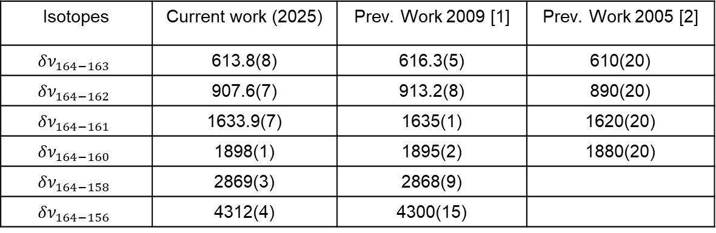
Dy results
Isotopes | Current work (2025) | Prev. Work 2009 [1] | Prev. Work 2005 [2]
$${δν}_{164−163}$$ | 613.8(8) | 616.3(5) | 610(20)
$${δν}_{164−162}$$ | 907.6(7) | 913.2(8) | 890(20)
$${δν}_{164−161}$$ | 1633.9(7) | 1635(1) | 1620(20)
$${δν}_{164−160}$$ | 1898(1) | 1895(2) | 1880(20)
$${δν}_{164−158}$$ | 2869(3) | 2868(9)
$${δν}_{164−156}$$ | 4312(4) | 4300(15)
Isotope | HF parameters | Current work 2025 | Prev. Work 2009 [1]
¹⁶³Dy | $$A_{ex}$$ | 121.63(2) | 121.62(2)
 | $$B_{ex}$$ | 1848(2) | 1844.9(4)
¹⁶¹Dy | $$A_{ex}$$ | -87.06(3) | -86.90(2)
 | $$B_{ex}$$ | 1748(3) | 1747.4(5)
Overall agreement with the
literature results
[1] N. Leefer et al. Measurement of hyperfine structure and isotope shifts in the
Dy 421-nm transition. Opt. Lett. 34, 2548-2550 (2009)
[2] C. I. Hancox. Magnetic trapping of transition-metal and rare-earth atoms usingbuffer-gas loading. Harvard Thesis, (2005).

Slide 9
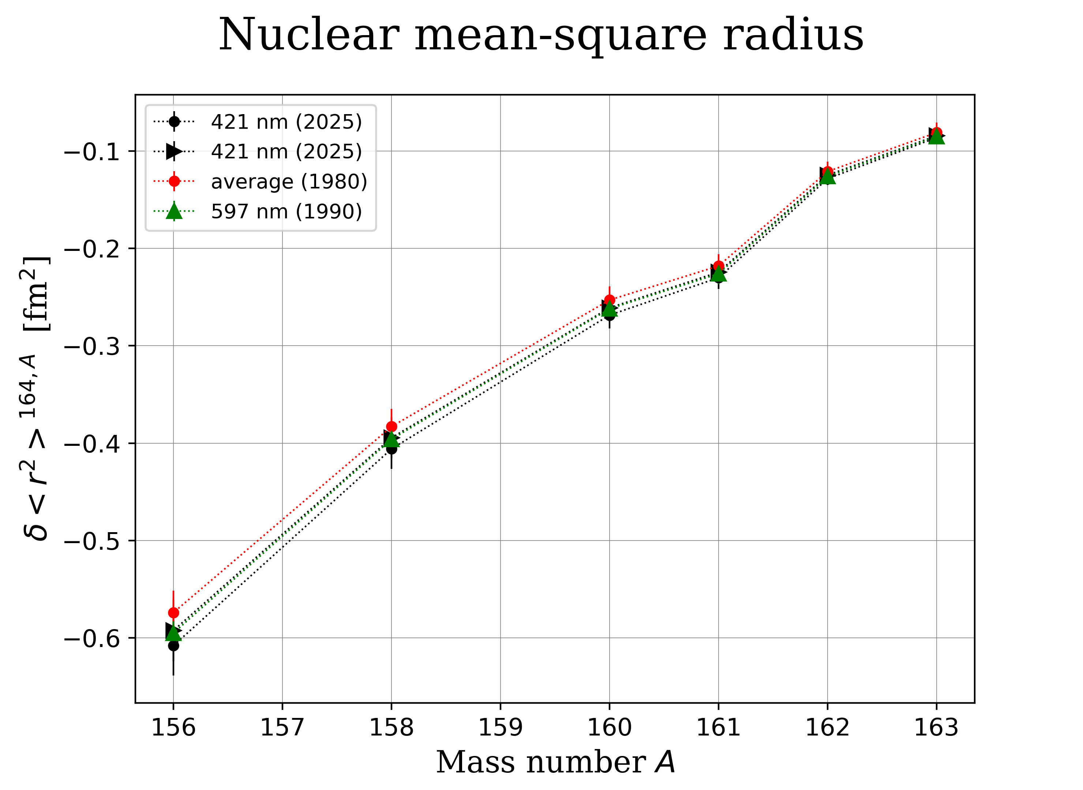
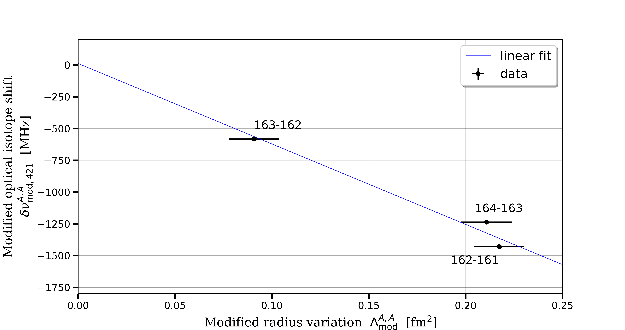
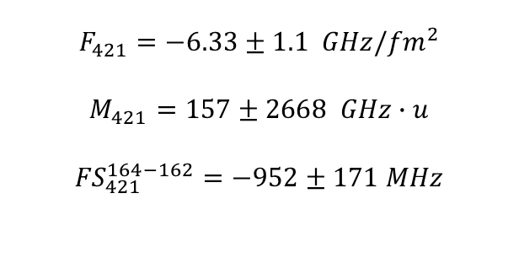
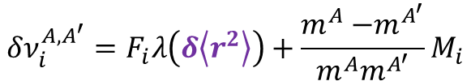
Dy results: Combined analysis
$$F_{421}=−6.33±1.1 GHz/{fm}^{2}$$
$$M_{421}=157±2668 GHz∙u$$
$${FS}_{421}^{164−162}=−952±171 MHz$$
King Plot
Preliminary
$$δν_{i}^{A,A^{′}}=F_{i}λ\left(δ\left\langle r^{2}\right\rangle \right)+\frac{m^{A}{−m}^{A^{′}}}{m^{A}m^{A^{′}}}M_{i}$$

Slide 10
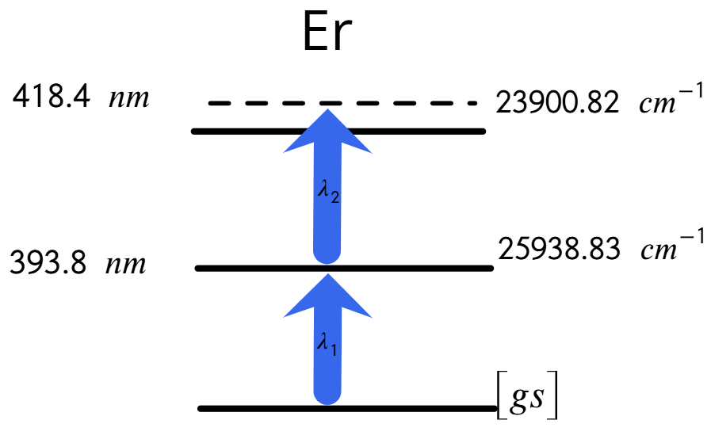
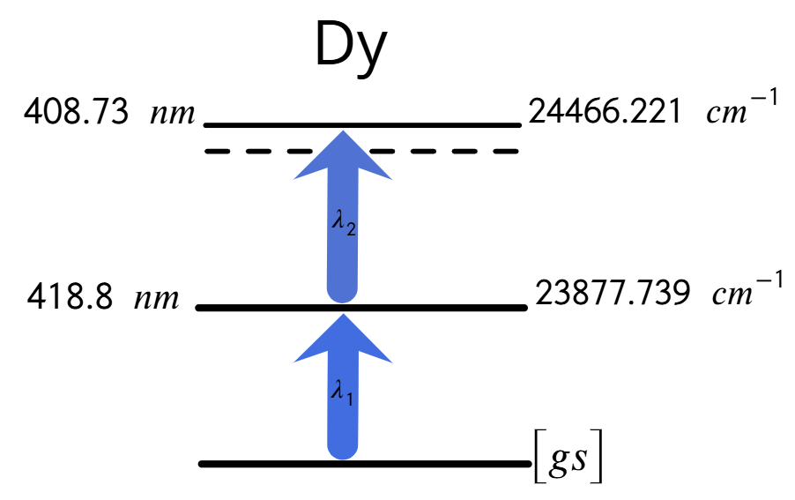
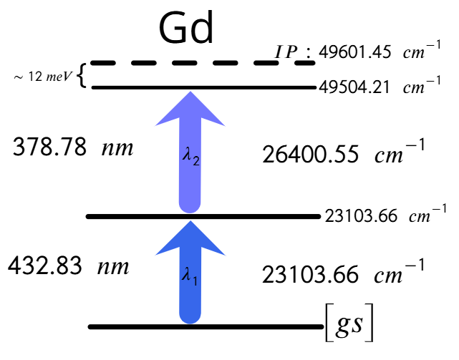
03/2025
07/2025
12/2025 Valentin’s talk
02/2026… coming soon

Slide 11
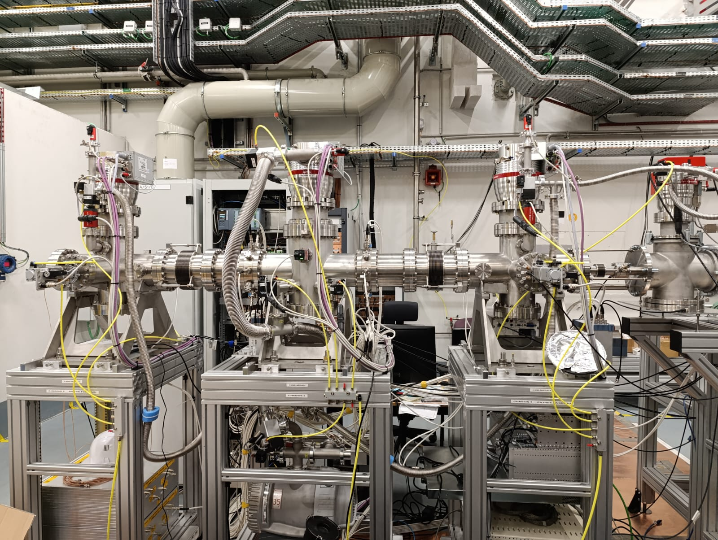
Online commissioning of the MR-TOF-MS: PILGRIM

Slide 12
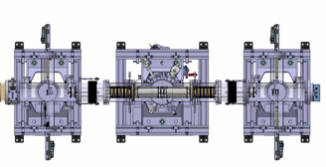
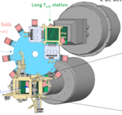

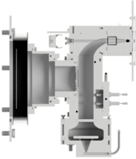
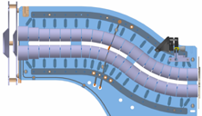
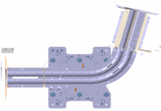
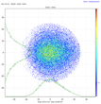
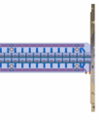


50.0% (0 laps)
50.5% (1000 laps)
MagneTOF
S³-LEB
MR-TOF MS
81%
PILGRIM
MCP_{inj}
100%
MCP 3
SEASON
Laser system
100%
100%
MCP 1
MCP 2
λ₁
λ₂
Pulse up
(~ 3 kV)
Gas cell
+
RFQ
Cooler
Buncher
+
+
S³ beam
S-shape RFQ
miniRFQ
QMF
He: 10⁻² - 10⁻³ mbar
RFQs
Ar: 200 - 500 mbar

Slide 13
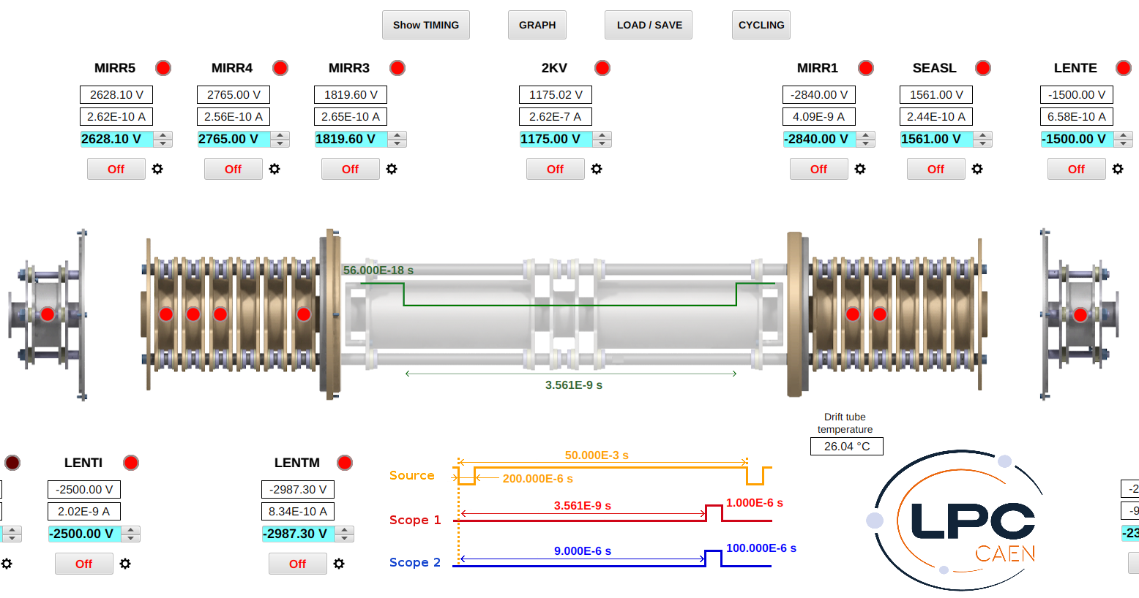
MR-TOF-MS: PILGRIM

Slide 14
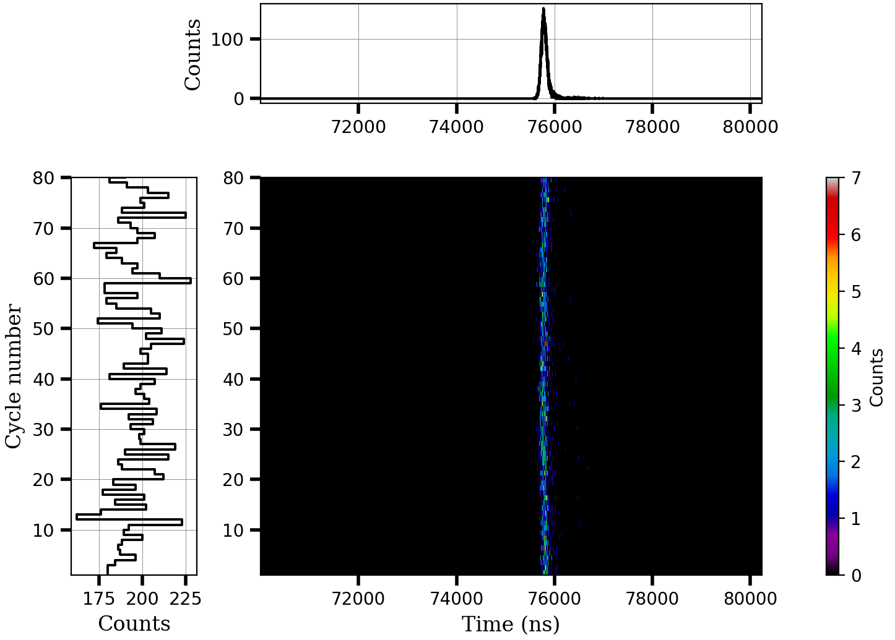
Data visualisation
@ S. Pineda, A.F. Lopez-Loaiza, M. Brun

Slide 15
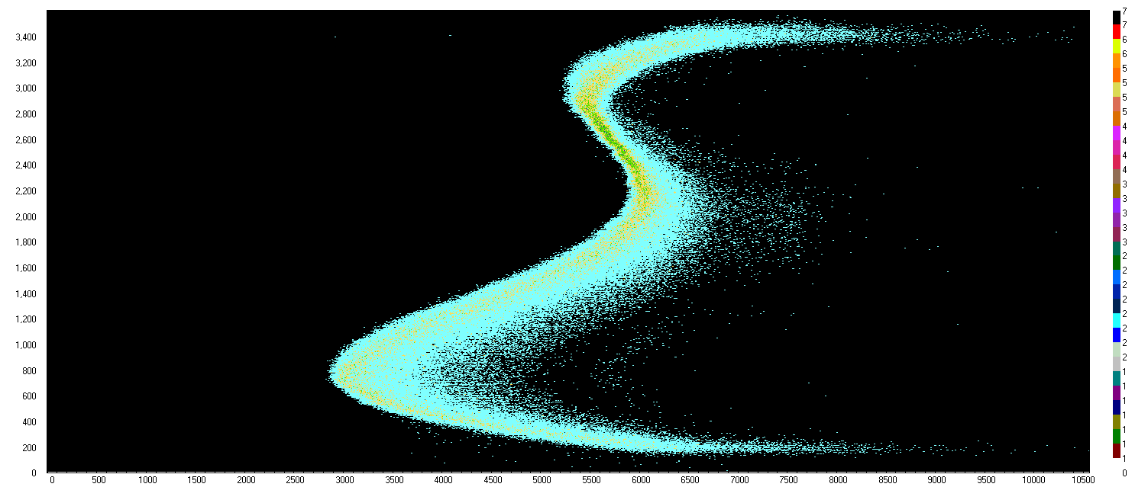
PDT voltage scan
860 – 1220 V
1116 V
10s per volt

Slide 16
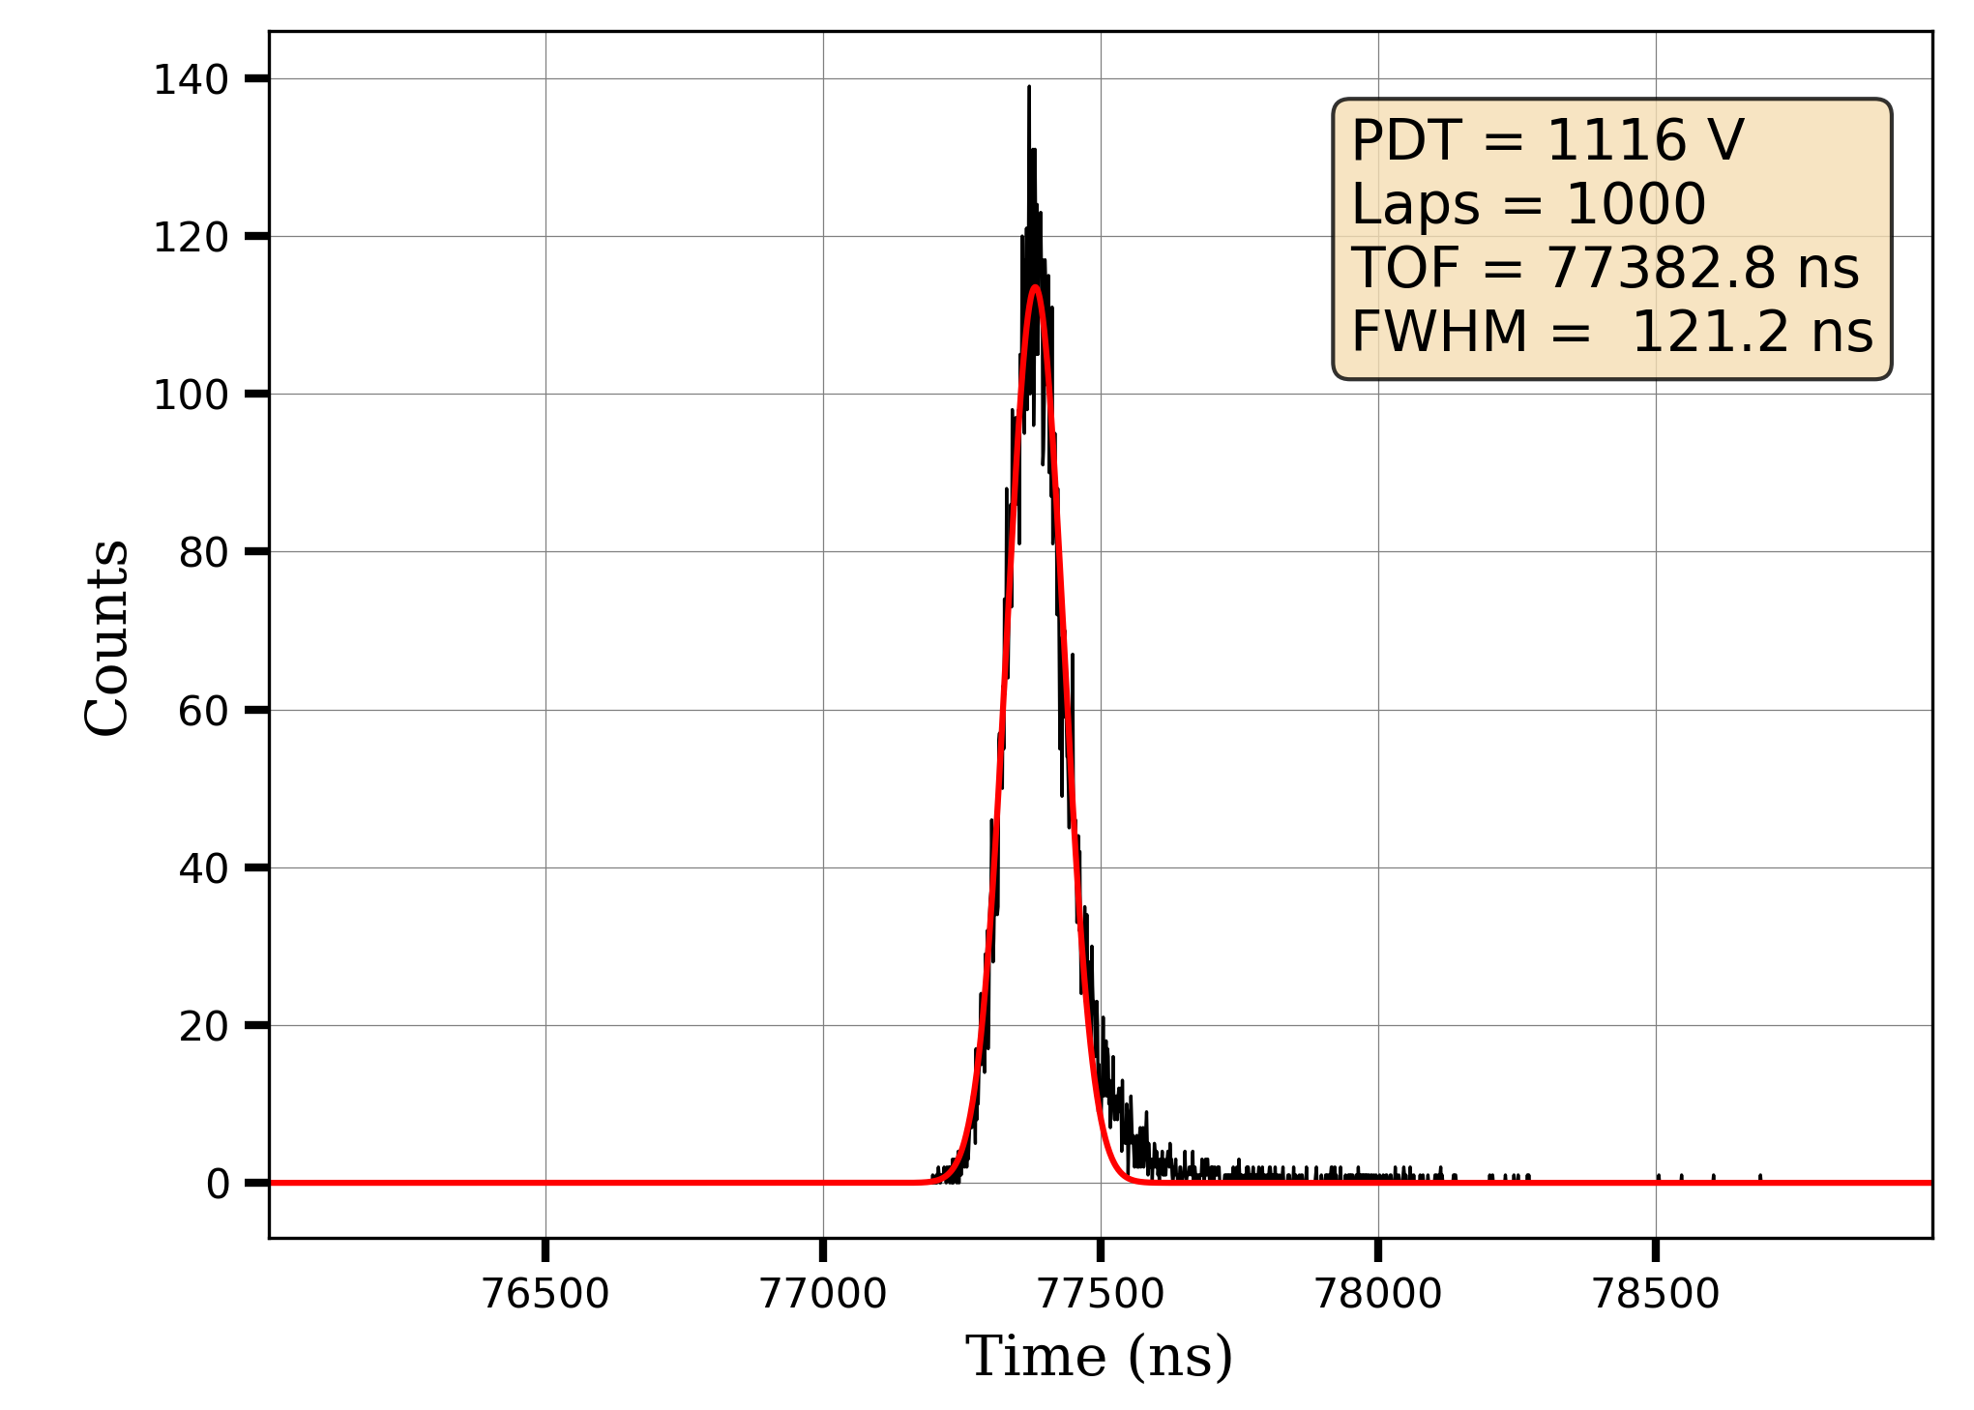
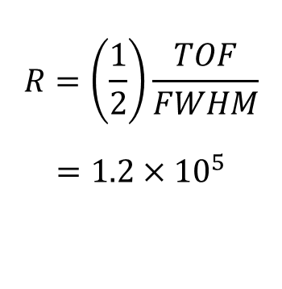

Resolving power
Thermo-ionic source: ¹³³Cs
$τ_{1000}=29.43244373$ms
$$R=\left(\frac{1}{2}\right)\frac{TOF}{FWHM}$$
$=1.2×{10}^{5}$
Same FWHM shoothing through and Trapping 1000 laps

Slide 17
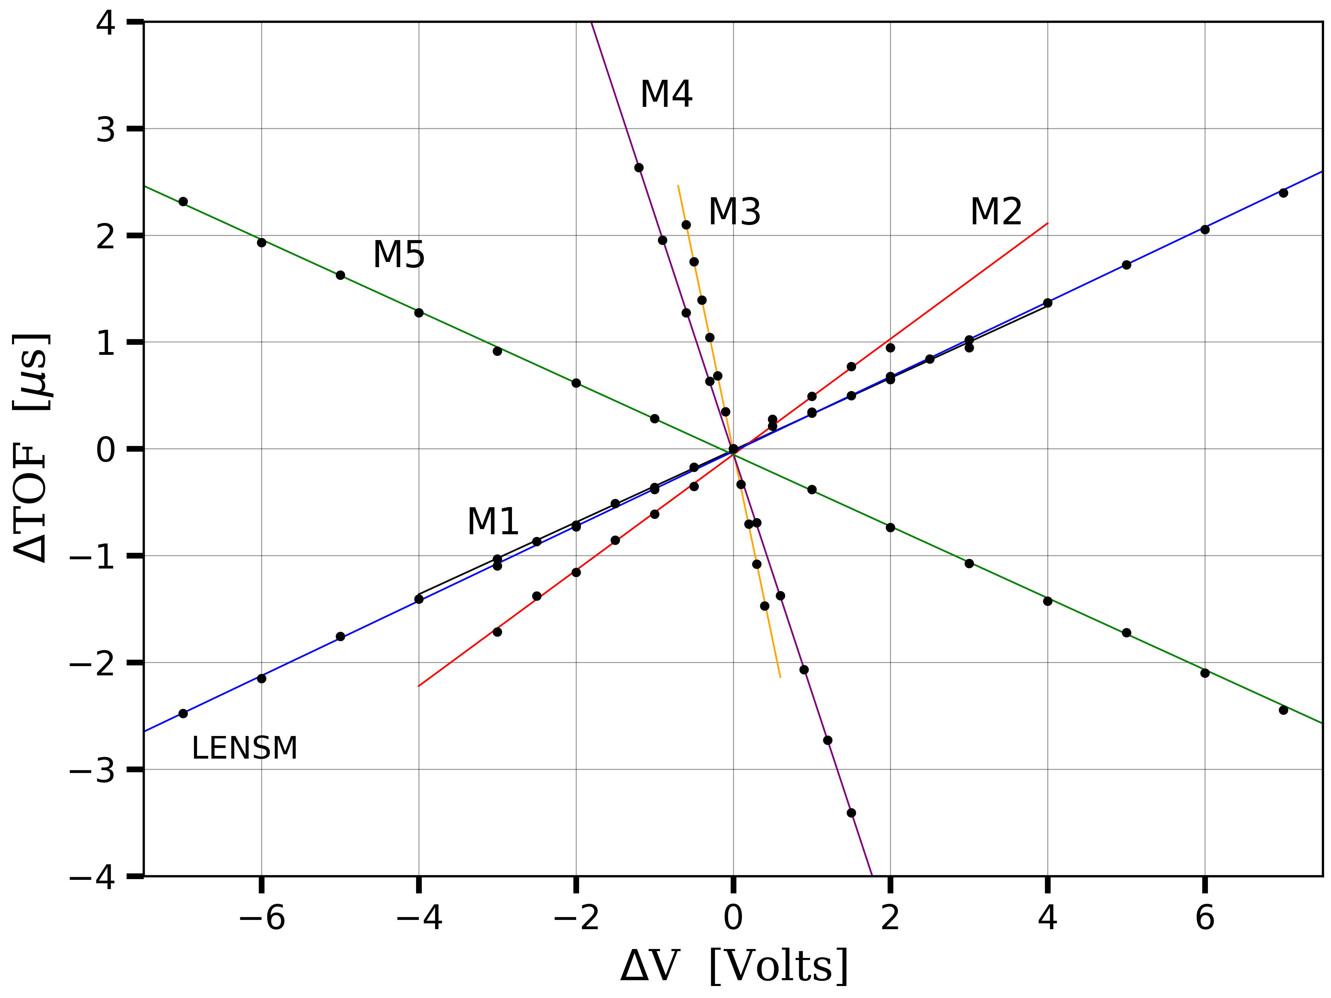

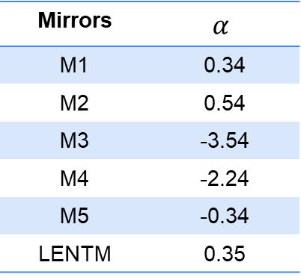
Mirror Sensitivity
$$α=\frac{ΔTOF [ns]}{ΔV [V]}$$
Mirrors | $$α$$
M1 | 0.34
M2 | 0.54
M3 | -3.54
M4 | -2.24
M5 | -0.34
LENTM | 0.35

Slide 18
Perspectives
Off-line studies will be resumed on stable Gd at GISELE lab.
Laser transport from ALTISA to S³-LEB in the following weeks.
Continuation of the complete characterization of PILGRIM.
Laser spectroscopy studies in-gas-jet will be conducted.

Slide 19
The end Thanks!

Slide 20
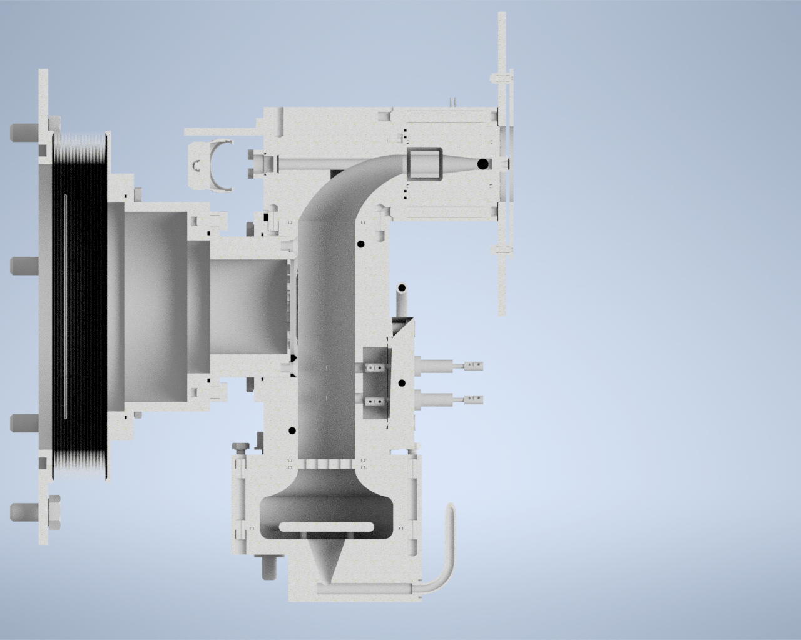
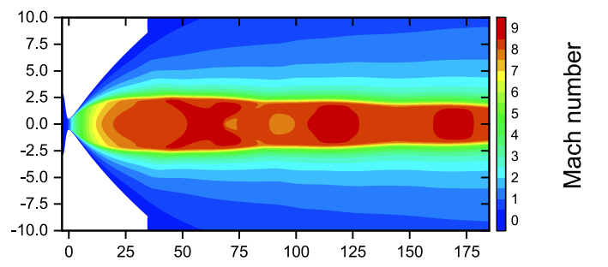
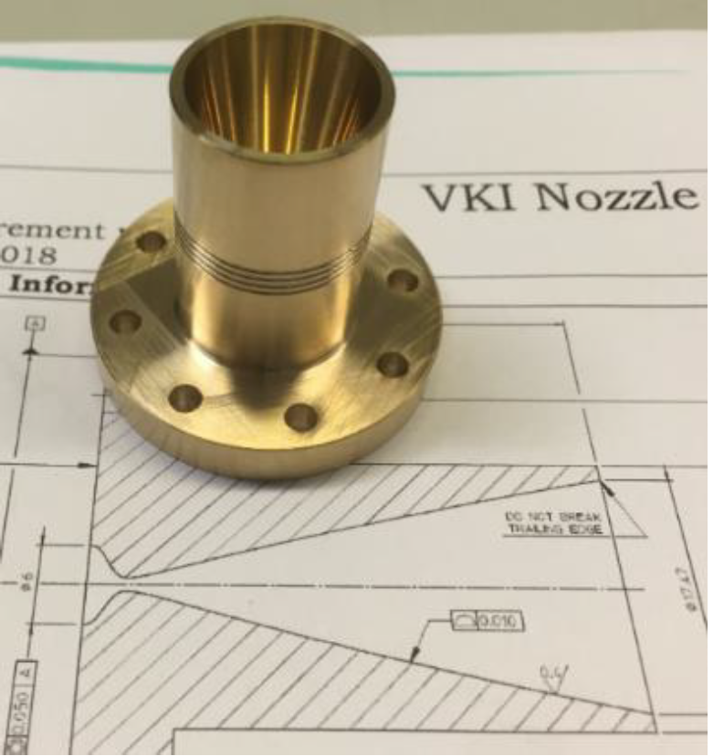
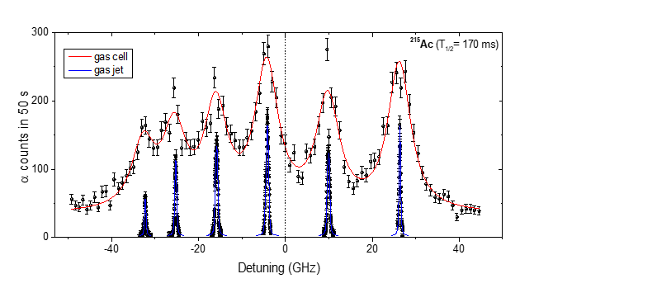


Gas jet laser probing
Gas cell
Broadening effects
Broadband laser (GHz)
Extraction time ~500 ms
de Laval Nozzle
Hypersonic gas jet : ρ ↘︎ T ↘︎
Narrowband laser (MHz)
Proof of principal @ LISOL
λ₂
λ₁
Gas cell laser probing
Ion collector
Supersonic jet
Extraction by gas flow only
+
+
+
+
$E<1$ MeV/u
Stopping, thermalization
and neutralization
Thin window
Ar buffer gas at 100-500 mbar
R. Ferrer, Nat. Comm. 8 (2017)

Slide 21
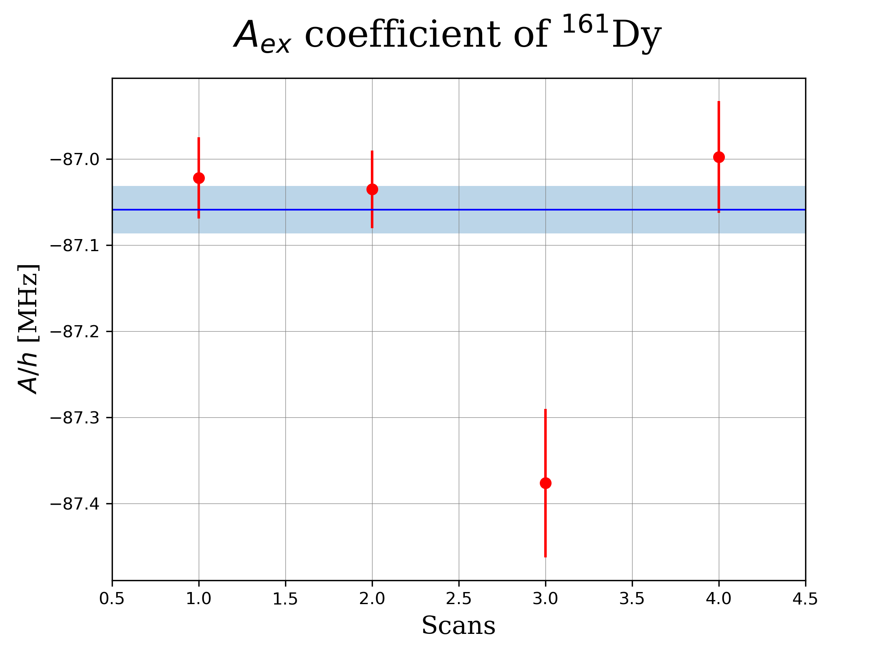
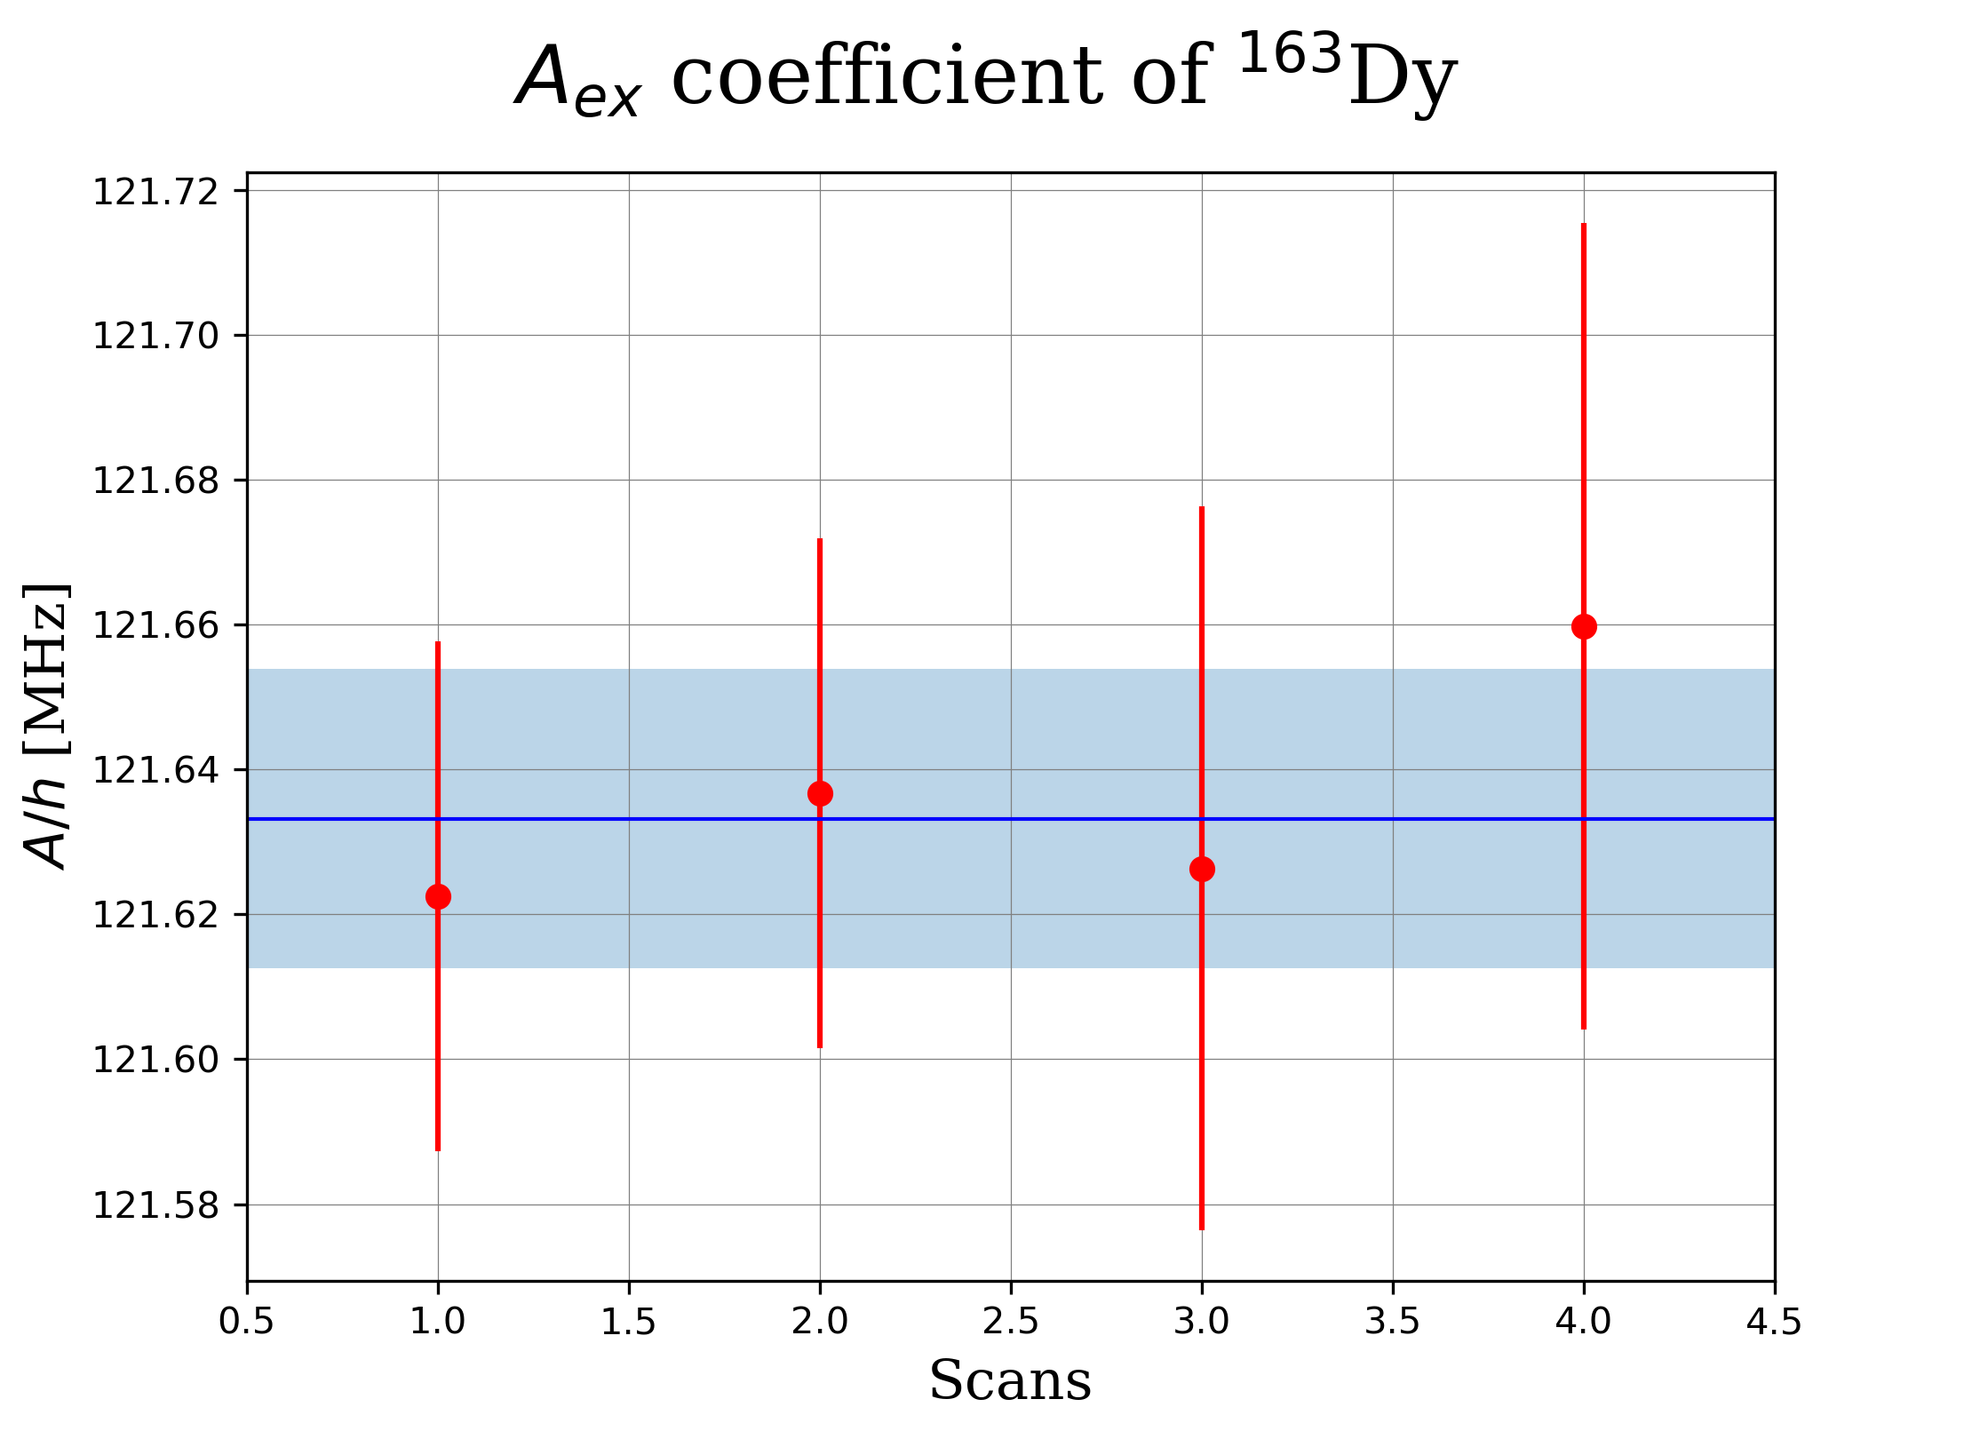
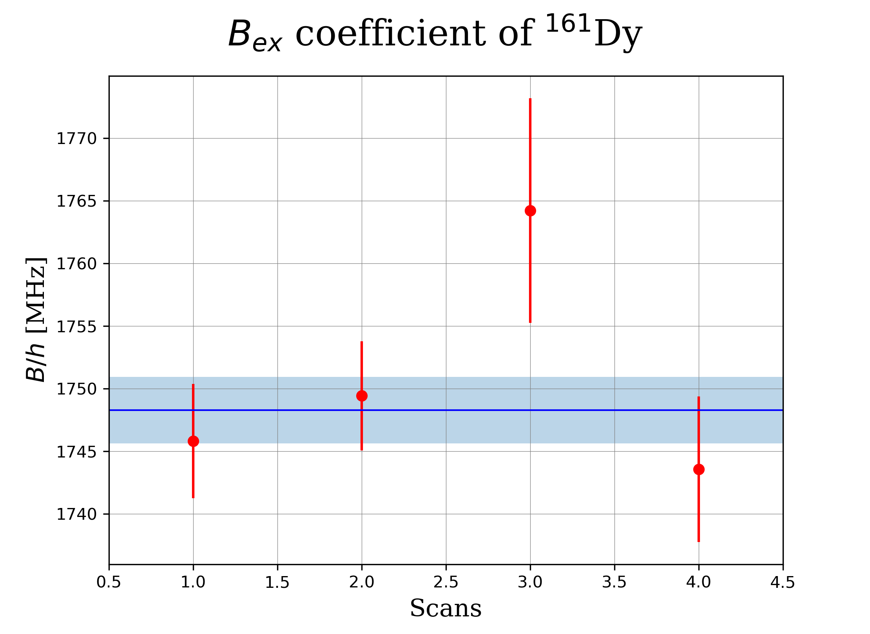
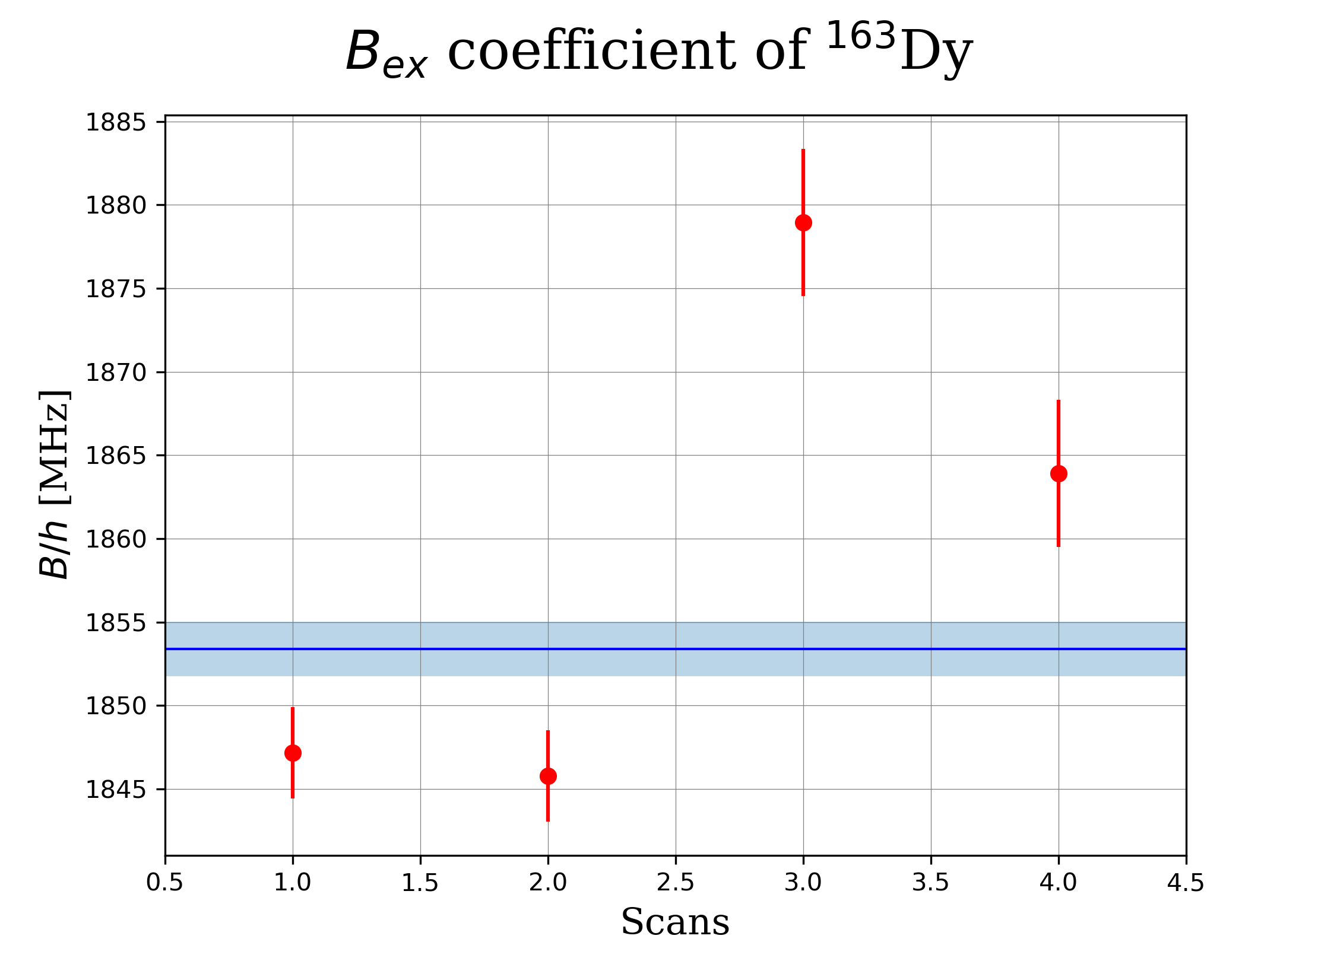

Slide 22
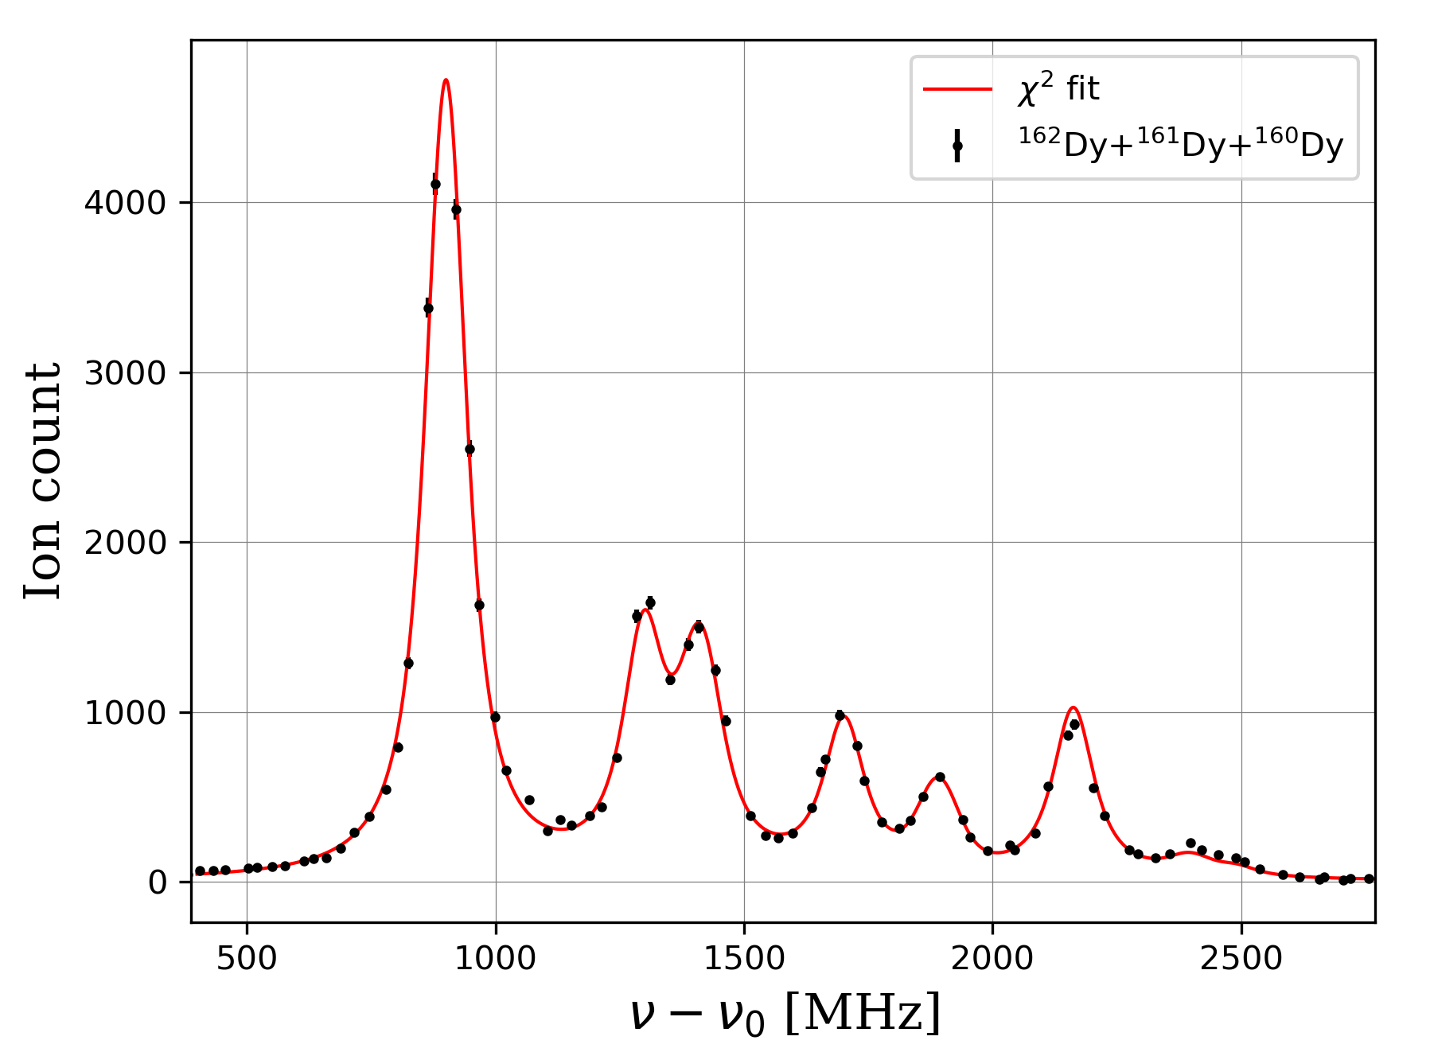
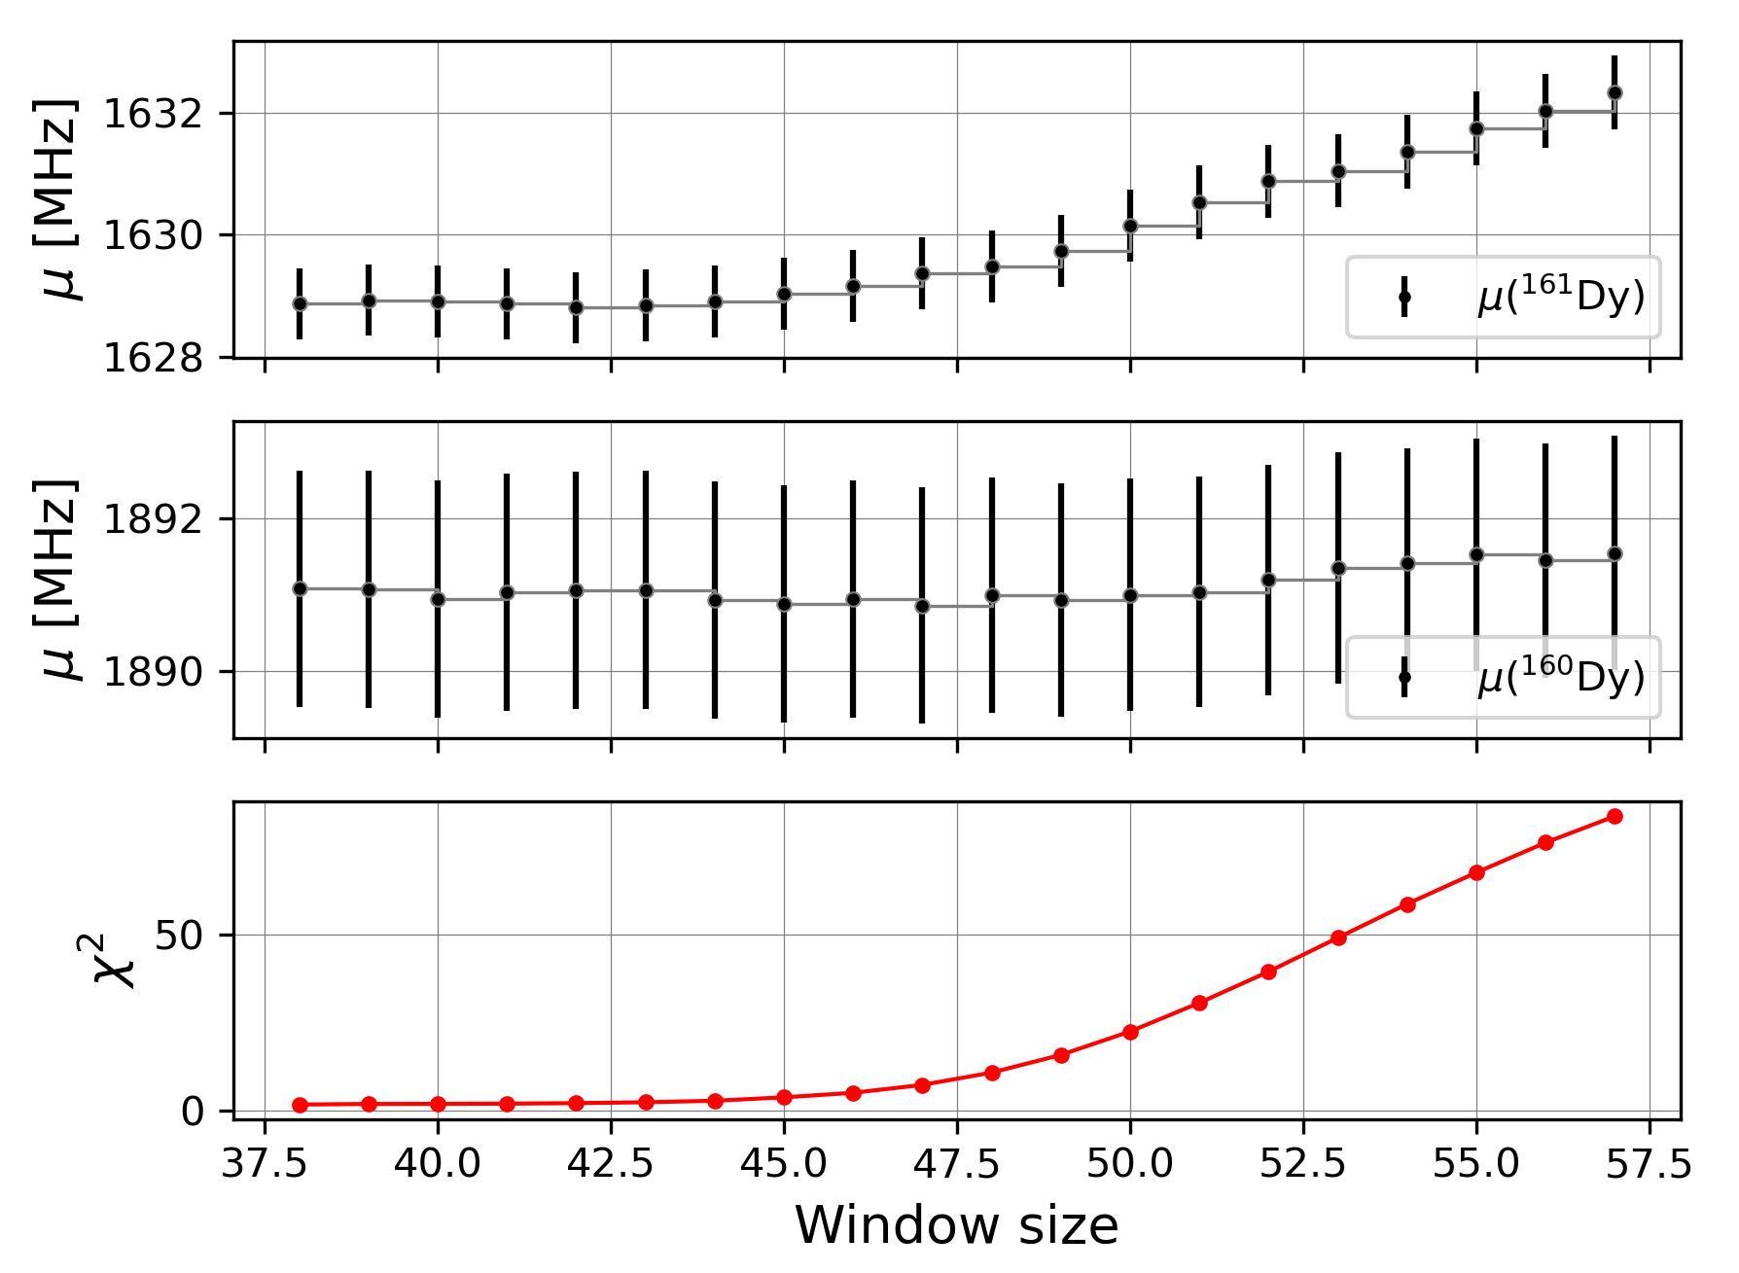

Slide 23
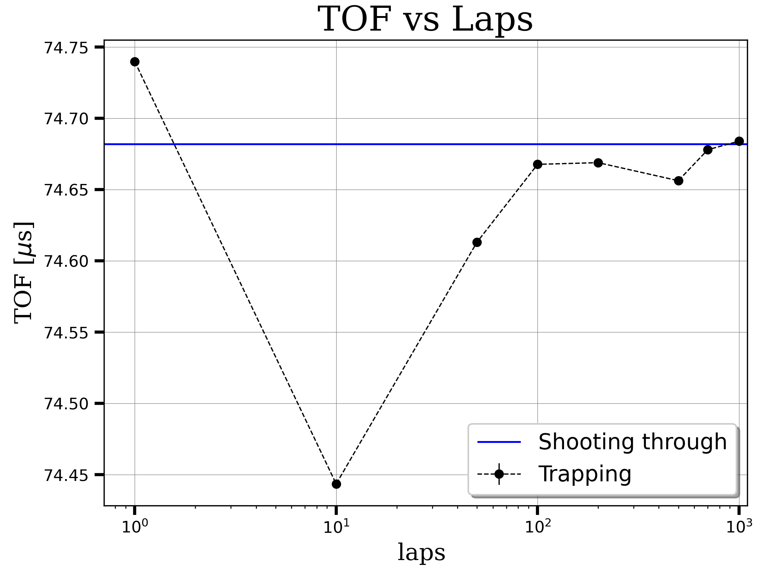

Trapping duration calibration
Thermo-ionic source: ¹³³Cs
$τ_{1000}=29.43244373$ms

