Slide 1
LABS Tour 2026
GT Gravité Cosmologie Métrologie
Martin boutelier
2026

Slide 2
Agenda
01
General information
04
APR Process, Calendar, Useful information
02
CALL M8/F3/mini-F
05
GCM main results : APR, PhD, PDoc
03
GCM Missions : news, programmatic

Slide 3
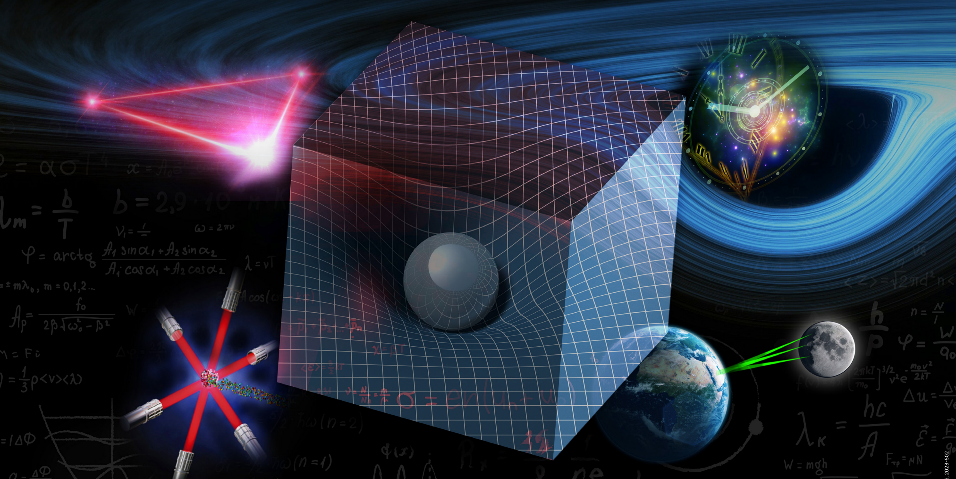
CNES General information

Slide 4
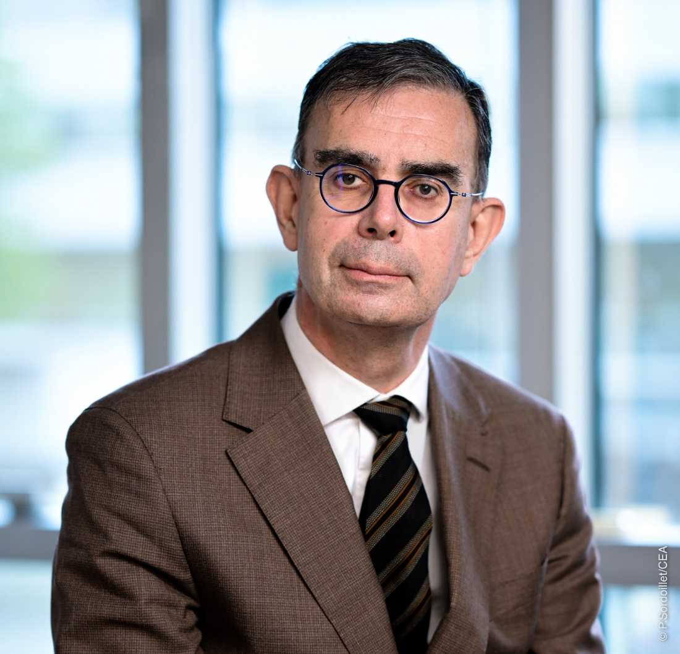
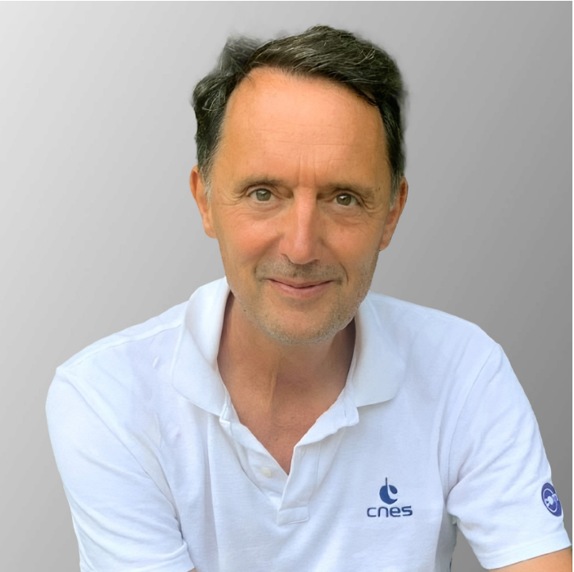
New CNES president and strategic director
François Jacq
Jean Claude Souyris
Ingénieur et docteur X-Mines
Ingénieur ENSEEIHT
MESR
Doctorat à l’ONERA en télédétection radar
Andra
Ministère de l’économie et des finances
CESBIO
Chef de service Altimétrie Radar
Cabinet du 1er ministre, énergie et développement durable
Chef de service Techniques et préparation du futur
MéteoFrance
Ifremer
Directeur adjoint de la direction Innovation, Applications, Sciences
Administrateur général CEA
Membre du CA du CNES, P du comité d’audit du CNES
Directeur adjoint de la direction Technique et Numérique
Prise de fonction : 23 mai
Directeur de la Stratégie depuis le 1er janvier

Slide 5
CNES general information
National strategy for Space :
Link : https://www.sgdsn.gouv.fr/publications/strategie-nationale-spatiale-2025-2040040 | SGDSN
Choose France : end of selection process. 33 candidates validated by ANR; 1 candidate for SU (LAM)
Budget:
2025 : - 100 M€ asked on the CNES multilateral budget:
Reduction of running costs: travels restriction, ban of entertainment and representation expenses
Stop endorsement of new affairs
Postpone to 2026 some projects due date
2026-2028 : Final budget is not completely set but some scenarios are studied with already consequences
Reduction of financial support to National Program AA
Likely reduction of APR budget of 20%
Likely reduction of DOC/PDOC allocation
Spending review at director level is planned first quarter of 2026 (due date 31st of March)

Slide 6
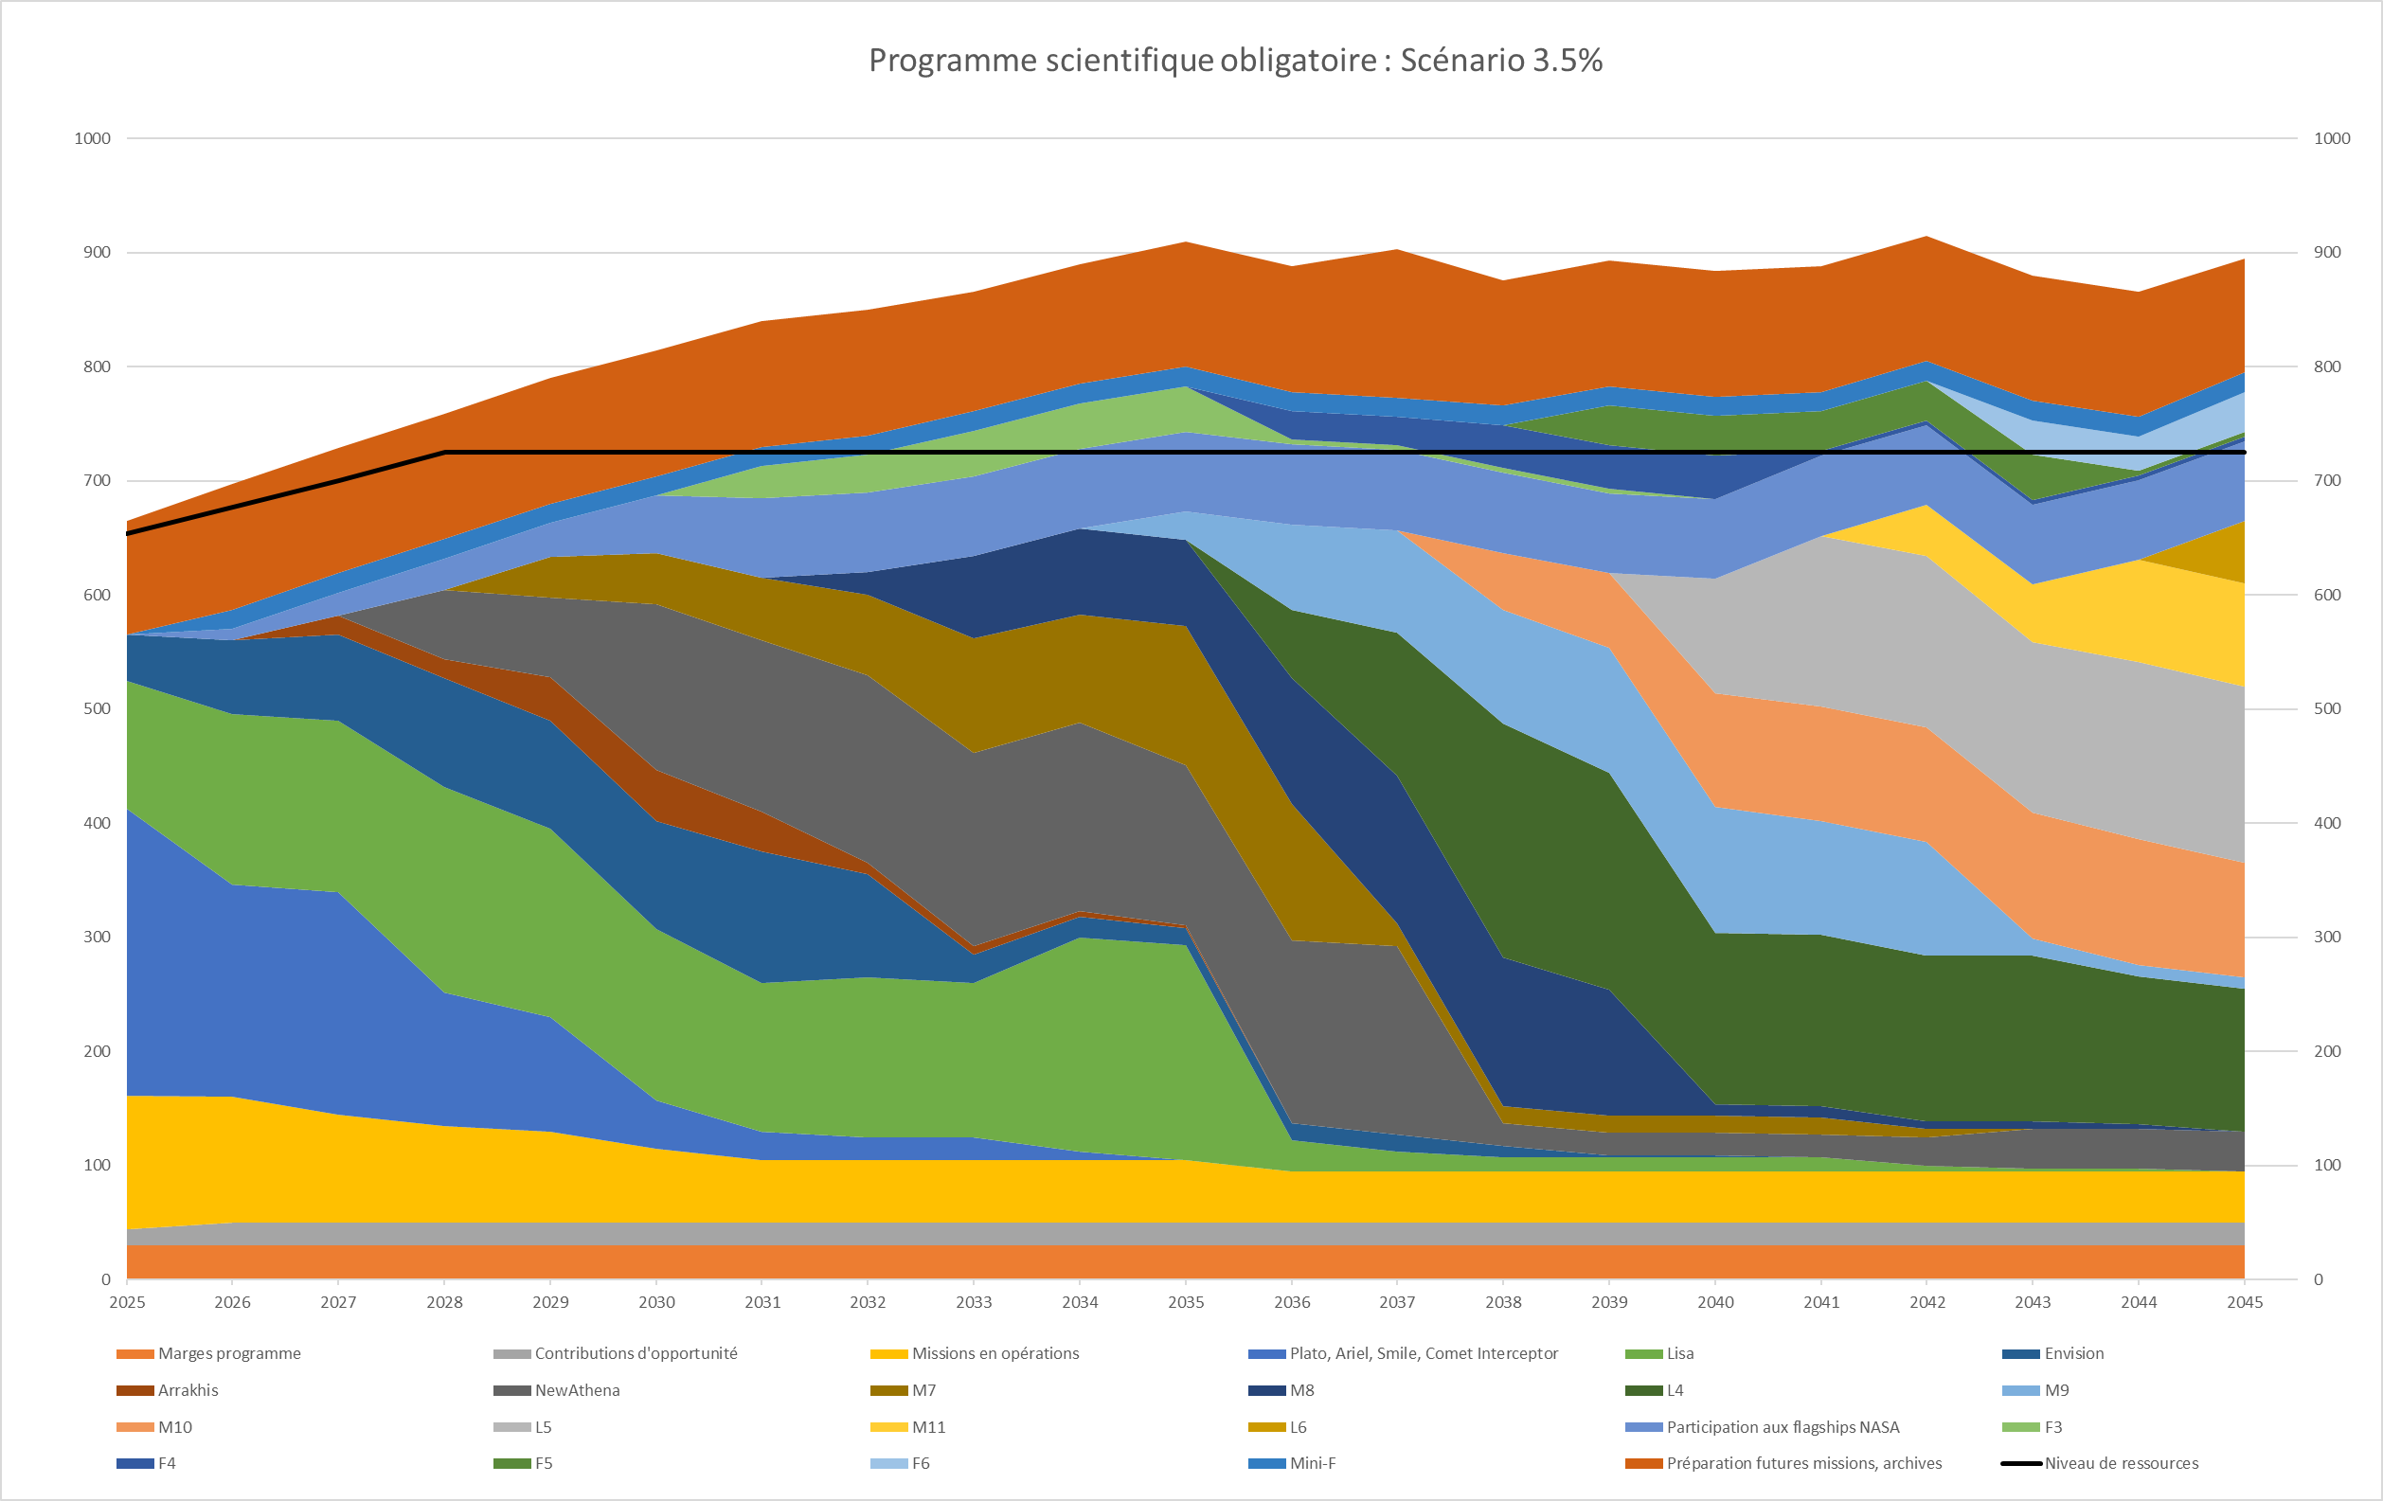
CNES general information
CMIN outcome : a global success for Space in Europe !
Total subscription : 22.159 Md€ ; +17% wrt CMIN22
Science mandatory program : +3.5% (ESA proposal was +4.5%)
Préparation du futur
NASA flagships
L5
M11
M7
M9
3 787 M€ for 2026 – 2030 (compared to 3 186 M€ for 2023-2027)
L2 (NewAthena)
M8
M10
L4 (Encelade)
M5 (Envision)
L3 (Lisa)
Missions Cosmic Vision en fin de développement
Mixed results for exploration program : only 80% of the total budget has been subscribed :
FR activities are focused on european cargo and RFM (ex-Exomars)
No budget to support ZefERO activities
Missions en opérations
Marge programme

Slide 7
NASA situation
Budgetary context :
Rejection of White House budget proposal last september by House of representant and Senate
Shutdown between 1st october and 13 november
Minibus provides a 24,4 B$ budget for NASA for FY2026 on 6th of January 2026
Governance :
Jared Isaacman eventually nominated as NASA administrator
Impact on scientific mission :
Most of scientific missions should be preserved in 2026
ESA is studying alternative to NASA contribution for Athena, LISA and Envision

Slide 8
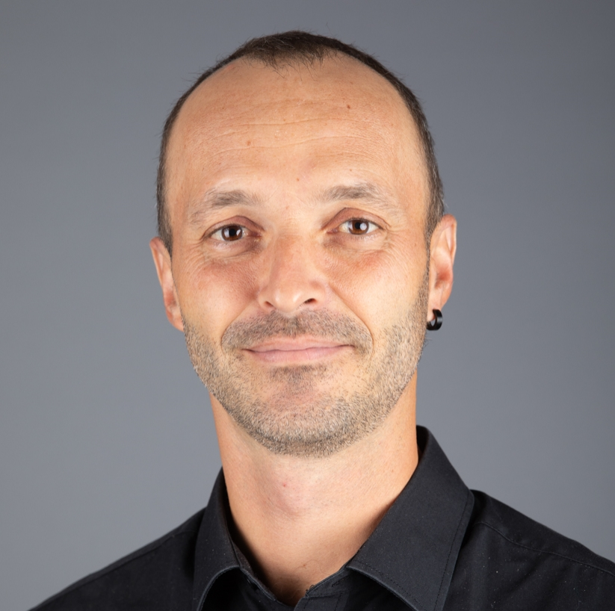
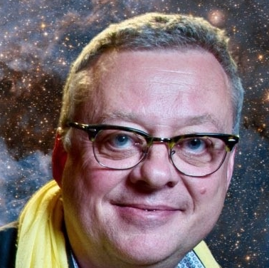

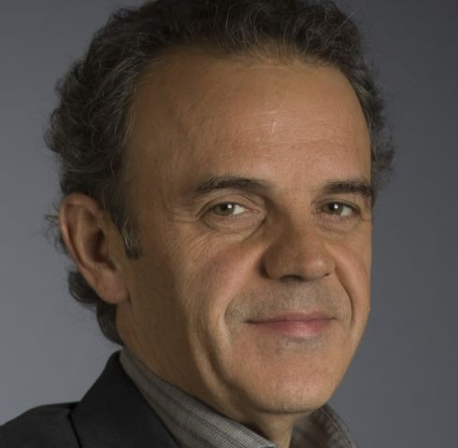

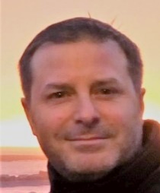
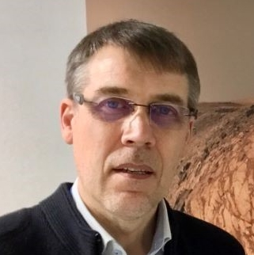
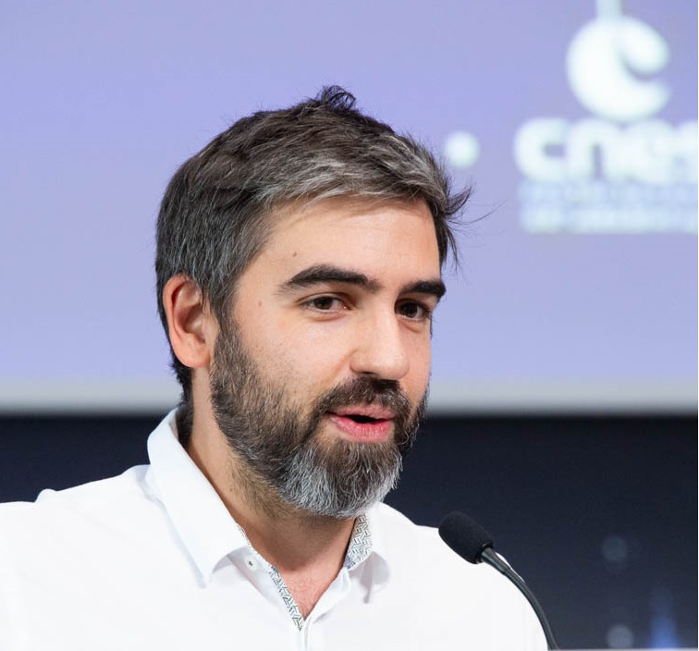
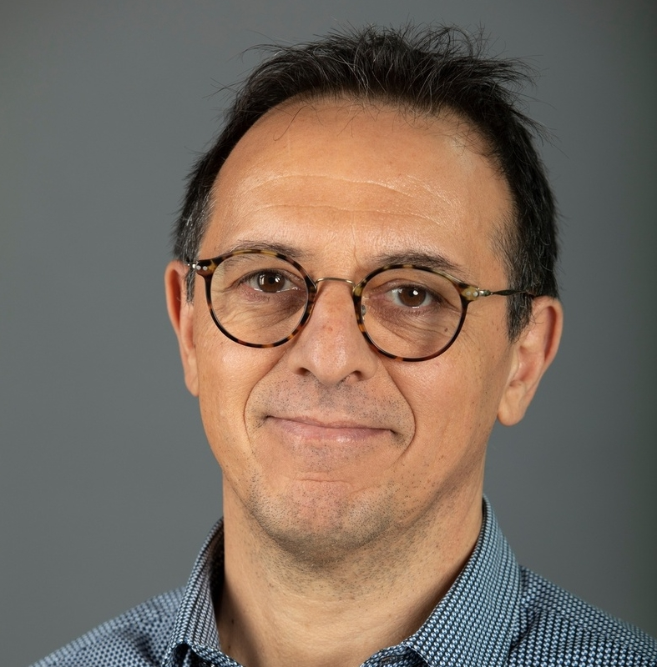
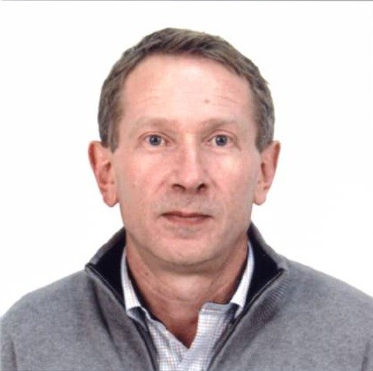
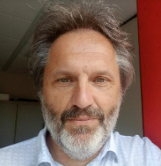
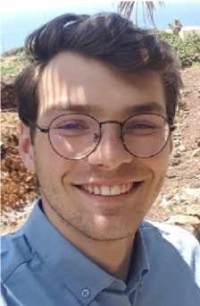
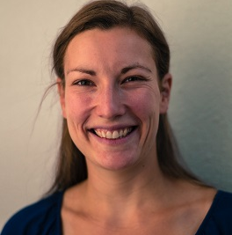

CNES consultative structures
CPS Comité des Programmes Scientifiques
President : Jean Marie Hameury, Secretary : Pascale Ultre-Guerard
Conseil Administration
CERES
Comité d’Evaluation sur la Recherche et l’Exploration Spatiales
TOSCA
Terre Océan Surfaces Continentales Atmosphères
Ph. Fondamentale
MARTIN BOUTELIER
Terre Solide
Astronomie
Syst. Solaire
PHILIPPE LAUDET
FELIX PEROSANZ
Océan
Exobio / Exoplan.
FRANCIS ROCARD
YANNICE FAUGERE
AURELIEN CARBONNIERE
Atmosphères
Soleil, Hél., Magnréto.
CHRISTIANMUSTIN
ADRIEN DESCHAMPS
CAROLE DENIEL
Sc. de la Matière
KADER AMSIF
Surfaces Continentales
Sc. de la Vie
THIERRY BRET-DIBAT
PHILIPPE MAISONGRANDE
AURELIEN SACOTTE
DELPHINE LEROUX
GUILLEMETTEGAUQUELIN-KOCH
RESEARCH LABORATORIES

Slide 9
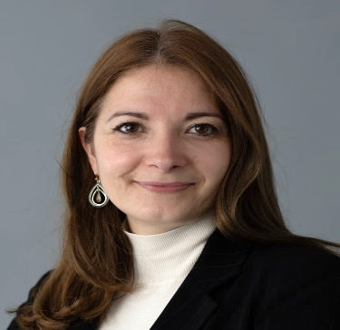
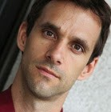
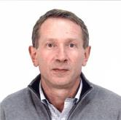


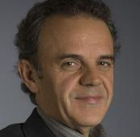
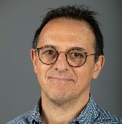


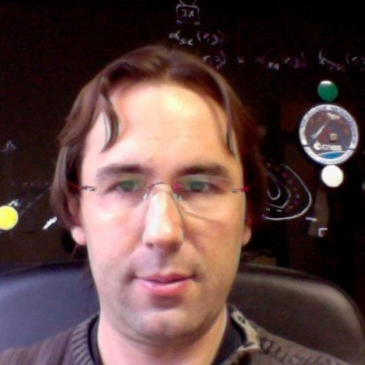

Universe science and exploration
Poste ouvert
CAROLINE BAILLY Assistante de sous-direction
OLIVIER LA MARLE Responsable Programme SCIENCE de l’UNIVERS
THIERRY BRET-DIBAT Sous-Directeur
JEAN BLOUVAC Responsable Programme EXPLORATION Et Vols Habités
Chargé de mission Montages de projet et Synthèse
PHILIPPE LAUDET Expert thématique Astronomie Astrophysique
FRANCIS ROCARD Expert thématique Système Solaire
KADER AMSIF Expert thématique Soleil, Héliosphère Magnétosphère
MARTIN BOUTELIER Expert thématique Gravité, Cosmologie, Métrologie
CHRISTIAN MUSTIN Expert thématique Expert Exobiologie-Exoplanètes
Guillaume LEGROS Expert thématique Science de la Matière en Microgravité
GUILLEMETTE GAUQUELIN-KOCH Expert thématique Sciences de la Vie

Slide 10
Perimeter evolution in thematic groups
Groupe Astronomie / Astrophysique
Groupe Physique Fondamentale
Gravité Cosmologie Métrologie
Hautes énergies
Cosmologie
Systèmes de référence
Gravitation
Milieu interstellaire
Galaxie
Cosmologie
Systèmes de référence
Physique stellaire
LiteBIRD, Euclid, BISOU

Slide 11
ESA Call M8/F3

Slide 12
M8/F3 ESA calls
Mission M8
CaC : 650 M€
Target mission:
ESA standalone mission
Expected launch year : 2041
Mission F3
CaC : 200 M€
Target mission:
ESA standalone mission
Expected launch year : 2034
Mini F
CaC : 50 M€
Target mission:
Short timeline mission(<3 years)
Passenger or companion of opportunity mission
Expected launch year : TBD
Mai 2025
Phase1 submission
Oct 2025
Phase 2 Workshop
Nov 2026
Select 5 M8 for competitive phase 0
1 F3 selected
Dec 2024
Information Workshop
Mars 2030
M8 mission selected
F3 mission adopted
2034
F3 launch
June 2025
CNES internal review
Apr 2026
CNES internal review
Mars 2025
Open the Call
Sept 2025
Select proposition for phase 2
Mars 2026
Phase 2 proposition submission
Nov 2027
3 M8 selected to continue competitive Phase A
Nov 2032
M8 mission adopted
2041
M8 launch
Link : COSMOS Briefing Meeting - Call for a Medium-size and a Fast mission opportunity - 2025 - Cosmos
Notes:
Revues CNES : 16-18 juin 2025

Slide 13
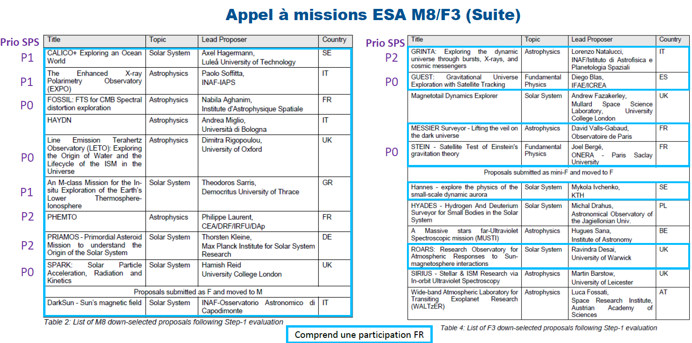
Selected missions for Phase 2

Slide 14
GCM Missions :
news, programmatic

Slide 15
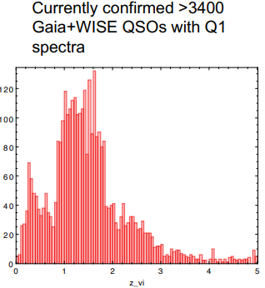
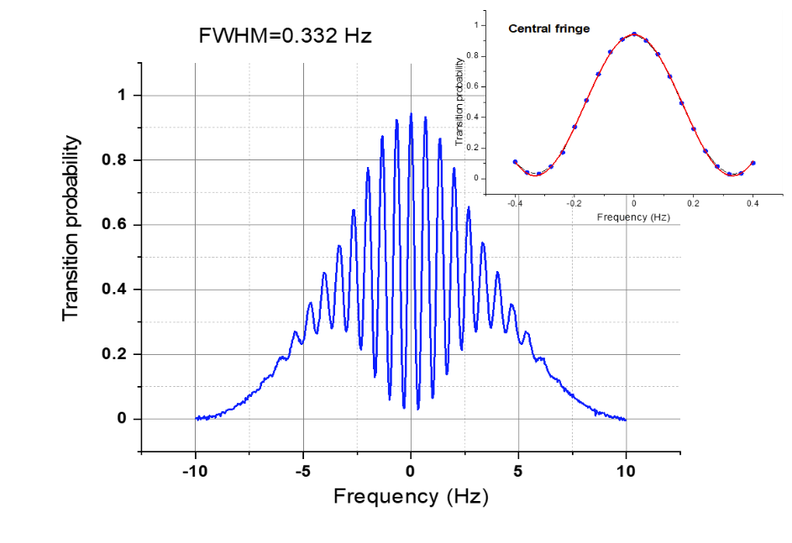
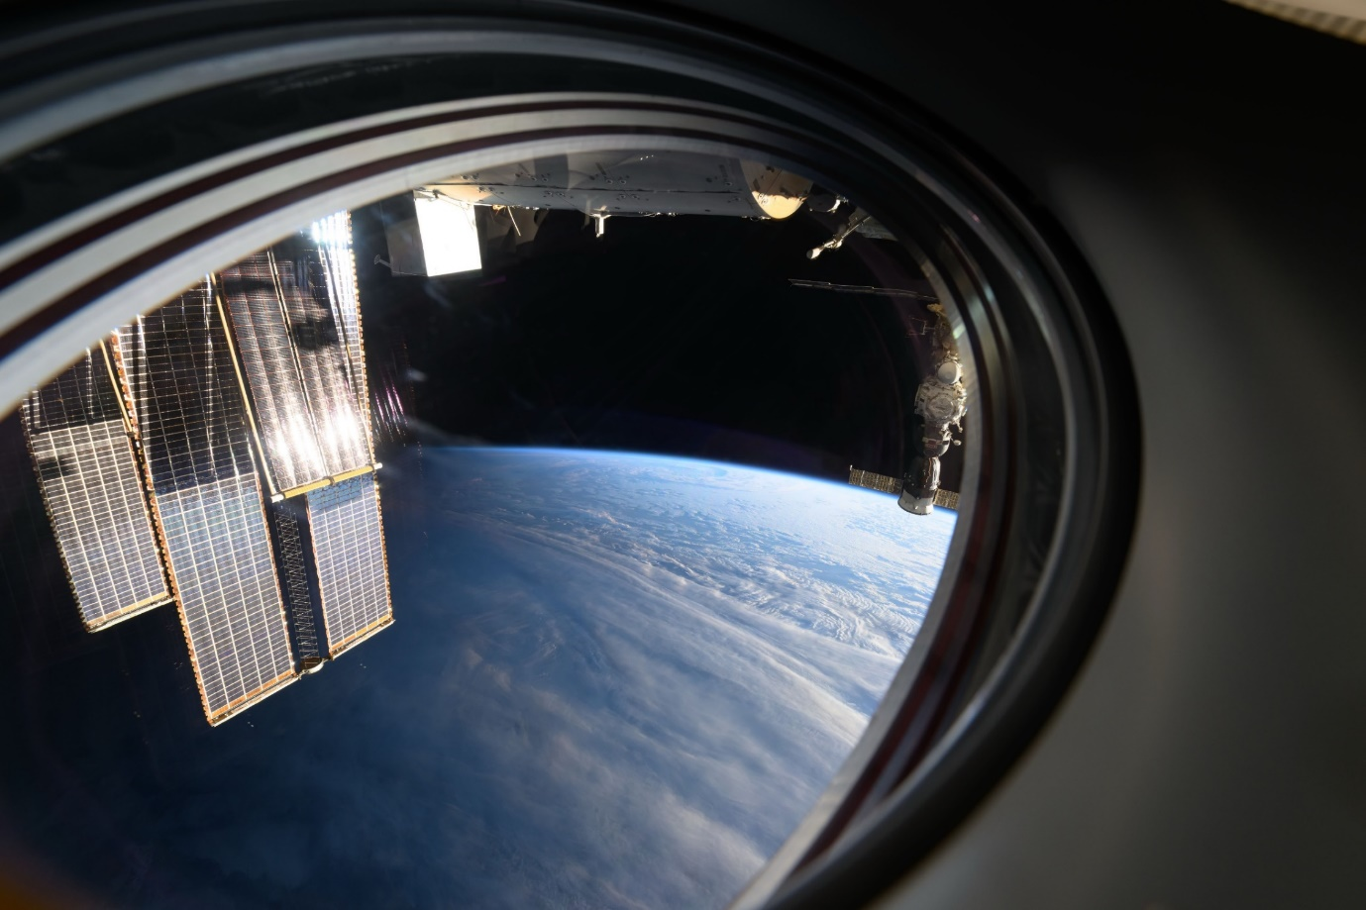
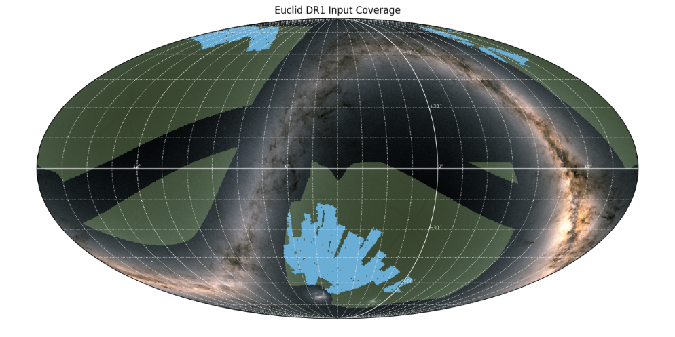
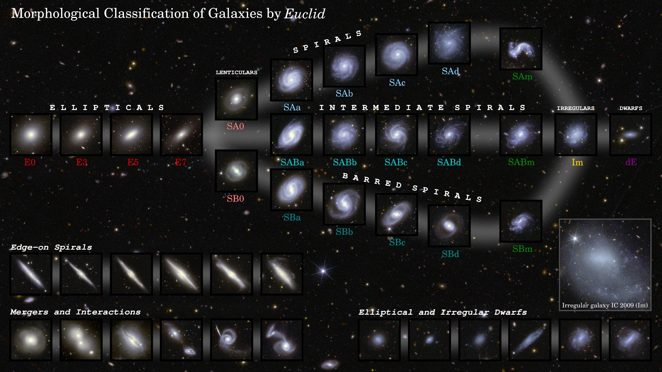
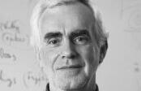
Missions in operation
Euclid (ESA – Dark Energy) - 2023
First data published and consolidation of data release dates
Q1 (63 deg.²) 19/03/2025
DR1 (1900 deg.²) 21/10/2026
DR2 Mars 2029 (+9 mois)
DR3 Octobre 2031 (+4 mois)
ESLAB 2025
Fu et al. 2025, in prep.
zoomx150
ACES (ESA – Fundamental Physic) - 2025
Launched 21st of april with Cargo SpX-32
Installed on ISS the 25th of april
Comissioning phase in progress :
Acquisition of the thinnest Ramsey fringes demonstrated the correct behavior of Pharo Clock
SHM is (almost) definitely out
Uge effort made by scientific community is done to work around SHM failure
ESA/Euclid/Euclid Consortium/NASA, Diagram by J.-C. Cuillandre, L. Quilley, F. Marleau.
DR1 (in blue)
« Wide » survey (in green)
Euclid coverage images, credit: H. Aussel/ESA/Euclid/Euclid Consortium/NASA; ESA/Gaia/DPAC. Acknowledgement: A. Moitinho

Slide 16
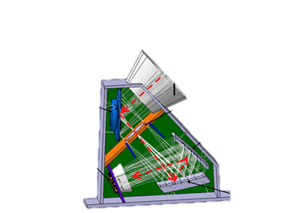
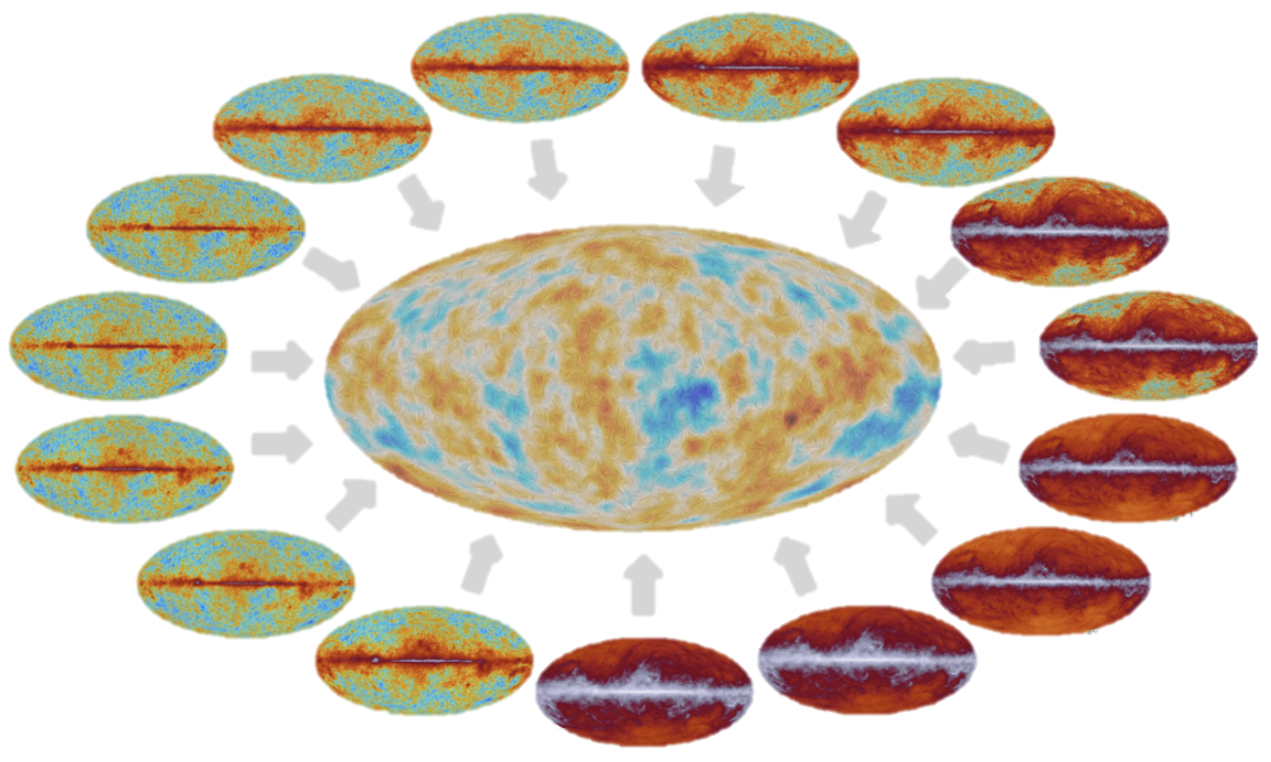
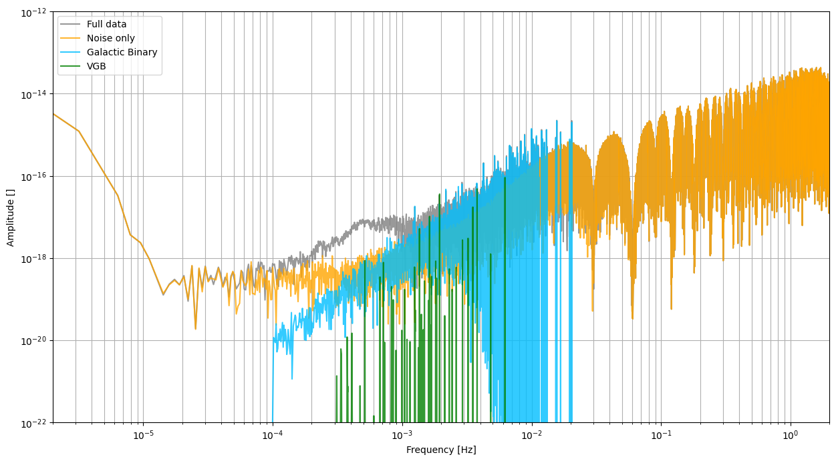
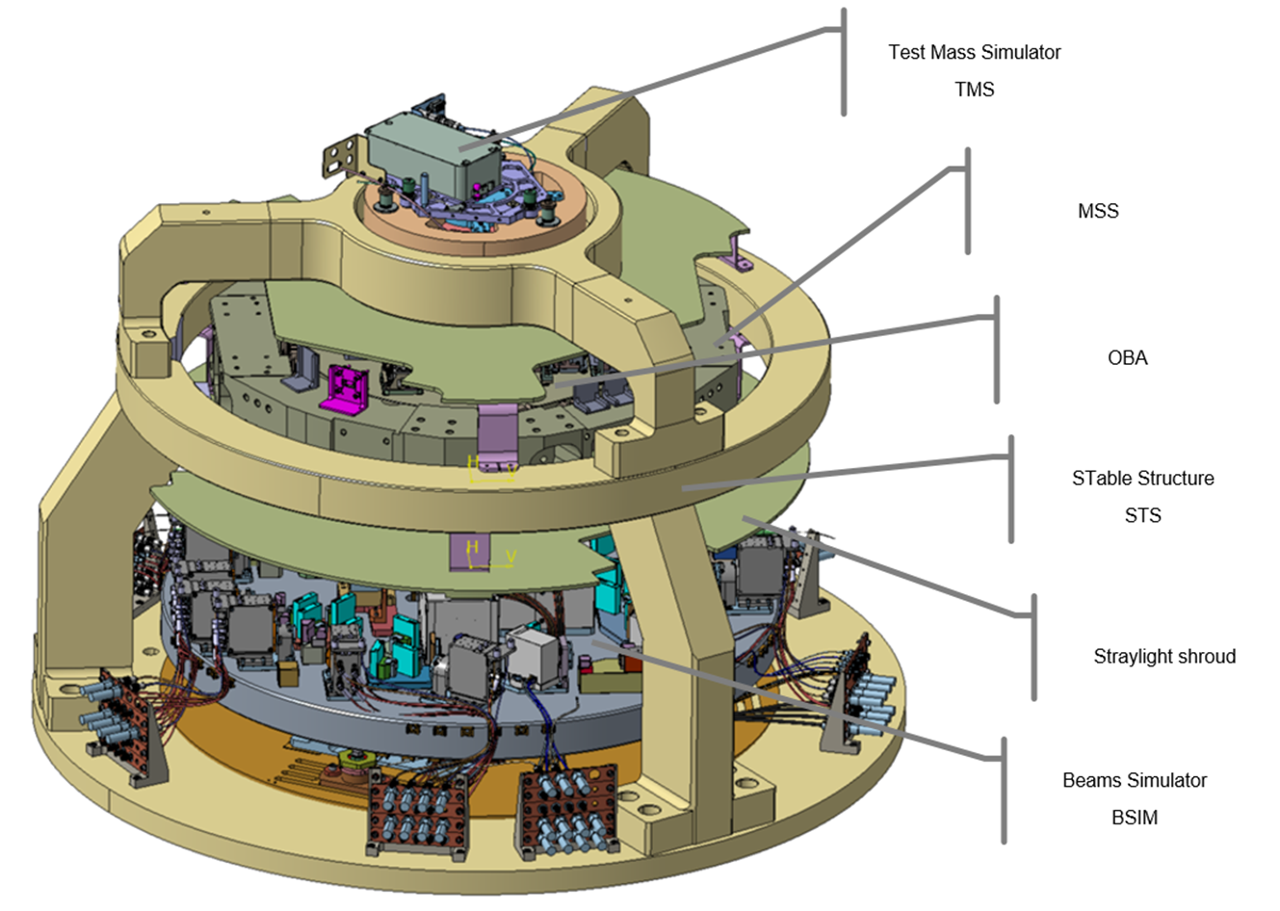
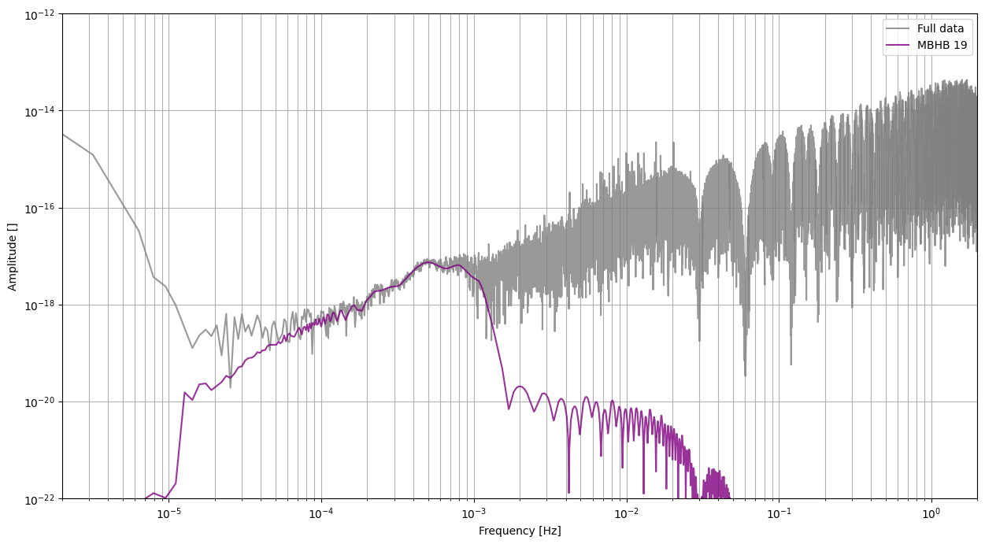
Missions in development
LISA (ESA – GW – 2035)
IDS :
Definition and prototyping of BSIM, TMS and STS nearly completed
Most of industrial contracts in place
First delivery foreseen in T3 2026
DDPC :
Definition and delivery of common data set Mojito Light
LiteBIRD (Jaxa – Inflation – 2038)
Success of KDP#2 in september, MDR foreseen in May/June 2026
CNES architecture KP 18th of June 2025
European initiative with IT, UK and NL to pave the way for EU detectors development

Slide 17
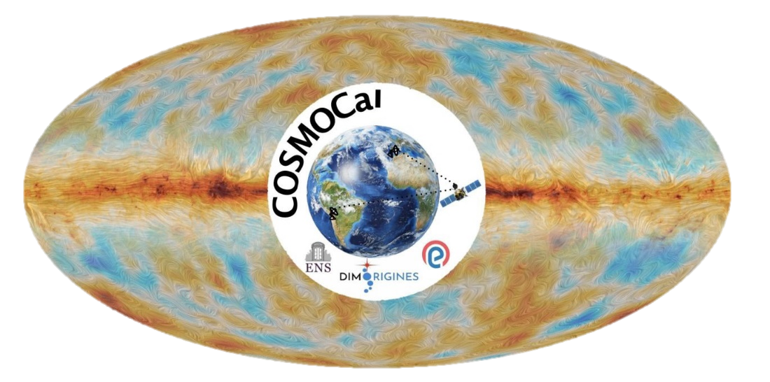
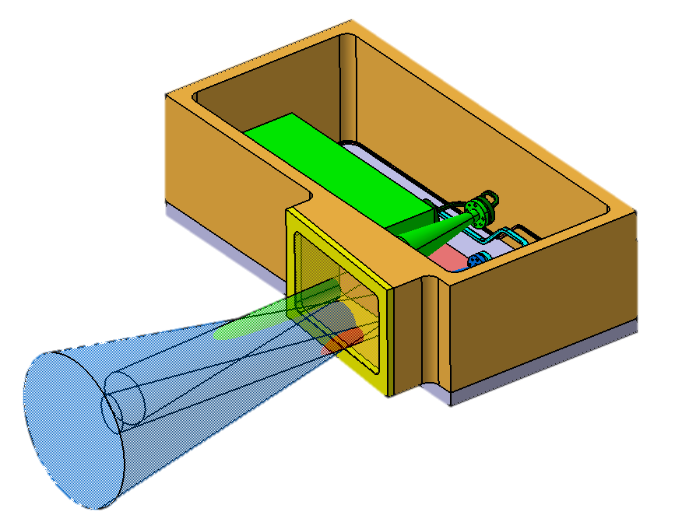
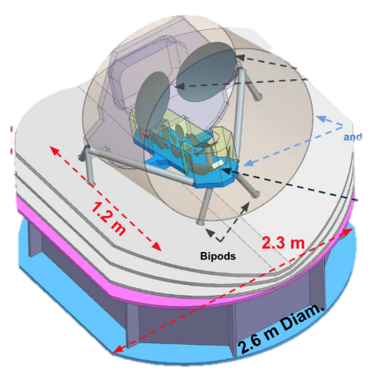
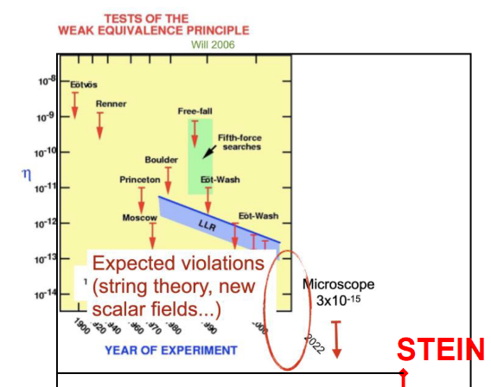

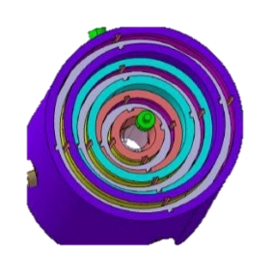
Missions in study phase
FOSSIL (ESA M8 candidate – spectral distortion – 2041)
Support from PASO to elaborate Phase 2 proposal
Cost estimation and consolidation
Consolidation of power, mass and thermal assessment
CosmoCal (FR – CMB calibration source – 2030)
Support from CNES by organizing regular reviews with CNES experts
Goal : to reach RDM maturity level by the end of 2026
STEIN (ESA F3 candidate – spectral distortion – 2034)
Support from PASO to elaborate Phase 2 proposal
Orbitography and compatibility with the LOS
Propulsion solution

Slide 18
APR process, calendar, useful information

Slide 19
2026 calls calendar
2026 | Start | End
PhD : Call for candidates for PhD and PostDoc | 02/02/2026 | 13/03/2026
PhD candidate selection by PhD directors |  | End of April 2026
PostDoc preselection by CNES thematic experts |  | Beginning of April 2026
Selected PostDoc audition |  | 18-19 May 2026
PhD/PostDoc final commission |  | 5 June 2026
APR : Appel à propositions de Recherche (no extra time foreseen) | Mid-May | Mid-June
JC1 : Journées Jeunes Chercheurs au CST | 1/04/2026 | 2/04/2026
PhD : subject submission 2026 | Mid September 2026 | Mid October 2026
JC2 : at la Cité de l’Espace | 15/10/26 (TBC) | 17/10/26 (TBC)
APR : report deadline | November 2026 | 30 November 2026
PhD : subject evaluation and ranking | Mid November 2026 | Mi December 2026

Slide 20







Prepare the FUTURe : PhD and POSTDOCS
Appel à sujets
Sélection sujets
(Comités experts)
Commission Sélection Sujets
Appel à candidatures
Sélection
candidats
Commission finale Information
candidats
Contrat de travail
CNES
Convention cofinancement CNES/Partenaires
Allocation Recherche :
Doctorat (3 ans)
Postdoctorat (1an +1)
du 15 sept
au 17 oct 2025
du 27 oct au 28 nov 2025
5 déc 2025
2 fév au 13 mars 2026
Mi-mars à
fin mai 2026
5 juin 2026
Juillet à
Octobre 2026
À partir d’octobre de N+1….
Année N
Année N+1
Années suivantes…..
2026 campaign:
368 PhD subject received (212 in 2025), 79 in SUE
30 SUE PhD subject selected
18 PhD eventually co funded by CNES
Every year :
Roughly 80 PhD and 35 PostDoc are supported by CNES contracts
PostDoc and 1/3 of PhD are CNES employees
Roughly 60 french labs are concerned every year

Slide 21

CNES PhD/Postdoc: duties and obligations
Participation to events organized by CNES for young researchers:
JC1 (01 – 02/04/2026)
JC2 (mid october 2026)
Submission of annual activity report and final report
June of year n
2 monthes after defence (PhD) or end of the 2nd year (PDOC)
For CNES employee (PDOC and some PhD student) :
Communication of holidays
Coverage mission for all mission even if it is not paid by CNES
Communication of every administrative modification
mail to postdoctorants-RH@cnes.fr,
cc martin.boutelier@cnes.fr and caroline.bailly@cnes.fr

Slide 22

APR call : general information
Some numbers - 16 themes - roughly 900 actions/an - roughly 16 M€/an
Reports (30th of november) in WORD, in french (please respect the template !) - Study report - Budget remainder - required for the administration (payments) and to prepare the global report (Livre bleu)
Livre bleu : evaluation of APR activity based on data extracted from the report (number of actions, pulications, collaborations, HR effort, etc…)
1er livre bleu (APR 2018) published in 2019
2ème livre bleu (APR 2019 & APR 2020) published in 2022
3ème livre bleu (APR 2021 & APR 2022) in preparation
Livres bleus available on : https://sciences-techniques.cnes.fr/fr/appel-propositions-de-recherche
Yearly call
Prepare Space Science program
In relation with national program and ESA projects
Related to science of the Universe, exploration, human space flight, science in microgravity and Earth Science
Your contacts
Program manager : https://sciences-techniques.cnes.fr/fr/sciences-et-techniques/politique-scientifique-du-cnes/programme-du-cnes/liste-des-thematiques-et
Administrative matter : Rapports Labos (rapportslabos@cnes.fr)
Répondre à l’appel annuel : https://appels-sciences.cnes.fr/fr
Generic mail box: AppelAPropositions@cnes.fr
Cécile Vignolles (APR process manager)
APR 2025 ⇨ more than 655 proposals and co-proposals (454 for SUE )

Slide 23
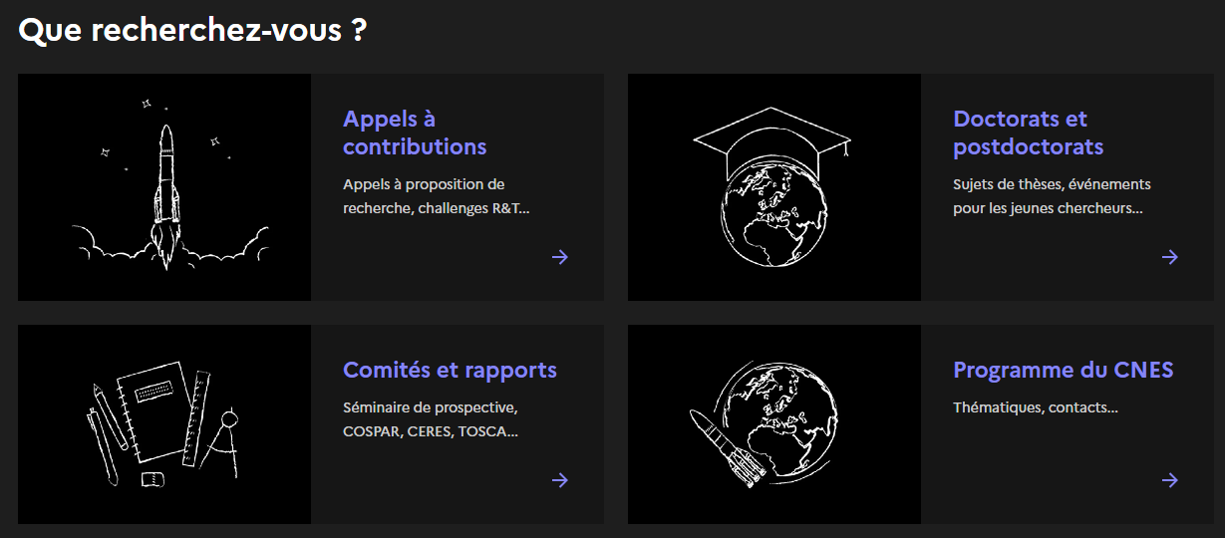
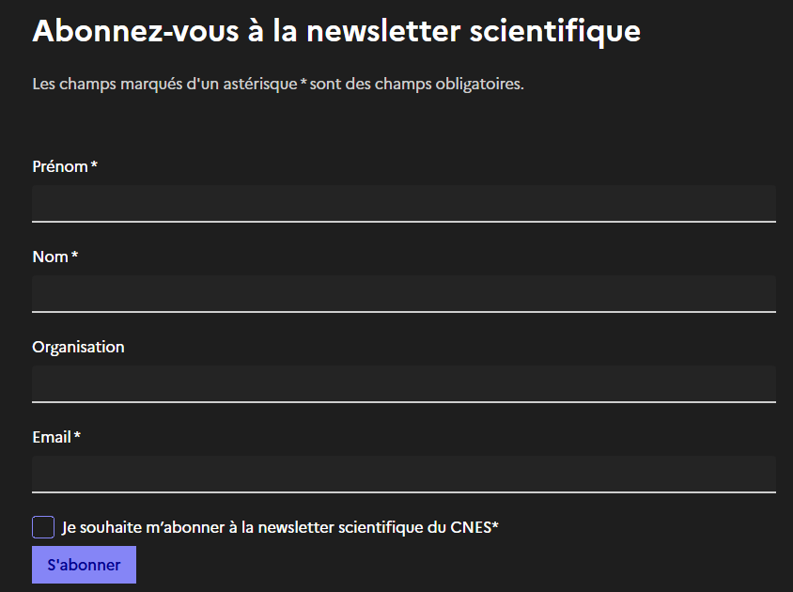
CNES scientific newsletter
All CNES scientific activities are here: Scientifiques | CNES
A specific CNES newsletter dedicated to Science can be subscribed here Newsletter scientifique | CNES
Quarterly publication
Highlights recent scientific results in
Universe Science
Exploration
Earth Observation
Contains a short summary of 6-8 scientific publications obtained with the support of CNES

Slide 24
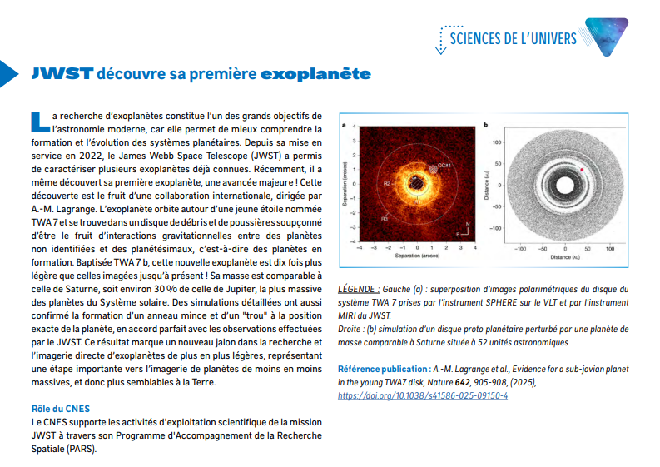
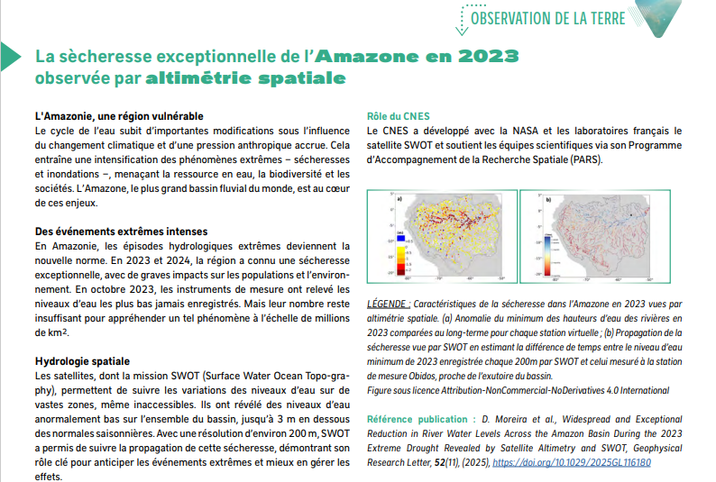
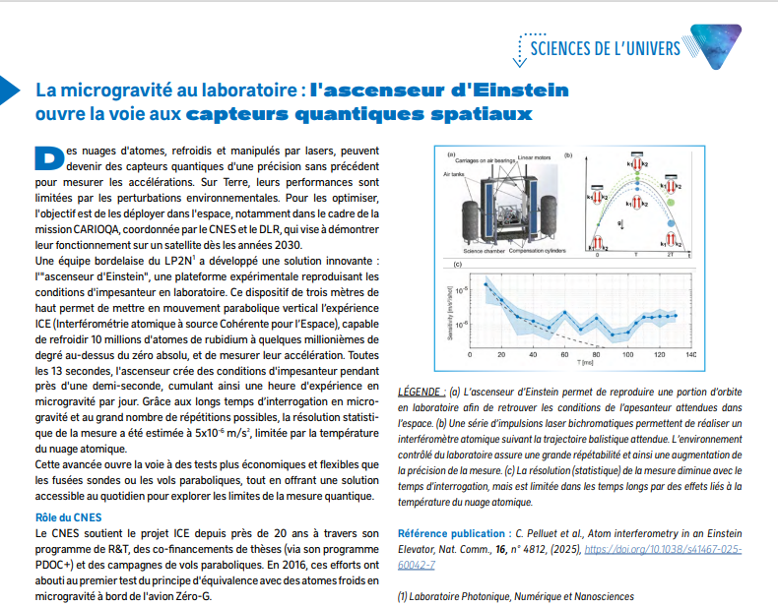
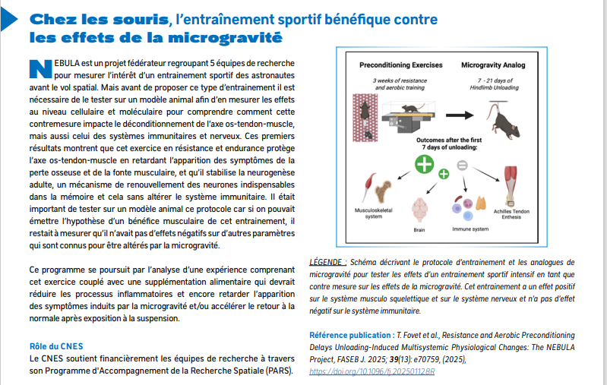
Some examples of last editions

Slide 25
GCM results : APR, PHD, PDOC

Slide 26
GCM working group members
Name | Lab | Appointment | Expertise field
PETITEAU Antoine | CEA | 2019 | Gravitational waves, data processing, LISA mission
HEES Aurélien | SYRTE | 2024 | Gravitational tests /Dark matter (in labs, solar system, galaxies), LISA
GALLI Silvia | IAP | 2024 | CMB data processing, cosmology
ASTIER Pierre | LPNHE | 2019 | Particule physics, cosmology
BERTOLDI Andrea | LP2N | 2019 | Cold atoms, 0-g, MIGA
BRAX Philippe | IPhT | 2023 | Theoretical cosmology, gravitational test
RODRIGUES Manuel | ONERA | 2022 | High precision accelerometers, weak equivalent principle
CLEVA Frédéric | ARTEMIS | 2019 | Lasers, VIRGO, LISA
ESCOFFIER Stéphanie | CPPM | 2024 | Cosmology, astroparticules
COURDE Clément | GEOAZUR | 2023 | Laser link, time transfer, space geodesy (SLR, LLR)

Slide 27
PhD subject / Post doc in GCM
PhD in 2025 :
Proposant | Laboratoire | Titre | Statut
Nicolas Martinet | LAM | Shear calibration for Euclid DR2 | Sélectionné
Stéphanie Escoffier | CPPM | Combined analysis of galaxy clustering and weak lensing with Euclid | Sélectionné
Martin Kilbinger | CEA | Machine-learning methods for weak lensing with Euclid | Abandon du candidat
Post doc in 2025 : :
Proposant | Laboratoire | Projet | Statut
Clément Leloup | IJCLab | Comprendre l'inflation cosmique par l'observation de la polarisation du CMB | Retenu
Carole Perigois | IRAP | Inferring model of the Galaxy with compact binaries observed by LISA | Liste d’attente → retenu
Monica Seglar Arroyo | L2IT | Exploring binary systems with LISA and CTAO: Multi-Messenger Insights From Gravitational Waves and Gamma Rays | Retenu
LABS TOUR 2024 – FP
Notes:
Le salaire d’un Postdoc CNES est au 1er juin 2023 2900 € brut / mois, sur 13 mois ;
Bien que l’annonce sur laquelle il faut postuler sur le site Digital Recruiters CNES mentionne Toulouse comme lieu, les postdocs seront bien dans leur labo d’accueil.

Slide 28
PhD subject / Post doc in GCM
List of PhD subject selected for 2026 :
Proposant | Laboratoire | Titre
Samuel Farrens | CEA | Unbiased Shear Estimation for Euclid
Sandrine Pires | CEA | Euclid Weak-Lensing Cluster Cosmology Inference
James Bartlett | CPB | Cosmic Census
Jerome Bobin | CEA | Methods for the rapid detection of gravitational events from LISA Data
Peter Wolf | SYRTE | Detection of dark matter using MICROSCOPE and LISA space missions
Nabila Aghanim | IAS | Preparing for CMB spectral distortion measurement with space missions
Lionel Bigot | Lagrange | Gravitational signatures of Sun's core rotation into planetary orbits
LABS TOUR 2024 – FP
Notes:
Le salaire d’un Postdoc CNES est au 1er juin 2023 2900 € brut / mois, sur 13 mois ;
Bien que l’annonce sur laquelle il faut postuler sur le site Digital Recruiters CNES mentionne Toulouse comme lieu, les postdocs seront bien dans leur labo d’accueil.

Slide 29
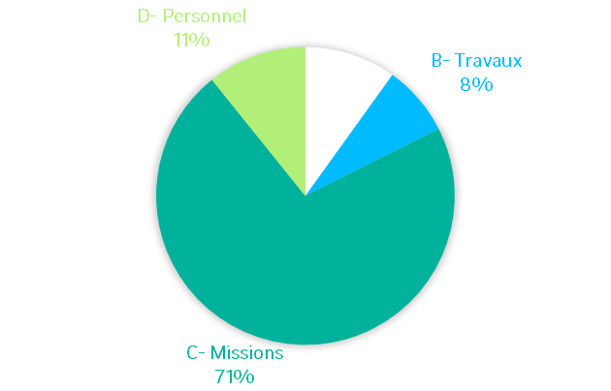
Synthesis of APR for GCM in 2025
40 evaluated proposal for a total budget of 990 k€
11 proposals to prepare the future: cold atom interferometry, strange quark matter research, M8/F3 missions preparation, radio observation on the Moon
14 proposals dedicated to support mission in exploitation: Euclid and ACES/Pharao
15 proposals dedicated to support mission in development: LISA, LiteBIRD
Budget allocation

Slide 30
Information on APR evaluation
Evolution in travel package allocation
Mission France
Voyage A/R | 300 €
Indemnité journalière | 150 €
3 jours | 750 €
5 jours | 1 050 €
7 jours | 1 350 €
Mission Europe
Voyage A/R | 400 €
Indemnité journalière | 200 €
3 jours | 1 000 €
5 jours | 1 400 €
7 jours | 1 800 €
Mission Monde
Voyage A/R | 1000 €
Indemnité journalière | 300 €
3 jours | 1 900 €
5 jours | 2 500 €
7 jours | 3 100 €
Conference fees : 400 €
Limited support to publication fees

Slide 31
Merci pour votre attention

