Slide 1

Einstein Telescope
ET-CEA IRFU
Einstein Telescope Project
Christian.olivetto@ijclab.in2p3.fr

Slide 2
Einstein Telescope
ET-CEA IRFU
Einstein Telescope Project Timelapse
ET-PP (Preparatory Phase)
ET-COMPASS
ET Project
2023-2026
2027-2029
2030- ….

Slide 3
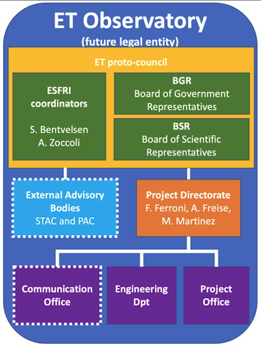
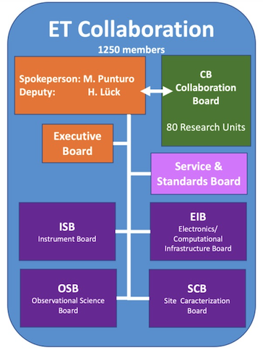
Einstein Telescope
ET-CEA IRFU
Einstein Telescope Project Timelapse
ET-PP (Preparatory Phase)
ET– Preparatory Phase
WP1: Project Management
WP2: Legal Framework
WP3: Financial Model
WP4: Site Characterization
WP5: PO & Eng Dept
WP6: Technical Designs
WP7: Innovation, Industrial Eng
WP8: Computing Model
WP9: Sustainability
WP10: Education, Outreach

Slide 4
Einstein Telescope
ET-CEA IRFU
Einstein Telescope Project Timelapse
ET-PP (Preparatory Phase)
Due date: August 2026
Postponed to November 2026
ET– Preparatory Phase
WP1: Project Management
WP2: Legal Framework
WP3: Financial Model
WP4: Site Characterization
WP5: PO & Eng Dept
WP6: Technical Designs
WP7: Innovation, Industrial Eng
WP8: Computing Model
WP9: Sustainability
WP10: Education, Outreach
ESFRI funds
Study all domains to study and deploy process in order
To consolidate the project management
Main milestones:
Legal framework
TDR
Site characterisation with requirements identified
Project management process and Infrastrcutures
Sustainability

Slide 5
Einstein Telescope
ET-CEA IRFU
Einstein Telescope Project Timelapse
ET-PP (Preparatory Phase)
Due date: August 2026
Postponed to November 2026
ETO Organisation to prepare the final operationnal management of ET
ETO upgraded begin of 2026 with CERN contracts in some
Topics (Vacuum pipe, Temporary position for Infra, configuration, schedule, …)
Main funds by NL-IT but others country funds are coming

Slide 6
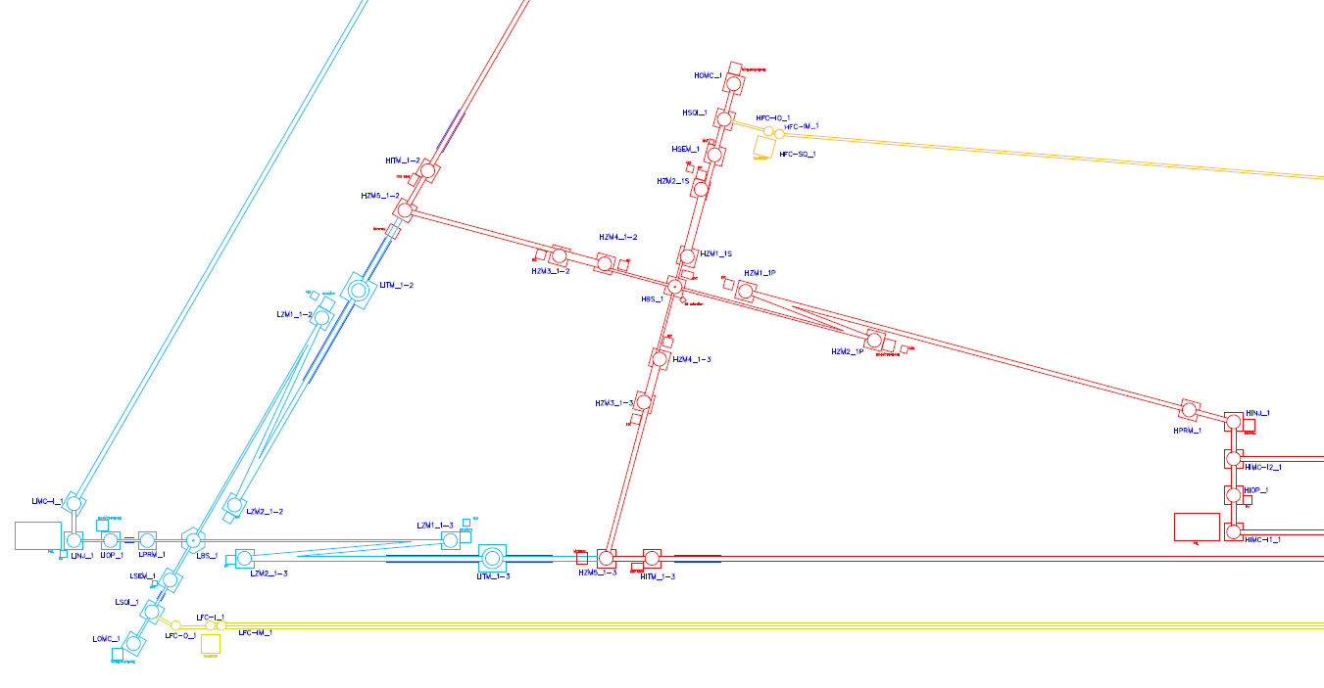
Einstein Telescope
ET-CEA IRFU
WP5: Engineering Department
Optical Layout Draft (ISB with Interferometers and Optics)

Slide 7
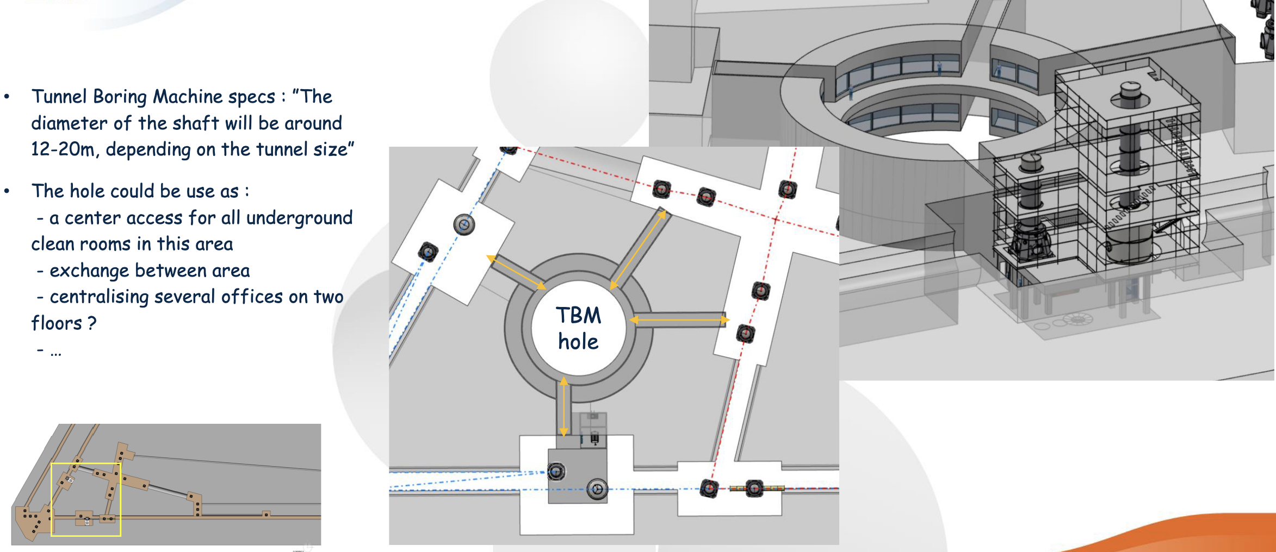
Einstein Telescope
ET-CEA IRFU
WP5: Engineering Department
Integration scenarios Studies
And strong impacts

Slide 8
Einstein Telescope
ET-CEA IRFU
WP5: Project Office
WP1: PO Management
WP2: Technical Management
WP3: Safety Management
Project Office Organization in internal Work Package
Al management domains are studying
The goals is to study, tests (if possible) and compare
all process or tools
Each domain has to produce a Management Plan
WP4: Scope Management
WP5: Schedule Management
WP6: Ressource & Financial
WP7: Quality Assurance Mgt
WP8: Risks Management
WP9: Configuration Mgt

Slide 9
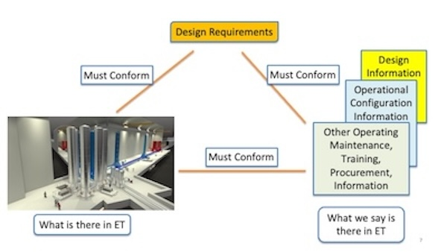
Einstein Telescope
ET-CEA IRFU
WP5: Project Office – Configuration example

Slide 10
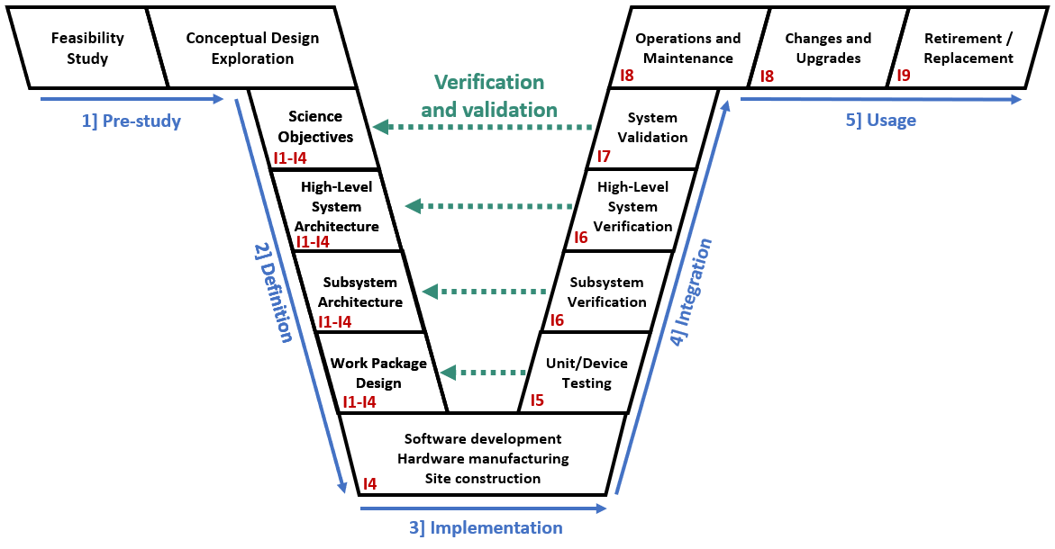
Einstein Telescope
ET-CEA IRFU
WP5: Project Office – System Engineering (Requirements-Interfaces)

Slide 11
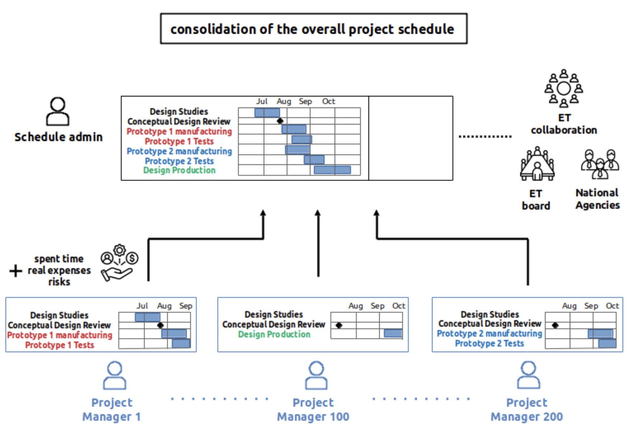
Einstein Telescope
ET-CEA IRFU
WP5: Project Office – Schedule, Budget, HR Reporting
Project Management Process for
Schedule upgrade in real time (more than 200 PM in //)
Budget estimated and real
HR reporting end of each month
Dashboard, graphics, indicators readable by all collaborators (2000) and National Agencies.

Slide 12
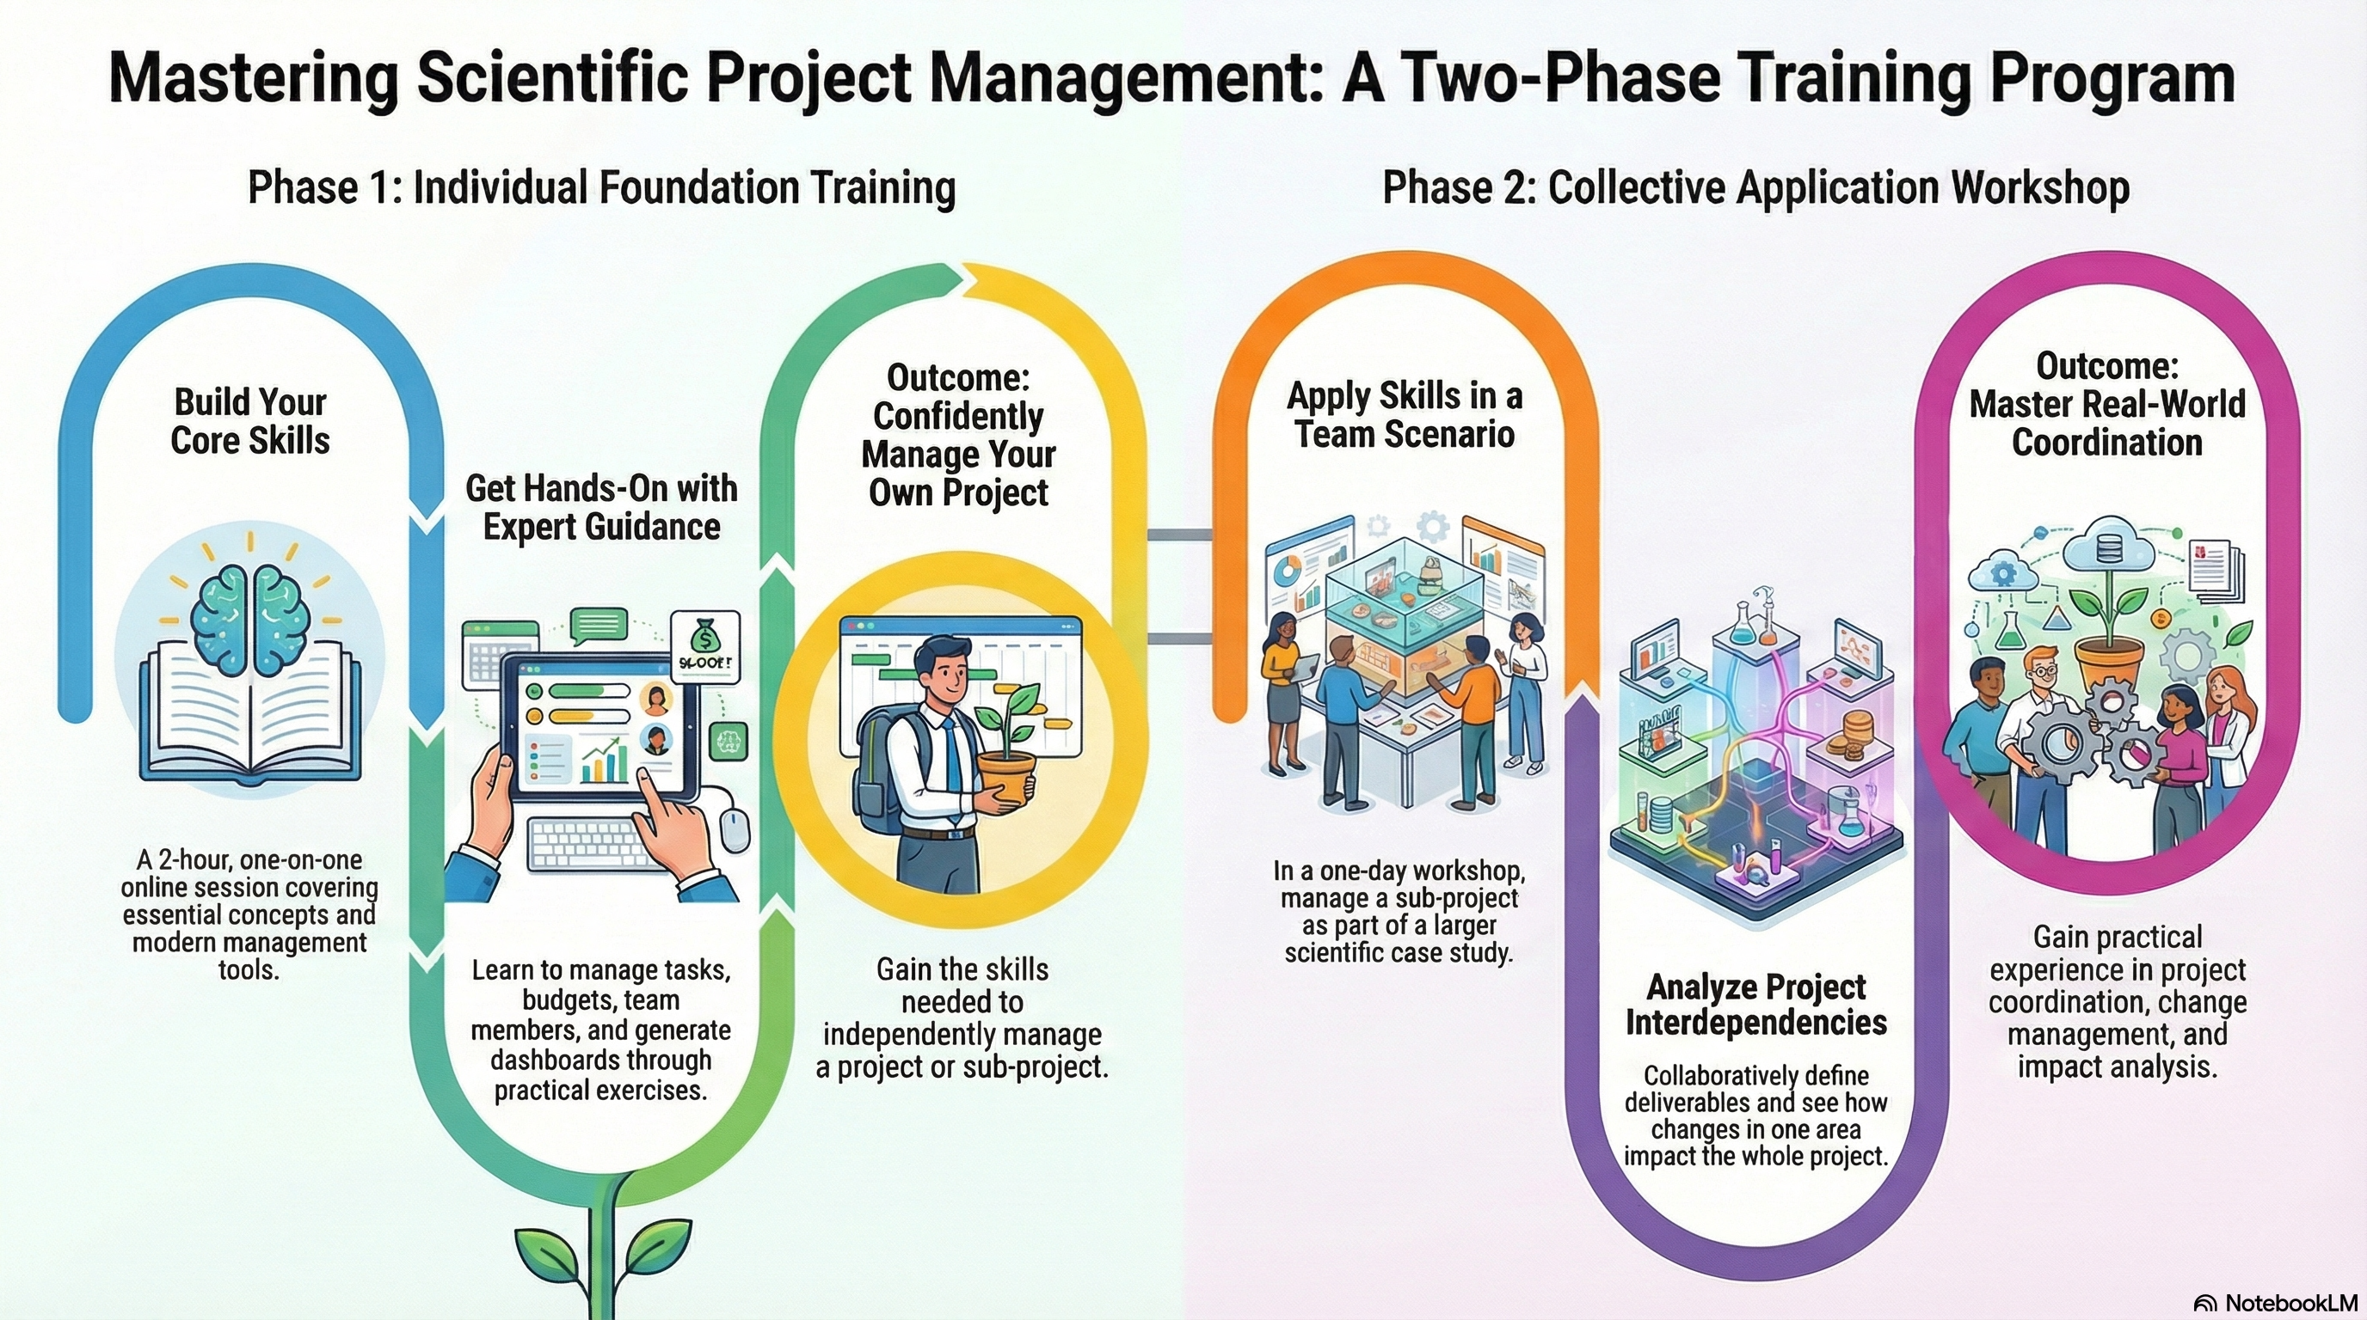
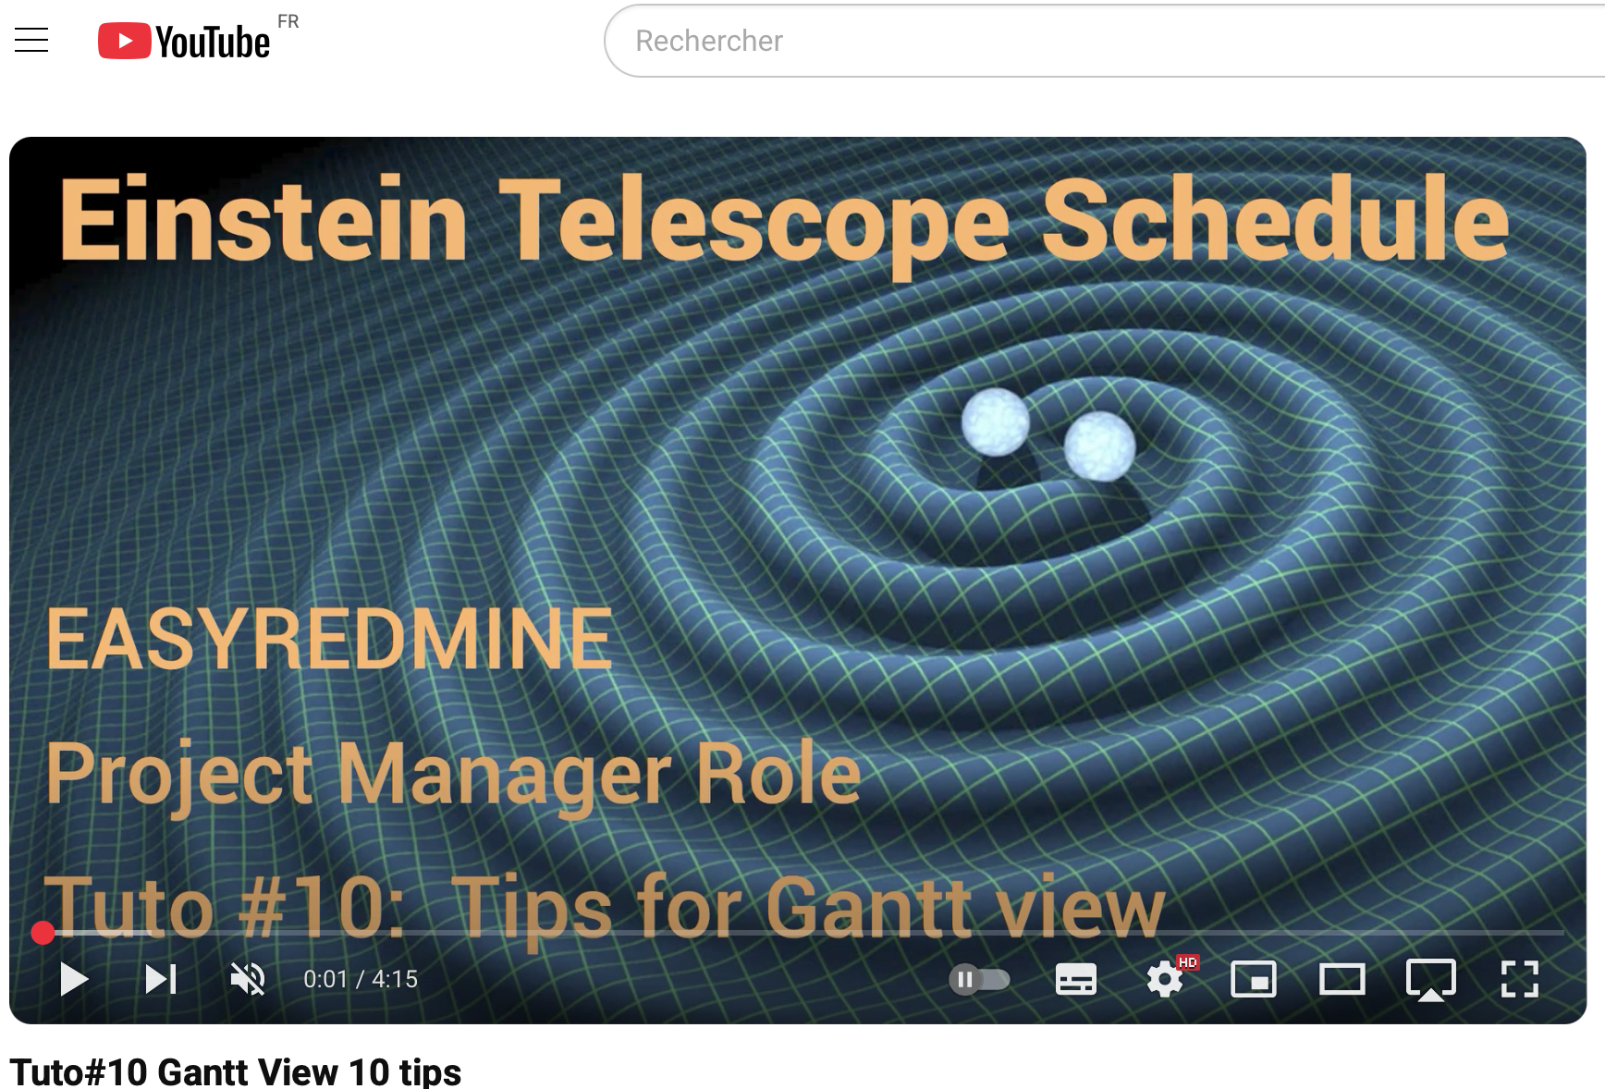
Einstein Telescope Organisation
ET Schedule Training March 26/27 2026

Slide 13
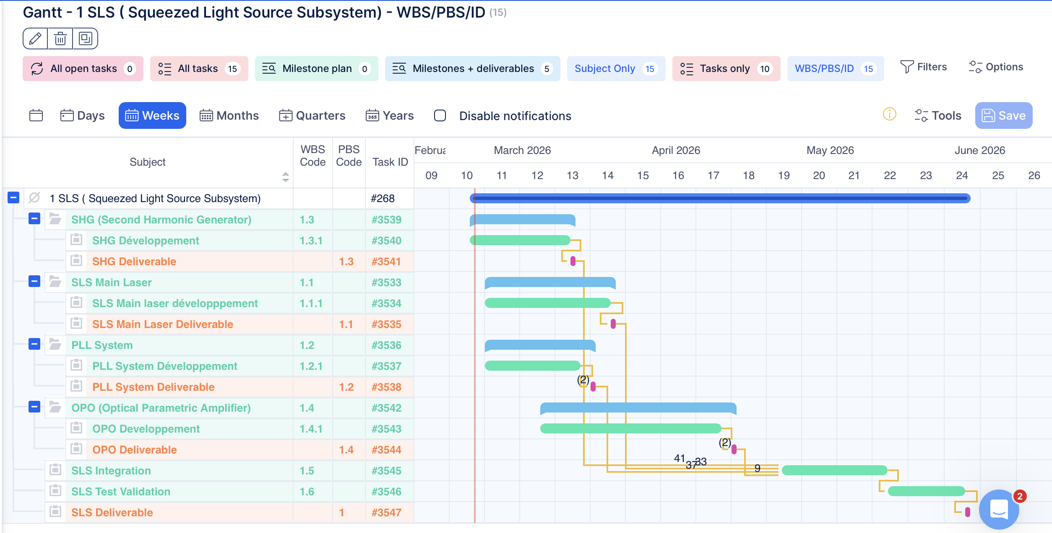
Einstein Telescope Organisation
ET Schedule Training March 26/27 2026
Main Task in Blue
Deliverable in purple
To simplify the organisation
Each subsystem has a
Integration task &
Validation task

Slide 14
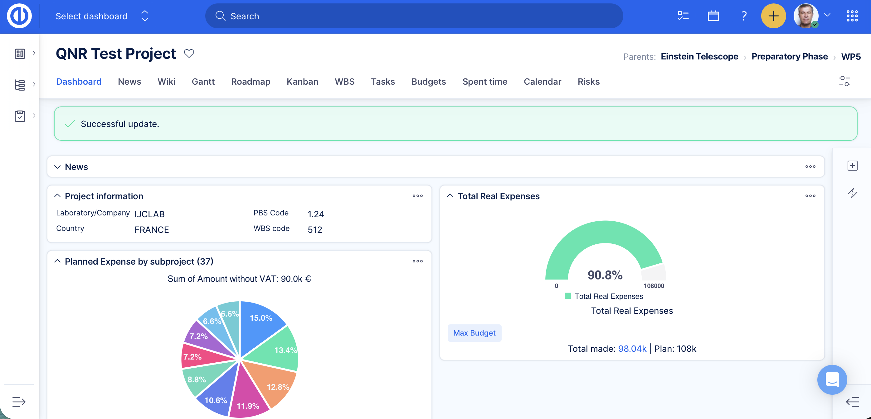
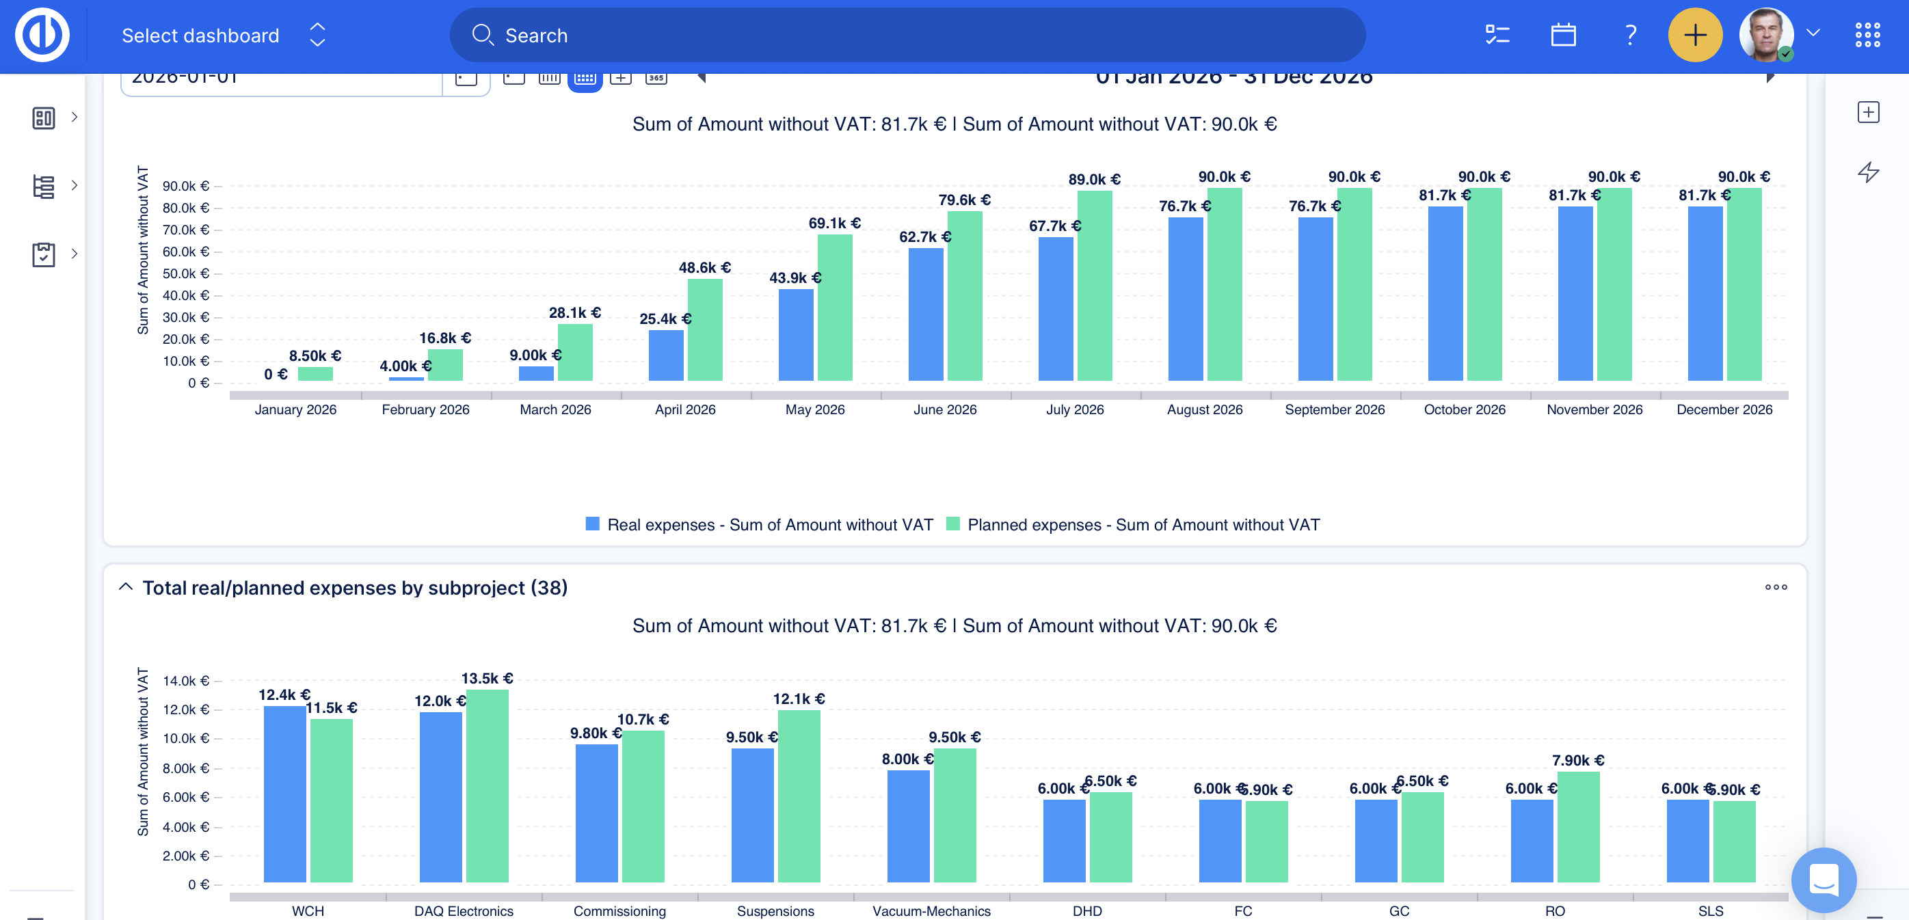
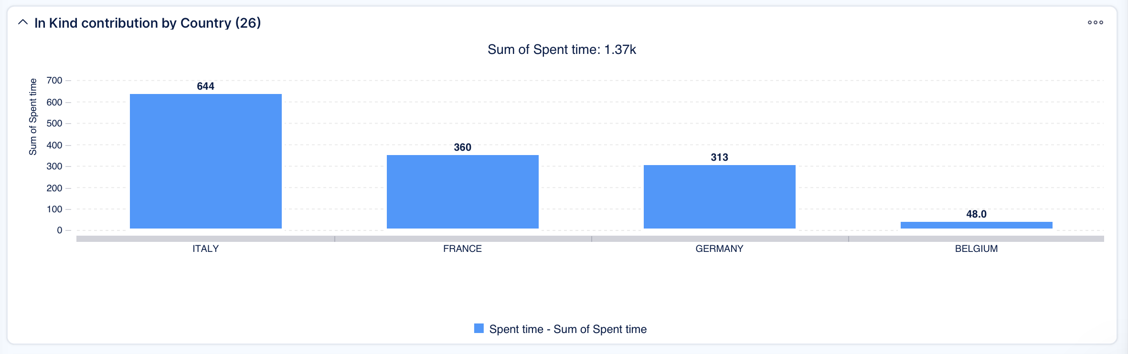
Einstein Telescope Organisation
ET Schedule Training March 26/27 2026

