Slide 1
Dressing factor
in integrable
AdS/CFT system
Dmytro Volin
arXiv:0904.4929
arXiv:1003.4725
x
x
x
x
x
x
x
x
x
x
x
-2g
x
x
x
2g
x
x
x
x
x
x
x
x
Annecy, 15 April 2010
Notes:
Good evening.
Today I would like to tell you about explicit calculations that verify the Maldacena’s conjecture.

Slide 2

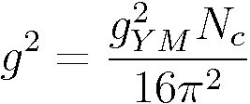


In the last decade we learned how to calculate certain nontrivial quantities in one 4-dimensional theory
This theory is
How we learned this?
1) AdS/CFT duality
2) Integrability
= IIB, AdS₅xS⁵
g=0
g = 1
Local operators
=
String states
Conformal dimension
=
Energy
x
.
.
AdS₅
S⁵
.

Slide 3




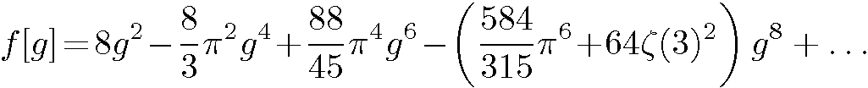
Example 1:
Cusp anomalous dimension
[Beisert, Staudacher, 03]
[Beisert, 03-04]
[Moch, Vermaseren, Vogt, 04]
[Lipatov et al., 04]
[Bern et al., 06]
[Cachazo et al., 06]
[Beisert, Eden, Staudacher, 06]
[Gubser, Klebanov,
Polyakov, 02]
[Frolov, Tseytlin, 02]
[Roiban, Tseytlin, 07]
[Klebanov et al, 06]
[Kotikov,Lipatov, 06]
[Alday et al, 07]
[Kostov, Serban, D.V., 07]
[Beccaria, Angelis, Forini, 07]
[Casteill,
Kristjansen, 07]
[Belitsky, 07]
(not from BES)
[Basso, Korchemsky,
Kotanski, 07]
[Kostov, Serban, D.V., 08]
[Benna, Benvenuti, Klebanov, Scardicchio, 06]

Slide 4

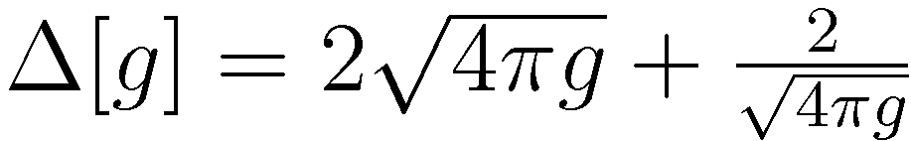
Example 2:
Anomalous dimension of Konishi state
[Gromov, Kazakov, Kozak, Vieira, 09]
[Arutyunov, Frolov, 09]
[Bombardelli, Fioravanti, Tateo, 09]
[Fiamberti, Santambrogio, Sieg , Zanon,,’08]
[Bajnok, Janik,’08]
[Bajnok, Hegedus, Janik, Lukowski’09]
[Arutyunov, Frolov’ 09]
[Roiban, Tseytlin, 09]
Only numerics and discrepancy with string
[Gromov, Kazakov, Vieira, 09]
[Rej, Spill, 09]
[Gromov, Kazakov, Vieira, 09]

Slide 5
Plan for this talk
Asymptotic Bethe Ansatz for
SU(2)£ SU(2) PCF
2. Asymptotic Bethe Ansatz for
spectral problem of AdS/CFT
→ Dressing phase and
analytical structure
3. Thermodynamic BA for
SU(N)£ SU(N) PCF
4. Thermodynamic BA for
spectral problem of AdS/CFT
x
x
x
x
x
x
x
x
x
-2g
x
x
x
x
x
2g
x
x
x
x
x
x
x
x

Slide 6
Part I
Asymptotic Bethe Ansatz for
SU(2)£ SU(2) PCF

Slide 7


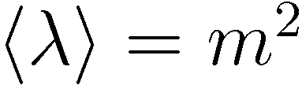
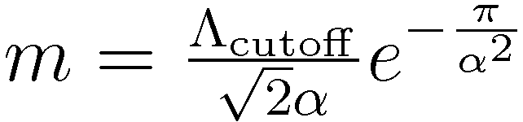
SU(2)£ SU(2) PCF is equivalent to the O(4) vector sigma model
Target space is
There is a dynamically generated mass scale
Particle content of the theory: massive vector multiplet of O(4).

Slide 8



Polyakov showed presence of infinitely many conserved charges
[Polyakov ’75]
No particle production
Only permutation of the momenta
Factorization of scattering
Completely know scattering process if the scattering matrix is known

Slide 9
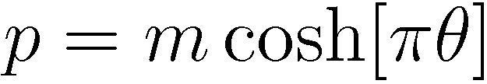
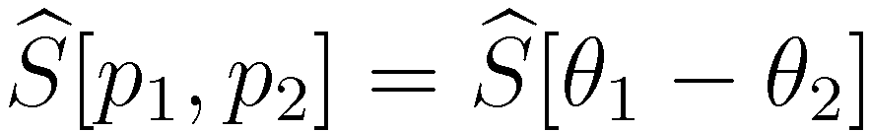
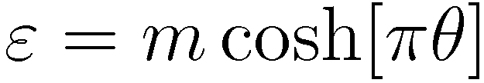

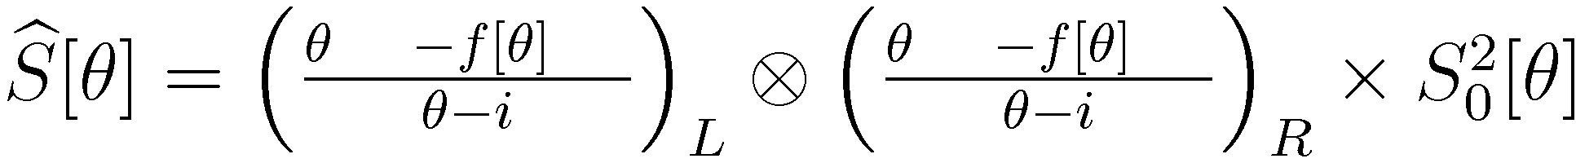

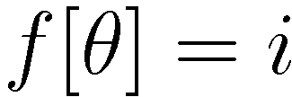
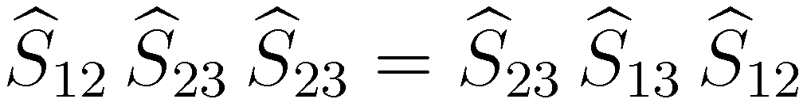
Can uniquely fix the S-matrix
Lorenz invariance
Invariance under the SU(2)£SU(2) symmetry:
Yang-Baxter equation
Bootstrap approach
[Zamolodchikov, Zamolodchikov ’77]

Slide 10
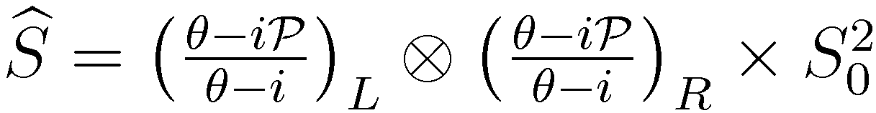
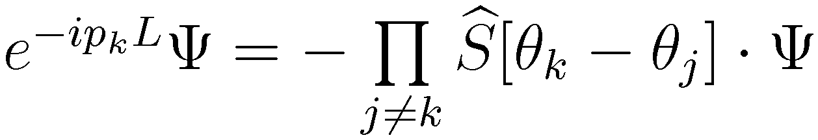

Asymptotic Bethe Ansatz
Number of particles is conserved. Therefore we can use a first quantization language and describe scattering in terms of wave function.
Periodicity condition is realized as:
Algebraic part of S-matrix, , is the same as R-matrix of
Heisenberg XXX spin chain. Diagonalization of periodicity condition – the same as albraic Bethe Ansatz in XXX.

Slide 11




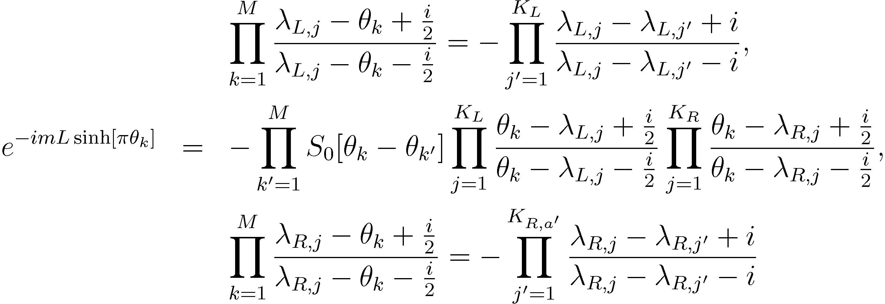
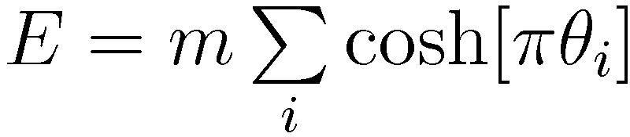
Asymptotic Bethe Ansatz
Solve Beth Ansatz and find spectrum:

Slide 12
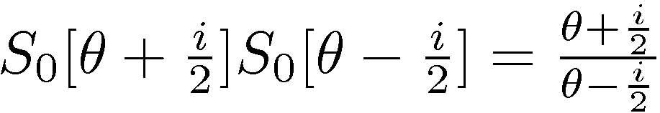

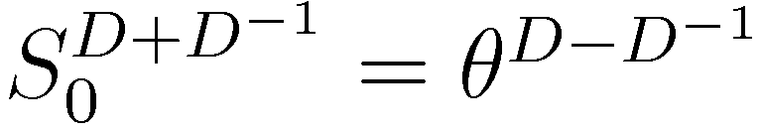
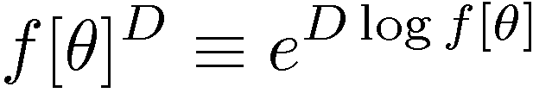
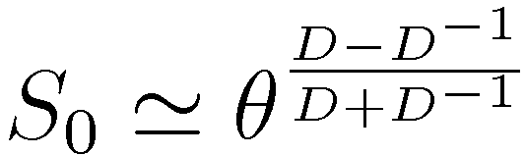
Fixing the scalar factor
Unitarity and crossing conditions require:
Solution of crossing:

Slide 13
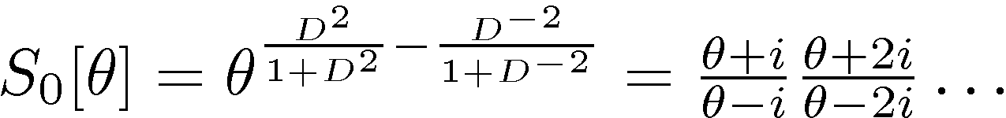
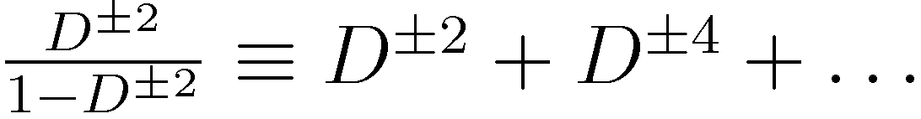
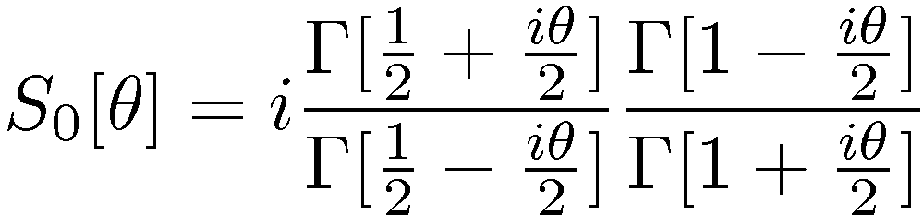
Fixing the scalar factor
How give a sense to this expression?
Particle content → analytical structure in the physical strip
µ
i
0
S-matrix is completely fixed!

Slide 14
Part II
Asymptotic Bethe Ansatz in
spectral problem of AdS/CFT

Slide 15
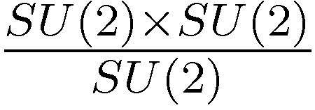
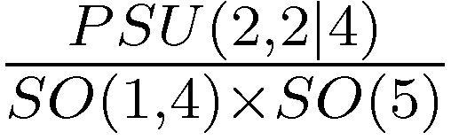
Integrability in AdS/CFT
SU(2)£ SU(2) PCF is a sigma model on a coset
Type IIB string theory (1st quantized only) is described by a coset sigma model
J
x
AdS₅
S⁵
Difference: in AdS/CFT we are dealing with a string sigma model
need to pick a nontrivial string solution from the beginning
standard choice: BMN string: a point-like string encircling the equator of S⁵ with angular momentum J.
The symmetry is broken (both symmetry of target space and relativistic invariance)
SU(2)£ SU(2)£ Poincare
Elementary excitations: Oscillations around the BMN solution. Mass is due to the centrifugal force, not due to the dimensional transmutation.

Slide 16
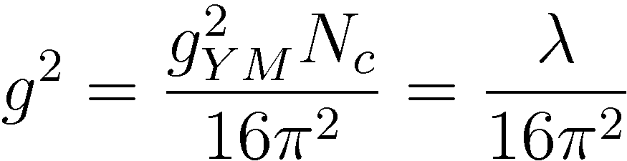
Integrability in AdS/CFT
J
x
AdS₅
S⁵
Integrability [Staudacher, 04]
    was observed
    classically on the string side (g is large) [Bena, Polchinski, Roiban, 04]
    at one-loop and partially up to three loops on the gauge side (g is small)
[Minahan, Zarembo, 02]
[Beisert, 04]
    was conjectured to hold on the quantum level
    [Beisert, Kristjansen, Staudacher 03]
    has nontrivial checks of validity up to
    2 loops on the string side […………………….]
    5 loops on the gauge side […………………….]

Slide 17
Integrability in AdS/CFT
J
x
AdS₅
S⁵
If integrability holds on the quantum level, let us apply bootstrap approach
                [Staudacher’04]
Algebraic part of 2-particle S-matrix is fixed using
Can then apply Bethe Ansatz technis.
[Beisert’04]

Slide 18
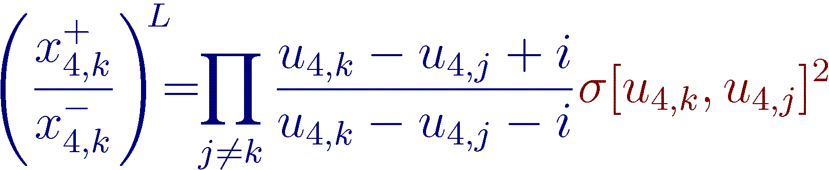
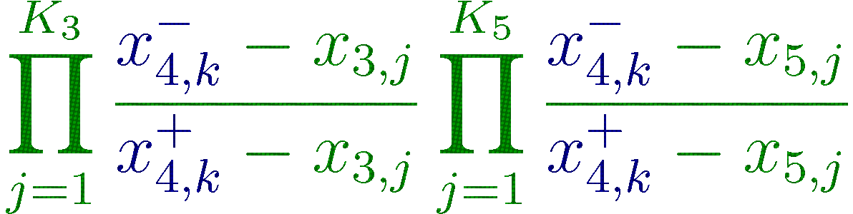
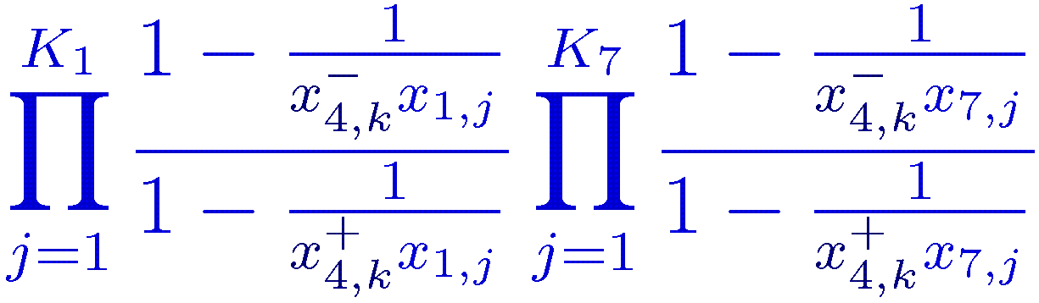
Bethe Ansatz in AdS/CFT (Beisert-Staudacher Bethe Ansatz)
[Beisert, Staudacher, 03]
[Beisert, 03-04]
[Arutyunov, Frolov, Zamaklar, 06 ]
u₁
The symmetry fixes the form of the Bethe equations up to a scalar factor (dressing factor):
u₂
u₃
u₄
PSU(2,2|4)
u₅
u₆
u₇

Slide 19
Some history…
Solution up to the dressing factor
Dressing factor is not trivial
The dressing factor is constrained by the
crossing equations
Asymptotic strong coupling solution for crossing .
Exact expression (BES/BHL proposal)
Useful Integral representations
…… getting experience ……
Check that BES/BHL satisfy crossing
Direct solution of crossing equations
[Beisert, Staudacher, 03]
[Beisert, 03-04]
[Arutyunov, Frolov, Staudacher, 04]
[Hernandez, Lopez, 06]
[Janik, 06]
[Beisert,Hernandez, Lopez 06]
[Beisert,Eden, Staudacher 06]
[Kostov, Serban, D.V. 07]
[Dorey, Hofman, Maldacena, 07]
[Arutyunov, Frolov, 09]
[D.V. 09]

Slide 20
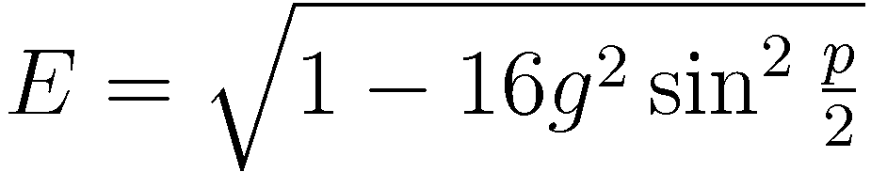
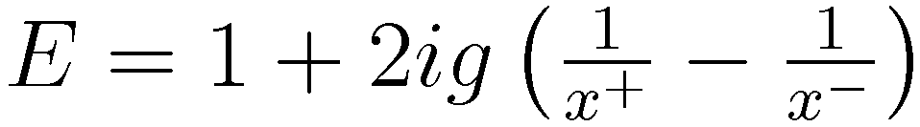
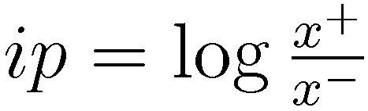
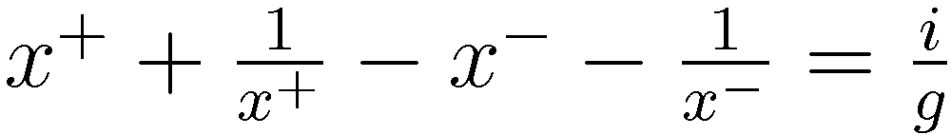
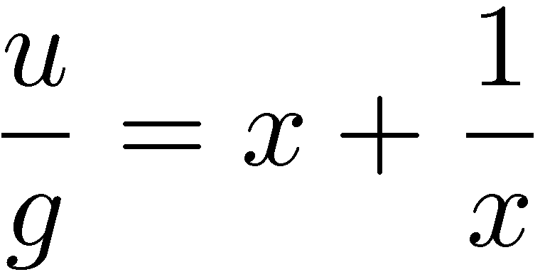

Dispersion relation
Zhukovsky parametrization
u
-1
o
1
-2g
2g
x
x

Slide 21
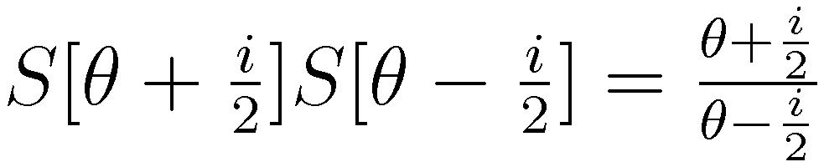
Crossing equations
Relativistic case:
Shift by i changes sign of E and p

Slide 22
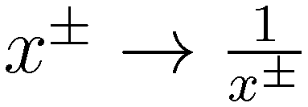





Crossing equations
AdS/CFT case:
u
cross
-1
o
1
-2g
2g
2g+i/2
A
x
x
-2g+i/2
[Janik, 06]

Slide 23


Solution of crossing equations
u
cross
2g+i/2
A
-1
o
1
-2g
2g
x
x
-2g+i/2
Assumptions on the structure of the dressing factor:
Decomposition in terms of Â:
Â is analytic for |x|>1
All branch points of Â (as a function of u) are of square root type. There are only branch points that are explicitly required by crossing.
Â→ const, x→ 1

Slide 24


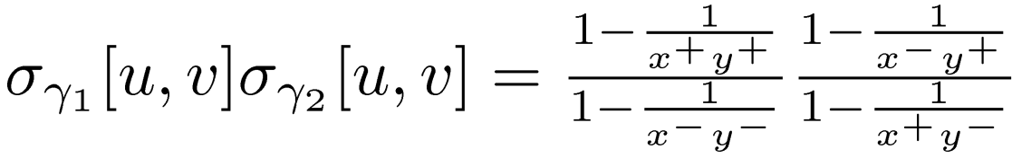
Solution of crossing equations
cross
A
B
Complication with crossing equation: We do not know analytical structure of Â for |x|<1.
Solution: analytically continue the equation through the contour
Resulting equations are:

Slide 25
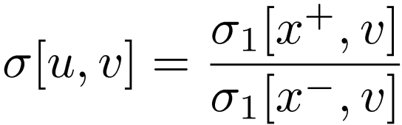
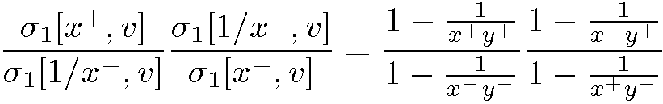
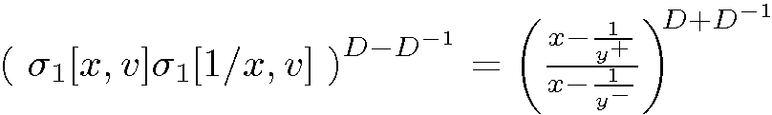
Solution of crossing equations
cross
A
B

Slide 26
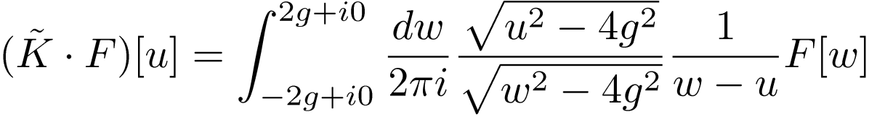
Solution of crossing equations
If the dressing factor satisfies the assumptions given above then it is fixed uniquely and coincides with the BES/BHL proposal
It is given by the expression:
This Kernel creates Jukowsky cut. The main property of the Kernel:
u+i0
-2g
u-i0
2g

Slide 27
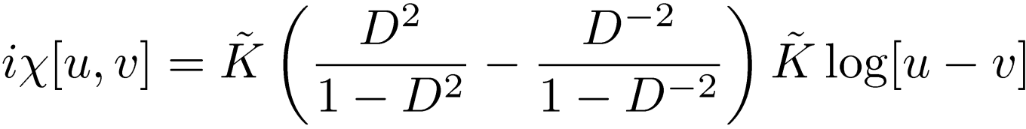
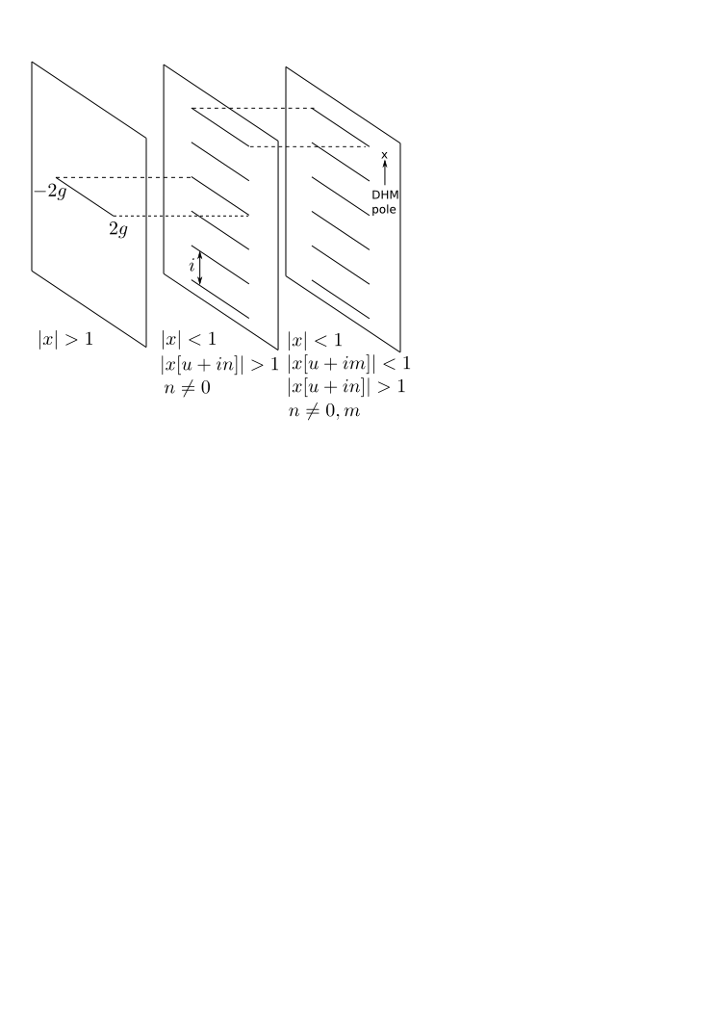
Analytical structure of the dressing factor

Slide 28
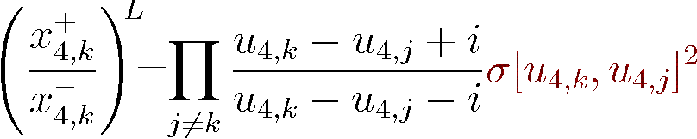
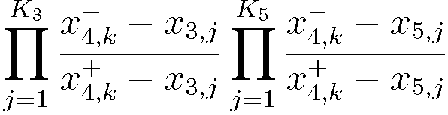
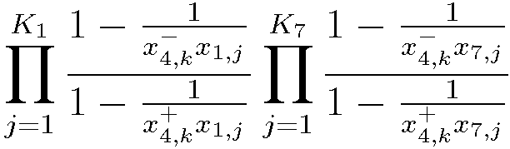
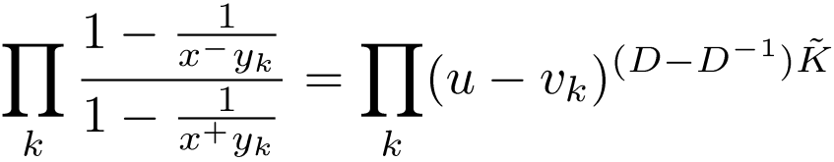
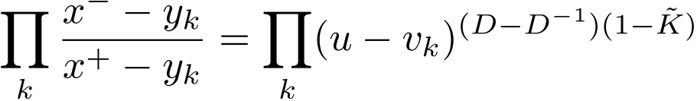


Simplified form of Bethe Ansatz equations
We can write these equations in a more suggestive form using the properties:
The Bethe equations in the Beisert-Staudacher Bethe Ansatz can be written in terms of difference function (u-v) in the power of a rational combination of the operators and .

Slide 29
Part III
Thermodynamic Bethe Ansatz (TBA) for
SU(N)£ SU(N) PCF

Slide 30




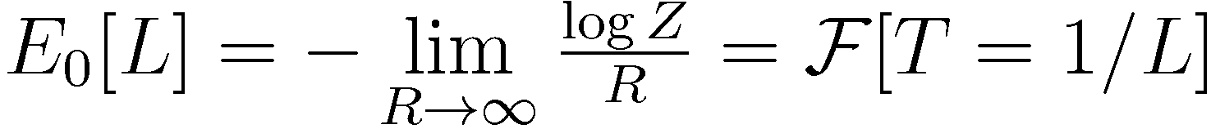
Basic idea of TBA

Slide 31
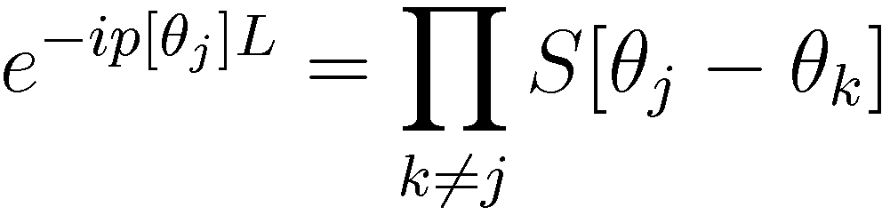





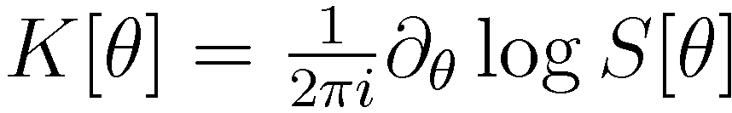
Basic idea of TBA
To calculate free energy at finite temperature one needs to know how to solve Bethe Ansatz equatons in the thermodynamic limit (many Bethe roots)
-5
-4
-3
-2
-1
0
1
2
3
4
5
6
particles
- holes

Slide 32




Example: XXX spin chain
Define:

Slide 33





Example: XXX spin chain
Where did we see such formulas?

Slide 34




General situation: SU(N) XXX spin chain
1
2
N-1
Each type of Bethe root can be real or form a string combination
density of strings of length s formed from Bethe roots of type a
- corresponding resolvent

Slide 35




General situation: SU(N) XXX spin chain
Integral equations can be rewritten as:
The Case of GN model:

Slide 36


General situation: SU(N) XXX spin chain
Integral equations can be rewritten as:
The Case of PCF model:

Slide 37





General situation: SU(N) XXX spin chain
TBA

Slide 38
Part IV
Thermodynamic Bethe Ansatz (TBA) in
spectral problem of AdS/CFT

Slide 39


General situation: rational Gl(N|M) spin chain
1
0
0
0
0
0
0
[Saleur, 99]
[Gromov, Kazakov, Kozak, Vieira, 09]
[D.V., 09]

Slide 40

General situation: rational Gl(N|M) spin chain
0
0
1
0
0
0
0
[Saleur, 99]
[Gromov, Kazakov, Kozak, Vieira, 09]
[D.V., 09]

Slide 41
AdS/CFT case
0
0
0
1
0
0
0
But AdS/CFT is like this
Problems?

Slide 42




AdS/CFT case
    No relativistic invariance H_{¾}≠ H¿
    … but mirror theory can be also solved if to suggest integrability
The same symmetry , therefore bootstrap is the same
Dispersion relation is reversed
Dispersion relation in terms of x is the same :
But different branches of x⁺ and x⁻ are chosen:
Physical
-2g
2g
Mirror
-2g
2g

Slide 43



Bethe Ansatz are written using the blocks:
Changing of the prescription about the cuts is completelly captured by the replacement:
Integration over the complementary intervals
Physical
-2g
2g
Mirror
-2g
2g

Slide 44



Bethe Ansatz are written using the blocks:
Whent K is zero, rational Bethe Ansatz is obtained → T-hook structure
Terms which contain K - zero modes C_{s,s’} → T-hook structure again. Some problems in the corner node, but there is a remarkable relation

Slide 45
Summary and conclusions.
Relativistic integrable quantum field theories are solved using
the Bethe Ansatz techniques.
The Bethe Ansatz has almost rational structure
One way to see this - to derive this QFTs from Bethe Ansatz from
The lattice. It also helps us to see that 1) Dressing phase is an ~ inverse D-deformed cartan
Matrix. 2) All integral equations organize in
AdS/CFT integrable system is solved similarly to the relativistic case.
The Bethe Ansatz has also almost rational structure:

Slide 46
Differences to the relativistic case
Dressing phase is not an inverse Cartan matrix.
Dressin phase instead a zero mode of the Cartan matrix
Spin chain discretization is not known.
Instead, AdS/CFT is like a spin chain
Possible solutions: No underlying spin chain, everything as is.
          Condensation of roots on the hidden level
          Hubbard-like models

