Slide 1


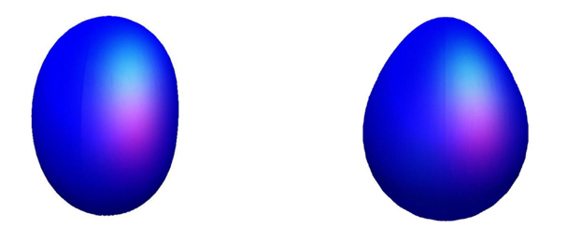
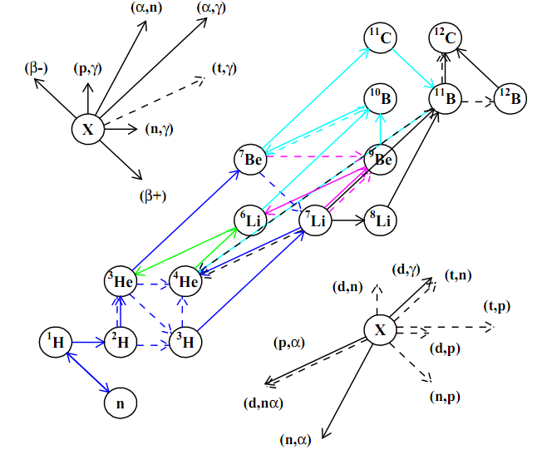
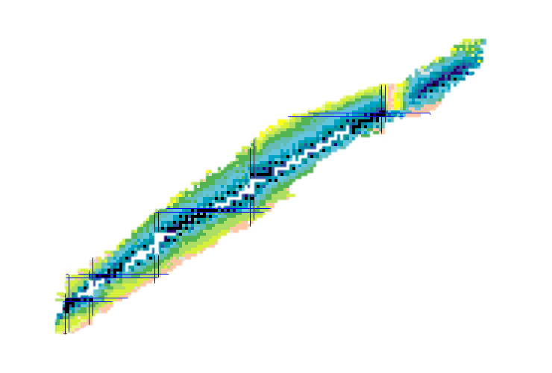






Astrophysics and reactions
Structure of the ⁵He ${3/2}^{+}$ resonance
$${}_{ }^{0}{p_{1/2}}$$
p-shell
$${}_{ }^{0}{p_{3/2}}$$
Nuclear structure from nuclear reactions
1p1h excitation
s-shell
Primordial Nucleosynthesis (blue)

Slide 2
An incomplete list of References (textbooks)
Quantum Collision Theory C. J. Joachain, ISBN 978-0-444-86773-5, North-Holland, 1975.
Scattering Theory, J. R. Taylor, 978-0-486-45013-1, Dover publications, 1983.
Introduction to Nuclear Reactions, C. A. Bertulani and P. Danielewicz,978-0-750-30932-5, Taylor & Francis, 2003.
Nuclear Reactions for Astrophysics, I. J. Thompson and F. M. Nunes, 978-0-524-85635-5, Cambridge University press, 2009.
Nuclear Reactions, H.P. gen. Schieck, 978-3-642-53985-5, Springer, 2014.
Introduction to Nuclear Reactions, G.R. Satchler, 0-333-25907-6, Macmillan Press, 1980.
This presentation brings together material from lectures by several authors to provide a comprehensive overview of the different approaches required to understand and model nuclear reactions in astrophysics.
  Carl Brune
  James deBoer
  Chloë Hebborn
  Stephane Hilaire
  Denis Lacroix

Slide 3
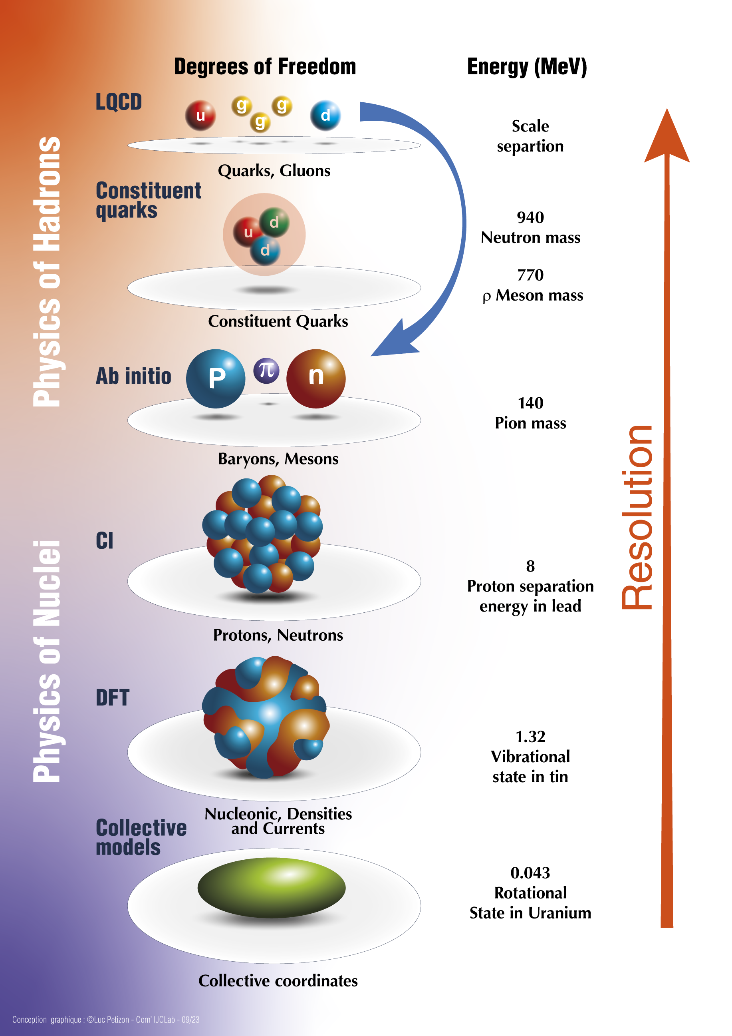
ab initio in nuclear physics
First principles for Nuclear Physics: QCD
  Non-perturbative at low energies;
  Still outstanding to perform $a→0$ LQCD.
Assuming degrees of freedom to be nucleons (including antinucleons and hyperons…):
  Nuclei made of nucleons;
  Interacting by nucleon-nucleon and three-nucleon potentials.
ab initio means
All nucleons are active;
Exact Pauli principle;
Realistic inter-nucleon interactions;
  Accurate description of NN and 3N data
Controllable approximations.

Slide 4


Reaction theory
Nuclear structure
Reaction theory

Slide 5
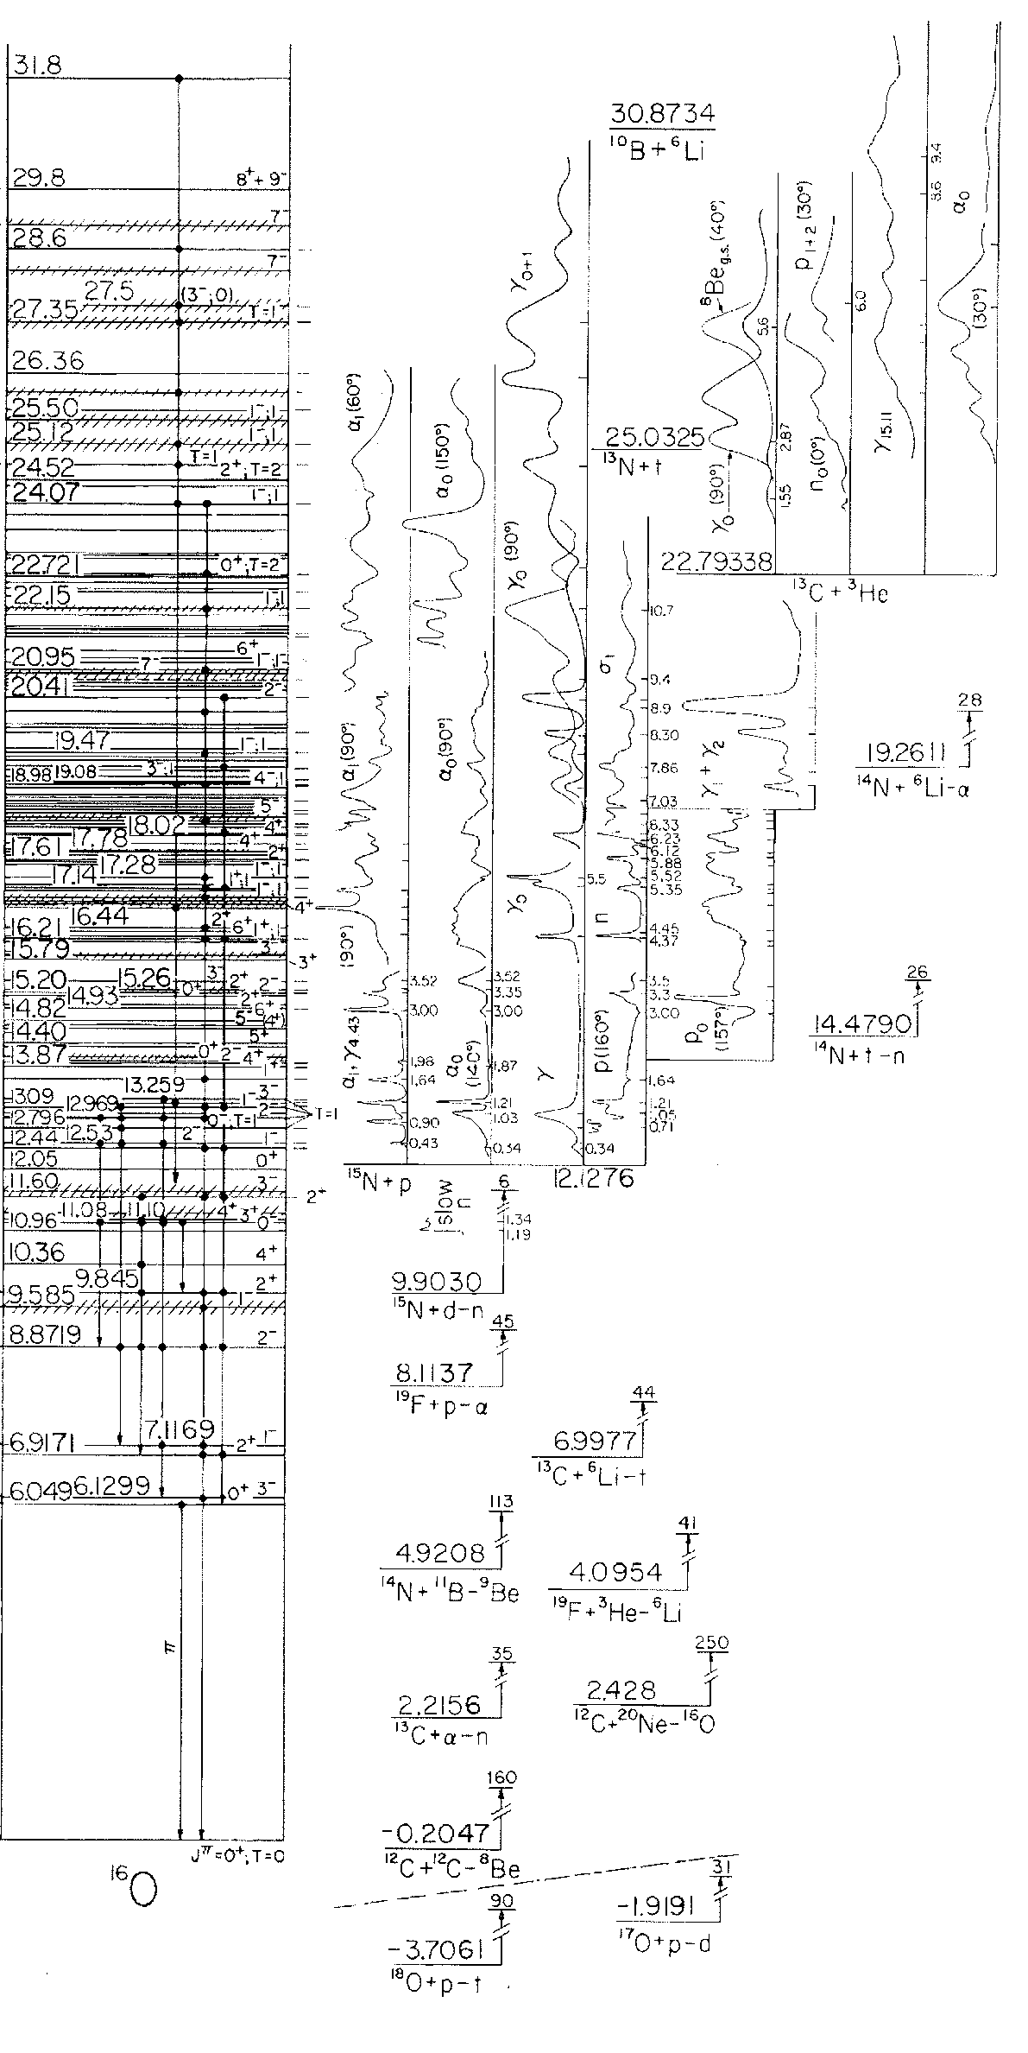
The nuclear many-body problem
Assume A active nucleons with a spatial, spin, and isospin components
$$\vec{r_{i}}=\left\{\vec{r_{i}},\vec{σ_{i}},\vec{τ_{i}}\right\} i=1,2…A$$
For non-relativistic energies, the microscopic A-nucleon Hamiltonian
  $$H^{\left(A\right)}=\sum_{i=1}^{A}{\frac{p_{i}^{2}}{2m}}+\sum_{1≤i<j}^{A}{V^{NN}\left(r_{ij}\right)+\sum_{1≤i<j<j}^{A}{V_{ijk}^{3N}}}+…$$
  Nucleons are composite systems and nuclei is highly correlated
Find the state vector that minimize the energy by solving the many-body Schrödinger equation
$$H_{ }^{(A)}Ψ_{ε}^{\left(A\right)}(\vec{r_{1}}…\vec{r_{A}})=E_{ε}Ψ_{ε}^{(A)}(\vec{r_{1}}…\vec{r_{A}})$$
  $E−E_{threshold}<0$ are bound-states and subject to vanishing boundary conditions
    Find eigenfunctions and eigenenergies
  $E−E_{threshold}>0$ are continuum states
Bound state problem
Notes:
bb

Slide 6
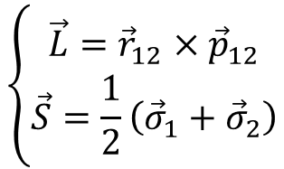
Nuclear forces
Symmetries and associated conservation of strong force between $n$ and $p$
  Any 3D rotation $⟷$ total angular momentum J conserved
  Point reflection $⟷$ total parity ($π$) conserved
  Translation and Galilean invariance $⟷$ no dependence on $R_{CM}$ and $P_{CM}$
  Particle exchange ($P_{r}P_{σ}P_{τ}$) $⟷$ total wave-function is antisymmetric
  Time reversal $⟷$ Hamiltonian is real symmetric
  Isospin rotations (in first approximation) $⟷$ partially conserved T
The nucleon-nucleon interaction can be cast either in a local form
$$V^{NN}=V_{C}\left(r_{12}\right)+V_{S}\left(r_{12}\right){\vec{σ}}_{1}∙{\vec{σ}}_{1} +V_{LS}\left(r_{12}\right){\vec{L}}_{ }∙{\vec{S}}_{ }{+V}_{T}\left(r_{12}\right){\vec{S}}_{12}\left(\vec{r}\right)+⋯$$
or a general non-local interaction (generally softer)
$$V^{NN}=V_{C}\left(p_{12}^{′},p_{12}^{ }\right)+V_{S}\left(p_{12}^{′},p_{12}^{ }\right){\vec{σ}}_{1}∙{\vec{σ}}_{1} +V_{LS}\left(p_{12}^{′},p_{12}^{ }\right)\left[{−i\vec{S}}_{ }∙\left(\vec{q}×\vec{K}\right)\right]+⋯$$
$$\left\{\begin{aligned}\vec{L}={\vec{r}}_{12}×{\vec{p}}_{12} \\ \vec{S}=\frac{1}{2}\left({\vec{σ}}_{1}+{\vec{σ}}_{2}\right)\end{aligned}\right.$$
$$\left\{\begin{aligned}\vec{q}=p_{12}^{′}−p_{12}^{ } \\ \vec{K}=\frac{p_{12}^{′}+p_{12}^{ }}{2}\end{aligned}\right.$$
Notes:
bb

Slide 7
The nuclear many-body wave function
Nucleons are fermions $→$ only the antisymmetric wave function is relevant
$$Ψ_{ε}^{\left(A\right)}\left(\vec{r_{1}}…,\vec{r_{i}},…,\vec{r_{j}},…,\vec{r_{A}}\right)=−Ψ_{ε}^{\left(A\right)}\left(\vec{r_{1}}…,\vec{r_{j}},…,\vec{r_{i}},…,\vec{r_{A}}\right)$$
Conserved total angular momentum J and parity $π$
  And approximately conserved total isospin T
  $$Ψ_{ε}^{\left(A\right)}=Ψ_{ε}^{J^{π}T \left(A\right)}$$
Due to translational invariance all nucleonic operators are defined in the intrinsic frame (C.M. frame is irrelevant)
  The wave function must be translational invariant
  $$Ψ_{ε}^{\left(A\right)}≔Ψ_{ε}^{\left(A\right)}\left(\vec{ξ_{0}}…, \vec{ξ_{j}},…,\vec{ξ_{A−1}}\right)$$
  $$T^{t}Ψ_{ε}^{\left(A\right)}\left(\vec{ξ_{0}}…, \vec{ξ_{j}},…,\vec{ξ_{A−1}}\right)=Ψ_{ε}^{\left(A\right)}\left(\vec{ξ_{0}}…, \vec{ξ_{j}},…,\vec{ξ_{A−1}}\right)$$
  Traditionally in nuclear physic with can either break symmetry and restore it or keep it enforced:
    Work with $A−1$ translational invariant coordinates
    Work with $A$ single-particle coordinates and achieved restoration
    $$Ψ_{ε}^{\left(A\right)}\left(\vec{r_{1}}…,\vec{r_{i}},…,\vec{r_{j}},…,\vec{r_{A}}\right)=Ψ_{ε}^{\left(A\right)}\left(\vec{ξ_{0}}…, \vec{ξ_{j}},…,\vec{ξ_{A−1}}\right)Ψ_{ε}^{ }\left({\vec{R}}_{C.M.}\right)$$
Notes:
bb

Slide 8






Coordinate systems…
Two-nucleon system
Three-nucleon system
$$\vec{ξ_{1}}$$
$$\left\{\begin{aligned}\vec{ξ_{0}}=\frac{1}{\sqrt{2}}\left(\vec{r_{1}}+\vec{r_{2}}\right)∝{\vec{R}}_{CM} \\ \vec{ξ_{1}}=\frac{1}{\sqrt{2}}\left(\vec{r_{1}}−\vec{r_{2}}\right)∝{\vec{r}}_{12}\end{aligned}\right.$$
$$\left\{\begin{aligned}\vec{r_{1}}=\frac{1}{\sqrt{2}}\left(\vec{ξ_{0}}+\vec{ξ_{1}}\right) \\ \vec{r_{2}}=\frac{1}{\sqrt{2}}\left(\vec{ξ_{0}}−\vec{ξ_{1}}\right)\end{aligned}\right.$$
$$\vec{ξ_{0}}$$
$$\vec{r_{1}}$$
$$\vec{r_{2}}$$
$$\vec{ξ_{1}}$$
$$\left\{\begin{aligned}\vec{ξ_{0}}=\frac{1}{\sqrt{3}}\left(\vec{r_{1}}+\vec{r_{2}}+\vec{r_{3}}\right) \\ \vec{ξ_{1}}=\frac{1}{\sqrt{2}}\left(\vec{r_{1}}−\vec{r_{2}}\right) \\ \vec{ξ_{2}}=\frac{\sqrt{2}}{\sqrt{3}}\left(\frac{1}{2}\left(\vec{r_{1}}+\vec{r_{2}}\right)−\vec{r_{3}}\right)\end{aligned}\right.$$
$$\left\{\begin{aligned}\vec{r_{1}}=\frac{1}{\sqrt{3}}\vec{ξ_{0}}+\frac{1}{\sqrt{2}}\vec{ξ_{1}}+\frac{\sqrt{2}}{\sqrt{6}}\vec{ξ_{2}} \\ \vec{r_{2}}=\frac{1}{\sqrt{3}}\vec{ξ_{0}}−\frac{1}{\sqrt{2}}\vec{ξ_{1}}+\frac{\sqrt{2}}{\sqrt{6}}\vec{ξ_{2}} \\ \vec{r_{3}}=\frac{1}{\sqrt{3}}\vec{ξ_{0}}−\frac{\sqrt{2}}{\sqrt{3}}\vec{ξ_{2}}\end{aligned}\right.$$
$$\vec{ξ_{0}}$$
$$\vec{ξ_{2}}$$
$$\vec{r_{1}}$$
$$\vec{r_{2}}$$
$$\vec{r_{3}}$$
Notes:
bb

Slide 9
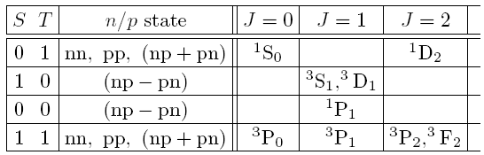

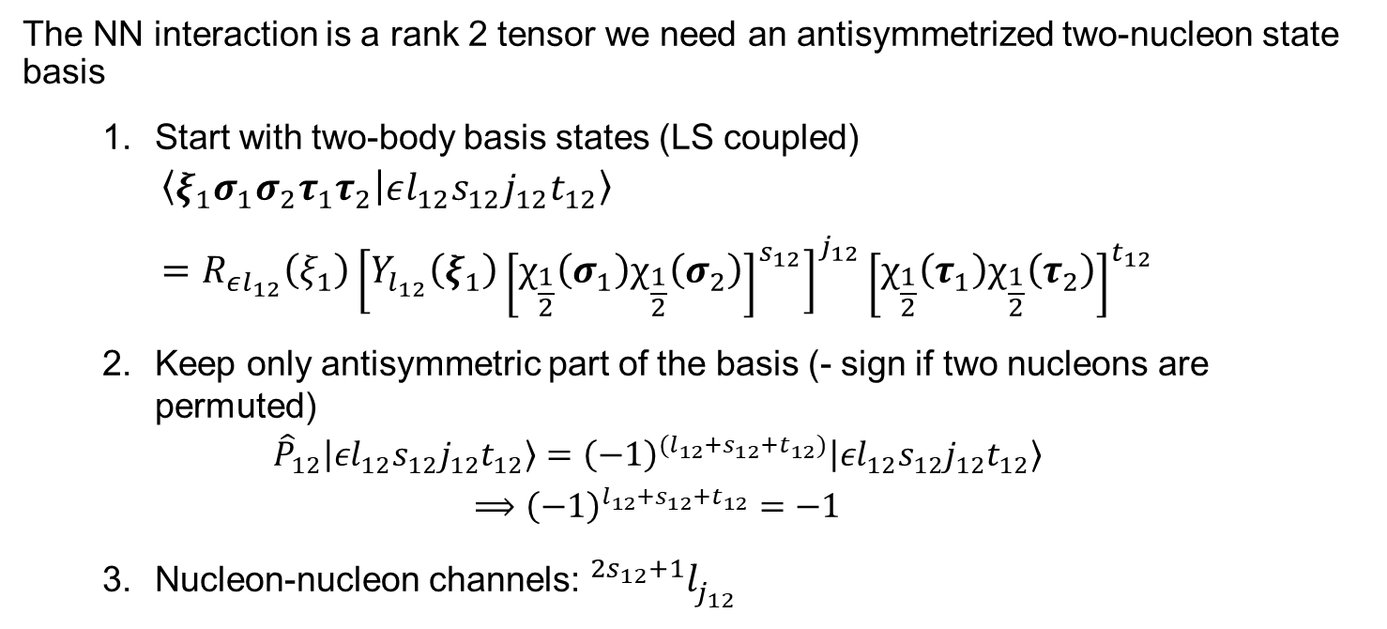
Two-nucleon system
The NN interaction is a rank 2 tensor we need an antisymmetrized two-nucleon state basis
  Start with two-body basis states (LS coupled)
  $$\left\langle ξ_{1}σ_{1}σ_{2}τ_{1}τ_{2} | εl_{12}s_{12}j_{12}t_{12}\right\rangle \\ =R_{εl_{12}}\left(ξ_{1}\right){\left[Y_{l_{12}}\left(ξ_{1}\right){\left[χ_{\frac{1}{2}}\left(σ_{1}\right)χ_{\frac{1}{2}}\left(σ_{2}\right)\right]}^{s_{12}}\right]}^{j_{12}}{\left[χ_{\frac{1}{2}}\left(τ_{1}\right)χ_{\frac{1}{2}}\left(τ_{2}\right)\right]}^{t_{12}}$$
  Keep only antisymmetric part of the basis (- sign if two nucleons are permuted)
  $${\hat{P}}_{12}\left|\left.εl_{12}s_{12}j_{12}t_{12}\right\rangle \right.={\left(−1\right)}^{(l_{12}+s_{12}+t_{12})}\left|\left.εl_{12}s_{12}j_{12}t_{12}\right\rangle \right. \\ ⟹{\left(−1\right)}^{l_{12}+s_{12}+t_{12}}=−1$$
  Nucleon-nucleon channels: ${}_{ }^{2s_{12}+1}{l_{j_{12}}^{ }}$
$$\vec{ξ_{1}}$$
$$={\vec{r}}_{1}−{\vec{r}}_{2}$$
$$\left\{\begin{aligned}s_{12}∈\{0,1\} \\ t_{12}∈\{0,1\} \\ π{=\left(−1\right)}^{l_{12}}\end{aligned}\right.$$
Notes:
bb

Slide 10









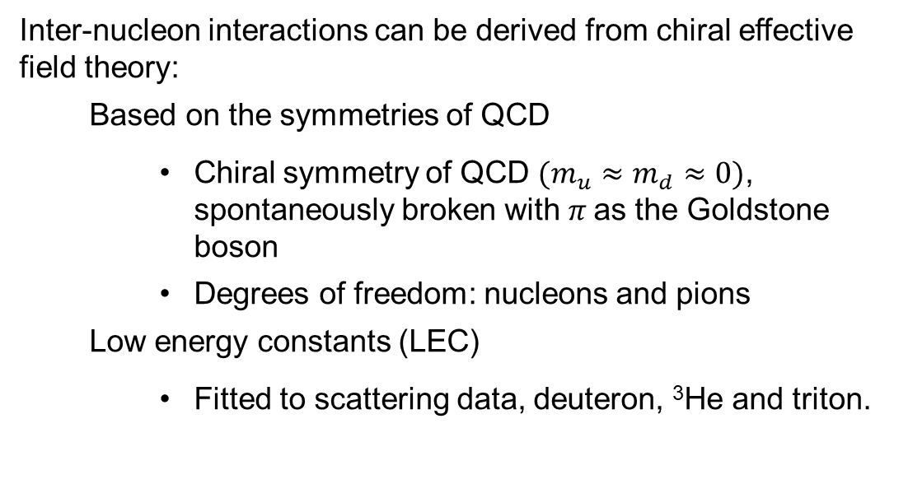
Chiral Effective Field Theory
Inter-nucleon interactions can be derived from chiral effective field theory:
  Based on the symmetries of QCD
    Chiral symmetry of QCD $(m_{u}≈m_{d}≈0)$, spontaneously broken with $π$as the Goldstone boson
    Degrees of freedom: nucleons and pions
  Low energy constants (LEC)
    Fitted to scattering data, deuteron, ³He and triton.
Weinberg ‘90’91’92 Ordóñez and vK ’92 etc…
Importance
$$𝒪(1)$$
$$𝒪(Q/M_{hi})$$
Friar ’97
  Systematic low-momentum expansion to a given order ($Q/Λ$);
  Hierarchy;
  Consistency.

Slide 11
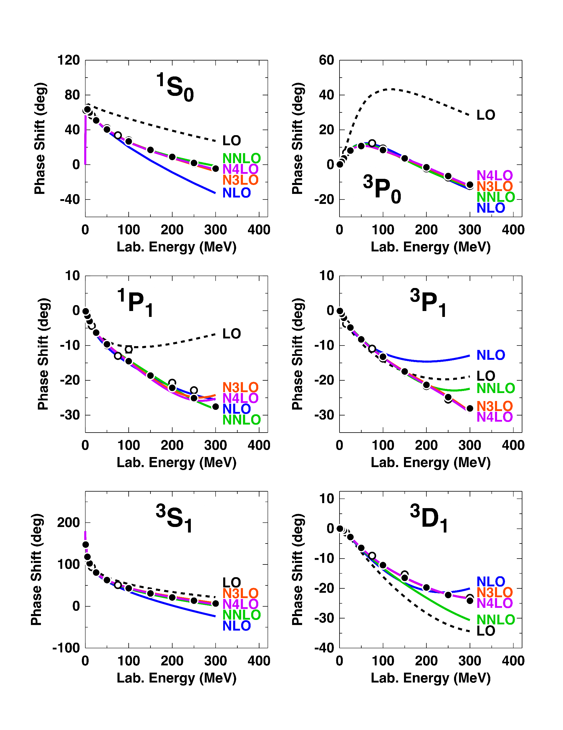
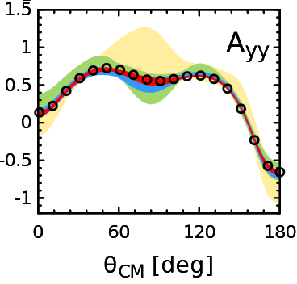
The NN interaction from chiral EFT
Nowadays chiral NN potential up to N⁵LO
Set of six potentials constructed
  Sequence of LO, NLO,…,N⁵LO
  Uncertainty quantification
At N³LO and N⁴LO:
  24 NN LECs fitted to the np and pp scattering data and the deuteron properties
    Including c_{i} LECs $(i=1−4)$ from pion-nucleon scattering or Rey-Steiner equation/pionic atoms
  2 3N LECs (at N²LO)
N⁴LO NN fitted to data up to pion production threshold with 𝜒²/datum∼1.15
E. Epelbaum, et al. PRL115 (2015)
D.R. Entem et al. PRC96 (2017)

Slide 12
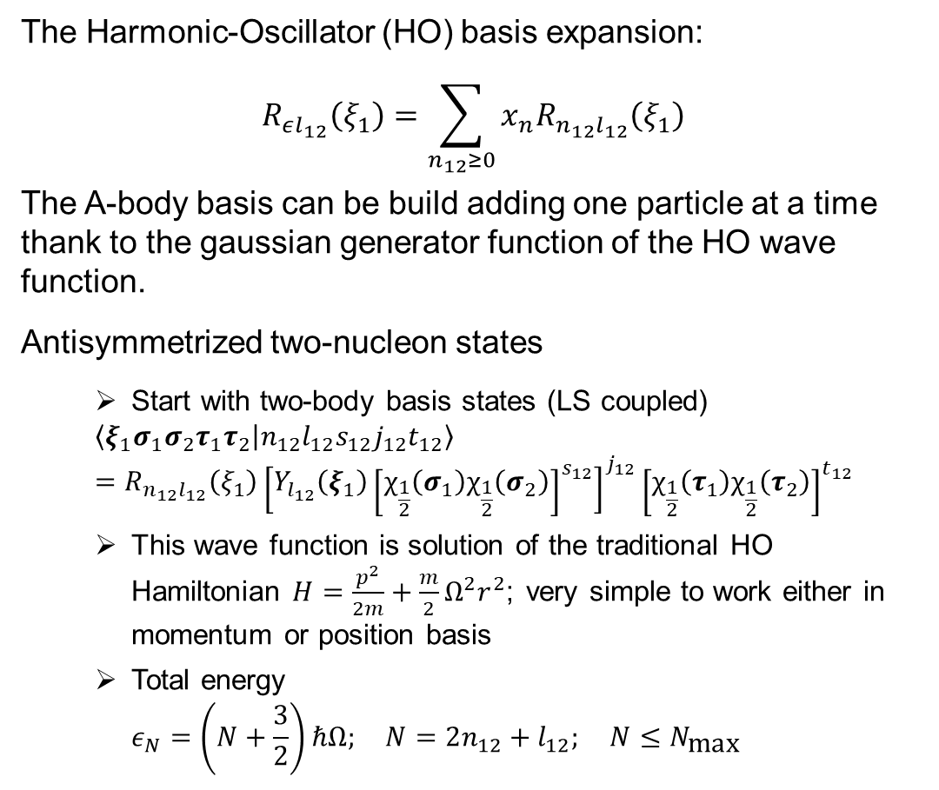
Solver in CI with Jacobi coordinate system
The Harmonic-Oscillator (HO) basis expansion:
$$R_{εl_{12}}\left(ξ_{1}\right)=\sum_{n_{12}≥0}{x_{n}R_{n_{12}l_{12}}\left(ξ_{1}\right)}$$
The A-body basis can be build adding one particle at a time thank to the gaussian generator function of the HO wave function.
Antisymmetrized two-nucleon states
  Start with two-body basis states (LS coupled)
  $$\left\langle ξ_{1}σ_{1}σ_{2}τ_{1}τ_{2} | n_{12}l_{12}s_{12}j_{12}t_{12}\right\rangle \\ =R_{n_{12}l_{12}}\left(ξ_{1}\right){\left[Y_{l_{12}}\left(ξ_{1}\right){\left[χ_{\frac{1}{2}}\left(σ_{1}\right)χ_{\frac{1}{2}}\left(σ_{2}\right)\right]}^{s_{12}}\right]}^{j_{12}}{\left[χ_{\frac{1}{2}}\left(τ_{1}\right)χ_{\frac{1}{2}}\left(τ_{2}\right)\right]}^{t_{12}}$$
  This wave function is solution of the traditional HO Hamiltonian$H=\frac{p^{2}}{2m}+\frac{m}{2}Ω^{2}r^{2}$; very simple to work either in momentum or position basis
  Total energy
  $$ε_{N}=\left(N+\frac{3}{2}\right)ℏΩ; N=2n_{12}+l_{12}; N≤N_{\text{max}}$$
$$\vec{ξ_{1}}$$
$$≈e^{−αr^{2}}$$
$$={\vec{r}}_{1}−{\vec{r}}_{2}$$
$R_{n_{12}}\left(ξ_{1}\right)$depends on HO length$b=\sqrt{ℏ/mΩ}$
N_{max}
$$ℏΩ$$
No-Core Shell Model
Notes:
bb

Slide 13
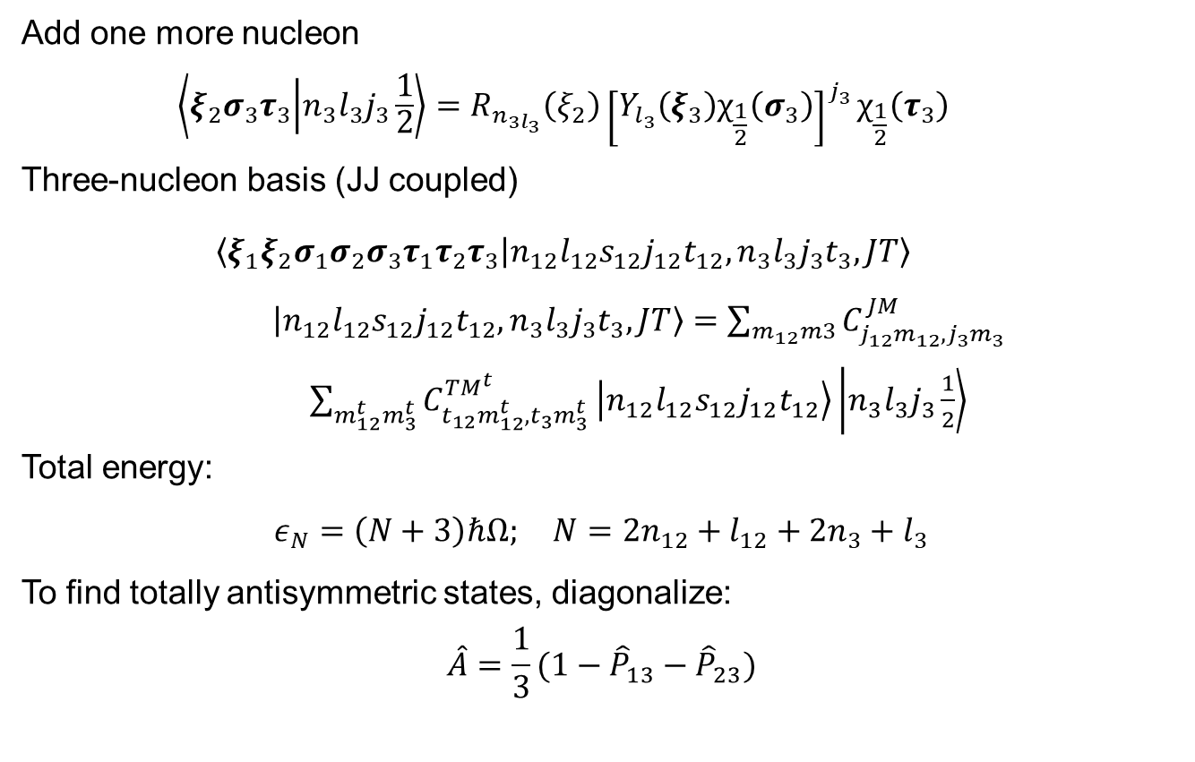
Solver in CI with Jacobi coordinate system
Add one more nucleon
  $$\left\langle ξ_{2}σ_{3}τ_{3} | n_{3}l_{3}j_{3}\frac{1}{2}\right\rangle =R_{n_{3l_{3}}}\left(ξ_{2}\right){\left[Y_{l_{3}}\left(ξ_{3}\right)χ_{\frac{1}{2}}\left(σ_{3}\right)\right]}^{j_{3}}χ_{\frac{1}{2}}\left(τ_{3}\right)$$
Three-nucleon basis (JJ coupled)
  $$\left\langle ξ_{1}{ξ_{2}σ}_{1}σ_{2}σ_{3}τ_{1}τ_{2}τ_{3} | n_{12}l_{12}s_{12}j_{12}t_{12},n_{3}l_{3}j_{3}t_{3},JT\right\rangle$$
  $\left|\left.n_{12}l_{12}s_{12}j_{12}t_{12},n_{3}l_{3}j_{3}t_{3},JT\right\rangle \right.=\sum_{m_{12}m3}{C_{j_{12}m_{12},j_{3}m_{3}}^{JM}}$ $\sum_{m_{12}^{t}m_{3}^{t}}{C_{t_{12}m_{12}^{t},t_{3}m_{3}^{t}}^{TM^{t}}}\left.\left|n_{12}l_{12}s_{12}j_{12}t_{12}\right.\right\rangle \left.\left|n_{3}l_{3}j_{3}\frac{1}{2}\right.\right\rangle$
Total energy:
$$ε_{N}=\left(N+3\right)ℏΩ; N=2n_{12}+l_{12}+2n_{3}+l_{3}$$
To find totally antisymmetric states, diagonalize:
$$\hat{A}=\frac{1}{3}(1−{\hat{P}}_{13}−{\hat{P}}_{23})$$
$$\vec{ξ_{1}}$$
$$\vec{ξ_{2}}$$
$$\vec{ξ_{2}}$$
$$\vec{ξ_{2}}$$
$$\vec{ξ_{1}}$$
$$\vec{ξ_{1}}$$
Notes:
bb

Slide 14

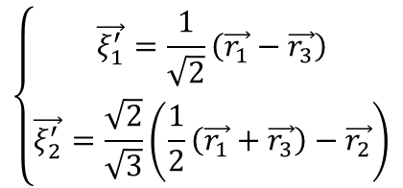
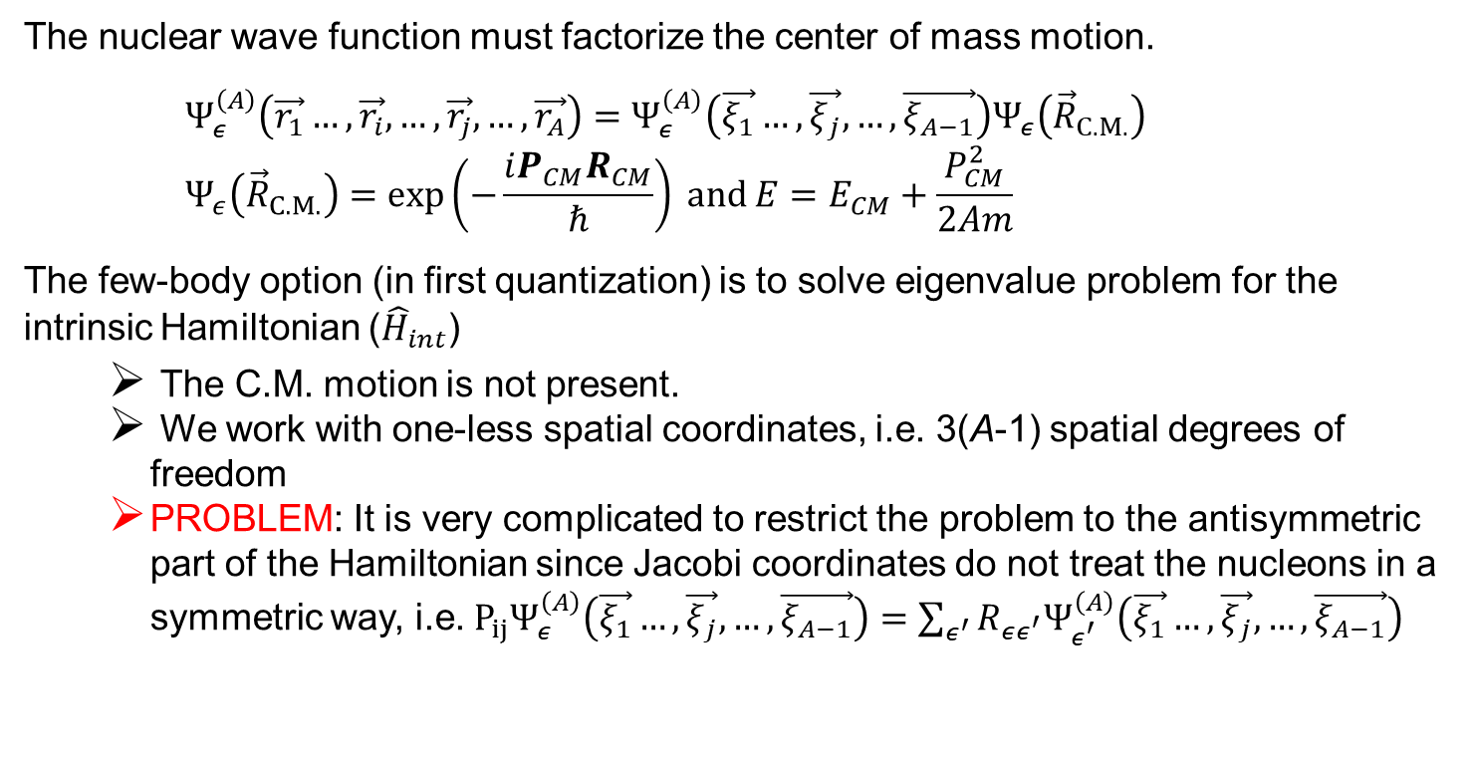
How to solve the many-body Schrödinger equation?
The nuclear wave function must factorize the center of mass motion.
    $$Ψ_{ε}^{\left(A\right)}\left(\vec{r_{1}}…,\vec{r_{i}},…,\vec{r_{j}},…,\vec{r_{A}}\right)=Ψ_{ε}^{\left(A\right)}\left(\vec{ξ_{1}}…, \vec{ξ_{j}},…,\vec{ξ_{A−1}}\right)Ψ_{ε}^{ }\left({\vec{R}}_{C.M.}\right) \\ Ψ_{ε}^{ }\left({\vec{R}}_{C.M.}\right)=\exp\left(−\frac{iP_{CM}R_{CM}}{ℏ}\right) and E=E_{CM}+\frac{P_{CM}^{2}}{2Am}$$
The few-body option (in first quantization) is to solve eigenvalue problem for the intrinsic Hamiltonian (${\hat{H}}_{int}$)
  The C.M. motion is not present.
  We work with one-less spatial coordinates, i.e. 3(A-1) spatial degrees of freedom
  PROBLEM: It is very complicated to restrict the problem to the antisymmetric part of the Hamiltonian since Jacobi coordinates do not treat the nucleons in a symmetric way, i.e. $P_{ij}Ψ_{ε}^{\left(A\right)}\left(\vec{ξ_{1}}…, \vec{ξ_{j}},…,\vec{ξ_{A−1}}\right)=\sum_{ε^{′}}{R_{εε^{′}}Ψ_{ε^{′}}^{\left(A\right)}\left(\vec{ξ_{1}}…, \vec{ξ_{j}},…,\vec{ξ_{A−1}}\right)}$
$$\left\{\begin{aligned}\vec{ξ_{1}}=\frac{1}{\sqrt{2}}\left(\vec{r_{1}}−\vec{r_{2}}\right) \\ \vec{ξ_{2}}=\frac{\sqrt{2}}{\sqrt{3}}\left(\frac{1}{2}\left(\vec{r_{1}}+\vec{r_{2}}\right)−\vec{r_{3}}\right)\end{aligned}\right.$$
$$\left\{\begin{aligned}\vec{ξ_{1}^{′}}=\frac{1}{\sqrt{2}}\left(\vec{r_{1}}−\vec{r_{3}}\right) \\ \vec{ξ_{2}^{′}}=\frac{\sqrt{2}}{\sqrt{3}}\left(\frac{1}{2}\left(\vec{r_{1}}+\vec{r_{3}}\right)−\vec{r_{2}}\right)\end{aligned}\right.$$
$$\vec{ξ_{2}}$$
$$\vec{ξ_{2}}$$
$$\vec{ξ_{1}}$$
$$\vec{ξ_{1}}$$

Slide 15
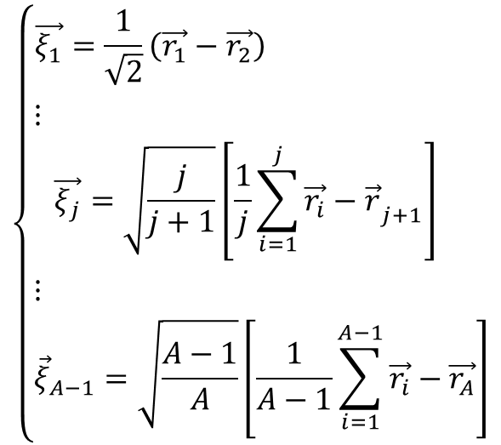
Jacobi relative coordinates for A nucleons
$$\left\{\begin{aligned}\vec{ξ_{0}}=\sqrt{\frac{1}{A}}\sum_{i=1}^{A}{\vec{r_{i}}} \\ {\vec{R}}_{C.M.}=\sqrt{\frac{1}{A}}\vec{ξ_{0}}\end{aligned}\right.$$
The vector proportional to the C.M. coordinate
$$\vec{ξ_{2}}$$
$$\vec{ξ_{3}}$$
$$\left\{\begin{matrix}\begin{matrix}\begin{matrix}\vec{ξ_{1}}=\frac{1}{\sqrt{2}}\left(\vec{r_{1}}−\vec{r_{2}}\right) \\ ⋮ \end{matrix} \\ \vec{ξ_{j}}=\sqrt{\frac{j}{j+1}}\left[\frac{1}{j}\sum_{i=1}^{j}{\vec{r_{i}}−{\vec{r_{ }}}_{j+1}}\right] \end{matrix} \\ \begin{matrix}⋮ \\ {\vec{ξ}}_{A−1}=\sqrt{\frac{A−1}{A}}\left[\frac{1}{A−1}\sum_{i=1}^{A−1}{\vec{r_{i}}−\vec{r_{A}}}\right]\end{matrix}\end{matrix}\right.$$
$$\vec{1}$$
$$\vec{ξ_{4}}$$
The relative coordinate between the C.M. of the first $k$ nucleons and the $(k+1)$th nucleon
Notes:
bb

Slide 16
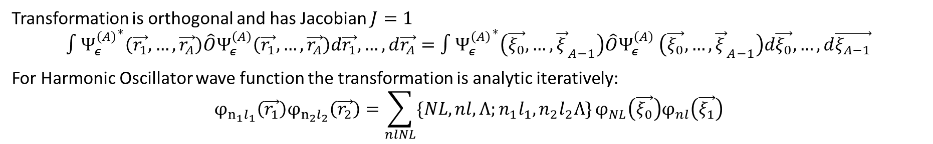
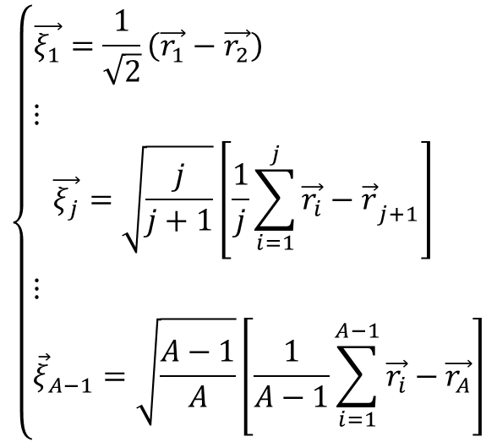
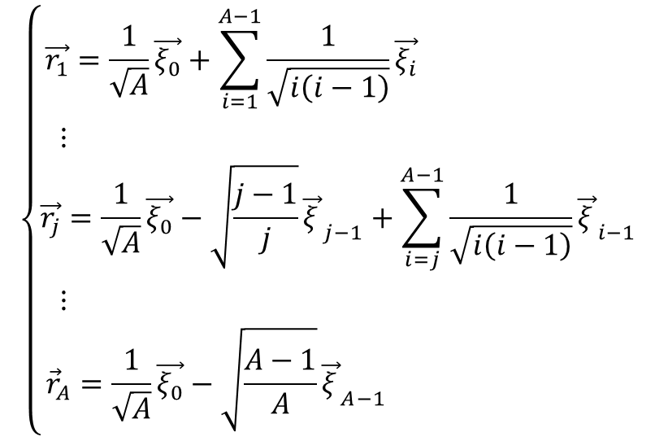
Jacobi relative coordinates for A nucleons
$$\left\{\begin{matrix}\begin{matrix}\begin{matrix}\vec{ξ_{1}}=\frac{1}{\sqrt{2}}\left(\vec{r_{1}}−\vec{r_{2}}\right) \\ ⋮ \end{matrix} \\ \vec{ξ_{j}}=\sqrt{\frac{j}{j+1}}\left[\frac{1}{j}\sum_{i=1}^{j}{\vec{r_{i}}−{\vec{r_{ }}}_{j+1}}\right] \end{matrix} \\ \begin{matrix}⋮ \\ {\vec{ξ}}_{A−1}=\sqrt{\frac{A−1}{A}}\left[\frac{1}{A−1}\sum_{i=1}^{A−1}{\vec{r_{i}}−\vec{r_{A}}}\right]\end{matrix}\end{matrix}\right.$$
$$\left\{\begin{matrix}\begin{matrix}\begin{matrix}\vec{r_{1}}=\frac{1}{\sqrt{A}}\vec{ξ_{0}}+\sum_{i=1}^{A−1}{\frac{1}{\sqrt{i\left(i−1\right)}}\vec{ξ_{i}}} \\ ⋮ \end{matrix} \\ \vec{r_{j}}=\frac{1}{\sqrt{A}}\vec{ξ_{0}}−\sqrt{\frac{j−1}{j}}{\vec{ξ_{ }}}_{j−1}+\sum_{i=j}^{A−1}{\frac{1}{\sqrt{i\left(i−1\right)}}{\vec{ξ_{ }}}_{i−1}}\end{matrix} \\ \begin{matrix}⋮ \\ {\vec{r}}_{A}=\frac{1}{\sqrt{A}}\vec{ξ_{0}}−\sqrt{\frac{A−1}{A}}{\vec{ξ_{ }}}_{A−1} \end{matrix}\end{matrix}\right.$$
$$\vec{ξ_{2}}$$
$$\vec{ξ_{3}}$$
$$\vec{ξ_{1}}$$
$$\vec{ξ_{4}}$$
Transformation is orthogonal and has Jacobian $J=1$
$$∫{Ψ_{ε}^{\left(A\right)}}^{∗}\left(\vec{r_{1}},…,\vec{r_{A}}\right)\hat{O}Ψ_{ε}^{\left(A\right)}\left(\vec{r_{1}},…,\vec{r_{A}}\right)d\vec{r_{1}},…,d\vec{r_{A}}=∫{Ψ_{ε}^{\left(A\right)}}^{∗}\left(\vec{ξ_{0}},…,{\vec{ξ_{ }}}_{A−1}\right)\hat{O}{Ψ_{ε}^{\left(A\right)}}^{ }\left(\vec{ξ_{0}},…,{\vec{ξ_{ }}}_{A−1}\right)d\vec{ξ_{0}},…,d\vec{ξ_{A−1}}$$
For Harmonic Oscillator wave function the transformation is analytic iteratively:
$$φ_{n_{1}l_{1}}\left(\vec{r_{1}}\right)φ_{n_{2}l_{2}}\left(\vec{r_{2}}\right)=\sum_{nlNL}{\{NL,nl,Λ;n_{1}l_{1},n_{2}l_{2}Λ\}}φ_{NL}\left(\vec{ξ_{0}}\right)φ_{nl}\left(\vec{ξ_{1}}\right)$$

Slide 17
How to solve the many-body Schrödinger equation
The many-body option (second quantization) is to solve eigenvalue problem for the intrinsic Hamiltonian plus center of mass Hamiltonian (${\hat{H}}_{int}$+ ${\hat{H}}_{C.M.}$)
$${\hat{H}}_{ }^{A}=\sum_{i}^{A}{\frac{p_{i}^{2}}{2m}+V^{MF}\left(r_{i}\right)}+\sum_{i>j=1}^{A}{V^{NN}\left(r_{ij}\right)−}\sum_{i}^{A}{V^{MF}\left(r_{i}\right)}$$
The Mean-Field Hamiltonian is a the auxiliary one-body fields ($φ$) to approximate the energy of the system it is obtained as solution of $\left(\frac{p^{2}}{2m}+V_{k}^{MF}\left(r_{ }\right)\right)φ_{k}\left(r\right)=ε_{k}φ_{k}\left(r\right)$
The total wave function is then an antisymmetrized product state $Ψ_{ε}^{\left(A\right)}≈𝒩\hat{𝒜}φ_{1}\left(r_{1}\right)…φ_{A}\left(r_{A}\right)$. This basis is complete and orthonormalized. It can be cast as
$$Ψ_{ε}^{\left(A\right)}≈\frac{1}{\sqrt{A!}}\left[\begin{matrix}φ_{1}\left(r_{1}\right) & ⋯ & φ_{A}\left(r_{1}\right) \\ ⋮ & ⋱ & ⋮ \\ φ_{1}\left(r_{A}\right) & ⋯ & φ_{A}\left(r_{A}\right)\end{matrix}\right]$$
$$\vec{r_{1}}$$
$$\vec{r_{5}}$$
$$\vec{r_{2}}$$
$$\vec{r_{3}}$$
$$\vec{r_{4}}$$
$$H_{i}^{MF}=\frac{p_{i}^{2}}{2m}+\frac{m}{2}Ω^{2}r_{i}^{2}$$
$$H_{i}^{MF}=\frac{p^{2}}{2m}+V_{ }^{MF}\left(r_{i}\right)$$
N_{max}
$$ℏΩ$$
No-Core Shell Model
MF+CI (à la shell model)
The mean field determines at first order the shell structure.

Slide 18
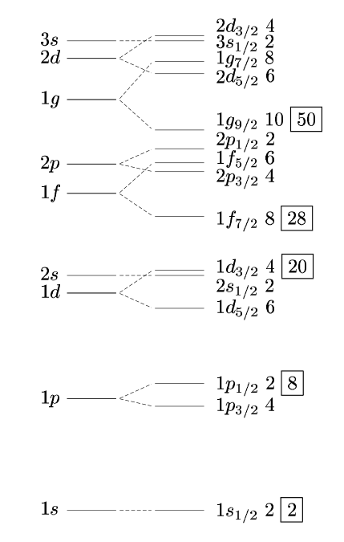
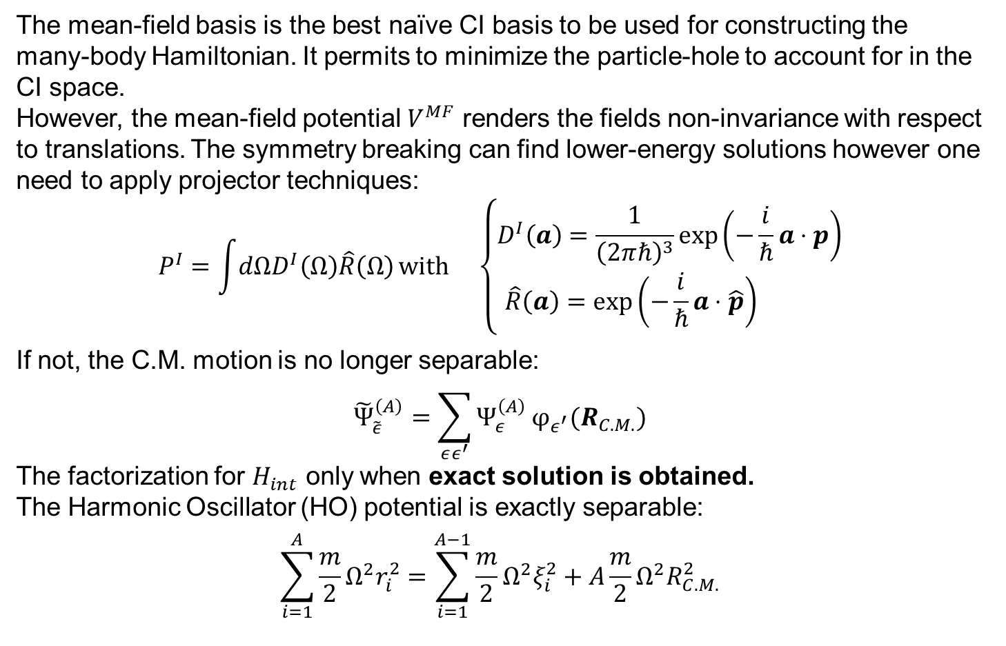
How to solve the many-body Schrödinger equation
The mean-field basis is the best naïve CI basis to be used for constructing the many-body Hamiltonian. It permits to minimize the particle-hole to account for in the CI space.
However, the mean-field potential $V^{MF}$ renders the fields non-invariance with respect to translations. The symmetry breaking can find lower-energy solutions however one need to apply projector techniques:
$$P^{I}=\int{dΩD^{I}\left(Ω\right)\hat{R}\left(Ω\right)}with \left\{\begin{aligned}D^{I}\left(a\right)=\frac{1}{{\left(2πℏ\right)}^{3}}\exp\left(−\frac{i}{ℏ}a⋅p\right) \\ \hat{R}\left(a\right)=\exp\left(−\frac{i}{ℏ}a⋅\hat{p}\right) \end{aligned}\right.$$
If not, the C.M. motion is no longer separable:
$${\tilde{Ψ}}_{\tilde{ε}}^{\left(A\right)}=\sum_{εε^{′}}{Ψ_{ε}^{\left(A\right)}}φ_{ε^{′}}(R_{C.M.})$$
The factorization for $H_{int}$ only when exact solution is obtained.
The Harmonic Oscillator (HO) potential is exactly separable:
$$\sum_{i=1}^{A}{\frac{m}{2}Ω^{2}r_{i}^{2}}=\sum_{i=1}^{A−1}{\frac{m}{2}Ω^{2}ξ_{i}^{2}}+A\frac{m}{2}Ω^{2}R_{C.M.}^{2}$$
Major shells
(HO eigenbasis)
+spin orbit splitting

Slide 19
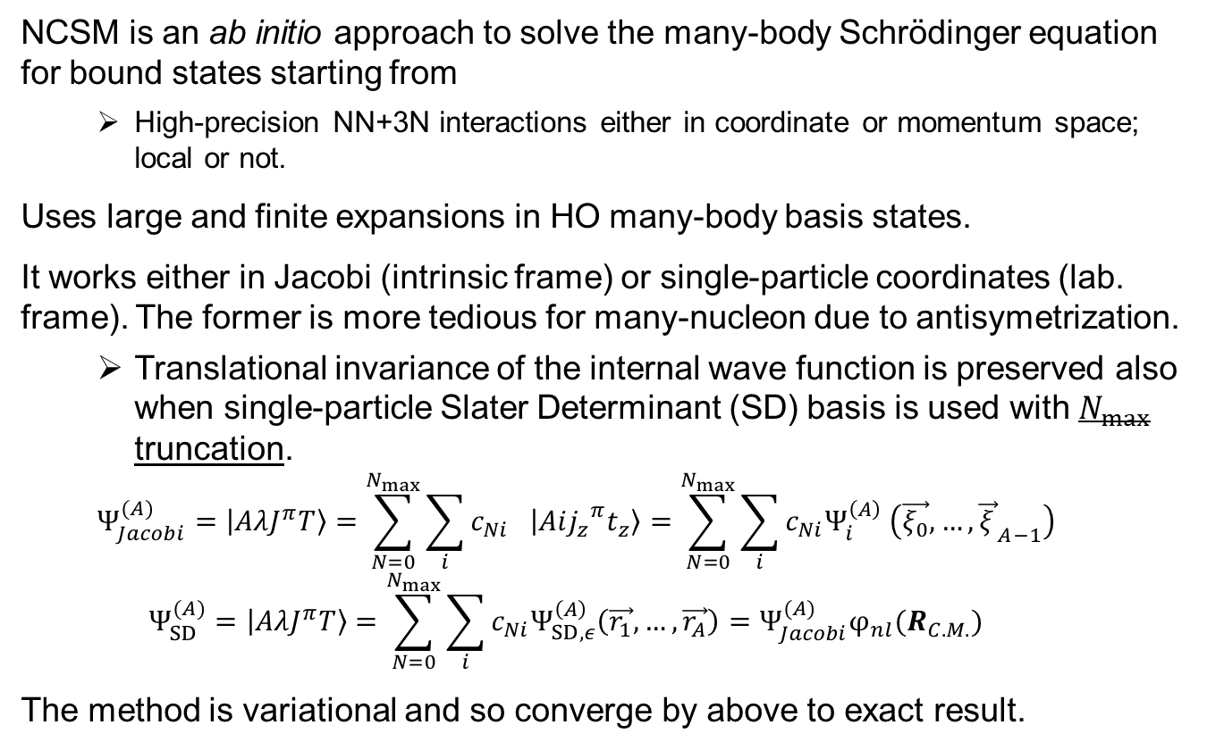
No-Core Shell Model (NCSM)
NCSM is an ab initio approach to solve the many-body Schrödinger equation for bound states starting from
  High-precision NN+3N interactions either in coordinate or momentum space; local or not.
Uses large and finite expansions in HO many-body basis states.
It works either in Jacobi (intrinsic frame) or single-particle coordinates (lab. frame). The former is more tedious for many-nucleon due to antisymetrization.
  Translational invariance of the internal wave function is preserved also when single-particle Slater Determinant (SD) basis is used with $N_{max}$ truncation.
  $$Ψ_{Jacobi}^{(A)}=\left|\left.AλJ^{π}T\right\rangle \right.=\sum_{N=0}^{N_{max}}{\sum_{i}{c_{Ni} \left|\left.Ai{j_{z}}^{π}t_{z}\right\rangle \right.}}=\sum_{N=0}^{N_{max}}{\sum_{i}{c_{Ni}{Ψ_{i}^{\left(A\right)}}^{ }\left(\vec{ξ_{0}},…,{\vec{ξ_{ }}}_{A−1}\right)}}$$
  $$Ψ_{SD}^{(A)}=\left|\left.AλJ^{π}T\right\rangle \right.=\sum_{N=0}^{N_{max}}{\sum_{i}{c_{Ni}Ψ_{SD,ε}^{\left(A\right)}\left(\vec{r_{1}},…,\vec{r_{A}}\right)}}=Ψ_{Jacobi}^{(A)}φ_{nl}(R_{C.M.})$$
The method is variational and so converge by above to exact result.
$$N=N_{max} \\ +N_{lowest}$$
$$ΔE=ΔNℏΩ$$
$$ℏΩ$$
$$⋱$$
$$N=3$$
$$N=2$$
Lowest configuration
$$N=1$$
No-Core Shell Model
$N_{max}$ is the maximal allowed HO excitation above the lowest possible A-nucleon configuration
Full $N_{max}$ space: All basis states with $N≤N_{max}$kept

Slide 20
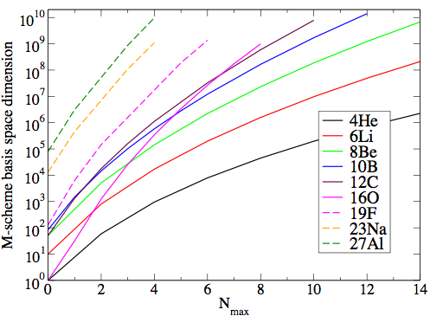
Multi-particle states in the Slater Determinant basis
Many-body HO Slater determinants
$$Ψ_{ϵ}^{\left(A\right)}=\left\{\begin{aligned}𝒩\hat{𝒜}φ_{1}\left(r_{1}σ_{1}τ_{1}\right)…φ_{A}\left(r_{A}σ_{A}τ_{A}\right) \\ \frac{1}{\sqrt{A!}}\left[\begin{matrix}φ_{1}\left(r_{1}σ_{1}τ_{1}\right) & ⋯ & φ_{A}\left(r_{1}σ_{1}τ_{1}\right) \\ ⋮ & ⋱ & ⋮ \\ φ_{1}\left(r_{A}σ_{A}τ_{A}\right) & ⋯ & φ_{A}\left(r_{A}σ_{A}τ_{A}\right)\end{matrix}\right]\end{aligned}\right.$$
The one-body state reads (are fixed!)
$$φ_{n_{1}l_{1}j_{1}m_{j}\frac{1}{2}m_{t}}\left(r_{1}σ_{1}τ_{1}\right)=R_{n_{3}l_{3}}\left(r_{1}\right){\left[Y_{l_{3}}\left({\hat{r}}_{1}\right)χ_{\frac{1}{2}}\left(σ_{3}\right)\right]}^{j_{3}m_{j}}χ_{\frac{1}{2}m_{t}}\left(τ_{3}\right)$$
The total wave function is anti symmetric and has good $M_{J}$, $MT$ and parity quantum numbers, but not J and T. They are restored when the p-h truncation is consistent.
Very large number of basis state to reach accurate results (but sparse matrices).
Courtesy of J.P. Vary and P. Maris

Slide 21

Reaction theory
Reaction theory
Nuclear structure

Slide 22
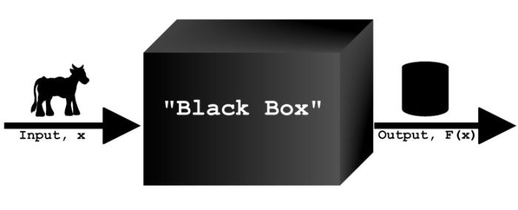
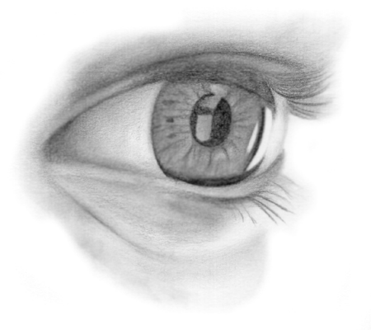
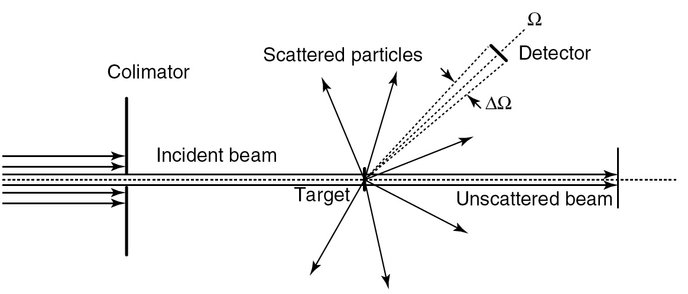
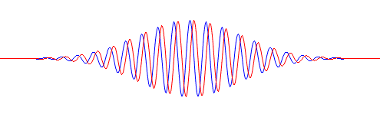
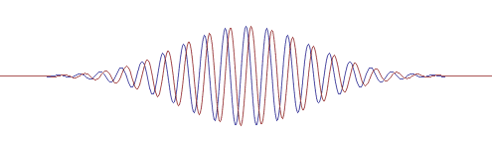
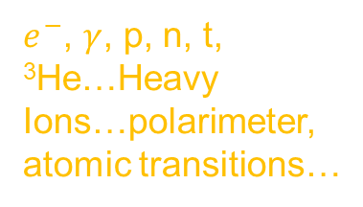

A nuclear reaction in the laboratory
Typical experiment:
Expt. parameters
Theory
Detection
$e^{−}$, $γ$, p, n, t, ³He…Heavy Ions…polarimeter, atomic transitions…
$e^{−}$, $γ$, p, n, t, ³He…Heavy Ions…
Target
Role of reaction theory:
Reconstruct the unseen history of the reaction and connect to nuclear structure properties
Beam control:
Beam energy, reactant polarization

Slide 23
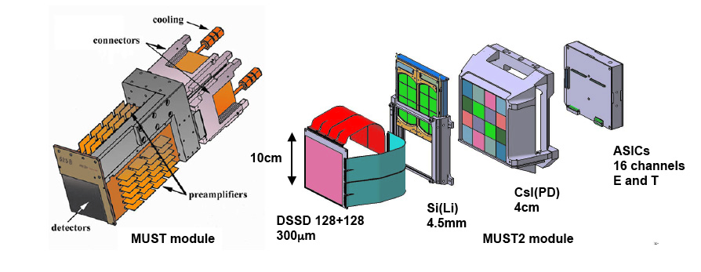

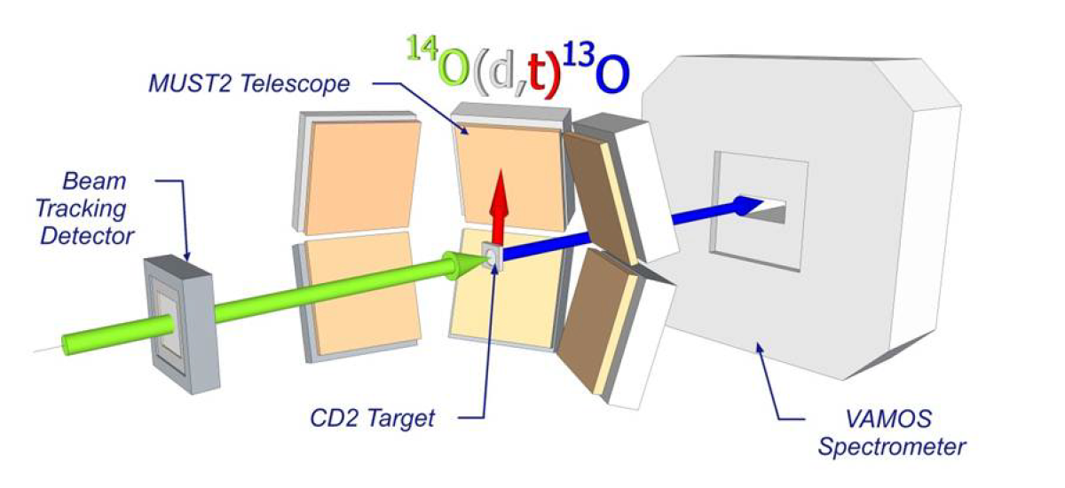
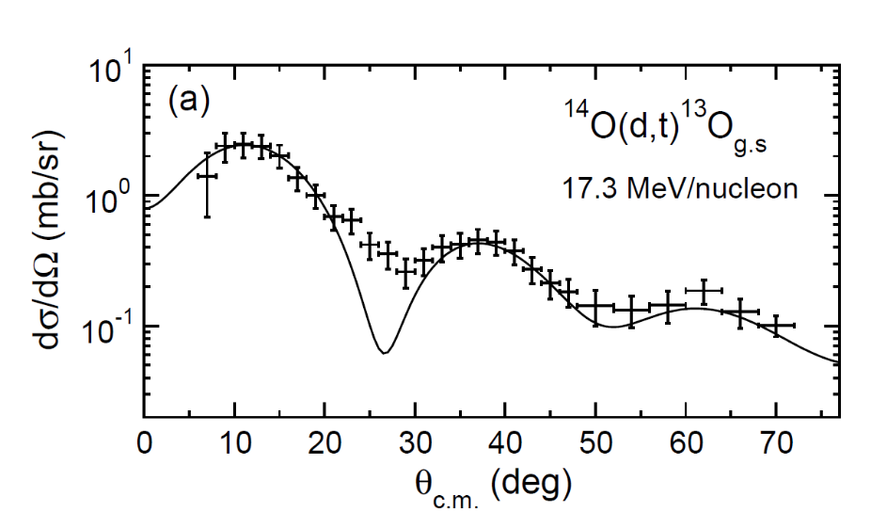
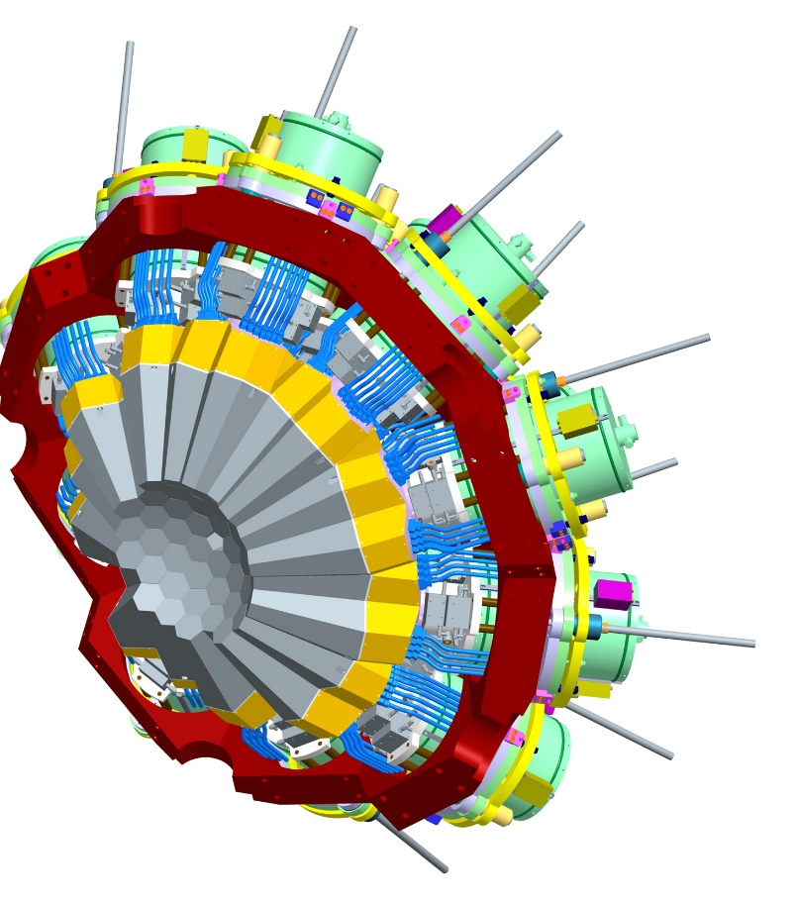
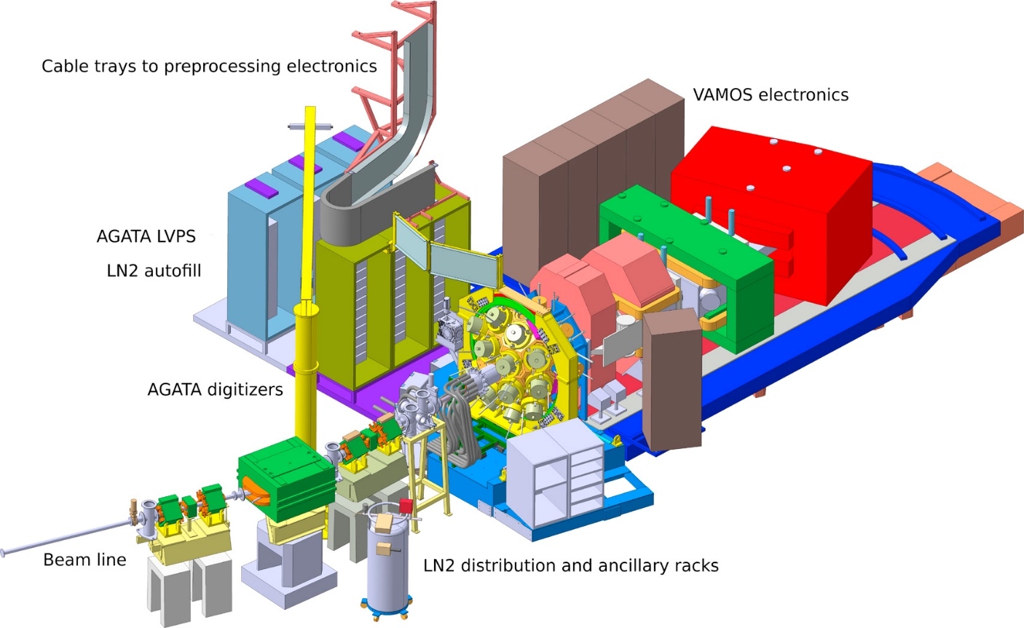
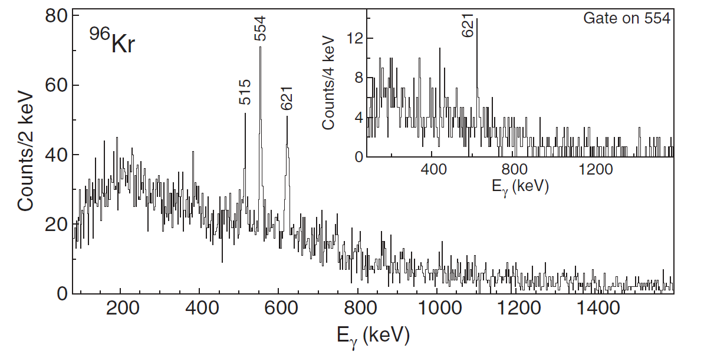
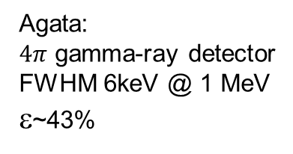
Today’s nuclear reactions in the laboratory
An example of experiment:
  Determination of the nature of the products (PID)
  Energy and angular resolution
  Momentum distributions
  γ measurements
Agata:
$4π$ gamma-ray detector
FWHM 6keV @ 1 MeV
ε~43%
VAMOS spectrometer

Slide 24



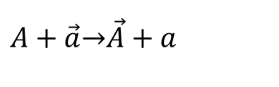

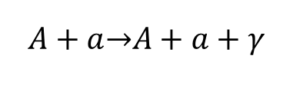

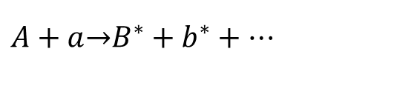


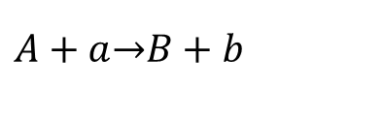

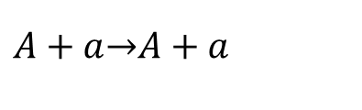
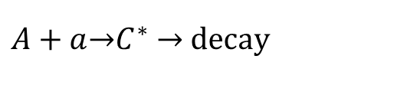
Classification of reactions
Entrance channel
Exit channel
$$\left(A_{P},Z_{P}\right)$$
Inclusive/exclusive
Strongly detectors dependent
E_{p}
b
$$\left(A_{T},Z_{T}\right)$$
$$\vec{S}$$
$${\vec{R}}_{c.m.}$$
$$\vec{S}$$
$$A+a\underset{→}{ }A+a$$
Elastic scattering $A(a,a)A$
No energy transfer
$$A+\vec{a}\underset{→}{ }\vec{A}+a$$
Spin transfer $A(\vec{a},a)\vec{A}$
$$A+a\underset{→}{ }B+b$$
Transfer reaction $A\left(a,b\right)B$
$$A+a\underset{→}{ }A+a+γ$$
Nuclear Bremsstrahlung
Energy transfer
Inelastic scattering
Deeply inelastic…
$$A+a\underset{→}{ }B^{∗}+b^{∗}+…$$
$A+a\underset{→}{ }C^{∗}$ $\underset{→}{ } \text{decay}$
Compound nucleus

Slide 25


Nuclear reactions by classifications
Direct reaction
Elastic and quasi-elastic
grazing
Fusion
Large amplitude Collective motion
b
Multi-nucleon transfer
Deep inelastic
$$P\left(b\right)=2πb$$
Elastic/Quasi-elastic
Cross section
Adapted from : W. Nörenberg and H.A. Weidenmüller, “Introduction to Heavy-Ion theory”, Springer-Verlag 1981.
Direct
FUSION
b
The more peripheral is the collision the highest is the associated cross-section

Slide 26



From reaction observables to nuclei
Nuclear structure
Knockout reactions (high energy)
$$t_{−∞}$$
$$t_{+∞}$$
Spectroscopic information
Transfer reactions (low energy)

Slide 27
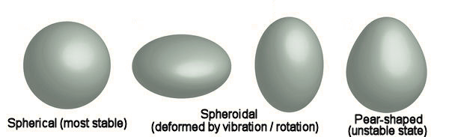
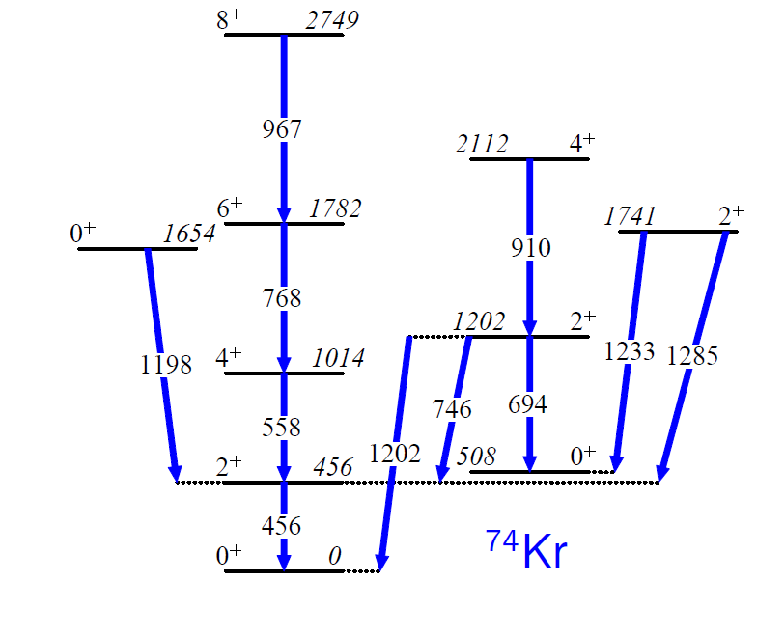
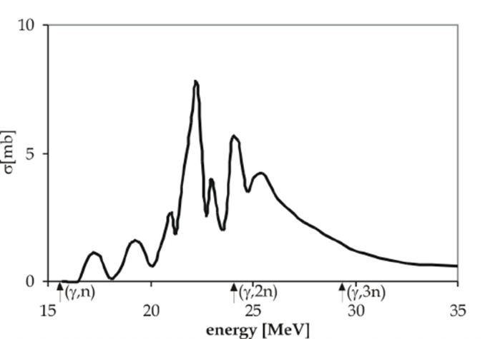


From reaction observables to nuclei
Nuclear spectroscopy
Photonuclear reactions
$$t_{−∞}$$
$$t_{+∞}$$
GDR excitation
$$γ$$
Collective motion
$$γ$$
Bremsstrahlung, radiative capture.
Nuclear force imprints low-energy resonances.
Sensitive to off-shellness.

Slide 28
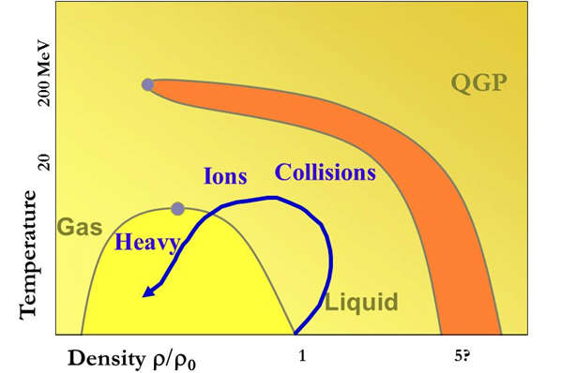


From reaction observables to nuclei
Out of equilibrium properties (away from nuclear density)
Reactions at Fermi energy
$$t_{−∞}$$
$$t_{+∞}$$

Slide 29
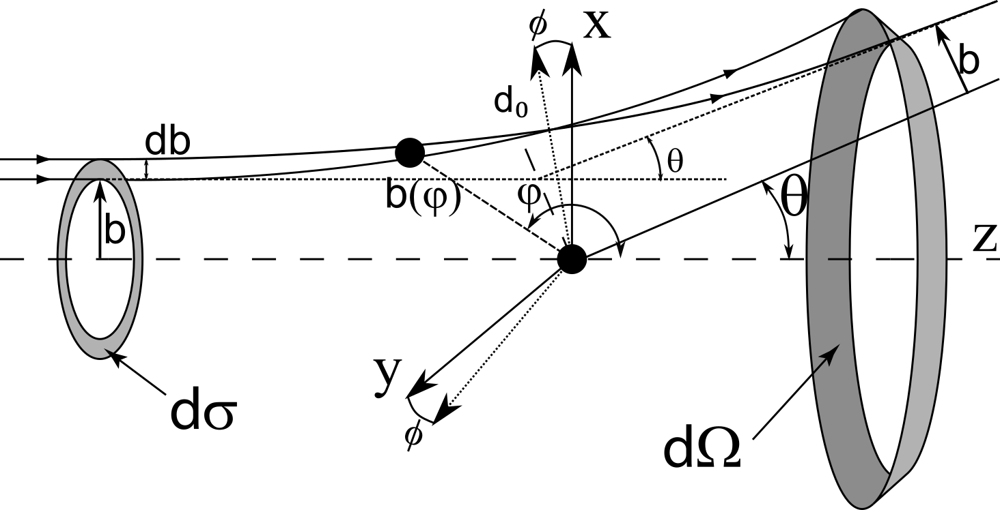



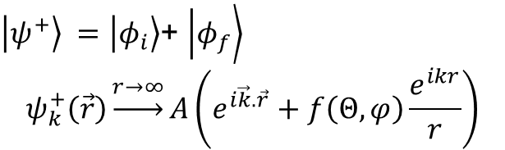

Definitions of cross-section and other quantities
Differential cross-section
$$\frac{{dσ}_{channel}\left(θ,φ\right)}{dΩ}=\frac{\text{(}\text{\# }\text{scattered particle}\text{.}{\text{s}}^{−1}\text{)(}θ,φ\text{) }}{\text{(Inc}\text{.}\text{ flux)(}\text{\# s}\text{catt}\text{.}\text{ centers)(unit of }Ω\text{) }}$$
$$\underset{→}{n=1}\frac{j_{f}\left(θ,φ\right)}{j_{i}}$$
We define the outgoing solution
The flux is given by
$\left.\left|ψ^{+}\right.\right\rangle =\left.\left|φ_{i}\right.\right\rangle$+ $\left.\left|φ_{f}\right.\right\rangle$
$$ψ_{k}^{+}\left(\vec{r}\right)\underset{→}{r→∞}A\left(e^{i\vec{k}.\vec{r}}+f\left(Θ,φ\right)\frac{e^{ikr}}{r}\right)$$
$$\vec{J}=\frac{ℏ}{2μi}\left({\left(ψ_{k}^{+}\right)}^{∗}∇ψ_{k}^{+}−ψ_{k}^{+}∇{\left(ψ_{k}^{+}\right)}^{∗}\right)$$
We find the cross section to be:
$$\frac{{dσ}_{ }\left(θ,φ\right)}{dΩ}={\left|f\left(Θ,φ\right)\right|}^{2}$$

Slide 30
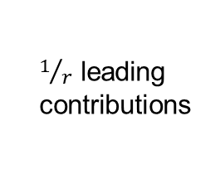
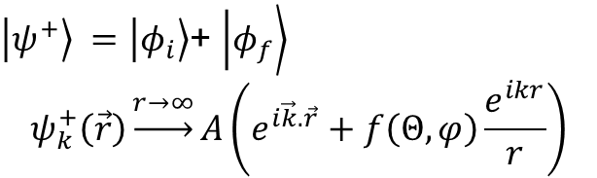






Wave effects
$\left.\left|ψ^{+}\right.\right\rangle =\left.\left|φ_{i}\right.\right\rangle$+ $\left.\left|φ_{f}\right.\right\rangle$
$$ψ_{k}^{+}\left(\vec{r}\right)\underset{→}{r→∞}A\left(e^{i\vec{k}.\vec{r}}+f\left(Θ,φ\right)\frac{e^{ikr}}{r}\right)$$
Quantum current is defined as
$$\vec{J}=\frac{ℏ}{2μi}\left({\left(ψ_{k}^{+}\right)}^{∗}∇ψ_{k}^{+}−ψ_{k}^{+}∇{\left(ψ_{k}^{+}\right)}^{∗}\right)$$
$$\vec{J}={\vec{j}}_{i}+{\vec{j}}_{f}+{\vec{j}}_{int}$$
We obtain:
$$j_{f}\left(θ,φ\right)=\vec{J}∙\hat{r}{ r}^{2}$$
$$j_{f}\left(θ,φ\right)={v\left|A\right|}^{2}{\left|f\left(Θ,φ\right)\right|}^{2}$$
$$j_{i}={v\left|A\right|}^{2}$$
$$j_{int}=0 for θ≠0$$
$j_{i}=\vec{J}$ $∙\hat{z}$
$1/r$ leading contributions
For $θ=0$
$Φ_{int}=r^{2}\int{dΩ{ j}_{int}}=−\frac{4πℏ}{m}ℑ(f\left(0\right))$ Since the flux ($Φ_{int}+Φ_{sc}=0$) is conserved we obtain that $σ_{tot}=\frac{4π}{k}ℑ(f\left(0\right))$
${\vec{j}}_{int}​$represents the flux removed from the incident beam by destructive interference in the forward direction. That lost forward flux exactly accounts for the flux scattered out of the beam.
Notes:
Verifier le r^2

Slide 31





Quantum effects
Few implications of quantum mechanics
Trajectories are indistinguishable
Impact parameter is not defined in the quantum world
Quantum interference phenomenon
Interfering trajectories can be constructive or destructive.
$$b$$
$$b′$$
Particle-Target motion must be described by wave functions
Impossible in classical world

Slide 32



Quantum effect
If target/beam are identical particles or nuclei then
scattering of ¹²C + ¹²C @ 5 MeV
Rutherford
One cannot distinguish the two cases: w.f. is symmetric or antisymmetric depending on the spin
This leads to
$$\frac{{dσ}_{ }\left(θ,φ\right)}{dΩ}={\left|f\left(Θ,φ\right)+f\left(π−Θ,φ\right)\right|}^{2}$$
Exp
causes interferences !
Note that the same happens with Coulomb
Illustration from G. R. Satchler “Introduction to direct reactions”

Slide 33




Translational invariance: C.M. frame
The Schrödinger equation
  $\left[−\frac{ℏ^{2}}{2m_{A}}∇_{A}^{2}−\frac{ℏ^{2}}{2m_{B}}∇_{B}^{2}+V\left(\left|{\vec{r}}_{A}−{\vec{r}}_{B}\right|\right)\right]ψ_{k}^{+}\left({\vec{r}}_{A},{\vec{r}}_{B}\right)=Eψ_{k}^{+}\left({\vec{r}}_{A},{\vec{r}}_{B}\right)$
reduces in the c.m. frame
  $$\left[−\frac{ℏ^{2}}{2μ}∇_{ }^{2}+V\left(\left|{\vec{r}}_{ }\right|\right)\right]ψ_{k}^{+}\left({\vec{r}}_{ } \right)=E_{C.M.}ψ_{k}^{+}\left({\vec{r}}_{ } \right)$$
phase velocity
$$w=\frac{E}{ℏ}=\frac{ℏk^{2}}{2μ}=kv$$

Slide 34











Bound state E<0
$$Ψ_{A+a}^{J^{π}}=S_{a,A}^{A}{\left[Ψ_{a}Ψ_{A}χ_{k_{β}}^{f}\left(\vec{r}\right) \right]}^{J^{π}}$$
  $S_{a,A}^{A}$spectroscopic amplitude
  ${\left|S_{a,2}^{A}\right|}^{2}$~ probability to form the configuration $(a+A)$ in the nucleus $A$
The Asymptotic Normalization Coefficient (ANC) $C_{c}=\frac{u_{c}\left(r\right)}{W_{−η_{B},l+1/2} (2κr)}$ pour $r>R.$
$$u_{c}\left(r\right)$$
Internal region
External region
$$V=V_{N}+V_{\text{Coul}}$$
$V=0 (\text{or} V_{\text{Coul}}$)
$$u_{c}\left(r\right)=\sum_{n}{A_{cn}f_{n}(r)}$$
$$u_{c}\left(r>R\right)=C_{c,l}W_{−η_{B},l+1/2} (2κr)$$
$$0$$
$$R$$
$$r$$
The tail of the wave function is determined by $E_{B}$ and $κ$
$u_{c}\left(r→∞\right)\sim x^{−η_{B}}e^{−\frac{2κr}{2}}$, $κ=\sqrt{−\frac{2μE_{B}}{ℏ^{2}}}$

Slide 35








Phase shifts, resonances E>0
Internal region
External region
$$V=V_{N}+V_{\text{Coul}}$$
$V=0 (\text{or} V_{\text{Coul}}$)
$$u_{c}\left(r\right)=\sum_{n}{A_{cn}f_{n}(r)}$$
$$u_{c}\left(r>R\right)=α_{c}ρ\left(J_{c}\left(ρ\right)+β_{c}N_{c}\left(ρ\right)\right)$$
$$0$$
$$R$$
$$r$$
Matching conditions on $u_{k,l≡c}^{ }\left(ρ_{ }\right)$ and ${du_{k,l≡c}^{ }\left(ρ_{ }\right)}/{dr}$ at $r=R$ between region I and II determines $β_{c}$.
If we write $β_{c}=\tan{δ_{c}}$, $δ_{c}$called the phase shift since:
$$u_{c}\left(r→∞\right)\sim \sin\left(ρ−lπ/2+δ_{c}\right)$$
While the plane wave gives
$$\sin\left(ρ−lπ/2\right)$$

Slide 36




Solution of the scattering problem with R-matrix method
Internal region
External region
$$V=V_{N}+V_{\text{Coul}}$$
$V=0 (\text{or} V_{\text{Coul}}$)
$$u_{c}^{I}\left(r\right) \text{from }\left(H_{A+B}+ℒ\left(B\right)\right)\left.\left|ψ_{i}^{+}\right.\right\rangle =E_{ }\left.\left|ψ_{i}^{+}\right.\right\rangle$$
$$u_{c}^{II}\left(r\right)=A_{c}ρ\left(H_{c}^{−}\left(ρ\right)−S_{c}H_{c}^{+}\left(ρ\right)\right)$$
$$0$$
$$R$$
$$r$$
Hermitian region (under conditions)
We know expand the interieur wave function on a square integrable basis, i.e.
$$u_{c}^{I}\left(r\right)=\sum{c_{j}φ_{j}(r)}$$
The R-matrix is defined by the differential equation
$$(3) → u_{c}\left(R\right)=ℛ_{c}\left(E\right)\left[R{u′}_{c}\left(R\right)−Bu_{c}\left(R\right)\right], \text{B is arbitrary}$$
To have an Hermitian problem in I, we must use the Bloch-Schrodinger equation
$\left(H_{l}+ℒ(B)−E\right)u_{c}^{I}\left(r\right)=ℒ\left(B\right)u_{c}^{II}\left(r\right)$ where$ℒ\left(B\right)=\frac{ℏ^{2}}{2μ}δ(r−R)\left(\frac{d}{dr}−\frac{B}{r}\right)$
B correspond to a choice of logarithmic boundary condition
$$⟨c|\frac{∂}{∂r_{α}}r_{α}|ψ_{i}^{+}⟩ = b_{c}⟨c|ψ_{i}^{+}⟩$$

Slide 37


Solution of the scattering problem with R-matrix method
Internal region
External region
$$V=V_{N}+V_{\text{Coul}}$$
$V=0 (\text{or} V_{\text{Coul}}$)
$$u_{c}^{I}\left(r\right) \text{from }\left(H_{A+B}+ℒ\left(B\right)\right)\left.\left|ψ_{i}^{+}\right.\right\rangle =E_{ }\left.\left|ψ_{i}^{+}\right.\right\rangle$$
$$u_{c}^{II}\left(r\right)=A_{c}ρ\left(H_{c}^{−}\left(ρ\right)−S_{c}H_{c}^{+}\left(ρ\right)\right)$$
$$0$$
$$R$$
$$r$$
Hermitian region (under conditions)
Application of $ℒ(B)$ to $u_{c}^{II}\left(r\right)$ gives the right-hand side of (3) times ${\left(ℛ_{c}\left(E\right)\right)}^{−1}$
We only must solve [formally] the linear equation for the $c_{j}$ introduce them in the expansion of $u_{c}^{I}\left(r\right)$ and use the differential equation that defines $ℛ_{c}\left(E\right)$ to find that
$$ℛ_{c}\left(E\right)=\frac{ℏ^{2}}{2μ}\sum{φ_{i}^{∗}(R){\left[C^{−1}\right]}_{i,j}^{ } φ_{j}(R)}$$
Where the collision matrix is defined as${\left[C\right]}_{i,j}^{ }=\left\langle φ_{i}\left|H_{A+B}+ℒ\left(B\right)−E\right|φ_{j}\right\rangle$. In the eigen-basis of $C$, we have
$$ℛ_{c}\left(E\right)=\sum{\frac{γ_{i}^{2}}{E_{i}−E}}$$
NB: $S_{c}\left(E\right)=(f∘ℛ_{c})\left(E\right)$

Slide 38





Solution of the scattering problem with R-matrix method
Internal region
External region
$$V=V_{N}+V_{\text{Coul}}$$
$V=0 (\text{or} V_{\text{Coul}}$)
$$u_{c}\left(r\right)=\sum_{n}{A_{cn}f_{n}(r)}$$
$$u_{c}\left(r>R\right)=α_{c}ρ\left(J_{c}\left(ρ\right)+β_{c}N_{c}\left(ρ\right)\right)$$
$$0$$
$$R$$
$$r$$
Decomposition on a Lagrange mesh.
In general, this is used as a parametrization and fitted to data: phenomenological R-matrix
NCSMC can be cast as Bloch-Schrödinger equation:
$$\left(C−EI\right)\vec{X}=Q(B)$$
And solved using R-matrix, which in the eigen basis of $C−EI$ reads:
$${b_{c}=S_{c}\left(E\right)=ℜ\left(\frac{a_{c}}{O_{c}}\frac{∂O_{c}}{∂r_{c}}\right)}_{a_{c}}$$
$$R_{cc′}=\sum_{λ}{\frac{γ_{λc}γ_{λc^{′}}}{E_{λ}−E}}$$
Simple for binary reacting system, more involved for neutral ternary system and extremely challenging for charged breakup.
$$a_{c} = 1.4(A_{1}^{\frac{1}{3}} + A_{2}^{\frac{1}{3}} ) \text{fm}$$

Slide 39






Asymptotically vanishing equivalent problem
Complex scaling
Kruppa et al. PRC89 (2014)
The complex scaling and the resonance states
Aguilar-Balslev-Combes theorem: the resonant states of the original Hamiltonian are invariant and the non-resonant scattering states are rotated and distributed on a $2θ$ray that cuts the complex energy plane with a corresponding threshold being the rotation point. Math. Phys. 22, 269 (1971)
$$\hat{H}\left(θ\right)=e^{−2iθ}\hat{T}+\hat{V}\left(re^{iθ}\right)$$
$$\hat{H}\left(r\right)=\hat{U}\left(θ\right)\hat{H}\left(r\right){\hat{U}}^{−1}\left(θ\right)$$
$$\hat{H}\left(r\right)=\hat{T}+\hat{V}\left(r\right)$$
$$\hat{H}\left(r,θ\right)ψ\left(r,θ\right)=\left(E−\frac{iΓ}{2}\right)ψ\left(r,θ\right)$$
Energy
Half-life

Slide 40




Asymptotically vanishing equivalent problem
Complex scaling
Kruppa et al. PRC89 (2014)
The complex scaling and the resonance states
$$\hat{H}\left(θ\right)=e^{−2iθ}\hat{T}+\hat{V}\left(re^{iθ}\right)$$
$$\hat{H}\left(r\right)=\hat{U}\left(θ\right)\hat{H}\left(r\right){\hat{U}}^{−1}\left(θ\right)$$
$$\hat{H}\left(r\right)=\hat{T}+\hat{V}\left(r\right)$$
$$U\left(θ\right)H(r){U\left(θ\right)}^{−1}$$
Spatially extended but exponential fall off
Boundary limit problem
Known asymptotic
Bound state problem
$$ψ\left(r,θ\right)\underset{∞}{\sim}e^{−kr\sin{θ}}$$

Slide 41






From phase shifts to cross-sections
$$H_{A+B}\left.\left|ψ_{i}^{+}\right.\right\rangle =E_{i}\left.\left|ψ_{i}^{+}\right.\right\rangle$$
$$\left[−\frac{d^{2}}{{dr}^{2}}+\frac{l\left(l+1\right)}{r^{2}}+\frac{2μ}{ℏ^{2}}V\left(r\right)\right]u_{k,l}^{ }\left(r_{ } \right)=k^{2}u_{k,l}^{ }\left(r_{ } \right)$$
Solve
$$f_{l}\left(k\right)=\frac{e^{2iδ_{l}\left(k\right)}−1}{2ik}$$
$$ψ_{k}^{+}\left(\vec{r}\right)⟶\left(e^{i\vec{k}.\vec{r}}+f\left(Θ,φ\right)\frac{e^{ikr}}{r}\right)$$
Match
Differential cross-sections for central potential
$\frac{{dσ}_{ }\left(θ,φ\right)}{dΩ}$, $σ_{tot}$
$$\frac{{dσ}_{ }\left(θ,φ\right)}{dΩ}=\frac{1}{4k^{2}}{\left|\sum{\left(2l+1\right){\left(1−e^{2iδ_{l}\left(k\right)}\right)P}_{l}\left(\cos{Θ}\right)}\right|}^{2}$$
Calculate

Slide 42










Reaction theory as a series
The Lippmann-Schwinger equation gives
$$ψ_{k}^{±}\left(\vec{r}\right)=\frac{e^{i\vec{k}∙\vec{r}}}{{\left(2π\right)}^{3/2}}−\frac{2μ}{ℏ^{2}}\int{d^{3}r′\frac{e^{±ik\left|r−r^{′}\right|}}{4π\left|r−r^{′}\right|}V\left(\vec{r}′\right)ψ_{k}^{±}\left({\vec{r}}^{′}\right)}$$
$$r$$
$$r−r^{′}$$
with ${\vec{k}}^{′}=k{\vec{e}}_{r}$
$$k′=k$$
$${\vec{e}}_{r}$$
Looking for the solution following
$$ψ_{k}^{+}\left(\vec{r}\right)⟶\frac{1}{{\left(2π\right)}^{3/2}}\left(e^{i\vec{k}.\vec{r}}+f\left(Θ,φ\right)\frac{e^{ikr}}{r}\right)$$
We obtain the scattering amplitude:
$$f\left(θ,φ\right)=−2π^{2}\frac{2μ}{ℏ^{2}}\int{d^{3}r^{′}\frac{e^{−i{\vec{k}}^{′}∙{\vec{r}}^{′}}}{{\left(2π\right)}^{3/2}}V\left(\vec{r}′\right)ψ_{k}^{+}\left({\vec{r}}^{′}\right)}$$
$$r^{′}$$
Interaction region $V\left(\vec{r}′\right)≠0$

Slide 43









Reaction theory as a series
T-matrix is defined as
$$f\left(θ,φ\right)=−2π^{2}\frac{2μ}{ℏ^{2}}\left\langle φ_{0,k^{′}} | V | ψ_{k}^{+}\right\rangle =−2π^{2}\frac{2μ}{ℏ^{2}}T_{k^{′},k}$$
Outgoing
$${\vec{k}}^{′}$$
$$r$$
$$k=k^{′}$$
We deduce the differential cross-section as:
$$\frac{{dσ}_{ }\left(θ,φ\right)}{dΩ}={\left(2π^{2}\frac{2μ}{ℏ^{2}}\right)}^{2}{\left|T_{k^{′},k}\right|}^{2}$$
$T_{k^{′},k}$ is the on-shell $[k=k’]$ T-matrix element and relates to the S-matrix by
$$S_{k^{′},k}=δ\left({\vec{k}}^{ }−{\vec{k}}^{′}\right)−2πiδ\left(E_{k}−E_{k^{′}}\right)T_{k^{′},k }$$
Incoming
$${\vec{e}}_{r}$$
$$Θ$$
$$\vec{k}$$
So $T_{l}\left(E\right)=−1/πe^{iδ_{l}(E)}\sin{δ_{l}(E)}.$Similarly, $T_{l}(E)=\frac{2μ}{{πℏ}^{2}}\int{dr rJ_{l}(kr) V\left(r\right)u_{l}^{ }\left(r\right)}$
Reaction observables carry imprints of the nuclear force

Slide 44







Representation of the born series
From the Lippmann-Schwinger equation we define the Born series expansion
$$f\left(Θ,φ\right)=−{\left(2π\right)}^{2}\frac{μ}{ℏ^{2}}\left\langle φ_{0,k^{′}} | V\sum{{\left(\frac{2μ}{ℏ^{2}}G_{0}V\right)}^{n}} | φ_{0,k}^{ }\right\rangle$$
We can understand that the unperturbed plane wave undergoes a sequences of multiples scattering events from inside the potential region:
$${\vec{k}}_{f}$$
$${\vec{k}}_{i}$$
$${\vec{k}}_{i}$$
$${\vec{k}}_{f}$$
$${\vec{k}}_{i}$$
$${\vec{k}}_{f}$$
…
Free propagation
Free propagation
Interaction region
Interaction region
Interaction region
But the series may not converge until all terms are including if the potential is strong enough.

Slide 45






The Distorted Wave-Born Approximation (DWBA)
Born Approximation
$$χ_{k}^{+}\left(\vec{r}\right)=\frac{e^{i{\vec{k}}_{α}∙\vec{r}}}{{\left(2π\right)}^{3/2}}−\frac{2μ}{ℏ^{2}}\int{d^{3}r^{′\frac{e^{ik_{β}\left|r_{ }−r_{ }^{′}\right|}}{4π\left|r_{ }−r_{ }^{′}\right|}}V\left(\vec{r}′\right)χ_{k}^{+}\left({\vec{r}}^{′}\right)}$$
Systematic constructive treatment
$$f_{Born}=−{\left(2π\right)}^{2}\frac{μ}{ℏ^{2}}\left\langle k^{′} | V | k \right\rangle$$
$${\vec{k}}_{α}$$
$${\vec{k}}_{ }^{′}$$
$$\left.\left|χ_{1}^{−}\right.\right\rangle$$
$$\left.\left|χ_{1}^{+}\right.\right\rangle$$
In some cases, the free-wave approximation is rather poor starting point.
Suppose $V=V_{MF}+V_{res}$ and the solutions of $\left(∇^{2}+k^{2}−V_{MF}\right)χ_{1}\left(k,r\right)=0$ are known/computable
One can show $f=f_{1}−{\left(2π\right)}^{2}\frac{μ}{ℏ^{2}}\int{d^{3}r^{′}χ_{1}^{−}\left(k,\vec{r}\right)V_{res}\left({\vec{r}}^{′}\right)χ_{k}^{+}\left({\vec{r}}^{′}\right)}$
The DWBA approximation consists in:
$χ_{k}^{+}⟶χ_{1}^{+}\left(k,r\right)$ then $f=f_{1}−{\left(2π\right)}^{2}\frac{μ}{ℏ^{2}}$ $\left\langle χ_{1}^{−} | V_{\text{res}} | χ_{1}^{+}\right\rangle$

Slide 46
























Multichannel reactions
$$f\left(Θ,φ\right)=\sum_{β}{f_{β}\left(Θ,φ\right)}$$
All energetically allowed opened channels $β$
Note that, in a finite basis, closed channels also contribute but to reaction observables
$$t=t_{0}$$
$$t≫t_{0}$$
Incoming wave
Elastic channel, always opened
$$\left.\left|a+A^{ }\right.\right\rangle$$
$$\left.\left|a+A^{ }\right.\right\rangle$$
$$Ψ_{a}Ψ_{A}χ_{k_{β}}^{f}(\vec{r})$$
$$\vec{k}$$
$${\vec{k}}_{β}$$
$${H_{a}Ψ}_{a}=E_{0}Ψ_{a}$$
$${H_{A}Ψ}_{A}=E_{0}Ψ_{A}$$
$$\left.\left|C^{∗}\right.\right\rangle$$
$$Ψ_{C^{∗}}$$
$$Ψ_{a}Ψ_{A}χ_{k}^{i}\left(\vec{r}\right)$$
$$χ_{k}^{i}\left(\vec{r}\right)∝e^{i\vec{k}.\vec{r}}$$
$${H_{a}Ψ}_{a}=E_{0}Ψ_{a}$$
$${\vec{k}}_{β}$$
$${H_{C}Ψ}_{C^{∗}}=E_{n}Ψ_{C^{∗}}$$
$${H_{A}Ψ}_{A}=E_{0}Ψ_{A}$$
$$Ψ_{b}Ψ_{C}χ_{k_{β}}^{f}(\vec{r})$$
channel Q-value
$Ψ_{a}$ and $Ψ_{A}$ quantum numbers defined conservation of total relative angular momentum
$$\left.\left|b+C^{ }\right.\right\rangle$$
$${H_{b}Ψ}_{b}=E_{0}Ψ_{b}$$
$${\vec{k}}_{β}$$
$${H_{C}Ψ}_{C}=E_{0}Ψ_{C}$$

Slide 47









Multichannel reactions
Scattering wave-function
$$ψ_{k}^{+}\left(\vec{r}\right)⟶\left(e^{i\vec{k}.\vec{r}}Ψ_{a}Ψ_{A}+\sum_{β}{f_{β}\left(Θ,φ\right)\frac{e^{ik_{β}r}}{r}}Ψ_{i_{β}}Ψ_{I_{β}}\right)$$
Interaction
between target
and projectile
$${\vec{k}}_{β}$$
$$\left.\left|i_{β}+{I_{β}}^{ }\right.\right\rangle$$
$$\vec{k}$$
Partial cross-section
$$\frac{dσ_{β}}{dΩ}=\frac{{\vec{j}}_{f}∙{d\vec{S}}/{r^{2}}}{{\vec{j}}_{i}∙\hat{k}}$$
Since $\vec{j}=ρ\vec{v}$ with $\vec{v}$ the wave vector, we have that :
Elastic scattering
$${v_{β}}/v =1$$
$$\frac{dσ_{β}}{dΩ}=\frac{v_{β}}{v}{\left|f_{β}\left(Θ,φ\right)\right|}^{2}$$
Inelastic scattering
$${v_{β}}/v≠1$$

Slide 48








Multichannel reactions
$$\frac{dσ_{β}}{dΩ}=\frac{v_{β}}{v}{\left|{\breve{f}}_{β}\left(Θ,φ\right)\right|}^{2}$$
$$\left.\left|a+A^{ }\right.\right\rangle$$
Elastic channel with $\frac{v_{β}}{v}=1$, always opens
$${\vec{k}}_{β}$$
$$\left.\left|i_{β}+{I_{β}}^{ }\right.\right\rangle$$
$$\left.\left|a^{∗}+{A^{∗}}^{ }\right.\right\rangle$$
Inelastic scattering $\frac{v_{β}}{v}≠1$,
Energetically opens if $E_{c.m.}$is greater than the reaction threshold
$$\vec{k}$$
$$\left.\left|a+A^{ }\right.\right\rangle$$
Inelastic channels
$$\left.\left|b+C^{ }\right.\right\rangle$$
$$\left.\left|b+d+C^{ }\right.\right\rangle$$
All other reaction channels energetically allowed ($\frac{v_{β}}{v}≠1$)
The scattering amplitude contributing to the same final quantum state will interfere, and channel coupling affects all amplitudes dynamically.

Slide 49











Influence of the non-elastic channels on cross-section
With only elastic channel
$$ψ_{k}^{+}\left(\vec{r}\right)⟶\left(e^{i\vec{k}.\vec{r}}+f\left(Θ,φ\right)\frac{e^{ik_{α}r}}{r}\right)$$
$$u_{α,l}\left(r>R\right)=A_{α,l}ρ\left(H_{l}^{−}\left(ρ\right)−S_{α,l}H_{l}^{+}\left(ρ\right)\right)$$
Elastic channel has the same wave number so$k=k_{α}$, the conservation of the flux [which implies the unitarity of the S-matrix i.e. $S_{α,l}{S_{α,l}}^{∗}=1$] means $S_{α,l}=e^{2iδ_{l}}, δ∈ℝ$
$$u_{αα,l}\left(r>R\right)=A_{αα,l}ρ\left(H_{l}^{−}\left(ρ\right)−S_{αα,l}H_{l}^{+}\left(ρ\right)\right)$$
$$u_{β,l}\left(r>R\right)=−A_{β,l}ρS_{βα,l}H_{l}^{+}\left(ρ\right)$$
Where $S_{βα,l}=\sqrt{v/{v_{β}}}$ ${\tilde{S}}_{βα,l}$ and $S_{αα,l}=e^{2iδ_{l}}, δ∈ℂ$. Total energy is conserved but $k_{β}≠k$ due to energy consumed by the Q value. The flux is distributed among channels:
$${\left|S_{αα,l}\left(E\right)\right|}^{2}+\sum{{\left|S_{βα,l}\left(E\right)\right|}^{2}}=1={\left|S_{αα,l}\left(E\right)\right|}^{2}+T_{α,l}$$
If PW are coupled (tensor force) then $S_{αα,l}→S_{αα,ll^{′}}$ (more parameters).
$$\vec{k}$$
$${\vec{k}}_{α}$$
$$\left.\left|a+A^{ }\right.\right\rangle$$
$$\left.\left|a+A^{ }\right.\right\rangle$$
Adding non-elastic channels
$$\vec{k}$$
$${\vec{k}}_{α}$$
$$\left.\left|a+A^{ }\right.\right\rangle$$
$$\left.\left|a+A^{ }\right.\right\rangle$$
$${\vec{k}}_{β}$$
$$\left.\left|i_{β}+{I_{β}}^{ }\right.\right\rangle$$

Slide 50



Elastic, Reaction and Total cross section
Elastic channel:
$$σ_{el}=\frac{π}{k^{2}}\sum{\left(2l+1\right){\left|1−{\tilde{S}}_{αα,l}\right|}^{2}}$$
Inelastic channels:
$$σ_{in}=\frac{π}{k^{2}}\sum{\left(2l+1\right){\left|{\tilde{S}}_{βα,l}\right|}^{2}}$$
Sum of all inelastic channels (absorption cross-sec.):
$$σ_{abs}=\frac{π}{k^{2}}\sum{\left(2l+1\right)\left(1−{\left|{\tilde{S}}_{αα,l}\right|}^{2}\right)}=\frac{π}{k^{2}}\sum{\left(2l+1\right)T_{α,l}}$$
from${\left|S_{αα,l}\right|}^{2}+\sum{{\left|S_{βα,l}\right|}^{2}}=1$, and total cross-section
$$σ_{tot}=σ_{el}+σ_{abs}$$
$$=\frac{2π}{k^{2}}\sum{\left(2l+1\right)(1−Re({\tilde{S}}_{αα,l}))}$$
$$\vec{k}$$
$${\vec{k}}_{α}$$
$$\left.\left|a+A^{ }\right.\right\rangle$$
$$\left.\left|a+A^{ }\right.\right\rangle$$
$${\vec{k}}_{β}$$
$$\left.\left|i_{β}+{I_{β}}^{ }\right.\right\rangle$$
The transmission coefficient use in HF

Slide 51



Optical potential
Scattering equation with an imaginary potential
$$\left(∆+k^{2}−\frac{2μ}{ℏ^{2}}(V\left(\vec{r}\right)+iW(\vec{r})\right)φ\left(\vec{r}\right)=0$$
The standard conservation of matter
$$\frac{dρ}{dt}=−\vec{∇}∙\vec{J}$$
Is modified with a sink term $\frac{2}{ℏ}W(r)ρ(r)$.
Incoming
Outgoing
$$V\left(r\right)+iW(r)$$
Thus we have $ℏ$ $\vec{∇}∙\vec{J}=\frac{2}{ℏ}W(r)ρ(r)$ we immediately obtained the lost outgoing flux as $−\frac{2}{ℏ}\int{d^{3}rW(r)ρ(r)}$, the absorption cross-section reads
$$σ_{abs}=−\frac{2}{ℏv}\int{d^{3}rW(r)ρ(r)}$$
In practice, $W\left(r\right)<0$ is parametrized by various Woods-Saxon functions:
$$W\left(r,E\right)= −W^{\text{vol}}\left(E, r\right)+4a^{\text{sur}}W^{\text{sur}}\left(E\right)\frac{d}{dr}f(r) +W^{so}(r,E)$$

Slide 52












Nucleon transfer
DWBA applied to nuclear transfer reaction
$$(a+x)=A$$
$$(a)$$
$$(b)$$
$$(b+x)=B$$
At high energies, we assume internal dof are frozen (spectator nucleons) only the transferred particle (n, p, d, …) ic considered explicitly:
$$A+b→a+B ⟹\left(a+x\right)+b⟶a+(b+x)$$
The interaction potentials should be between all constituents [3-body problem]:
Entrance
Exit
$$Ψ_{A=(a+x)}^{J^{π}}=S_{a,x}^{A}{\left[Ψ_{a}Ψ_{x}χ_{k_{β}}^{f}\left(\vec{r}\right) \right]}^{J^{π}}+…$$
$$Ψ_{B=(b+x)}^{J^{π}}=S_{b,x}^{B}{\left[Ψ_{b}Ψ_{x}χ_{k_{β^{′}}}^{f}\left(\vec{r}\right) \right]}^{J^{π}}+…$$
$$χ_{1}^{−}$$
$$χ_{1}^{+}$$
$$\left\langle χ_{1}^{−} | V_{\text{res}} | χ_{1}^{+}\right\rangle ∝ \left\langle Ψ_{b}Ψ_{x}χ_{k_{β^{′}}}^{f}\left(\vec{r}\right) | V_{\text{res}} | Ψ_{a}Ψ_{x}χ_{k_{β}}^{f}\left(\vec{r}\right)\right\rangle$$

Slide 53





Scattering observables at very low energy
$$σ_{tot}=\frac{4π}{k^{2}}\sum{\left(2l+1\right){\left(\sin{δ_{l}\left(k\right)}\right)}^{2}}$$
Requires to estimate the phase-shift for all $l$, i.e. solve
$$\left[−\frac{d^{2}}{{dr}^{2}}+\frac{l\left(l+1\right)}{r^{2}}+\frac{2μ}{ℏ^{2}}V\left(r\right)\right]u_{k,l}^{ }\left(r_{ } \right)=k^{2}u_{k,l}^{ }\left(r_{ } \right)$$
Need two conditions:
  Request regular solution at $r⟶0$, i.e. $u_{k,l}\left(0\right)=0$
  At long relative distance should match free particle solution
At high energy many $l$ contributes
At very low-energy $k→0$ the cross section is dominated by $l=0$ (s-wave scattering)
$$σ_{tot}=\frac{4π}{k^{2}}{\left(\sin{δ_{0}\left(k→0\right)}\right)}^{2}$$
$$σ=4πa^{2}$$
If
$${\left(\sin{δ_{0}}\right)}^{2}\sim {\left(ka\right)}^{2}$$
Equivalent to hard-sphere scattering

Slide 54




Scattering length: $a$
It characterize the scattering potential at very low energy in an effective way.
A standard definition is
$$\lim_{k→0}{k\cot{δ_{0}}≅−\frac{1}{a}}$$
This expression is sometimes generalized to (called finite range expansion)
$$k\cot{δ_{0}}=−\frac{1}{a}+\frac{1}{2}k^{2}r_{\text{ef}}+O\left(k^{4}\right)$$
This can be interpreted as the solution of
$$\left[−\frac{d^{2}}{{dr}^{2}}+\frac{2μ}{ℏ^{2}}\left(V\left(r\right)−E\right)\right]u_{k,0}^{ }\left(r_{ } \right)=0$$
when $V(r)$ and $E$ goes to zero
Near threshold rule
No bound state case
a<0
effective range
bound state case
a>0
$${\frac{d^{2}}{{dr}^{2}}u}_{k,0}^{ }\left(r_{ } \right)=0$$
$$u_{k,0}^{ }\left(r_{ } \right)\sim \sin\left(kr+δ_{0}\right)≅kr+δ_{0}≅k\left(r−a\right)$$

Slide 55


Nucleosynthesis since $t=t_{0}$
Some schematic view of the Big Bang
To understand this one should be able to trace back the creation of light nuclei from nucleons and heavier nuclei from light nuclei [fusion, capture with EM emission].

Slide 56









Observation of today’s solar abundancy
Solar abundancy
Light nuclei formation
$\text{p + p → d + e⁺ + }\text{ν}\text{ₑ}$ $\text{Q = 0.42 MeV}$
$\text{ p + e⁻ + p → d + }\text{ν}\text{ₑ}$ $\text{Q = 1.42 MeV}$
$\text{ d + p → ³He + }\text{γ}$ $\text{Q = 5.49 MeV}$
$\text{ ³He + ³He → ⁴He + 2p}$ $\text{Q = 12.96 MeV}$
PPI chain is 91 % sun energy
N=50
N=82
N=126
…
How to have heavier systems?

Slide 57



Observation of today’s solar abundancy
Solar abundancy
Q-value problem
N=50
N=82
N=126
The guess of F. Hoyle
$$α+α+α⟶{}_{ }^{12}{C^{∗}}⟶{}_{ }^{12}C$$
Very low reaction rate but synthesis of C possible thanks to a resonance located around the threshold

Slide 58


Observation of today’s solar abundancy
Solar abundancy
CNO cycle
2 % sun energy
N=50
N=82
N=126

Slide 59





Observation of today’s solar abundancy
Solar abundancy
Alpha burning $α+α+α⟶{}_{ }^{12}C$
N=50
N=82
N=126

Slide 60



Observation of today’s solar abundancy
Solar abundancy
Synthesis of nuclei with $A<60$
Light-ion fusion
or incomplete
fusion
N=50
N=82
N=126

Slide 61






Observation of today’s solar abundancy
Solar abundancy
Synthesis of nuclei with $A>60$
  s-process: competition between neutron radiative capture
  and beta decay
Example:
N=50
N=82
N=126

Slide 62



Observation of today’s solar abundancy
The s-process compete with the r-process (rapid neutron capture), when neutron density is high [very astrophysical site dependent]
s-process limit
Core-collapse supernova
Neutron star merger

Slide 63


Nuclear inputs for astrophysics
Synthesis of nuclei in a stellar environment is modeled by a differential equation:
$${\left(\frac{dn_{i}}{dt}\right)}_{ρ=cst}=\sum{N_{j}^{i}r_{j}+N_{j,k}^{i}r_{j,k}⋯}$$
Corresponding to interaction with non-nuclear fields (weak decays, etc.) two-body nuclear reaction and so on.
The coefficient $N_{j}^{i}$ specifies how many particles of species $i$ are created in the reaction while $r_{j}$ is the nuclear reaction rate
A cross section between a target $j$ and a projectile $k$ is $σ=\frac{r/{n_{k}}}{n_{i}v}$ so, we define the average number of reactions per $\text{c}{\text{m}}^{3}$and $s$ as
$$r_{j,k}=\int{σ\left|v_{k}−v_{j}\right|d^{3}n_{j}d^{3}n_{k}}$$

Slide 64


Nuclear inputs for astrophysics
In general, for a plasma the species obeys a Maxwell-Boltzmann distribution
$$d^{3}n_{j}=n_{j}{\left(\frac{m_{j}}{2πkT}\right)}^{\frac{3}{2}}e^{−\frac{m_{j}^{2}v_{j}}{2kT}}d^{3}v_{j}$$
The reaction rate is often written as a function of the astrophysical S-factor that attempts to deconvolute the effect of the Coulomb barrier (we work at energy under the Coulomb barrier)
$$S\text{−}factor=Eσ\left(E\right)e^{2πη}$$
The reaction rate then reads
$$r_{j,k}=\frac{n_{j}n_{k}}{1+δ_{i,k}}\left\langle σv\right\rangle$$
$$\left\langle σv\right\rangle ={\left(\frac{8}{πμ}\right)}^{\frac{1}{2}}{\left(\frac{1}{kT}\right)}^{\frac{3}{2}}\int{S\left(E\right)e^{−\frac{E}{kT}−{\left(\frac{E_{g}}{E}\right)}^{\frac{1}{2}}}dE}$$

Slide 65








Nuclear structure viewed from nuclear reactions
bound
continuum
particle emission threshold $S_{n}$
High density of states followed by continuum and resonances
($E_{r},Γ_{r}$)
Overlapping resonances
cross section
Resolved resonances
Giant resonance
Bound discrete states ($E_{x}^{J^{π}T}$)
Ground state
($E_{B}$, $r_{c}$, $ρ_{c}$)

Slide 66


Capture processes: resonant capture
E
Incoming particle ${(E}_{kin}$)
Resonance
Continuum
$$S_{n}$$
Particle emission threshold (most likely neutron)
Bound states
Ground state (g.s) of the final nucleus

Slide 67

Capture processes: resonant capture
E
Draw a pot
Nuclear T-matrix
Strong interaction
$$T_{\text{nuc}}= \\ ⟨φ_{i}^{sc.}\left(E\right)\left|V^{\text{nuc}}\right|φ_{f}^{r}\left(E_{r}\right)⟩$$
$$S_{n}$$
An incoming particle gets trapped in the potential pocket of an isolated resonance:
the T-matrix is the amplitude for the capture process from the scattering state to the resonance.
Initial scattering state
Final resonant state
g.s.

Slide 68


Capture processes: resonant capture
E
Electromagnetic interaction
or
Photon is emitted to release energy
or
$$T_{γ}=⟨φ_{i}^{r}(E_{r})\left|V\right|φ_{f}⟩$$
$$S_{n}$$
Capture is favored if nuclear resonances are present:
the photon emission competes with particle emission;
electromagnetic T-matrix accounts for the probability to decay from the resonance to the final bound state.
Final bound state
(g.s. or ex. state)
g.s.

Slide 69
Capture processes: direct capture
Incoming particle ${(E}_{kin}$)
Continuum with too weak resonances or none
$$S_{n}$$
g.s.

Slide 70

Capture processes: direct capture
E
$$T_{f←i}=⟨φ_{i}^{sc.}(E_{kin})\left|V\right|φ_{f}⟩$$
$$S_{n}$$
This process is favored (by lack of competitors) if strong resonances are not present.
The probability to capture is uniquely E.M. (thus much weaker than nuclear resonantly enhanced).
g.s.

Slide 71




Capture processes: compound capture
E
Average density of state
Incoming particle ${(E}_{kin}$)
Dense continuum:
  High-level density
  Many overlapping resonances
$$S_{n}$$
Nuclear structure
g.s.
$$\left.\left|φ\right.\right\rangle$$
$$\left.a_{i}^{+}a_{j}\left|φ\right.\right\rangle$$
$$\left.a_{i}^{+}a_{k}^{+}a_{j}a_{l}\left|φ\right.\right\rangle$$

Slide 72

Capture processes: compound capture
E
Average density of state
$$S_{n}$$
$$T_{γ}^{c}⟶T_{γ}\left(E\right)$$
$T_{γ}\left(E\right)$is the $γ$ channel transmission coefficient or the probability to decay per E.M. transition in the compound nucleus.
Basically calculated from $γ$-strength functions and level densities.
g.s.

Slide 73





Hauser-Feshbach: $\lim_{N→∞}{ρ\left(E\right) }$
$$N\left(E\right)$$
$$N\left(E\right)=\sum_{n}{Θ(E−E_{n})}$$
$$ρ\left(E\right)=\frac{dN\left(E\right)}{dE}=\sum_{n}{δ\left(E−E_{n}\right)}$$
The level density $ρ\left(E\right)$ is very high
and
The experimental conditions impose that resonances are not resolved:
step function replaced by continuous function;
$ρ\left(E\right)$ is purely a statistical inference of data.
$$ρ\left(E\right)=N\frac{e^{2\sqrt{aE}}}{a^{\frac{1}{4}}E^{\frac{5}{4}}}$$
$$E$$

Slide 74









Hauser-Feshbach: « Memoryless »
Compound nucleus formation described by transmission coefficient $T_{α,n}\left(E\right)$
$$t_{+∞}$$
Decay channels are described by transmission coefficients:
$T_{α},T_{β}\left(T_{β,γ}\right),T_{β,f}$ etc..
Hypothesis of independence of probability (no memory of formation):
Elastic $T_{α}$
$$t_{−∞}$$
Whatever inelastic channel $T_{β}$, $T_{β,γ}$
$$T_{α,i}P=\frac{{T_{α,i}T}_{β,f}}{∑T_{β}}$$
fission $T_{β,f}$
After averaging over unresolved compound-nucleus resonances, channel couplings are characterized by transmission coefficients $T_{c}\left(E\right)$, rather than by individual resonance amplitudes.
On needs various models to compute the transmission coefficients:
  particle emission and absorption: optical model;
  $γ$ emission and absorption: $γ$-strength functions from electromagnetic response (E1, M1, E2…);
  fission: fission barriers.

Slide 75


Typical emission spectrum from compound reaction
⁵⁶Fe(p,xp) @ 62 MeV
In red: evaporation
  Slow reaction time${10}^{−14}\text{s}$.
  Isotropic angular distributions.
In green: “flat” region
  Intermediate reaction time.
  Anisotropic angular distributions that evolve slowly toward the forward direction as the emission energy increases.
In blue: discrete peaks
  Fast reaction time ${10}^{−21}\text{s}$.
  Angular distributions peaked in the forward direction and showing oscillations.

Slide 76



TALYS: flow chart
Direct elastic
Masses
Deformations
Discrete excited states
Matter densities
Transition densities
Elastique
Deformations
Partial level densities
Transition densities
Masses
Deformations
Discrete excited states
Level densities
Gamma strength functions
Fission pathways
Optical model
$$σ_{reac}$$
$$σ_{CN}$$
Compound nuclei
Pre-equilibrium
Fission
$$T_{ij}$$
Inelastic
(n,n’), (n,α),
(n,γ), etc…
Direct inelastic contribution

Slide 77
TALYS pre-equilibrium: exciton model principle
E
0
E_{F}
Compound
Nucleus
1p
2p-1h
3p-2h
4p-3h
time
1n
3n
5n
7n

Slide 78

TALYS pre-equilibrium: master equation exciton model
We want to track in time the evolution of different species (excited composite system to equilibrate. We define:
  $P(n,E,t)$ is the probability to find for at time $t$ the composite system with an energy $E$ and an exciton number $n$.
  $λ_{i⟶f}(E)$is the transition rate from an initial state $i$ a to a state $f$ for a given energy $E$.
The time evolution is a reaction network-like and thus follows (for each $n$):
  $\frac{dP\left(n,E,t\right)}{dt}=P\left(n−2,E,t\right)λ_{n−2⟶n}\left(E\right)+P\left(n+2,E,t\right)λ_{n+2⟶n}\left(E\right)−P\left(n,E,t\right)\left(λ_{n⟶n+2}\left(E\right)+λ_{n⟶n−2}\left(E\right)+\int{\sum_{c}{λ_{n⟶c}\left(E,ε_{c}\right)dε_{c}}}\right)$
Then compute the quantities of desire.. the emission cross-section in channel “c”:
$$\frac{dσ_{c}}{dε_{c}}=σ_{\text{reac}}\int_{0}^{∞}{\sum_{n,Δn=2}{P\left(n,E,t\right)}λ_{n⟶c}\left(E,ε_{c}\right) dt }$$
$$σ_{\text{reac}}=\frac{π}{k^{2}}\sum_{l,j}{\left(2J+1\right)T_{lj}^{\text{entrance}}}$$

Slide 79


TALYS pre-equilibrium: initialization & transition rates
Initialisation:
$P\left(n,E,0\right)=δ_{n,n_{0}}$ with for instance $n_0=3$for nucleon induced reactions
Transition rates:
Fermi's golden rule: $\frac{2π}{ℏ}$ |Matrix elements|² x density of final states
$λ_{n⟶n−2}\left(E\right)=\frac{2π}{ℏ}\left\langle M^{2}\right\rangle w(p,h,E)$ with $p+h=n−2$
$λ_{n⟶n+2}\left(E\right)=\frac{2π}{ℏ}\left\langle M^{2}\right\rangle w(p,h,E)$ with $p+h=n+2$
Particle emission:
$$λ_{n⟶c}\left(E,ε_{c}\right)=\frac{2S_{c}+1}{π^{2}ℏ^{3}}μ_{c}ε_{c}σ_{c,inv}\left(ε_{c}\right)\frac{w\left(\text{"residual conf"},E−ε_{c}−{\text{B}\text{E}}_{c}\right)}{w\left(p,h,E\right)}Q_{c}\left(n\right)F_{c}$$
State densities:
$w(p,h,E)$ = number of ways of distributing p particles and h holes among accessible single particle levels with the available excitation energy $E$,
Original
formulation
corrections for proton-neutron distinguishability & complex particle emission
From detailed balanced
$$w(p,h,E)≈\frac{ρ_{s.p. }^{p+h}E^{p+h−1}}{p!h!\left(p+h−1\right)!}$$

Slide 80




TALYS compound nucleus model
Compound nucleus hypothesis
  Continuum of excited levels
  Independence between incoming channel i and outgoing channel $f$
$$σ_{i⟶f}=σ_{i}^{CN}P_{f}$$
$$σ_{i}^{CN}=\frac{π}{k_{i}^{2}}T_{i}$$
$$P_{f}=\frac{T_{f}}{\sum_{d}{T_{d}}}$$
We recover the first step of the Hauser-Feshbach formula
$$σ_{i⟶f}=\frac{π}{k_{i}^{2}}\frac{{T_{i}T}_{f}}{\sum_{d}{T_{d}}}$$

Slide 81
TALYS compound nucleus model: observable signature
Compound angular distribution & direct angular distributions
45° 90° 135°

Slide 82

TALYS compound nucleus model : width fluctuation
Cross-section from a Breit-Wigner resonance (assumption: sharp resonance):
$$σ_{i→f​}^{r}\left(E\right)=\frac{π}{k_{i}^{2}}\frac{Γ_{i​}^{r}Γ_{f}^{r}}{{\left(E−E_{r}​\right)}^{2}+\frac{{Γ^{r}}_{tot}^{2}​}{4}​​. }$$
integrated and averaged ($D=\frac{ΔE}{\#res}$ is the mean CN resonance spacing) over an energy width corresponding to the incident beam dispersion to give:
$$\left\langle σ_{i⟶f}\right\rangle =\frac{π}{k_{i}^{2}}\frac{2π}{D}\left\langle \frac{Γ_{i}Γ_{f}}{Γ_{tot}}\right\rangle$$
The weak-coupling/narrow-width relation gives $T_{i}≈\frac{2π\left\langle Γ_{i}\right\rangle }{D}$
$$⟹\left\{\begin{matrix}\left\langle σ_{i⟶f}\right\rangle =\frac{π}{k_{i}^{2}}\frac{T_{i}T_{f}}{\sum_{d}{T_{d}}}W_{i⟶f} \\ W_{i⟶f}=\frac{\left\langle \frac{Γ_{i}Γ_{f}}{Γ_{tot}}\right\rangle }{\frac{\left\langle Γ_{i}\right\rangle \left\langle Γ_{f}\right\rangle }{\left\langle Γ_{tot}\right\rangle }}\end{matrix}\right.$$

Slide 83

TALYS compound nucleus model: cross-sections
$$σ_{CN}=\sum_{f}{σ_{i⟶f}}$$
The sum over the final state replace by an average given the statistical number of final channels:
$$\sum_{f}{ }→\int{ρ\left(E_{f}\right)dE_{f}}$$
The final state (mass partition) can be a $γ$, n , p, d, t,…, fission $⊗$ residual nucleus
$$σ_{i⟶f}=\frac{π}{k_{i}^{2}}\sum_{J,π}{\sum_{α,β}{\frac{2J+1}{\left(2S+1\right)\left(2I+1\right)}}T_{l_{α},j_{α}}^{J^{π}}\left(α\right)\frac{\left\langle T_{f}^{J^{π}}\left(β\right)\right\rangle }{\sum_{δ}{\left\langle T_{d}^{J^{π}}\left(δ\right)\right\rangle }}W_{i⟶f}}$$
With the quantum numbers $J=l_{α}+s_{α}+I_{i}=j_{α}+I_{i}$ and $π={\left(−1\right)}^{l_{α}}π_{i}$ composed of channel quantum numbers plus intrinsic (particle plus residual nucleus $f$).
The $\left\langle T_{f}^{J^{π}}\left(β\right)\right\rangle$ is the transmission coefficient to the outgoing channel $β$ with the outgoing particle plus residual nucleus $f$.

Slide 84

TALYS compound nucleus model: decay channels
Possible decays:
Emission to a discrete level with energy $Ed$
  $$\left\langle T_{f}\left(β\right)\right\rangle =T_{l_{β}j_{β}}^{J_{f}^{π}}\left(β\right)$$
  The transmission coefficient is calculated from the optical potential
Emission in the level continuum
  $$\left\langle T_{f}\left(β\right)\right\rangle =\int_{E}^{E+ΔE}{T_{l_{β}j_{β}}^{J_{f}^{π}}\left(β\right) ρ\left(E,J_{f},π\right)dE}$$
  $ρ\left(E,J_{f},π\right)$ is the level density of the residual nucleus with quantum number $J_{f}^{π}$and excitation $E$
Emission of photons, fission
  Specific treatment (not discussed here)

Slide 85

TALYS: model for level densities
How do we get a reasonable statistical model for the level density?

Slide 86



TALYS: level densities microphysics
n+²³²Th
⁵⁶Mn
N(E)
Total cross section (b)
⁵⁷Fe
⁵⁸Fe
E (MeV)
Incident neutron energy (eV)
Exponential increase of the cumulated number of discrete levels $N(E)$ with energy
    $ρ\left(E\right)=\frac{dN(E)}{dE}$ increases exponentially
    odd-even effects are important
Mean spacings of s-wave neutron resonances at E_{n} of the order of few eV
    $ρ(E_{n})$ is of the order of $104–106$levels per MeV (hence the statistical approximation)

Slide 87






TALYS: level densities microphysics
$$ρ\left(E,J,π\right)=\frac{1}{2}\frac{\sqrt{p}}{12}\frac{e^{2\sqrt{aE}}}{a^{\frac{1}{4}}E^{\frac{5}{4}}}\frac{2J+1}{2√2πσ^{3}}e^{−\frac{{\left(J+\frac{1}{2}\right)}^{2} }{2σ^{2}}}$$
With $σ^{2}=I_{rig}\sqrt{\frac{E}{a}}$ odd even effects are accounted via
$$E⟶E^{∗}=E−Δ$$
$$Δ=\left\{\begin{matrix}\begin{matrix}0 & \text{odd−odd}\end{matrix} \\ \begin{matrix}\frac{12}{\sqrt{A}} & \text{odd−even}\end{matrix} \\ \begin{matrix}\frac{24}{\sqrt{A}} & \text{even−even}\end{matrix}\end{matrix}\right.$$
Z=50,N=82
Z=82,N=126
N=50
Masse
Z=20, N=28
Shell effects

Slide 88


TALYS: level density regimes in literature
10 ⁶ -
10 ⁵ -
10 ⁴ -
N(E)
10 ³ -
10 ² -
10 -
1
1 2 3 4 5 6 7 8 9
E (MeV)
Discrete levels
(spectroscopy)
Temperature law
Fermi gaz (adjusted at B_{n})
$$ρ\left(E\right)∝\frac{e^{\left(2\sqrt{aU^{∗}}\right)}}{a^{\frac{1}{4}}U^{∗\frac{5}{4}}}$$
$$N\left(E\right)=e^{(\frac{{E−E}_{0}}{T})}$$

Slide 89






AZURE2 example case: level Structure of ¹³N review
$${{}_{ }^{12}C}^{∗}$$
$$S_{p}= 1.9435 \text{MeV}$$
$${{}_{ }^{13}N}^{∗}$$
Almost 3 MeV gap
$${{}_{ }^{13}N}^{ }$$
An ideal case for R-matrix
Low level density;
Isolated set of levels near threshold;
Resonances are broad enough to easily measure but not too broad so that their shape are not overlapping strongly.
https://nndc.bnl.gov
https://nucldata.tunl.duke.edu

Slide 90



AZURE2: Individual contributions of Coulomb and radiative direct capture
Level parameters:
Ground state proton $\text{ANC}=1.65 {\text{f}\text{m}}^{−\frac{1}{2}}$
Where does it come from?
  Fits to this data
  Proton transfer measurements (direct reaction studies)

Slide 91


AZURE2: Individual contributions of lowest energy proton-unbound level
Level parameters:
First excited state’s $J^{π}, E, Γ_{p}$ and $Γ_{γ}$;
Where do they come from?
  Fits to this data;
  Many other measurements;

Slide 92


AZURE2: Individual contributions of second excited state
Level parameters:
Second excited state’s $J^{π}, E, Γ_{p}$ and $Γ_{γ}$;
Where do they come from?
  Fits to this data;
  Many other measurements;

Slide 93


AZURE2: Individual contributions of the third excited state
Level parameters:
Third excited state’s $J^{π}, E, Γ_{p}$ and $Γ_{γ}$;
Where do they come from?
  Fits to this data;
  Many other measurements;

Slide 94


AZURE2: all contributions
Level parameters:
All excited state’s $J^{π}, E, Γ_{p}$ and $Γ_{γ}$;
Note that to extract accurate values for each of the level parameters from this data, this fit is about the minimum amount of complexity

Slide 95



The strength of R-matrix evaluation
Data to level scheme in the continuum
Same level parameters used to describe all of this data simultaneously!
The issue may also lie on the experimental side, for example in data curation, normalization, or unaccounted systematic uncertainties.
R-matrix theory is not predictive in the same sense as a microscopic reaction model; rather, it provides a physically constrained framework for extracting and describing the resonance information contained in the data.

Slide 96



Extracting nuclear data for astrophysics
n-¹⁷O R-matrix analyses of data
M.W. Paris and G.M. Hale R-matrix workshop 2016
Phenomenological R-matrix is
  Very efficient at extracting resonance properties and to evaluate data
  Well, situated for nuclear astrophysics
  Not systematically improvable

Slide 97



Conclusion
You have 5 minutes:
Mon premier ne porte aucun vêtement.
Mon deuxième peut ouvrir bien des portes.
Mon troisième tombe du ciel, coule dans les rivières et remplit les océans.
Mon quatrième rassemble en peu de mots l’essentiel d’un long discours.
Et mon tout, au cœur des étoiles comme dans leurs explosions, transforme les noyaux et forge les éléments de l’Univers.
Qui suis-je ?

